Slide 1
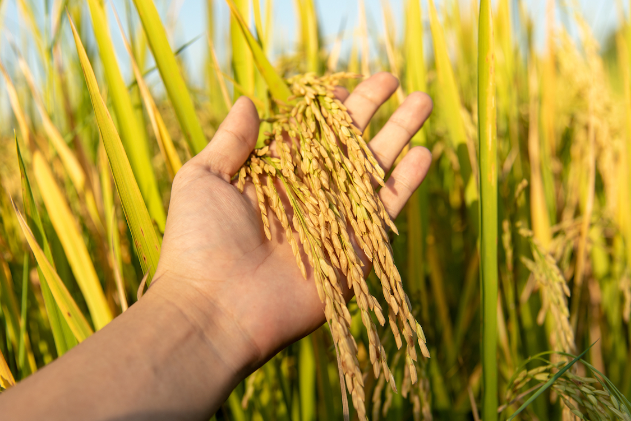
Correlation among variables in July for Maize (Peng et al., 2020)
Background
Comparison of observed and estimated corn yield based on Evaporative Stress Index (ESI) (Yang et al., 2021)
NDVI
EVI
PPI
Crop yield
SIF
ET
Comparison of VI time series with ground observed vegetation dynamics (Jin and Eklundh,2014)

Slide 2
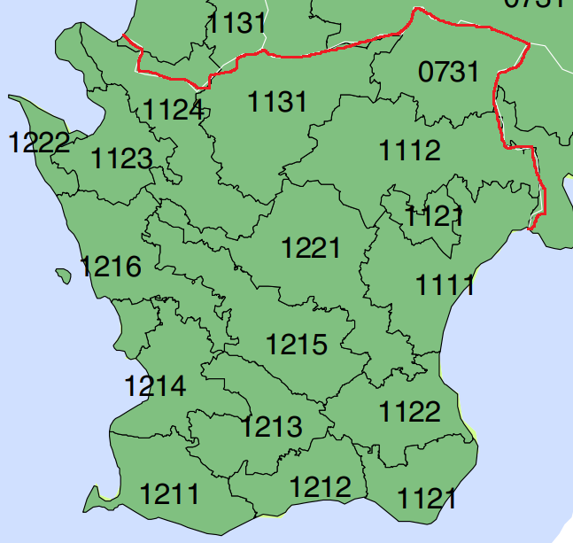
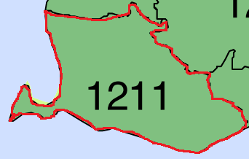
Methodology
Existing data
Crop yield data 2003-2022 kg/hectare (establishing model)
Crop yield data 1989-2002 kg/hectare (validating model)
17 Blocks distribution map
NDVI
Average value of each block
EVI
PPI
Crop yield
SIF
ET
Average value of each block
for each crop type

Slide 3
Methodology
Existing data
Crop yield data 2003-2022 kg/hectare (establishing model)
Crop yield data 1989-2002 kg/hectare (validating model)
17 Blocks distribution map
NDVI
Average value of each block
EVI
PPI
Crop yield
SIF
ET
crop A
crop B
Average value of each block
for each crop type
crop C

Slide 4
Methodology
Existing data
Crop yield data 2003-2022 kg/hectare (establishing model)
Crop yield data 1989-2002 kg/hectare (validating model)
17 Blocks distribution map
NDVI
Average value of each block
EVI
PPI
Crop yield
SIF
ET
Cover with satellite NDVI pixels
crop A
crop B
Average value of each block
for each crop type
crop C

Slide 5
Methodology
Existing data
Crop yield data 2003-2022 kg/hectare (establishing model)
Crop yield data 1989-2002 kg/hectare (validating model)
17 Blocks distribution map
NDVI
Average value of each block
EVI
PPI
Crop yield
SIF
ET
average NDVI value of for crop A
average NDVI value of for crop B
Average value of each block
for each crop type
average NDVI value of for crop B

Slide 6
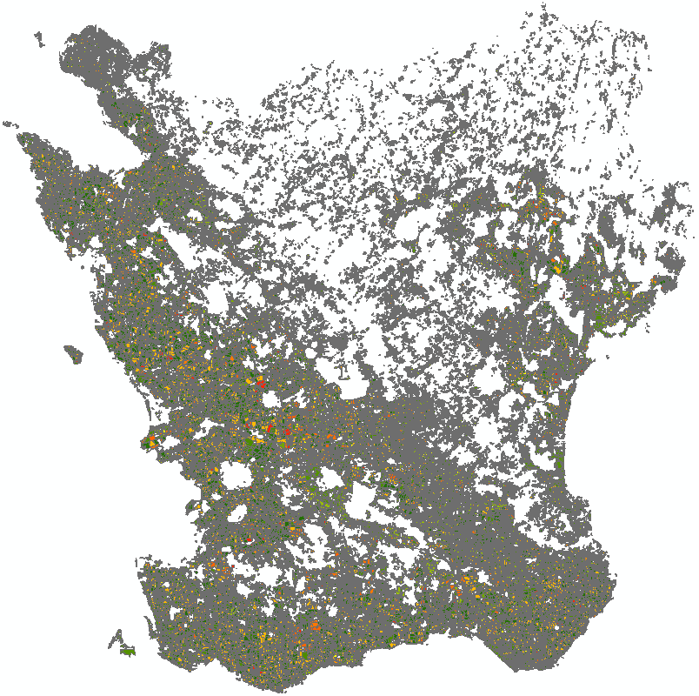
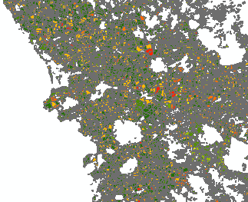
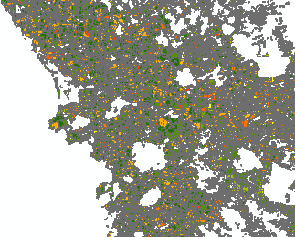
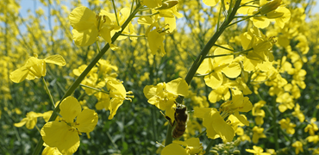
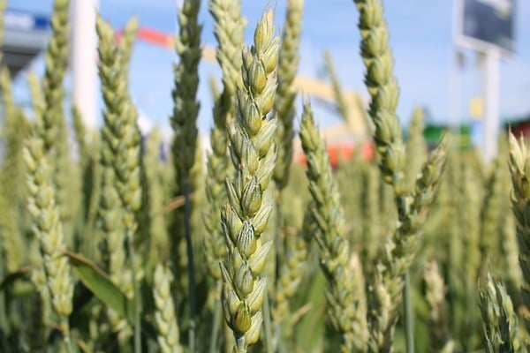
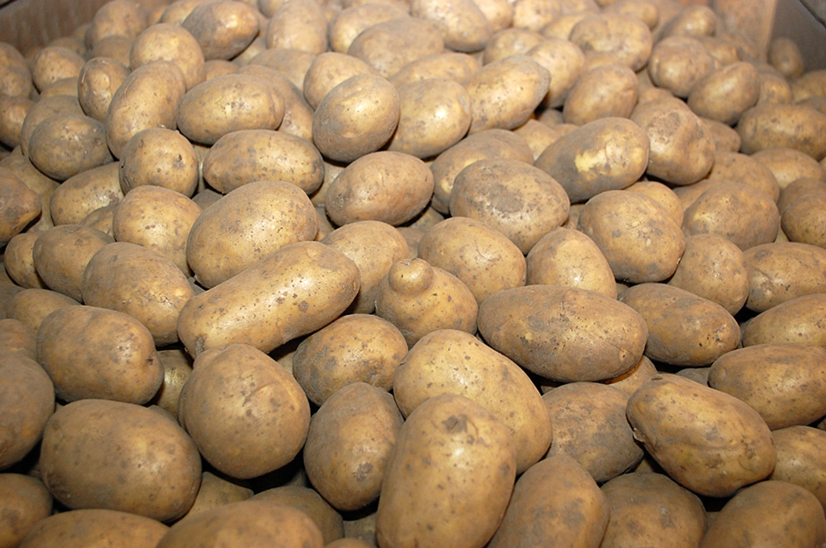
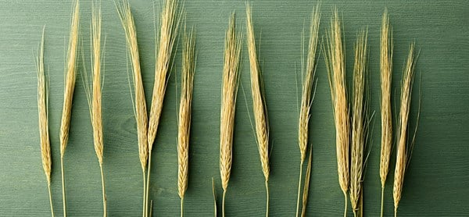
More data needed…
2017
2020
Crop type map 2003–2016, 2021–2022
Aim: Satellite-based VIs and ET calculation
in each block of Skane based on different crop types
Growing season of each crop type
Aim: VIs calculation of each crop type in their certain
growing season (Qiu et al., 2022; Kang et al., 2022)
Havre
Höstraps
Höstvete
Matpotatis
Råg
Vårkorn
Vårvete
…

