Slide 1
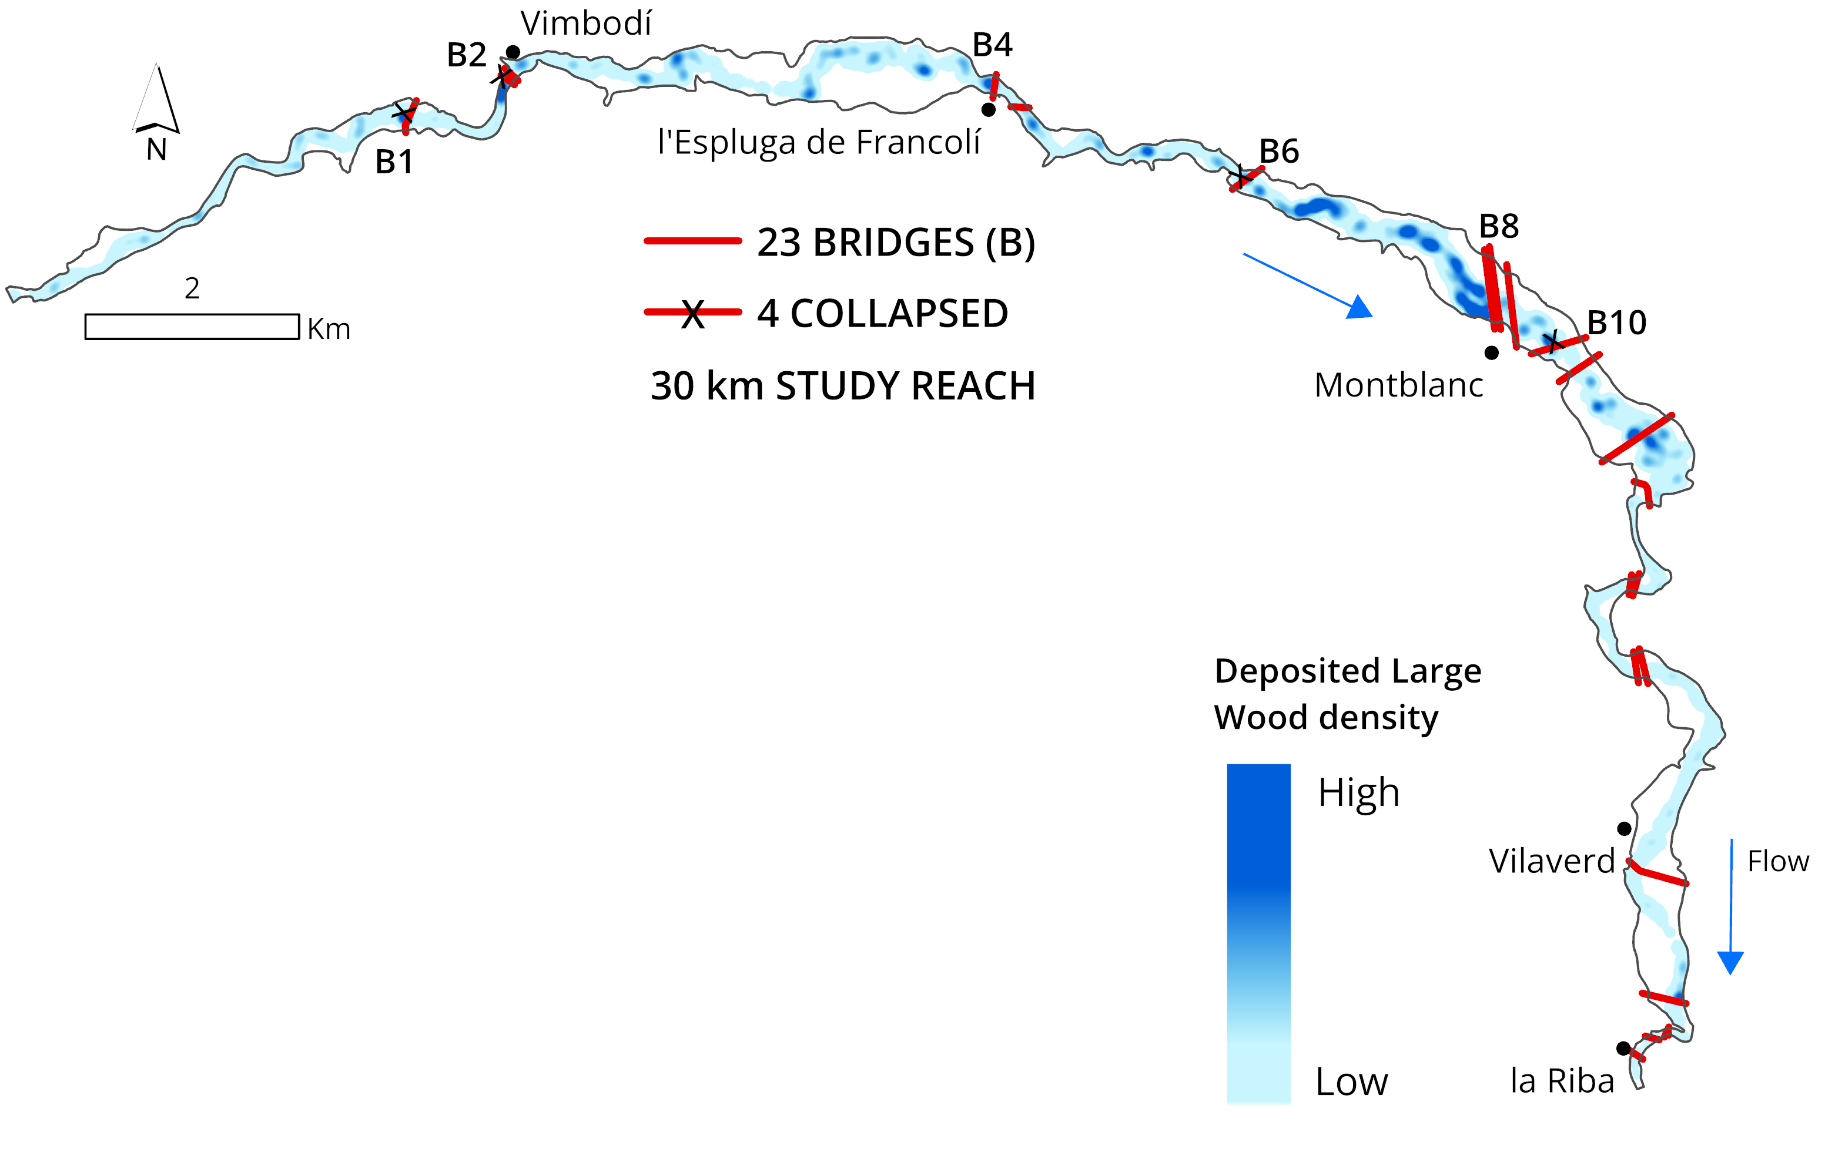
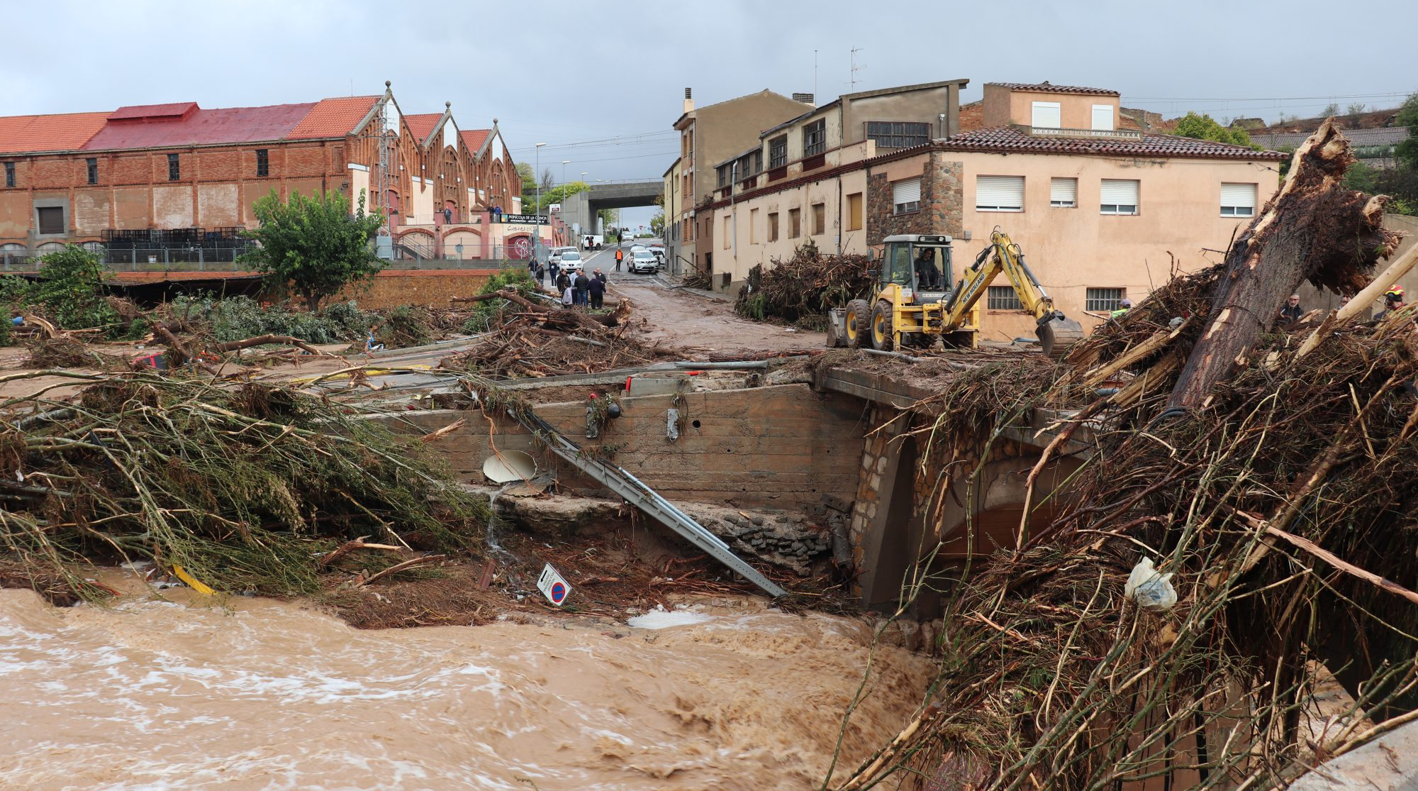
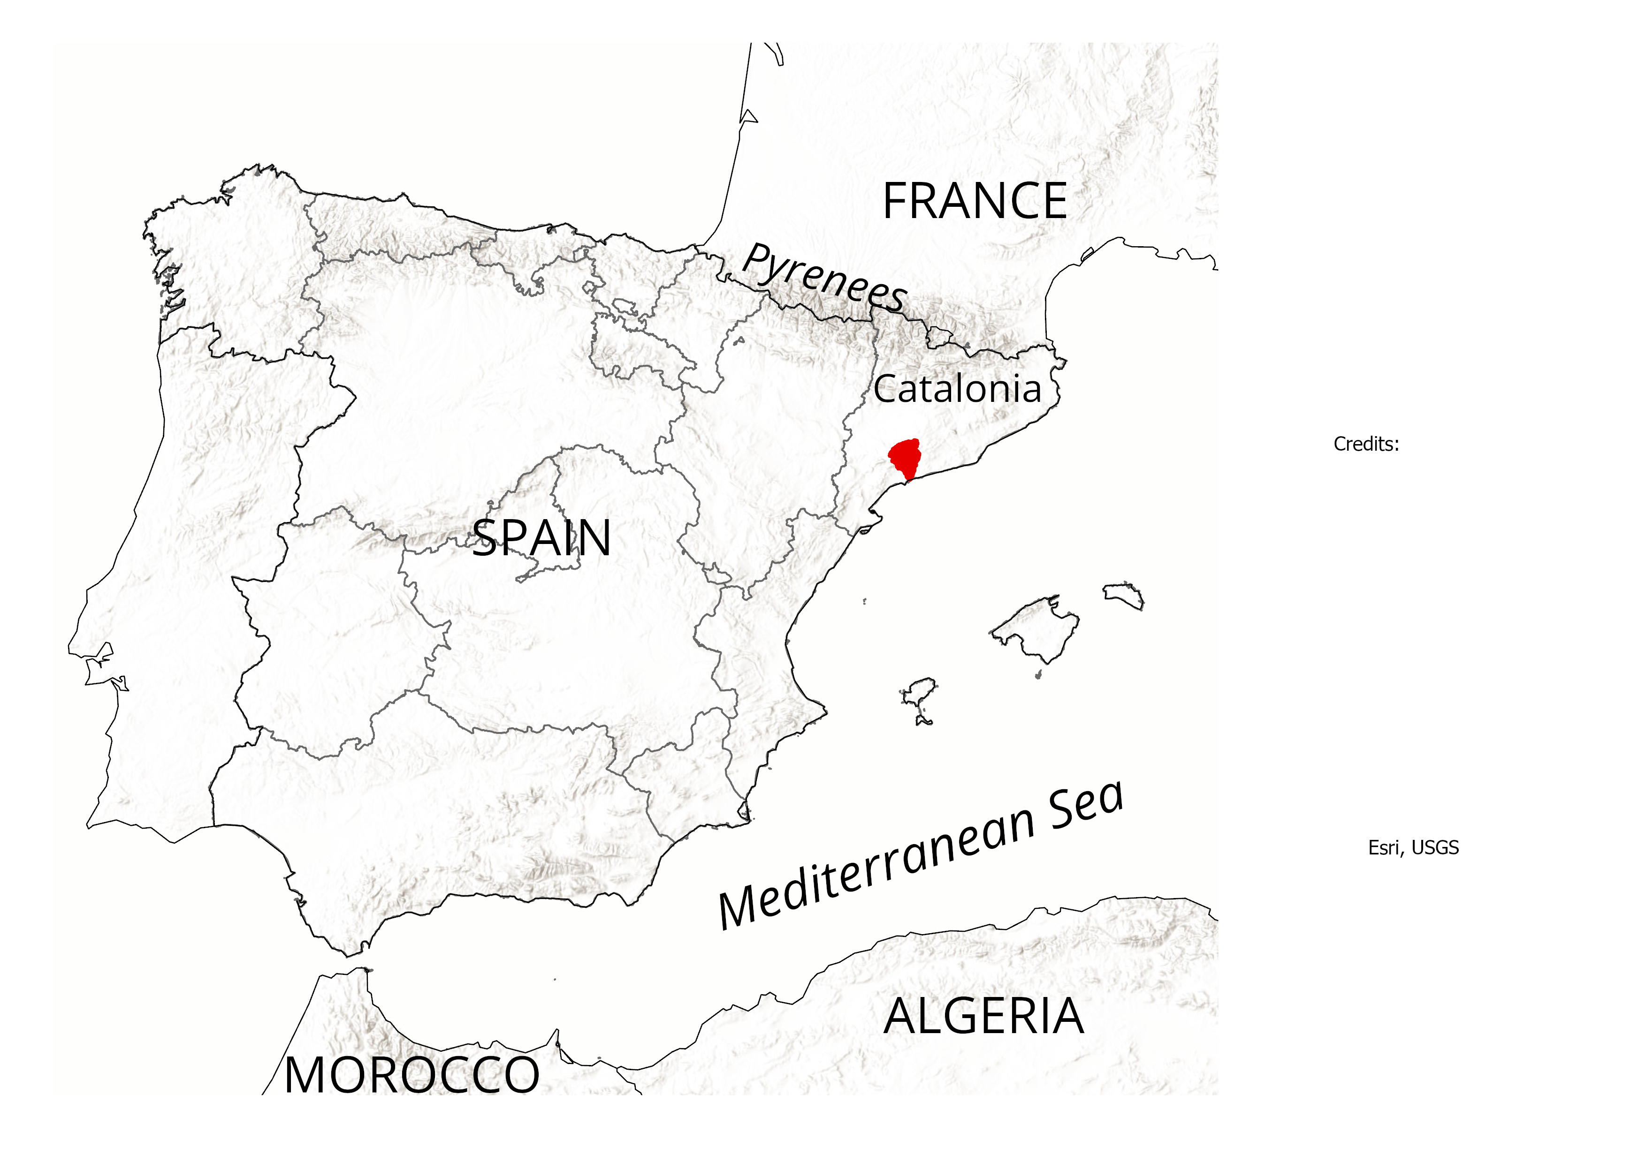
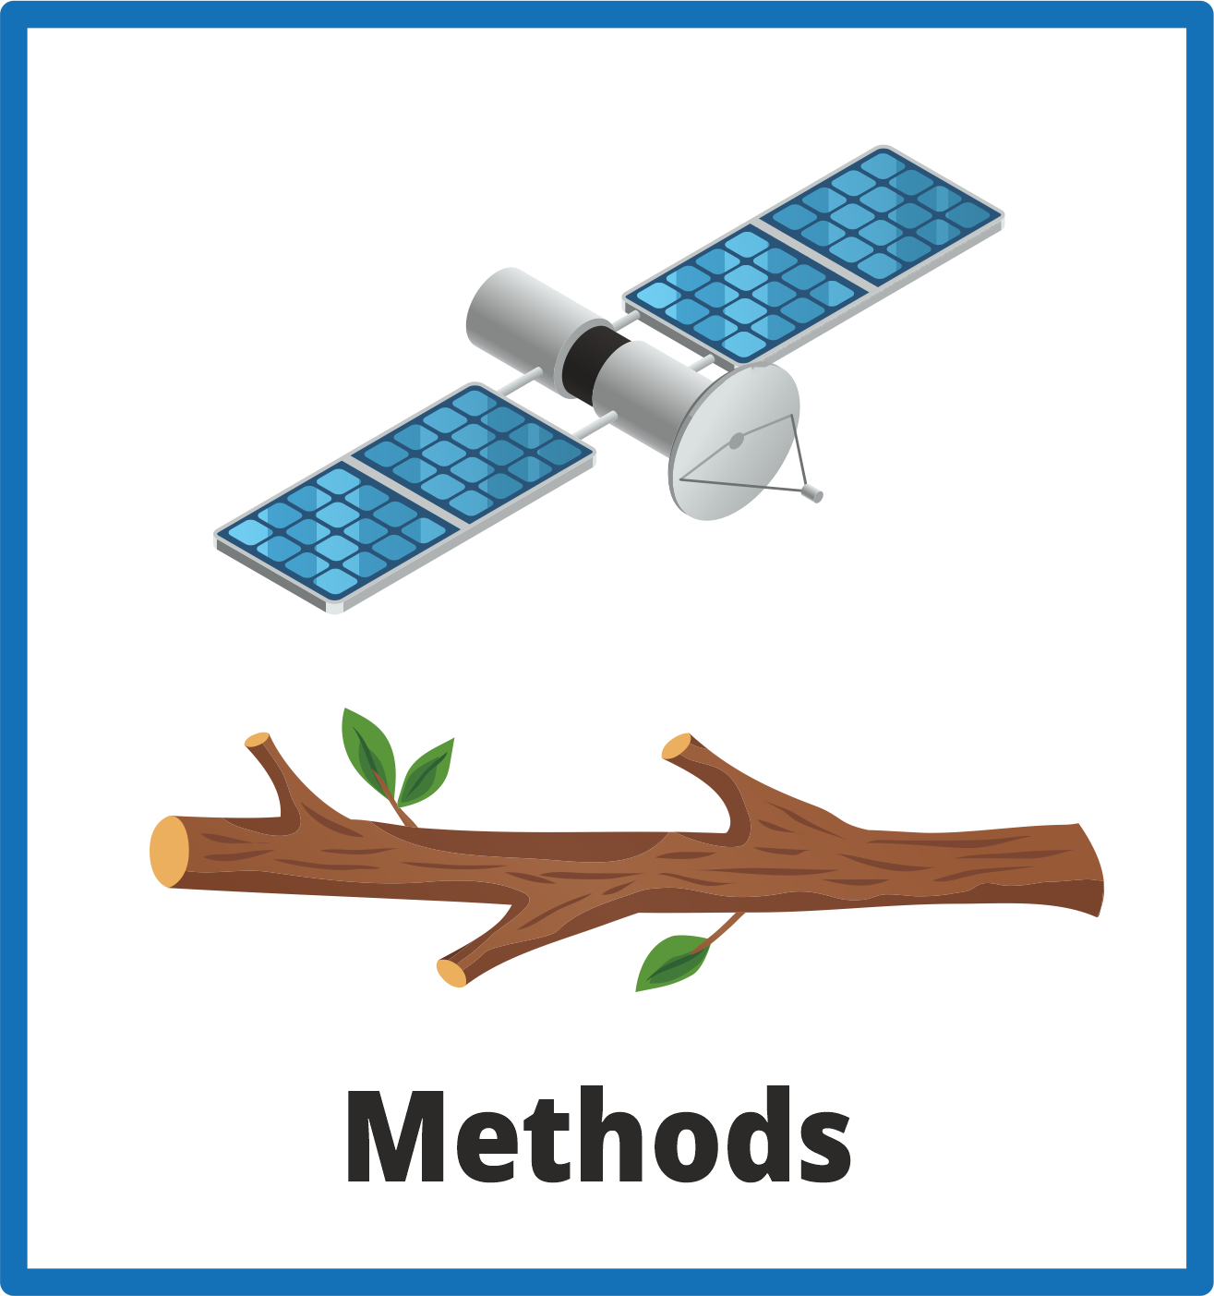
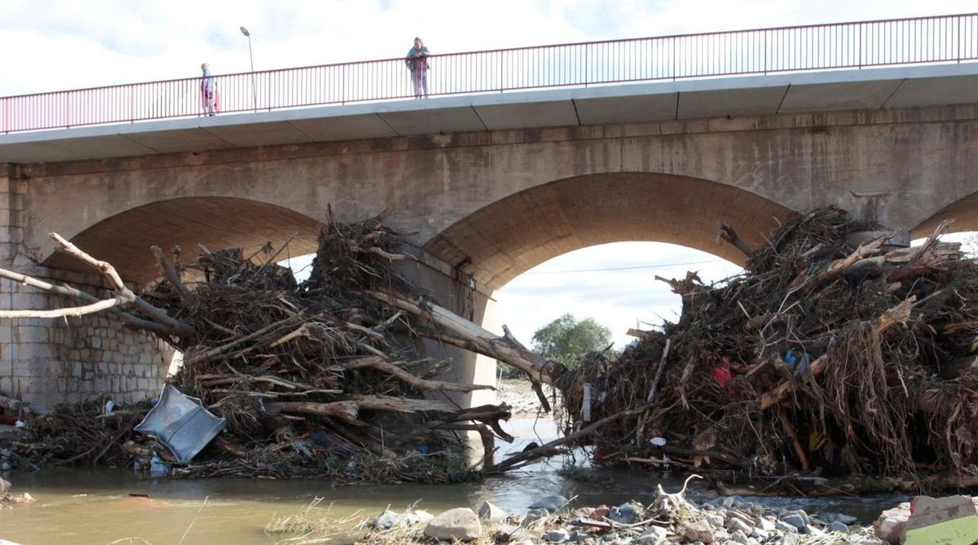
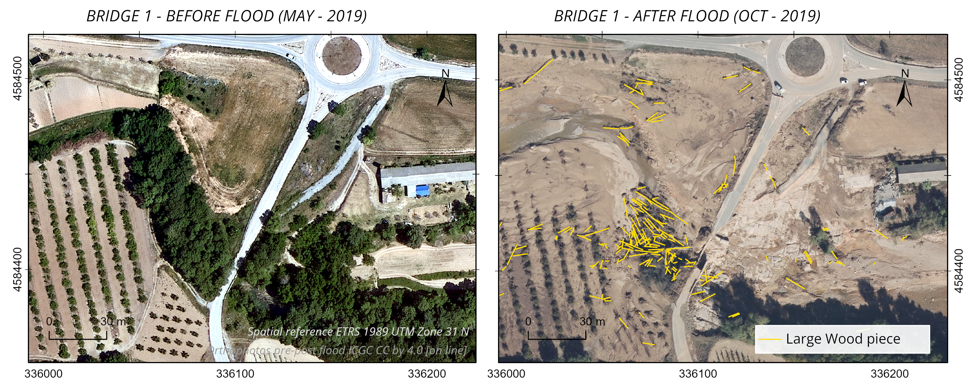
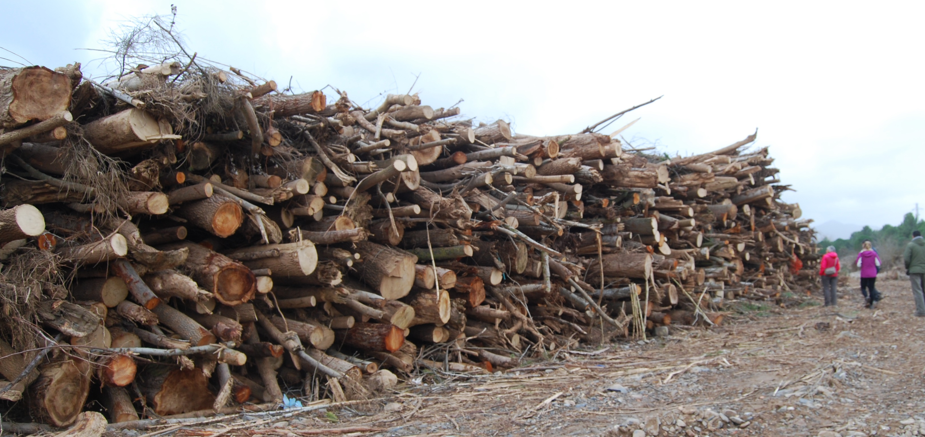
BRIDGES INFLUENCE LARGE WOOD TRAPPING EFFICIENCY DURING LARGE FLOODS: INSIGHTS FROM THE FRANCOLÍ RIVER FLOOD IN 2019
Llanos Valera-Prieto, Virginia Ruiz-Villanueva, Glòria Furdada
24 – 28 April 2023
llanosvalera@ub.edu, University of Barcelona
A. Roca
A. Roca
Confidencial.com
Orthophoto post-flood ICGG CC by 4.0 [on line]
1
M. Génova

Slide 2
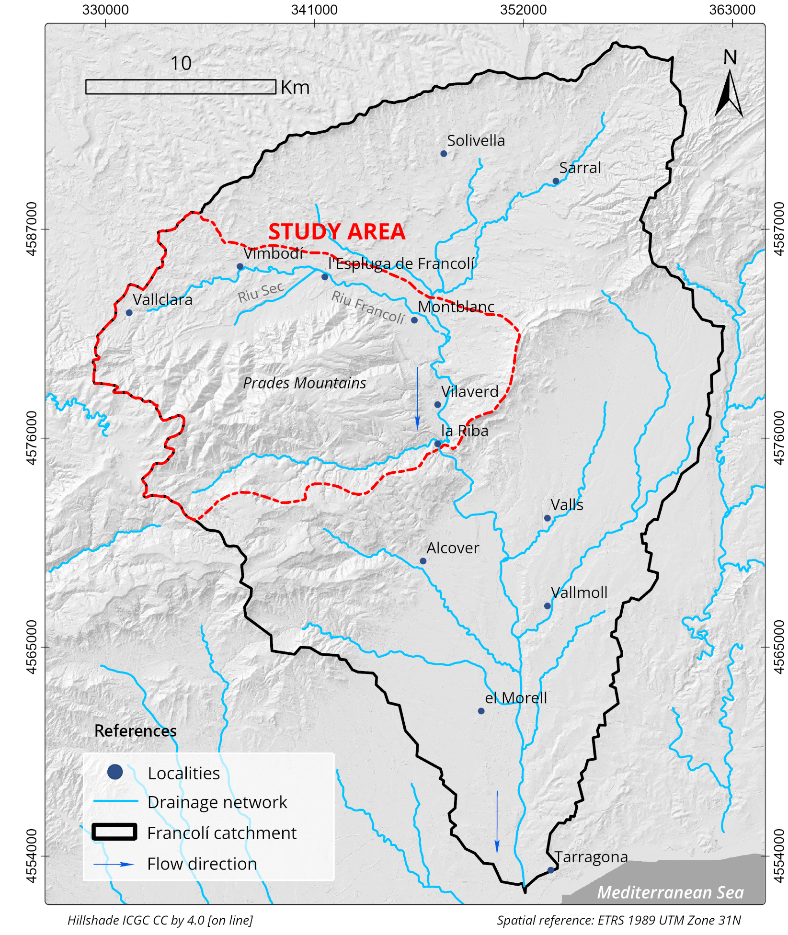
LOCATION OF THE STUDY AREA:
THE FRANCOLÍ RIVER
24 – 28 April 2023
llanosvalera@ub.edu
1/2
Warm Mediterranean climate and rainfall hydrological regime.
Subtropical high pressures in summer mild and rainy autumns.
 | Catchment | Study area
Drainage area | 856 km² | 223 km²
Length | 60 km | 30 km
Mean water flow | 1,2 m³/s | 1 m³/s
Mean temperatures | 12 – 15 ºC
Mean annual rainfall | 800 mm

Slide 3
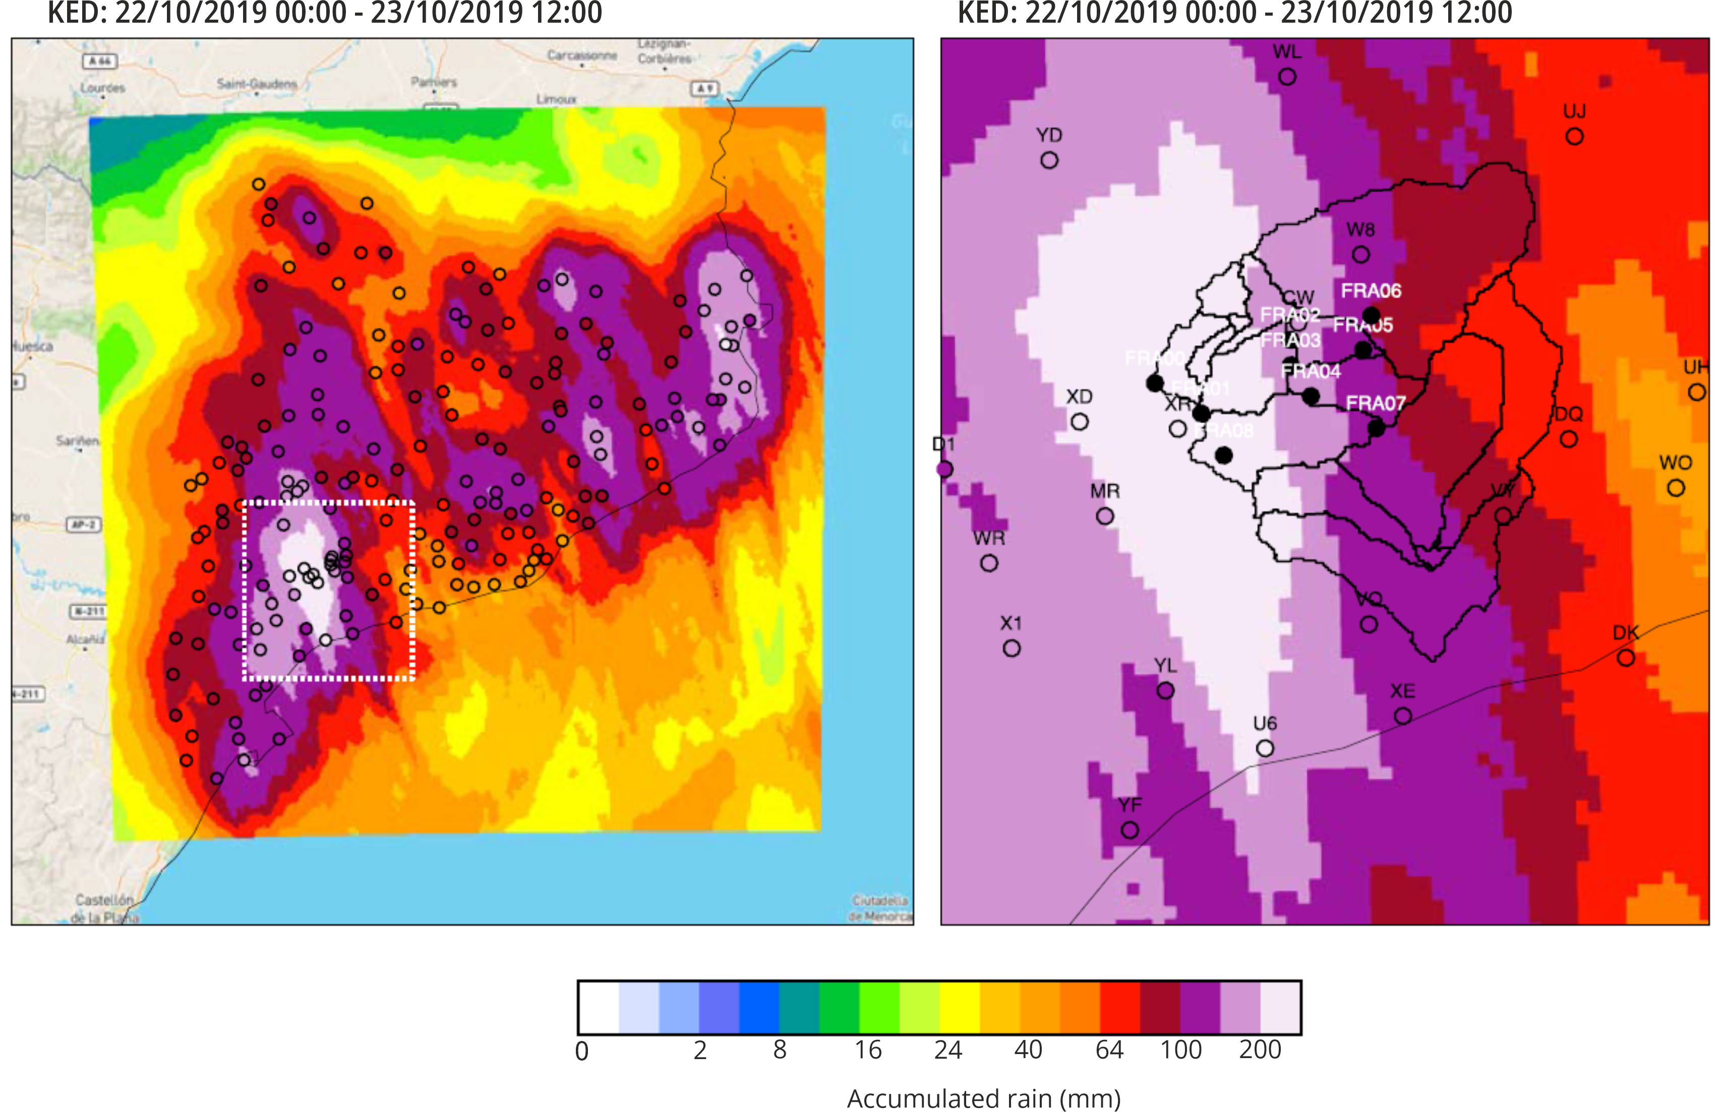
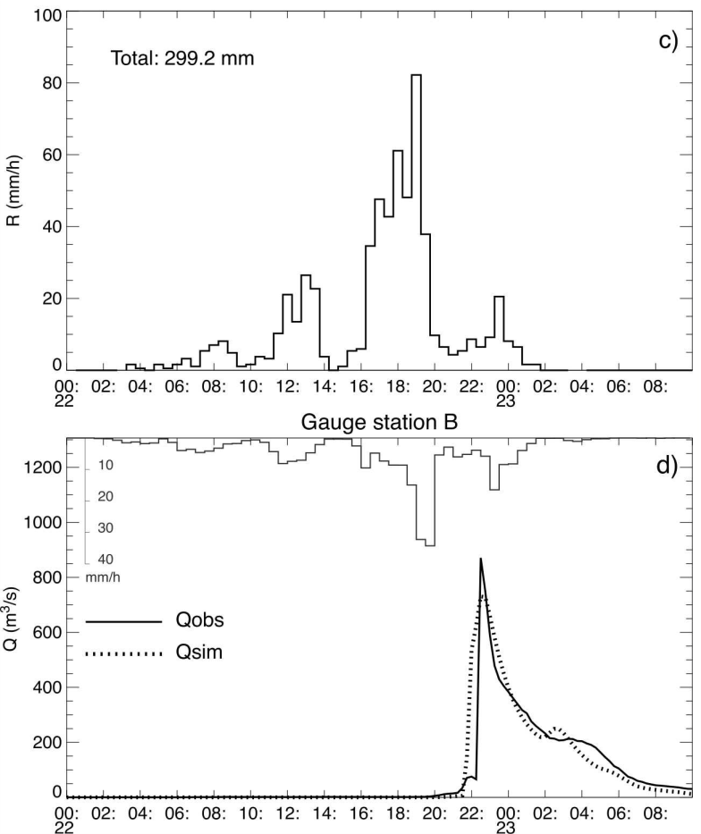
FLASH FLOOD EVENT (22nd OCTOBER 2019)
24 – 28 April 2023
llanosvalera@ub.edu
Discharge: 780 m³/s in Montblanc (Poll, 2021)
Return period: 50 -100 years
Accumulated rainfall: 299 mm (12 hours) (Martin-Vide et al., 2023)
Significant bio-geomorphological changes; large quantity of trees eroded
ACCUMULATED RAIN IN 12 HS (22/10/2019 00:00 – 23/10/2019 12:00)
Rainfall and Discharge
2/2
B
UPC, 2020
UPC, 2020
Martin-Vide et al., 2023

Slide 4
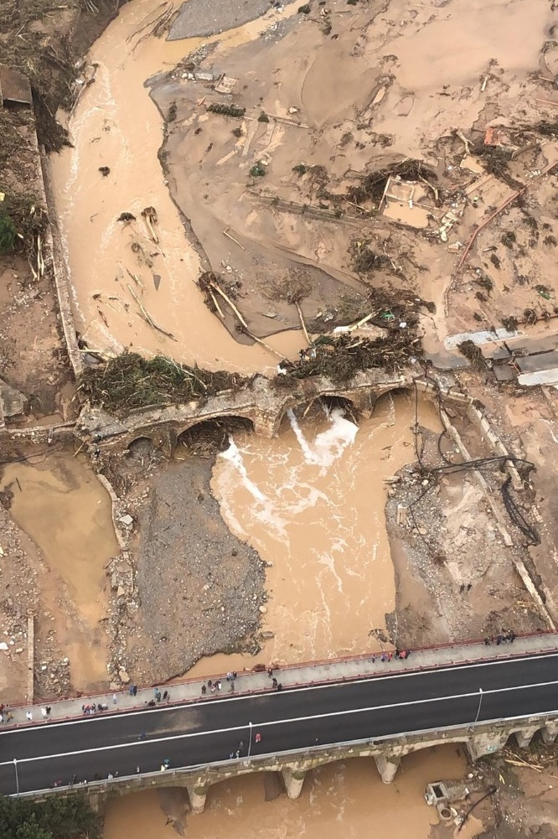
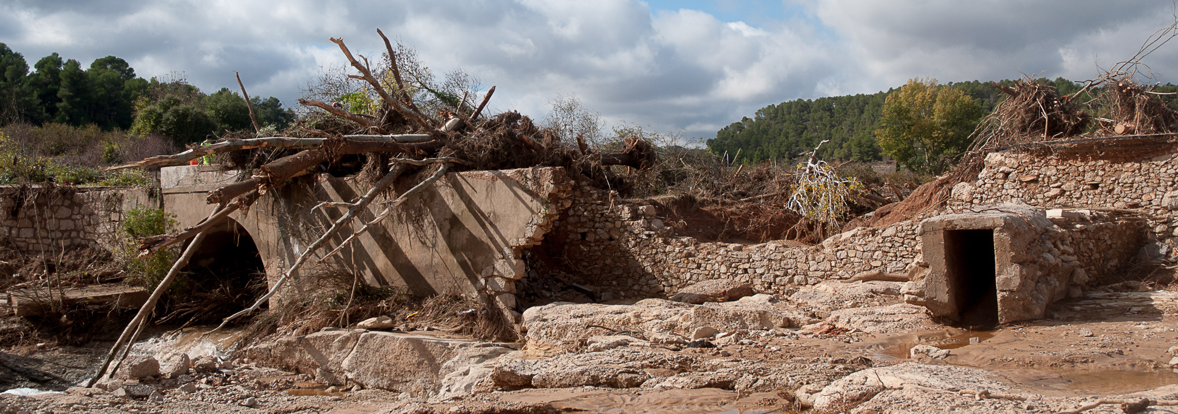
AIM – RESEARCH QUESTIONS
24 – 28 April 2023
llanosvalera@ub.edu
Goal: IMPROVE FLOOD HAZARD ASSESMENT
How much, what type of large wood (LW) was deposited, and where, during flood?
Which factors controlled the LW deposition along the river?
What role did the bridges play in trapping wood? Which bridges trapped more LW, and Why?
How LW accumulations at bridges impacted flooding?
1/1
ACN.cat
O. Riera
O. Riera
J.M. Potau

Slide 5
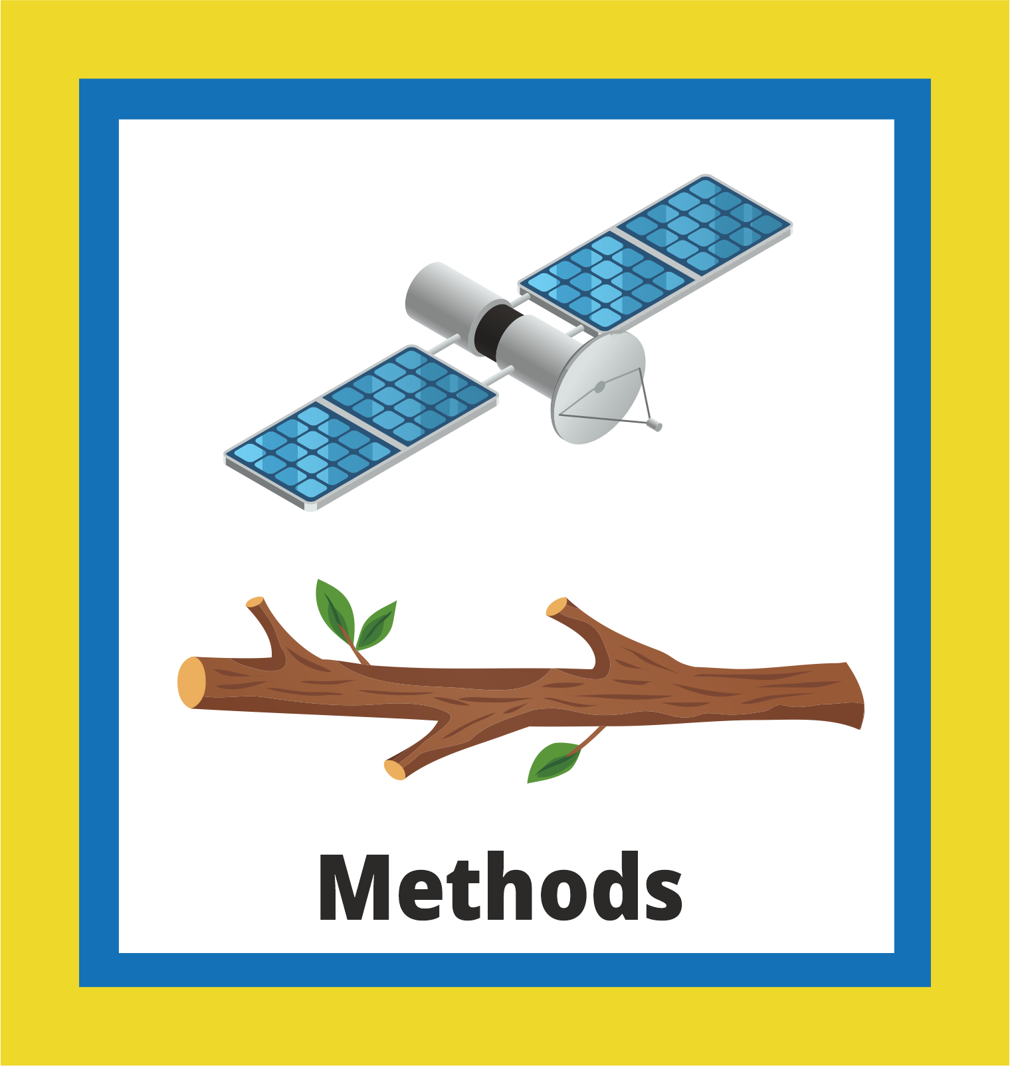
METHODS:
GIS AND STATISTICAL ANALYSIS
24 – 28 April 2023
llanosvalera@ub.edu
Identify deposited Large Wood (LW) characteristics:
Orthophoto post-flood (10 cm resolution), 12000 individual LW pieces (≤ 1m) digitalized
1/2
Flow

Slide 6
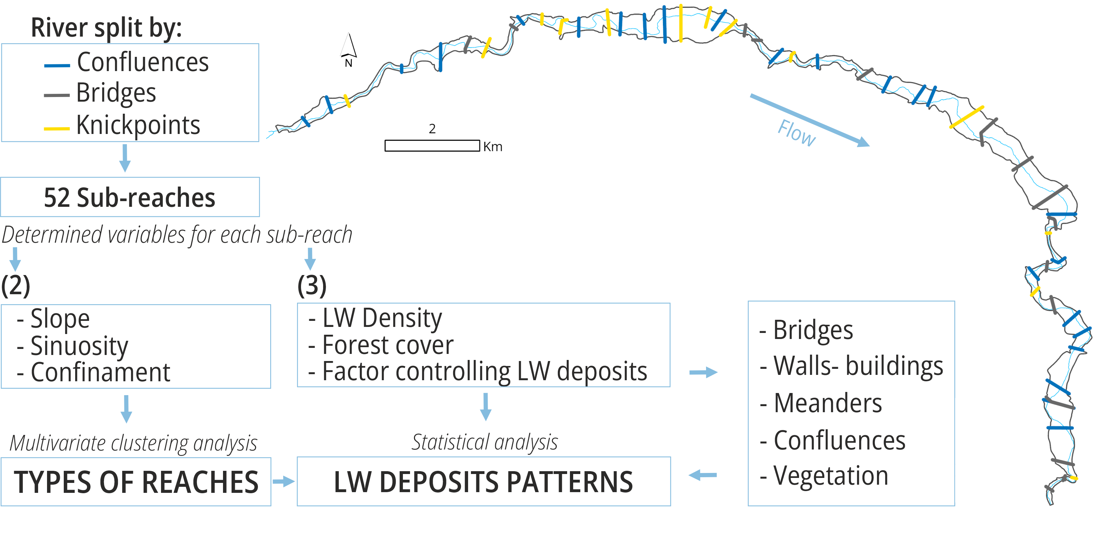
METHODS:
GIS AND STATISTICAL ANALYSIS
24 – 28 April 2023
llanosvalera@ub.edu
llanosvalera@ub.edu
(2) Characterize river morphology (Segmentation by types of reaches)
(3) Spatial analysis of Large Wood deposition patterns
2/2

Slide 7
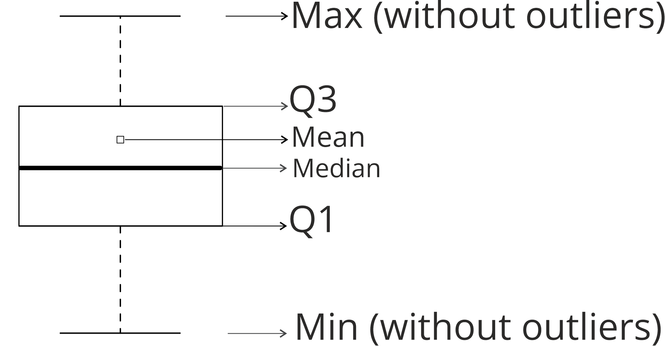
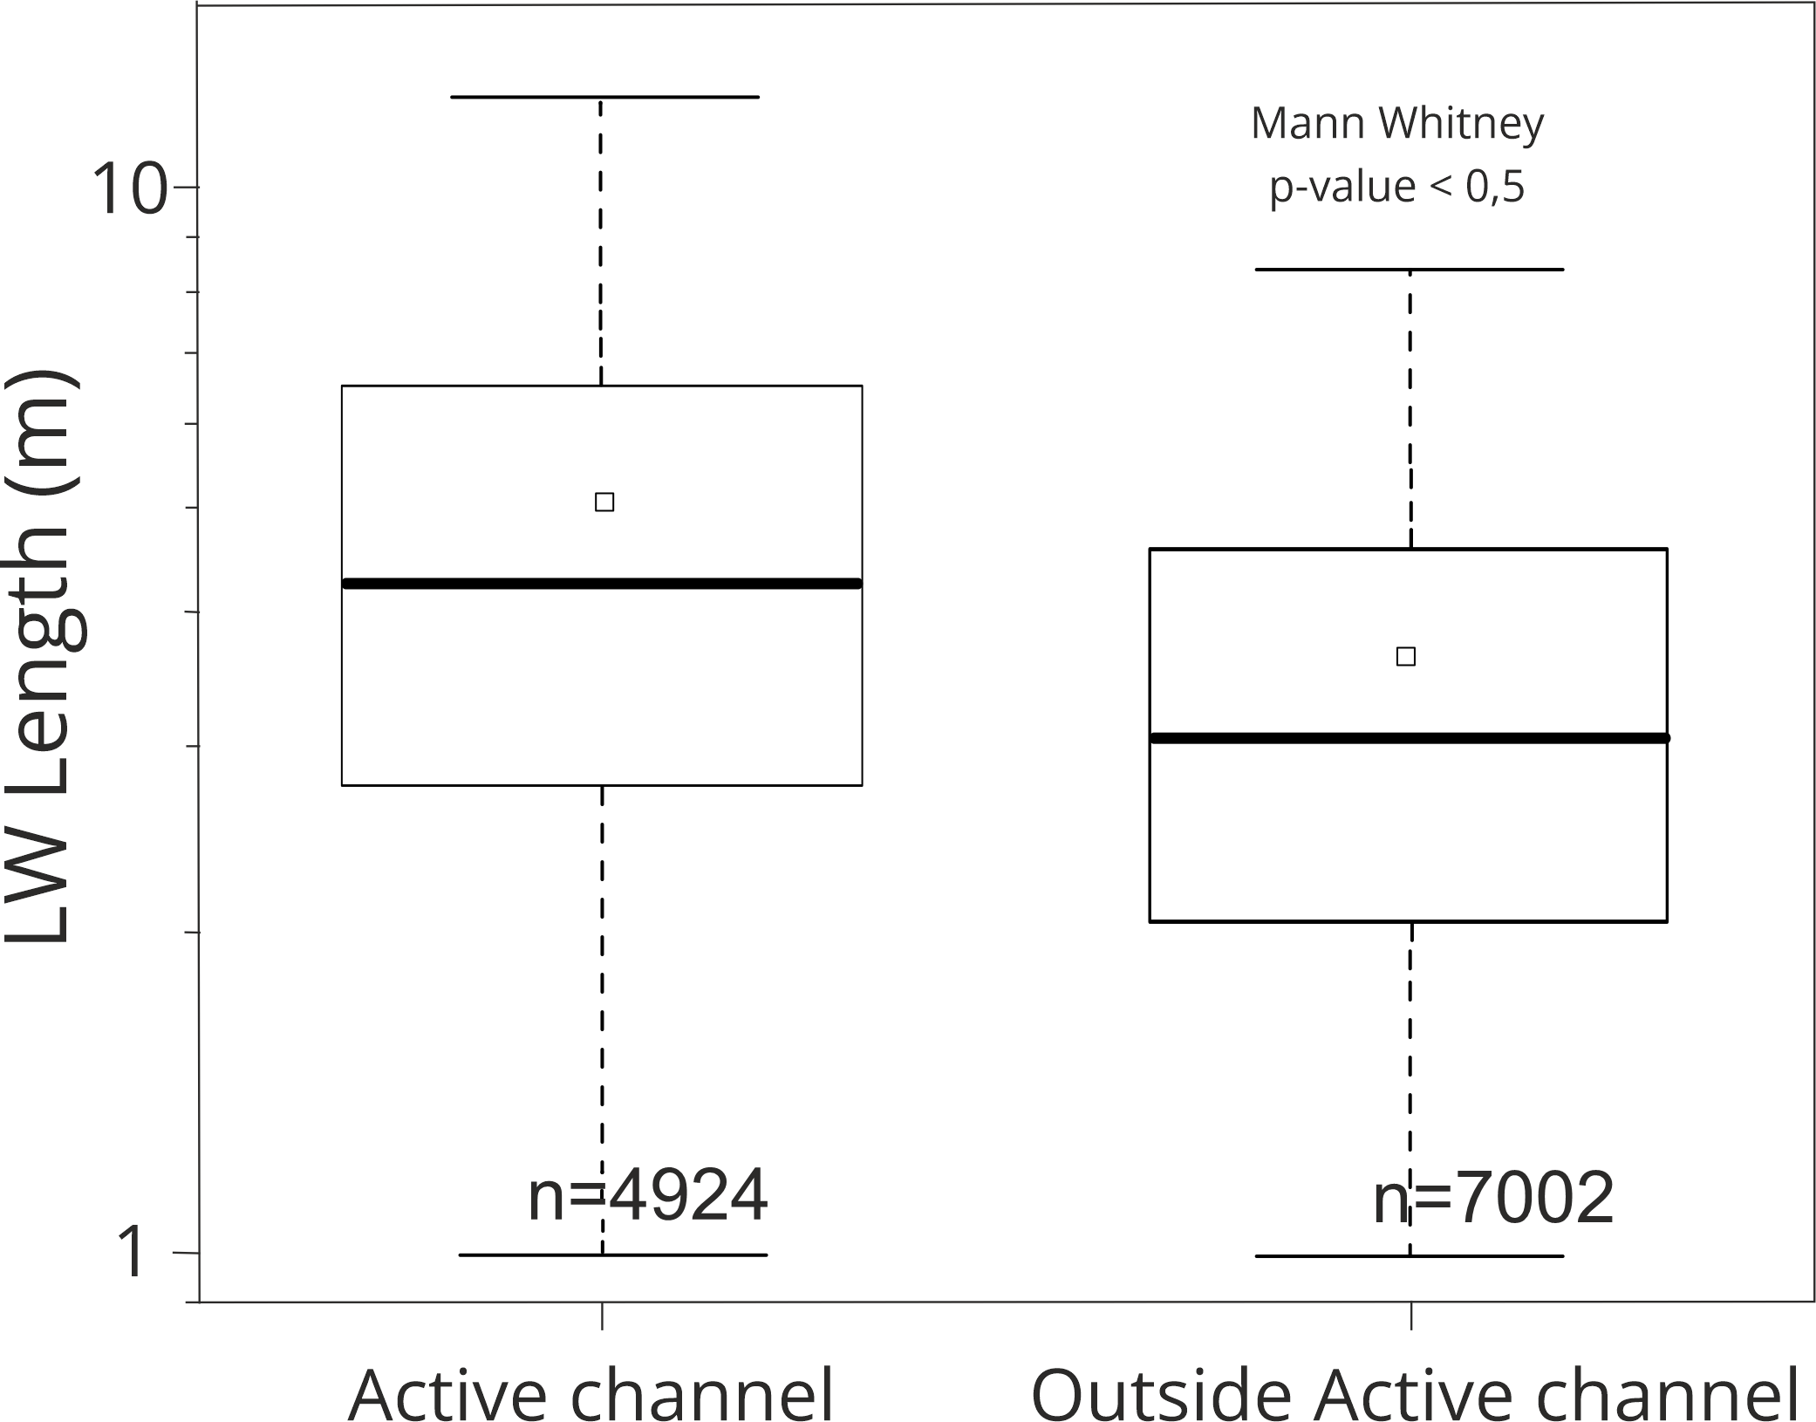
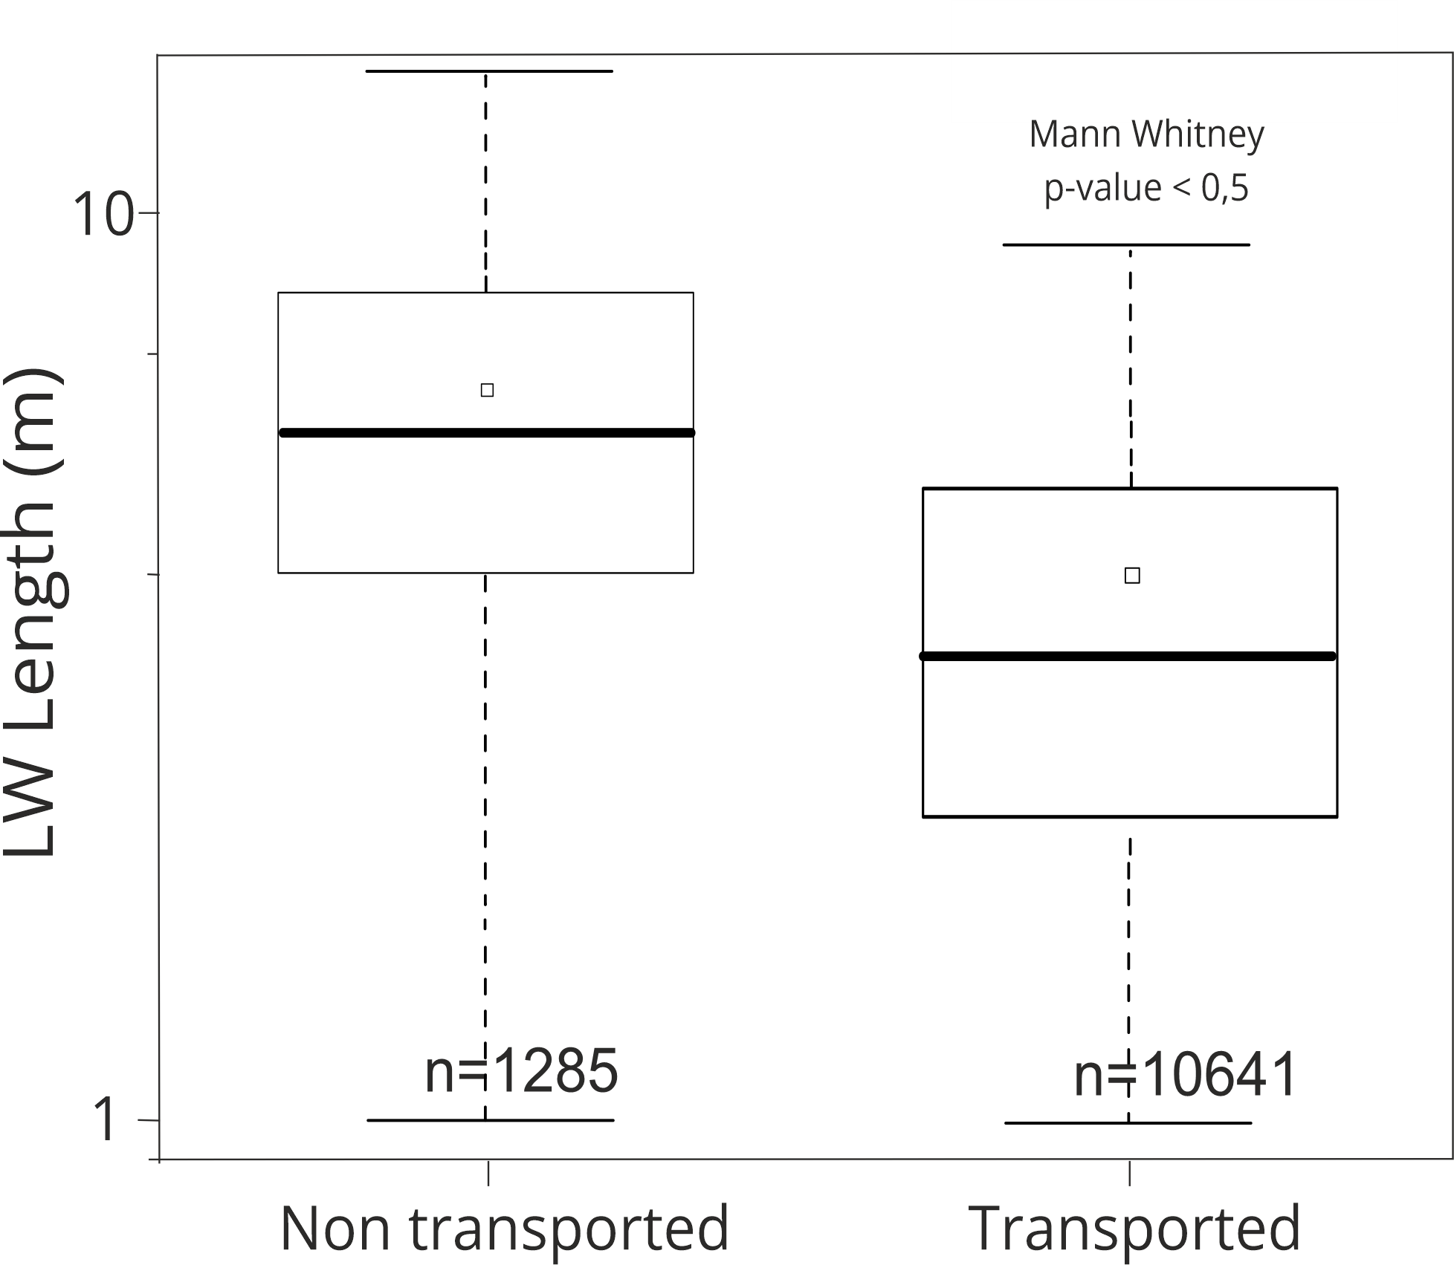
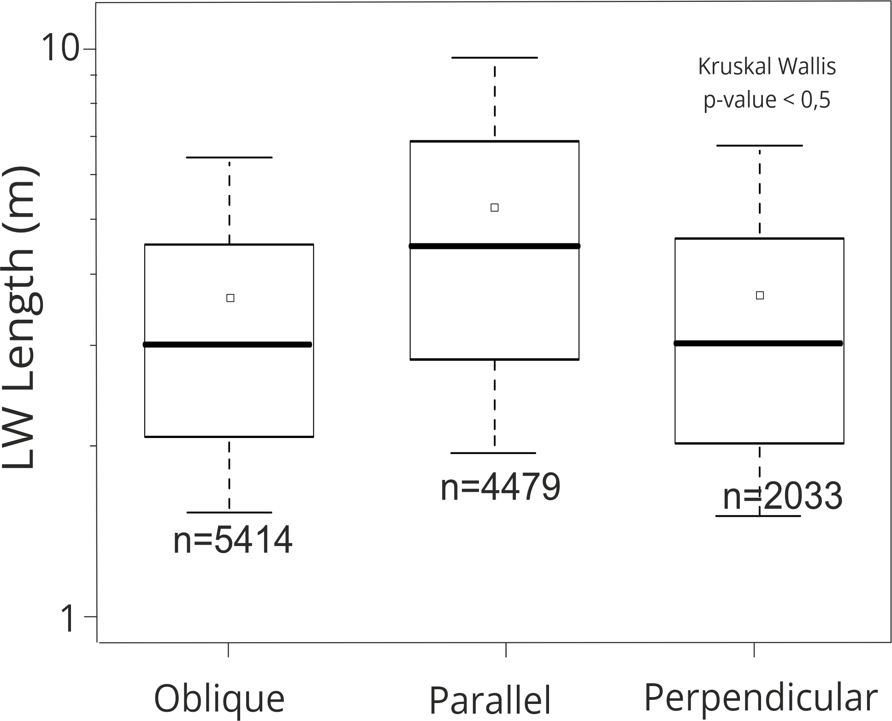
RESULTS:
(1) DEPOSITED LW CHARACTERISTICS
24 – 28 April 2023
llanosvalera@ub.edu
llanosvalera@ub.edu
Eroded forest was 110 ha (58 % of the valley bottom) equivalent to 13376 m³
Estimated LW deposited was 6360 m³
The maximum length was 24 m and the average was 4 m
1/8
More LW and smaller in size was deposited outside the active channel
~ 10% of digitalized LW pieces were not transported, the pieces were much larger than those transported
Most LW were deposited oblique and parallel to the flow. Parallel deposited LW was much longer

Slide 8
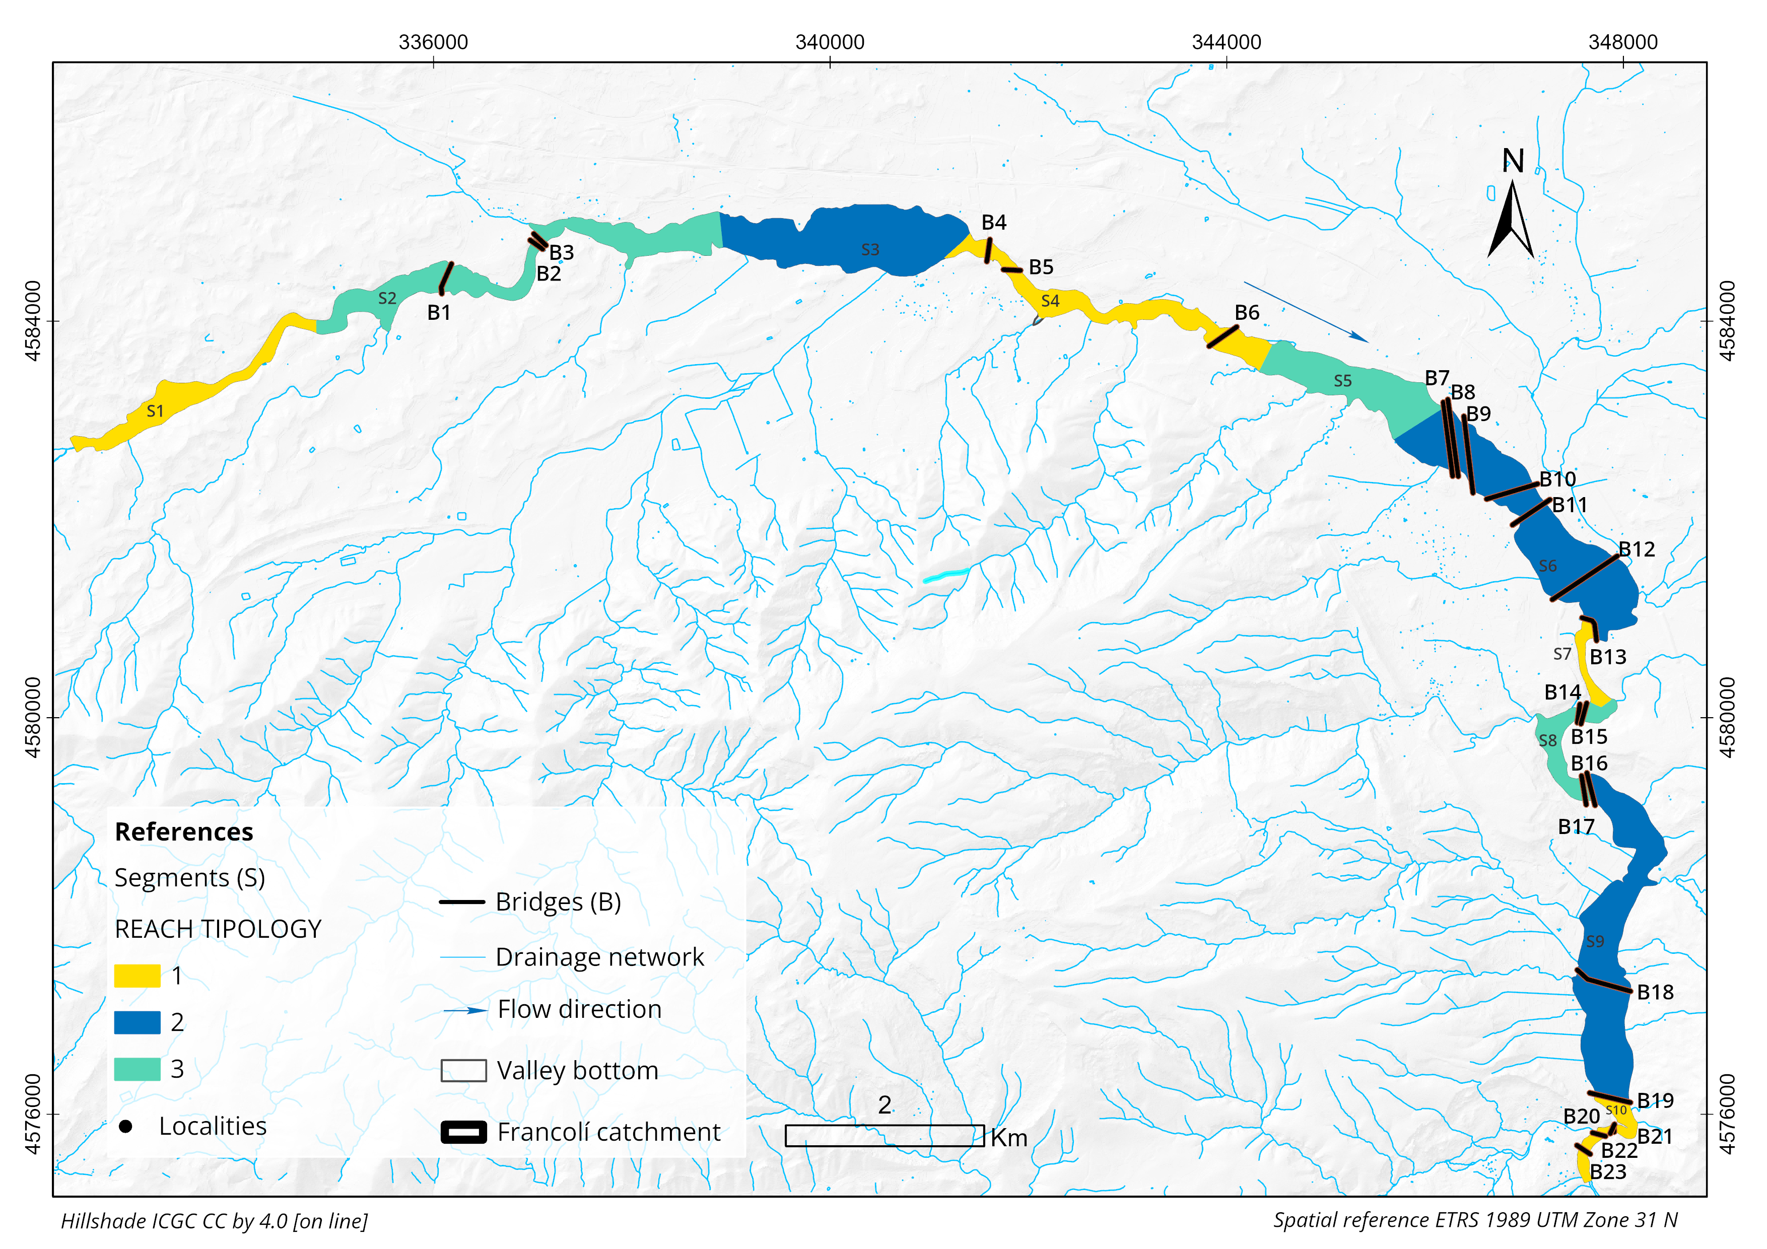
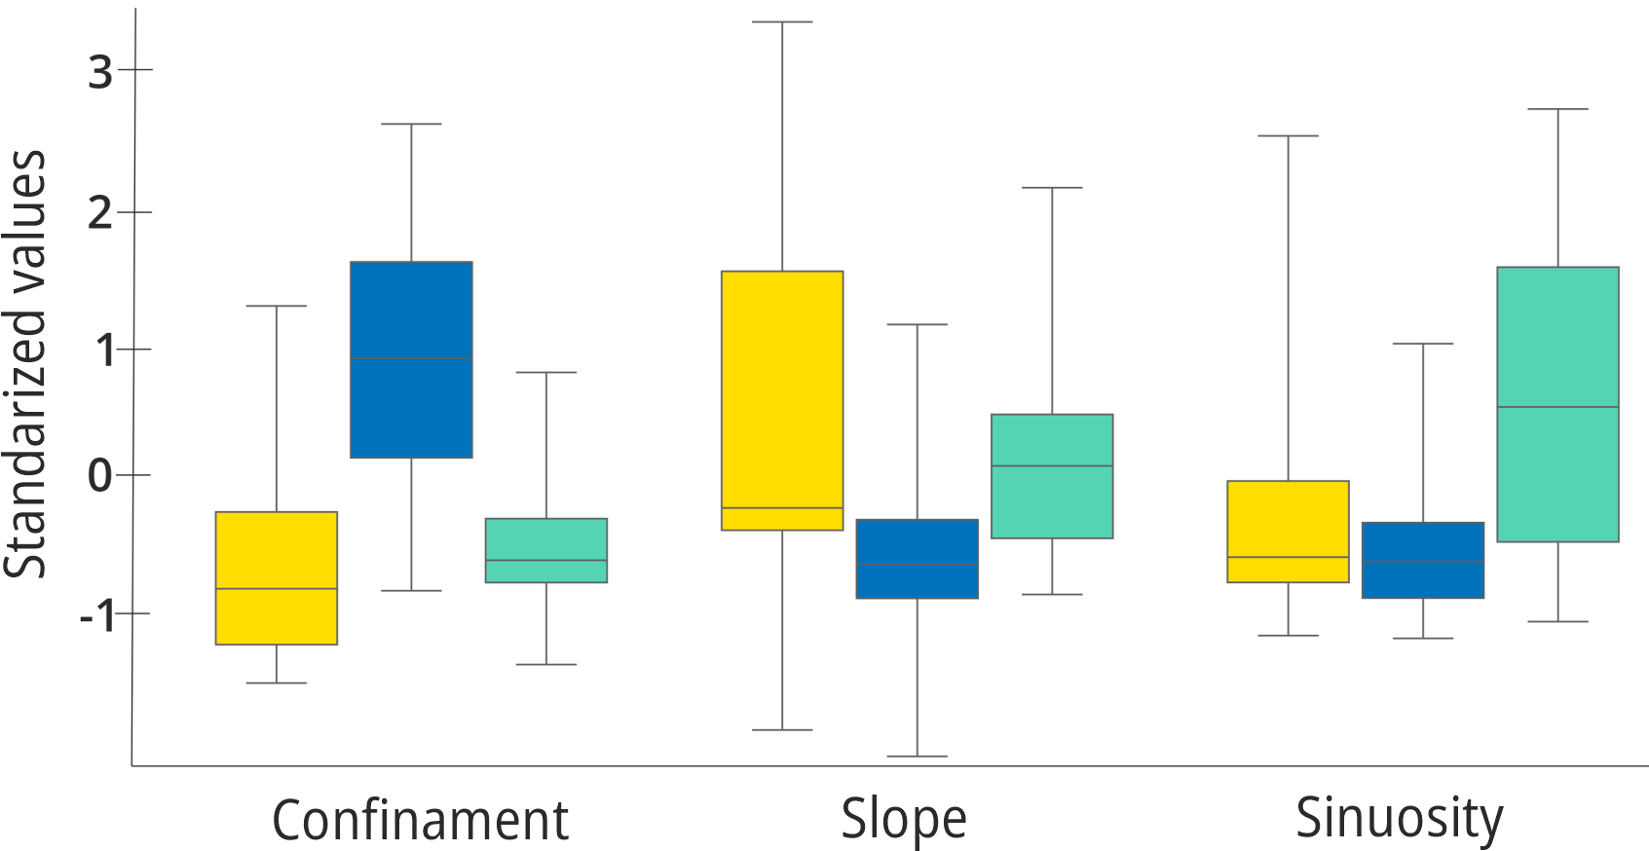
24 – 28 April 2023
RESULTS:
(2) SEGMENTATION BY RIVER MORPHOLOGY
llanosvalera@ub.edu
TYPE OF REACH | CONFINAMENT | SLOPE | SINUOSITY
1 | Confined | High | Relatively straight
2 | Unconfined | Low | Sinuous
3 | Partly confined | Medium | Meandering
2/8
3 reach types - 10 segment

Slide 9
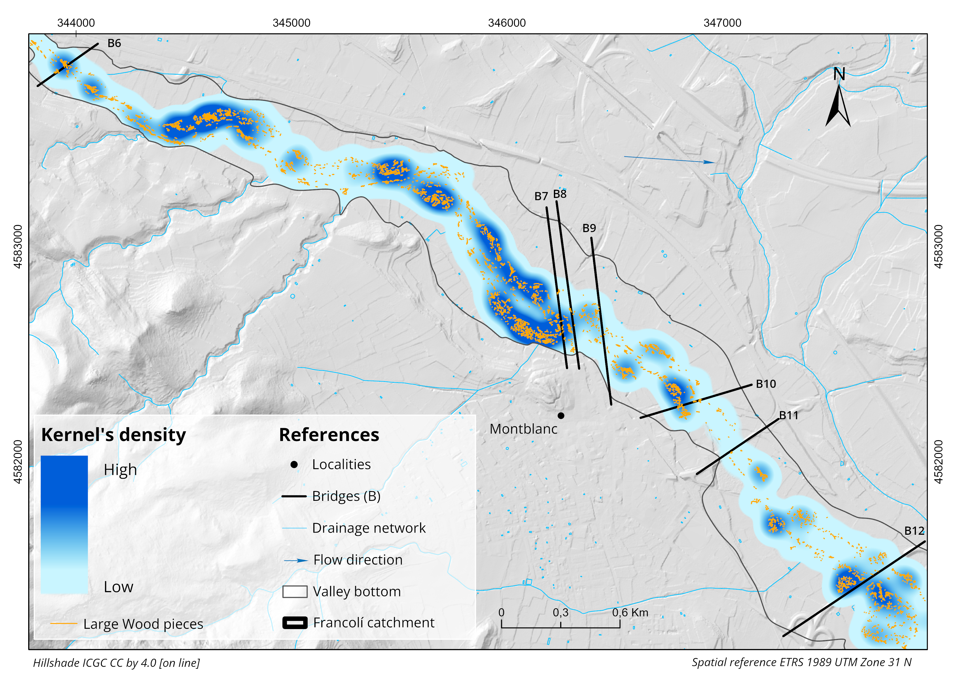
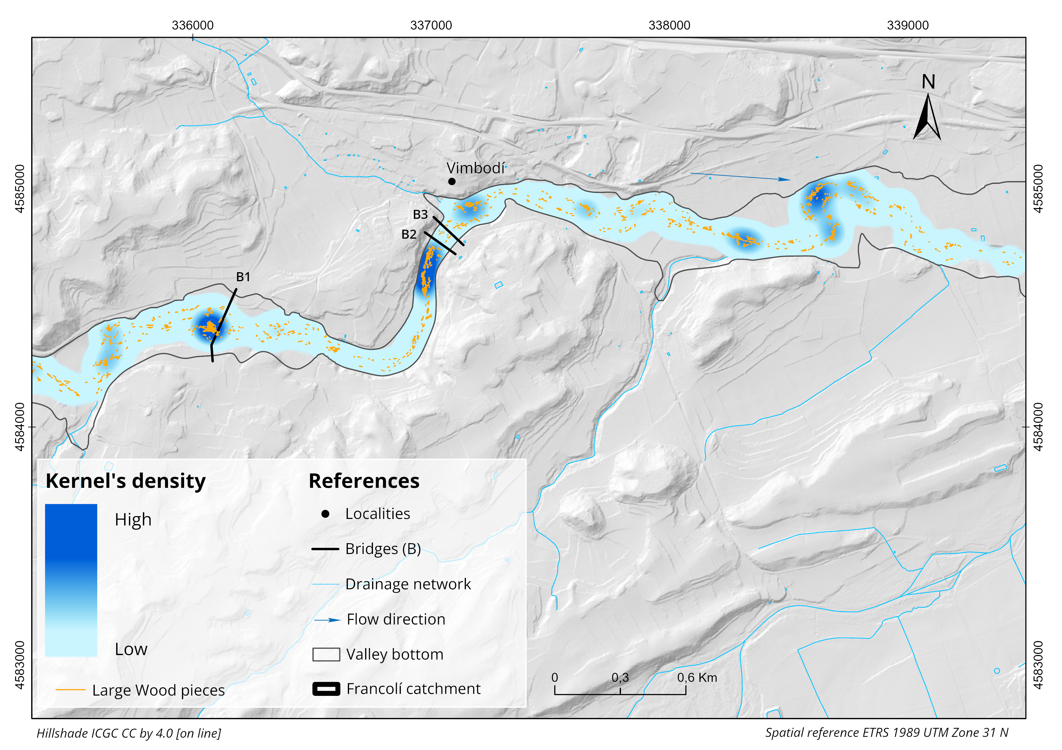
24 – 28 April 2023
RESULTS:
(3) SPATIAL ANALYSIS OF LW DEPOSITION PATTERNS
llanosvalera@ub.edu
Kernel´s Density algorithm (Silverman, 1986)
We used a search radius of 300 m and output cell size of 1m for the detection of neighbouring LW pieces
3/8
LW accumulations were clustered, with larger densities found upstream from bridges and trapped by standing vegetation

Slide 10
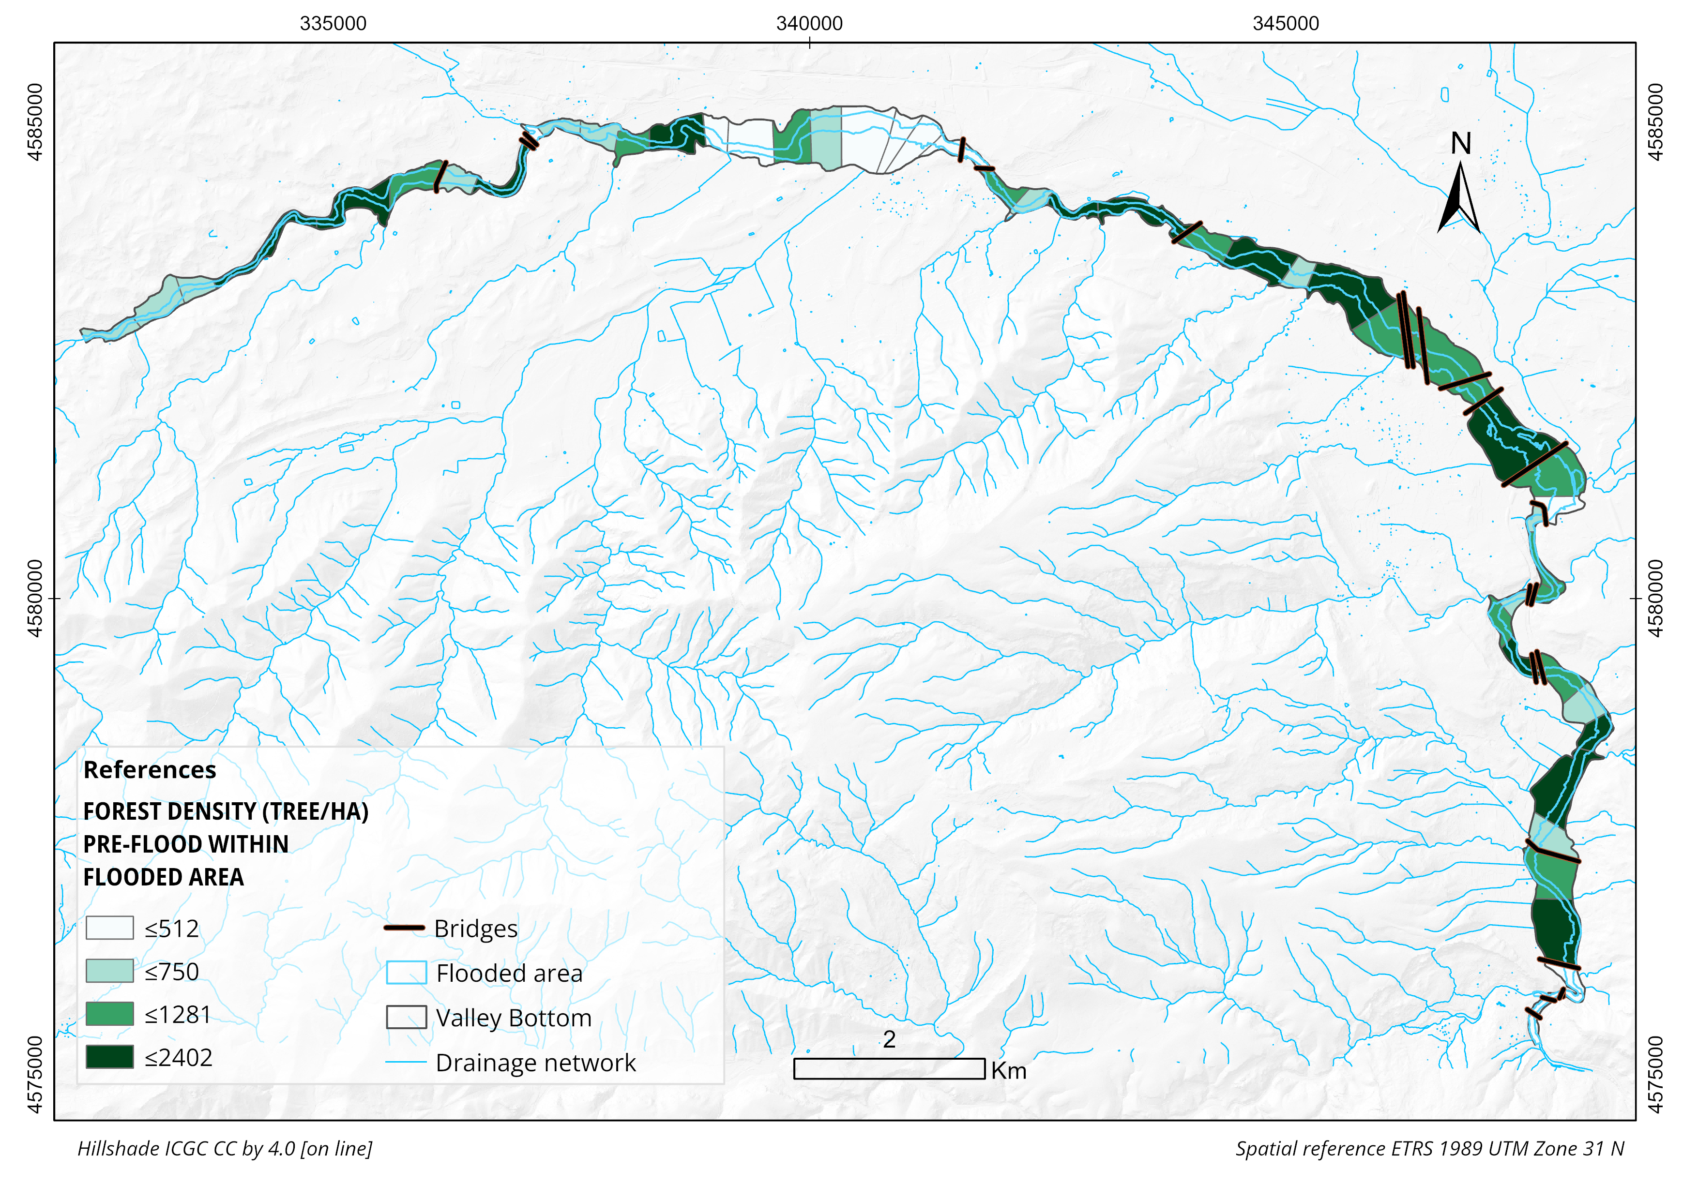
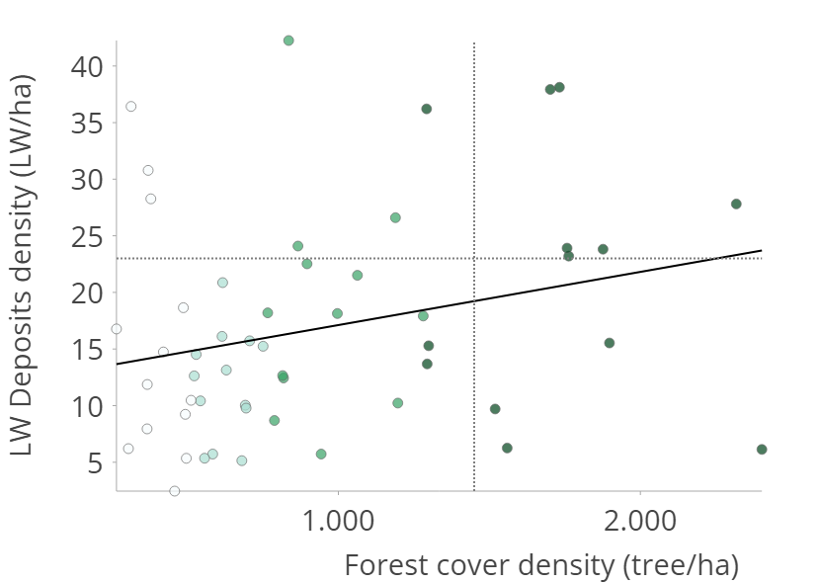
24 – 28 April 2023
RESULTS:
(3) SPATIAL ANALYSIS OF LW DEPOSITION PATTERNS
llanosvalera@ub.edu
Forest Density
Q₃
p-value < 0,05
R² = 0,07
Q₃
4/8
85% of the forest cover in the flooded area was eroded.
We found a positive relationship between LW accumulation density and forest density, but the forest density did not entirely explained the deposition of LW.

Slide 11
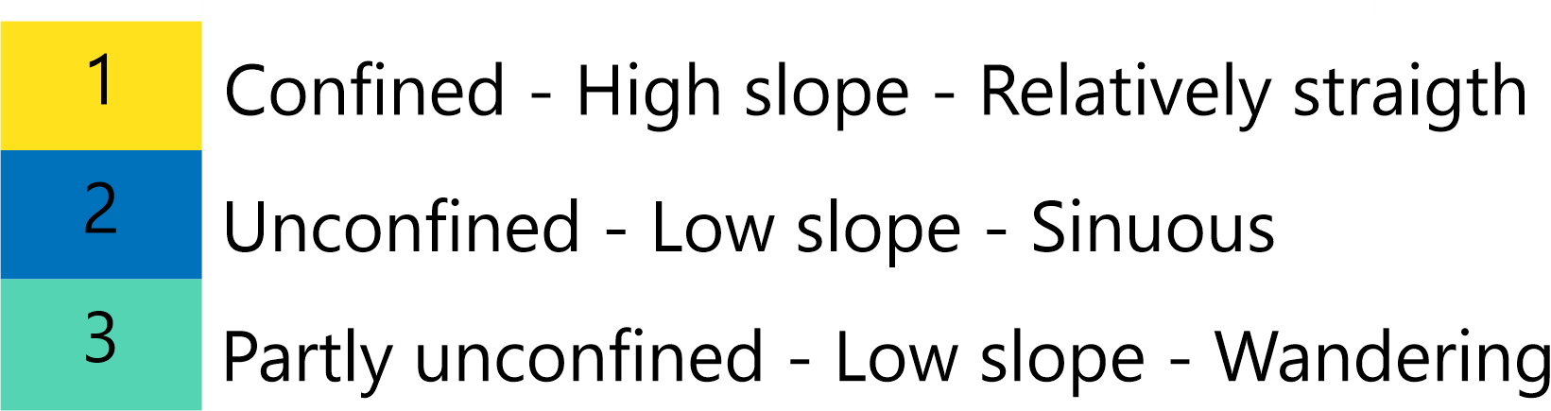
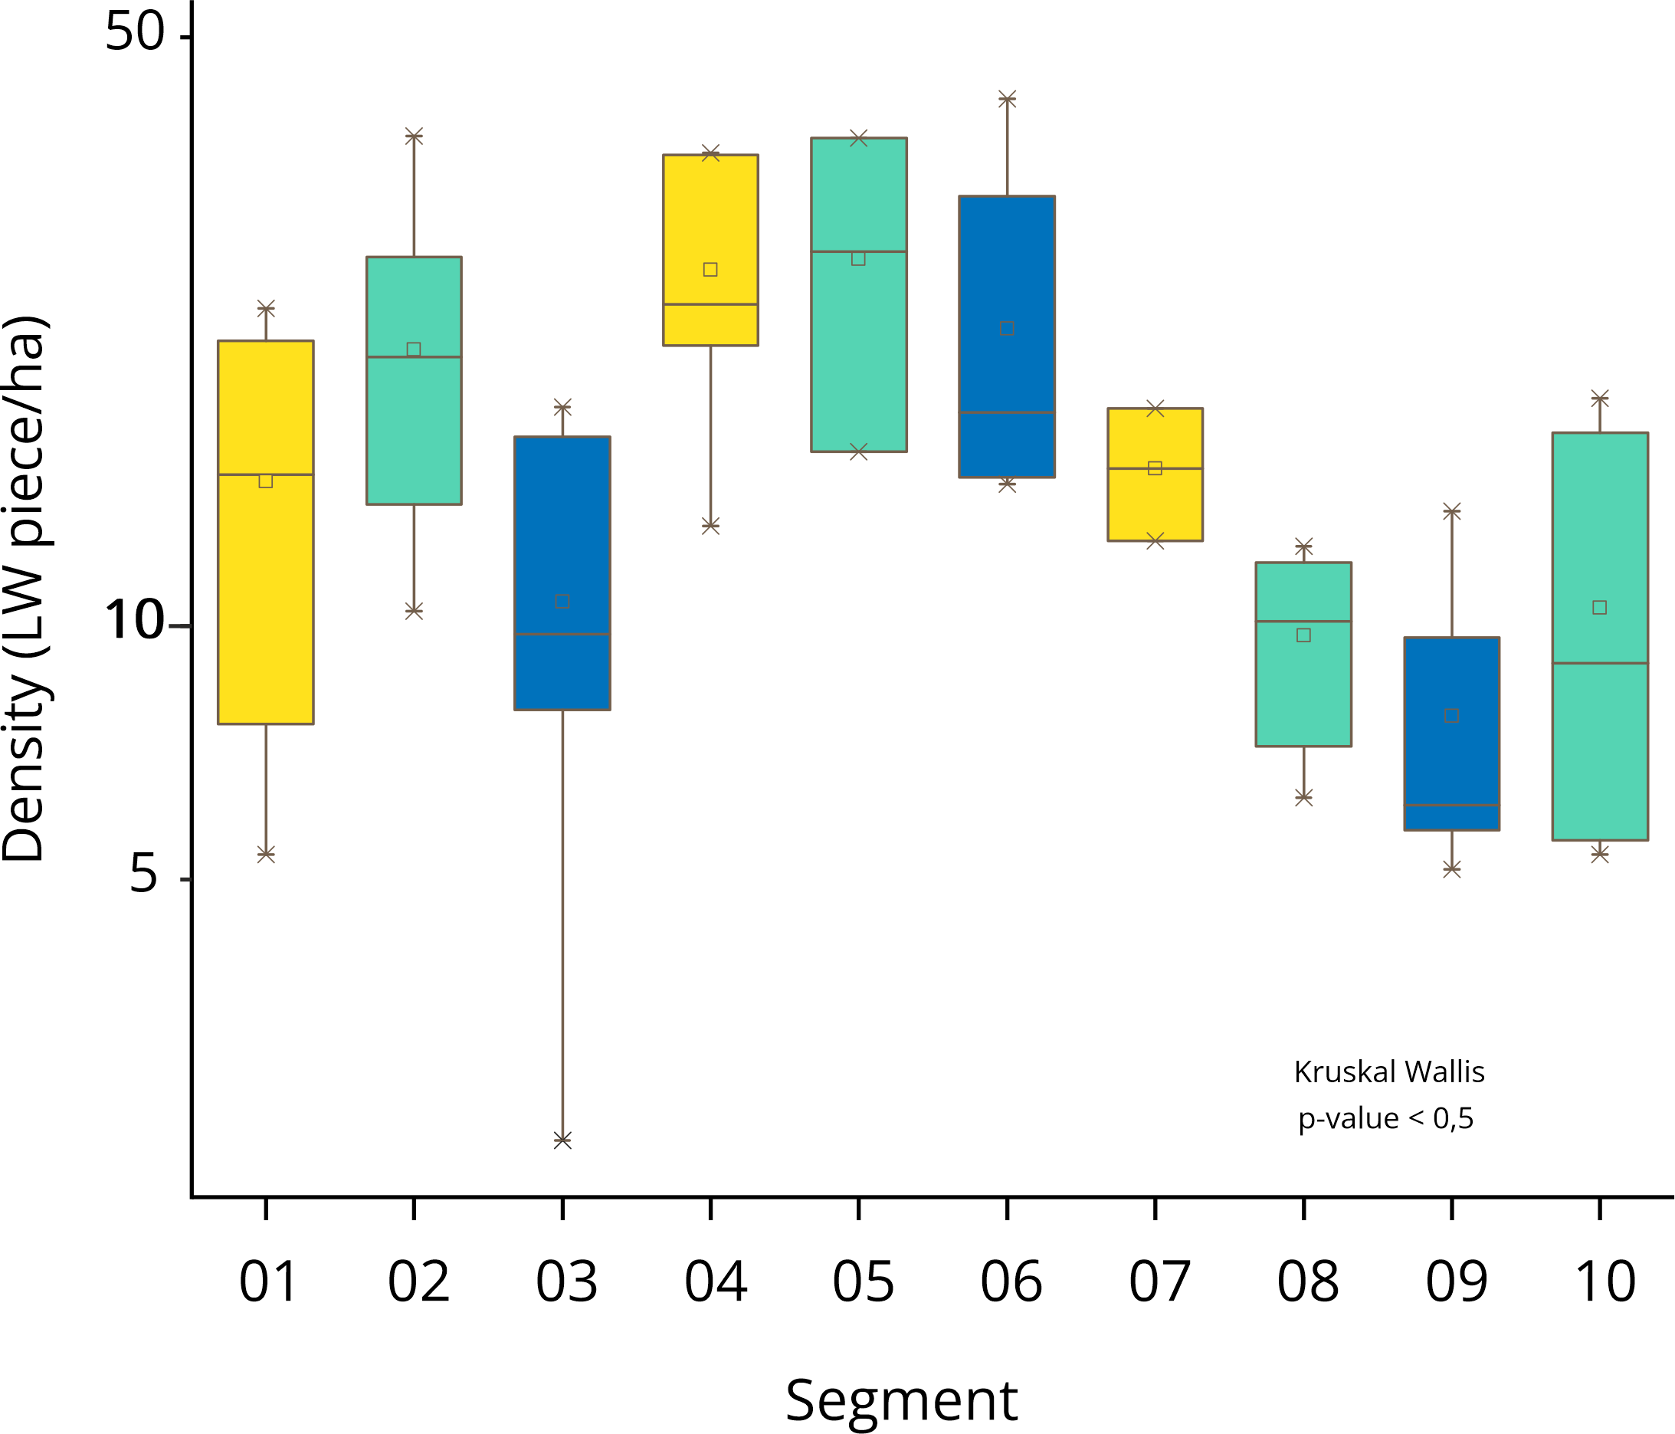
24 – 28 April 2023
RESULTS:
(2) SEGMENTATION BY RIVER MORPHOLOGY AND,
(3) SPATIAL ANALYSIS OF LW DEPOSITION PATTERNS
llanosvalera@ub.edu
LW Deposit Density
Vimbodí
L’Espluga
Montblanc
LW deposits density was higher in the first 7 segments and increases near towns
Morphology was not the main factor controlling wood deposition
5/8

Slide 12
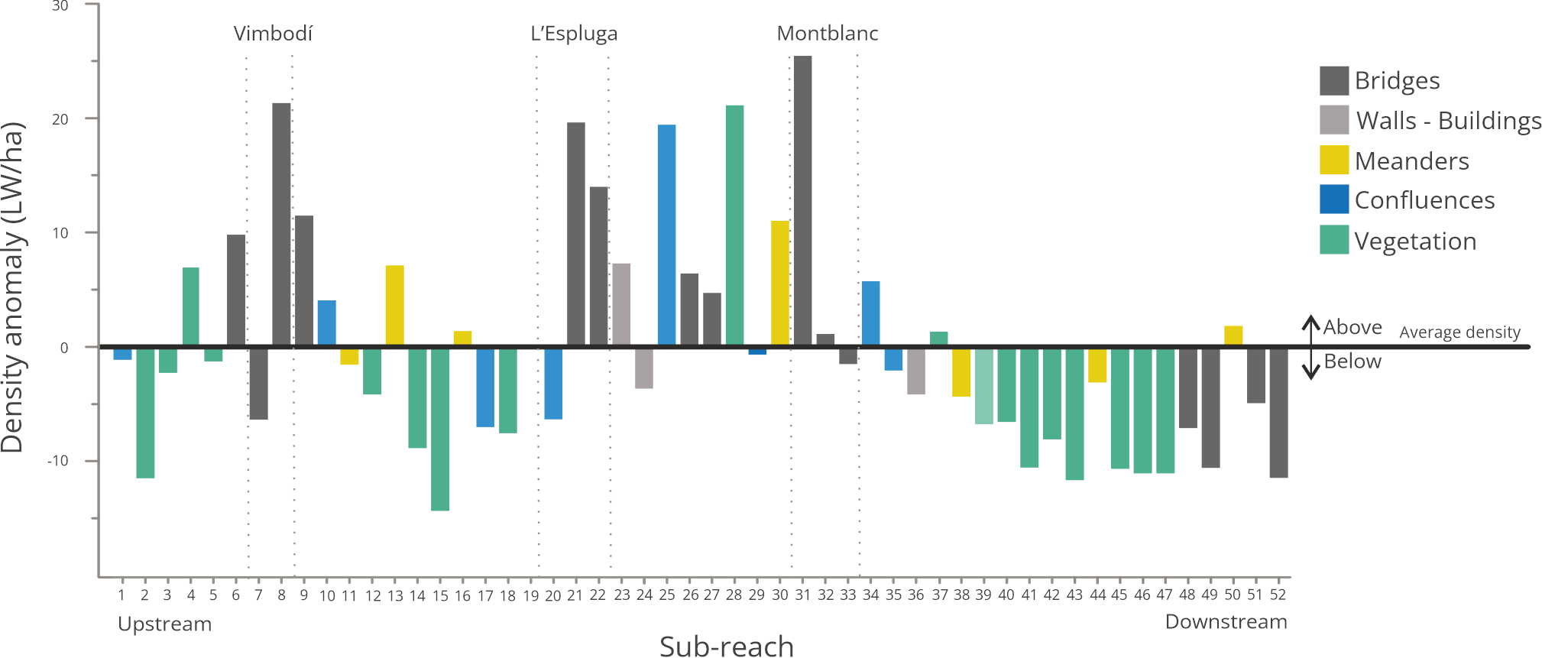
24 – 28 April 2023
RESULTS:
LW DEPOSITION PATTERNS IN FRANCOLÍ RIVER
llanosvalera@ub.edu
6/8
LW accumulation was much greater along the first 20 km (until subreach 31).
70% of accumulated LW pieces were trapped upstream from towns and bridges

Slide 13
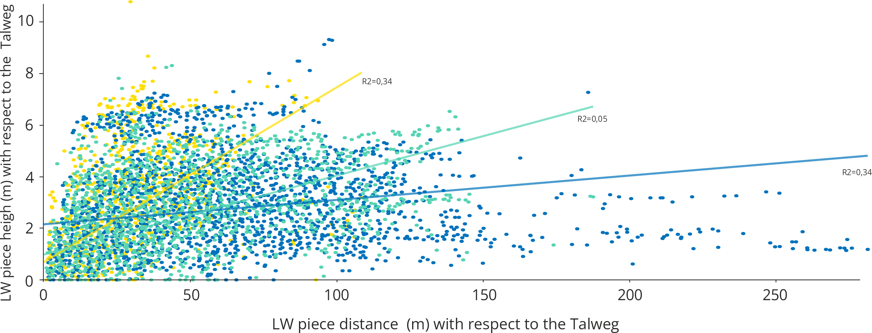
24 – 28 April 2023
RESULTS:
(1) DEPOSITED LW CHARACTERISTICS AND,
(2) SEGMENTATION BY RIVER MORPHOLOGY
llanosvalera@ub.edu
7/8
LW distance is greater in unconfine reaches and smaller in confined reaches
The height is variable in the three types of reaches.

Slide 14
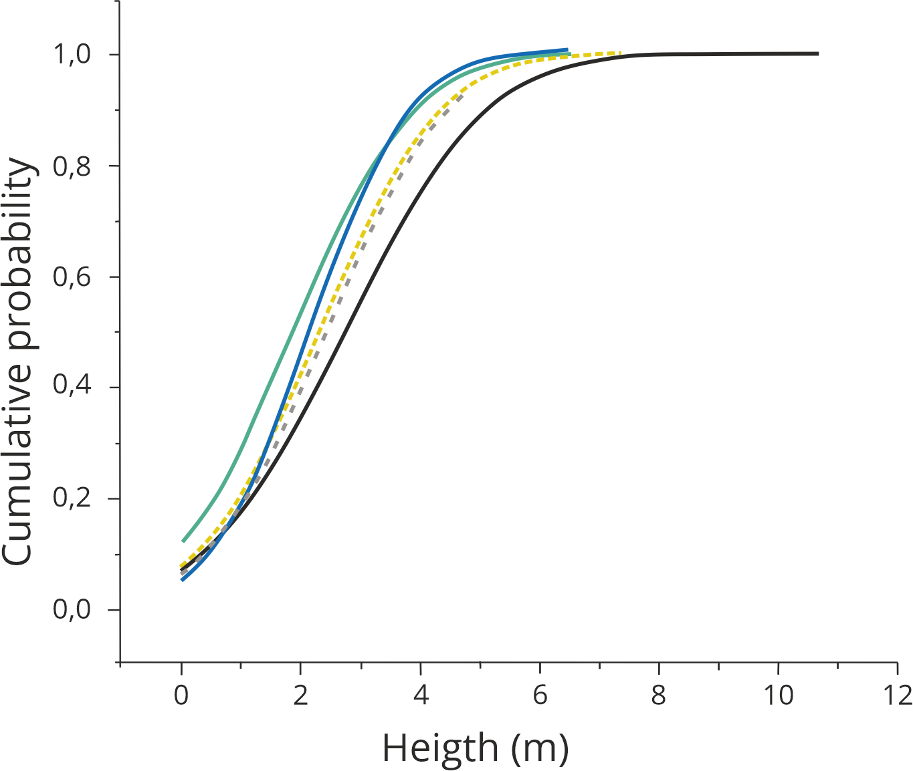
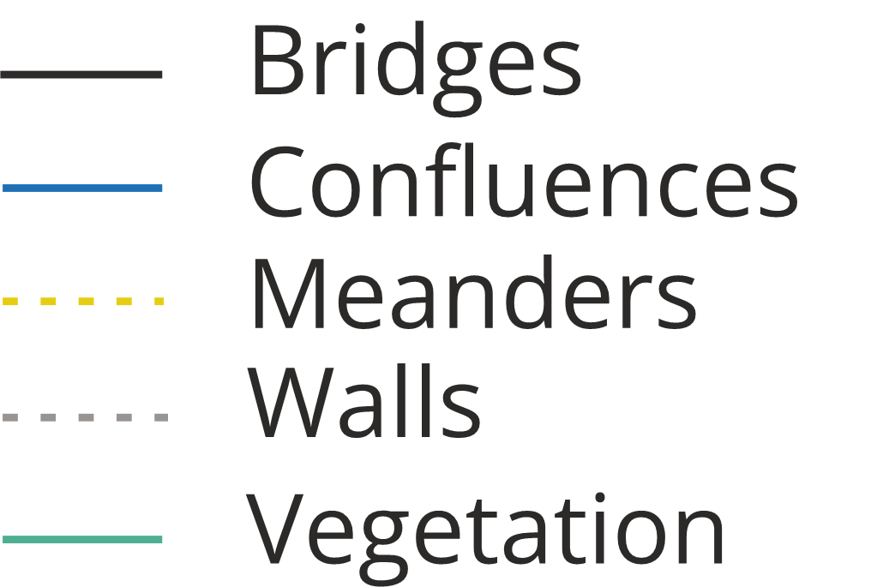
24 – 28 April 2023
RESULTS:
(1) DEPOSITED LW CHARACTERISTICS AND,
(3)SPATIAL ANALYSIS OF LARGE WOOD DEPOSITION PATTERNS
llanosvalera@ub.edu
Height and factor controlling LW deposits
LW accumulated at bridges was significantly higher with respect to the river thalweg than LW deposited somewhere else
8/8

Slide 15
24 – 28 April 2023
CONCLUSIONS:
llanosvalera@ub.edu
The flood in 2019 in the Francolí River supplied large amounts of LW.
LW was deposited at relatively unconfined, gentle slopes and meandering reaches, trapped by the living vegetation and by bridges.
Bridges trapped a significantly larger quantity of wood. The LW trapped at bridges was deposited at higher elevations.
Some bridges trapped more wood, we are analysing their characteristics to understand the variables that enhanced wood trapping.
Multivariate analysis is being carried out to explain LW deposition along the Francolí.
A decision model is being tested to predict bridges prone to trap wood.
1/1
References

Slide 16
24 – 28 April 2023
REFERENCES:
llanosvalera@ub.edu
ICGC, 2020. Cartografía topográfica, modelos de elevaciones del terreno, fotografías aéreas, ortofotos [en línea]. Barcelona, Generalitat de Catalunya. Departament de Territori i Sostenibilitat. Institut Cartogràfic i Geològic de Catalunya. CC by 4.0. Consultado el: 05/04/2023. URL: http://www.icgc.cat.
Martín-Vide, J.P.; Bateman, A.; Berenguer, M.; Ferrer-Boix, C. Amengual, A.; Campillo, M.; Corral, C.; Llasat, M.C.; Llasat-Botija, M.; Gómez-Dueñas, S. ; Marín-Esteve, B. ; Núñez-González, F.; Prats-Puntí, A.; Ruiz-Carulla, R.; Sosa-Pérez, R., 2023. Large wood debris that clogged bridges followed by a sudden release. The 2019 flash flood in Catalonia. Journal of Hydrology: Regional Studies, Volume 47, 2023, 101348, ISSN 2214-5818. https://doi.org/10.1016/j.ejrh.2023.101348
Poll Barrera, L., 2021. La conca alta del Francolí i els seus molins: reconstrucció hidràulica de crescudes extraordinàries per l’anàlisi de freqüències dels cabals de crescuda. S.l.: s.n. TFM Universitat de Barcelona.
Ruiz-Villanueva, V., Piégay, H., Gurnell, A. M., Marston, R. A., & Stoffel, M. (2016). Recent advances quantifying the large wood dynamics in river basins: New methods and remaining challenges. Reviews of Geophysics, 54, 611–652. https://doi-org.sire.ub.edu/10.1002/2015RG000514
Ruiz-Villanueva, V., Wyżga, B., Hajdukiewicz, H., and Stoffel, M., 2016. Exploring large wood retention and deposition in contrasting river morphologies linking numerical modelling and field observations. Earth Surf. Process. Landforms, 41: 446-459. ISSN 0197-9337. https://doi-org.sire.ub.edu/10.1002/esp.4091
Silverman, B.W. (1986) The kernel method for multivariate data. In: Silverman, B.W. (Ed.) Density Estimation for Statistic and Data Analysis. London: Chapman & Hall, pp. 75–94 Available from: https://doi-org.sire.ub.edu/10.1007/978-1-4899-3324-9_4
Wohl, E., Scott, D.N. y Lininger, K.B., 2018. Spatial Distribution of Channel and Floodplain Large Wood in Forested River Corridors of the Northern Rockies. Water resources research, vol. 54, no. 10, pp. 7879-7892. ISSN 0043-1397. https://doi-org.sire.ub.edu/10.1029/2018WR022750
UPC, 2020. Analysis of the flash flood in the Francolí River on October 22, 2019 (in Catalan). UPC field report to Catalan Water Authority, Barcelona, 2020. Available at: (https://www.upc.edu/ca/sala-de-prensa/pdfs/informe_francolí_memòria.pdf) (23/05/2022).

Slide 17
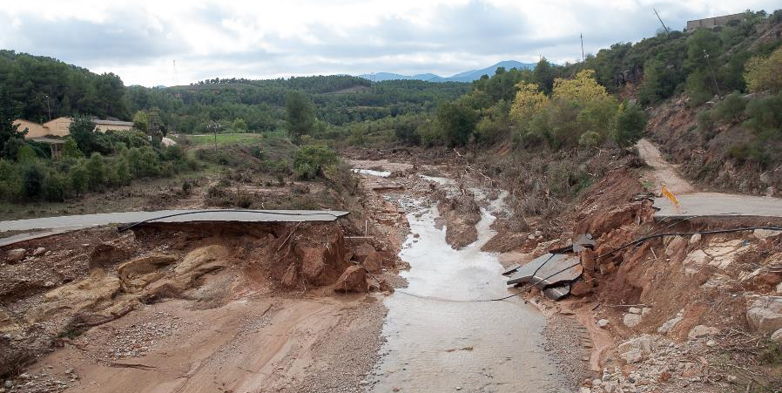
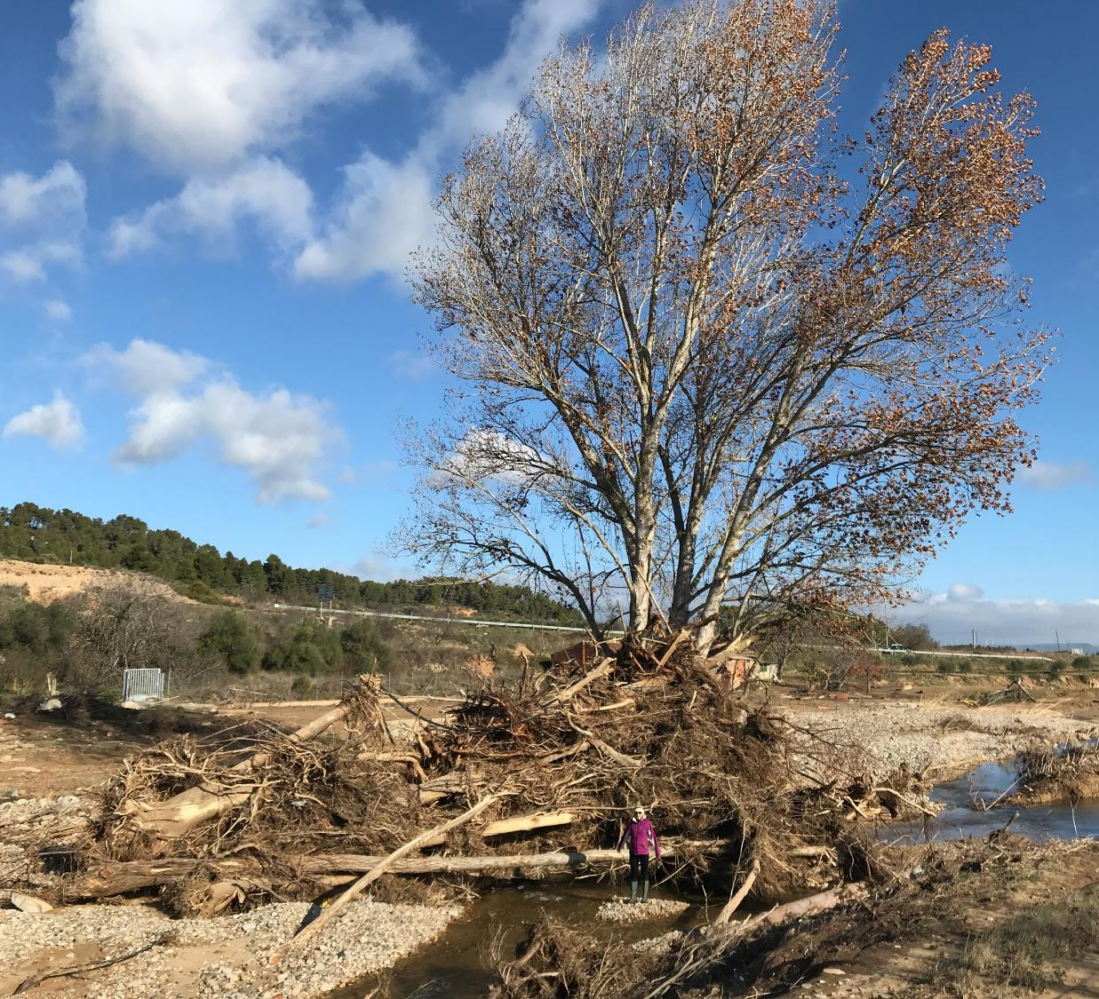
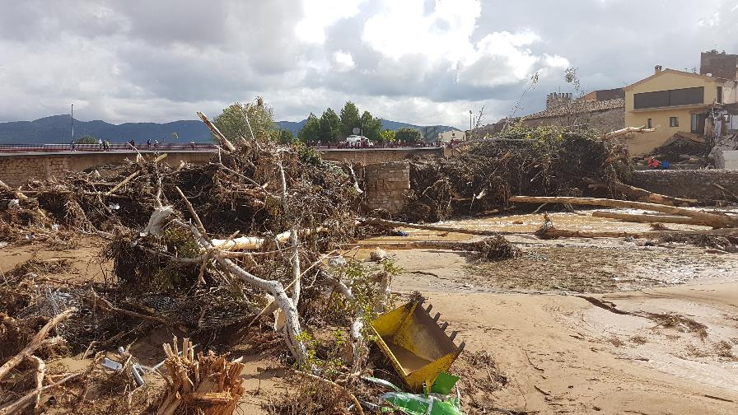
THANKS FOR YOUR ATTENCION
JM. Potau
A. Mestres
G. Furdada

