Slide 1
Exoplanet compositions - Devolatilization - Stellar compositions - Planet compositions - Compositional trends
Terrestrial exoplanet bulk composition
Effects on long-term planetary evolution
Rob Spaargaren*, Maxim Ballmer, Haiyang Wang, Stephen Mojzsis, Paul Tackley
*rob.spaargaren@erdw.ethz.ch
Exoplanet properties - Mantle mineralogy - Mantle viscosity
- Melting, basalt - Density

Slide 2
Introduction: Exoplanet diversity
NASA
Bulk composition of a terrestrial planet determines structure, mineralogy and rheological properties; affects thermal evolution.
Can exoplanet structure and mineralogy deviate from Earth (below)?
To understand full effect bulk composition, we first need to constrain the range of possible rocky planet compositions.
Stars show compositional diversity!
Earth
Stellar compositions from Hypatia catalog (Hinkel+, 2014); figure from Spaargaren+ (2020)
Mineral glossary: Pl:plagioclase; Cpx:clinopyroxene; Opx:orthopyroxene; C2/c:high-pressure orthopyroxene; Gt:Garnet; Sp:spinel; O:olivine; Wad:Wadsleyite; Ring:Ringwoodite; Bm:bridgmanite; Ppv:post-perovskite; St:stishovite; Ca-Pv:Ca-perovskite; Fp:ferropericlase. Figures from Spaargaren+ (accepted to ApJ)
Notes:
One of the main challenges of exoplanet astronomy right now is the characterization of atmospheres of the typically small rocky exoplanets
Some rocky exoplanet atmospheres have been characterized; example of TRAPPIST 1b+c
With JWST, more atm characterizations can be made
Future missions will make this even more possible, so we are getting close to a time where rocky exoplanet atmosphere observations will truly become available
But to interpret these observations, we need to understand atmospheric evolution

Slide 3
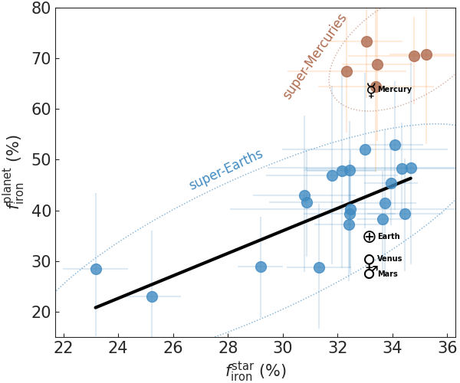
Introduction: Star-planet compositional link
NASA
Planet-forming disk and host star share composition
Can use stellar composition to constrain planet composition
Stellar abundances (relatively) easy to measure; available
Aims:
Constrain rocky exoplanet compositions using stellar compositions
Study effects composition on planet properties
Study long-term planet evolution for rocky planets with varying compositions
Adibekyan+ (2021) link core mass fractions inferred from exoplanet mass-radius (y-axis) measurements to expected core sizes from stellar abundances (x-axis). They find a clear linear trend, with some exceptions (Super-Mercuries)
Notes:
One of the main challenges of exoplanet astronomy right now is the characterization of atmospheres of the typically small rocky exoplanets
Some rocky exoplanet atmospheres have been characterized; example of TRAPPIST 1b+c
With JWST, more atm characterizations can be made
Future missions will make this even more possible, so we are getting close to a time where rocky exoplanet atmosphere observations will truly become available
But to interpret these observations, we need to understand atmospheric evolution

Slide 4
Exoplanet compositions: Devolatilization
Comparing Earth and Sun composition: Simple general trend
Compositionally identical for refractory (high-Tc) elements, such as Ca, Al
Earth progressively more depleted for volatile (low-Tc) elements
General result of planet formation process => rocky exoplanets also devolatilized
Apply Earth-Sun devolatilization trend to stellar abundances to simulate planet formation
Element abundance ratios between Earth and the Sun, normalized to refractory element Al, and plotted against 50% condensation temperature of each element (Tc from Lodders+, 2003); figure from Wang et al. (2019)

Slide 5
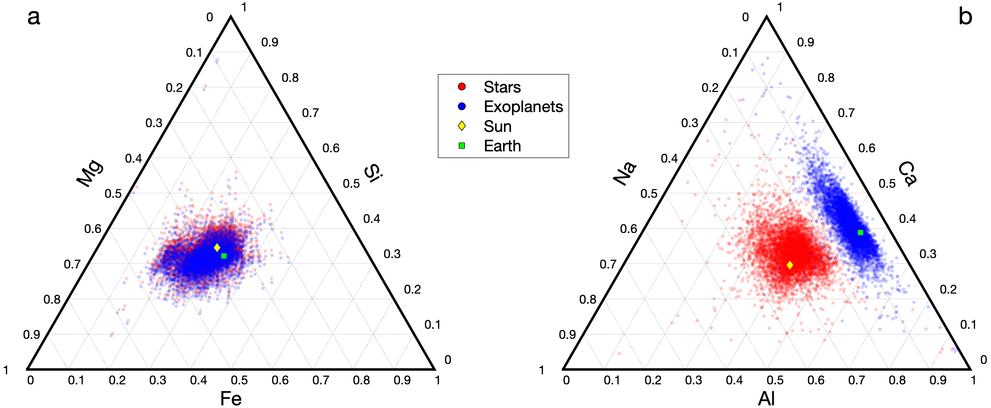
Exoplanet compositions: Stellar compositions
Bulk stellar compositions (red) from combining Hypatia catalog (Hinkel+, 2014) and GALAH catalog (Buder+, 2018); compositions for Solar neighbourhood (<200 pc). Bulk exoplanet compositions (blue) are from applying devolatilization trend to stellar abundance data. Little difference for Fe, Mg, Si, as their condensation temperatures are similar. More pronounced difference between Ca and Al (refractory), and Na (moderately volatile). Figure from Spaargaren+ (Accepted to ApJ).

Slide 6
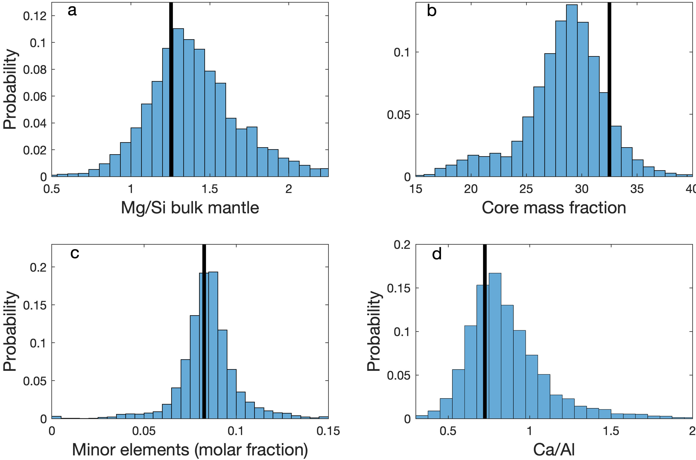
Exoplanet compositions: Exoplanet compositions
Mantle Mg/Si (molar) controls mantle mineralogy and viscosity. Earth is fairly average
Core size mainly depends on stellar [Fe/Mg], affects dynamics. Earth has above-average core size.
Minor elements (Ca+Al+Na; cf. Fe+Mg+Si) form a small part of the Earth mantle, and exoplanets are not much different. Most exoplanet mantles consist mainly of Fe,Mg-silicates
Ca/Al shows how minor elements are distributed (Na often low abundance due to volatility)
Exoplanet bulk composition histograms (Spaargaren+, Accepted to ApJ).

Slide 7
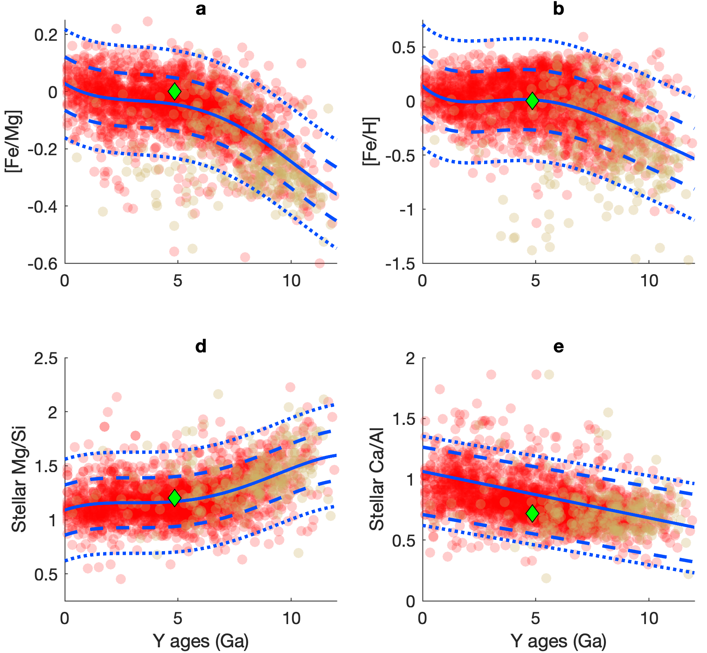
Exoplanet compositions: Compositional trends
Stellar composition evolves with time
Exoplanets with larger cores typically have lower Mg/Si (see below)
Stellar Fe/Mg increases with time, Mg/Si decreases (see right)
Young planets form with larger cores and stiffer mantles
Planet compositions (Mantle Mg/Si vs core mass fraction), Earth (McDonough, 2003), Sun (Lodders+, 2009), and some representative compositions (orange; Spaargaren+, ApJ)
Stellar compositions as a function of age
Bedell+ (2018; left), Spaargaren+ (accepted to ApJ, right)

Slide 8
Exoplanet dynamics: Mantle mineralogy
Mg/Si = 0.8
Bulk exoplanet mantle compositions ->
Use Perple_X (Connolly, 2005) to simulate mineralogy
Database from Stixrude+Lithgow-Bertelloni (2022; same for all figures from here on)
Mineral species similar to Earth, relative abundances deviate
Earth
Mg/Si = 2.0
Mineral glossary: Pl:plagioclase; Cpx:clinopyroxene; Opx:orthopyroxene; C2/c:high-pressure orthopyroxene; Gt:Garnet; Sp:spinel; O:olivine; Wad:Wadsleyite; Ring:Ringwoodite; Bm:bridgmanite; Ppv:post-perovskite; St:stishovite; Ca-Pv:Ca-perovskite; Fp:ferropericlase. Figures from Spaargaren+ (accepted to ApJ)

Slide 9
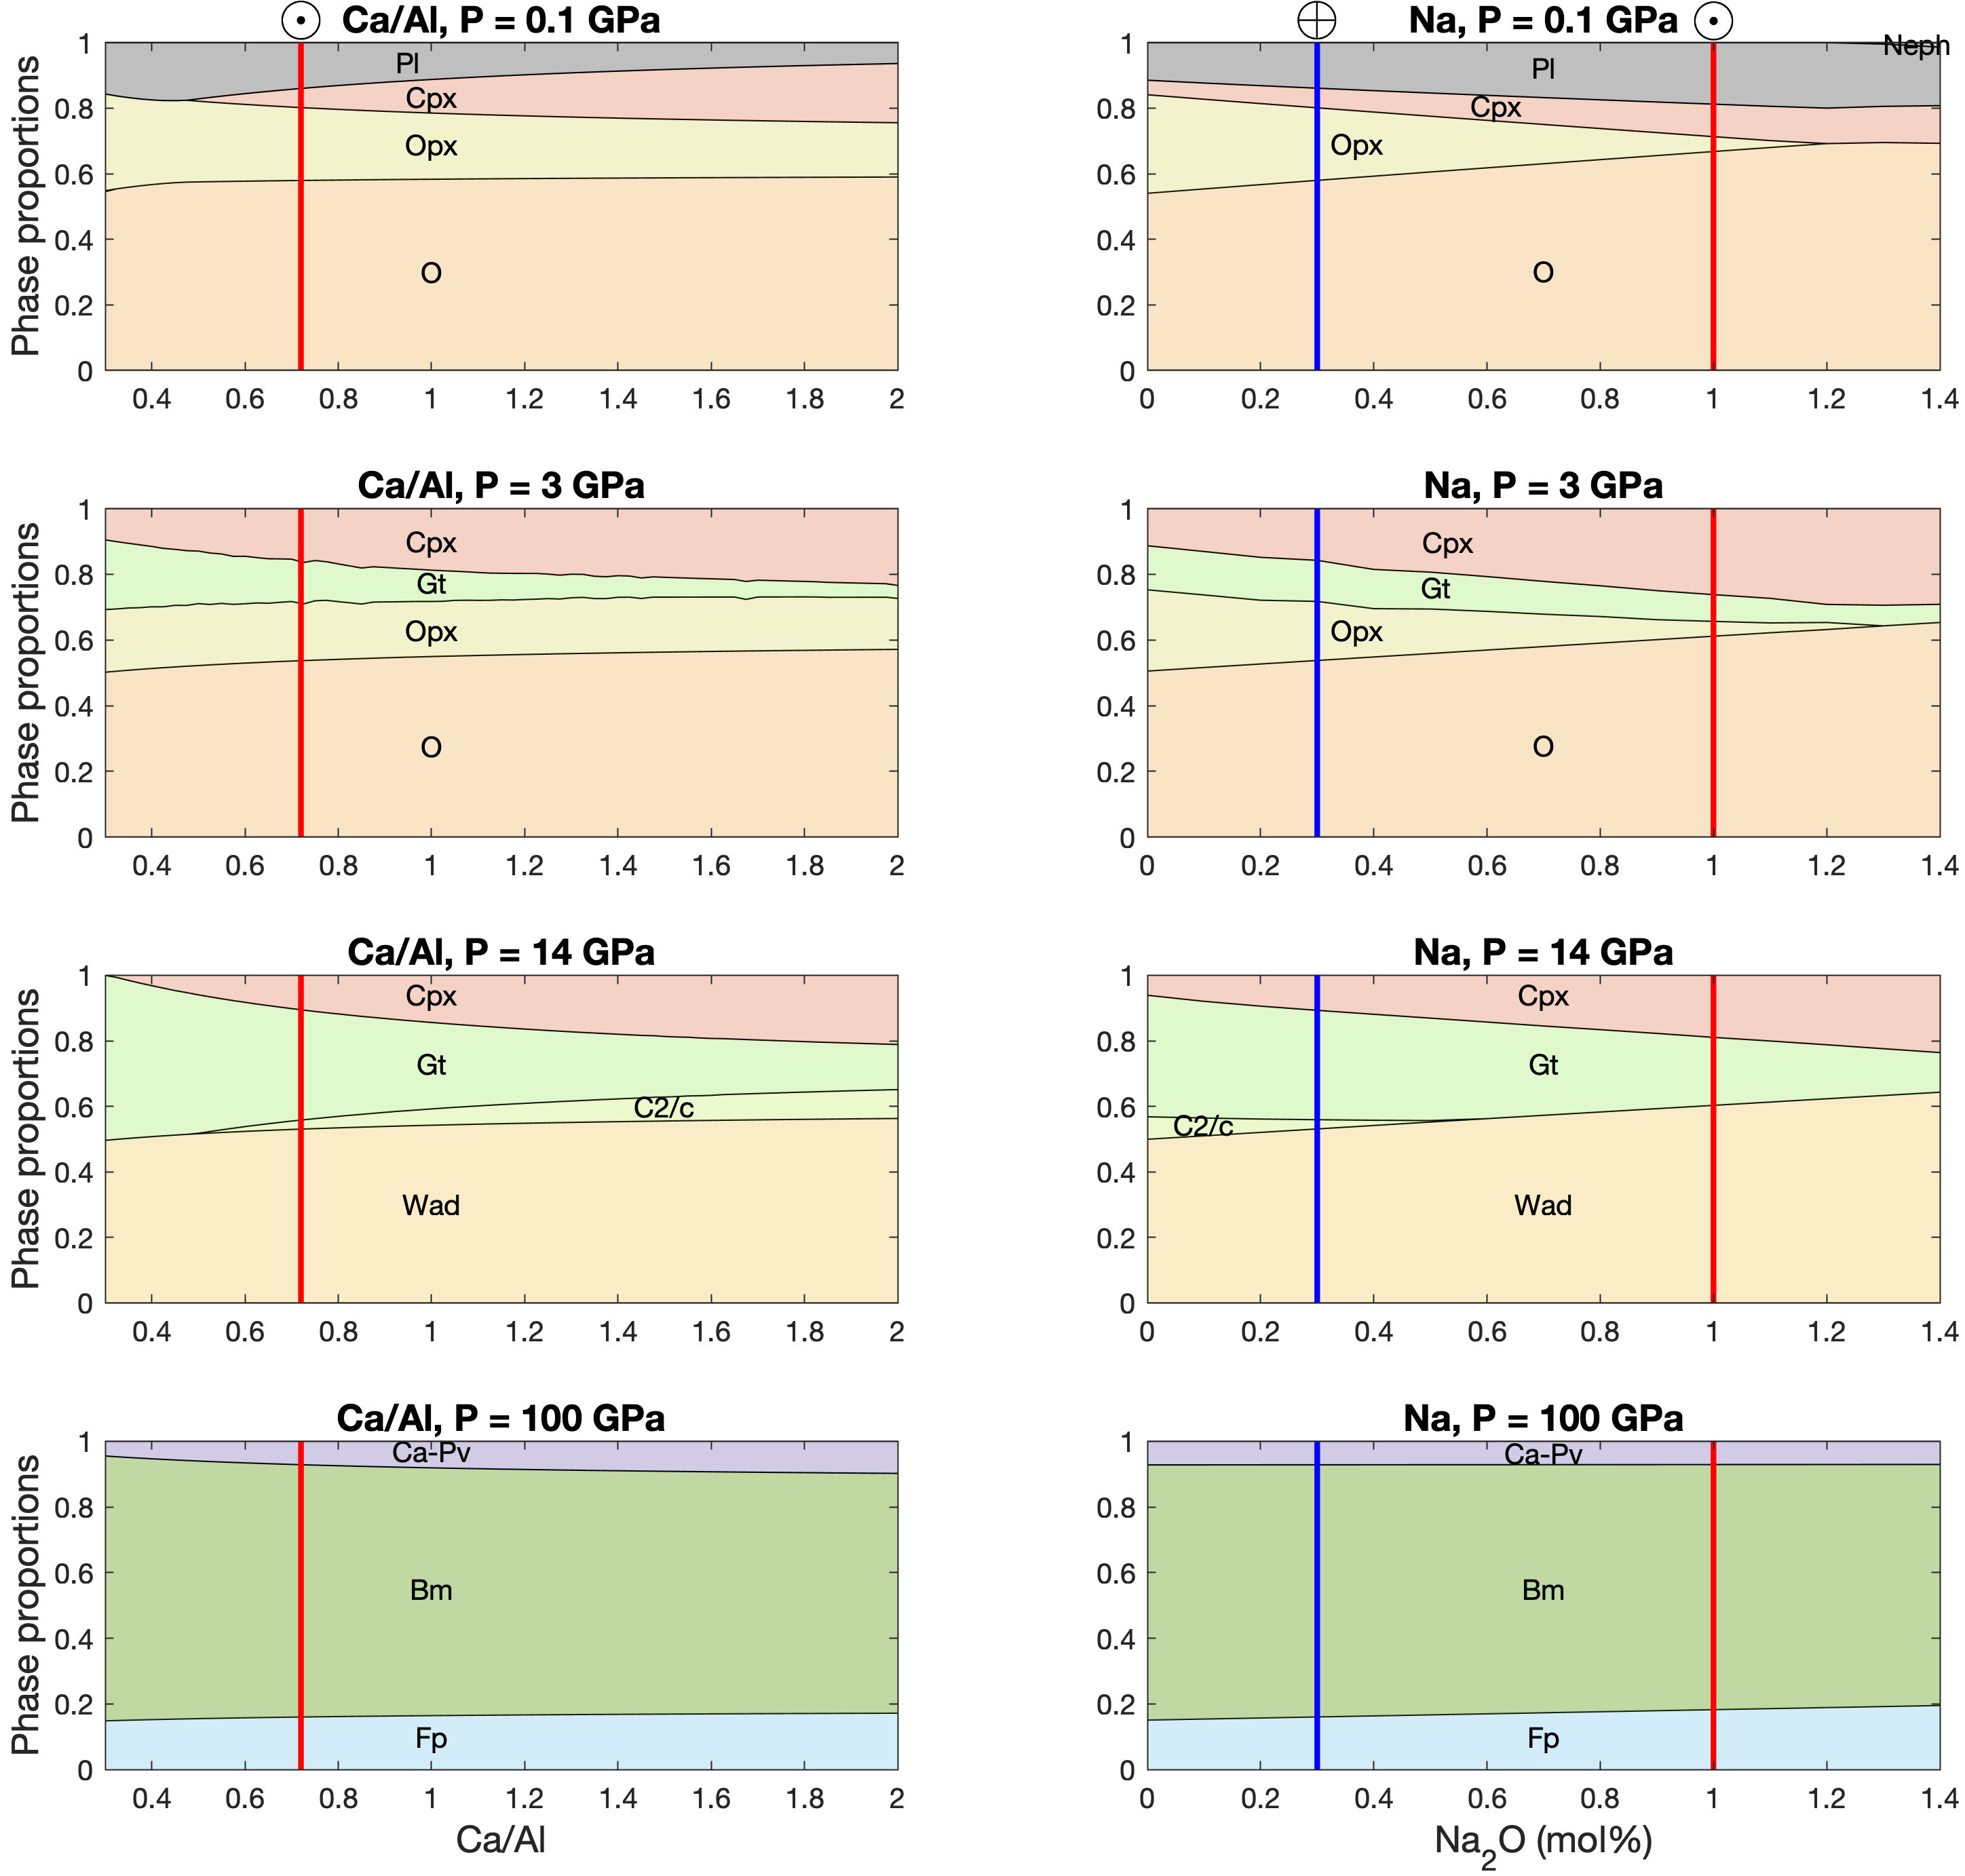
Exoplanet dynamics: Mantle mineralogy
High minor element (Ca+Al+Na) abundances: mainly more Cpx, slightly more Ca-Pv
Same mineral species as Earth; no exotic minerals
Cpx important for melting; more cpx likely means more fertile mantle
⊙: Sun; ⊕: Earth
Mineral glossary: Pl:plagioclase; Cpx:clinopyroxene; Opx:orthopyroxene; C2/c:high-pressure orthopyroxene; Gt:Garnet; Sp:spinel; O:olivine; Wad:Wadsleyite; Ring:Ringwoodite; Bm:bridgmanite; Ppv:post-perovskite; St:stishovite; Ca-Pv:Ca-perovskite; Fp:ferropericlase. Figures from Spaargaren+ (accepted to ApJ)

Slide 10
Exoplanet dynamics: Mantle mineralogy
Mg/Si controls relative abundances of major minerals
Olivine vs pyroxene+garnet in upper mantle
Bridgmanite vs ferropericlase in lower mantle
Very high Mg/Si: Ferropericlase in upper mantle!
SiO₂-minerals appear at low Mg/Si, outside of range found from stellar compositions (black rectangle, right)
⊙: Sun; ⊕: Earth
Mg/Si = 0.8
Mg/Si = 2.0
Mineral glossary: Pl:plagioclase; Cpx:clinopyroxene; Opx:orthopyroxene; C2/c:high-pressure orthopyroxene; Gt:Garnet; Sp:spinel; O:olivine; Wad:Wadsleyite; Ring:Ringwoodite; Bm:bridgmanite; Ppv:post-perovskite; St:stishovite; Ca-Pv:Ca-perovskite; Fp:ferropericlase. Figures from Spaargaren+ (accepted to ApJ)

Slide 11
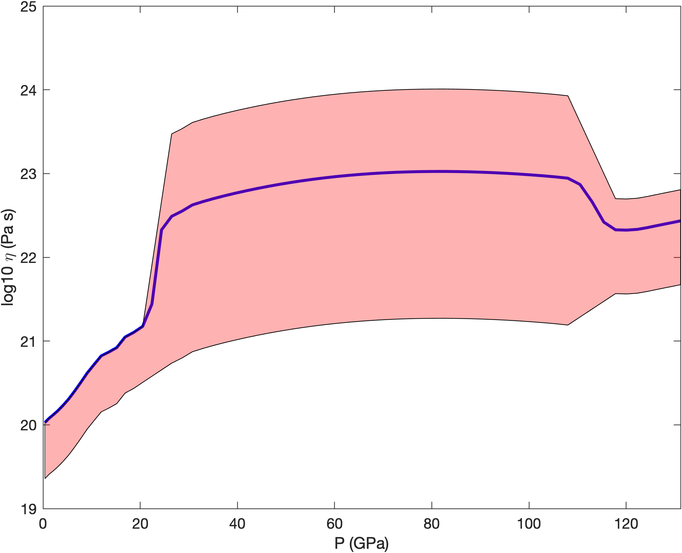
Exoplanet dynamics: Mantle viscosity
Mantle viscosity controlled by strong and weak minerals
Strong: bridgmanite, pyroxene, olivine, garnet
Weak: Ferropericlase, Ca-perovskite
Range of exoplanet compositions: much weaker mantle possible
Weakest planets dominated by fp → No viscosity jump at 660km depth (density jump across transition still exists)
Mg/Si = 0.8
Mg/Si = 2.0
Viscosity along 1700K adiabat; Earth (blue line) compared to exoplanets (red area).
Mineral glossary: Pl:plagioclase; Cpx:clinopyroxene; Opx:orthopyroxene; C2/c:high-pressure orthopyroxene; Gt:Garnet; Sp:spinel; O:olivine; Wad:Wadsleyite; Ring:Ringwoodite; Bm:bridgmanite; Ppv:post-perovskite; St:stishovite; Ca-Pv:Ca-perovskite; Fp:ferropericlase. Mineralogy figures from Spaargaren+ (accepted to ApJ)

Slide 12
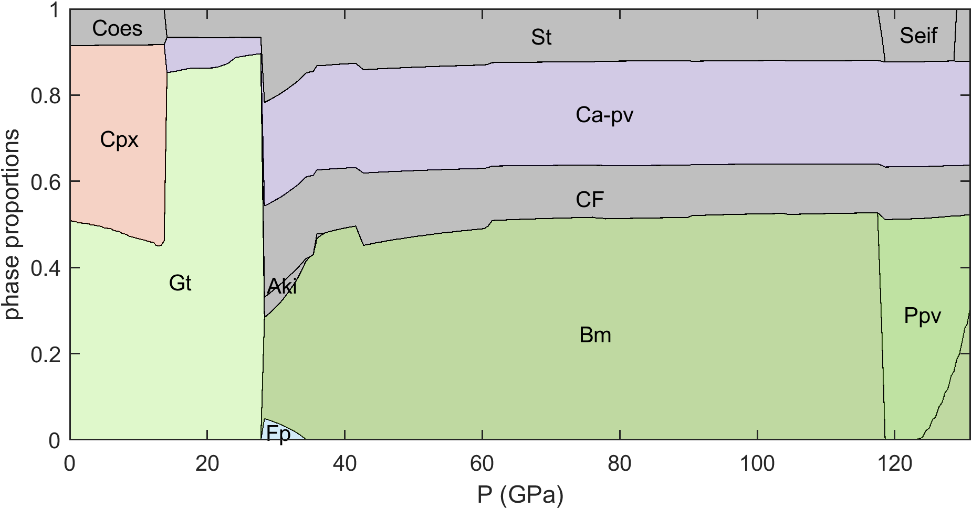
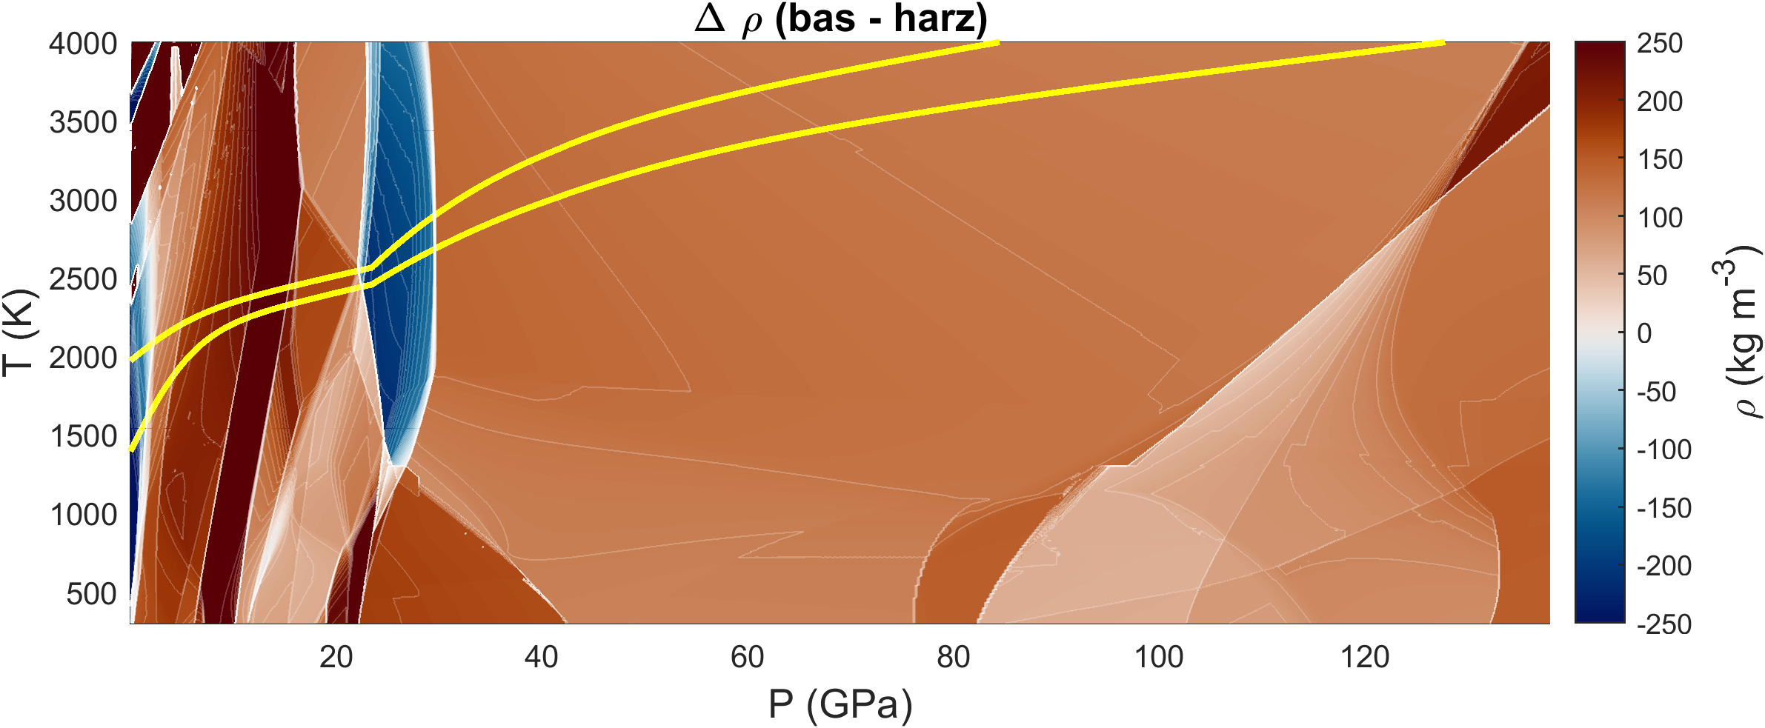
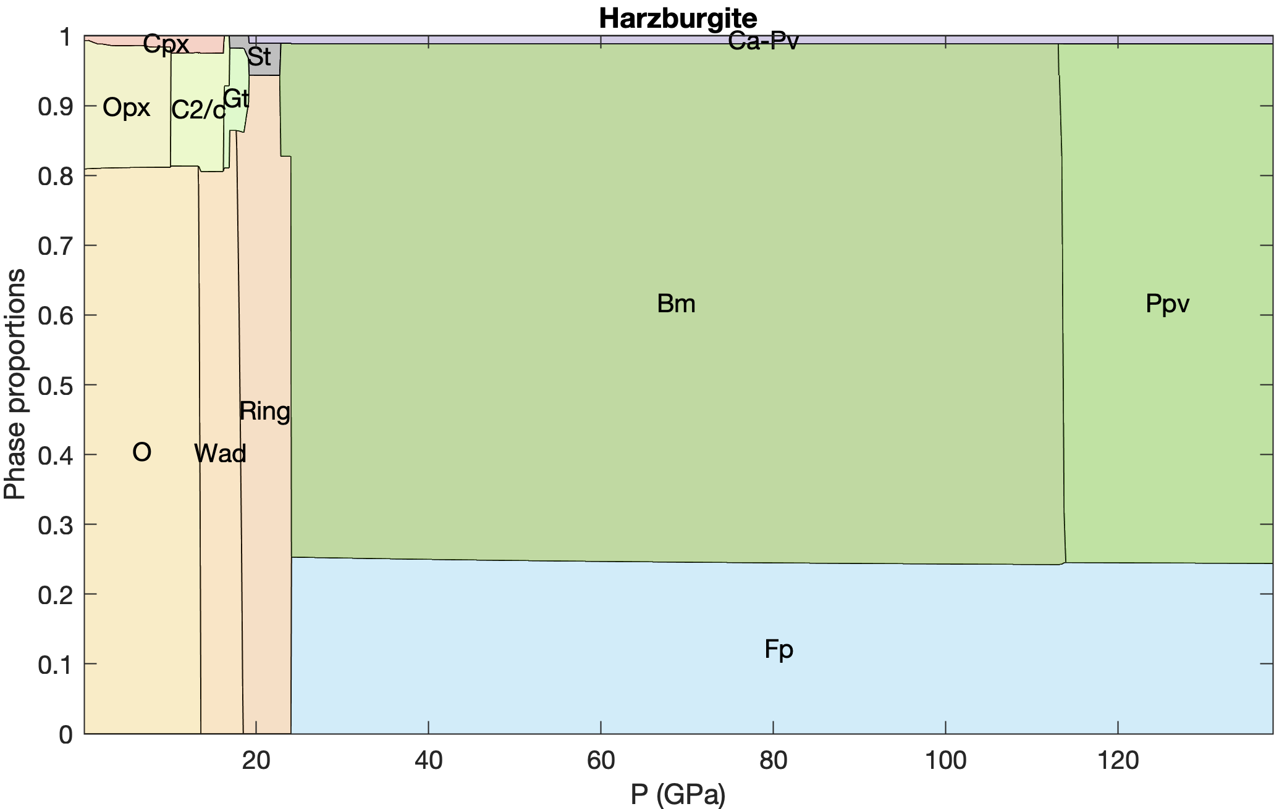
Exoplanet dynamics: Melting, basalt
Basalt
Assumption: Earth mantle is mechanical mixture of melting product (basalt) and residue (harzburgite)
Basalt heavier except on top of the mantle and just below transition zone
Density contrast between basalt and harzburgite; solidus and liquidus curves indicated in green.
Mineral glossary: Pl:plagioclase; Cpx:clinopyroxene; Opx:orthopyroxene; C2/c:high-pressure orthopyroxene; Gt:Garnet; Sp:spinel; O:olivine; Wad:Wadsleyite; Ring:Ringwoodite; Bm:bridgmanite; Ppv:post-perovskite; St:stishovite; Ca-Pv:Ca-perovskite; Fp:ferropericlase.

Slide 13
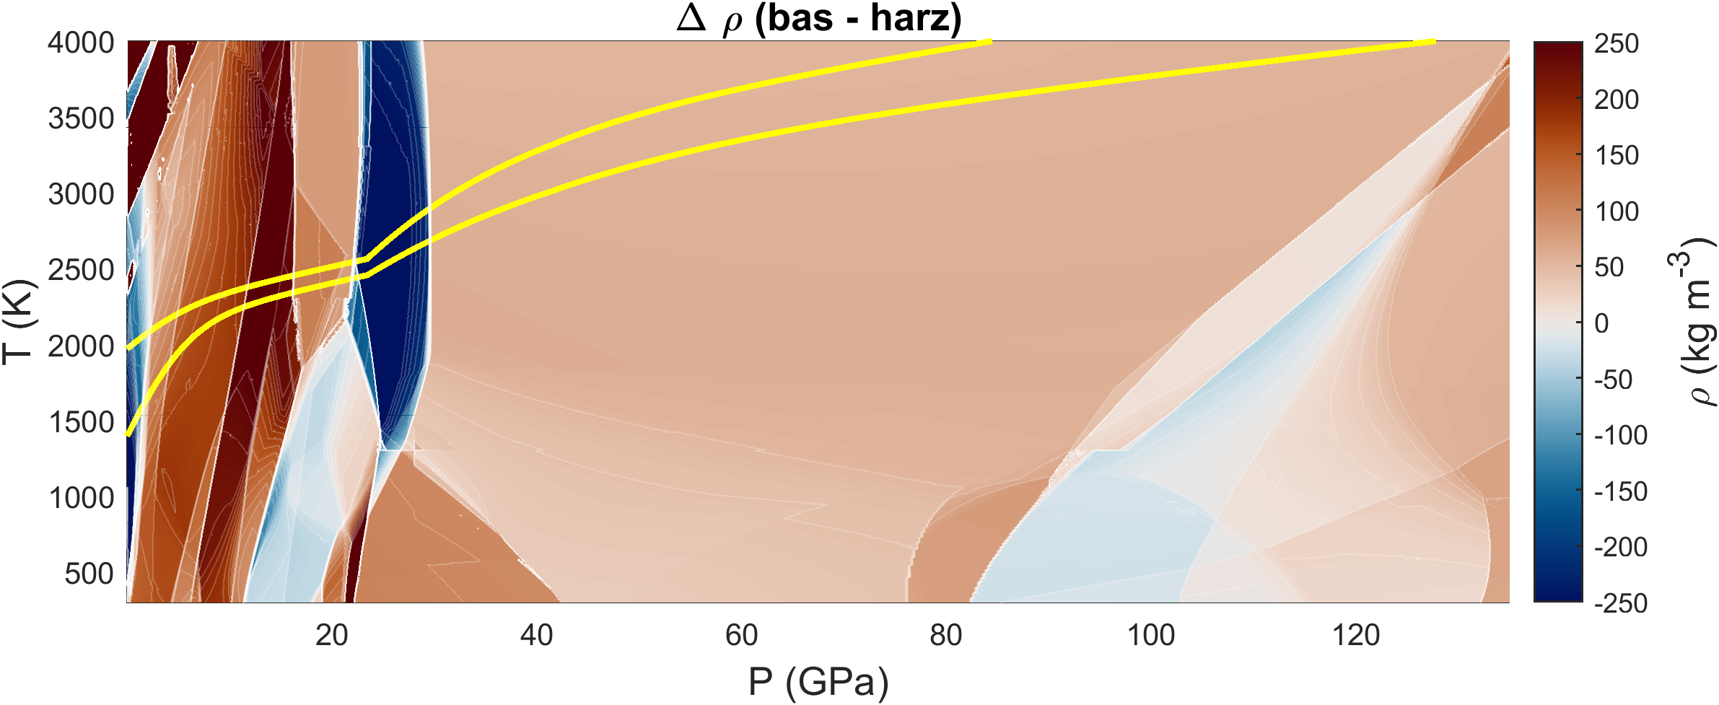
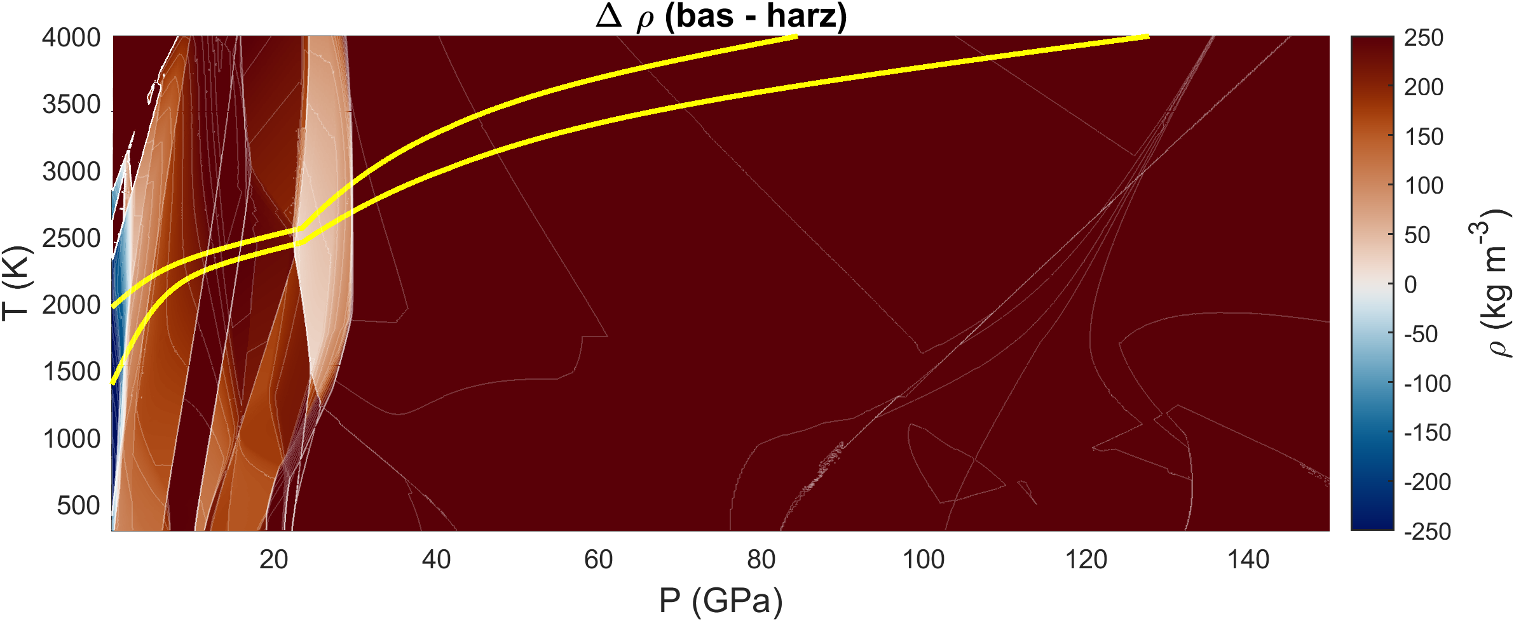
Exoplanet dynamics: Basalt-harzburgite density contrast
Density contrast basalt-harzburgite important for driving subduction, plate tectonics
Fe content of basalt and harzburgite can change the density contrast
Can cause faster slab sinking, or stronger stagnation on top of lower mantle; stronger basalt filter

Slide 14
Exoplanet dynamics: Post-perovskite
Using Stixrude+Lithgow-Bertelloni (2022) database leads to post-perovskite not being stable in lowermost mantle basalt
Reducing density contrast basalt-harzburgite in lowermost mantle prevents build-up of basaltic piles
Experimental results are sometimes contradictory
We introduce an adjustment to stability of Al-ppv, to bring back stability of ppv in basalt, and basalt piles (stx21-SpaarCo vs stx21-LB)
Our correction forms an alternative for modelling with formation of basaltic piles
Left: molar bm/(bm+ppv) in Earth basalt for original (left) and adjusted (right) stx21-database (Stixrude+Lithgow-Bertelloni 2022)
Right: $ρ_{basalt} − ρ_{harzburgite}$

Slide 15
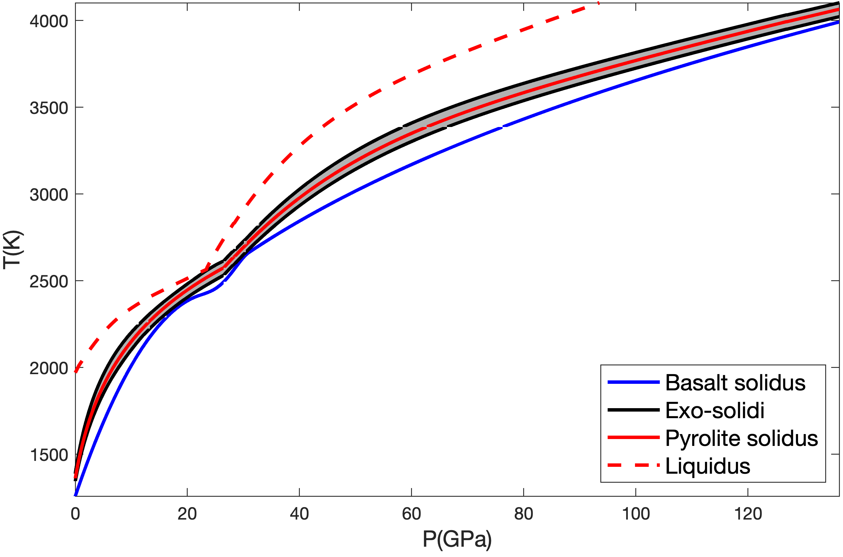
Exoplanet dynamics: Melting
Melting depends on basalt fraction and mantle iron content
Here: Tcpx,out (T at which all cpx is molten) is used as temperature at which rock is depleted in basalt
Basalt has lower melting T -> more basalt-rich planets have more fertile mantles, longer volcanism and thus outgassing lifetimes
Top: Spread of bulk mantle solidus curves for all exoplanet compositions considered here. Basalt solidus based on Yasuda+ (1994) and Pradhan+ (2015)
Left: Solidus, liquidus, and cpx,out temperatures for compositions linearly interpolated between Earth basalt and Earth harzburgite. Data generated with pMELTS (Ghiorso+, 2002).

Slide 16
Take-home messages
NASA
Exoplanets show great diversity
Exoplanet compositions can be constrained from stellar abundances
Exotic compositions are rare
Earth mostly has an average composition in the Solar neighbourhood
Younger planets tend to have larger cores and stiffer mantles
Mineralogy of exoplanets similar to Earth, no exotic minerals, but varying abundances
We find ferropericlase in upper mantles of Mg-rich planets
Viscosity can vary widely, especially in lower mantle
Melting modulated by basalt fraction, constrains volcanic outgassing lifetime
Exoplanet dynamics - Mantle mineralogy - Mantle viscosity
- Melting, basalt - Dynamics
Notes:
One of the main challenges of exoplanet astronomy right now is the characterization of atmospheres of the typically small rocky exoplanets
Some rocky exoplanet atmospheres have been characterized; example of TRAPPIST 1b+c
With JWST, more atm characterizations can be made
Future missions will make this even more possible, so we are getting close to a time where rocky exoplanet atmosphere observations will truly become available
But to interpret these observations, we need to understand atmospheric evolution

Slide 17
Supplementary: Earth and Sun compositions
NASA
 | Sun Dex; Lodders+ (2009) | Earth (bulk) Mol%; McDonough (2003) | Earth (bulk mantle) Mol%; McDonough (2003) | Earth (basalt) Mol%; Nakagawa+ (2010) | Earth (harzburgite) Mol%; Nakagawa+ (2010)
Si / SiO2 | 7.52 | 15.1 | 39.92 | 51.68 | 36.46
Mg / MgO | 7.54 | 16.69 | 48.32 | 16.43 | 57.78
Fe / FeO | 7.45 | 15.1 | 5.97 | 7.34 | 5.56
Ca / CaO | 6.33 | 1.12 | 3.26 | 12.64 | 0.49
Al / Al₂O₃ | 6.47 | 1.56 | 2.24 | 9.83 | 0
Na / Na₂O | 6.30 | 0.21 | 0.30 | 1.98 | 0
O | 8.73 | 48.89
S | 7.14 | 0.52
Ni | 6.23 | 0.82
Notes:
One of the main challenges of exoplanet astronomy right now is the characterization of atmospheres of the typically small rocky exoplanets
Some rocky exoplanet atmospheres have been characterized; example of TRAPPIST 1b+c
With JWST, more atm characterizations can be made
Future missions will make this even more possible, so we are getting close to a time where rocky exoplanet atmosphere observations will truly become available
But to interpret these observations, we need to understand atmospheric evolution

Slide 18
Supplementary: References
NASA
Hinkel, N.R. et al., 2014, the Astronomical Journal, 148, 54
Spaargaren, R.J. et al., 2020, Astronomy and Astrophysics, 643, A44
Adibekyan, V. et al., 2021, Science, 374, 330
Lodders, K., 2003, the Astrophysical Journal, 591, 1220
Wang, H. et al., 2019, Icarus, 328
Buder, S. et al., 2018, MNRAS, 478, 4513
McDonough, W.F., 2003, 3.16–Compositional model for the Earth’s core." Treatise on geochemistry 2 547-568
Lodders, K. et al., 2009, in Solar System- Landolt-Börnstein - Group VI Astronomy and Astrophysics, ed. J. Trumper, Vol. 4B (Springer Materials), 712-770
Bedell, M. et al., 2018, the Astrophysical Journal, 865, 68
Connolly, J.A., 2005, Earth and Planetary Sciences Letters, 236, 524
Stixrude, L. and Lithgow-Bertelloni, C., 2022, Geophysical Journal International, 228, 1119
Yasuda, A. et al., 1994, Journal of Geophysical Research: Solid Earth, 99, B5
Pradhan, G.K. et al., 2015, Earth and Planetary Sciences Letters, 431
Ghiorso, M.S. et al., 2002, Geochemistry, Geophysics, Geosystems, 3.5
Nakagawa, T. et al., 2010, Earth and Planetary Sciences Letters, 296, 3-4
Notes:
One of the main challenges of exoplanet astronomy right now is the characterization of atmospheres of the typically small rocky exoplanets
Some rocky exoplanet atmospheres have been characterized; example of TRAPPIST 1b+c
With JWST, more atm characterizations can be made
Future missions will make this even more possible, so we are getting close to a time where rocky exoplanet atmosphere observations will truly become available
But to interpret these observations, we need to understand atmospheric evolution

