Slide 1


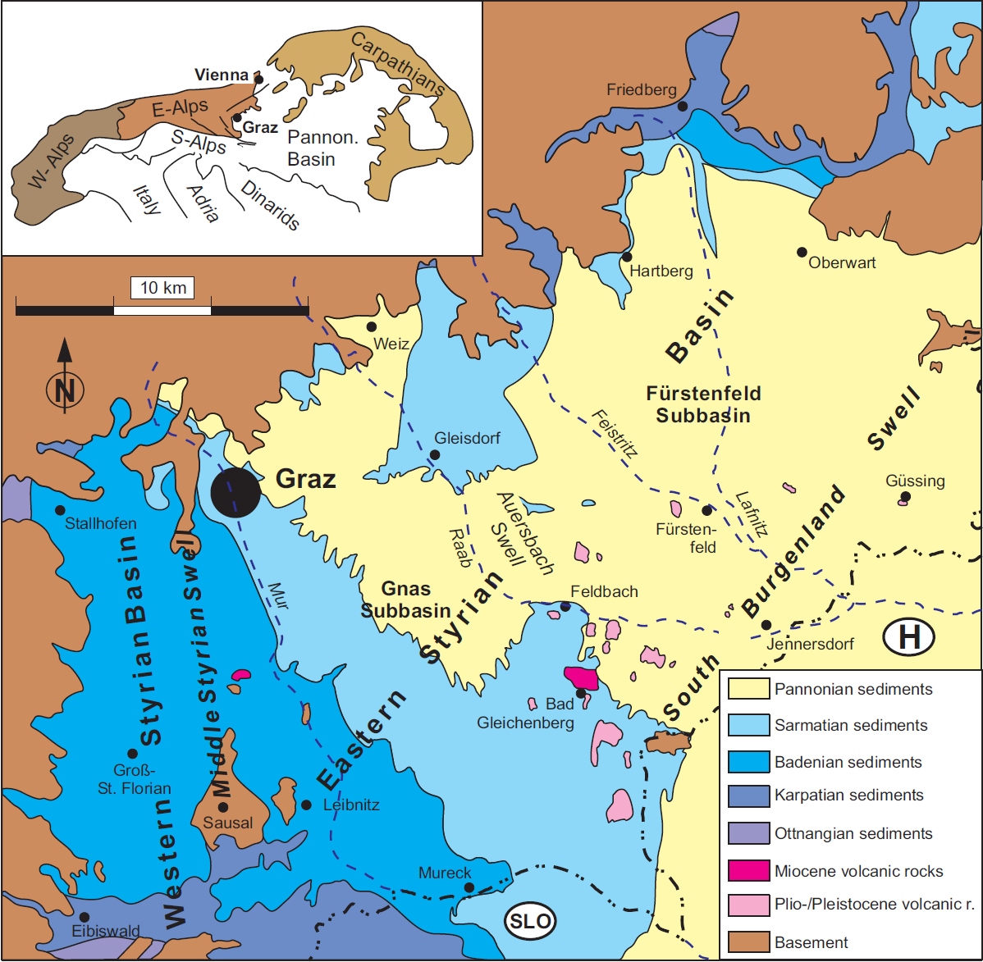
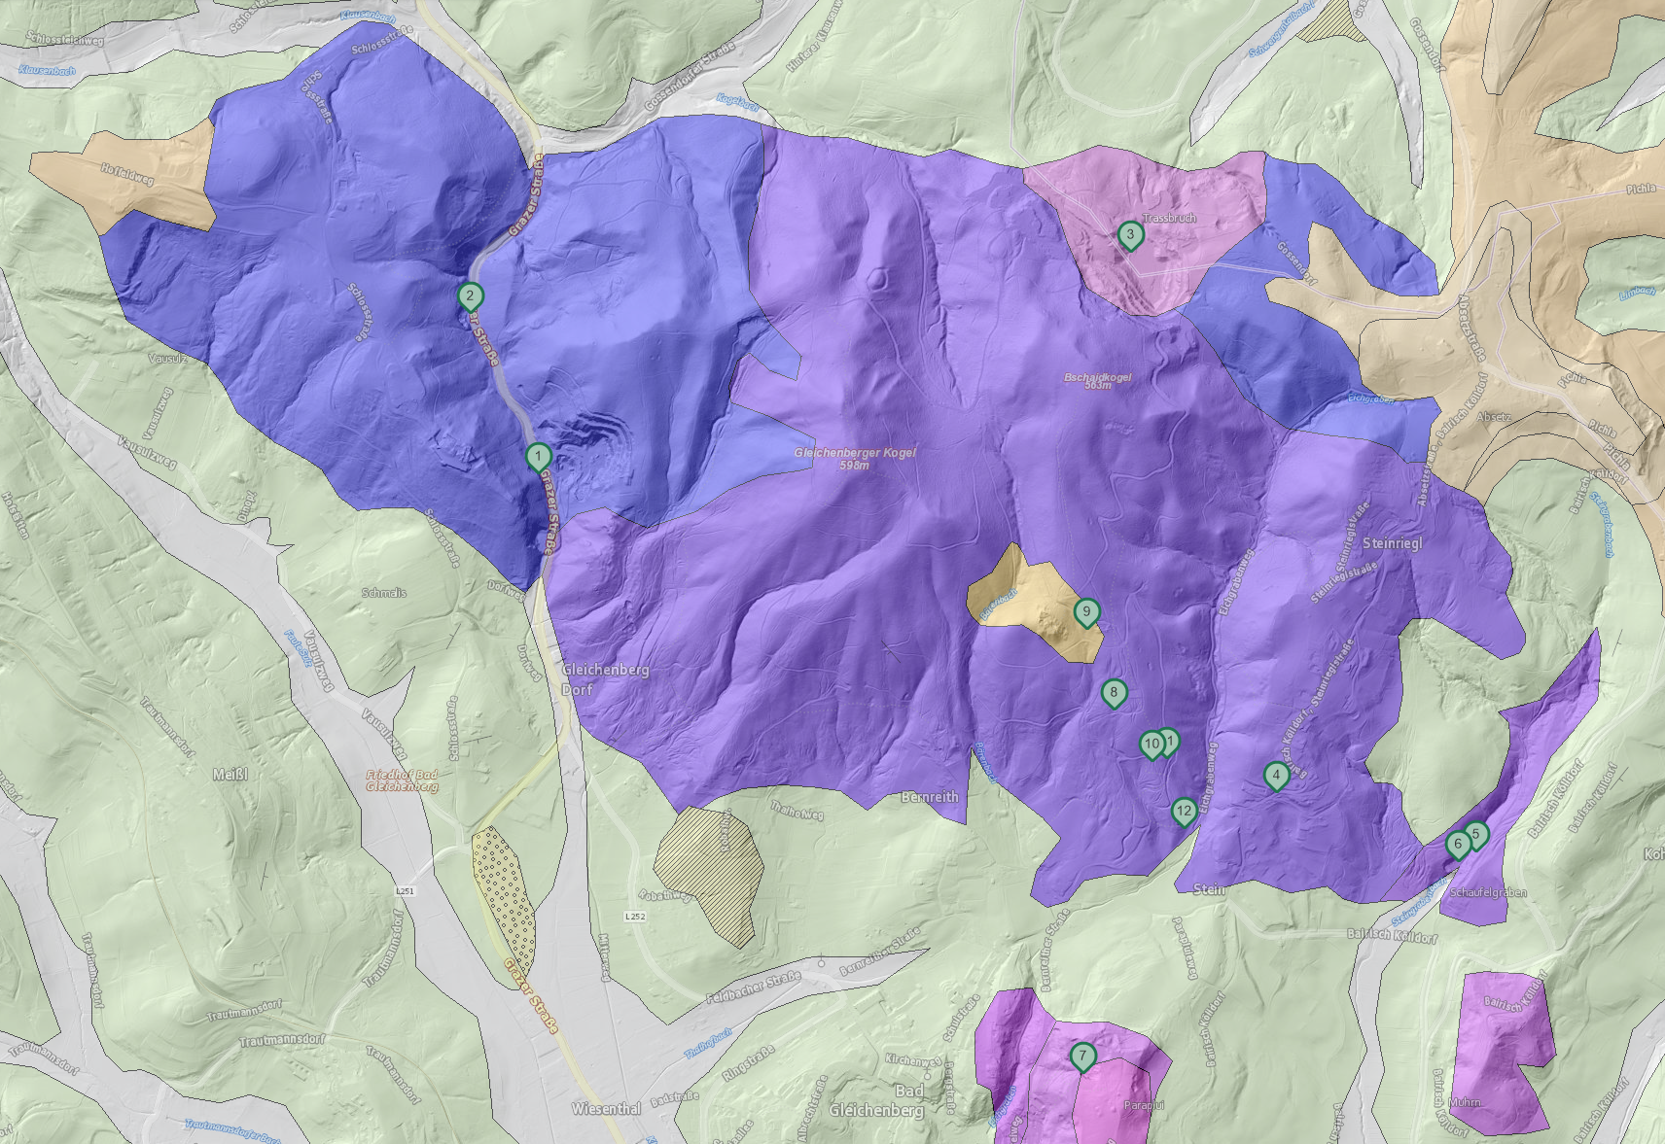
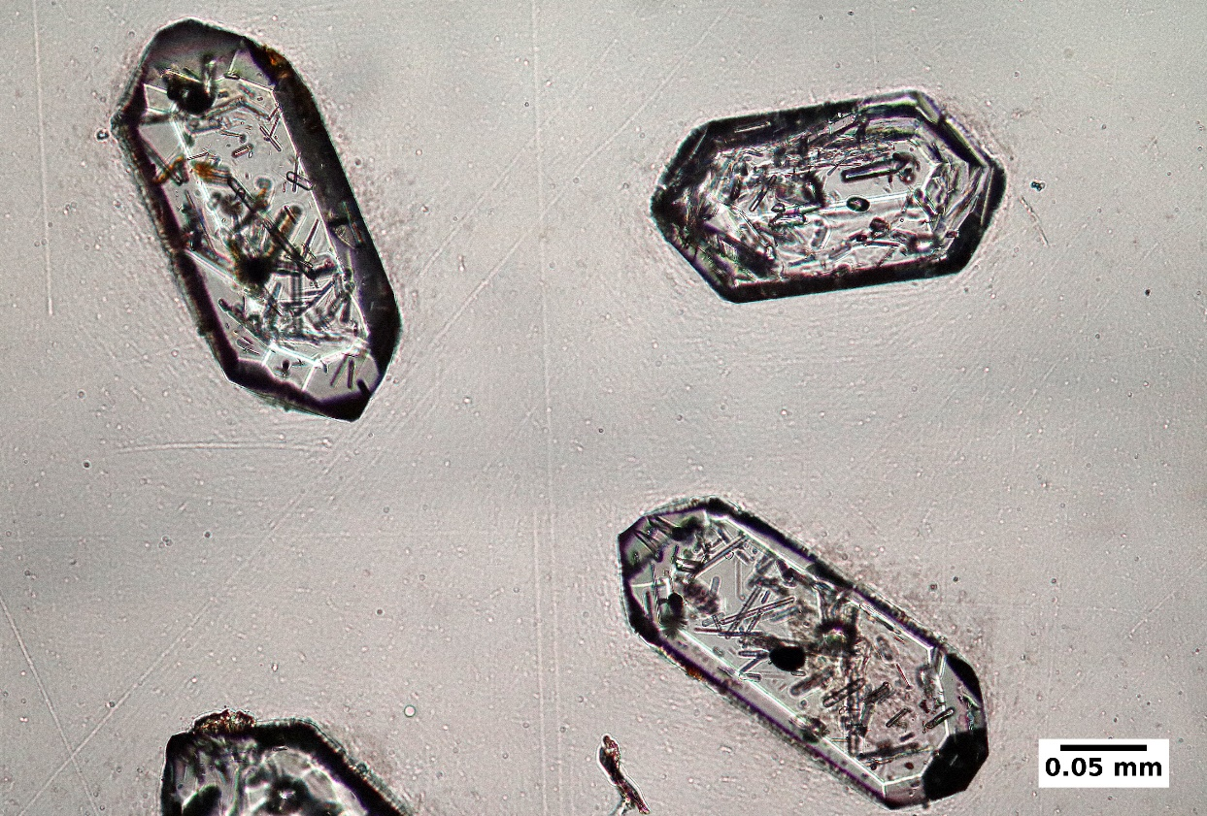
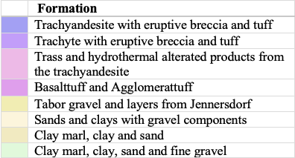
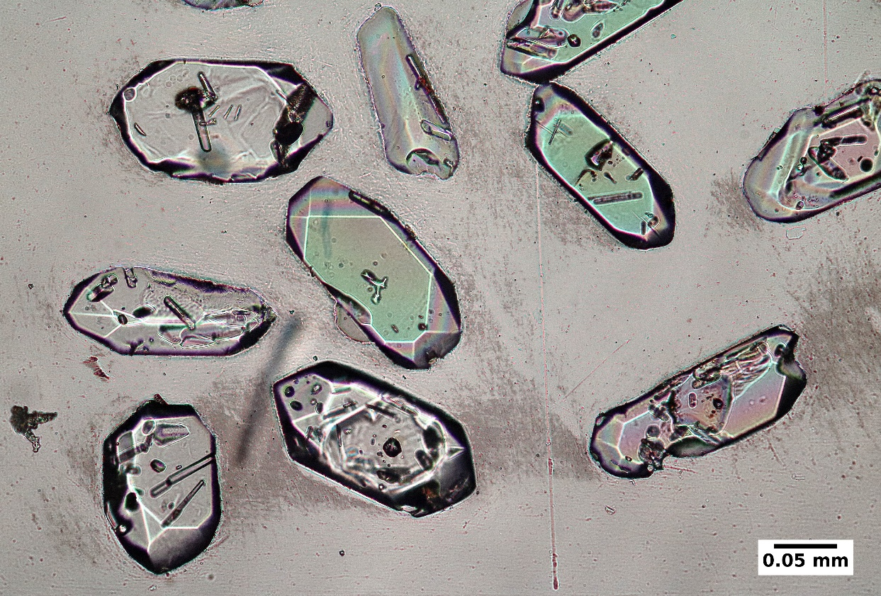
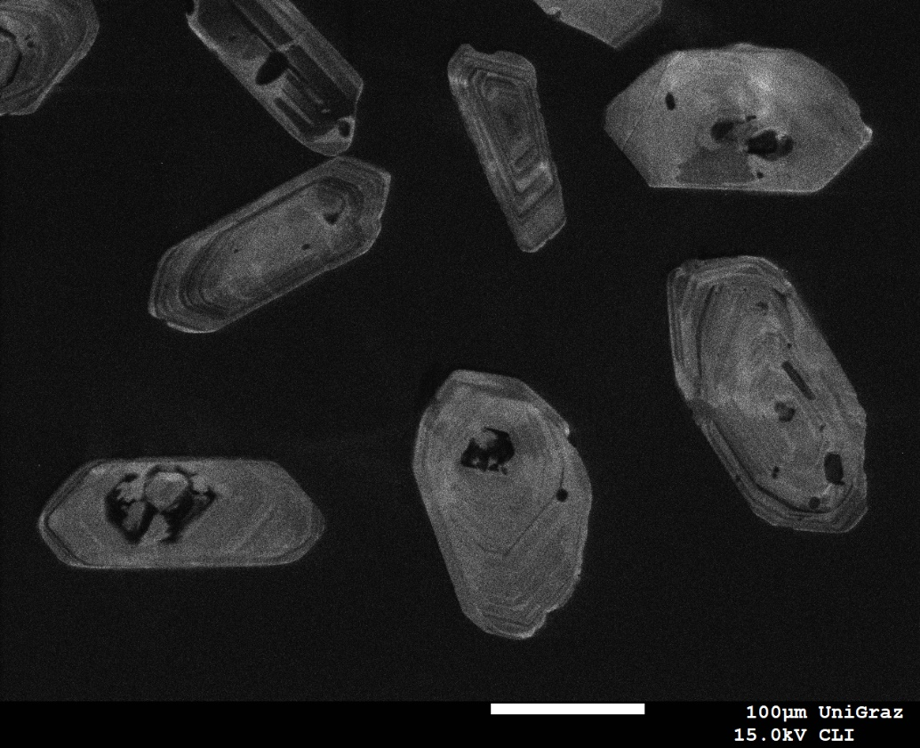
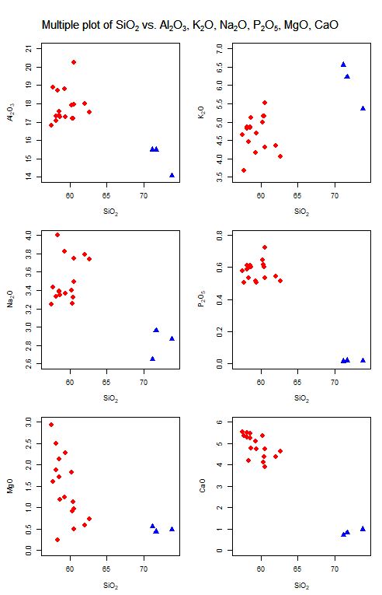
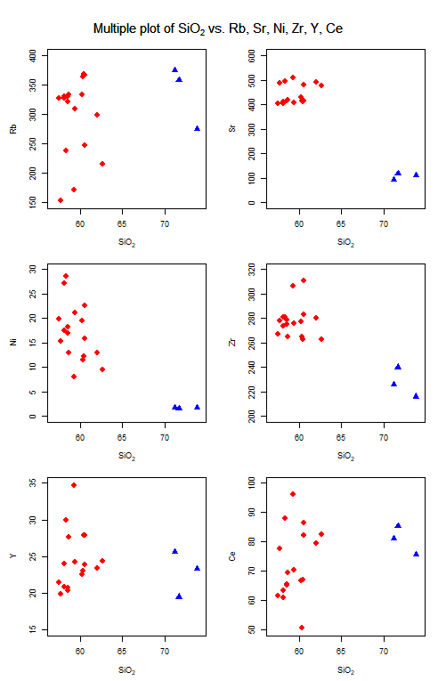
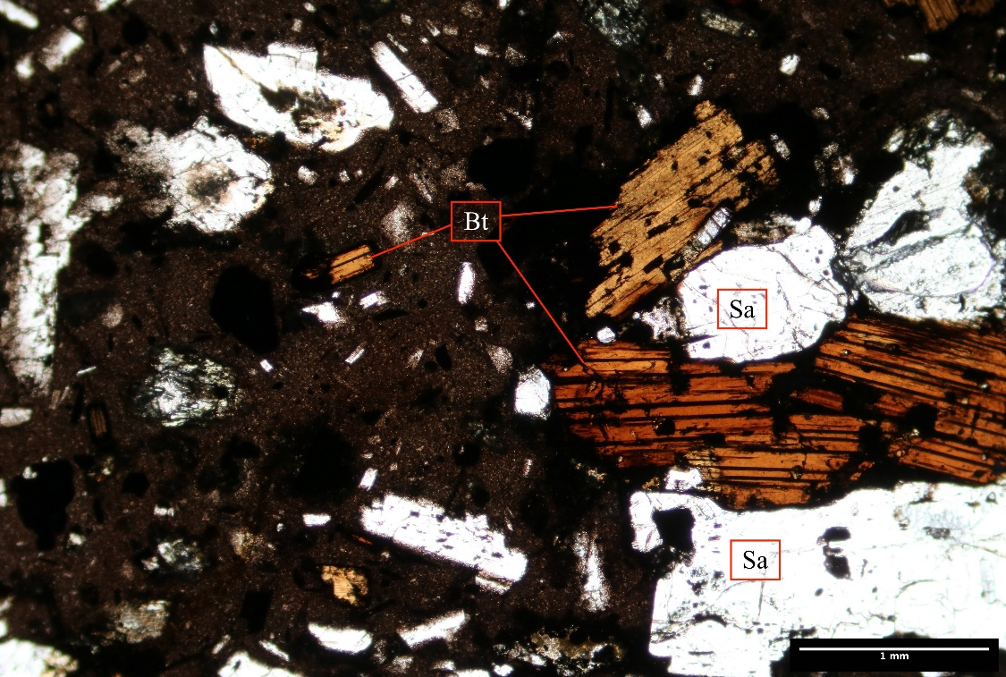
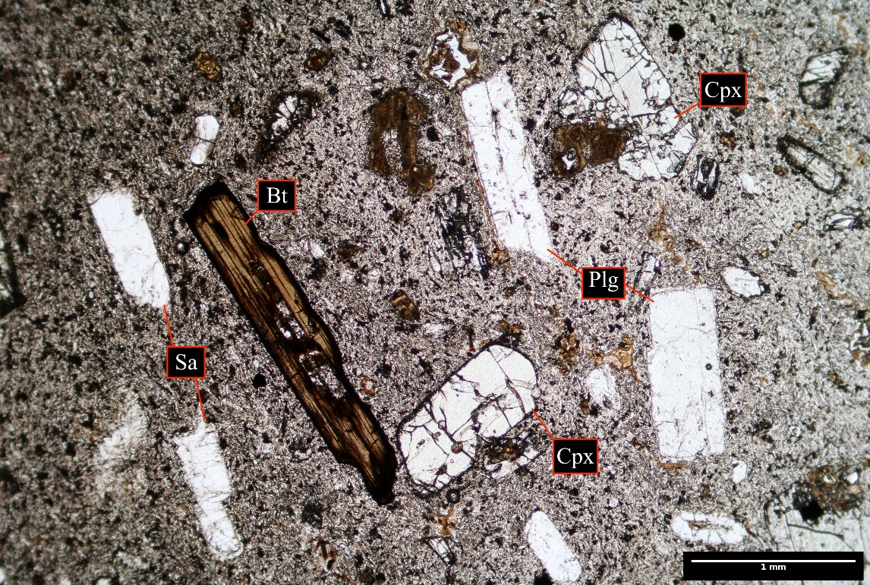
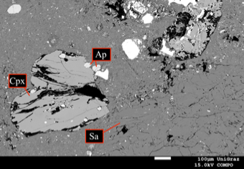
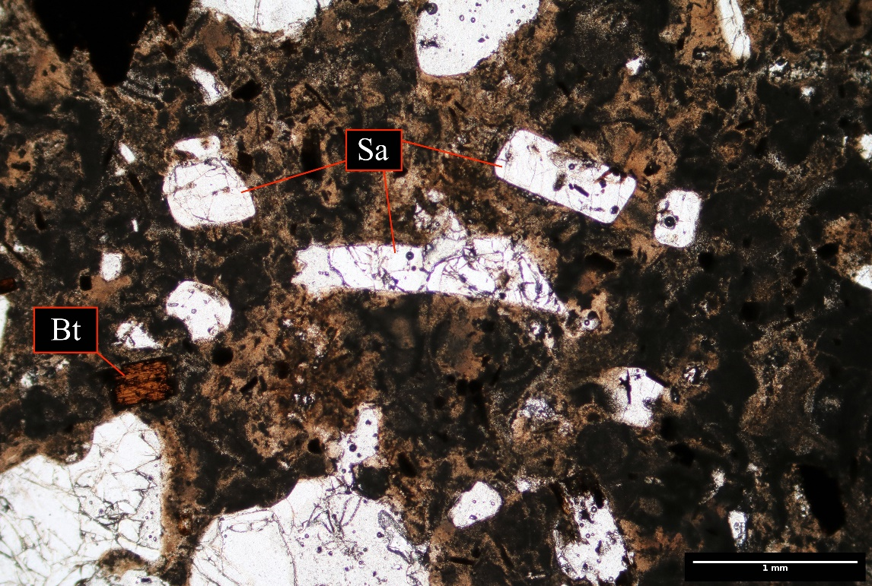

New petrological, geochemical and geochronological data on Miocene volcanism in the Styrian Basin
Fehleisen A., Hauzenberger C. , Gallhofer D., Skrzypek E.¹
¹University of Graz, Universitätsplatz 3, 8010 Graz
Introduction
a
b
Zircon Dating
The Gleichenberg volcano is situated in the Styrian Basin. The extensive volcanism of this region formed due to Miocene eastward lateral extrusion correlated with subduction after the Alpine collision. The magmatic rocks (Figure 1) comprise trachyandesites and rhyolites with a middle potassic shoshonite affinity. It is the only one of this kind in the Styrian Basin, while in western Hungary similar volcanism is observed.
The aim of this research is to document the petrology and geochemistry of this formation, obtain a better and closer understanding of the origin of these rocks and their later evolution, considering the development of the region since the Miocene.
Idiomorphic zircons are commonly found in all samples (Figure 3a, b).
a
b
Sampling spots of the dated samples
c
d
Petrography, Mineral Chemistry and Geochemistry
The trachyandesites and ryolites present a typical mineralogy with K-feldspar, plagioclase, biotite, ± quartz, ± pyroxenes and accessory zircon.
The rock texture varies between porphyritic and trachytic (Figure 2a, b, c)
Plagioclase has an anorthite between 40 and 70 mol%, while K-feldspar is between 45 to 60 mol% in the trachyandesites and higher (>70%) in the rhyolite samples.
The F content in apatite and biotite is unusual high (4.2 wt% and 3 wt%, respectively), together with TiO2 contents of up to 8 wt% in biotite.
Figure 1: (a) Geological map of the Styrian Basin taken from Gross et al. 2008, (b) Geological map of the volcanic formation in Bad Gleichenberg made with GIS Steiermark with the sampling points.
All samples show shoshonitic-calk-alkaline affinity (Figure 4a). The trachyandesites follow a typical magmatic differentiation trend (Figure 4b, c) with SiO2 varying from 57 to 62 wt%. Rhyolites occur in subordinate amounts with SiO2 values >71 wt%. No clear trend can be defined for the three rhyolite samples (Figure 4b, c).
Both points around 14.01 ± 0.01 Ma
a
Figure 3: (a) Zircons from the rhyolite sample. Many apatite inclusions, sometimes aligned with the growing zoning (b) Zircons from the same rhyolite sample. Thank to the BSE Image the growing zoning with varying U-concentration can be seen. (c) Zircons from the trachyandesite sample. Very less apatite inclusions. (d) BSE Image of zircons from the same trachyandesite sample, showing an internal zoning and core structures. No variation of the age between core and rim.
a
b
b
Trachyandesites
c
Similar crystallization ages of 14.1 ± 0.01 Ma resulted from LA-MC-ICPMS U-Pb analysis on zircons from both rock suites (Figure 3, 5). Therefore, despite the differences in major and minor element patterns, two eruption events couldn’t be identified.
Rhyolites
c
d
a
b
e
f
14.01 ± 0.02 | 0.19 Ma
MSWD = 1.8 (n=24|30)
14.121 ± 0.04 | 0.19 Ma
MSWD = 1.7 (n=22|23)
Figure 2: (a,b) Thin sections from trachyandesites. Bt, Fsp and Cpx phenocrysts with a fine grained matrix varying from light to dark grey (c, e, f) BSE Image of trachyandesites (d) Thin section of a rhyolite with alteration signs in the matrix and Fsp and Bt phenocrysts.
Figure 4: (a) TAS diagramm defining the samples as trachyandesites (red points) and rhyolites (blue triangles). (b) Harker Diagramms for major elements plotted against SiO2. CaO and MgO decrease with increasing SiO₂, while Al₂O₃, K₂O, Na₂O, and P₂O₅ increase with increasing SiO₂. In the rhyolites the Al₂O₃, MgO, CaO, Na₂O and P₂O₅ values are significantly lower in the rhyolite samples as expected for an evolved SiO₂ enriched magma (c) Harker Diagramms with Rb, Sr, Ni, Zr, Y, Ce plotted against SiO2. Clear distinction between trachyandesites and rhyolites. (All plots were created with GCDKit)
Figure 5: Weighted Mean and Concordia plots of uncorrected LA-MC-ICPMS U-Pb zircon ²⁰⁶Pb/²³⁸U data for trachyandesites (a) and rhyolites (b). The weighted mean ²⁰⁶Pb/²³⁸U age was calculated for zircons <5% discordant and is shown with internal 2SE|external 2SE uncertainties.
Conclusions
References
Trachyandesites and rhyolites with middle potassic shoshonite affinity, the only example in the Styrian Basin
Typical mineralogy with K-feldspar, plagioclase, biotite, ± quartz, ± pyroxenes and accessory zircon
Distictive geochemistry with shoshonitic-calk-alkaline affinity
14.1 ± 0.01 Ma zircon ²⁰⁶Pb/²³⁸U ages for both rock suites
Harangi, S., Downes, H., Thirlwall, M., & Gméling, K. (2007). Geochemistry, petrogenesis and geodynamic relationships of Miocene calc-alkaline volcanic rocks in the Western Carpathian arc, eastern central Europe. Journal of petrology, 48(12), 2261-2287.
Harangi, S., & Lenkey, L. (2007). Genesis of the Neogene to Quaternary volcanism in the Carpathian-Pannonian region: Role of subduction, extension, and mantle plume. Special papers-geological society of America, 418, 67.
Gross, M., Fritz, I., Piller, W.E., & Soliman, A. (2007). The Neogene of the Styrian Basin – Guide to Exkusions. Joenna Geol. Paläont. 9: 117-193.

