Slide 1
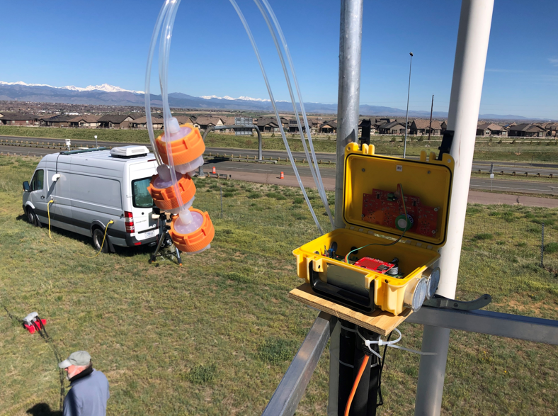
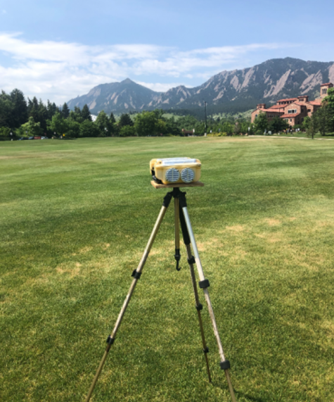
Comparing Low-Cost Sensors with In-Situ and Column Observations:
NO2 during the FRAPPE Field Campaign in Colorado, USA
Kristen Okorn, PhD
NASA Ames Research Center
kristen.e.okorn@nasa.gov
KristenOkorn

Slide 2
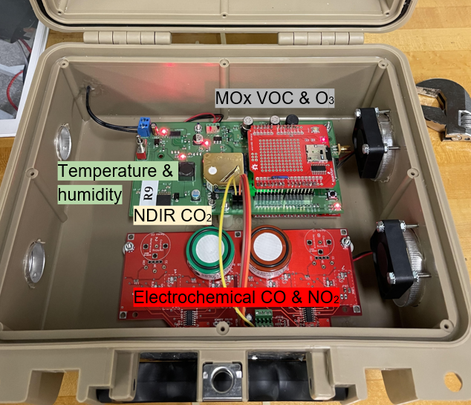
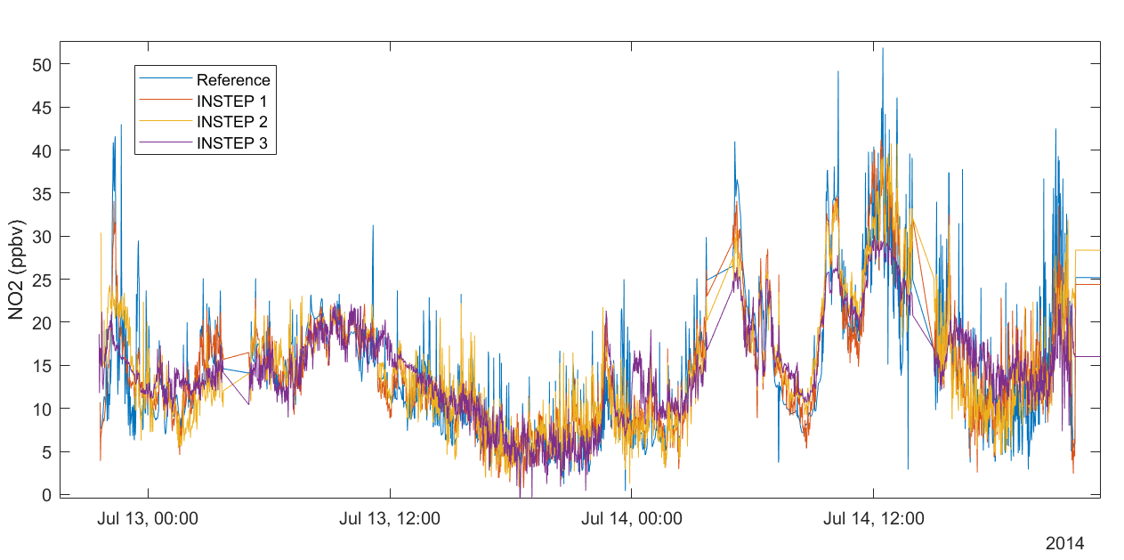
Intro to INSTEP
Inexpensive Network Sensor Technology for Exploring Pollution
Low-cost sensors measuring:
CO2
CO
NO2
O3
CH4
HCHO
Temperature
Humidity
Calibrated via co-location with regulatory-grade instruments
Artificial Neural Networks (ANNs) used
Co-Location of NO2

Slide 3
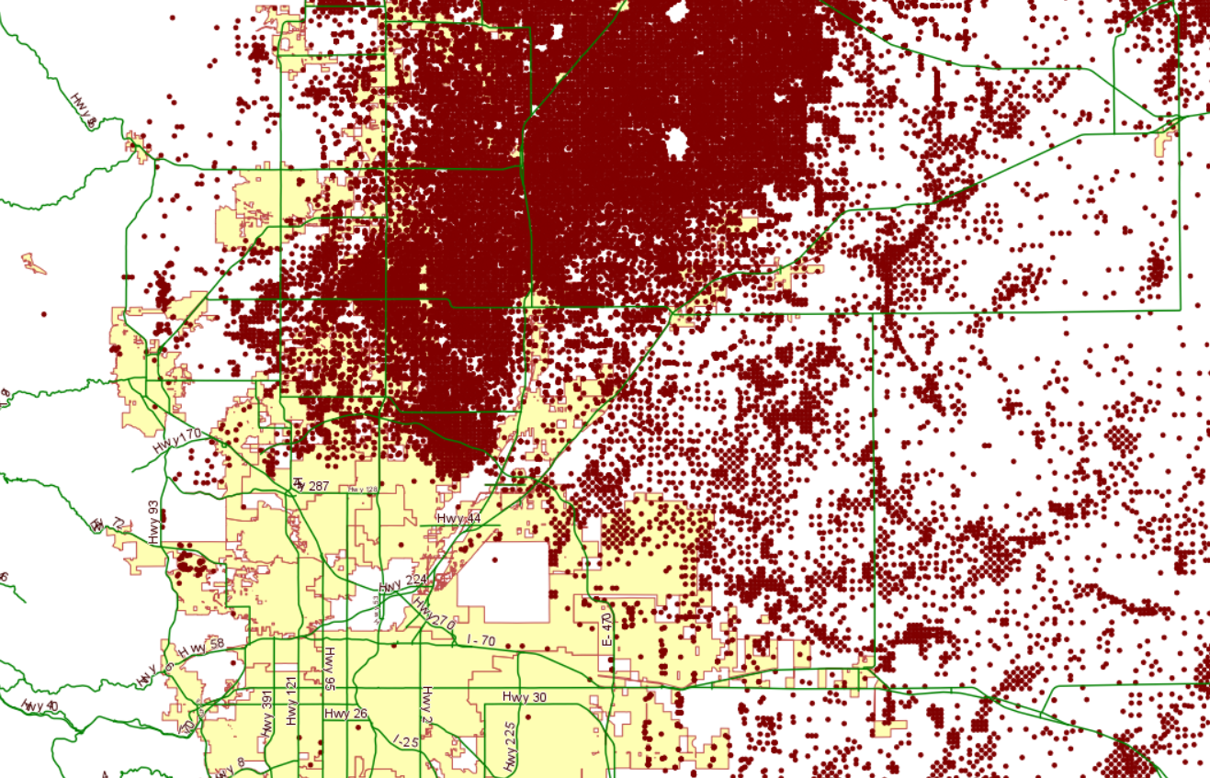
FRAPPE & DISCOVER-AQ Campaign – Colorado 2014
NASA/NOAA campaigns to measure photochemical ozone tracers
Area characterized by oil & gas production
Ground-based measurements:
Pandora column O3, NO2
In-situ O3, NO2, HCHO*
INSTEP low-cost O3, NO2, HCHO
Airborne measurements:
GCAS column NO2
GeoTASO column NO2
CAMS sounding spiral HCHO
Platteville
Boulder
Erie
Legend
BAO Tower Site
Platteville Site
Highway
Denver
City
Oil & Gas Well
*Platteville only
Map courtesy of Colorado Oil & Gas Conservation Commission (2023)

Slide 4
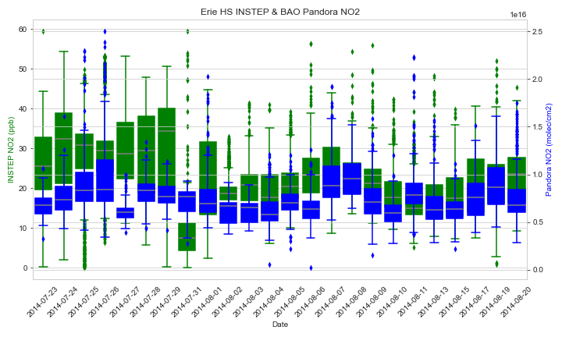
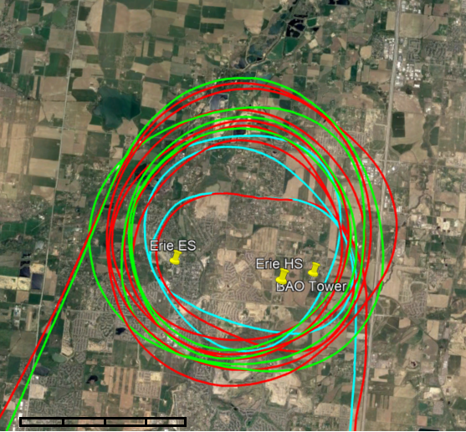
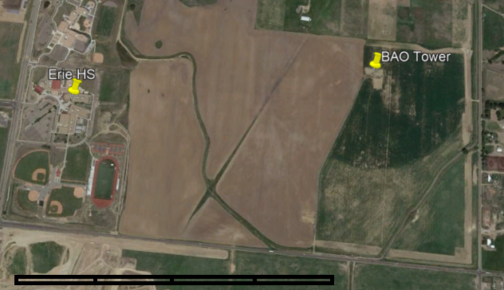
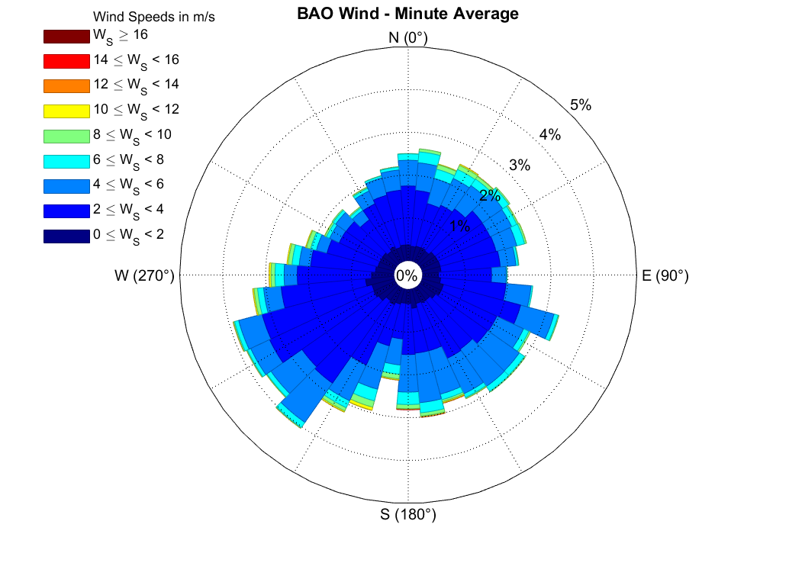
INSTEP – Pandora Comparisons
Agreement between INSTEP & Pandora only at select sites
Meteorological conditions influence trends
Case study: Boulder Atmospheric Observatory (BAO)
Upwind monitor shows strongest agreement; 2 days with anomalies
7/27 – cloudy conditions† may have hindered Pandora readings
7/31 – atypically low wind speeds (no gusts above 6 m/s)
INSTEP
Erie HS
INSTEP + Pandora
BAO Tower
Sounding Spirals
1 km
10 km
† Oltmans et. al. (2019)

Slide 5
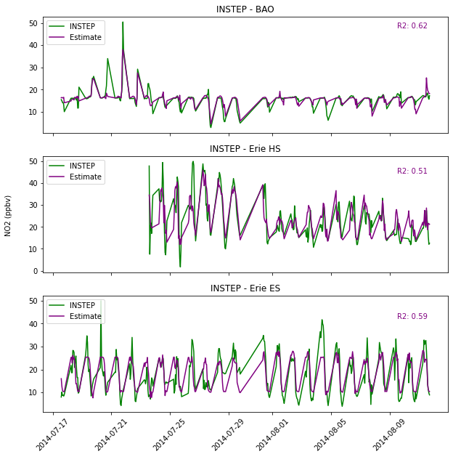
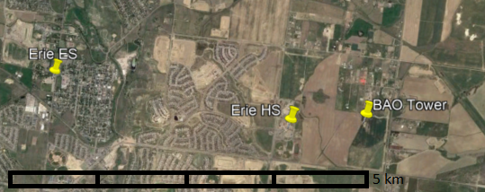
Extracting Ground-Level Estimates from Pandora Columns
Fit Pandora data to INSTEP measurements using ANN
Also included environmental parameters in model:
Strong correlations have implications in further data fusion & modeling
Temperature
Pressure
Humidity
Wind Speed*
Wind Direction*
Hour of day
INSTEP
INSTEP + Pandora
* for INSTEP monitors > 100 m away from Pandora only
10 km

Slide 6
Show kriging results w/ basic explanation
Krige ground-based measurements together, shown against Pandora & vertical profile data in other panels
Text here
Text here

Slide 7
Time permitting: any implications on VOC-Nox-O3 ratios? O3 formation Nox limited or VOC limited?
Text here
Text here

Slide 8
Conclusions
Surface comparable with column NO2 under select meteorological conditions
Artificial neural networks promising for relating column NO2 to surface
Something else about final slide or 2
Next Steps
Explore additional methods to compare surface and column ozone
More difficult comparison as most is not near surface level‡
Analyze HCHO spiral data against low-cost sensors
Insufficient overlap – may need to down sample INSTEP data
Kriging with external drift model to combine in-situ & column data further
Longer co-location of INSTEP with Pandoras in California, USA
‡ ozonewatch.gsfc.nasa.gov

