Slide 1


Selection of a sub-ensemble of CMIP6 projections for the EDF in-house climate service
P.-A. Michelangeli, S. Parey, J. Boé, H. Omrani, H. Filahi, L. Collet, B. Oueslati, K. Pol, C. Legorgeu

Slide 2
Selection criteria
Sub-sample representative of the whole CMIP6 projection ensemble
Sub-sample with (roughly) independent models
Some elements of the performance across France in the historical period
Equilibrium climate sensitivity in the observed very likely range + 1 or 2 more sensitive models as “low probability high impact scenarios”

Slide 3
Comparison of the CMIP5 and CMIP6 projections for France: DP / DT
stars = CMIP5 circles = CMIP6

Slide 4
Model dependencies
Number of common components:
Atmosphere
Ocean
Land
Ice
The bigger and the darker = more common components
Boé, J. (2018). Interdependency in multimodel climate projections: Component replication and result similarity, Geophysical Research Letters, 45, 2771– 2779.; https://doi.org/10.1002/2017GL076829

Slide 5
MODEL PERFORMANCE
For each season: distance = mean absolute error of spatial averages across France (ref = CRU-TS4)
Distance computed for:
  Climatological mean
  Interannual variability (standard-deviation)
  Trends
For models with ensemble members
  Computation of the distance for each member
  Ensemble mean of the distances

Slide 6
Elements of model performance across france
1951-2014

Slide 7
Elements of model performance across france
1951-2014

Slide 8
Model selection
Models with missing scenarios
Models with sensitivity > 5°C
Models close to others
Modèle | ECS (°C) | Hist | SSP1-2.6 | SSP2-4.5 | SSP3-7.0 | SSP5-8.5
ACCESS-CM2 | 4.72 | 3 | 1 | 1 | 1 | 3
ACCESS-ESM1-5 | 3.87 | 10 | 3 | 3 | 3 | 10
AWI-CM-1-1-MR | 3.16 | 5 | 1 | 1 | 5 | 1
BCC-CSM2-MR | 3.04 | 3 | 1 | 1 | 1 | 1
BCC-ESM1 | 3.26 | 3
CAMS-CSM1-0 | 2.29 | 2 | 2 | 2 | 2 | 2
CanESM5 | 5.62 | 40 | 40 | 40 | 40 | 40
CanESM5-CanOE |  | 3 | 3 | 3 | 3 | 3
CESM2 | 5.16 | 11 | 3 | 3 | 3 | 3
CESM2-FV2 | 5.14 | 3 | XXXX | XXXX | XXXX | XXXX
CESM2-WACCM | 4.75 | 3 | 1 | 3 | 1 | 3
CESM2-WACCM-FV2 | 4.79 | 3 | XXXX | XXXX | XXXX | XXXX
CMCC-CM2-SR5 | 3.52 | 1 | 1 | 1 | 1 | 1
CMCC-ESM2 |  | 1 | 1 | 1 | 1 | 1
CNRM-CM6-1 | 4.83 | 30 | 6 | 6 | 6 | 6
CNRM-CM6-1-HR | 4.28 | 1 | 1 | 1 | 1 | 1
CNRM-ESM2-1 | 4.76 | 9 | 5 | 5 | 5 | 5
E3SM-1-0 | 5.32 | 5 | XXXX | XXXX | XXXX | XXXX
E3SM-1-1-ECA |  | 1 | XXXX | XXXX | XXXX | XXXX
E3SM-1-1 |  | 1 | XXXX | XXXX | XXXX | 1
EC-Earth3 | 4.10 | 23 | 7 | 22 | 7 | 7
EC-Earth3-Veg | 4.31 | 5 | 4 | 5 | 4 | 4
EC-Earth3-Veg-LR |  | 1 | XXXX | XXXX | XXXX | 1
FGOALS-f3-L | 3.00 | 3 | 1 | 1 | 1 | 1
FGOALS-g3 | 2.88 | 6 | 1 | 1 | 1 | 4
FIO-ESM-2-0 |  | 3 | 3 | 3 | XXXX | 3
GFDL-CM4 | 3.89 | 1 | XXXX | 1 | XXXX | 1
GFDL-ESM4 | 2.60 | 3 | 1 | 3 | 1 | 1
GISS-E2-1-G | 2.72 | 39 | 2 | 15 | 2 | 7
GISS-E2-1-G-CC |  | 1 | XXXX | XXXX | XXXX | XXXX
GISS-E2-1-H | 3.11 | 1 | XXXX | XXXX | XXXX | XXXX
HadGEM3-GC31-LL | 5.55 | 4 | 1 | 1 | XXXX | 3
HadGEM3-GC31-MM | 5.42 | 2 | 1 | XXXX | XXXX | 3
INM-CM4-8 | 1.83 | 1 | 1 | 1 | 1 | 1
INM-CM5-0 | 1.92 | 10 | 1 | 1 | 5 | 1
IPSL-CM6A-LR | 4.56 | 32 | 6 | 11 | 11 | 6
KACE-1-0-G | 4.48 | 3 | 2 | 3 | 3 | 3
MCM-UA-1-0 | 3.65 | 2 | 1 | 1 | 1 | 1
MIROC-ES2L | 2.68 | 10 | 2 | 1 | 1 | 10
MIROC6 | 2.61 | 10 | 3 | 3 | 3 | 3
MPI-ESM-1-2-HAM | 2.96 | 2 | XXXX | XXXX | XXXX | XXXX
MPI-ESM1-2-HR | 2.98 | 10 | 2 | 2 | 10 | 2
MPI-ESM1-2-LR | 3.00 | 10 | 10 | 10 | 10 | 10
MRI-ESM2-0 | 3.15 | 5 | 1 | 1 | 5 | 2
NESM3 | 4.72 | 5 | 2 | 2 | XXXX | 2
NorCPM1 | 3.05 | 30 | XXXX | XXXX | XXXX | XXXX
NorESM2-LM | 2.54 | 3 | 1 | 3 | 1 | 1
NorESM2-MM | 2.50 | 1 | 1 | 1 | 1 | 1
SAM0-UNICON | 3.72 | 1 | XXXX | XXXX | XXXX | XXXX
TaiESM1 | 4.31 | 1 | 1 | 1 | 1 | 1
UKESM1-0-LL | 5.34 | 17 | 5 | 5 | 5 | 5

Slide 9
projections in the EDF Climate service

Slide 10
MAIN VARIABLES
  Temperature: Tas, Tasmax, Tasmin
  Surface wind
  Precipitation
  Radiation: rsds, rlds
  Humidity: hurs, huss
  Pressure
  Land-sea mask
  orography

Slide 11
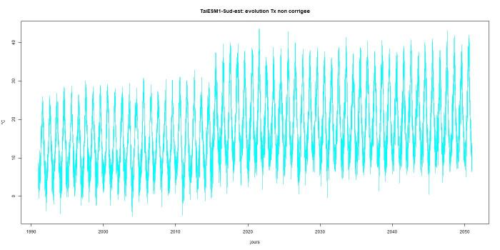
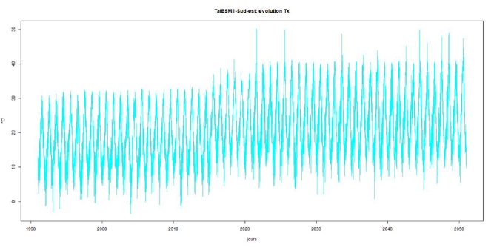
A problem for taiesm1 tasmax
Raw data for 1 grid point
Bias adjusted data (CDFt)

Slide 12
THANKS

