Slide 1
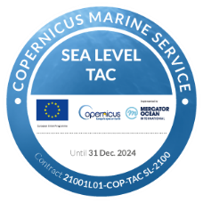
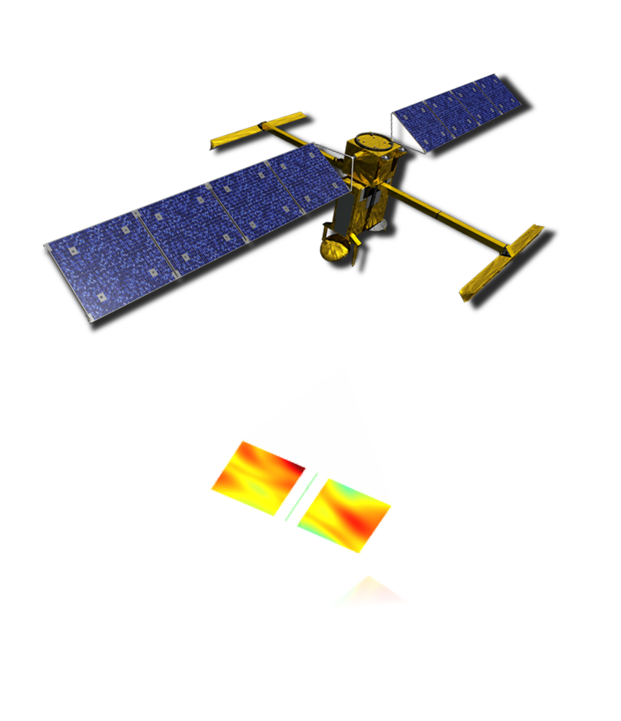
Sea level maps of the Arctic (and southern) ocean from satellite altimetry
from 2011 to 2021
Pierre Veillard⁽¹⁾, Pierre Prandi⁽¹⁾, Matthis Auger⁽¹⁾, Yannice Faugere⁽¹⁾, Gérald Dibarboure⁽²⁾
(1) CLS, (2) CNES
EGU General Assembly 2023, Vienna, Austria, 24–28 Apr 2023, EGU23-7859

Slide 2
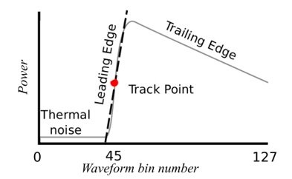
Computing sea level maps over the polar regions
In the polar regions satellite sea level observations are limited by the sea ice.
SLIDE TITLE
From Quartly, 2019

Slide 3
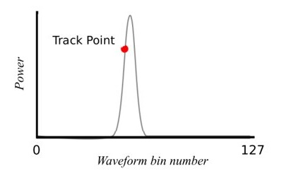
Computing sea level maps over the polar regions
In the polar regions satellite sea level observations are limited by the sea ice.
Thanks to a dedicated processing, sea level can however be estimated within fractures in the ice (leads).
Processing of specular (leads) and diffuse (open ocean) echoes from 3 missions (SARAL/AltiKa, Sentinel-3A, Cryosat-2) to cover the ice-covered and open ocean regions.
SLIDE TITLE
From Quartly, 2019

Slide 4
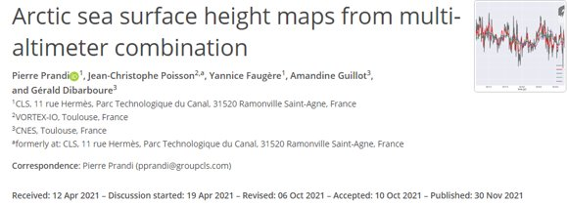
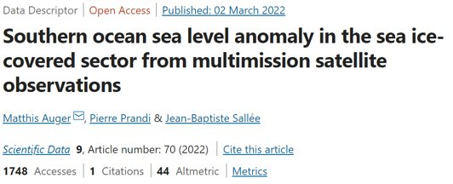
Computing sea level maps over the polar regions
In the polar regions satellite sea level observations are limited by the sea ice.
Thanks to a dedicated processing, sea level can however be estimated within fractures in the ice (leads).
Processing of specular (leads) and diffuse (open ocean) echoes from 3 missions (SARAL/AltiKa, Sentinel-3A, Cryosat-2) to cover the ice-covered and open ocean regions.
This resulted in multi-mission polar maps prototypes for the Arctic (Prandi et al., 2021) and the Southern Ocean (Auger et al., 2022).
SLIDE TITLE
From Quartly, 2019

Slide 5
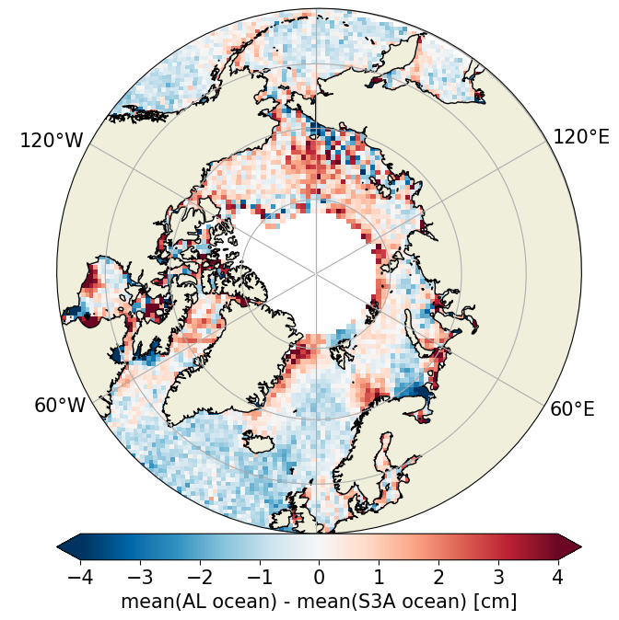
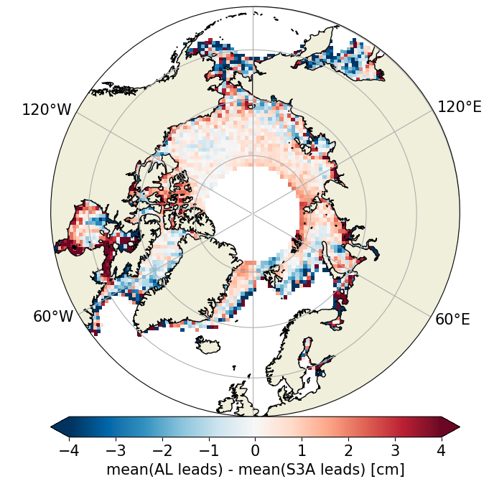
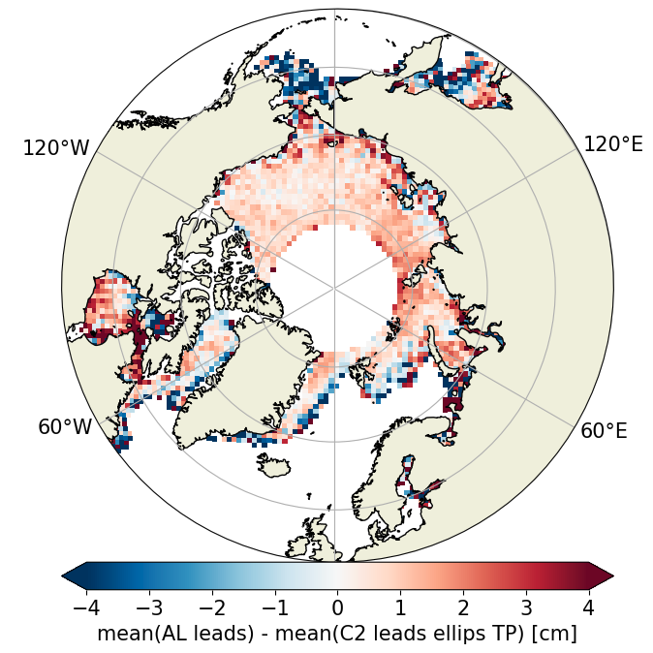
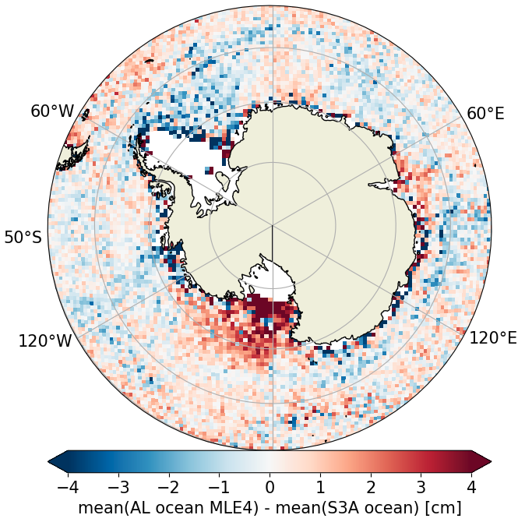
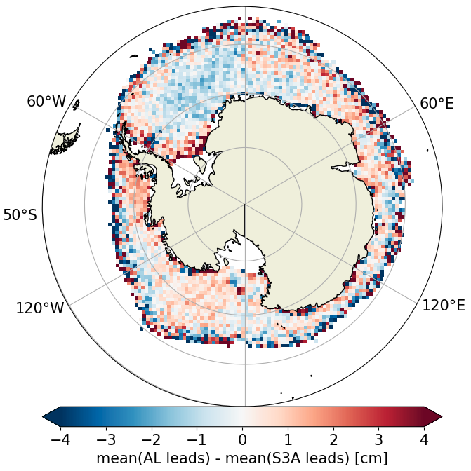
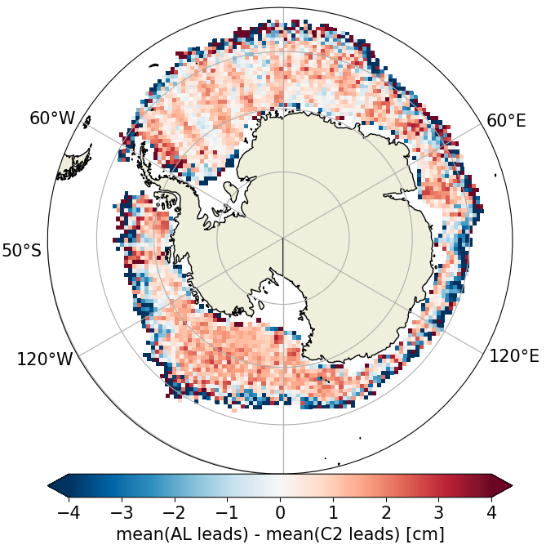
Multi-mission consistency
Altika – S3A (ocean)
AltiKa – S3A (leads)
AltiKa – Cryosat-2 (leads)
The three missions are consistent both in the Arctic and Southern Ocean.
In the open ocean and ice-covered regions, patterns are below 4 cm.

Slide 6
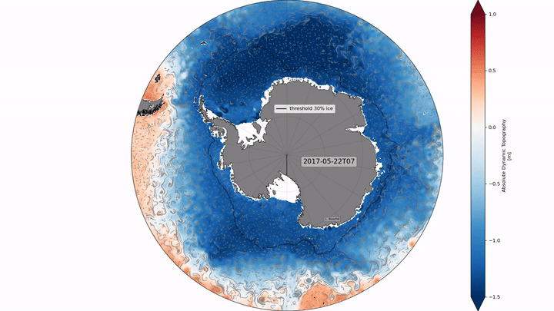
Maps and along-track of Absolute Dynamic Topography (ADT)
Arctic ADT for lat>50°N
Over 2011-2021
Southern Ocean ADT for lat<50°S
Over 2013-2021
Maps and along-track on AVISO (V2 update soon) : doi.org/10.24400/527896/a01-2020.001
Maps and along-track on AVISO (V2 update soon) : doi.org/10.24400/527896/a01-2022.010

Slide 7
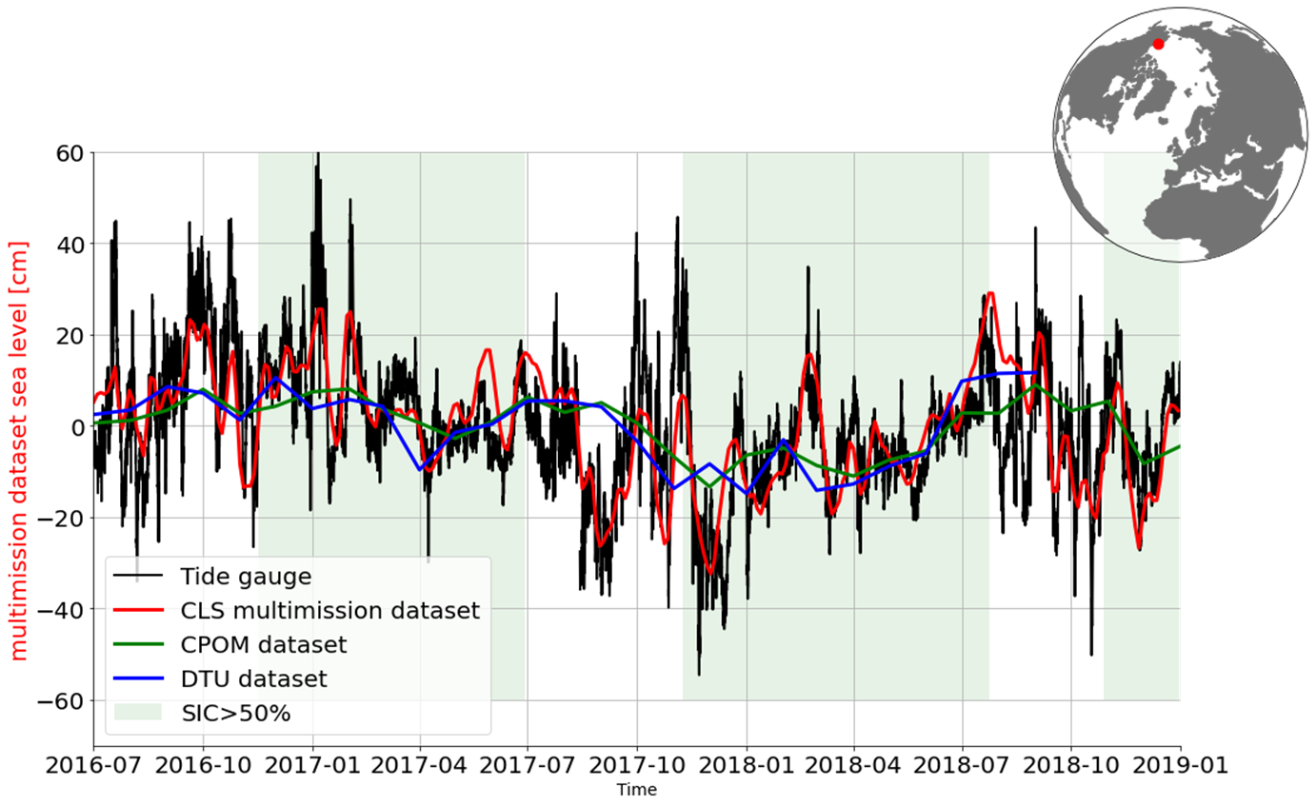
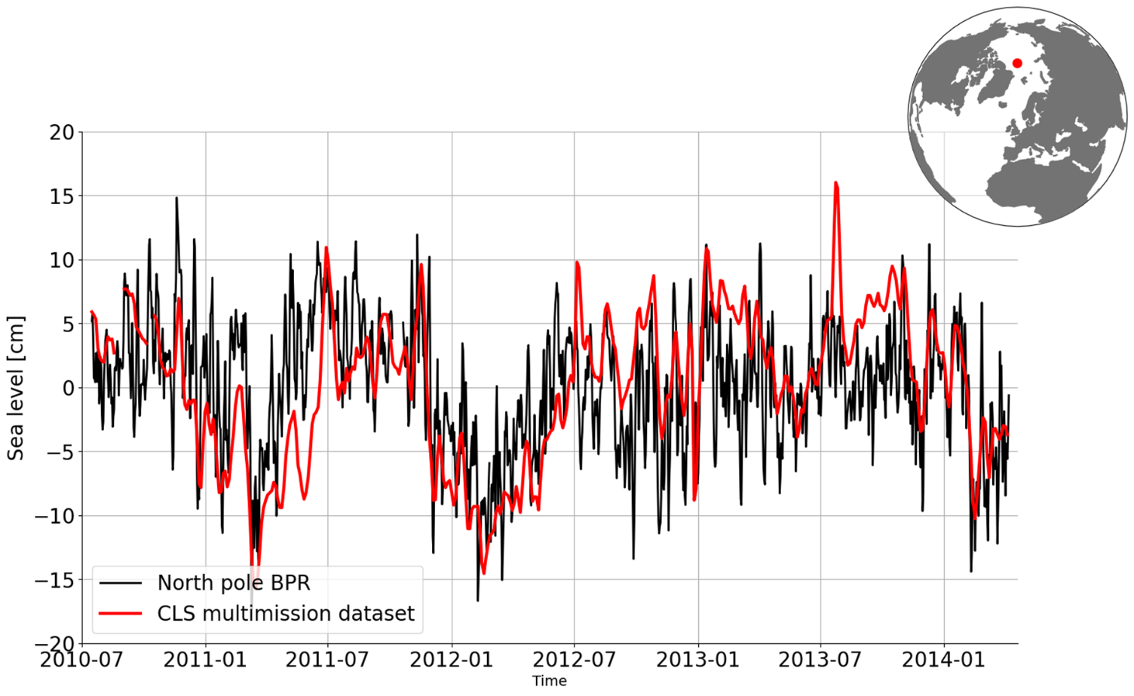
Validation against in-situ
Prudhoe Bay tide gauge
North pole Bottom Pressure recorder
Few in-situ data in the ice-covered polar regions. Only Prudhoe Bay tide gauge in the ice-covered Arctic region provides valid hourly data. Great correlation with the altimetric dataset.
North pole bottom pressure recorder is also well correlated with altimetry sea level.

Slide 8
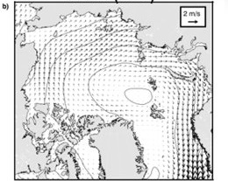
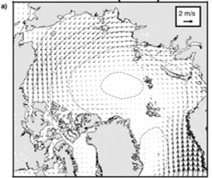
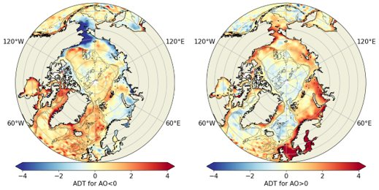
Linkage with Arctic Oscillation atmospheric index
Wind (AO-)
Wind (AO+)
From Armitage, 2016
Arctic oscillation (AO) modulates the Arctic Ocean circulation (Morrison, 2012)​​
AO - → High sea level pressure in the central arctic​
→ Negative SLA along the shelves (Armitage, 2018) ​
→ Positive SLA in deeper basin (Armitage, 2018)
SLA (AO-)
SLA (AO+)

Slide 9
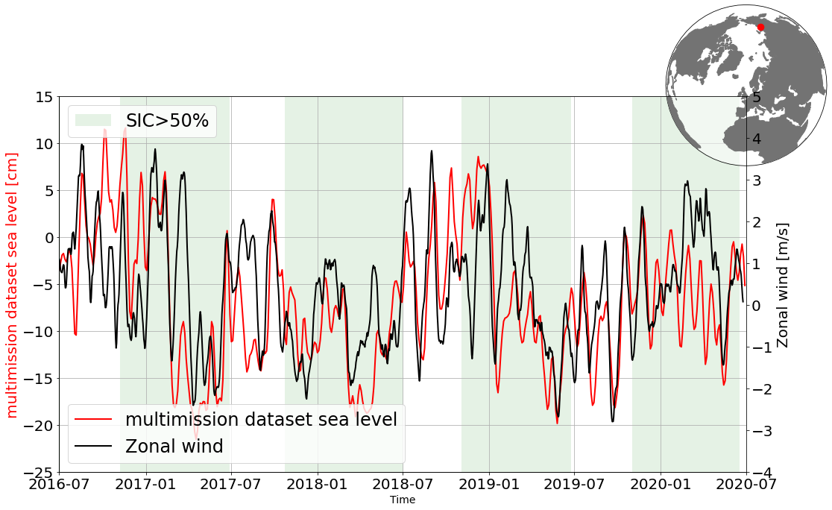
Against wind circulation in the Siberian shelf region
Siberian shelf zonal wind
In the Siberian shelf region, sea level is mostly driven by the wind. Positive zonal wind producing cross-shelf sea level accumulation.

Slide 10
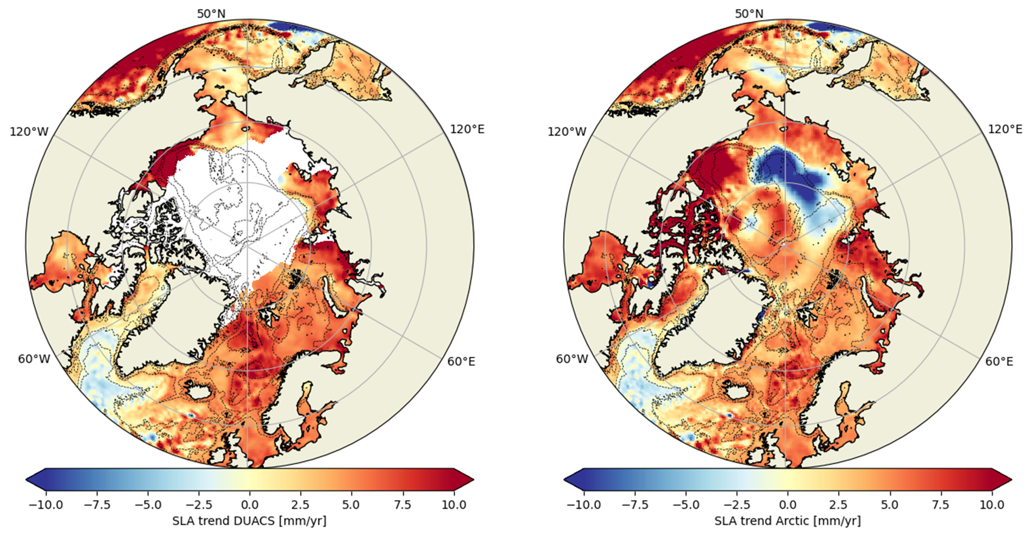
Maps of sea level trends over 2011-2021
Open ocean DUACS trends
Arctic trends
Complete map of sea level trends can be estimated in the North Pole over 2011-2021.
Sea level trends of ~4mm/yr in most of the region with local sea level decrease.

Slide 11
Conclusion and perspectives
Multi-satellite sea level polar maps and along-track (V2) produced over 2011-2021. Available on AVISO portal in the next few days.
SLA from the three satellites are consistent and validation of the maps are made with in-situ data and atmospheric circulation.
Use new advances in altimetry processing for V3 (retracking, corrections)
Extension of the product backwards (ESA’s FDR4ALT)​ and forwards.
Copernicus operational product : in 2024+, The Sea Level production Center of the Marine Copernicus Service plans to ingest the future specific Eumetsat upstream with the aim of producing operational SLA in the ice-covered regions for Model Forcasting Center
Conclusion
Perspectives

