Slide 1
Predictions of future water scarcity: How important is the plant physiological response to rising CO2? J. Stacey, R. Betts, A. Hartley, L. Mercado
Jessica Stacey
Climate Scientist, Met Office
Postgrad Student, University of Exeter

Slide 2
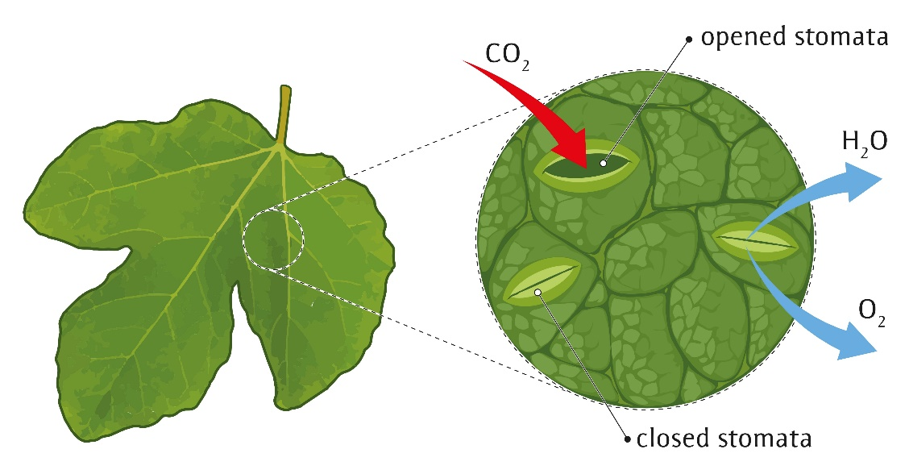
Plant stomata
Stomatal aperture is a balance between maintaining high rates of photosynthesis and low rates of water loss
Notes:
Microscopic pores in plant tissue
Act as tiny mouths, which open and close as they assist in photosynthesis and transpiration, absorbing carbon dioxide (CO₂) while releasing oxygen and water.
Plants continuously adjust the widths of their stomata – known as stomata aperture…

Slide 3
Plant physiology is changing with rising CO₂
Contradictory impacts on transpiration and runoff…
(NB we assume precipitation remains constant)
Stomata-level
Canopy-level
1850
atmospheric CO₂ = 285 ppm
2020
atmospheric CO₂ = 415 ppm
2020
atmospheric CO₂ = 415 ppm
precipitation
precipitation
precipitation
transpiration
less transpiration
+/- transpiration?
lower stomatal aperture
lower stomatal aperture, but higher leaf area
stomata
runoff
more runoff
+/- runoff?

Slide 4
What’s the problem?
Many climate models incorporate the plant physiological response
… however, some water-related impact studies use hydrology models that do not
Does this matter?
Notes:
Plant phys responses well supported by the literature, first papers 1916,
although more has to be done to understand details, Millions of plant species and different climate envelopes, but basic concepts are well supported

Slide 5
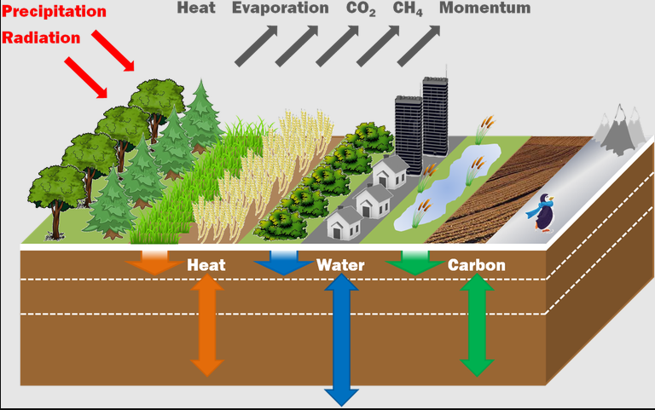
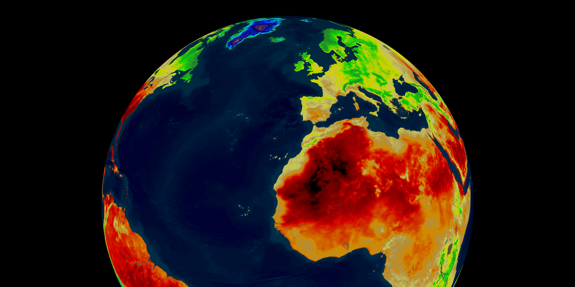
My research
Met Office climate model:
HADGEM2-ES
JULES land surface model
How do these plant processes influence water supply and water scarcity?

Slide 6
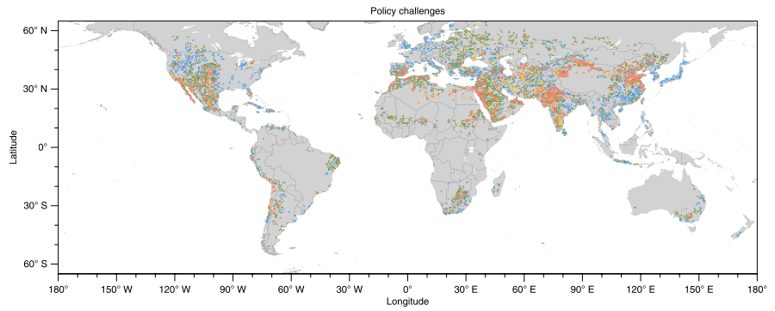
Policy Challenges based on Water Scarcity Index
Is the message from these water impact predictions inaccurate?
Greve (2018): Global assessment of water challenges under uncertainty in water scarcity projections
Featured in IPCC AR6
Low
Medium
Medium
High
Notes:
Example of high profile study by Peter Greve in 2018 – included in IPCC AR6 water chapter – based on hydrology models that do not include these feedbacks
Clusters different regions into 4 different categories
A useful plot for policy makers to make decisions on

Slide 7
Gap in the literature
Many studies have shown the effect of plant physiological response on different aspects of water cycle…
… however, studies that translate this to human impacts are limited
Notes:
Like the figure by Greve we have just seen

Slide 8
Methodology
JULES land surface model
Driving climate model: HADGEM2-ES
From 1861 to 2100
RCP 6.0
Four experiments
 | Pre-Ind. veg. dist. | Δ veg. dist.
Pre-Ind. CO₂ | E1. ΔCLIM | E2. ΔCLIM + ΔVEG_DIST
Δ CO₂ | E3. ΔCLIM + ΔPLANT_PHYS | E4. ΔCLIM + ΔVEG_DIST + ΔPLANT_PHYS

Slide 9
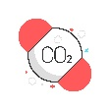
Experimental Design
Preindustrial CO₂ in JULES
Changing CO₂ in JULES
Inputs from climate model
RCP 6.0
RCP 6.0
Changes in JULES
temperature
atmospheric CO₂ fixed to preindustrial
precipitation
temperature
precipitation
atmospheric CO₂
JULES model
Smaller stomatal aperture but higher LAI due to CO₂ fertilisation
The difference between these two outputs indicates the influence of physiological forcing

Slide 10
Calculating contributing factors
 | Pre-industrial veg. distribution | Δ veg. distribution | Difference shows…
Pre-industrial CO₂ | E1. ΔCLIM | E2. ΔCLIM + ΔVEG_DIST | VEG DIST: Vegetation distribution changes due to climate changes only
Δ CO₂ | E3. ΔCLIM + ΔPLANT_PHYS | E4. ΔCLIM + ΔVEG_DIST + ΔPLANT_PHYS | VEG DIST (with PHYS change): Vegetation distribution changes due to CO2 effects & climate (includes stomatal effect on change on additional leaf area)
Difference shows… | STOM (no VEG DIST change): Stomatal effect (land use change only) | PLANT PHYS: Combined changes due to stomatal and CO2 fertilisation effects

Slide 11
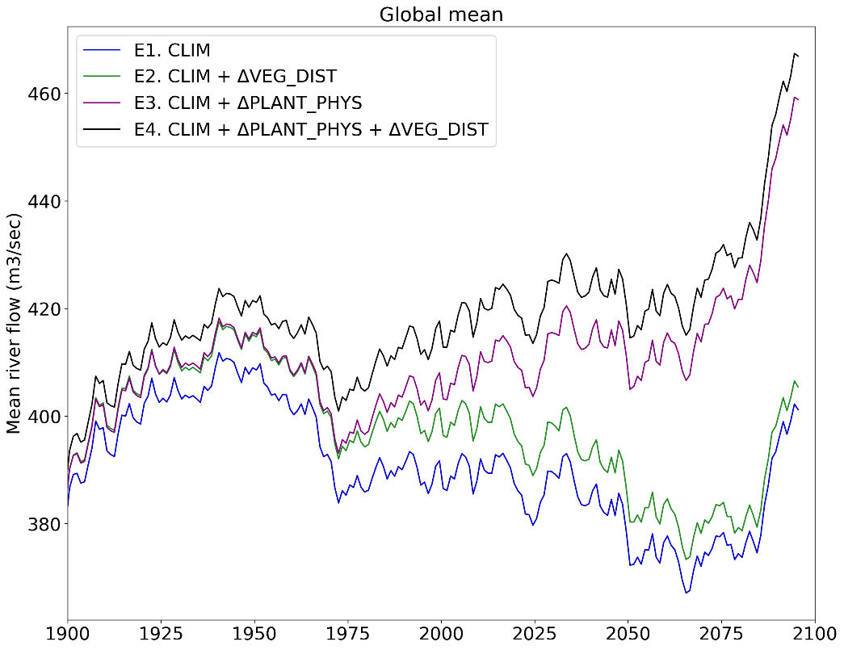
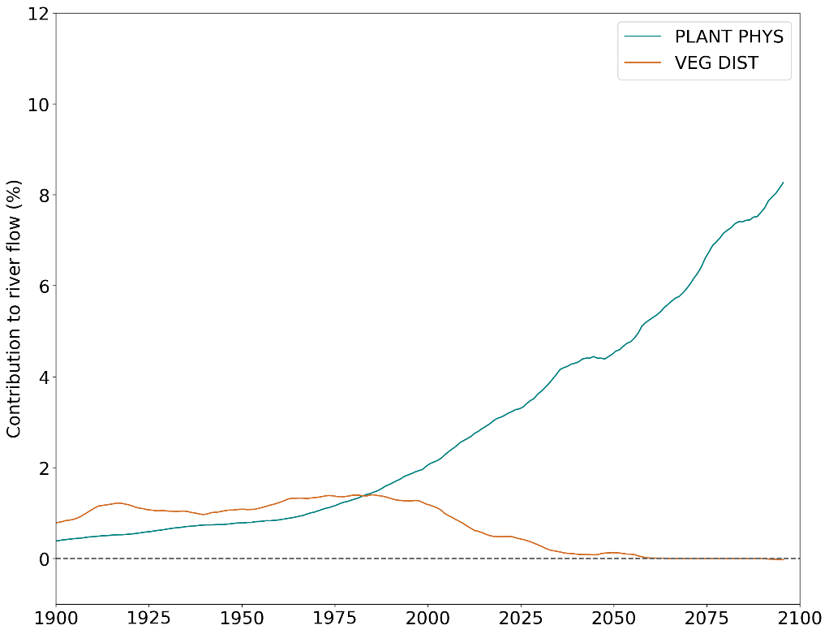
Global mean river flow in the four experiments
PLANT_PHYS = combination of stomatal and CO2 fertilisation effect
VEG_DIST = climate-forced vegetation changes
PLANT_PHYS increases global mean river flow, especially in future, while the contribution from VEG_DIST changes become relatively smaller

Slide 12
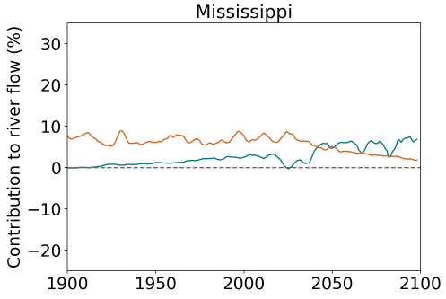
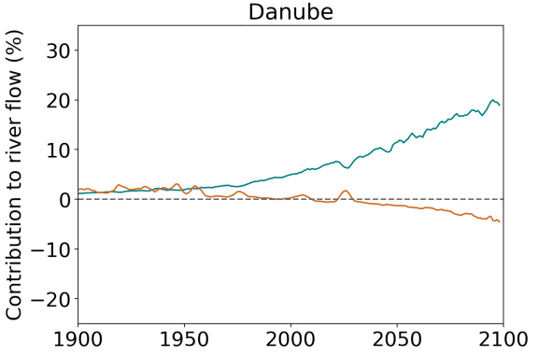
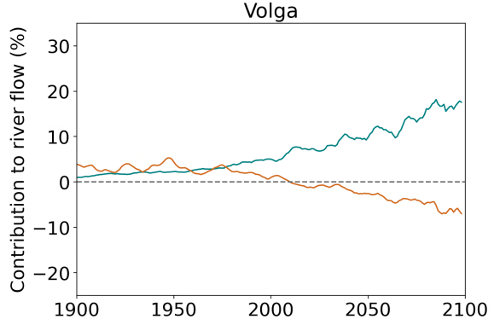
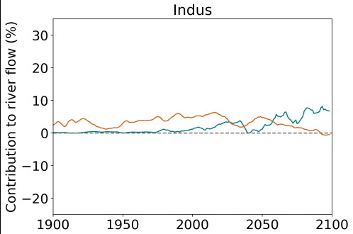
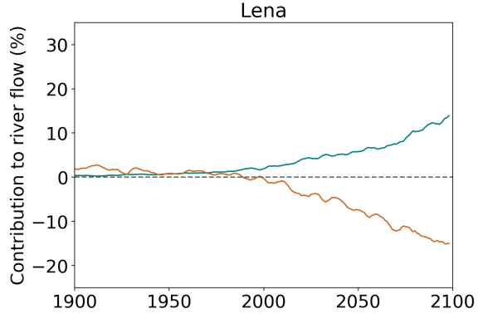
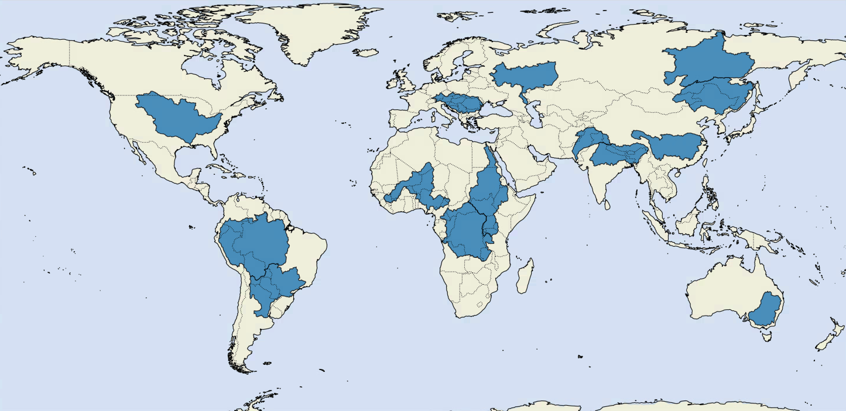
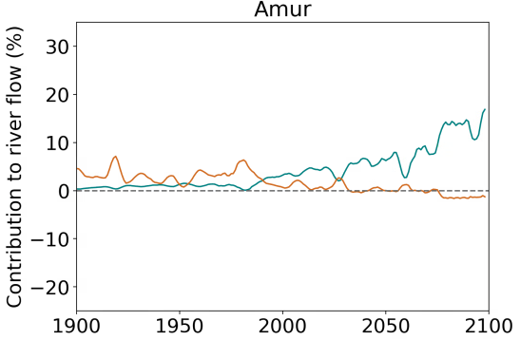
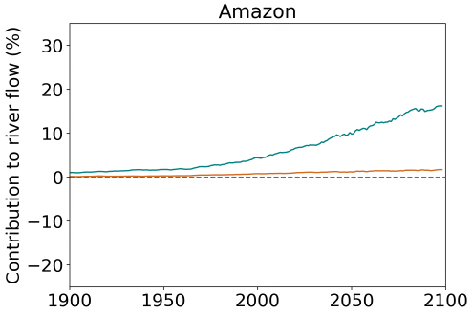
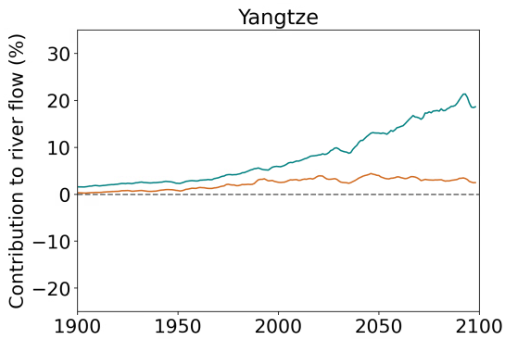
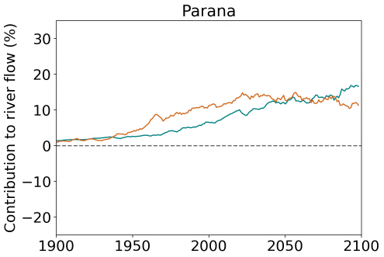
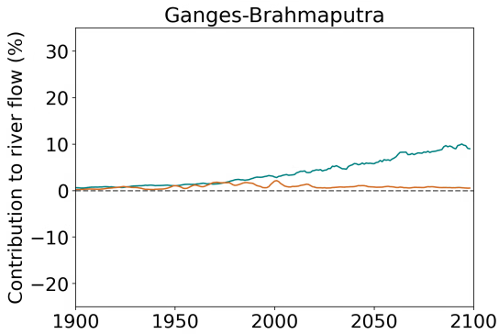
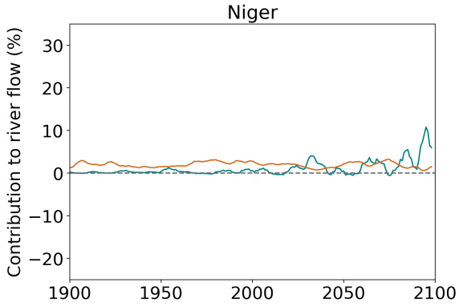
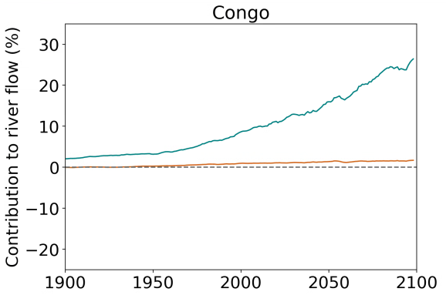
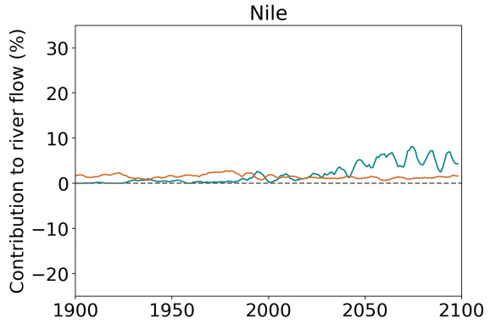
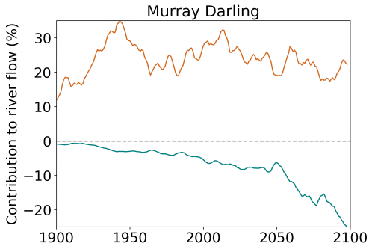
For most basins, PLANT PHYS dominates, with VEG DIST usually leading to decreases in river flow.
Parana: both factors give increases, but in Amazon, PLANT PHYS dominates
CO2 fertilisation effect? Mortality?

Slide 13
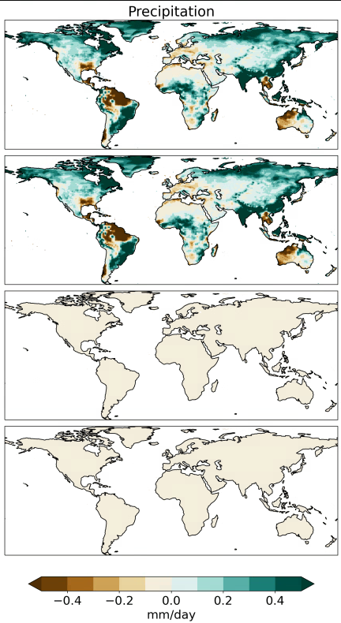
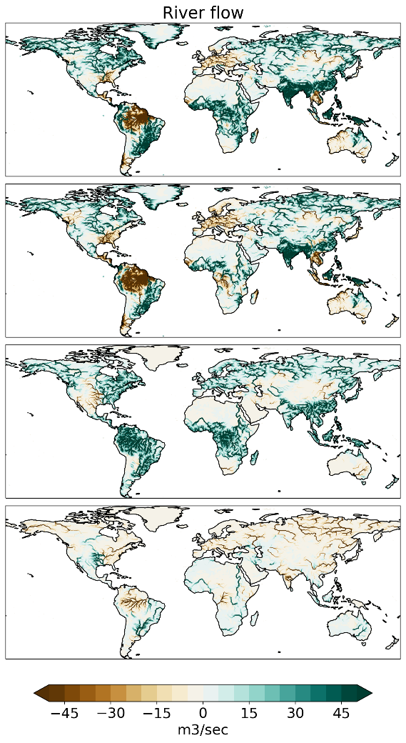
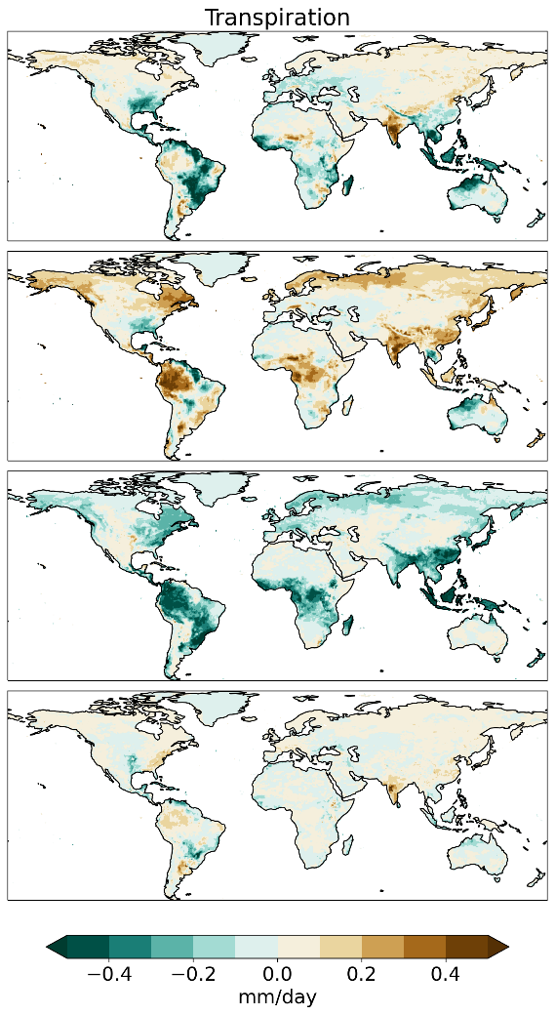
How does each factor contribute to changes in the water cycle?
Mean change from 1980-2000 to 2080-2100
Precipitation
River flow
Transpiration
ALL
CLIM
Plant physiology increases river flow (& decreases transpiration) considerably in many places, e.g., tropics.
PLANT PHYS
No change
VEG DIST
Veg distribution changes = mostly decreases in river flow
No change

Slide 14
Water Scarcity Index calculation
Water demand*:
Regional rivalry (SSP3)
Includes demand from domestic, industrial & irrigation
Incorporates population & GDP
Water supply:
Using our river flow results
Includes river routing scheme
Water scarcity Index (WSI):
WSI = demand / supply
Index from 0 to 1
WSI of 0.2–0.4 = mild or emerging water scarcity
WSI ≥ 0.4 = severely water scarce (conditions under which human water use accounts for about 40% or more of the average water supply)
Non water scarce places (WSI < 0.05) masked out
*Courtesy of Peter Greve

Slide 15
How is water scarcity changing under the “regional rivalry” scenario (SSP3)?
Water demand (SSP3)*
Water supply**
WSI
Water demand is increasing almost everywhere
Supply varies greatly by region
Water scarcity is predicted to worsen across north Africa, Middle East, western USA and central America, and parts of India and China
2010
Decadal means
2050
2010 to 2050
Difference
*Includes domestic, industrial & irrigation
**Uses river flow as includes routing scheme

Slide 16
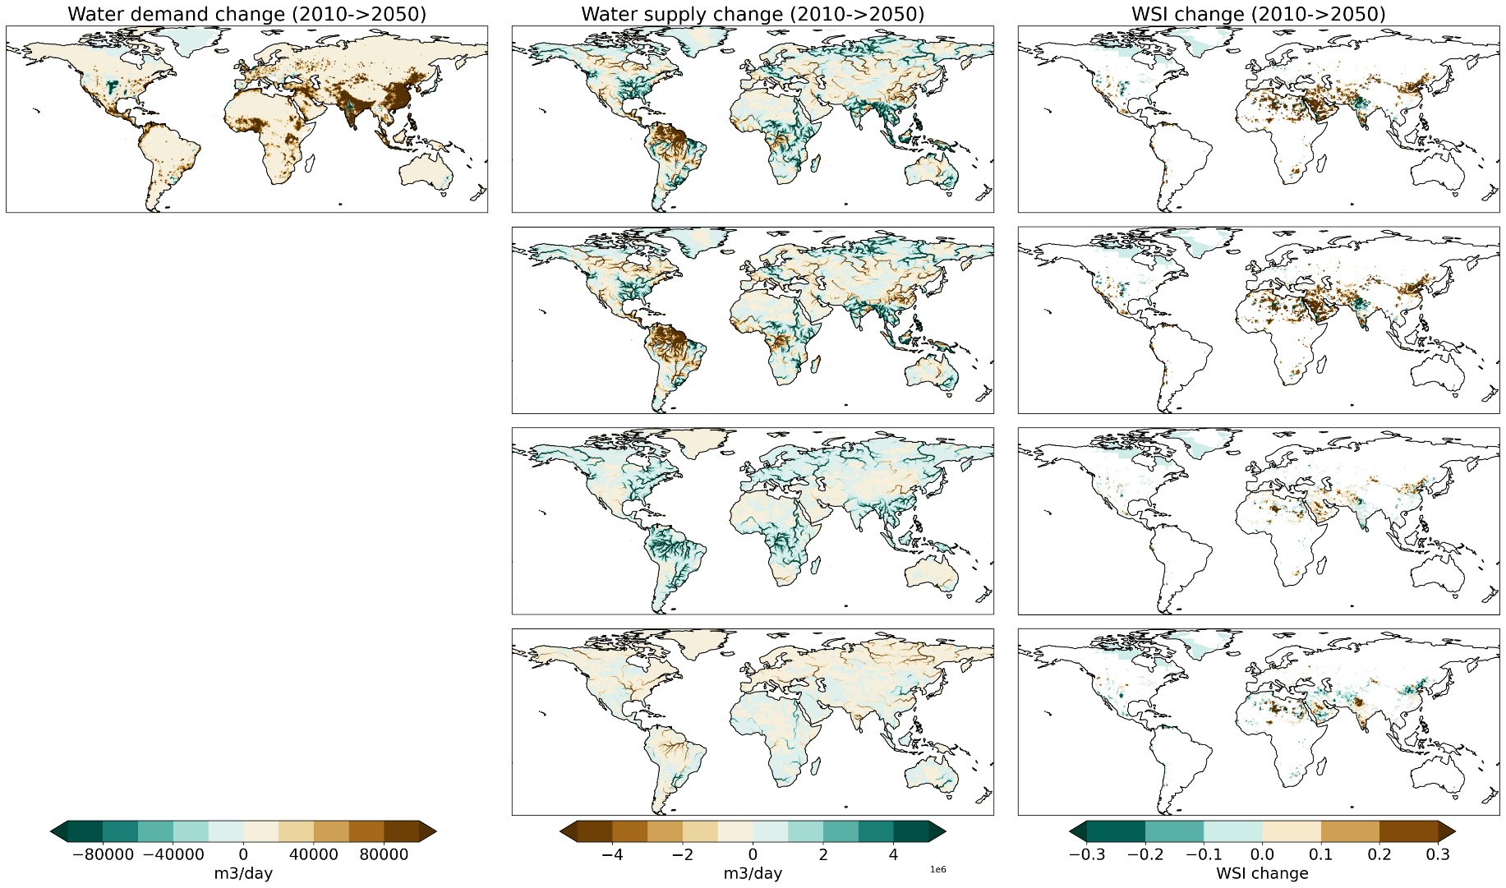
How is each factor contributing to the change in water scarcity (2010 -> 2050)?
Non water-scarce areas (WSI < 0.05) masked out
Water demand (SSP3)
Water supply change
WSI change
ALL
Climate changes (e.g., precipitation/temperature) are contributing to worsening water scarcity
Not applicable
CLIM
Physiological forcing further worsens water scarcity in areas; the stomatal effect shows limited positive contribution
PLANT PHYS
Not applicable
Not applicable
VEG DISTRIBUTION
Vegetation distribution changes contribute to negative and positive WSI changes

Slide 17
Key points
Plant physiological response to rising CO2 is increasing global water supply on average through the reduction in stomatal aperture
…albeit with considerable regional variation.
Despite this wetting effect, plant physiology appears to worsen water scarcity predictions
… likely due to increased vegetation from the CO2 fertilisation effect occurring in places which are more water scarce
The increase in supply from reduced stomatal aperture is widespread, but most prevalent in non-water scarce locations, and thus does not alleviate water scarcity

Slide 18
Supplementary information

Slide 19
Questions left to answer
Further investigation into water scarce areas; is vegetation increasing in these areas?
Are increases in river flow from VEG DIST due to mortality?
How do the results vary with different scenarios / climate models?

Slide 20
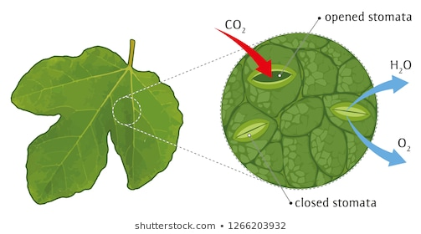
Stomatal behaviour is changing with rising CO₂
Plant stomata open less widely
Less transpiration
More water remains in ground
Notes:
… good news for plant as more efficient in terms of water-use

Slide 21
BUT plants also photosynthesize (and grow) faster
More overall stomata
More transpiration by overall canopy
The CO2 fertilisation effect
Less water remains in ground
Notes:
Another plant response to higher CO2 is that…

Slide 22
Plants are having contradictory effects on the water cycle…
Plant responses
Less plant
transpiration
Wetter ground
Reduction in stomatal aperture
Higher
atmospheric CO₂
At the stomata level
Increased vegetation
More plant
transpiration
Drier ground
Notes:
To summarise

Slide 23
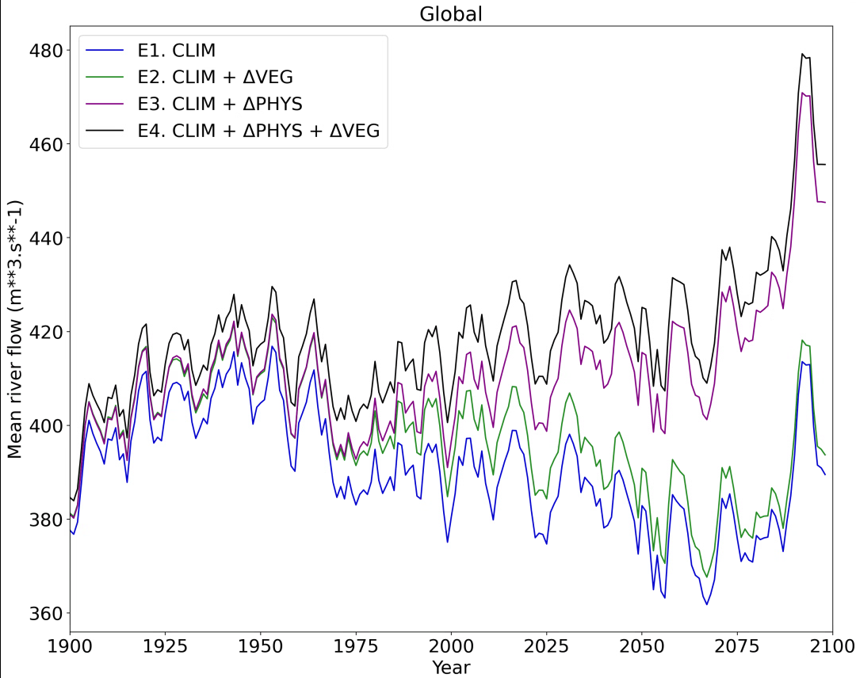
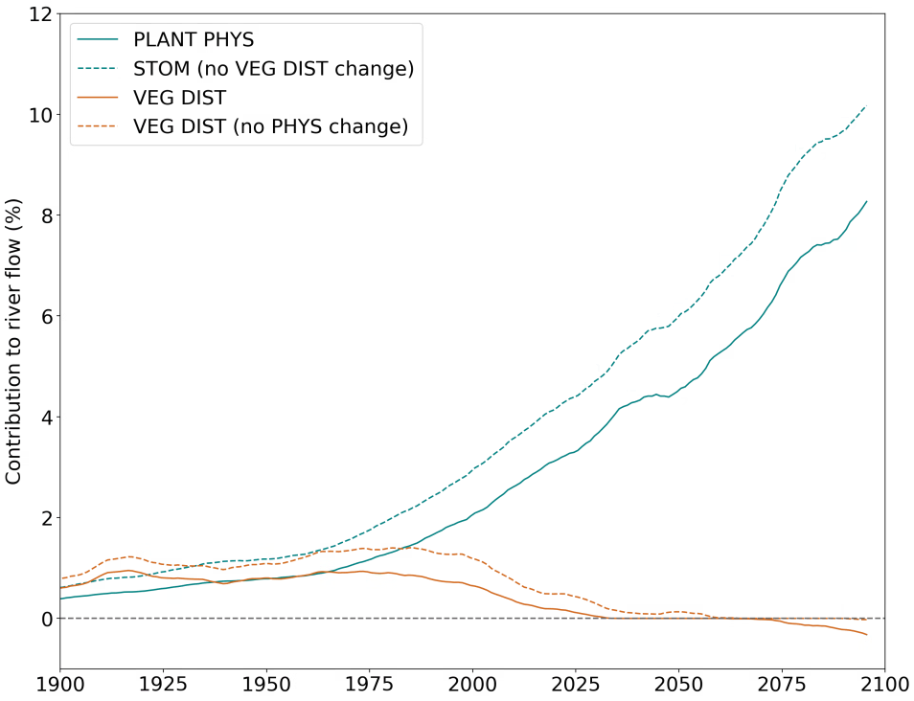
Global mean river flow in the four experiments

Slide 24
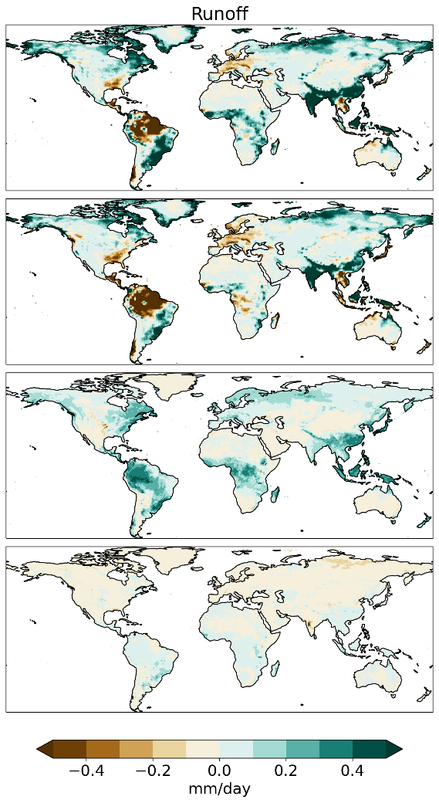
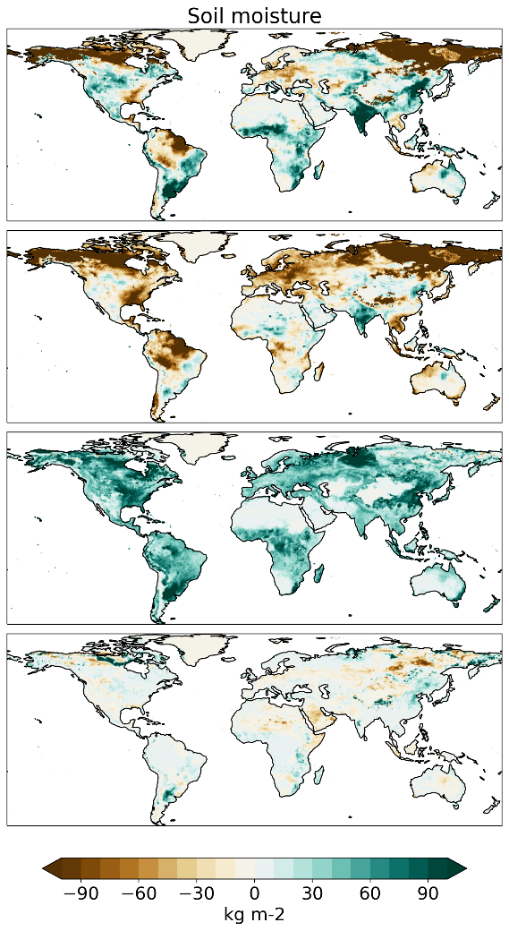
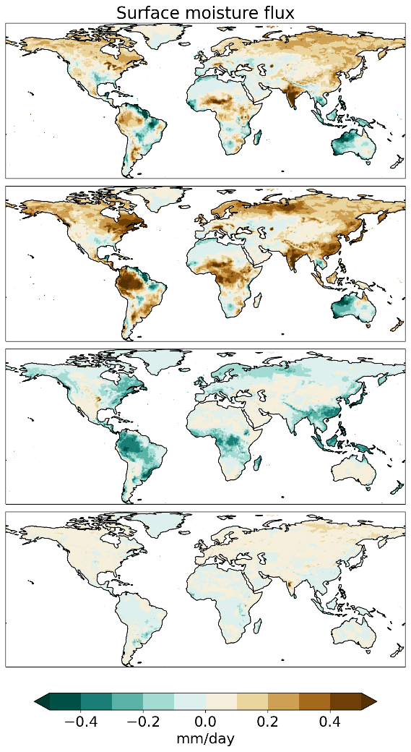
How does each factor contribute to changes in the water cycle?
Mean change from 1980-2000 to 2080-2100
Runoff
Total soil moisture in column
Surface water flux
ALL
CLIM
PLANT PHYS
VEG DIST

Slide 25
How is water scarcity changing for the “middle of the road” scenario (SSP2)?
Water demand
Water supply (SSP2)
WSI
2010
Decadal means
2050
Difference
2010 to 2050

Slide 26
Median WSI by river basin
All very low (< 0.1) - look at range of distribution and basins in water scarce areas

Slide 27
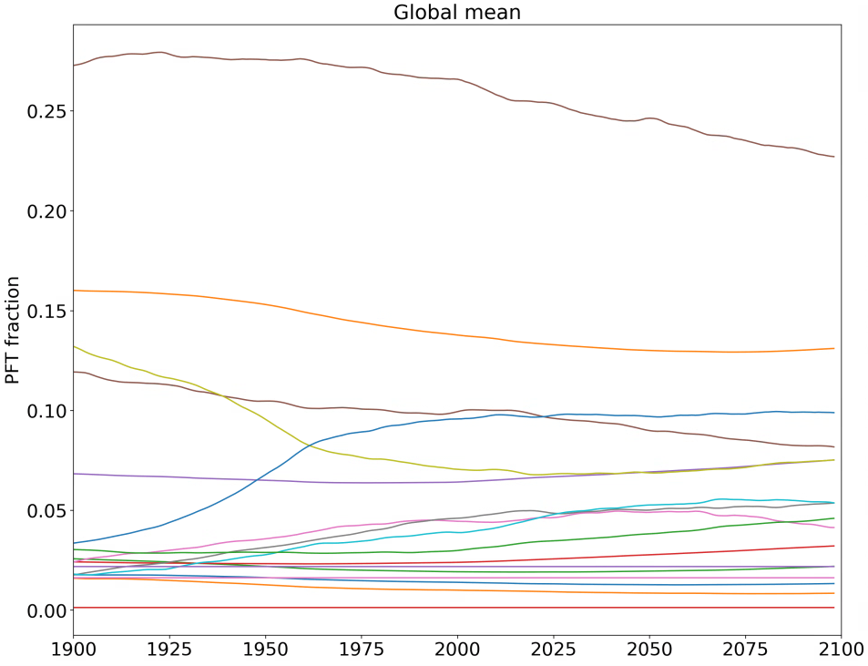
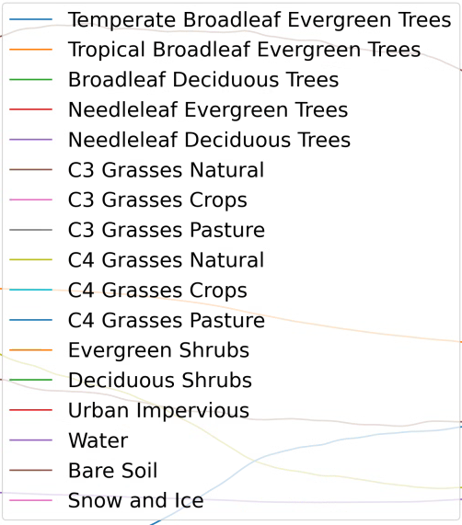

Slide 28
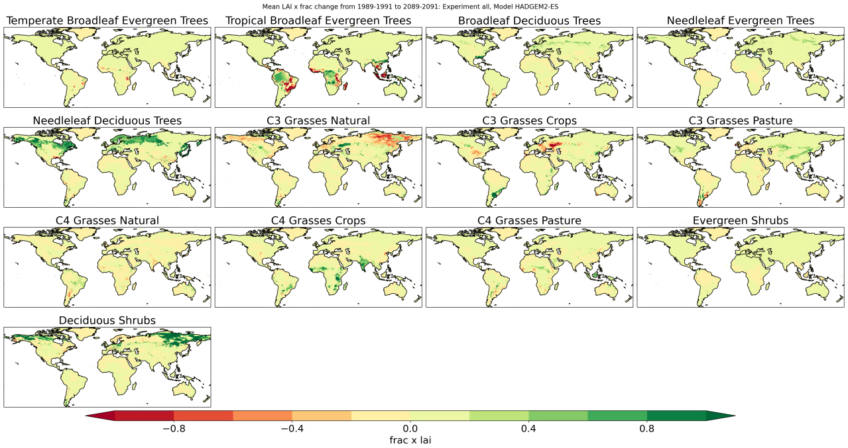

Slide 29
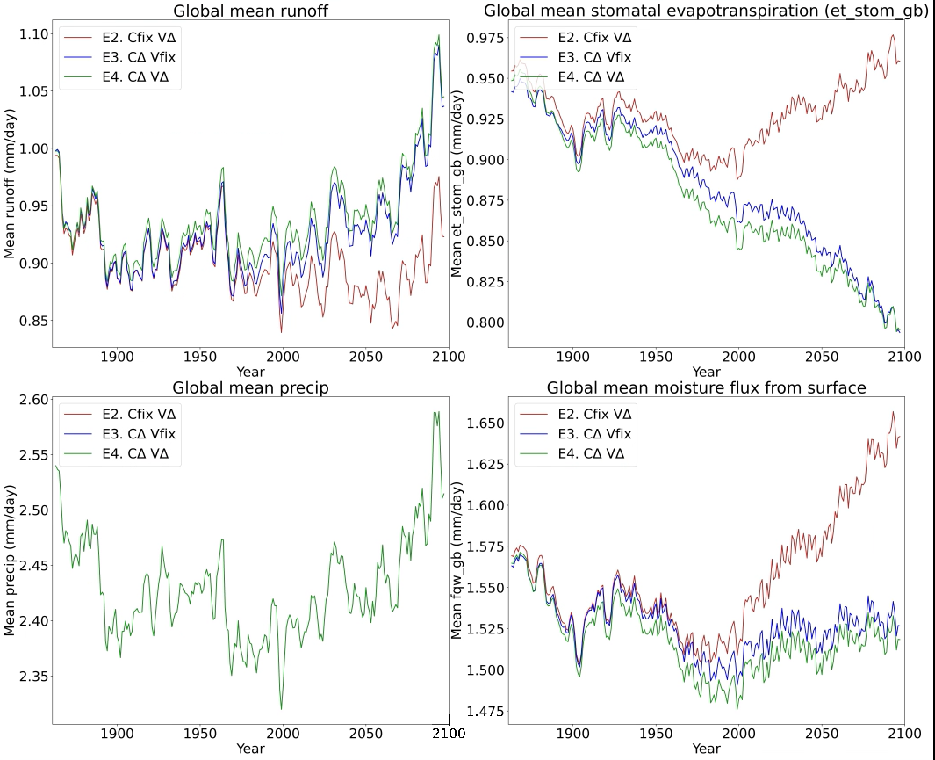
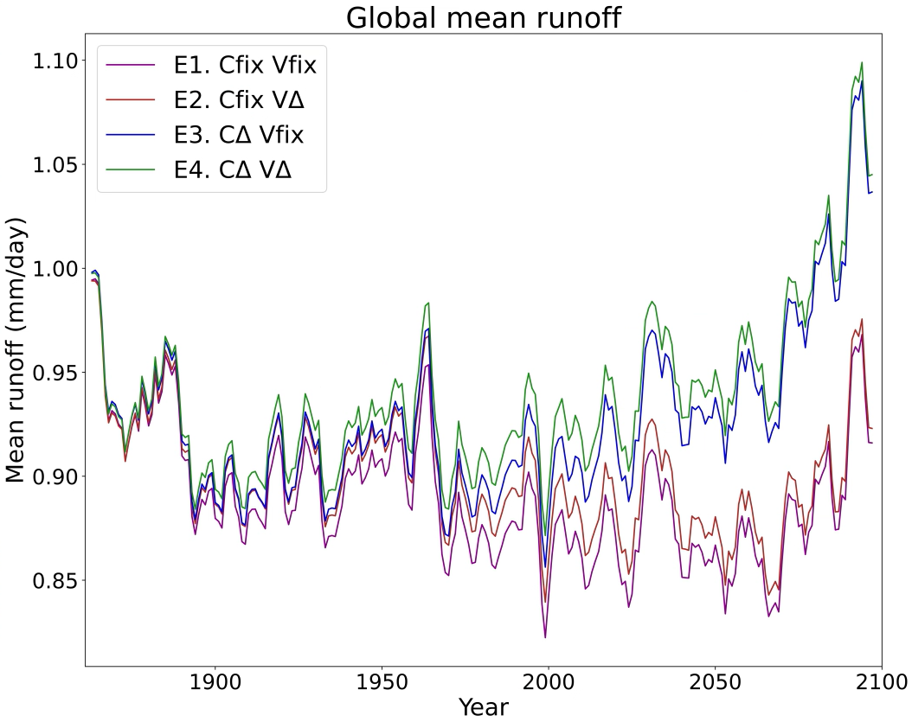
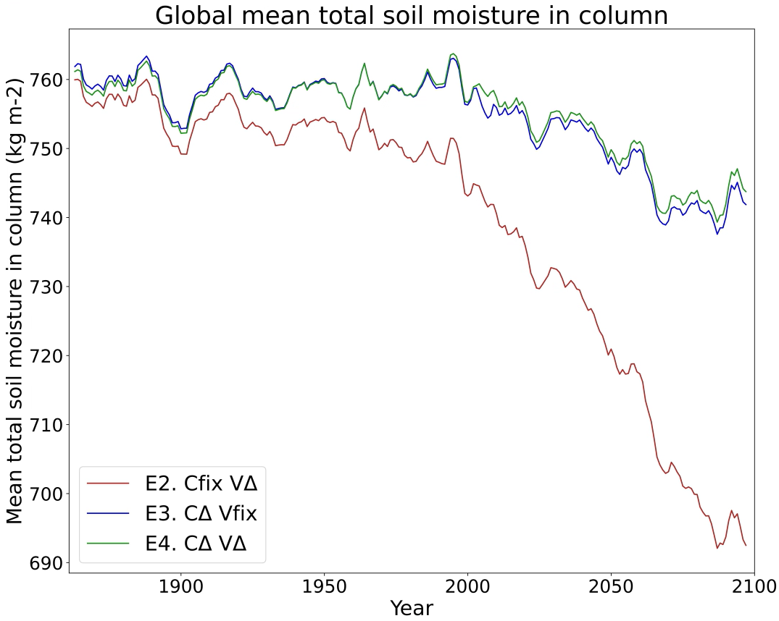
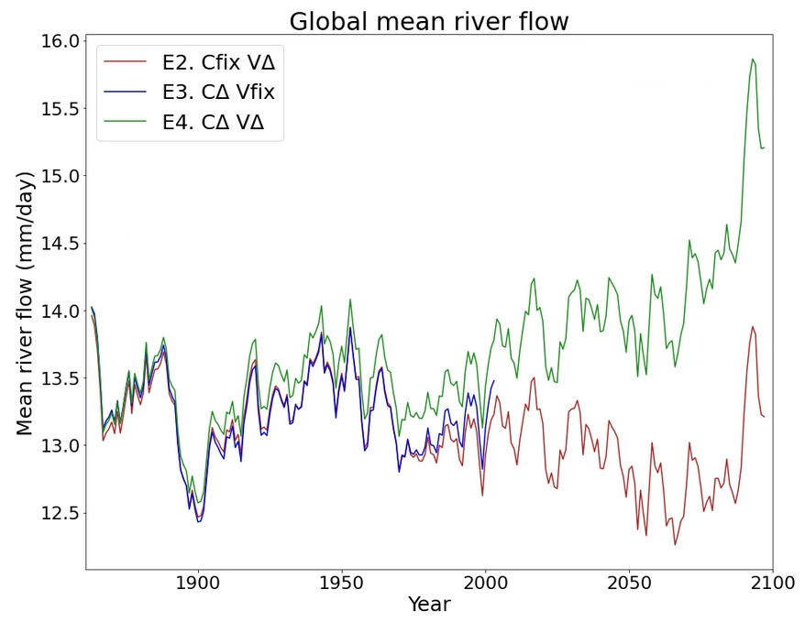
Notes:
The increase in runoff is driven by an increase in ppn and decrease in ET,
When plant response is included, ET decreases rather than increases – driving runoff to be much higher than when plant response not included
Considerable drop in soil moisture in future is less dramatic when plant phys included
Precip
Clearly shows impact of including plant response – historic trend looks negative – already a stomatal response
River flow only increasing when plant response included

