Slide 1
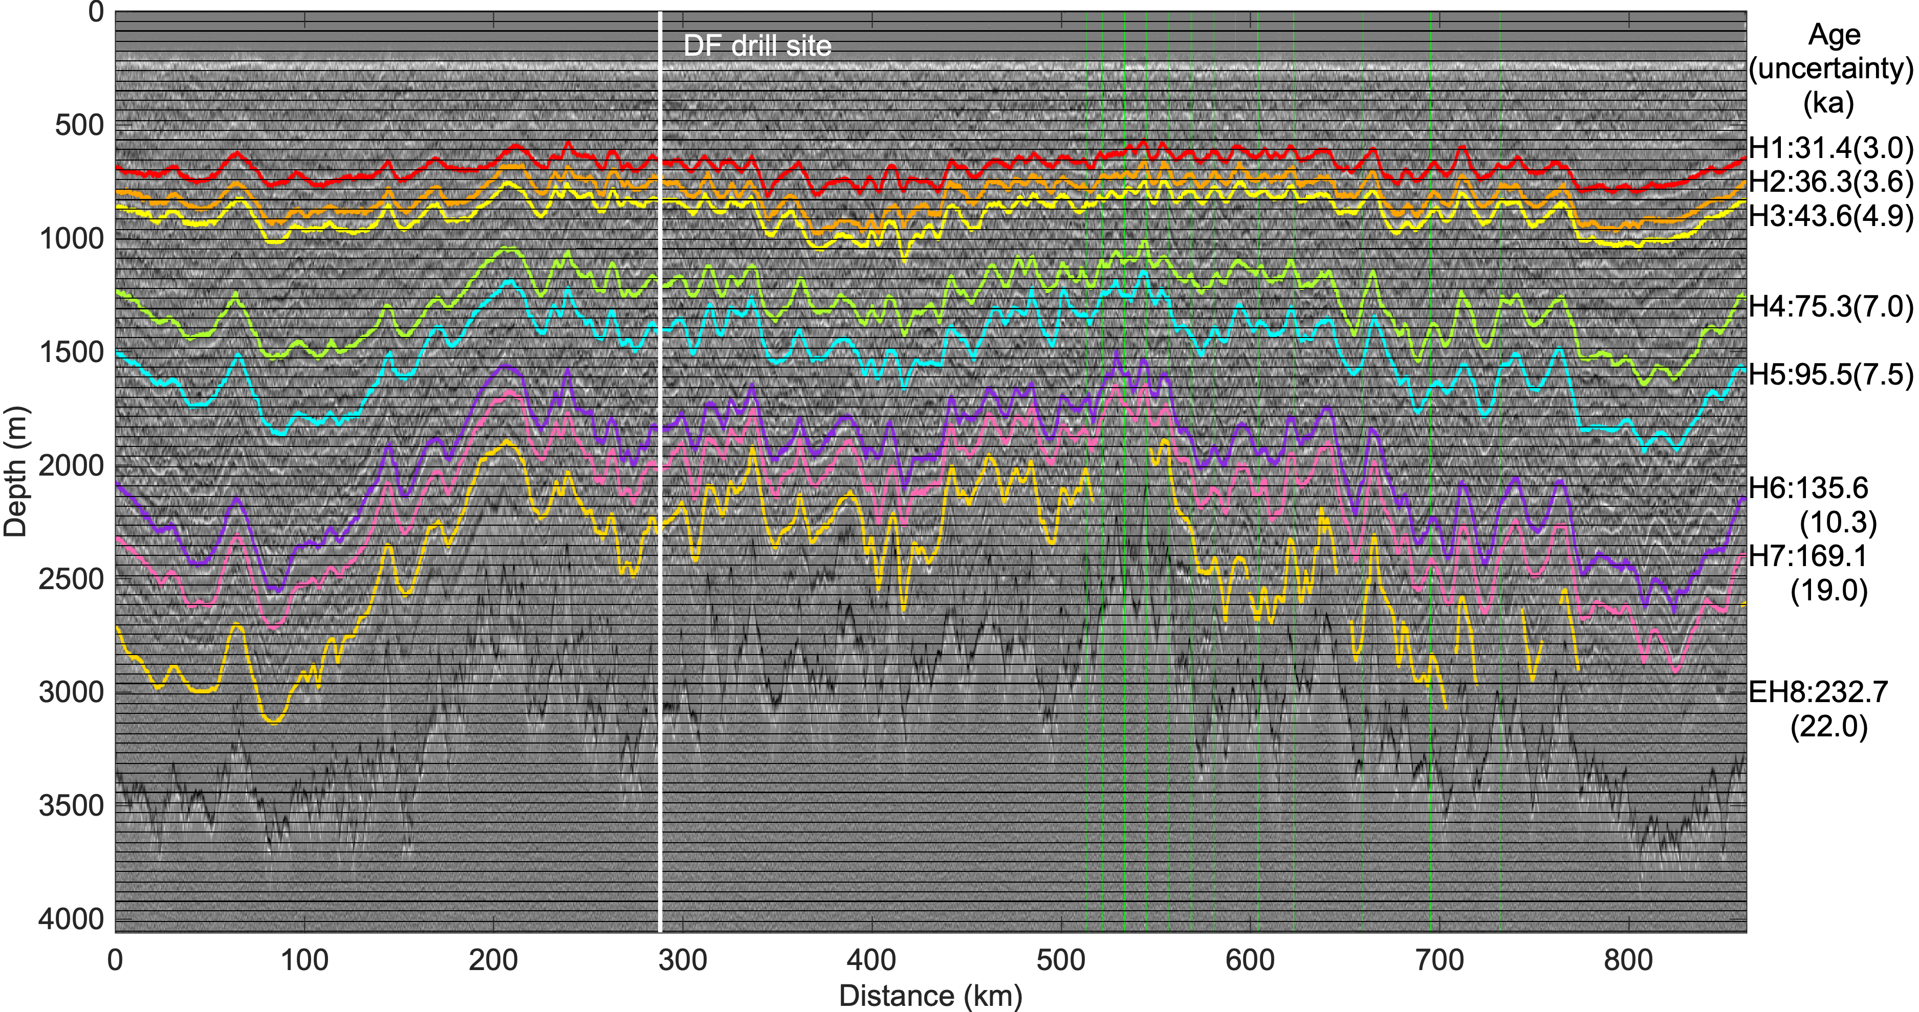
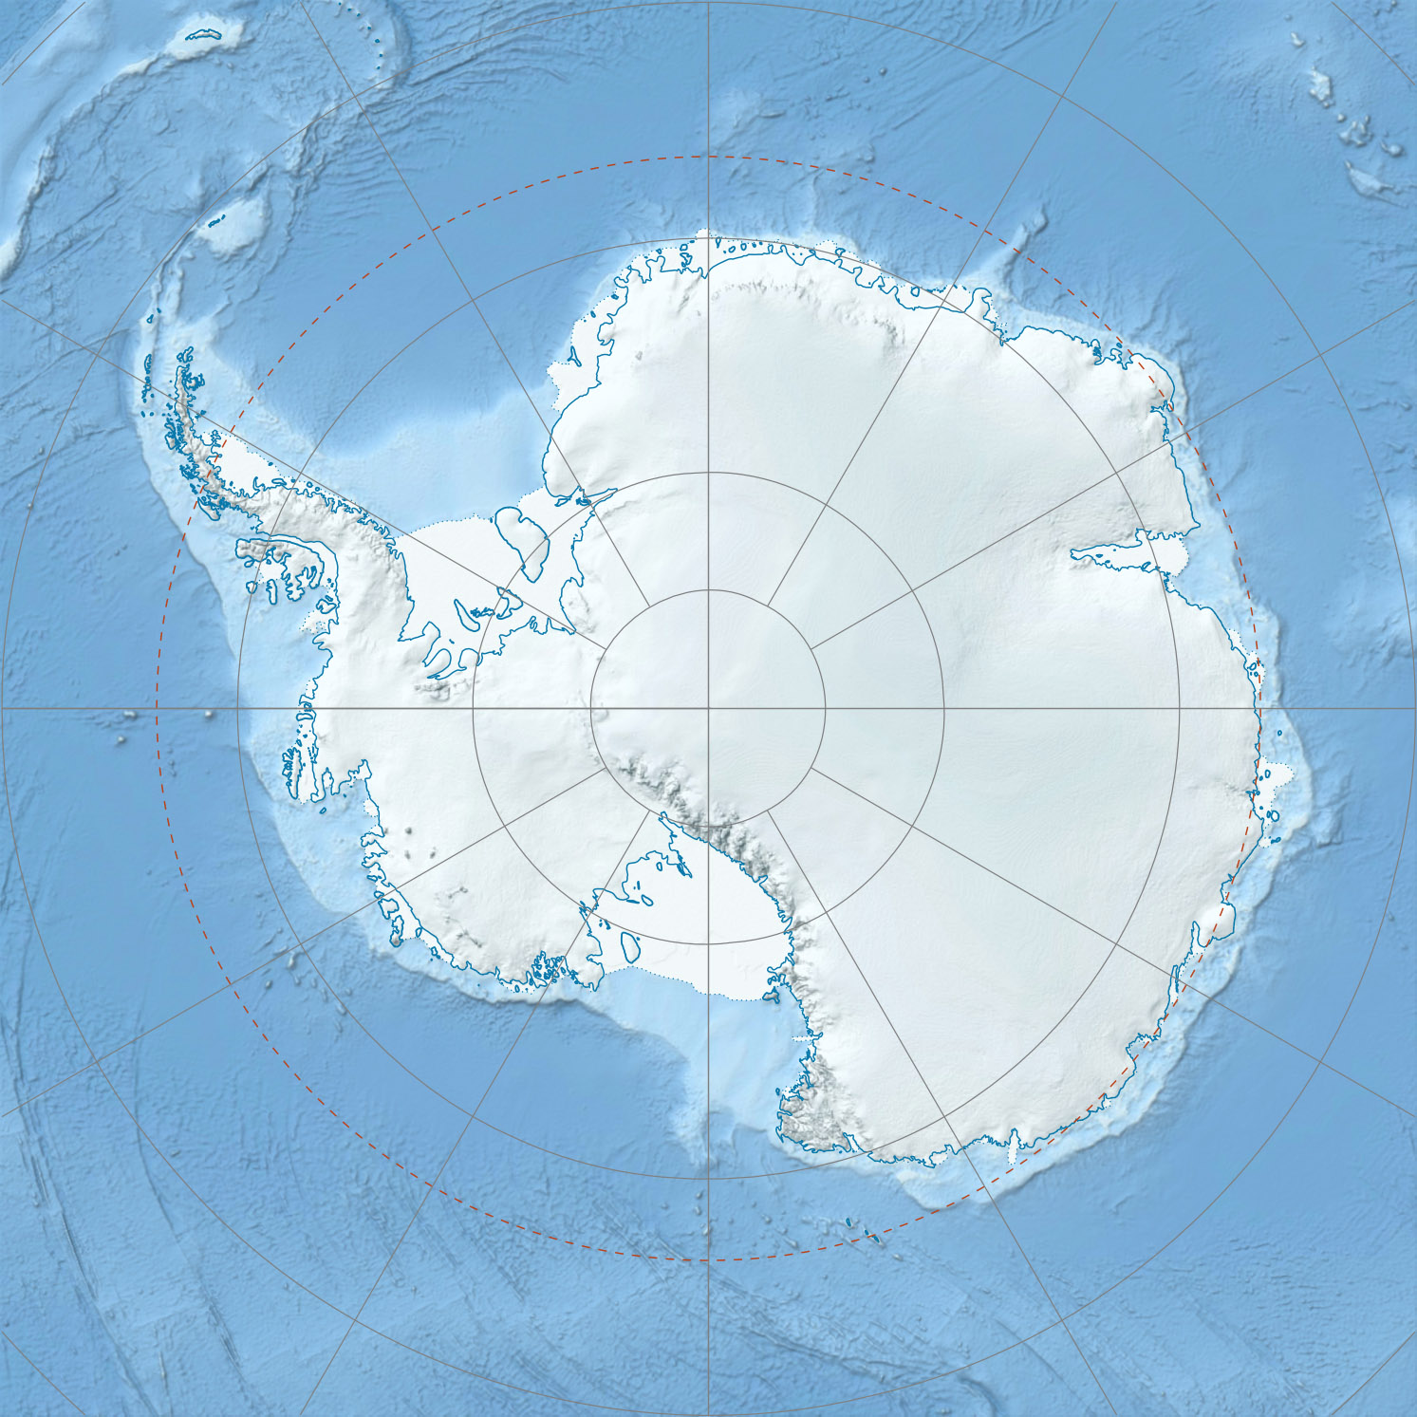
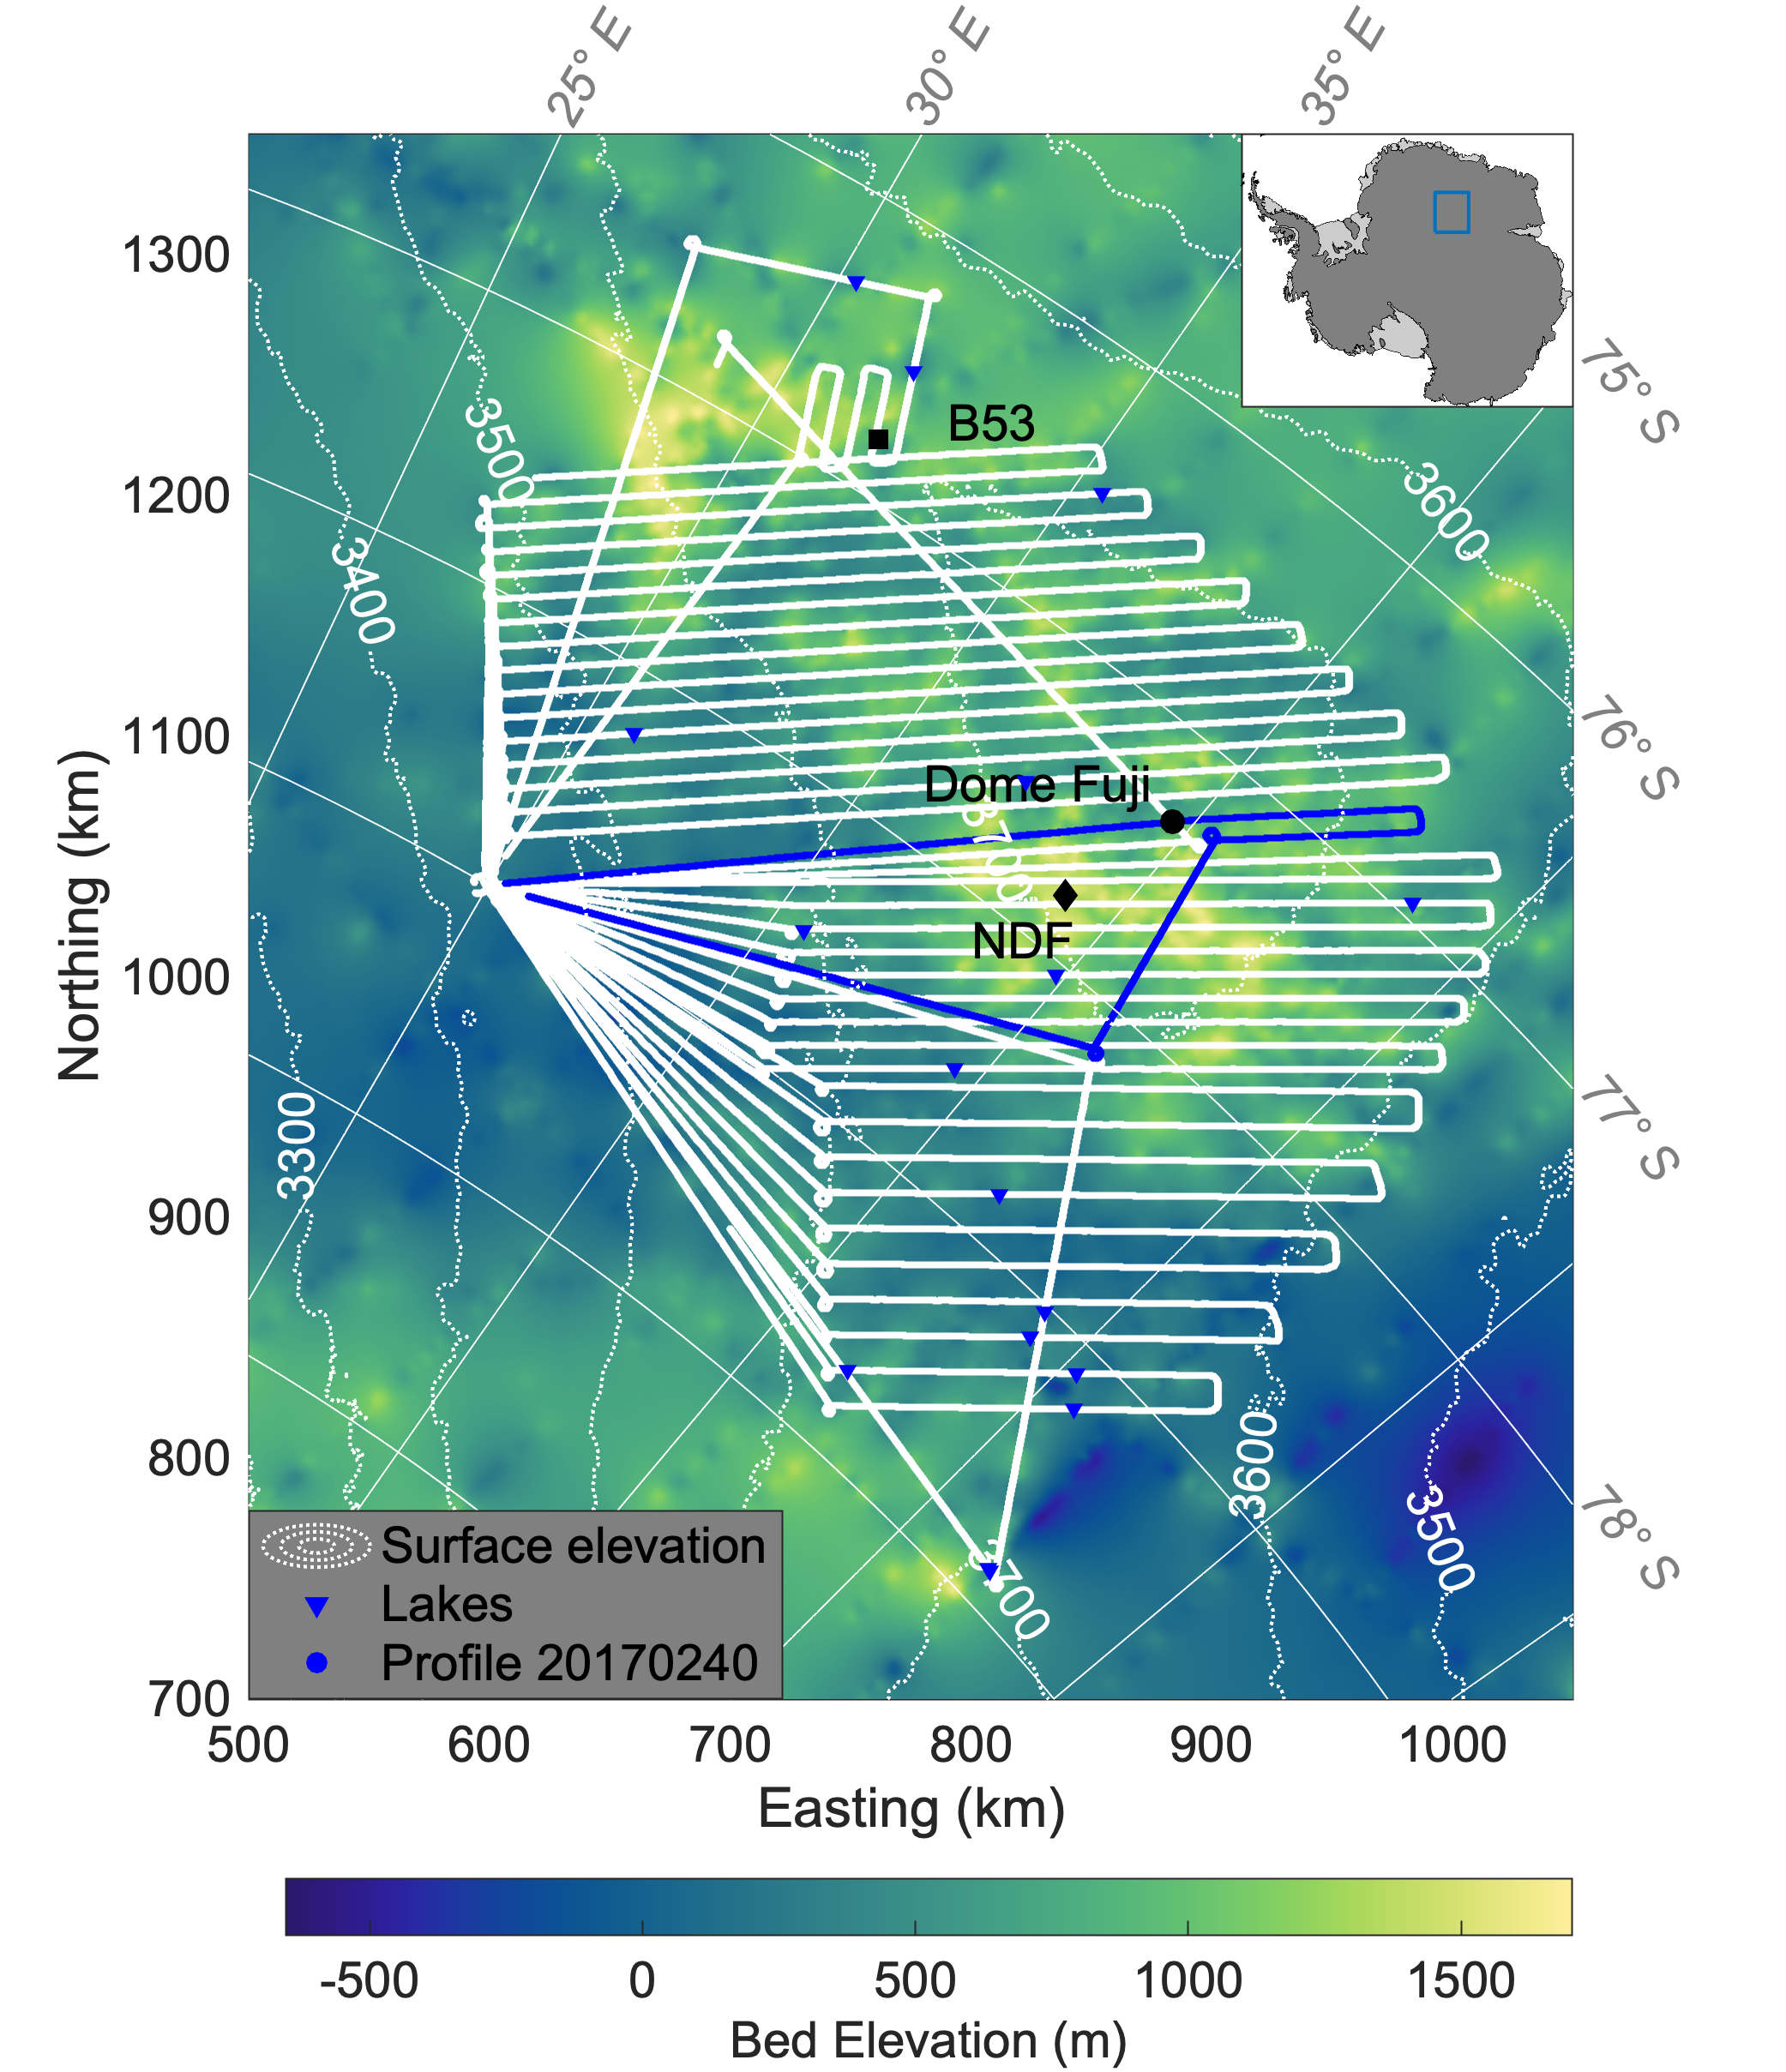
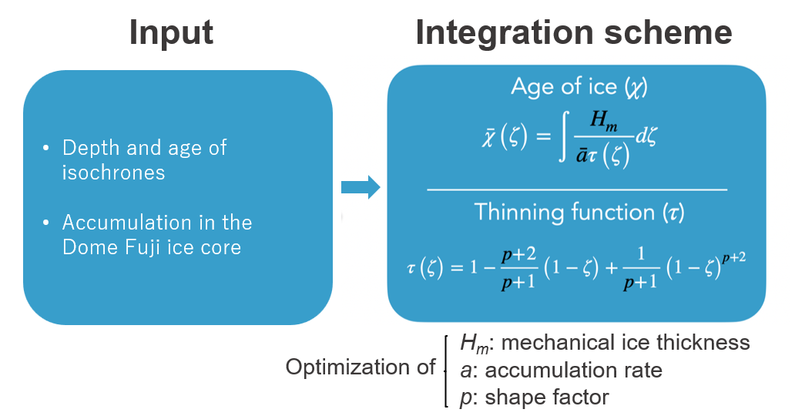
Mapping age and basal conditions of ice in the Dome Fuji region, Antarctica
Zhuo Wang, Olaf Eisen, Ailsa Chung, Daniel Steinhage, Frédéric Parrenin and Johannes Freitag
1. MPT and Old ice
Ice > 1200 ka BP
4. Radargram
Radar profiles
(Berends et al, 2021)
2. Dome Fuji
3. Radar survey
Research area
Dome Fuji
5. 1D Model

Slide 2
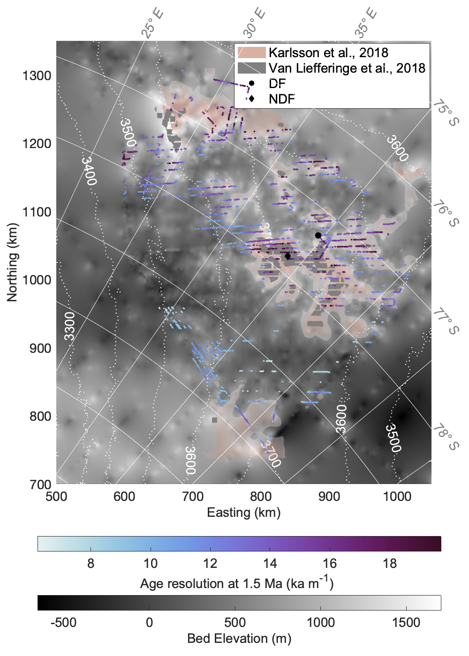
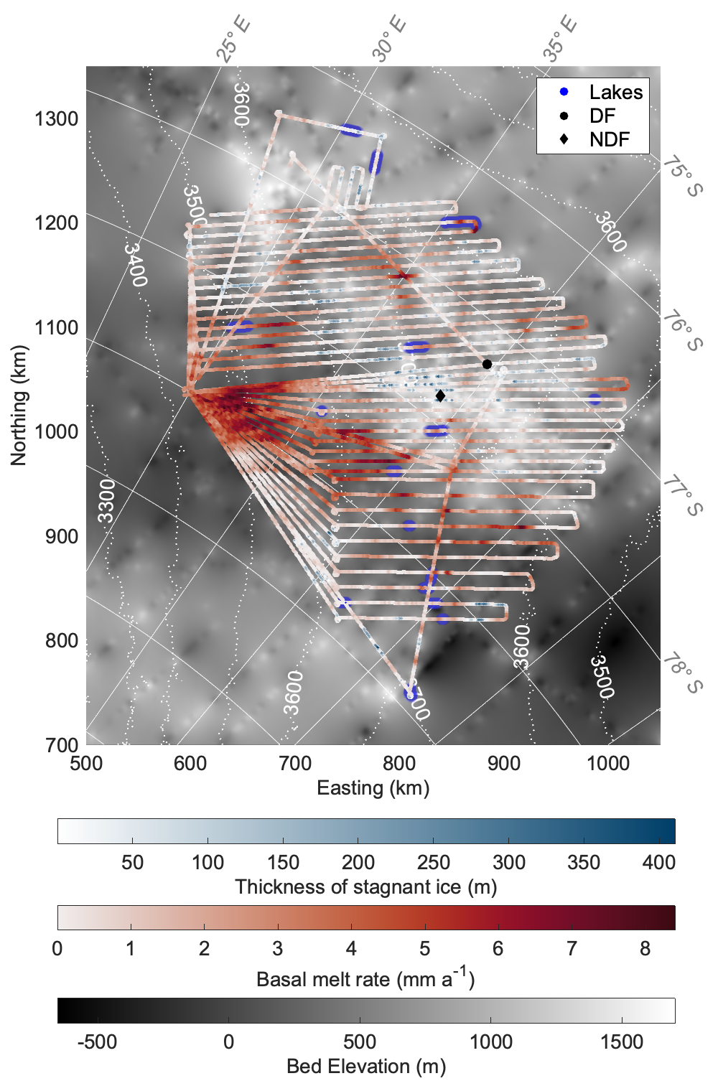
Mapping age and basal conditions of ice in the Dome Fuji region, Antarctica
Zhuo Wang, Olaf Eisen, Ailsa Chung, Daniel Steinhage, Frédéric Parrenin and Johannes Freitag
Age of basal ice
Age density at 1.5 Myr
Basal thermal state
Stagnant ice cluster
Old ice candidates

Slide 3
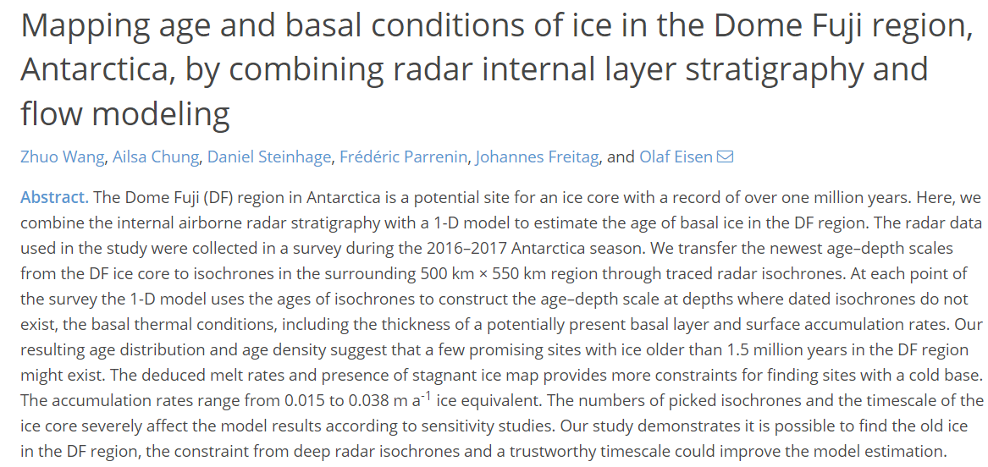
Mapping age and basal conditions of ice in the Dome Fuji region, Antarctica
Zhuo Wang, Olaf Eisen, Ailsa Chung, Daniel Steinhage, Frédéric Parrenin and Johannes Freitag
Our preprint in discussion
Pico 3a.11
Results
Basal thermal state
Surface accumulation rate
Age of the ice
Model
evaluation
Sensitivity study
Reliability
Reference
Berends, C. J., Köhler, P., Lourens, L. J., and van de Wal, R. S. W: On the cause of the mid-Pleistocene transition, Reviews of Geophysics, 59, e2020RG000727, 2021
Parrenin, F., Cavitte, M. G. P., Blankenship, D. D., Chappellaz, J., Fischer, H., Gagliardini, O., Masson-Delmotte, V., Passalacqua, O., Ritz, C., Roberts, J., Siegert, M. J., and Young, D. A.: Is there 1.5-million-year-old ice near Dome C, Antarctica?, The Cryosphere, 11, 2427–2437, 2017

Slide 4
Mapping age and basal conditions of ice in the Dome Fuji region, Antarctica
Zhuo Wang, Olaf Eisen, Ailsa Chung, Daniel Steinhage, Frédéric Parrenin
and Johannes Freitag
April 23 – 28, Vienna
Menu

Slide 5
Mapping age and basal conditions of ice in the Dome Fuji region, Antarctica
Zhuo Wang, Olaf Eisen, Ailsa Chung, Daniel Steinhage, Frédéric Parrenin and Johannes Freitag
₀₀
Introduction
Conclusion
Radar survey
Radar survey
₀₁
₀₁
Method
Method
1D Ice flow model
1D Ice flow model
Modelled age
₀₂
Results
Basal thermal state
Surface accumulation rate
Realibility
₀₃
Model evaluation
Sensitivity study
2

Slide 6
Introduction
MPT
100 ka cycle
(MPT)
41 ka cycle
(Berends et al, 2021)
Responded
Forced
Antarctica ice core covering MPT
CO₂
> 1200 ka BP
800 ka Bp
Direct record
Investigate the age of ice in the Dome Fuji region
3

Slide 7
Method – Radar survey
AWI RES burst system
Pulse: 600ns
22 radar survey profiles (White lines)
Trace spacing: ~35 m (after stacked 7)
Dome Fuji drill site: 77.3167°S, 39.7˚ E
Closest point on radar profile P40: 91.05 m
4
Notes:
We approximately consider this point as the DF drill site when we transfer the age from ice core to the DF region, which will result in uncertainty because of the offset,it will be discussed later.

Slide 8
Method – Isochrones in radargram
Age-depth scale at the DF drill site (DFO2006+AICC2012)
Isochrones
Intersections of the drill site and isochrones.
Ice-age of isochrones in this profile. From 31.4 ka to 169.1 ka.
Intersections of 22 radar profiles
Ice-age of isochrones in the DF region.
Radargram of profile P40.
5

Slide 9
Method – 1D ice flow model
Input
Integration scheme
Depth and age of isochrones
Accumulation in the Dome Fuji ice core
H_{m}: mechanical ice thickness
a: accumulation rate
p: shape factor
Optimization of
7

Slide 10
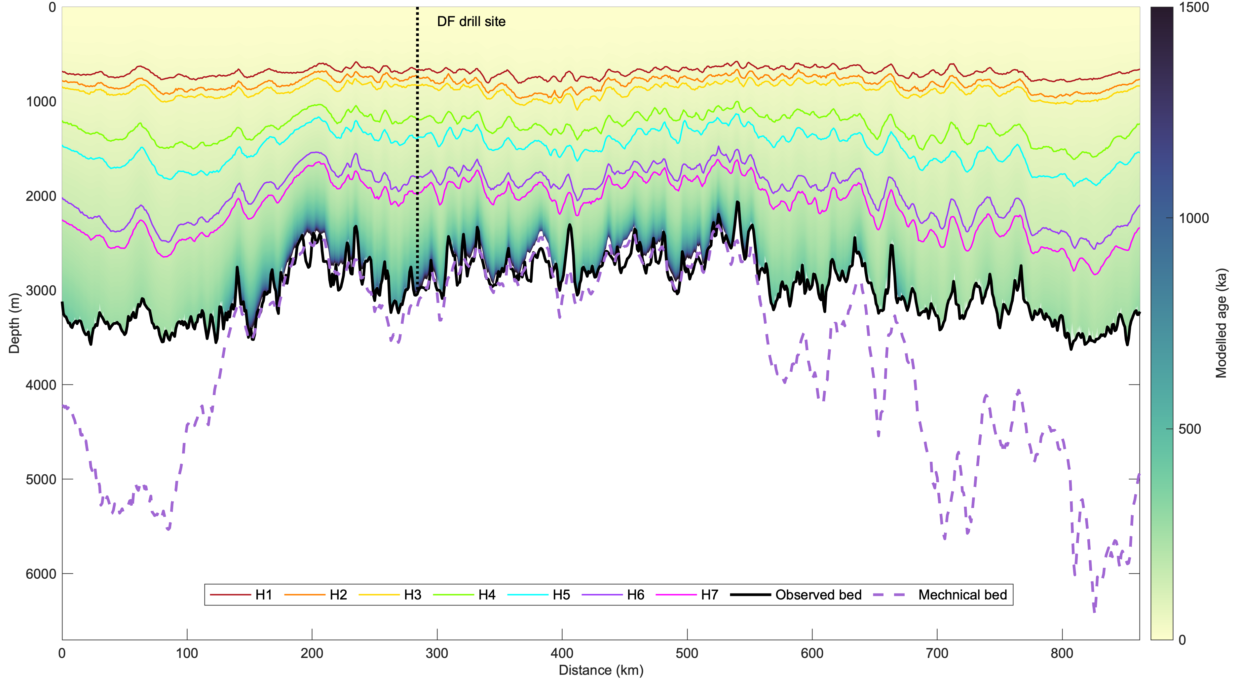
Results – Modelled ice-age for P40
Basal thermal state:
Stagnant ice:
Melting:
$$H_{stagnant}=H_{obs}−H_{m}$$
$$m=\overline{a} τ(\frac{H_{obs}}{H_{m}})$$
Bed
Mechanical ice thickness
Modelled ice-age of P40 by combining 1D models
8
Notes:
What information could we get from the figure?

Slide 11
Results – Age of basal ice
Basal ice: With a cut-off value of 20 kyr/m
(a) Modelled age of the basal ice.
(b) Corresponding depth of basal ice.
Age of basal ice at the DF drill site:
1345.8$±$494.3 ka
9
Notes:
Which corresponds to a 40 kyr full cycle in 2 m.

Slide 12
Results – Age density of ice at 1.5 Ma
Old ice candidates:
A large subglacial mountain range located ~ 100 km around the DF drill site.
~160 km to the north-west of the DF drill site, connected with the first site
~240 km to the north-west of the DF drill site
~260 km to the south-west of the DF drill site
10

Slide 13
Results – Basal thermal state
Melting (92%):
Ice thicker than 3000 m
Melt rate at the DF drill site: 0.11$±$0.37 mm a⁻¹
Stagnant ice (8%):
Immediately north of NDF (Main)
~180 km north-west of the DF
Average thickness: 95.6 m
11

Slide 14
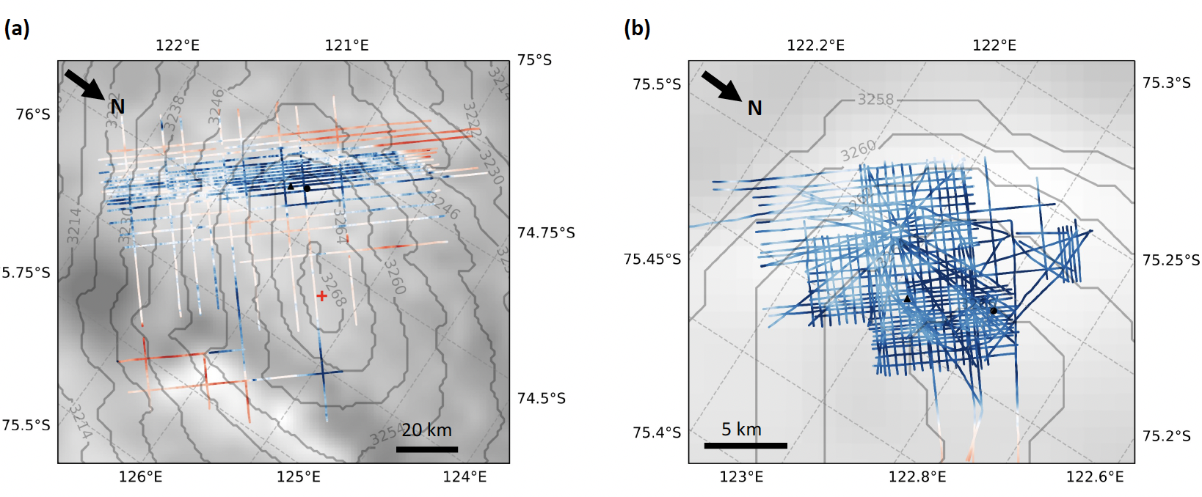
Results – Basal thermal state
Dome C
Little Dome C
(Chung et al., 2023, preprint)
12
Notes:
Compare with LDC. If we also shows the s in LDC from Ailsa Chung… DF has a less favorable basal thermal condition for old ice

Slide 15
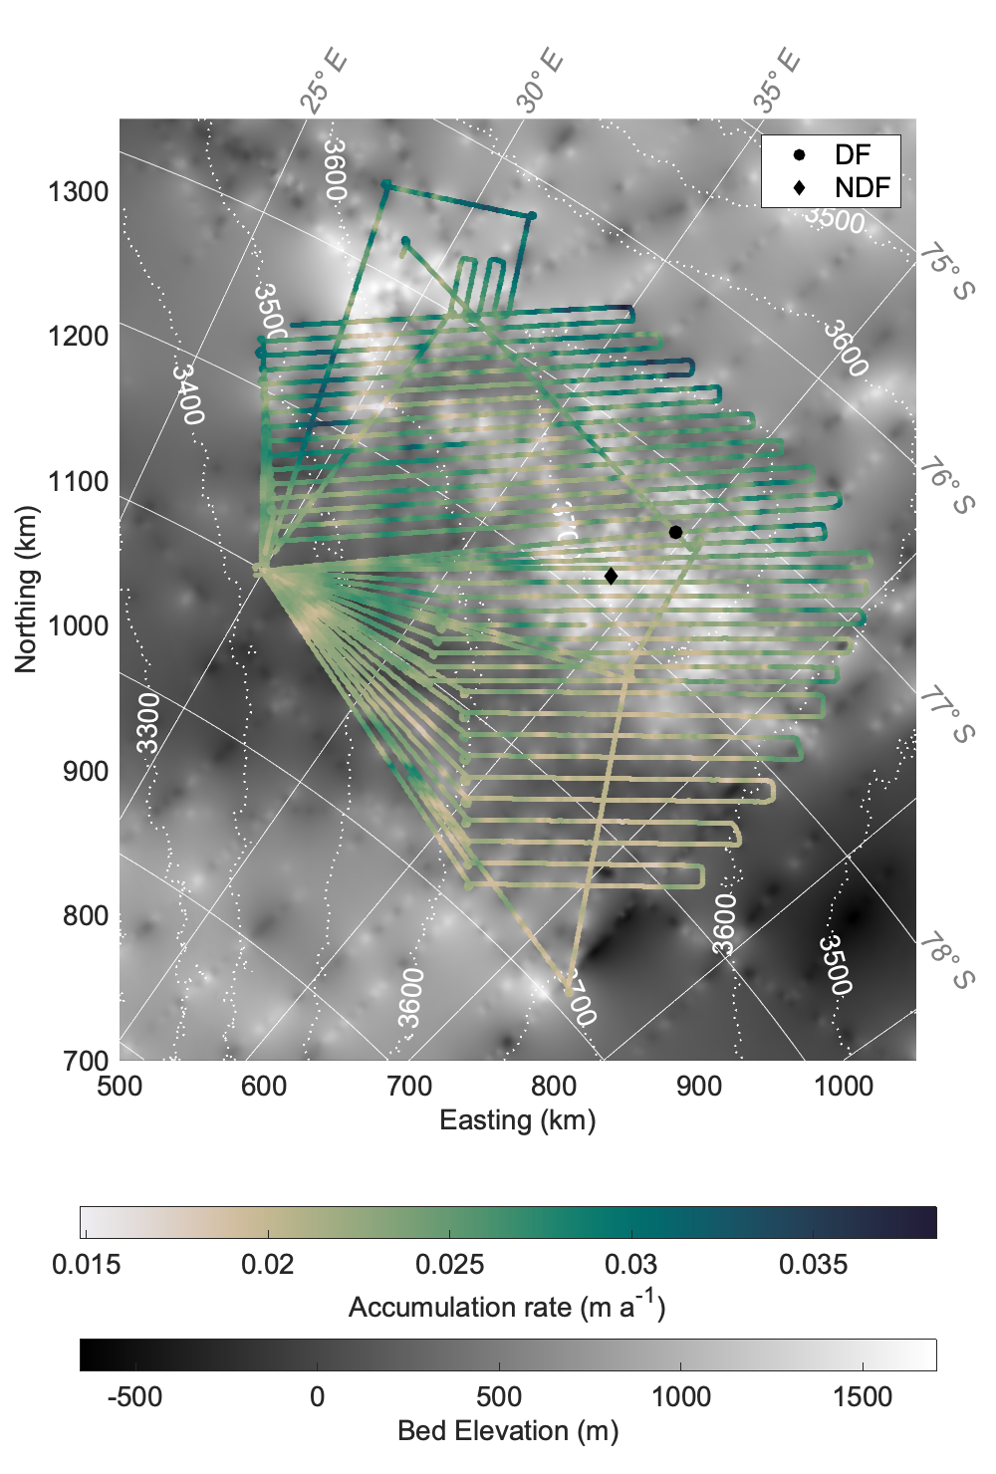
Results – Surface accumulation rate
Temporally averaged
North--south decreasing gradient
Accumulation rate at the DF drill site:
0.022 m a⁻¹
13

Slide 16
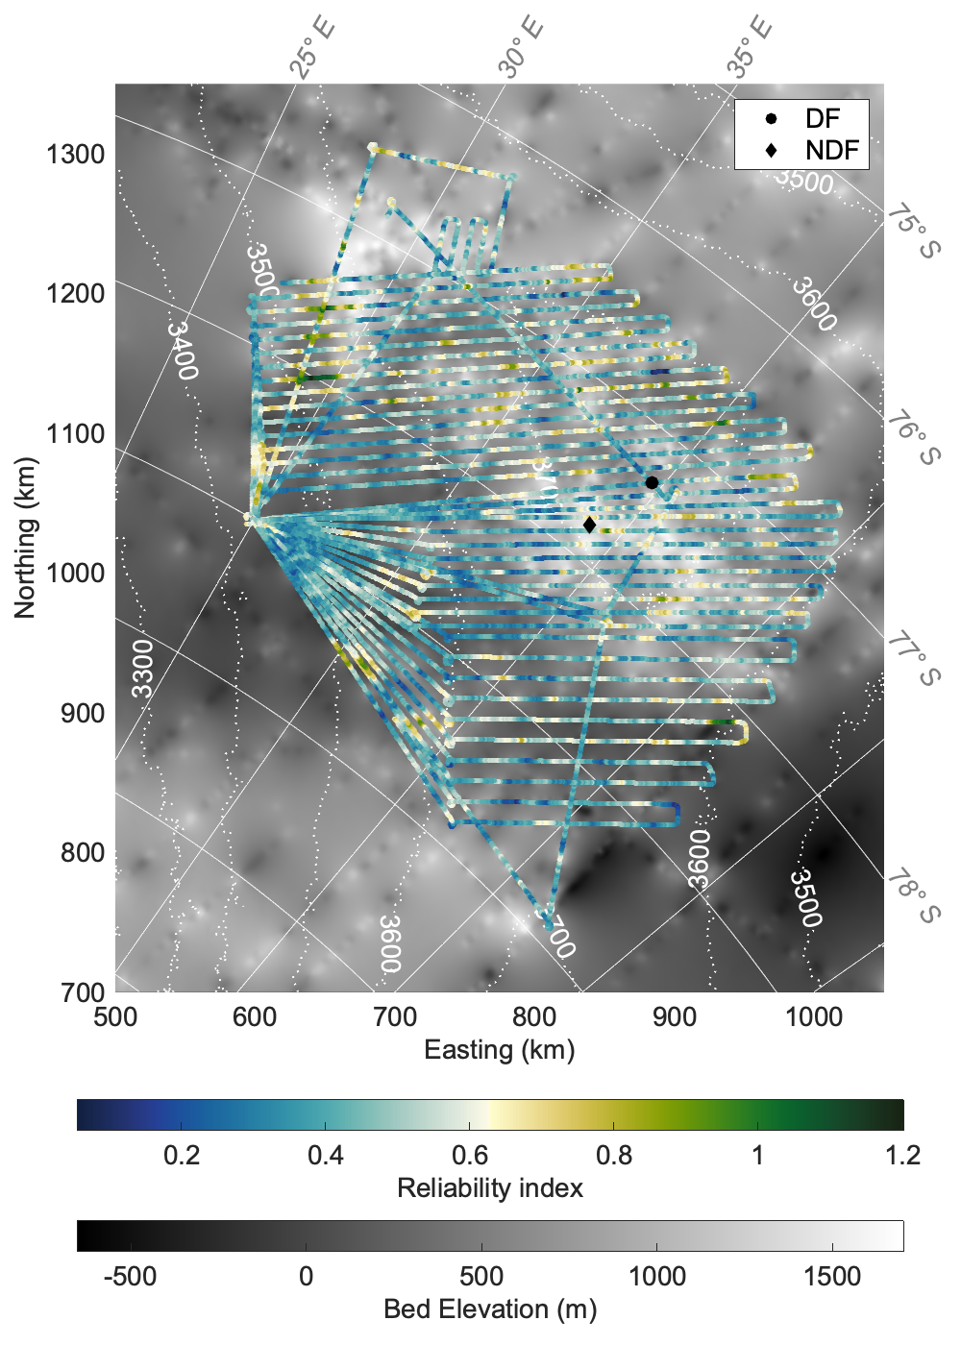
Model evaluation – Reliability
$σ_{R}$ = $\sqrt{\frac{R_{t} R}{n_{iso}}}$
$$R=\sqrt{\frac{{\overline{χ}}_{iso}−{\overline{χ}}_{mod}}{σ_{χ_{iso}}}}$$
0.1 (reliable) to 1.2 (unreliable)
High reliability (consider > 2 as unreliable)
Limitation of depth of horizons traced
14
Notes:
we can evaluate the model through the reliability index

Slide 17
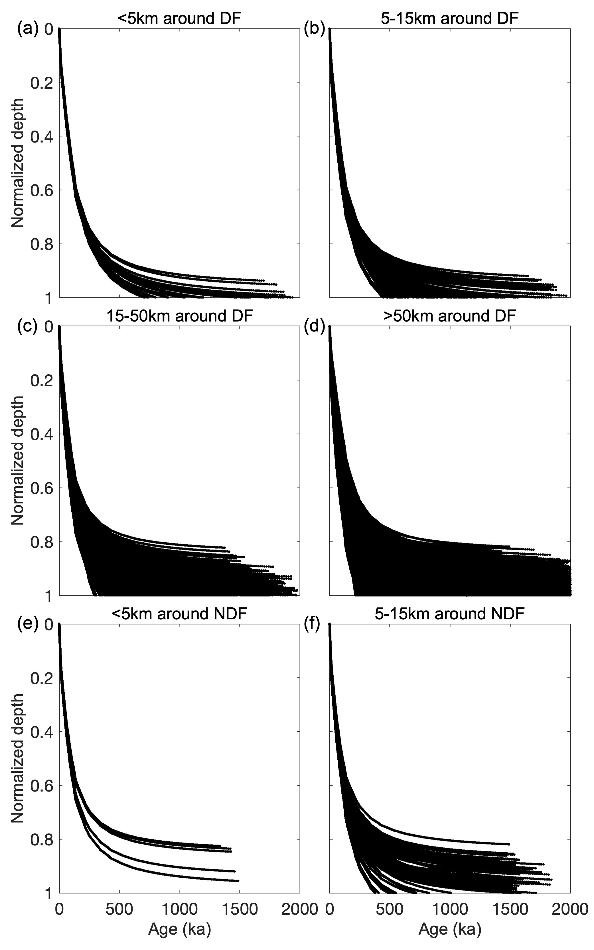
Model evaluation – Reliability
Normalization: remove the effect of ice thickness
<15 km around DF and NDF: less spreading
Dome-flow
Larger
spread
Flank-flow
15
Notes:
To involve in the reliability of the model deeper than the available isochrones, we also plot the age-nd distribution around DF and NDF

Slide 18
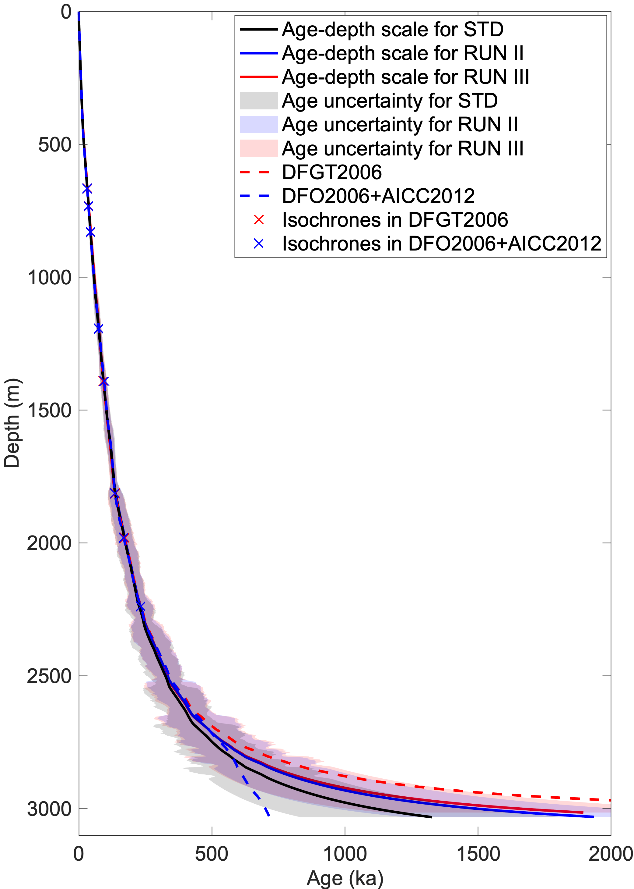
Model evaluation – Sensitivity study
 | Age of basal ice (ka)
STD | 1345.8$±$494.3
RUN II (extra IRH) | 1956.1$±$716.8
RUN III (Different timescale) | 1933.7$±$751.9
2300 m
< 2300 m, all runs fit the timescale
2300—2750 m, RUN II fits its timescale
2750 m
> 2750 m, timescale changes the trend
16
Notes:
Both age scale and isochrone have significant impact on the model results

Slide 19
Conclusions
We combine radar internal layer stratigraphy and flow modeling, to
reconstruct age of basal ice (250-2500 ka),
map basal thermal state (92% melting; 8% stagnant ice, mainly around DF),
map surface accumulation rate (0.015-0.038 m/a),
Four Old ice candidates.
in the DF region.
Evaluate the reliability and the limitation of the model results:
The isochrones as deep as possible and trustworthy timescale favor the model result
The age of the basal ice could be overestimated because of the limitation of depth of isochrones
17

