Slide 1
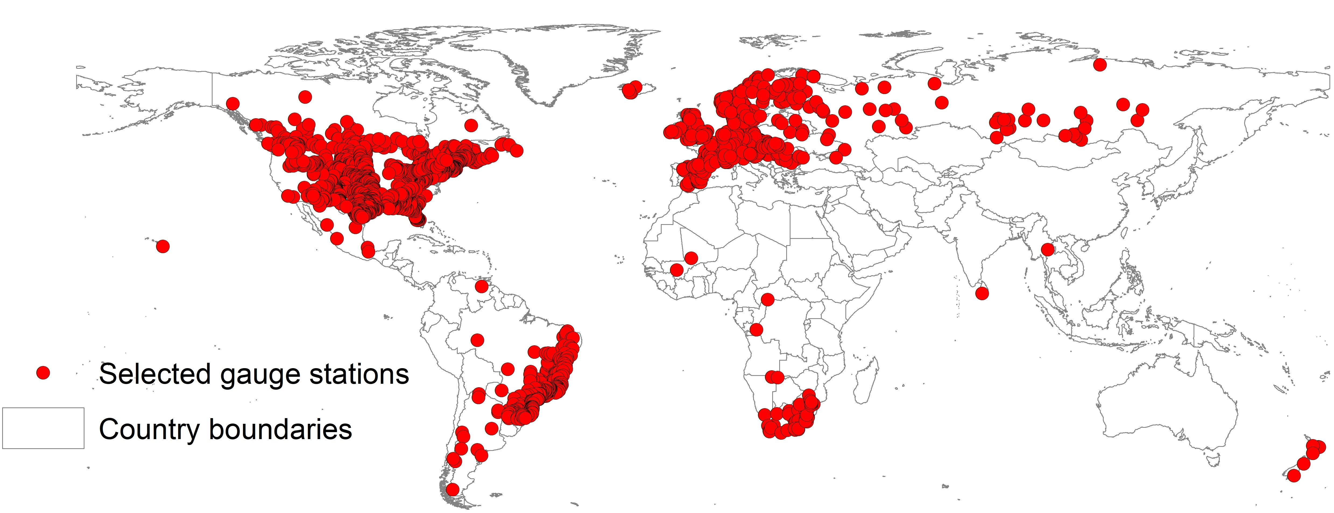
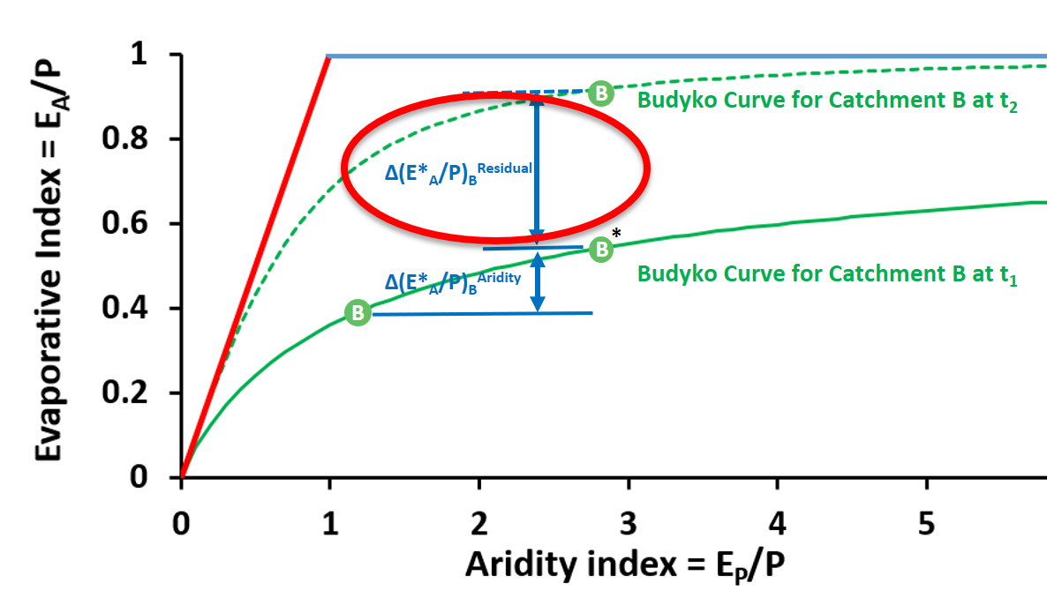

Quantification of hydro-climatic shifts of river basins in past century at global scale
Muhammad Ibrahim, Miriam Coenders-Gerrits, Ruud van der Ent, Markus Hrachowitz
Delft University of Technology, Netherlands
EGU23 | HS 2.8.1 abstract 789 | 27 April 2023
*Slide for two minutes talk only
Less runoff
2344 catchments
Warmer, drier
1901 to 2000
EGU 2023 M. Ibrahim, m.Ibrahim@tudelft.nl

Slide 2
Quantification of hydro-climatic shifts of river basins in past century at global scale
Introduction and background
Research question
Datasets and methodology
Results
Muhammad Ibrahim, Miriam Coenders-Gerrits, Ruud van der Ent, Markus Hrachowitz
Delft University of Technology, Netherlands
EGU23 | HS 2.8.1 abstract 789 | 27 April 2023
Conclusions
EGU 2023 M. Ibrahim, m.Ibrahim@tudelft.nl

Slide 3
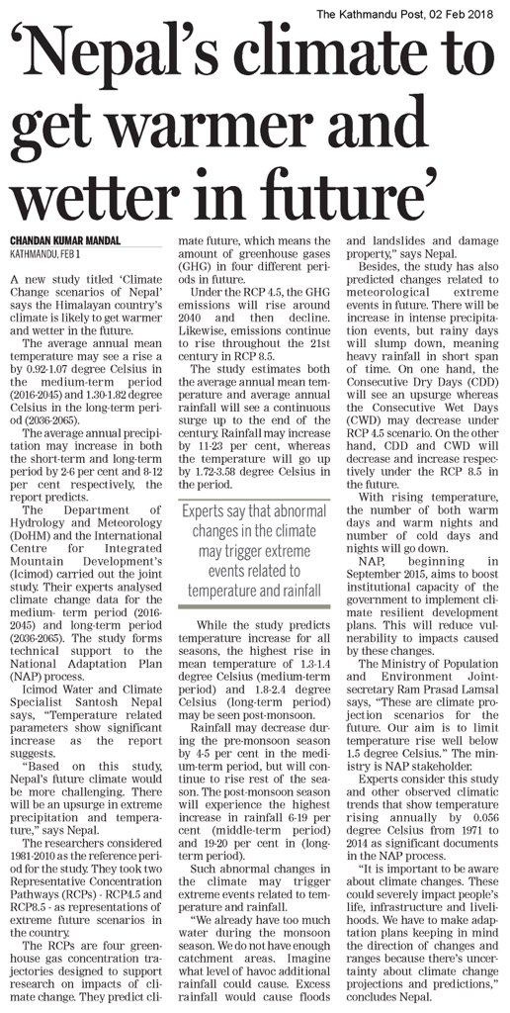
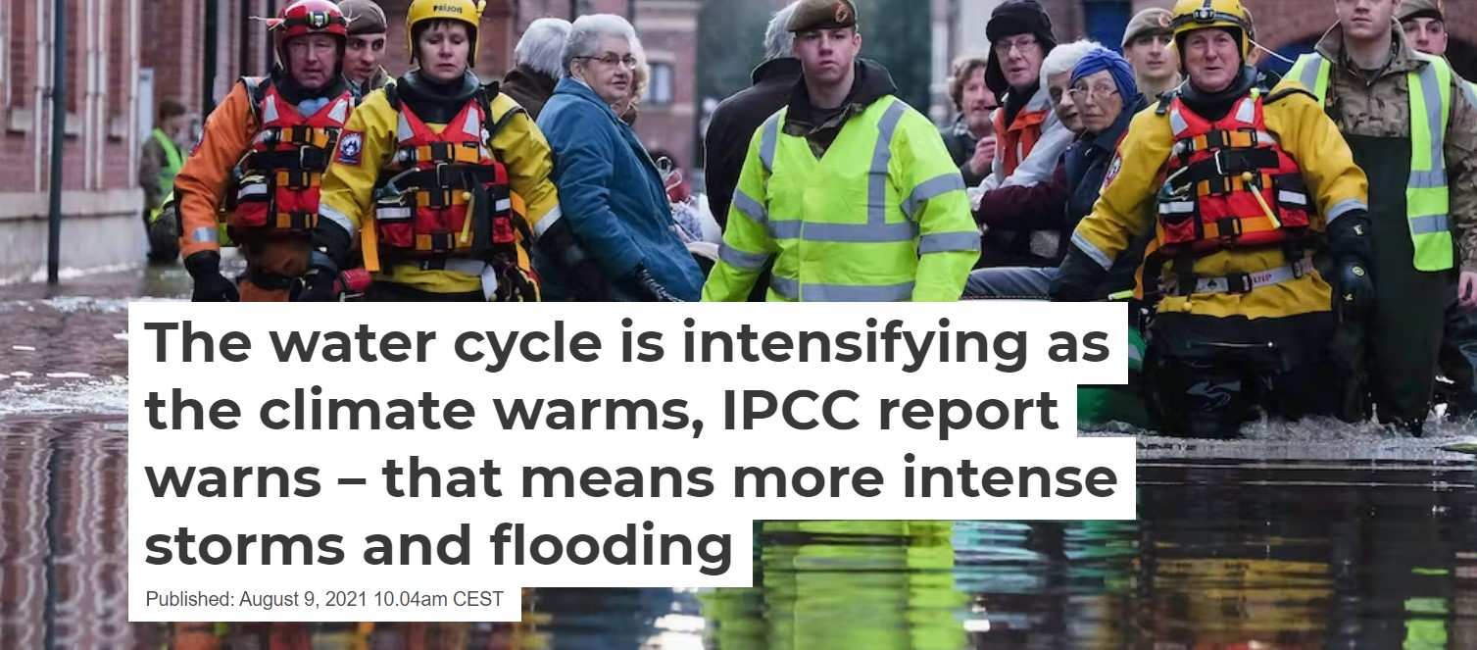
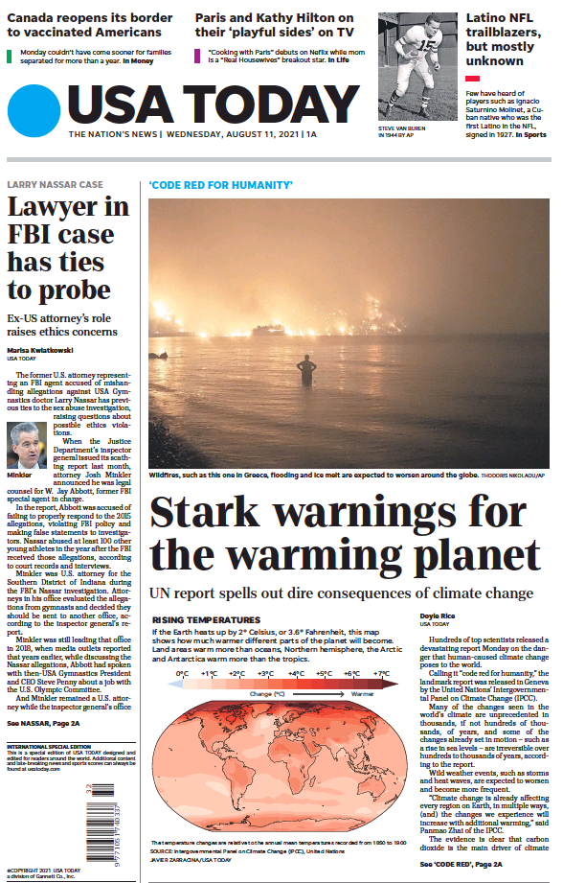

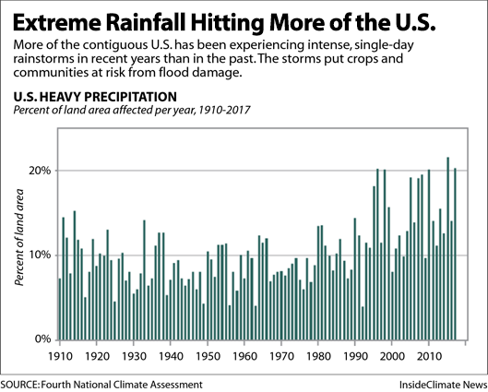
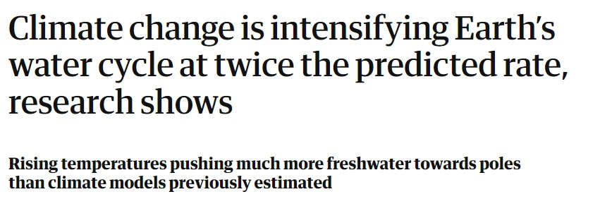
Introduction and background
Introduction and background (1/2)
Direct impacts of climate change
Research question
Datasets and methodology
Results
Conclusions

Slide 4
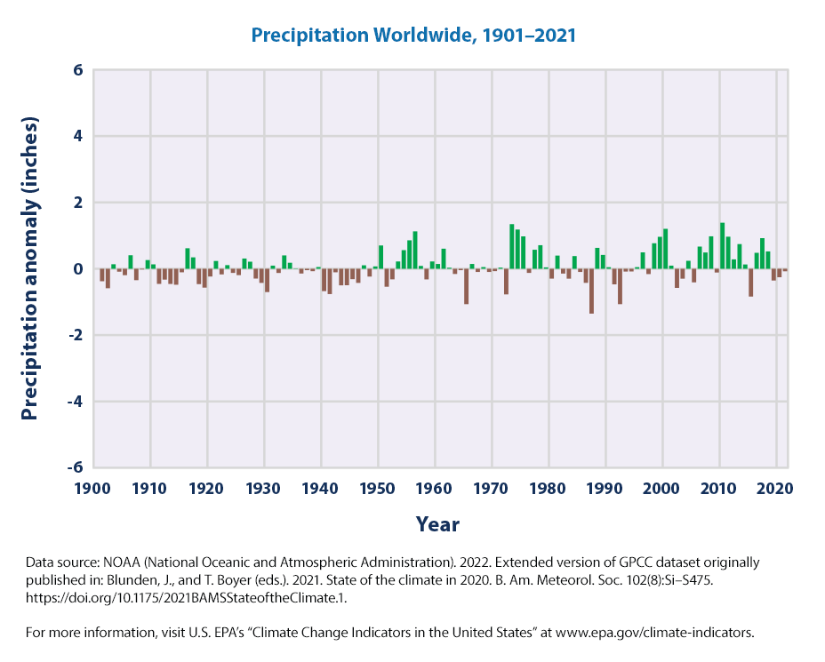
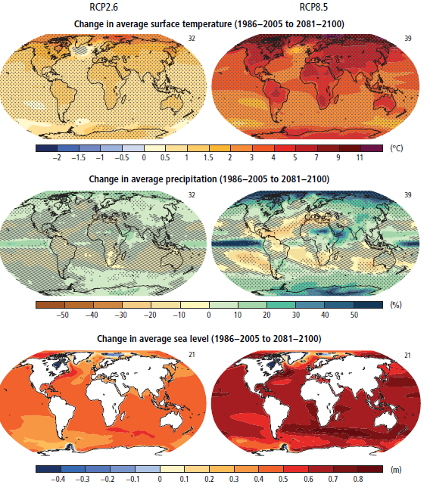
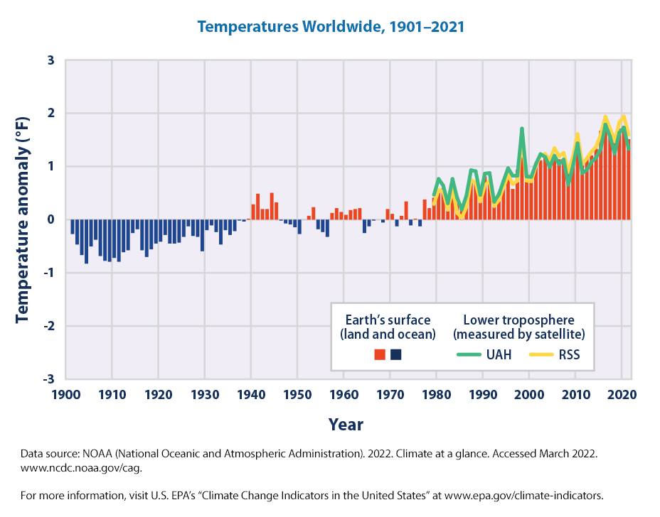
Introduction and background
Introduction and background (2/2)
Direct impacts of climate change
Research question
Datasets and methodology
These are some direct impacts.
What are the in-direct impacts? i.e., Natural feedbacks?
Results
Conclusions
Source: IPCC, 2014

Slide 5
Introduction and background
Research question
How did the partitioning of precipitation into evaporation and runoff change over the past century in catchments worldwide?
Does the Budyko assumption hold for changes in aridity index over the past century in catchments worldwide?
  More specifically, what are the vertical deviations from the parametric Budyko curve considering changes in aridity index
Research question
Datasets and methodology
Results
Conclusions
2344 catchments

Slide 6
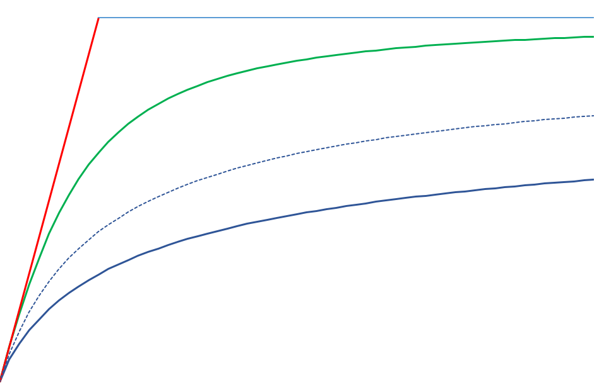
Introduction and background
Datasets and methodology (1/2)
E_{A}/P
Research question
1
Budyko Curve for Catchment A at t₁ and at t₂
ω_{A(t1,t2)}
A
Datasets and methodology
Δ(E_{A}/P)_{A} = Δ(E*_{A}/P)_{A}^{Aridity}
A
Budyko Curve for Catchment B at t₂
ω_{B(t2)}
B
Δ(E*_{A}/P)_{B}^{Residual}
Budyko Curve for Catchment B at t₁
ω_{B(t1)}
Results
*
Δ(E_{A}/P)_{B}
B
Δ(E*_{A}/P)_{B}^{Aridity}
Conclusions
B
Less runoff
E_{P}/P
0
1
t₁
Δ(E_{P}/P)_{A}
, _{B}
t₂
Warmer, drier

Slide 7
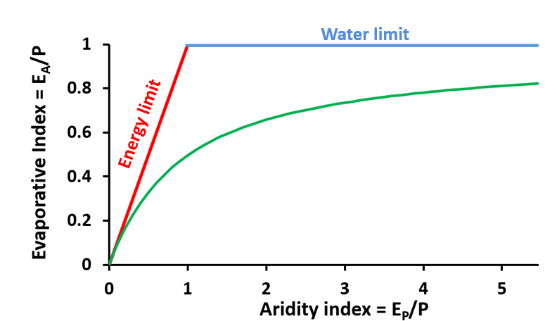
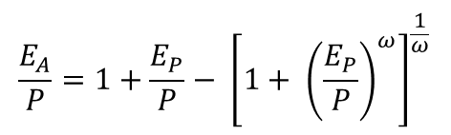
Introduction and background
Datasets and methodology (2/2)
GSIM (GSIM (Global Streamflow Indices and Metadata Archive, 30959 catchments)
  2344 Catchments (1901-2000)
Research question
Datasets and methodology
Precipitation (GSWP-3, 1901-2000, 0.5^{O} X 0.5^{O})
Temperature (GSWP-3, 1901-2000, 0.5^{O} X 0.5^{O})
Actual evaporation
Potential evaporation (Hargreaves and Samani, 1982)
Results
1901-1920 | V₁
1921-1940 | V₂
1941-1960 | V₃
1961-1980 | V₄
1981-2000 | V₅
Conclusions
$$\frac{E_{A}}{P}=1+\frac{E_{P}}{P}− {\left[{1+ \left(\frac{E_{P}}{P}\right)}^{ω}\right]}^{\frac{1}{ω}}$$
Fu, 1981

Slide 8
Introduction and background
Results (1/8)
Changes in hydro-climatic variables in the past century
Research question
Datasets and methodology
Results
Conclusions
V₁= 1901→1920, V₂= 1921→1940, V₃= 1941→1960, V₄= 1961→1980, V₅= 1981→2000
Note: Outliers are removed for visualization purpose

Slide 9
Introduction and background
Results (2/8)
Catchments movement in the Budyko space
Research question
Datasets and methodology
Results
Conclusions

Slide 10
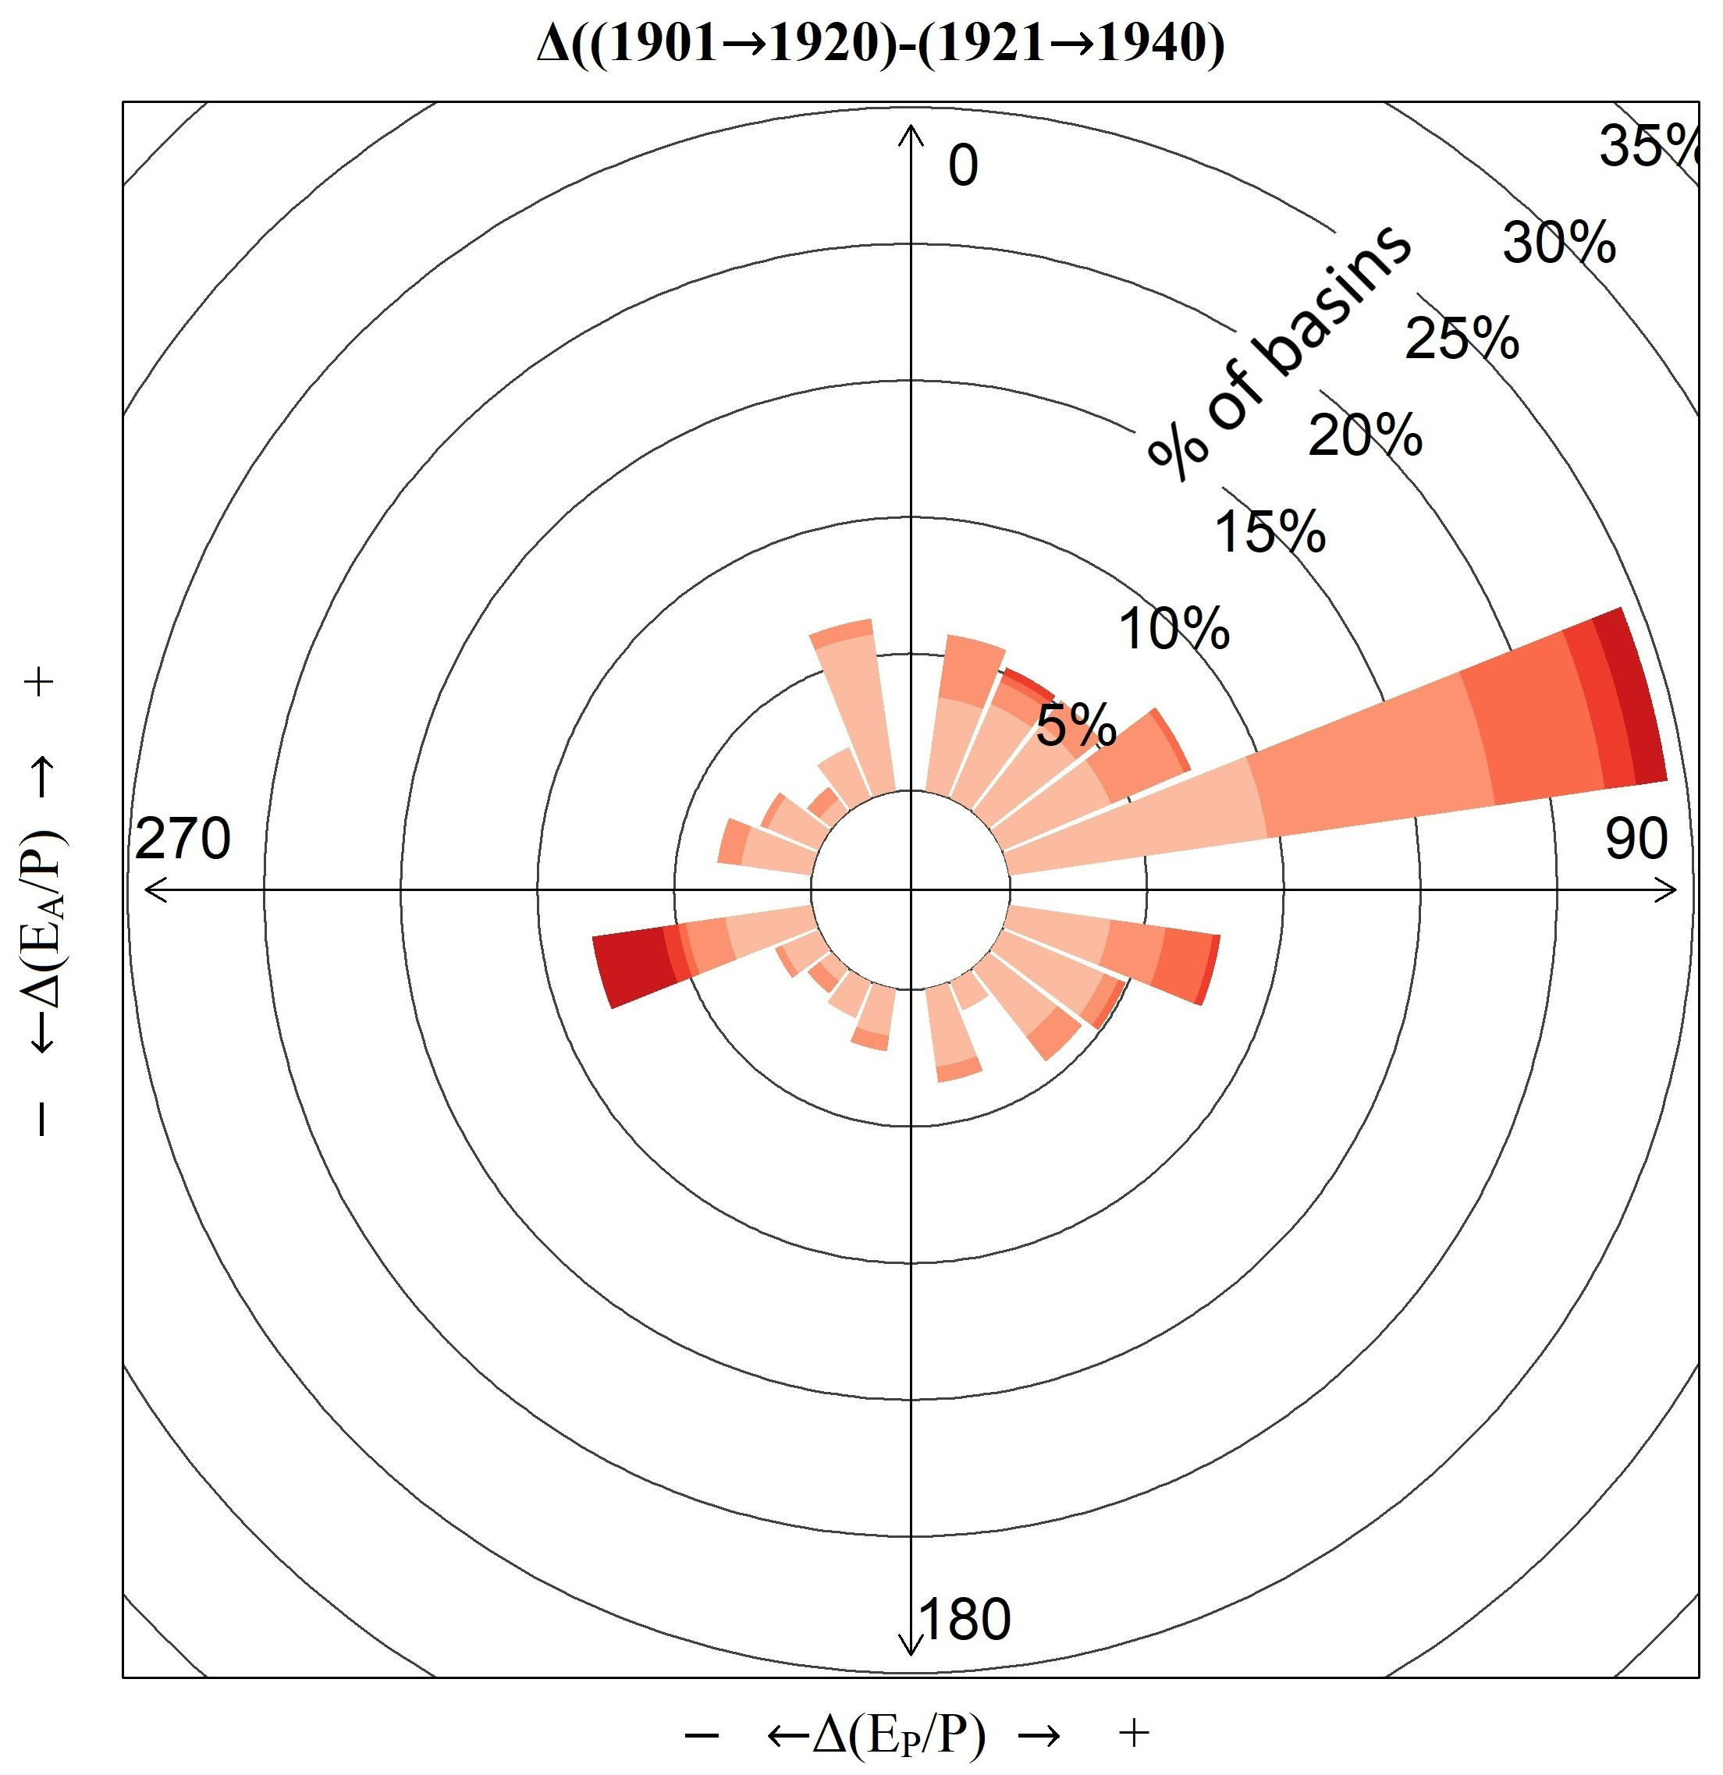
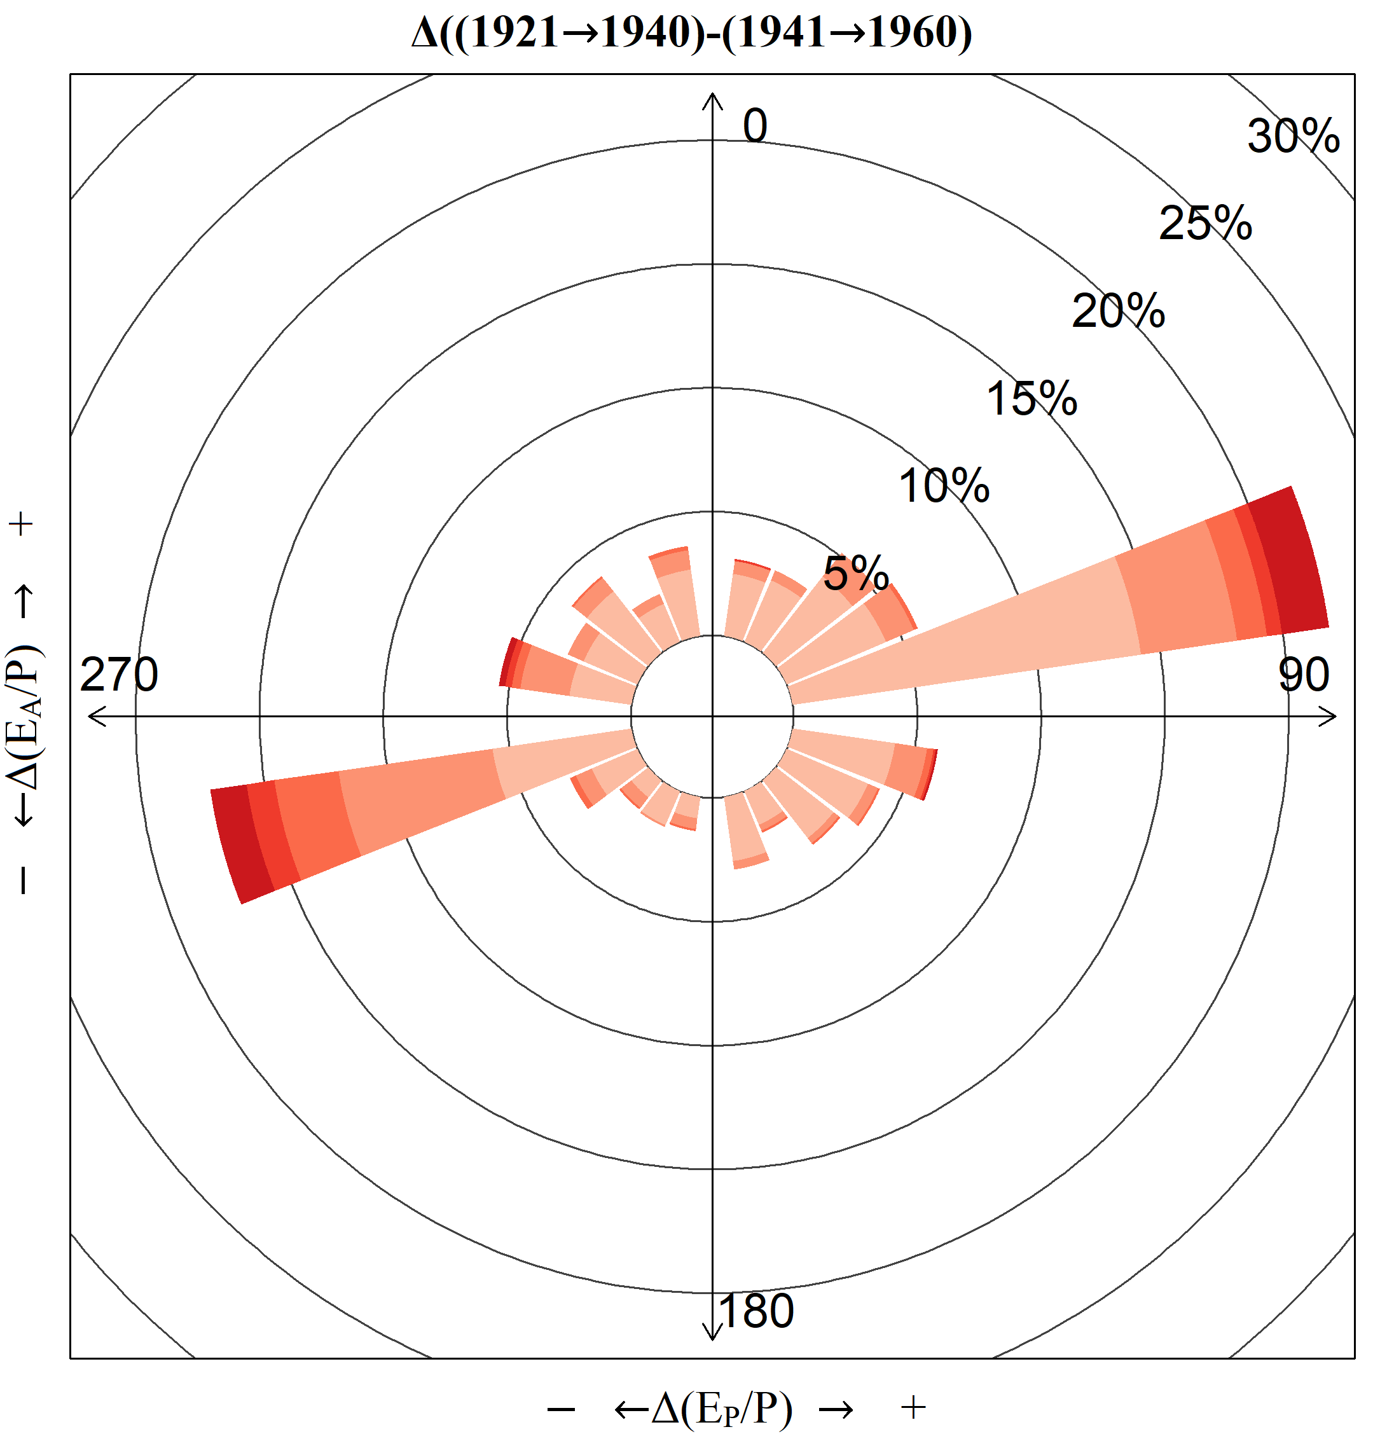
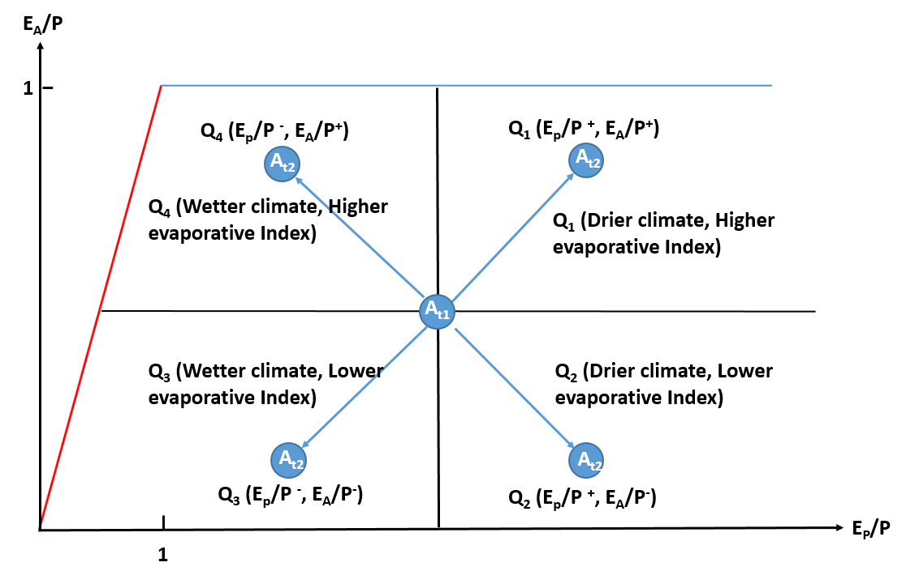
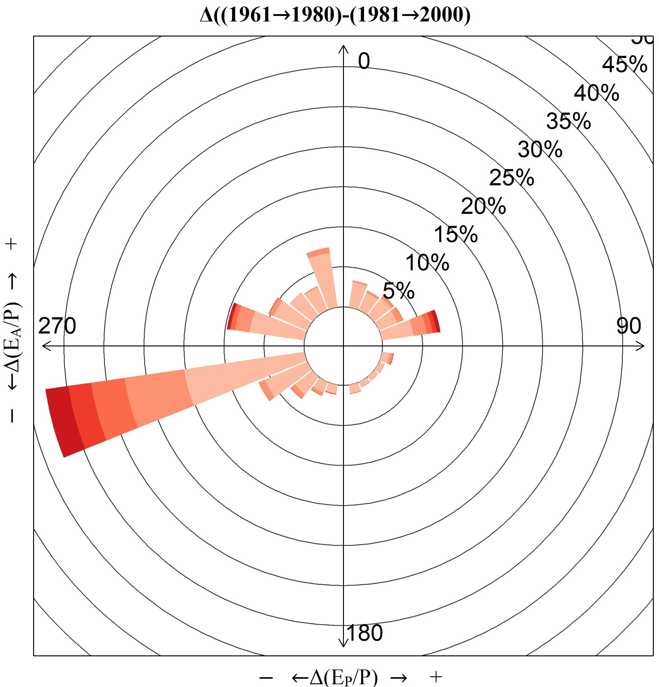
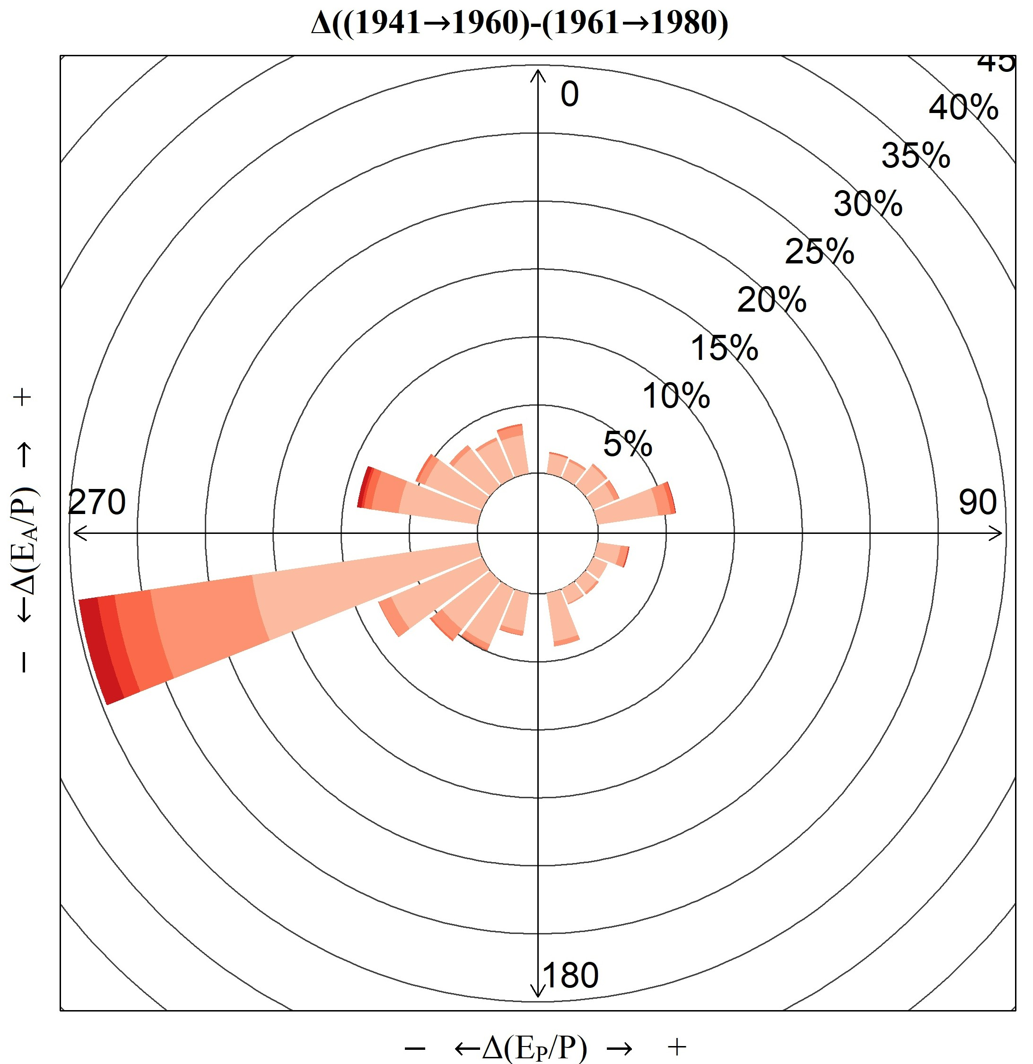
Introduction and background
Results (3/8)
Roses of movement of catchments in the Budyko space
Research question
Datasets and methodology
Results
Time periods | Q₁ | Q₂ | Q₃ | Q₄
Δ((1901→1920) –(1921→1940)) | 47% | 23% | 15% | 15%
Δ((1921→1940) –(1941→1960)) | 39% | 19% | 24% | 18%
Δ((1941→1960) –(1961→1980)) | 13% | 10% | 51% | 26%
Δ((1961→1980) –(1981→2000)) | 20% | 5% | 44% | 31%
Conclusions

Slide 11
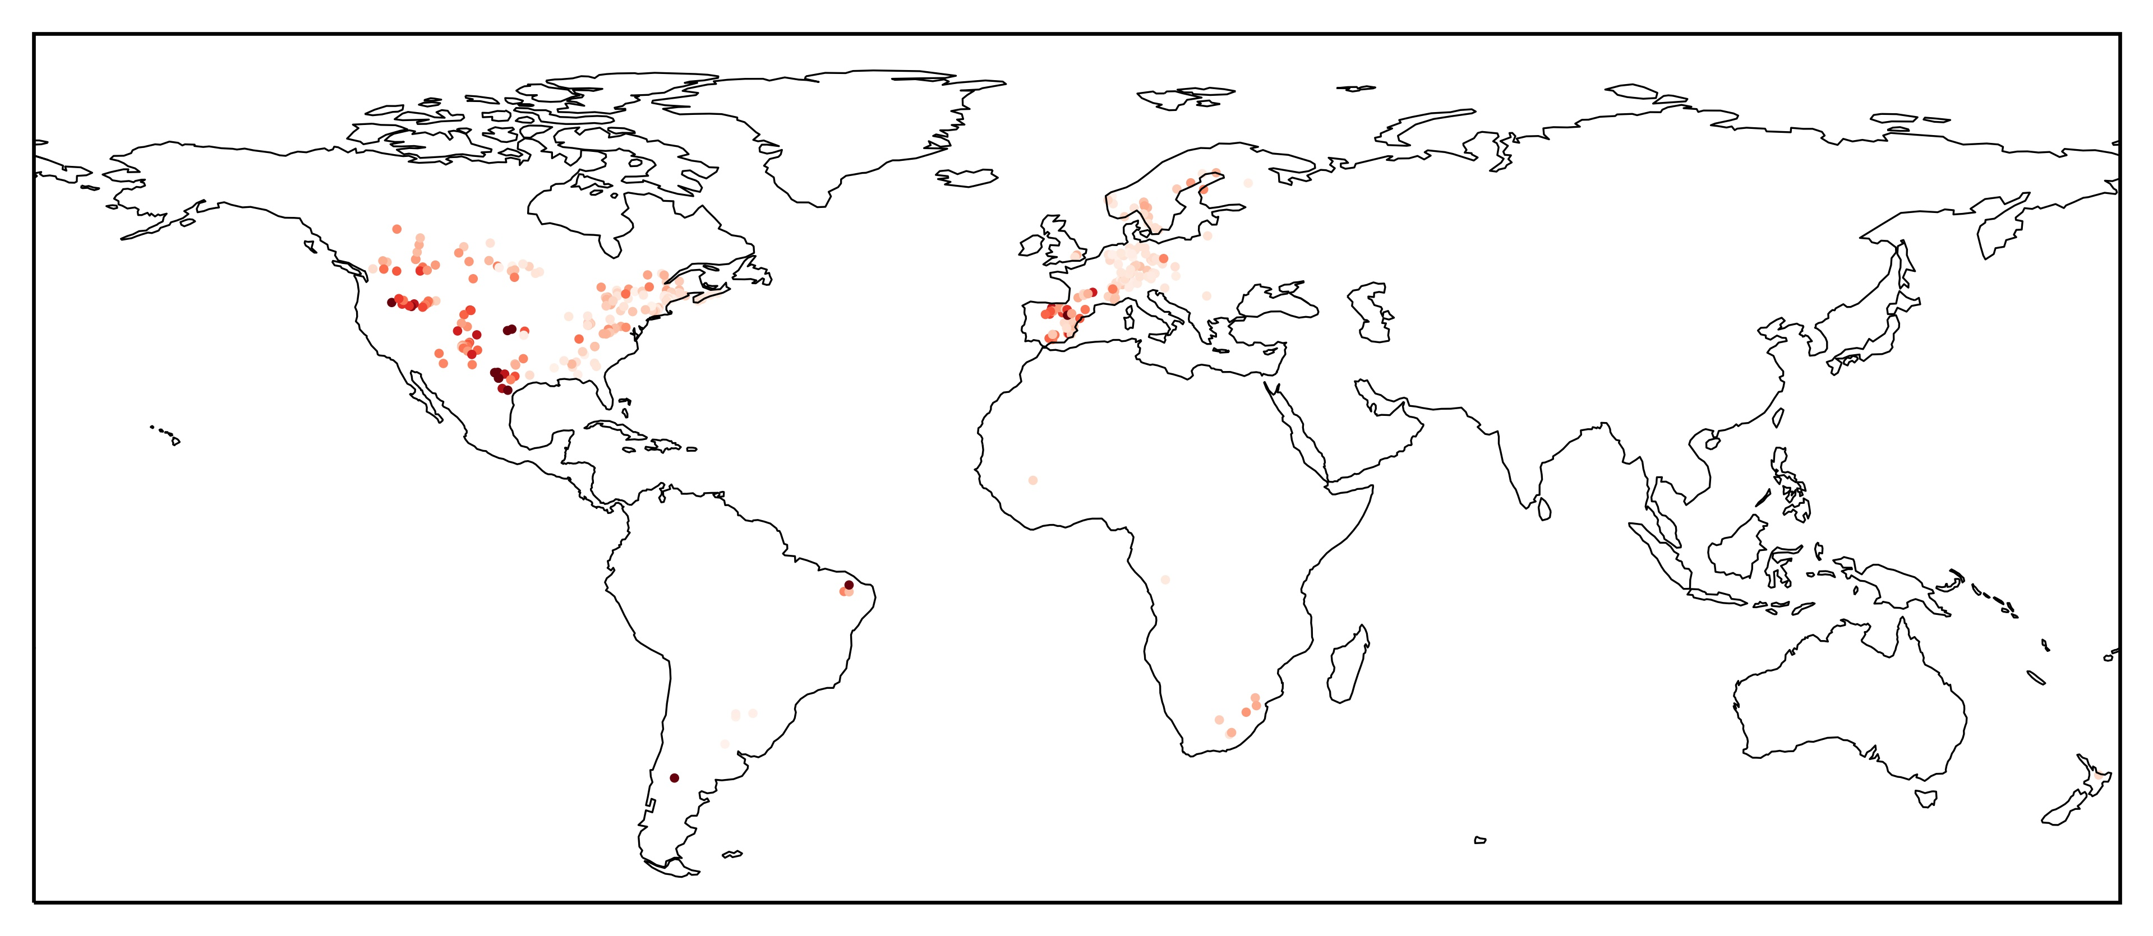
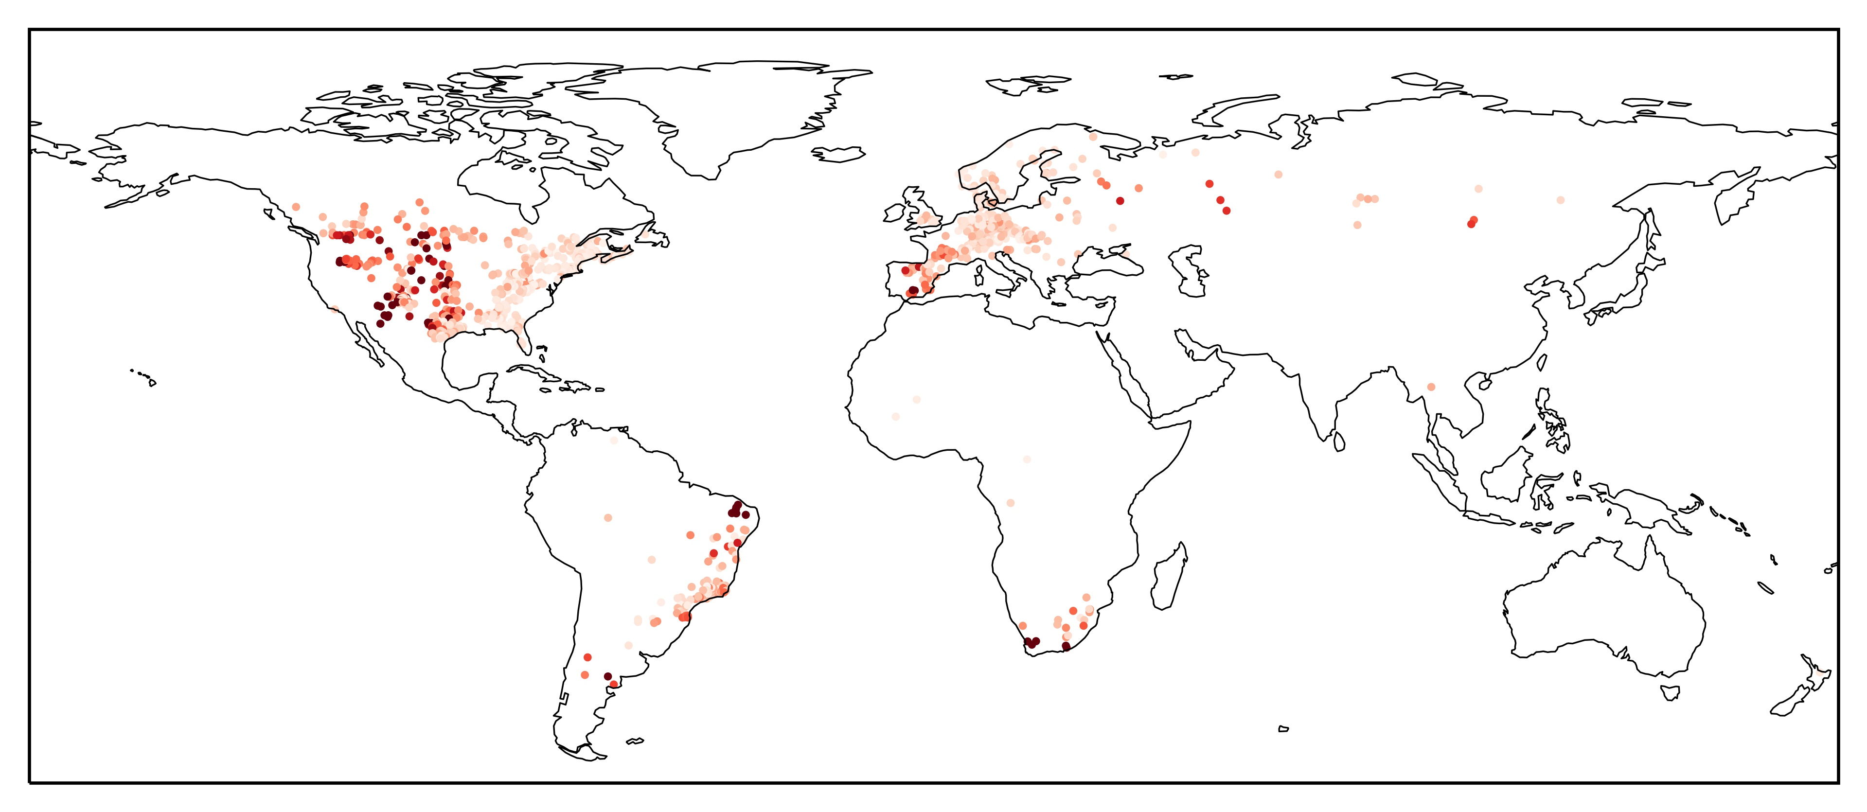
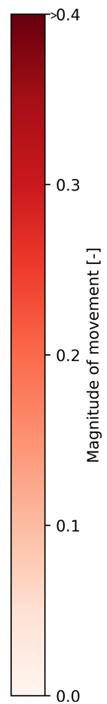
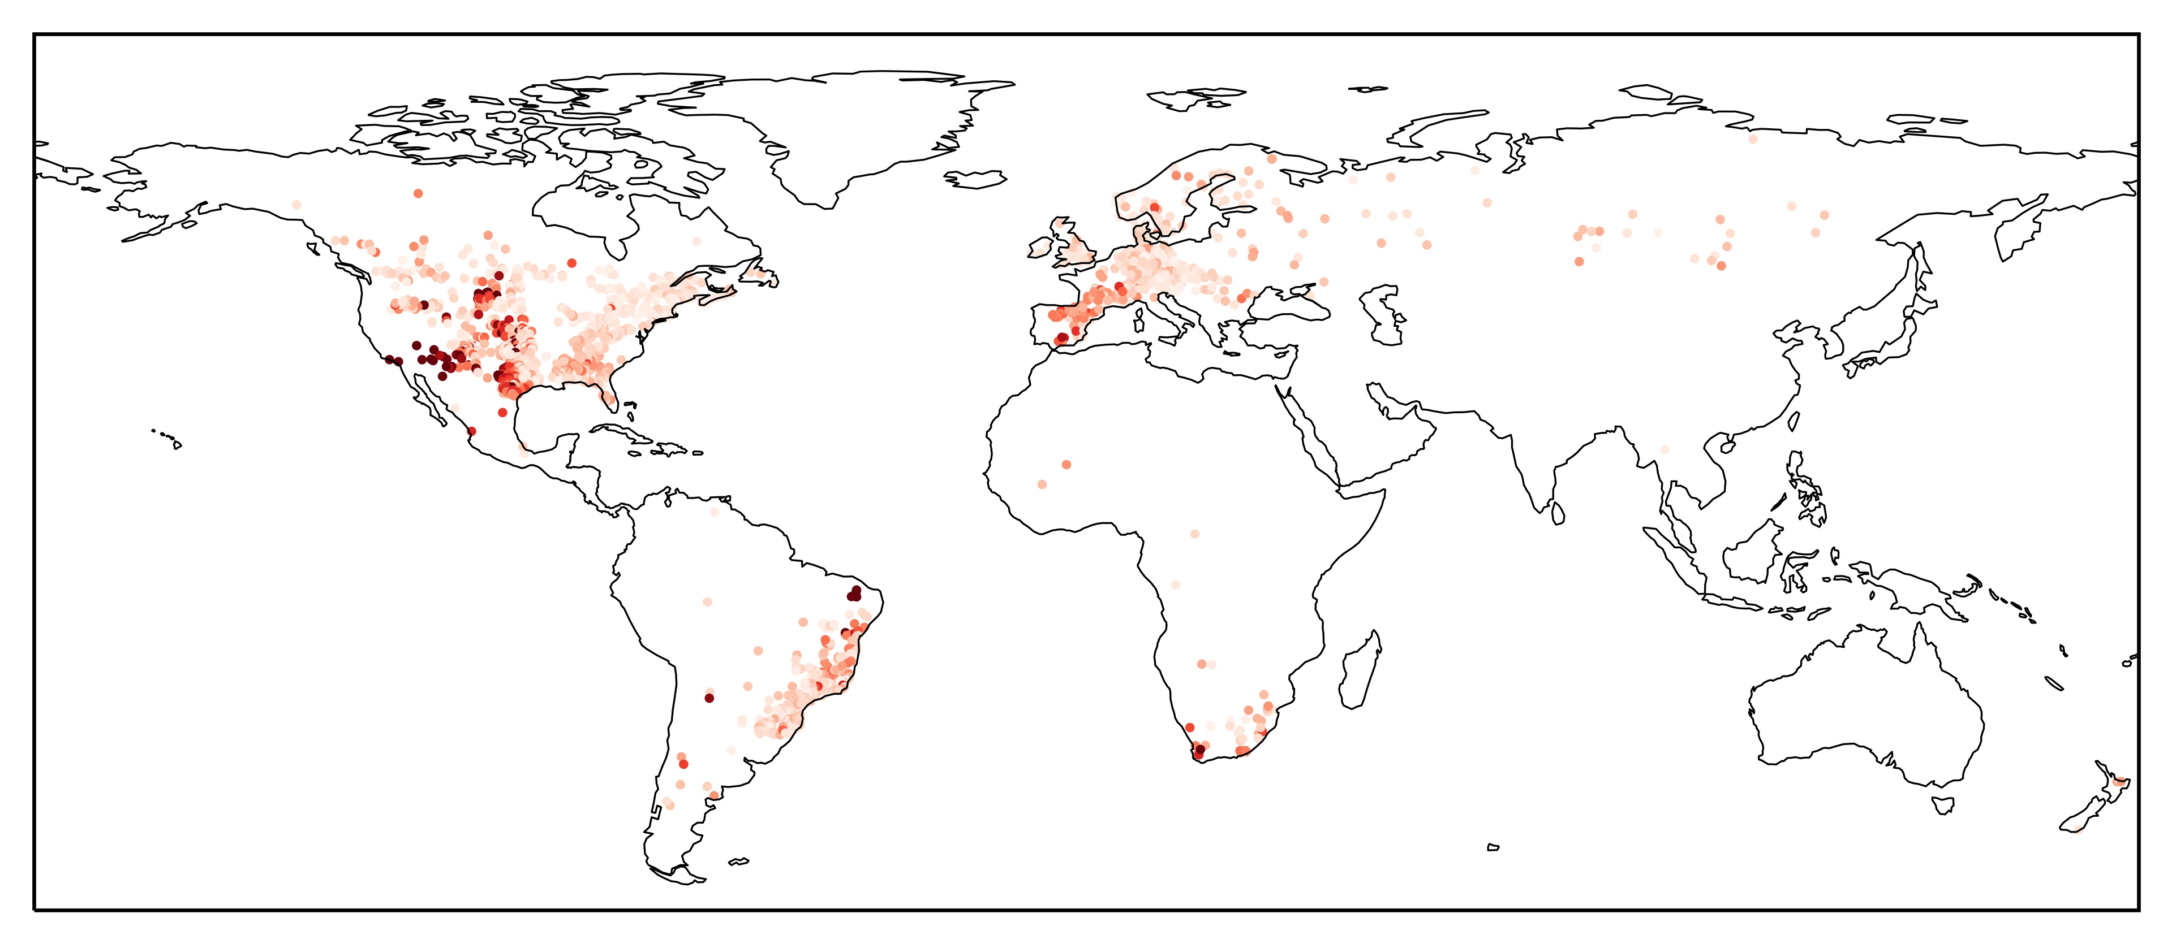
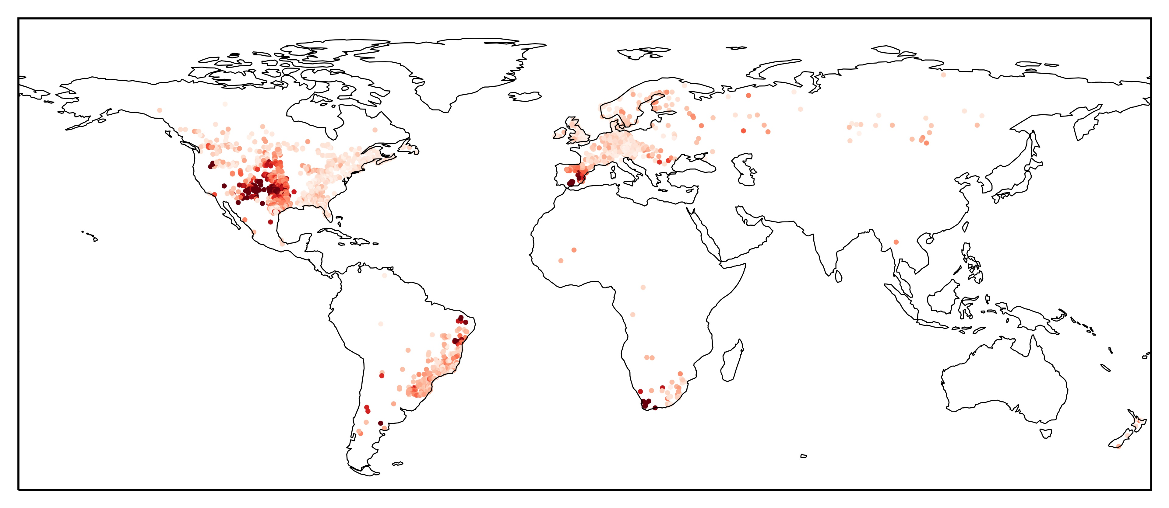
Introduction and background
Results (4/8)
Magnitude of movement of catchments in the Budyko space
Research question
Δ((1901→1920) –(1921→1940))
Δ((1921→1940) –(1941→1960))
Datasets and methodology
Results
Δ((1941→1960) –(1961→1980))
Δ((1961→1980) –(1981→2000))
Conclusions

Slide 12
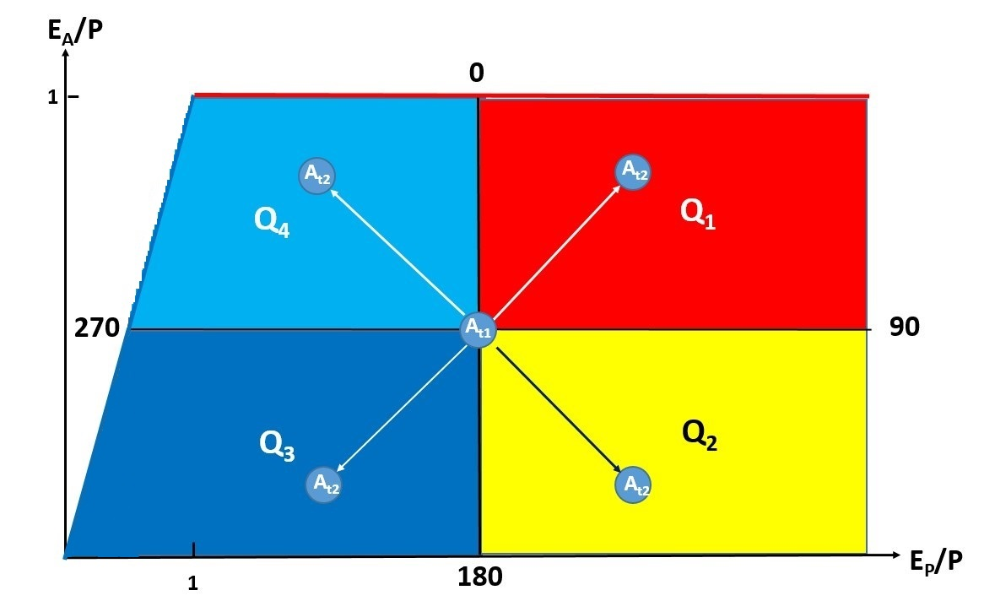
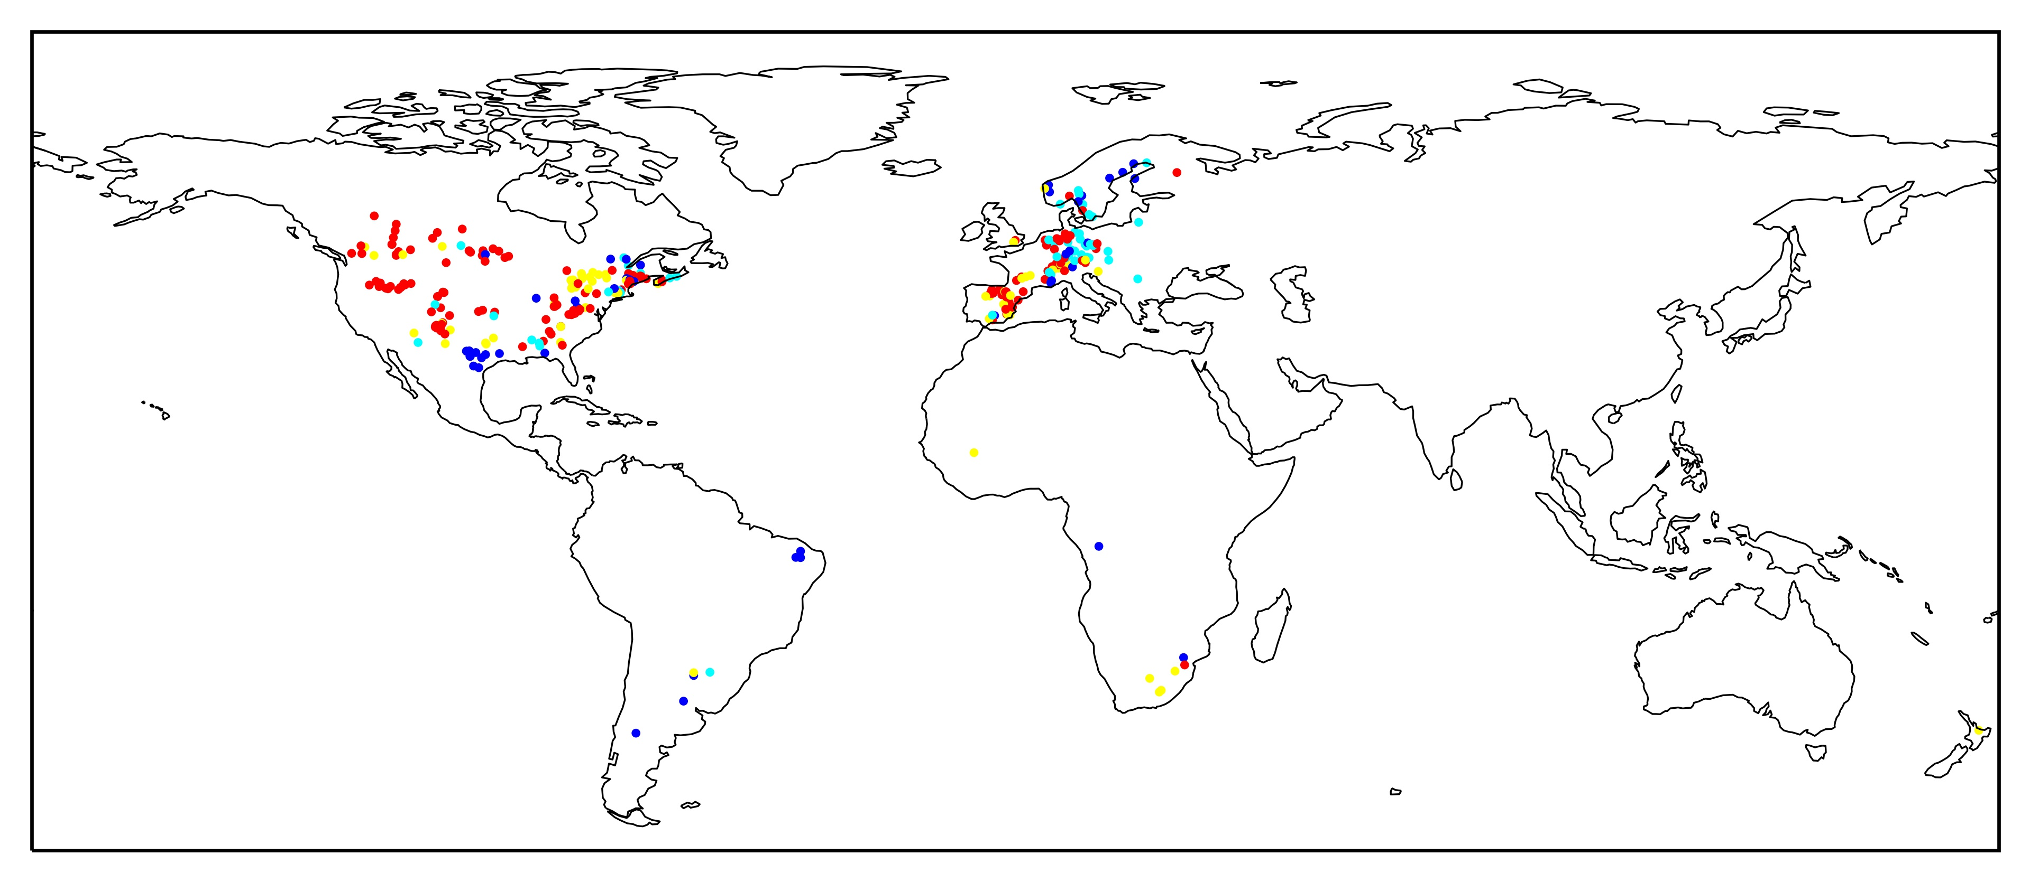
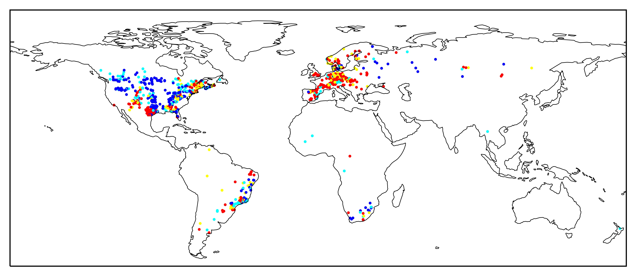
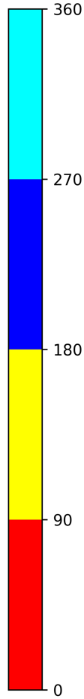
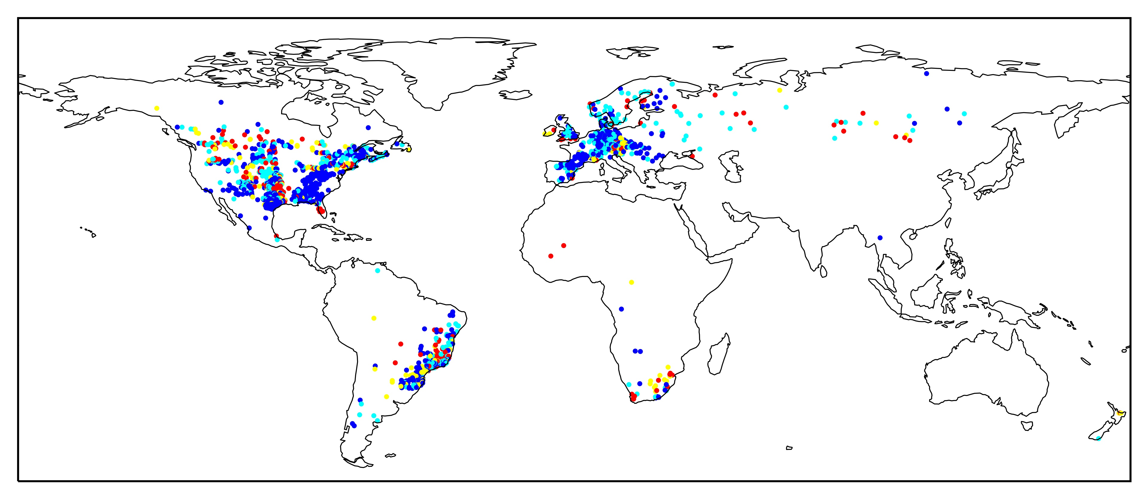
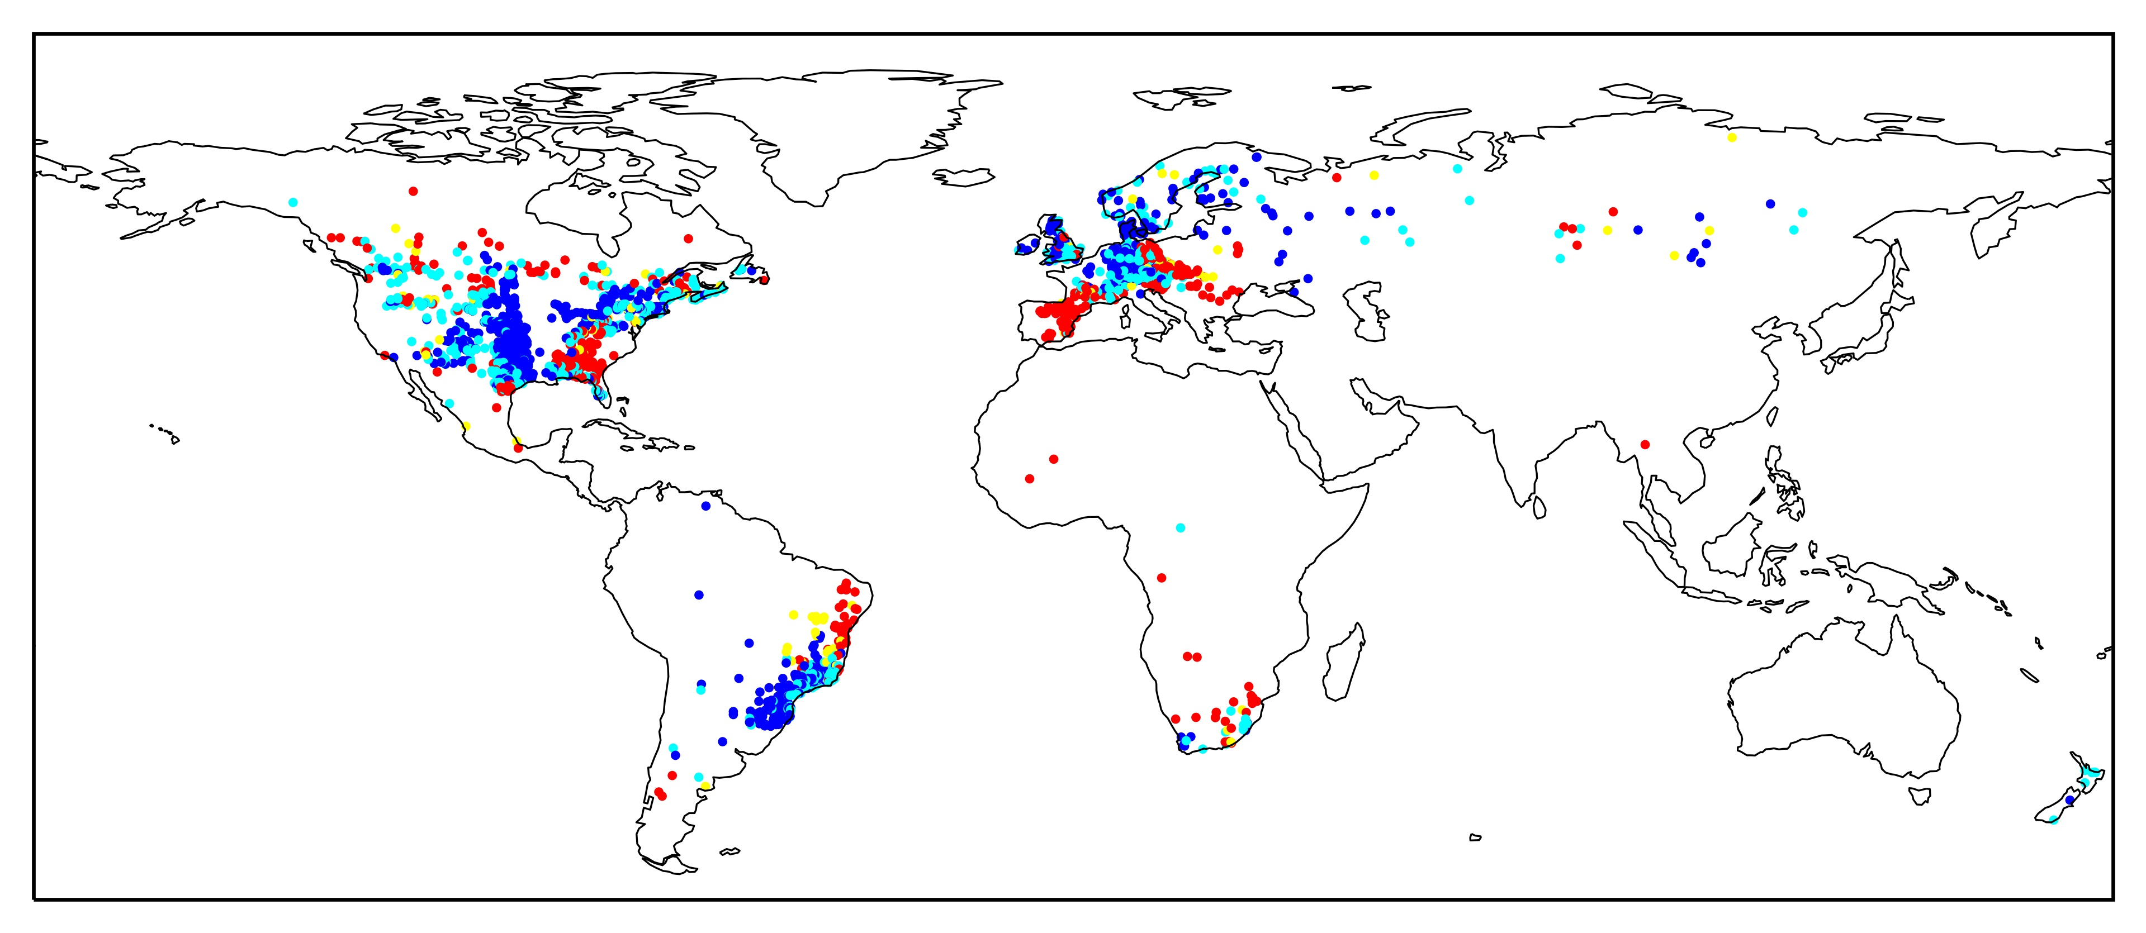
Introduction and background
Results (5/8)
Direction of movement of catchments in the Budyko space
Research question
Δ((1901→1920) –(1921→1940))
Δ((1921→1940) –(1941→1960))
Datasets and methodology
Results
Δ((1941→1960) –(1961→1980))
Δ((1961→1980) –(1981→2000))
Conclusions

Slide 13
Introduction and background
Results (6/8)
Histogram of residual changes
Research question
Datasets and methodology
Results
Conclusions

Slide 14
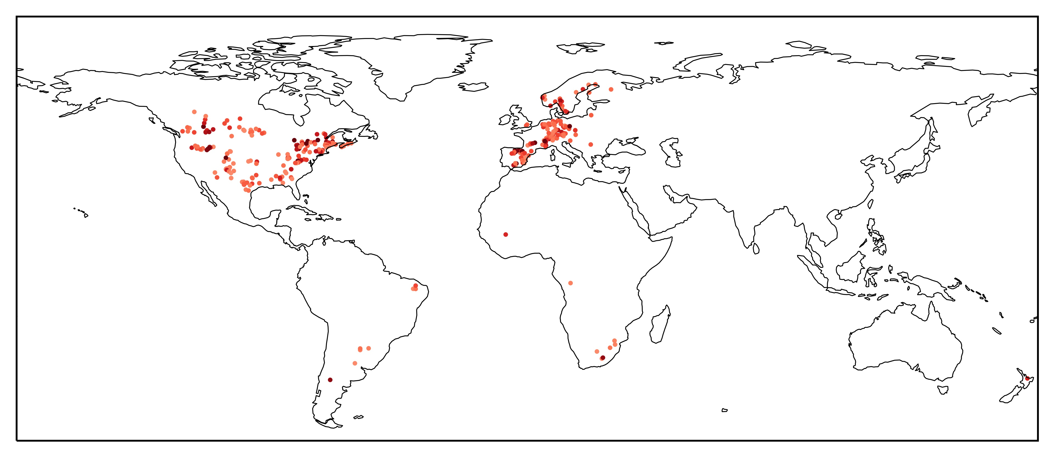
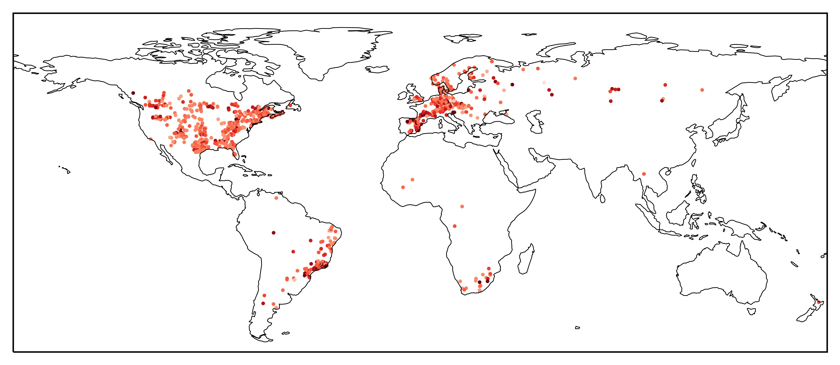
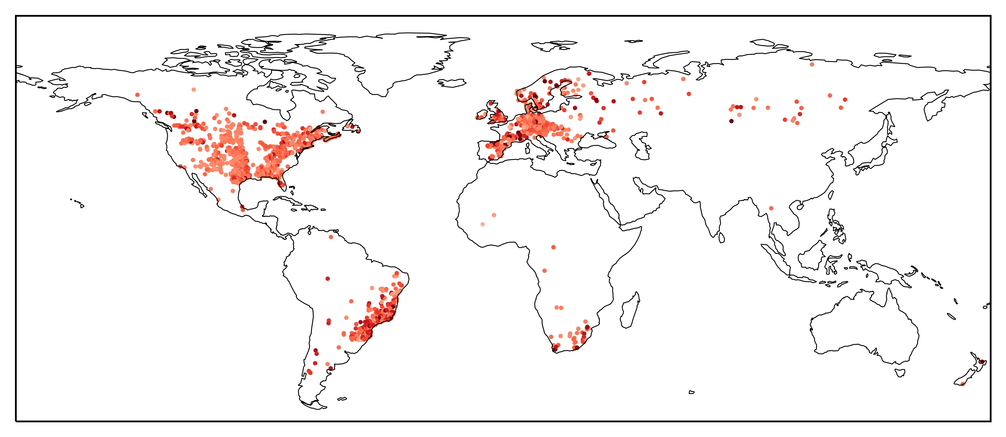

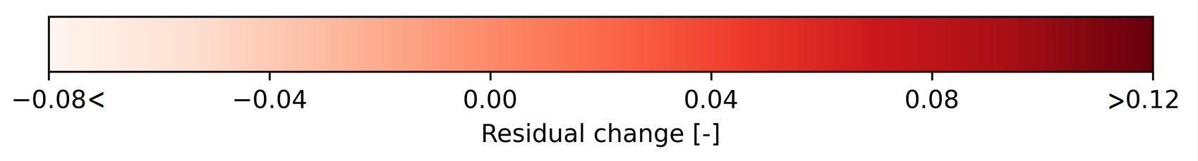
Introduction and background
Results (7/8)
Residual changes of catchments in the Budyko space
Research question
Δ((1901→1920) –(1921→1940))
Δ((1921→1940) –(1941→1960))
Datasets and methodology
Results
Δ((1941→1960) –(1961→1980))
Δ((1961→1980) –(1981→2000))
Conclusions

Slide 15

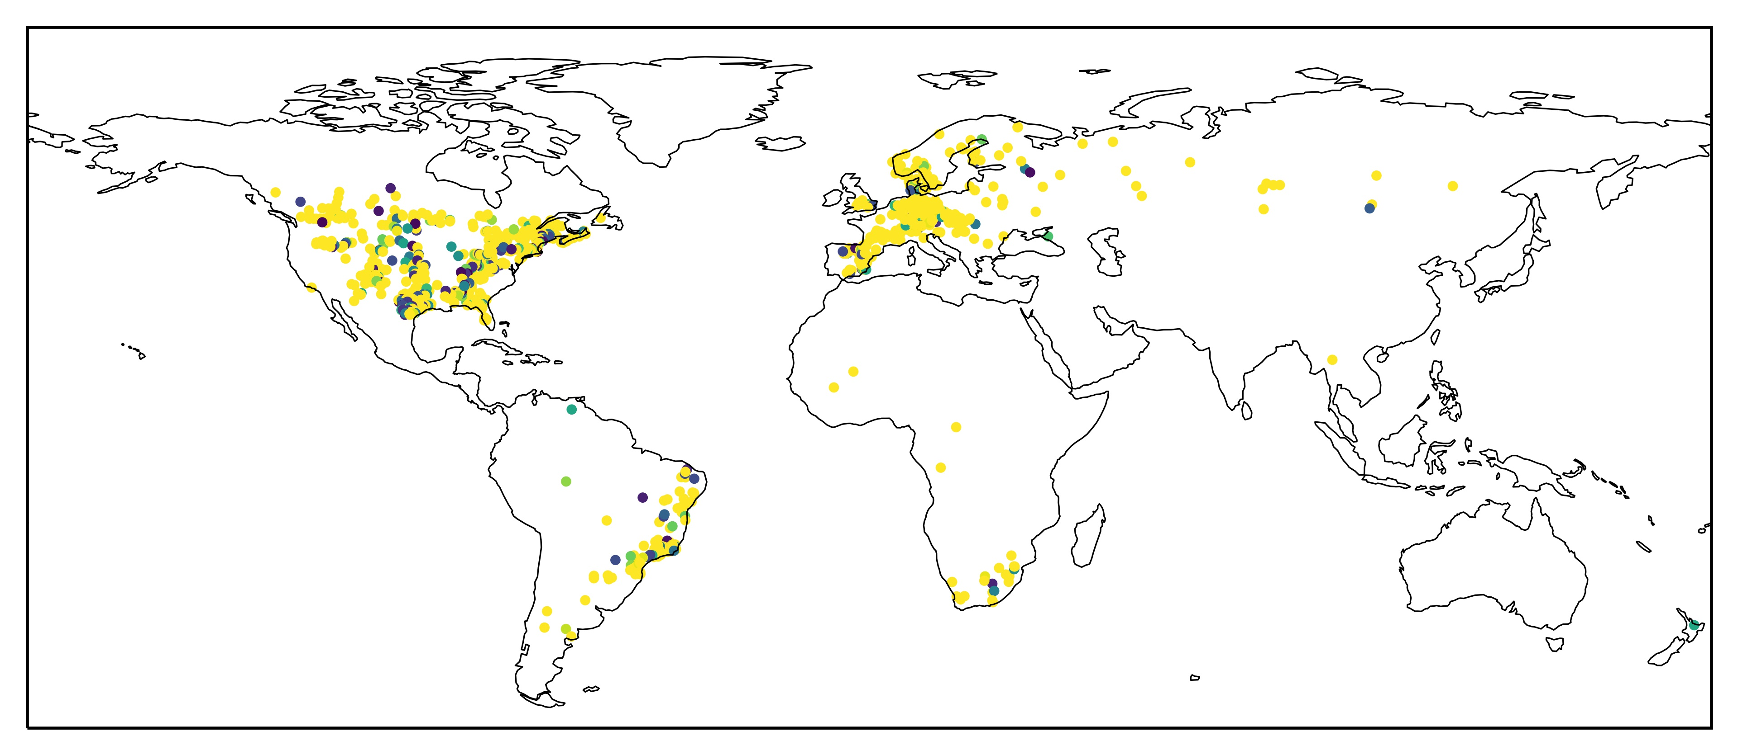
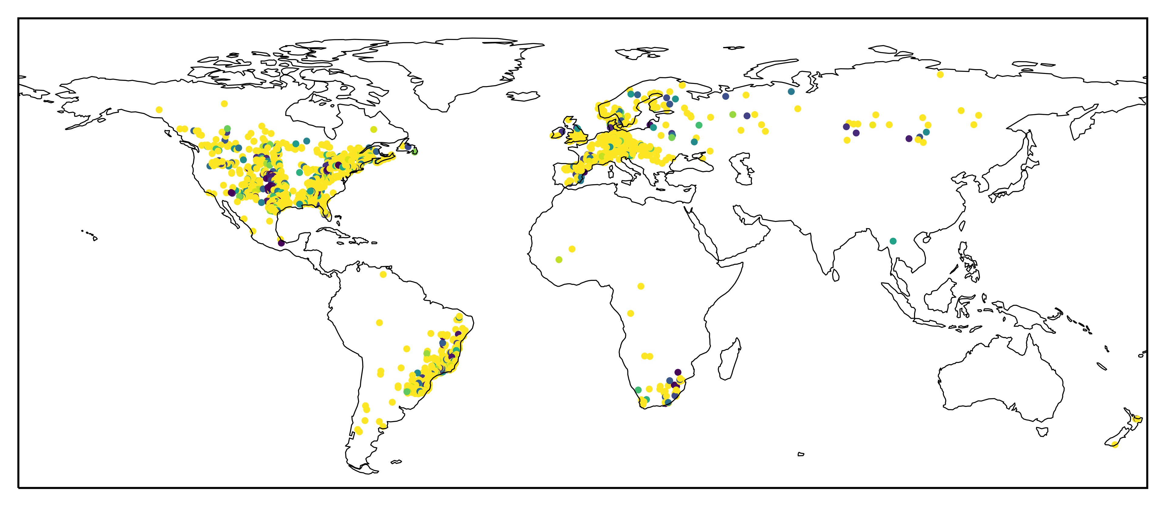
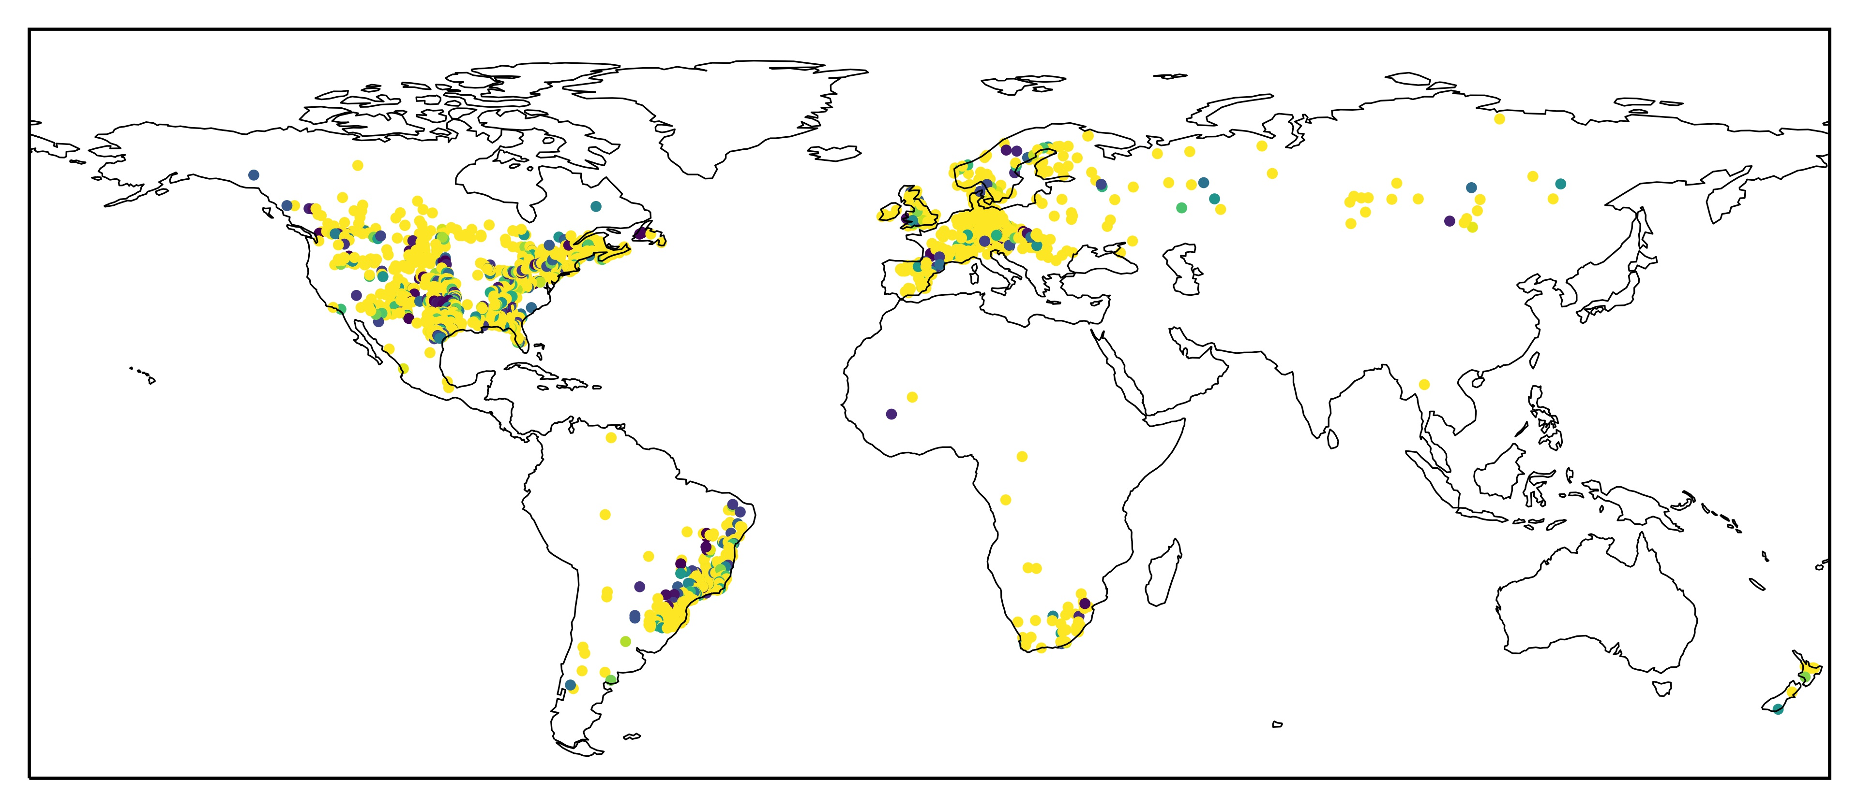
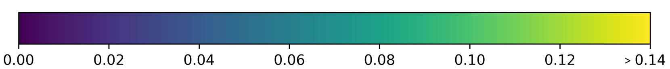
Introduction and background
Results (8/8)
P-Value for yearly residual changes
Δ((1901→1920) –(1921→1940))
Δ((1921→1940) –(1941→1960))
Research question
Datasets and methodology
Results
Δ((1941→1960) –(1961→1980))
Δ((1961→1980) –(1981→2000))
Conclusions
More significant
Less significant

Slide 16
Introduction and background
Conclusions
Major hydro-climatic shifts have occurred in the past century:
  More number of catchments have become wetter and observed an increase in partitioning of precipitation into run off over time i.e., from 15% in first 40 years to 44% in the last 40 years of past century.
Most sensitive to change catchments (having high magnitude of movement in the Budyko space) are found in central America, East Brazil, Argentine, West of South Africa and south of Spain.
Long term change in the aridity index is found to be the main driver of movement for 90% of the catchment in the Budyko space i.e., minor deviations from their original Budyko curve trajectories in the past century (p-value >0.05).
10% of the catchments are found with major deviations (changes in the evaporative index not defined by changes in the aridity index) from the original Budyko curve (p-value ≤0.05)
Research question
Datasets and methodology
Results
Conclusions

