Slide 1
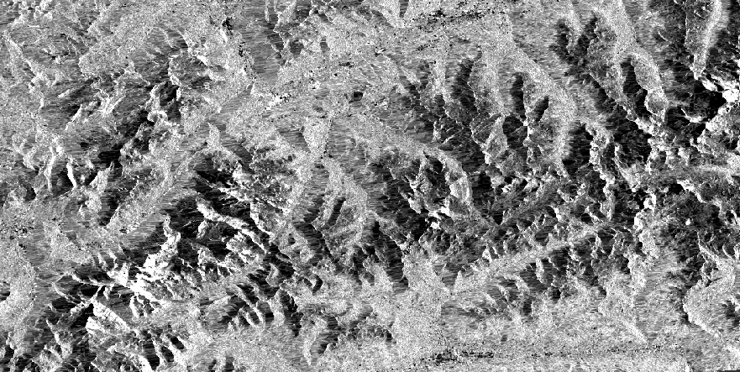
Sensitivity of Sentinel-1 observations to snow properties, comparing radar backscatter, polarimetric decomposition parameters, and interferometric phase changes
Morgane De Breuck, Hans Lievens, Jonas-Frederik Jans, Ezra Beernaert, Niko Verhoest

Slide 3
Predicting Snow Properties
Using C-band SAR

Slide 4
Backscatter
InSAR
PolSAR

Slide 5
Backscatter
InSAR
PolSAR
Team members:
VV
VH
VH-VV
Strategy:
Amplitude
Team members:
S1A-B
S1A-A
S1B-B
Strategy:
Phase
Team members:
α
DpRVI
Depolarization
Strategy:
Polarization

Slide 6
Backscatter
InSAR
1
2
PolSAR
3

Slide 7
Sensitivity of Sentinel-1 observations to snow properties, comparing radar backscatter, polarimetric decomposition parameters, and interferometric phase changes
Morgane De Breuck, Hans Lievens, Jonas-Frederik Jans, Ezra Beernaert, Niko Verhoest

Slide 8
Contents
Goal
Study area
Data
Backscatter
Physical process
Method
Results
PolSAR
Physical process
Method
Results
InSAR
Physical process
Method
Results
Conclusion

Slide 9
Goal
Backscatter
InSAR
PolSAR
C-band
Snow properties
Notes:
The goal of my research is to see if it is possible to estimate snow properties based on backscatter, InSAR or PolSAR data and to compare them to see which one of these techniques has the best performance.
What stands out in my research is that C-band SAR is used.

Slide 10
Study area

Slide 11
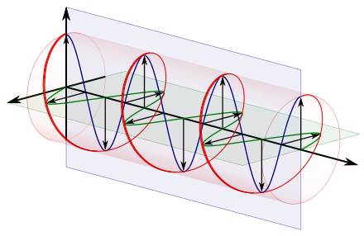
Data
Satellite data
Modelled data
Sentinel-1
C-band SAR
NoahMP
Amplitude
Snow depth
(SD)
Snow Water Equivalent (SWE)
Phase
Polarization
Notes:
In this study, two types of data are used: satellite data from Sentinel-1, and modelled data from a NoahMP simulation.
The Sentinel-1 data is C-bans SAR data and tells us something about the sensed area in terms of amplitude, phase and polarization.
The NoahMP model provides data about the snow depth and SWE.

Slide 12
Backscatter

Slide 13
Backscatter – Physical process
SAR signal is backscattered from
Air – Snow interface
→ Negligible
Snow volume
→ Dependent on depth, amount of liquid water, other snow properties,…
Ground
Most of the signal
➔ Amplitude
Air
Snow
Ground
Notes:
How the emitted wave from S1 interacts with a snowpack is illustrated here. It interacts first with the air-snow interface, but because the dielectric contrast between both is quite small.
The scattering that happens in the snow volume is dependent on a lot of thing such as snow properties, but also other properties such as the wavelength and incident angle.
In C-band, the main part of the signal is due to scattering on the ground. The penetration depth in snow is inversely proportional to wavelength, and C-band (6 cm) is quite small, so a lot of the signal can penetrate.
These different scattering processes all contribute to the backscatter signal, and here we are interested in the amplitude of that signal.

Slide 14
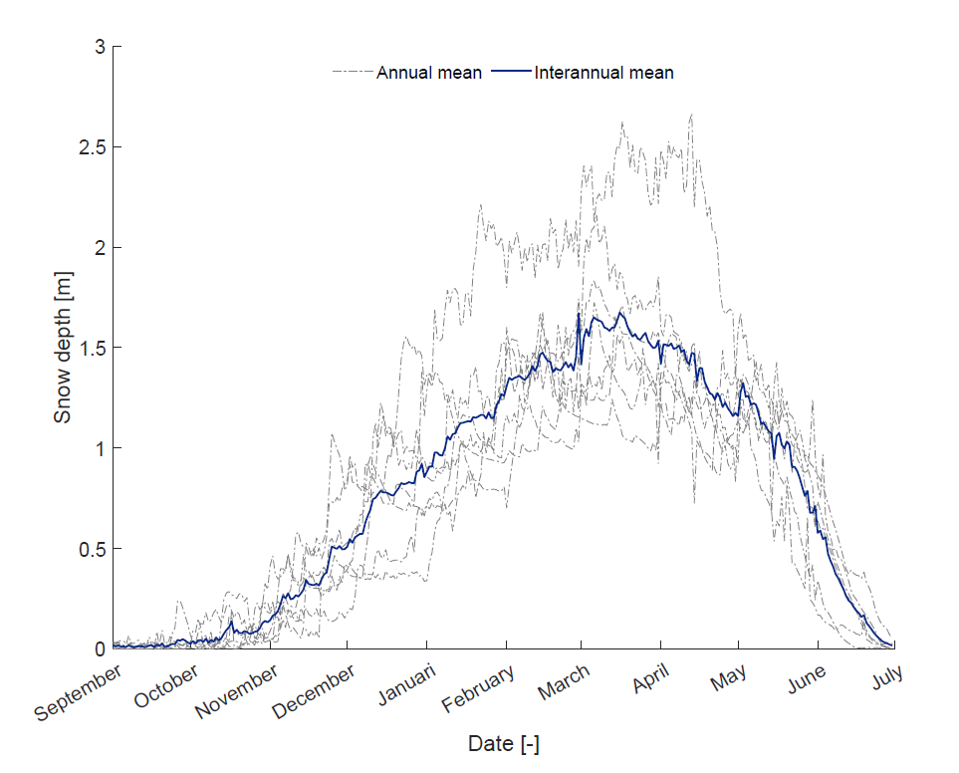
Backscatter – Method
Sentinel-1 backscatter
VH backscatter
VV backscatter
Only for snow accumulation period:
Sep - Mar
Modelled
SD & SWE
(NoahMP)
VH - VV
Correlation
snow properties – VH
Correlation
snow properties – VV
Correlation
snow properties – VH-VV
Boeykens et al. (2023)
Notes:
The VV and VH backscatter components of S1 from sep 2017 until march 2018 are taken and the co-cross ratio is calculated. These three timeseries are then correlated with modelled timeseries of SD and SWE to form maps.

Slide 15
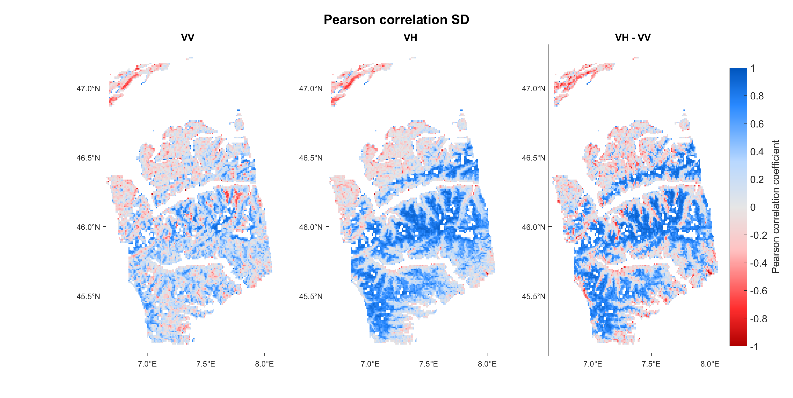
Correlation BS – SD
Notes:
VH better than VV where snow is expected
Co-cross ratio also good

Slide 16
Correlation BS – SWE
Notes:
Idem but a bit better in VV and marginal areas of VH
less good in VH-VV

Slide 17
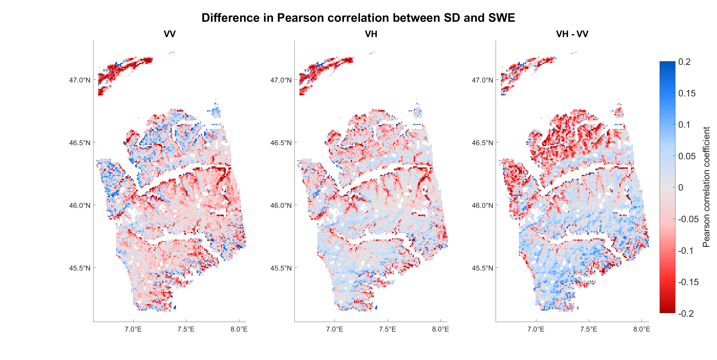
Correlation difference SD - SWE
Notes:
Correlation of SD minus correlation of SWE
-> For areas where snow is expected (positively correlated):
if red: SWE better correlated
if blue: SD better

Slide 18
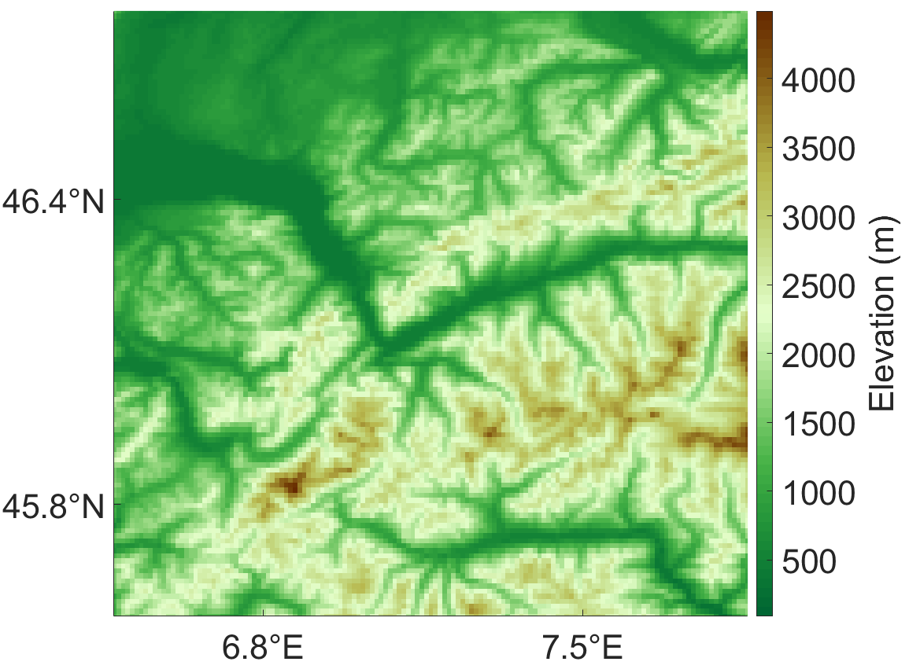
BackScatter – Timeseries
Method
Forest
Bare ground
Grassland
Glacier

Slide 19
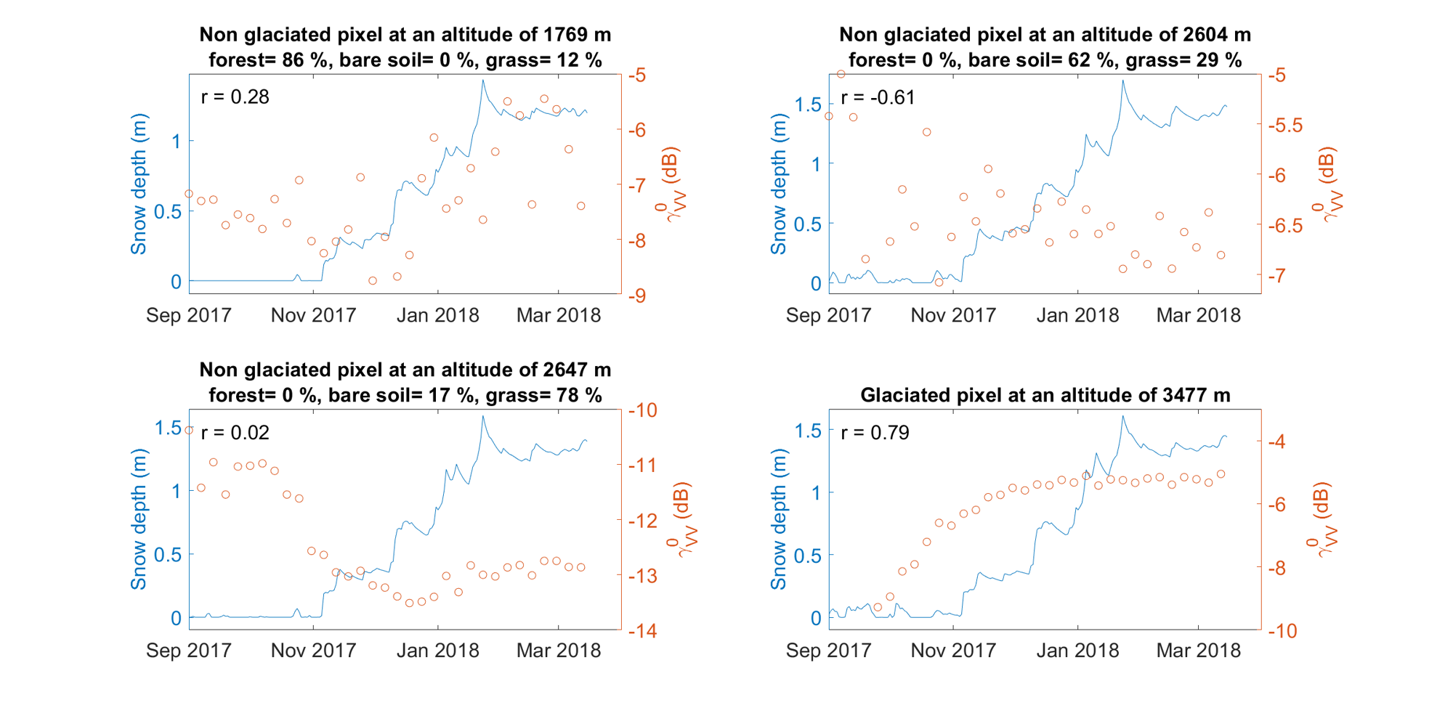
Backscatter – Timeseries
VV
Notes:
In general, the correlations with VV are not that great

Slide 20
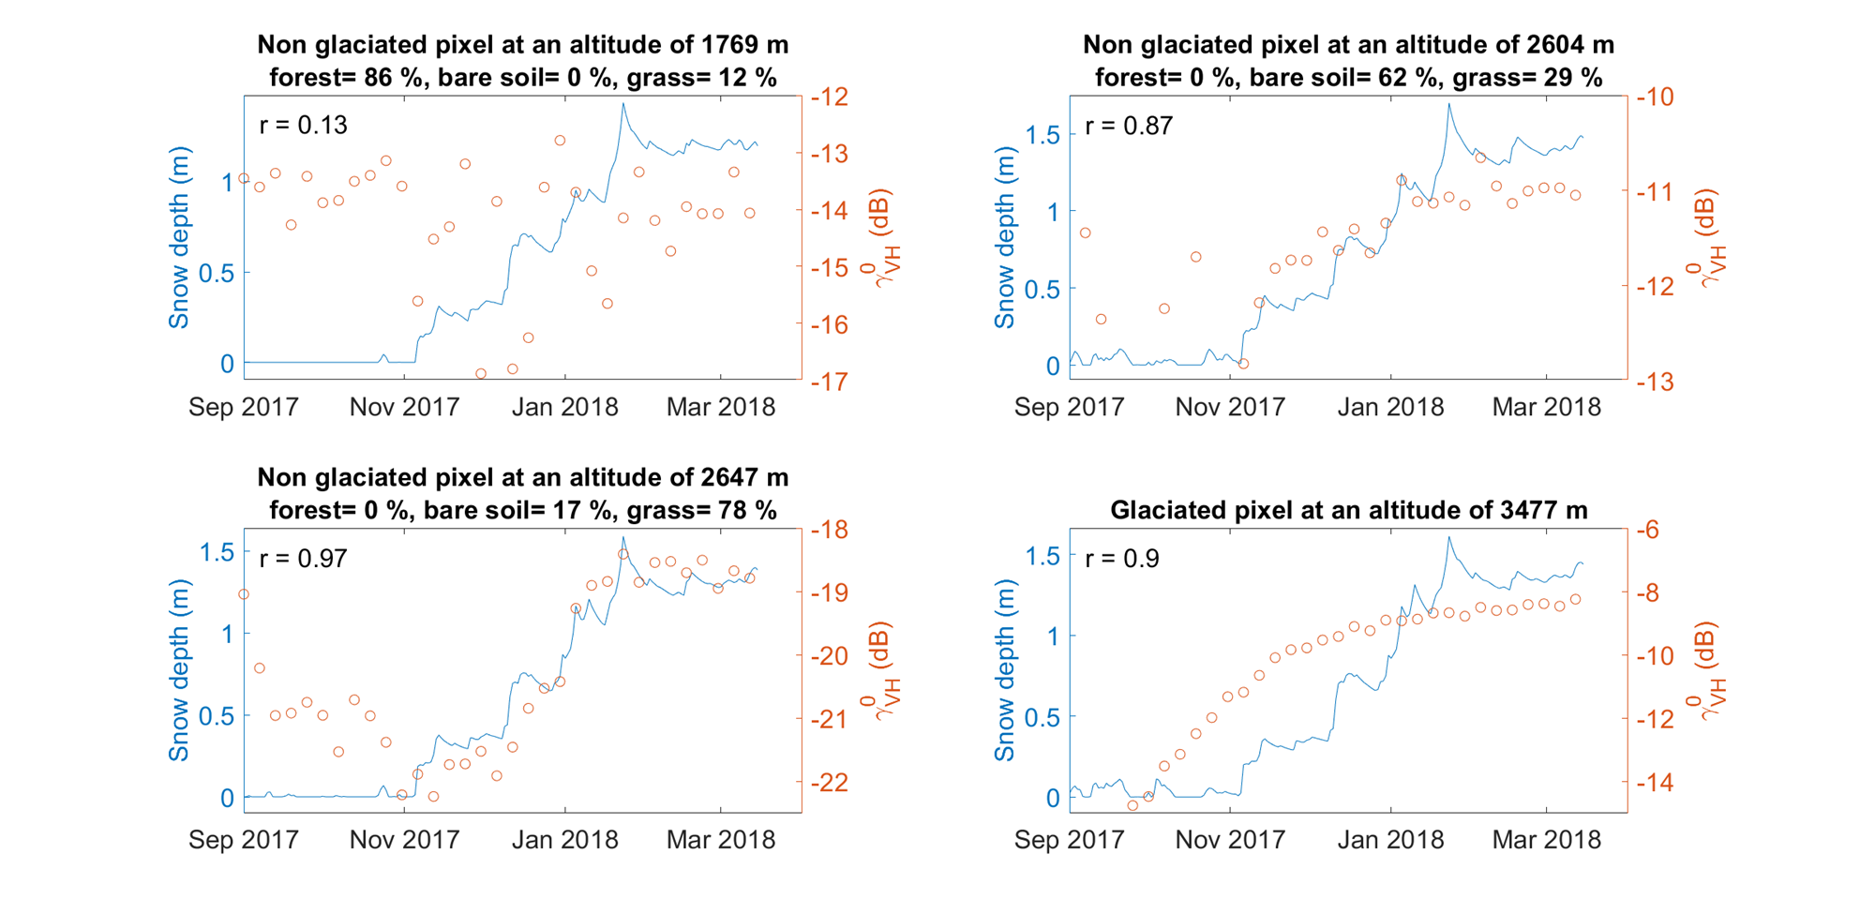
Backscatter – Timeseries
VH
Notes:
For the forested pixel, the correlation is very low.
For the other land uses it is quite high.

Slide 21
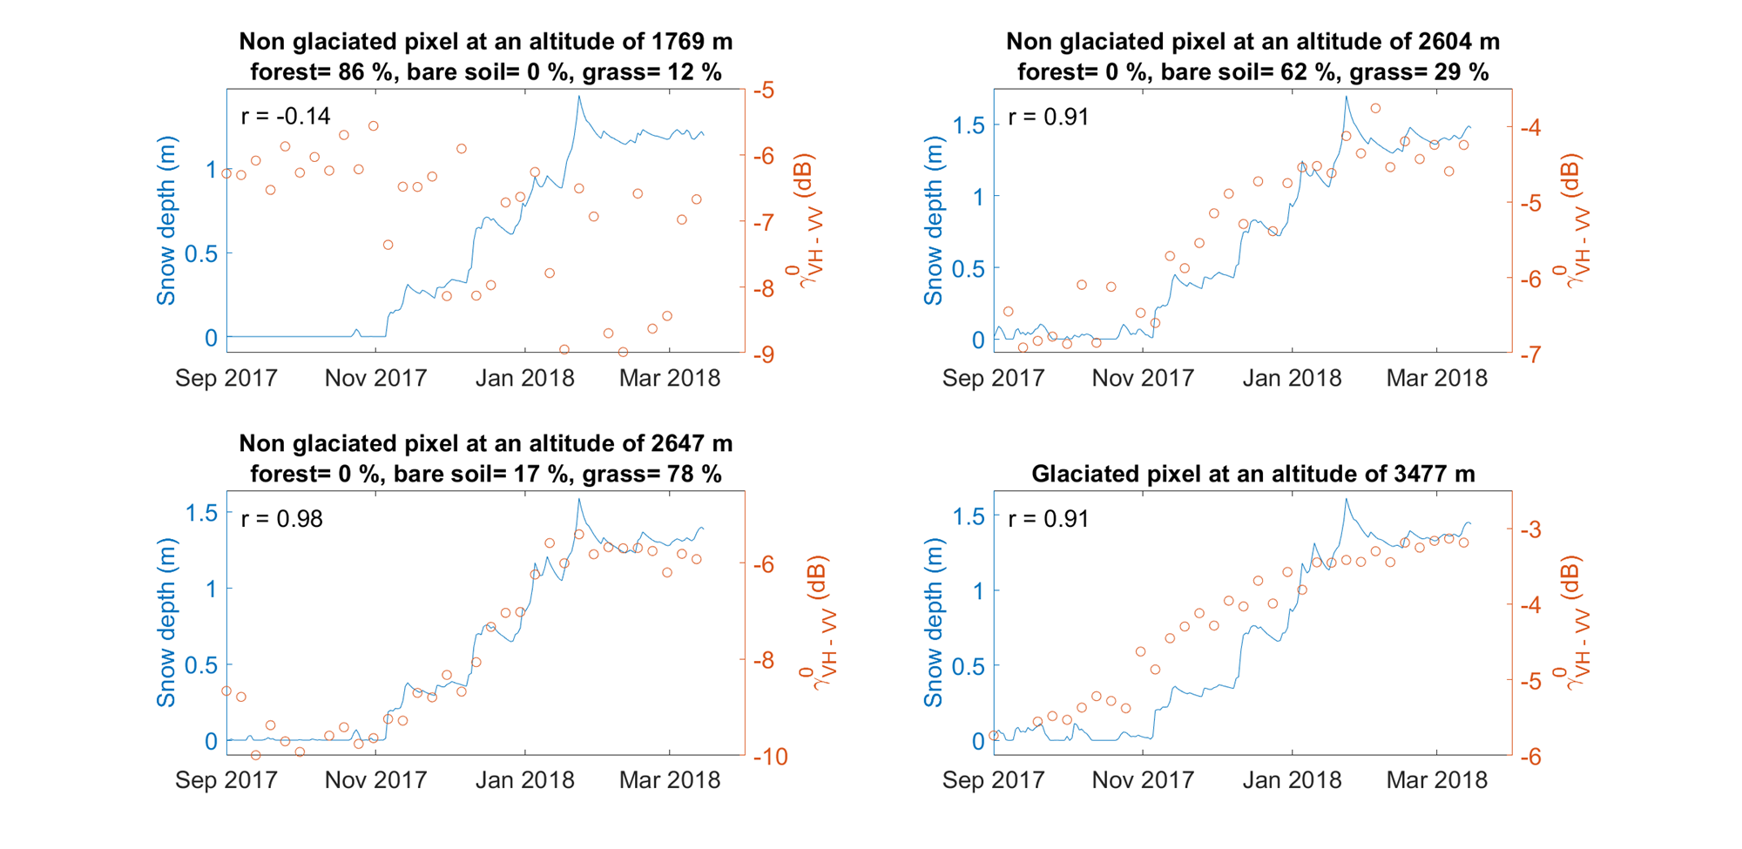
Backscatter – Timeseries
VH - VV
Notes:
Idem VH but slightly better

Slide 22
POLSAR

Slide 23
PolSAR – Physical process
Backscatter
Decomposition
Polarimetric decomposition parameters
e.g.
Mean α angle
Dual pol Radar Vegetation Index
Degree of depolarization
Notes:
The backscatter from S1 is decomposed by different processes and polarimetric decomposition parameters are the result from that. Here we will discuss 3 of those: alpha, DpRVI and depol,

Slide 24
PolSAR – Physical process
Mean α angle
Dual pol Radar Vegetation Index
Degree of depolarization
Air
Identifying dominant scattering mechanism
Low α: Single bounce
High α: Volume scattering
Volume scattering
Snow
Single bounce scattering
Ground

Slide 25
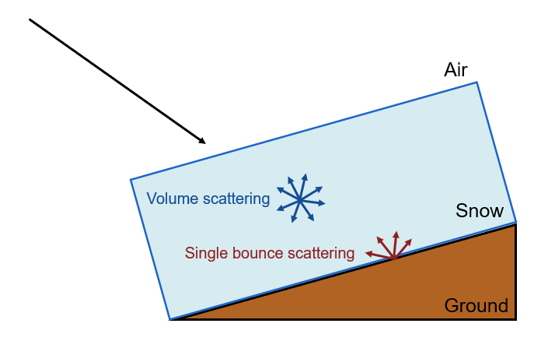
PolSAR – Physical process
Mean α angle
Dual pol Radar Vegetation Index
Degree of depolarization
Identifying randomness of scattering mechanism
Low DpRVI: Pure scatterer ~ Single-bounce scattering
High DpRVI: Random scattering ~ Volume scattering

Slide 26
PolSAR – Physical process
Mean α angle
Dual pol Radar Vegetation Index
Degree of depolarization
Air
Quantifies isotropy
Low Depol: Single-bounce scattering
High Depol: Volume scattering
Volume scattering
Snow
Single bounce scattering
Ground

Slide 27
PolSAR – Method
Only for snow accumulation period:
Sep 2017 – Mar 2018
Sentinel-1 backscatter
Stokes decomposition
H-α Dual Pol decomposition
Dual Pol RVI decomposition
Dual pol Radar Vegetation Index
Mean α angle
Degree of depolarization
Modelled SD &SWE
(NoahMP)
Correlation
snow properties – α
Correlation
snow properties – DpRVI
Correlation
snow properties – Depol

Slide 28
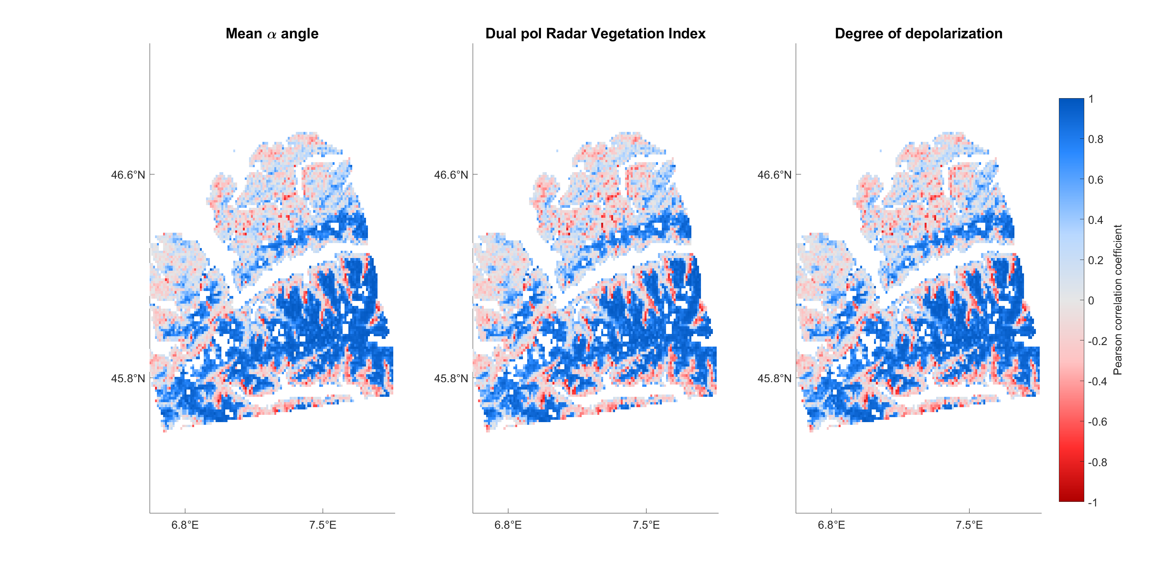
Correlation PolSAR parameters – SD
Notes:
Good correlations where snow is expected

Slide 29
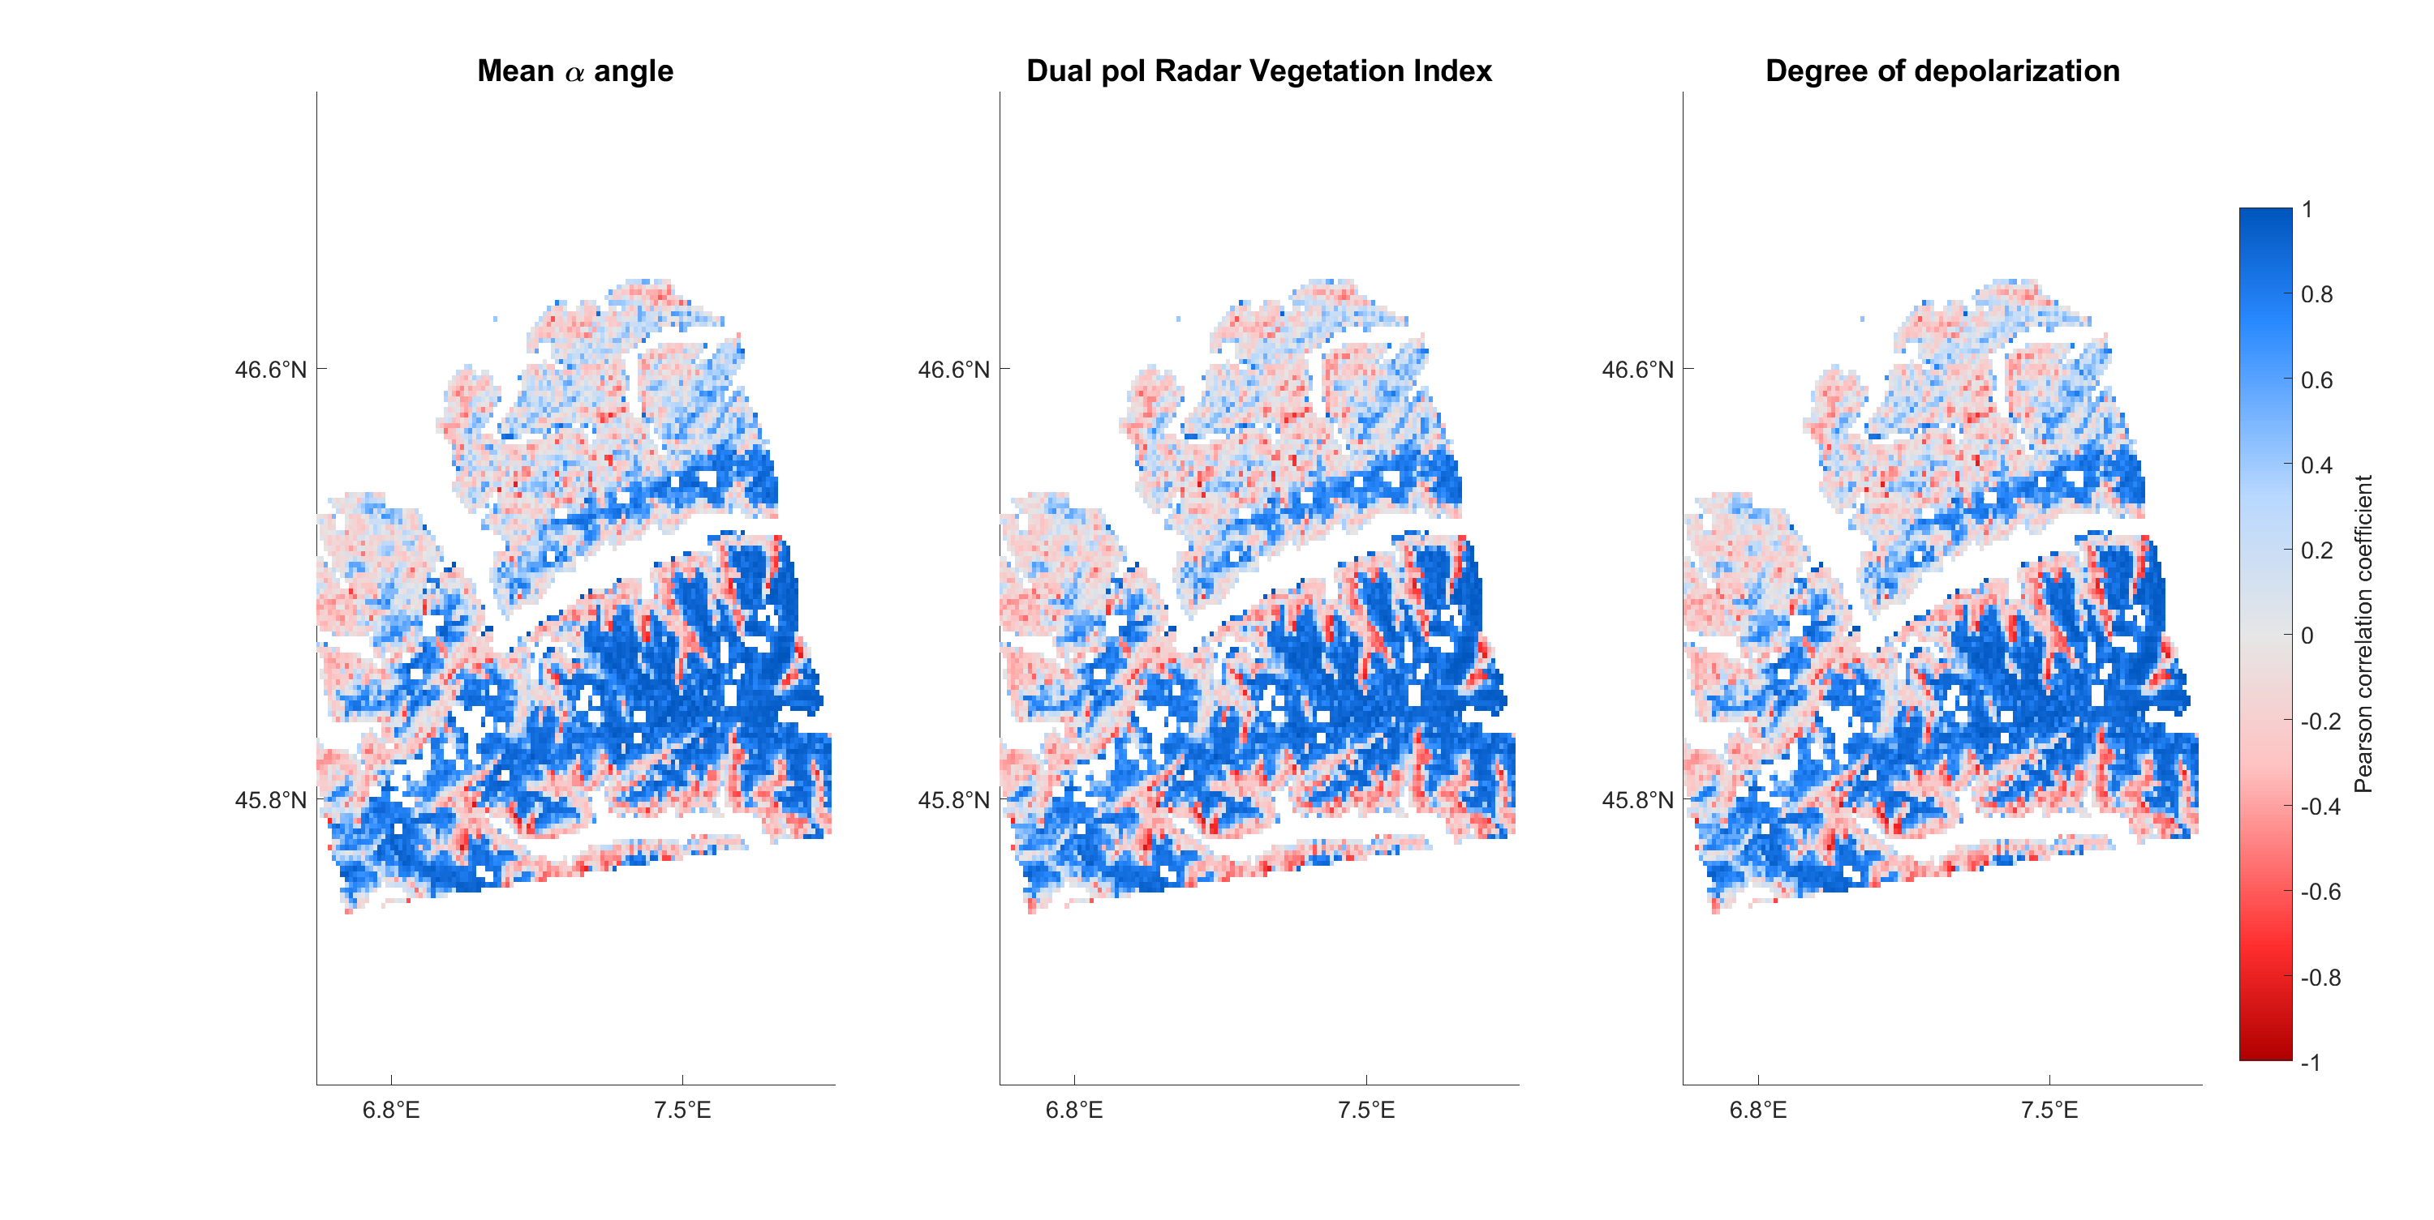
Correlation PolSAR parameters – SWE
Notes:
Idem

Slide 30
PolSAR – Timeseries
Method
Forest
Bare ground
Grassland
Glacier

Slide 31
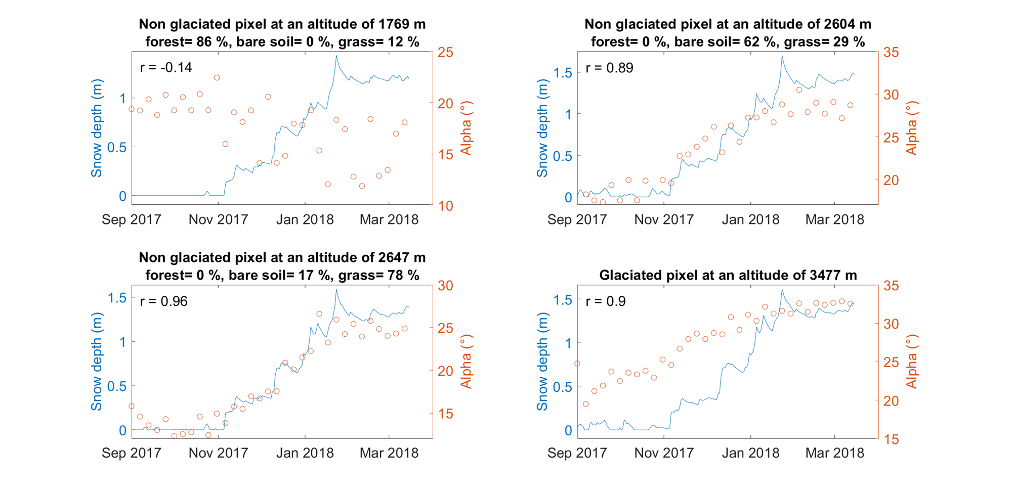
PolSAR – Timeseries
αlpha

Slide 32
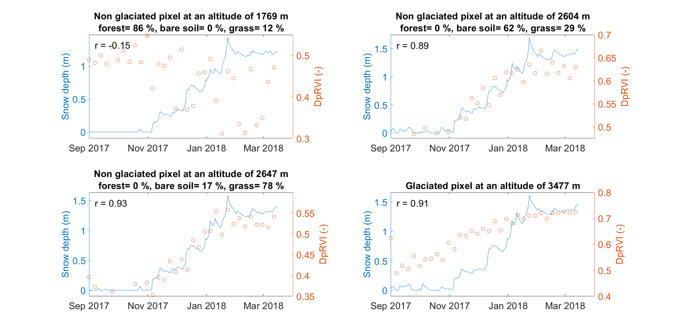
PolSAR – Timeseries
DpRVI

Slide 33
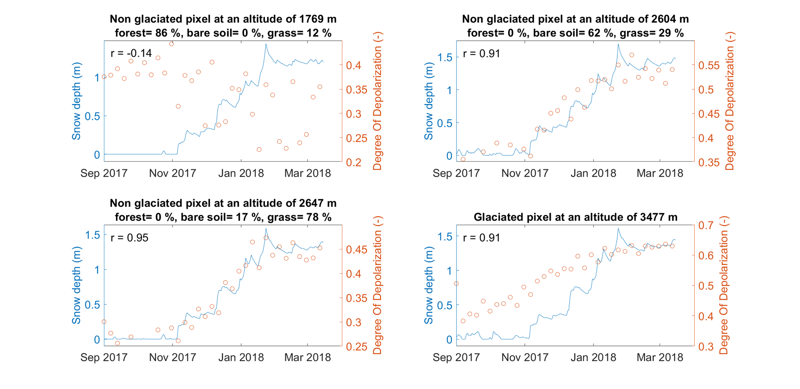
PolSAR – Timeseries
Depol

Slide 34
InSAR
InSAR

Slide 35
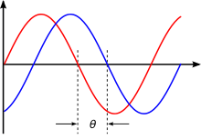
InSAR – Physical process
Radar signal in snow:
Refraction → pathlength ↑
Velocity of wave ↓
➔ Phase difference
Through snow
Air
Snow-free
Snow
Ground
Notes:
When a radar wave passes through snow, refraction happens due a dielectric difference between air and snow, leading to an increase in pathlength.
Additionally, the velocity of the wave decreases.
Due to this, the wave passing through snow will have a slight delay on a wave if there was no snow and this phase difference between 2 images that are taken at different times is used in InSAR

Slide 36
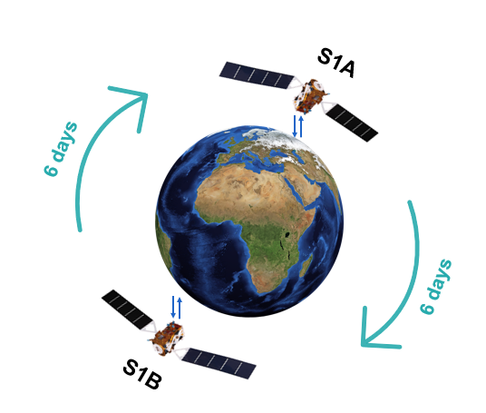
InSAR – Method
Phase difference
Calculate phase difference between two images, separated by 6 days
➔ Wrapped phase
Notes:
Sentinel-1 consists of 2 satellites: S1A and S1B. InSAR pairs have to be formed and to get a continuous timeseries, there are 3 options:
- Timeseries of a mix of S1A and S1B, separated by 6 days
Timeseries of only S1A, separated by 12 days
Timeseries of only S1B, separated by 12 days

Slide 37
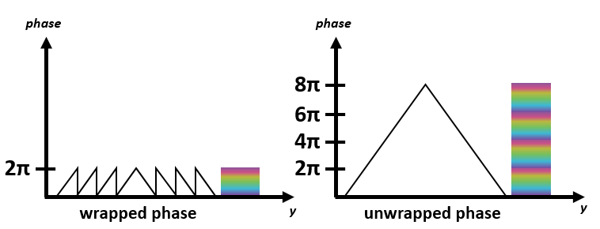
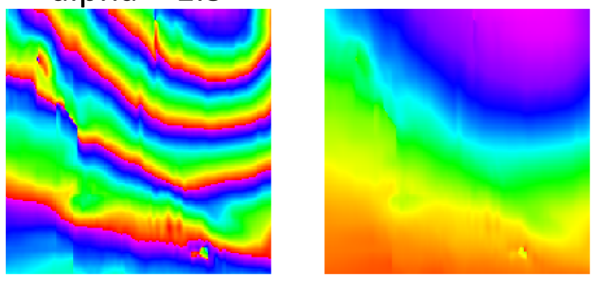
InSAR – Method
Phase unwrapping
Phase difference
(Wrapped phase)
Unwrapped phase
Braun (2020)
Phase unwrapping
Notes:
The phase difference that is obtained from the images can only be between –pi and pi (called fringes).
To be able to detect how much actually changed, phase unwrapping has to be applied. In phase unwrapping the fringes are combined added to get the total phase displacement or the unwrapped phase.

Slide 38
InSAR – Method
Relating to snow properties
Unwrapped phase
Cumulative unwrapped phase
Correlation timeseries
snow properties
cumulative unwrapped phase
Only for snow accumulation period:
Sep - Mar
Modelled data (NoahMP)
Lucas Boeykens, Hans Lievens, Ezra Beernaert, Jonas-Frederik Jans, Niko Verhoest. SWE retrieval in the European Alps based on Sentinel-1 snow depth observations and modelled snow density.
_
Boeykens et al. (2023)
Notes:
These unwrapped phases are then added cumulatively for the snow accumulation period and this timeseries is correlated to the modelled timeseries of SD and SWE.

Slide 39
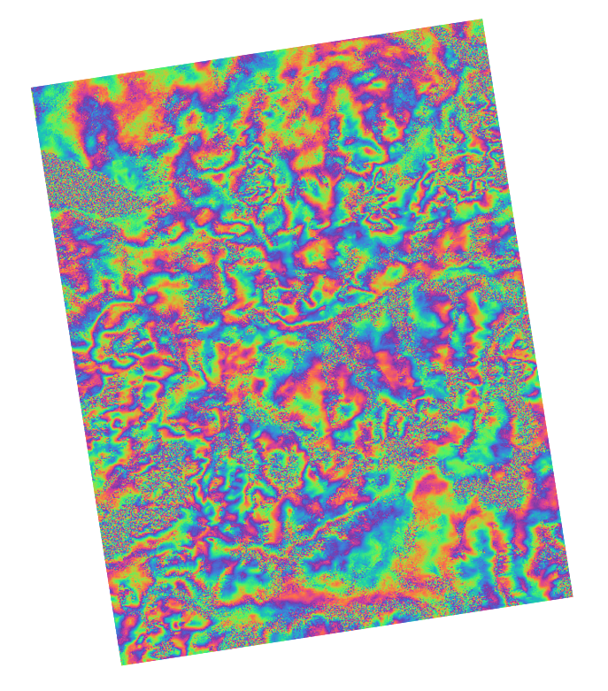
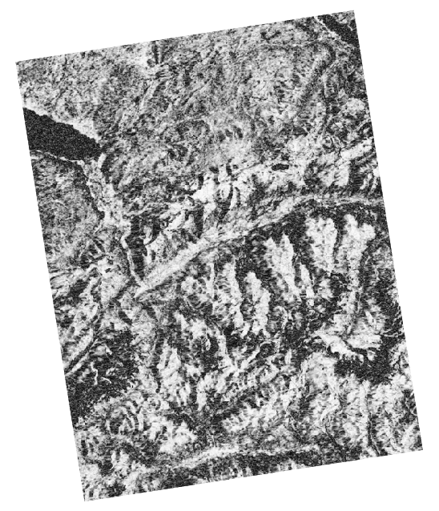
InSAR - Results
03/08/2018 – 09/08/2018
Summer
Wrapped phase
Coherence
Notes:
InSAR works fine in the summer when no (or very little) snow is present

Slide 40
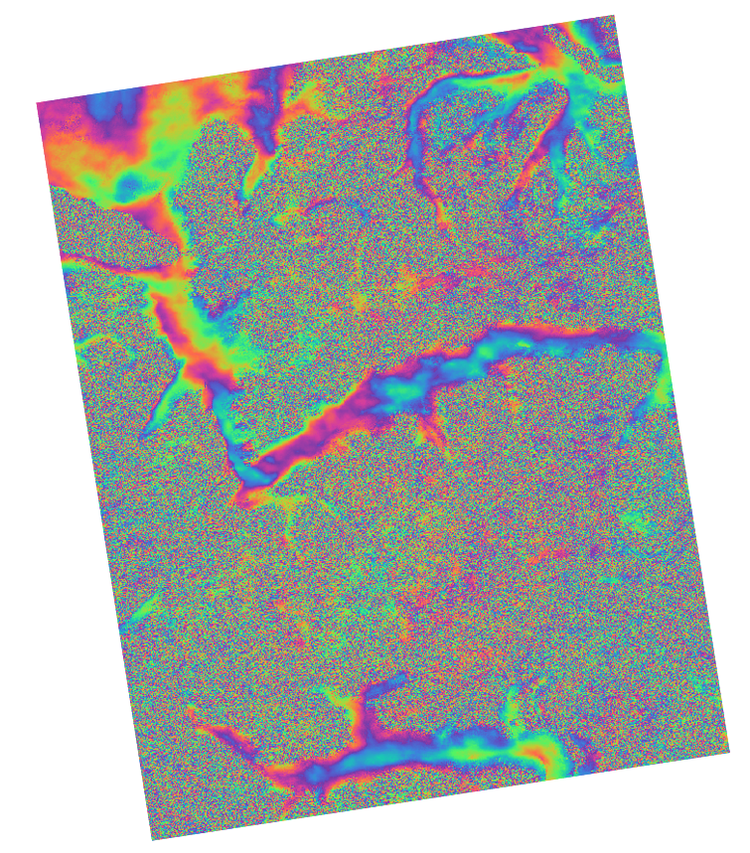
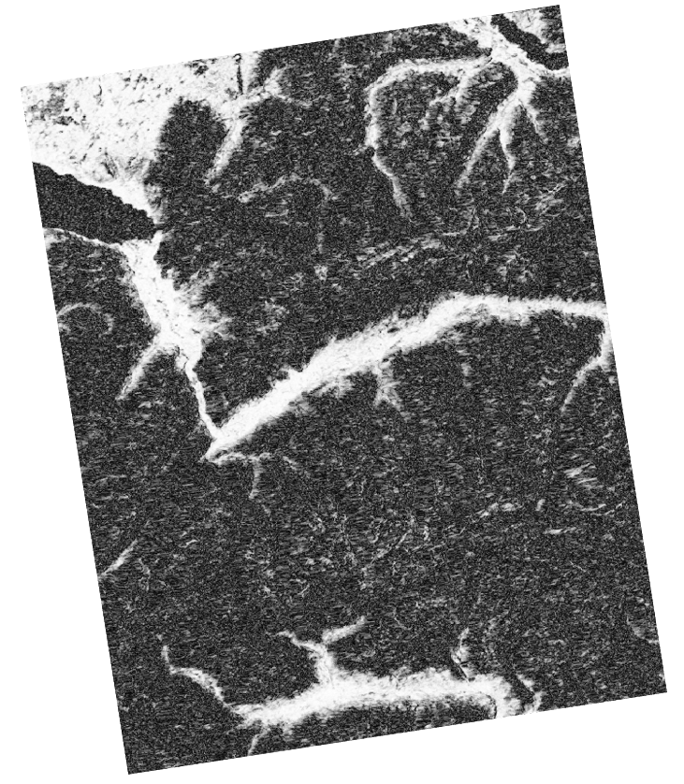
InSAR - Results
11/01/2018 – 17/01/2018
Dry snow
Wrapped phase
Coherence
Notes:
When dry snow is present, the coherence is low and the wrapped phase shows too much noise

Slide 41
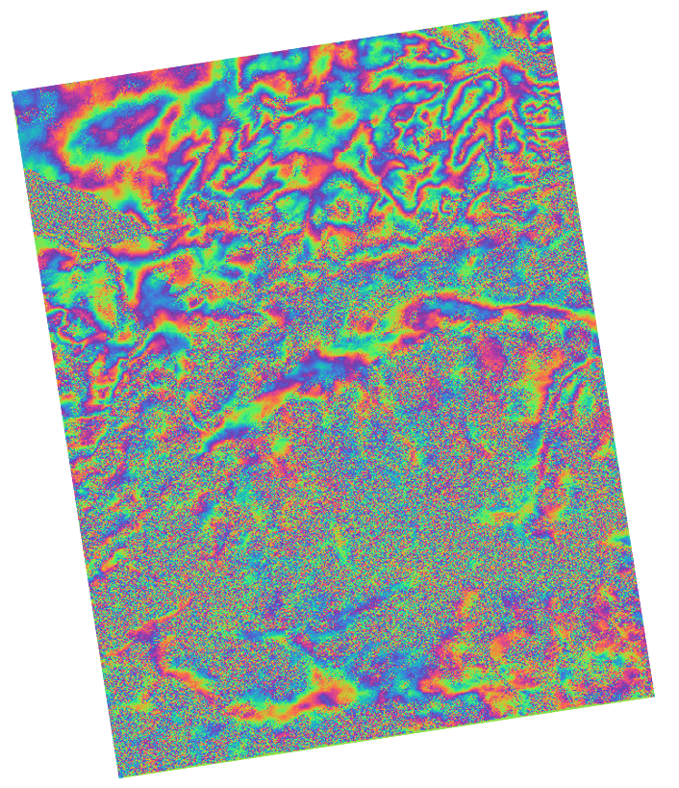
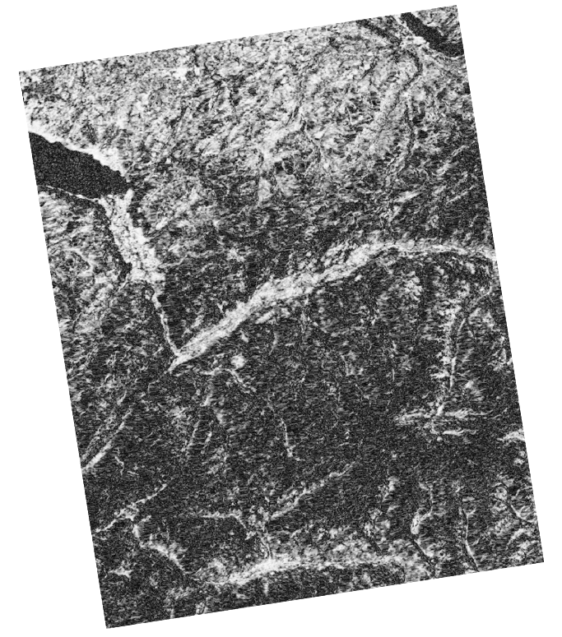
InSAR - Results
29/04/2018 – 05/05/2018
Wet Snow
Wrapped phase
Coherence
Notes:
When wet snow is present, the coherence becomes better again

Slide 42
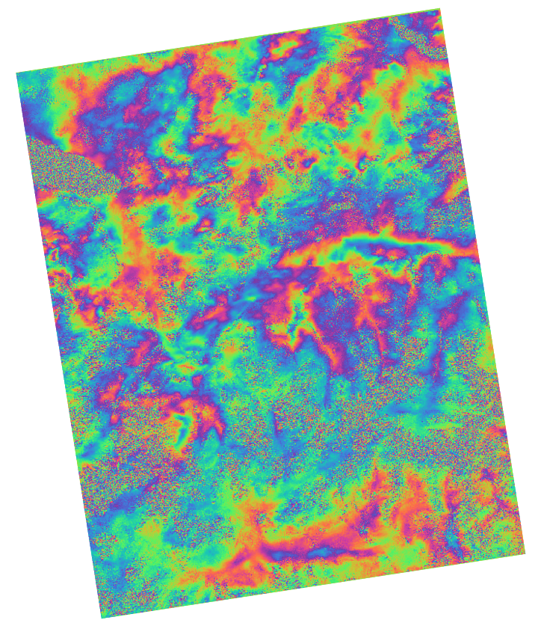
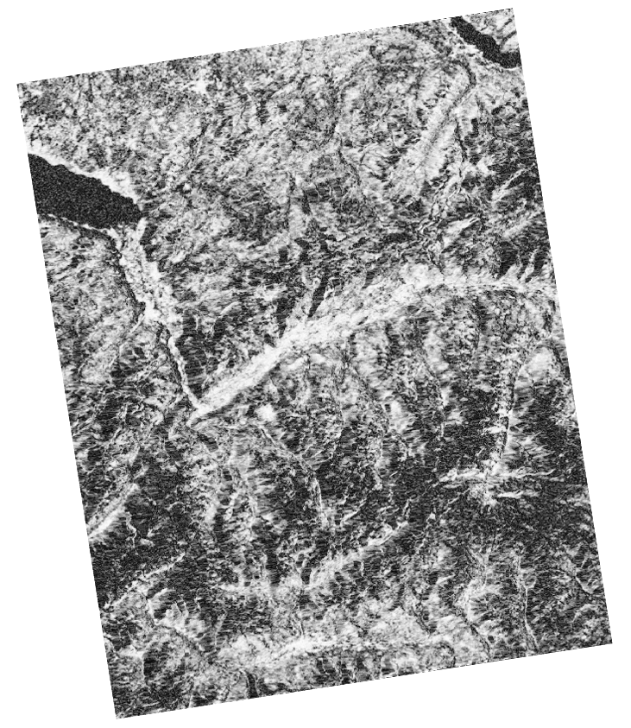
InSAR - Results
05/05/2018 – 11/05/2018
Wet Snow
Wrapped phase
Coherence
Notes:
And 6 days later even better. However 6 days after this, the coherence is similar to the previous slide.
We are still researching the reason for this.

Slide 43
Conclusion

Slide 44
Correlation BS – SD
Notes:
VV does not work well, VH and VH-VV give good correlations

Slide 45
Correlation PolSAR – SD
Notes:
They all give good correlations

Slide 46
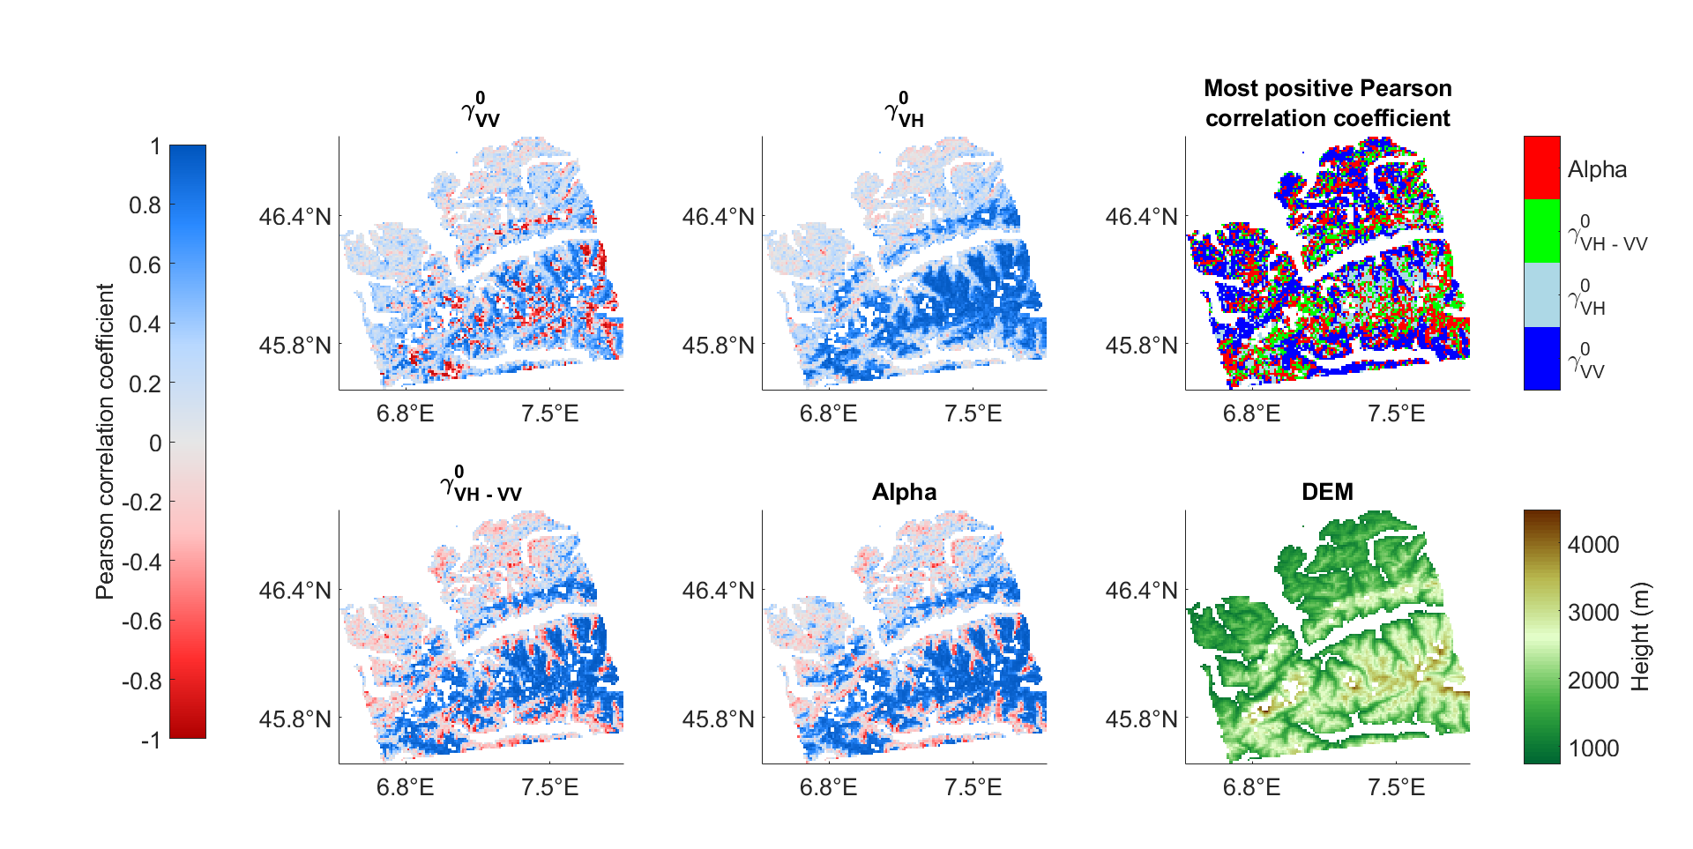
BS & PolSAR – Temporal correlation
Notes:
When looking at the ‘Most positive Pearson correlation coefficient’ plot, we can see that VV performs better at lower altitudes, while VH, VH-VV and Alpha perform better at high altitudes and we can consider them to have very similar performances.

Slide 47
INSAR
11/01/2018 – 17/01/2018
Dry snow
Wrapped phase
Coherence
Notes:
InSAR is not able to predict snow properties

Slide 48
Conclusion
Backscatter
InSAR
PolSAR
Snow properties

Slide 49
Conclusion
Backscatter
PolSAR
InSAR
1
2
3
Notes:
When comparing BS and polsar temporarily (as shown in maps), BS seems better, but comparing them spatially (difference begin-end for whole area), PolSAR seems better
BUT the research is still ongoing

