Slide 1
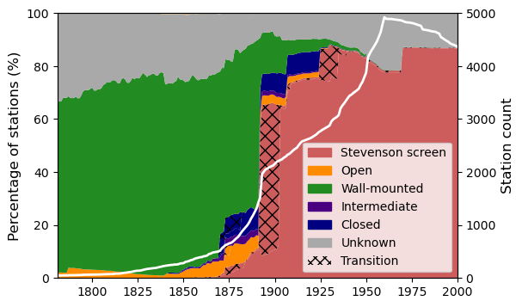
ESTIMATING EXPOSURE BIASES IN EARLY INSTRUMENTAL
LAND SURFACE AIR TEMPERATURE DATA
Emily Wallis, Timothy Osborn, Michael Taylor; School of Environmental Sciences, University of East Anglia, UK
THE PROBLEM
OUR APPROACH
1. Define the characteristics of the bias
2. Develop models to estimate the bias
3. Identify bias-affected stations and months
4. Apply the models to stations identified in (3)
The transition from non-standard thermometer exposures to Stevenson screens introduced exposure biases
5. Apply adjustments based on estimates produced in (4)
EGU2023 PICO Presentation

Slide 2
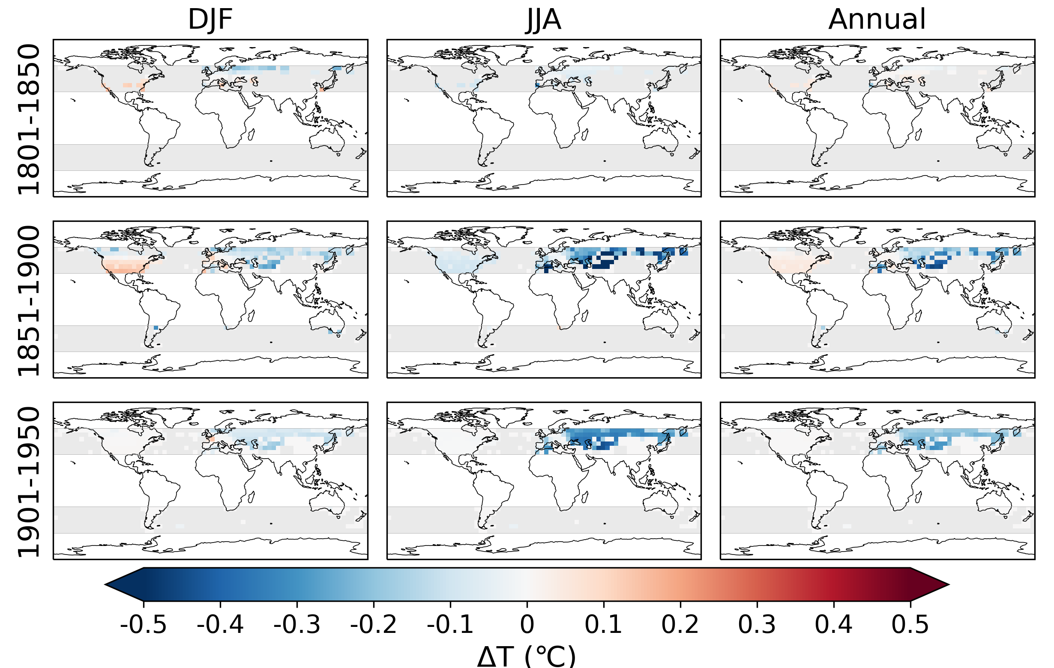
RESULTS
1801-1850
1851-1900
1901-1950
EGU2023 PICO Presentation
Notes:
Shows adjusted minus unadjusted data

Slide 3
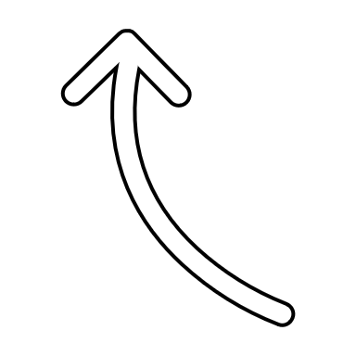
ESTIMATING EXPOSURE BIASES
IN EARLY INSTRUMENTAL LAND SURFACE AIR TEMPERATURE DATA
Emily Wallis^{1*}, Timothy Osborn¹ and Michael Taylor¹
¹Climatic Research Unit, School of Environmental Sciences, University of East Anglia, UK
*emily.wallis@uea.ac.uk
Link
to abstract
EGU2023 Supplementary Display Material

Slide 4
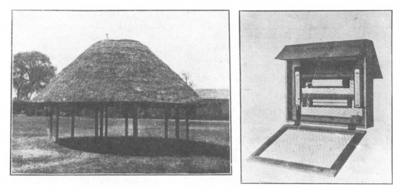
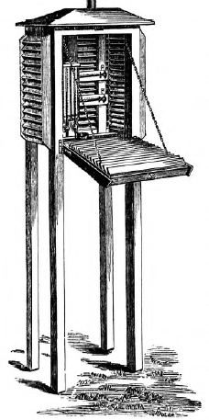
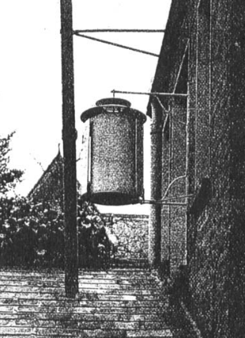
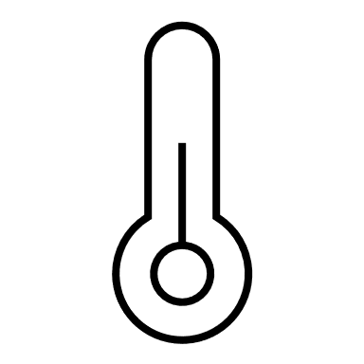
WHAT IS THE EXPOSURE BIAS?
Exposure biases are non-climatic changes in land surface air temperature (LSAT) records introduced by changes to the way thermometers have been protected from solar radiation.
Prior to the widespread adoption of Stevenson screens, various thermometer exposures were used. Some examples of common thermometer exposures (grouped into classes) are shown here.
Each exposure influenced temperature readings differently (see diagram) meaning when Stevenson screens were adopted biases were introduced into LSAT records.
Intermediate
Open
Summerhouse
Thatched shelter and ‘cage’
Glaisher
Montsouris
Stevenson screen
Wall-mounted
DIRECT RADIATION
Closed
CLOUD COVER
SCREEN MATERIAL
WIND
SCATTERED RADIATION
VENTILATION
TERRESTRIAL RADIATION
Wild Hut
Images: Trewin, 2010; Royal Meteorological Society; Trewin, 2010; Parker, 1994; Gaster, 1882;
Mawley, 1897; Wild, 1891; diagram adapted from Venema (variable-variability.blogspot.com)
ALBEDO
EGU2023 Supplementary Display Material

Slide 5
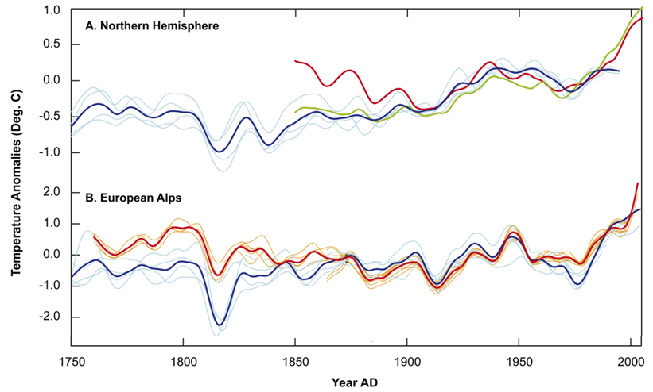
MOTIVATIONS
Exposure biases have not been widely corrected – regions often introduced new exposures quasi-simultaneously making the bias hard to identify and correct using traditional methods (e.g. near-neighbour comparison).
Assessments, such as the one shown here by Frank et al. (2007), have found possible evidence of the exposure bias in long observational records.
These biases must be accounted for before data is used for climate assessment.
Divergence between observed and reconstructed summer temperature anomalies indicates a possible bias
CRUTEM3 JJA data
CRUTEM3 annual mean
Tree-ring-based
reconstruction
HISTALP instrumental data
Tree-ring-based reconstruction
Frank et al., 2007; Quaternary Science Reviews
EGU2023 Supplementary Display Material

Slide 6
MOTIVATIONS (cont’d) and AIMS
The HadCRUT5 dataset (Morice et al., 2021) accounts for exposure biases in it’s error model (right).
Recent work, however, suggests the representation is too simplistic (for the reasons in red).
This work therefore aims to:
Account for exposure biases by producing metadata-based predictions of the bias at the station-level.
These predictions can then be used to refine dataset error models, or to adjust the data directly.
In this piece of work we apply adjustments directly to land stations in HadCRUT5 (CRUTEM5).
Fixed annual bias
Fixed timing
Positive or negative bias
Morice et al., 2012; Journal of Geophysical Research
EGU2023 Supplementary Display Material

Slide 7
APPROACH
1. Define the characteristics of the bias by analysing 54 parallel measurement series
2. Develop models to estimate the bias based on the relationship between the bias, solar radiation and temperature
3. Identify bias-affected stations by compiling exposure metadata for individual stations
4. Estimate the bias by applying the models to the bias-affected stations
EGU2023 Supplementary Display Material

Slide 8
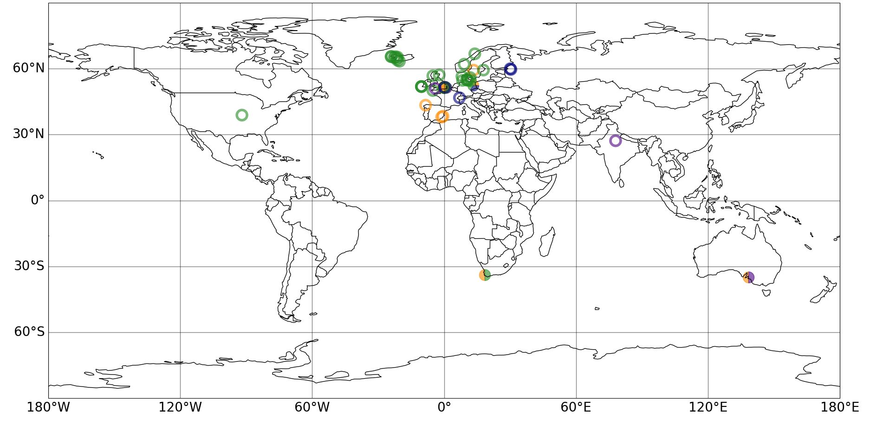
1. DEFINE THE CHARACTERISTICS
Parallel measurements are temperatures recorded near-simultaneously in two or more exposures in the same location.
Here we conduct an empirical analysis of 54 parallel measurement series (right), which compare the Stevenson screen to one other exposure, to identify the characteristics of the bias.
Parallel measurements are grouped into four classes for analysis.
An example of the characteristics of the bias in open exposures is shown on the following slide.
LOCATION OF PARALLEL MEASUREMENT SERIES USED
Open Wall-mounted Intermediate Closed
EGU2023 Supplementary Display Material

Slide 9
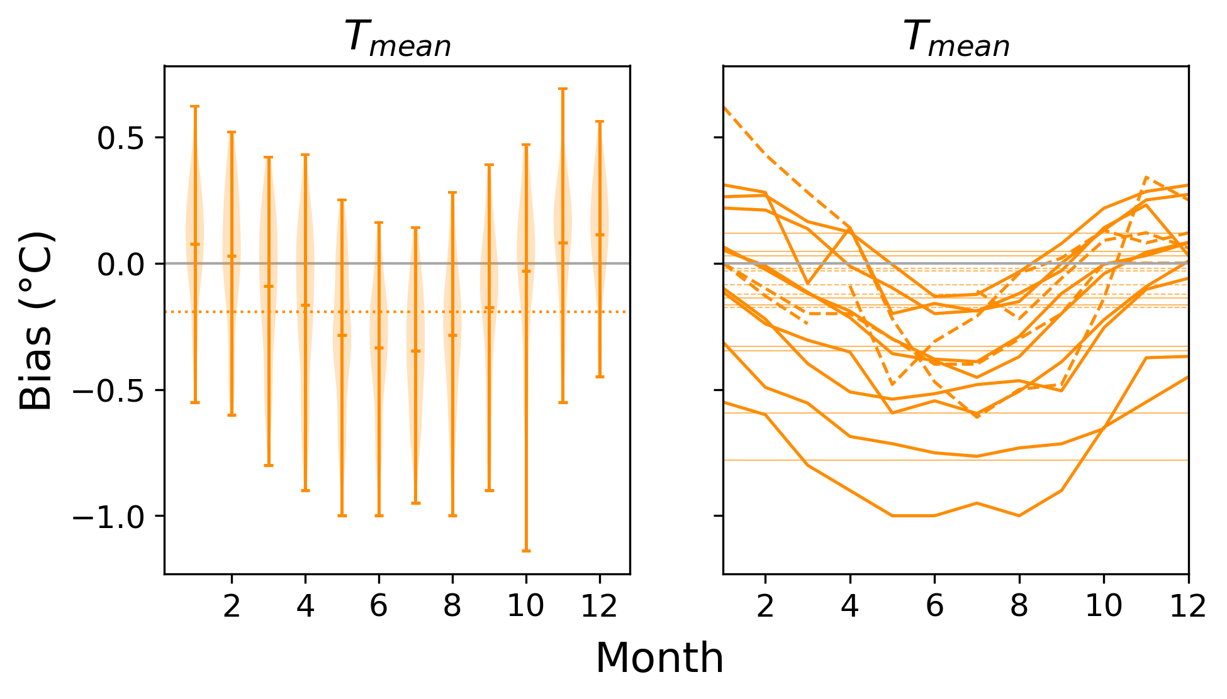
1. DEFINE THE CHARACTERISTICS
Open Exposures: “freestanding exposures; thermometers exposed fully, or nearly fully, to the air”
Open exposures record annual mean temperatures which are, on average, 0.2°C warmer than Stevenson screens.
There is a clear seasonal cycle to the bias with smaller/cold biases in winter and larger/warm biases in summer.
The seasonal structure of the bias is similar between series but the magnitude of the bias varies between sites.
This analysis was completed for each exposure class (not shown).
Distribution and mean of all parallel measurements
STEVENSON SCREEN MINUS OPEN EXPOSURES
Open exposure
cooler
Open exposure
warmer
Mean monthly and annual biases for each parallel measurement series
(dashed series have ≤12 values)
Wallis et al. (2023; in prep)
EGU2023 Supplementary Display Material

Slide 10
1. CHARACTERISE THE BIAS
2. DEVELOP MODELS
Conclusions:
Step one highlights clear differences between the mean temperatures recorded in Stevenson screens and all four classes of historic exposure:
Open, intermediate and closed exposures produce a warm bias in annual mean temperatures. Wall-mounted exposures produce small warm or cold biases in the annual mean, dependent on location / site-specific factors
In each class of exposure the bias is seasonally-varying, but the shape of the cycle is not consistent between classes
The characteristics of the bias are similar between series (within exposure classes) but the magnitude of the bias varies
The findings reinforce the need to account for the exposure bias introduced by the transition to Stevenson-type screens.
Next step: Develop models to estimate the bias
The models are developed by building an understanding of the variables which influence the monthly bias for each class of exposure.
We do this via a regression analysis of the relationship between the monthly bias in T_{mean} (calculated from the parallel measurements in step 1) and three variables considered a priori to influence the bias:
Absolute temperature (T_{Hist})
Top of Atmosphere solar radiation (TOA)
Shortwave Downward solar radiation (SWD)
Where significant relationships are found simple statistical models are developed and assessed to determine whether the relationship can be used to predict the exposure bias.
The remaining sections focus on biases between 30° to 60° latitude, as additional factors become more important at higher latitudes and because only one tropical series was available for analysis.
EGU2023 Supplementary Display Material

Slide 11
2. DEVELOP MODELS TO ESTIMATE THE BIAS
Open Exposures:
The plots on the right show the correlation between the monthly mean bias in T_{mean} and each of the three previously listed variables.
The results show the bias is significantly related to all three of the variables.
The strongest relationships are with T_{Hist} and SWD.
When used as predictors in a simple model, T_{Hist} skilfully predicts the magnitude of the bias but not the timing of the seasonal cycle; the opposite is true for SWD.
Magnitude
Timing of seasonal cycle
Magnitude
Timing of seasonal cycle




Wallis et al. (2023; in prep)
EGU2023 Supplementary Display Material

Slide 12
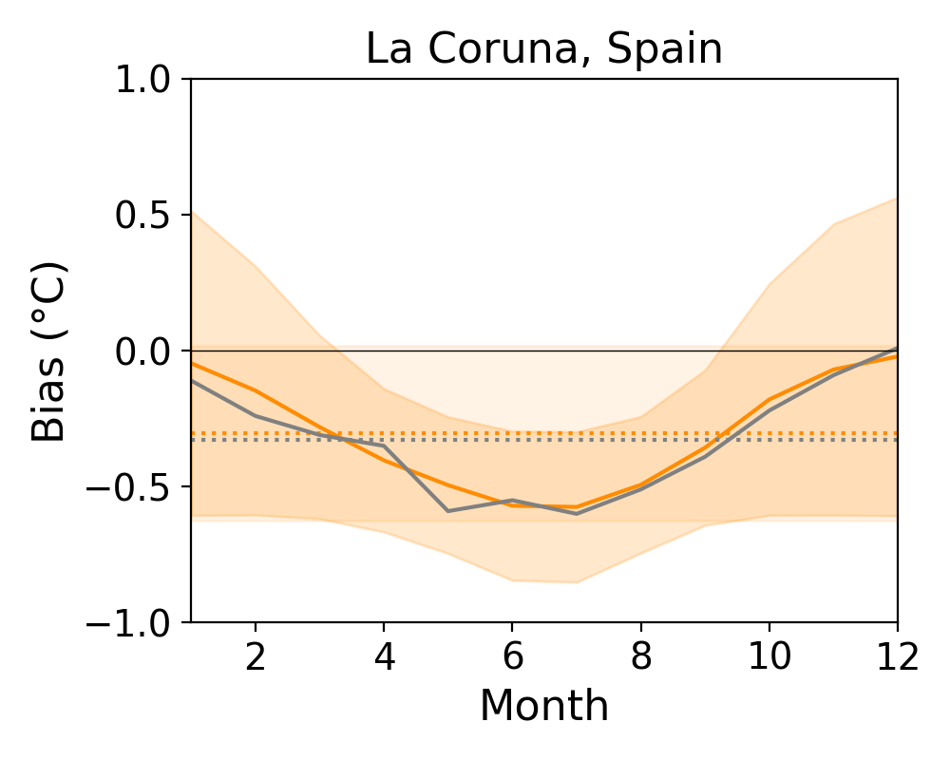
2. DEVELOP MODELS TO ESTIMATE THE BIAS
Open Exposures:
We thus combine the two predictors to form a model which estimates the seasonal cycle of the bias from SWD and the magnitude / amplitude from T_{Hist.}
Using this model produces skilful predictions of the exposure bias. One example for La Coruna, Spain is shown in the plot on the right.
Indicators of model performance, tested across all available series (lower and upper quartiles):
Skill score: 0.39 – 0.96
RMSE: 0.09 – 0.21°C
Difference in the annual mean bias: ±0.08°C
SWD seasonal cycle normalised and scaled to the maximum and minimum bias values defined by T_{Hist}
Maximum bias
Predicted bias
Minimum bias
Observed bias
The maximum and minimum bias is determined by regression on annual mean T_{Hist}
Wallis et al. (2023; in prep)
EGU2023 Supplementary Display Material

Slide 13
2. DEVELOP MODELS TO ESTIMATE THE BIAS
This process was repeated for the remaining exposures:
Wall-mounted: “any exposure mounted on a wall/fence/window”
Intermediate: “freestanding exposures; provide some lateral protection as well as protection above the thermometer”
Closed: “freestanding exposures; fully enclose the thermometer”
to produce four bias-estimation models.
The correlations between the bias and the variables used in each bias estimation model are shown on the right.
WALL-MOUNTED EXPOSURES
INTERMEDIATE
EXPOSURES
CLOSED
EXPOSURES
The bias in wall-mounted exposures is significantly related to TOA.
The quadratic relationship with TOA produces skilful predictions of the exposure bias
The bias in intermediate exposures is significantly related to all three variables tested.
Using TOA as predictor produced the most skilful predictions of the exposure bias
The bias in closed exposures is significantly related to all three variables tested.
Using SWD as predictor produced the most skilful predictions of the exposure bias
Wallis et al. (2023; in prep)
EGU2023 Supplementary Display Material

Slide 14
2. DEVELOP MODELS
3. IDENTIFY BIAS
Conclusions:
Step two demonstrates:
The magnitude of the exposure bias from the transition to the Stevenson screen is significantly related to temperature and/or solar radiation indicators in all classes of historic exposure
It is possible to estimate the exposure bias at extratropical stations using temperature, solar radiation, or a combination of the two
Three of the models developed as part of this work – the models for open, wall-mounted and closed exposures - are considered robust enough to apply more broadly to stations in CRUTEM5.
Next step: Identify bias-affected stations and time periods
To apply the models developed in step two to the CRUTEM5 station data, we need to know:
When or if stations introduced the Stevenson screen
Which (if any) non-standard exposures were used before the introduction of the Stevenson screen
Which (if any) station records have already been adjusted for the exposure bias
To address these questions, exposure metadata was gathered from an extensive search of the literature and compiled to form an ‘historic exposures’ database.
Metadata has only been collected for stations with data prior to 1961, after which point it is assumed stations would have had Stevenson screens (or other standardised exposures). Metadata for stations within 30° to 60° latitude has also been prioritised.
EGU2023 Supplementary Display Material

Slide 15
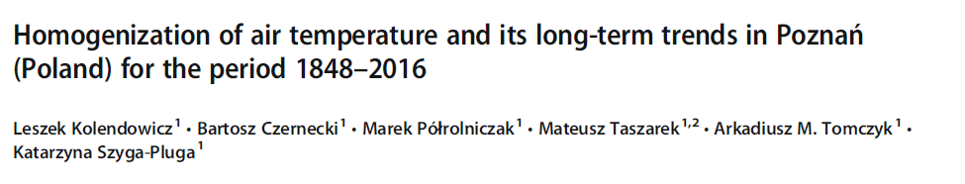
3. IDENTIFY BIAS-AFFECTED STATIONS AND TIME PERIODS
Exposure metadata:
Where possible, exposure metadata was compiled for individual stations within CRUTEM5.
On the right is an example of the metadata collated and entered into the database for a station in Poland.
Unknown
Wall-mounted
Stevenson-type screen
1850
1900
1950
2000
EGU2023 Supplementary Display Material

Slide 16
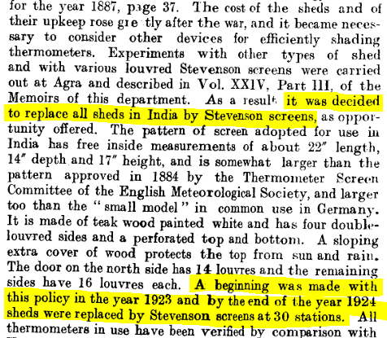
3. IDENTIFY BIAS-AFFECTED STATIONS AND TIME PERIODS
Exposure metadata:
Where it was not possible to compile exposure metadata for an individual station, country or region-specific information was used to build a picture of the exposures in use.
On the right is an example of the metadata used to build a picture of the exposures in use at stations in India and Pakistan.
1)
2)
3)
Unknown
Intermediate
Transition
Stevenson-type screen
1850
1900
1950
2000
EGU2023 Supplementary Display Material

Slide 17
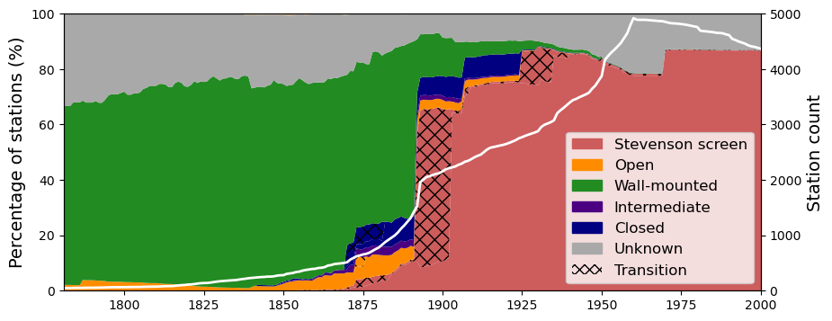
3. IDENTIFY BIAS-AFFECTED STATIONS AND TIME PERIODS
Exposure metadata:
The result of the exposure metadata collection exercise (for extratropical stations) is shown on the right.
The results show a clear temporal evolution in the use of exposures:
Wall-mounted exposures were almost exclusively used in the early period
Freestanding exposures became more popular (open first, then intermediate and closed) from the mid-1800s
The use of Stevenson screens rapidly increased in the late-19th century; by the 1930s they were almost exclusively used
Wallis et al. (2023; in prep)
EGU2023 Supplementary Display Material

Slide 18
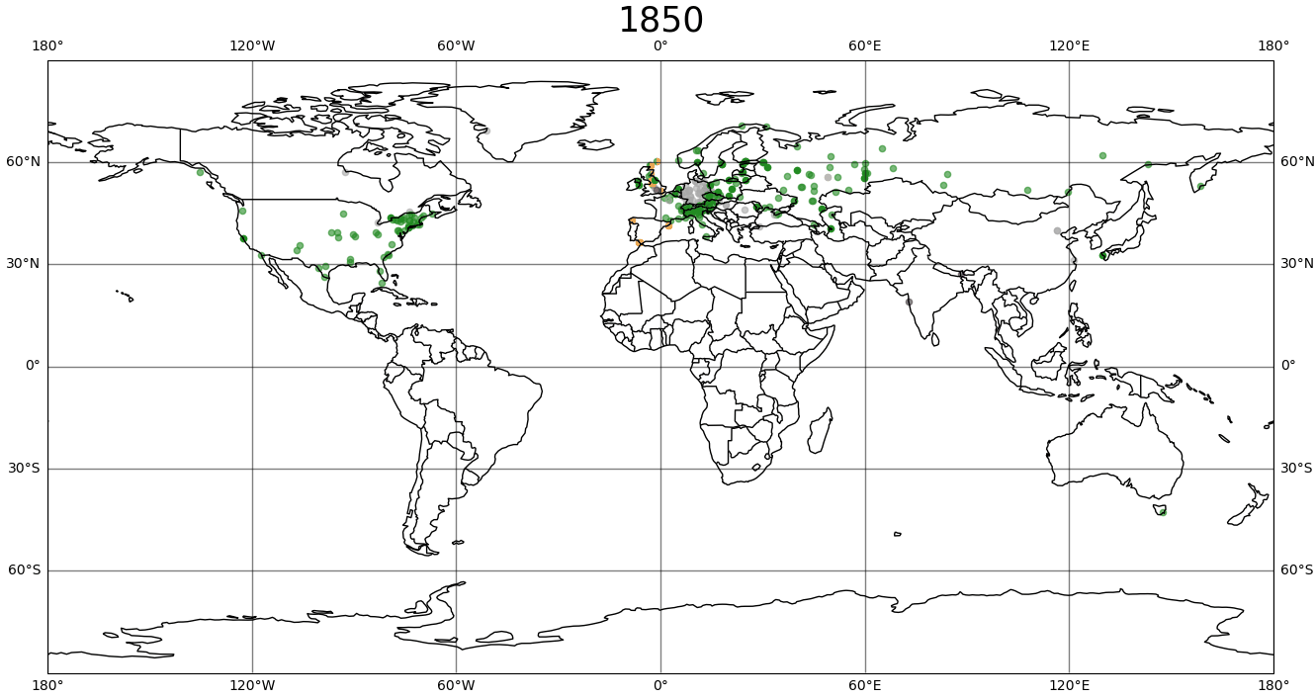
3. IDENTIFY BIAS-AFFECTED STATIONS AND TIME PERIODS
Exposure metadata:
The use of, and transition between, exposures was not spatially or temporally homogenous.
Different regions favoured different exposures and introduced the Stevenson screen at different times, as is shown on the right.
Each coloured dot represents the exposure in use at a station.
Each transition from a non-red dot (historic exposure) to a red dot (Stevenson screen) represents a possible bias in the data.
Stevenson-type Open Wall Intermediate Closed Unknown
Wallis et al. (2023; in prep)
EGU2023 Supplementary Display Material

Slide 19
3. IDENTIFY BIAS
4. ESTIMATE THE BIAS
Conclusions:
Exposure metadata has been collated by the authors for stations within CRUTEM5.
Overall, 88% of extratropical stations (with data before 1960) have at least one entry in the ‘historic exposures’ database and 2,519 stations with probable exposure biases were identified.
The metadata highlights the use of, and transition between, exposures was not spatially or temporally homogenous. This reinforces the need to consider the exposure history of individual stations and/or regions when accounting for exposure biases in observational datasets.
Next step: Estimate the bias and apply adjustments
Three models – the open, wall-mounted and closed models - were applied to the bias-affected stations identified in step four to produce metadata-based monthly predictions of the exposure bias.
The estimated biases were then added to the station data, as per WMO (2020) guidelines, to minimize the exposure bias.
Adjustments were applied to stations within 30° to 60° latitude, only.
Data adjusted to minimize the bias and make it comparable with data from Stevenson screens
Open
Stevenson-type screen
Wall
1850
1900
1950
EGU2023 Supplementary Display Material

Slide 20
4. ESTIMATE THE BIAS AND APPLY ADJUSTMENTS
Results
The bias estimation models were applied to 1,960 stations resulting in 524,894 monthly adjustments.
At the hemispheric and annual scales the adjustments are relatively small, less than 0.12°C.
The changing magnitude, and seasonal structure, of the bias reflects the transition between exposures. The increase in the Northern Hemisphere bias in the late-1800s, for example, is due to freestanding exposures replacing wall-mounted exposures.
Regionally the differences are larger, up to 0.6°C annually (next).
NORTHERN HEMISPHERE
SOUTHERN HEMISPHERE
CRUTEM5 adjusted – CRUTEM5 (°C)
Wallis et al. (2023; in prep)
EGU2023 Supplementary Display Material

Slide 21
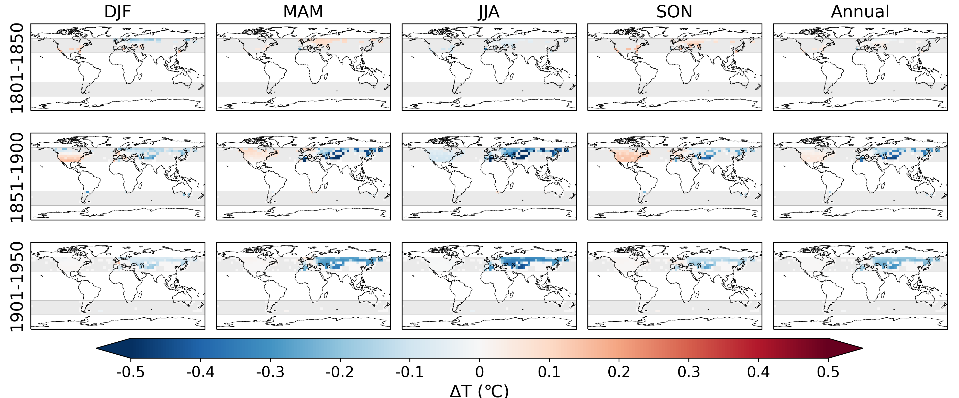
4. ESTIMATE THE BIAS AND APPLY ADJUSTMENTS
Wallis et al. (2023; in prep)
EGU2023 Supplementary Display Material

Slide 22
4. ESTIMATE THE BIAS AND APPLY ADJUSTMENTS
Comparison with HadCRUT5
The predicted hemispheric annual biases generally fall within the range of the HadCRUT5 error model (grey shading, dashed outline).
At the grid cell level, however, our predictions of the annual bias (grey shading) exceed the range present in the HadCRUT5 error model, particularly in the Northern Hemisphere.
The predictions of a generally warm bias also suggest the symmetrical nature of the HadCRUT5 model is not appropriate to represent the bias.
Annual bias in HadCRUT5 error model
NORTHERN HEMISPHERE
SOUTHERN HEMISPHERE
CRUTEM5 adjusted – CRUTEM5 (°C)
Predicted annual bias in each grid cell
Wallis et al. (2023; in prep)
EGU2023 Supplementary Display Material

Slide 23
CONCLUSIONS AND NEXT STEPS
Conclusions:
Transitions between historic exposures and Stevenson screens have likely introduced exposure biases into the LSAT record
In this piece of work we used parallel measurements to characterise the exposure bias and to develop models to predict the bias for four classes of historic exposure
Three of the bias estimation models - the open, wall-mounted and closed exposure models – have been applied to the land component of HadCRUT5 (CRUTEM5), using the collated exposure metadata to identify bias-affected stations, to create a partially bias-adjusted version of the dataset. 75.1% of extratropical stations in CRUTEM5 (representing 86.3% of the data) have now been adjusted.
At the hemispheric and annual scale the adjustments are relatively small (up to 0.12°C), but seasonally and regionally adjustments are larger, up to 1.3°C in summer (in individual years).
Next steps:
Journal paper currently in prep (Wallis et al., 2023; in prep)
The bias estimations are being incorporated into a new Global Surface Air Temperature Dataset (Morice et al. 2023; in prep)
The work presented here represents our current understanding of the exposure bias, however it is designed to be continually updated and improved and any information regarding additional parallel measurements series / exposure metadata would be gratefully received.
Wallis et al. (2023) Quantifying exposure biases in early instrumental land surface air temperature observations [Manuscript in preparation]
EGU2023 Supplementary Display Material

Slide 24
REFERENCES
Parallel Measurements:
Adelaide Observatory Yearbooks – Government of South Australia (multiple years) ‘Meteorological Observations made at the Adelaide Observatory and other places in South Australia and the Northern Territory’.
AEMET (Brunet, pers. comms)
Butler, C.J. et al. (2005) ‘AIR TEMPERATURES AT ARMAGH OBSERVATORY, NORTHERN IRELAND,FROM 1796 TO 2002’, International Journal of Climatology, 25, pp. 1055–1079.
Chandler, T.J. (1964) ‘North-wall and stevenson screen temperatures at kew observatory’, Quarterly Journal of the Royal Meteorological Society, 90(385), pp. 332–333.
Chenoweth, M. (1992) ‘A Possible Discontinuity in the U.S. Historical Temperature Record’, Journal of Climate, 5(10), pp. 1172–1179.
Dines, L.H.G. (1921) A comparison between the dry bulb temperature in the climatological screen at Valencia Observatory and that in a Stevenson screen exposed in an open field adjoining.
Ellis, W. (1891) ‘On the comparison of thermometrical observations made in a Stevenson screen with corresponding observations made on the revolving stand at the royal observatory, Greenwich’, Quarterly Journal of the Royal Meteorological Society, 17(80), pp. 240–249.
Field, J.H. (1920) ‘On exposures of thermometers in India’, in India Meteorological Memoirs, pp. 21–73.
Gaster, F. (1882) ‘Report on experiments made at Strathfield Turgiss in 1869 with stands or screens of various patterns, devised and employed for the exposing of thermometers, in order to determine the temperature of the air’’, Quarterly Weather Report
Gill, D. (1882) ‘On the effect of different kinds of thermometer screens, and of different exposures, in estimating the diurnal range of temperature at the royal observatory, cape of good hope’, Quarterly Journal of the Royal Meteorological Society, 8(44), pp. 238–243..
Gorczynski, W. (1910) ‘Klatka angielska nowego typu w porownaniu z ochronami termetrycznemi innych systemow.’, Wiadomosci Matematyczne, 14.
Greenwich Observatory Yearbooks – Board of Admiralty (multiple years) ‘Results of the Magnetical and Meteorological Observations made at the Royal Observatory, Greenwich’.
Grissolet (1935) ‘Comparaison entre les temperatures observees dans l'abri anglais O.N.M petit modele et sous l'abri Montsouris’, Annales des services techniques d'hygeine de la ville de Paris, XVII, pp. 256-267
Koppen (1913) ‘Uniform thermometer set-up for meteorological stations for the determination of air temperature and humidity’, Meteorol. Zeitschr., 30, pp. 474-488 and 514-523.
Margary, I.D. (1924) ‘Glaisher stand versus stevenson screen. A comparison of forty years’ observations of maximum and minimum temperature as recorded in both screens at Camden Square, London’, Quarterly Journal of the Royal Meteorological Society, 50(211), pp. 209–226.
Marriott, W. (1879) ‘Thermometer exposure - Wall versus Stevenson Screens’, Quarterly Journal of the Royal Meteorological Society.
Marriott, W. (1894) ‘Comparative observations with two sets of instruments at llfracombe, north devon, during 1893’, Quarterly Journal of the Royal Meteorological Society, 20(90), pp. 164–168.
Wallis et al. (2023) Quantifying exposure biases in early instrumental land surface air temperature observations [Manuscript in preparation]
EGU2023 Supplementary Display Material

Slide 25
REFERENCES
Parallel Measurements continued:
Martinez Ibarra, E. et al. (no date) ‘INTERCOMPARACIÓN DE LAS TEMPERATURAS EXTREMAS EN TRES TIPOS DE GARITA METEOROLÓGICA: MONTSOURIS, STEVENSON Y YOUNG’.
Mawley, E. (1897) ‘Shade temperature’, Quarterly Journal of the Royal Meteorological Society, 23(102), pp. 69–87.
Moden (1954) `Thermometer stands - a short comparison between free-standing screens and shelters, Notiser och preliminara rapporter, 1(3), 12 pp.
Muller, G. (1984) Vergleich der temperaturen verschiedener wetterhuetten an einigen stationen des anetzes.
Nordli, P.Ø. et al. (1997) ‘The effect of radiation screens on Nordic time series of mean temperature’, International Journal of Climatology, 17(15), pp. 1667–1681.
Omond, R.T. (1906) ‘Temperatures in thermograph and Stevenson screens’, Journal of the Scottish Meteorological Society, XIV(XXIII), pp. 15–20.
Sprung, A. (1890) ‘Bericht uber vergleichende Beobachtungen an verschiedenen Thermometer-Aufstellungen zu Gross-Lichterfelde bei Berlin’, Abhandlungen des Koniglich Preussuschen Meteorologischen Instituts, 1(2).
Veðráttan Journal (1962) ‘Annual Report 1962’, Veðráttan
Vigurs (1935) ‘Temperature at Falmouth’, The Meteorological Magazine, 70(832), pp. 91-92.
Whipple, G.M. (1883) ‘Report on experiments made at the Kew Observatory with thermometer screens of different patterns during 1879, 1880, and 1881’, Quarterly Weather Report.
References
Frank, D. et al. (2007) ‘Warmer early instrumental measurements versus colder reconstructed temperatures: shooting at a moving target’, Quaternary Science Reviews, 26(25–28), pp. 3298–3310.
Kolendowicz et al. (2019) ‘Homogenization of air temperature and its long-term trends in Poznań (Poland) for the period 1848–2016’, Theoretical and Applied Climatology, 136(3-4), pp. 1357-1370
Morice, C.P. et al. (2012) ‘Quantifying uncertainties in global and regional temperature change using an ensemble of observational estimates: The HadCRUT4 data set’, Journal of Geophysical Research: Atmospheres, 117(D8)
Morice, C.P. et al. (2021) ‘An updated assessment of near‐surface temperature change from 1850: the HadCRUT5 dataset’, Journal of Geophysical Research: Atmospheres.
Osborn, T.J. et al. (2021) ‘Land Surface Air Temperature Variations Across the Globe Updated to 2019: The CRUTEM5 Data Set’, Journal of Geophysical Research: Atmospheres, 126(2).
Parker, D.E. (1994) ‘Effects of changing exposure of thermometers at land stations’, International Journal of Climatology, 14(1), pp. 1–31. Trewin, B. (2010) ‘Exposure, instrumentation, and observing practice effects on land temperature measurements’, Wiley Interdisciplinary Reviews: Climate Change, 1(4), pp. 490–506.
Wallis et al. (2023) Quantifying exposure biases in early instrumental land surface air temperature observations [Manuscript in preparation]
World Meteorological Organization (2020) Guidelines on Homogenization. 2020 edition. Edited by V. Venema et al. Geneva.
Wallis et al. (2023) Quantifying exposure biases in early instrumental land surface air temperature observations [Manuscript in preparation]
EGU2023 Supplementary Display Material

