Slide 1
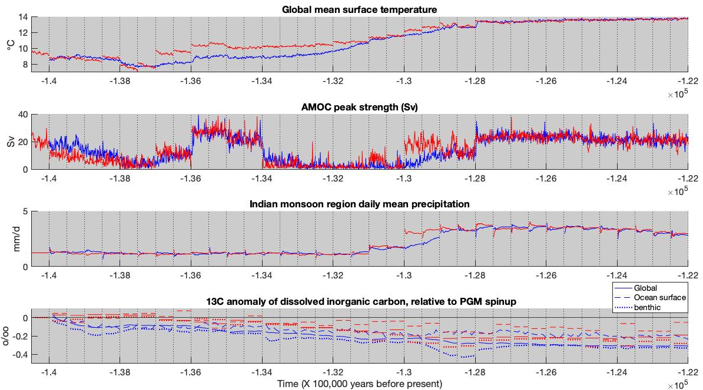
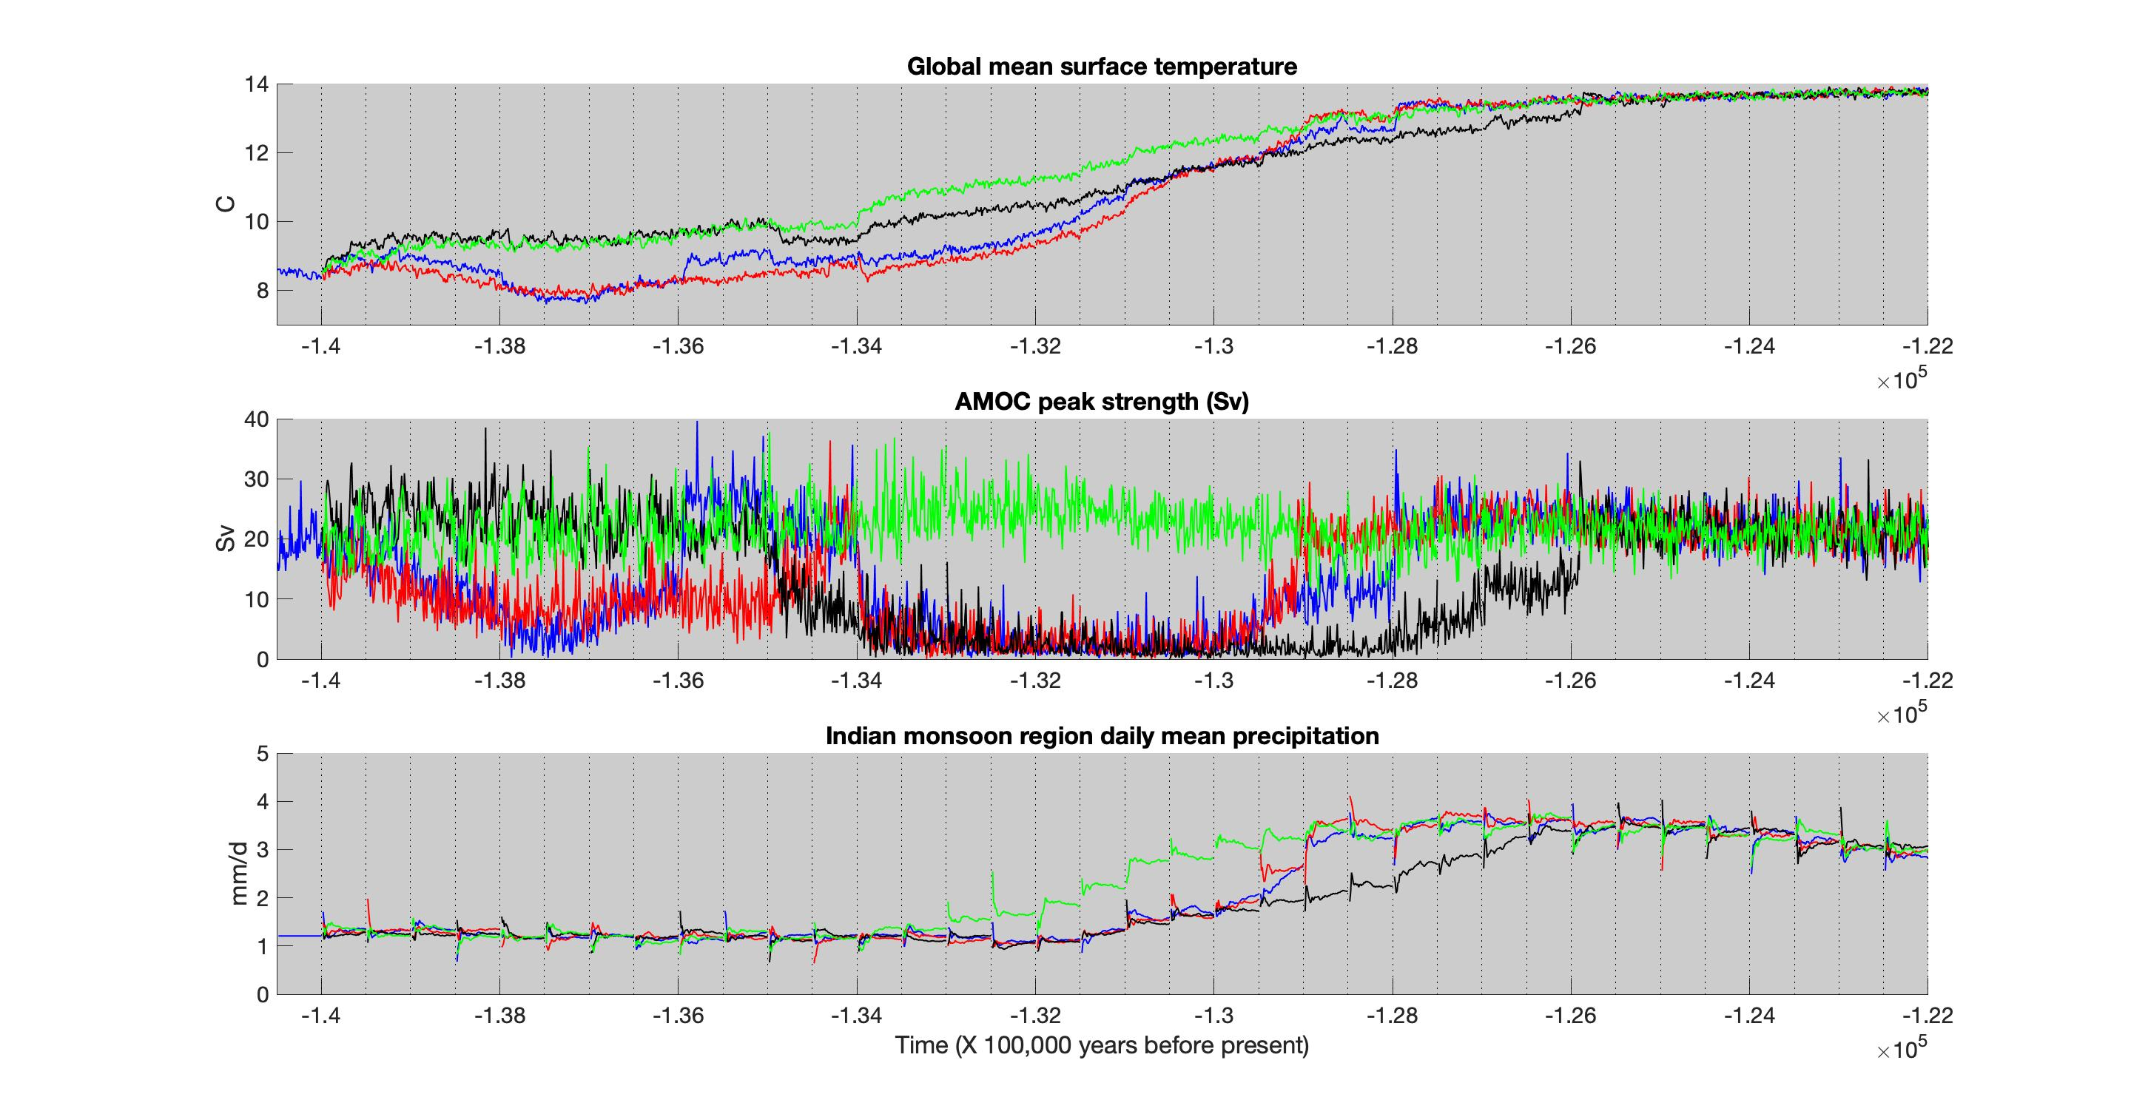
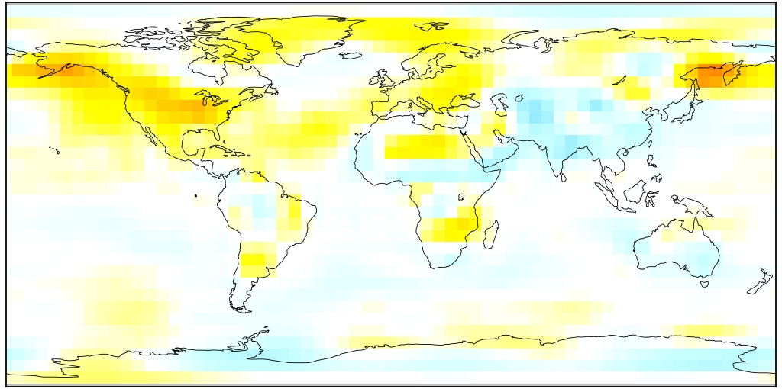
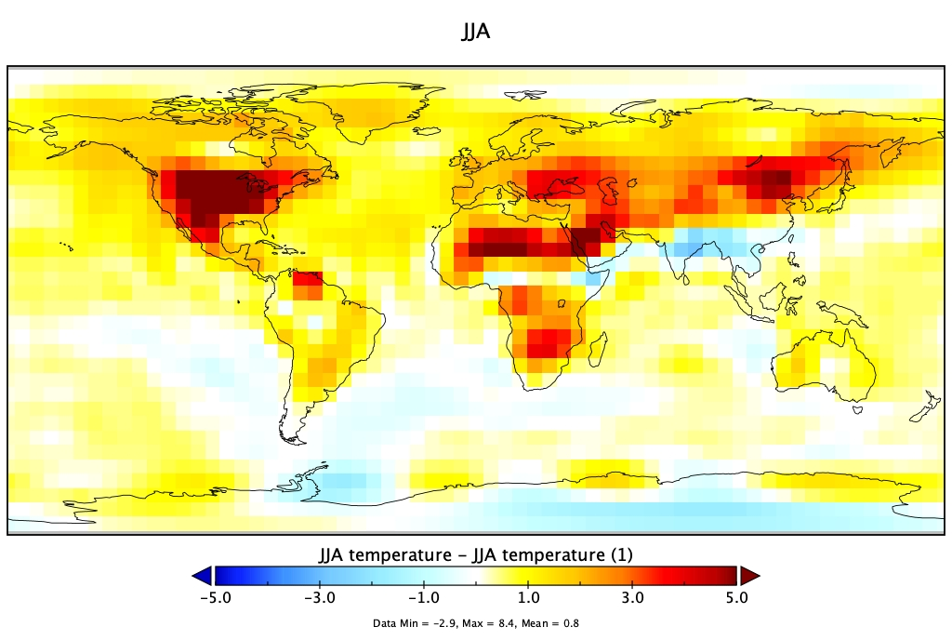
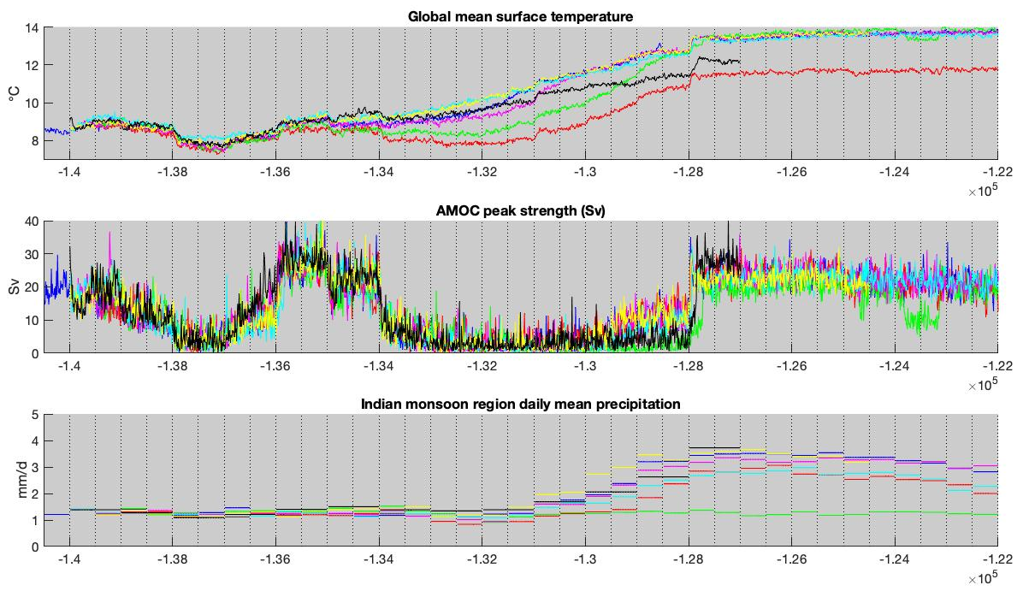
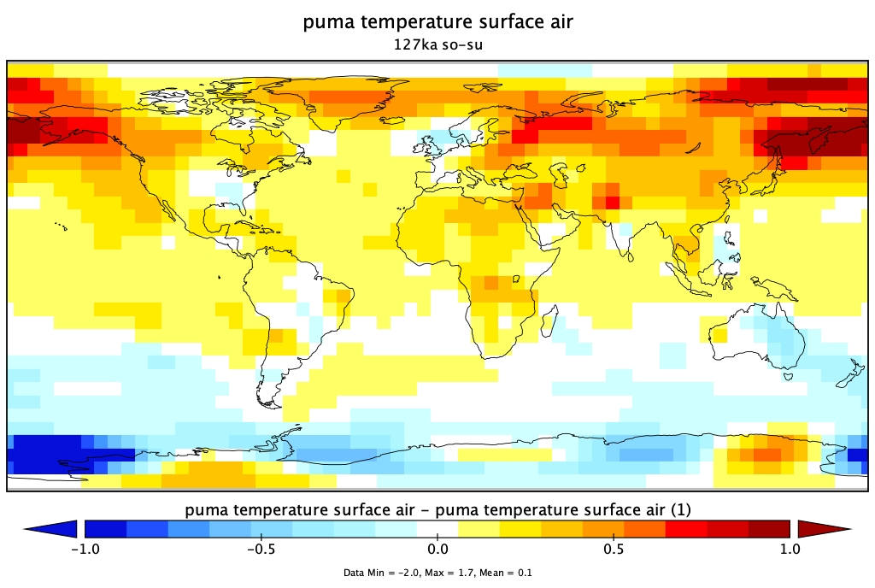
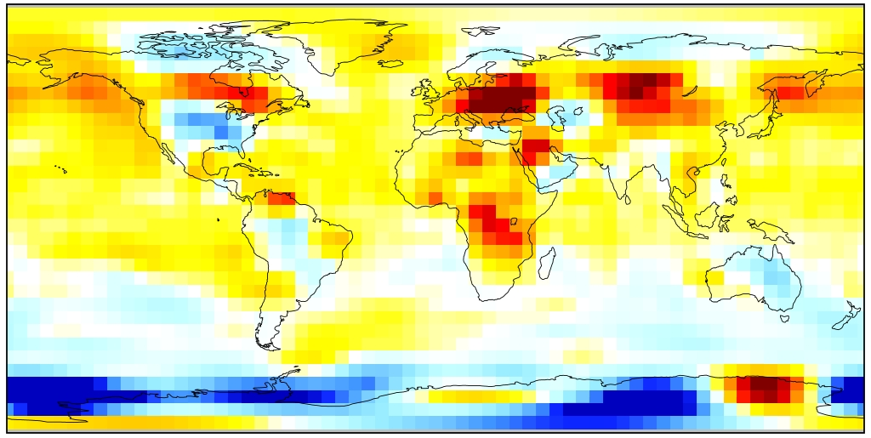
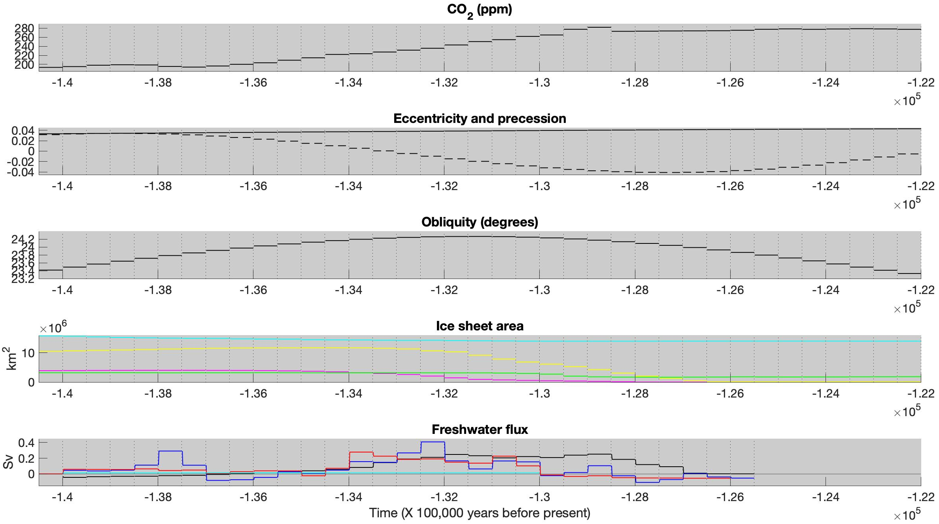
Coupled climate-carbon simulations of the Penultimate Deglaciation and Last Interglacial in the PLASIM-GENIE model
Tim Cutler, Philip Holden, Pallavi Anand, Neil Edwards
Contact: tim.cutler@open.ac.uk
Introduction
The Penultimate Deglaciation saw warming and ice sheet retreat from the Penultimate Glacial Maximum 140,000 years before present (ka) into the Last Interglacial (LIG) which occurred 130-115 ka.
The peak of the LIG around 127ka is indicated by proxies to be around 1-2 ℃ warmer than preindustrial, but models fail to replicate this warmth (e.g. Lunt et al, 2013).
Most paleoclimate modelling studies use steady state timeslices which may be missing superimposed long-term trends.
Annual mean JJA
Above: models and proxy LIG temperature difference from preindustrial (Lunt et al., 2013). Below: In this model, PLASIM-GENIE, comparing steady state simulations, 127ka is cooler than a preindustrial control.
Annual mean JJA
℃ ℃
Method
PLASIM-GENIE model is used in this study to run multimillennial climate-carbon cycle simulations, orders of magnitude faster than high-complexity models.
Here, quasi-transient experiments are run in PLASIM-GENIE where boundary conditions are updated every 500 model years between 140-122ka.
Steady state experiments are also run for every 500 years of the same interval, where the model is spun-up for 3000 years in each.
Boundary conditions follow PMIP4 Penultimate Deglaciation protocol (Menviel et al, 2019).
Three different Northern Hemisphere freshwater flux data sources are used: from sea level (blue), ice sheets (black) and ice-rafted debris (red). A constant Antarctic freshwater flux (cyan) is used in all.
Quasi- transient (blue) compared to steady-state (red) experiments
Quasi-transient simulations find delayed global warming, later recovery of the Atlantic Meridional Overturning Circulation (AMOC) and associated Indian monsoon rainfall strengthening, and stronger perturbations to δ¹³C of dissolved inorganic carbon (DIC), compared to steady state simulations.
Short-term perturbations to δ¹³C are possibly caused by AMOC altering vertical mixing. Long term δ¹³C trend is possibly associated with atmospheric CO₂ rise.
Annual mean surface temperature ℃ JJA surface temperature ℃
+ 0.121 ℃ (500-year mean) + 0.083 ℃
At 127ka, quasi-transient simulations have LIG temperatures warmer than steady state spin-ups at high northern latitudes, (where proxies show strongest warming) despite small difference in global mean temperature.
Sensitivity experiments (all quasi-transient)
Using meltwater flux data derived from either sea level changes or ice-rafted debris results in an early weak phase of AMOC. Main AMOC weakening and final recovery occur later than in proxies.
Meltwater flux input derived from ice sheets results in even later AMOC recovery.
With no meltwater flux, AMOC does not weaken.
Timing of Indian monsoon strengthening is strongly linked to timing of AMOC recovery.
Holding precession fixed at 140ka phase delays global warming and AMOC recovery, and prevents Indian monsoon strengthening. Obliquity has a similar effect, but milder.
When the relative phasing of orbital cycles is switched to that of the Last Deglaciation (so that precession peaks earlier and obliquity later), the Indian monsoon strengthens earlier. But lowering eccentricity to Last Glacial Maximum value (0.018994) has the opposite effect.
Indian monsoon strengthening before AMOC recovery (Nilsson-Kerr et al, 2019) is reproduced here, caused by amplitude of precession.
Global mean surface temperature
Global mean surface temperature
Freshwater forcing:
None
AMOC peak strength
AMOC peak strength
<- Interval of weak AMOC expected from proxies (Deaney et al, 2017) ->
Indian monsoon region mean precipitation
Indian monsoon region mean precipitation
Figure 6: Control experiments. Red: CO2. Green: precession. Purple: obliquity. Cyan: eccentricity lowered to LGM value. Yellow: orbital phasing shifted. Black: Ice sheets kept at 140ka. All are quasi-transient with boundary conditions updated at 500-year intervals, except for ice sheet experiment which used 1000-year intervals.
¹³C anomaly of dissolved inorganic carbon
Global mean surface temperature
Figure 4; Spin-ups (red) compared to spin-ons (blue) GMST, AMOC, monsoon, 13C.
AMOC peak strength
Indian monsoon region mean precipitation
Ecc
Pre
Eurasia
North America
Antarctica
Greenland
Conclusions
Using long quasi-transient instead of steady state simulations slightly narrows the gap between proxies and modelled Last Interglacial global temperature and temperature distribution.
CO₂, precession, obliquity, and ice sheets and freshwater flux (as a cause of AMOC variability) all contribute to deglacial Indian monsoon strengthening.
References
Lunt, D. J., et al.: A multi-model assessment of last interglacial temperatures, Clim. Past, 9, 699–717,
Deaney, E. L. et al.: Timing and nature of AMOC recovery across Termination 2 and magnitude of deglacial CO₂ change. Nat. Commun. 8, 14595
Menviel, L. et al.: The penultimate deglaciation: protocol for Paleoclimate Modelling Intercomparison Project (PMIP) phase 4 transient numerical simulations between 140 and 127 ka, version 1.0. Geosci. Mod. Dev. 12, 3649–3685 (2019)
Nilsson-Kerr, K., et al.: Role of Asian summer monsoon subsystems in the inter-hemispheric progression of deglaciation. Nat. Geosci. 12, 290–295 (2019).
Future work
Run with fully interactive CO₂
Different scenarios of West Antarctic deglaciation
Parametric uncertainty?

