Slide 1
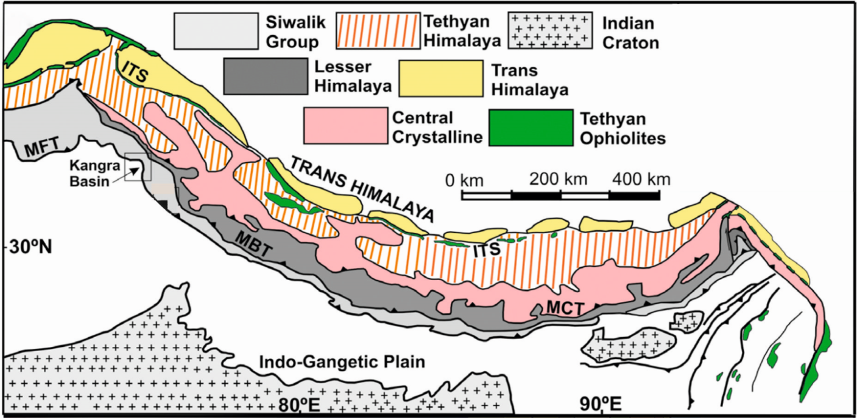
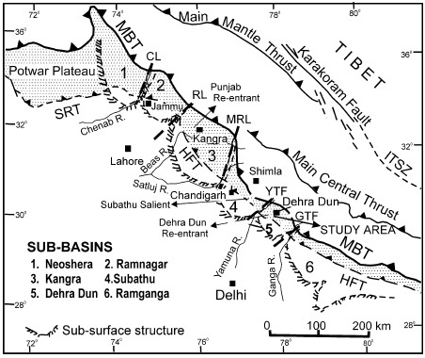
India-Asia Collision
(After Goswami et. al., 2017)
After Acharyya,2007; Acharyya & Saha, 2018
(After Raiverman et al., 1983)
Notes:
As we all know that, the Himalayan mountain range was formed as a result of collision b/w Indian and Eurasian plate which began at about 55 Ma.
The outer part of this range is marked by foreland basin in south that resulted due to the thrust loading and subsidence with synorogenic sedimentation from the hinterland (Raiverman et al., 1983; Burbank et al., 1996).
The lowermost part of the Himalayan foreland is marked by marine (Subathu) to continental (Dagshai-Kasauli) formation. It is overlain by the molassic sediments of “Siwalik”
this is the map showing the siwalik from west to east which is bounded by MBT in the north and MFT in the south.
HFB is divided into number of sub-basin by several basement highs and and lineament
age siwalik 16 to 1.5ma valdiya.

Slide 2
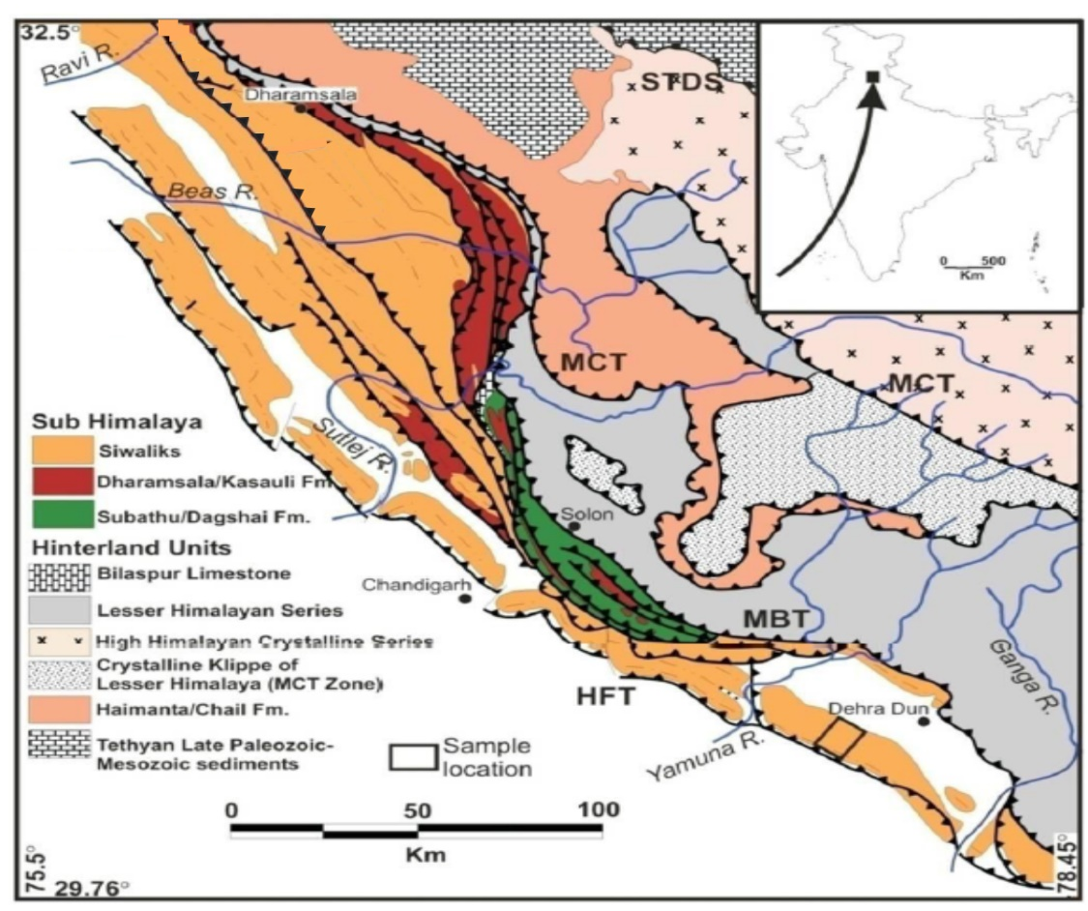
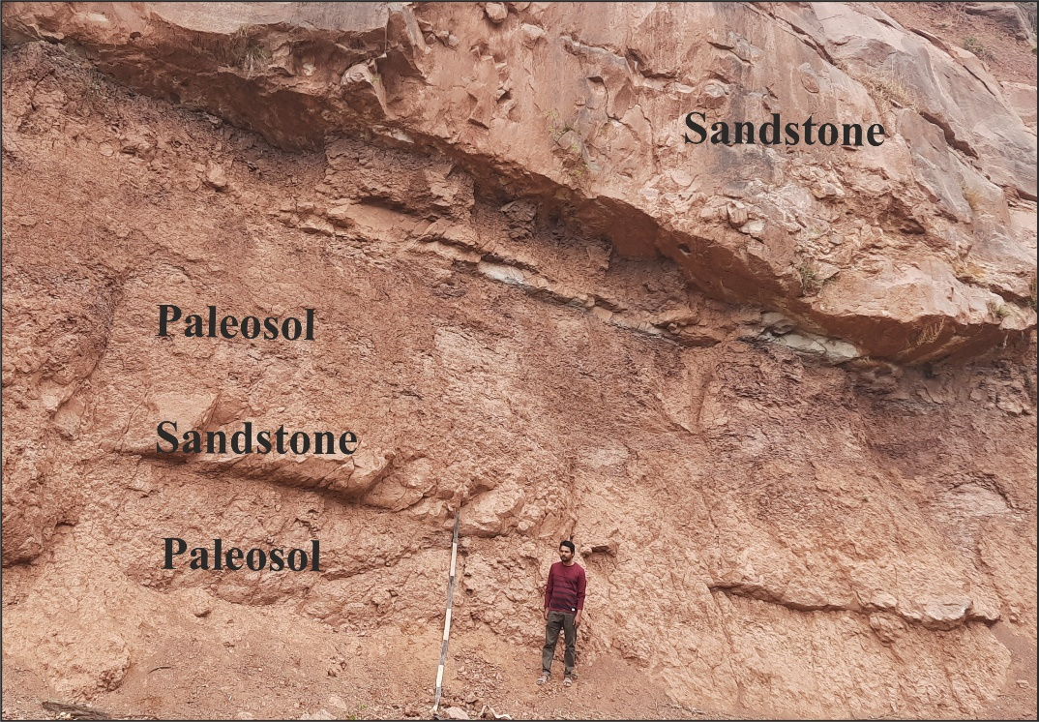
Introduction
Paleosols: Very useful because of their formation at Earth’s surface directly in contact with atmospheric and climatic conditions (Sheldon and Tabor, 2009).
Paleosols form at the interface of the past landscape and atmosphere and therefore have the potential to archive the climatic and environmental changes at their time of formation.(Soil Survey Staff 1999).
Kangra Sub-Basin
It is important because:
Well exposed.
Largest intermontane basin.
Drainage re-organization at sub-basin scale.
Varying proportion of granite clasts (SE part <5%, NW part >20%)
Contrasting paleoflow (SW paleoflow in the southeastern part and in the northwestern part a SE paleoflow).

Slide 3
What is significance of this study?
This study provides the first detailed record of Siwalik paleosols (11Ma-6 Ma) from Kangra Sub-Basin. The paleopedological study of the HFB (Siwalik) sediments is very significant on account of:
Re-activation of MCT
Activation of MBT
Intensification and fluctuations of Monsoon
Varying sedimentation rate
Transition from C3 to C4 types of vegetation
The paleopedological information, in particular, will be extremely useful to researchers in the field of paleoclimate, tectonics, and sedimentology of the foreland basins elsewhere.

Slide 4
Objective
To explore paleopedological features of the Siwalik Group that could be useful to highlight paleoenvironmental conditions including monsoonal conditions archived in foreland sediments of the Kangra Sub-Basin. This can be divided into the following sub-objectives:
Characterization of the paleosols horizons.
Micromorphological details of the paleosols
Clay mineralogy of the paleosols.
Bulk geochemistry of the paleosols.
Stable isotope geochemistry of pedogenic carbonate.
Pedogenic variability of the paleosols.

Slide 5
Literature Review
Pakistan Siwalik | Indian Siwalik | Nepal Siwalik | NE Siwalik
Litho-bio- and chrono- stratigraphy Barndt et al., 1978 Opdyke et al.,1979, Johnson et al.,1982, 1985 Barry el al., 1982,1990, Nanda et al., 2017 | Litho-bio- and chrono- stratigraphy Pilgrim., 1913, Johnson et al., 1983; Sangode et al., 1996, 1999, 2003; Sinha et al., 2005, Sangode, 2014, 2016; Gilbert et al., 2017 Govin et al., 2018 | Litho-bio- and chrono- stratigraphy well established Corvinus et al. 1994, Sah et al. 1994 Ojha et al 2000, Gautam et al.2000 Adhikari et al. 2015 | Magneto-stratigraphy Chirouze et al., 2012b
Sedimentation pattern Willis et al., 1993b, 1994, Critelli et al., 1994, Khan et al., 1997 | Sedimentation pattern established mainly for west of Ganga River Rangaraj 1978, Tandon et al., 1979, Prakash et al., 1980 Kumar et al., 2003a; 2004a,b; 2011; Goswami and Deopa, 2018; Kumar 2020 | Sedimentation pattern well established Ulak, P. D., 2004,2009 Sigdel et al 2013,2016 Sakai 2016 | Sedimentation pattern Karunakaran et al., 1976 Banerjee 1982, Kumar G. 1997 Kundu et al.,2011
Systematic unroofing history of the source area is fairly well understood Johnson et al.,1982a | Systematic unroofing history of the source area is fairly attempted White et al., 2002; Jain et al., 2009; Najman 2009; Lang et al., 2016; Gavillot et al., 2018; Patel et al, 2020 | Systematic unroofing history of the source area is fairly well understood DeCelles et al 1998, Bernet et al. 2006 Szulc et al. 2006, Chirouze et al. 2012 | Systematic unroofing history of the source area Cina et al., 2009 Chirouze et al., 2013
Thrusting events are well constrained Johnson et al.,1979 and 1985 | Thrusting events are well constrained for west of Ganga River Meigs et al., 1995; Kumar et al., 1999; 2002; 2003a,b; Gavillot et al., 2018 | Various thrusting events and emplacement of Dadeldhura batholith are well established DeCelles et al 2001, Huyghe et al 2005 Robinson et al. 2006 | Various thrusting events Acharyya, S. K., 1976,1994 Kelty et al., 2004 Ding et al.,2000 Yin et al., 2006 and 2010
Paleoclimate attempted using paleosol stable isotope geochemistry Quade et al., 1994,2012 Cerling et al.,1999. Zaleha, M.J.,1994,1997a, Behrensmeyer 2017 et al., | Application of paleosol for paleoclimatic variation is not attempted in detail. Thomas et al.,2002, seema et al., 2011; Vogeli et al 2018, Hameed at al., 2021 | Paleoclimatic variation attempted using paleosol stable isotope geochemistry Quade et al., 1995 | Paleoclimatic variation attempted using paleosol stable isotope geochemistry Vogeli et al., 2018

Slide 6
METHODO LOGY
Literature Review
Laboratory Method
*Chronologically constrained sections
*Fluvial architecture
*Paleosol-bearing horizons
*Sampling of representative paleosols samples
(Undisturbed sampling and bulk sampling)
* Macromorphology
Field Method
*Slide preparation for Micromorphology
*Particle Size Distribution
*Oriented clay(slide) for XRD Analysis
*Sample preparation for XRF Analysis
*Stable isotope geochemistry
*Summarizing knowledge
*Significance of research problem
*Study of previous work

Slide 7
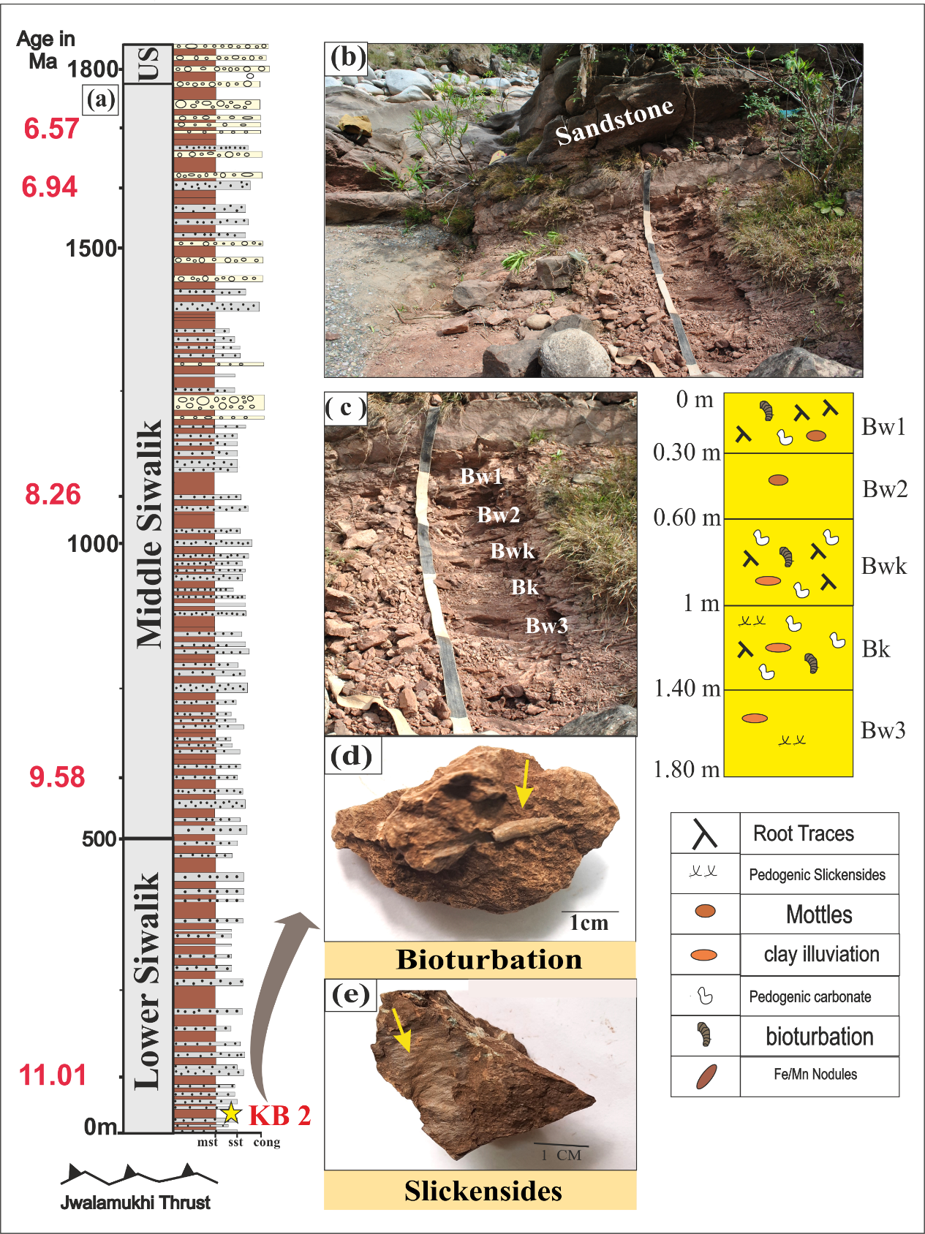
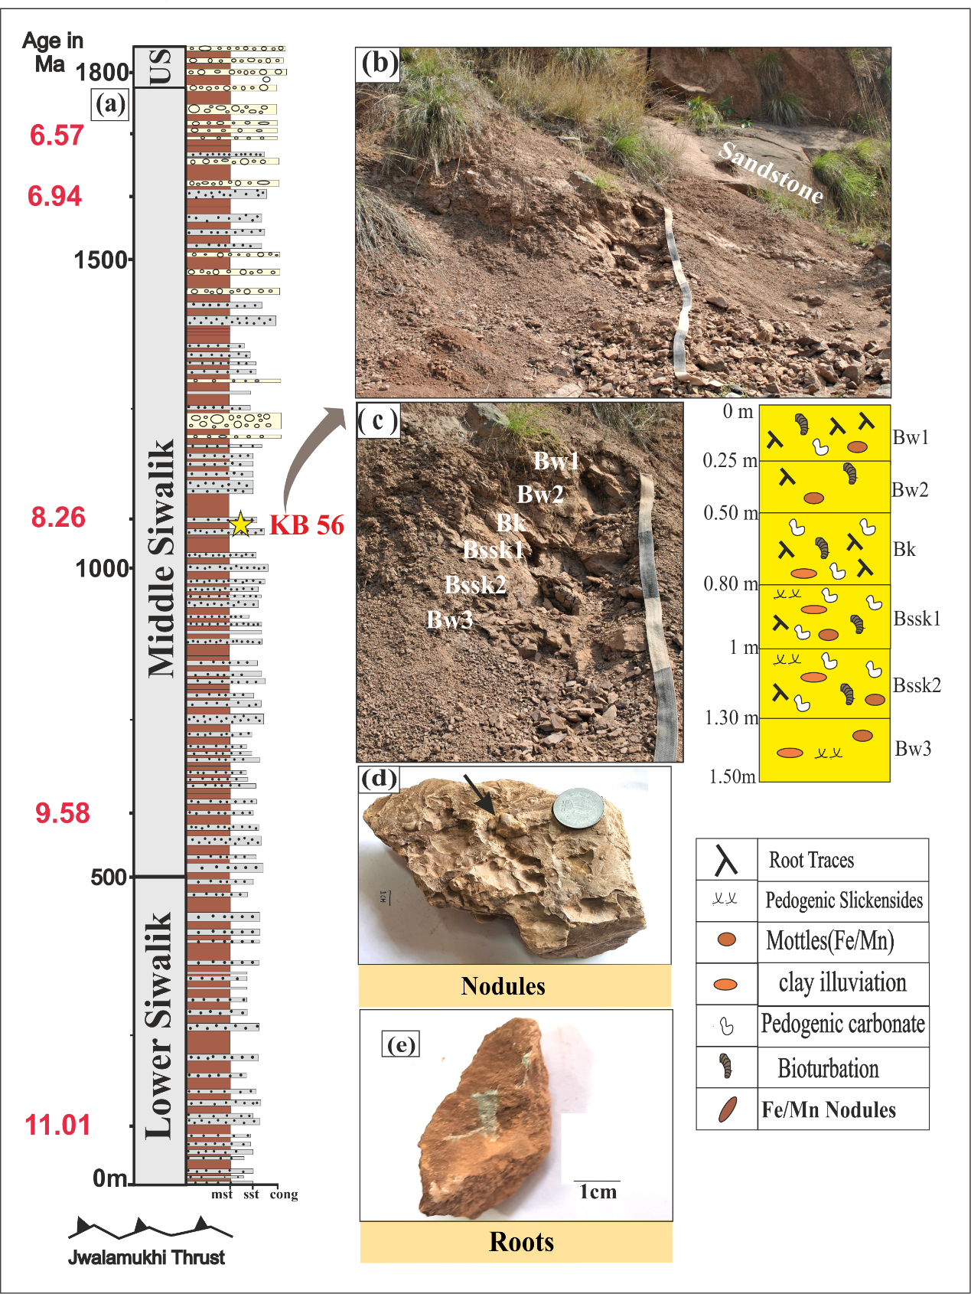
Field characteristic/Macromorphology
1cm

Slide 8
Key Points from Field characterization/ Macromorphological Study
The macromorphological investigation of 23 paleosol profiles from Lower Siwalik and 60 paleosol profiles from middle Siwalik has been carried out.
The macroscopic features of pedogenesis of the lower and middle Siwalik paleosols in the overbank sediments include paleosol horizons with root traces, blocky and wedge-shaped pedogenic structures, color mottling, Fe-Mn oxide concretions, slickensides, pedogenic CaCO_{3,} and bioturbation features.
In the lower siwalik the presence of weak red to reddish brown paleosols( 2.5YR- 5YR)with Bt, Bw, Bwk, and Bss horizons, well to moderately developed blocky structure, rizocreation, bioturbation, clay coating with or without pedogenic CaCO₃ indicate moderately to well developed paleosol.
In the middle siwalik presecnce of the Reddish grey to yellowish brown paleosols (5YR-7.5YR)with pedogenic carbonate, slickensides and amount of pedogenic carbonate decreases and Fe-Mn nodule increases in the upper of middle Siwalik. The horizon were mainly Bk, Bss, and Bw Type, indicating weakly to moderately developed paleosol.

Slide 9
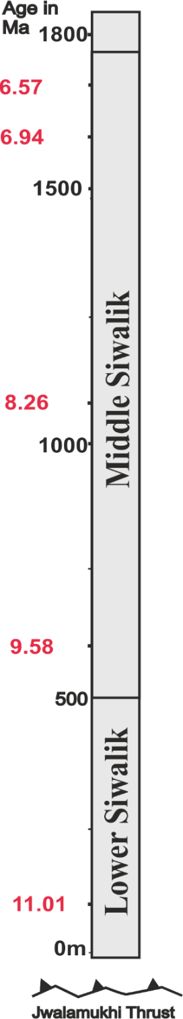
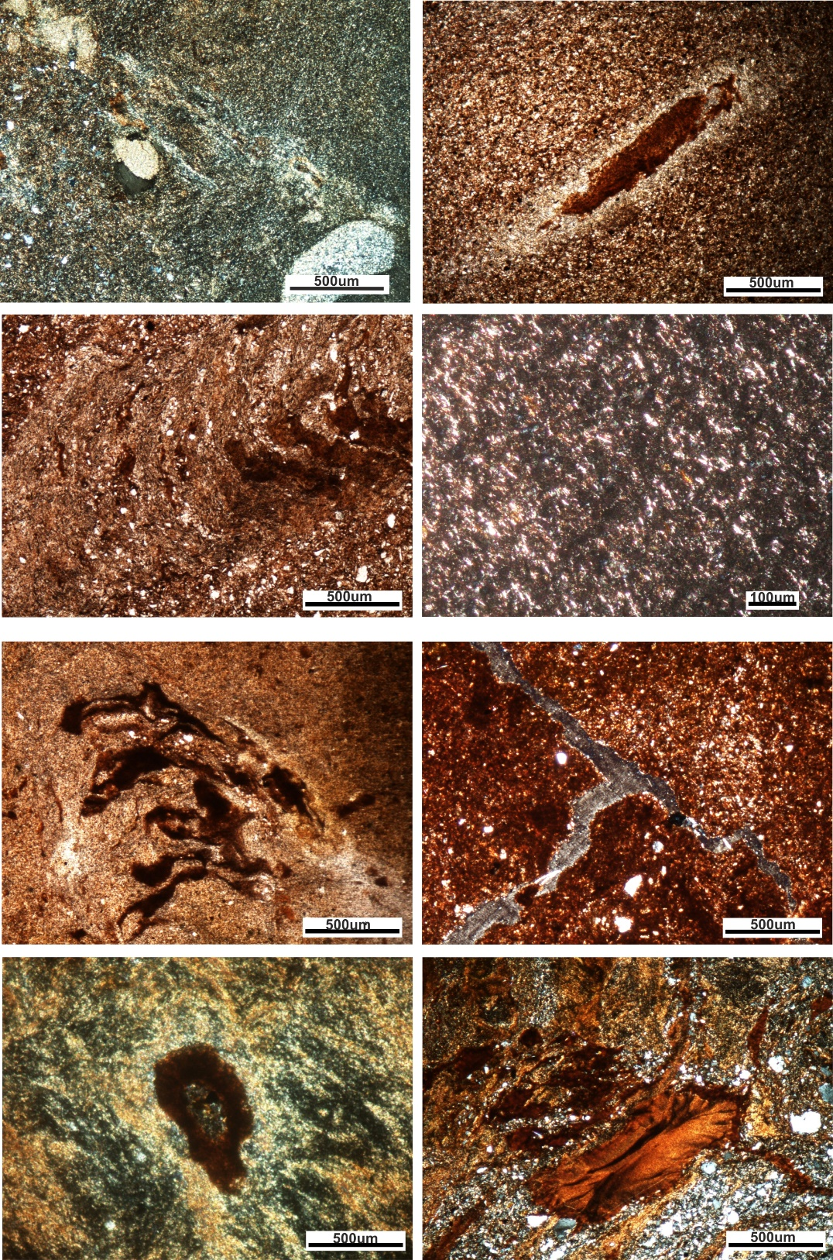
Micromorphology of Lower Siwalik
Shrink Swell
Feature
Root with CaCO₃
Micromorphology: large area (4 x 6 cm thin sections)
Key micromorphological features: Structure, pedality, b-fabric, clay coatings, pedogenic carbonate, faunal activity, rhizocretions
Lower Siwalik: clay coatings, extensive pedogenic calcium carbonate, mottles, rhizocretions, bioturbation features
Diagenetic overprinting as comapaction of peds and disruption of clay pedofeatures
Bioturbation
Parallel
b-fabric
Structure
(sbk)
Organic
Matter
KB 10
Root
Illuviation
KB 1

Slide 10
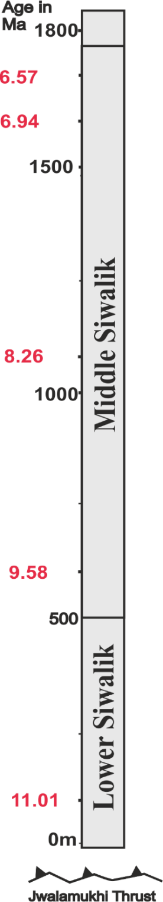
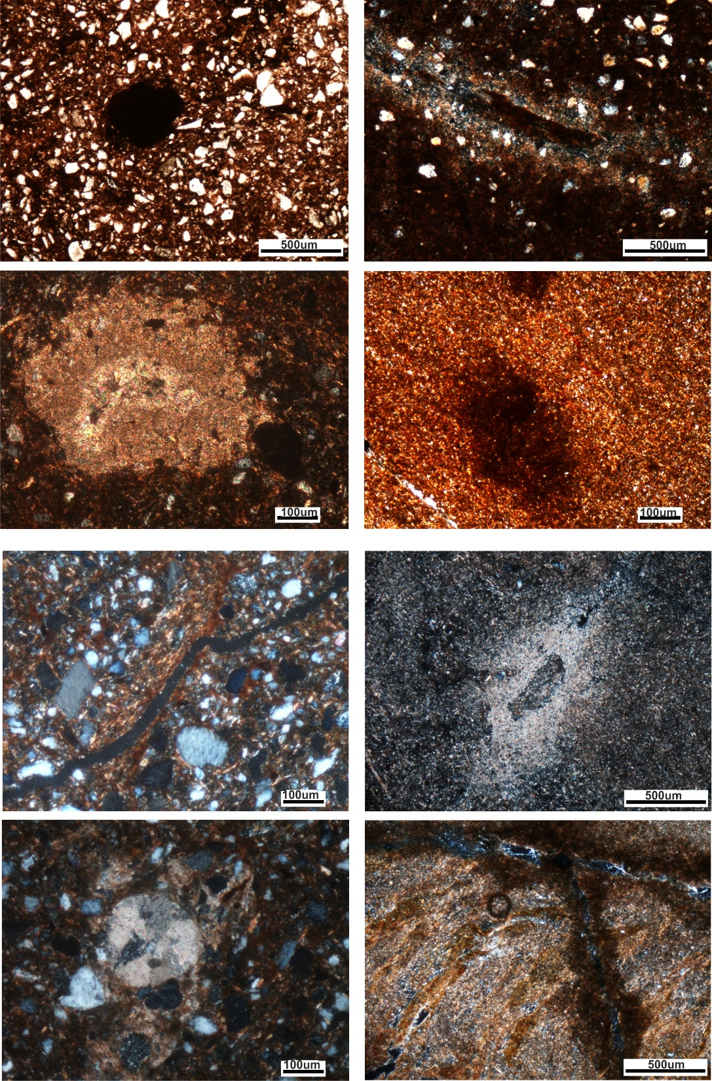
Micromorphology of Middle Siwalik
Root
Traces
Root Deacy
Micromorphology: large area (4 x 6 cm thin sections)
Key micromorphological features: Structure, pedality, texture, b-fabric, clay coatings, pedogenic carbonate, faunal activity, rhizocretions
Middle Siwalik: clay coatings, pedogenic calcium carbonate, illuviation, mottles, rhizocretions, bioturbation features
Pedogenic
CaCO₃
KB 56
Mottles
KB 30
Clay coating along ped
Organic matter
with CaCO₃
CaCO₃
Bioturbation, structure(Abk)
Nodule

Slide 11
Key Points from Micromorphological/Thin section study
The micromorphological investigation of 30 representative thin sections from Lower Siwalik and 60 thin sections from middle Siwalik confirms pedogenic features: illuviation, clay coatings, strong pedality, cross and parallel striated b-fabric, bioturbation, rhizocretions, ferruginous concretions, and pedogenic carbonates.
These features are important indications of substantial pedogenic activity during the formation of paleosols.
The paleosol of lower Siwalik showing Bt, Bk, Bss, and Bw horizons suggest the Moderate to well-developed paleosol
The paleosol of middle Siwalik showing mainly Bk, Bw, and Bss horizon with shrink-swell features suggest the weak to moderately developed paleosol
Also, the presence of clay coatings along with pedogenic carbonates, mottles, shrink and swell features supports the possibility of seasonality during paleosol formation in the both Lower and middle Siwalik.

Slide 12
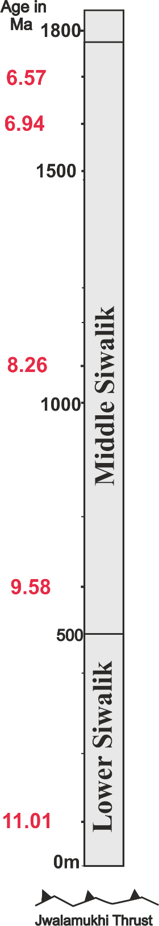
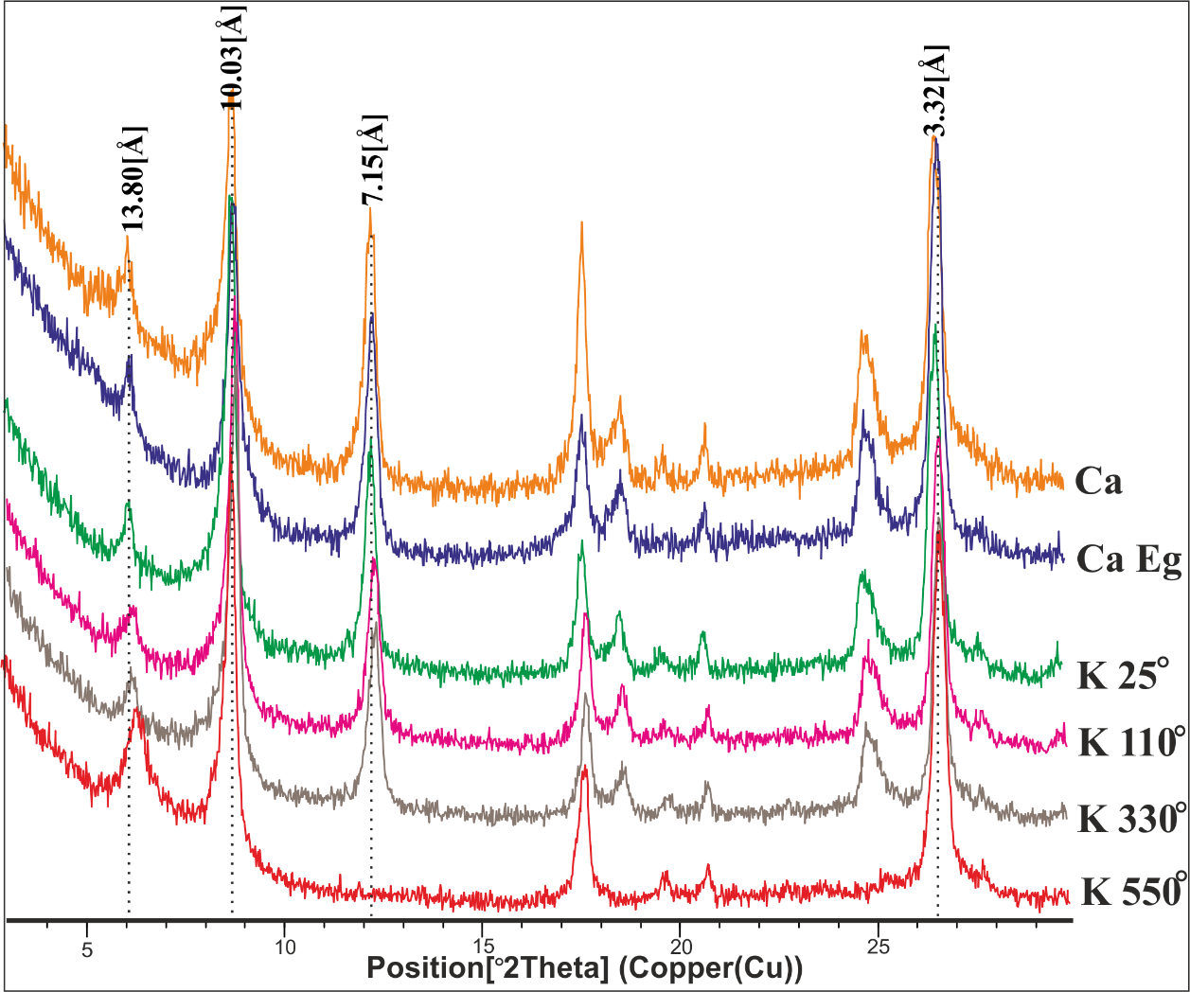
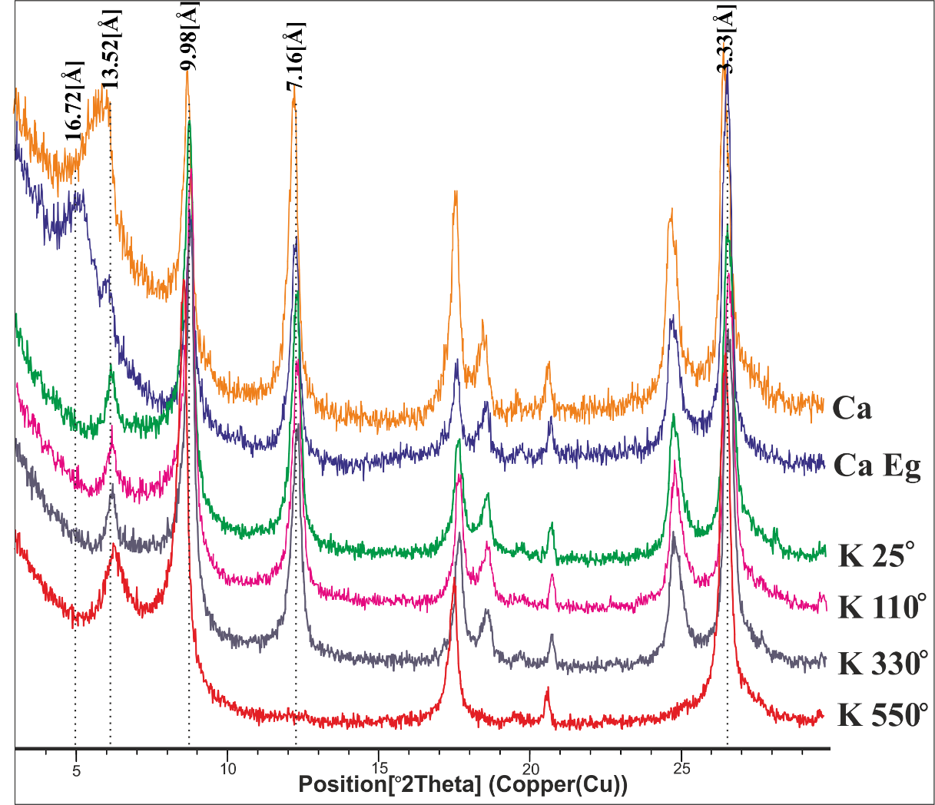
XRD diffractogram (Total clay <2µm)
Lower Siwalik- KB 2/3
Middle Siwalik- KB 56/2
KB 56
Clay minerals (Lower Siwalik)
13.80Å=Chlorite
10.03Å=Mica/Illite
7.15Å=Kaolinite μm 75°
Clay minerals (Middle Siwalik)
16.72Å=Smectite
13.52Å=Chlorite
9.98Å=Mica/Illite
7.16Å=Kaolinite
Ca= Calcium Chloride treated
Ca Eg= Calcium Chloride + Ethylene glycol
K= Potassium Chloride treated + Heated at different temperature
KB 2

Slide 13

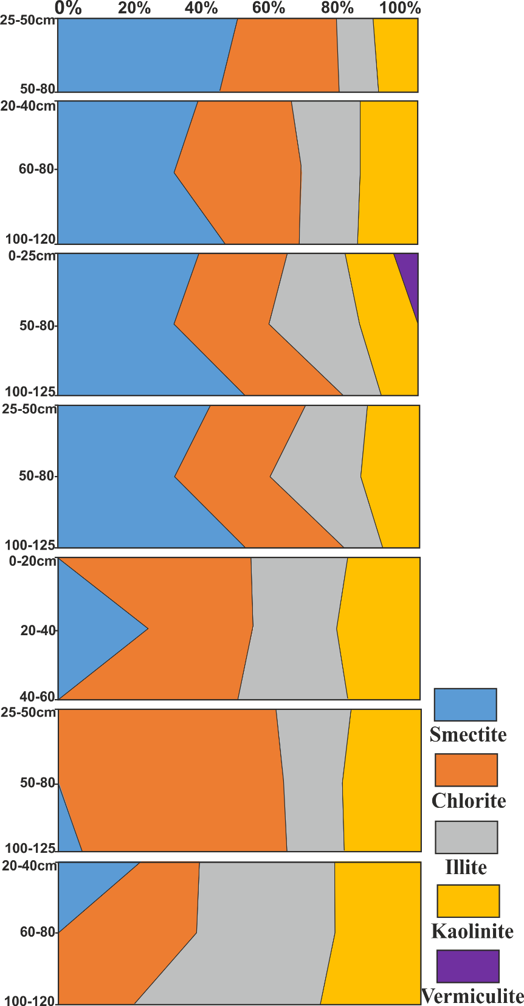
Semi Quantitative Estimate of Clay Minerals
US
KB 69
KB 56
Clay Mineralogy (Total clay <2µm):
Middle Siwalik: Smectite(18.0-42.5%), chlorite(15.5-25.2%), illite(10.2-18.5%), Kaolinite(8.0-12.0%) and Vermiculite (0-4.9%)
Lower Siwalik: Smectite(5-12.4%),chlorite(12.6-44.6%), illite(10.2-22.2%), Kaolinite(8.5-15.4%)
KB 69
KB 47
KB 56
KB 47
KB 31
KB 31
KB 22
KB 22
KB 12
KB 12
KB 2
KB 2

Slide 14
Key Points from Clay Minerological study
Clay mineralogy of the total clay (<2 μm) and fine clay fraction (< 0.2 μm) of the 9 paleosol profiles suggest weathering of silicate minerals and change of paleoclimatic conditions, source and weathering condition over a period of 11 to 8 Ma during paleopedogenic activity in the Siwalik sedimentation.
Lower Siwalik with the presence of kaolin, illuvial features, and dissolution of pedogenic carbonates suggests possibly sub-humid to humid conditions. Whereas, the large amounts of smectite together with pedogenic carbonates in the lower to middle part of middle Siwalik suggest possibly semiarid to dry conditions.

Slide 15
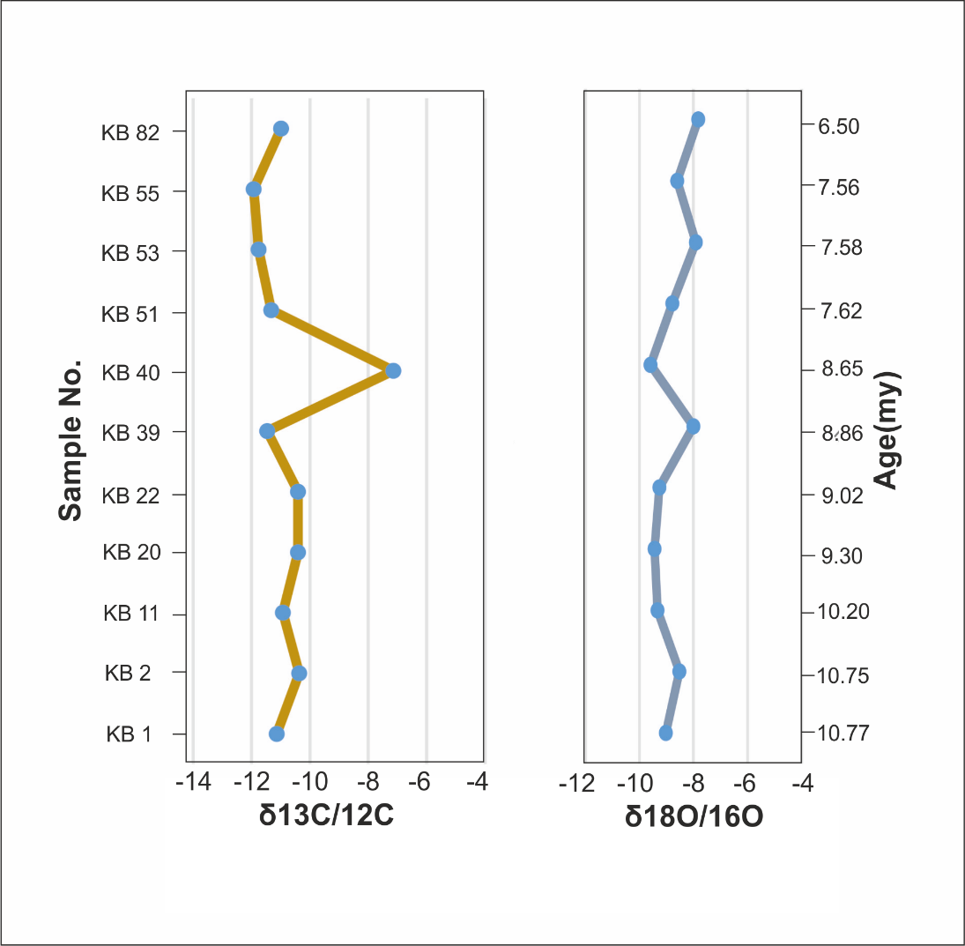
Stable Isotope Ratio
Carbon and oxygen isotope ratios of paleosol carbonate nodules were measured from Indian Siwalik stratigraphic successions in order to reconstruct vegetational history and change in contemporaneous precipitation.
The d¹⁸O variations of soil carbonates suggest that the monsoon system intensified, with one probable peak at around 10.5 Ma and a clear onset at 6 Ma (Sanyal et al., 2004)
The covariation between d¹⁸O and d¹³C data suggests that a change in precipitation pattern was partly responsible for the expansion of C4 grasses. (Sanyal et al., 2004)
Fig:5 Composite plot of isotope ratios against age of soil carbonate nodules from Kotla-brail section (a) carbon, (b) oxygen isotopic ratios from the same nodules.

Slide 16
Findings
Based on present study following highlights can be summarized as:
The paleosols show Bw, Bt, Bk, Bss and BC horizons with key pedogenic features.
Micromorphology shows structural elements, b-fabrics, illuviation, roots, organic matter, bioturbation, and carbonate nodules related to warm and humid conditions.
Pedogenic carbonate nodule and dense impure micritic nodule shows that formation of pedogenic carbonate possibly occurred during monsoonal conditions.
The presence of smectite in the paleosol profiles at different interval from lower to middle Siwalik Sub-Group shows some aridity and absence of smectite and presence of dominance of kaolinite in different paleosol profiles shows humid to sub-humid climate.
Notes:
key pedogenic features as color, roots, mottles, carbonate nodules and pedogenic structures.

