Slide 1
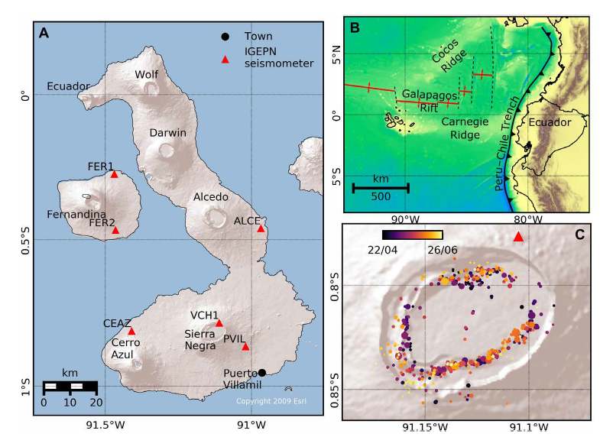
Ground Motion and Unrest Triggering on Volcanoes
Eleanor Dunn¹, Chris Bean¹, Andy Bell², Ivan Lokmer³
¹School of Cosmic Physics, Dublin Institute for Advanced Studies, Dublin, Ireland. ²School of GeoSciences, University of Edinburgh, Edinburgh, Scotland. ³School of Earth Sciences, University College Dublin, Dublin, Ireland.
Bell et al., 2021

Slide 2
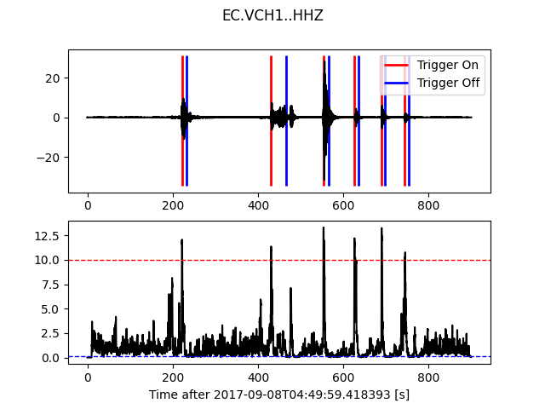
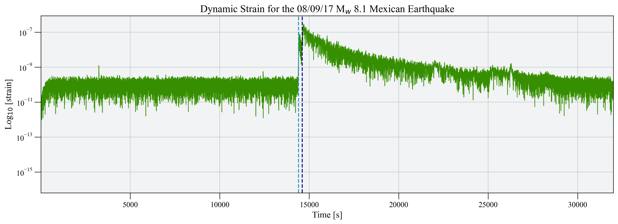
Introduction(PICO) → Methods → Results → Conclusion
An STA/LTA Detection Algorithm for Triggered Events
Dynamic Strain calculated during a period of dynamic triggering

Slide 3
Introduction → Methods → Results → Conclusion
Location: Isabela Island, Galápagos
^{Type: basaltic shield volcano}
^{Has a trapdoor fault system}
^{Last eruption: 2018}

Slide 4
Introduction → Methods → Results → Conclusion
Bell et al., 2021

Slide 5
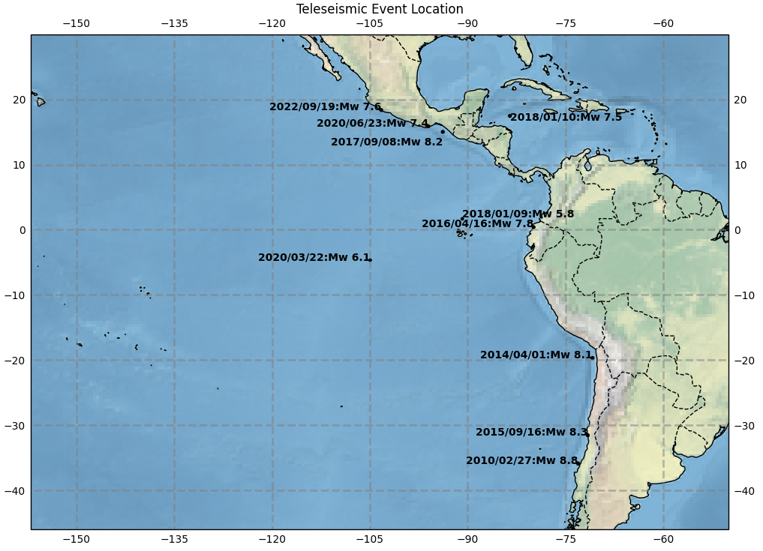
Introduction → Methods → Results → Conclusion
→ The process where local earthquakes are triggered by the dynamic stress perturbations associated with the arrival of transient seismic waves from distant earthquakes.

Slide 6
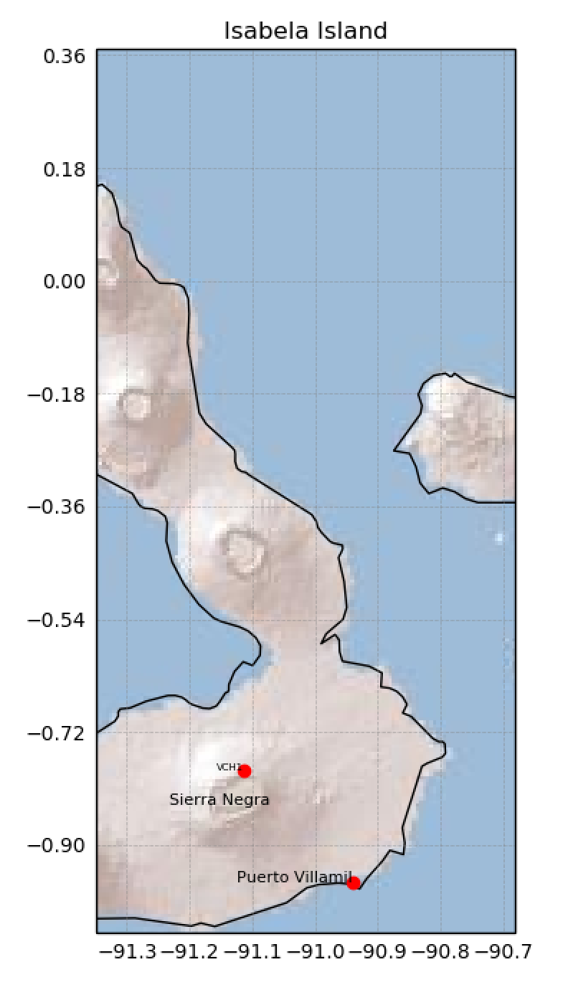
Introduction → Methods → Results → Conclusion

Slide 7
Introduction → Methods → Results → Conclusion
STA/LTA Detection
Case Study 1:
Location: Chiapas, Mexico
Date: 8th September 2017
M_{w}: 8.2
Teleseismic arrival of earthquake at station VCH1
Local earthquakes at detected by VCH1, following the arrival of the teleseismic event

Slide 8
Introduction → Methods → Results → Conclusion
STA/LTA Detection
Case Study 1:
Location: Chiapas, Mexico
Date: 8th September 2017
M_{w}: 8.2
Detected triggered events with an STA/LTA algorithm

Slide 9
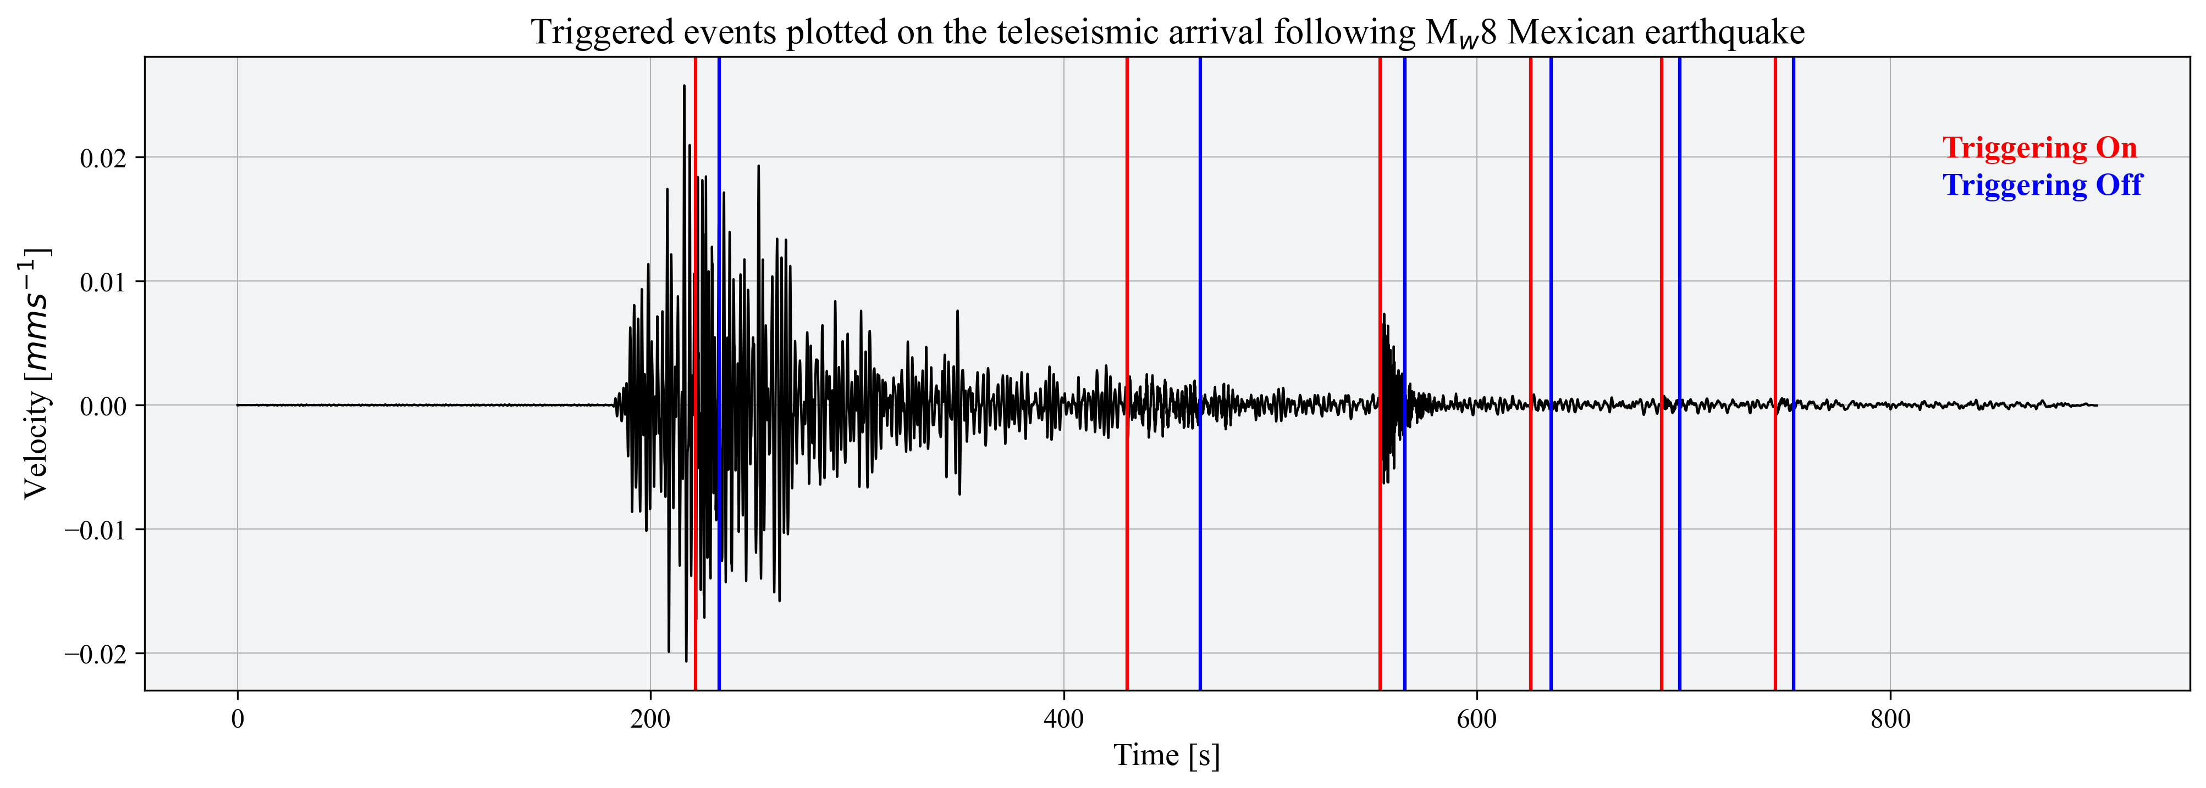
Introduction → Methods → Results → Conclusion
STA/LTA Detection
Case Study 1:
Location: Chiapas, Mexico
Date: 8th September 2017
M_{w}: 8.2
Triggered events overlaying the teleseismic arrival at VCH1

Slide 10
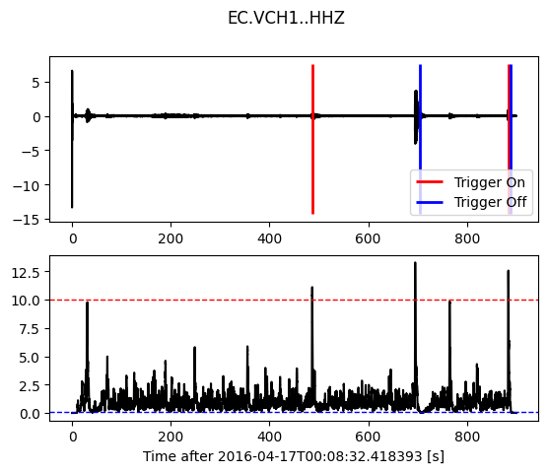
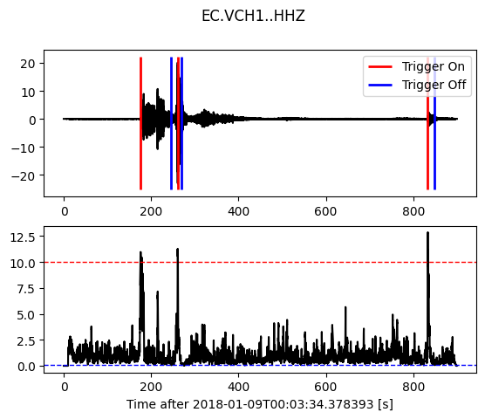
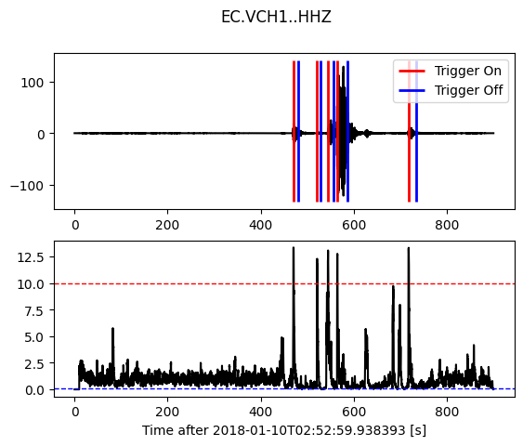
Introduction → Methods → Results → Conclusion
Event 1:
Location: Ecuador coast
Date: 16/04/2017
M_{w}: 7.8
Event 2:
Location: Chiapas, Mexico
Date: 08/09/2017
M_{w}: 8.1
Event 3:
Location: Galápagos Island Region
Date: 09/01/2018
M_{w}: 5.8
Event 4:
Location: North of Honduras
Date: 10/01/2018
M_{w}: 7.6

Slide 11
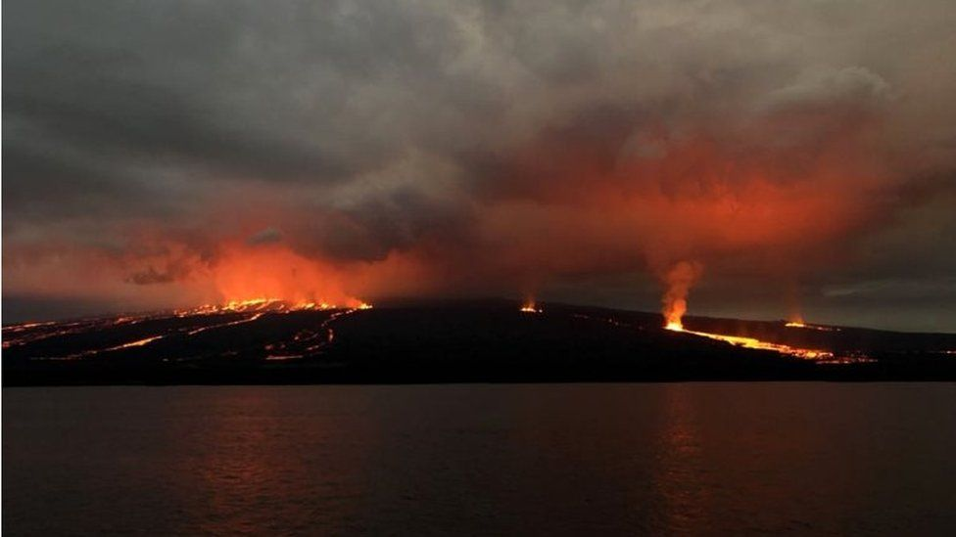
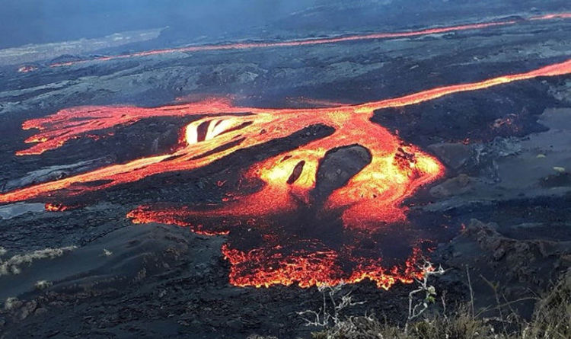
Introduction → Methods → Results → Conclusion
26th July – late August: eruption

Slide 12
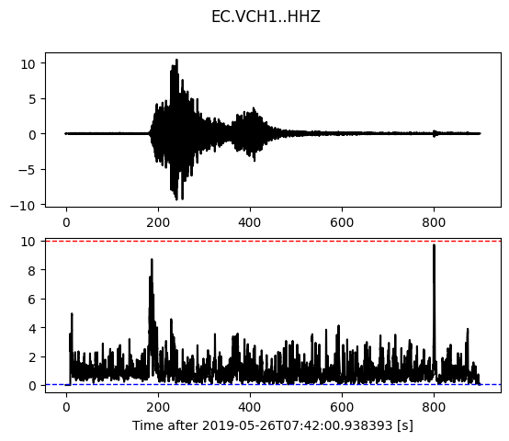
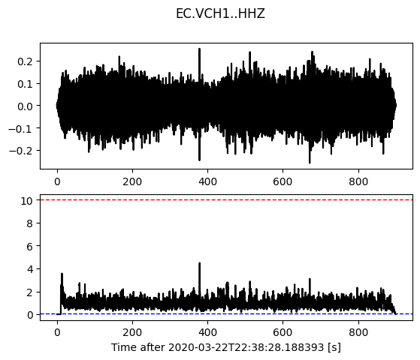
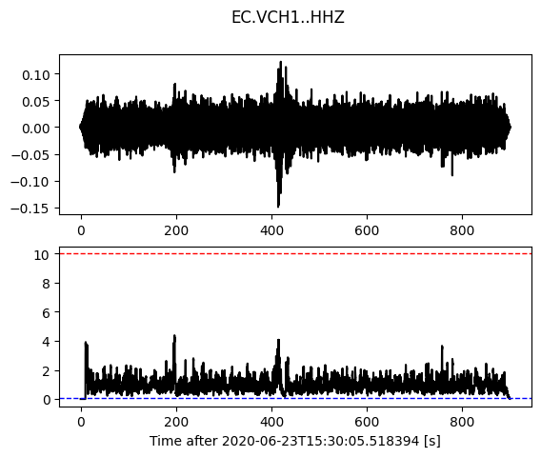
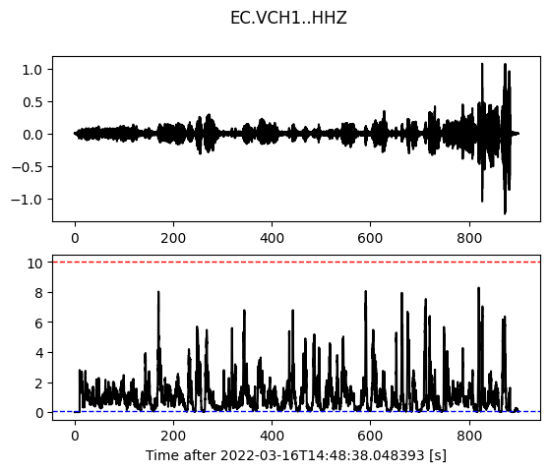
Introduction → Methods → Results → Conclusion
Event 5:
Location: Northern Peru
Date: 26/05/2019
M_{w}: 8.0
Event 6:
Location: East Pacific Rise
Date: 22/03/2020
M_{w}: 6.3
Event 7:
Location: Oaxaca, Mexico
Date: 23/06/2020
M_{w}: 7.4
Event 8:
Location: East Coast of Honshu, Japan
Date: 16/03/2022
M_{w}: 7.3

Slide 13
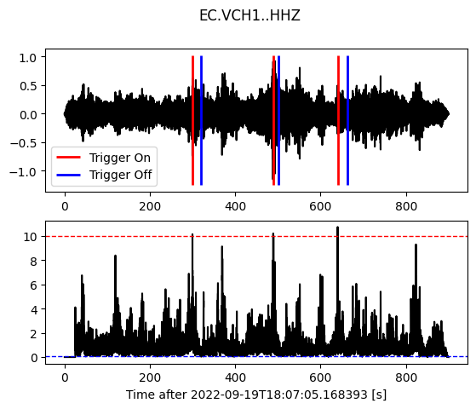
Introduction → Methods → Results → Conclusion
Event 9:
Location: Michoacan, Mexico
Date: 19/09/2022
M_{w}: 7.6

Slide 14
Introduction → Methods → Results → Conclusion
Dynamic Strain:
→ Dynamic strain differs from static strain because it does not generate a permanent deformation and decays more gradually.
$$DS= \frac{V_{mag}}{C}$$

Slide 15
Introduction → Methods → Results → Conclusion

Slide 16
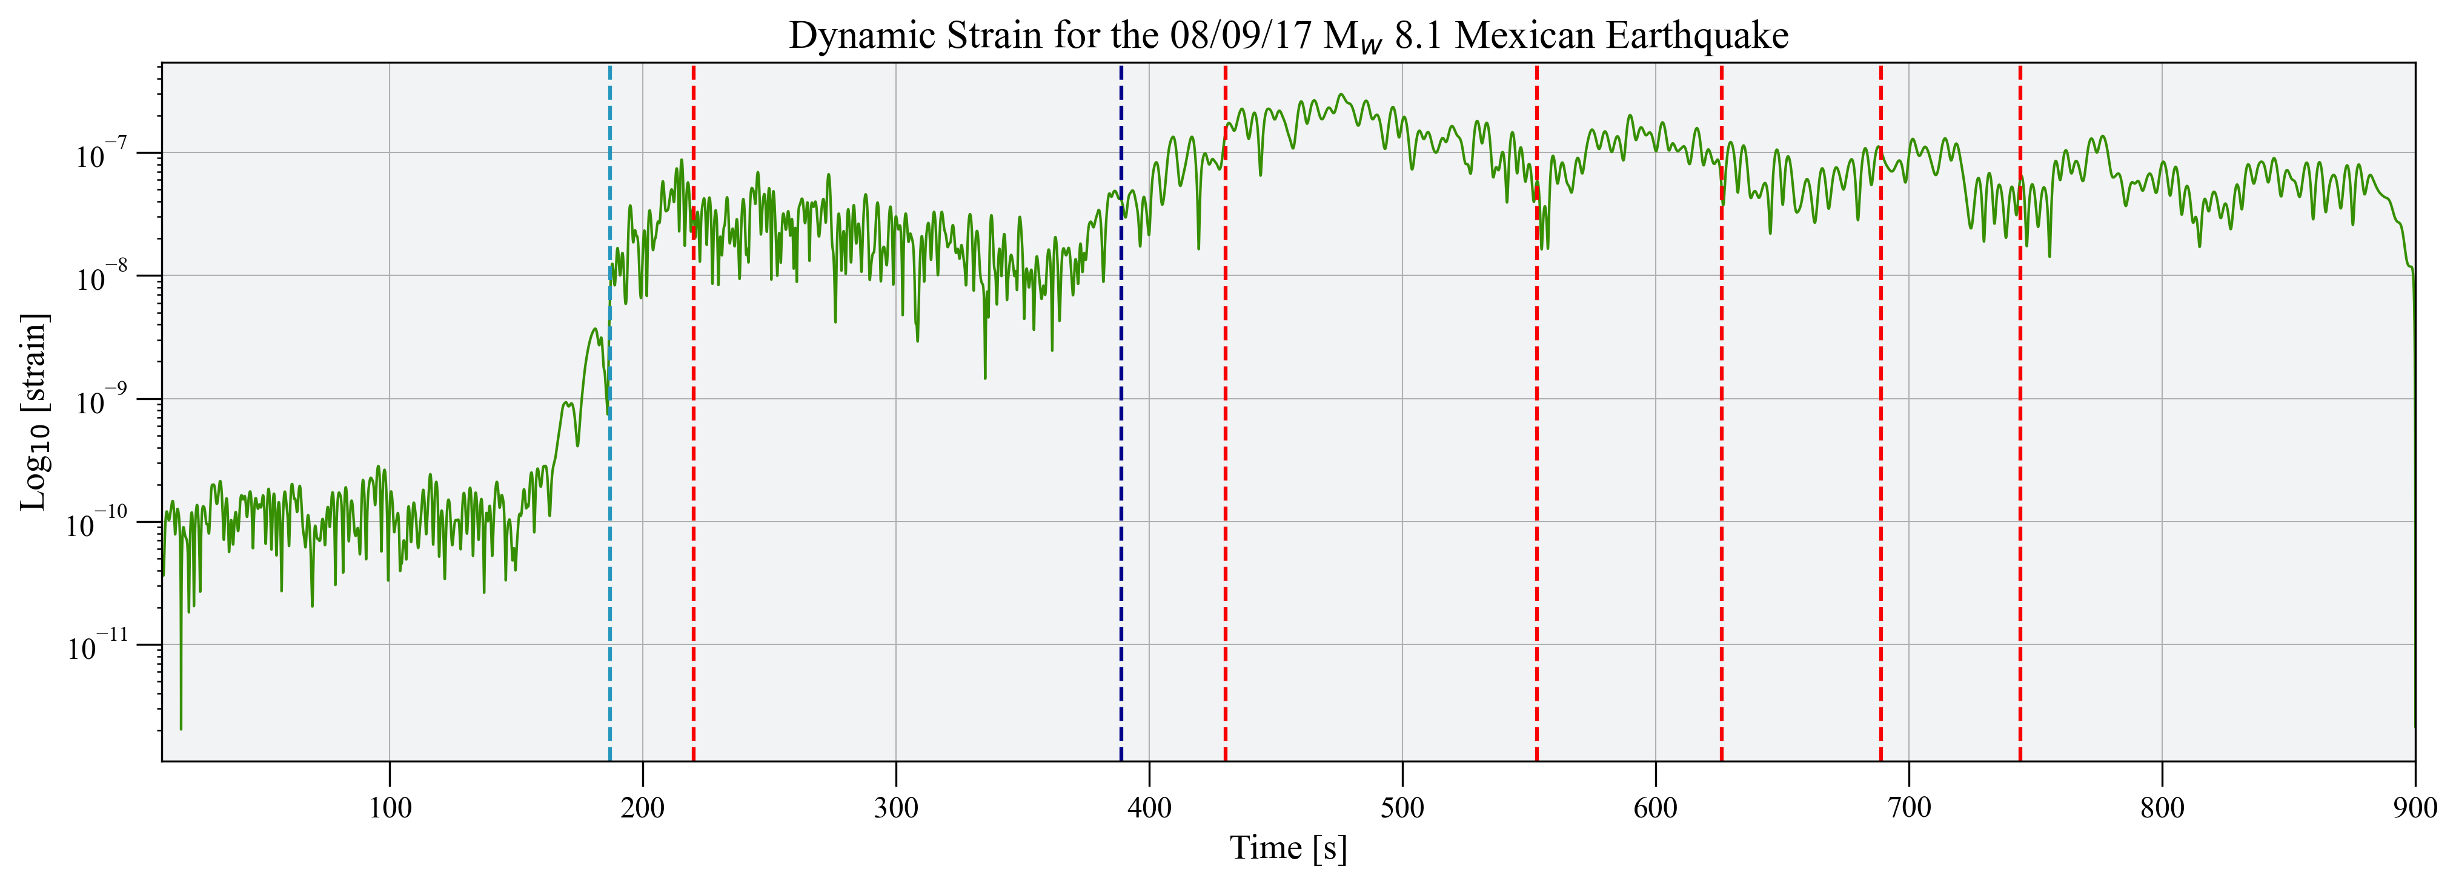
Introduction → Methods → Results → Conclusion

Slide 17
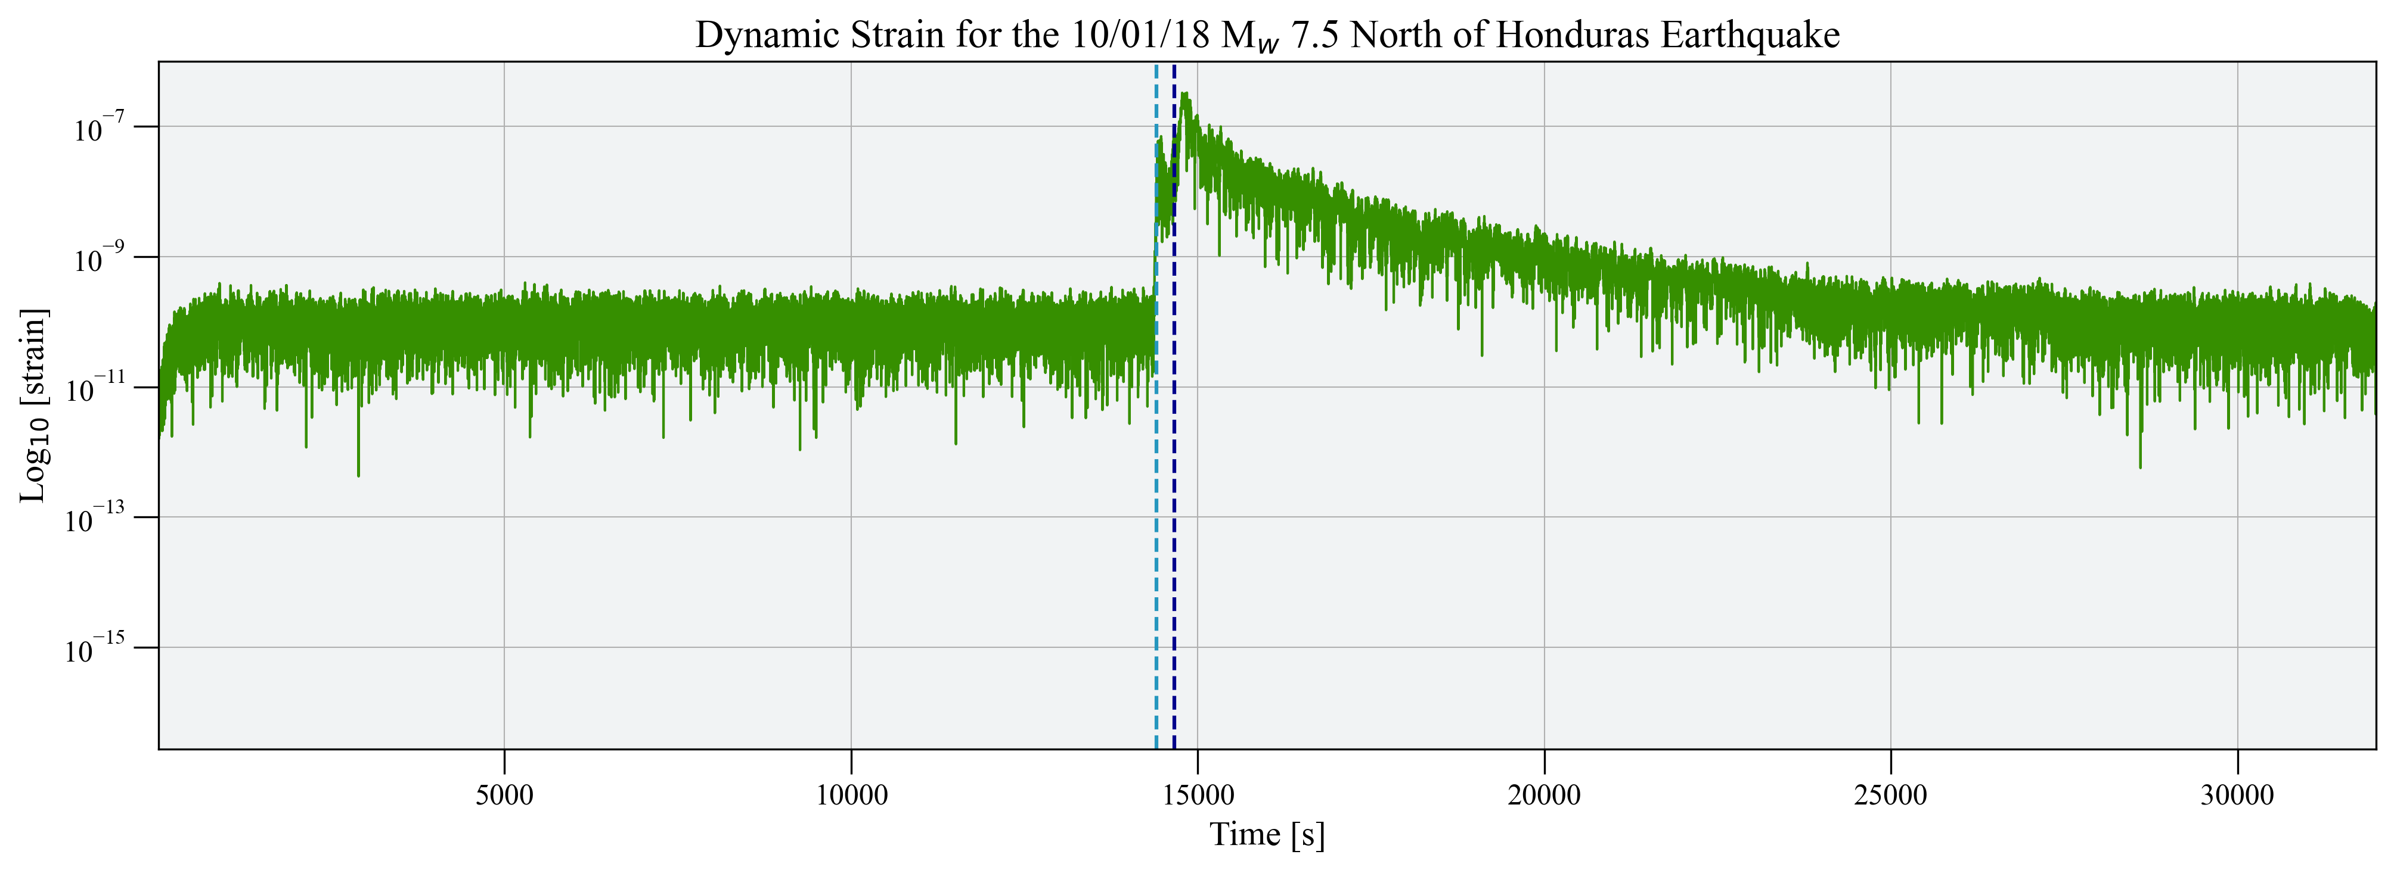
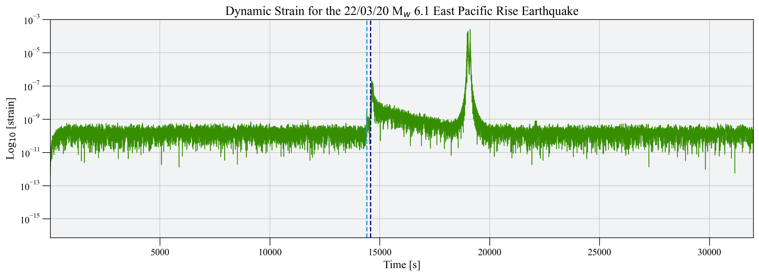
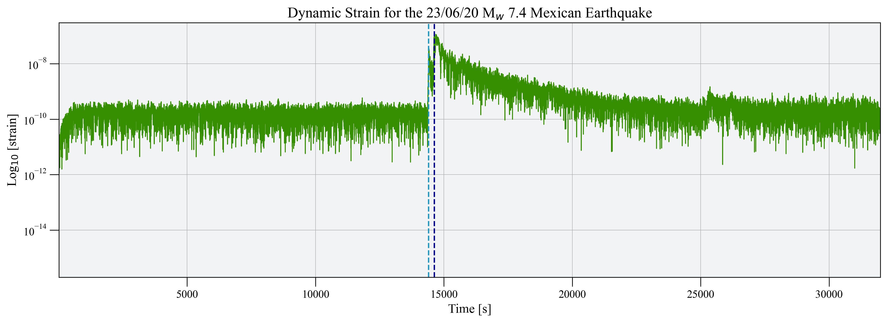
Introduction → Methods → Results → Conclusion
Event 2:
Location: Chiapas, Mexico
Date: 08/09/2017
M_{w}: 8.1
Event 4:
Location: North of Honduras
Date: 10/01/2018
M_{w}: 7.5
Event 6:
Location: East Pacific Rise
Date: 22/03/2020
M_{w}: 6.1
Event 7:
Location: Oaxaca, Mexico
Date: 23/06/2020
M_{w}: 7.4

Slide 18
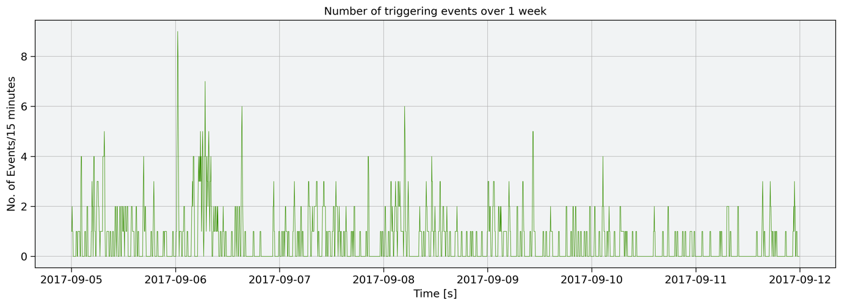
Introduction → Methods → Results → Conclusion
Statistical Confidence of Events:
→ Looked at the number of events detected over a 15 minute time window for an entire week.

Slide 19
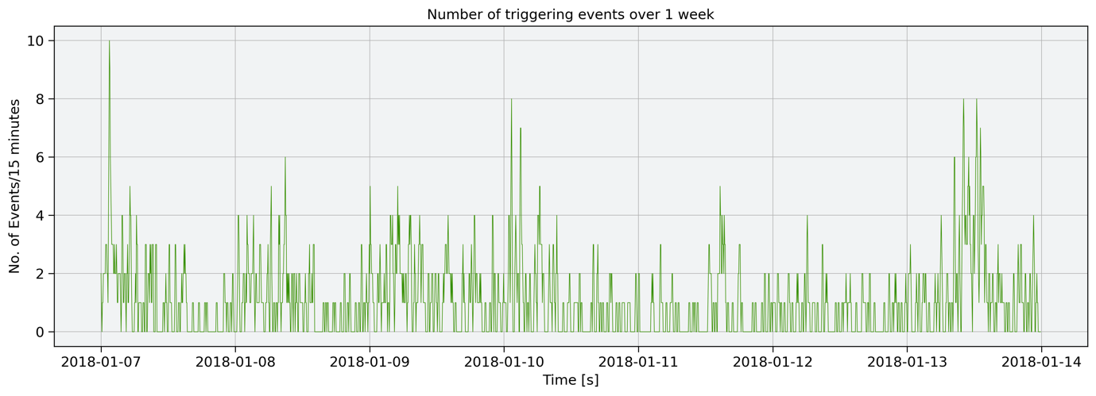
Introduction → Methods → Results → Conclusion
What’s next?
Improve statistical confidence of triggered events.
Event location plotting of triggered events.
Importance of dynamic strain in relation to volcanic stress state.
Move onto other volcanic locations of interest.

Slide 20
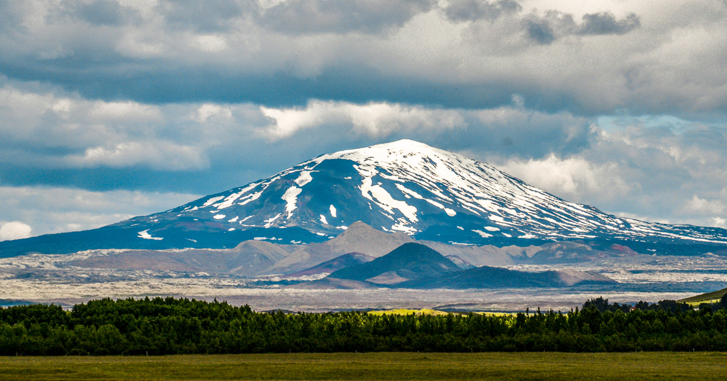
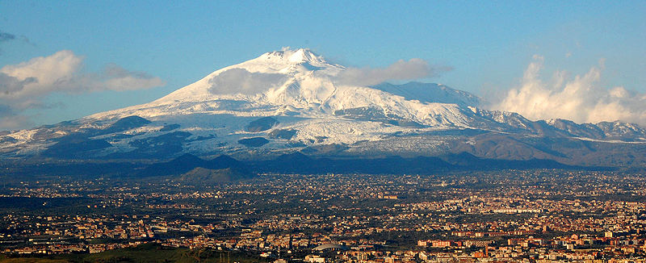
Introduction → Methods → Results → Conclusion
Hekla, Iceland. Daniel Freyr @ stock.adobe.com
Mt Etna. Ben Aveling.

Slide 21
Introduction → Methods → Results → Conclusion
Sierra Negra is a basaltic shield volcano which last erupted in 2018. It experiences a cycle of inflation and deflation.
Following teleseismic events, Sierra Negra has responded with its own local events – considered to be dynamic triggering.
An STA/LTA detection algorithm has been set up to show the trends of dynamic triggering. More triggering occurs pre-2018 eruption than post-eruption. Finding trends in dynamic triggering is difficult because of the lack of large, teleseismic events.
Peak Dynamic Strain has the possibility to be used as a stress gauge to understand the changing strain that Sierra Negra is under.
_{Contact me:}
_{Twitter: @basalticeleanor}
_{Email: edunn@cp.dias.ie}
_{Acknowledgements:}
Supervisors: Chris Bean, Andy Bell & Ivan Lokmer
SPIN is a European project funded by the European Union’s Horizon 2020 research and innovation programme under the Maria Skłodowksa-Curie grant agreement No 955515. The project is a Marie Skłodowska-Curie Innovative Training Network (MSCA ITN); a join research training and doctoral programme

