Slide 1


26th January 2023 IBS, Busan, South Korea (remotely)
Meridional heat transports and the general circulation: from global scale to extremes
Valerio Lembo
with hints and contributions by:
Doris Folini, Martin Wild (ETH), Piero Lionello (UniSalento), Vera Melinda Galfi, Gabriele Messori (Uppsala University), Rune Graversen (UiT), Valerio Lucarini (University of Reading), Federico Fabiano (CNR-ISAC)

Slide 2
Outline
The inhomogeneous radiative energy budget triggering poleward transports and the mean meridional circulation;
Model characterization of zonal mean energy asymmetries and cross-equatorial transports;
Meridional heat transports in mid-latitudinal eddies and the role of extremes;

Slide 3
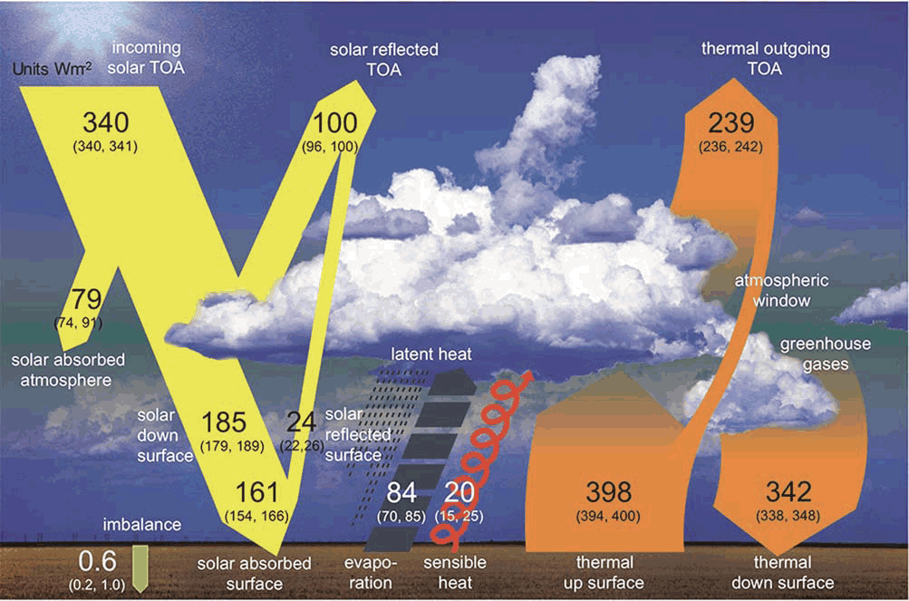


The global mean energy budget
$$\left\langle \overline{R_{t}}\right\rangle =\left\langle \overline{S_{t}}\right\rangle −\left\langle \overline{L_{t}}\right\rangle ≈0$$
$$\left\langle \overline{F_{a}}\right\rangle =\left\langle \overline{R_{t}}\right\rangle −\left\langle \overline{F_{s}}\right\rangle ≈0$$
$$\left\langle \overline{F_{s}}\right\rangle =\left\langle \overline{R_{s}}\right\rangle −\left\langle \overline{H_{L}}\right\rangle −\left\langle \overline{H_{S}}\right\rangle ≈0$$
(Wild 2015)

Slide 4
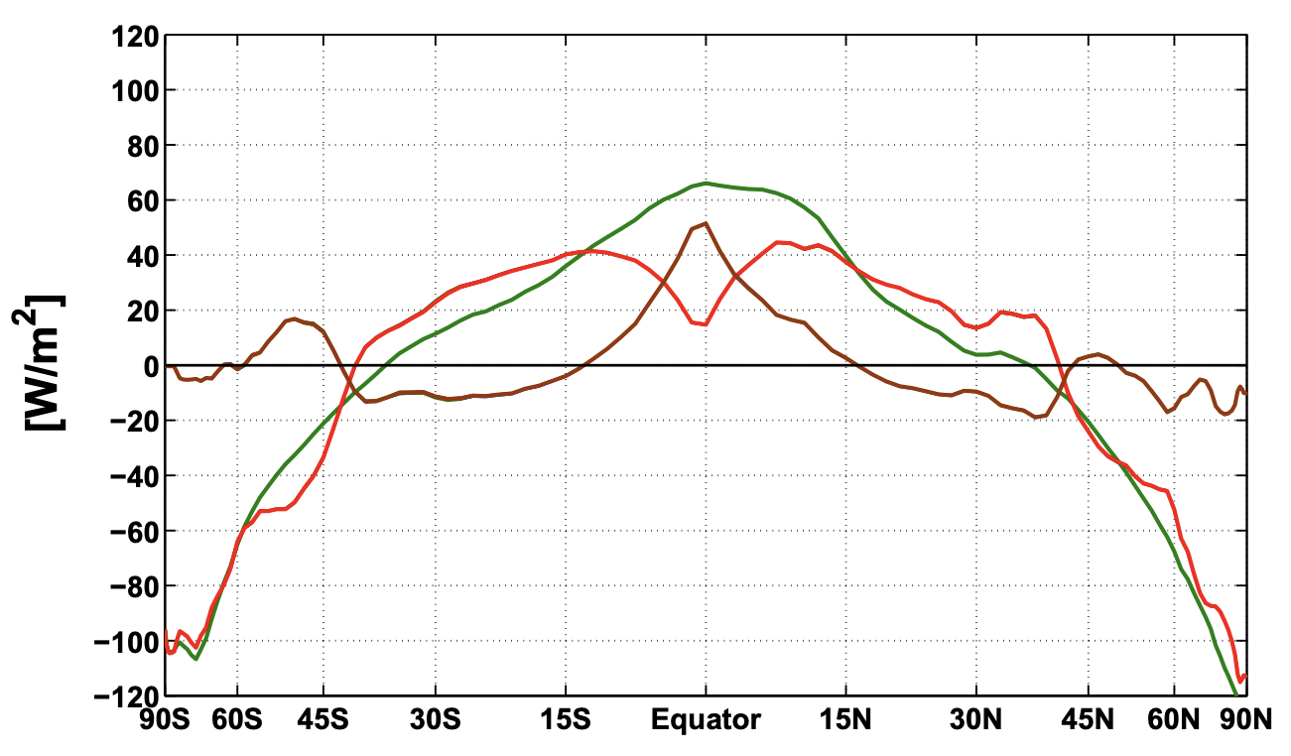
From inhomogeneous heating to transports
(Lembo et al. 2017)

Slide 5
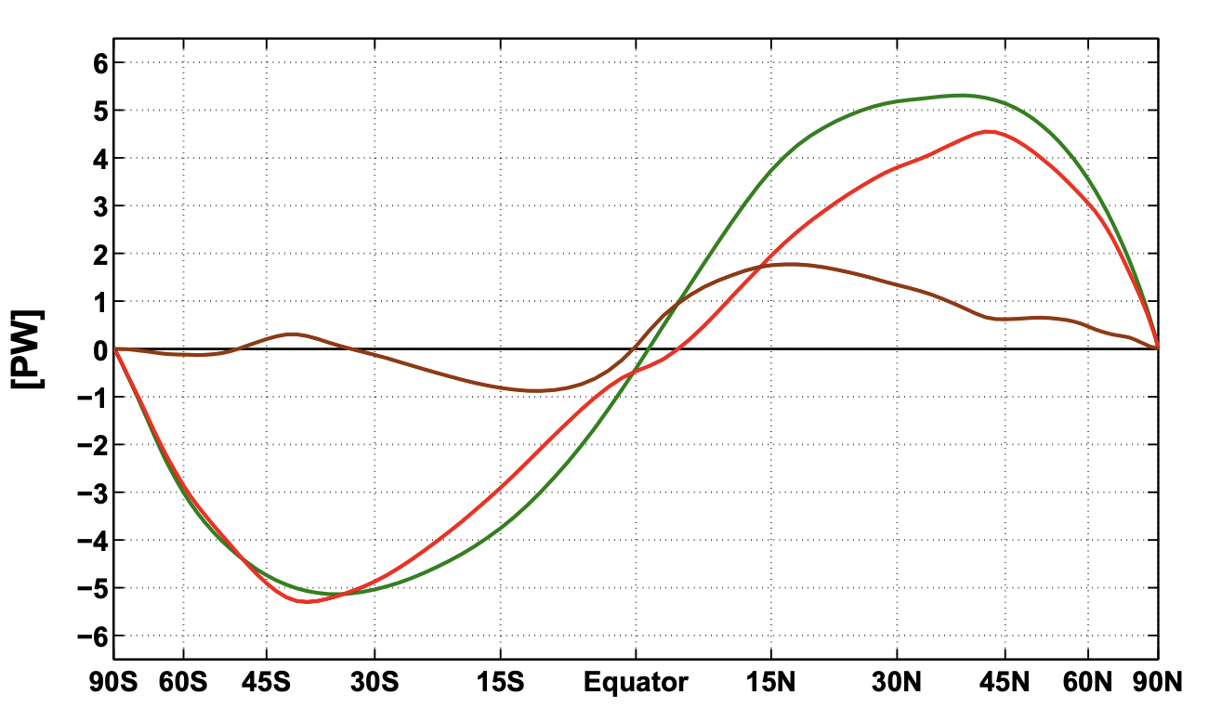



From inhomogeneous heating to transports
(Lembo et al. 2017)
$$\overline{R_{t}(φ)}=∇∙T_{t}(φ)$$
$$\overline{F_{a}(φ)}=∇∙T_{a}(φ)$$
$$\overline{F_{s}(φ)}=∇∙T_{s}(φ)$$

Slide 6
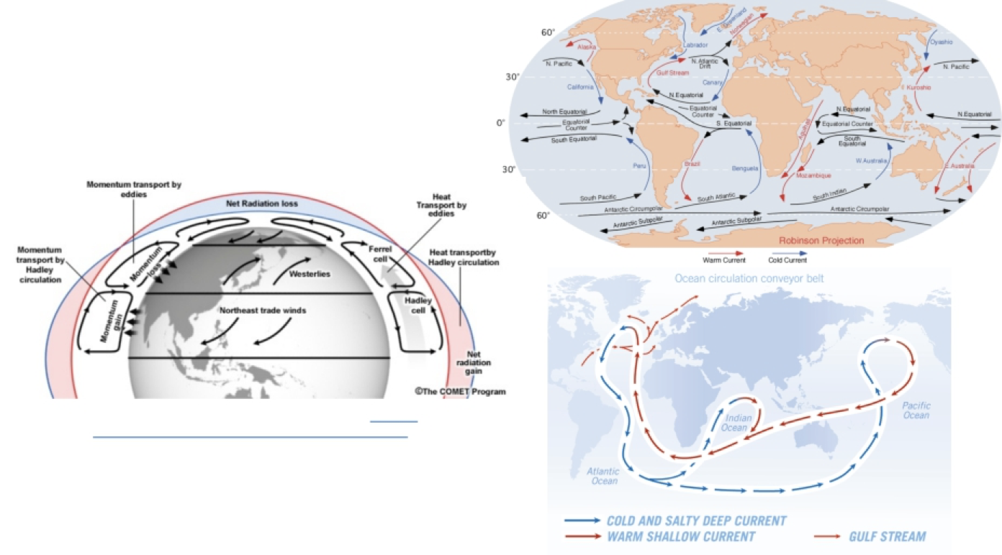
The general circulation of the atmosphere and the oceans

Slide 7
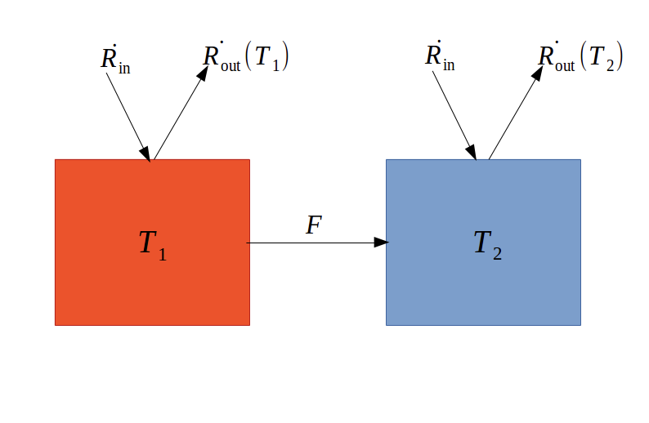
A (very) inefficient thermal engine
(Lembo et al. 2017)
(Adapted from Ambaum 2010)

Slide 8
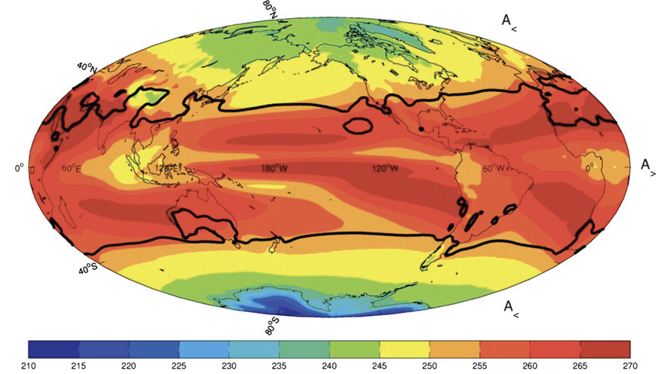

A (very) inefficient thermal engine
$$η=1−\frac{T_{2}}{T_{1}}\sim 0.057$$
For T1 the emission temperature of the net surplus region, T2 the emission temperature of the net deficit region (Lucarini et al. 2011)

Slide 9
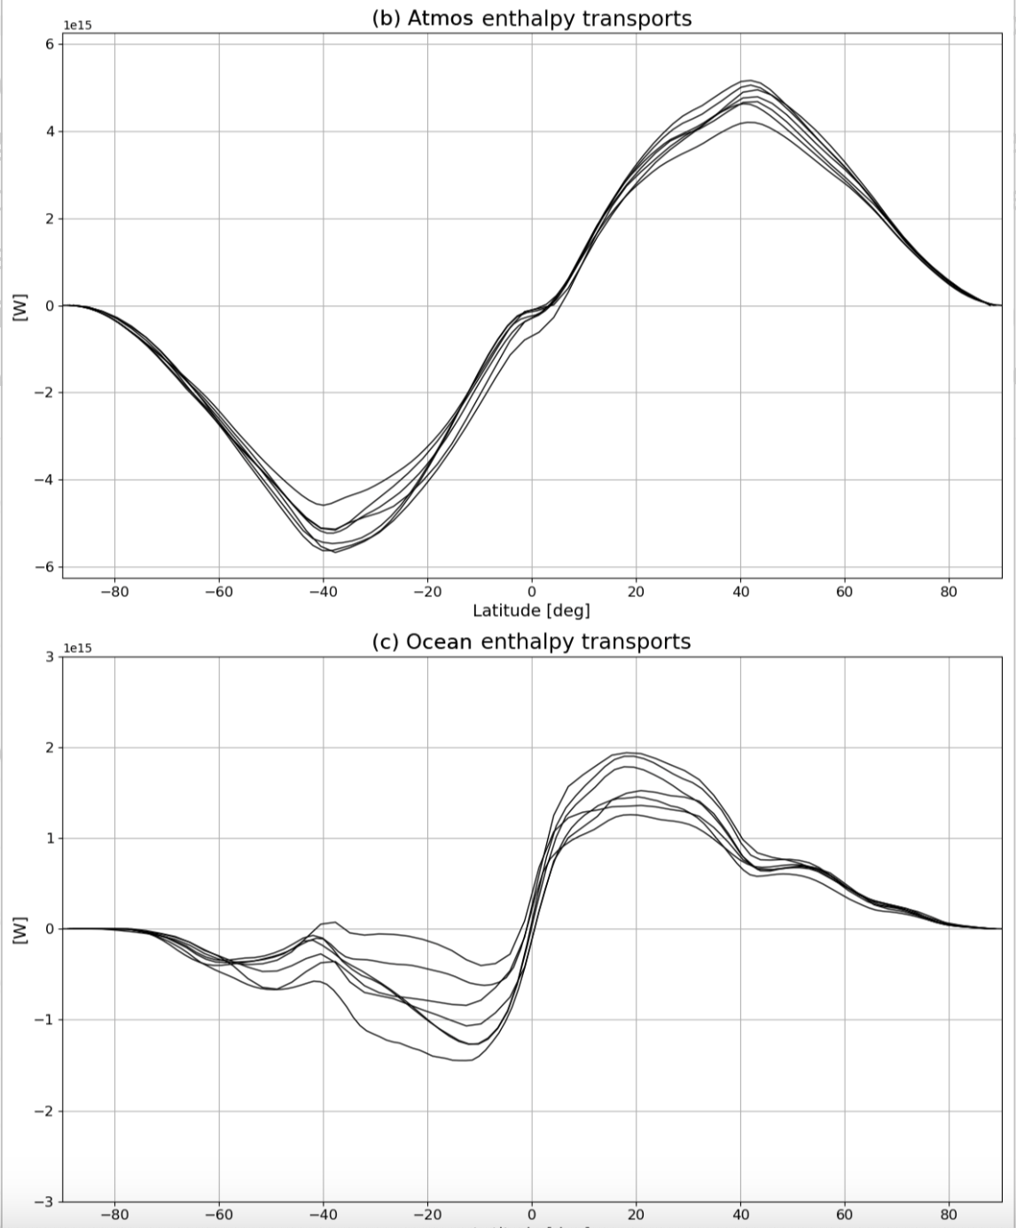
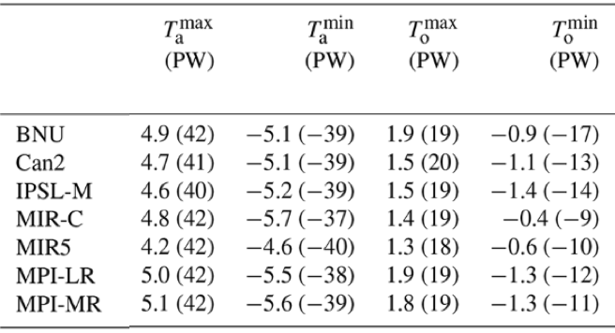
Model representation of meridional enthalpy transports
(Lembo et al. 2020)
Despite reasonable agreement on peak location, peak magnitudes range by 20% of median value…

Slide 10
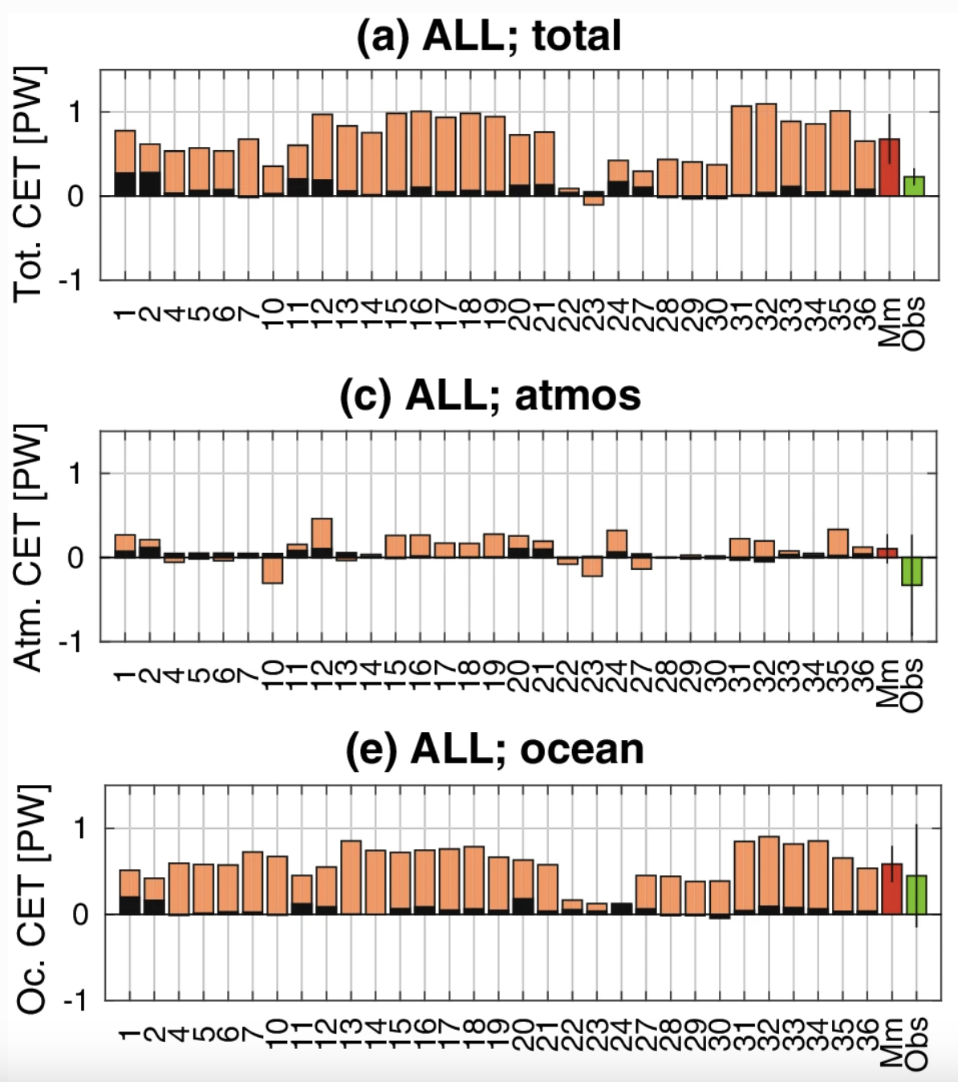
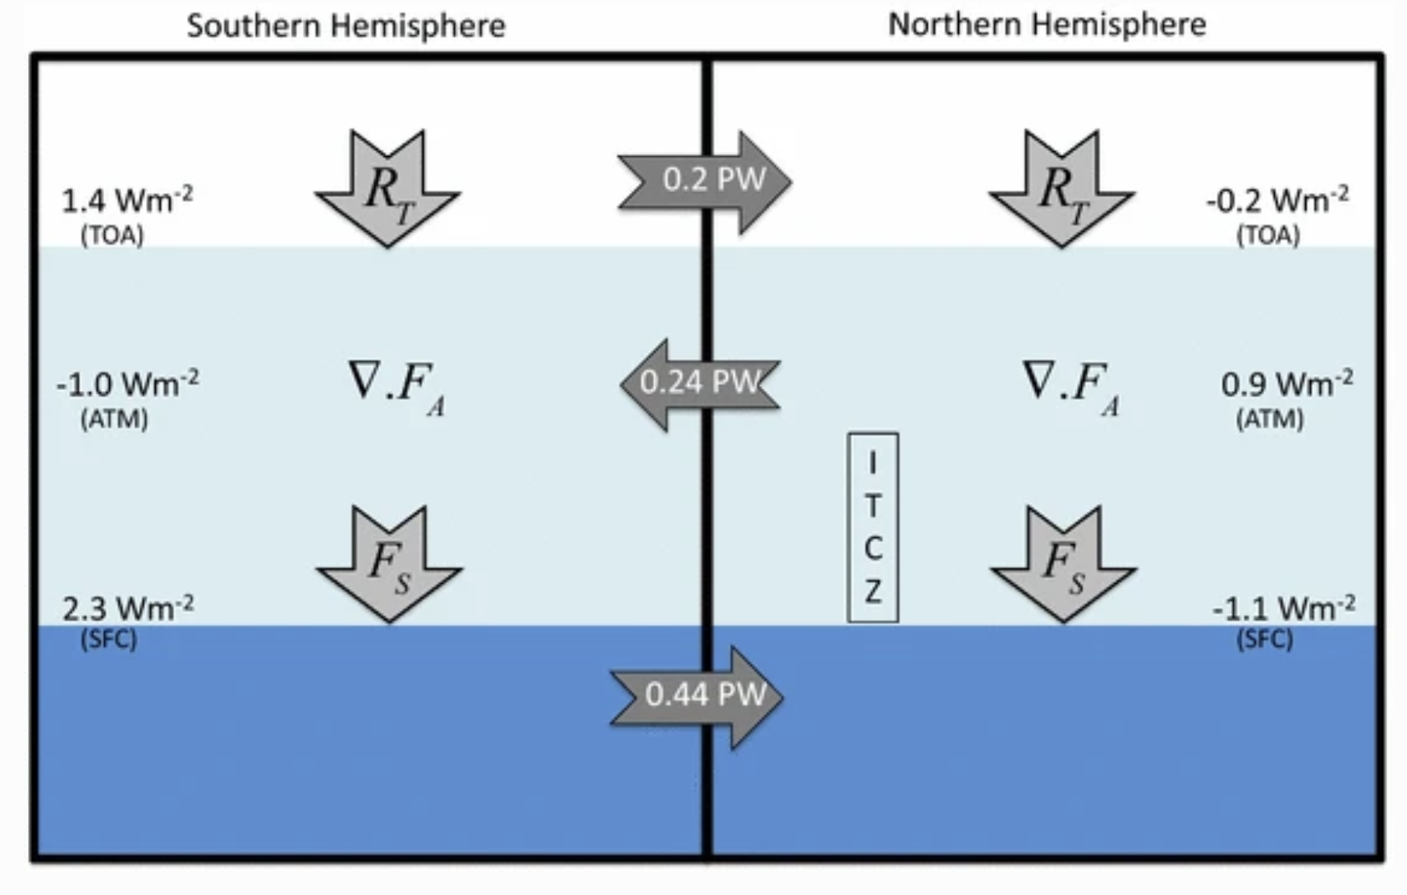
Cross-equatorial transports (CET)
(Loeb et al. 2015)
An overall underestimation (or even sign reversal) of long-term mean atmospheric CETs lead to inconsistent oceanic/total transport.
(Lembo et al. 2019)

Slide 11
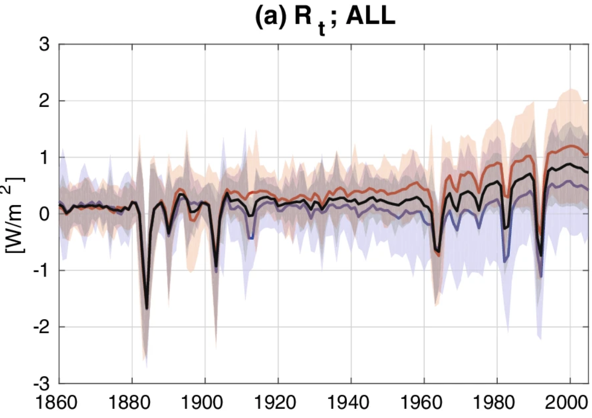
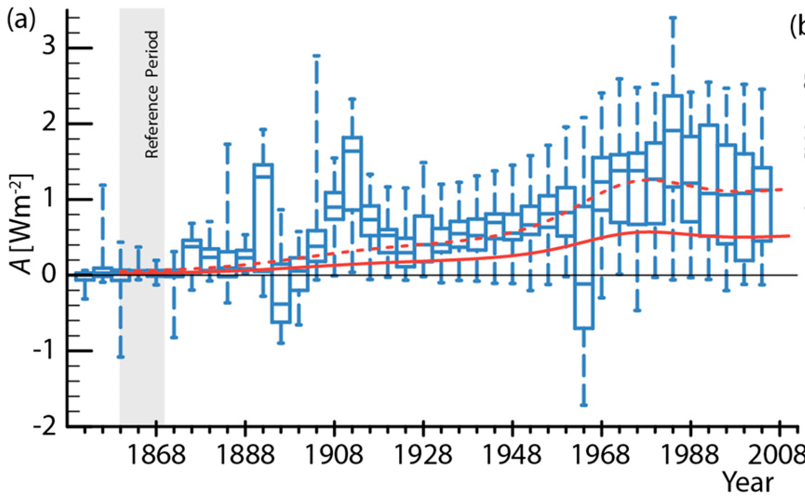
Aerosol forcing and hemispheric asymmetries
Annual mean Rt anomaly for a multi-model ensemble of historical simulations in the Northern Hemisphere (blue) in the Southern Hemisphere (red) and as global mean (black) (from Lembo et al. 2019);
Surface albedo asymmetry (SH-NH) over oceans from a set of CMIP5 multi-model ensemble historical simulations, from CERES observations rescaled backward for SO2 emissions (solid red) and the same multiplied by a 2.2 factor (dashed red) (from Stevens 2015);

Slide 12
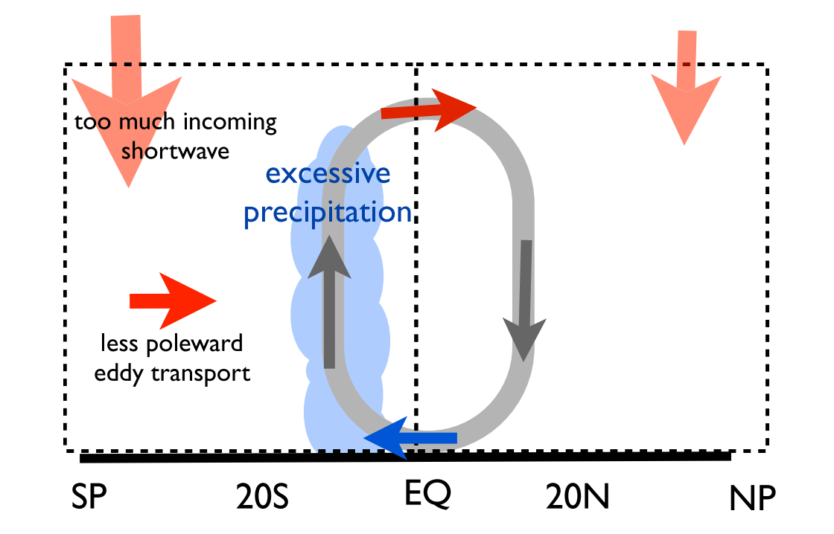
Hemispheric asymmetries and the double ITCZ problem
Excessive absorption of shortwave (SW) radiation in the Southern Hemisphere (SH) due to cloud biases over oceans;
Warmer SH mid-latitudes produce weaker eddy heat transport towards the high latitudes;
Instead of transporting energy southwards, the Hadley circulation across the equator transports energy northwards;
The moisture transports across these homogeneous tropics induce excessive precipitation in the SH;
(Hwang and Frierson, 2013)

Slide 13
Hemispheric asymmetries and the double ITCZ problem
More realistic cloud physics is needed (especially regarding shallow cumulus clouds over oceans)!
Increasing aerosol lifetime in clouds leads to a larger sensitivity of ITCZ to aerosol forcing!
(Hwang and Frierson, 2013)

Slide 14
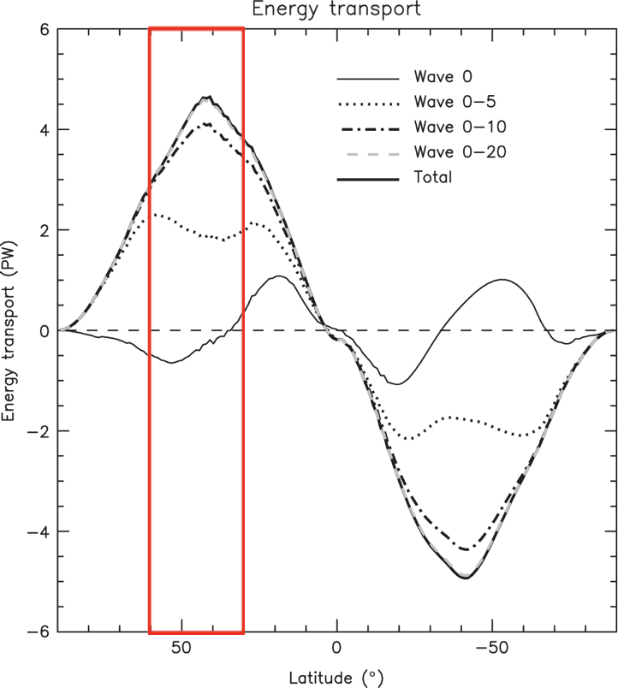
Wavenumber decomposition of meridional energy transports
We propose an algorithm for zonal wavenumber decomposition of meridional energy transports, allowing for the detection of individual spatial scales;
Wave 0: the mean meridional circulation (Hadley and Ferrel cells);
Wave 1-5: planetary eddy scales, usually associated with stationary waves;
Wave 6-10: synoptic eddy scales, mainly transient baroclinic waves peaking in midlatitudes;
Waves 11- : mesoscale and smaller scales;
(Graversen et al. 2016)

Slide 15
Wavenumber decomposition of meridional energy transports
In mid-latitudes, almost all the meridional transport is carried by eddies, and is directed «polewards» (i.e. northwards in the NH, southwards in the SH);
(Graversen et al. 2016)

Slide 16
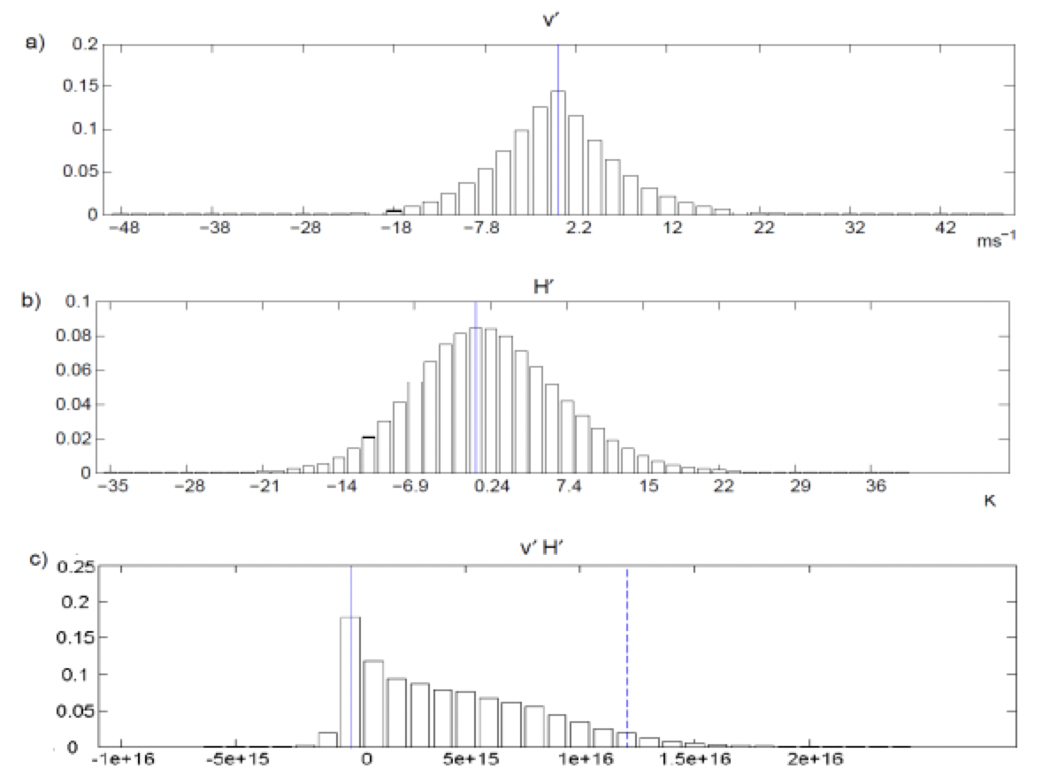
The non-linearity of baroclinic eddy transports
(Messori and Czaja 2013;
Messori and Czaja 2015)
The PDF of meridional transports across NH mid-latitudes is definitely non-Gaussian

Slide 17
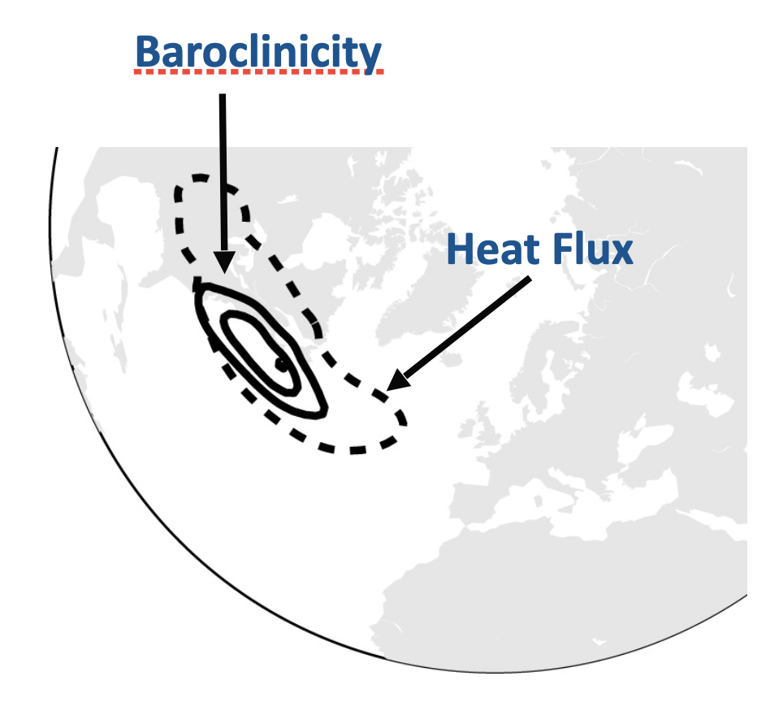
The non-linearity of baroclinic eddy transports
The strongest heat fluxes are co-located with the areas of most intense baroclinic activity
(Novak et al. 2015)
(Messori and Czaja 2013;
Messori and Czaja 2015)
The PDF of meridional transports across NH mid-latitudes is definitely non-Gaussian

Slide 18
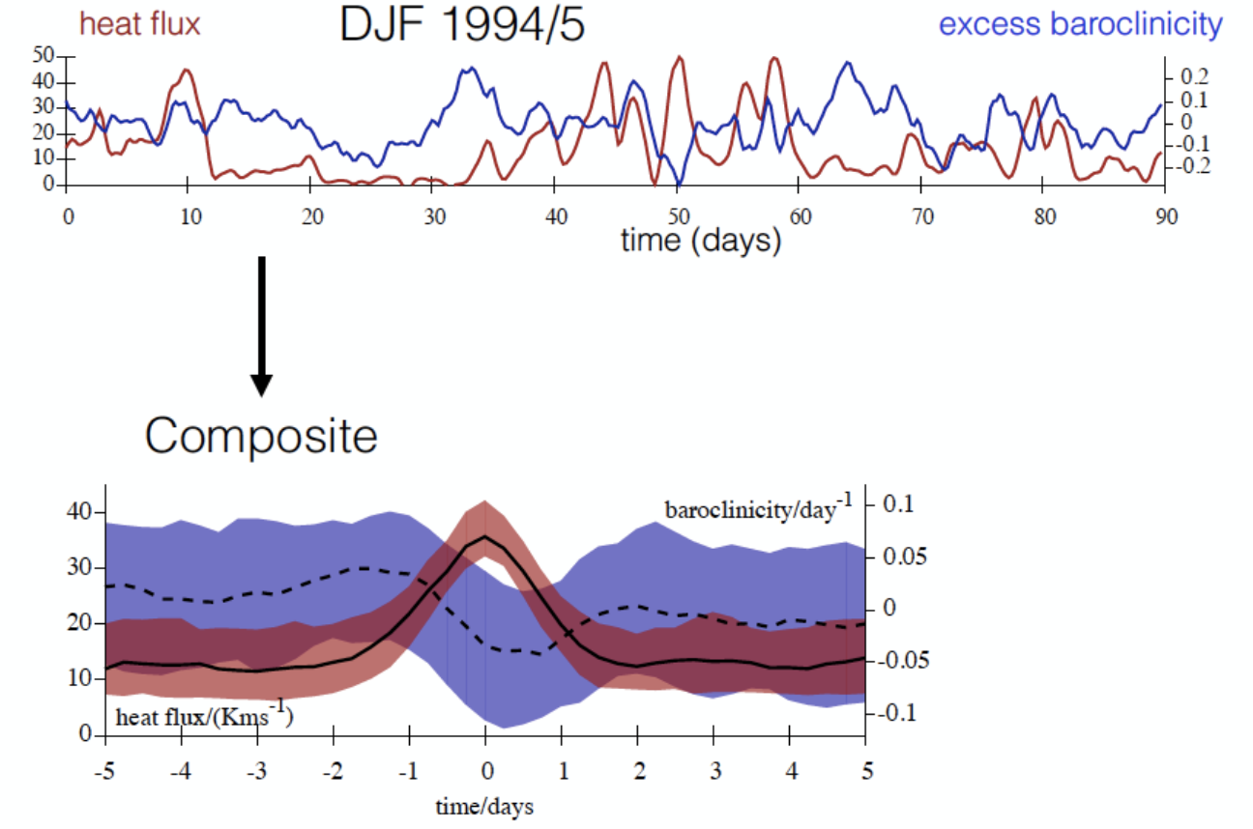
The non-linearity of baroclinic eddy transports
The strongest heat fluxes are co-located with the areas of most intense baroclinic activity
(Novak et al. 2015)
(Messori and Czaja 2013;
Messori and Czaja 2015)
Heat fluxes are very non-linear (as baroclinic activity does) and occur as bursts of intense transports;
The PDF of meridional transports across NH mid-latitudes is definitely non-Gaussian
(Ambaum and Novak 2014)

Slide 19
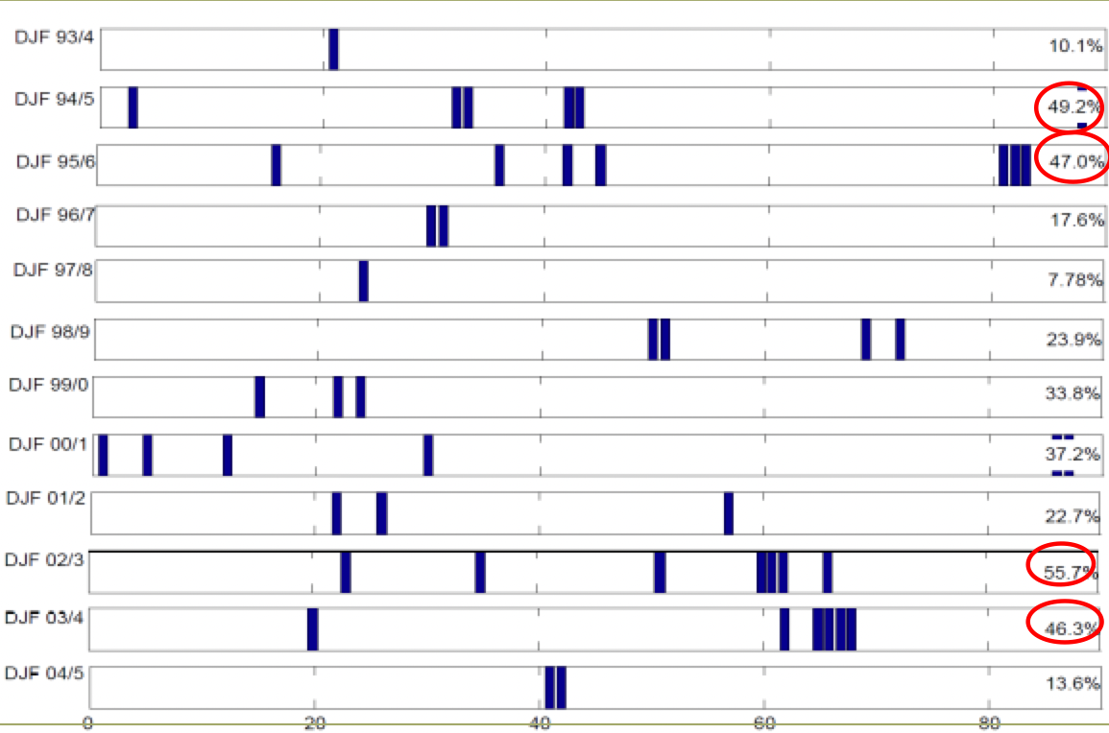
The non-linearity of baroclinic eddy transports
A few sporadic events can make up to 56% of the total poleward transport related to eddies in a season!
(Messori and Czaja, 2013)

Slide 20




The computation of the energy transport
The computation of atmospheric energy results from the combination of dry static, moist static and kinetic component:
$$E= c_{p}T+gz+Lq+\frac{1}{2}{\text{v}}^{2}$$
The zonal integrated total meridional heat transport is thus:
$$vE\left(φ\right)=\int_{0}^{p_{s}}{\oint{vE\frac{dp}{g}dx}}$$
The Fourier coefficients (a, b) are separately computed for meridional velocity and energy at every level, so that the heat transport carried by wavenumber n is retrieved as:
$$\left\{\begin{aligned}a_{n}^{Ψ}= \frac{2}{D}\oint{Ψ(t,φ,λ)\cos\left(\frac{n2πλ}{d}\right)dλ} \\ b_{n}^{Ψ}= \frac{2}{D}\oint{Ψ(t,φ,λ)\sin\left(\frac{n2πλ}{d}\right){dλ}}\end{aligned}\right.$$
$$vE_{n}\left(φ\right)=D\sum{\left\{\int_{0}^{p_{s}}{\frac{1}{2}\left(a_{n}^{v}a_{n}^{E}+b_{n}^{v}b_{n}^{E}\right)\frac{dp}{g}}\right\}}$$
where

Slide 21
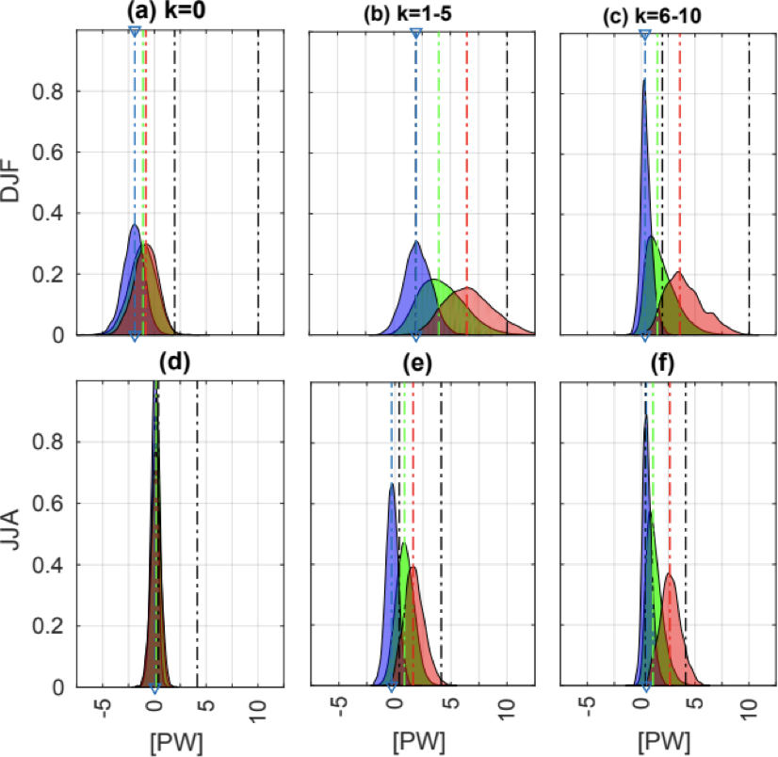
The distribution of energy transports and extremes across n
Standardized PDFs evidence that:
Transport is stronger in eddies than in the mean meridional circulation;
Transport is also stronger in DJF than in JJA;
Planetary scales carry much more energy than synoptic scales, especially in DJF;
(Lembo et al. 2019)

Slide 22
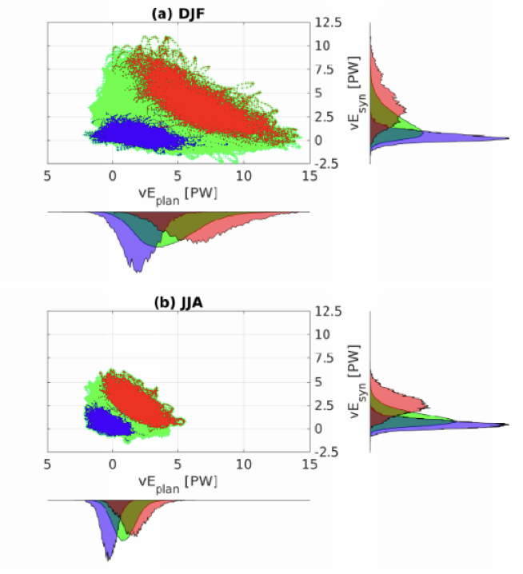
Which scales are involved in the extreme transport?
Scattering the contributions of planetary vs. synoptic scales to the two tails of extremes:
The planetary contribution reaches 1.5 times the synoptic in DJF;
The balance is more even in JJA;
Either planetary or synoptic scales contribute to the extremes, not both;
(Lembo et al. 2019)

Slide 23
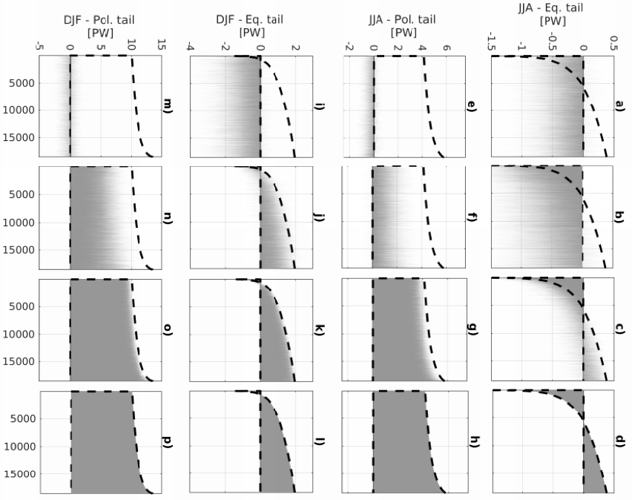
Which scales are involved in the extreme transport?
K=0
K=0-5
K=0-10
K=0-20
(Lembo et al. 2019)

Slide 24
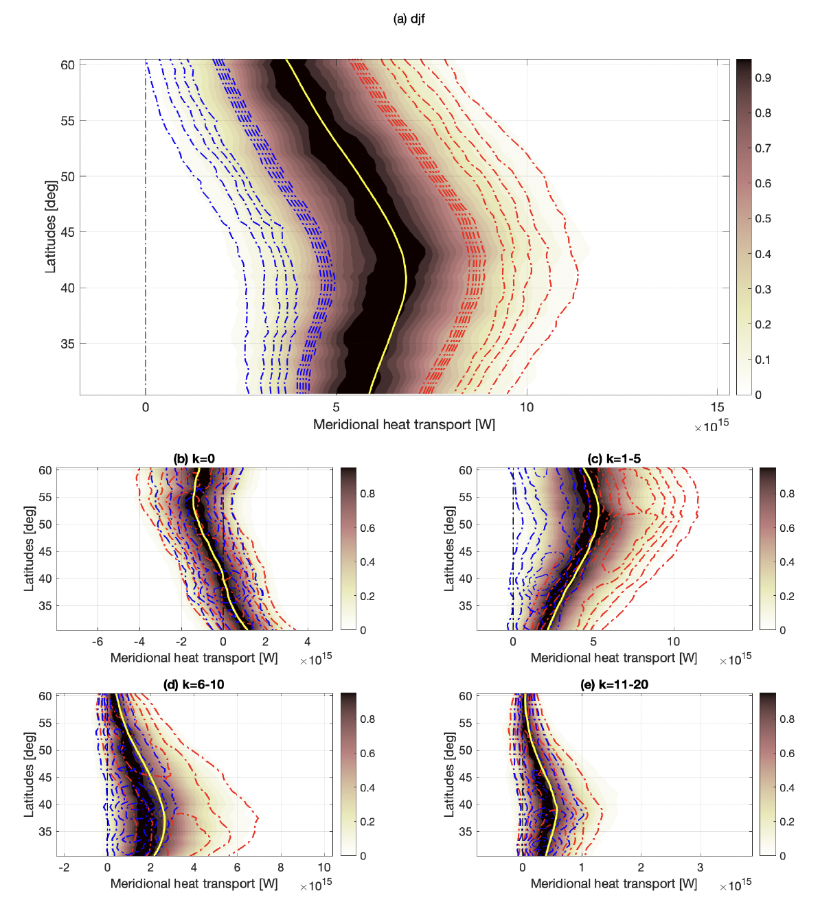
Distributions of energy transports along latitudes (DJF)
Synoptic scales peak around 40, planetary scales peak around 55;
Maxima and minima in planetary scales are independent of the median value of the transport, whereas synoptic maxima/minima depend on it;
Zonal mean and smaller scale eddies do not matter for the extreme transport;
(Lembo et al. 2022)

Slide 25
Dominant weather regimes in NH mid-latitudes
(Lembo et al. 2022)

Slide 26
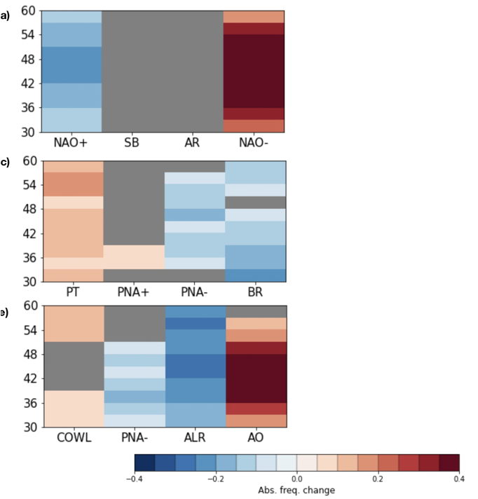
Change in frequencies of dominant weather regimes (DJF)
Looking at frequencies of dominant weather regimes in the population of DJF »poleward» extreme transports:
NAO- and AO patterns are favored by extremes occurring in the central part of the channel;
ALR is less likely as well as NAO+;
Overall, high latitudinal blocking and mid-latitudinal baroclinic activity are associated with such extreme transports in DJF.
NB: the opposite occurs for weaker transports (not shown)
EAT
PAC
NH

Slide 27
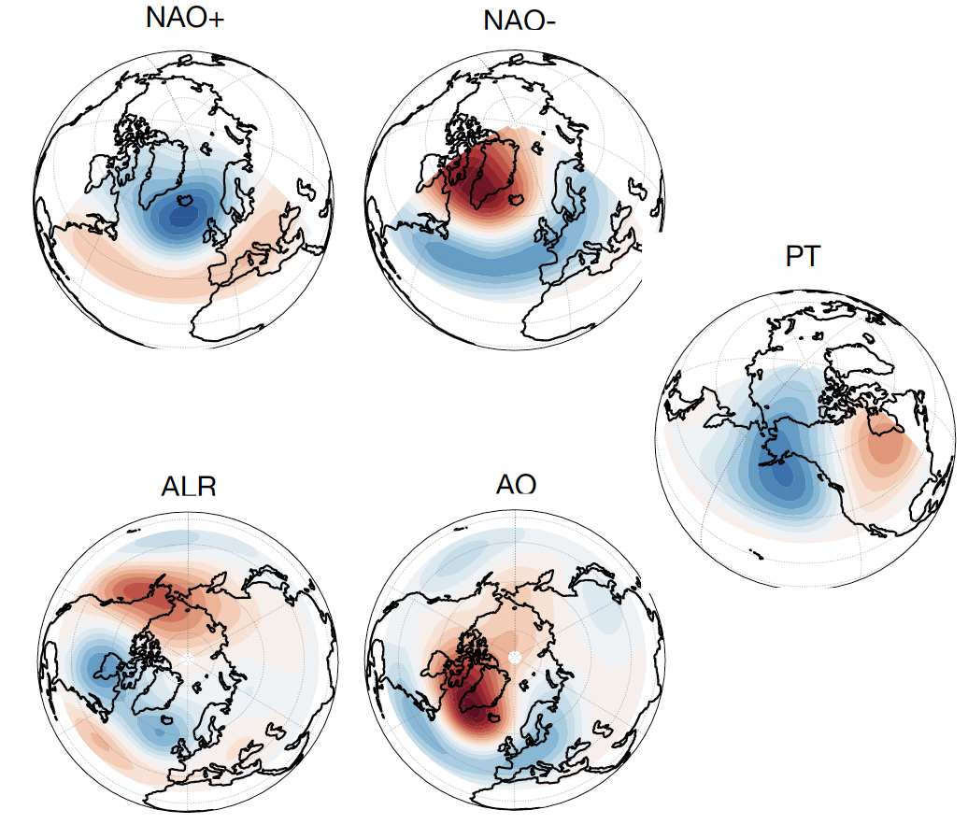
Change in frequencies of dominant weather regimes (DJF)
EAT
PAC
NH

Slide 28
Change in frequencies of dominant weather regimes (JJA)
Looking at frequencies of dominant weather regimes in the population of JJA »poleward» extreme transports:
A strong SB-like pattern signal (EATC2, NHC4) becomes more likely;
Pacific and Atlantic troughs (resembling NAO-/AO and PT winter regimes) become less likely;
These changing frequencies are suggestive of a more compact polar vortex favoring high pressure systems lying along the parallels with some waviness;
EAT
PAC
NH

Slide 29
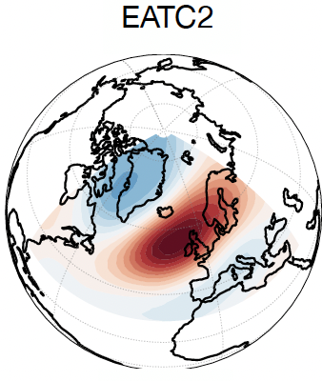
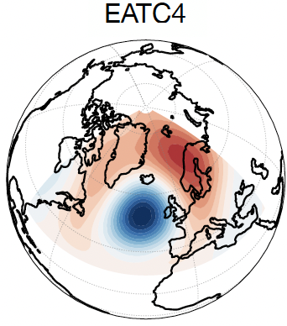
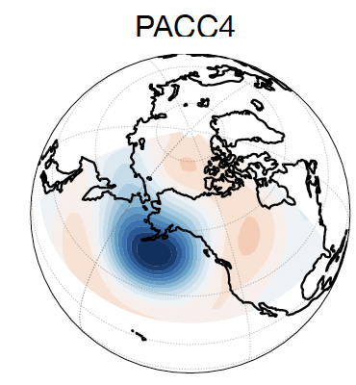
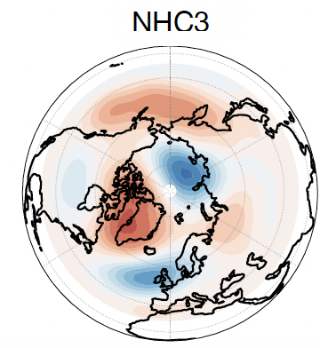
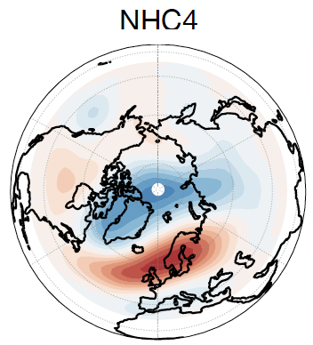
Change in frequencies of dominant weather regimes (JJA)
EAT
PAC
NH

Slide 30
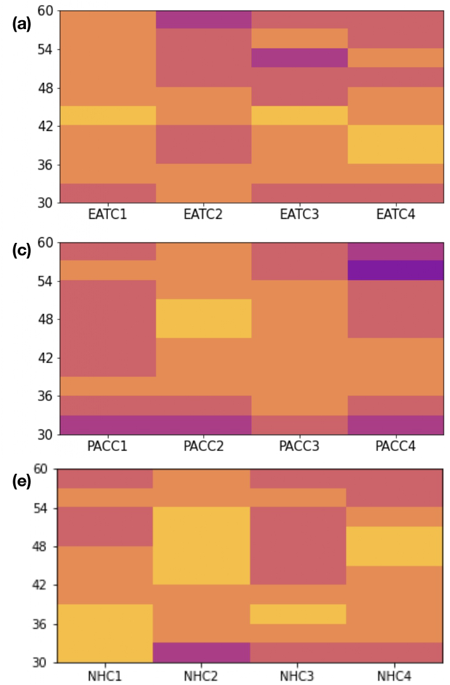
Dominant wavenumbers for DJF and JJA extremes
DJF
JJA
Looking at dominant wavenumbers in the population of »poleward» extreme transports:
k=2-4 dominates in DJF;
k=4-6 dominates in JJA;
High latitudinal blockings are associated with ultra-long (mainly k=3) scales in DJF, while the mentioned waviness of low-latitudinal high pressure systems in JJA, coherently with the Rossby wavenumbers associated with recurrent heat waves in NH’s summer (e.g. Kornhuber et al. 2019).
EAT
PAC
NH

Slide 31
Summary
The zonal mean general circulation of the atmosphere has been evaluated in CMIP models through integration of radiative/heat fluxes at the interfaces;
The inter—hemispheric asymmetry of energy budgets produces inconsistent cross-equatorial transports, reverbering in misplacement of the ITCZ, excessive impact of anthropogenic aerosol forcing;
Zonal wavenumber decomposition of meridional energy transports in the NH mid-latitudes reflects the non-linearity of baroclinic activity and the relevance of planetary eddy transports for the dynamics in the channel;

Slide 32
References
Ambaum, M. H. P.: Thermal Physics of the Atmosphere, Wiley-Blackwell (2010)
Graversen, R. G. and Burtu, M.: Arctic amplification enhanced by latent energy transport of atmospheric planetary waves, Q J R Meteorol Soc 142, 2046–2054 (2016)
Liang, M., Czaja, A., Graversen, R., and Tailleux, R.: Poleward energy transport: is the standard definition physically relevant at all time scales?, Clim Dyn 50:5, 50, 1785–1797 (2017)
Lembo, V., Folini, D., Wild, M. and Lionello P.: Energy budgets and transports: global evolution and spatial patterns during the twentieth century as estimated in two AMIP-like experiments. Clim Dyn 48, 1793–1812 (2017)
Lembo, V., Folini, D., Wild, M., and Lionello, P.: Inter-hemispheric differences in energy budgets and cross-equatorial transport anomalies during the 20th century. Clim Dyn 53:1, 115-135 (2019)
Lembo, V., Lunkeit, F., and Lucarini, V.: TheDiaTo (v1.0) – a new diagnostic tool for water, energy and entropy budgets in climate models, Geosci. Model Dev., 12, 3805–3834 (2020)
Lembo, V., Fabiano, F., Galfi, V. M., Graversen, R., Lucarini, V., and Messori, G.: Meridional energy transport extremes and the general circulation of NH mid-latitudes: dominant weather regimes and preferred zonal wavenumbers, Weather Clim Dynam, 3, 1037–1062 (2022)
Messori, G. and Czaja, A., On the sporadic nature of meridional heat transport by transient eddies. Q J R Meteorol Soc 139(673), 999-1008 (2013)
Messori, G. and Czaja, A., On local and zonal pulses of atmospheric heat transport in reanalysis data. Q J R Meteorol Soc, 141(691), 2376-2389 (2015)
Novak, L., M.H. Ambaum, and R. Tailleux, 2015: The Life Cycle of the North Atlantic Storm Track. J. Atmos. Sci.
Wild, M. The global energy balance as represented in CMIP6 climate models. Clim Dyn 55, 553–577 (2020)

Slide 33
The computation of the energy transport
In order to account for the net instantaneous energy transport, one has to remove the mass contribution from the zonal mean component (cfr. Liang et al. 2017):
{ } : vertical mean
[ ] : zonal mean
Dagger: departure from the vertical mean
$$\left\{{\left[v\right]}^{†}{\left[E\right]}^{†}\right\}=\left\{\left[v\right]\left[E\right]\right\}−\left\{\left[v\right]\right\}\left\{\left[E\right]\right\}$$
The first term on the rhs is recognized as the wave zero energy transport component

