Slide 1
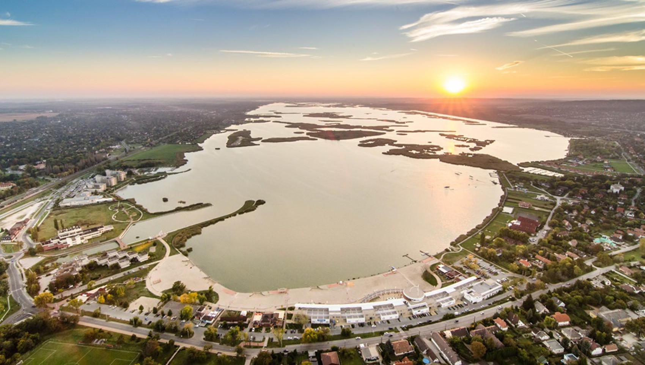
Improving methods to calculate monthly water budget for Lake Velence, Hungary
EGU23 - General Assembly
Section: HS 2.5.2
Abstract: EGU23-8334
PICO presentation
Vienna, 26th April 2023.
Máté Chappon – PhD candidate - chappon.mate@sze.hu
Katalin Bene PhD – associate professor - benekati@sze.hu
National Laboratory for Water Science and Water Security, Széchenyi István University, Department of Transport Infrastructure and Water Resources Engineering, Hungary

Slide 2
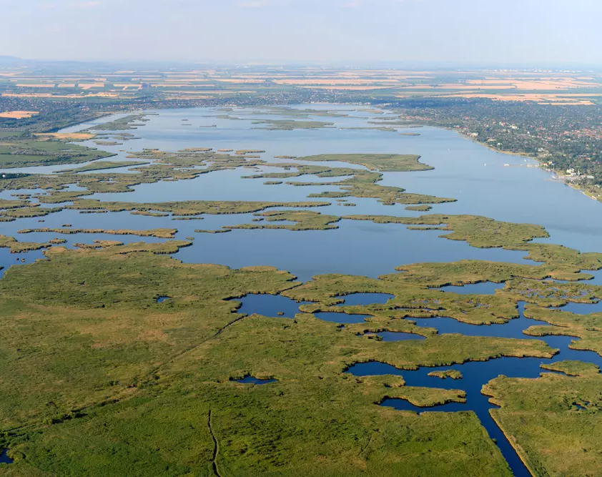
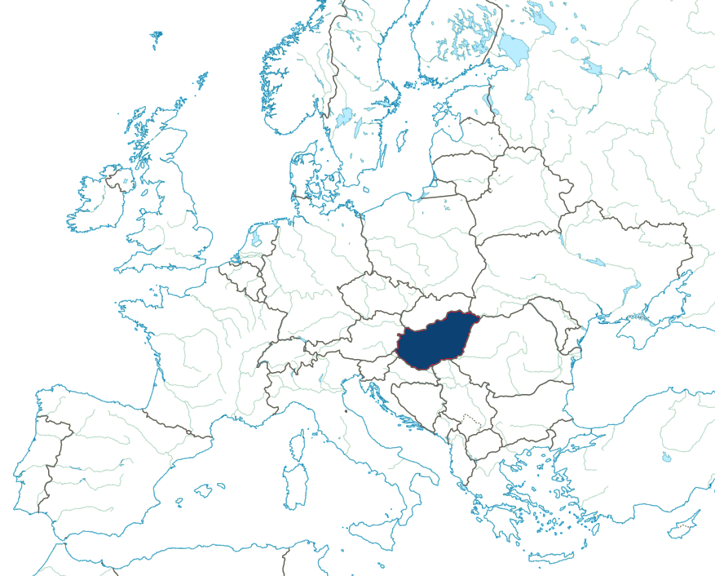
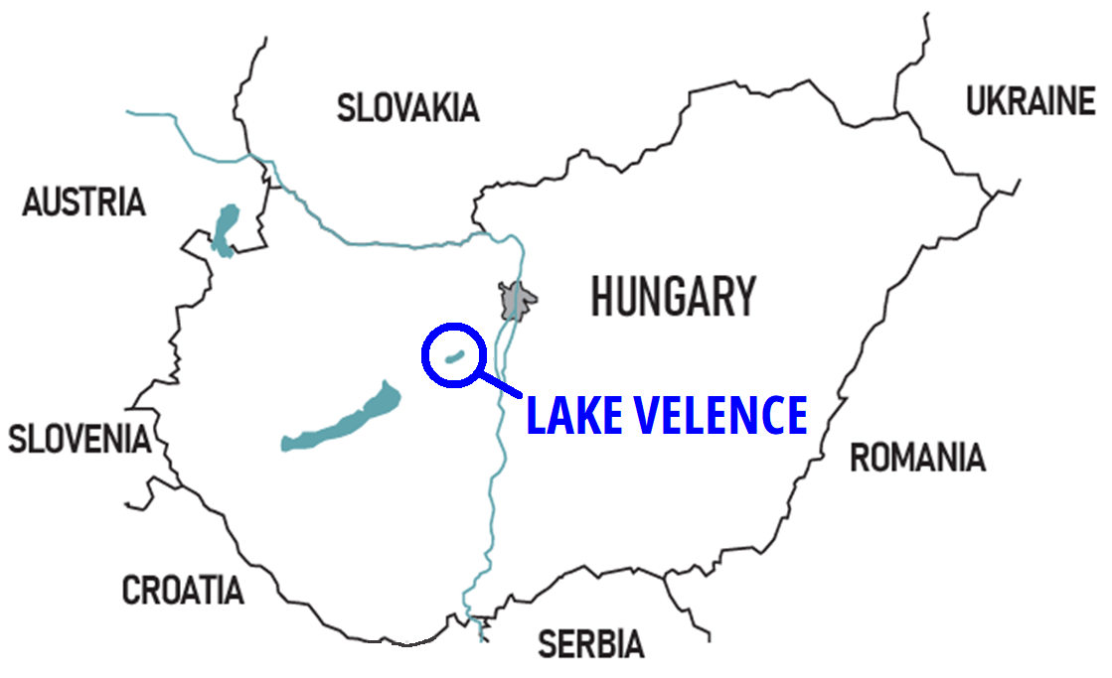

Slide 3
Water level hit negative record in 2022

Slide 4
What is wrong with the current calculation method?

Slide 5
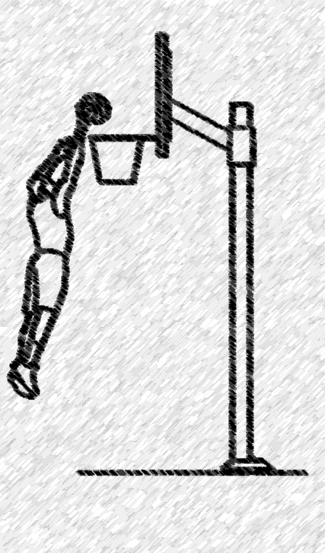
What is wrong with the current calculation method?
www.dimensions.com/element/basketball-hoop

Slide 6
What is wrong with the current calculation method?
dimensions.com/element/basketball-hoop

Slide 7
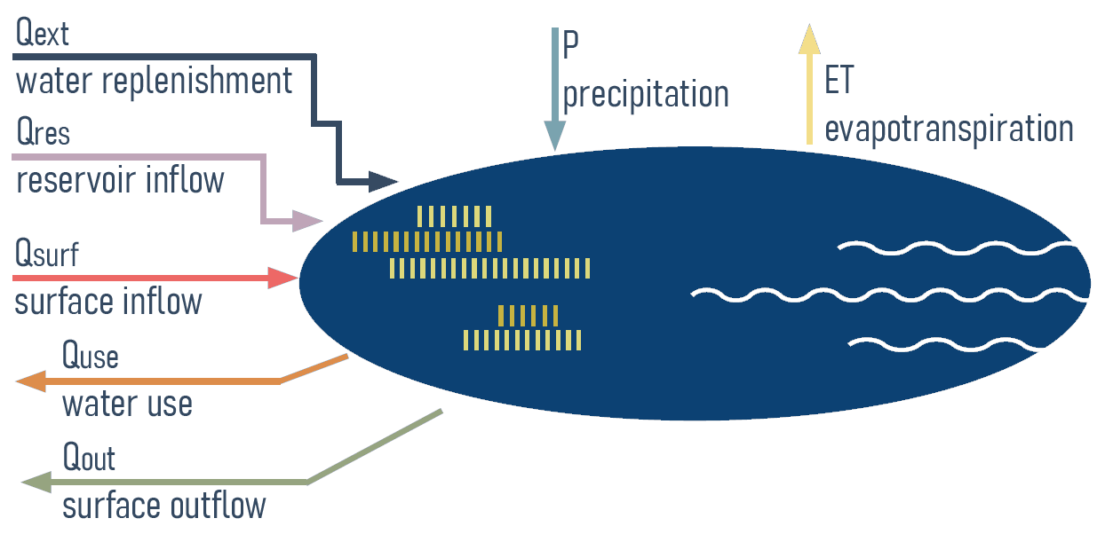
Water Budget calculation method
ΔH(M)
Lake Velence
G - groundwater
CALCULATION
ERROR:
Z = ΔH(C) - ΔH(M)
ΔH(C) = P + Qsurf + Qres + Qext – ET – Qout – Quse ª

Slide 8
THANK YOU FOR YOUR ATTENTION!
The research presented in this PICO presentation was carried out within the framework of the Széchenyi Plan Plus program with the support of the RRF 2.3.1 21 2022 00008 project.

Slide 9
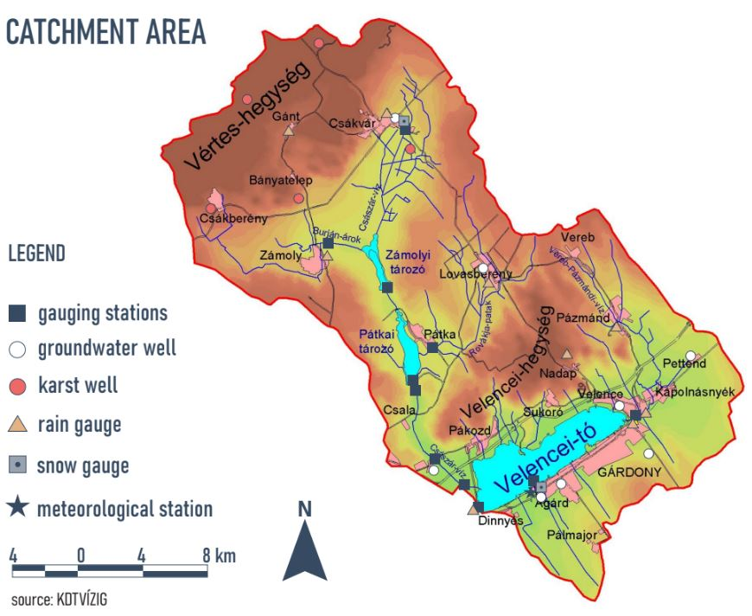
Lake Velence, Hungary
Catchment information
Total area: 615 km2
Elevation: 100 – 325 m.a.s.l.
Precipitation average: 540 mm/yr
Water surf. Evap. ave.: 930 mm/yr
Reservoirs: 2 large, several smaller
Lake dimensions: L = 10 km
W = 2.5 km
H = 1.9 m !!!
KDTVÍZIG

Slide 10
Lake Velence, Hungary
Water budget contributions
(based on the current calculation method ^{b} )
KDTVÍZIG

Slide 11
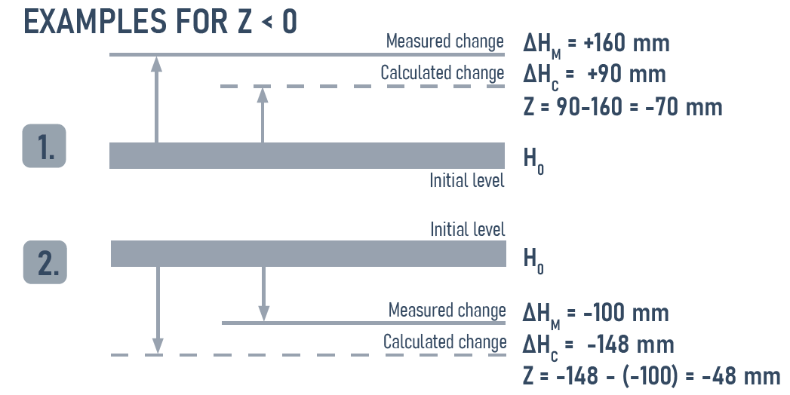
Calculation error – definition
CALCULATION ERROR: Z
Z = ΔH(C) - ΔH(M)
ΔH(C) – calculated change in water level
ΔH(M) – measured change in water level
Negative Z value means underestimating influxes and/or overestimating outfluxes

Slide 12
Calculation error – annual values
Weak negative correlation (-0.33) between P and Z

Slide 13
Calculation errors – monthly values
Annual errors accumulate in Jan-May period!

Slide 14
Evapotranspiration - current method
Calculation method: ^{c}
Based on ground measurements of temperature, windspeed, vapour pressure, and pan evaporation at Agárd.
Winter:
XI. – III.: modified Meyer equation:
P=0.55 × [(E-e)/1,33]^{0,9} × (1+T/273)⁹ × (1+0,015 × u)² × n [mm/month]
Summer:
IV. – X.: pan evaporation (A), with reed constants (K):
P=1,11 × (0,58+0,42×K) × A^{0,79} × (1+u)^{0,13} × n [mm/month]
Main focus on the January - May period

Slide 15
Evapotranspiration – satellite data
Google Earth Engine ET products ^{d}:
GLDAS: Nasa GLDAS V2.1
M-500: Modis 500 m, 8 day
^{e}PML-V2: Penman Monteith- Leuning (Modis500, 8day, GLDAS forcing data) Zhang et al., 2019
^{d}GEE code: https://github.com/ mikhailsmilovic/Earth-Engine/blob/main/ET
^{f} EEFLUX: LANDSAT 30×30 m – METRIC method (Allen et. al 2007)
GEE products yield low ET, EEFLUX closest to current results

Slide 16
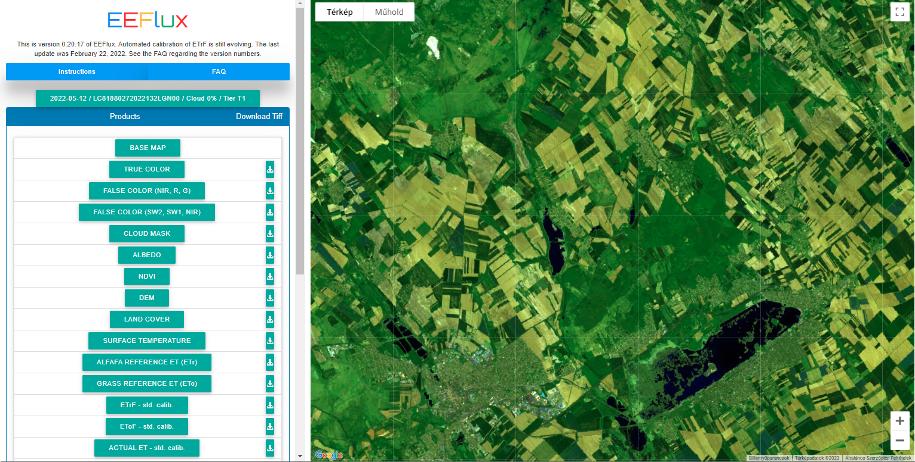
Evapotranspiration – EEFLUX-METRIC
Satellite data:
Landsat images – high resolution (30×30 meter) imagery of atmospheric variables
METRIC method:
Automatic calibration of Energy Balance equations with Penman-Monteith method
Image frequency:
~ 1-2 weeks, but clouds and other anomalies occur
Clouds and other anomalies can cause large time-gaps!

Slide 17
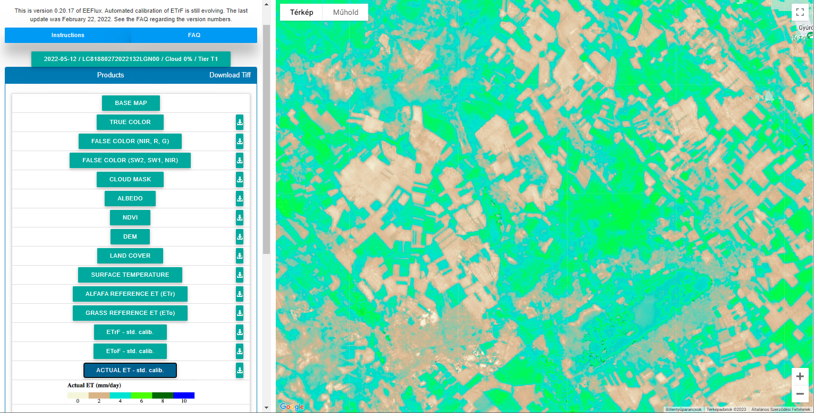
Evapotranspiration – EEFLUX-METRIC
With EEFLUX slightly smaller ET values for Jan-May period!

Slide 18
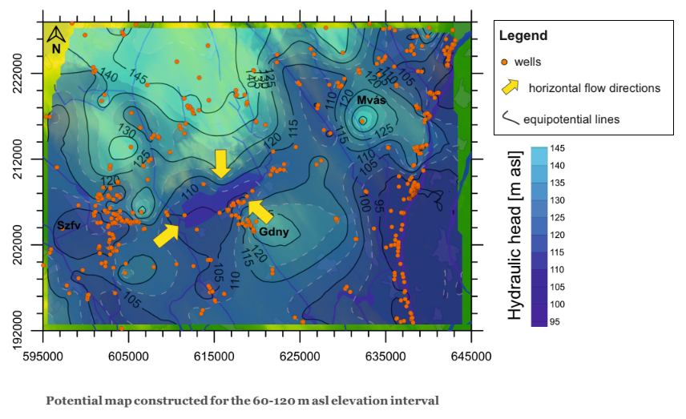
Groundwater flow mapping^{g}
Calculation method:
Currently, the groundwater component is not included in the Lake Velence water budget calculation!
However evidence shows, that it should be included.
Modelling the groundwater flow system is in progress.
^{g} Research paper:
P. Baják et. al, "Integration of a Shallow Soda Lake into the Groundwater Flow System by Using Hydraulic Evaluation and Environmental Tracers," Water 14, 2022, 951 doi:10.3390/w14060951
P. Baják et. al, 2022
GW modelling of Lake Velence: EGU-HS8.2.3 - Friday

Slide 19
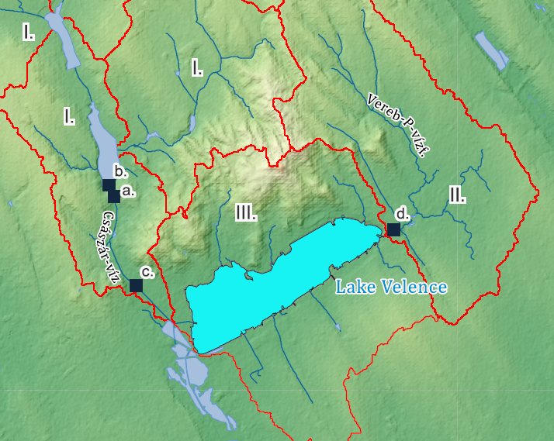
Surface inflow - current method
Calculation method: ^{c}
based on hydrological analogy
constants calculated in 1970-s
I. Császár-víz:
Q_{CSV} = [Gauge (a.) – Gauge (b.)] × 2.63
II. Vereb-P. vízf.:
Q_{VPV} = Gauge (d.)
III. Lake direct catchment:
Q_{LDC} = Gauge (d.) × 0.84
Need to revisit calculation method, include gauge (c.)

Slide 20
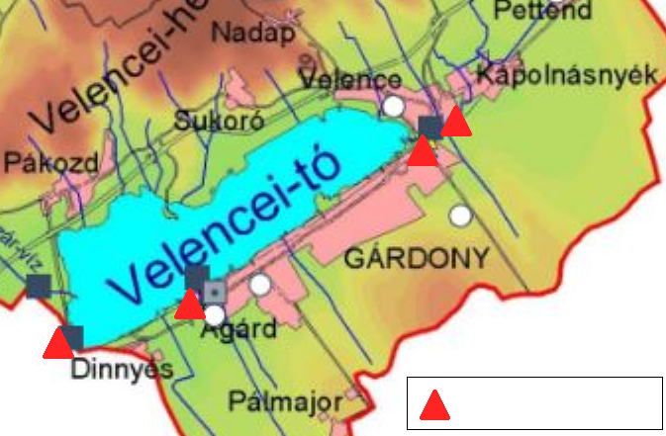
Precipitation – current method
Calculation method:
Based on ground measurements, averaging data from 4 stations
No stations on the north shore of the lake.
Slight increasing trend in annual precipitation.
rain gauge
KDTVÍZIG

Slide 21
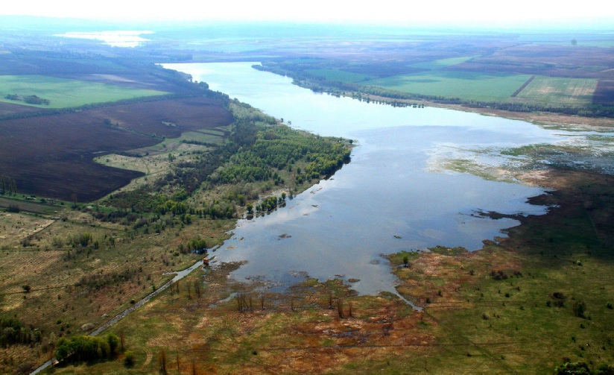
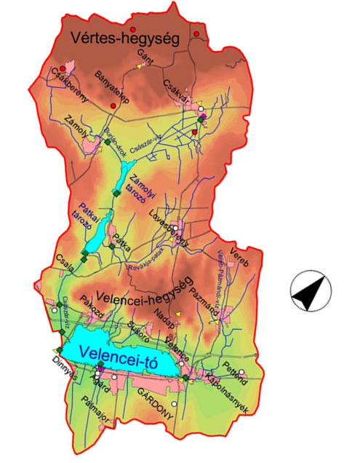
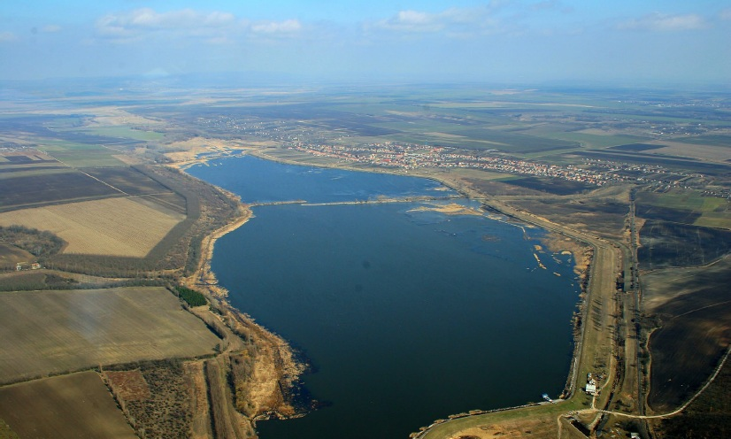
Water replenishment from reservoirs (Q_{res})
Reservoirs:
Reservoir 1 (Zámolyi): max: 4 Mm³
Reservoir 2 (Pátkai): max: 7 Mm³
Lake Velence at stage 140 cm: 41 Mm³
Operation:
Filling up from floods, replenishment if lake level goes below 140 cm.
Calculation method:
Based on discharge curves of gates.
Aquamagazin.hu
Aquamagazin.hu
KDTVÍZIG

Slide 22
External water replenishment (Q_{ext})
External water replenishment in 1993-1994:
why? → water level under min. operational level for 3 consecutive years
how? → building a pipe system to divert karst water from an existing mine dewatering well
how much? → ~ 11 Mm³
External water replenishment 2023 ?
Not yet!
But ongoing negotiations on possibilities.
External water replenishment '93-'94
??

Slide 23
Water discharges (Q_{out} ; Q_{use})
Lowering water levels (Qout):
When water levels in the lake exceed max operational level. Last time the water level was lowered: 2016.
Water use (Quse):
Water from the main tributary of the lake can be diverted towards the Dinnyés Fish Farm.
Calculation method:
Based on discharge curves of gates and weirs, with high uncertainty. ^{b}

Slide 24
References
a) Water Resources Research Center Hungary (VITUKI), "Hydrological and water quality characteristics of Lake Velence and its reservoirs," Budapest 1985
b) Middle Transdanubian Water Directorate (KDTVÍZIG), "Water budget of Lake Velence: 1986 - 2021," Available at: http://www.kdtvizig.hu/hu/velencei-to-vizmerleg (Accessed: 21st April 2023.)
c) Water Resources Research Center Hungary (VITUKI), "Monthly water budget calculation for Lake Velence and its catchment," Budapest, 1976
d) Google Earth Engine evapotranspiration products - EE code: https://github.com/mikhailsmilovic/Earth-Engine/blob/main/ET
e) Zhang, Y., Kong, D., Gan, R., et al., 2019. Coupled estimation of 500 m and 8-day resolution global evapotranspiration and gross primary production in 2002–2017. Rem. Sens. Environ. 222, 165–182.
f) Allen, R.G., Tasumi, M., Trezza, R., 2007a. Satellite-based energy balance for mapping evapotranspiration with internalized calibration (METRIC) Model. J. Irrig. Drain. Eng. 133 (4), 380–394. https://doi.org/10.1061/(ASCE)0733-9437(2007)133:4 (380). https://eeflux-level1.appspot.com/
g) Baják, P.; Hegedűs-Csondor, K.; Tiljander, M.; Korkka-Niemi, K.; Surbeck, H.; Izsák, B.; Vargha, M.; Horváth, Á.; Pándics, T.; Erőss, A. Integration of a Shallow Soda Lake into the Groundwater Flow System by Using Hydraulic Evaluation and Environmental Tracers. Water 2022, 14, 951. https://doi.org/10.3390/w14060951
The research presented in this PICO presentation was carried out within the framework of the Széchenyi Plan Plus program with the support of the RRF 2.3.1 21 2022 00008 project.

