Slide 1








Modern Earth system science visualization and exploration techniques
--the balancing act between complex information, broad functionality and simple illustration
Construction of a fluvial facies knowledge graph and its application in sedimentary facies identification
Lei Zhang, Mingcai Hou, Anqing Chen, Hanting Zhong, James G. Ogg, Dongyu Zheng
Key Laboratory of Deep-time Geography and Environment Reconstruction and Applications, MNR & Institute of Sedimentary Geology, Chengdu University of Technology
b State Key Laboratory of Oil and Gas Reservoir Geology and Exploitation (Chengdu University of Technology)
LEI ZHANG
zhangleilei@stu.cdut.edu.cn
April 28 2023

Slide 2
outline
Fluvial facies knowledge system
Fluvial facies knowledge graph
Application in sedimentary facies identification ＆ knowledge reasoning

Slide 3
outline
Fluvial facies knowledge system
Fluvial facies knowledge graph
Application in sedimentary facies identification ＆ knowledge reasoning

Slide 4
Data sources: Unstructured/semi-structured geoscience literature.
Data pre-processing:
1. Cleaning and denoising.
2. Standardization, merging and aligning knowledge.
3. Rule set.
1. Schema layer-Conceptual ontology layer (Sedimentary facies layer).
2. Data layer-Attribute data layer (Facies marker layer).
Construction knowledge system.
Knowledge storage.
Knowledge representation.
Domain ontology and triples modeling.
Knowledge storage.
Visualization, query, and retrieve.
Reasoning principles and model design.
Reasoning algorithm and system development process.
Reasoning results and quality assessment.
Construction of a fluvial facies knowledge graph
and its application in sedimentary facies identification
Design logic knowledge architecture
Sedimentary facies identification ＆ knowledge reasoning
Knowledge acquisition
Knowledge system
Knowledge graph
Application ＆ Knowledge service
Construction ＆ Workflow of domain knowledge graph
The technical framework of knowledge graph construction and application

Slide 5
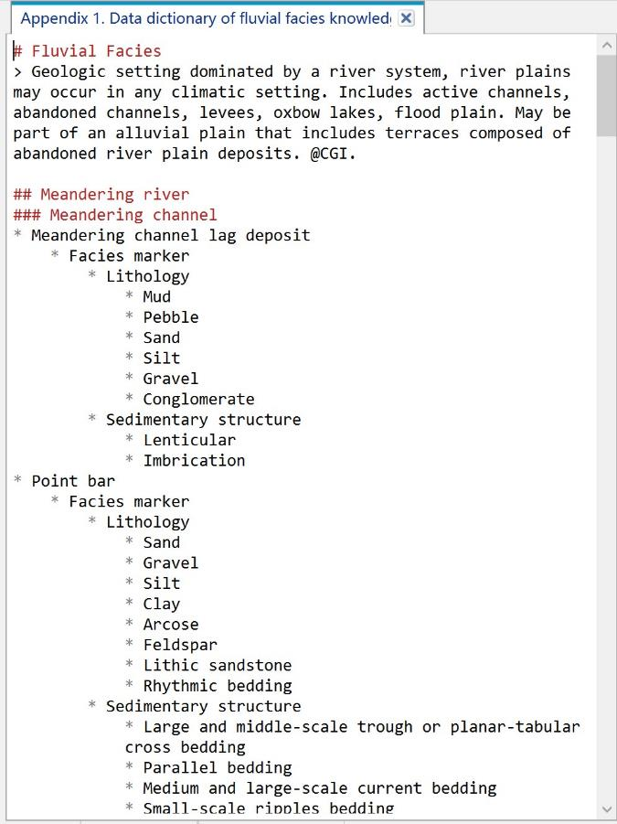
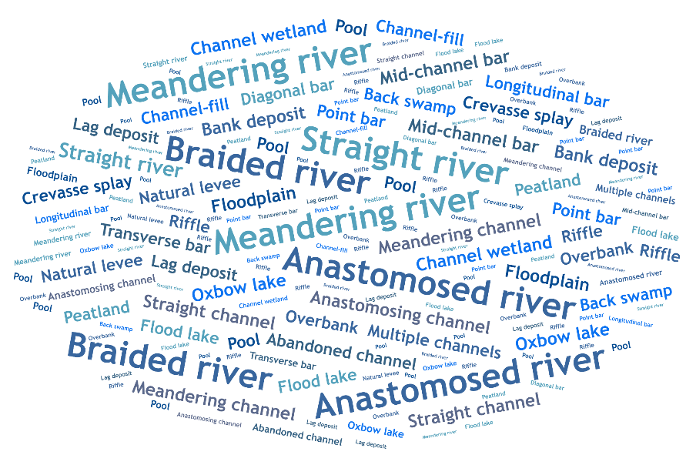
1. Knowledge acquisition
Glossary of fluvial facies knowledge
Part of the fluvial facies data dictionary in LML (Lightweight Markup Language) format code

Slide 6
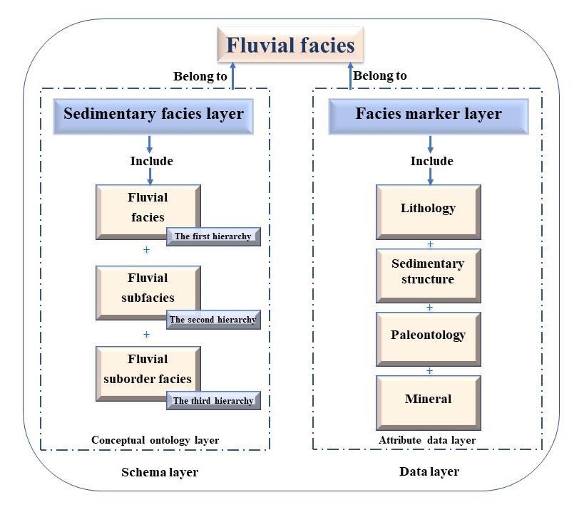
2. Design logic knowledge architecture

Slide 7
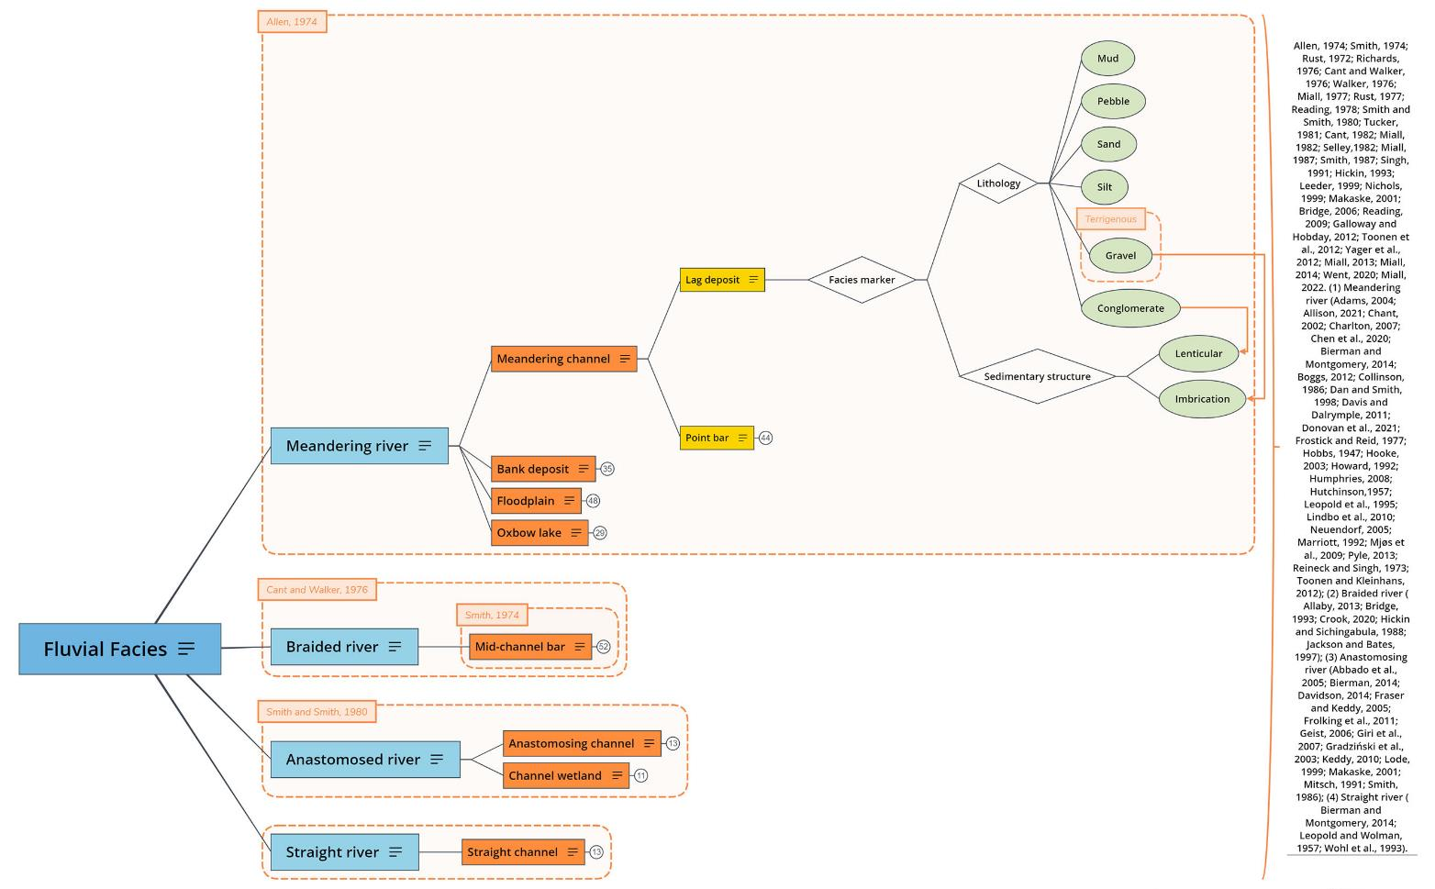
3. Construct fluvial facies knowledge system
The number in the circle represents the number of collapsed nodes (click to expand)
Excerpt from the conceptual model of fluvial facies knowledge system hierarchy tree

Slide 8
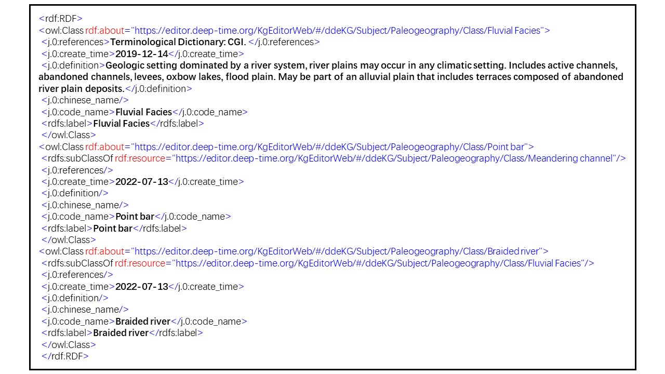
4. Fluvial facies knowledge storage
Fluvial facies knowledge storage-RDF
Resource Description Framework

Slide 9
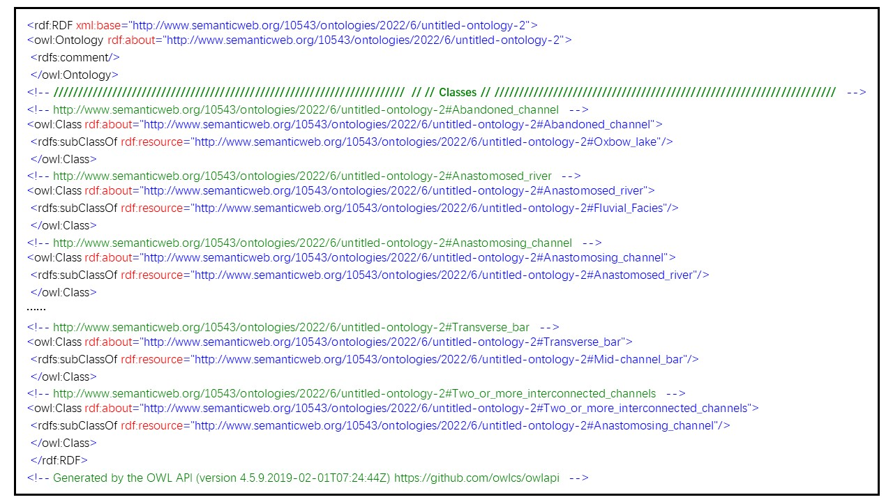
4. Fluvial facies knowledge storage
Fluvial facies knowledge storage-OWL
Ontology Web Language

Slide 10
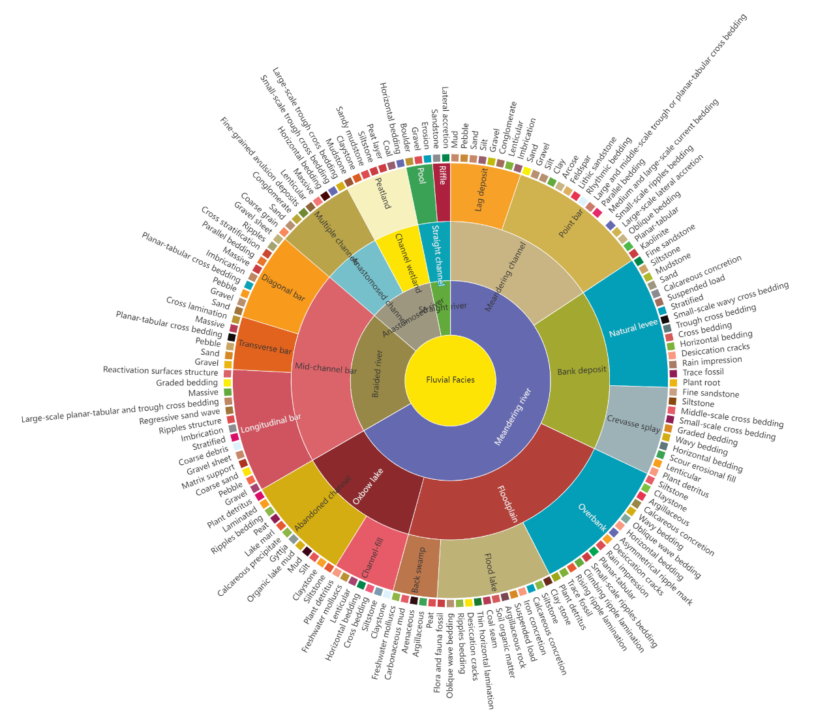
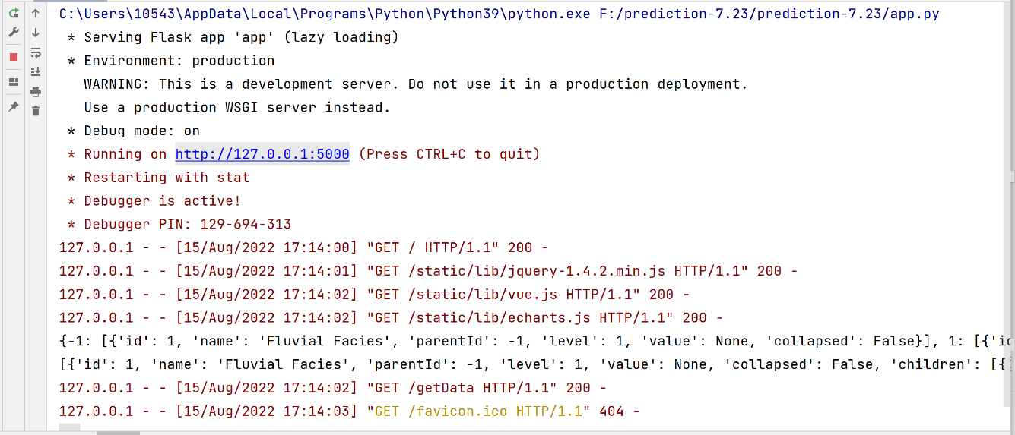
5. Fluvial facies knowledge representation
Fluvial facies knowledge system visualization of the Sunburst chart

Slide 11
outline
Fluvial facies knowledge system
Fluvial facies knowledge graph
Application in sedimentary facies identification ＆ knowledge reasoning

Slide 12
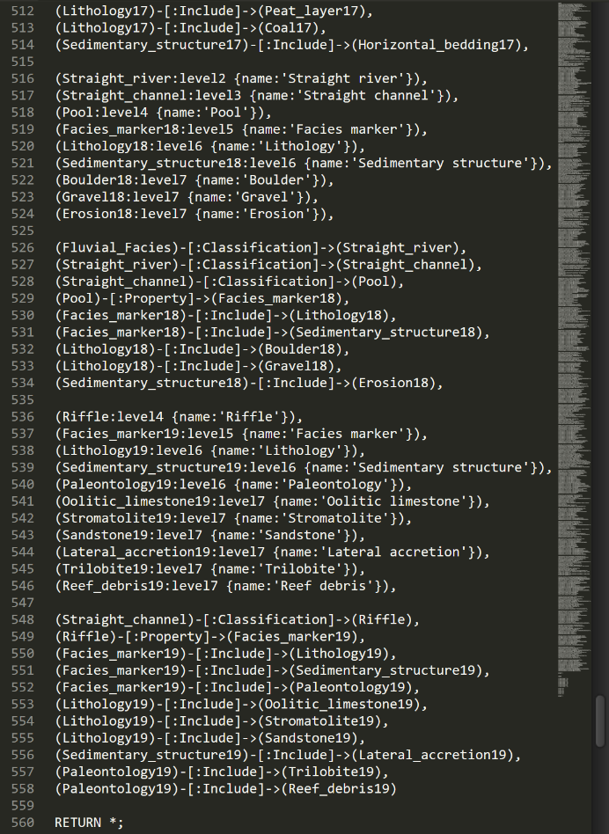
1. Domain ontology and triples modeling
2. Knowledge storage
Nodes-Edges-Nodes
（1）Ontology/Entity-Relationship-Ontology/entity
(Fluvial_Facies)-[:Classification]->(Meandering_river),
（2）Ontology/entity-Property-Property values
(Natural_levee)-[:Property]->(Facies_marker5),
(Facies_marker5)-[:Include]->(Paleontology5),
(Paleontology5)-[:Include]->(Plant_root5),
Steps
Describe and define fluvial facies ontologies and entities.
Clarify and customize (or follow existing definitions) relationships between ontologies and entities.
For qualitative data, the properties of ontology and entity should be set. For quantitative data, the corresponding property values should be added.
Create and list the instance.
Part of the Cypher code

Slide 13
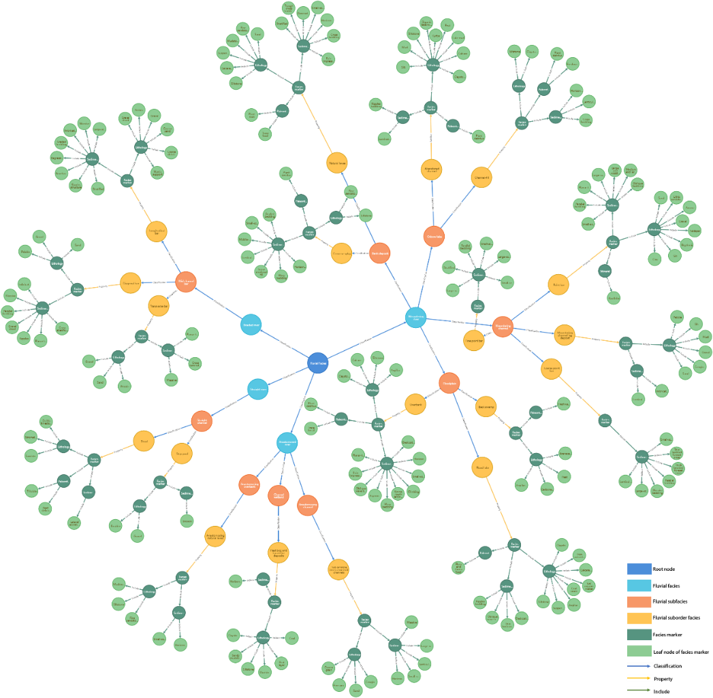
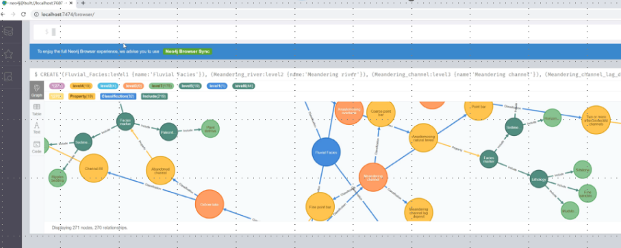
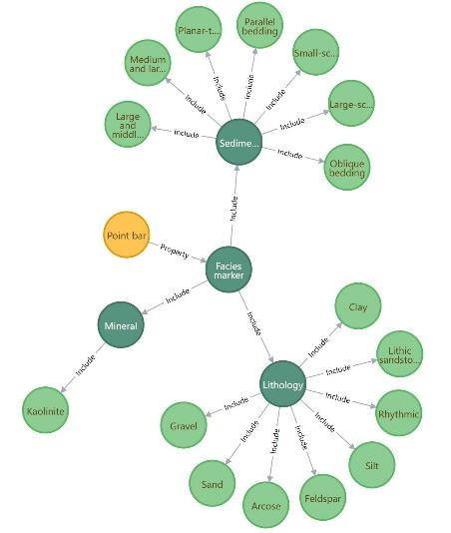
3. Visualization, query, and retrieve
Query and retrieve
Visualization

Slide 14
outline
Fluvial facies knowledge system
Fluvial facies knowledge graph
Application in sedimentary facies identification＆ knowledge reasoning

Slide 15
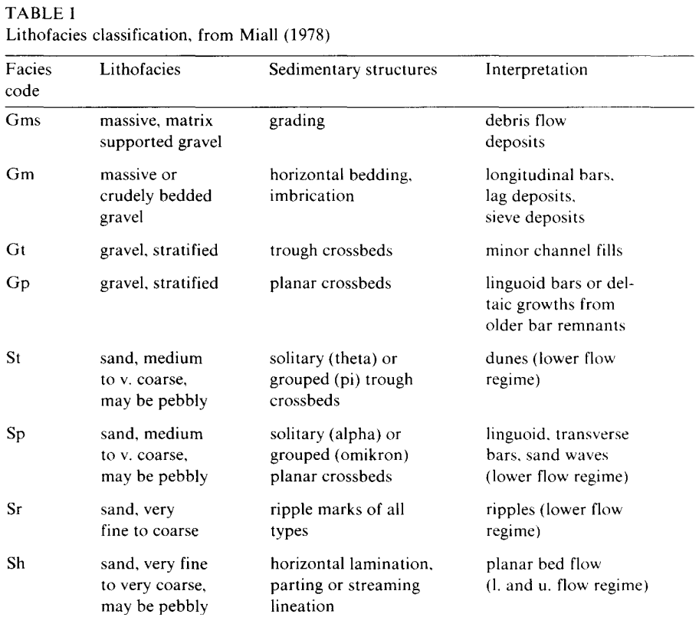
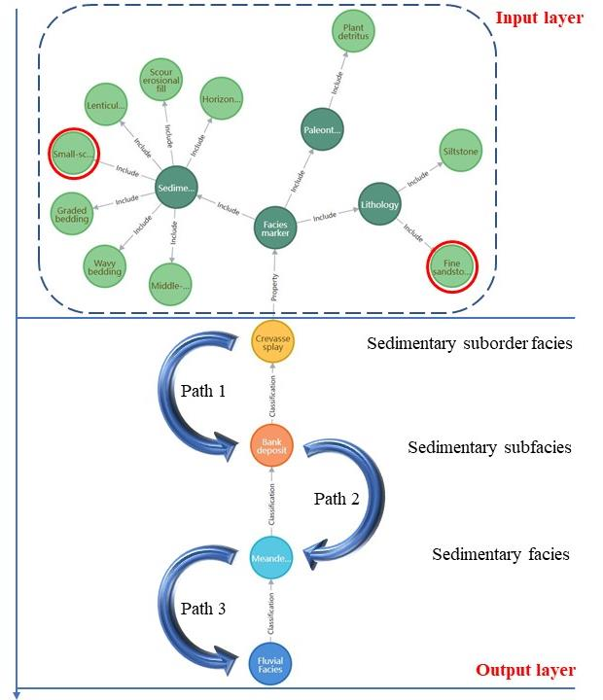
1. Reasoning principles and model design
Sedimentary facies identification based on expert prior knowledge
Reasoning path of knowledge reasoning model

Slide 16
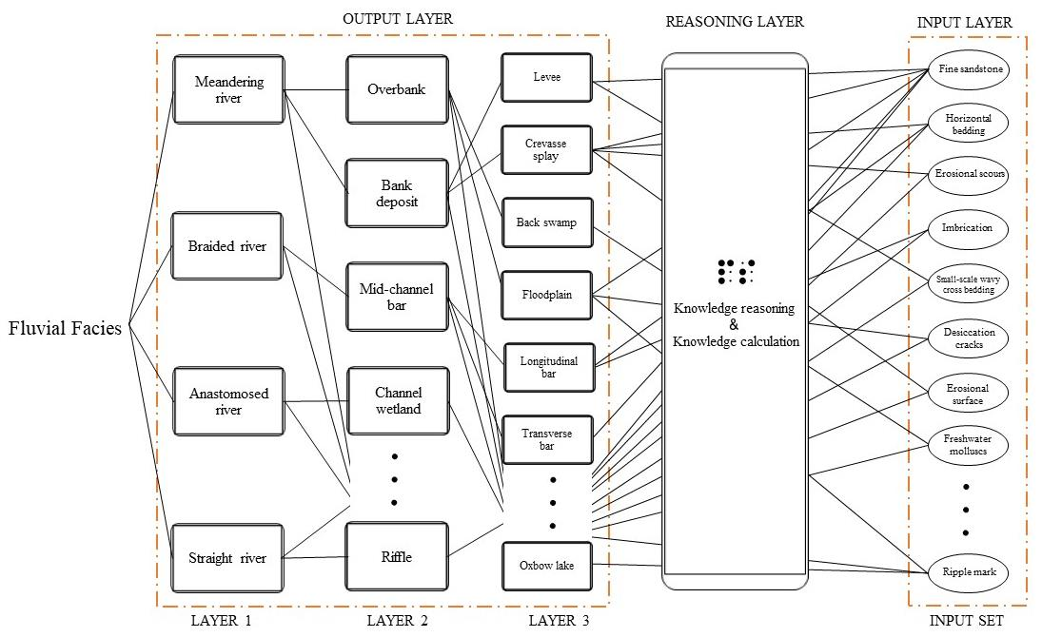
1. Reasoning principles and model design
The reasoning principles of the model are described as follows:
The probabilities of all the fluvial suborder facies add up to 100%.
The probabilities of each layer are summed up by the probabilities of its subterms.
The less a single keyword appears in the database, the greater the weight of the keyword.
The weight of the fluvial suborder facies is equal to the sum of the weight of the keywords contained in it.
Fluvial sedimentary facies identification and knowledge reasoning model

Slide 17

2. Reasoning algorithm and system development process
The following sections describe in detail the development process of the knowledge reasoning system, the mathematical formula derivation process, and the actual calculation methods and steps:
(1) Create a new embedded local database (using SQLite) named "initDB" in Python language.
(2) A "DB operation" module was built with the data of sedimentary layer and facies marker layer of fluvial facies, which can be used to creat, read (retrieve), update, and delete fluvial facies data, and query sub-nodes.
(3) Input keywords in the fluvial facies knowledge graph reasoning model, separated by English commas ','. For example, "Gravel, Massive, Sand".
(4) Keywords spotting ($k_{1}$, $k_{2}$, $k_{3}$… $k_{n}$).
(5) Search the database to find out how many times all the keywords ($C_{k1}$, $C_{k2}$, $C_{k3}$ … $C_{kn}$) appear in the model.
(6) The weight of each keyword Ki is calculated, and the weight of the keyword is inversely proportional to the number of times the keyword appears in the database. Thus
$W_{ki}=\frac{\prod_{i=1}^{n}{C_{ki}}}{C_{ki}}$
Where $W_{ki}$ is the weight of the i-th keyword, and $C_{ki}$ is the number of occurrences of the i-th keyword in the database.
(7) Calculate the weight of the sedimentary suborder facies, which is equal to the sum of the keyword weights contained in this sedimentary suborder facies. We have
$W_{mi}=\sum_{i=1}^{n}{C_{wi}W_{ki}}$
Where $W_{mi}$ is the total weight of the i-th suborder facies, $C_{wi}$ is the number of occurrences of the i-th keyword in the suborder facies characteristic sign (0 or 1).
(8) Convert the sedimentary suborder facies weights to probabilities. Therefore
$P_{mi}=\frac{W_{mi}}{\sum_{i=1}^{n}{W_{mi}}}$
Where $P_{mi}$ is the probability of the i-th sedimentary suborder facies.
(9) Upward inference computes the probability of the upper layer, and the probability of each layer is the sum of the probabilities of its sublayers.

Slide 18
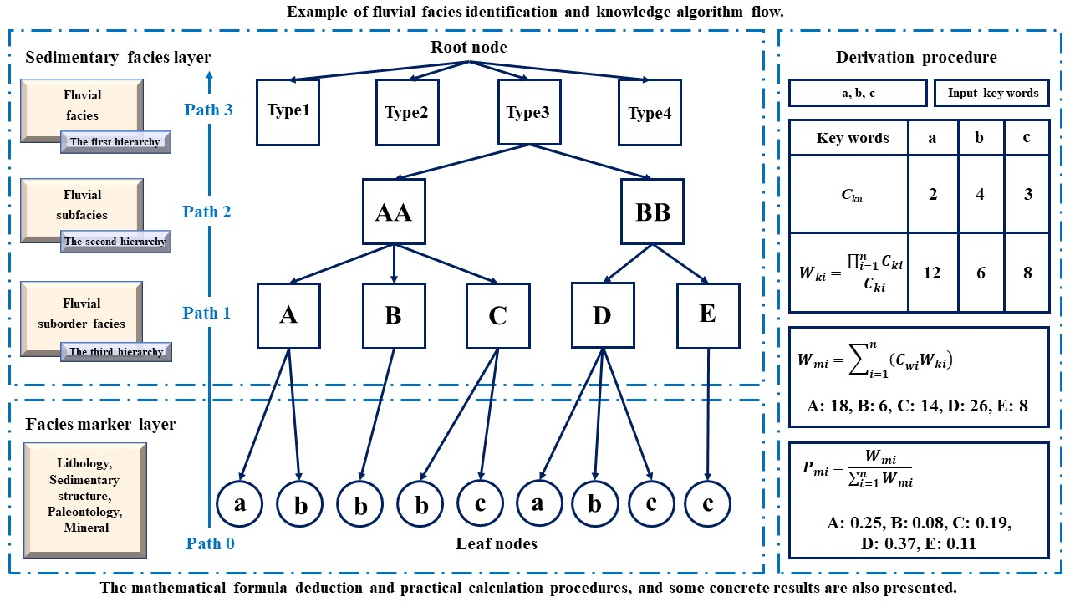
2. Reasoning algorithm and system development process
A:12+6 B:6 C:6+8 D:12+6+8 E:8
A:18/72 B:6/72 C:14/72 D:36/72 E:8/72

Slide 19
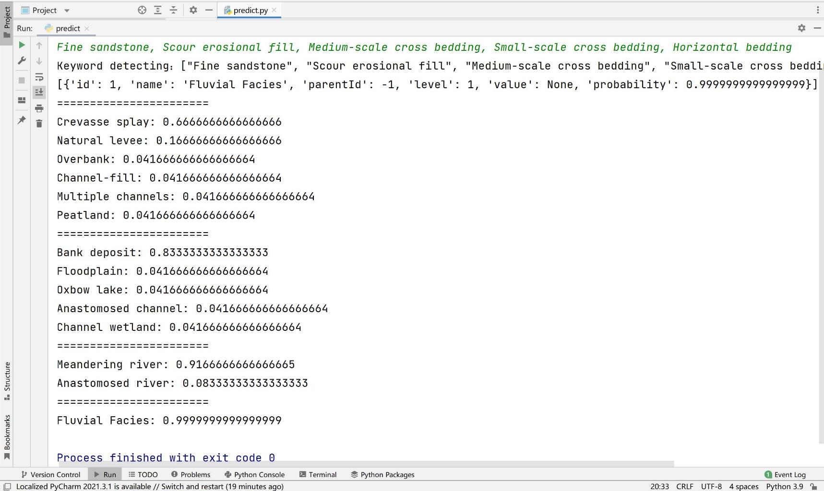
2. Reasoning algorithm and system development process

Slide 20
3. Reasoning results and quality assessment
Yellow: model
Green: expert
Supplementary data 1. The results of knowledge calculation--Comparison table between the results of fluvial facies knowledge reasoning model and the results of expert prior knowledge (partial truncated)

Slide 21
3. Reasoning results and quality assessment
Yellow: model
Green: expert
Supplementary data 2. The results of knowledge calculation and reasoning by fluvial facies knowledge reasoning model are consistent with the results of expert prior knowledge

Slide 22

thanks

