Slide 1




Model evaluation strategy impacts the interpretation and performance of machine learning models
Lily-belle Sweet¹, Christoph Müller², Mohit Anand¹, Jakob Zscheischler^{1,3}
1. Helmholtz Centre for Environmental Research – UFZ, Leipzig, Germany
2. Potsdam Institute for Climate Impact Research (PIK), Potsdam, Germany
3. Technische Universität Dresden
lily-belle.sweet@ufz.de
@lilybellesweet

Slide 2
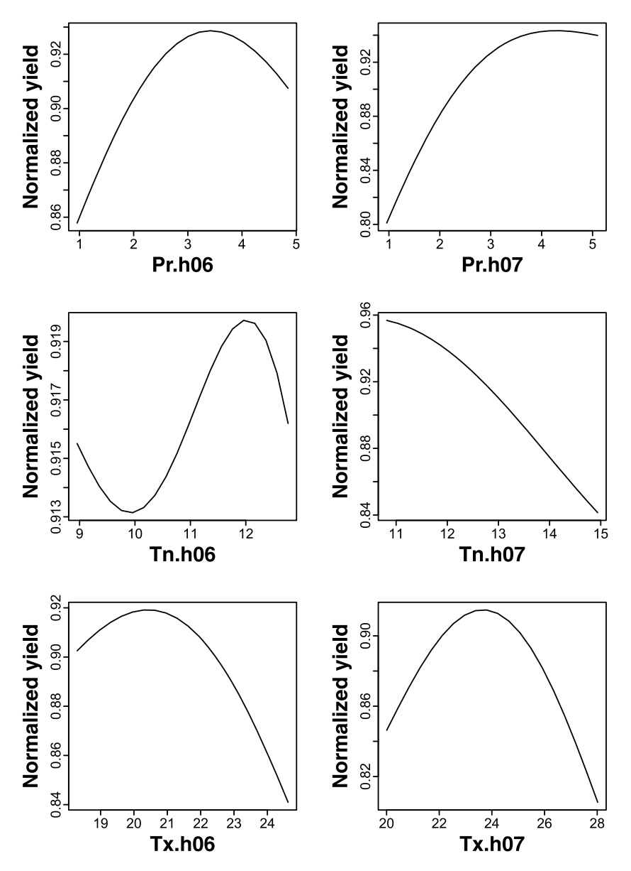
Introduction
Crop yields depend on climate conditions in complex, nonlinear ways.
Machine learning models are able to capture these relationships.
‘Explainable’ machine learning could be used to improve scientific understanding of climate-crop dynamics.
Gunnar Lischeid et al. Agricultural and Forest Methodology. (2022)
lily-belle.sweet@ufz.de
@lilybellesweet

Slide 3
How should we evaluate spatiotemporal model performance?
random test set?
heldout regions?
heldout years?
or something else?
lily-belle.sweet@ufz.de
@lilybellesweet

Slide 4
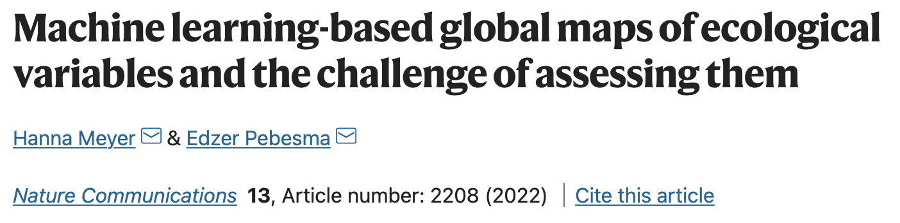

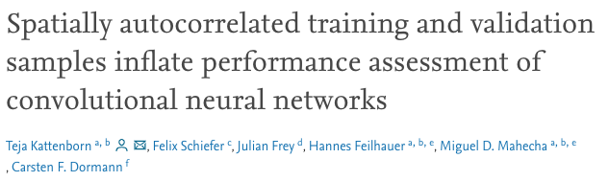
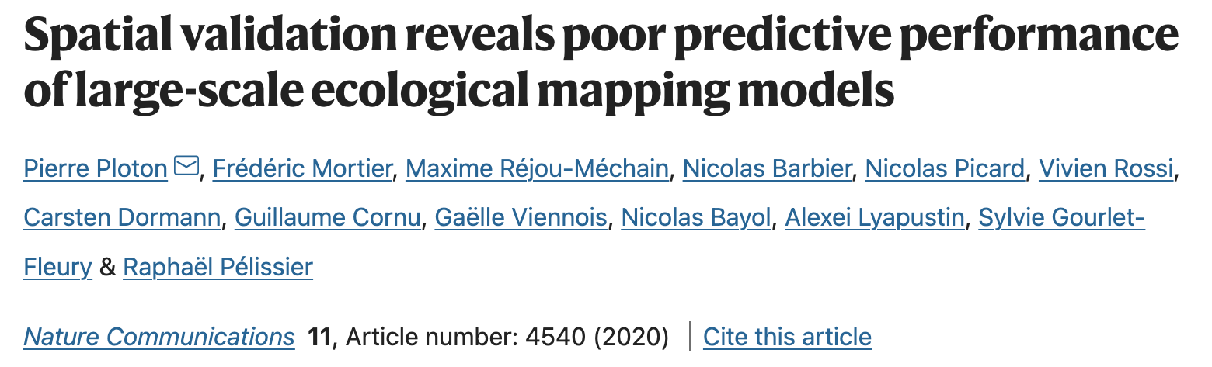
It’s a known issue:
lily-belle.sweet@ufz.de
@lilybellesweet

Slide 5
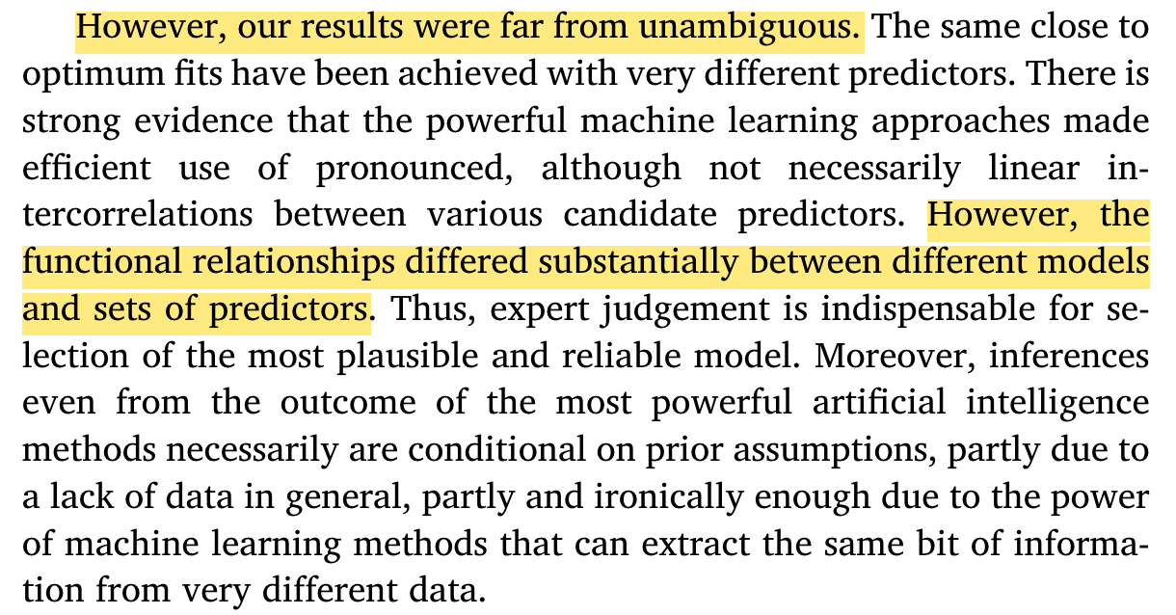
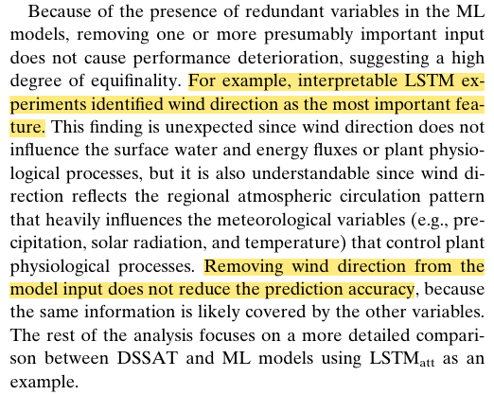
The impact on model interpretation is not yet clear.
Gunnar Lischeid et al. Agricultural and Forest Methodology. (2022)
Q. Liu et al. Agricultural Intelligence for the Earth Systems. (2022)
lily-belle.sweet@ufz.de
@lilybellesweet

Slide 6



Our strategy
Train machine learning models to emulate a process-based crop model (LPJmL).
Vary the model evaluation strategy used.
Interpret models & measure model performance on unseen regions and/or years.
lily-belle.sweet@ufz.de
@lilybellesweet

Slide 7

Model evaluation strategy impacts the interpretation and performance of machine learning models
Lily-belle Sweet¹, Christoph Müller², Mohit Anand¹, Jakob Zscheischler^{1,3}
1. Helmholtz Centre for Environmental Research – UFZ, Leipzig, Germany
2. Potsdam Institute for Climate Impact Research (PIK), Potsdam, Germany
3. Technische Universität Dresden
lily-belle.sweet@ufz.de
@lilybellesweet

Slide 8


Methodology
Heldout regions
Maize yield from LPJmL
Covers 1948-2008
0.5 degree resolution
No irrigation, fertilization etc
Current cropping areas only
Crop yield data
Global daily reanalysis data
Covers 1948-2008
0.5 degree resolution
Variables used: monthly average pr, tas, rsds
Extreme indicators (WD, CD, FD, min temp, max temp, mean diurnal range, max five-day precipitation)
Use 3 months before planting date plus the duration of growing season
Climate data
lily-belle.sweet@ufz.de
@lilybellesweet

Slide 9
Random k-fold overestimates model performance on unseen years or regions
Temporal or feature-clustered cross-validation returns a more reasonable estimation.
lily-belle.sweet@ufz.de
@lilybellesweet
Sweet et al. Artificial Intelligence for the Earth Systems (in review)

Slide 10
Cross-validation strategy impacts permutation feature importances
lily-belle.sweet@ufz.de
@lilybellesweet
Sweet et al. Artificial Intelligence for the Earth Systems (in review)

Slide 11
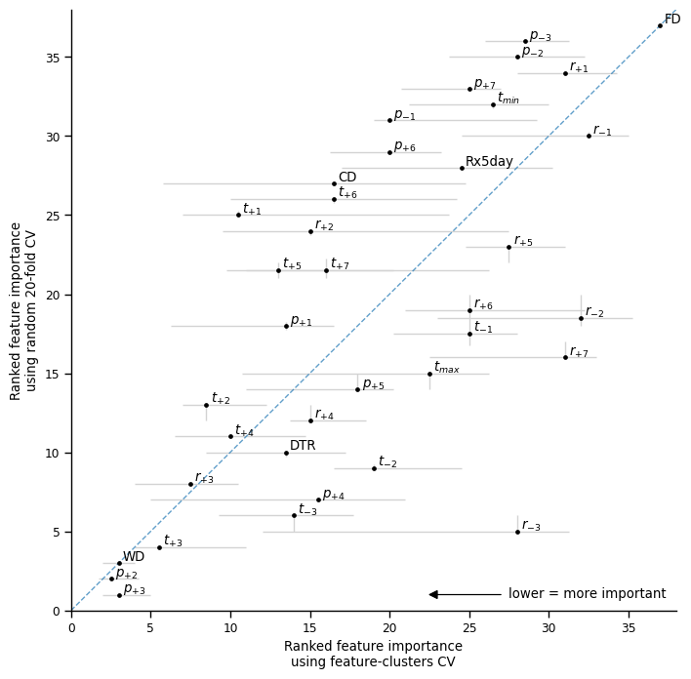
Cross-validation strategy impacts permutation feature importances
lily-belle.sweet@ufz.de
@lilybellesweet
Sweet et al. Artificial Intelligence for the Earth Systems (in review)

Slide 12
Cross-validation strategy impacts hyperparameters, feature selection
Sweet et al. Artificial Intelligence for the Earth Systems (in review)

Slide 13
Cross-validation strategy impacts model performance on unseen years and/or regions
Model skill is evaluated after hyperparameter-tuning and feature-selection is conducted using the selected (nested) cross-validation strategy.
Use of feature-clusters CV improved model performance on unseen years and regions.
lily-belle.sweet@ufz.de
@lilybellesweet
Sweet et al. Artificial Intelligence for the Earth Systems (in review)

Slide 14
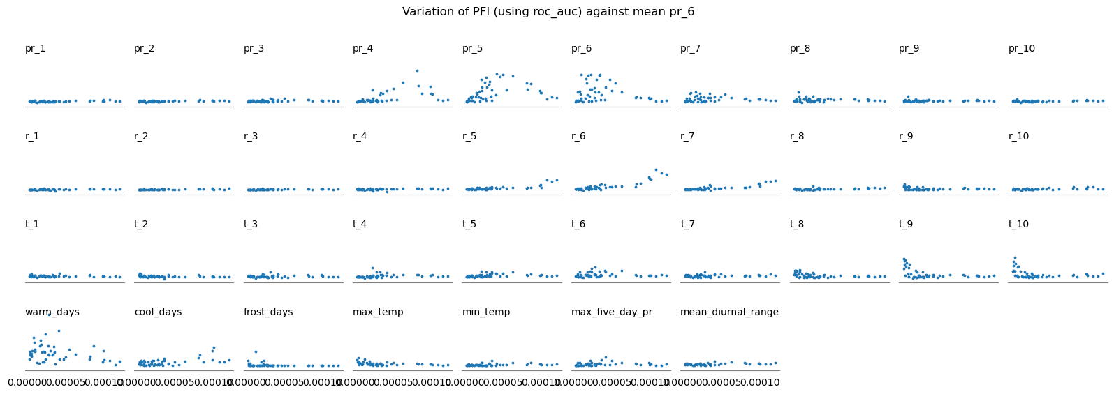
The variation in feature importances across CV folds may reveal relationships between drivers.
For example, by regressing the mean climatic conditions against the feature importance score in each test fold, we can identify the conditions in which a certain driver becomes relevant.
lily-belle.sweet@ufz.de
@lilybellesweet
Sweet et al. Artificial Intelligence for the Earth Systems (in review)

Slide 15
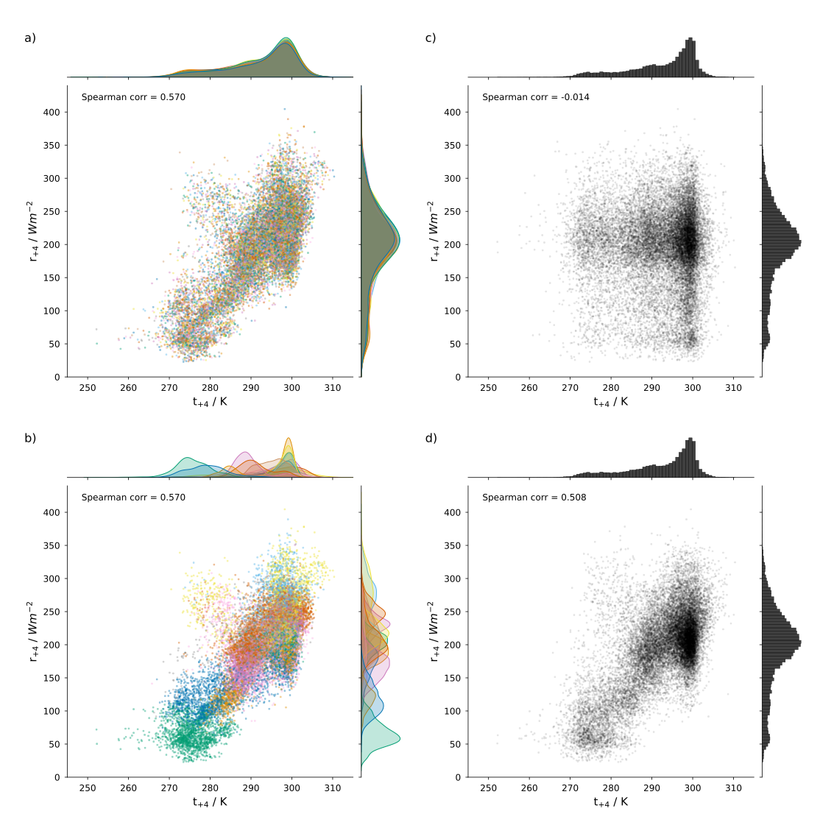
Why does the use of feature-space clustered cross-validation return more plausible feature importances?
lily-belle.sweet@ufz.de
@lilybellesweet
Sweet et al. Artificial Intelligence for the Earth Systems (in review)

Slide 16
Table of contents
Title
Hyperparameters & features
Methodology
Model performance
Model evaluation
Variation in importances
Permutation importances 1
Correlation in permuted data
Permutation importances 2

