Slide 1
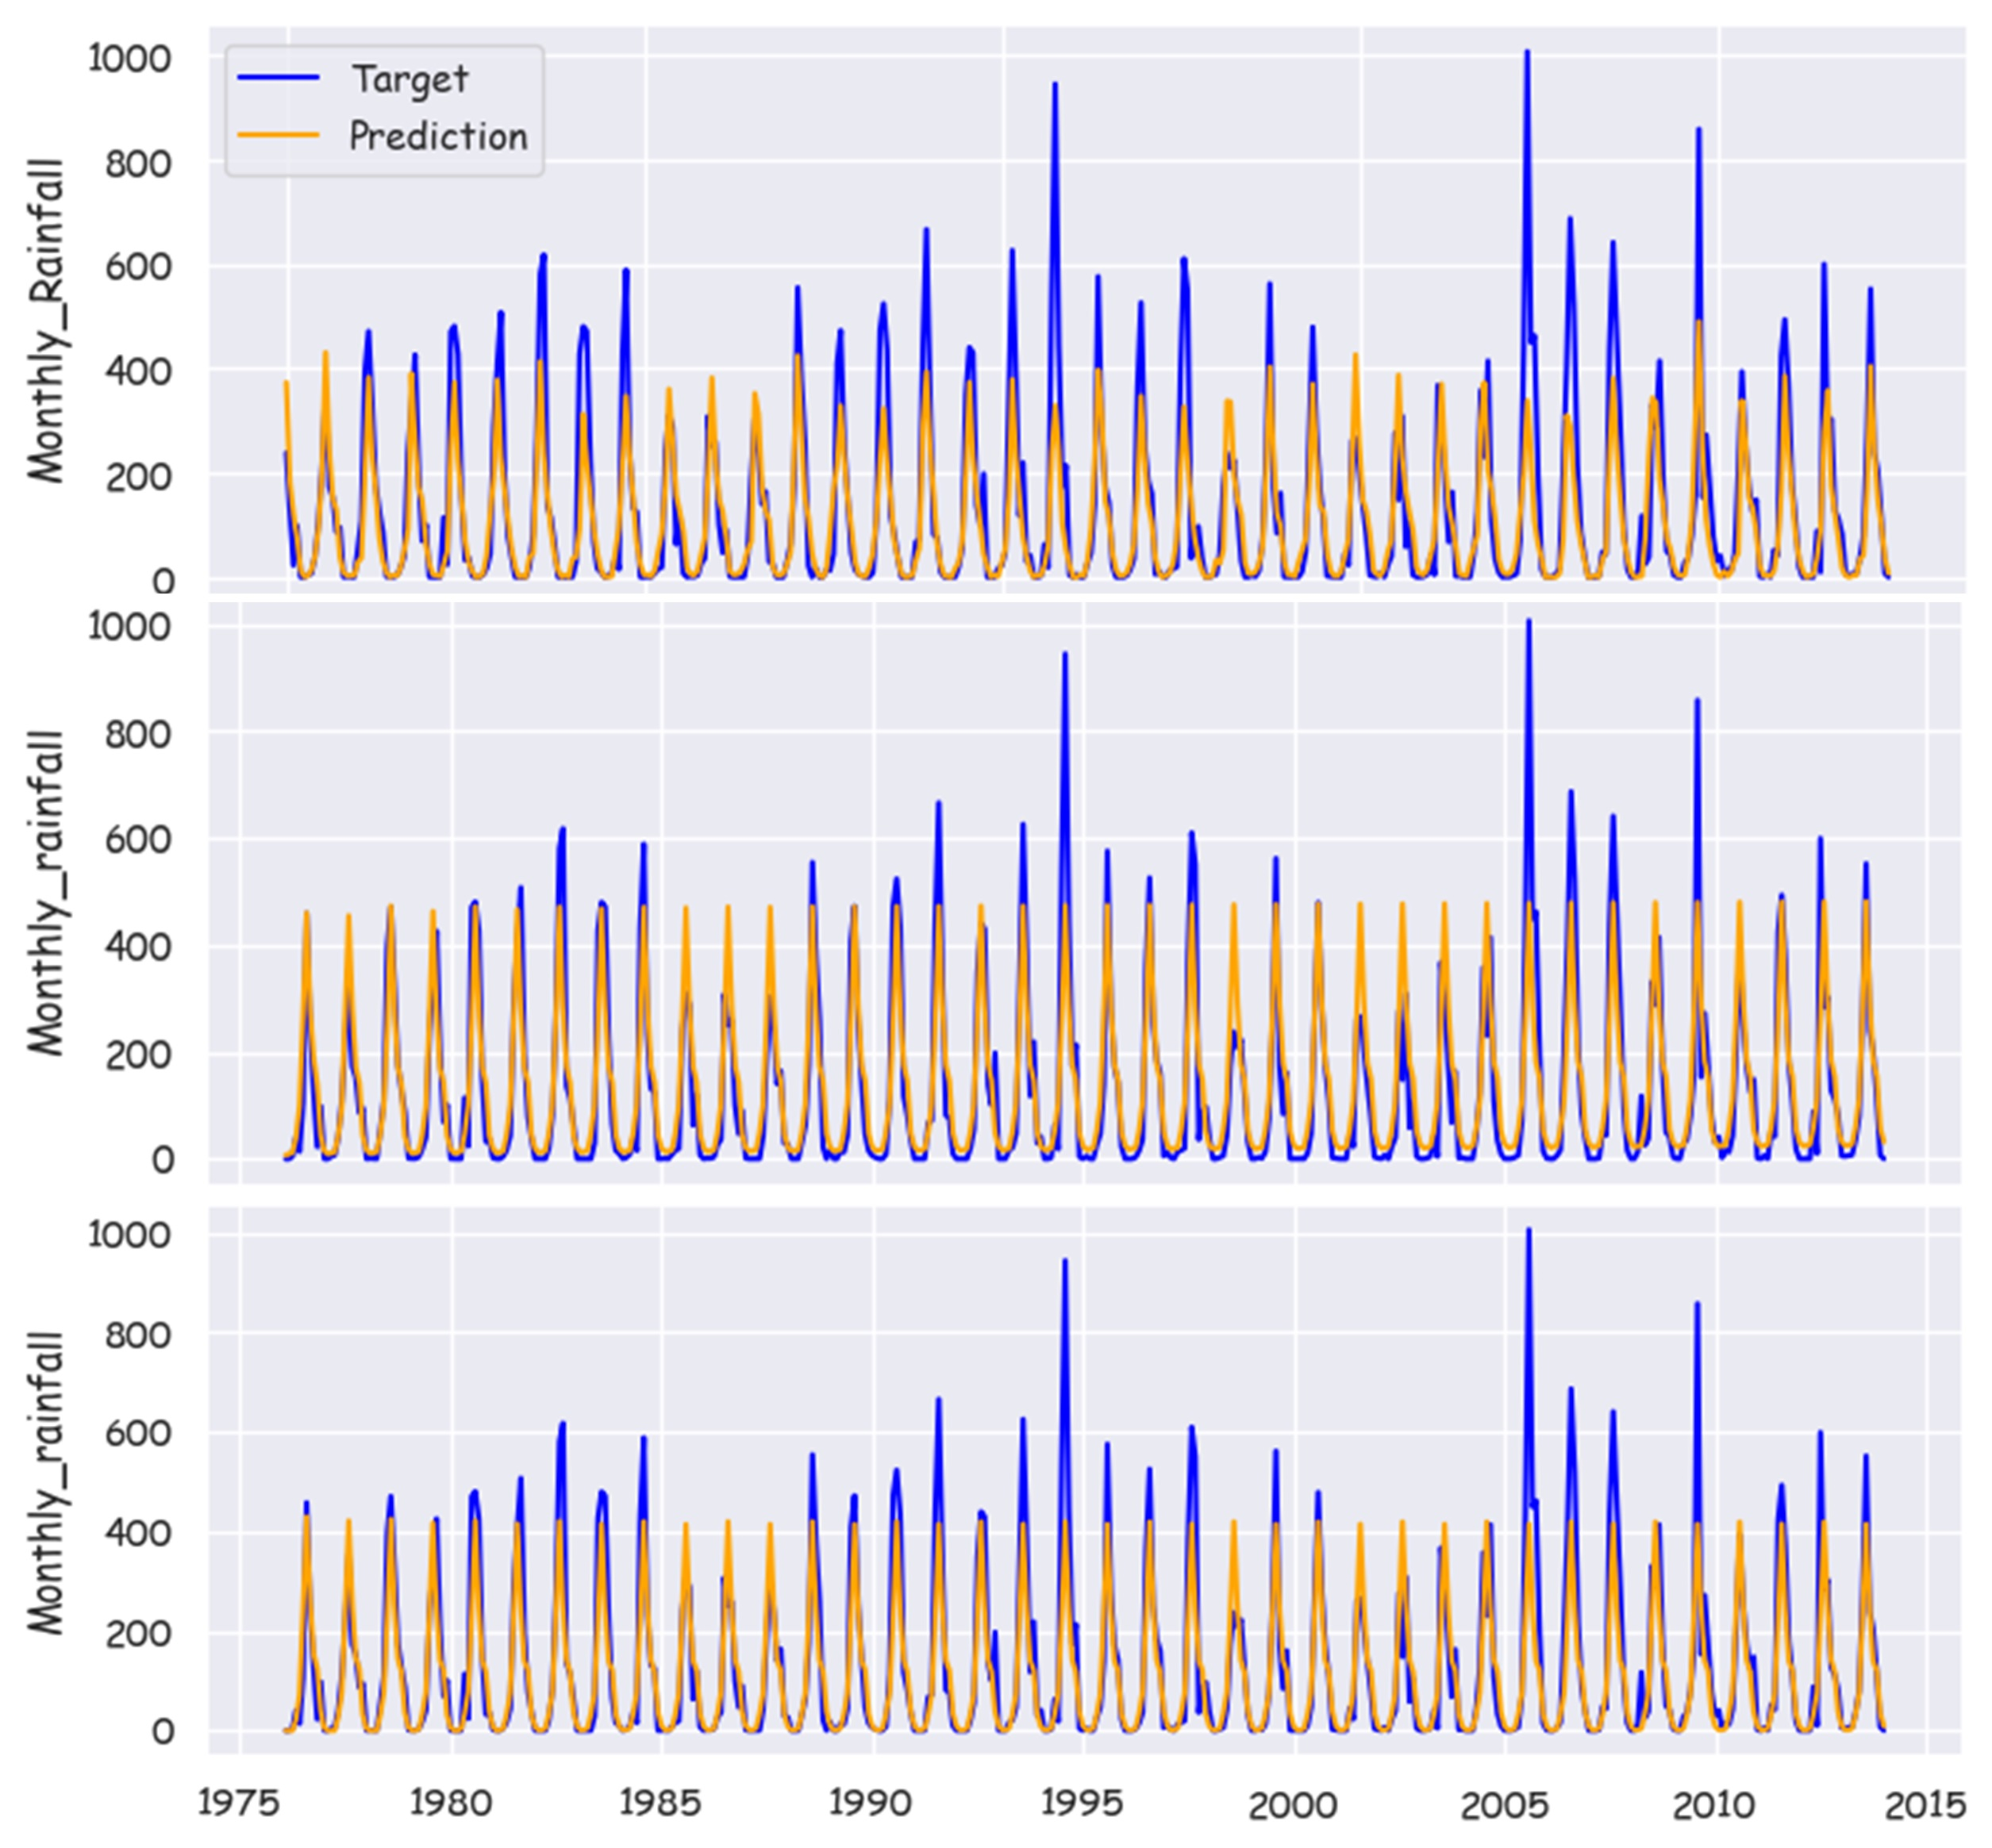
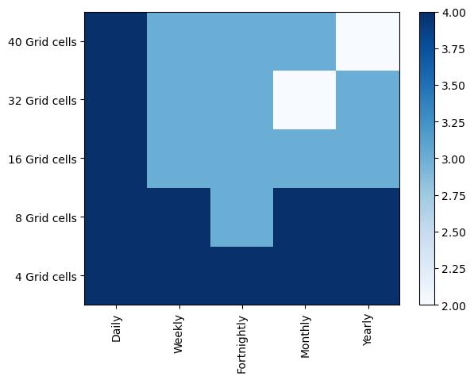
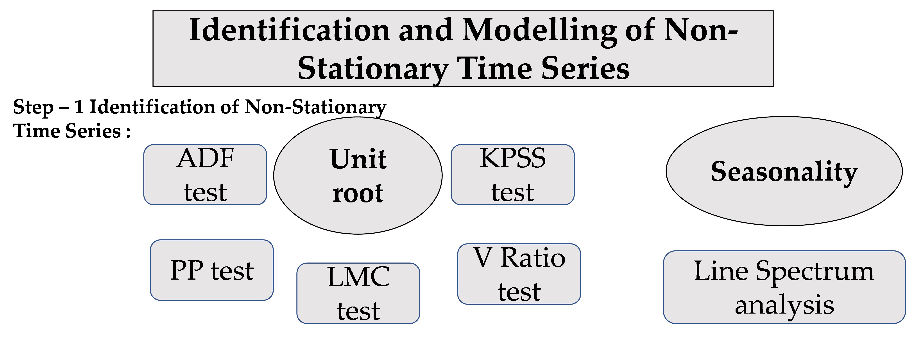
Spatiotemporal Analysis and Modeling of Non-Stationarity in Hydrological Time Series
Nishant Kumar¹, D. Nagesh Kumar², Tirthankar Roy¹
¹University of Nebraska-Lincoln, Department of Civil and Environmental Engineering, Omaha, Nebraska, USA
²Indian Institute of Science, Department of Civil Engineering, Bengaluru, India
Introduction
Non-stationarity refers to fluctuations in the statistical properties of time series. Unit root tests (Unit roots) and Line spectrum analysis (Seasonality) are used extensively but had not been used simultaneously. Spatiotemporal effects on the degree of non-stationarity had not been explored extensively in the existing literature. In this study, we addressed the two issues mentioned above. Long Short-Term Memory (LSTM) Network, Seasonal Autoregressive Moving Average (SARIMA), and Exponential Smoothing (ES) were used to model the time series with the maximum degree of non-stationarity detected across various spatiotemporal scales.
Results and Discussions
The Six different tests for non-stationarity detected 80% seasonality and 65-70% unit root in 25-time series generated across the spatiotemporal scales. Daily and monthly time series for 4-grid and 8-grid aggregation was found to be non-stationary most frequent. Monthly time series for the 8-grid aggregation was found with the maximum degree of non-stationarity and was modeled through LSTM, SARIMA, and ES. No fixed pattern was found in the change of degree of non-stationarity due to the presence of unit roots over the various spatiotemporal scales. Seasonality shows a significant increasing trend with an increase in the temporal scales but a non-monotonic pattern with spatial scales. Among all the three models, LSTM was the most effective based on Nash Sutcliffe Efficiency (NSE) and R² .
Data, Study Area,& Methodology
ES
NSE: 0.71
R²: 0.66
Study area: Malaprabha basin, Karnataka, India.
Daily gridded rainfall data from Indian Meteorological Department for 40 grid cells (0.25* 0.25 degree) from 1901 to 2013 was used for analysis.
We obtained a total of 25-time series based on five spatial (aggregating 4, 8,16, 32, and 40 grid cells) scales and five temporal scales (daily, weekly, fortnightly, monthly, and yearly).
SARIMA
NSE: 0.68
R²: 0.46
LSTM
NSE: 0.77
R²: 0.71
Figure 1. The methodology used for this study
Figure 2. Modeling results for ES, SARIMA, and LSTM
Figure 3. Spatiotemporal variability of non-stationarity

