Slide 1
Simultaneous Treatment of Hospital Wastewater Contaminated with Sulfamethoxazole and Generation of Bioenergy with the Application of Integrated Constructed Wetland and Microbial Fuel Cell System (CMFC)
Authors
Mahak Jainª, Partha Sarathi Ghosalª, Ashok Kumar Gupta^{b}
ª School of Water Resources, Indian Institute of Technology Kharagpur, Kharagpur, 721302, India
^{b} Environmental Engineering Division, Department of Civil Engineering, Indian Institute of
Technology Kharagpur, Kharagpur 721302, India

Slide 2
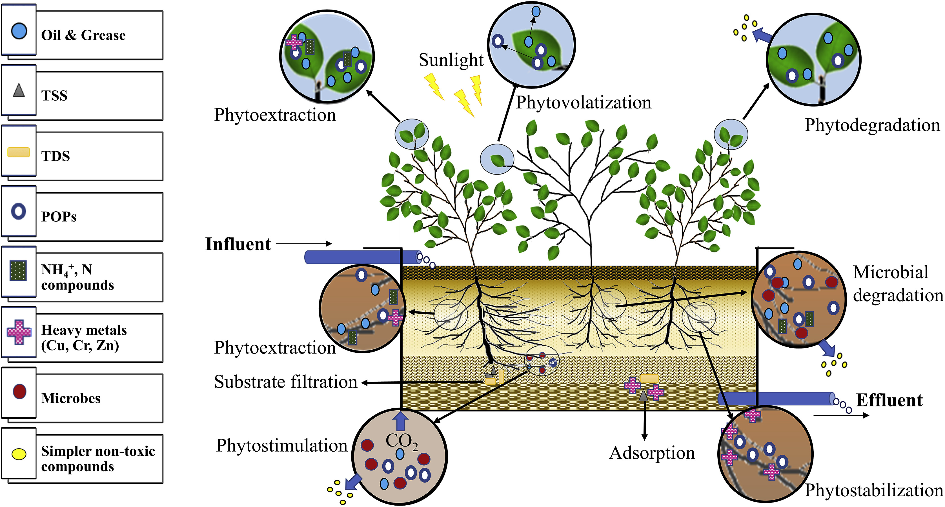
Constructed Wetlands (CW)
Environment friendly
Cost-efficient
Easy operation
Less skilled manpower requirement
Low sludge production
Fig. 1. Wastewater treatment mechanism in a typical CW
(Jain et al., 2020)
2

Slide 3
Microbial fuel cell (MFC)
Electrochemical systems that produce electricity by using the organic content of the wastewater
Bacteria
Act as catalyst
Anodic chamber
Bacteria generate electrons utilizing organic and inorganic matter
Cathodic chamber
Electrons are transferred through an external circuit and electric current is generated
Fig. 2. Working of a Microbial Fuel Cell
3

Slide 4
Combination of CW and MFC
A combination of CW and MFC is a potential approach to overcome the requirements of both technologies
CWs eventually develop a redox gradient along the depth and flow of wastewater
Gravels have been demonstrated to be suitable surface for electrogens to as well as good anodic material when an electron collector is provided (Corbella et al., 2019)
Biofilm growth in both the anode and cathode is promoted by planting the CW-MFC (Liu et al., 2015)
These hybrid technologies have the larger potential for scaling up and practical application compared with the pure MFC (Xu et al., 2015)
CW
MFC
CW (Require large area)
MFC (Require redox conditions)
CW-MFC (Overcome drawbacks of both the systems)
4

Slide 5
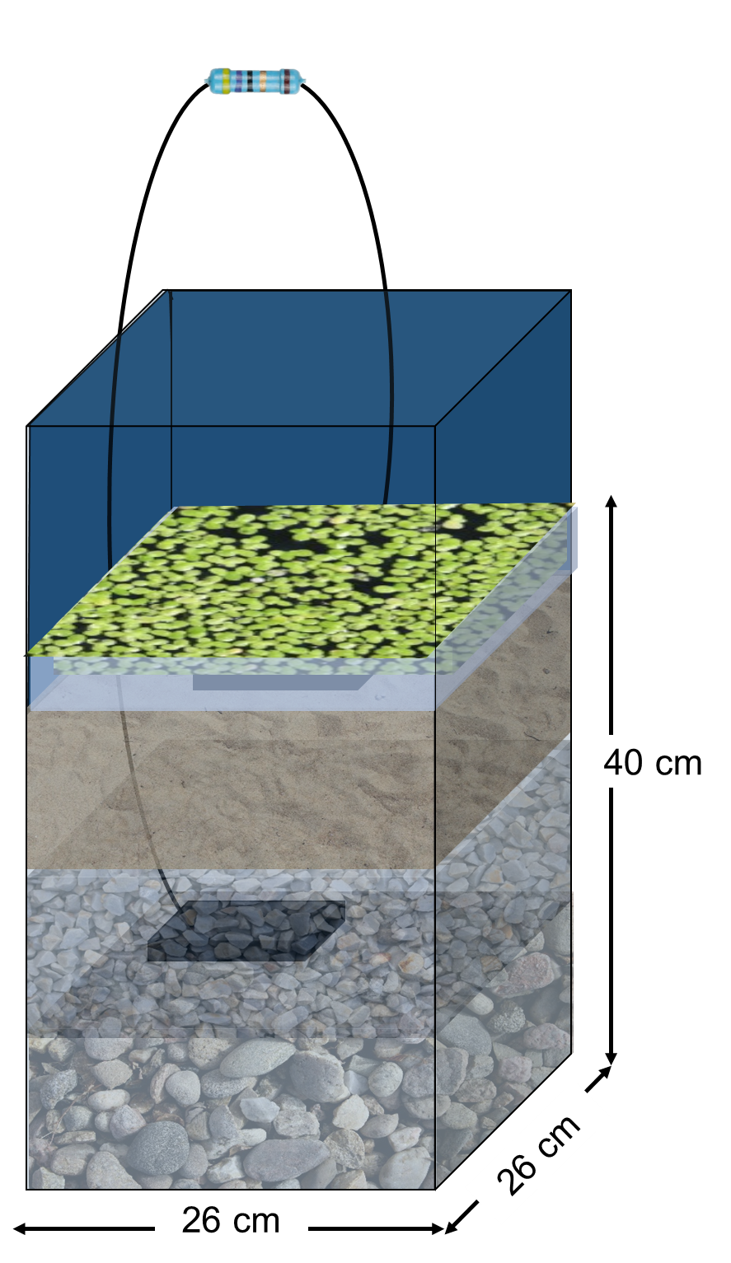
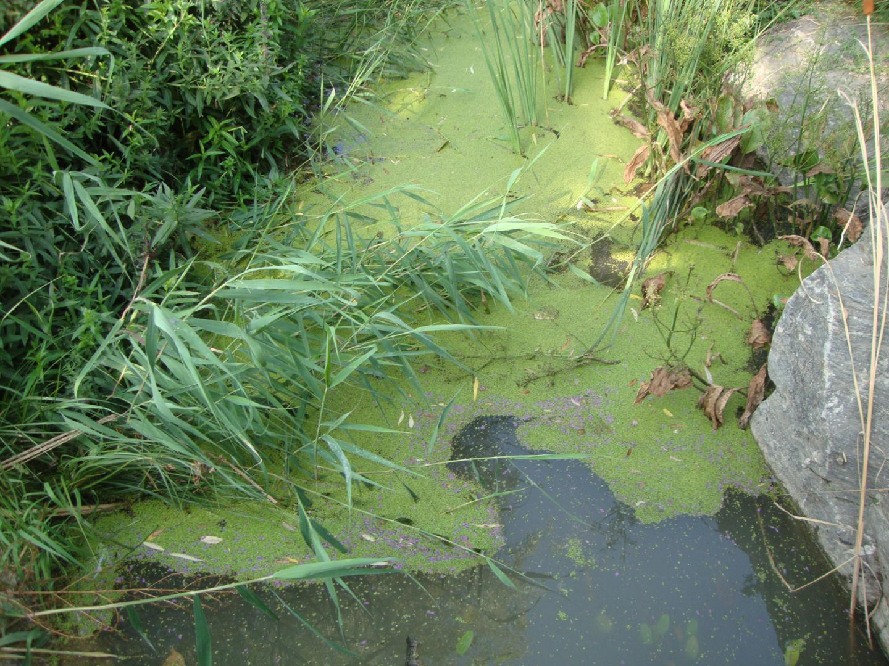
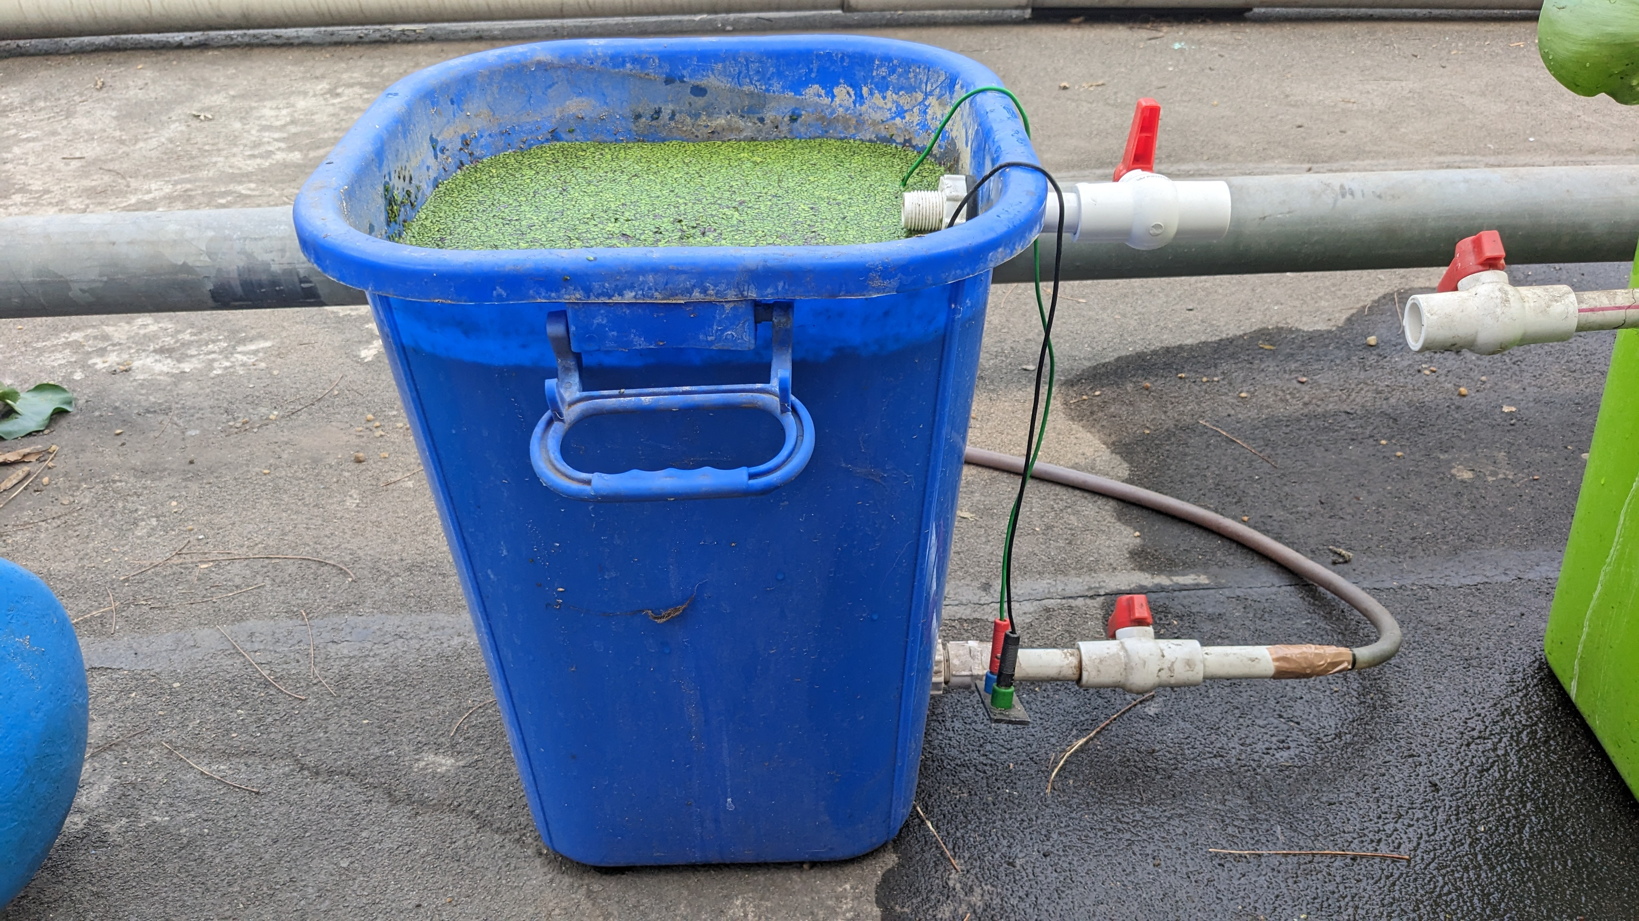
Materials and method
(a)
(c)
(d)
(e)
(b)
Fig. 3. (a) Duckweed (Lemna minor) collection; (b) Graphite electrode; (c) CMFC system (enlarged view); (d) Substrate; (e) Schematic diagram of CMFC system
5

Slide 6
Results and Discussion
Fig. 4. Plot depicting COD removal and voltage generation obtained during control study with:
Plants and electrodes
Only electrodes
Only plants
No plants and electrodes
6

Slide 7
Results and Discussion
Fig. 5. Plot depicting COD removal and voltage generation using CWMFC: (A) Initial concentration- 500 mg/l, Substrate: water depth- 1:1, Electrode spacing- 5 cm; (B) Initial concentration- 1500 mg/l, Substrate: water depth- 1:1, Electrode spacing- 5 cm; (C) Initial concentration- 1500 mg/l, Substrate: water depth- 3:1, Electrode spacing- 5 cm; (D) Initial concentration- 1500 mg/l, Substrate: water depth- 3:1, Electrode spacing- 20 cm
(a)
(b)
At Initial concentration- 1500 mg/l, Substrate: water depth- 3:1, Electrode spacing- 20 cm
SMX removed up to 99 %
COD removed up to 94.1 %
Voltage generated up to 133 mV
7

Slide 8
Conclusions
Presence of plants and electrodes improved system performance.
On increasing initial COD concentration of wastewater, voltage generation increased.
The voltage generation and COD removal efficiency increased with the increase in substrate to water depth ratio.
Approximately 99% removal of sulfamethoxazole and 94.1% elimination of COD were observed alongside the production of 133 mV of voltage at initial COD concentration- 1500 mg/l, Substrate: water depth ratio- 3:1, Electrode spacing- 20 cm.
Duckweed (Lemna minor) was observed to be a suitable macrophyte species for wastewater treatment with high tolerance for toxic organic compounds.
8

Slide 9
References
A. Majumder, B. Gupta, A.K. Gupta, Pharmaceutically active compounds in aqueous environment: A status, toxicity and insights of remediation, Environ. Res. (2019) 108542. doi:10.1016/J.ENVRES.2019.108542.
Al-Baldawi IA (2018) Removal of 1,2-Dichloroethane from real industrial wastewater using a sub-surface batch system with Typha angustifolia L. Ecotoxicol Environ Saf 147:260–265. doi: 10.1016/j.ecoenv.2017.08.022
Corbella C, Garfí M, Puigagut J (2016) Long-term assessment of best cathode position to maximise microbial fuel cell performance in horizontal subsurface flow constructed wetlands. Sci Total Environ 563–564:448–455. doi: 10.1016/j.scitotenv.2016.03.170
Corbella C, Guivernau M, Vi M (2015) Operational , design and microbial aspects related to power production with microbial fuel cells implemented in constructed wetlands. 84:232–242. doi: 10.1016/j.watres.2015.06.005
9

