Slide 1
Use of machine learning for drain flows predictions in tile-drained agricultural areas
Dated: 26.04.2023
Hafsa Mahmood¹, Ty P. A. Ferre², Raphael J. M. Schneider³, Simon Stisen³,
Rasmus R. Frederiksen⁴, and Anders V. Christiansen¹
¹Aarhus University, Hydro geophysics group, Geoscience Department, Aarhus, Denmark (hm@geo.au.dk)
²University of Arizona, Department of hydrology and atmospheric sciences, Tucson, Arizona, USA
³Geological Survey of Denmark and Greenland (GEUS), Department of Hydrology, Copenhagen, Denmark
⁴Aarhus University, Department of Eco science, Aarhus, Denmark

Slide 2
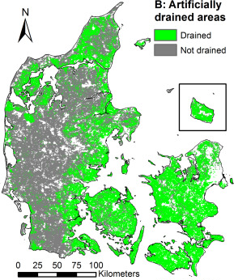
Background
50% of Denmark’s agriculture area with tile drains
Drain flow predictions using physics-based models – time-intensive and data-intensive with complex setup and calibration
Supervised machine learning – an alternative with a relatively simpler approach
Objective: Prediction of daily drain flow data in tile-drained agricultural areas using supervised machine learning (ML) methods
Investigate the potential of Extreme Gradient Boosting (XGBoost) and Convolutional neural network (CNN)
Identify the main control variables
Compare the prediction performance of an existing physics-based model of drain sites with XGBoost and CNN models.
Møller et al, 2018
Notes:
A little bit about why we came up with this specific research idea. As many of you know that 50% of Denmarks agriculture area has tile drains that covers wide range of hydrogeological and topographical conditions

Slide 3
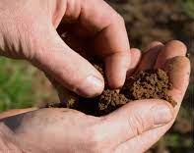
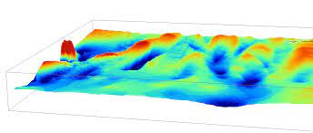
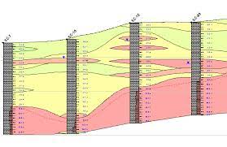
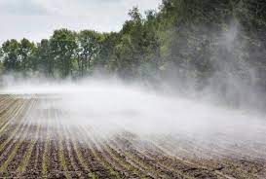
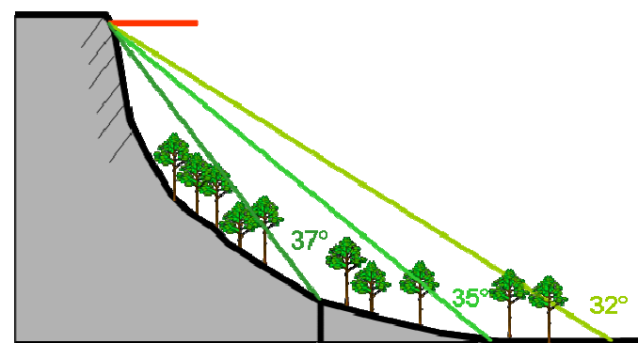
Static and dynamic variables
Topographical variables
Topographical variables
Topographical variables
Temperature
Topographical variables
Geological variables
Climate variables
Time variables
Topographical wetness index
Clay fraction
Temperature
Seasonality
Evapotranspiration
Hydrological day of year
Topographical position index
Clay/Sand thickness
Slope
Precipitation

Slide 4
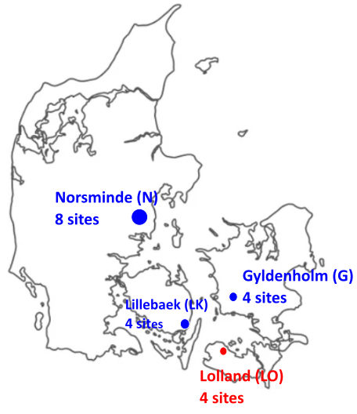
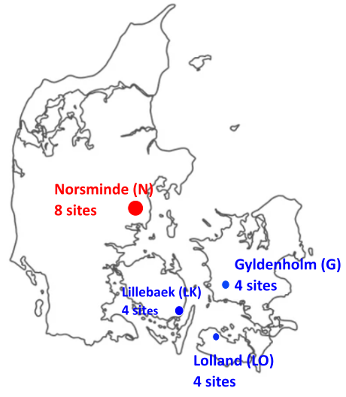
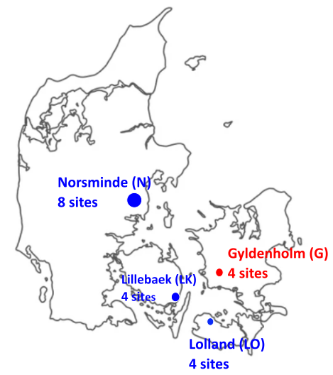
XGBoost and CNN scenarios
Model 1
Test sites: Lillebaek (LK)
Train sites: all except LK
Model 2
Test sites: Lolland (LO)
Train sites: all except LO
Model 3
Test sites: Norsminde (N)
Train sites: all except N
Model 4
Test sites: Gyldenholm (G)
Train sites: all except G
Test drain sites
‘Leave one catchment out’ technique
Train drain sites
20 drain sites were tested
8 models – 4 for XGBoost, 4 for CNN

Slide 5
Workflow for each model
Training, Hyperparameter tuning on 5 train-test sets
(optimizer: Gridsearch)
Training Dataset
Dividing into 5 train-test sets (randomly division)
Verification / Validation
Evaluation metric: RMSE, R2, PBIAS, KGE
Crossvalidation / Calibration
(Evaluation metric: RMSE, R2, PBIAS, KGE)
Addition of noise (Repeating top 1% of high drain flow covariates)
Compute feature importance

Slide 6
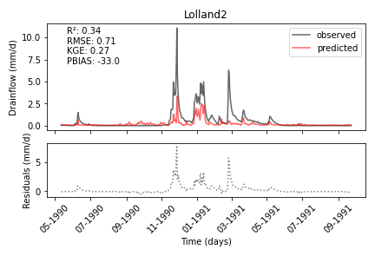
Hydrograph examples

Slide 7
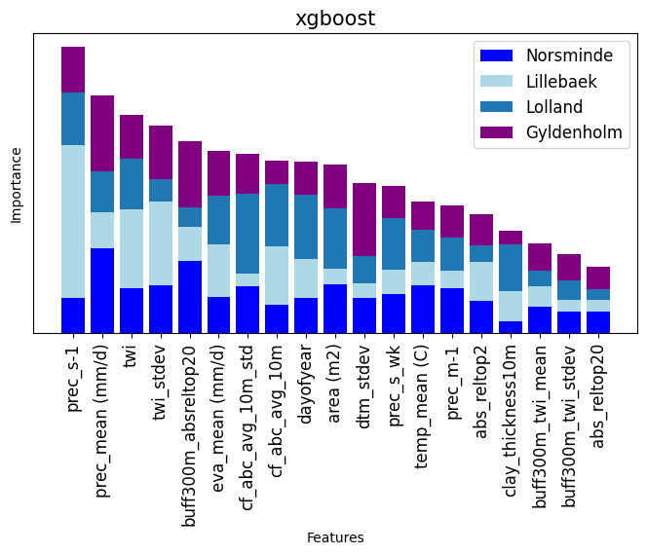
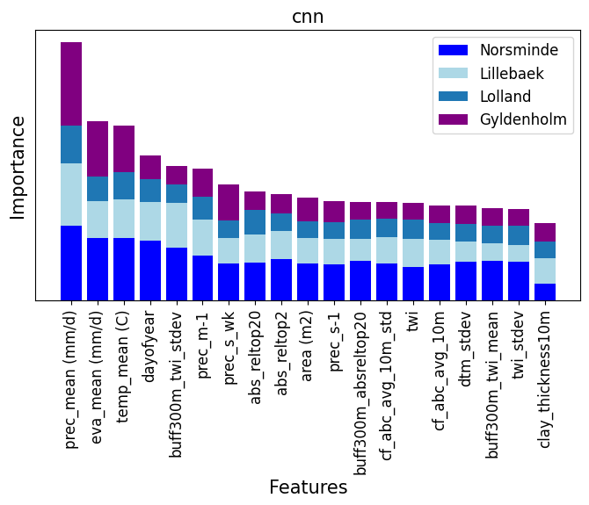
Feature importance
Importance
Prec_previous day
Prec of day
twi_mean
twi_std
Around catch_tpi_20m
Evap_on day
Clayfraction_std
Clayfraction_mean
Hydrological day
Area
Elevation_std
Prec previous week
Temp of day
Prec_month
|tpi_2m|
Clay thickness
Around catch_twi_mean
Around catch_twi_std
|tpi_20m|
Importance
Prec of day
Evap_on day
Temp of day
Hydrological day
Around catch_twi_std
Prec_last day
Prec previous week
|tpi_20m|
|tpi_2m|
Area
Prec_previous month
Around catch_tpi_20m
Clayfraction_std
twi_mean
Clayfraction_mean
Elevation_std
Around catch_twi_mean
twi_std
Clay thickness
Notes:
Remove z from plot,eva_sum,eva_mean, permutation importance, dtm, adding slope, feature importance plot all together,, mike she scatter plots, mikeshe, hydrograph,

Slide 8
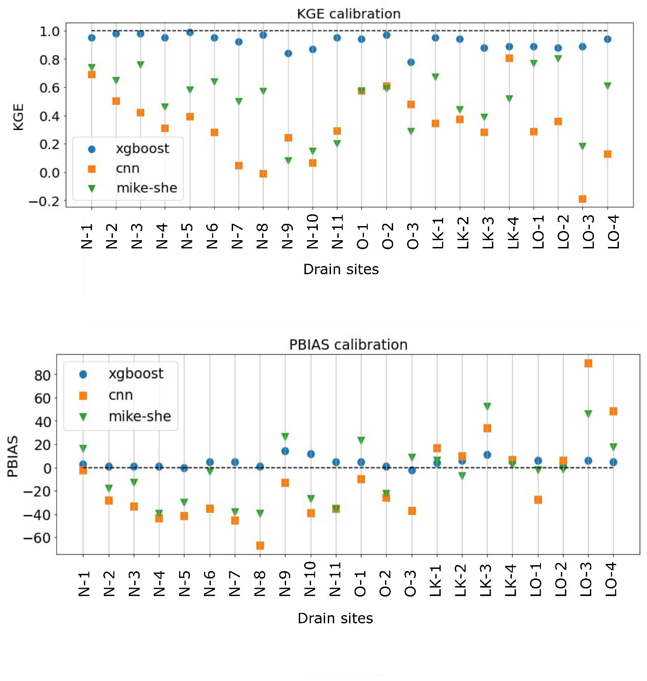
Calibration
Performance: XGBoost > MIKE-SHE > CNN
Mahmood, H., Schneider, R. M., Frederiksen, R. R., Christiansen, A. V., & Stisen, S. (2023). Using jointly calibrated fine-scale drain models across Denmark to assess the influence of physical variables on spatial drain flow patterns. Journal of Hydrology: Regional Studies, 46(101353). https://doi.org/https://doi.org/10.1016/j.ejrh.2023.101353
Notes:
Rank performance xgboost,

Slide 9
Validation
Performance
XGBoost ≈ MIKE-SHE
CNN < MIKE-SHE
CNN < XGBoost
MIKE-SHE model was not calibrated using ‘leave one catchment out’ technique
Notes:
Characteristic based grouping, kge red line at 1 and pbias red line at 0

Slide 10
Conclusion
XGBoost can be used to predict the dynamics of drain flows in tile drain regions with no drain stations.
XGBoost (decision tree) performs better than CNN (neural network).
XGBoost performed similarly to the physics-based MIKE-SHE model
Other ML techniques such as LSTM could also be explored in the future.

Slide 11
Thanks Any question?

