Slide 1
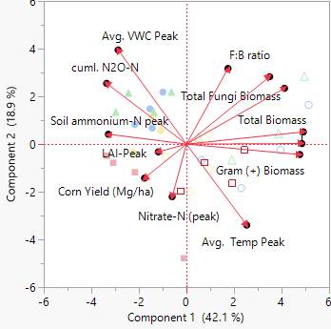
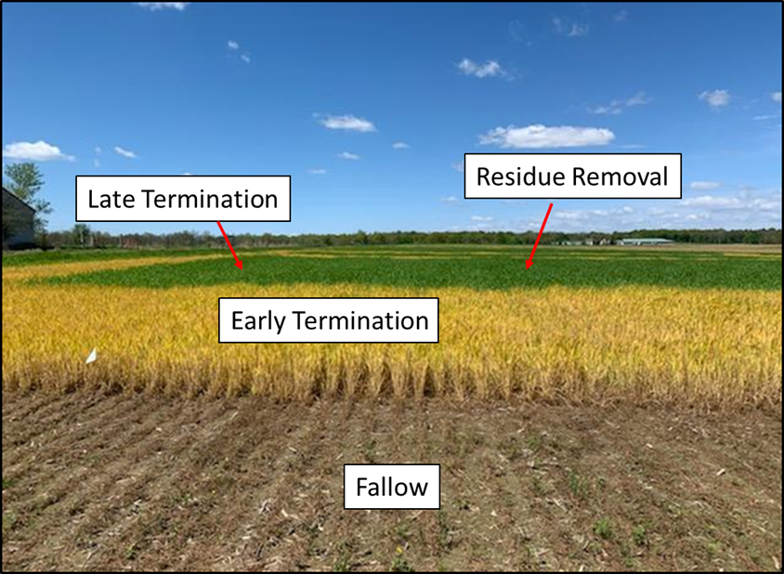
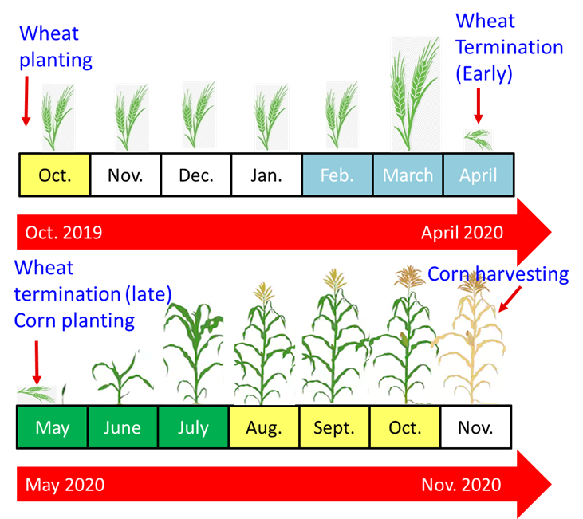
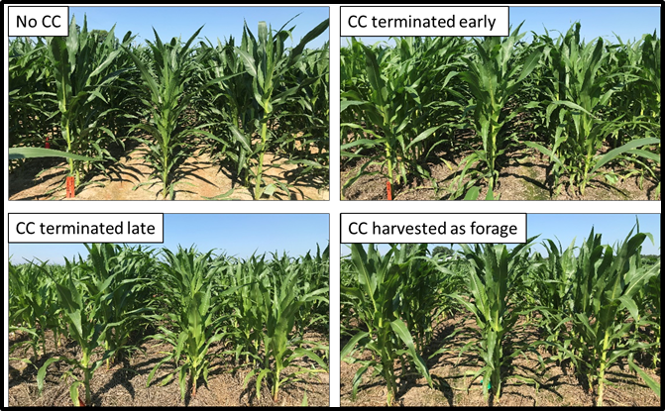
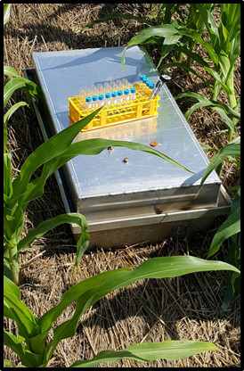
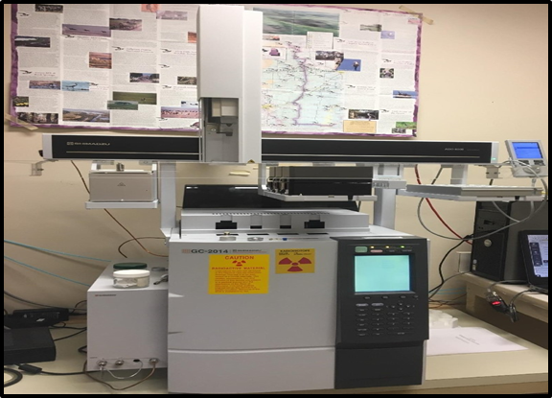
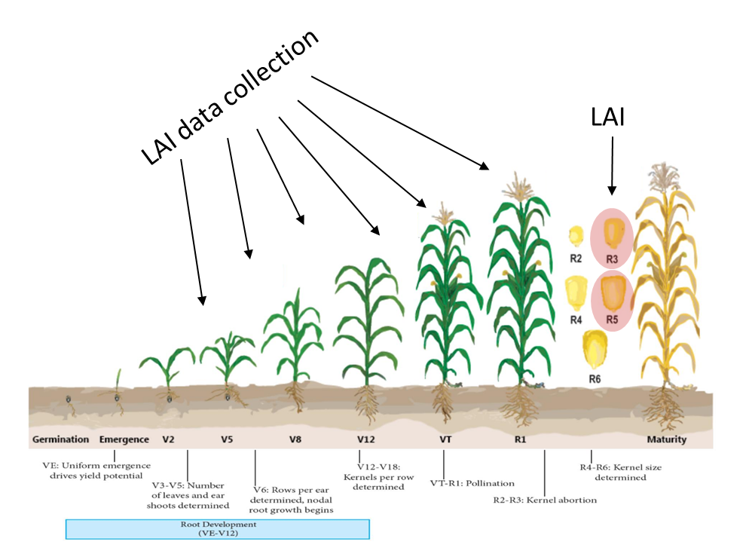
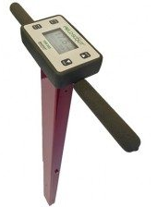
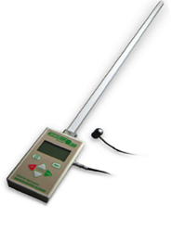
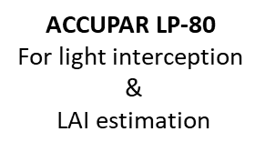
Wheat Cover Crop Management Impacts Corn Yield, Soil Nitrogen Dynamics
and Nitrous Oxide Emission
Oladapo Adeyemi¹ and Amir Sadeghpour¹
¹School of Agricultural Sciences, Southern Illinois University, Carbondale, IL, USA
Introduction
Materials and Methods
Results and Discussion
According to the US Environmental Protection Agency (USEPA), agricultural soil management is the main source of nitrous oxide (N₂O) emission, contributing 78% of total N₂O emissions.
Winter cereal cover crops (WCCCs) are recommended as the best in-field management practice to minimize nutrient loss to Illinois water and the Gulf of Mexico (https://www2.illinois.gov/sites/agr/Resources/NutrientLoss/Pages/default.aspx).
WCCCs including wheat (Triticum aestivum L.) are often terminated 3-4 weeks prior to planting corn (early April). Delaying the termination increases N uptake and decreases N leaching potential but could immobilize N during corn growing season due to increased C/N ratio of wheat (Adeyemi et al., 2020).
Literature is scant on the effect of wheat termination (early vs. late or cover crop removal) on corn yield and N₂O emission during corn growing season in the Alfisols of Midwestern USA.
Wheat (var. Agrima 446) was planted on October 8th and 14th of 2019 and 2020 respectively at 4.75 million plants ha⁻¹. Wheat was top-dressed with 34 kg N ha⁻¹. Wheat above- and belowground biomass were collected and analyzed for C and N content by combustion method (Table 1-2).
Plots were 10m long and 3.3m wide. A no-till drill was used to plant corn (Dekalb “DKC64-35RIB”) at 74,100 seeds ha⁻¹ on 12 May 2020 and 2021.
112 kg N ha⁻¹ was applied at planting in the form of liquid urea ammonium nitrate (28-0-0). An extra 112 kg N ha⁻¹ was applied at sidedress timing (corn V4-V5 stage) on 18 June 2020 and June 16 in 2021.
Soil samples were collected using a soil probe (0-15 cm depth) prior to (for Phospholipid Fatty Acids) and over the corn growing seasons of 2020 and 2021 for nitrate-N and ammonium-N analysis.
Closed vented chambers made of aluminum were constructed for the gas sampling. The chambers were placed in between the corn rows on anchors fixed to the soil (Fig. 2B).
Air samples were collected a total of 19 times in 2020 and 2021 during the duration of the corn growth using syringes at 0, 15, 30 and 45 minutes each sampling day and analyzed for N₂O using gas chromatography (GC) (Fig. 2C).
N₂O emission rates were calculated by regressing N₂O concentration (ppm) vs. time.
The cumulative N₂O emissions were estimated by linear interpolation between sampling periods.
Yield-scaled N₂O emissions were calculated as (N₂O fluxes/corn grain yield) as suggested in Venterea et al. (2011).
Soil VWC and temperature were measured at each N₂O emission sampling date.
Corn yield was higher in Fallow and explained by peak LAI values indicating greater photosynthesis capacity as seen also in fig 4 below
Table 1. Wheat above- and belowground biomass and their C:N ratio as influenced by termination management (early, late, and residue removal).
Figure 4. Corn leaf area index (LAI) (A) over the corn growing season and corn yield (B) in 2020 and 2021 as influenced by wheat management compared to a no-cover crop control (Fallow).
Wheat termination Management | Aboveground biomass (Mg ha⁻¹) |  | Aboveground C:N ratio |  | Belowground biomass (Mg ha⁻¹) |  | Belowground C:N ratio
 | 2020 | 2021 | 2020 | 2021 | 2020 | 2021 | 2020 | 2021
Early | 3.78 | 3.42 | 35.81 | 25.68 | 0.81 | 0.57 | 61.46 | 54.71
Late | 6.94 | 6.41 | 57.37 | 37.74 | 1.26 | 0.85 | 72.75 | 71.18
Residue Removal | 6.68 | 6.37 | 58.96 | 36.74 | 1.22 | 0.81 | 70.26 | 68.88
Majority of N₂O emissions occurred after N fertilization prior to corn V10 growth stage.
Figure 5. 2020 (A) and 2021 (B) soil N₂O emission trends during the corn growing season as influenced by wheat management compared to a no-cover crop control (Fallow).
Soil nitrate-N had its peak period after sidedressing N (Fig. 6) coinciding with peak N₂O emissions across the cover crop treatments (Fig. 4).
Objectives
Figure 6. Soil NO₃-N over the corn growing season in 2020 (A) and 2021 (B) as influenced by wheat management compared to a no-cover crop control (Fallow).
To evaluate the effect of wheat termination management vs. a no-cover crop control on (I) corn leaf area index (LAI) and grain yield; (II) soil nitrate-N, ammonium-N, and total N dynamics; (III) soil volumetric water content (VWC) and temperature trends; (IV) soil N₂O emission; and (V) yield-scaled N₂O emissions.
Yield-scaled N₂O emission were lowest in the fallow in both years (Fig. 7A-B) and varies across other cover crop treatments in 2020 and 2021 reflecting on lower N balances in that treatment (data not shown).
Experimental Design and Treatments
Figure 7. Yield-scaled N₂O emission as influenced by wheat management compared to a no-cover crop control (Fallow) in 2020 (A) and 2021 (B).
Treatments were laid out in a randomized complete block design (RCBD) with 4 replicates in 2020 and 2021. The treatments were (I) fallow (no-cover crop control); (II) early termination (3-4 week before planting corn); (III) late termination (at corn planting; planting green); and (IV) residual removal (Fig. 1A-B; Fig. 2A).
LAI peak (maximum LAI during the growing season) explained 51% of corn grain yield variability.
Average soil VWC prior to corn V10 growth stage (Avg. VWC peak) explained 74% of soil N2O-N emissions indicating when N is supplied in high amount (>224 kg N ha-1 in current study), soil VWC drives N2O-N emissions.
Gram + bacteria was negatively (explained 59% of variability) related to cumulative N2O-N emissions indicating opportunities for DNA sequencing to find genes that are suppressing denitrification.
Figure 8. Principal Component Analysis for exploring factors that influence soil cumulative N2O emissions and corn yield in 2020 and 2021. Squares represent “Fallow”; Diamonds represent “early termination”; Triangles represent “Late termination; and Circles represent “Residue Removal treatments. Empty shapes are data from 2020 and shapes with color are data from 2021.
(A)
(B)
(A)
(B)
(C)
Conclusion and Future Research
Wheat cover crop prior to corn increased soil VWC which created a microclimate leading to increased soil N₂O emissions.
Future research should assess the tradeoffs between N losses (emissions and leaching) with soil C sequestration for better recommendations.
Current models should be re-evaluated for crediting N₂O emission loss to WCCCs.
Figure 1. Field plot showing cover crop management treatments (A) and schematic of dates for planting
wheat, terminating wheat, planting corn, and harvesting corn from Oct. 2019 to Nov. 2020 (B).
Figure 2. Corn in each cover crop treatment (A), gas chamber (B), and a GC (C) used to analyzed N₂O concentration.
(C)
(D)
Acknowledgements
(A)
This project was funded by Illinois Nutrient Research Education Council (NREC). We thank Chris Vick and Randy Lange for assisting with field trials. We also thank Omid Zandvakili, Casey Kula, Justin Berberich, and Garrett Williams for assisting with field measurements.
(B)
References
Figure 3. TDR 350 (A), soil thermometer (B), ACCUPAR LP-80 for measuring LAI (C) during the corn growth stages (D).
Adeyemi, O., R. Keshavarz-Afshar, E. Jahanzad, M.L. Battaglia, Y. Luo, and A. Sadeghpour. Effect of wheat cover crop and split nitrogen application on corn yield and nitrogen use efficiency. Agronomy 10, no. 8 (2020): 1081.
Illinois Nutrient Loss Reduction Strategy: November, 2014 Press Release. https://www2.illinois.gov/sites/agr/Resources/NutrientLoss/Pages/default.aspx (accessed 30 Oct. 2021)

