Slide 1
The Virtual Water Gallery:
Changing Attitudes through Art
Louise Arnal, Martyn Clark, Stacey Dumanski, Effie Kosmas, John Pomeroy, Corinne Schuster-Wallace
EGU 2023

Slide 2
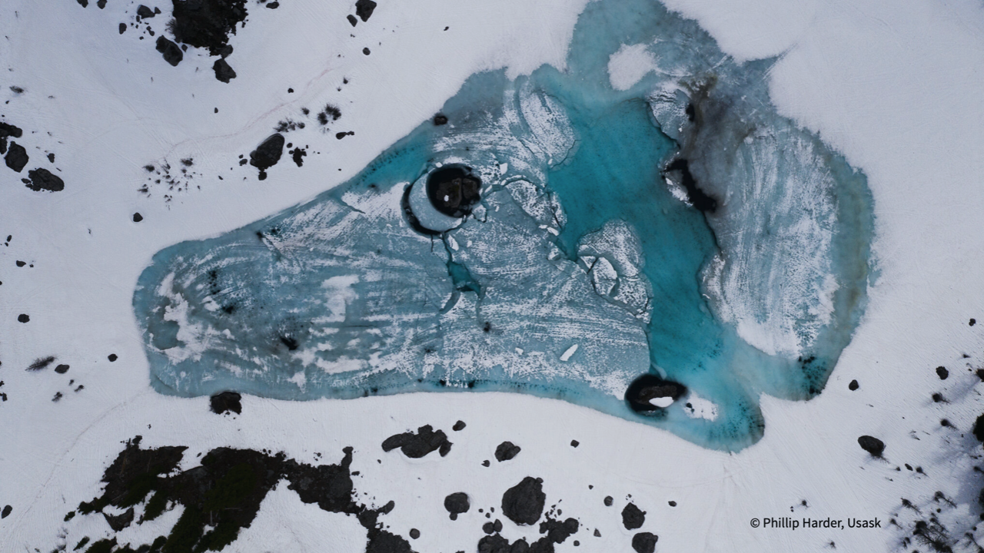
Water is life
Water-related challenges, exacerbated by CC, affect everyone.
Yet, communicating science on difficult, highly volatile topics such as water & CC is challenging.
Conceptualizing socio-environmental issues in novel ways, with engagement between diverse audiences, may lead to comprehensive & creative solutions.

Slide 3
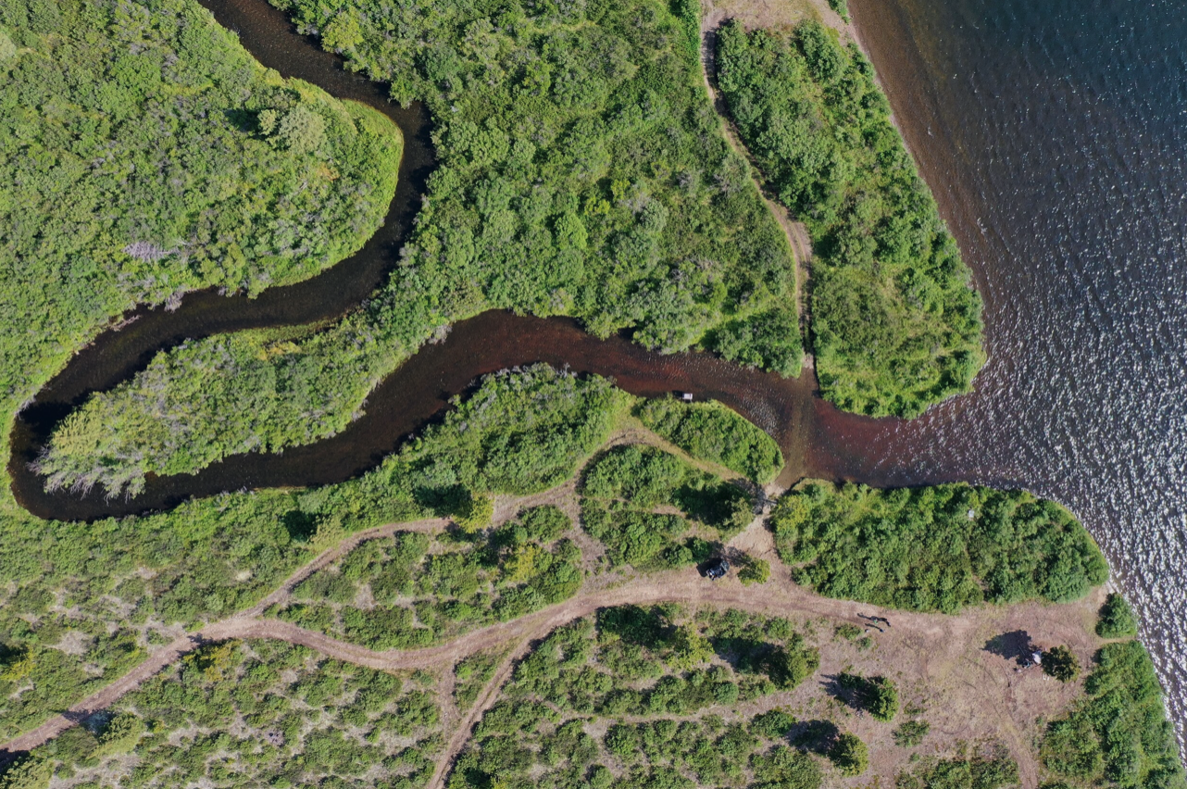
SciArt
SciArt can help communicate science & open ongoing scientific discussions to a larger audience.
Art adds an emotional dimension to cold scientific facts.
Exhibitions & galleries provide a space for a diverse audience to meet & engage.

Slide 4
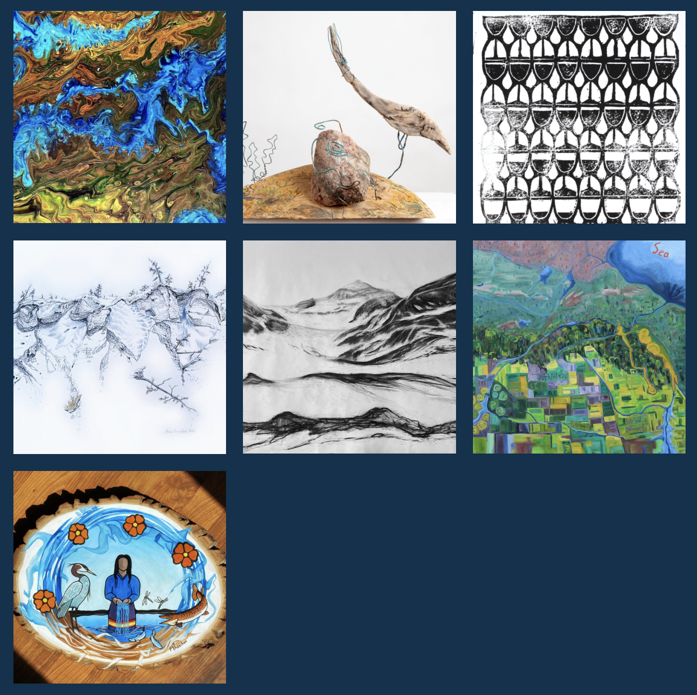
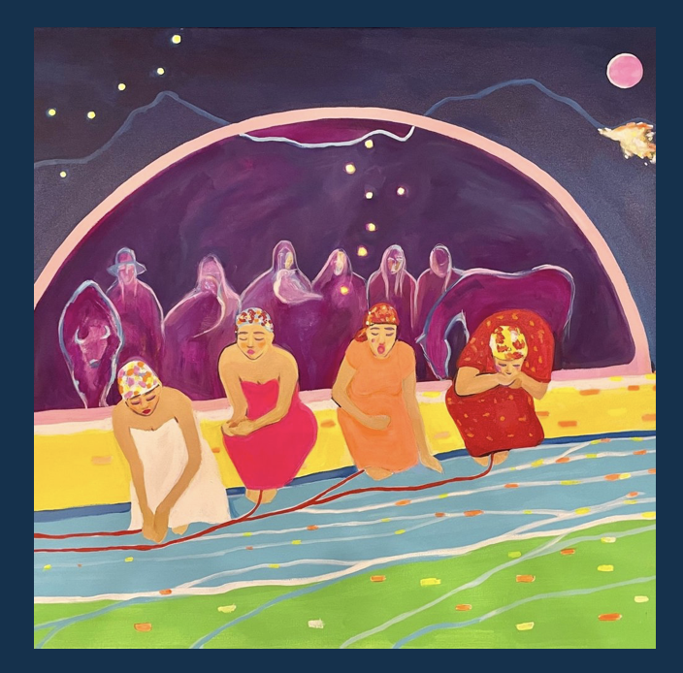
Virtual Water Gallery
An online SciArt space that brings together diverse voices to collectively reflect on water challenges.
Launched in 2020.
8 projects showcasing water across various Canadian landscapes & communities (+1 in progress).
Collaborations between 13 artists & 16 water experts from across Canada.
www.virtualwatergallery.ca
Curated by Louise Arnal, Martyn Clark, Stacey Dumanski & John Pomeroy
Funded by Global Water Futures

Slide 5
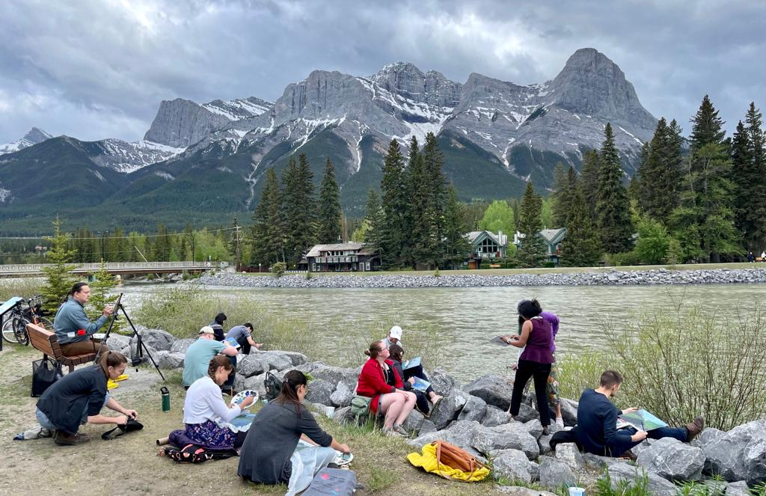
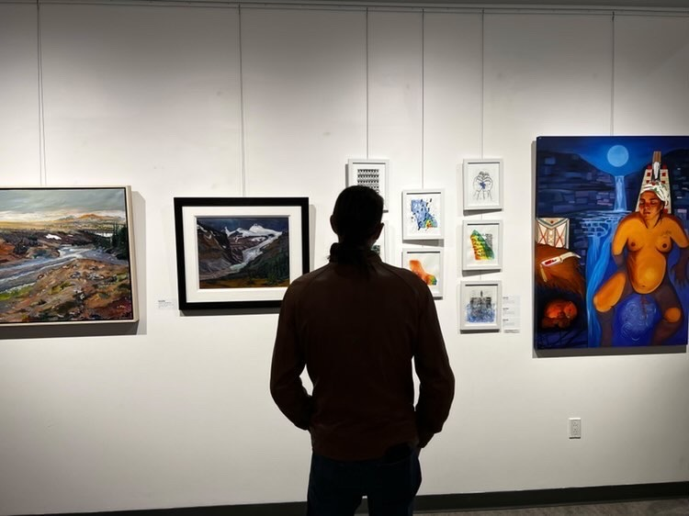
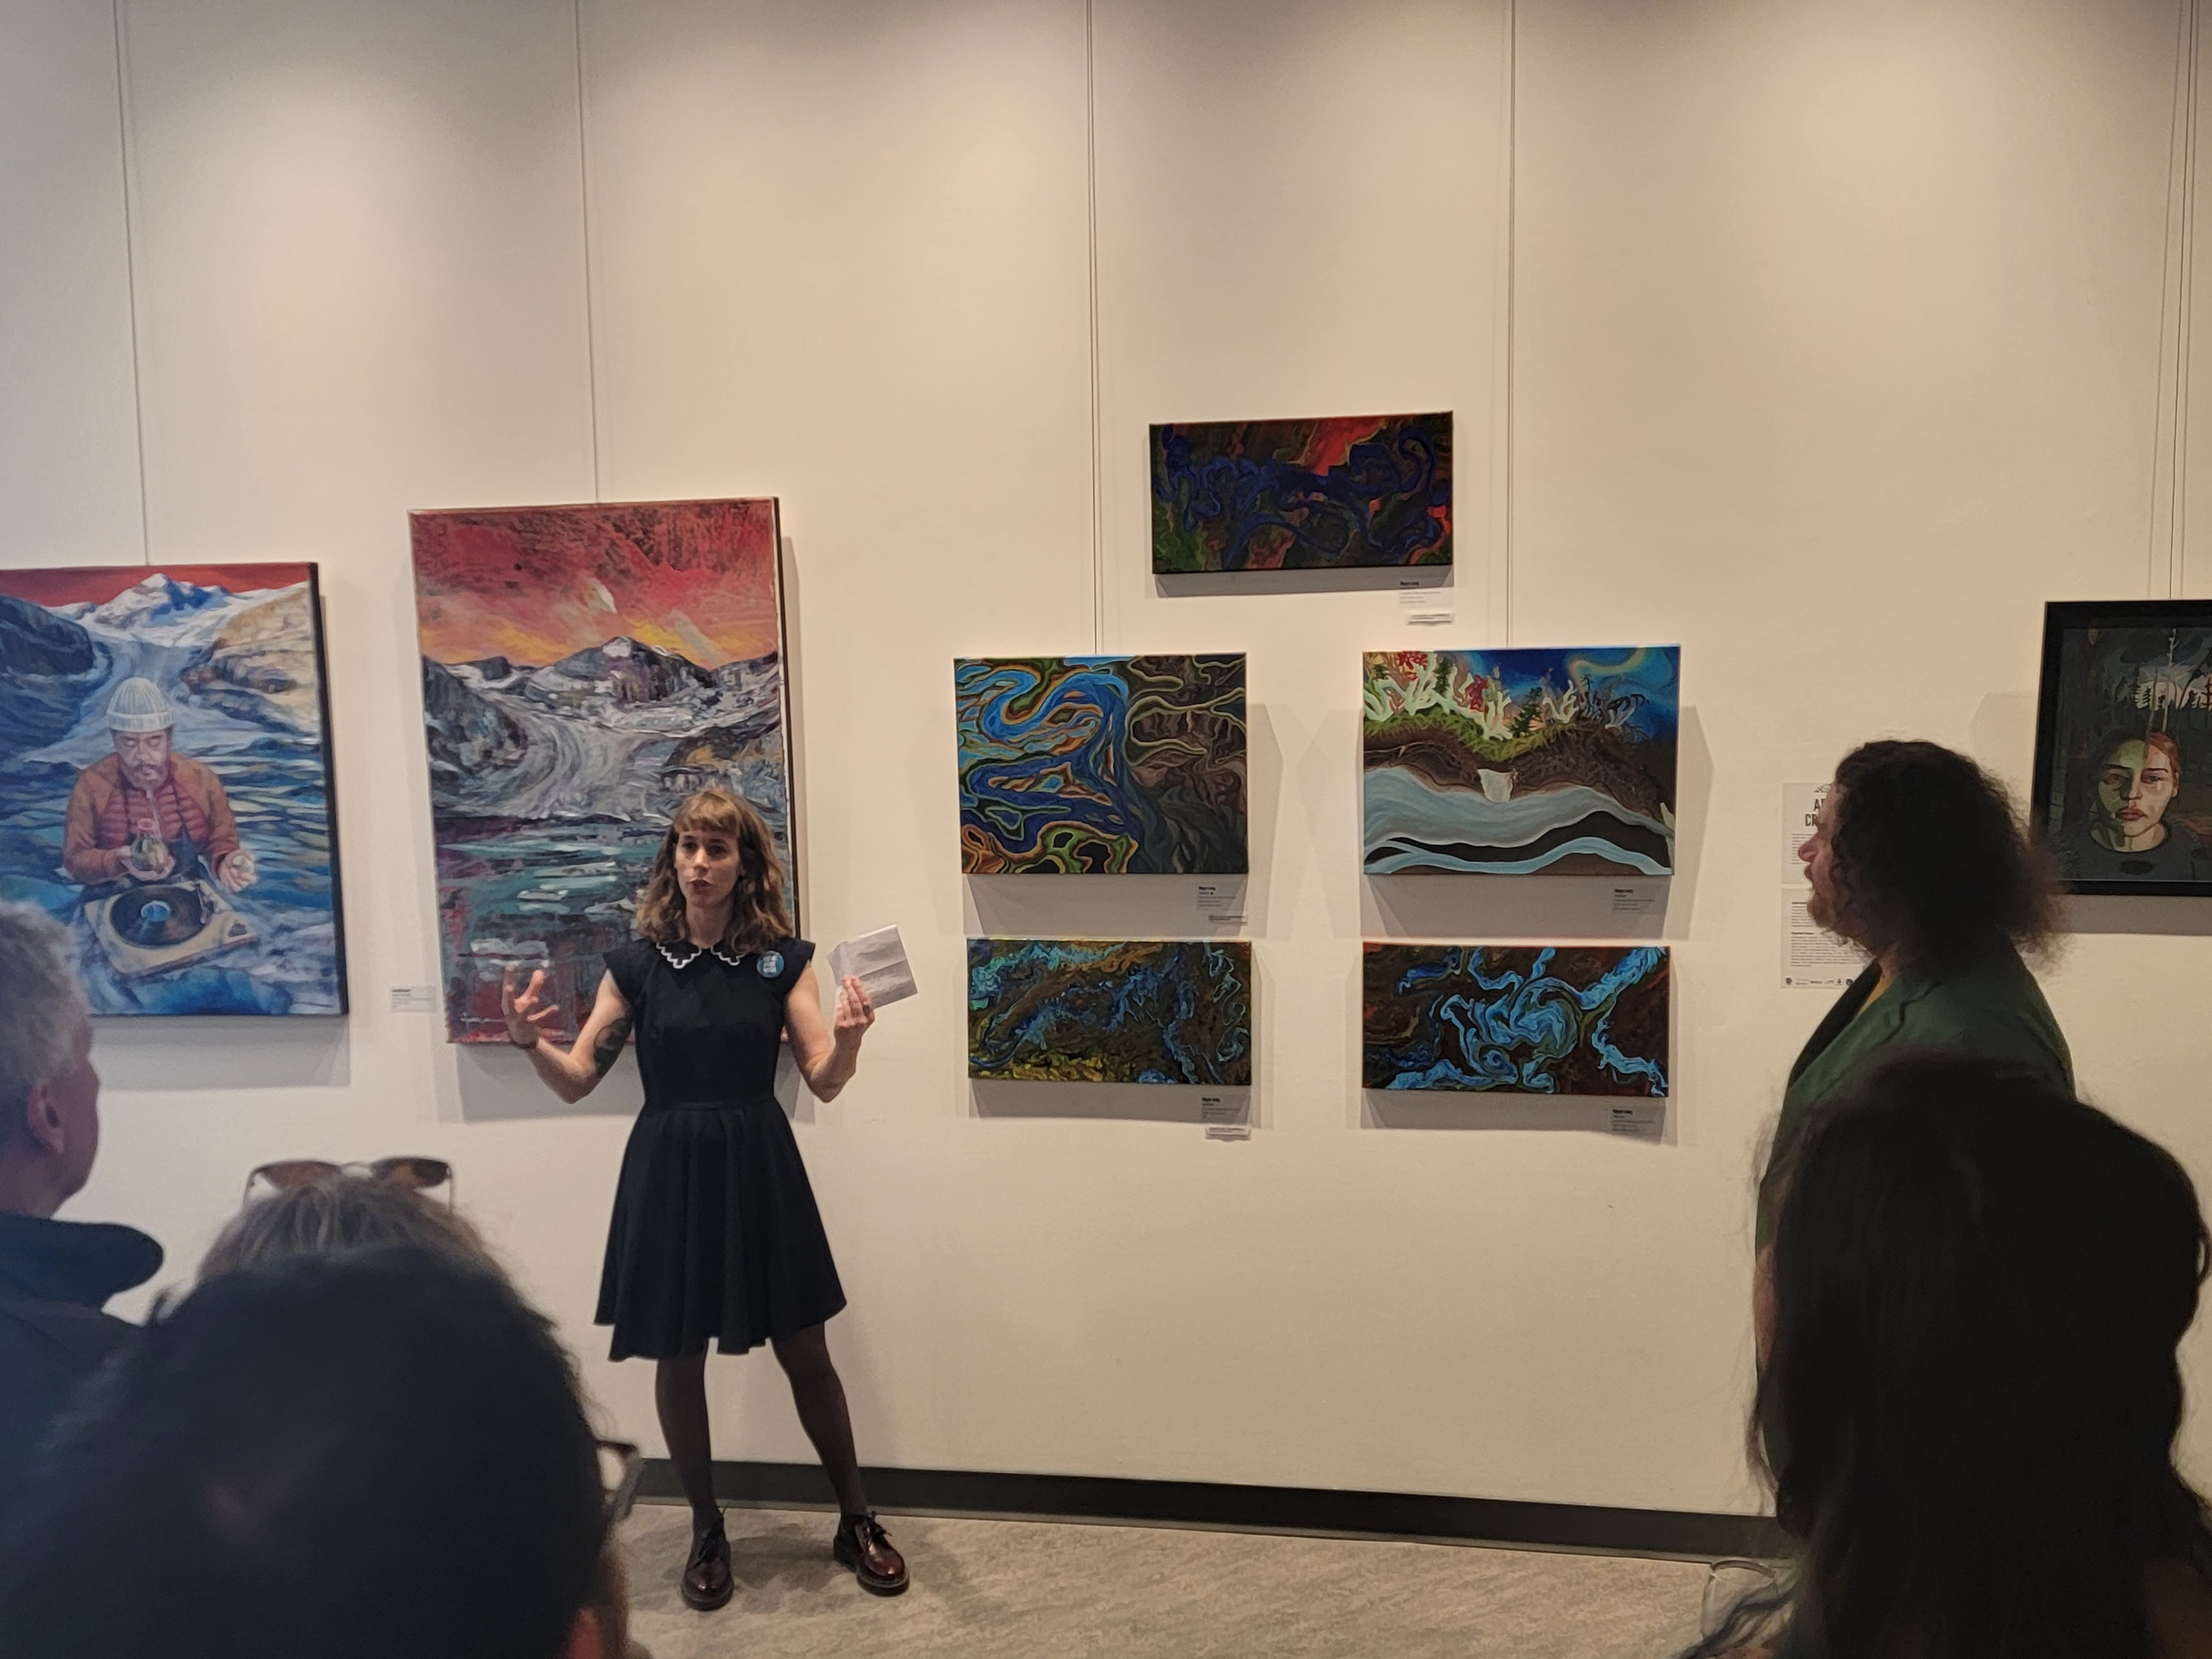
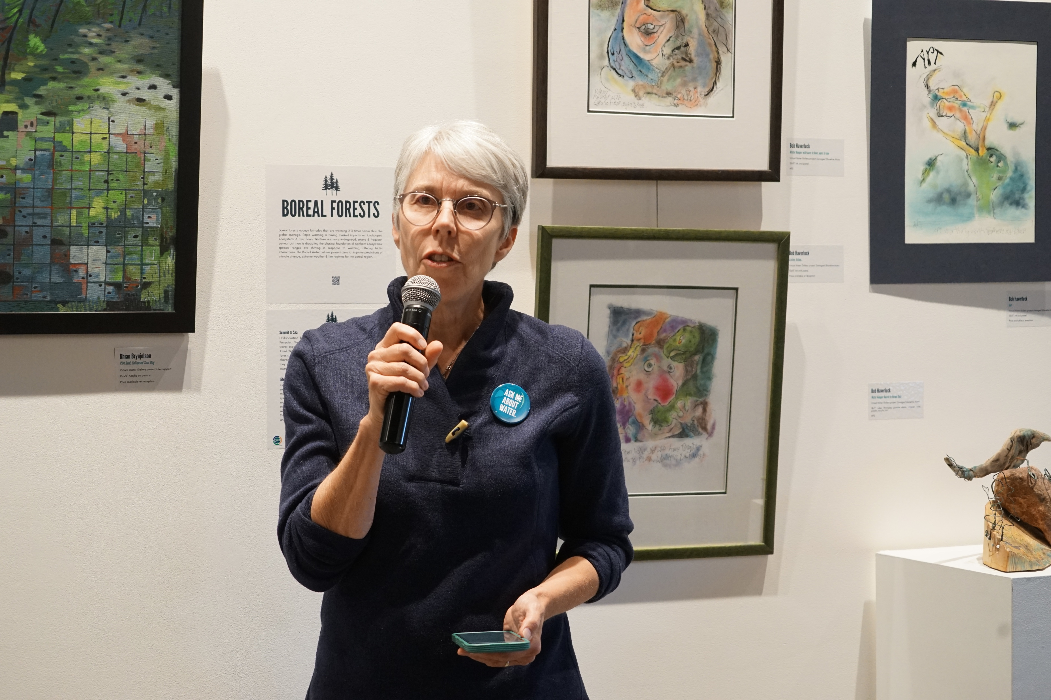
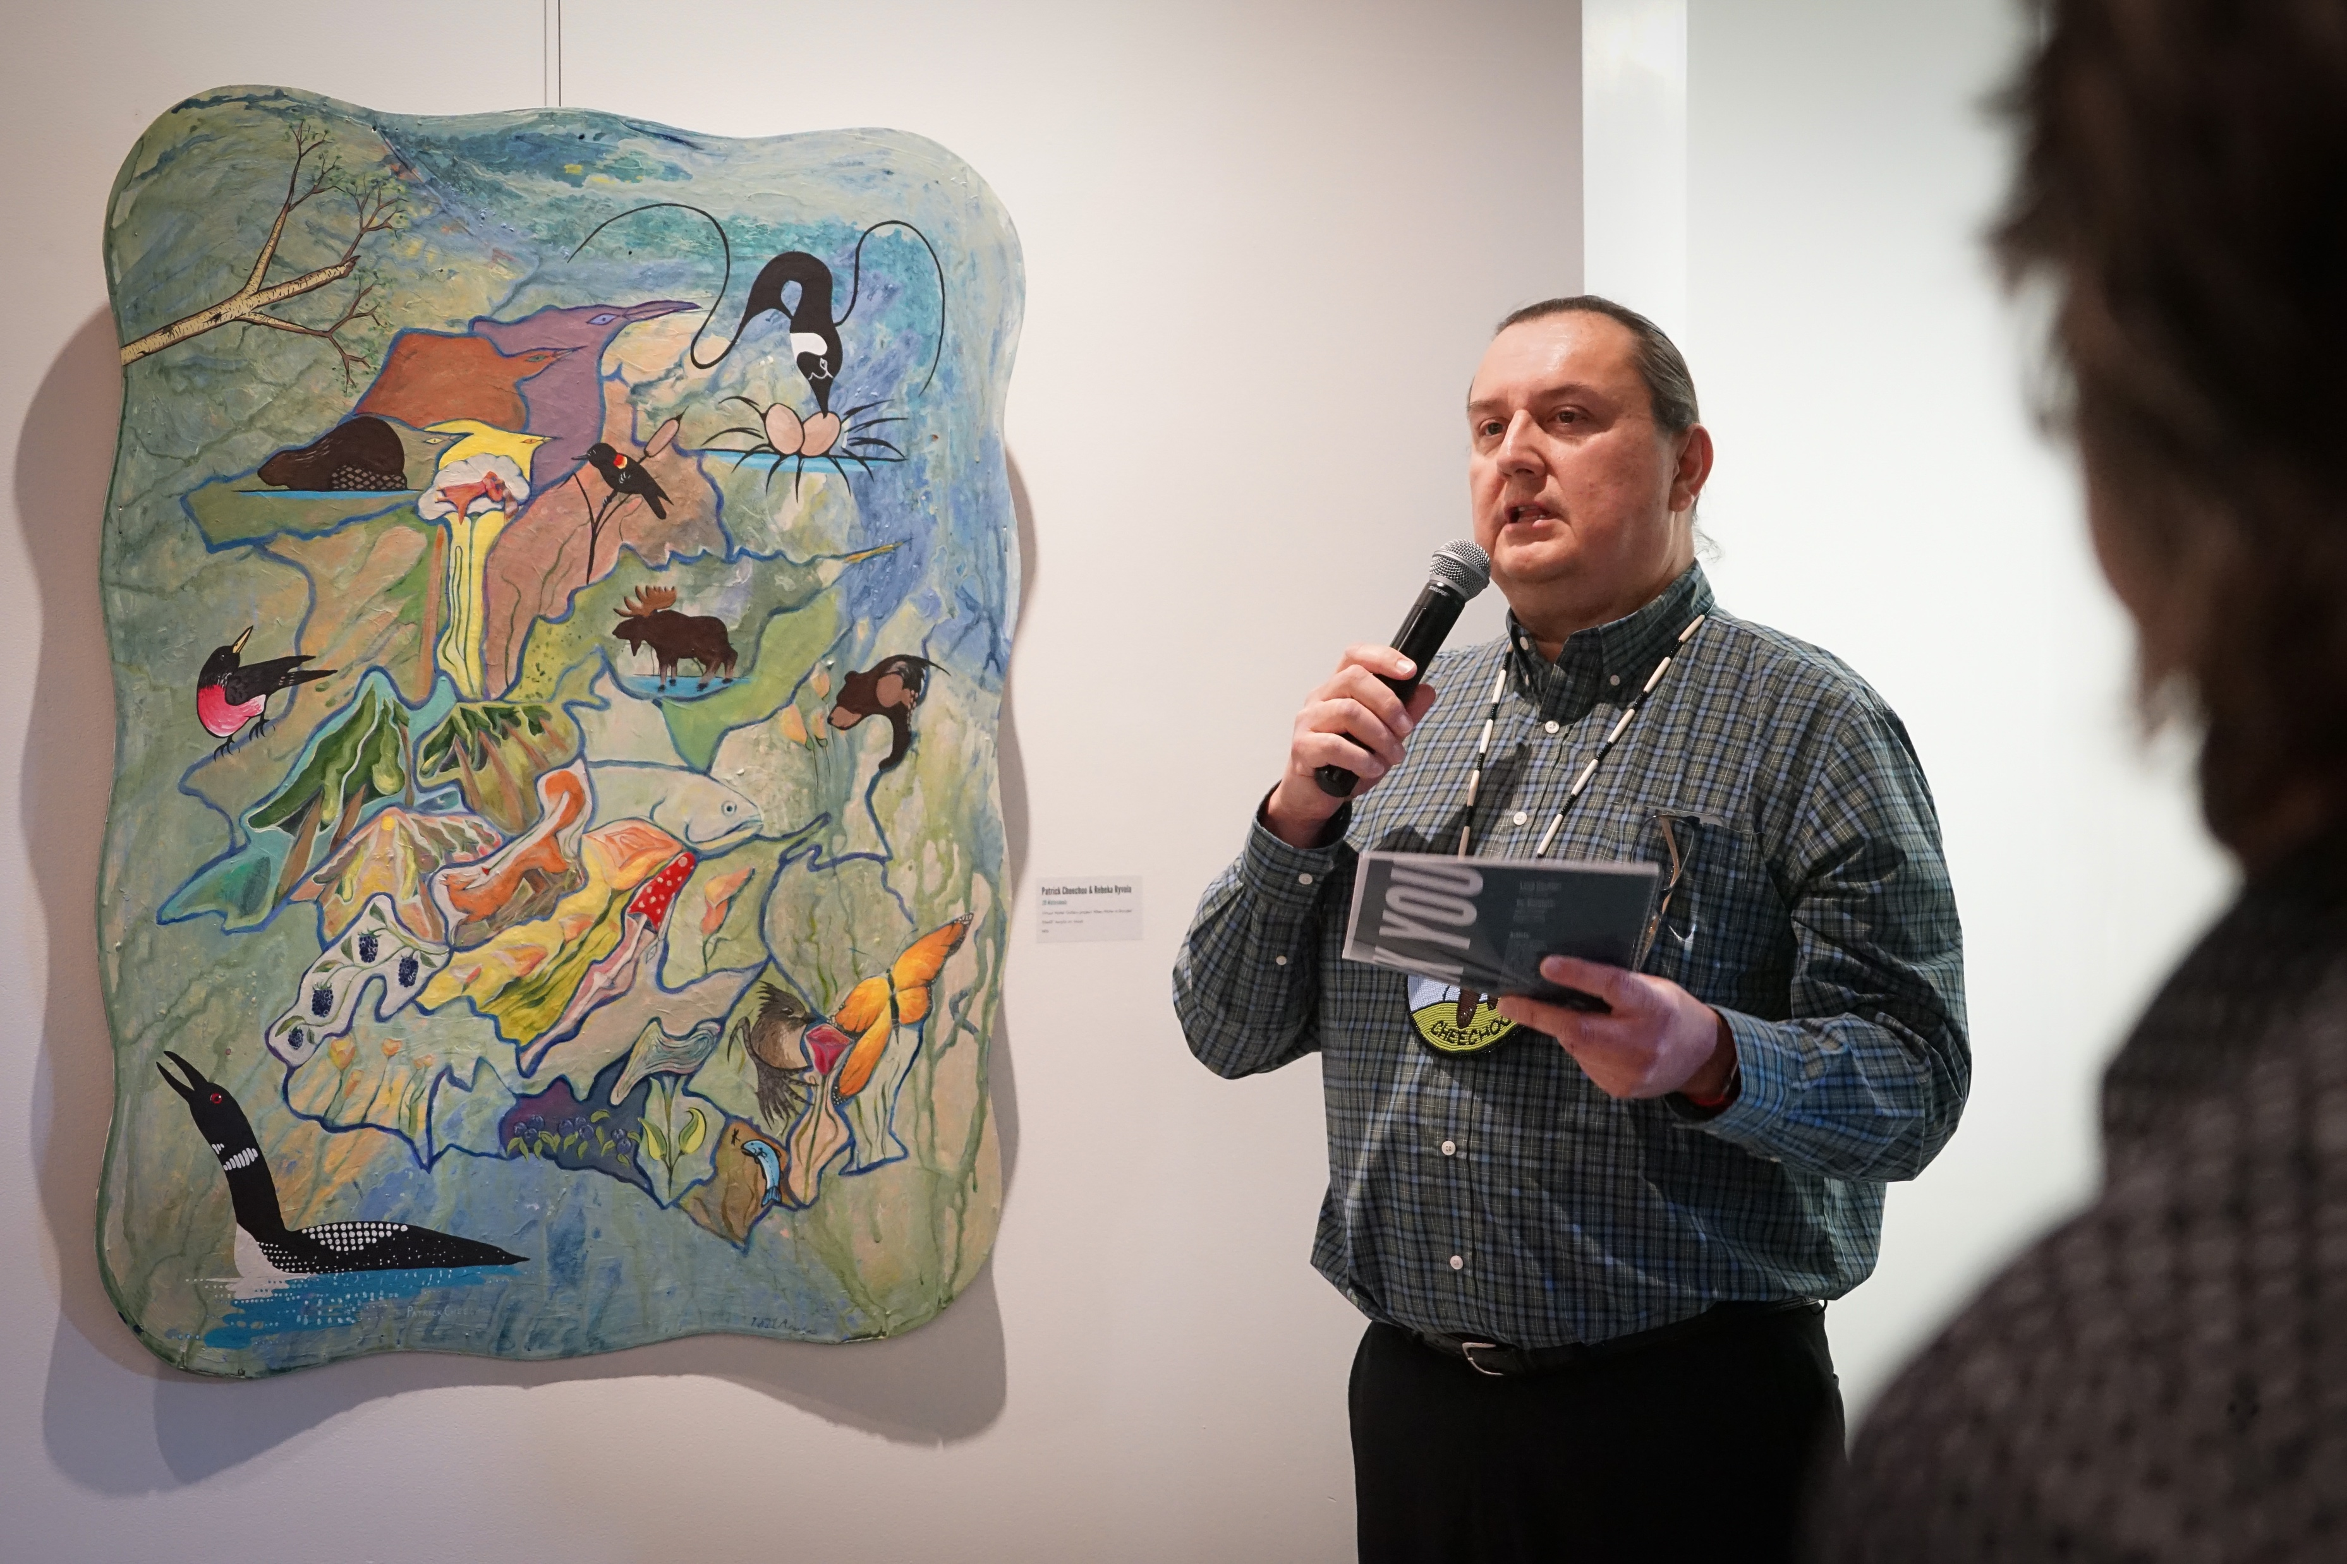
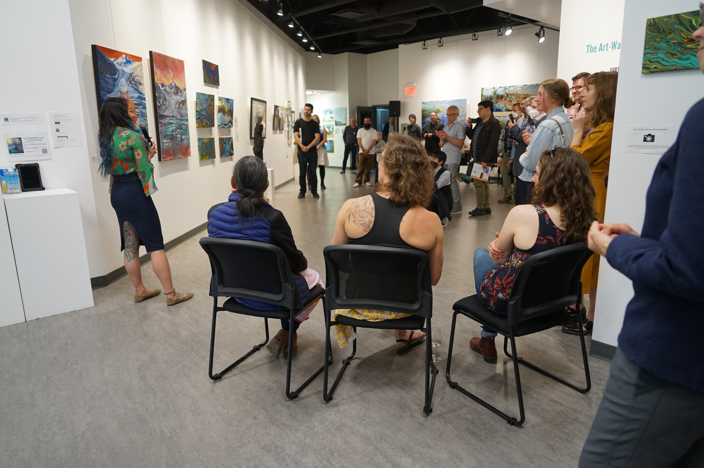
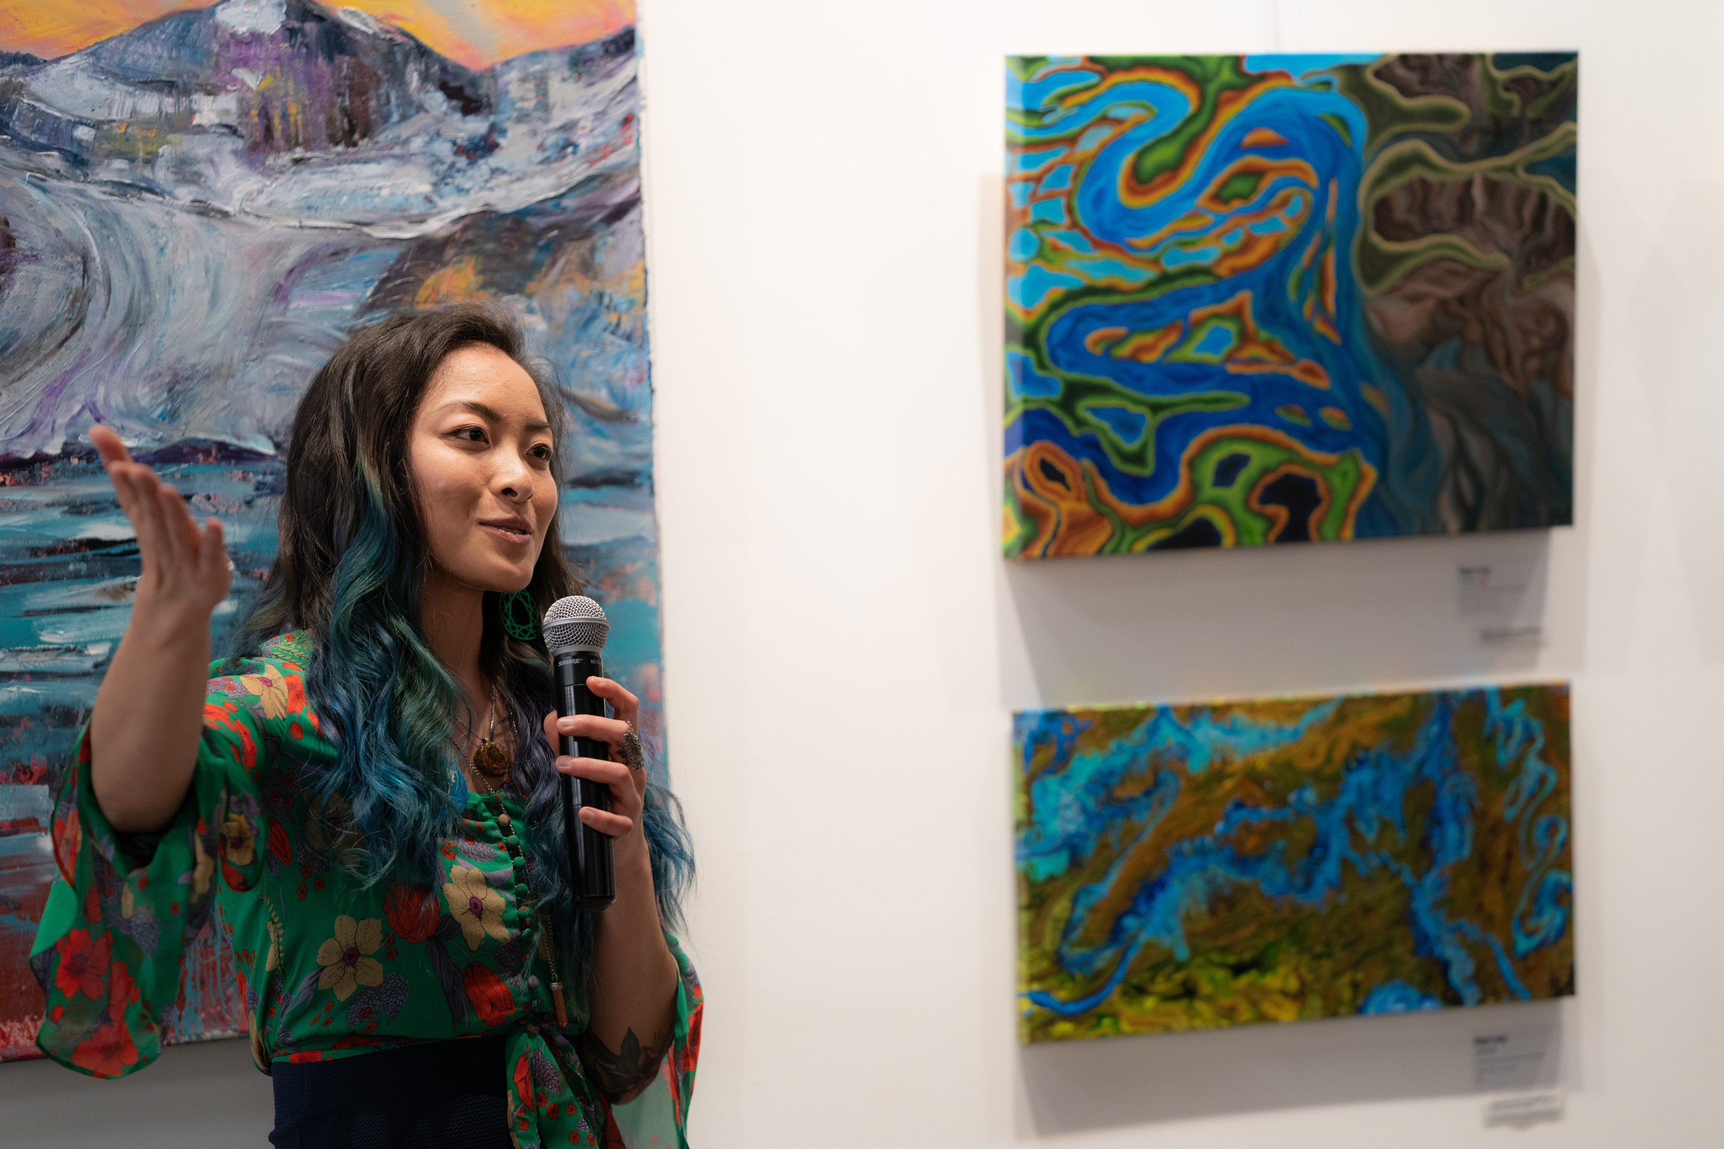
The Virtual Water Gallery comes to life
Virtual Water Gallery
first in-person exhibition
artsPlace (Canmore, Canada),
May-June 2022
Notes:
SSHRC funding to assess

Slide 6
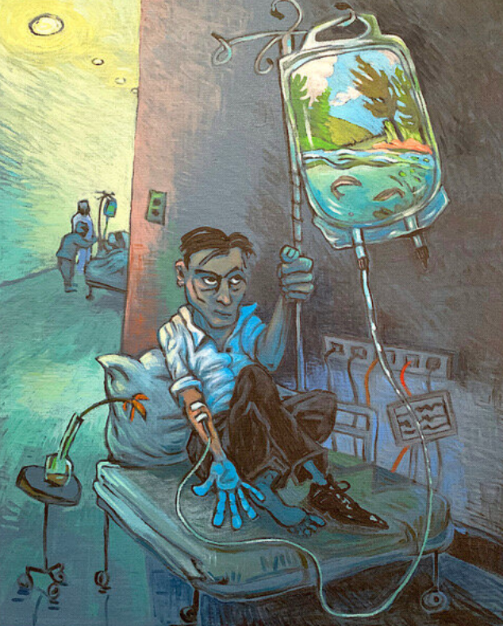
Surveys
Art as a tool to change attitudes & behaviours?
Visitor survey
Developed to capture changes in perspectives regarding CC & water resources (WR) through this exhibit.
Online & in-person visitors invited to take part.
The results will help elucidate:
How art viewers engage with SciArt.
How science messages can be more effectively communicated through art.
Participant survey
For Virtual Water Gallery water experts & artists.
Funded by the Social Sciences and Humanities Council of Canada
Life Support by Rhian Brynjolson

Slide 7
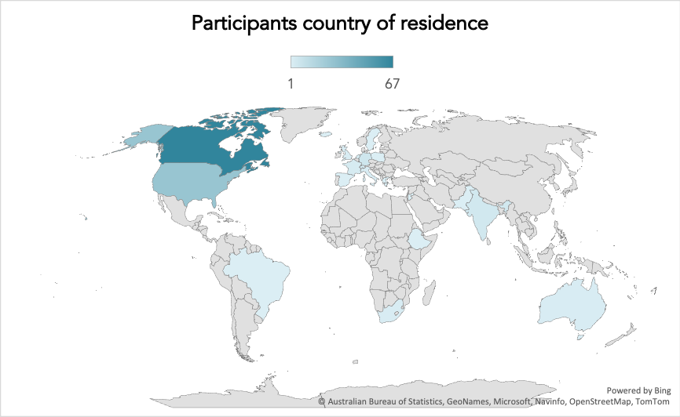
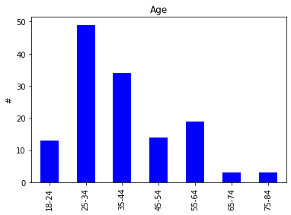
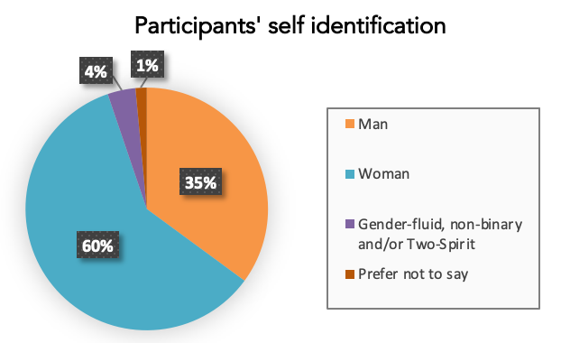
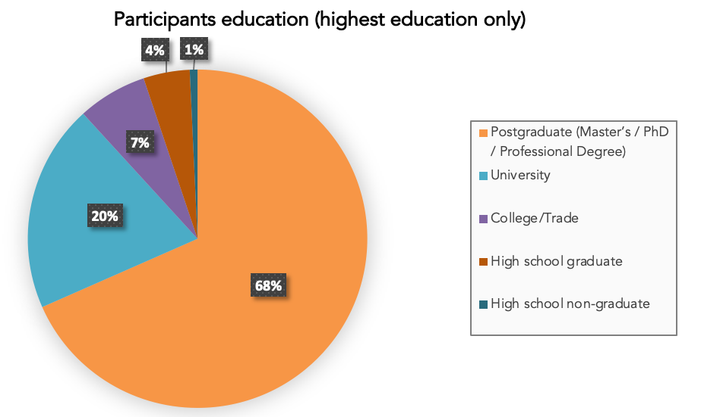
Survey preliminary results: Who are we reaching?
139 survey participants
92 virtual/online
47 in person
Participants’ age
Notes:
Who engages with SciArt?
Who is willing to engage in (SciArt) surveys?

Slide 8
Survey preliminary results: Who are we reaching?
Virtual gallery opportunity to engage diverse audience.
Prior knowledge of CC consequences
Prior knowledge of CC impacts on water resources
I have no knowledge
I am aware
I have a very strong understanding
I have no knowledge
I am aware
I have a very strong understanding

Slide 9
Survey preliminary results: Who are we reaching?
Virtual gallery opportunity to engage diverse audience.
Virtual participation capturing people with low knowledge of CC/WR.
Prior knowledge of CC consequences
Prior knowledge of CC impacts on water resources
I have no knowledge
I am aware
I have a very strong understanding
I have no knowledge
I am aware
I have a very strong understanding

Slide 10
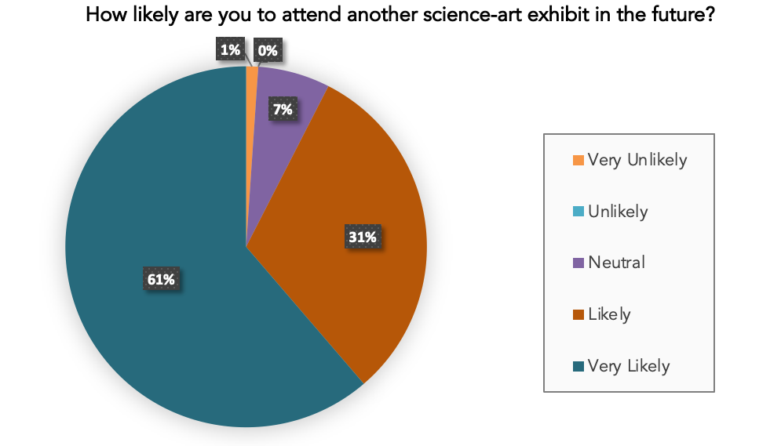
Survey preliminary results: Art as comms
90% of survey participants think that more scientists should collaborate with artists.
And are likely/very likely to attend another SciArt exhibit in the future!

Slide 11
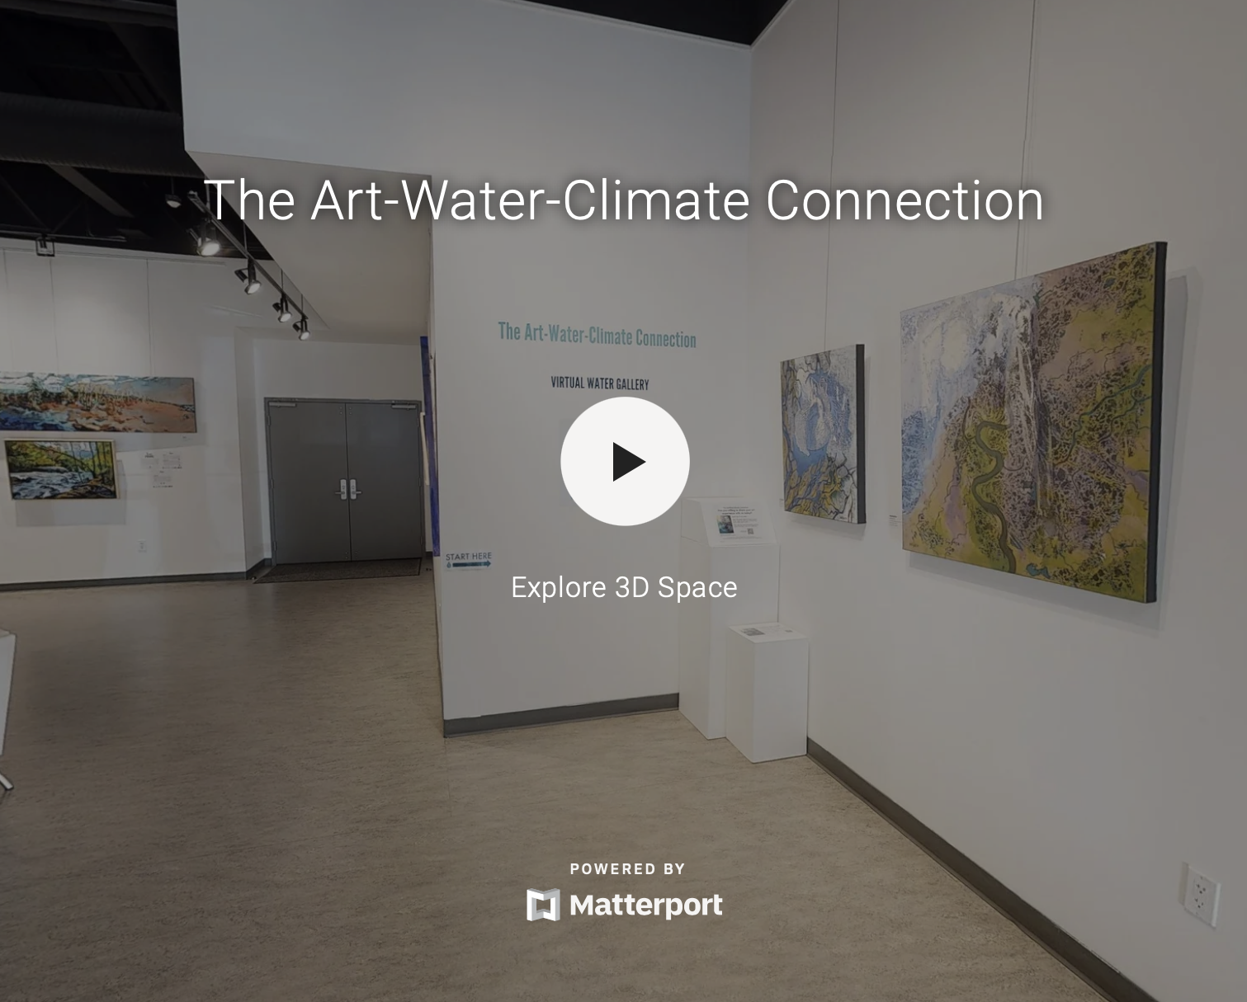
Thank you!
@ArnalLouise louise.arnal@usask.ca virtualwatergallery.ca
Notes:
Mention the need for robust survey and survey analysis tools for SciArt, and the formation of a group to discuss these topics in N. America.

