Slide 1
Simulating wet front evolution along a sinuous riverbank to understand impact of bank slope on hyporheic flow and transport
-Supplymentary material
Yiming Li^{1,2}, Zhang Wen¹, Stefan Krause², and Uwe Schneidewind²
¹Hubei Key Laboratory of Yangtze River Catchment Environmental Aquatic Science, School of Environmental Studies, China University of Geosciences, People’s Republic of China
²School of Geography, Earth and Environmental Sciences, University of Birmingham, UK
Contact:
Tel. +86 18571633452;
E-Mail: liym@cug.edu.cn

Slide 2
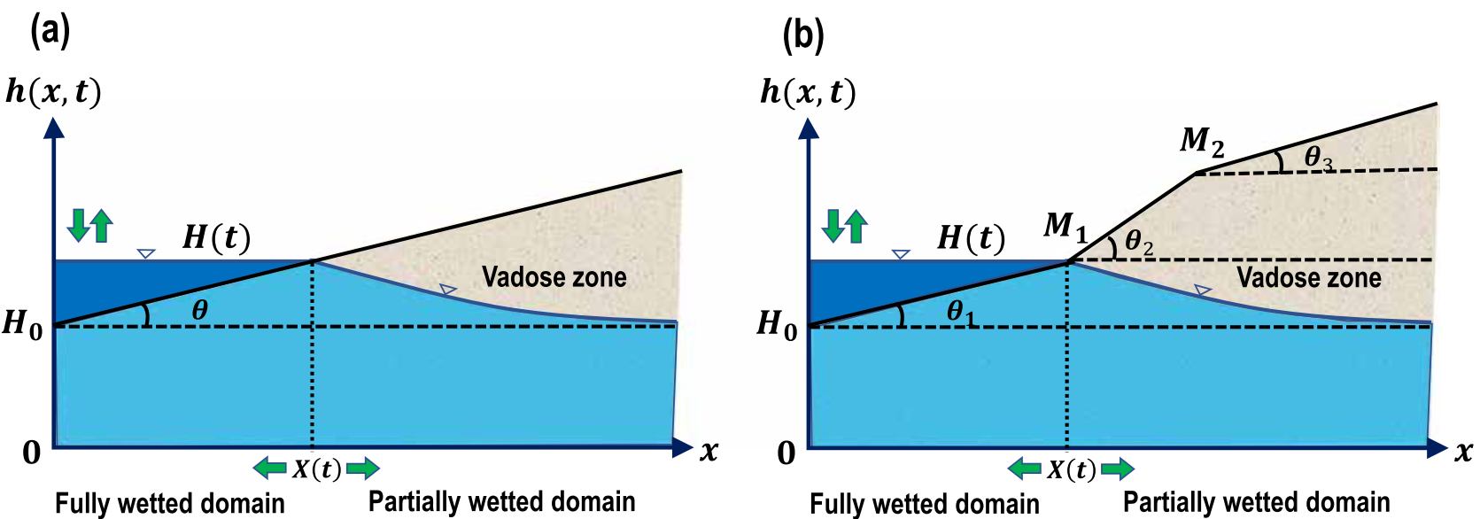
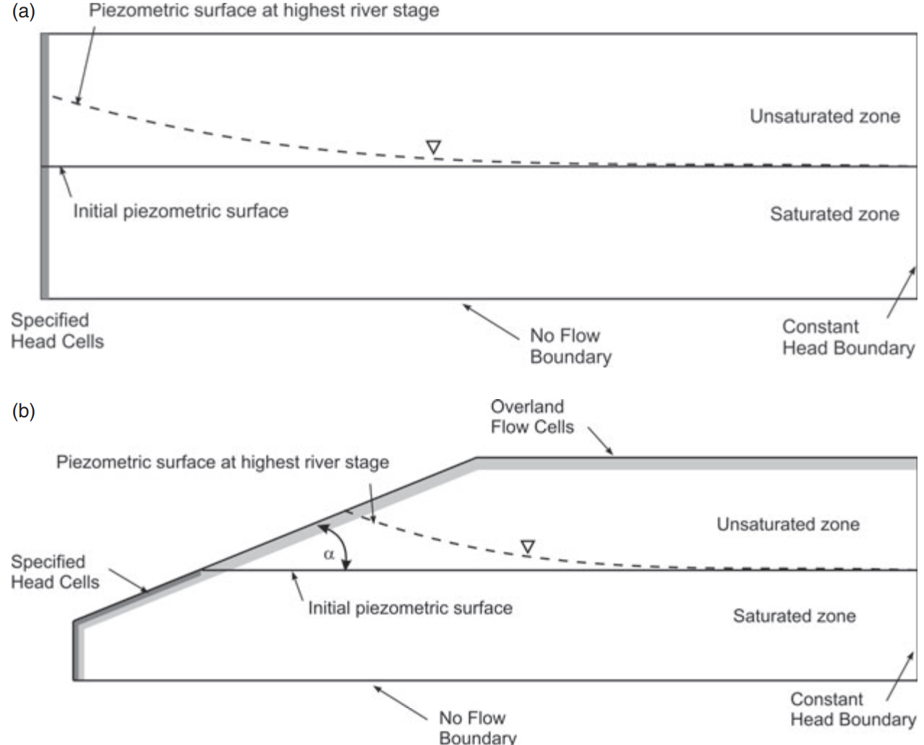
1. Background
River bank are mostly tilted rather than vertical because of the river and rainfall erosion.
Most previous study neglect the influence of bank slope on HE model, especially in lateral HE model
Previous research on the impact of bank slope on HE were at vertical cross-section scale, which neglect the up-downstream lateral exchange
Notes:
2

Slide 3
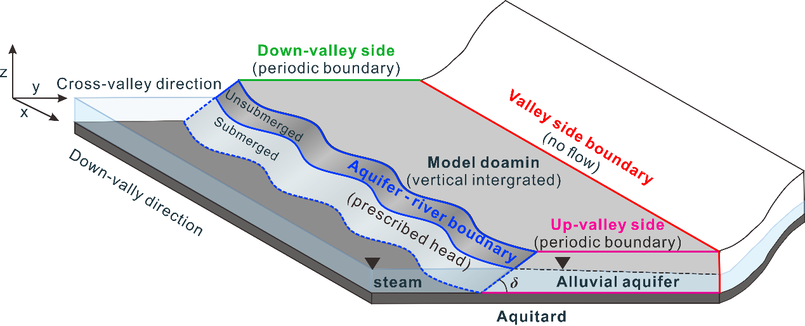
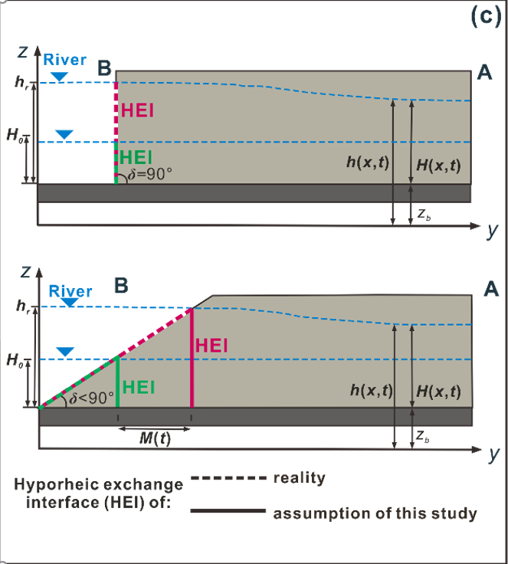
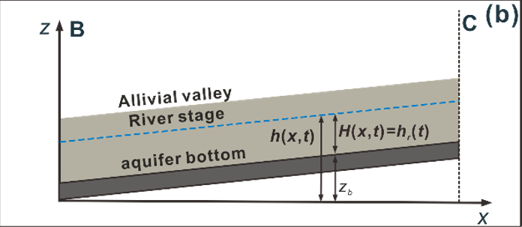
2. Conceptulization
3-D conceptual model
Vertical riverbank
Sloping river bank
River bank are mostly tilted rather than vertical because of the river and rainfall erosion.
Most previous study neglect the influence of bank slope on HE model, especially in lateral HE model
3-D model will encounter numerous compute cost.
We aim to consider bank slope in a 2-D horizontal model—more accurate with lower cost
Notes:
3

Slide 4
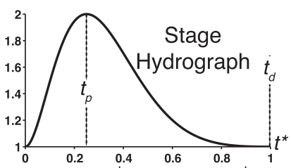
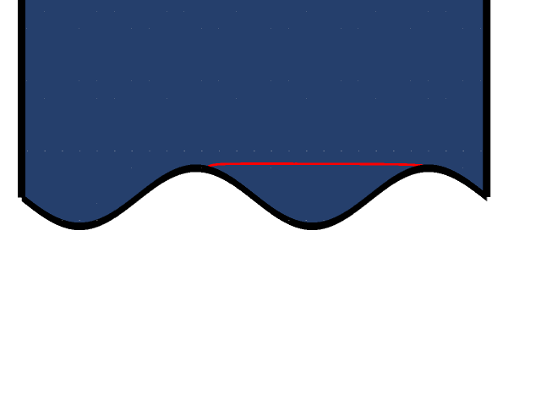
2. Numerical method
Driver: a flood event pulse
Vertical river bank condition
Sloping river bank condition
The displacement of riverbank accomplished in the model using Deformed Geometry method
assessed the impact of bank slope on HE patterns in different hydraulic conductivity (K) and slope angle (δ) condition
Notes:
4

Slide 5
2. Parameters
Table 1. Parameters and values used in our numerical model simulations (adopted from Gomez-Velez et al. (2017)).
Parameters | Value | Description
Constant model parameters
S_{y} | 0.3 | Specific yield [-]
λ | 40 | River boundary wave length [L]
α | 5 | River boundary amplitude [L]
θ | 0.3 | Efficient porosity [-]
J_{x} | 0.0025 | Base groundwater gradient [-]
σ | 1.14 | River boundary sinuosity [-]
t_{d} | 10 | Duration of flood event [T]
n_{d} | 0.25 | Skewness of flood event [-]
t_{p} | n_{d}t_{d} | Time to peak river stage [T]
H₀ | 1 | Base river stage [L]
n₀ | 1 | Intensity of flood event [-]
α_{L} | 2 | Longitudinal dispersivity [L]
α_{T} | 0.1α_{L} | Transverse dispersivity [L]
Varied model parameters
Γ_{d} | 0.1 1 10 100 | Dimensionless aquifer transmissivity [-]
δ | 90 70 50 20 10 | Bank slope angle [°]
$$\text{Γ}\text{d} \text{=}\frac{\text{S}\text{y}\text{λ}\text{2}}{\text{0.5}\text{K}\text{(1+}\text{n}\text{0}\text{)}\text{H}\text{0}\text{t}\text{d}}$$
Notes:
5

Slide 6
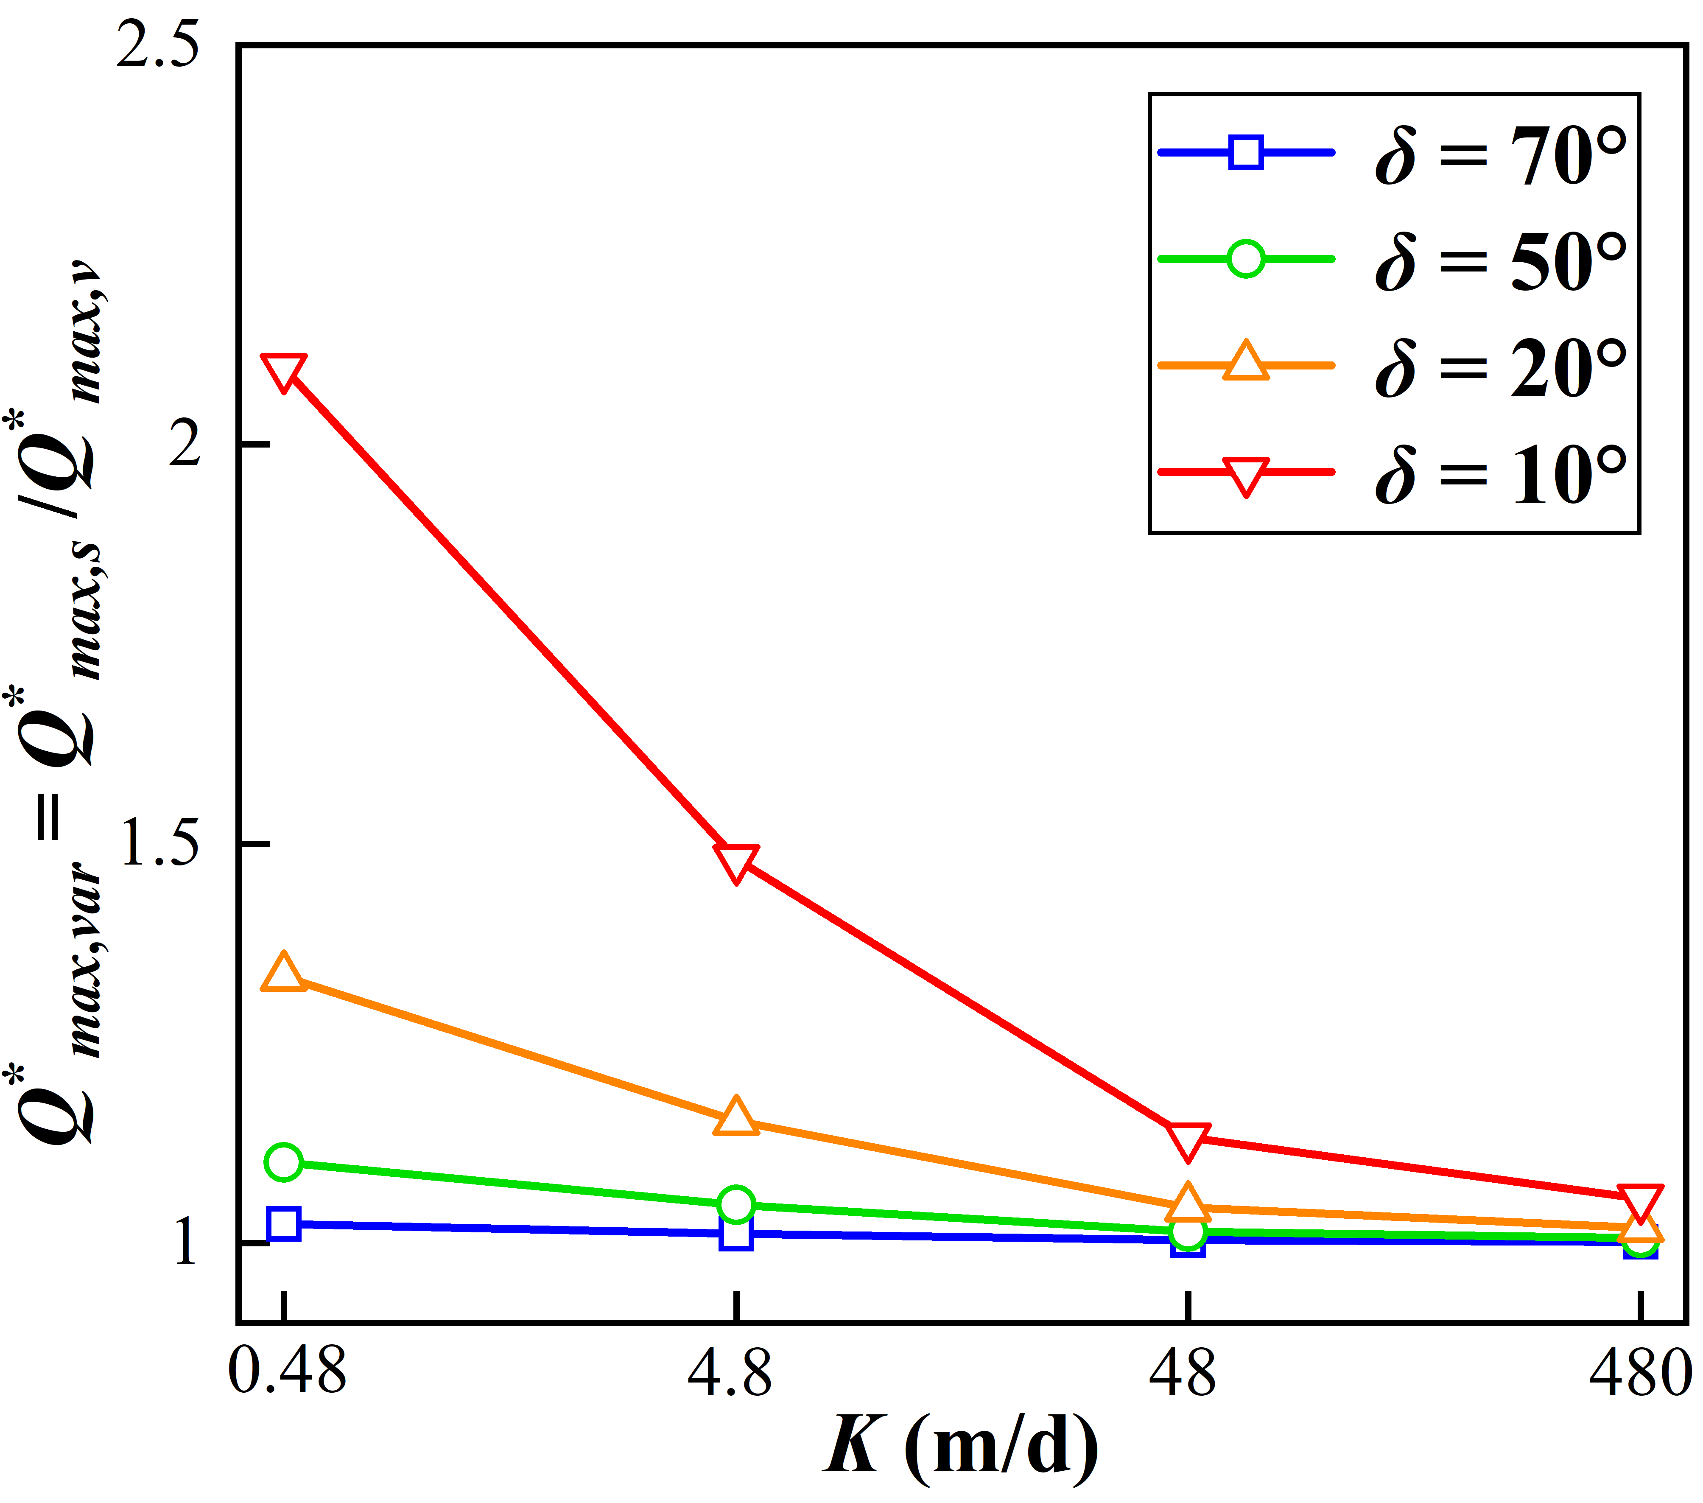
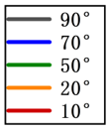
3. Net hyporheic flux
Γ_{d} = 0.1
Γ_{d} = 1
Ratio of max net flux between sloping and vertical condition
Γ_{d} = 10
Γ_{d} = 100
Notes:
氧气的出现导致：潜在ROS的产生和可利用Fe(II)的急剧减少；Fe(II)通过Fenton反应转化而增强氧毒性(ROS/高价铁)
6

Slide 7
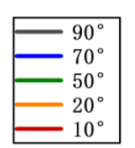
3. Area of hyporheic zone
Γ_{d} = 0.1
Γ_{d} = 1
Γ_{d} = 10
Γ_{d} = 100
Notes:
7

Slide 8
3. Penatration Distance of hyporheic zone
Γ_{d} = 0.1
Γ_{d} = 1
Γ_{d} = 10
Γ_{d} = 100
Notes:
8

Slide 9
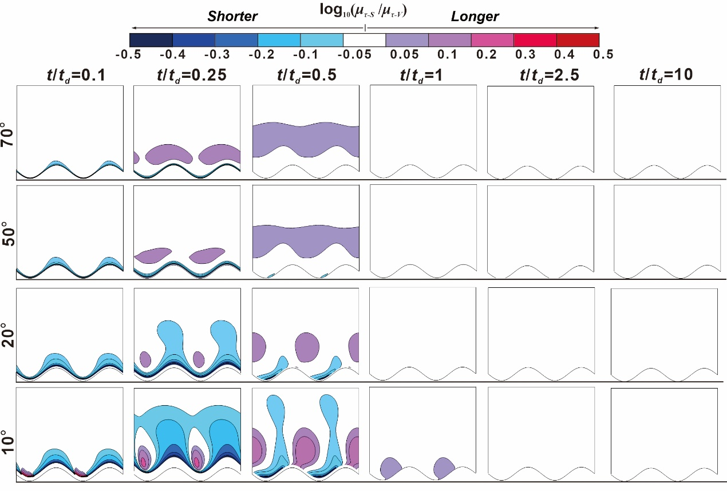
3. Relative RTD Γ_{d} = 0.1
Displacement （contraction） of wet front
Notes:
9

Slide 10
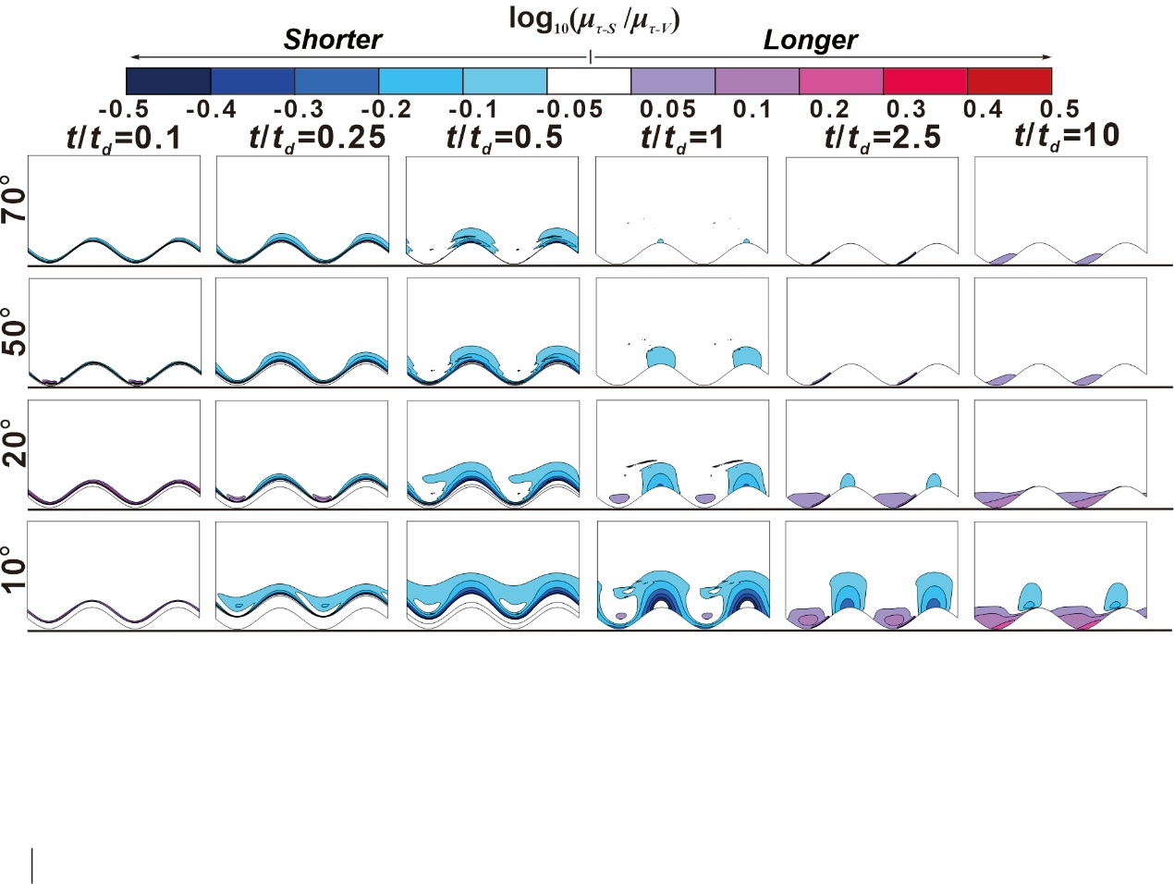
3. Relative RTD Γ_{d} = 1
Displacement of wet front
Notes:
氧气的出现导致：潜在ROS的产生和可利用Fe(II)的急剧减少；Fe(II)通过Fenton反应转化而增强氧毒性(ROS/高价铁)
10

Slide 11
3. Relative RTD Γ_{d} = 10 and 100
Γ_{d} = 10
Γ_{d} = 100
Notes:
11

