Slide 1
Glacier and snow melt contributions to streamflow on James Ross Island, Antarctic Peninsula
Ondřej Nedělčev¹, Michael Matějka², Kamil Láska²,
Zbyněk Engel¹, Jan Kavan² and Michal Jeníček¹
¹Charles University, Department of Physical Geography and Geoecology, Prague, Czechia
²Masaryk University, Department of Geography, Brno, Czechia
EGU General Assembly, Vienna, 26. 4. 2023

Slide 2
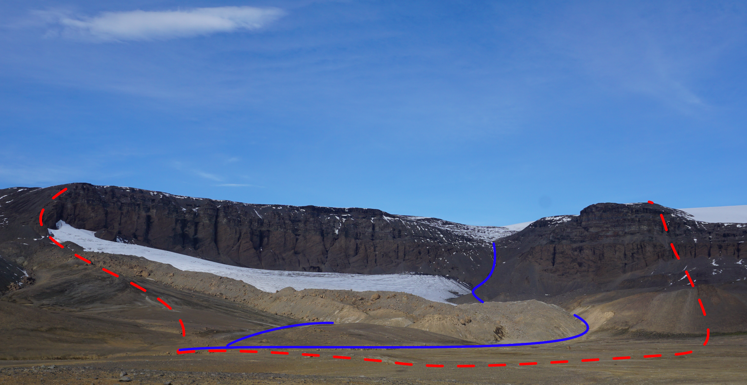
research objectives
1) To reconstruct streamflow in small partly glaciated catchment
2) To assess the inter-annual variations in rain, snow
and glacier contributions to streamflow
Rainfall
runoff
Snow
runoff
Glacier
runoff

Slide 3
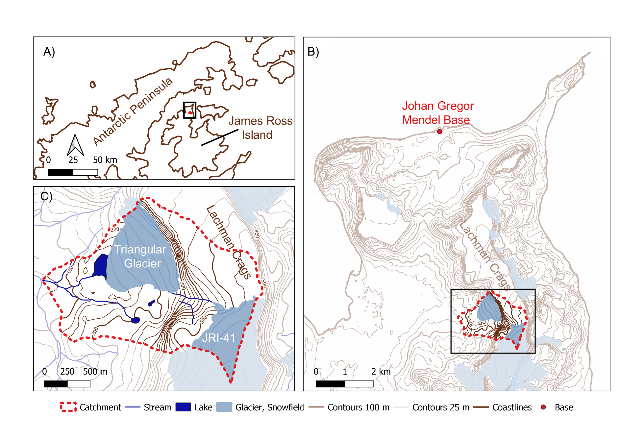
James Ross Island, Antarctic Peninsula
Johan Gregor Mendel Station
Seasonal operation (Jan-Mar)
Triangular catchment
Area: 2.8 km²
Glaciated: 28%
Discharge: February and March 2018
Seasonal glacier ablation: 2014–2020

Slide 4
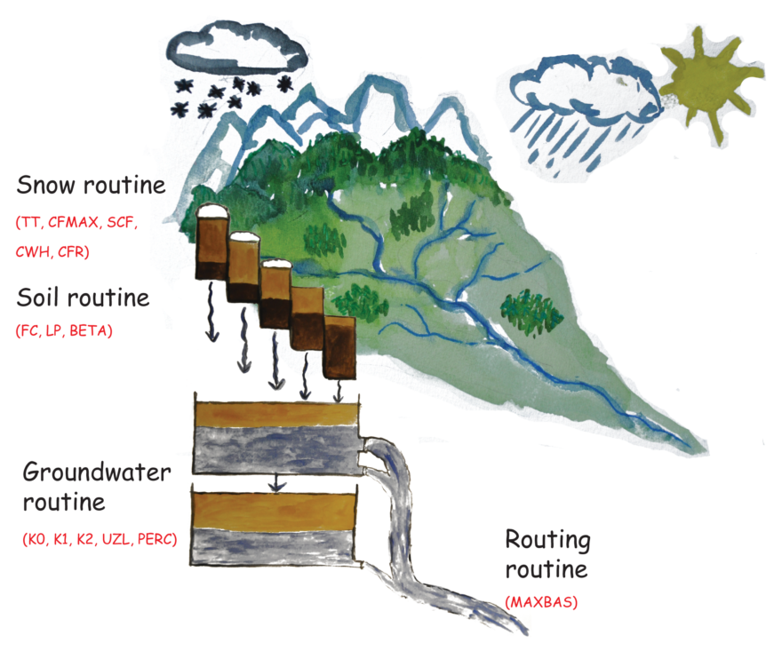
Hydrological modeling
HBV-light structure
HBV-light model
Daily step 2011-2021
Driven by: Measured air temperature Simulated precipitation (WRF, ERA5)
Calibration against: Measured streamflow Measured glacier ablation
Source:
https://www.geo.uzh.ch/en/units/h2k/Services/HBV-Model.html

Slide 5
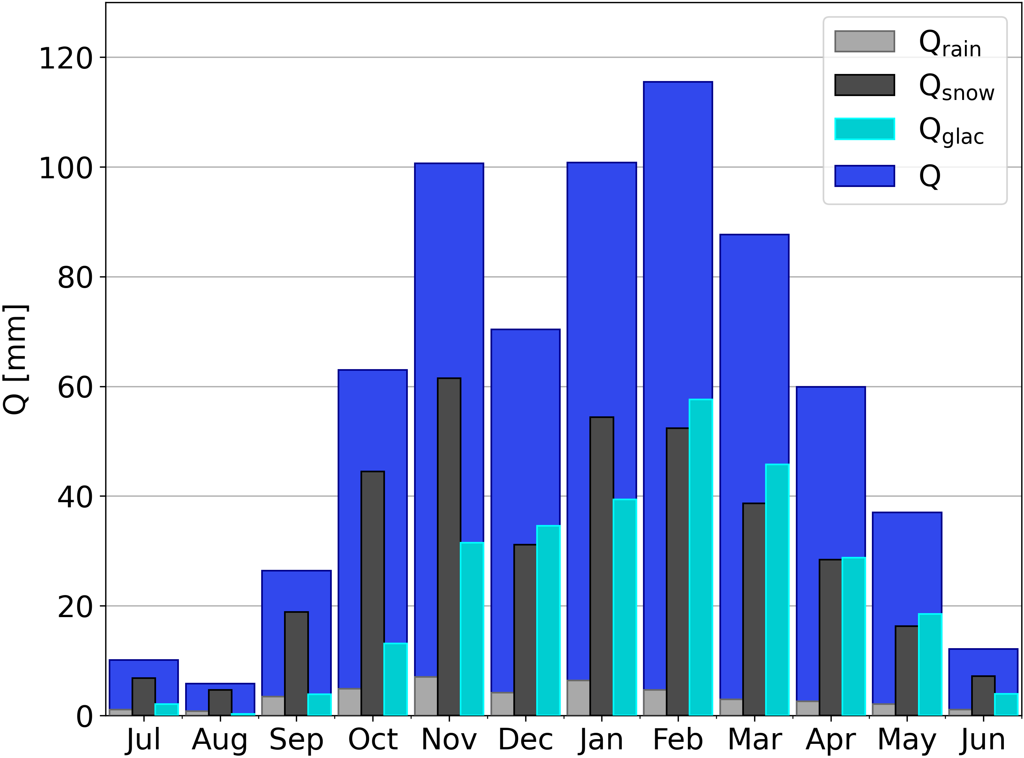
Monthly runoff
Average contribution to streamflow
Snow runoff: 53%
Glacier runoff: 41%
Rainfall runoff: 6%
93 % of the runoff occurred from October to April

Slide 6
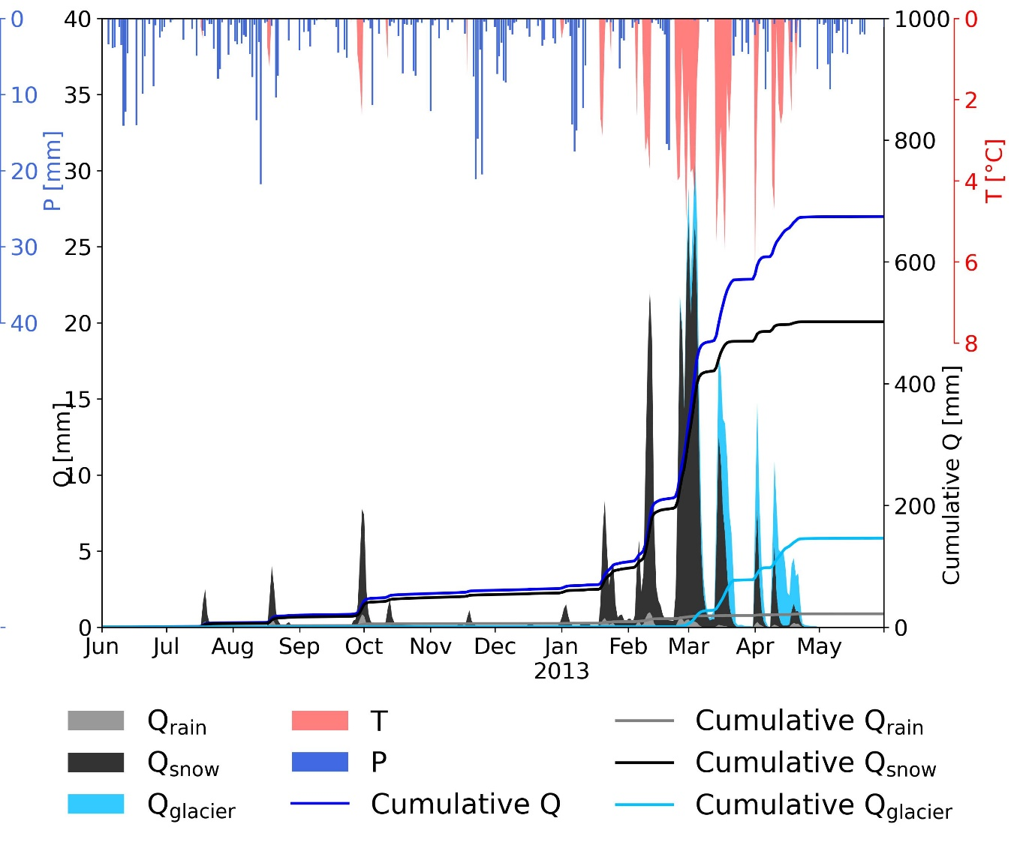
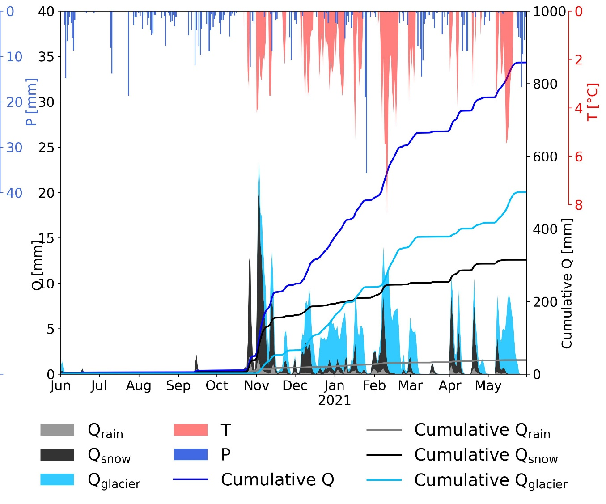
Inter-annual variability
Snow runoff dominant year
Glacier runoff: 21 %, snow runoff: 74 %
Glacier runoff dominant year
Glacier runoff: 58 %, snow runoff: 37%

Slide 7
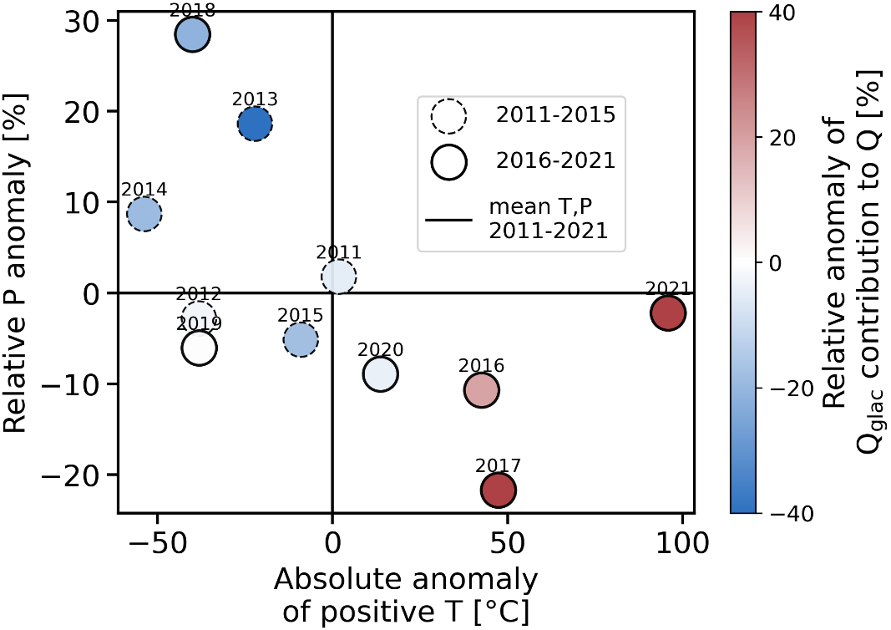
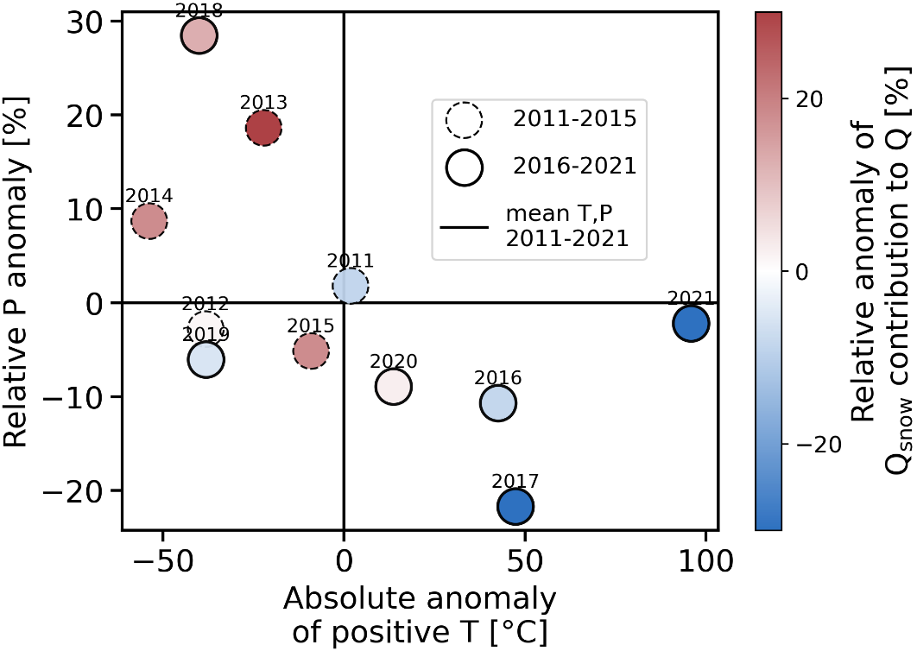
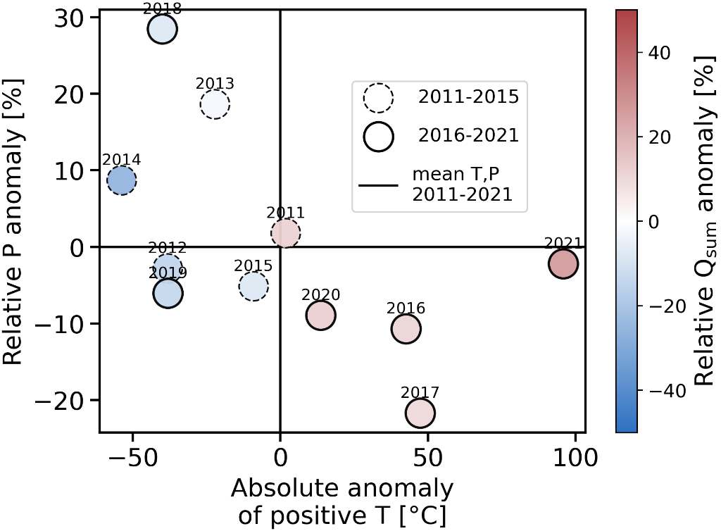
Impact of Climate on runoff variability

Slide 8
Conclusions
Runoff regime with two peaks
spring snowmelt
summer glacier melt
Snow runoff is the main contributor to streamflow
Snow contributed more in colder years with higher precipitation
Glacier contributed more in warmer years with less precipitation

Slide 9
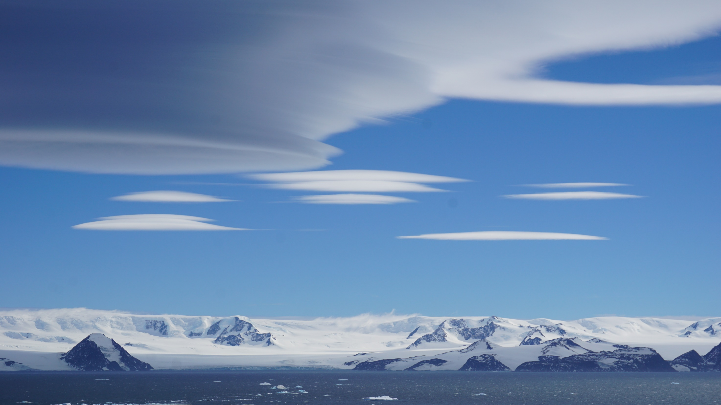
RESEARCH GROUP OF HYDROLOGY
Faculty of Science, Charles University, Prague
https://hydro.natur.cuni.cz
ondrej.nedelcev@natur.cuni.cz
EGU23-8748
\

