Slide 1






Assimilation of SMAP surface soil moisture retrievals into the FAO crop growth model AquaCrop v7.0
Michel Bechtold, Louise Busschaert, Shannon de Roos, Zdenko Heyvaert, Sujay Kumar, Jonas Mortelmans, Samuel Scherrer, Maxime Van den Bossche, Dirk Raes, Elias Fereres, Margarita Garcia-Vila, Pasquale Steduto, Theodore Hsiao, Maher Salman, Gabriëlle De Lannoy

Slide 2
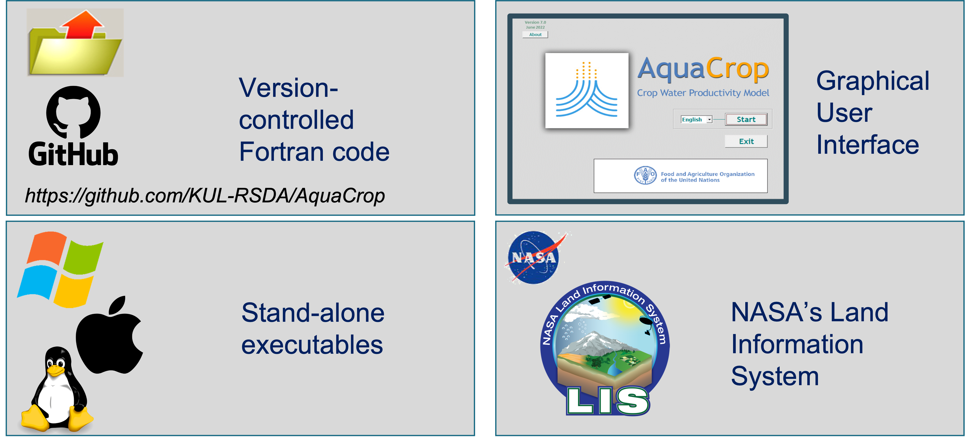
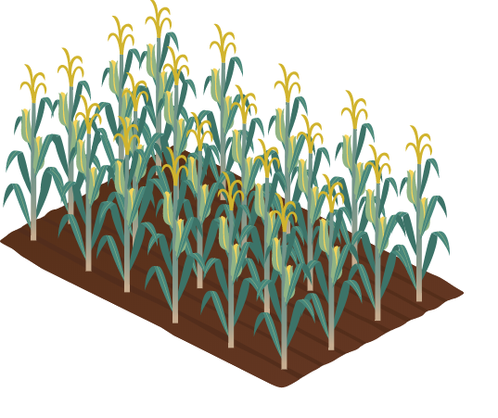

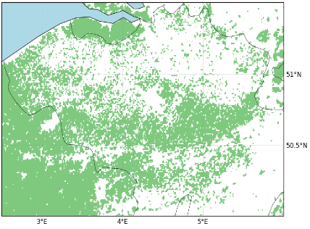
AquaCrop v7.0: “The FAO crop model”
AquaCrop model:
‘water-driven’ crop growth (linked to transpiration, indirectly to radiation)
Daily time step, robust, used in agricultural management
Field to continental scale
(de Roos et al., 2021, Busschaert et al., 2022)
https://www.fao.org/aquacrop/en/
Released open source: 09/2022
Notes:
Compared to other crop model: simpler, water- instead of radiation-driven, using CC instead of LAI

Slide 3
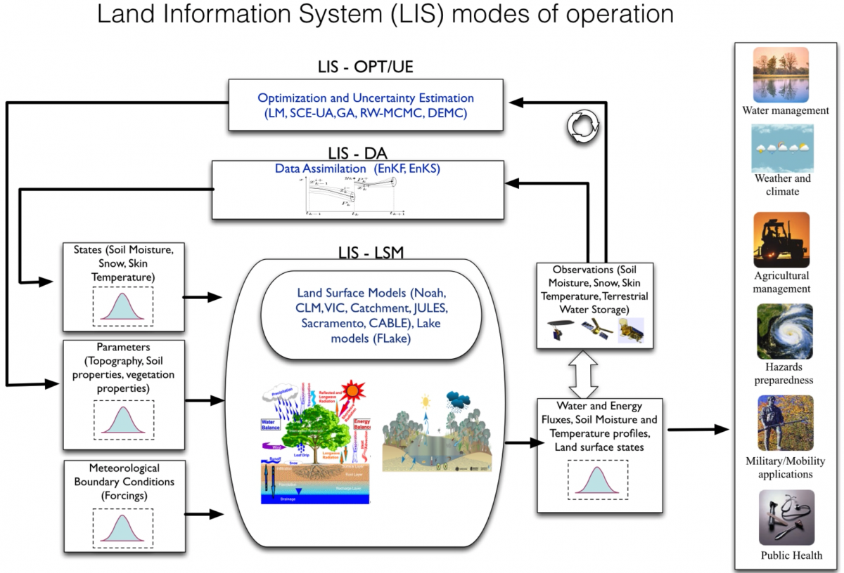

AquaCrop v7.0 in NASA LIS
Water management
Agricultural management
AquaCrop

Slide 4

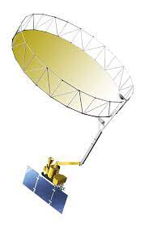
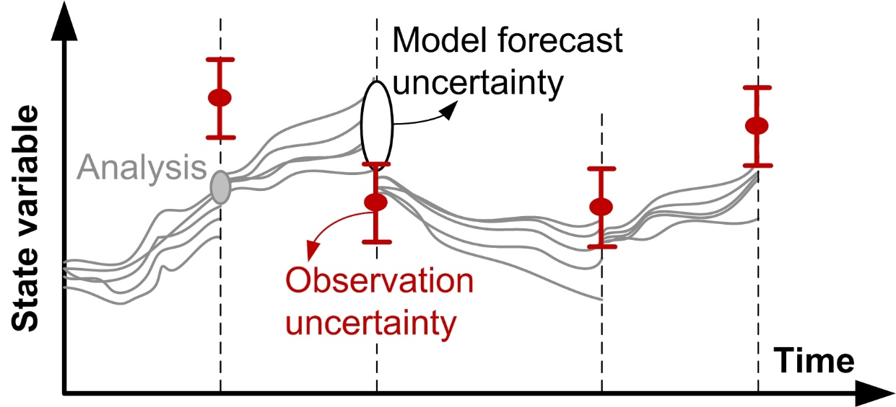
Data Assimilation (DA) experiment
Assimilation of SMAP Level-2 soil moisture at 0.25° resolution
→ Soil Moisture (SM) updating
LIS
AquaCrop
AquaCrop

Slide 5

EnKF setup
SM1 to SM3: Changes through direct updates due to sample covariance with predicted observation
SM1 to SM12 & Biomass: Changes through model propagation
SM1
SM1
SM2
predicted states
predicted observation
SM3
cdf matching
SM4
$$G_{k}=\frac{\text{Cov}\left({\hat{x}}_{k}^{−},{\hat{y}}_{k}^{−}\right)}{\text{Var}\left({\hat{y}}_{k}^{−}\right)+S2}$$
Soil Moisture (SM)
120 cm
...
Kalman gain
→ determines strength of state updates
observation error variance
predicted observation
SM12

Slide 6
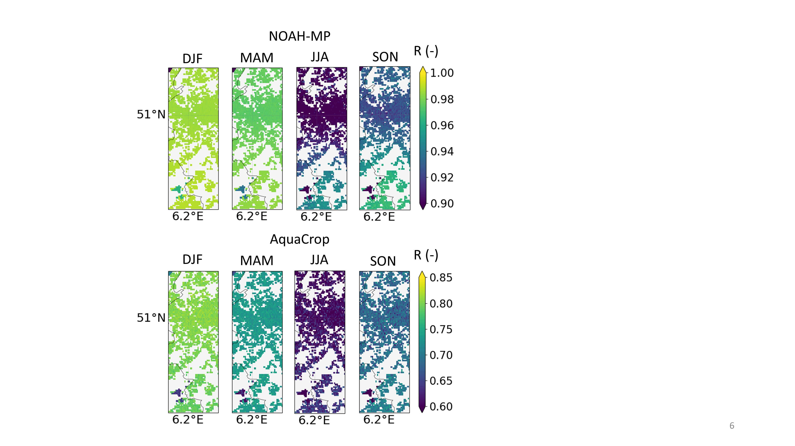
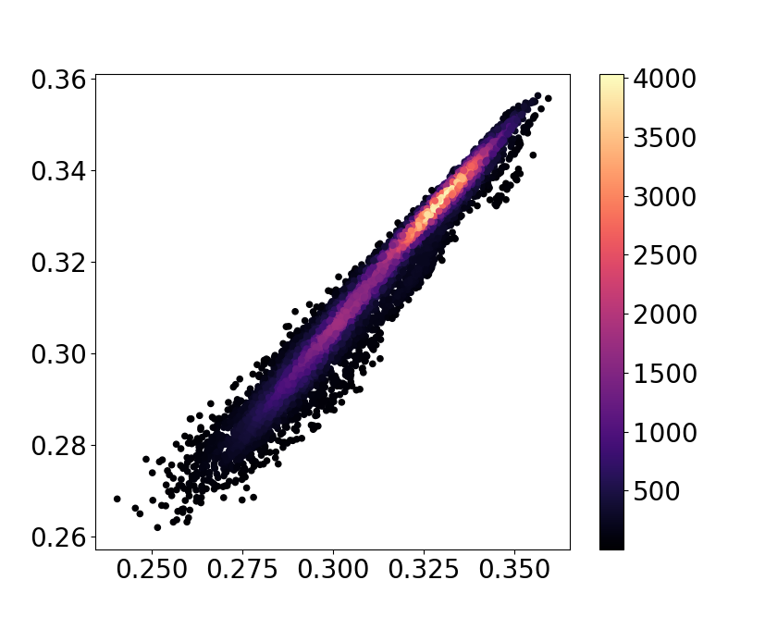
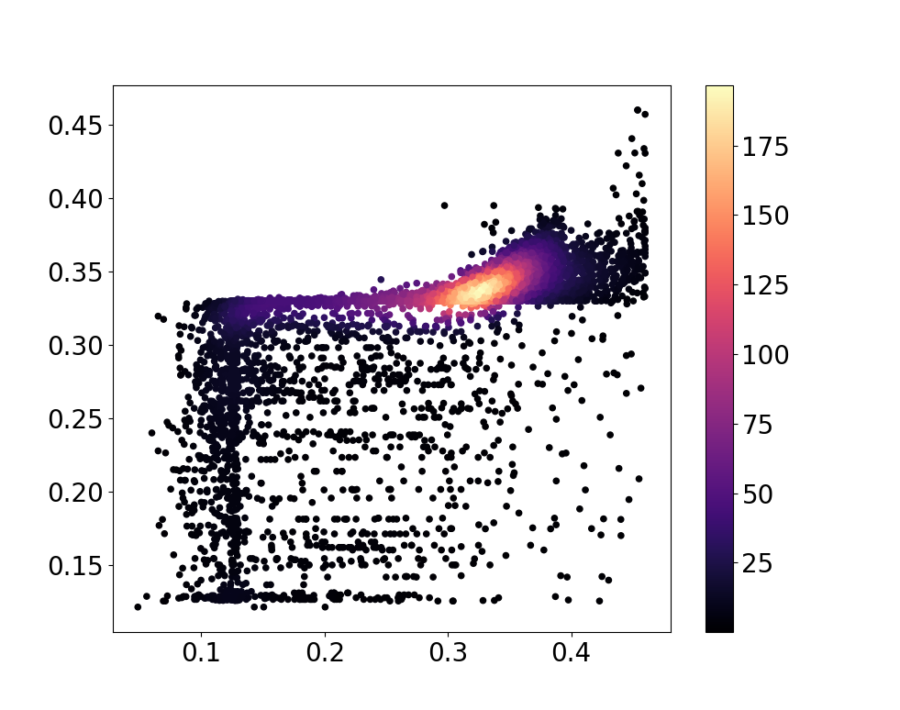

Vertical coupling strength: Noah-MP vs. AquaCrop
AquaCrop: weaker vertical coupling strength
→ limited DA impact on deeper layers
Approach:
weight
SM1
SM2
SM3
SM obs prediction
SM Layer 2 (m³/m³)
SM Layer 2 (m³/m³)
$$G_{k}=\frac{\text{Cov}\left({\hat{x}}_{k}^{−},{\hat{y}}_{k}^{−}\right)}{\text{Var}\left({\hat{y}}_{k}^{−}\right)+S2}$$
SM Layer 1 (m³/m³)
SM Layer 1 (m³/m³)

Slide 7
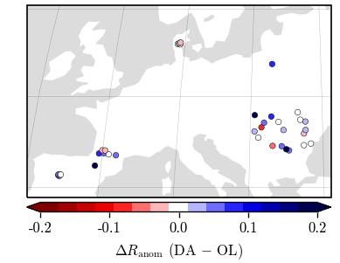
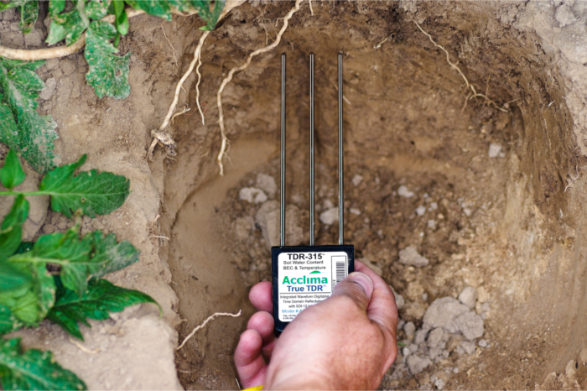
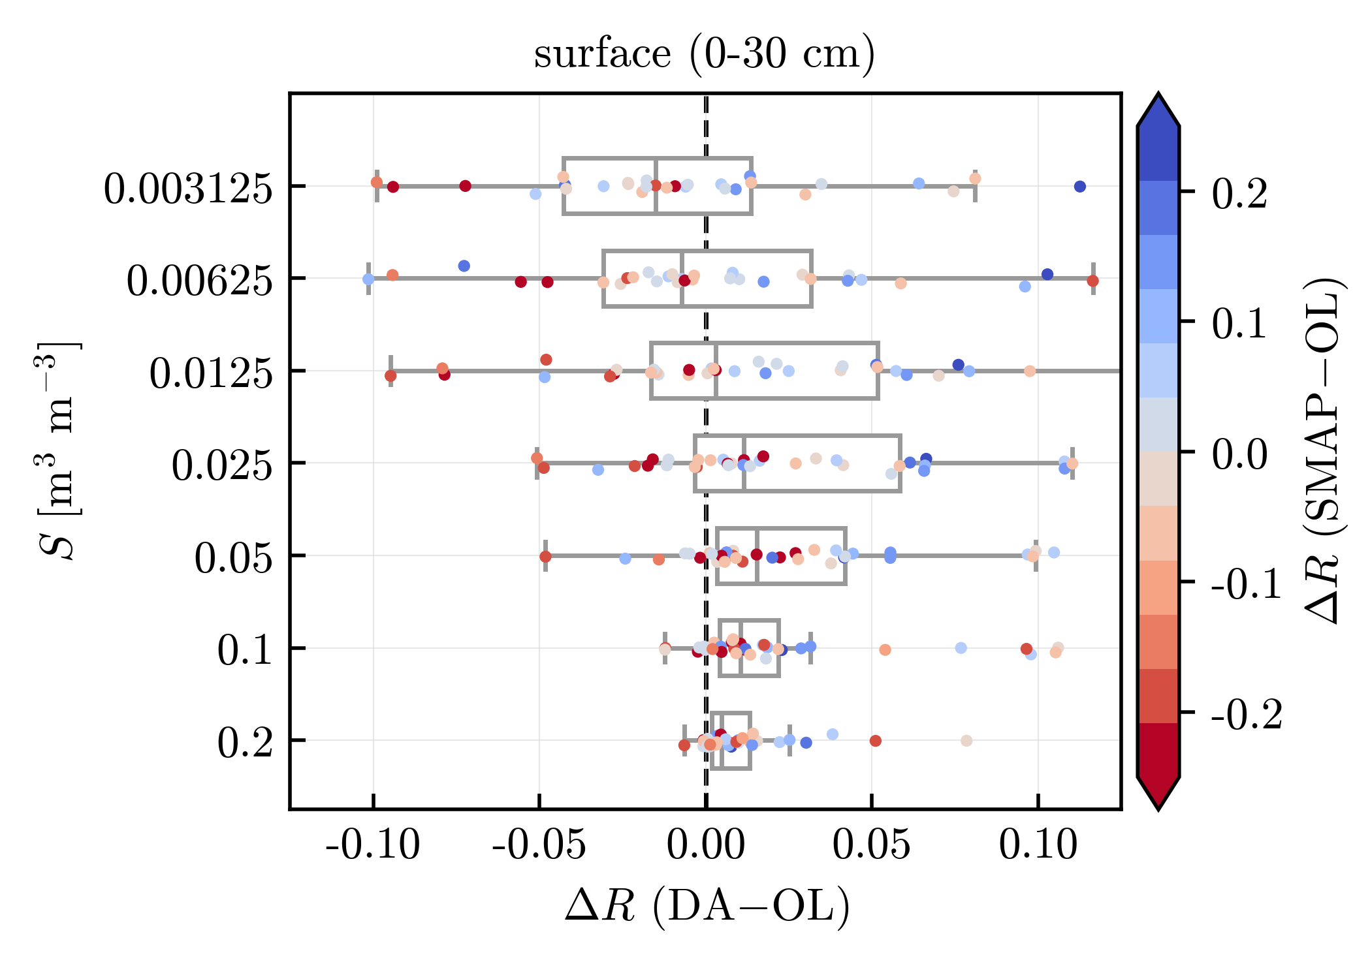
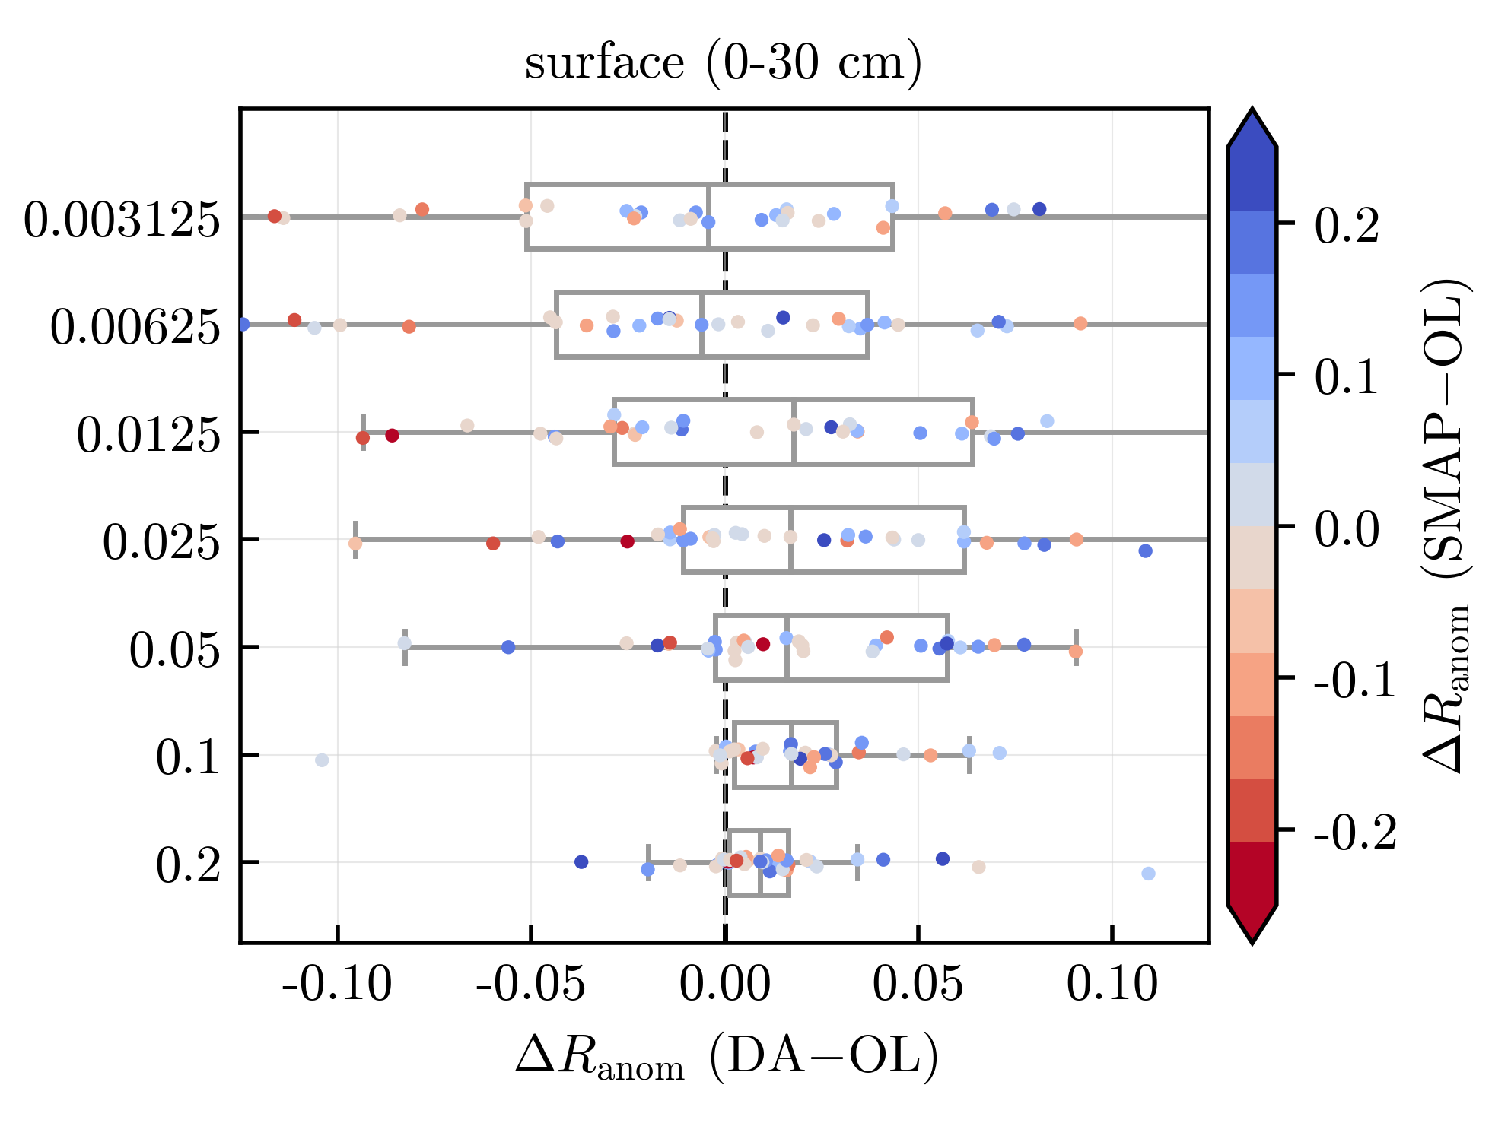
Evaluation against in-situ data
available after SMAP QC flags
DA (2015-2020): positive impact on SM at 0-30 cm
Similar skill improvement w/ Noah-MP + CCI-SM (Heyvaert et al. 2023, JHM)
ISMN in situ data from 37 grid cells (0.25 deg res.) → metrics averaged over grid cell
Observation error

Slide 8
Evaluation against in-situ data
available after SMAP QC flags
DA (2015-2020): positive impact on SM at 0-30 cm
Similar skill improvement w/ Noah-MP + CCI-SM (Heyvaert et al. 2023, JHM)
ISMN in situ data from 37 grid cells (0.25 deg res.) → metrics averaged over grid cell
Observation error

Slide 9
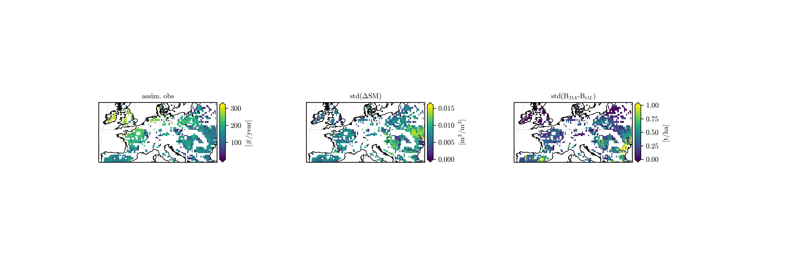
Impact on Biomass
Areas with most/highest soil moisture increments
≠
Areas with largest DA impact on biomass
SMAP QC flagging
higher soil moisture sensitivity for more water limited areas

Slide 10
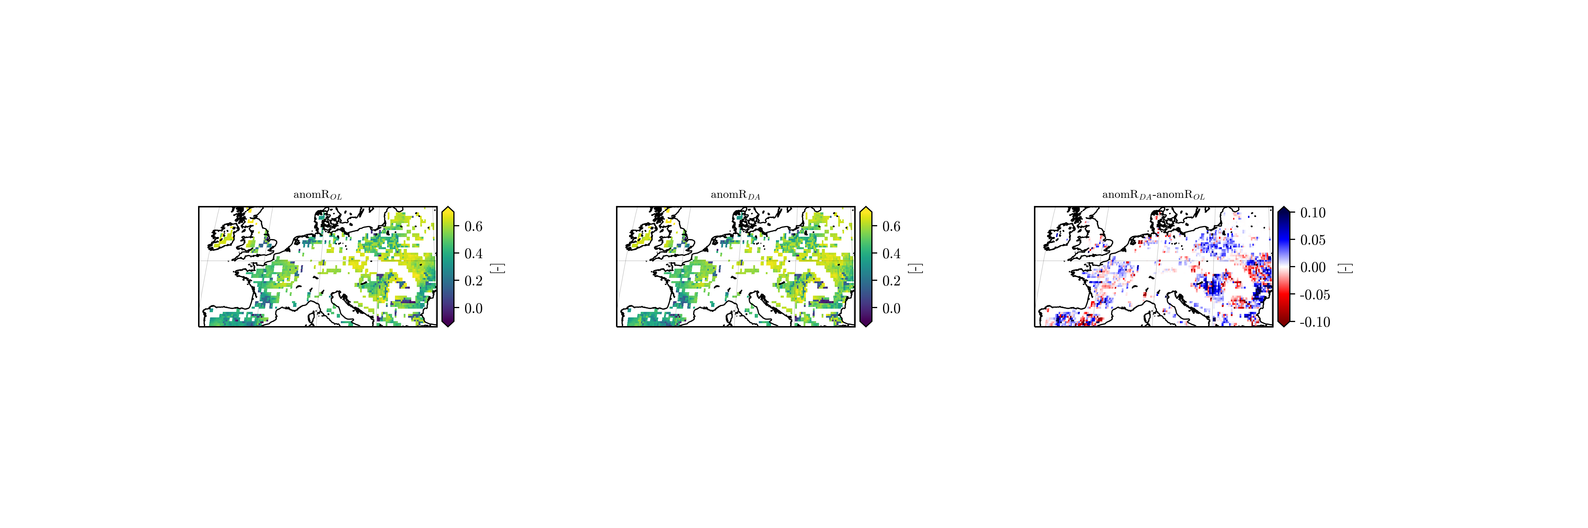
Evaluation against Copernicus Dry Matter Productivity
Both increases and decreases in anomR
Secondary variables only benefit from DA if model is able to propagate the new information accurately
→ Major uncertainties: Irrigation, soil texture / PTF, generic C3 crop vs. crop-specific responses, ...

Slide 11



Conclusions and outlook
Funding acknowledgments:
https://github.com/KUL-RSDA/AquaCrop
AquaCrop v7.0 in the NASA LIS framework → makes wealth of satellite data and data assimilation techniques accessible
Weak vertical coupling in AquaCrop
→ Soil moisture profile updating more complex but skill improves with SMAP
Impacts on biomass substantial but not always positive
→ Need for accurate model propagation (crop, soil, crop-soil interaction)
→ Additional assimilation of vegetation observations (e.g, FCOVER, LAI)
Thanks for your attention!

