Slide 1
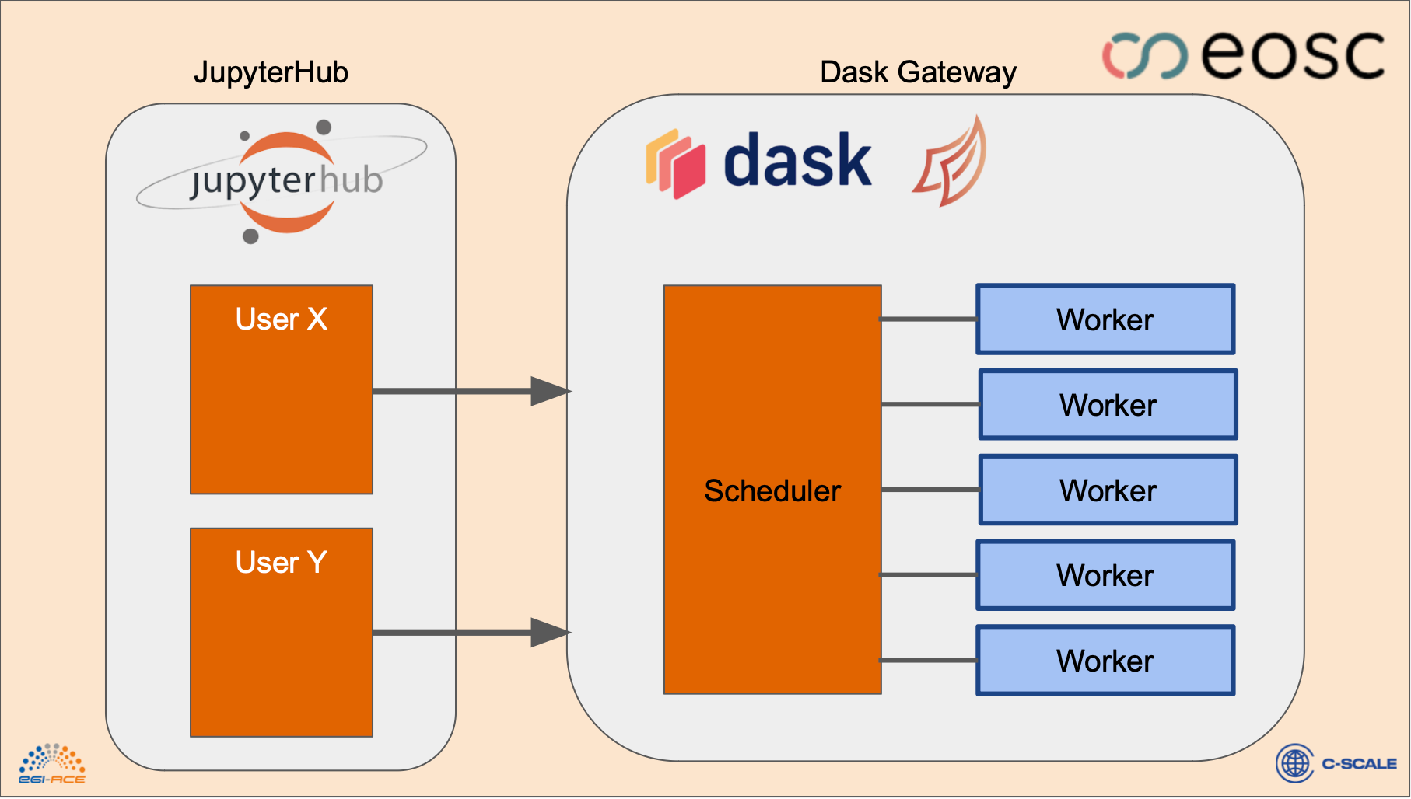
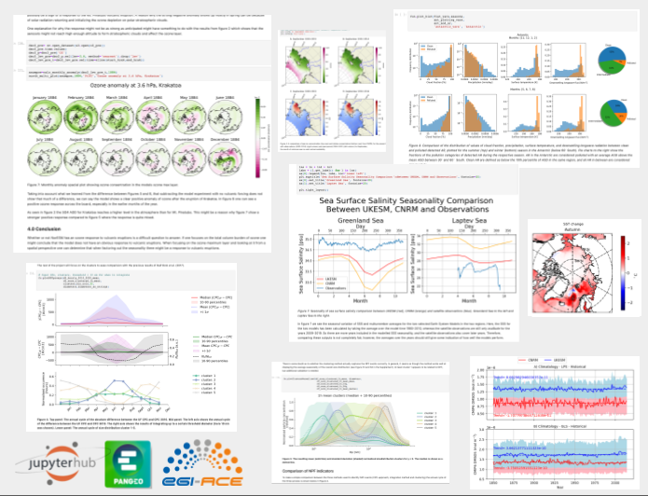
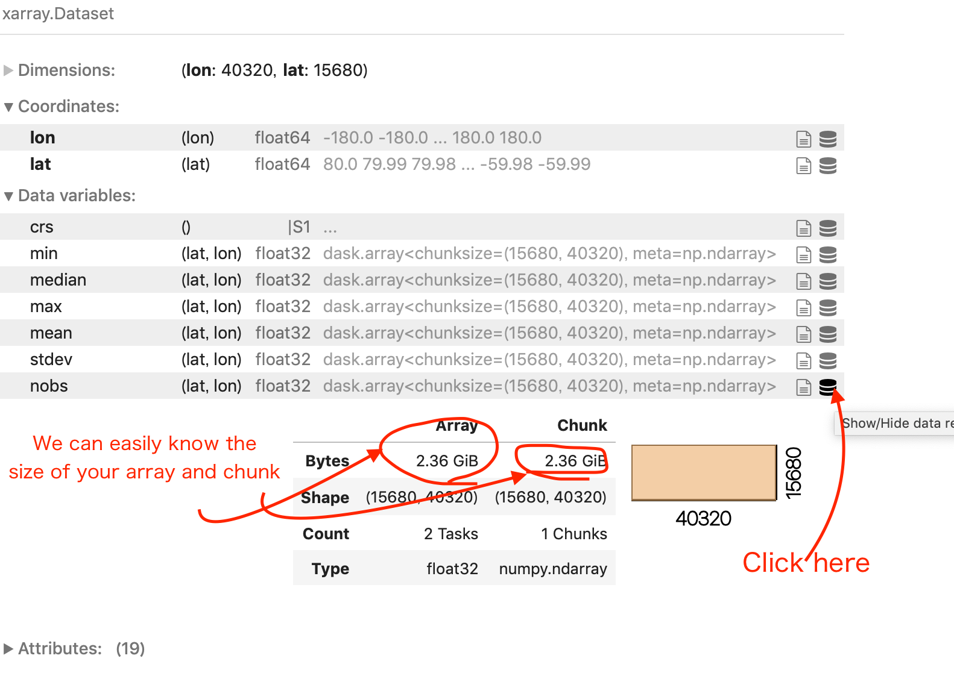
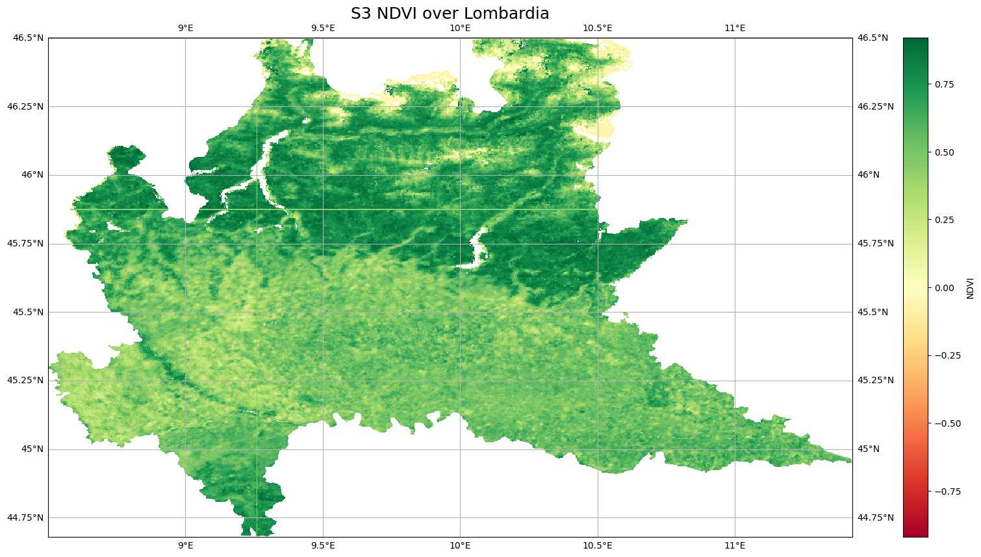
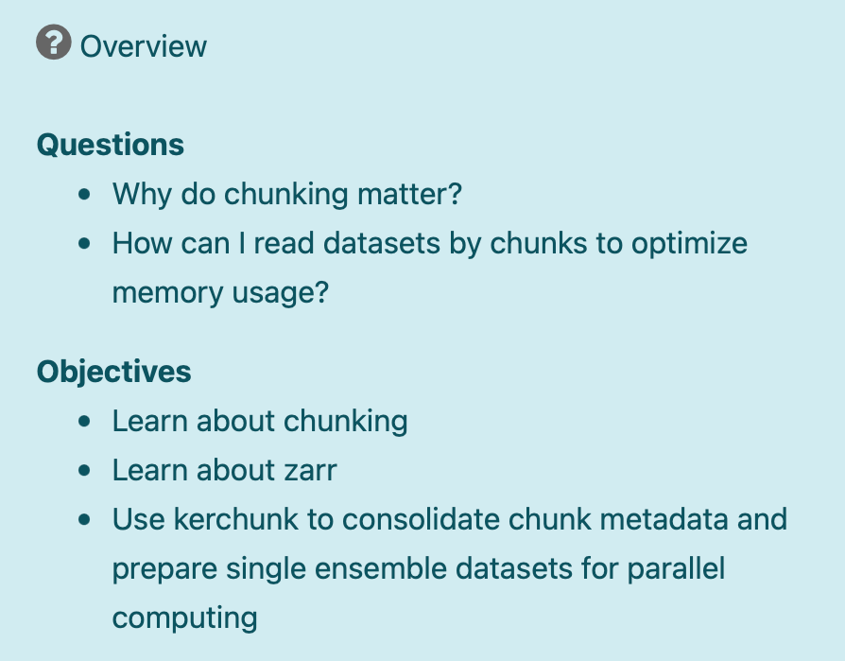
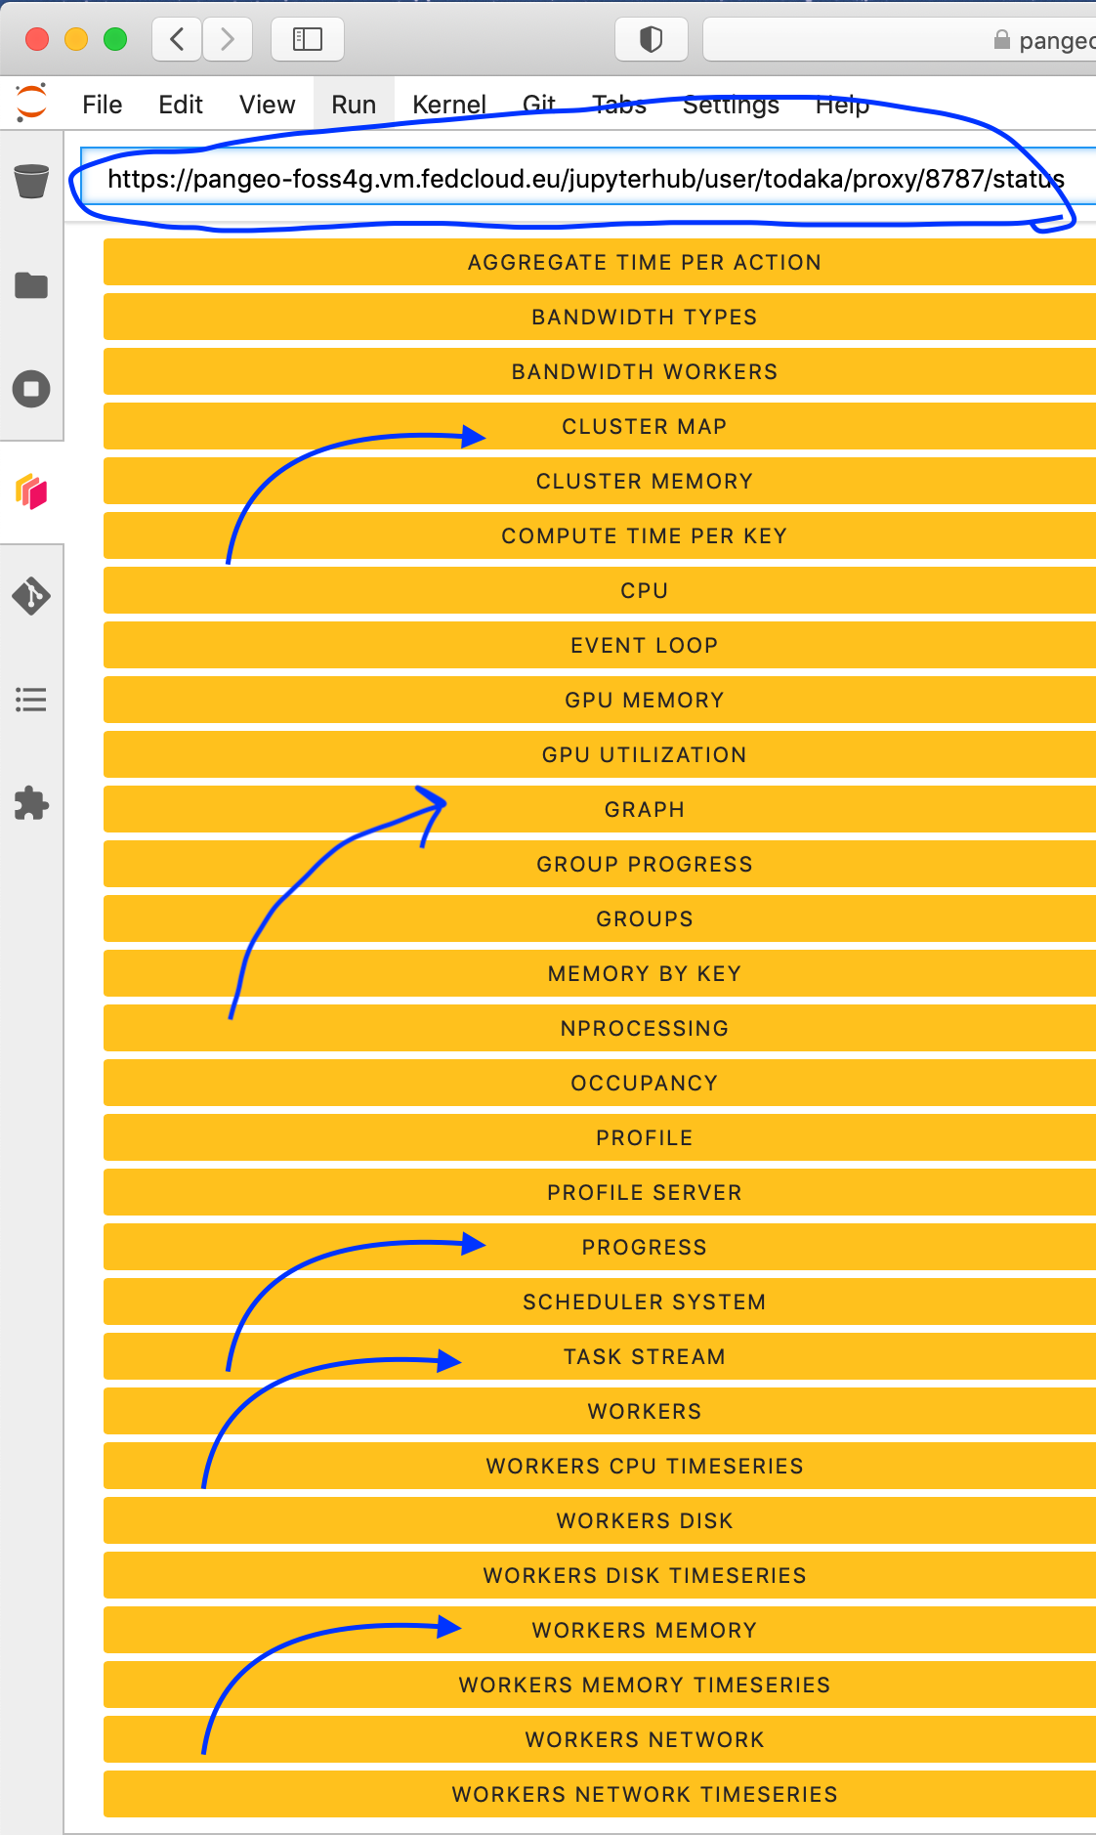
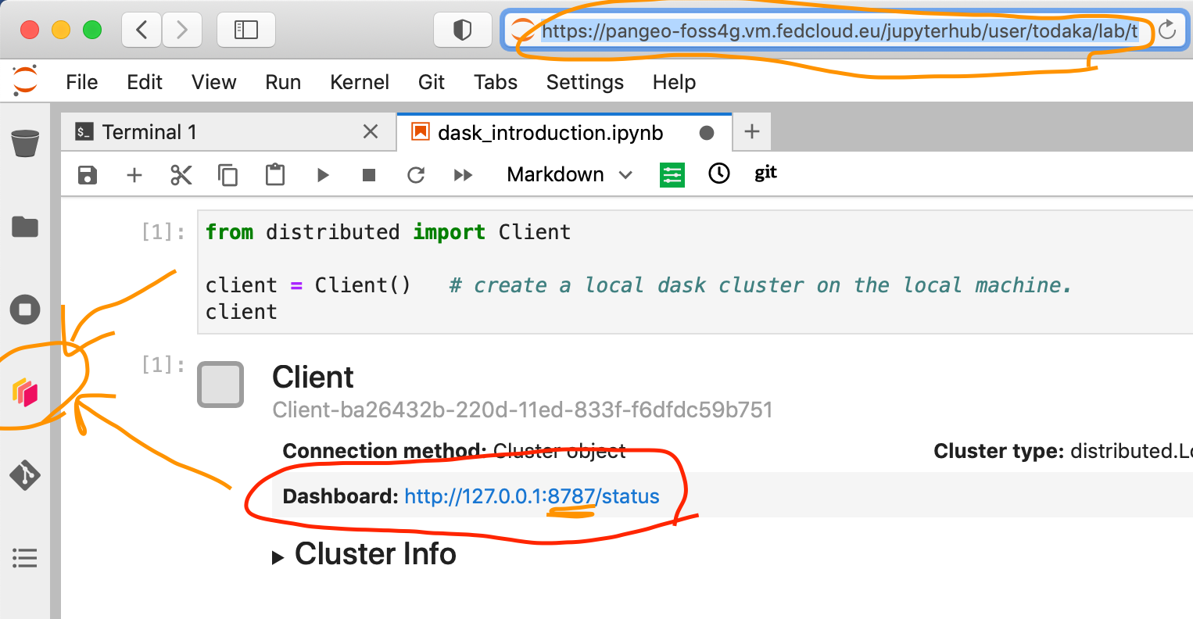
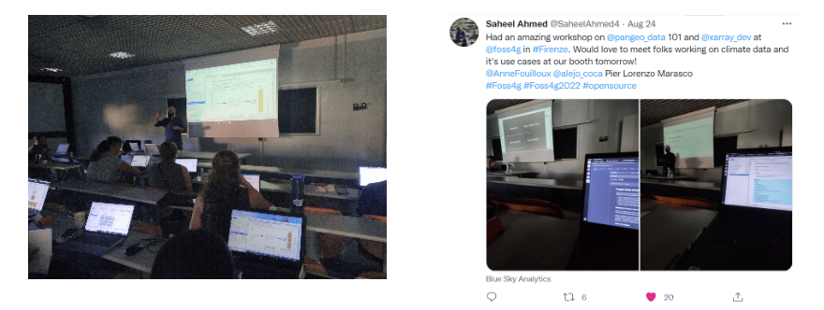
Pangeo framework for training: experience with FOSS4G, the CLIVAR bootcamp and the eScience course
Anne Fouilloux¹, Pier Lorenzo Marasco², Tina Odaka³, Ruth Mottram⁴, Paul Zieger⁵, Michael Schulz⁶, Alejandro Coca-Castro⁷, Jean Iaquinta⁸, and Guillaume Eynard Bontemps⁹
¹
²
³
⁴
⁵
⁶
⁷
⁸
⁹
The framework
Underlying infrastructure
FOSS4G workshop
eScience Course
CLIVAR/IASC CMIP6 Arctic Bootcamp
One framework for Pangeo@EOSC
Pangeo 101 workshop at the FOSS4G conference
Integrate EOSC into master students’ courses
Supporting researchers in becoming competent practitioners in their scientific domain
Thanks to EGI-ACE and C-Scale EOSC projects, Pangeo is now easily deployable on EOSC (kubernetes cluster) on-demand for research or teaching purposes. Compute and storage resources can be customised depending on the user needs.
The newly deployed infrastructure was successfully used to onboard users during a course provided at the FOSS4G conference in Firenze, Italy. The training material is open source (CC-BY-4.0 license) and has been collaboratively developed.
During the workshop, attendees learned about the Pangeo ecosystem and how to make open, reproducible, and scalable Earth science on the EOSC infrastructure. Fully reproducible Jupyter notebooks were prepared and used to teach how to:
Access local and remote data;
Load and analyse data with Xarray;
Visualise data with Hvplot interactive visualisation package;
Understand how to scale computations with Dask.
Sentinel-3 NDVI Analysis Ready Data (ARD) provided by the Copernicus Global Land Service was used during the workshop. All the Python packages used during the training are Open-source.
Pangeo@EOSC was also used to onboard master students and teach them Climate Science and Open Science on Pangeo@EOSC.
The 6th course on “eScience tools in climate science: linking observations with modelling” was held in Tjärnö, Marine Laboratory, Sweden with 17 students from Sweden, Norway, Denmark, Finland, Canada, South Africa and Australia.
The course was open to master students and/or new PhD students: the majority of the participants were master students. For the master students from the University of Oslo (Norway) the course was part of the GEO4990 course (10 ECTS with 5 ECTS for the eScience practicals). Students at Stockholm University (Sweden) can take this course as part of a master course MI7025 (7.5 ECTS).
The acquisition of foundational coding and data analysis skills is necessary for scientists but usually not sufficient to become competent practitioners in their field and integrate Open Science principles into their day to day work.
Early Career Researchers and their mentors:
Learned about CMIP6 climate data and how to work with CMIP6 output from many models via the cloud computing infrastructure (Pangeo JupyterHub) delivered by the Pangeo Community and EGI-ACE;
Embedded learning within actual science projects, i.e. apply the tools and Open Science principles to answer research questions participants had developed in small groups in collaboration with senior scientist mentors
Participants at the CMIP6 Bootcamp in Søminestationen, Denmark were split into groups, each working on different scientific questions and datasets. This setup allowed them to fully exploit the cloud infrastructure provided by Pangeo@EOSC and to get a deep understanding of the benefits Pangeo offered to analyse data at scale with a Dask Gateway.
Training material was collaboratively developed
Clear learning objectives;
Provide formative assignments;
Get regularly feedback from attendees;
Q&A and open discussions;
Debriefing/lessons learned after the workshop.
Several data space for different usage
Different data spaces can be created for handling public and/or private datasets. By default Pangeo@EOSC offers:
One local and individual storage for each user on the JupyterLab front-end;
A shared data space (read-only) containing widely used datasets, usually served through Spatio-Temporal Asset Catalog (STAC). Some datasets can be public or accessible upon requests;
Data space accessible (read/write) for a pre-defined group of users (course instructors, students, administrators, etc.). Several data space can be created depending on the needs.
Impact
25 people
At least 4 different countries
https://pangeo-data.github.io/foss4g-2022/intro.html
https://pangeo-data.github.io/escience-2022/intro.html
https://pangeo-data.github.io/clivar-2022/intro.html

