Slide 1
Aerosol Radiative Forcing time development in the CMIP6 historical experiment
Ragnhild Bieltvedt Skeie, Gunnar Myhre
EGU23
27th April 2023, Vienna
Photo: Skeie

Slide 2
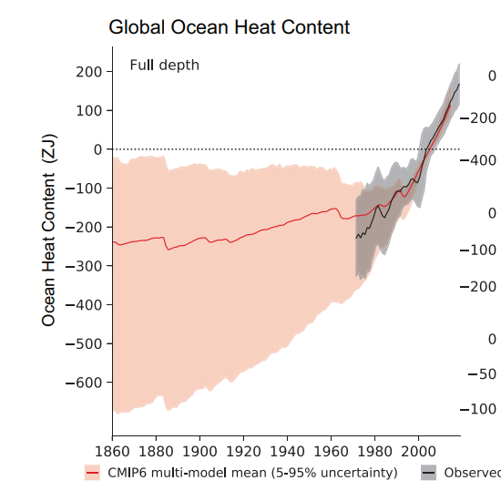
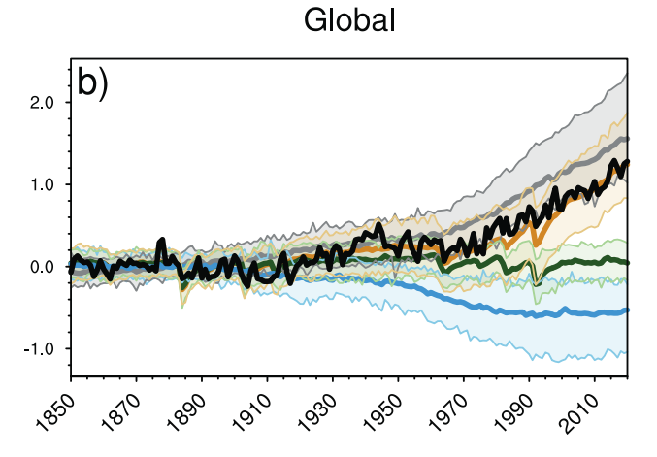
Motivation:
The Earth Energy Balance:
Uptake of heat in the system = Forcing – λ* ΔTemperature
λ:Climate Feedback Parameter
Ocean heat content: Radiative Forcing: Global surface temperature:
Fig 3.26 IPCC AR6
Fig 2.10 IPCC AR6
Fig 3.9a IPCC AR6
Important to understand past drivers of climate change (in reality and in the models):
Aim: Make estimates of aerosol radiative forcing time series from CMIP6 models.

Slide 3
CMIP6 historical experiment all-forcing simulation of the recent past (1850 to 2014) AeroCom phase III historical experiment To understand regional trends in aerosol distribution from 1850 to 2015. Both model experiments used CEDS historical emissions (Hoesly et al. GMD, 2018)
https://aerocom.met.no/
Data used:
monthly 3-d mmr-fields for sulphate (SO4), black carbon (BC), organic aerosols (OA) and nitrate (NO3).
5-year averages
one ensemble member per model.

Slide 4
Aerosol radiative forcing calculation:
RFari: Radiative forcing of aerosol-radiation interaction
calculated using a radiative kernel.
RFaci: Radiative forcing of aerosol-cloud interaction
calculated using a radiative transfer model (Myhre et al., 2017 (ACP) ) and satellite based statistical relationship for aerosol and cloud droplet concentrations (Quaas et al. ACP 2006), where the cloud droplet concentration alter the cloud effective radius and thus the optical properties of the clouds.
Work in progress

Slide 5
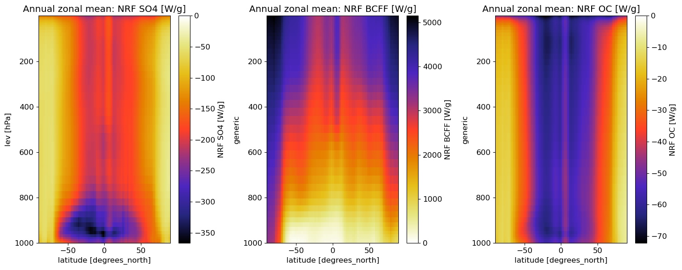
Radiative kernel
DISORT burden-to-forcing-kernel for SO4/BC/OC.
mmr fields regridded to the resolution of the kernel.
Used airmass from the kernel.
Normalized radiative forcing (NRF):
Kernel based on Samset and Myhre 2011

Slide 6
From the modelled changes in atmospheric composition of aerosols:
What is the historical time developments of aerosol RF?
What are the differences between the models?

Slide 7
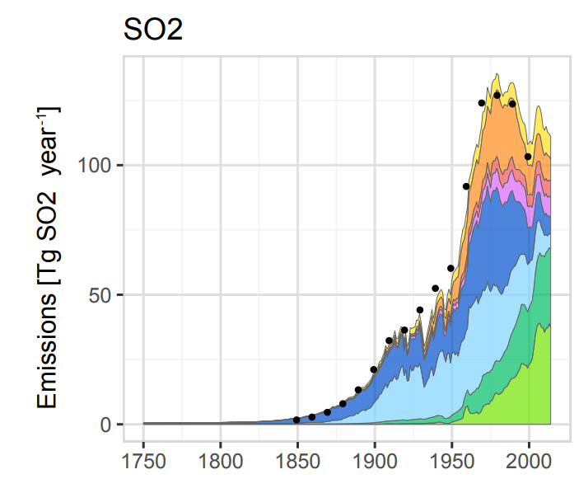
RFari SO4:
Rapid strengthening of RFari from ~1950.
Symbol indicate year of strongest RFari (1990, 2005 or 2010).
CEDS emissions:
Hoesly et al. 2018, Historical (1750–2014) anthropogenic emissions of reactive gases

Slide 8
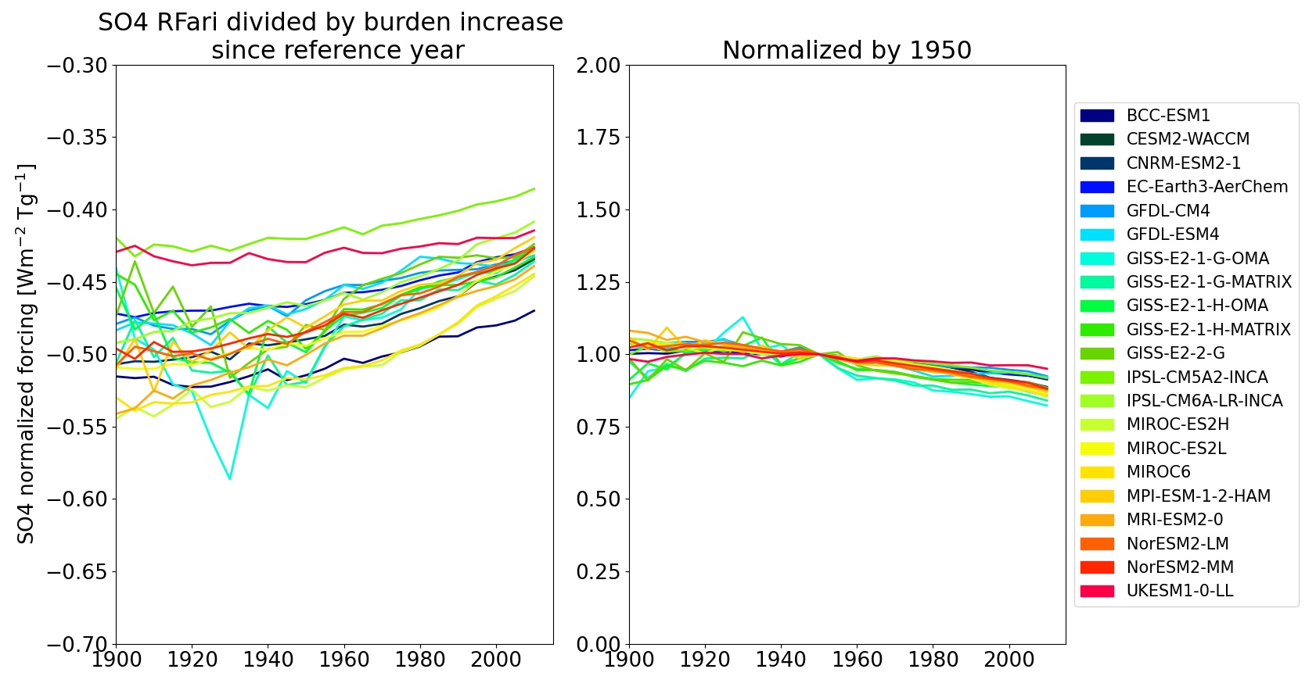
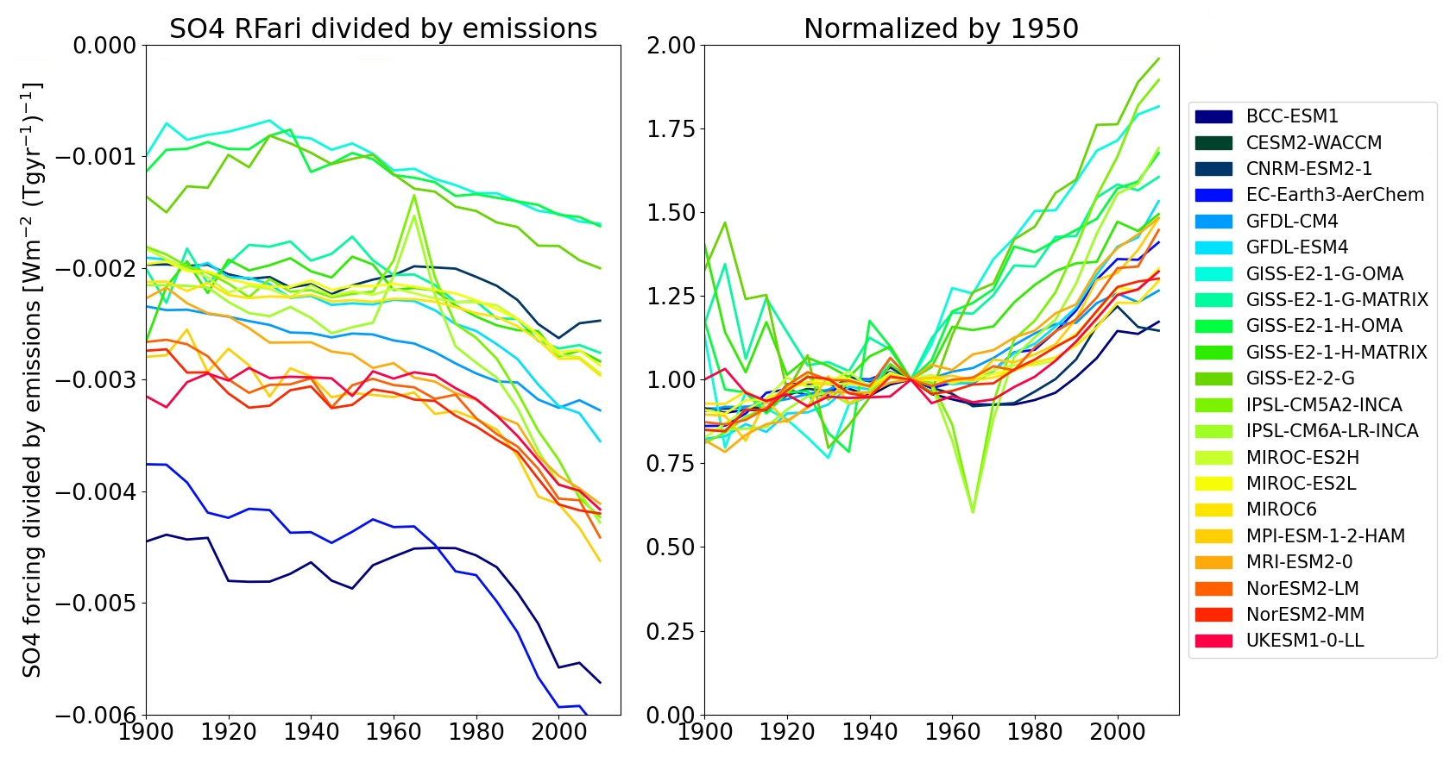
RFari SO4 normalized:
by burden
Summary:
Slightly weaker RFari per burden increase by time (shift in geographical distribution of the burden)
Stronger RFari per SO2 emissions by time (shift in geographical distribution of the emissions enhancing the lifetime and burden of SO4)
by SO2 emissions

Slide 9
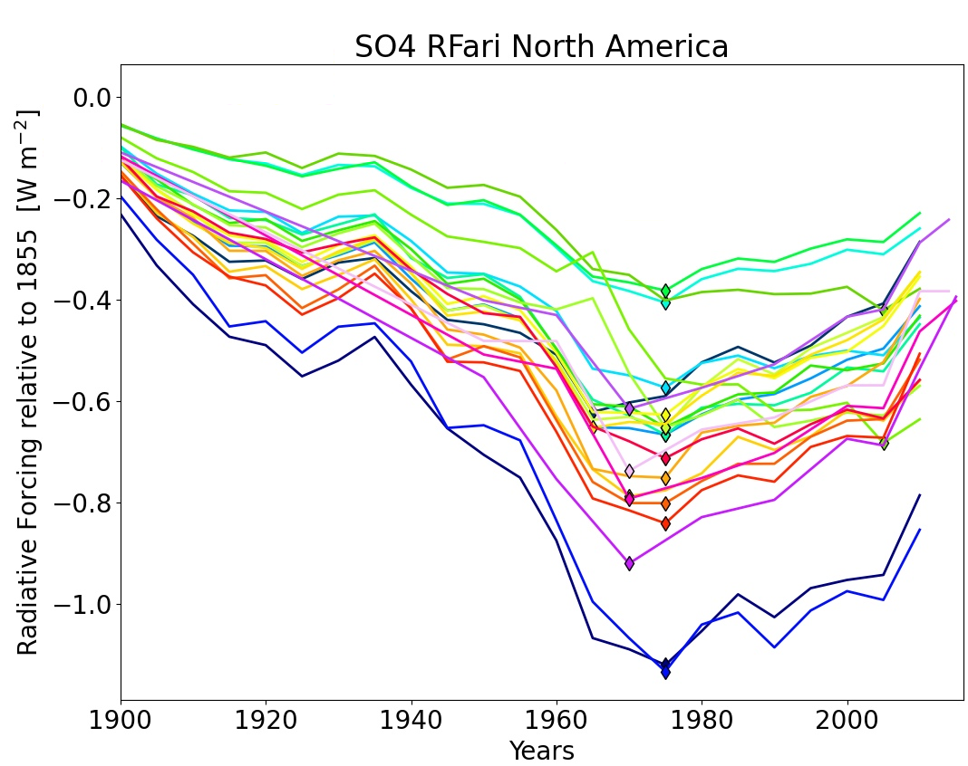
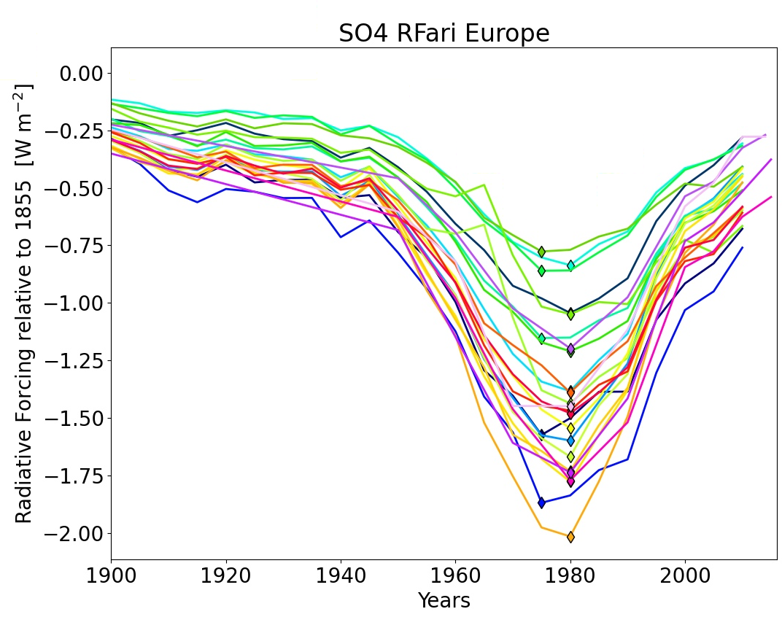
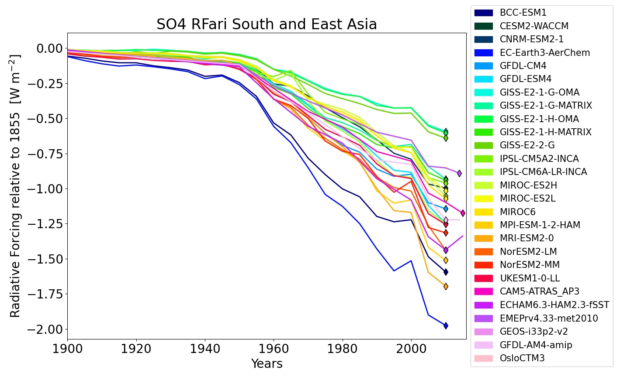
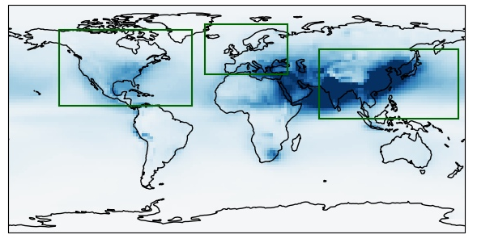
Geographical distribution
Europe and North America SO4 RFari 2010 back to 1950 levels.
South and East Asia SO4 RFari still strengthening.
NB: Time series end in 2010.

Slide 10
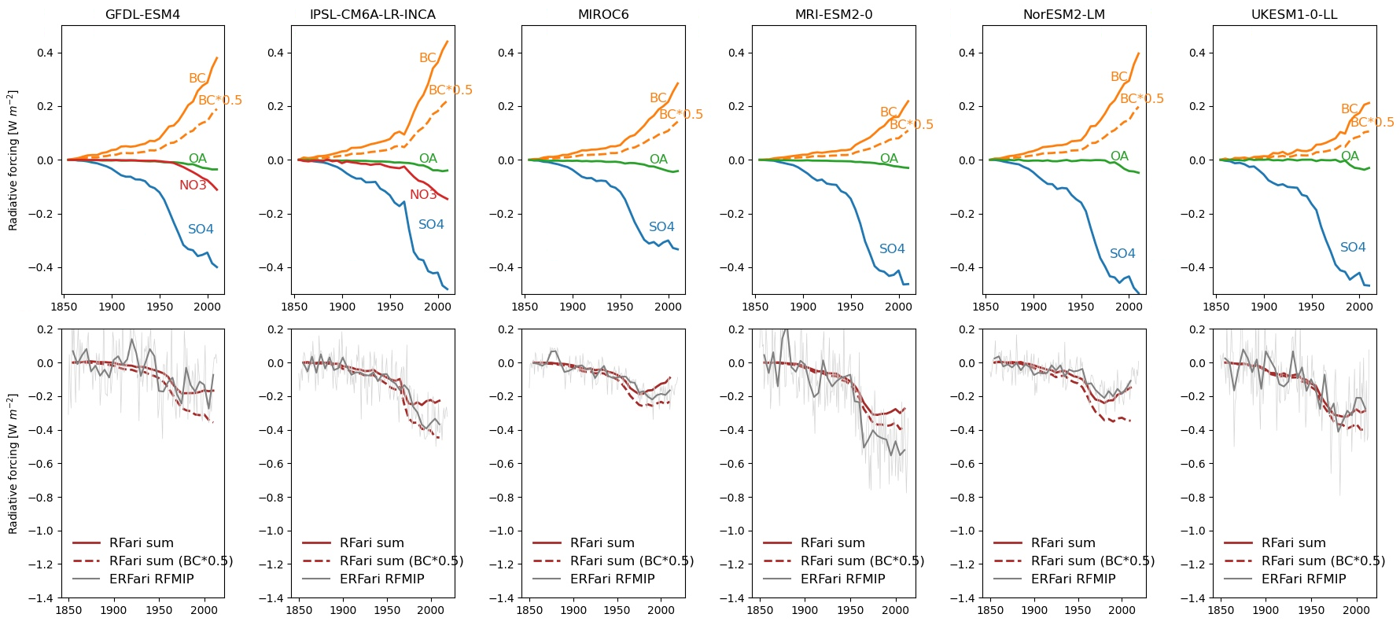
Compare RFari results to ERFari from RFMIP
RFari dominated by SO4 and BC, NO3 more important in recent decades.
Dashed line: BC-RFari*0.5: indication of weaker BC-RFari or negative adjustments in some models?
ERFari data from RFMIP: Smith, C. J., Harris, G. R., Palmer, M. D., Bellouin, N., Collins, W., Myhre, G., et al. (2021). Energy budget constraints on the time history of aerosol forcing and climate sensitivity. Journal of Geophysical Research: Atmospheres

Slide 11
RFaci: “Twomey effect”
Summary
RFaci strengthening from 1950s and flattening out over the last few decades.
But almost all models have the strongest RFaci at the end, in 2010.

Slide 12
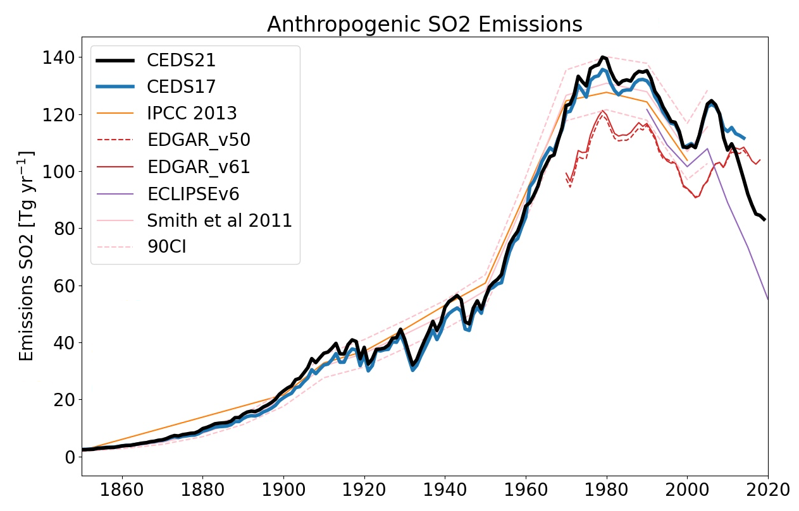
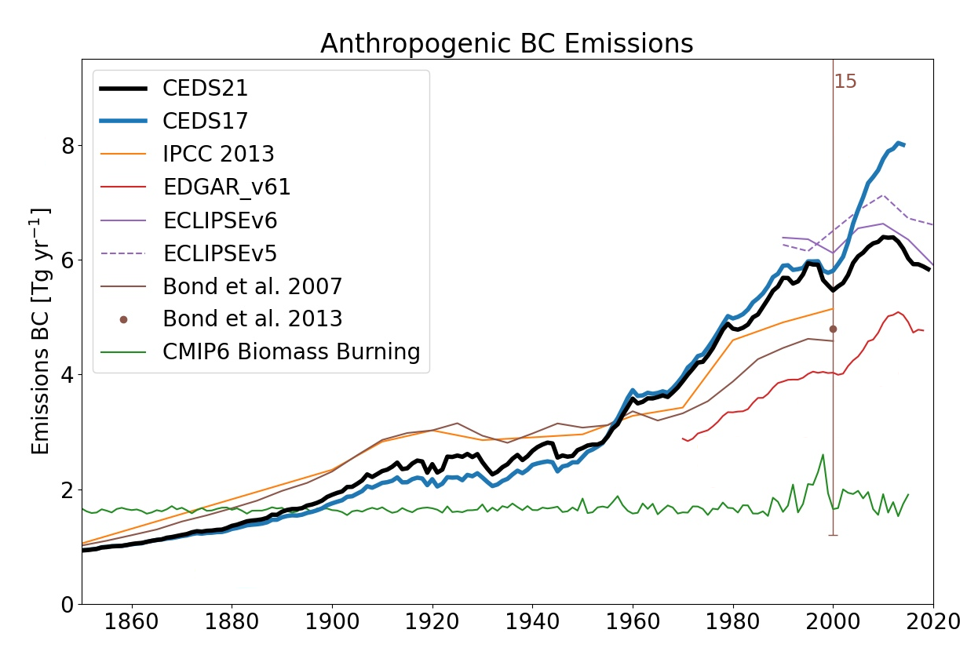
Final remark: Different Emission Inventories
CEDS used in CMIP6 (CEDS17) updated (CEDS21):
Both SO2 and BC lower emissions in 2014 (RFari SO4 and RFari BC would be weaker, compensating)
Rapid emission reduction over the last decade.
Uncertainties for SO2: 8–14 % (Smith et al., 2011) while for BC much larger (Bond et al. 2013).

Slide 13
Summary:
Calculated RFari and RFaci time series from CMIP6 and AeroCom:
RFari dominated by SO4 and BC.
Nitrate aerosols included in a limited number of models, increasingly more important.
Further work:
Uncertainties in historical emissions.
Recent decade, with rapid SO2 emission reduction.
Thank you!
Supplementary materials available online.
Ragnhild Bieltvedt Skeie
r.b.skeie@cicero.oslo.no
www.cicero.oslo.no
@RBSkeie

Slide 14
Extra

Slide 15
Compare kernel results from monthly output and RFari calculated using 3-hourly output and a radiative transfer model (Lund18: Lund et al, GMD, 2018)
Limitations:
Kernel:
Kernel constructed based on an older version of the radiative transfer model used in Lund18.
Sulphate: Kernel stronger forcing than in Lund18.
BC: Kernel weaker forcing than in Lund18.
Monthly output vs 3 hourly.
No kernel for nitrate, used the sulphate kernel.
CMIP6 model output:
BC and OA: No split fossil-/bio- fuel (FFBF) and biomass burning (BB)
Nitrate: No split in fine and coarse mode.
Note: Different scale on y-axes.

Slide 16
Keep in mind:
RFari dominated by BC FFBF (fossil fuel and biofuel) and sulphate in Lund18.
Total RFari not equal to the sum of individual components.
From the modelled changes in atmospheric composition of aerosols:
What are the temporal developments of RFari?
What are the differences between the models?

Slide 17
Burden

Slide 18
Ensamble spread vs. model spread
Spread between models larger than ensemble spread within one model.
→ Use one ensemble for each model.
→ and 5 year averages to remove some interannual variability.
Calculated from loadso4 in CMIP6

Slide 19
CMIP6 variables
Variable | Description
mmrso4 | mass_fraction_of_sulfate_dry_aerosol_particles_in_air, Aerosol Sulfate Mass Mixing Ratio [kg kg-1] , Dry mass of sulfate (SO4) in aerosol particles as a fraction of air mass.
mmrbc | mass_fraction_of_elemental_carbon_dry_aerosol_particles_in_air, Elemental Carbon Mass Mixing Ratio [kg kg-1], Dry mass fraction of black carbon aerosol particles in air.
mmroa | mass_fraction_of_particulate_organic_matter_dry_aerosol_particles_in_air , Total Organic Aerosol Mass Mixing Ratio [kg kg-1], We recommend a scale factor of POM=1.4*OC, unless your model has more detailed info available.
mmrno3 | mass_fraction_of_nitrate_dry_aerosol_particles_in_air, NO3 Aerosol Mass Mixing Ratio [kg kg-1], Dry mass fraction of nitrate aerosol particles in air.
For calculating burden, the mmr fields are regridded to the resolution of the kernel and airmass of the kernel (OsloCTM) are used to calculate the burden.

Slide 20
Burden:
Summary
Large spread both in absolute burden and increase since 1850.
Rapid increase from ~1950.
Latest decades, weaker increase, flat or slighly decreasing.

Slide 21
Summary:
Large spread both in absolute burden and increase since 1850.
Rapid increase from ~1950 continuing up to 2010.

Slide 22
Summary
Similar development as BC
Larger spread among models, likely due to SOA included or not.

Slide 23
Summary
Only a few models include nitrate
No split between fine and coarse mode nitrate.
Rapid increase in burden since ~1960.

Slide 24
Vertical distribution

Slide 25
Vertical distribution:

Slide 29
Radiative Forcing

Slide 30
RFari SO4:
Symbol indicate year of strongest RFari (1990,2005 or 2010).
Hoesly et al. 2018: Historical (1750–2014) anthropogenic emissions of reactive gases

Slide 31
Geographical distribution
Europe and North America SO4 RFari 2010 back to 1950 levels.
South and East Asia SO4 RFari still strengthening.
NB: Time series end in 2010.

Slide 32
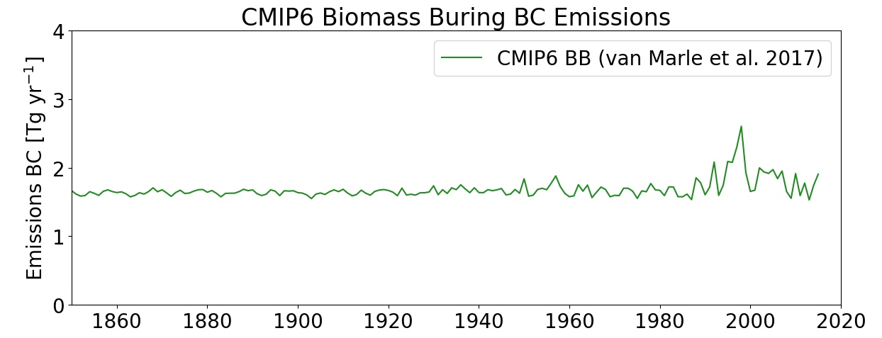
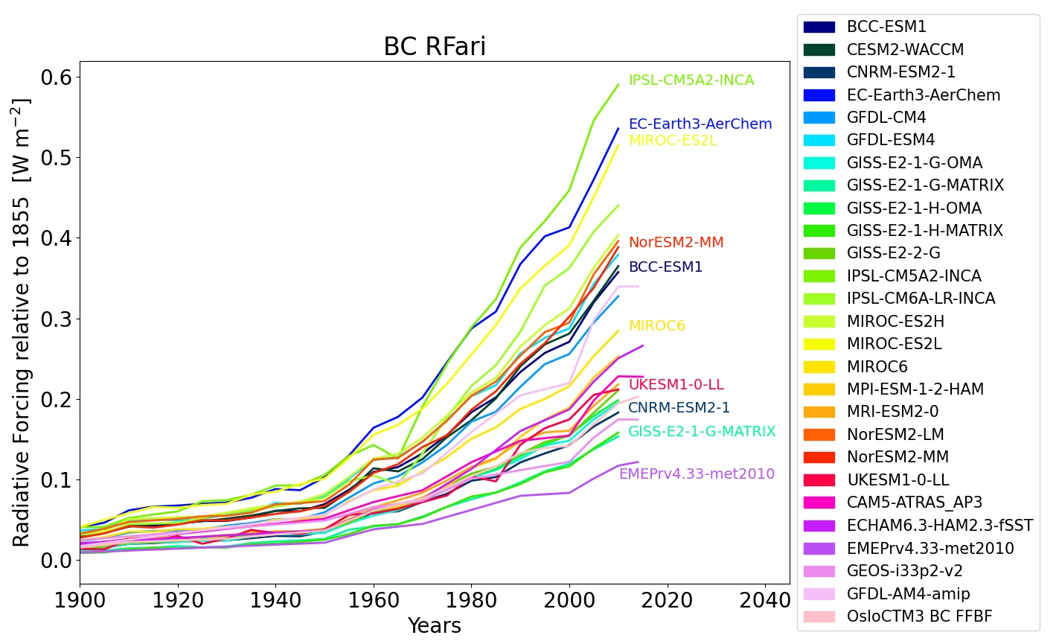
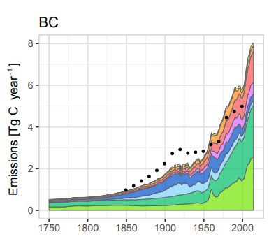
RFari BC:
Hoesly et al. 2018: Historical (1750–2014) anthropogenic emissions of reactive gases

Slide 33
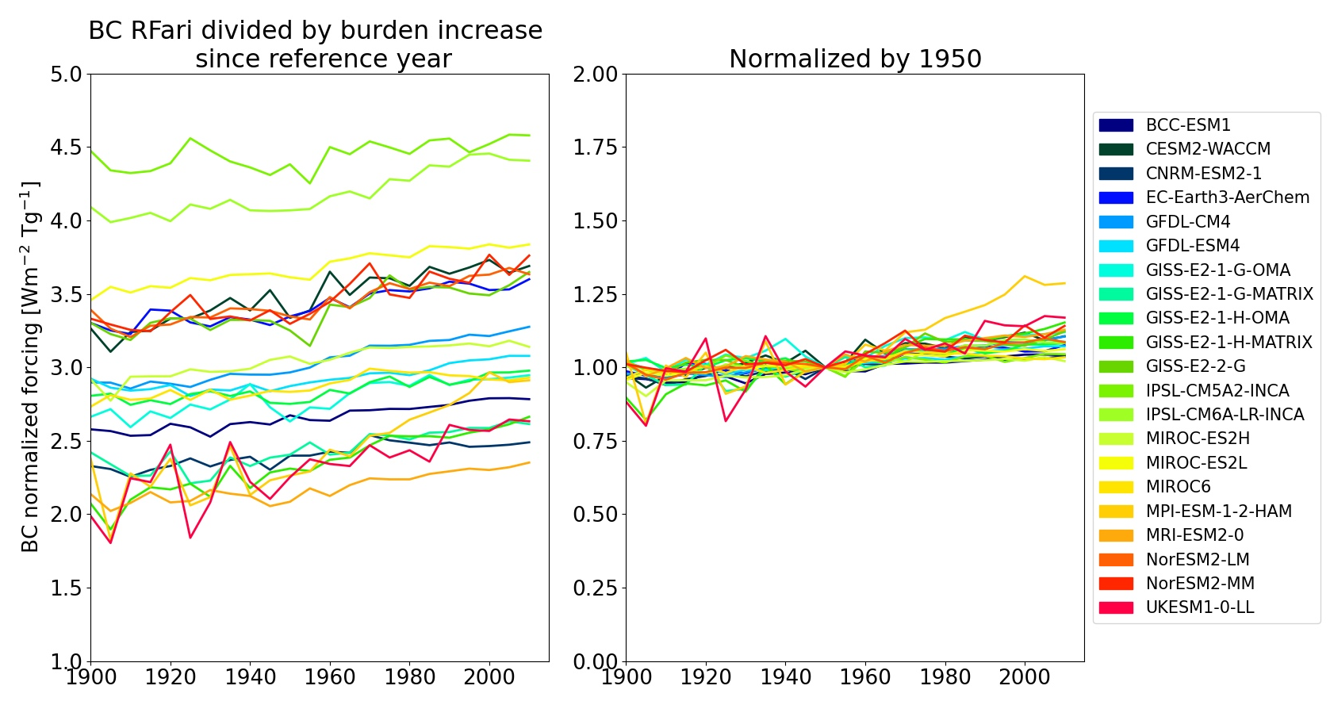
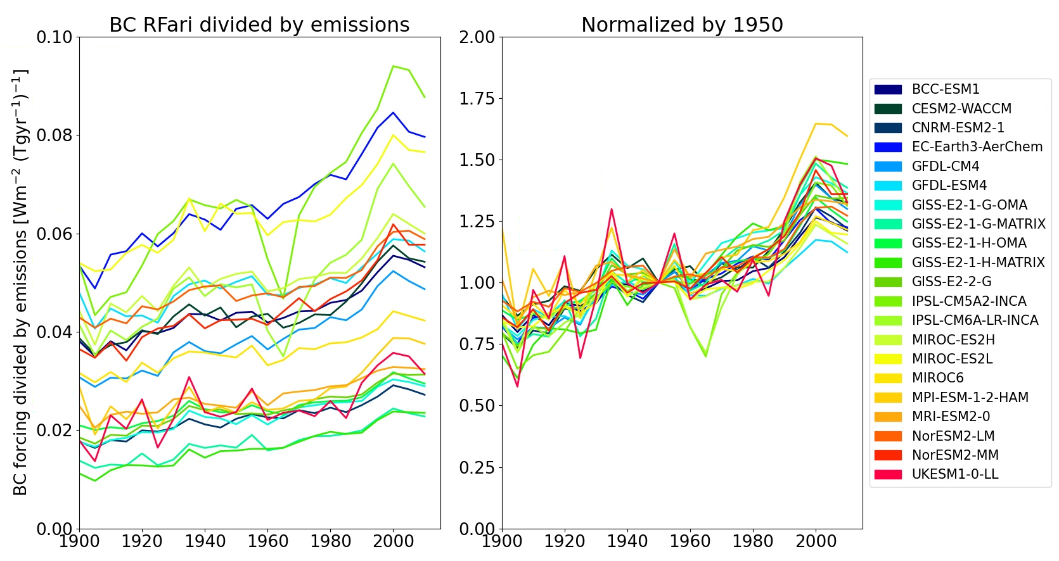

Slide 34
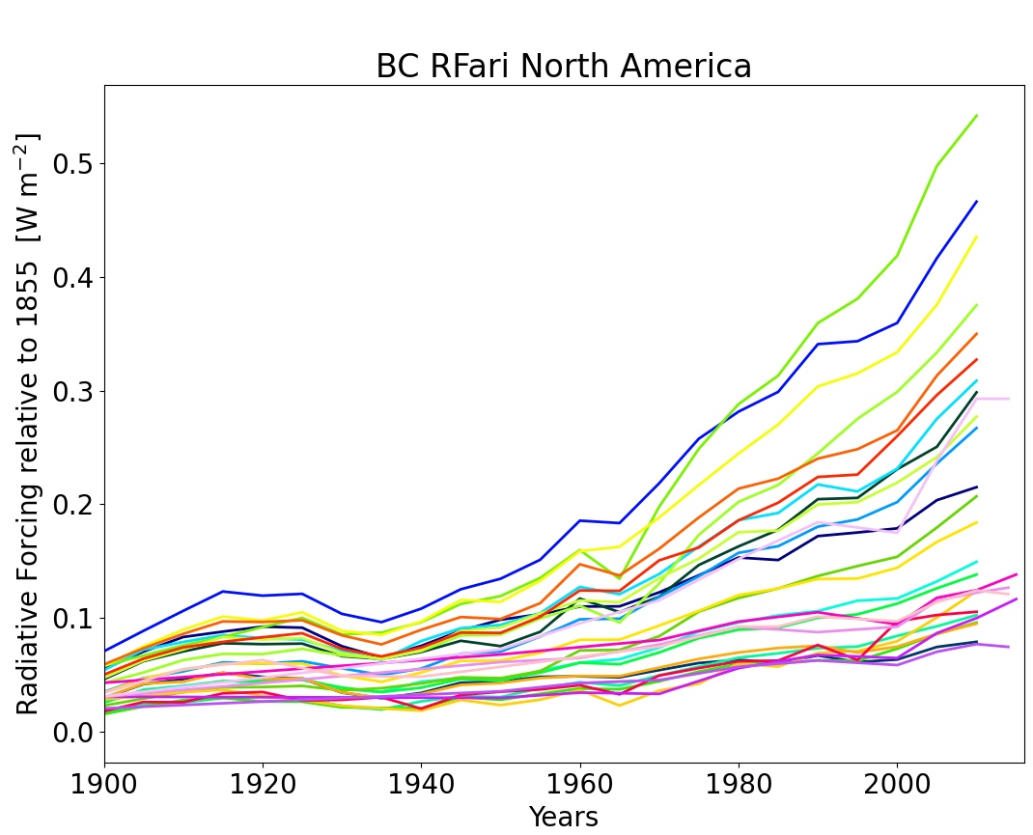
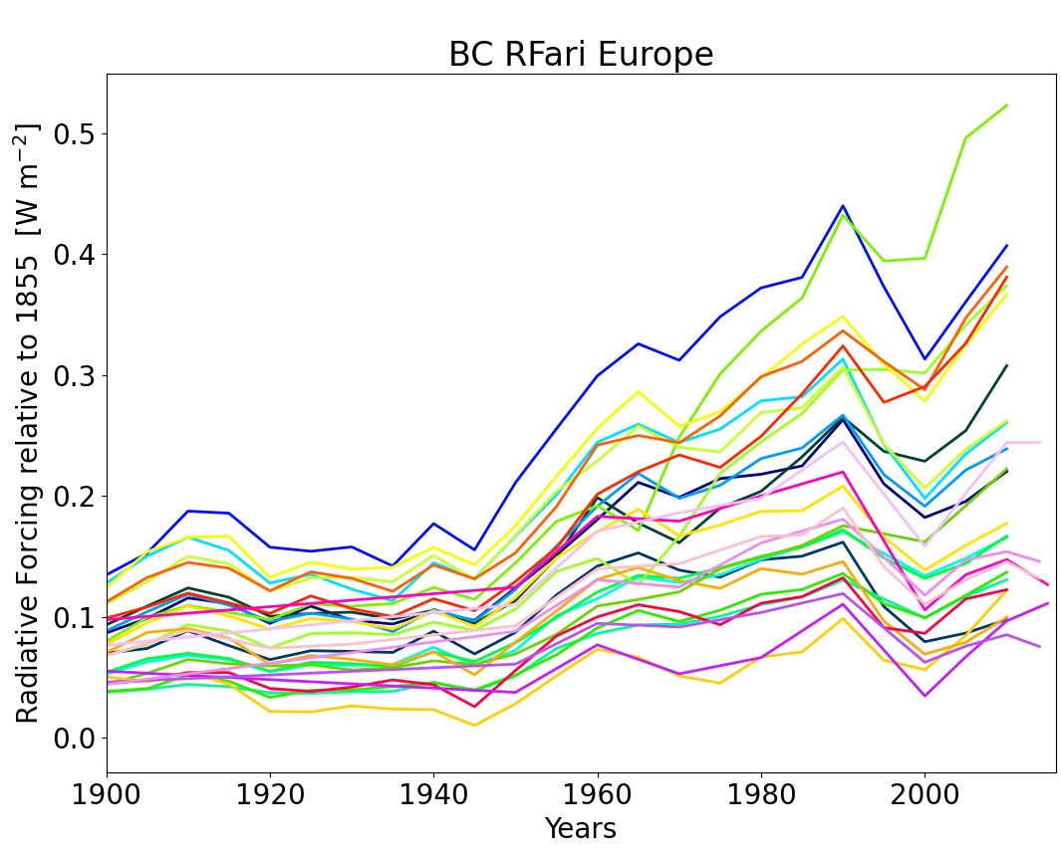
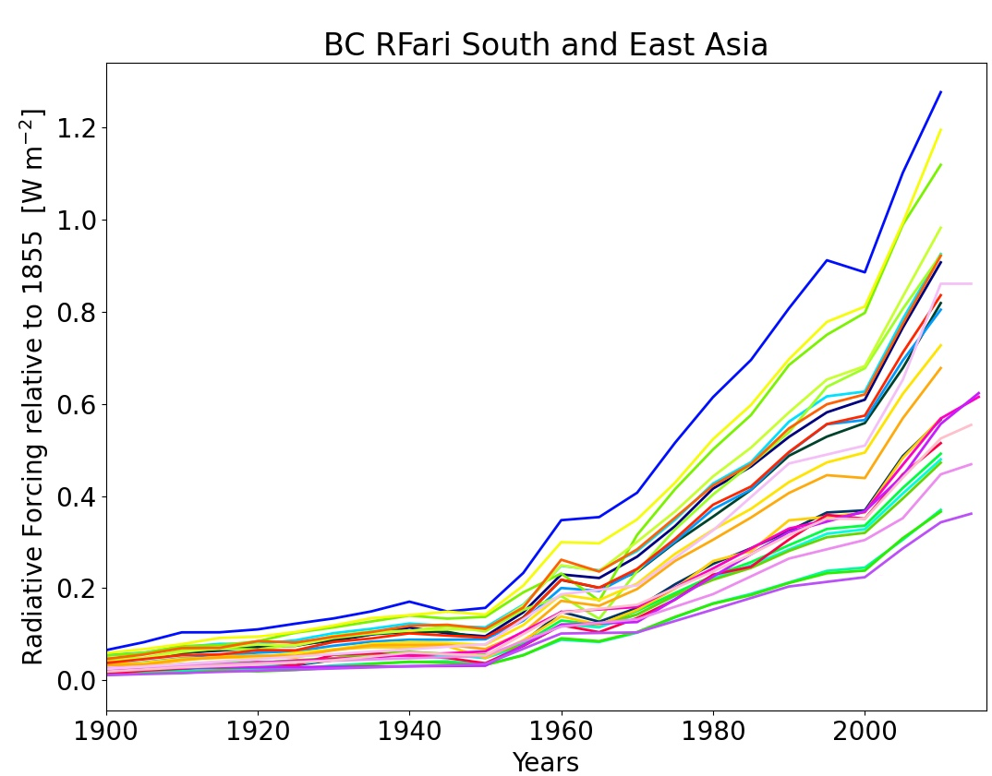
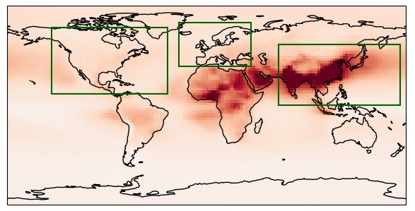
Geographical distribution
NB: This includes BC from Biomass burnig. Can influence regional trends, although the global RFari of BC-BB is small. Also keep in mind long range transport.
South and Eastern Asia BC RFari strengthening.

Slide 35
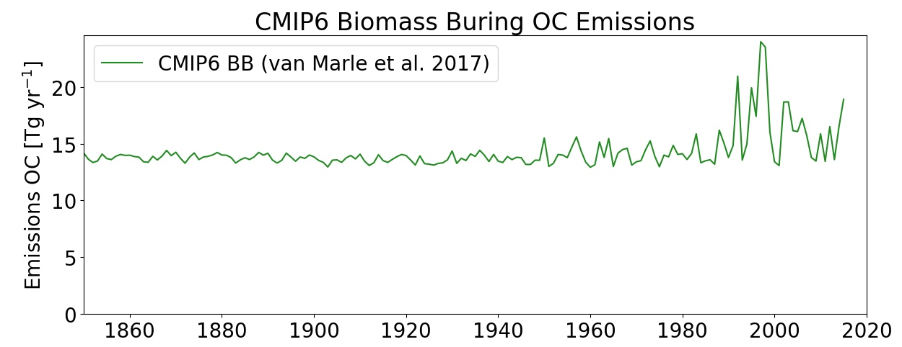
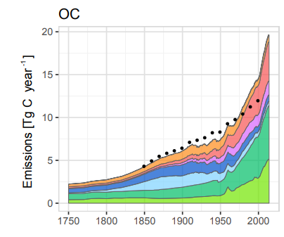
RFari OA:
Hoesly et al. 2018: Historical (1750–2014) anthropogenic emissions of reactive gases

Slide 36
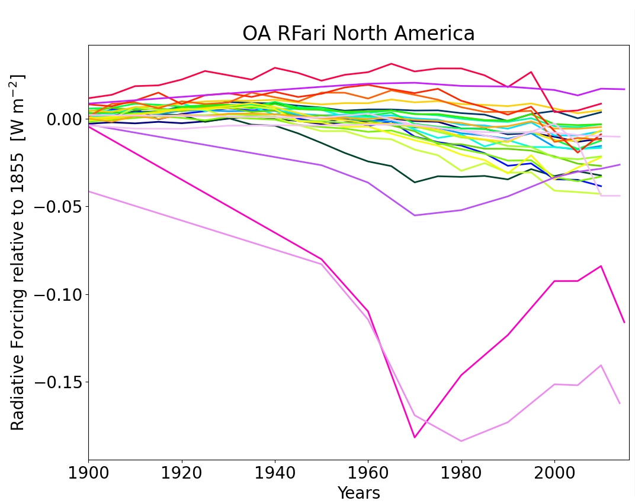
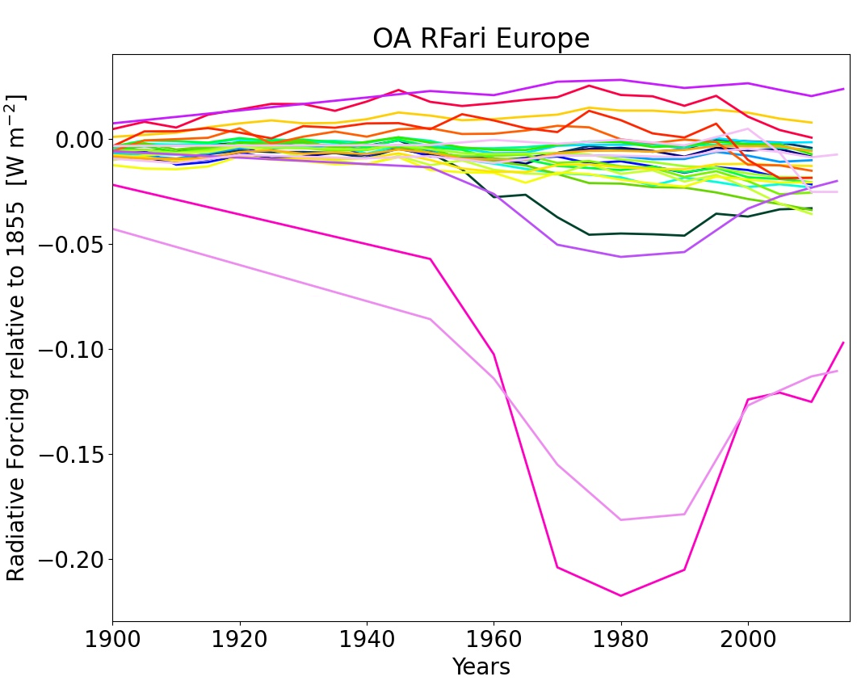
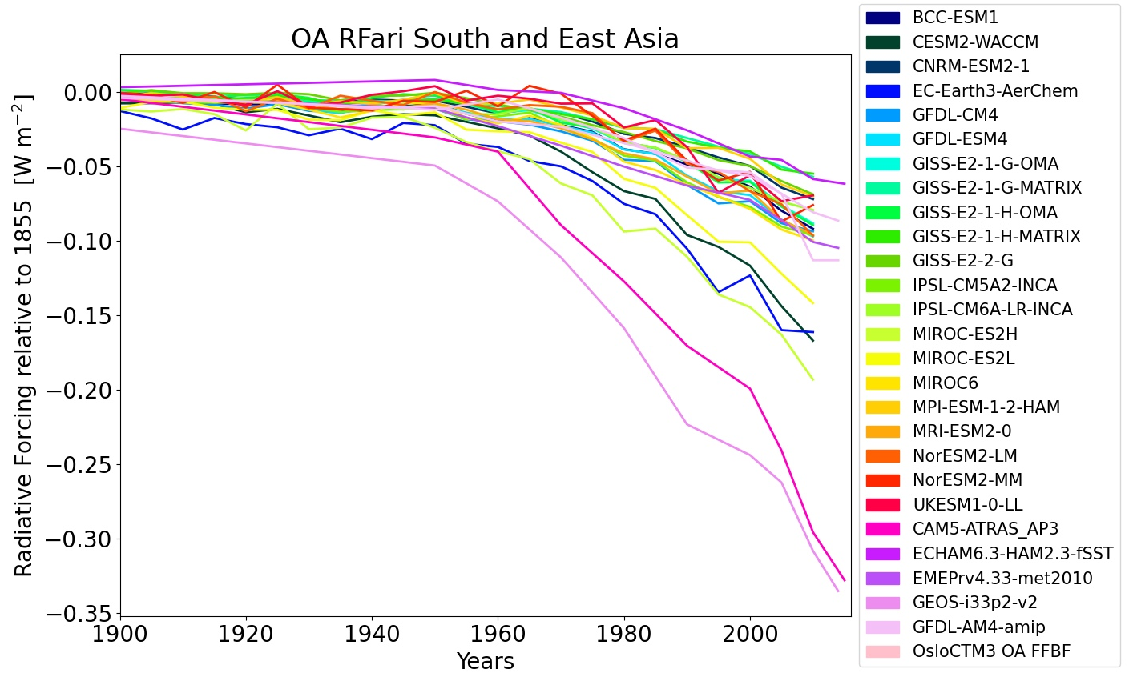
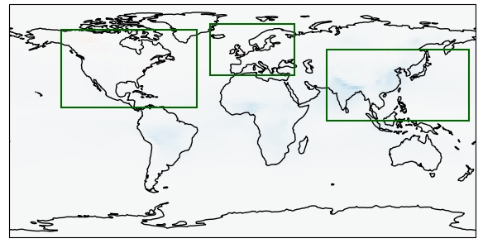
Geographical distribution
NB: This includes OA from Biomass burning. Can influence regional trends.
For OsloCTM: only primary organic aerosols from fossil fuel and biofuel (FFBF) is plotted here.

Slide 37
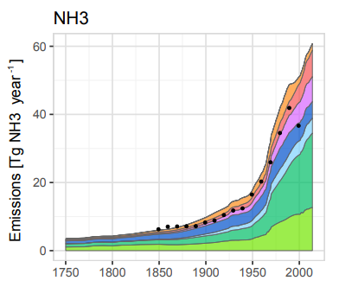
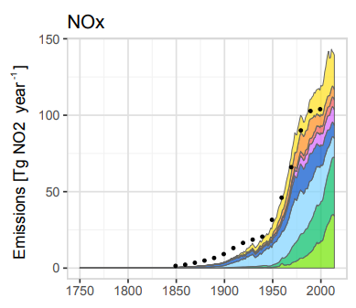
RFari NO3:
Note: No split in fine mode and coarse mode in CMIP6 and AeroCom model results.
OsloCTM results is for fine mode aerosol only.
Hoesly et al. 2018: Historical (1750–2014) anthropogenic emissions of reactive gases

Slide 38
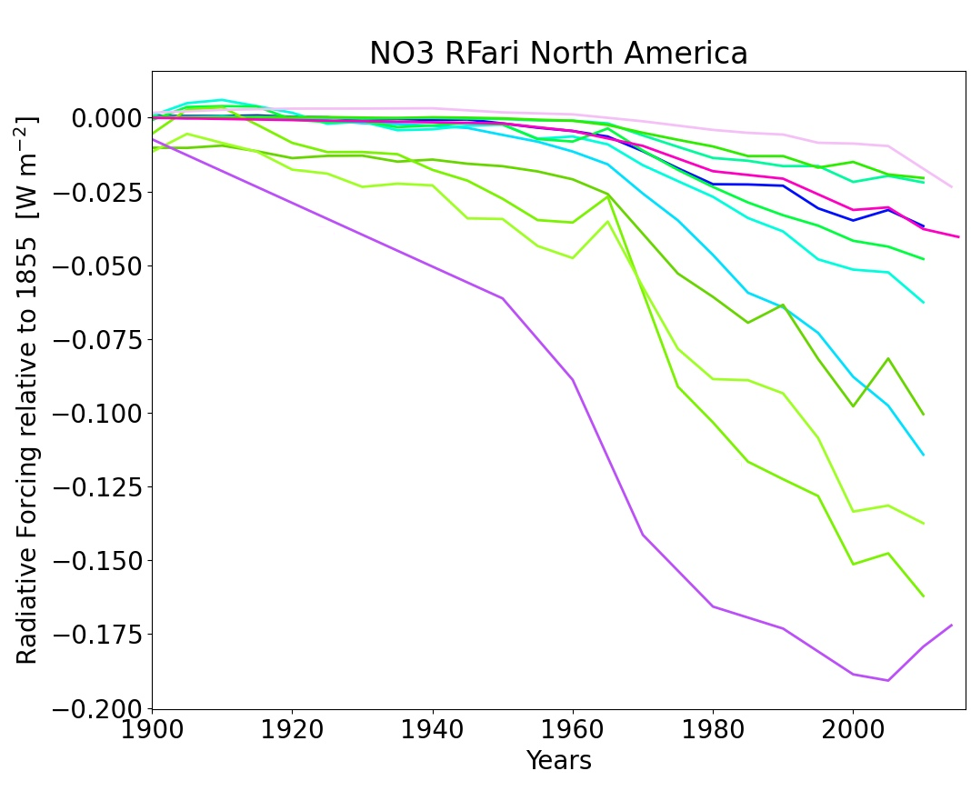
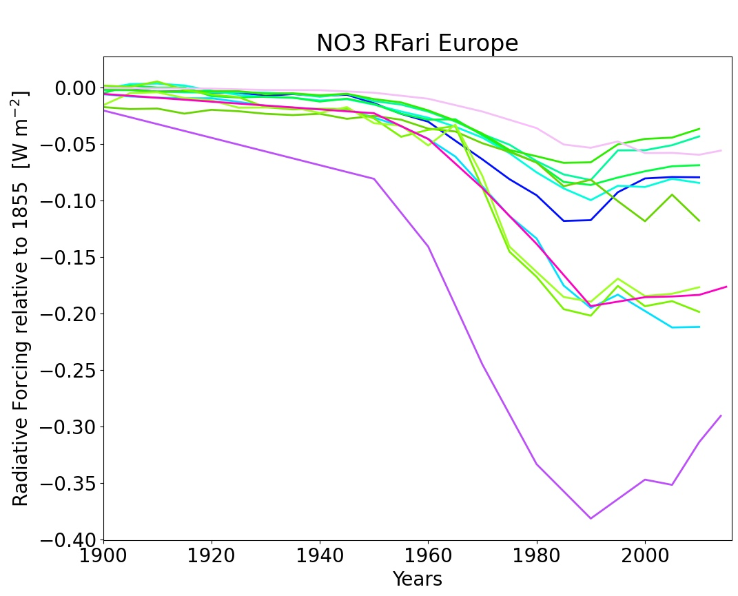
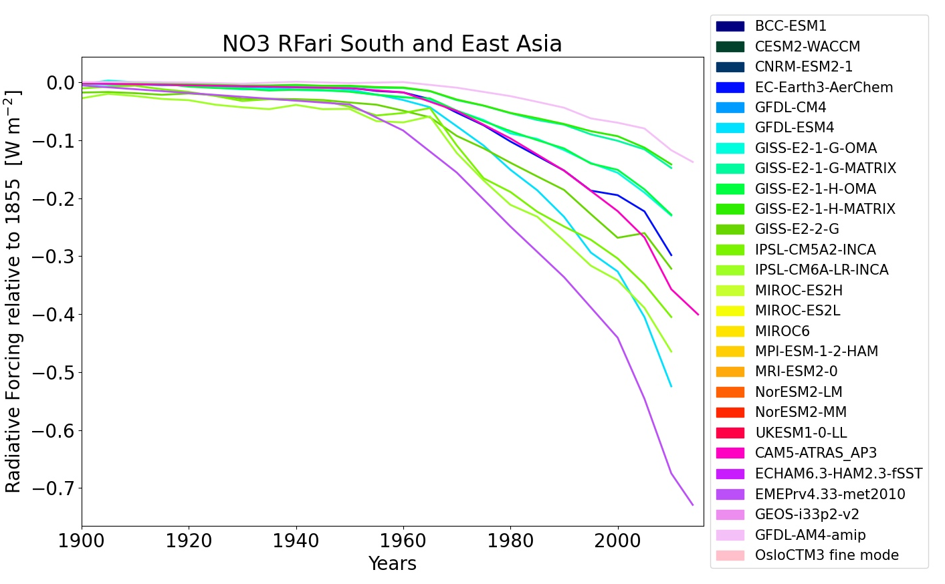
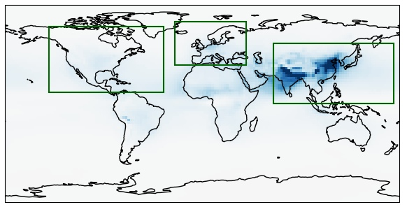
Geographical distribution

Slide 39
Compare RFaci results to ERFaci from RFMIP
Note: RF and ERF for the same models, but not the same simulations.
Indication of stronger adjustments in some models, but RFaci (“Twomey effect”) calculation within models can be quite different.
ERFari data from RFMIP: Smith, C. J., Harris, G. R., Palmer, M. D., Bellouin, N., Collins, W., Myhre, G., et al. (2021). Energy budget constraints on the time history of aerosol forcing and climate sensitivity. Journal of Geophysical Research: Atmospheres

