Slide 1

Scale separation diagnostics and the Symmetric Bounded Efficiency for the inter-comparison of precipitation re-analyses
International Journal of Climatology (2022)
https://doi.org/10.1002/joc.7975
Barbara Casati, Meteorological Research Division, ECCC - barbara.casati@ec.gc.ca
Cristian Lussana, Division for Climate Services, Met Norway
Alice Crespi, Institute of Earth Observation, EURAC, Bolzano, Italy
Talk Outline
Context and precipitation data-set
Scale Separation diagnostics
  Energy Normalized Bias
  Skill on separate scales
  Symmetric and Bounded Efficiency
Summary
Notes:
I am going to present some scale separation diagnostics and the Symmetric Bounded Efficiency, and how I apply those for comparing precipitation reanalyses.
This work has been recently published into the Int J of Climatology, by Casati, Lussana and Crespi, you can read the article and email me if you want the R code.
During the presentation, I will start with some context and a brief description of the precipitation datasets I use. Then I’ll introduce one by one the scale separation diagnostics, and illustrate their diagnostic capabilities as I discuss the results.
35’’

Slide 2
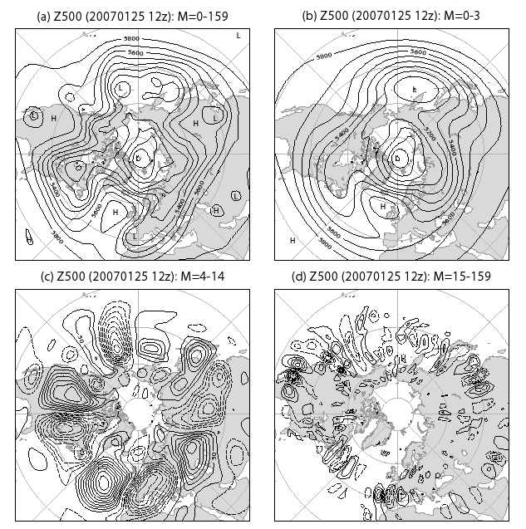
Scale Separation methods
Assess scale structure
Bias, error and skill on different scales
Scale dependency of forecast predictability (no-skill to skill transition scale)
1. Decompose forecast and observation fields into spatial scale components (filters: wavelets, Fourier, DCT, … )‏
2. Perform verification on different scale components, separately (continuous, categorical, probabilistic scores)
Rationale: weather phenomena of different spatial scales are governed by different physical processes
from Jung and Leutbecher (2008)
Briggs and Levine (1997), wavelet cont (MSE, corr); Zepeda-Arce et al. (2000), Harris et al. (2001), Tustison et al. (2003), scale invariants parameters; Casati et al. (2004), Casati (2010), wavelet cat (HSS, FBI, scale structure);
Casati and Wilson (2007), wavelet prob (BSS=BSSres-BSSrel, En2 bias, scale structure); Jung and Leutbecher (2008), spherical harmonics, prob (EPS spread-error, BSS, RPSS); Denis et al. (2002,2003), De Elia et al. (2002), discrete cosine transform, taylor diag; Livina et al (2008), wavelet coefficient score. Buschow and Friederich (2020,2021), scale structure, anisotropy, direction, displacement (dual-tree complex wavelet transforms).
Notes:
Scale separation methods are a class of spatial verification methods which enable to:
- Compare the scale structure of forecast and gridded observations
- Assess Bias, error and skill on different scales
- Assess the scale dependency of forecast predictability (no-skill to skill transition scale)
There are several approaches, I have included here some references from the published literature.
All these techniques have a common approach:
first the decompose the forecast and observation fields into different scale components, by using some spatial filters (wavelets, Fourier transforms, etc.). In the image you see an example from Jung and Leuthbecher 2008, where they decompose 500GZ fields on different scales with spherical harmonics.
Once the fields are decomposed on different scales, the verification of these different scale components is performed, separately, by using some traditional verification approaches.
The rationale behind these methods is that weather phenomena of different spatial scales are governed by different physical processes, hence verification on the different scales can provide feedback on how these different processes are represented by the models.
1’23’’

Slide 3
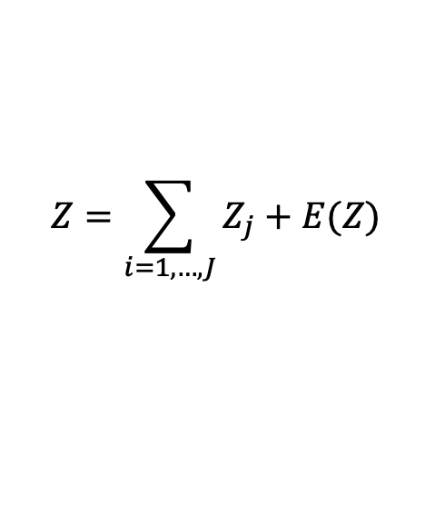
Data
Case study 2011-08-29
COSMO-REA6: high resolution (6km) regional reanalysis
ECMWF-ERA5 reanalysis:
High resolution (31km) control (EA-HRES)
10 member ensemble (EA-EDA) with reduced resolution (62 km)
24h accum. precipitation fields are decomposed into the sum of components on different spatial scales by using a 2D Haar discrete wavelet transform.
COSMO-REA6
Control EA-HRES
$$Z=\sum_{i=1, …, J}{Z_{j}}+E(Z)$$
Ensemble mean
(EA-EDA-mean)
Ensemble spread
(90th – 10th %tile)
Notes:
I use scale-separation diagnostics to compare 24h accumulated precipitation fields from the ERA5 reanalysis to the COSMO-REA6, which is a regional reanalysis at 6km resolution. For the ERA5 I consider both the high res (HRES) control member, at 31km resolution, and the ensemble of 10 members, which has half the resolution.
In the figure you can see one of the case studies analyzed: top-left is COSMO-REA6, the precipitation field has finer details, whereas the ERA5 products are smoother. The large scale precipitation features are however mainly co-located, and the ERA5 ensemble members differ between each other mainly for intensity.
24h accum. precipitation fields are decomposed into the sum of components on different spatial scales by using a 2D Haar discrete wavelet transform (I indicate with j the scales). I won’t touch on the wavelet filter, but I have extra material if anyone is interested in looking into the wavelet transforms.
For the rest of the presentation I will instead focus on the scores and their properties.
1’16’’

Slide 4
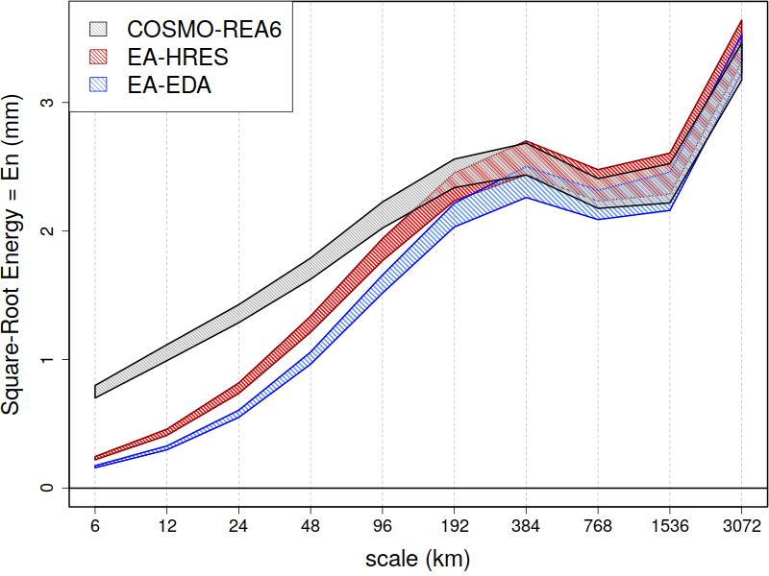
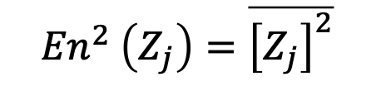
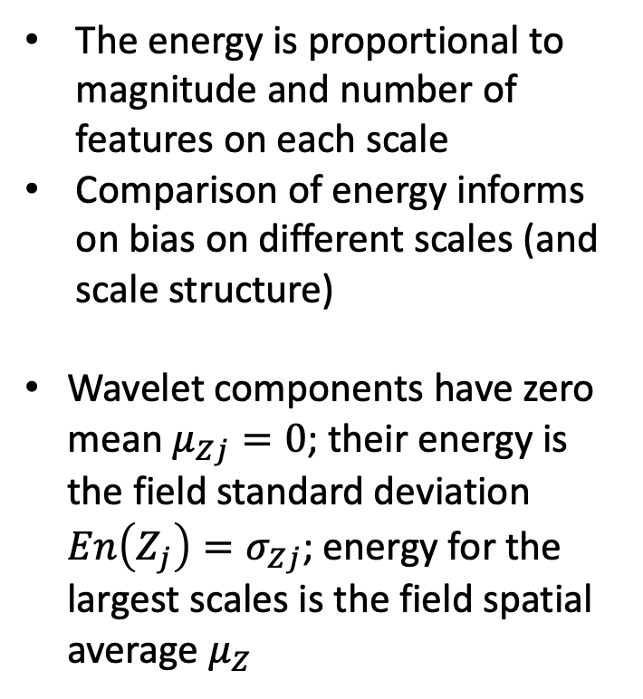
Assessment of the energy bias on separate scales (1/2)
$${En}^{2} \left(Z_{j}\right)=\overline{{\left[Z_{j}\right]}^{2}}$$
dominant features at 200-400 km scales
The energy is proportional to magnitude and number of features on each scale
Comparison of energy informs on bias on different scales (and scale structure)
Wavelet components have zero mean $μ_{Zj}=0$; their energy is the field standard deviation ${En\left(Z_{j}\right)=σ}_{Zj}$; energy for the largest scales is the field spatial average $μ_{Z}$
  Small scale energy
  COSMO >> Control > Ensemble
Notes:
The first scale-dependent diagnostic I evaluate is the energy, which for each scale component is the average of the square values.
The energy is proportional to magnitude and number of precipitation features on each scale
Comparison of energy informs on bias on different scales (and scale structure)
In the figure (and in all subsequent figures) I plot the scale separation statistics as a function of scales (along the x-axis).
As expected the COSMO-REA6 (in grey) has larger energy, much more small to medium scale features, than the ERA5 products. The ERA5 control member (in red) has slightly more small scale details than the lower resolution ensemble members (in blue).
All products show that the dominant precipitation features have scales ranging between 200-400km.
47’’

Slide 5
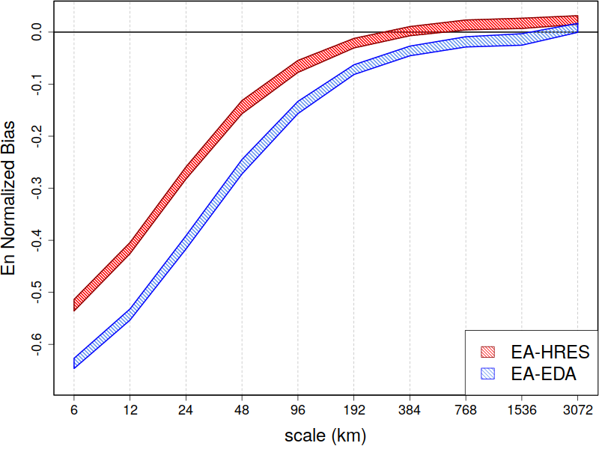
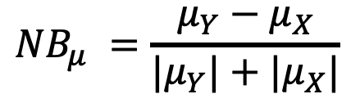
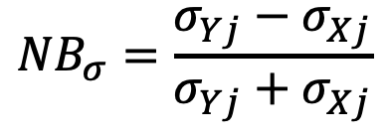
Assessment of the energy bias on separate scales (2/2)
Energy Normalized Bias (NB_{En}):
for the largest scale
Why normalizing? Additive bias would be small for small energies, even if their relative difference (e.g. as assessed by the ratio) could be large.
Bounded: range [-1,1]; Symmetric (these are key properties for defining the Symmetric and Bounded Efficiency).
$${NB}_{σ}=\frac{σ_{Yj}−σ_{Xj}}{σ_{Yj}+σ_{Xj}}$$
$${NB}_{μ} =\frac{μ_{Y}−μ_{X}}{{|μ}_{Y}|+{|μ}_{X}|}$$
Notes:
To assess the bias on different scales I evaluate the energy normalized bias, which is the difference between the two energies divided by the sum of two energies of the two products compared.
Note that the Energy NB is bounded (it ranges between -1 and 1) and symmetric (its absolute value does not change if we swap the two products compared): these are key properties for defining the Symmetric and Bounded Efficiency, later.
In the figure (and subsequent figures) I show the scale-separation statistics comparing the ERA5 products (denoted by Y) to the COSMO-REA6 (denoted by X).
The figure shows that both ERA5 products underestimate small to medium scales compared to COSMO-REA6, the high res control member slightly less that ensemble members.
The HRES overforecast largest scales.
54’’

Slide 6
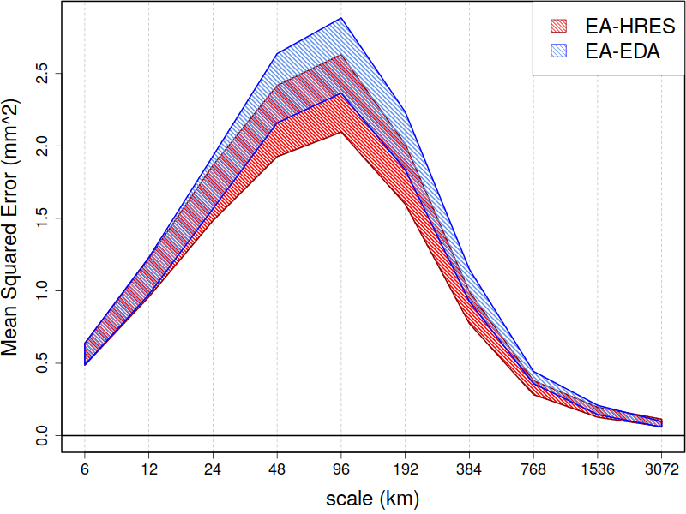
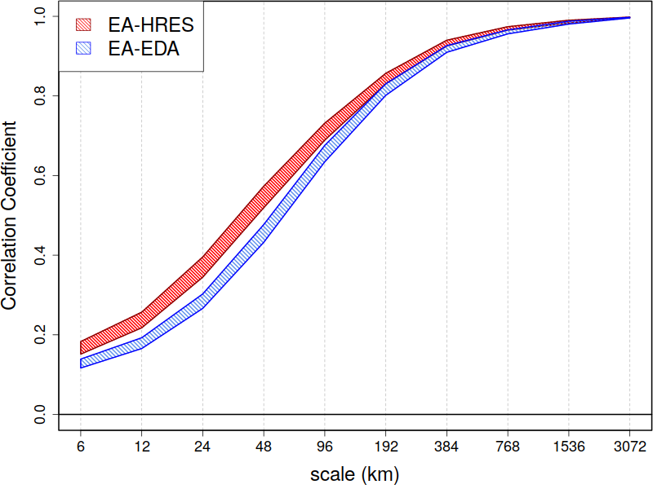
Measures of error and association
Correlation separates HRES from EDA
MSE does
not separate HRES from EDA
$$MSE\left(Y,X\right)= \overline{{\left[Y−X\right]}^{2}}= {\left(μ_{Y}−μ_{X}\right)}^{2}+σ_{Y}^{2}+σ_{X}^{2}−2σ_{Y}σ_{X}r_{Y,X}$$
Bias²
Variability
Covariance
Notes:
Next I evaluate the MSE and correlation on the separate scale components.
While the correlation separates the performance of the ERA5 products, the MSE does not.
This is due to the fact that the MSE highly depends on the variability of the products compared, both observation and forecast variabilities, so that higher resolution forecast (which have higher variability) tend to be more penalized wrt coarser/smoother forecasts.
29’’

Slide 7
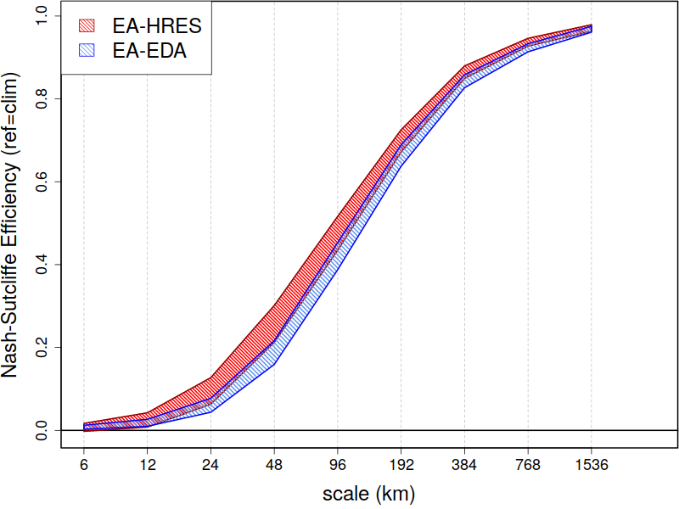
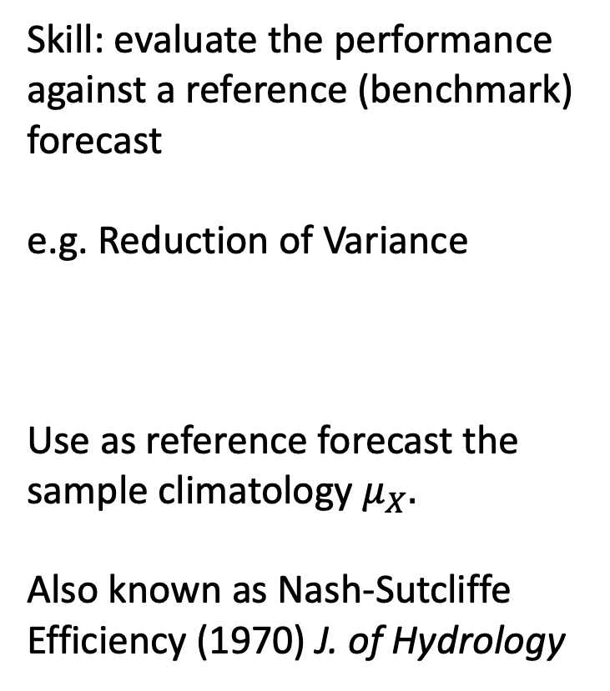
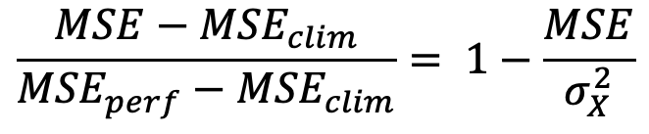
Assessment of the skill on separate scales (1/2)
Skill: evaluate the performance against a reference (benchmark) forecast
e.g. Reduction of Variance
Use as reference forecast the sample climatology $μ_{X}.$
Also known as Nash-Sutcliffe Efficiency (1970) J. of Hydrology
$$\frac{MSE−{MSE}_{clim}}{{MSE}_{perf}−{MSE}_{clim}}= 1−\frac{MSE}{σ_{X}^{2}}$$
as the MSE, NSE is not capable of fully separating HRES from EDA
Notes:
The reduction of variance, also known as Nash Sutcliffe Efficiency, is a skill score which was introduced to reduce the effect of the variability while assessing the forecast performance.
However the NSE compensate solely for the observed variability, the MSE is normalized by the observed variance.
Then we have not solved the problem of comparing products with different resolutions,
the higher resolution / more noisy forecast is still penalized wrt the coarser / smoother one.
Also the NSE cannot separate the performance of the two ERA5 products.
35’’

Slide 8
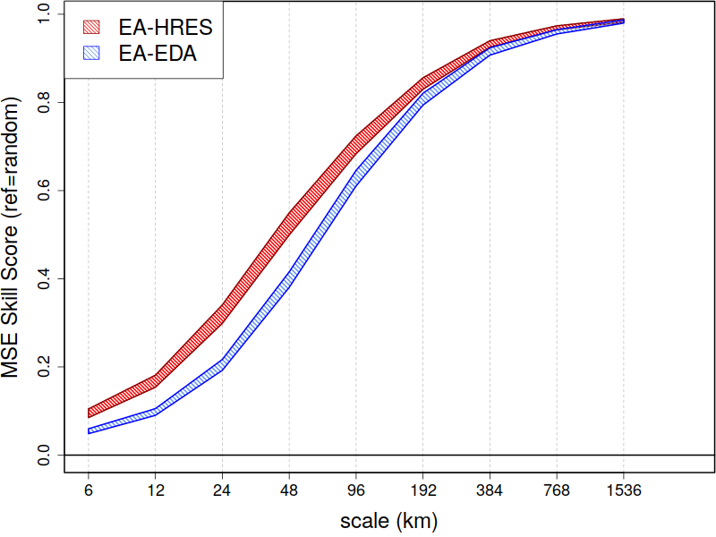
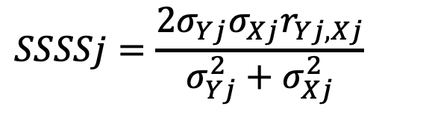
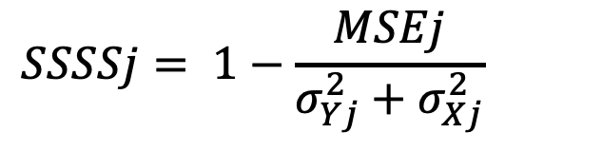
Assessment of skill on separate scales (2/2)
The Scale Separation Skill Score (SSSS) consider random chance* as reference forecast
Normalize with the sum of both obs and forecast variability
SSSS is symmetric; SSSS is negative if forecast and obs are decorrelated
$$SSSSj= 1−\frac{MSEj}{σ_{Yj}^{2}+σ_{Xj}^{2}}$$
SSSS is capable of separating HRES from EDA
$$SSSSj=\frac{2σ_{Yj}σ_{Xj}r_{Yj,Xj}}{σ_{Yj}^{2}+σ_{Xj}^{2}}$$
$${MSE}_{random}\left(Y_{j},X_{j}\right)= {\left(μ_{Yj}−μ_{Xj}\right)}^{2}+σ_{Yj}^{2}+σ_{Xj}^{2}−2σ_{Yj}σ_{Xj}r_{Yj,Xj}$$
* Proof:
0
0
0
Notes:
To address the problem, and being able to fairly compare the performance of two products with different resolutions, we introduce a skill score which considers random chance a reference forecast.
Now the MSE is normalized by the variances of both obs and forecast products, the forecast variability is factored in, and the skill score is capable of separating the performance of the ERA5 products.
The SS allows a fairer comparison of products with different resolutions and enable the assessment of the added value of increasing resolution.
Note that this SS is also symmetric, invariant wrt the definition of obs and forecast in the comparison of the two products, whereas NSE is not symmetric.
45’’

Slide 9
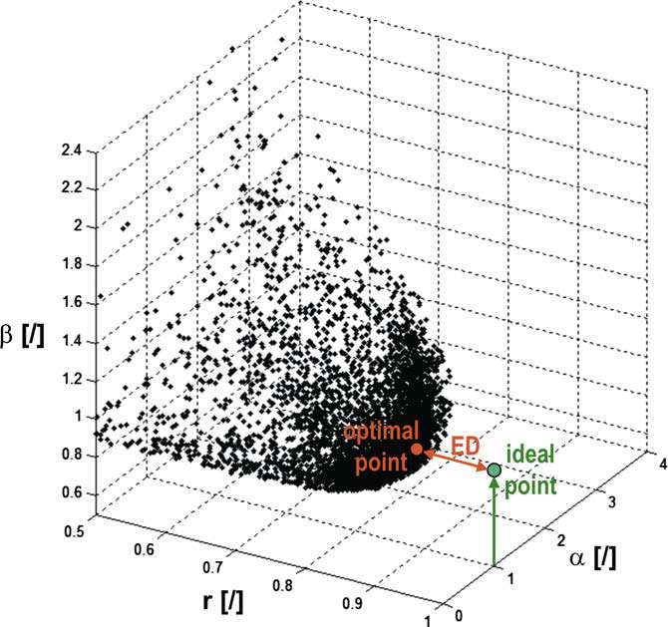
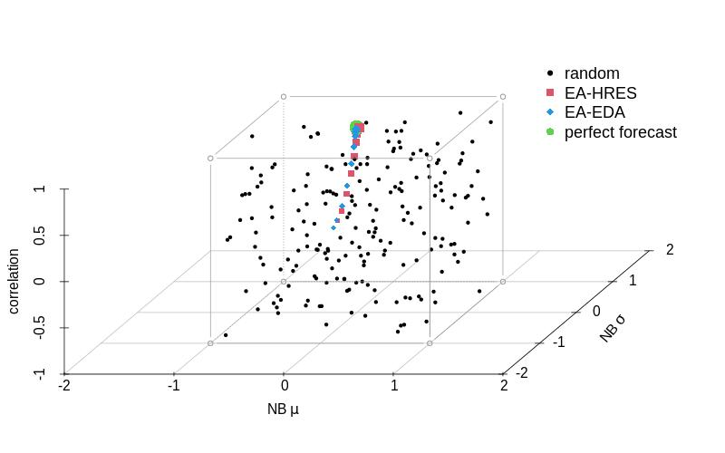
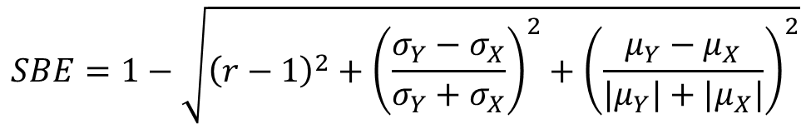
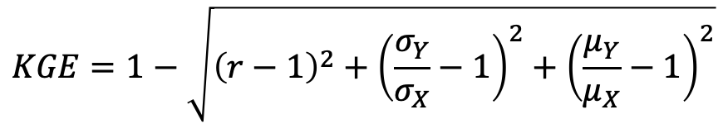
The Kling-Gupta and the Symmetric Bounded Efficiency
The SBE is defined as the KGE, but the (ratio-1) is replaced by the Normalized Bias:
$$SBE=1−\sqrt{{\left(r−1\right)}^{2}+{\left(\frac{σ_{Y}−σ_{X}}{σ_{Y}+σ_{X}}\right)}^{2}+{\left(\frac{μ_{Y}−μ_{X}}{{|μ}_{Y}|+{|μ}_{X}|}\right)}^{2}}$$
Corr
Variability
Bias
Gupta et al (2009) J. of Hydrology:
$$KGE=1−\sqrt{{\left(r−1\right)}^{2}+{\left(\frac{σ_{Y}}{σ_{X}}−1\right)}^{2}+{\left(\frac{μ_{Y}}{μ_{X}}−1\right)}^{2}}$$
Corr
Variability
Bias
Notes:
The Kling Gupta Efficiency was introduced also to overcome some of the issues of the NSE. The Efficiency combine in a single measure the correlation, and the forecast accuracy in reproducing the observed variability and average. However variances and averages are compared with the ratio, which renders the KGE unbounded and asymmetric.
We then define the Symmetric and Bounded Efficiency, which is defined as the KGE.
The term below the square root represents the distance in a 3D space from the perfect forecast.
However, in the SBE the variances and averages are compared with the normalized bias,
Which renders the SBE bounded and symmetric –aka SBE is invariant on the order of comparison of the two products-
45’’

Slide 10
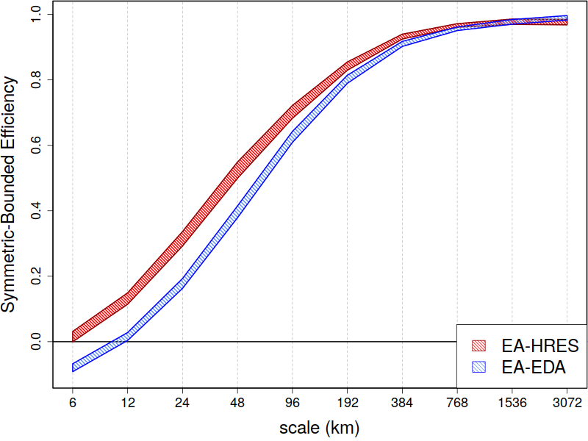
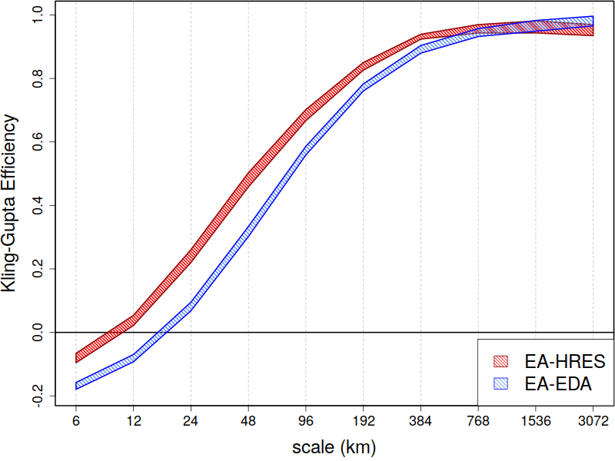
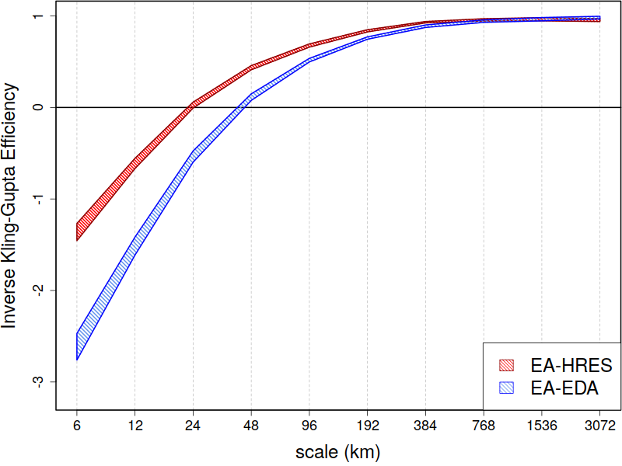
SBE
Both SBE and KGE separate the performance of HRES from EDA, as SSSS did (whereas NSE did not)
KGE
IKGE
  The better performance
  of HRES is due to the
  better representation of
  variability at small-to-medium scales, as well as better linear dependence (corr). On the largest scale, on the other hand, HRES is slightly underperforming EDA due to over-forecast bias.
KGE is unbounded and asymmetric: swapping X and Y gives different results
Notes:
Here are the results in terms of the efficiencies:
Both SBE (top-left) and KGE separate the performance of HRES from the ensemble (EDA), as SSSS did (whereas NSE and MSE did not). However the KGE is asymmetric, and when I swap the two products (bottom-right) I obtain different scores (much more negative) and different skill to no-skill transition scale.
The better performance of HRES is due to the better representation of variability at small-to-medium scales, as well as better linear dependence (corr). On the largest scale, on the other hand, HRES is slightly underperforming EDA due to over-forecast bias.
45’’

Slide 11
Summary and Conclusions
Scale separation diagnostics assess the bias, error and skill on separate scales: they enable in-depth analysis of forecast performance in association with its scale structure.
MSE as NSE tend to overly penalize high resolution products wrt coarser/smoother products.
The SSSS and SBE, instead, allow a fairer comparison of products with different resolutions, enable the assessment of the added value of increasing resolution.
Moreover, SSSS and SBE are symmetric (whereas KGE and NSE are not): suitable for assessing reanalyses, since invariant wrt the order of comparison.
  The Energy NB, SSSS, SBE separate HRES from EDA (whereas MSE and NSE do not).
  The better performance of HRES is dominated by better representation of variability at small-to-medium scales, as well as better linear dependence (corr). On the largest scale, on the other hand, HRES is slightly underperforming EDA due to over-forecast.
Thank you!
Notes:
In summary, I have shown you some scale separation diagnostics which assess the bias, error and skill on separate scales: they enable in-depth analysis of forecast performance in association with its scale structure.
I have shown that MSE as NSE tend to overly penalize high resolution products wrt coarser/smoother products.
Then I have introduced a Skill Score (ref=random) and the Symmetric and Bounded Efficiency, which instead allow a fairer comparison of products with different resolutions, and enable the assessment of the added value of increasing resolution.
Moreover SS and the SBE are symmetric (whereas KGE and NSE are not): suitable for assessing reanalyses, since invariant wrt the order of comparison.
I thank you for your attention, and I am open for questions.
49’

Slide 12
Extras: Spatial Verification Methods

Slide 13

Existing verification methods
Traditional (point-by-point) methods:
1. Graphical summary (scatter-plot, box-plot, quantile-plots).
2. Continuous scores (MSE, MAE, correlation).
3. Categorical scores from contingency tables (FBI,HSS,PC).
4. Probabilistic verification (Brier, CRPS, rank histogram, reliability diagram).
5. Extreme dependency scores: Ferro and Stephenson 2011 (EDI,SEDI)
Spatial verification methods:
Account for coherent spatial structure and the presence of features
Aim to provide information on error in physical terms (meaningful verification): e.g. assess scale structure and displacement error (separately from intensity error)
Account for small time-space uncertainties (avoid double-penalty issue)
There is no single technique which fully describes the complex observation-forecast relationship! Key factors to select the appropriate method: 1. available observations ; 2. (statistical) characteristics of the variable & forecast; 3. verification end-user and purpose

Slide 14
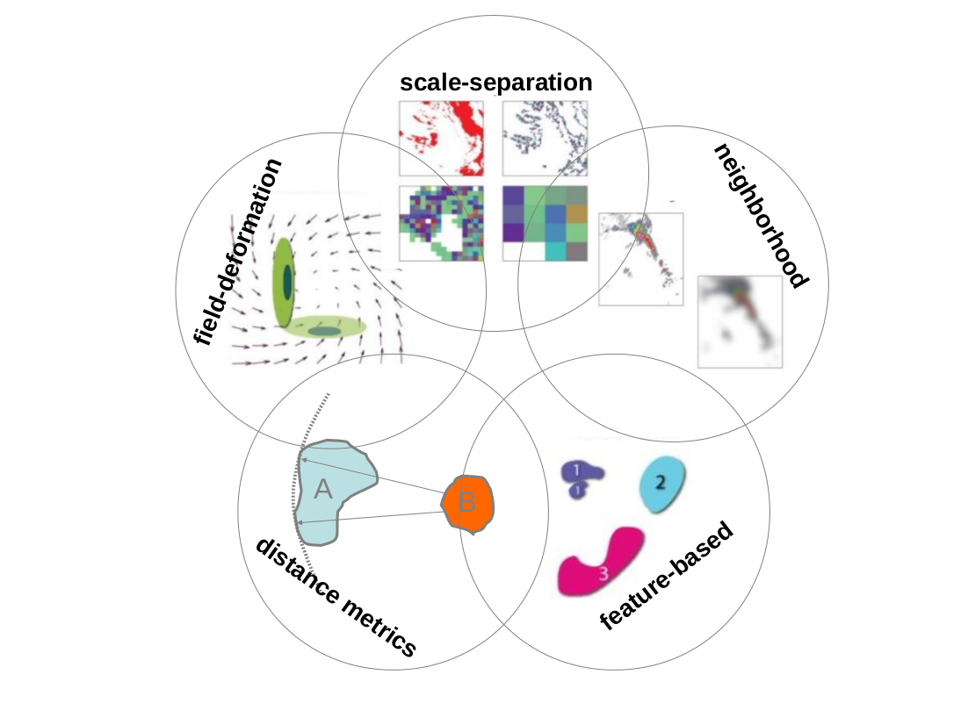
Spatial verification approaches
Scale-separation: analyse scale-dependency of forecast error
Field-deformation: use a vector and scalar field to morph forecast into obs
Neighborhood: relax requirement of exact space-time matching
Distance metrics: evaluate distances for all grid-points
Feature-based: evaluate attributes of isolated features
Spatial Verification Inter-Comparison Project (ICP): Gilleland et al (2010), BAMS
Mesoscale Verification Intercomparison in Complex Terrain (MesoVICT): Dorninger et al (2018), BAMS
http://www.ral.ucar.edu/projects/icp includes a list of more than 200 peer-review articles
Open source community verification software: R spatialVx package, MET and METplus

Slide 15
Neighbourhood verification
1. Define neighbourhood of grid-points: relax requirements for exact positioning (mitigate double penalty: suitable for high resolution models); account for forecast and obs time-space uncertainty.
2. Perform verification over neighbourhoods of different sizes: verify deterministic forecast with probabilistic approach
t - 1
observation
observation
t
forecast
forecast
Frequency
Frequency
t + 1
Forecast value
Rainfall
Yates (2006), upscaling, cont&cat scores; Tremblay et al. (1996), distance-dependent POD, POFD;
Rezacova and Sokol (2005), rank RMSE; Roberts and Lean (2008) Fraction Skill Score;
Theis et al (2005); pragmatical approach; Atger (2001), spatial multi-event ROC curve;
Marsigli et al (2005, 2006) probabilistic approach.

Slide 16
Scale Separation methods
Briggs and Levine (1997), wavelet cont (MSE, corr); Zepeda-Arce et al. (2000), Harris et al. (2001), Tustison et al. (2003), scale invariants parameters; Casati et al. (2004), Casati (2010), wavelet cat (HSS, FBI, scale structure);
Casati and Wilson (2007), wavelet prob (BSS=BSSres-BSSrel, En2 bias, scale structure); Jung and Leutbecher (2008), spherical harmonics, prob (EPS spread-error, BSS, RPSS); Denis et al. (2002,2003), De Elia et al. (2002), discrete cosine transform, taylor diag; Livina et al (2008), wavelet coefficient score. Buschow and Friederich (2020,2021), scale structure, anisotropy, direction, displacement (dual-tree complex wavelet transforms).
1. Decompose forecast and observation fields into spatial scale components (filters: wavelets, Fourier, DCT, … )‏
2. Perform verification on different scale components, separately (continuous, categorical, probabilistic scores)
Rationale: weather phenomena of different spatial scales are governed by different physical processes
Assess scale structure
Bias, error and skill on different scales
Scale dependency of forecast predictability (no-skill to skill transition scale)
from Jung and Leutbecher (2008)

Slide 17
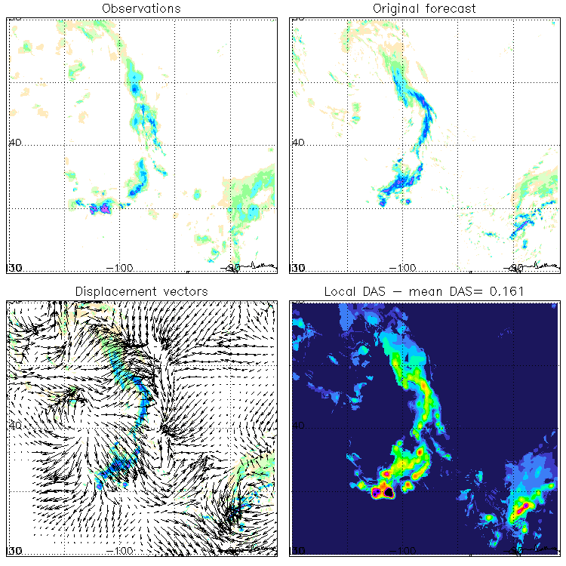
Field-deformation methods
Hoffmann et al (1995); Hoffman and Grassotti (1996), Nehrkorn et al. (2003); Brill (2002); Germann and Zawadzki (2002, 2004);
Keil and Craig (2007, 2009) DAS;
Marzbar and Sandgathe (2010) optical flow;
Alexander et al (1999), Gilleland et al (2010) image warping
Use a vector (wind) field to deform the forecast field towards the obs field
Use an amplitude field to correct intensities of (deformed) forecast field to those of the obs field
Vector and amplitude fields provide physically meaningful diagnostic information: feedback for data assimilation and now-casting.
Error decomposition is performed on different spectral components: directly inform about small scales uncertainty versus large scale errors.

Slide 18
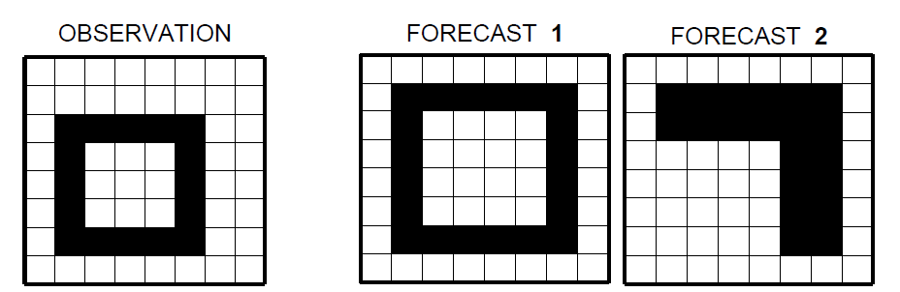



Distance metrics for binary images
Average distance
K-mean
Fréchet distance
Hausdorff metric
    Modified Hausdorff
    Partial Hausdorff
  Baddeley metric
Pratts’ figure of merit
Δ= 0.5625
Δ= 0.96875
Evaluate distances for all grid-points
Account for distance between objects, and similarity in shapes.
Compare binary images: alternative metrics to be used along with traditional categorical scores
hits = 9; false alarms = 11;
misses = 7; nils = 37
Image Processing: Baddeley (1992); Dubuisson and Jain (1994). Precipitation: Gilleland et al.(2008, 2011), Schwedler & Baldwin (2011), Venugopal et al. (2005); Zhu et al (2010), Aghakouchak et al (2011). Brunet and Sills (2015). Sea-ice: Heinrichs et al (2006); Dukhovskoy et al (2015), Hebert et al (2015).
Notes:
18

Slide 19
Feature-based techniques
Forecast
Ebert and McBride (2000), Grams et al (2006), Ebert and Gallus (2009): CRA
Davis, Brown, Bullok (2006) I and II, Davis et al (2009): MODE
Wernli, Paulat, Frei (2008): SAL score
Nachamkin (2004, 2005): composites
Marzban and Sandgathe (2006): cluster
Lack et al (2010): procrustes
Observed
Identify and isolate (precipitation) features in forecast and observation fields (thresholding, image processing, composites, cluster analysis)
assess displacement and amount (extent and intensity) error for each pairs of obs and forecast features; identify and verify attributes of object pairs (e.g. intensity, area, centroid location); evaluate distance-based contingency tables and categorical scores; perform verification as function of feature size (scale); add time dimension for the assessement of the timing error of precipitation systems.
Notes:
19

Slide 20
Extras: Wavelets

Slide 21
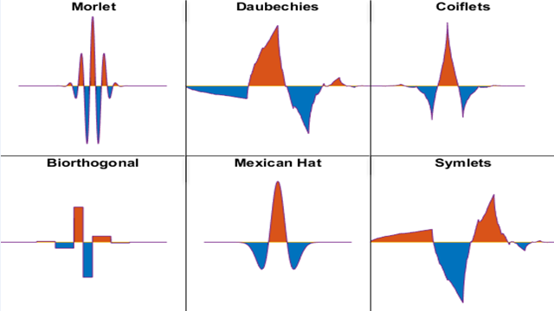
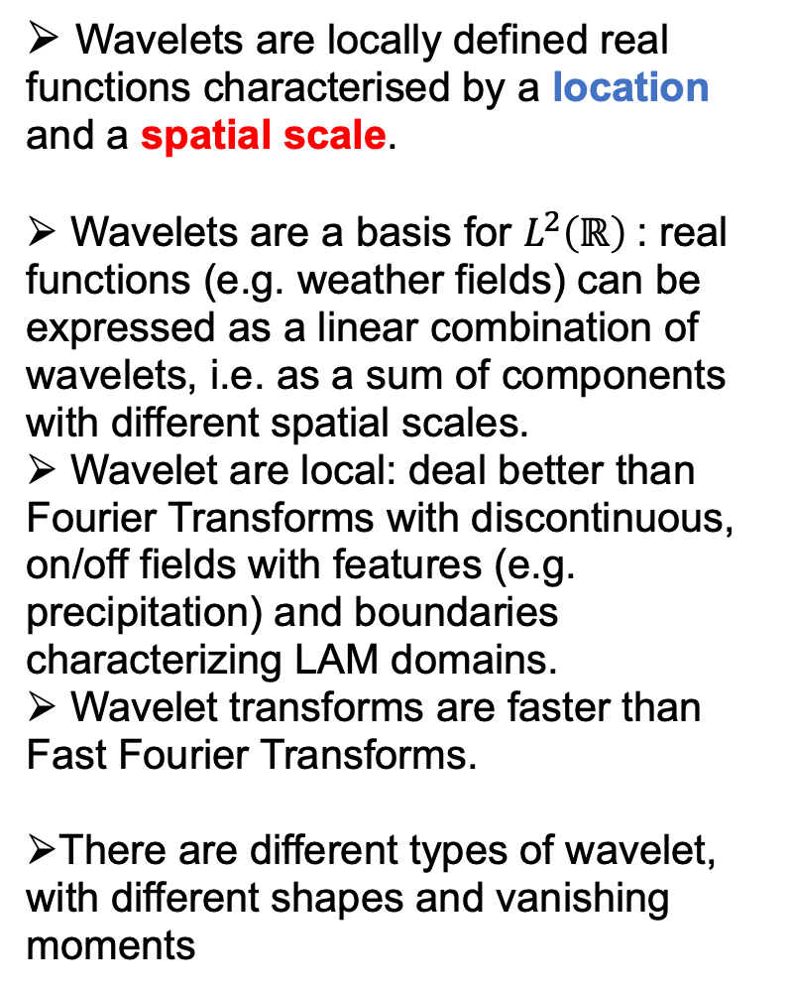
Wavelets
Haar wavelet ψ
Wavelets are locally defined real functions characterised by a location and a spatial scale.
Wavelets are a basis for $L^{2}\left(ℝ\right)$: real functions (e.g. weather fields) can be expressed as a linear combination of wavelets, i.e. as a sum of components with different spatial scales.
Wavelet are local: deal better than Fourier Transforms with discontinuous, on/off fields with features (e.g. precipitation) and boundaries characterizing LAM domains.
Wavelet transforms are faster than Fast Fourier Transforms‏.
There are different types of wavelet, with different shapes and vanishing moments
1
0
-1

Slide 22
The 1D Haar Wavelet filter
mean value over 2 gpt
deviation from mean value
+
Scale 1
mean value over 4 gpt
deviation from mean value
+
Scale 2
mean value on the whole domain

Slide 23
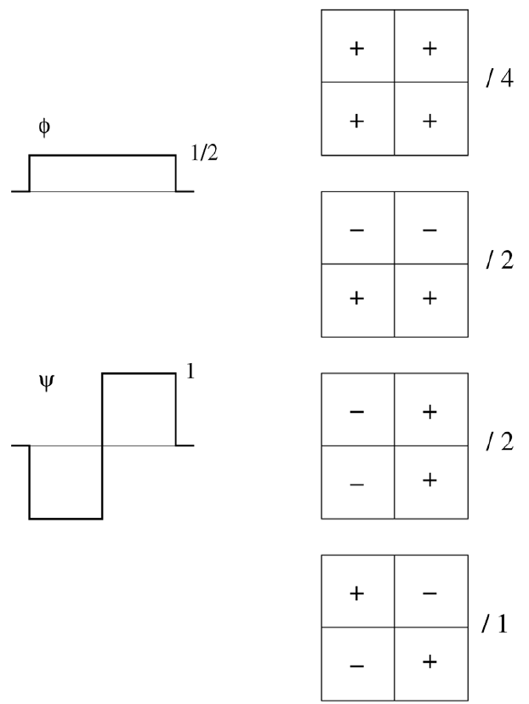
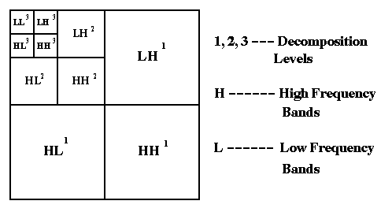
2D Haar wavelet filter
2D wavelets are obtained from the orthogonal products of the corresponding 1D wavelet and scaling function
2D Haar Wavelet Decomposition:

Slide 24
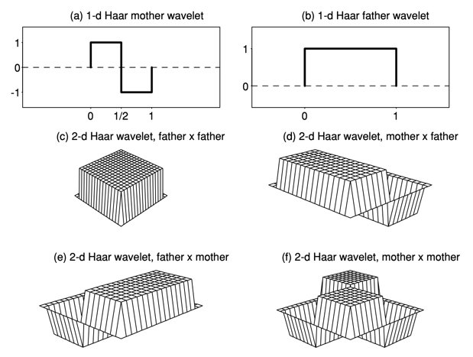
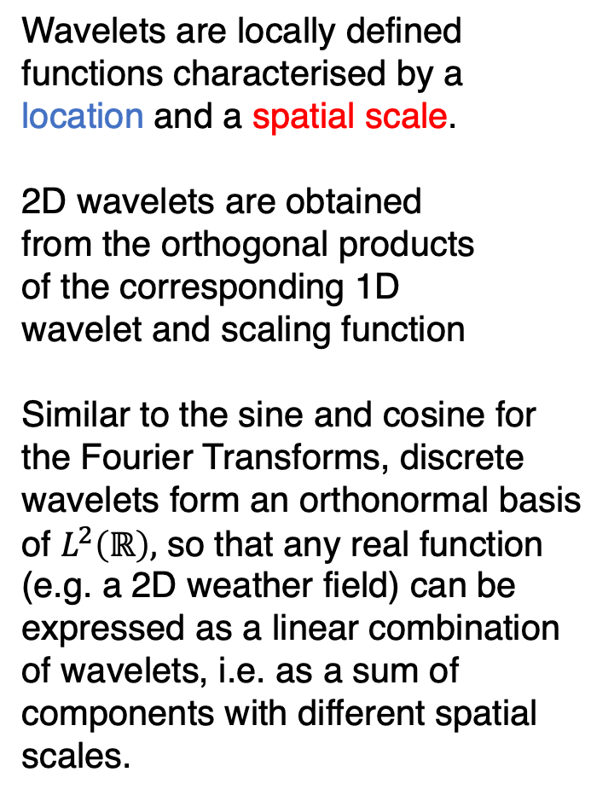
The 2D Haar wavelet
Wavelets are locally defined functions characterised by a
location and a spatial scale.
2D wavelets are obtained
from the orthogonal products
of the corresponding 1D
wavelet and scaling function
Similar to the sine and cosine for the Fourier Transforms, discrete wavelets form an orthonormal basis of $L^{2}\left(ℝ\right),$ so that any real function (e.g. a 2D weather field) can be expressed as a linear combination of wavelets, i.e. as a sum of components with different spatial scales.

Slide 25
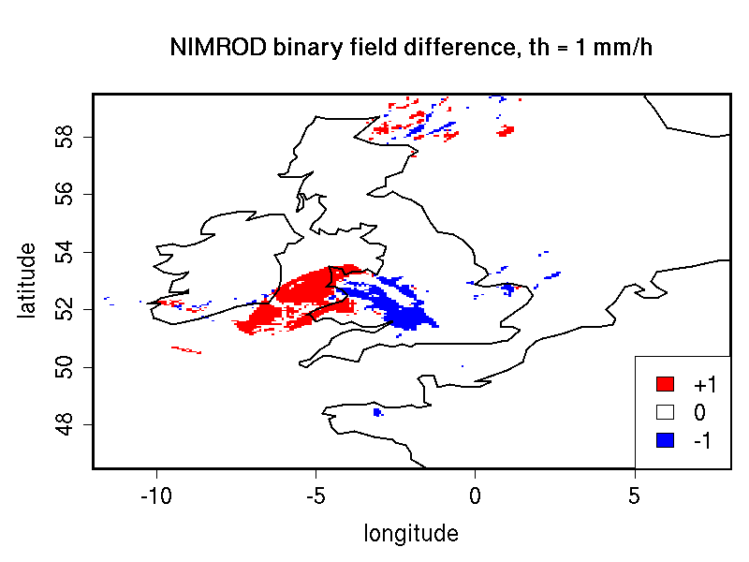
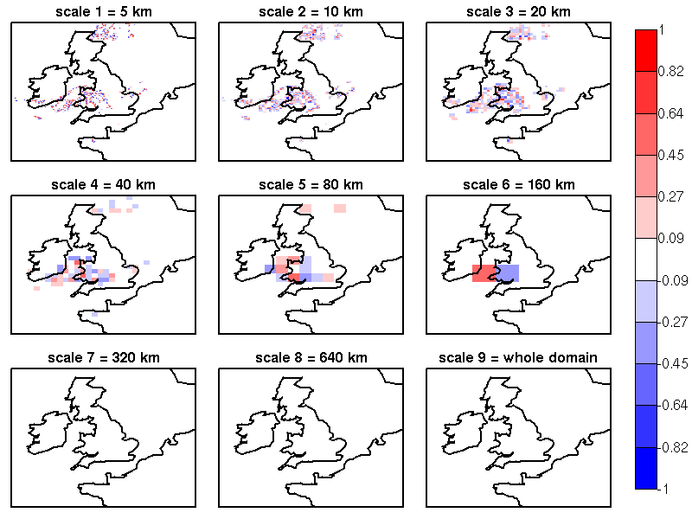

2D Haar discrete wavelet decomposition
The field is decomposed into the sum of different components on different spatial scales
The largest component is the field average.
$$Z=Σ_{j=1}^{J}Z_{j}+\overline{Z}$$

Slide 26
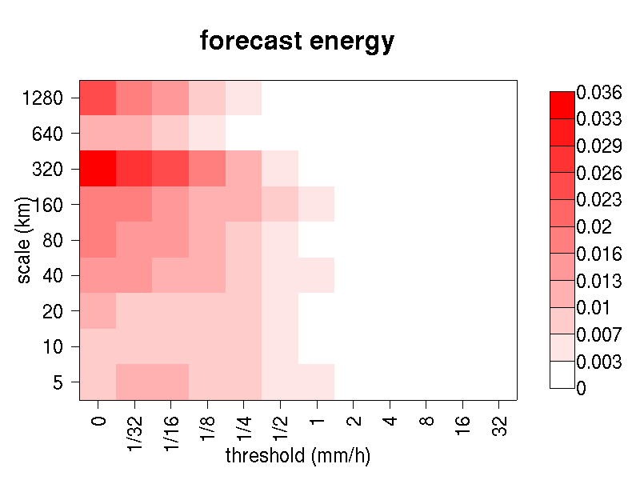
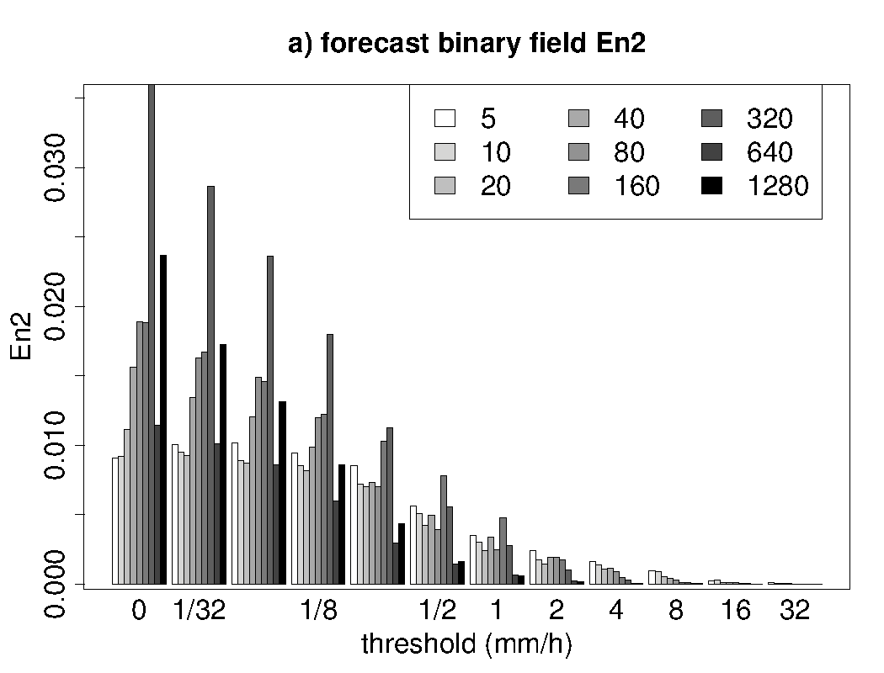
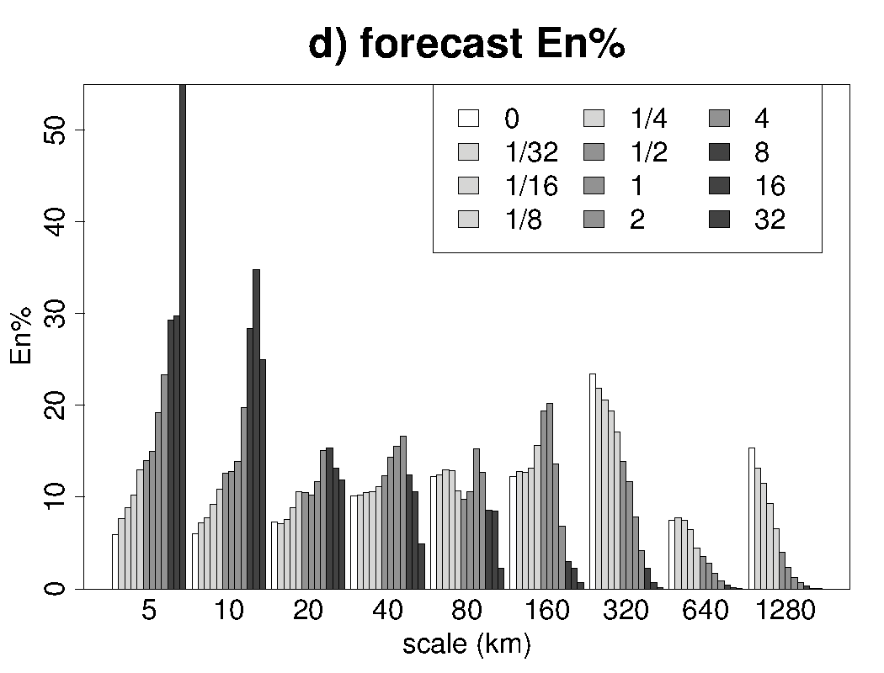
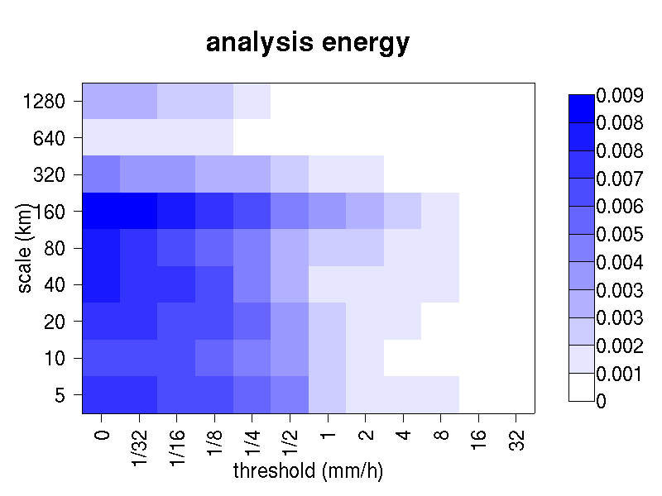
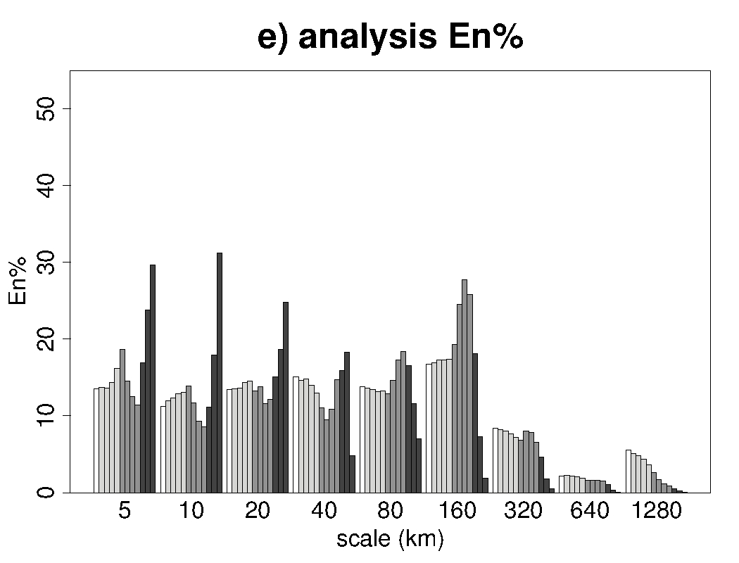
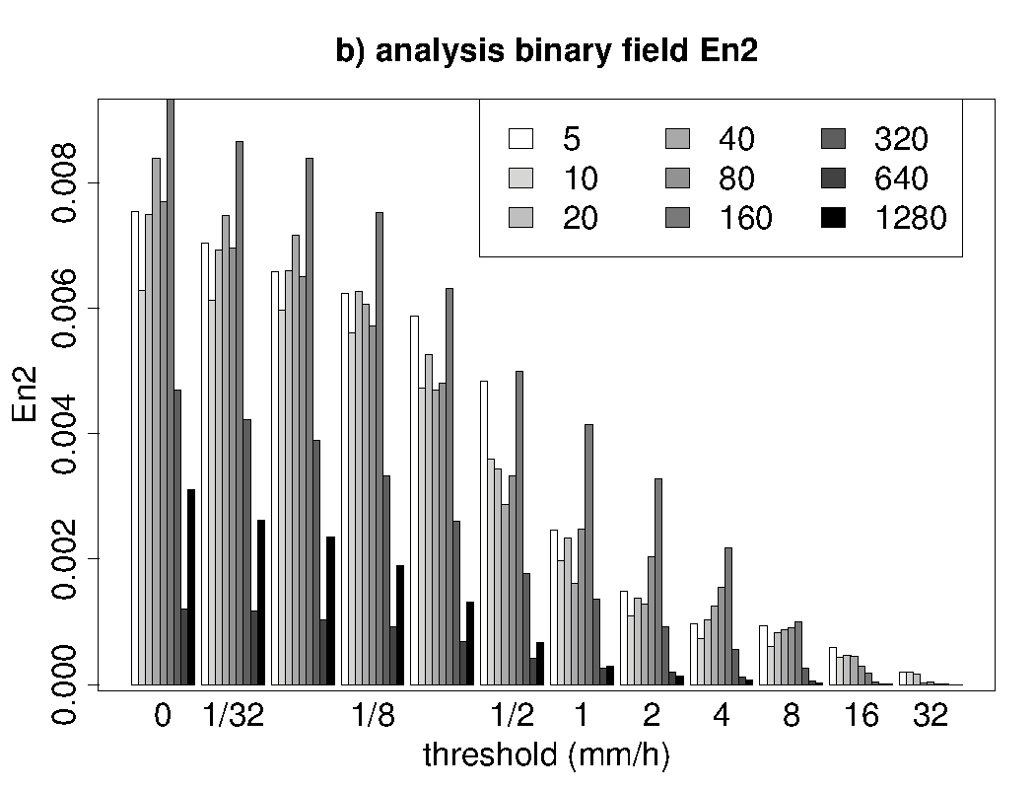
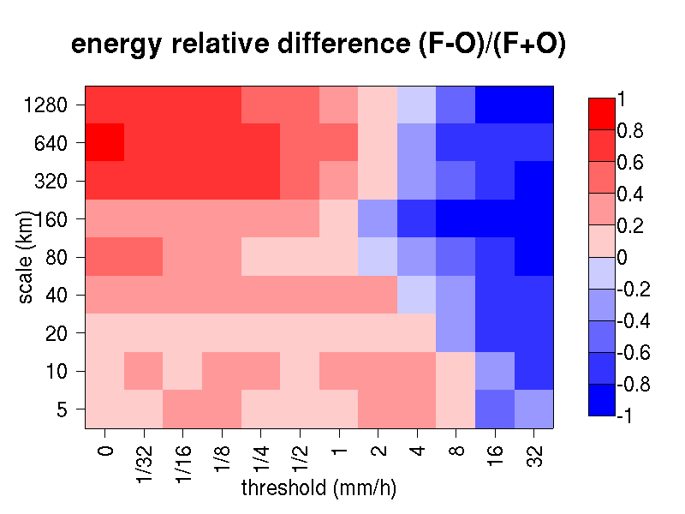
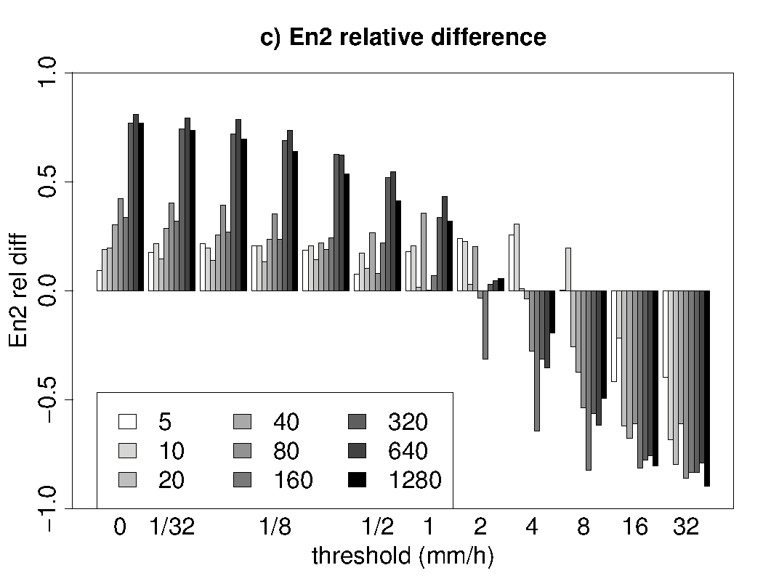
Casati (2010) Wea & For, vol. 25
Intensity-scale verification technique
For each threshold and scale:
energy informs on the amount of events;
energy relative diff. measures the bias;
energy % assess the scale structure.
Notes:
26

Slide 27
Extras:
Aggregation and Bootstrap CI

Slide 28
Aggregation and bootstrap Confidence Intervals of the scale separation and continuous statistics
Results are aggregated on 50 cases of intense precipitation in 2010-2014.
90% bootstrap confidence intervals for these aggregated 50 cases are shown.
90% CI

Slide 29
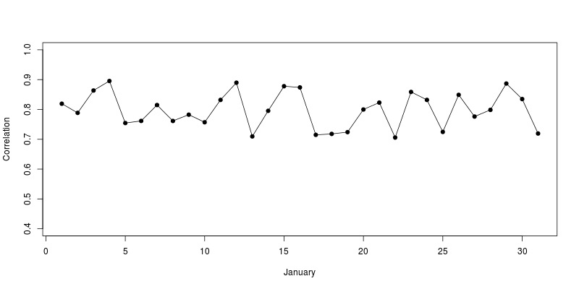
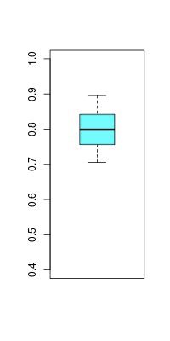
Aggregation is not equivalent to averaging
The aggregated score is the score obtained by pulling all the data together, for all cases, prior to evaluating the score itself.
Example1: the aggregated correlation is different than averaging the correlations of individual days
Example2: the aggregated MSE is equivalent to averaging the MSE of the individual days provided they were evaluated over the same sample size; otherwise a weighted mean ought to be used, with weights proportional to the different sample sizes (e.g. number of stations reporting each day).

Slide 30
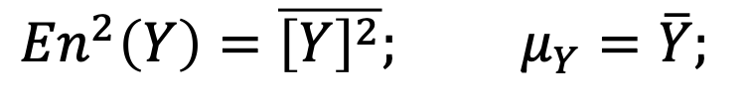
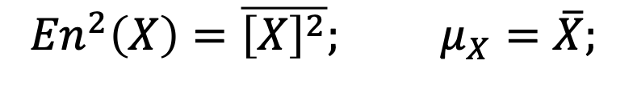
Aggregation of the continuous scores
All the continuous scores described in this study can be calculated from five “atomic” statistics: the forecast (Y) and observation (X) means, their energies (which are the means of the squared values) and the MSE:
We first aggregate the five atomic statistics over the 50 case studies, by averaging the forecast and observation means, energies and MSE over the 50 cases [50 fields, they have all the same size];
Then, from these aggregated atomic statistics we evaluate all the other aggregated statistics (aggregated over the 50 case studies).
$${En}^{2}\left(Y\right)=\overline{{\left[Y\right]}^{2}}; μ_{Y}=\overline{Y};$$
$${En}^{2}\left(X\right)=\overline{{\left[X\right]}^{2}}; μ_{X}=\overline{X};$$
$$MSE\left(Y,X\right)= \overline{{\left[Y−X\right]}^{2}}$$

Slide 31
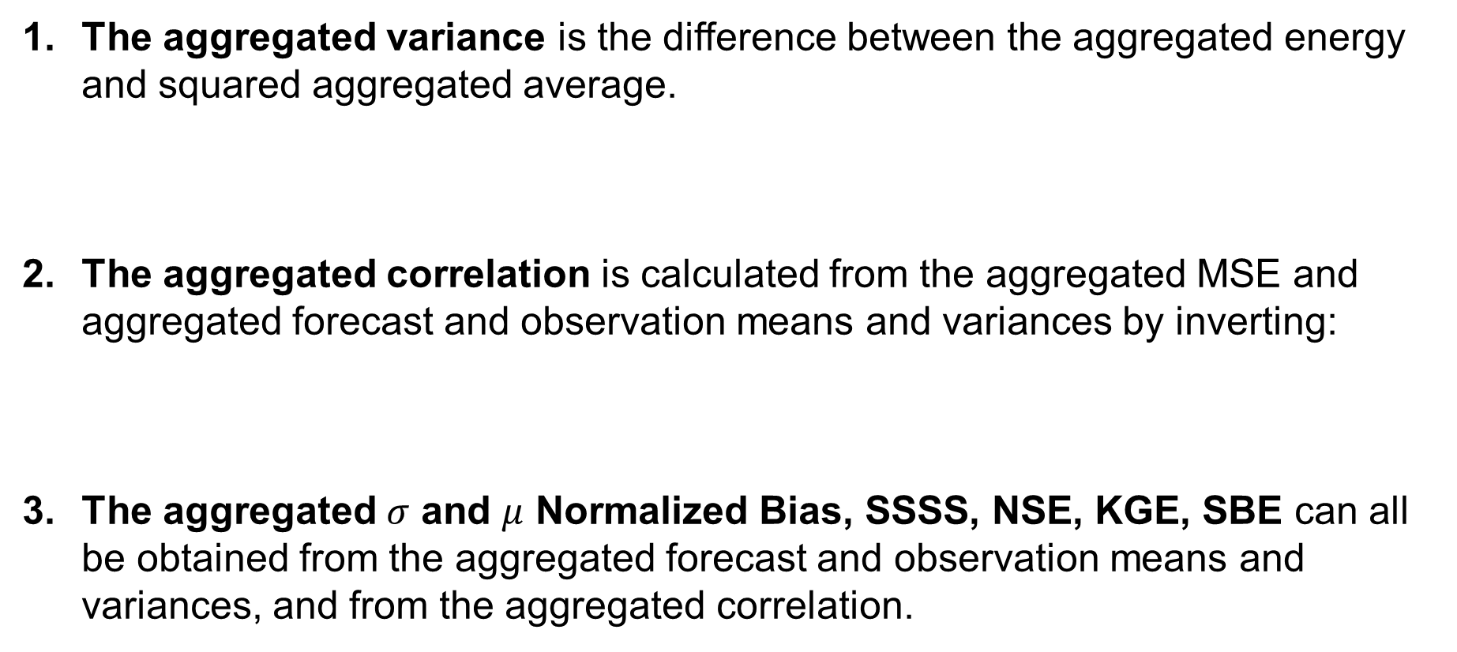

Examples
The aggregated variance is the difference between the aggregated energy and squared aggregated average.
The aggregated correlation is calculated from the aggregated MSE and aggregated forecast and observation means and variances by inverting:
The aggregated $σ$ and $μ$ Normalized Bias, SSSS, NSE, KGE, SBE can all be obtained from the aggregated forecast and observation means and variances, and from the aggregated correlation.
$${σ_{Y}^{2}=\overline{{\left[Y\right]}^{2}} −{\overline{Y}}^{2}=En}^{2}\left(Y\right)−μ_{Y}^{2}$$
$$MSE\left(Y,X\right)= \overline{{\left[Y−X\right]}^{2}}= {\left(μ_{Y}−μ_{X}\right)}^{2}+σ_{Y}^{2}+σ_{X}^{2}−2σ_{Y}σ_{X}r_{Y,X}$$

Slide 32
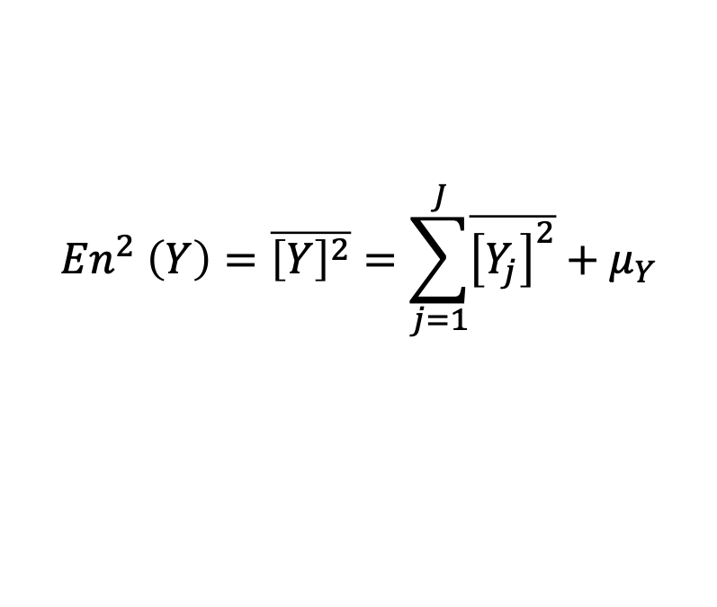
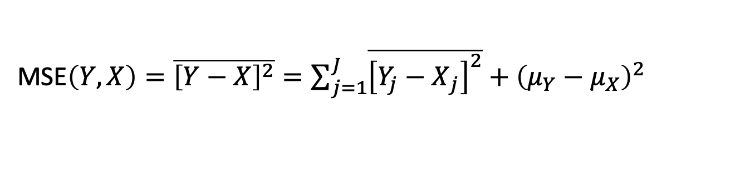
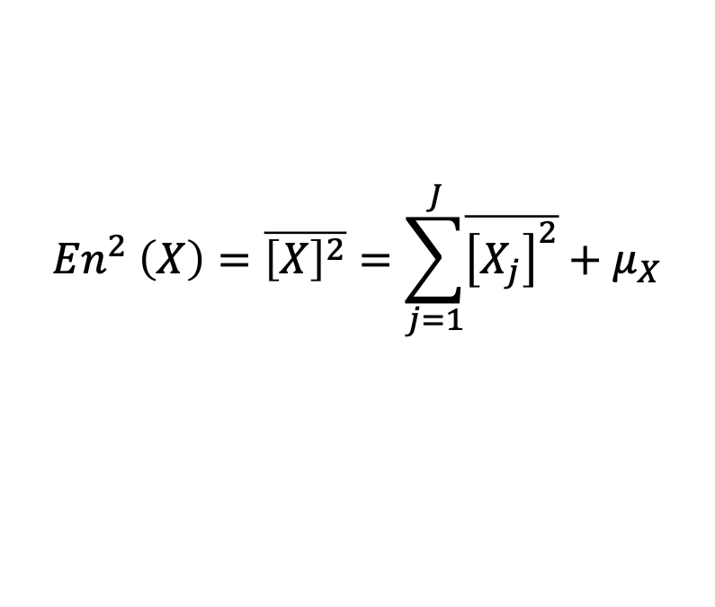
Aggregation of the scale separation statistics
The scale-separation statistics described in this study can be calculated from three “atomic” scale-separated statistics: the forecast and observation energies and the MSE, over the different scales j=1, … ,J:
For each scale, we first aggregate the three atomic statistics, over all the 50 case studies, by averaging the forecast and observation energies and MSE over the 50 cases [again, the 50 individual cases have same sample size];
Then, from these aggregated atomic statistics we evaluate all the other aggregated scale-separation statistics.
$${En}^{2} \left(Y\right)=\overline{{\left[Y\right]}^{2}}=\sum_{j=1}^{J}{\overline{{\left[Y_{j}\right]}^{2}}}+μ_{Y}$$
$${En}^{2} \left(X\right)=\overline{{\left[X\right]}^{2}}=\sum_{j=1}^{J}{\overline{{\left[X_{j}\right]}^{2}}}+μ_{X}$$
MSE$\left(Y,X\right)=\overline{{\left[Y−X\right]}^{2}}=\sum_{j=1}^{J}{\overline{{\left[{Y_{j}−X}_{j}\right]}^{2}}}+{\left(μ_{Y}−μ_{X}\right)}^{2}$

Slide 33



Bootstrap Confidence Intervals
90% Confidence Intervals associated to the aggregated scores (right panel)
are different (usually they are much less wide)
than the 5%-95% span of the scores for the 50 individual cases (left panel)

Slide 34






90% Bootstrap CI differs from sample pdf 5%-95% span
2m temperature, January time-series
2m temperature bias, January time-series

Slide 35









Bootstrap Confidence Intervals
re-sampling allowing repetition is performed on the 50 case studies*
for each re-sample the aggregated scores are evaluated (from the atomic stats) as described before.
we obtain 1000 aggregated scores, for 1000 resamples.
the 90% confidence interval is estimated from the 5% and 95% quantiles of the aggregated scores from the 1000 re-samples.
ORIGINAL SAMPLE -> AGGREGATED SCORE

Slide 36






Bootstrap Confidence Intervals
re-sampling allowing repetition is performed on the 50 case studies*
for each re-sample the aggregated scores are evaluated (from the atomic stats) as described before.
we obtain 1000 aggregated scores, for 1000 resamples.
the 90% confidence interval is estimated from the 5% and 95% quantiles of the aggregated scores from the 1000 re-samples.
ORIGINAL SAMPLE -> AGGREGATED SCORE
1st RE-SAMPLE -> AGGREGATED SCORE

Slide 37






Bootstrap Confidence Intervals
re-sampling allowing repetition is performed on the 50 case studies*
for each re-sample the aggregated scores are evaluated (from the atomic stats) as described before.
we obtain 1000 aggregated scores, for 1000 resamples.
the 90% confidence interval is estimated from the 5% and 95% quantiles of the aggregated scores from the 1000 re-samples.
ORIGINAL SAMPLE -> AGGREGATED SCORE
1st RE-SAMPLE -> AGGREGATED SCORE
2nd RE-SAMPLE -> AGGREGATED SCORE

Slide 38

Bootstrap Confidence Intervals
re-sampling allowing repetition is performed on the 50 case studies*
for each re-sample the aggregated scores are evaluated (from the atomic stats) as described before.
we obtain 1000 aggregated scores, for 1000 resamples.
the 90% confidence interval is estimated from the 5% and 95% quantiles of the aggregated scores from the 1000 re-samples.
ORIGINAL SAMPLE -> AGGREGATED SCORE
1st RE-SAMPLE -> AGGREGATED SCORE
2nd RE-SAMPLE -> AGGREGATED SCORE
3rd RE-SAMPLE -> AGGREGATED SCORE

Slide 39


Bootstrap Confidence Intervals
re-sampling allowing repetition is performed on the 50 case studies*
for each re-sample the aggregated scores are evaluated (from the atomic stats) as described before.
we obtain 1000 aggregated scores, for 1000 resamples.
the 90% confidence interval is estimated from the 5% and 95% quantiles of the aggregated scores from the 1000 re-samples.
ORIGINAL SAMPLE -> AGGREGATED SCORE
1st RE-SAMPLE -> AGGREGATED SCORE
4th RE-SAMPLE -> AGGREGATED SCORE
2nd RE-SAMPLE -> AGGREGATED SCORE
5th RE-SAMPLE -> AGGREGATED SCORE
3rd RE-SAMPLE -> AGGREGATED SCORE
6th RE-SAMPLE -> AGGREGATED SCORE
N^{th} RE-SAMPLE -> AGGREGATED SCORE

Slide 40

Bootstrap Confidence Intervals
re-sampling allowing repetition is performed on the 50 case studies*
for each re-sample the aggregated scores are evaluated (from the atomic stats) as described before.
we obtain 1000 aggregated scores, for 1000 resamples.
the 90% confidence interval is estimated from the 5% and 95% quantiles of the aggregated scores from the 1000 re-samples.
ORIGINAL SAMPLE -> AGGREGATED SCORE
1st RE-SAMPLE -> AGGREGATED SCORE
4th RE-SAMPLE -> AGGREGATED SCORE
2nd RE-SAMPLE -> AGGREGATED SCORE
5th RE-SAMPLE -> AGGREGATED SCORE
3rd RE-SAMPLE -> AGGREGATED SCORE
6th RE-SAMPLE -> AGGREGATED SCORE
N^{th} RE-SAMPLE -> AGGREGATED SCORE

Slide 41
Bootstrap Confidence Intervals
re-sampling allowing repetition is performed on the 50 case studies*
for each re-sample the aggregated scores are evaluated (from the atomic stats) as described before.
we obtain 1000 aggregated scores, for 1000 resamples.
the 90% confidence interval is estimated from the 5% and 95% quantiles of the aggregated scores from the 1000 re-samples.
ORIGINAL SAMPLE -> AGGREGATED SCORE
1st RE-SAMPLE -> AGGREGATED SCORE
4th RE-SAMPLE -> AGGREGATED SCORE
2nd RE-SAMPLE -> AGGREGATED SCORE
5th RE-SAMPLE -> AGGREGATED SCORE
3rd RE-SAMPLE -> AGGREGATED SCORE
6th RE-SAMPLE -> AGGREGATED SCORE
N^{th} RE-SAMPLE -> AGGREGATED SCORE
* trick: I do not resample the cases, I do not perform again the wavelet decomposition of the precipitation fields, 1000 times for 50 cases: I resample the atomic statistics!

Slide 42

Block bootstrapping (1/2)
COSMO-REA6 = 50 precipitation fields
EA-HRES = 50 precipitation fields
EA-EDA = 10 members x 50 cases = 500 precipitation fields
For each of the 50 synoptic situations analyzed, the ten EA-EDA ensemble members are not independent, since they represent the same weather. Hence, when bootstrapping on the 500 cases, we substantially underestimate the confidence intervals.
Too thin intervals, due to data dependency (members reproduce same weather event)

Slide 43
Block bootstrapping (2/2)
COSMO-REA6 = 50 precipitation fields
EA-HRES = 50 precipitation fields
EA-EDA = 10 members x 50 cases = 500 precipitation fields
For the EA-EDA members we perform a block bootstrapping, where the blocks are the aggregated atomic statistics of the ten ensemble members compared against COSMO-REA6, for each of the 50 synoptic situations analyzed.
Block bootstrap removes the effects of data dependency

