Slide 1
Effect of grain-size evolution on the lower mantle dynamics
Jyotirmoy Paul^{1*}, Gregor J. Golabek¹, Antoine Rozel², Paul Tackley², Tomo Katsura¹, Hongzhan Fei¹
¹ Bayerisches Geoinstitut, University of Bayreuth, * jyotirmoy.paul@uni-bayreuth.de, ² Institut für Geophysik, ETH Zürich

Slide 2
Effect of grain size
$$η_{df}=η_{0}\exp\left(\frac{E_{df}+PV_{df}}{RT}\right) {\left( \frac{𝕽}{𝕽_{0}}\right)}^{m}$$
$η_{df}$: Diffusion creep viscosity
$E_{df}$ : Activation energy for diffusion creep
$V_{df}$: Activation volume for diffusion creep
$𝕽_{0}$: Initial Grain size
$𝕽$ : equilibrium Grain size
Grain-size dependence
Initial grain size ($𝕽_{0}$) | New grain size ($𝕽$) | Viscosity change
100 μm | 500 μm | ~125×
100 μm | 1000 μm | ~1000×

Slide 3
Grain-size Evolution
$$\frac{dℜ}{dt}= \frac{G}{pℜ^{p−1}} − \frac{λ_{3}}{λ_{2}}\frac{ℜ^{2}}{3γ} f_{G}ψ$$
Grain reduction term
Grain growth term
$$G= k_{0}\exp\left(−\frac{E_{g}}{RT}\right)$$
$γ$: Surface tension
$λ_{3}$ and $λ_{2}$ : Dimensionless constants derived by Rozel et al. (2011)
$f_{G}$ : Work done to create new grain boundaries
$ψ$: Shear heating to create new grain boundary
$G$ : Grain coarsening coefficient
$p$: Grain coarsening exponent
$k_{0}$: Experimental prefactor
$R$: Universal gas constant
$E_{g}$: Activation energy
$T$: Temperature in Kelvin

Slide 4
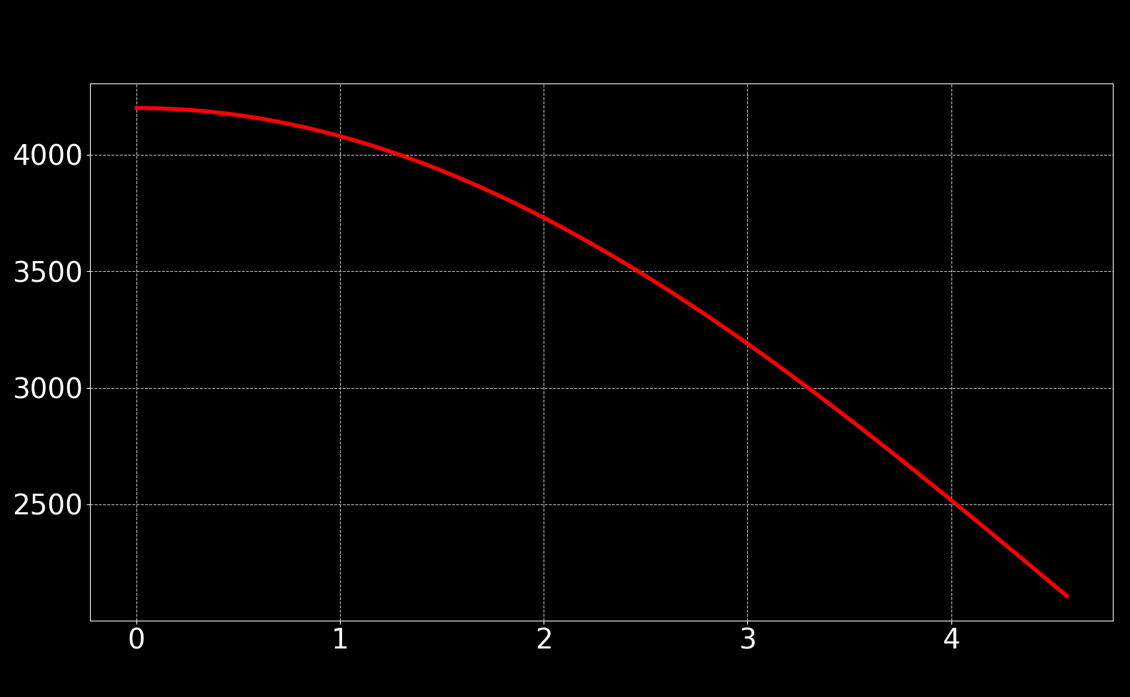
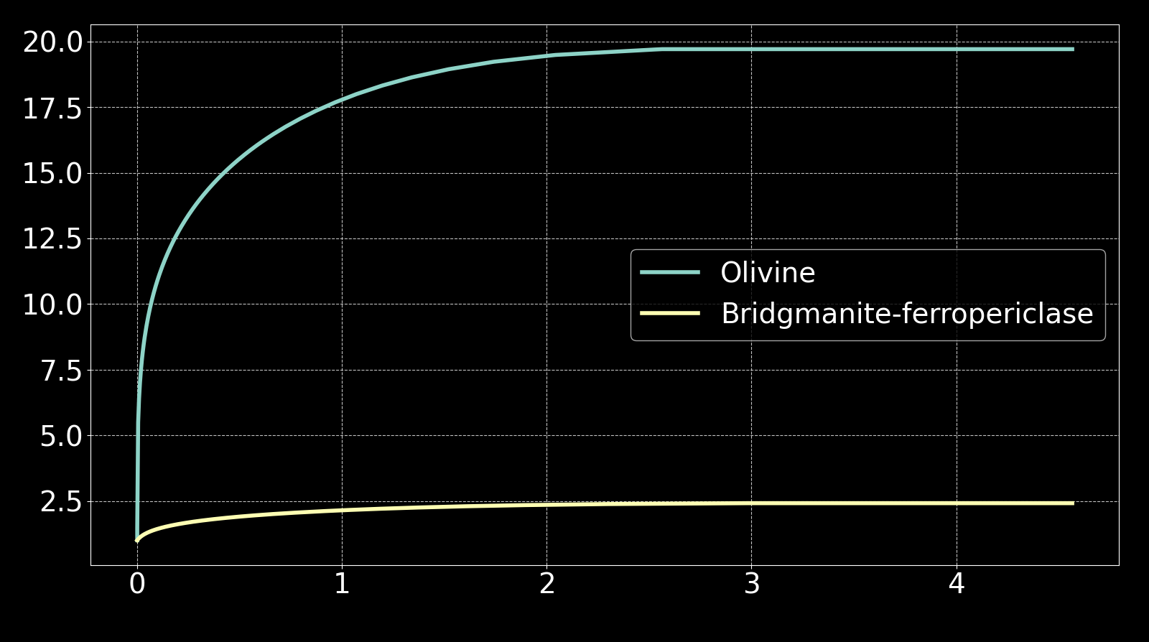
Differential grain growth of mantle minerals
A 0-D calculation assuming a simple cooling profile
Temperature I [K]
$$G= k_{0}\exp\left(−\frac{E_{g}}{RT}\right)$$
Time in billion years
(Hiraga et al., 2010)
(Fei et al., 2021)
$$\frac{𝕽}{𝕽_{0}}$$
$${\left(\frac{𝕽}{𝕽_{0}}\right)}_{ol}\sim 20$$
$${\left(\frac{𝕽}{𝕽_{0}}\right)}_{bg−fp}\sim 3$$
Time in billion years

Slide 5
Model types
Model Type | Parameter
Case I | No grain size evolution
Case II | Upper mantle (0-660 km) with olivine grain size evolution, Lower mantle with bridgmanite-ferropericlase grain size evolution (Fei et al., 2021)
Case III | Uniform grain size evolution parameters obtained from olivine experiment (Hiraga et al., 2010)

Slide 6
Case I
No grain growth,
η₀=10²³ Pa.s

Slide 7
Case II
Composite grain growth,
η₀=10²³ Pa.s

Slide 8
Case III
Uniform grain growth,
η₀=10²³ Pa.s

Slide 9
Case I
No grain growth,
η₀=10²² Pa.s

Slide 10
Case II
Composite grain growth,
η₀=10²² Pa.s

Slide 11
Case III
Uniform grain growth,
η₀=10²² Pa.s

Slide 12
Case I
No grain growth,
η₀=10²¹ Pa.s

Slide 13
Case II
Composite grain growth,
η₀=10²¹ Pa.s

Slide 14
Case III
Uniform grain growth,
η₀=10²¹ Pa.s

Slide 15
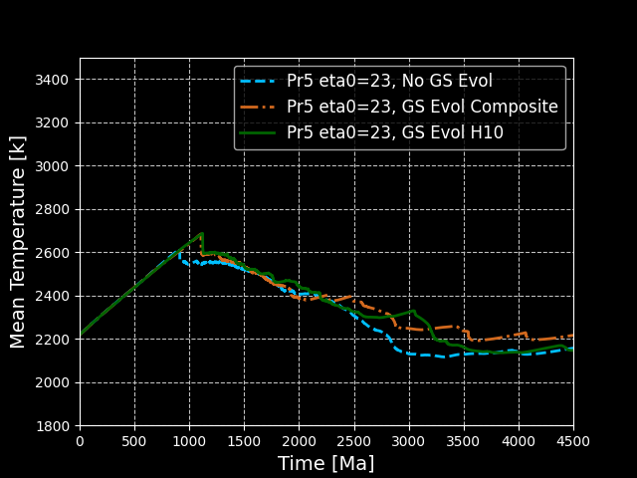
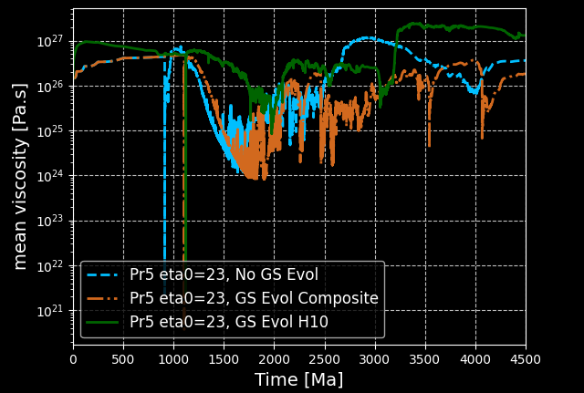
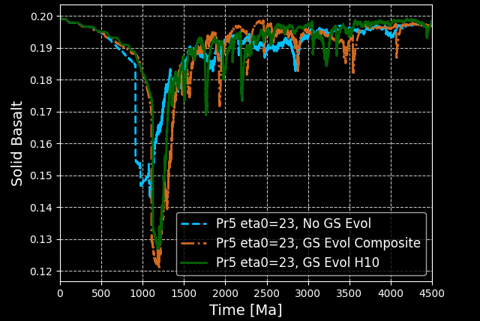
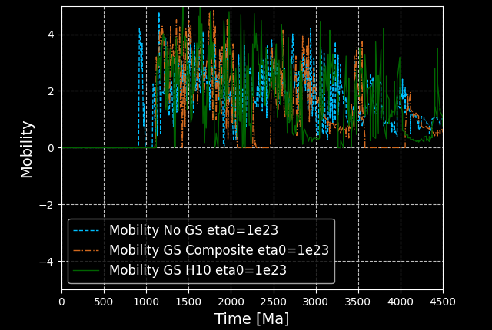

Slide 16
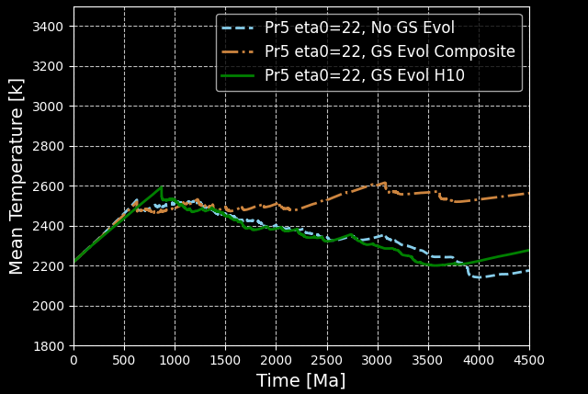
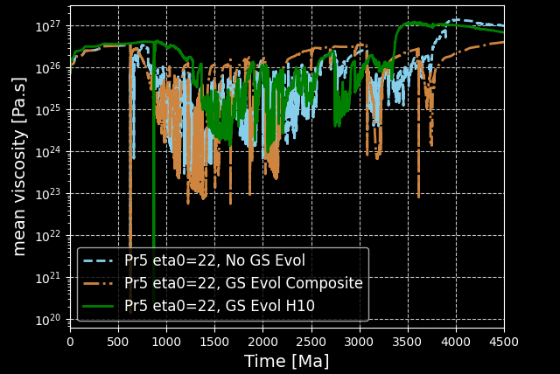
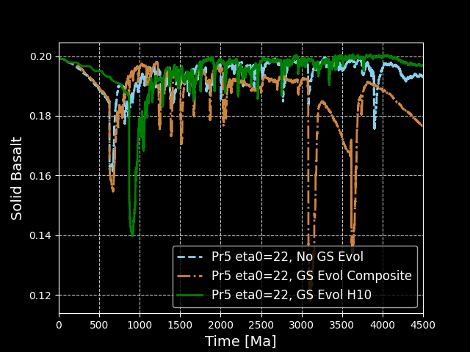
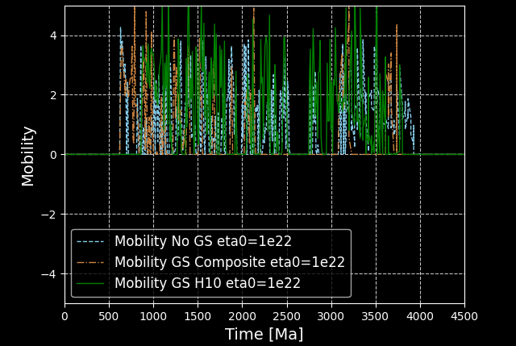

Slide 17
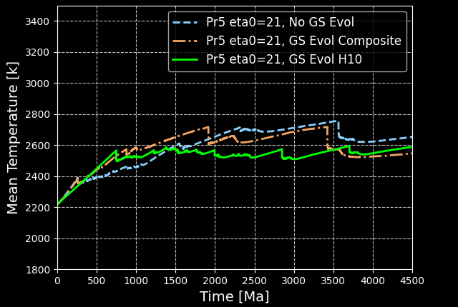
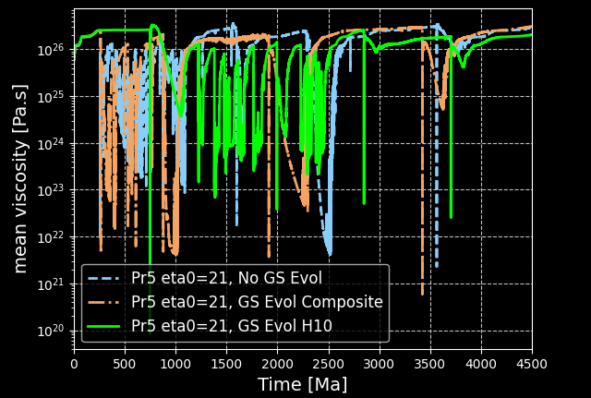
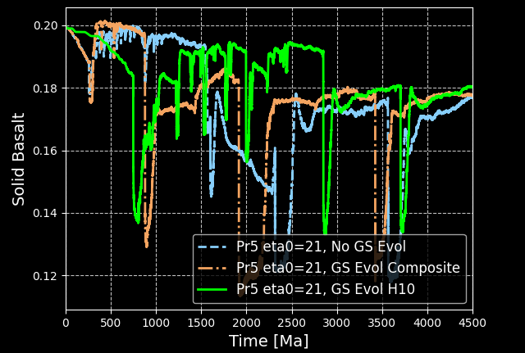
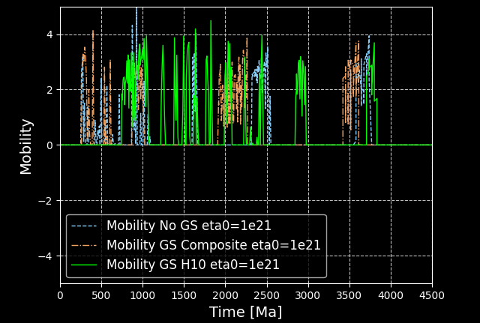

Slide 18
Conclusions
Gran size dependent viscosity has insignificant role in controlling lower mantle dynamics.
If the grain size is too large, dislocation creep starts dominating and viscosity becomes grain size independent
Recent experiment data of bridgmanite-ferropericlase grain growth suggests extremely slow grain growth of minerals (~3-5 times over 4.5 billion years). Such slow grain growth has hardly any effect on lower mantle dynamics.

