Slide 1
Mapping spatiotemporal variations in ionospheric electrodynamics
Karl Laundal, Jone Reistad, Spencer Hatch, Sara Gasparini, Simon Walker, Michael Madelaire, Anders Ohma, Amalie Hovland, Ashley Smith
github.com/klaundal/lompe
karl.laundal@uib.no

Slide 2
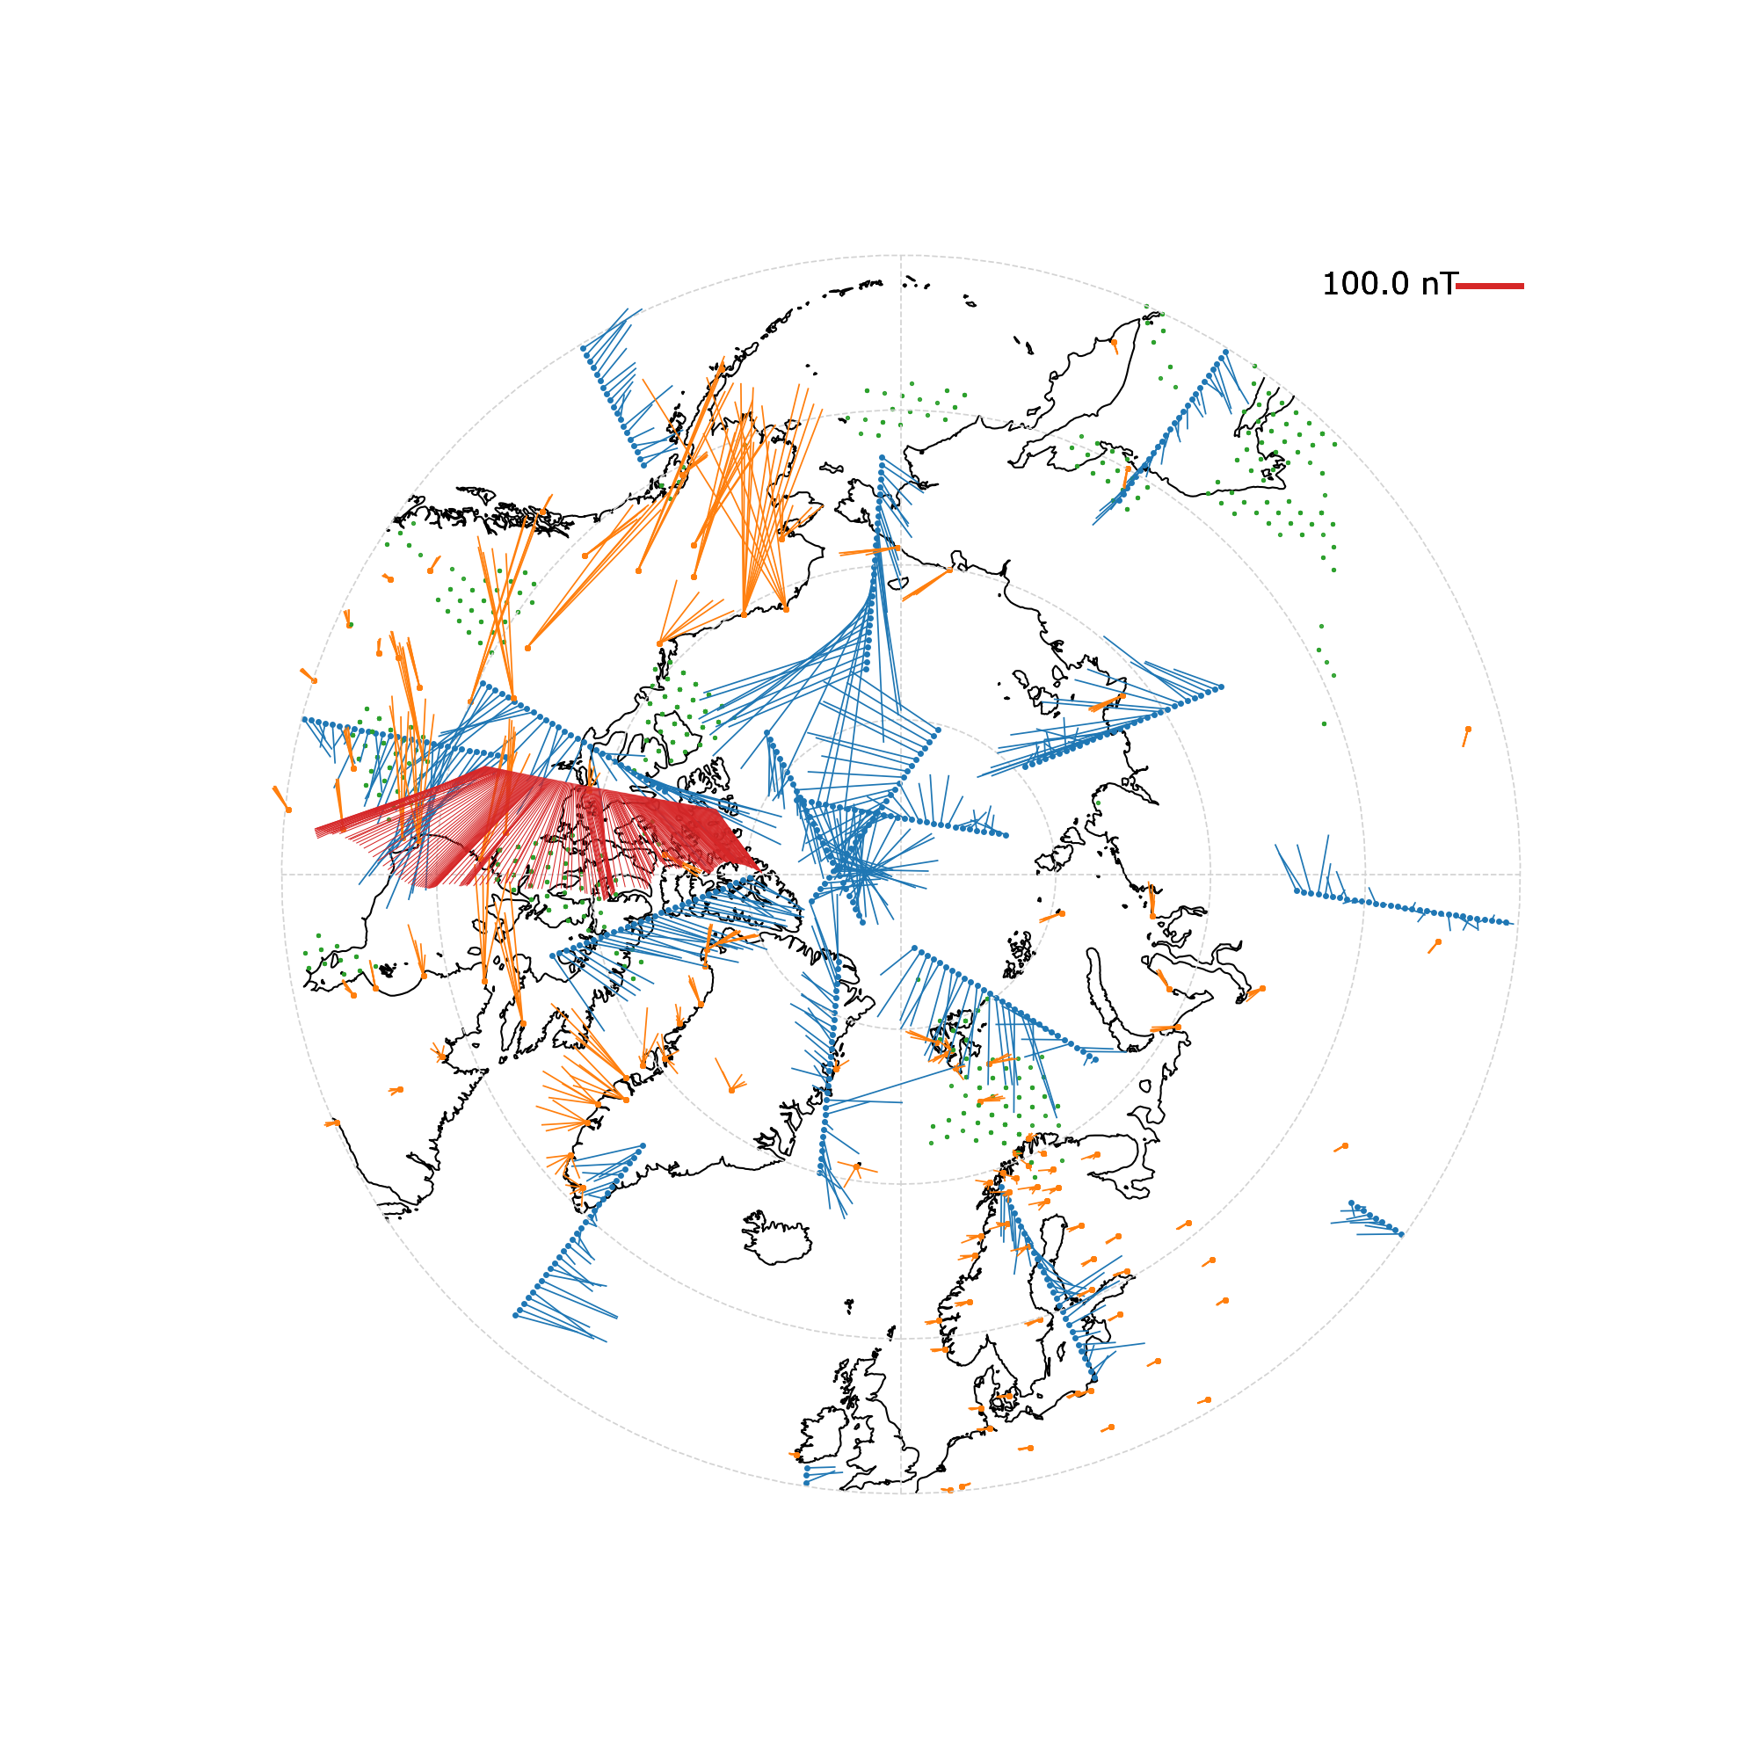
Swarm is not alone
The figure shows 4 min of data from Swarm bravo $ΔB$ (red) Iridium $ΔB$ (blue) Ground $ΔB$ (orange) SuperDARN $vlos$ locations (green)
How can we get the most out of all these different data sets?

Slide 3
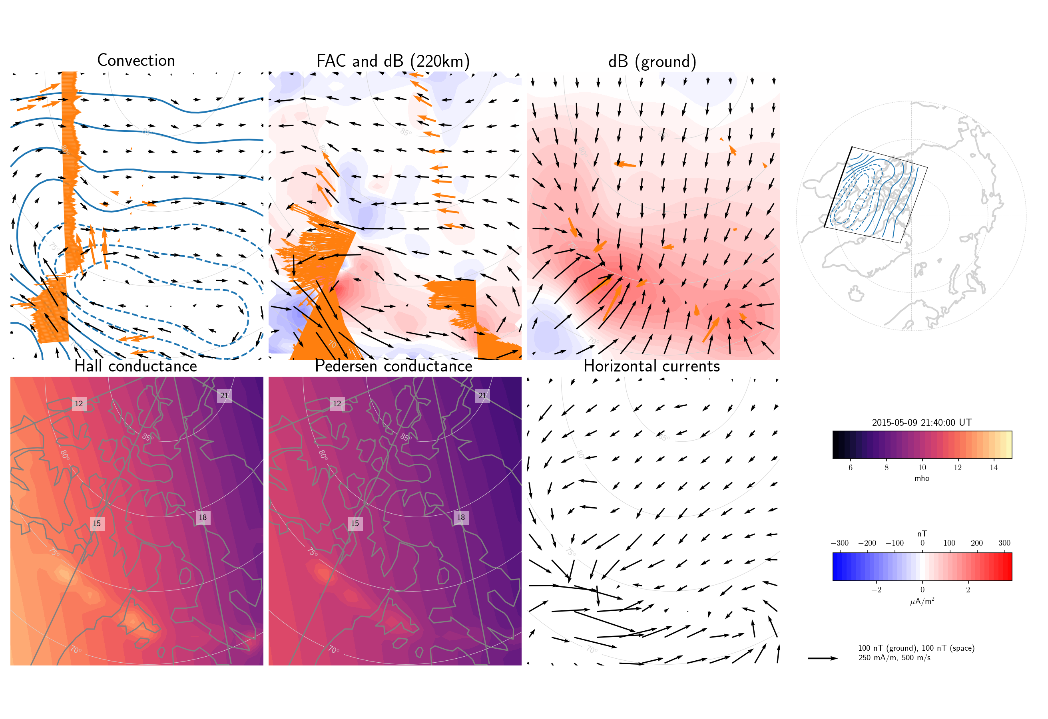
Local Mapping of Polar Ionospheric Electrodynamics (Lompe)
Example DMSP SSUSI UV scans $→$auroral conductance DMSP convection Swarm A, B, C magnetic field SuperDARN line-of-sight convection data Iridium magnetic field data
Ground magnetic field measurements

Slide 4
Ionospheric Ohm’s law
$$E=−v×B$$
$$J=Σ_{P}E+Σ_{H}B×E/B$$
Conductances
Main magnetic field (IGRF)
$$∇×ΔB=μ_{0}J$$
See Laundal et al. (2022) - JGR Space Physics doi.org/10.1029/2022JA030356 for all details on the Lompe formulation
Notes:
\begin{matrix}
\mathrm{Electric}\hspace{1mm}\mathrm{fields}\hspace{1mm}E\\
\mathrm{Velocities}\hspace{1mm}v\\
\mathrm{Ground}\hspace{1mm}\mathrm{magnetic}\hspace{1mm}\mathrm{disturbances}\hspace{1mm}\Delta B_g\\
\mathrm{Space}\hspace{1mm}\mathrm{magnetic}\hspace{1mm}\mathrm{disturbances}\hspace{1mm}\Delta B_s\\
\end{matrix}\hspace{2mm}\mathrm{are}\hspace{1mm}\mathrm{related}\hspace{1mm}\mathrm{to}\hspace{1mm}\mathrm{the}\hspace{1mm}\mathrm{same}\hspace{1mm}\mathrm{model}\hspace{1mm}\mathrm{vector}\hspace{1mm}m:\begin{pmatrix}
E\\
v\\
\Delta B_g\\
\Delta B_s\\
\end{pmatrix} = \begin{pmatrix}
G_E\\
G_v\\
G_{B_g}\\
G_{B_s}\\
\end{pmatrix}m = Gm

Slide 5
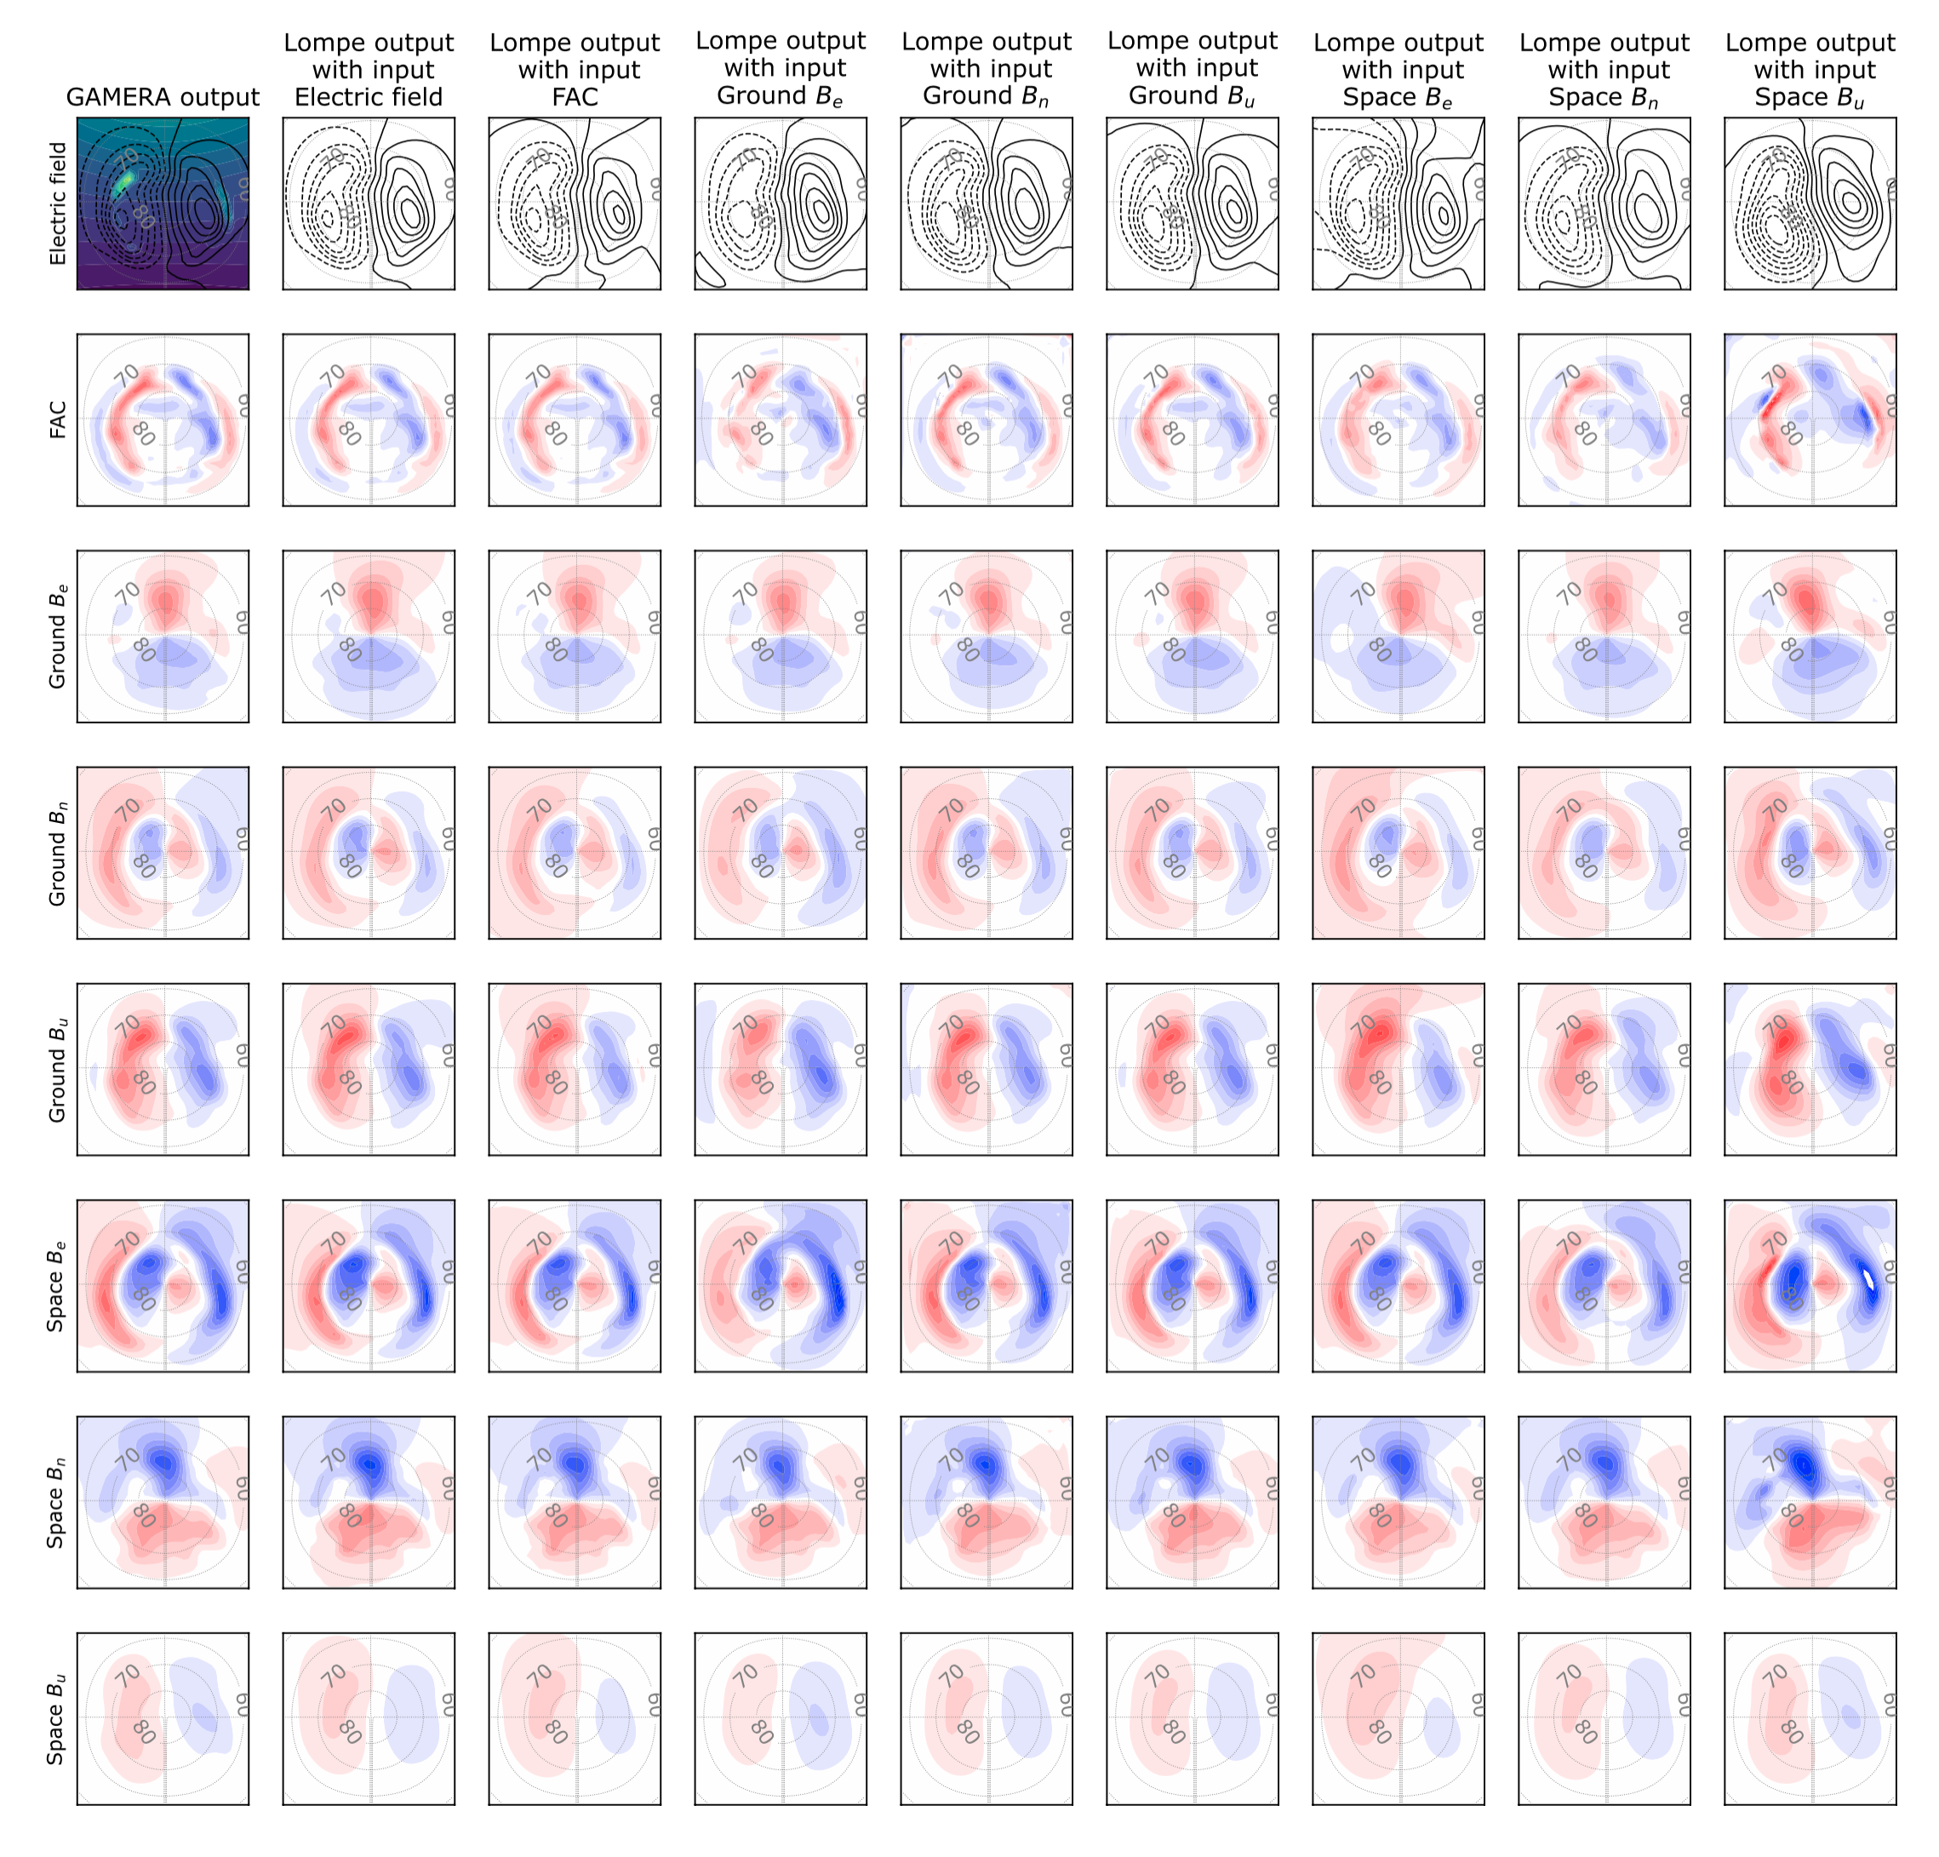
The Lompe concept
Input: Any combination of
Ground magnetic field
Space magnetic field
F-region plasma velocities
Ionospheric electric field
Field-aligned currents
Output:
All of the above

Slide 6
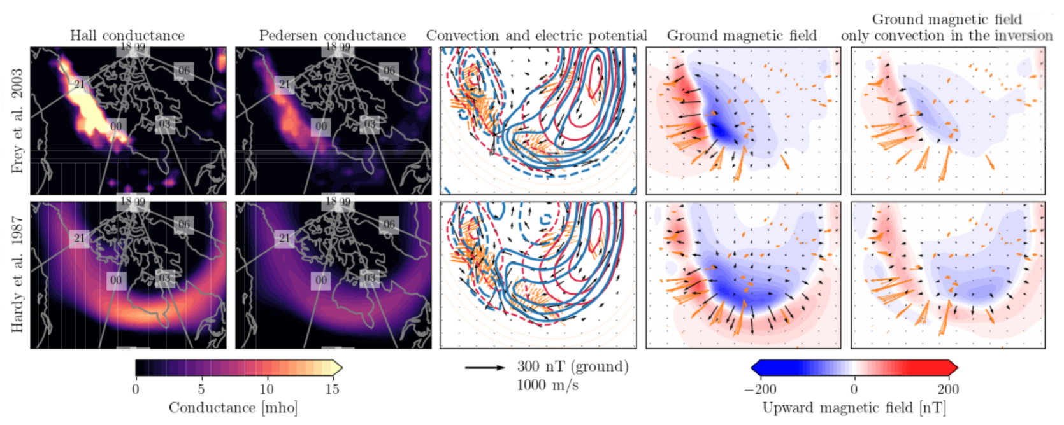
Major challenge: Auroral conductance
Knowing the conductance is critical for correctly relating magnetic field disturbances to ionospheric convection
Conductance based on UV imaging:
Conductance based on empirical model:
Different assumptions about the conductance can give very different results
See poster by Sara Gasparini for details (presenting right now)

Slide 7
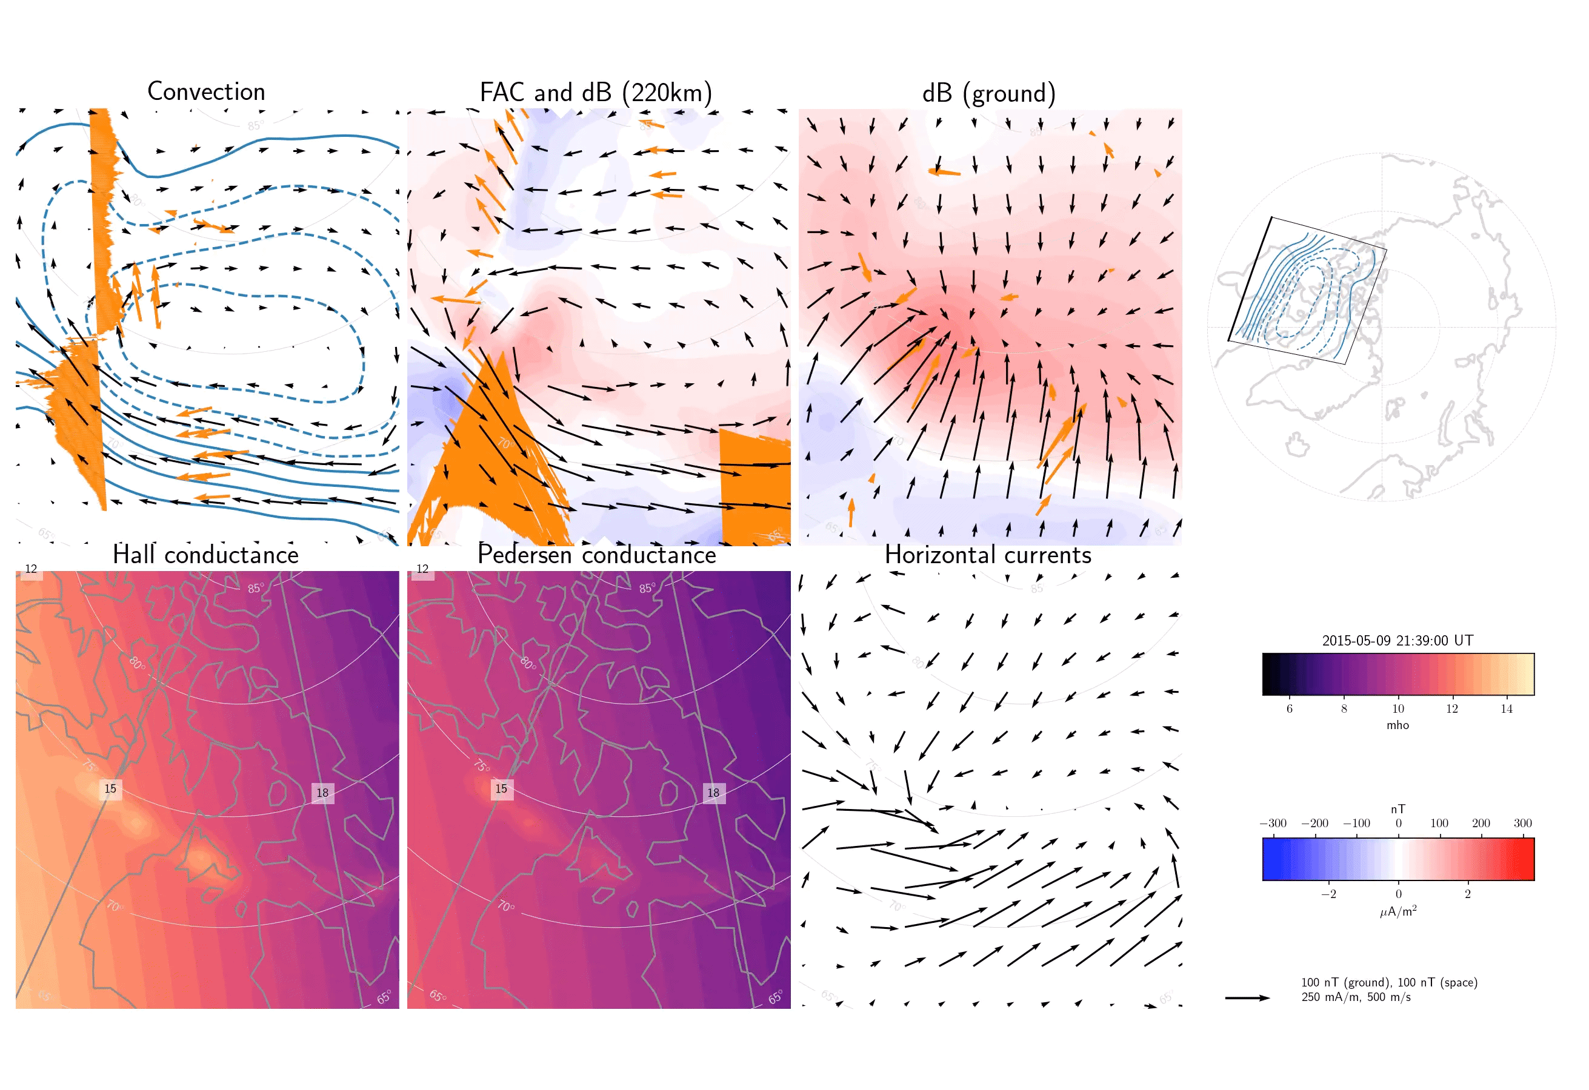
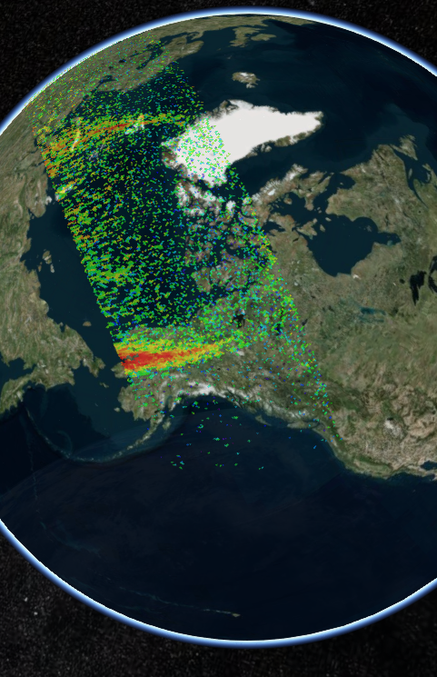
DMSP SSUSI
The only current instrument to reliably monitor auroral conductance
A ”1D camera” that scans the aurora every orbit
Project idea: Lock the Lompe grid to DMSP trajectory and make maps based on all data surrounding the ~400,000 SSUSI scans (proposed Horizon Europe)

Slide 8
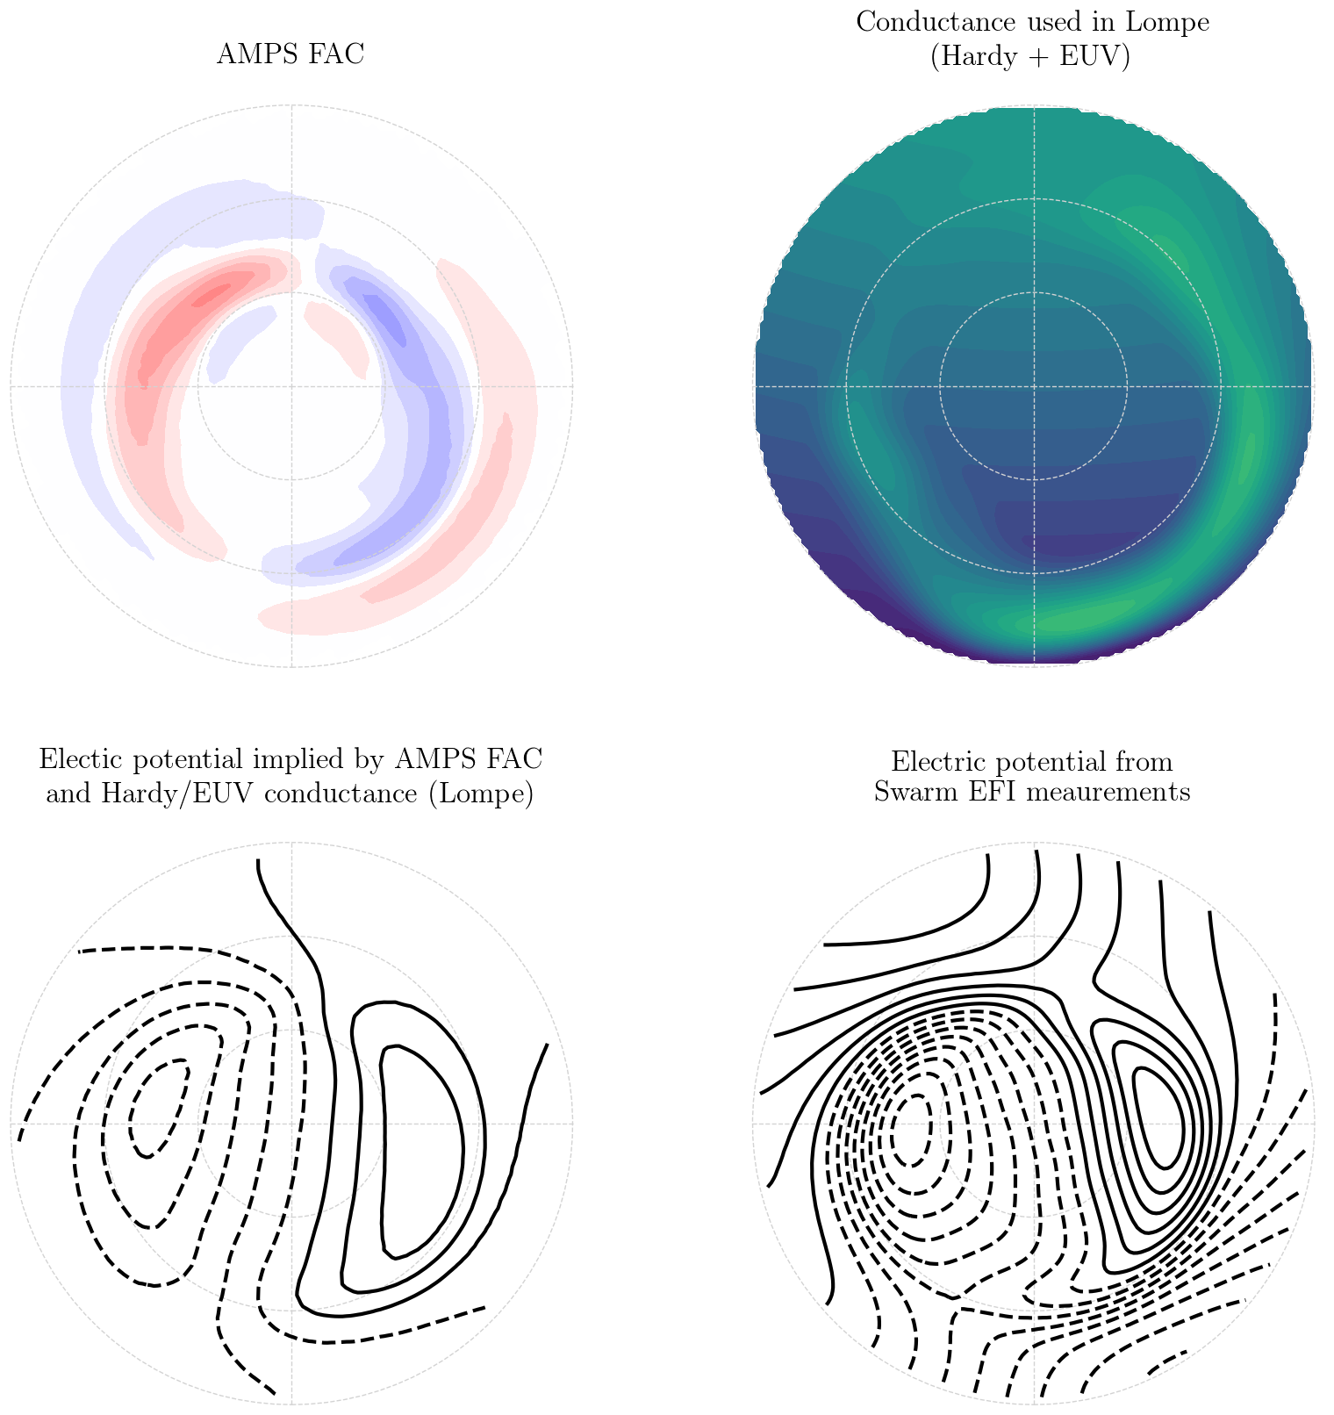
Combining Lompe and AMPS
AMPS is an empirical model of $ΔB$ and currents based on Swarm and CHAMP magnetic field data, funded by Swarm DISC github.com/klaundal/pyamps
Electric potential estimated with Swarm EFI data – preliminary output from future empirical model (Swarm DISC project led by Spencer Hatch)
Electric potential implied by AMPS and conductance pattern, calculated using Lompe

Slide 9
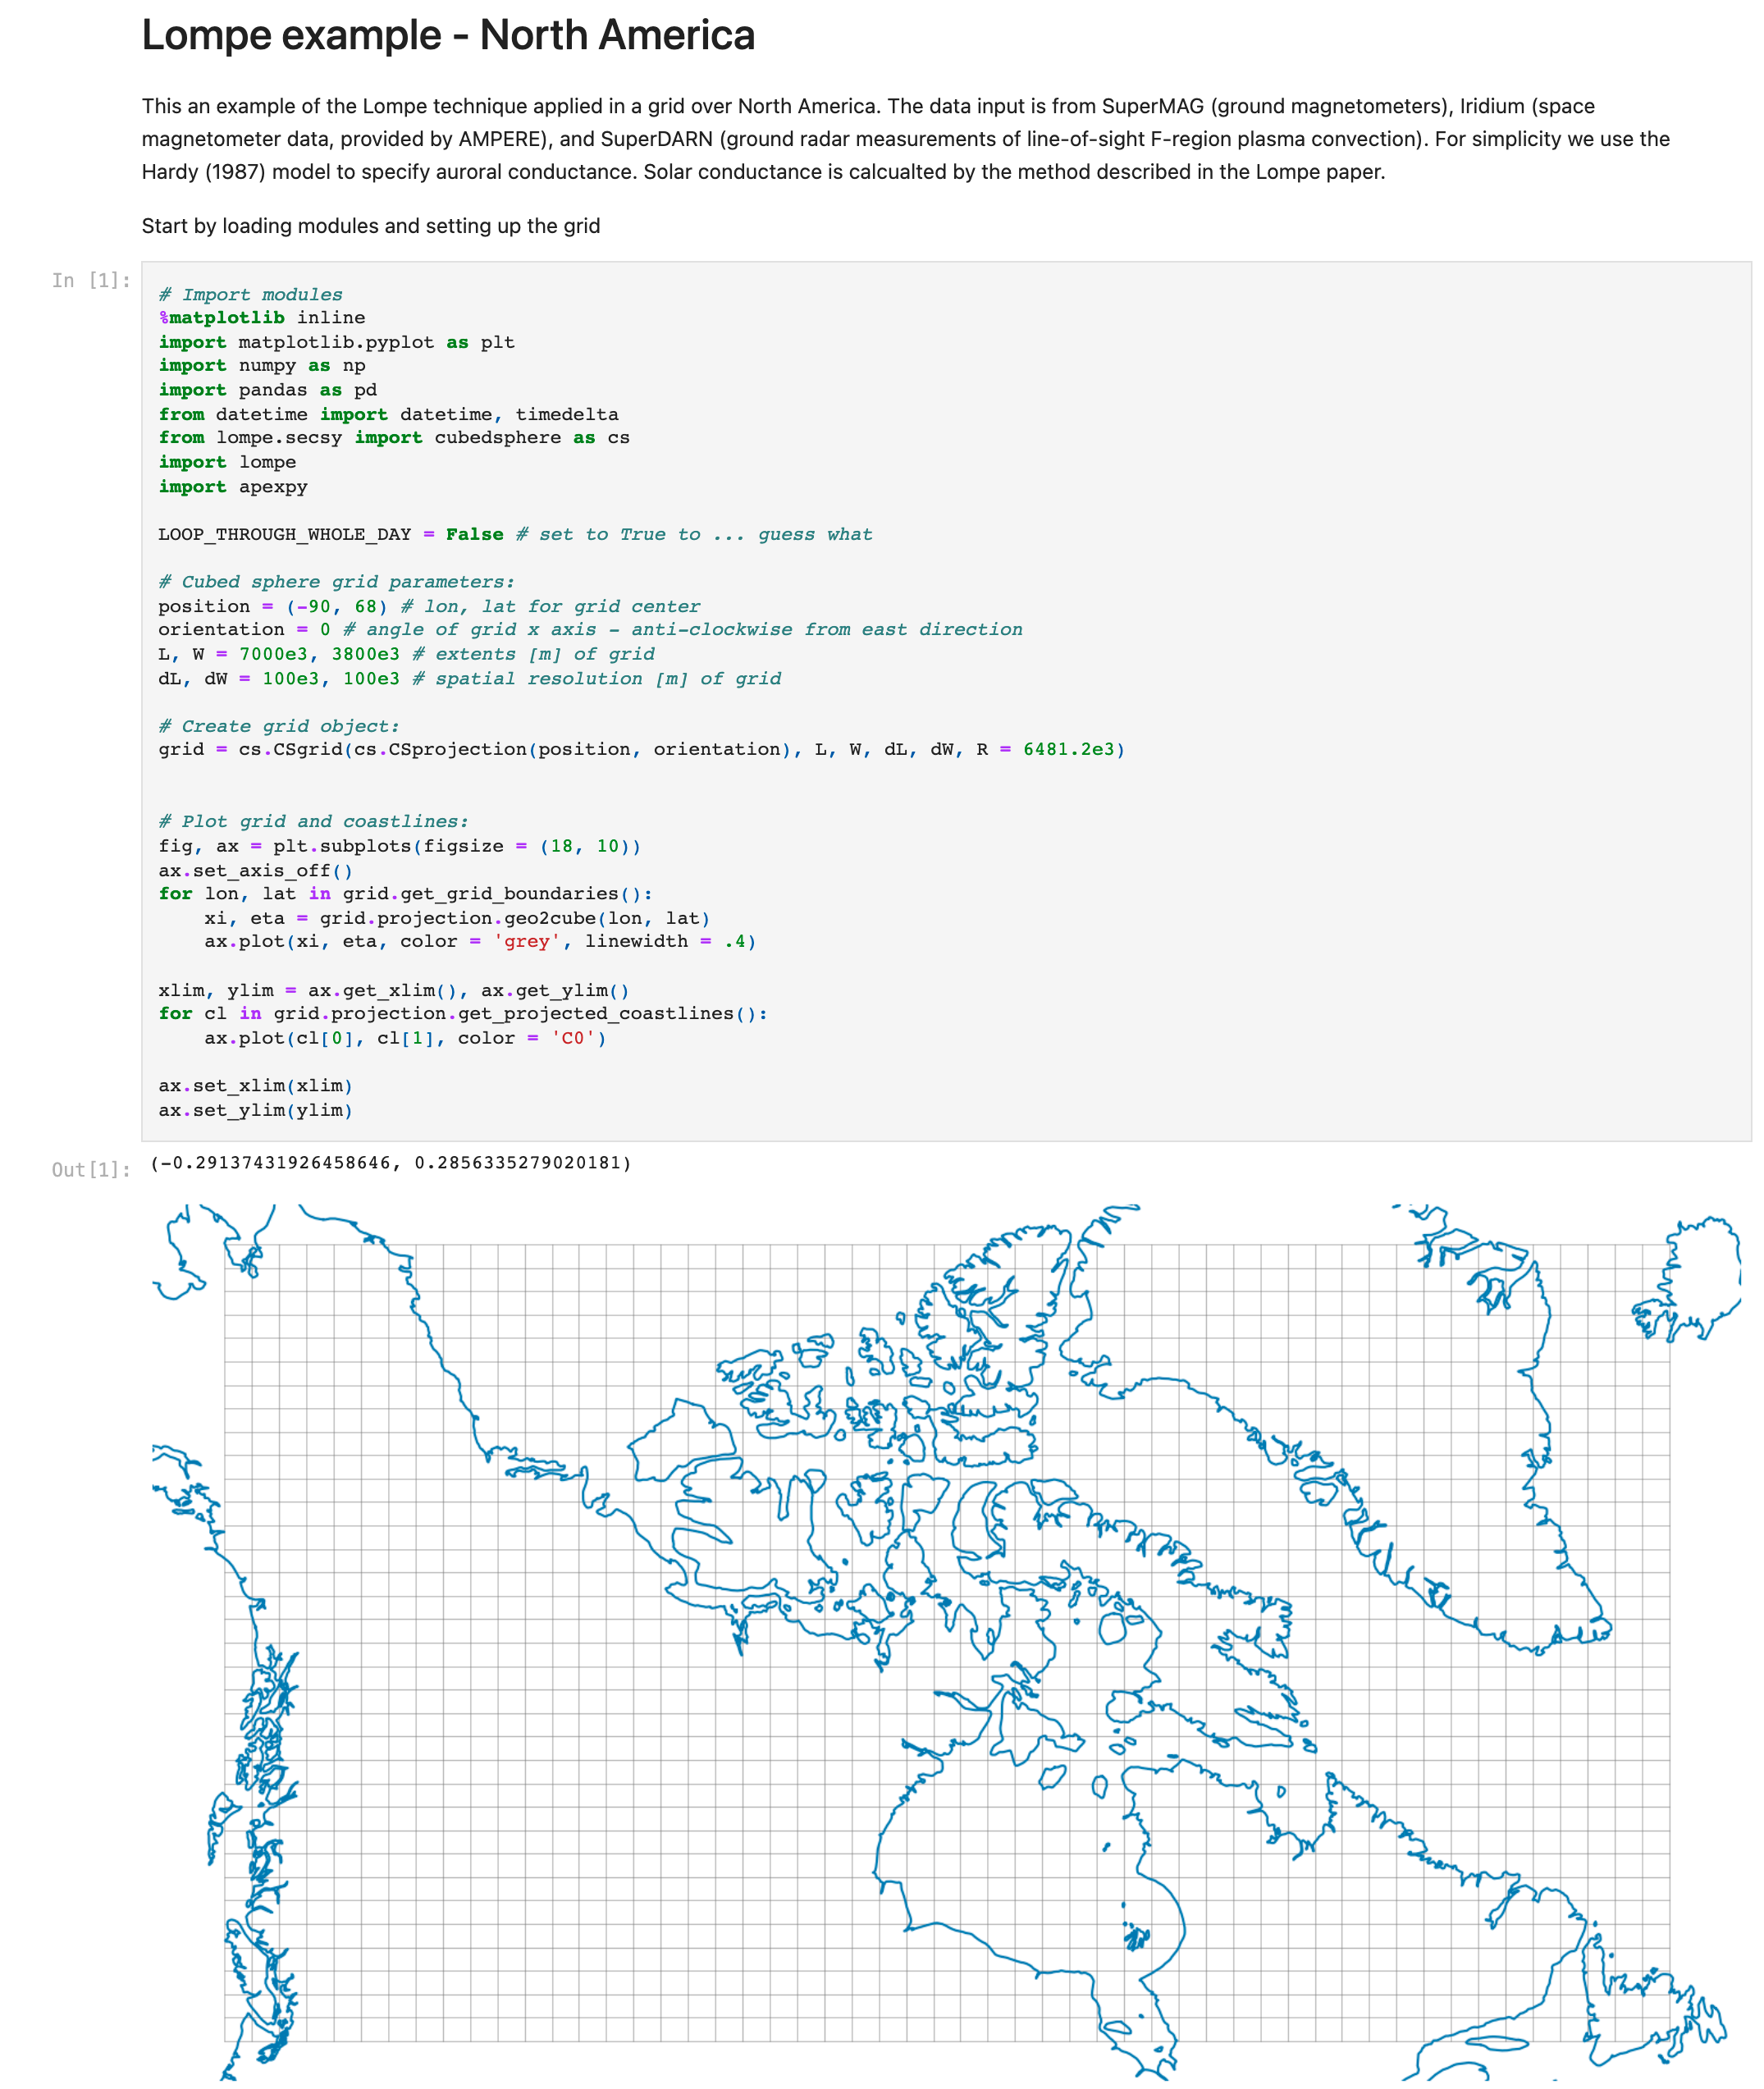
Lompe is open-source
The Lompe technique is implemented in Python
Includes Python code for working with Spherical Elementary Current Systems, for making polar plots, calculating IGRF model predictions, dipole coordinates, finite-difference differentiation in cubed sphere coordinates, ...
Code available at https://github.com/klaundal/lompe
Almost all published plots are made with notebooks in the examples folder
Papers: Lompe concept paper Laundal et al. (2022) - JGR Space Physics https://doi.org/10.1029/2022JA030356 Lompe code paper Hovland et al. (2022) - Frontiers https://doi.org/10.3389/fspas.2022.1025823

Slide 10
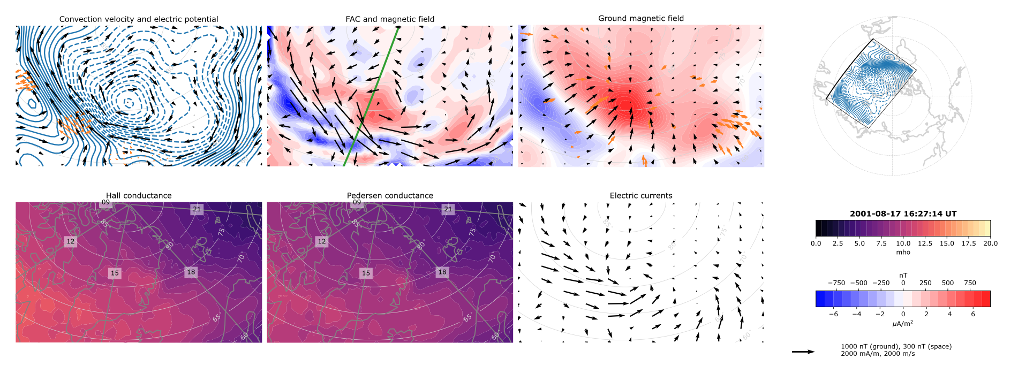
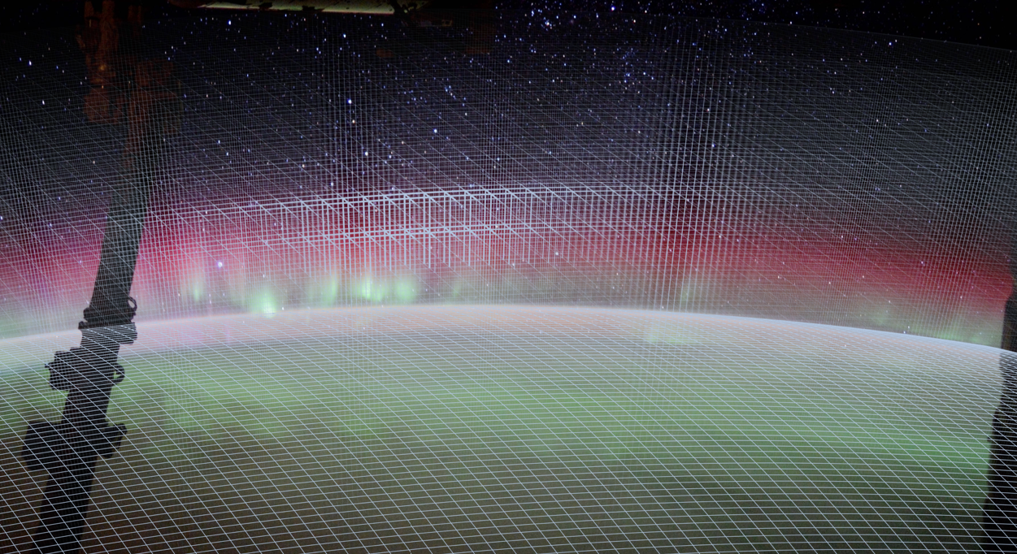
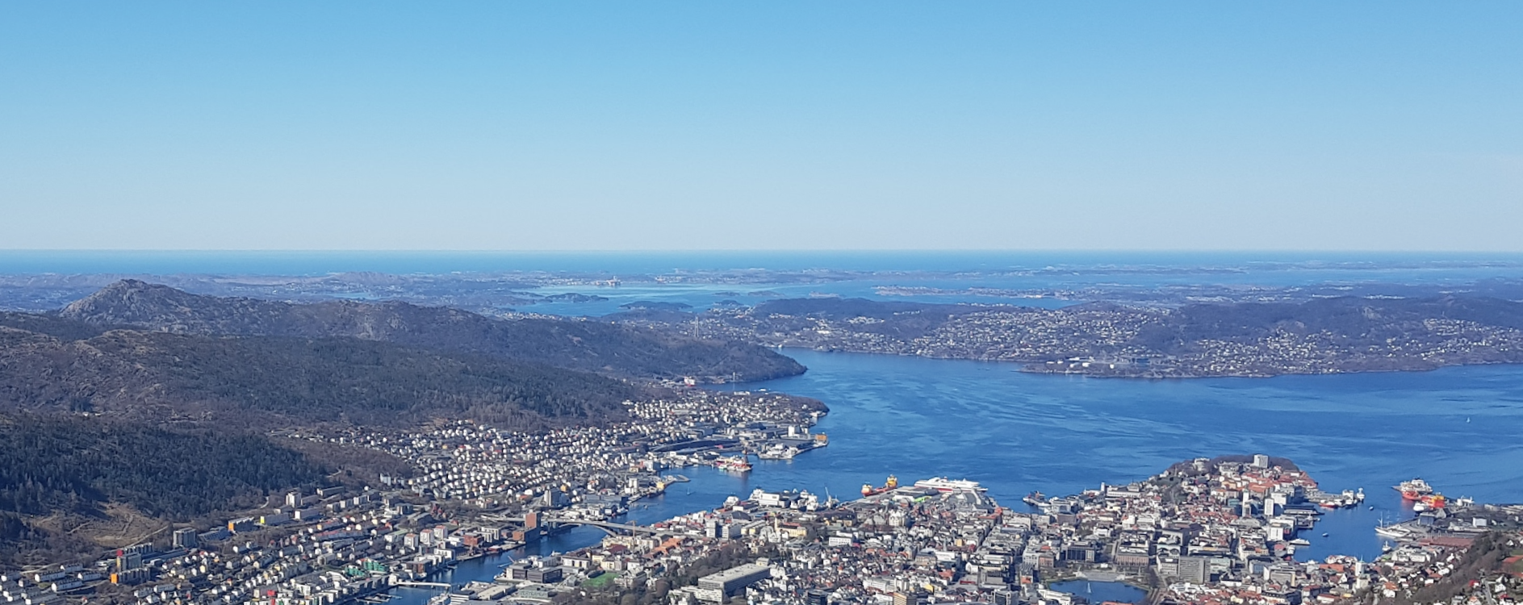
Future development
Lompe is developed as part of two projects, funded by the Norwegian Research Council and by Trond Mohn foundation
Future planned/possible improvements: Stabilize inversion in time using Kalman filter approach. Take into account ground induced currents Take into account induction electric field Take into account inclined magnetic field Better conductance models / co-estimate conductance Improve user-friendliness
2D steady state $→$ 3D dynamics 2 positions as researcher/developer just announced Funded for 5 years by the ERC
Come work with us and make a new dynamic 3D ionosphere simulation code
Bergen, Norway
karl.laundal@uib.no

Slide 13
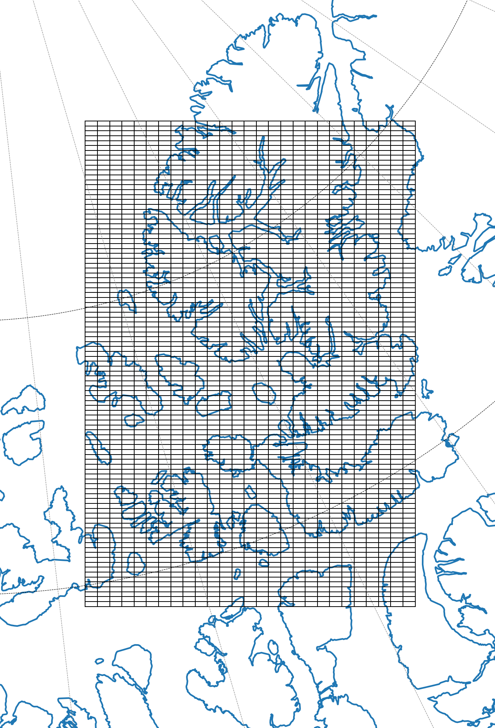
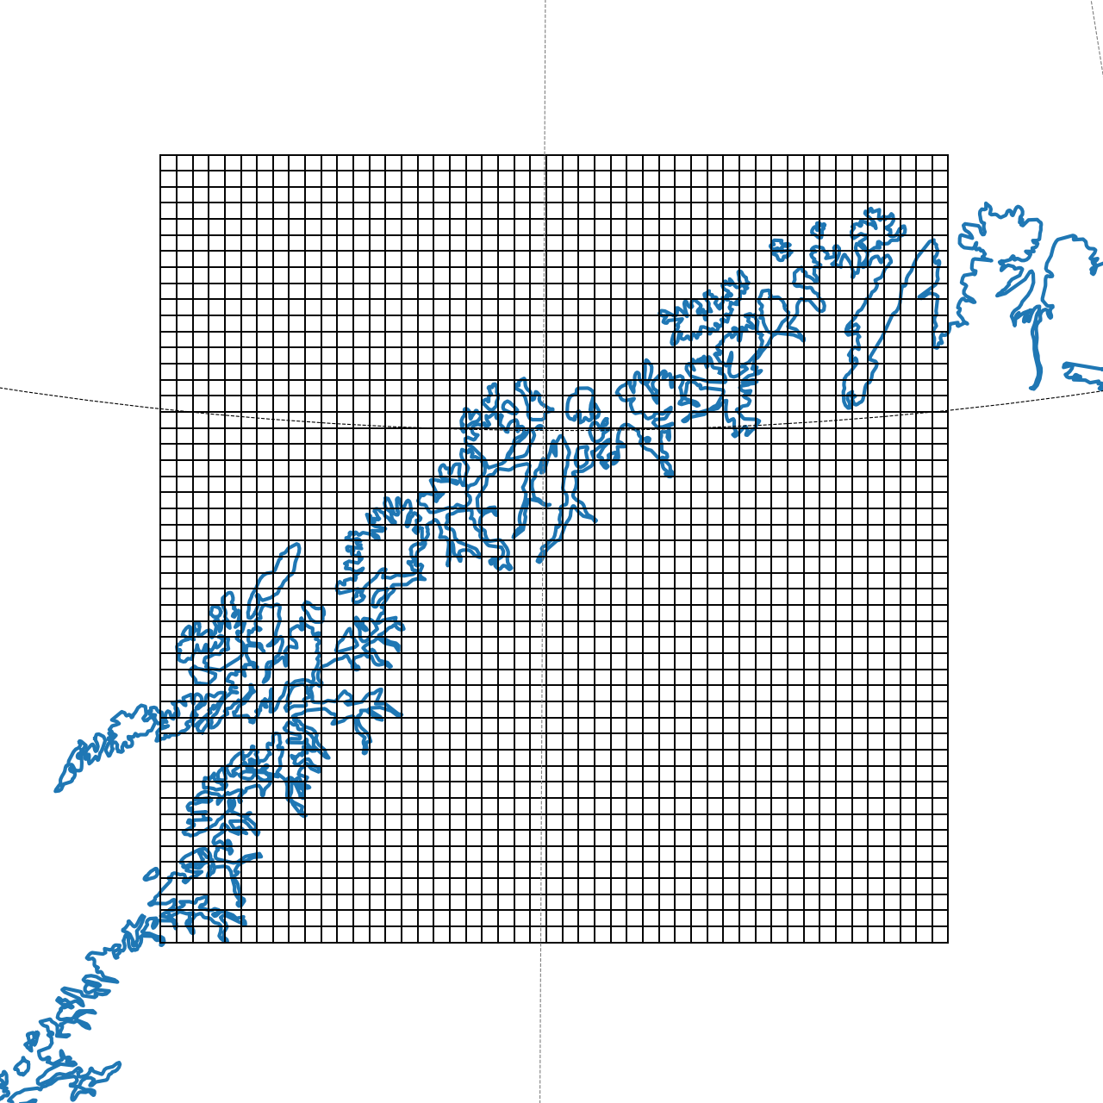
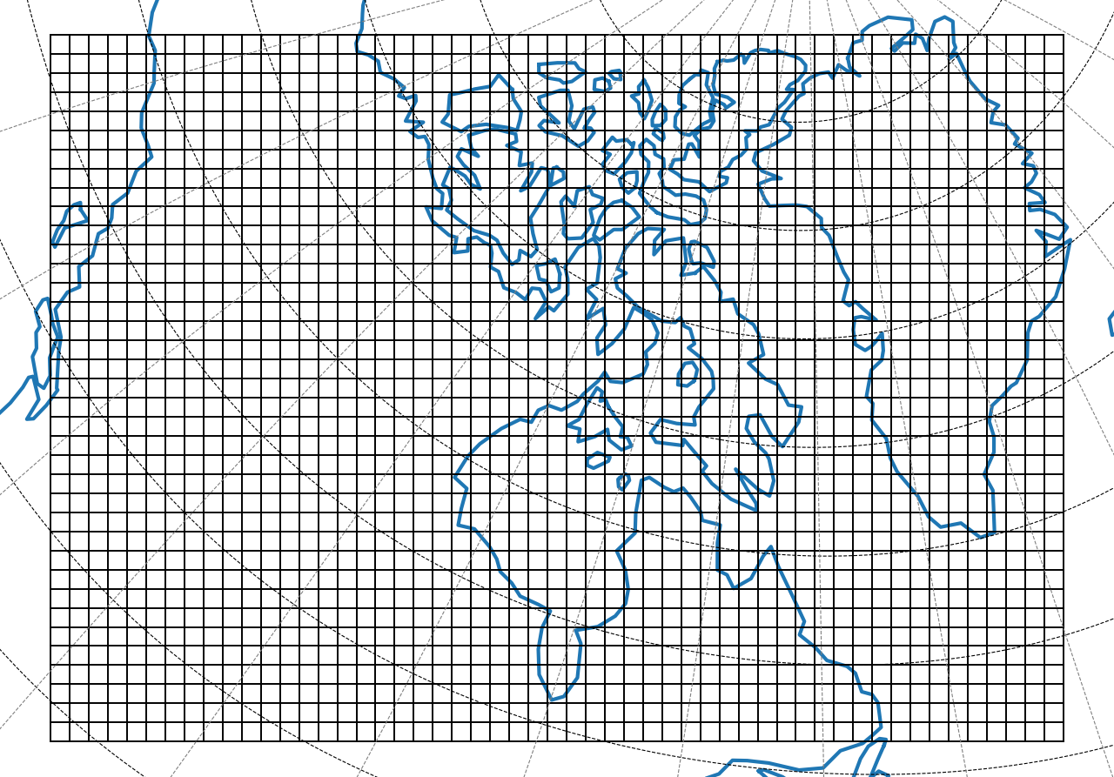
The grid
The LOMPE technique uses Spherical Elementary Current Systems - local basis functions - to represent ionospheric electrodynamics
The basis functions are placed on a regular grid in cubed sphere coordinates
Flexible spatial resolution
Flexible spatial extent

Slide 14
Example: A “space hurricane”
SuperMAG, SuperDARN + IMAGE FUV / EUV conductance estimates
See Zhang et al. (2021), Nature communications, for more about “space hurricanes”

Slide 15
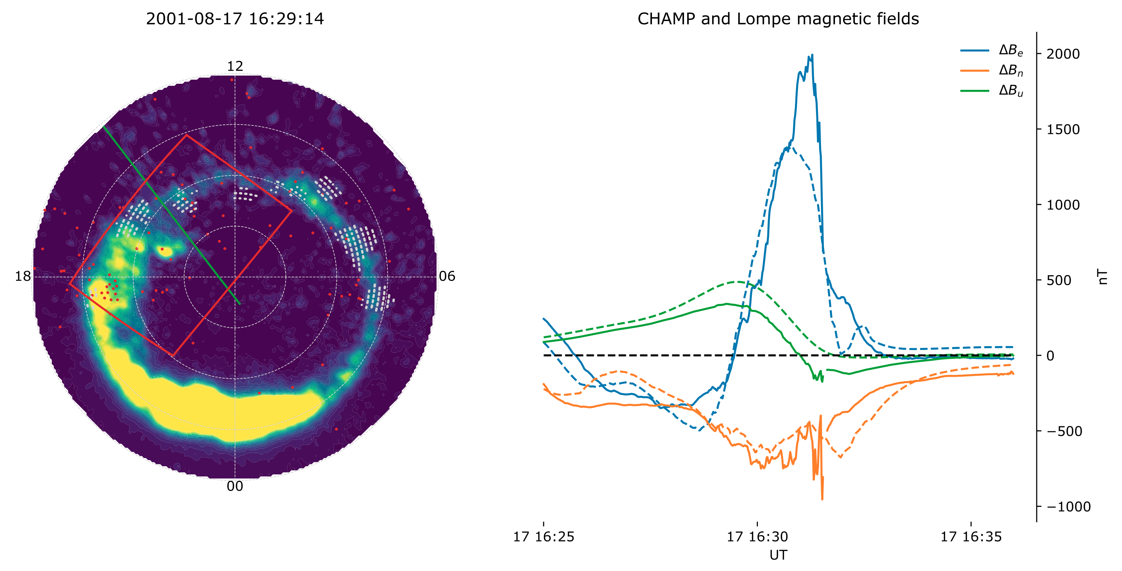
Example: A “space hurricane”
SuperMAG, SuperDARN + IMAGE FUV conductance estimates
CHAMP trajectory (green line) crossed the analysis region (red square), measuring the magnetic field. This was not included in the inversion
Model magnetic field (dashed), based on ground data, matches observed magnetic field (solid) very well

Slide 16
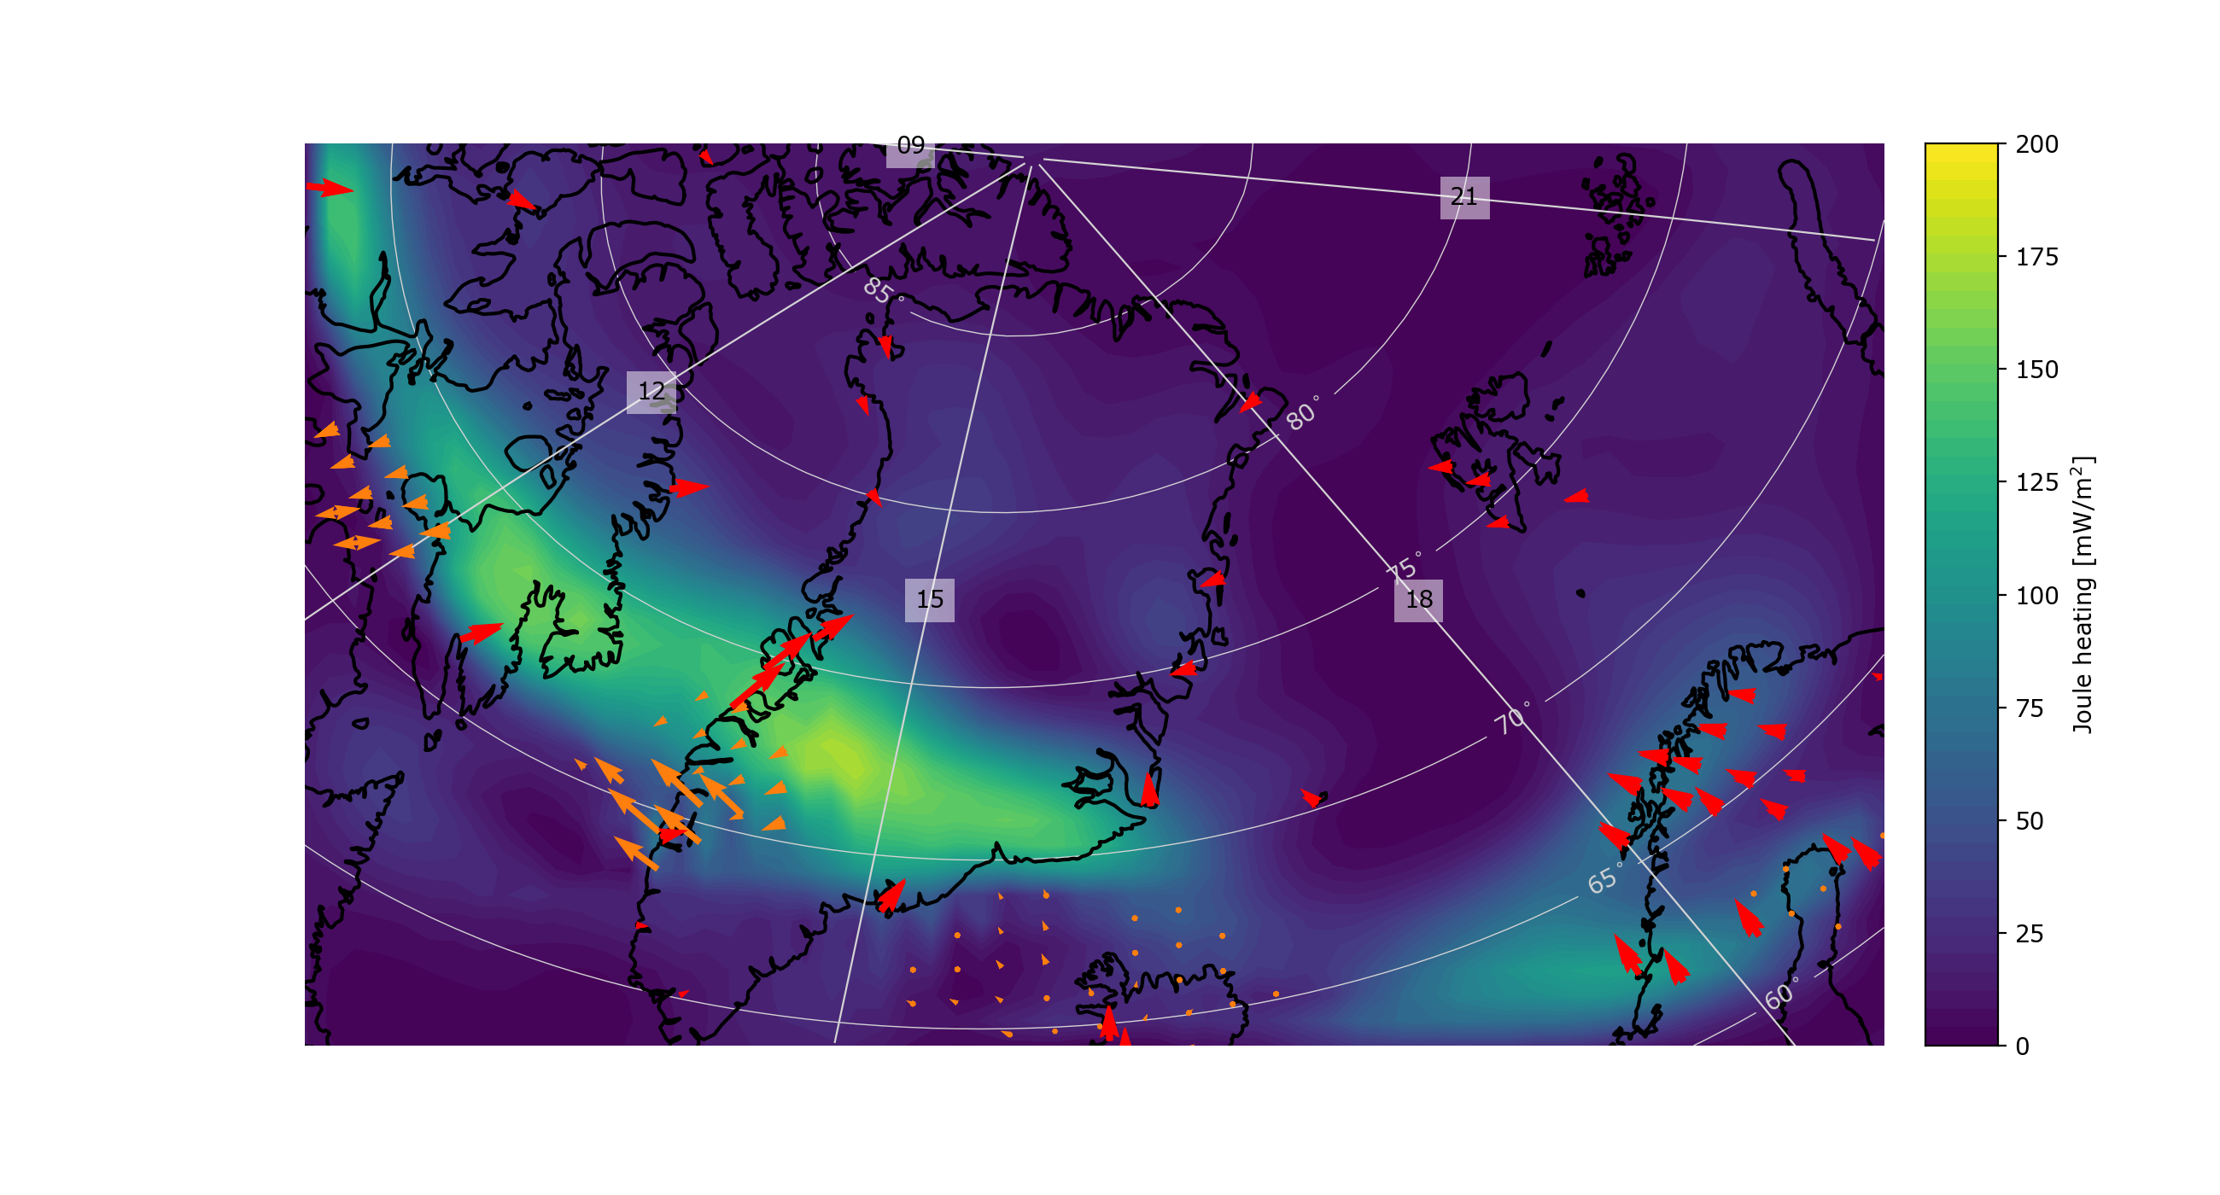
Example: A “space hurricane”
Total Joule heating in analysis region: 418 GW

Slide 17
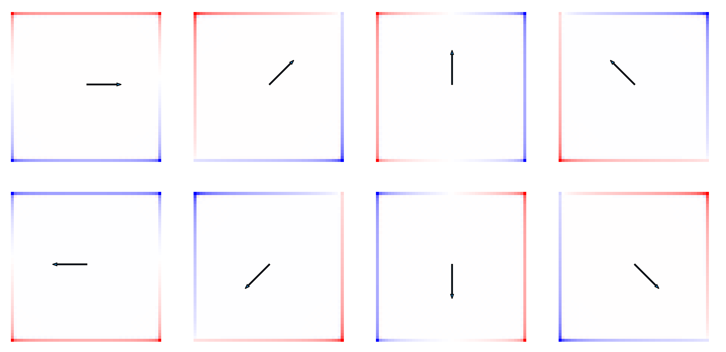
Boundary effect
What happens if the input data is a uniform flow field across the entire grid?

