Slide 1
Supplementary Array

Slide 2
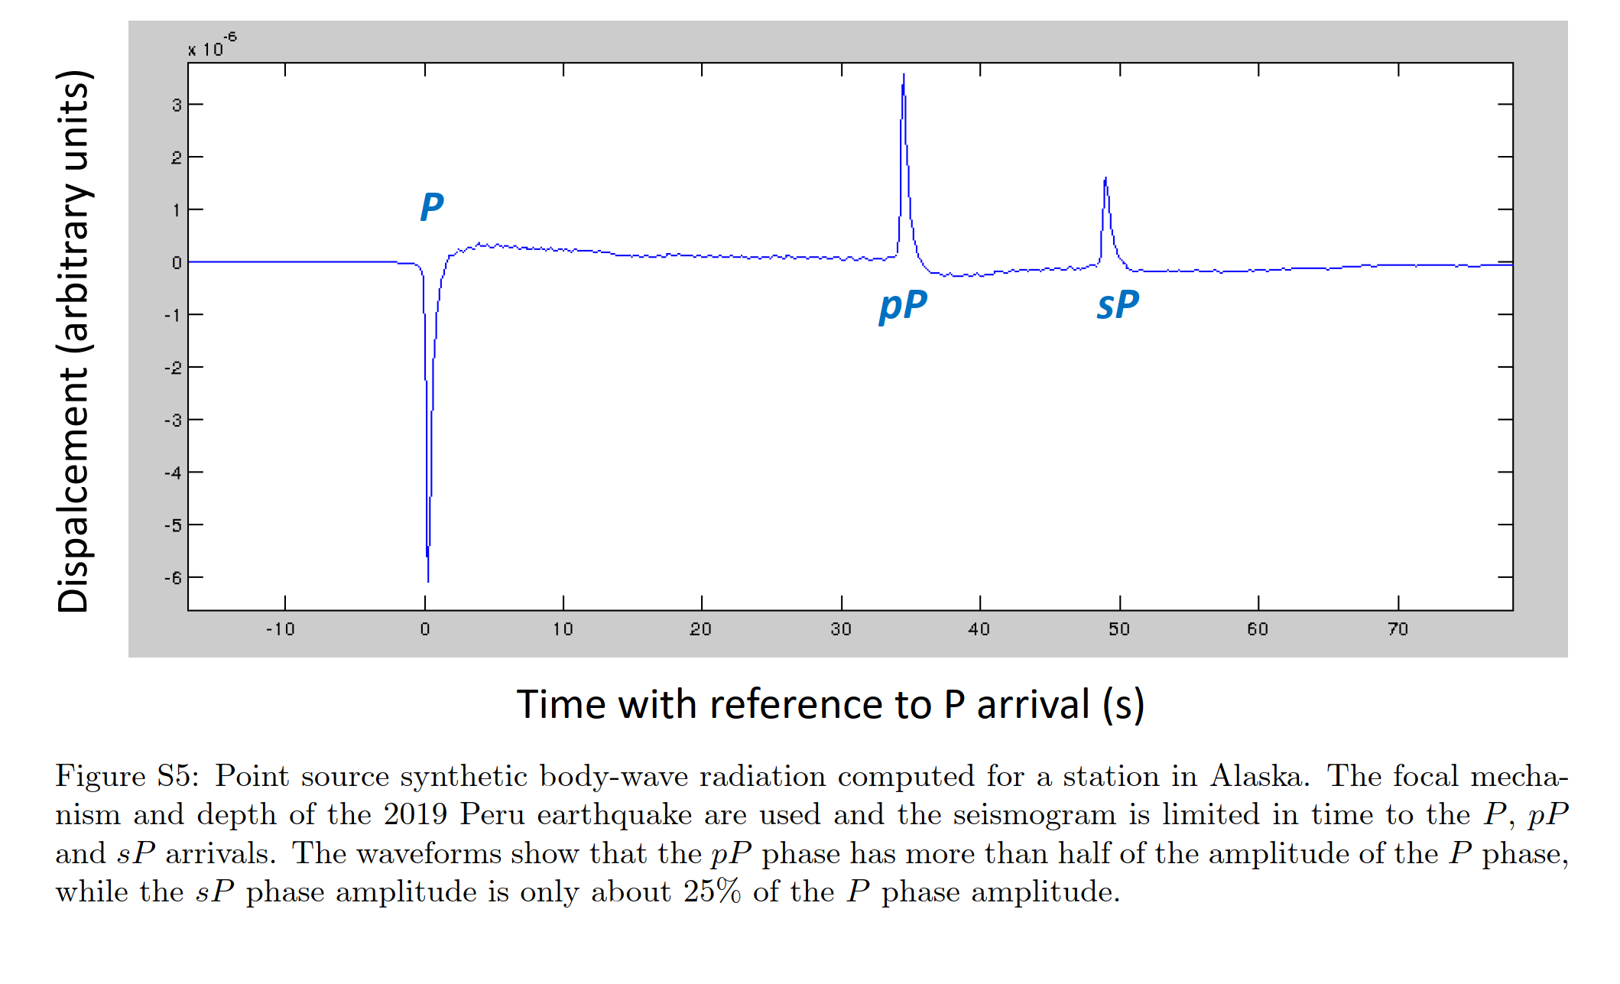

Slide 3
Depth phases detection
Time distance diagram of high-frequency emissions
As expected, observation of rupture replication due to pP or sP depth phases.
Depth phases imaging is not only time-shifted but also space-shifted, as they do not have the same ray parameter as the P wave.
Green and blue arrows show the space-time offset expected for pP and sP, respectively.

Slide 4
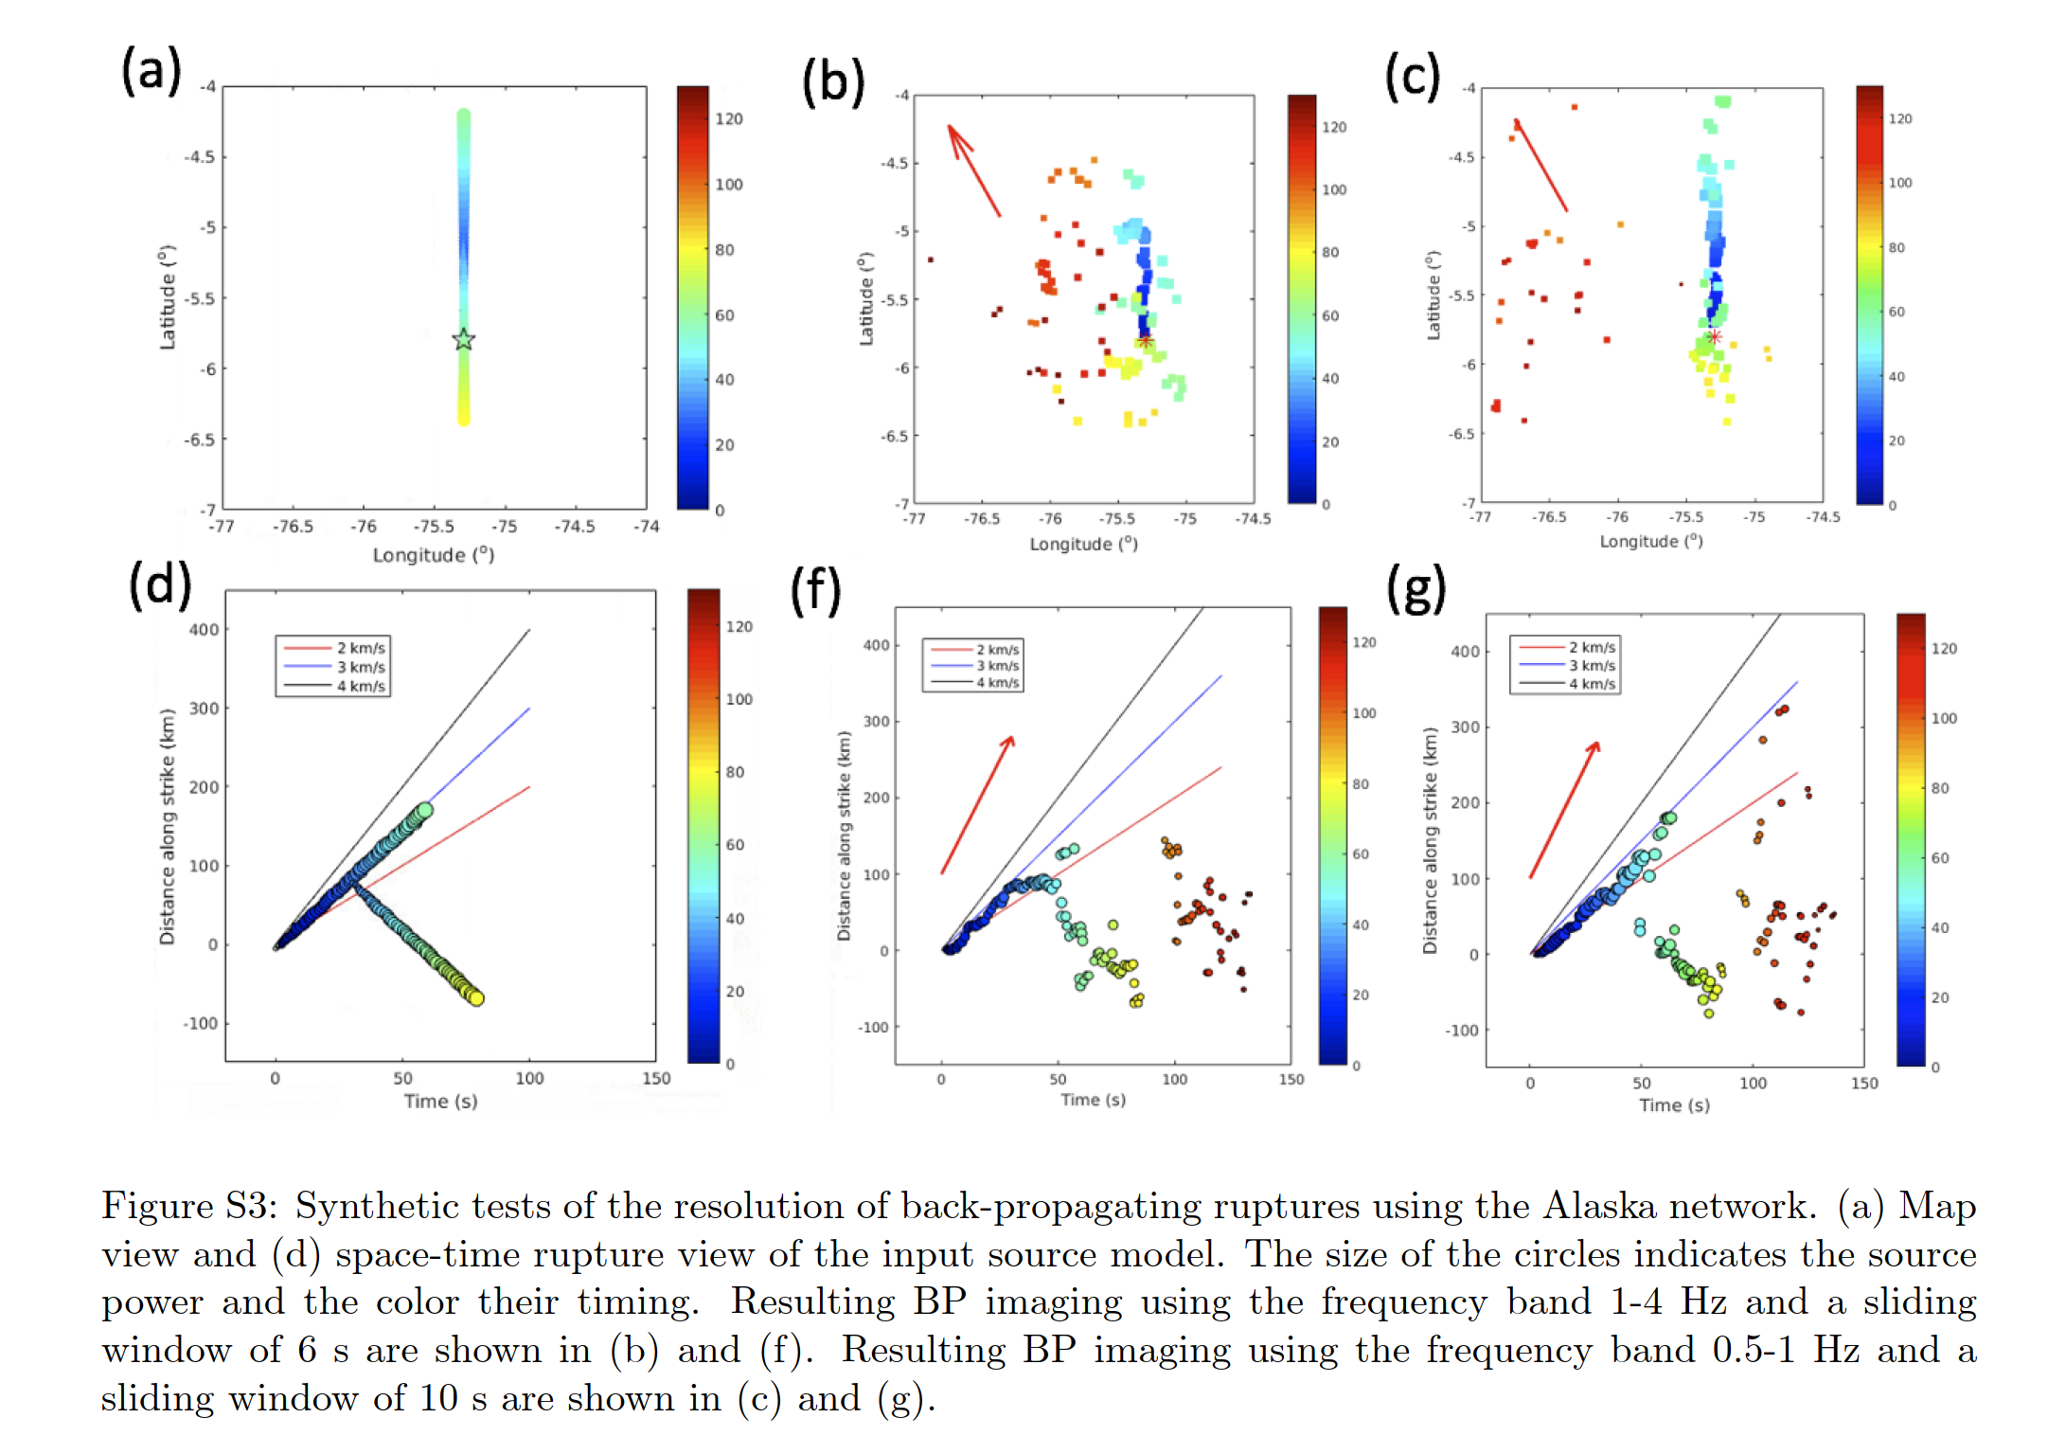

Slide 5
Supplementary slip inversion

Slide 6
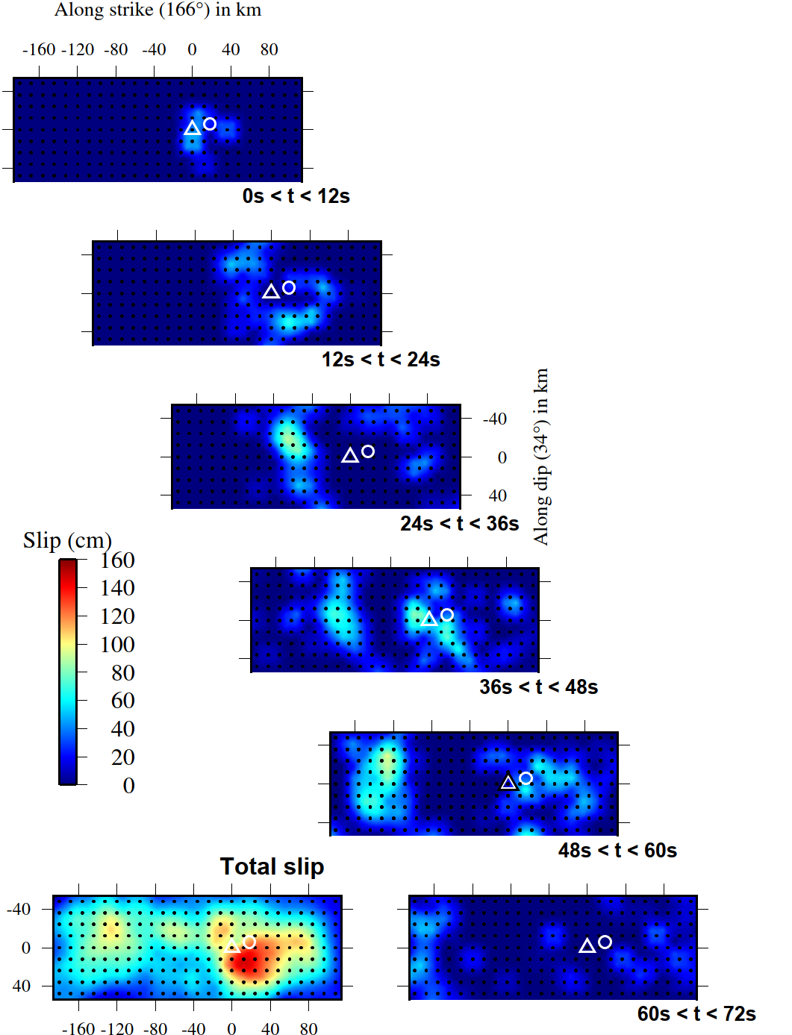
Warning: North now to the left !
b) FP2 model with « free rupture velocity » (0.3-4.5km/s), allowing for late rupture close to the hypocenter (but not re-rupturing)
Rupture snapshots
(slip occurring between each time interval)
Main rupture front propagating at 3-3.5km/s to the North
As for the FP1 scenario
+
Late rupture close from hypocenter

Slide 7
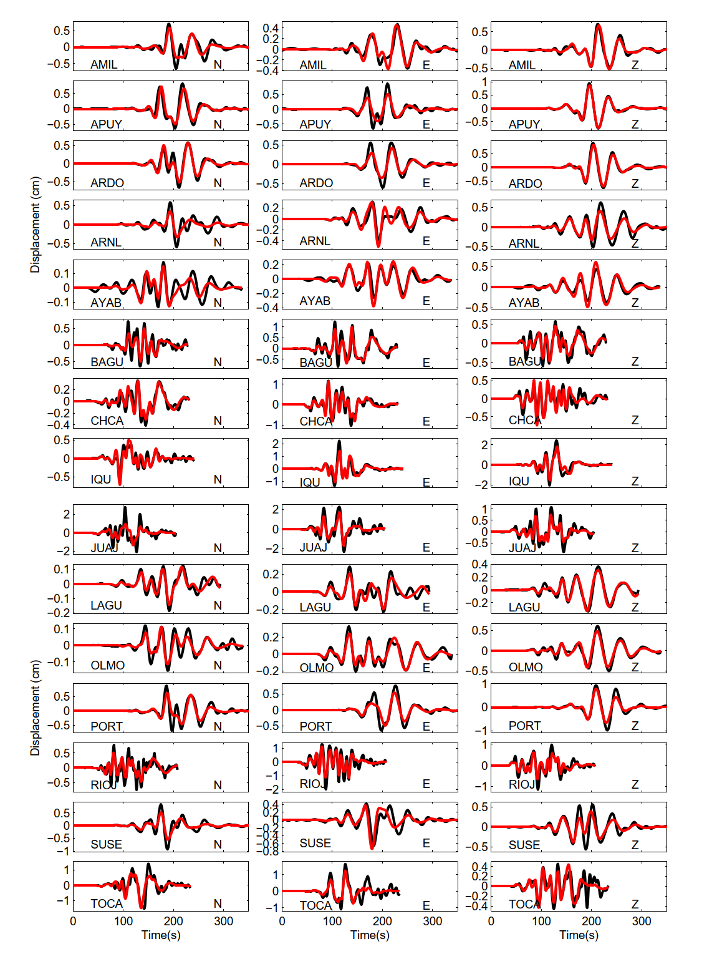
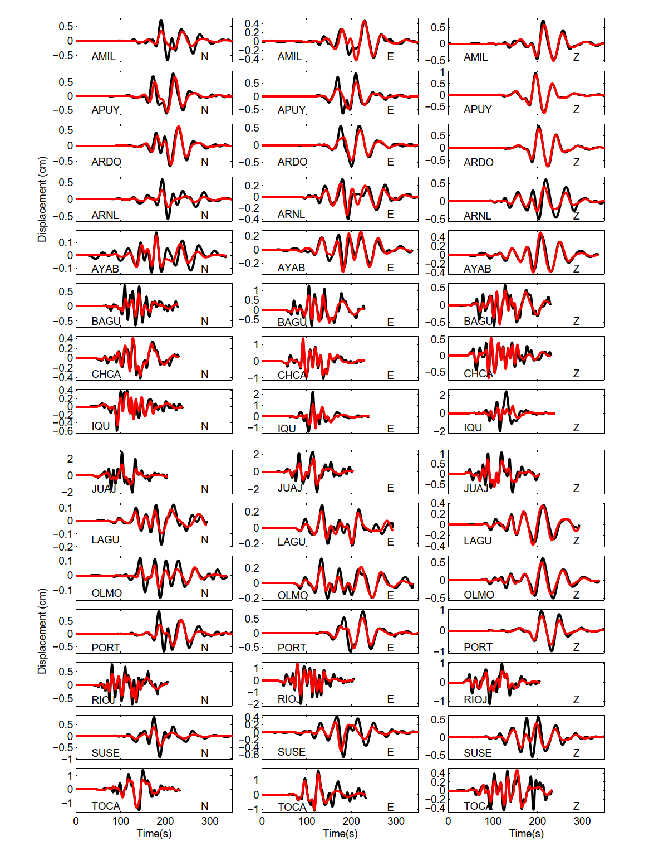
Local seismic data favor the FP1 scenario (to the left) compared to the FP2 scenario (to the right)

Slide 8
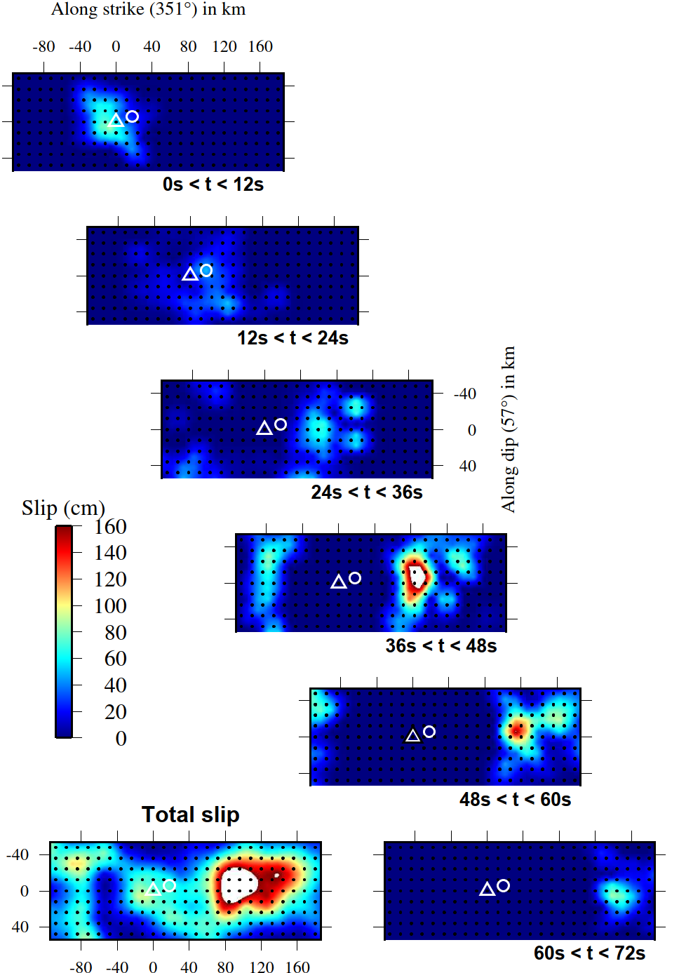
Rupture snapshots
(slip occurring between each time interval)
North to the right
c) FP1 model with « classical rupture velocity » (between 2.5km/s and 4.5km/s)
Main rupture front propagating at 3-3.5km/s to the North
+
Dubious rupture propagation far to the South
Significant decrease of the data agreement for :
  Strong Motion
  Teleseismic
  InSAR

Slide 9
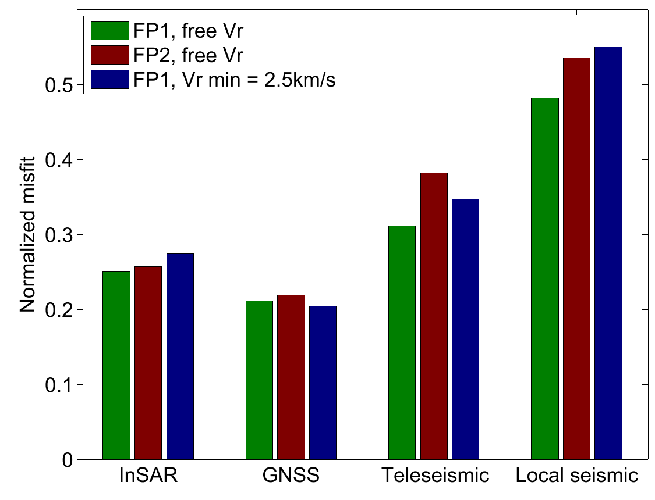
FP1 scenario allowing for late hypocentral reactivation better explains the full data set

Slide 10
Supplementary STF, pP, sP

Slide 11
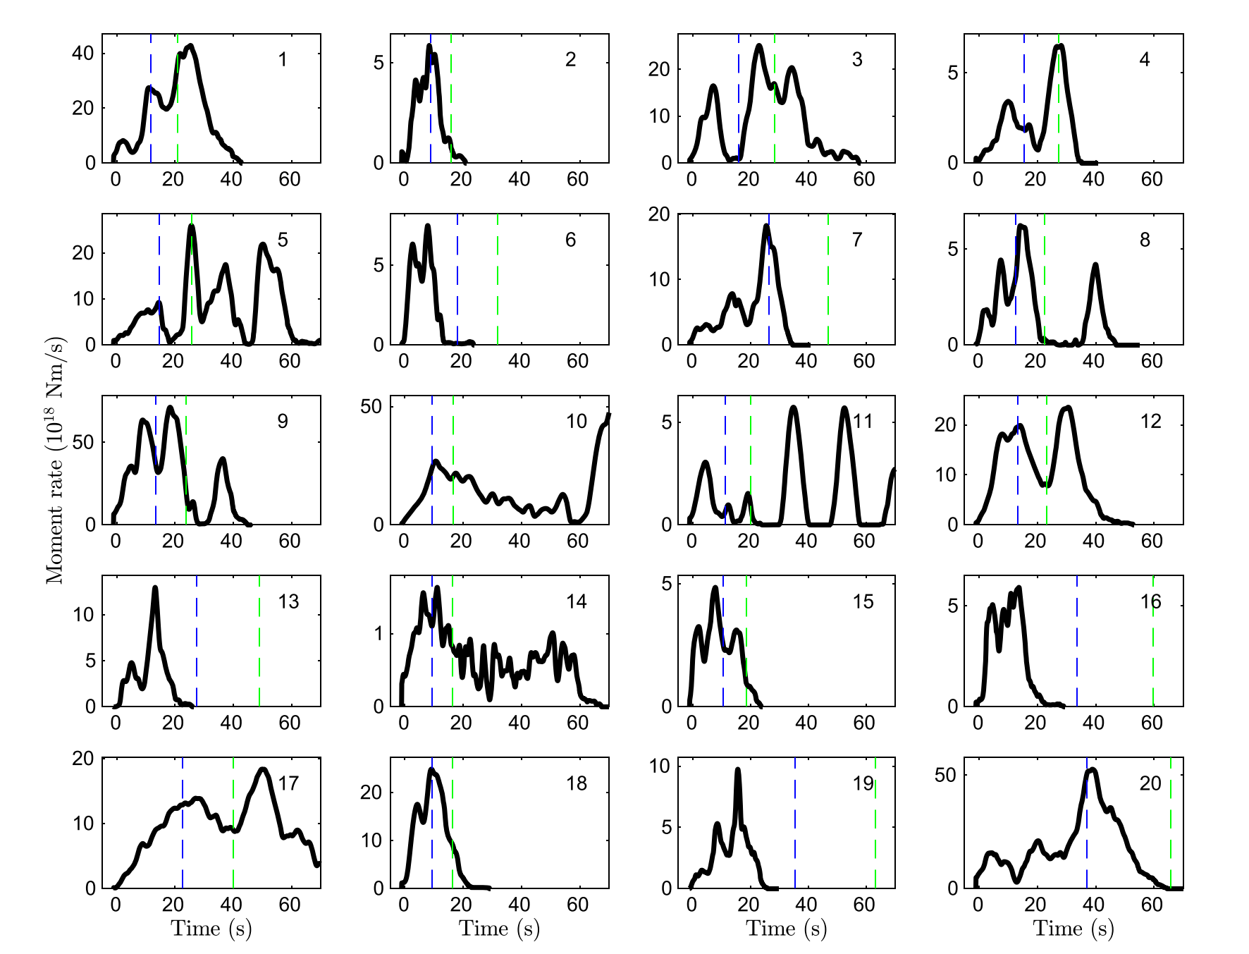
Are there clues of effects of the surface-reflected stress field for other earthquakes ?
SCARDEC STFs for Mw>= 7 earthquakes, in the 30-150km depth range, that exhibit non-monotonic moment rate growth
1st observation : such earthquakes can have long durations (>40s), which is not observed for deeper earthquakes
A mechanism for sustained rupture is present for intermediate-depth earthquakes
2nd observation : Depth phases arrivals correlate with rupture reactivation in a number of cases
Blue : first pP arrival ; Green : first sP arrival

