Slide 1
Arbuscular mycorrhizal fungi and their associated plant communities jointly respond to long-term nutrient deficiencies in a managed grassland
Kian Jenab¹, Lauren Alteio ¹, Ksenia Guseva¹, Stefan Gorka¹, Sean Darcy¹, Lucia Fuchslueger¹, Alberto Canarini¹, Victoria Martin¹, Julia Wiesenbauer¹, Felix Spiegel¹, Bruna Imai¹, Hannes Schmidt¹, Karin Hage-Ahmed², Erich M. Pötsch³, Andreas Richter¹, Jan Jansa⁴, and Christina Kaiser¹
¹Centre for Microbiology and Environmental Systems Science, University of Vienna, Vienna, Austria.
²Department of Crop Sciences, Institute of Crop Protection, University of Natural Resources and Life Sciences, Vienna, Austria
³Agricultural Research and Education Centre, Raumberg-Gumpenstein, Irdning, Austria
⁴Laboratory of Fungal Biology, Institute of Microbiology of the Czech Academy of Sciences, Prague, Czech Republic
Email : kian.jenab@univie.ac.at
kian_jenab

Slide 2
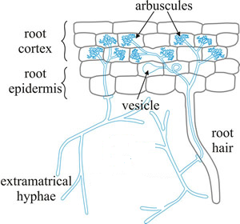
Arbuscular mycorrhizal (AM) Fungi and Nutrient Availability
AM fungal community composition could respond to nutrient availability
Phosphorus availability:
Improve plant growth in P-limited soil because their extraradical hyphal networks have better access to immobile inorganic P
Phosphorus increases the AM fungi species producig higher amount of extraradical hyphae
Nitrogen availability:
Several contradictory reports regarding N delivery to plants by AM fungi under N deficiency
N could indirectly affected AM fungal community composition by decreasing soil pH and increasing plant N:P ratio
Potassium availability:
Unfortunatly, it has been neglected so far!
Arbuscular Mycorrhiza (AM)
Moore, D., Robson, G.D. and Trinci, A.P., 2020. 21st century guidebook to fungi. Cambridge University Press.

Slide 3
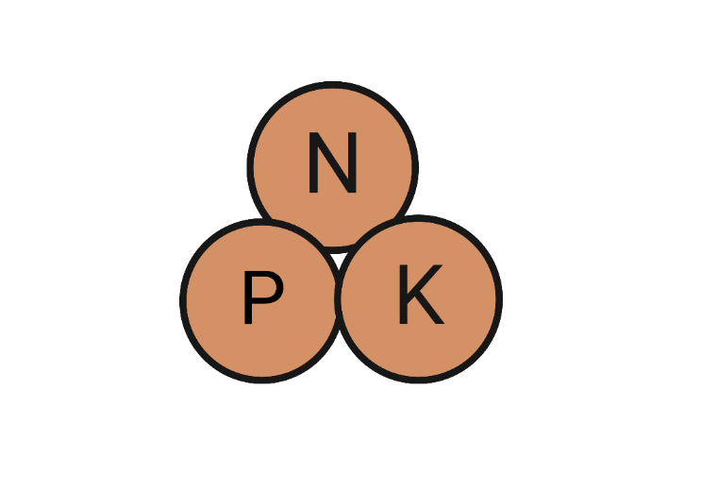
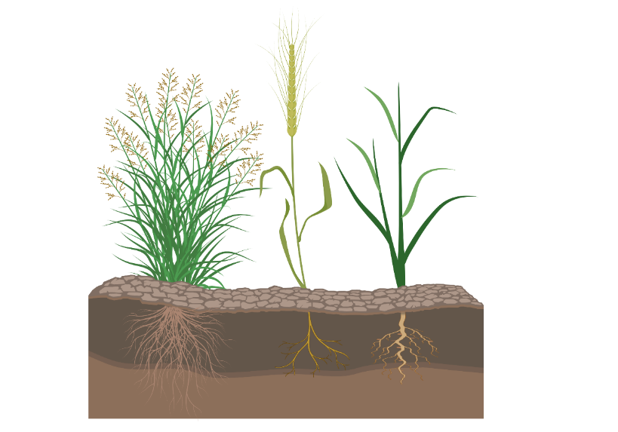
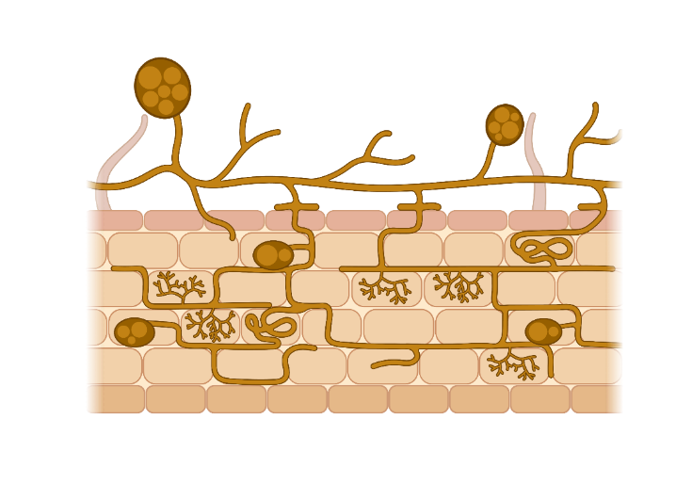
Research question:
How is combined response of AM fungi (belowground) and plant (aboveground) community compositions to long-term nutrient deficiency in a managed grassland?

Slide 4
Long-Term Nutrient Deficiency Experiment in a managed grassland
Located in Admont, Austria
Starting date: 1946
Experimental design: 24 fertilization treatments with different combinations of N,P, K or unfertilized
Management: hay meadow, three cuts per year
Continuous biomass removal in combination with selected or missing nutrient fertilization:
➔ Strong long-term nutrient deficiencies in N, P and K

Slide 5
Nutrient Deficiency Treatments
Control (NPK fertilized) (N+P+K)
2. Deficient (no fertilizer) (Unfertilized)
3. P deficiency (NK fertilized) (N+K)
4. K deficiency (NP fertilized) (N+P)
5. N deficiency (PK fertilized) (P+K)
6. NK deficiency (P fertilized) (p)
7. NP deficiency (K fertilized) (K)
8. KP deficiency (N fertilized) (N)

Slide 6
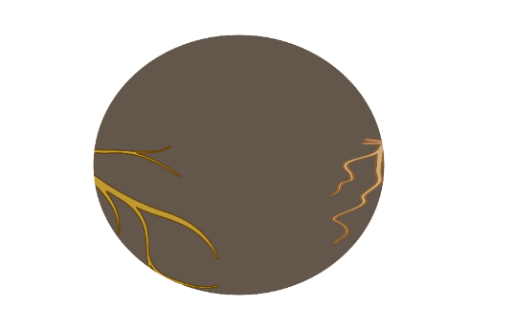
Measuring AM fungal and plant community composition
Soil samples (AM fungal hyphae and spores)
Root samples (AM fungi colonizing roots and their host plants)
AM fungal community composition
RNA and DNA-based amplicon sequencing (18S rRNA region )
WANDA-IL and AML2-IL primers
Plant Community composition
Recording plant coverage visually (Based on the report in 2015)
2. DNA amplicon sequencing of the rbcL (RuBisCo large subunit) gene region (Collected root samples)

Slide 7
AM fungal community composition
Soil (RNA) Samples
Root (DNA) Samples
Notes:
K enriched: Glomus and rhizophagus
N def: Acaulospora
N enriched: Ambispora

Slide 8
Why is AM fungi community composition so different between roots and soils?
Fungi with different growth strategies may be represented differently in soil and roots
Shown in Glomeraceae
Shown in Gigasporaceae
Conservative growth strategy
Short-distance hyphae in soil
Large infected regions in roots
→ likely overrepresented in root samples
Explorative growth strategy
Long-distance hyphae in soil
Small infected regions in roots
likely overrepresented in soil samples
Parniske, Nature Reviews Microbiology, 2008

Slide 9
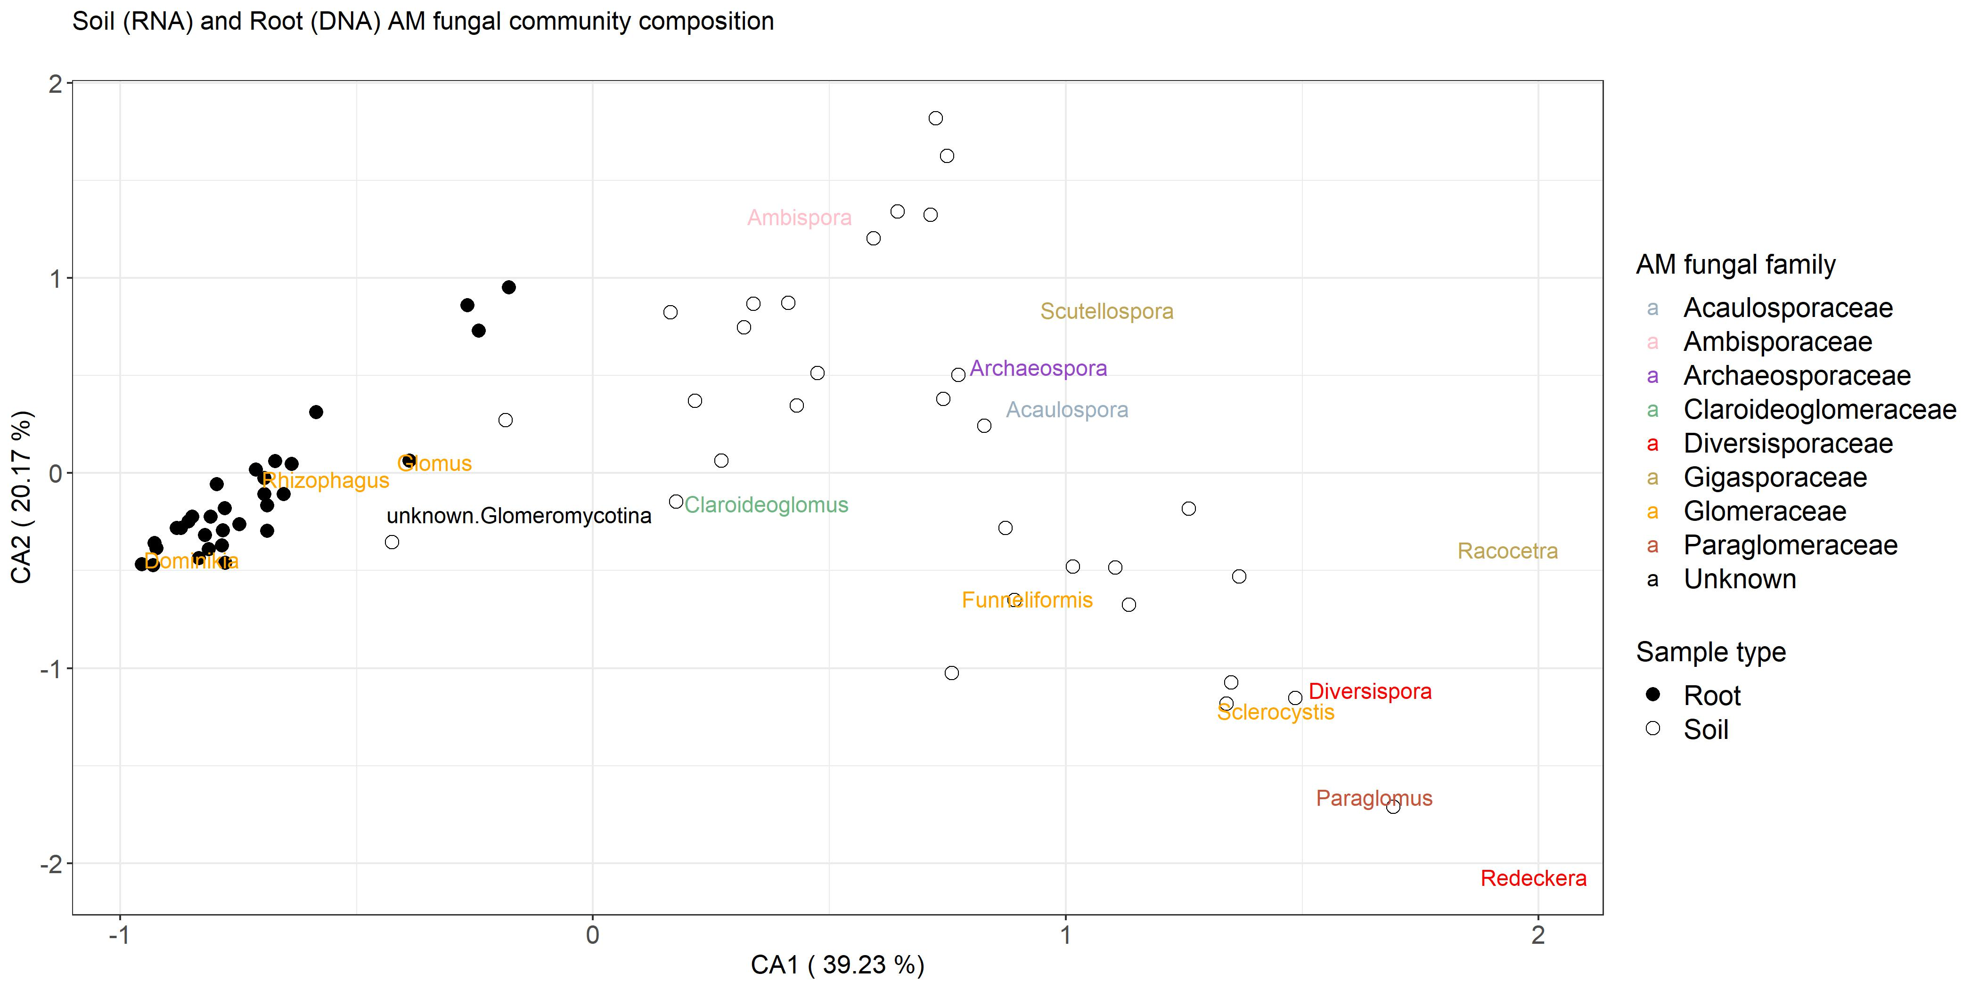
AM fungal community composition: Glomeraceae are overrepresented in root samples
PERMANOVA
Sample type: P<0.01

Slide 10
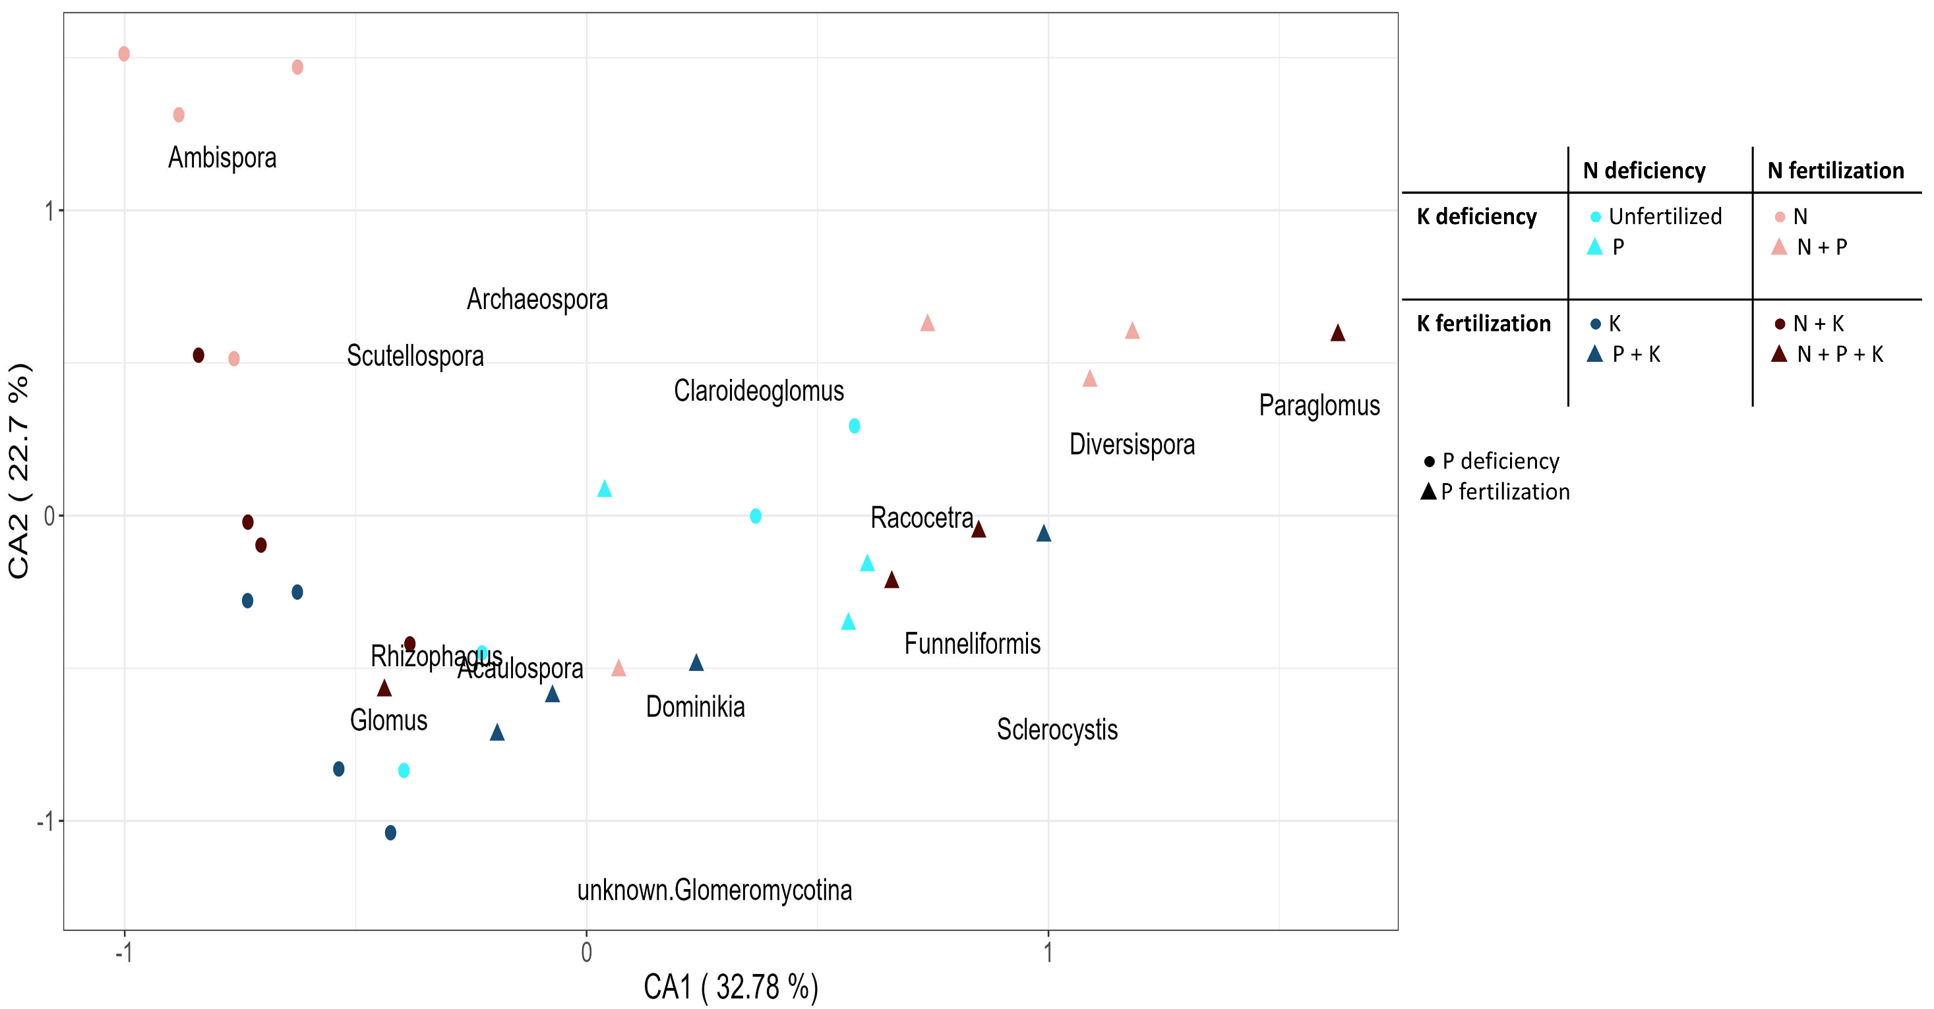
AM fungal community composition in soil
P-deficient
Mostly N+P together
Mostly N-deficient
N and P affected soil AM fungal community composition
PERMANOVA
Nutrient deficiency: P<0.01

Slide 11
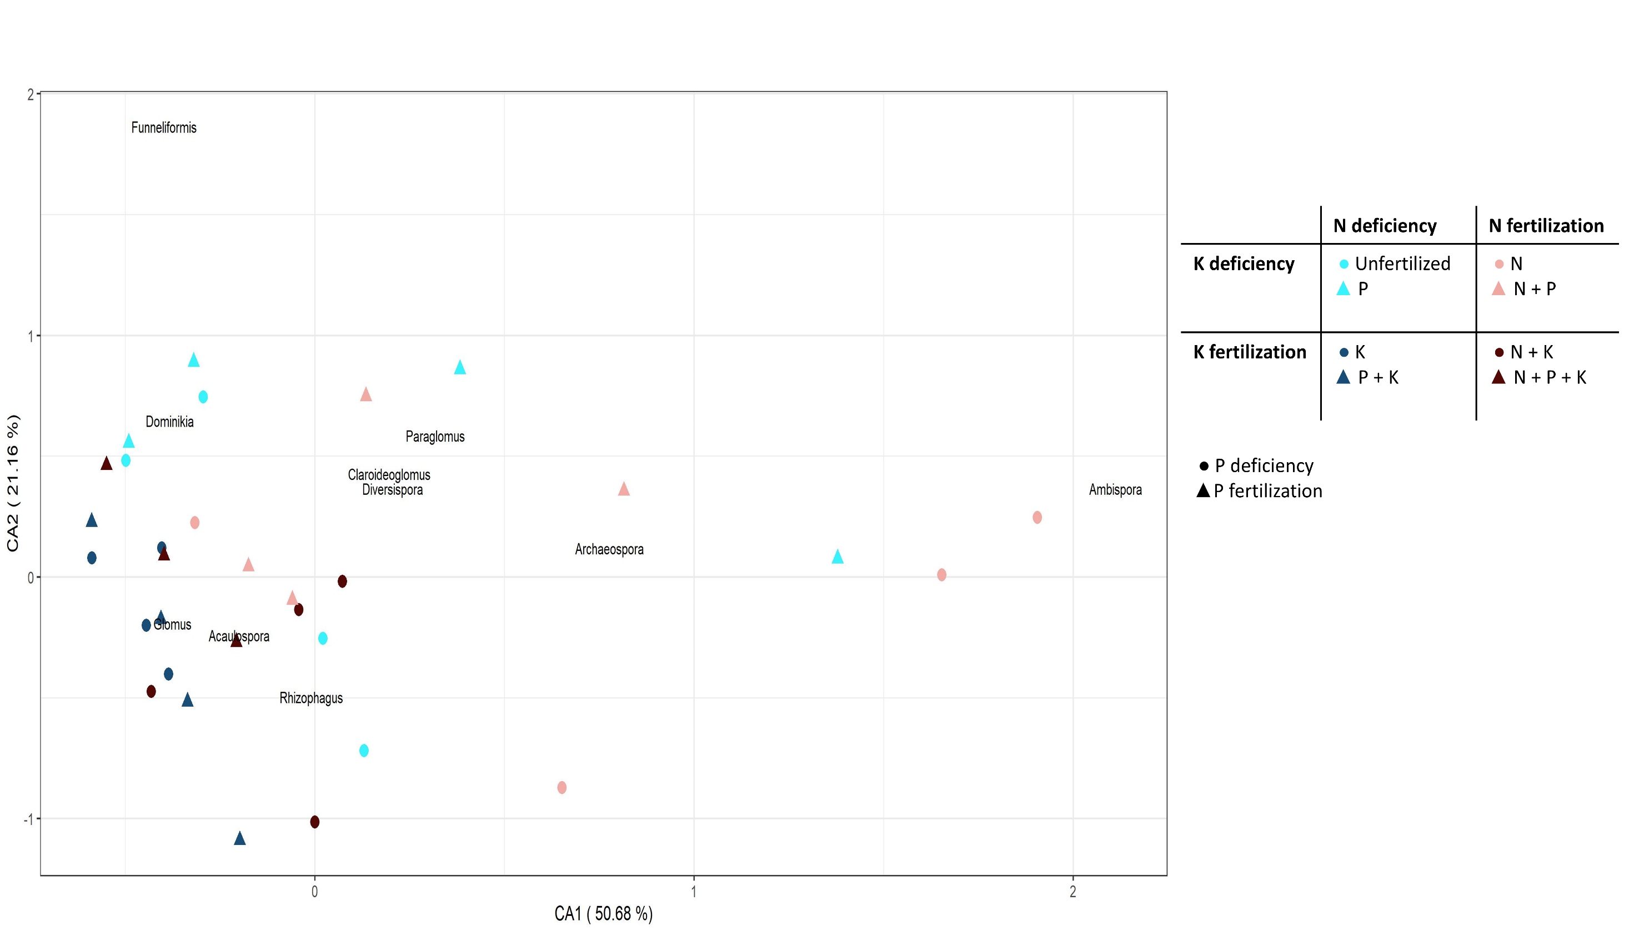
AM fungal community composition in roots
K affected root AM fungal community composition
K-deficient
K-fertilized
PERMANOVA
Nutrient deficiency: P<0.01

Slide 12
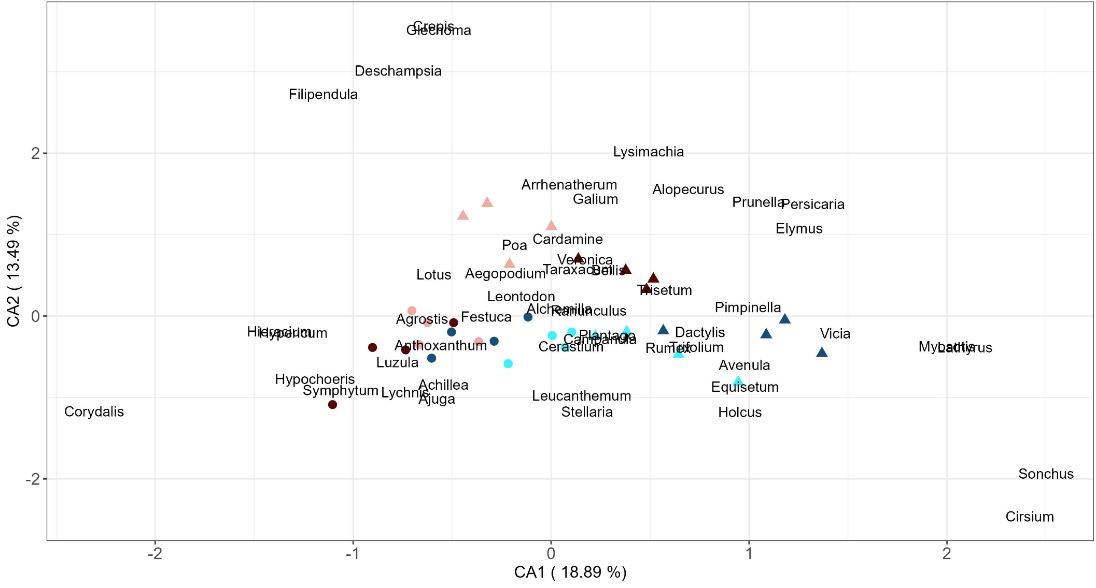
Aboveground Plant community composition
N and P affected plant community composition (similar to soil AM fungal community composition)
N+P fertilized
P-deficient
N-deficient
PERMANOVA
Nutrient deficiency: P<0.001

Slide 13
rbcL Plant community composition
K-deficient
K-fertilized
K affected rbcL plant community composition! (similar to root AM fungal community composition)
PERMANOVA
Nutrient deficiency: P<0.05

Slide 14
Aboveground plant community composition was affected by N and P
Similar to soil AM fungal community composition
Representative of all plants in the grassland
AM fungi Spores living in the past
However, rbcL plant community composition was influenced by K
Similar to root AM fungal community composition
Representative of plants we measured AM fungi colonizing in their roots

Slide 15
No significant correlation between soil and root AM fungal community compositions
Correlation between aboveground and rbcL plant communitiy composition
R² = 0.04
P> 0.5
R² = 0.34
P< 0.1

Slide 16
R² = 0.48
P< 00.1
R² = 0.05
P > 0.5
R² = 0.45
P< 00.1
R² = 0.07
P > 0.5

Slide 17
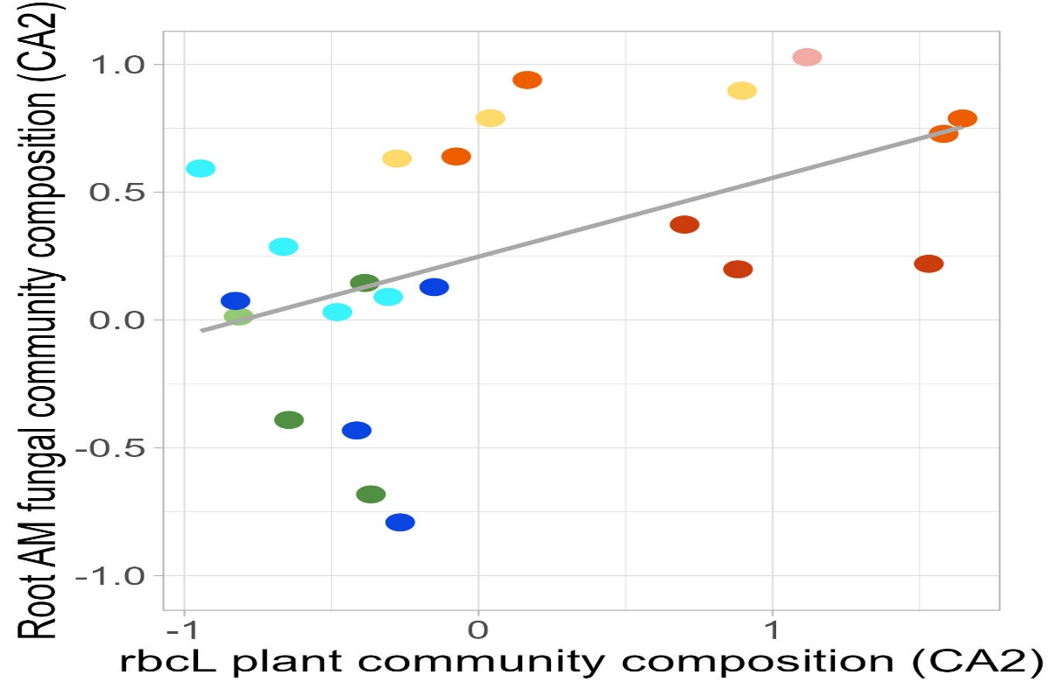
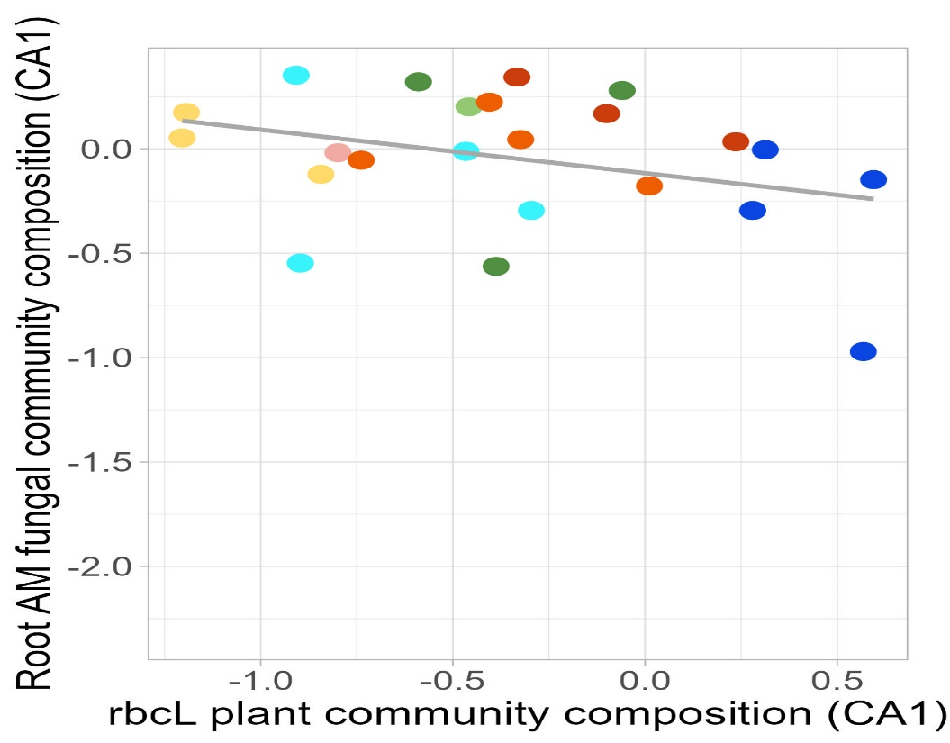
Stronger correlation of plant communitiy composition (both aboveground and rbcL) with soil AM fungal community composition than with root AM fungal community composition
rbcL plant community composition have a correlation with root AM fungal community composition in CA2 scores
CA2
CA1
R² = 0.21
P < 0.5
R² = 0.07
P > 0.5

Slide 18
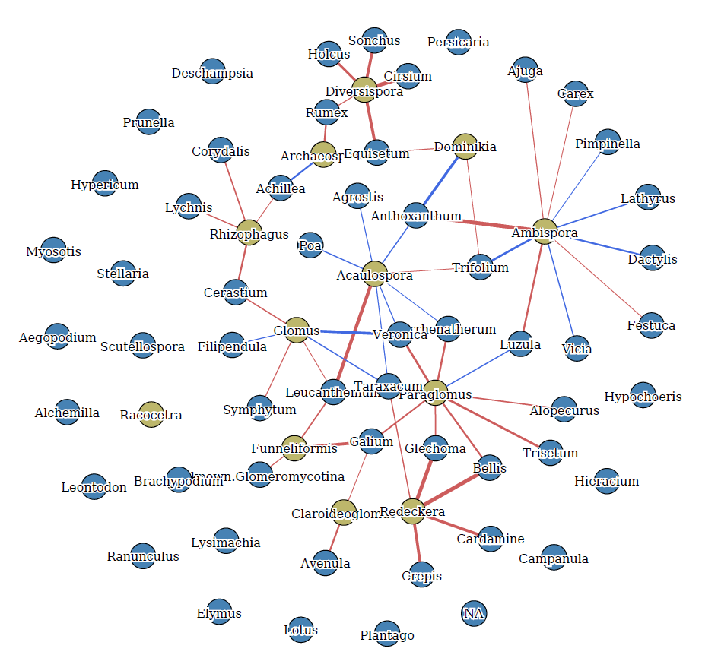
Bipartite Network between Soil and Root AM Fungal and Abovegroun plant communities
Soil Samples
Root Samples
Yellow node: AM fungi Blue node: Plant
Threshold: 0.4 Red edge: Positive correlation Blue edge: Negative correlation

Slide 19
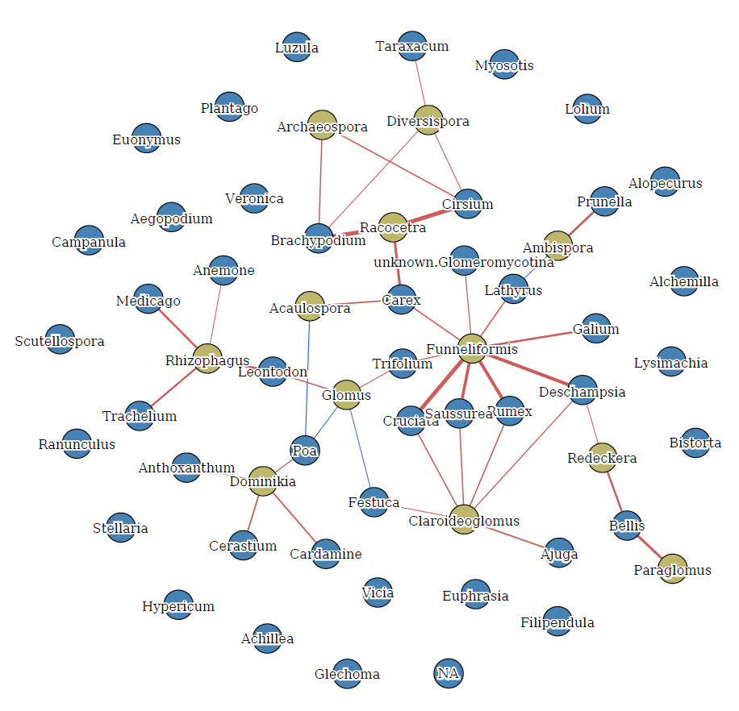
Bipartite Network between Soil and Root AM Fungal communities and rbcL plant in Inorganic Treatments
Soil Samples
Root Samples
Yellow node: AM fungi Blue node: Plant
Threshold: 0.4 Red edge: Positive correlation Blue edge: Negative correlation

Slide 20
Conclusion
Long-term nutrient deficiency of N, P and K strongly affected AM fungal and plant community composition.
The impact of nutrient deficiency on AM fungal community composition differs between soil and root samples:
AM fungi in soil samples affected by N and P
AM fungi in root samples affected by K
N, P
K
N and P may have a stronger effect on AM fungi with an explorative growth strategy while K could have a stronger effect on AM fungi with a conservative growth strategy
The long-term nutrient deficiency could also affect AM fungal community composition directly, and indirectly through the shifts in plant community composition.

Slide 21
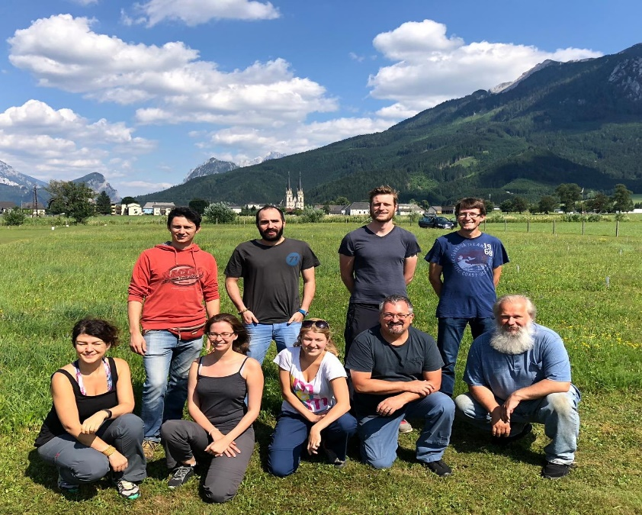
Cool friend in Admont
Admont – July 2019
After harvest….
Admont people

Slide 22
Supplementary Material

Slide 23
rbcL Plant community composition
N-deficient
P-deficient
N+P fertilized
PERMANOVA
Nutrient deficiency: P<0.01

Slide 24
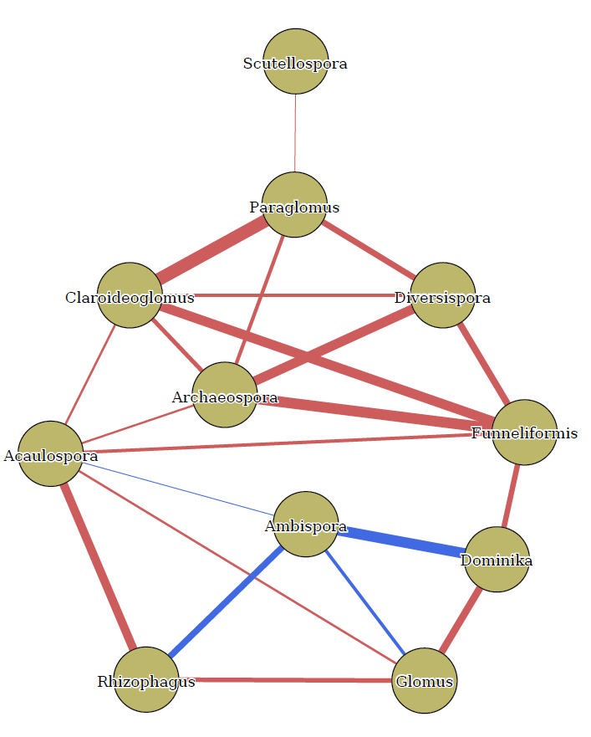
Network within Soil and Root AM Fungi
Soil
Root
Correlation Threshold: 0.3
Red: Positive correlation
Blue: Negative correlation

Slide 25
Correlation table between Soil and Root AM Fungal communities and Abovegroun plant
AM Fungi
Plant communities
Soil Samples
AM Fungi
AM Fungi
Plant communities
Root Samples
AM Fungi

Slide 26
Correlation table – Root AMF community – rbcl Data_Just Inorganic

Slide 27
Soil (RNA) AM fungal community composition _ CCA

Slide 28
Root AM fungal community composition _ CCA

Slide 29
Aboveground Plant community composition _ CCA

Slide 30
rbcl Plant community composition _ CCA

