Slide 1
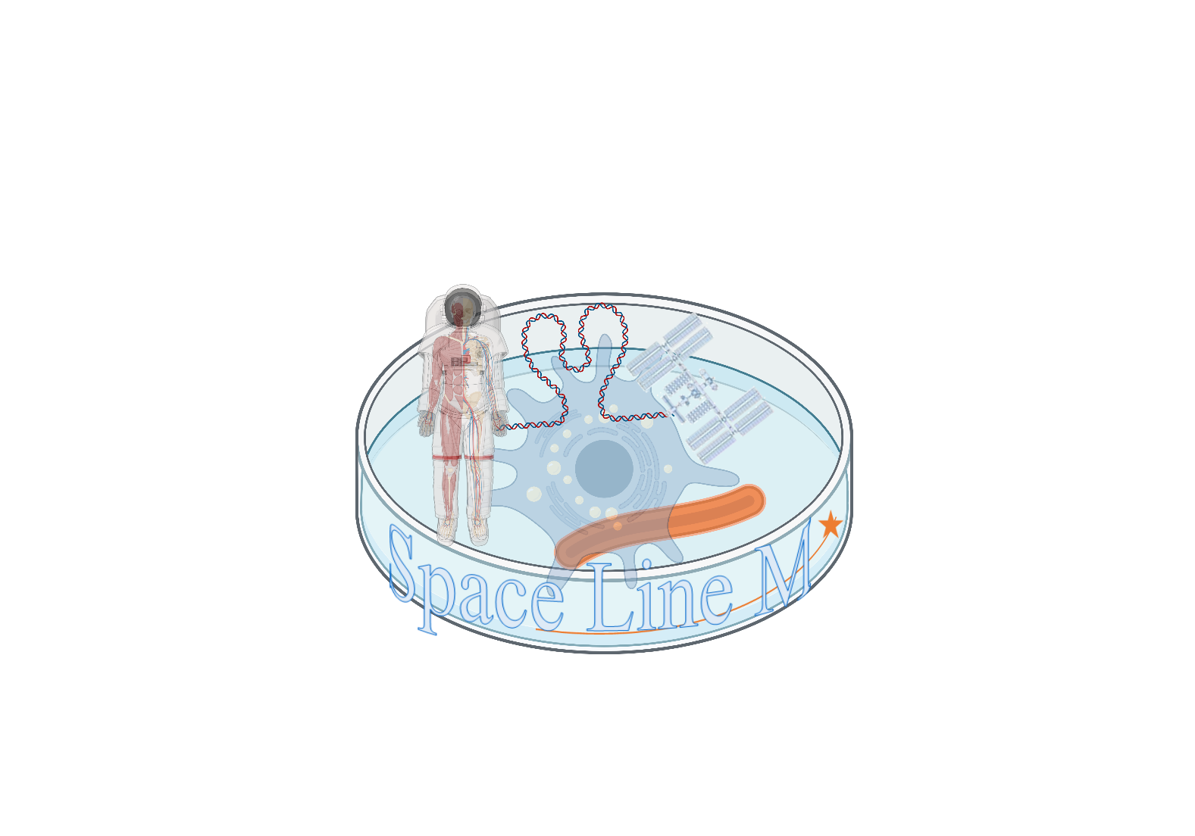
Investigation of the growth rate and antibiotic production of Marine Actinobacteria in the International Space Station
Marialina Tsinidis¹ and Manolis Simigdalas²
¹University of Glasgow , Glasgow, United Kingdom of Great Britain – England, Scotland, Wales (m.tsinidi@gmail.com)
²Heriot Watt University, Edinburgh, United Kingdom of Great Britain – England, Scotland, Wales (manolis.symigdalas@gmail.com)
Key Words: Marine Actinobacteria, Astrobiology, Space Medicine, ISS
Soil System Sciences
Microbial growth, turnover and functioning in soils:
modelling and experimental advances
Scientific Image and Illustration Software | BioRender
Space Line M

Slide 2
Is microgravity capable of affecting the behavior and development of actinobacteria (actinomycetes)?
Research Questions

Slide 3
Gram-positive bacteria
Background Information
Characteristics
high guanine and cytosine contents in DNA
include some of the most common soil, freshwater, and marine type
Play an important role in decomposition of organic materials, such as cellulose and chitin, thereby playing a vital part in organic matter turnover and carbon cycle, replenishing the supply of nutrients in the soil, and is an important part of humus formation (Anandan, Dharumadurai and Manogaran, 2016).

Slide 4
The actinobacteria might face a little to none affection during their presence in microgravity, which will prove that bacteria in general are ideal organisms for transportation through space, making them reliable for space exploration and experiments The researcher’s hypothesis is that the microgravity will have no effect on the viscosity of the liquid agar and actinobacteria.
Experiment
Hypothesis

Slide 5
Variables
Independent Variables
-Gravity
-Radiation
Dependent Variables
-Rate of development and behavior change of actinobacteria in microgravity.
-Antibiotics production
Controlled Variables (Constant)
The Substance of Actinobacteria which will not be mixed with any other substance and will not be transferred to any other than the controlled environment
Control of Variables
-Temperature
-Volume of Substances
-Volume of Substances mixed (Actinobacteria substance/Antibiotic Substance)

Slide 6
Category 1: Earth Apparatus which will be used for the experimentation required before and after the launch in order to compare the substances before and after exposure to microgravity. ^{• Substance of Actinobacteria} ^{• Casein Agar} ^{• Microscope} ^{• Pipettes} ^{• Beaker 100ml} ^{• Gloves} ^{• Goggles} ^{• Cotton tipped swabs} Category 2: Space Apparatus, which will be necessary for the activation, mixture and storage of the substances in Space. • MixStix tubes (and their associated materials) ^{• Substance of Actinobacteria}
Materials
Materials for the first research question
Materials for the second research question
^{Mixstix}
^{Ball}

Slide 7
Results

Slide 8
The researcher aims to test the antibiotic production of the actinobacteria that travelled to the ISS as compared to the ones in the lab. Since this type of bacteria can produce antibiotics, which is useful in medicine, the effects of microgravity on the antibiotic production could be investigated which is useful for astronauts. The aim is to create a mathematical model to predict the antibiotic production based on the growth rate.
Further Steps

Slide 9
Investigation of the growth rate and antibiotic production of Marine Actinobacteria in the International Space Station
Marialina Tsinidis¹ and Manolis Simigdalas²
¹University of Glasgow , Glasgow, United Kingdom of Great Britain – England, Scotland, Wales (m.tsinidi@gmail.com)
²Heriot Watt University, Edinburgh, United Kingdom of Great Britain – England, Scotland, Wales (manolis.symigdalas@gmail.com)
Key Words: Marine Actinobacteria, Astrobiology, Space Medicine, ISS
Soil System Sciences
Microbial growth, turnover and functioning in soils:
modelling and experimental advances
Space Line M

