Slide 1
Lexcube: An Interactive Earth Science Data Cube Visualization
Vote for OSPP Award!
ESSI4.1 – EGU23-9258
Vienna, 28th April 2023
Maximilian Söchting^{1,2}, Miguel Mahecha^{1,3}, David Montero¹, and Gerik Scheuermann² ¹Remote Sensing Centre for Earth System Research, Leipzig University, Leipzig, Germany ²Image and Signal Processing Group, Leipzig University, Leipzig, Germany ³Helmholtz Centre for Environmental Research (UFZ), Leipzig, Germany

Slide 2
SLIDE OVERVIEW
Vote for OSPP Award!
Lexcube: An Interactive Earth Science Data Cube Visualization
Maximilian Söchting^{1,2}, Miguel Mahecha^{1,3}, David Montero¹, and Gerik Scheuermann²
¹Remote Sensing Centre for Earth System Research, Leipzig University, Leipzig, Germany ²Image and Signal Processing Group, Leipzig University, Leipzig, Germany ³Helmholtz Centre for Environmental Research (UFZ), Leipzig, Germany
Literature

Slide 3
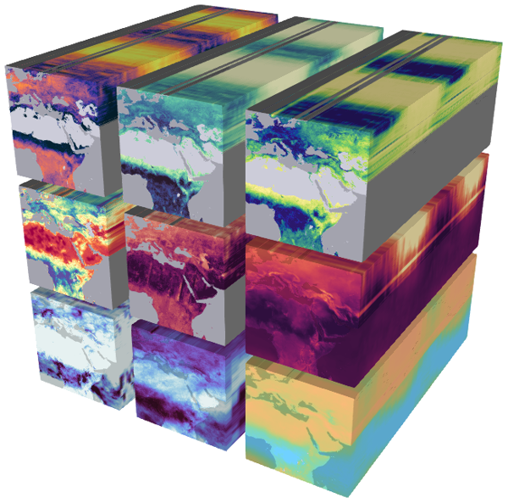
RESEARCH PROBLEM
The Earth is constantly monitored and analyzed via satellite remote sensing [1]
With increasing spatiotemporal resolutions, data set sizes are increasing
It becomes more difficult to explore the data and extract knowledge, e.g., about the anthropogenic interventions on the ecosystems [2]
Earth system data cube concept proposes gridding and integration of data sets, increasing interoperability [3]

Slide 4
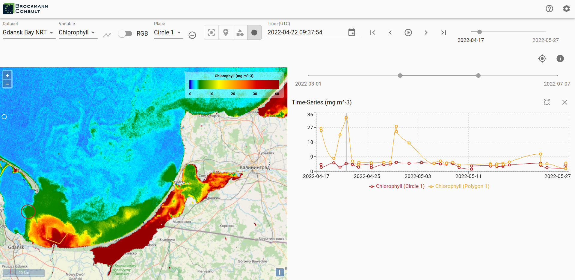
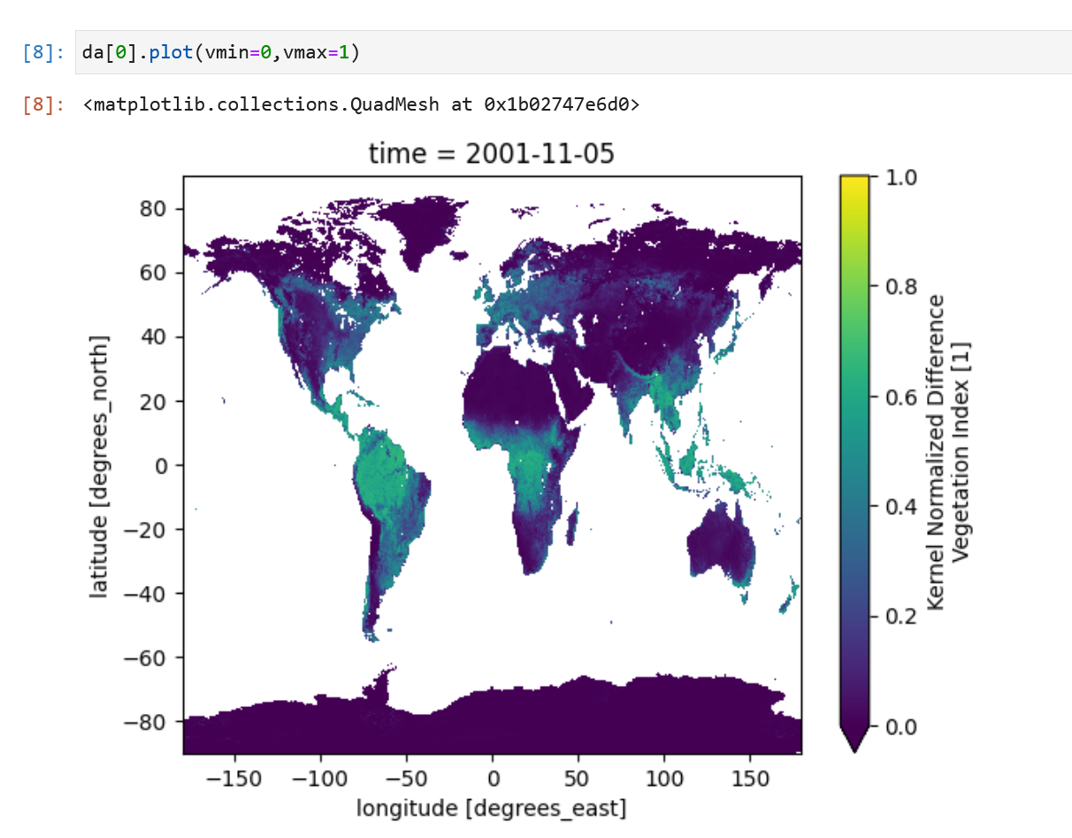
RELATED WORK
Existing visualization packages are powerful, however they:
Are usually limited to 2D plotting
Do not work on large data sets (100s of GBs) or only with noticeable latency
Sometimes have complex (user) interfaces that can be overwhelming
Do not work natively on mobile devices, e.g., for field work
⬆️ Figure: A 2D map in xcube-viewer [4].
⬅️ Figure: A 2D plot generated using matplotlib [5] in a Jupyter notebook.

Slide 5
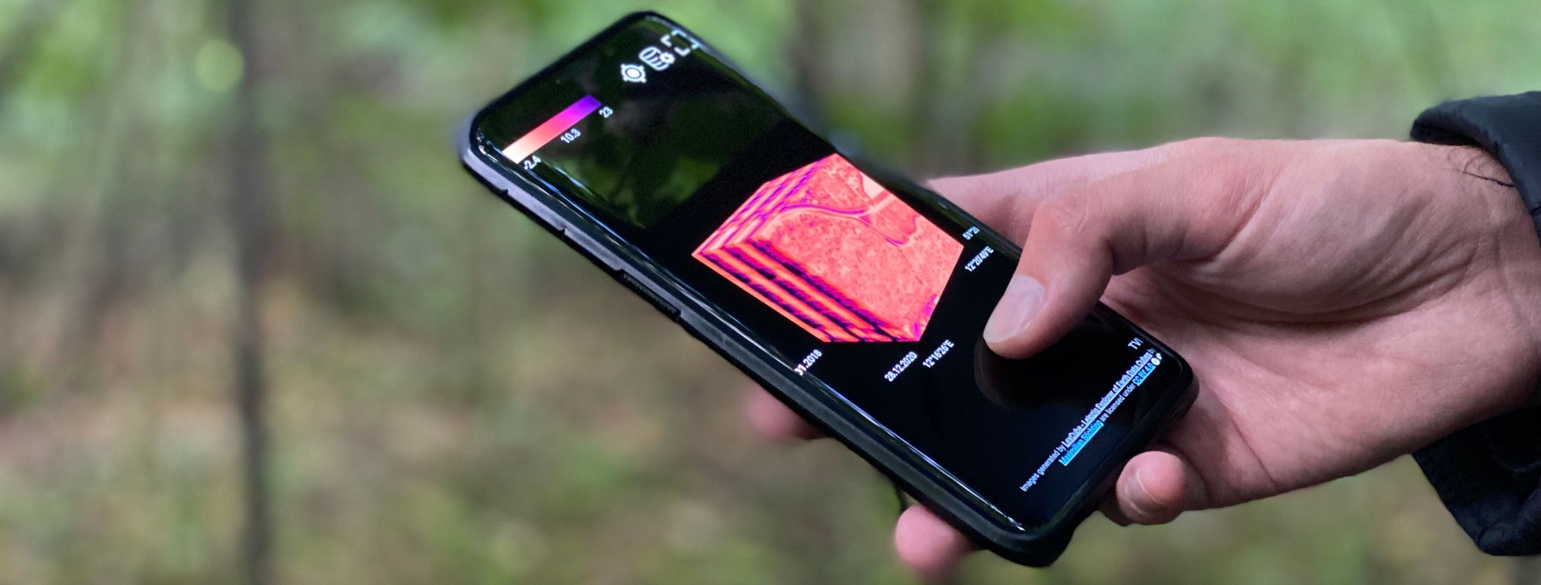
– CONCEPT
Interactive 3D earth science data cube visualization
Works with data sets of hundreds of gigabytes with low latency (<1s)
Intuitive UI – click/touch and drag anywhere, minimal menus
Native mobile device support with GPS tracking and touch controls

Slide 6
DEMO
Try it yourself!
Works on phones, laptops and tablets.
Data visualized: kNDVI based on global MODIS data (2018 – 2022), 2.2 TB

Slide 7
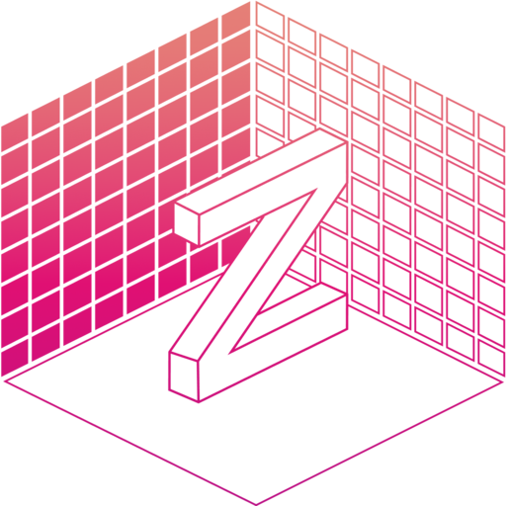
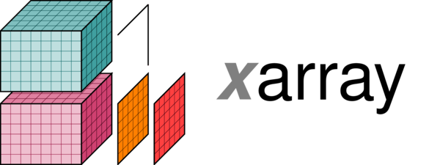
OPEN-SOURCE TECHNOLOGY
Lexcube is built in a client-server architecture:
TypeScript (JavaScript) client using Three.js
Python server using FastAPI and Xarray [4]
Transferred data is tiled and compressed using ZFP [5]
Client-server data exchange using REST and Websockets
Integration into existing data cube ecosystem – works with any gridded Zarr or NetCDF file
Lexcube will be open-sourced in 2023

Slide 8
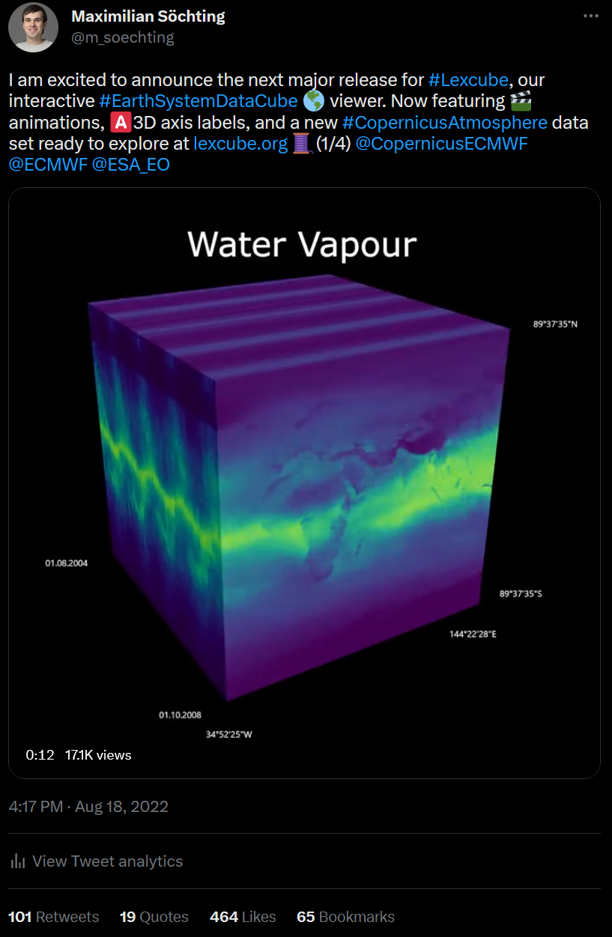
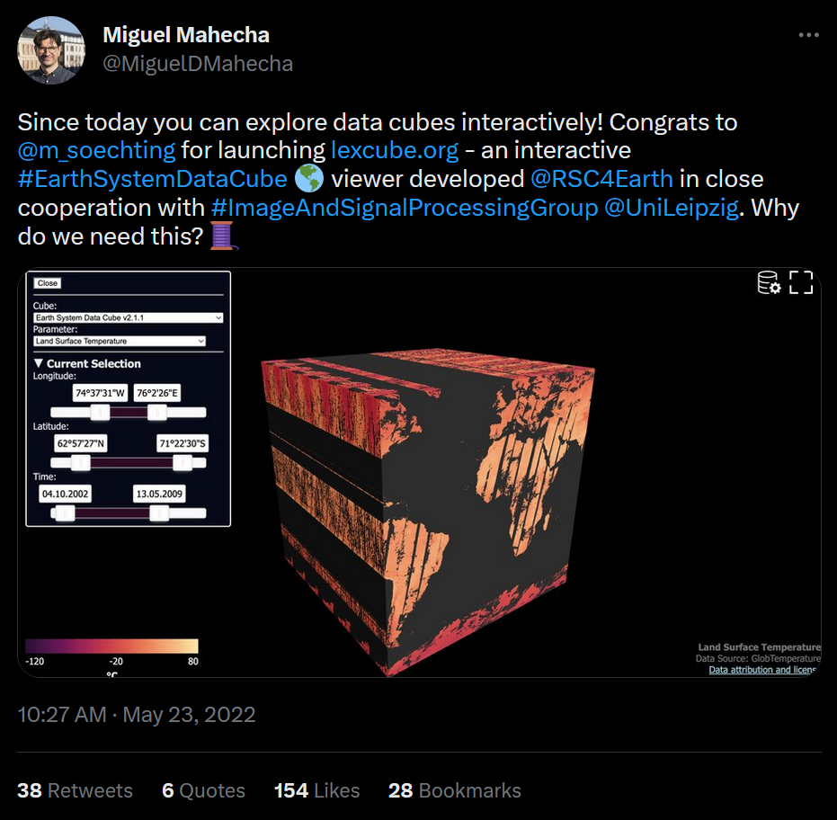
OUTREACH & IMPACT
2,800 users and 163,000 API requests on lexcube.org since public release in May 2022
774 likes, 205 retweets and 21,000 video views on Twitter over three tweets
Great qualitative feedback from various domain experts
“Fantastic tool! Looking forward to investigate extremes case studies [with Lexcube]!” (Sebastian Sippel, Climate and Earth System Scientist at ETH Zurich)

Slide 9
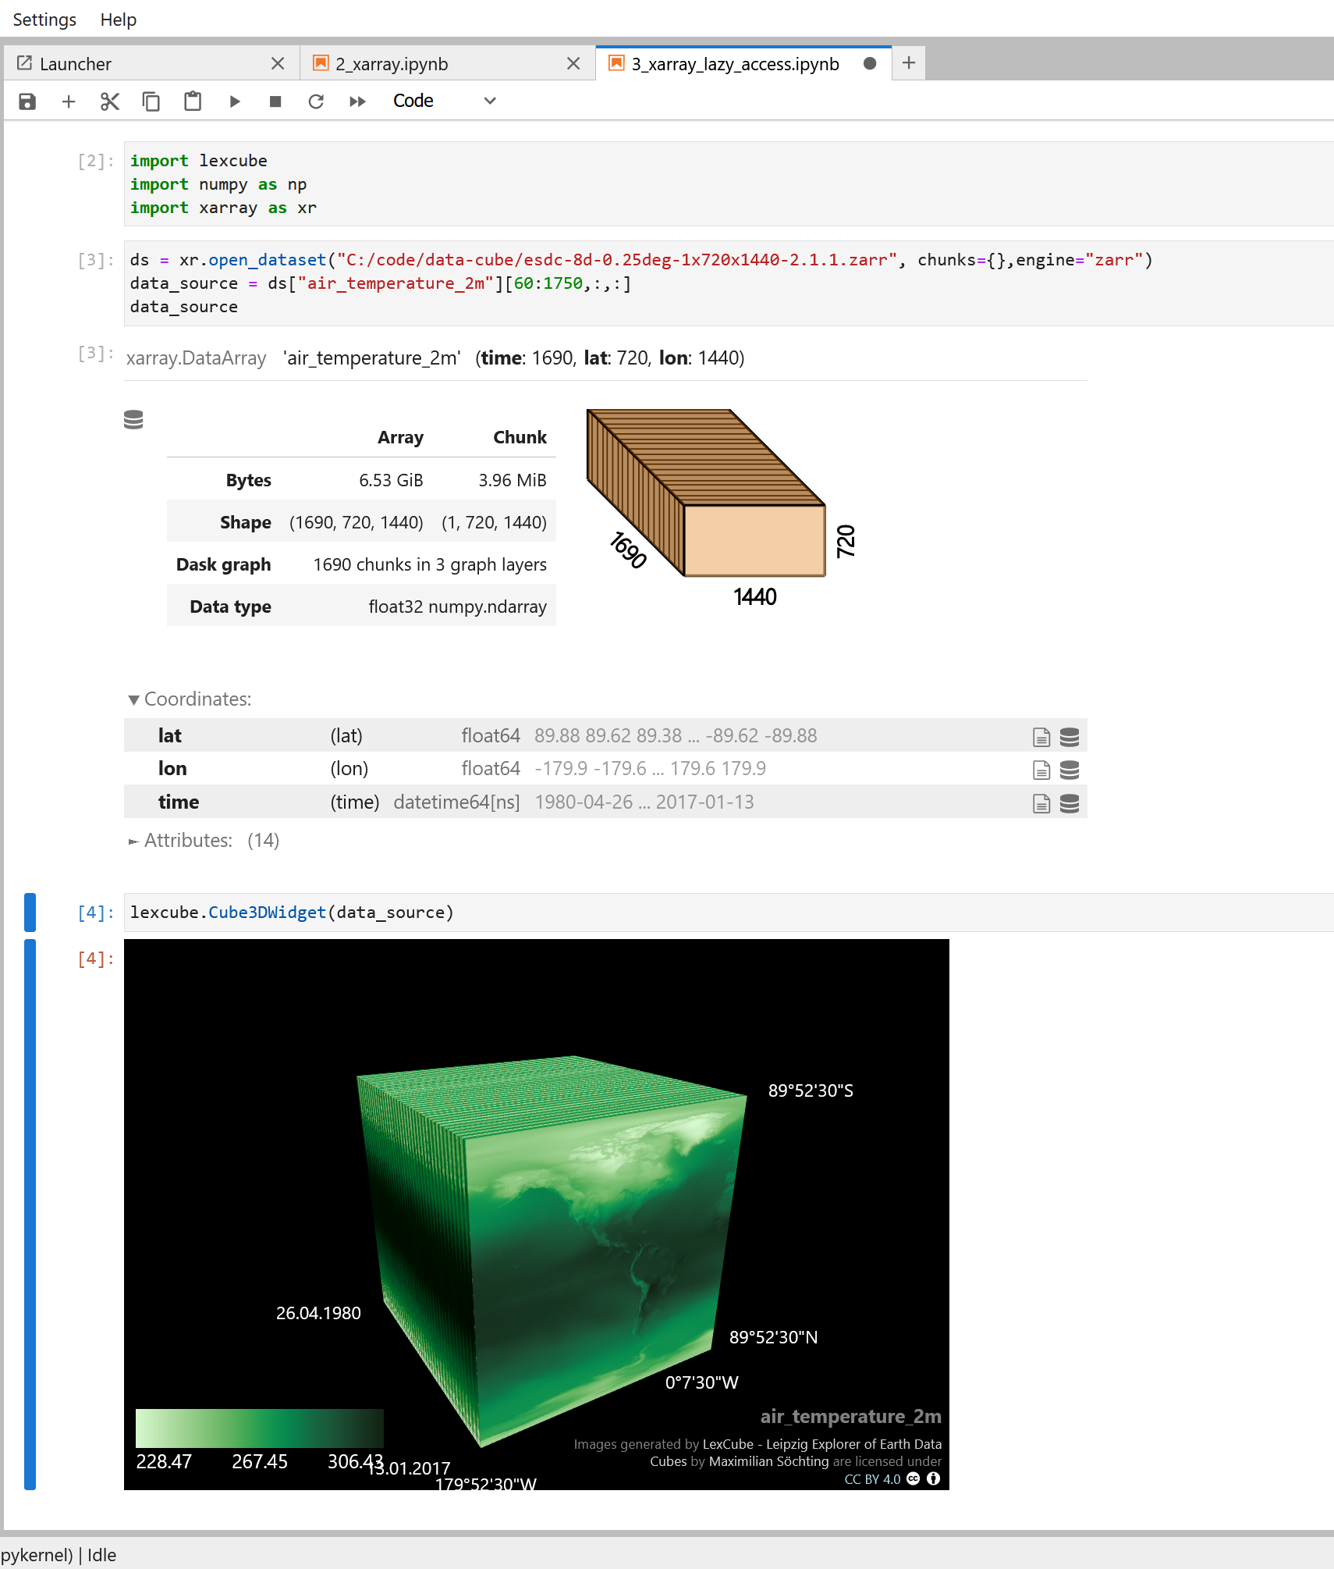
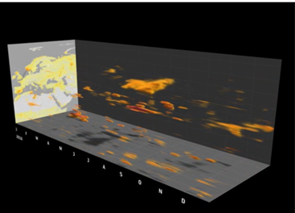
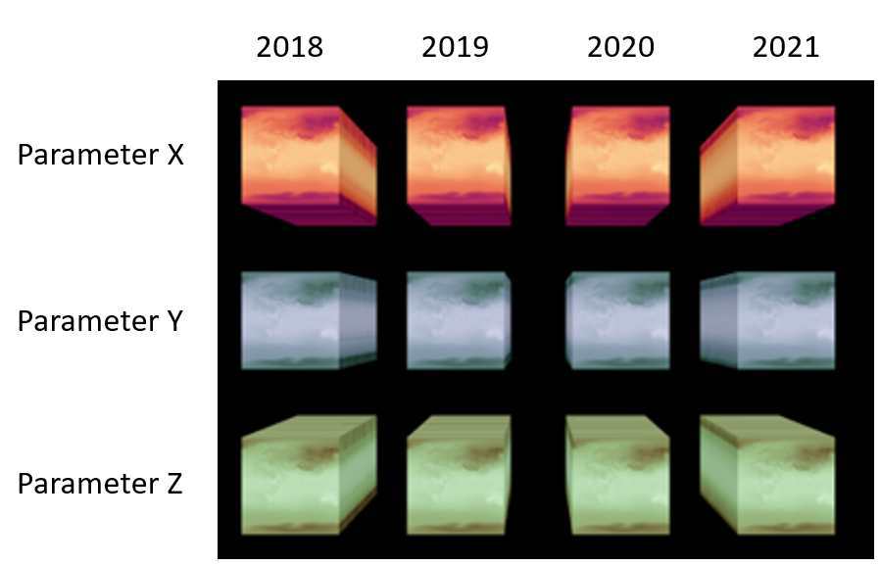
FUTURE WORK
3D volume visualization
Explore the “insides” of the cube
Multi-cube visualization
E.g. 2D grid of mini-cubes
Jupyter notebook integration & open-source release
Visualize any 3D array in a very accessible way, right in the notebook
→ within the next months

Slide 10
LITERATURE
[1] R. Baatz, H. J. Hendricks Franssen, E. Euskirchen, D. Sihi, M. Dietze, S. Ciavatta, K. Fennel, H. Beck, G. De Lannoy, V. R. N. Pauwels, A. Raiho, C. Montzka, M. Williams, U. Mishra, C. Poppe, S. Zacharias, A. Lausch, L. Samaniego, K. Van Looy, H. Bogena, M. Adamescu, M. Mirtl, A. Fox, K. Goergen, B. S. Naz, Y. Zeng, and H. Vereecken. Re-analysis in earth system science: Toward terrestrial ecosystem reanalysis. Reviews of Geophysics, 59(3):e2020RG000715, 2021. doi: 10.1029/2020RG00071
[2] A. Skidmore, N. Coops, E. Neinavaz, A. Ali, M. Schaepman, M. Paganini, W. Kissling, P. Viher- vaara, R. Darvishzadeh, H. Feilhauer, et al. Priority list of biodiversity metrics to observe from space. nat. ecol. evol. 5, 896–906, 2021
[3] M. D. Mahecha, F. Gans, G. Brandt, R. Christiansen, S. E. Cornell, N. Fomferra, G. Kraemer, J. Peters, P. Bodesheim, G. Camps-Valls, J. F. Donges, W. Dorigo, L. M. Estupinan-Suarez, V. H. Gutierrez-Velez, M. Gutwin, M. Jung, M. C. Londoño, D. G. Miralles, P. Papastefanou, and M. Reichstein. Earth system data cubes unravel global multivariate dynamics. Earth System Dynamics, 11(1):201–234, February 2020. doi: 10.5194/esd-11-201-2020
[4] Xcube-viewer: https://github.com/dcs4cop/xcube-viewer
[5] Matplotlib: https://matplotlib.org/
[6] E. Hovmöller. The trough-and-ridge diagram. Tellus, 1(2):62–66, 1949. doi: 10.1111/j.2153-3490.1949.tb01260.
[7] Xarray: https://docs.xarray.dev/en/stable/index.html
[8] P. Lindstrom. Fixed-rate compressed floating-point arrays. IEEE Transactions on Visualization and Computer Graphics, 20(12):2674–2683, 2014. doi: 10.1109/TVCG.2014.2346458

Slide 11
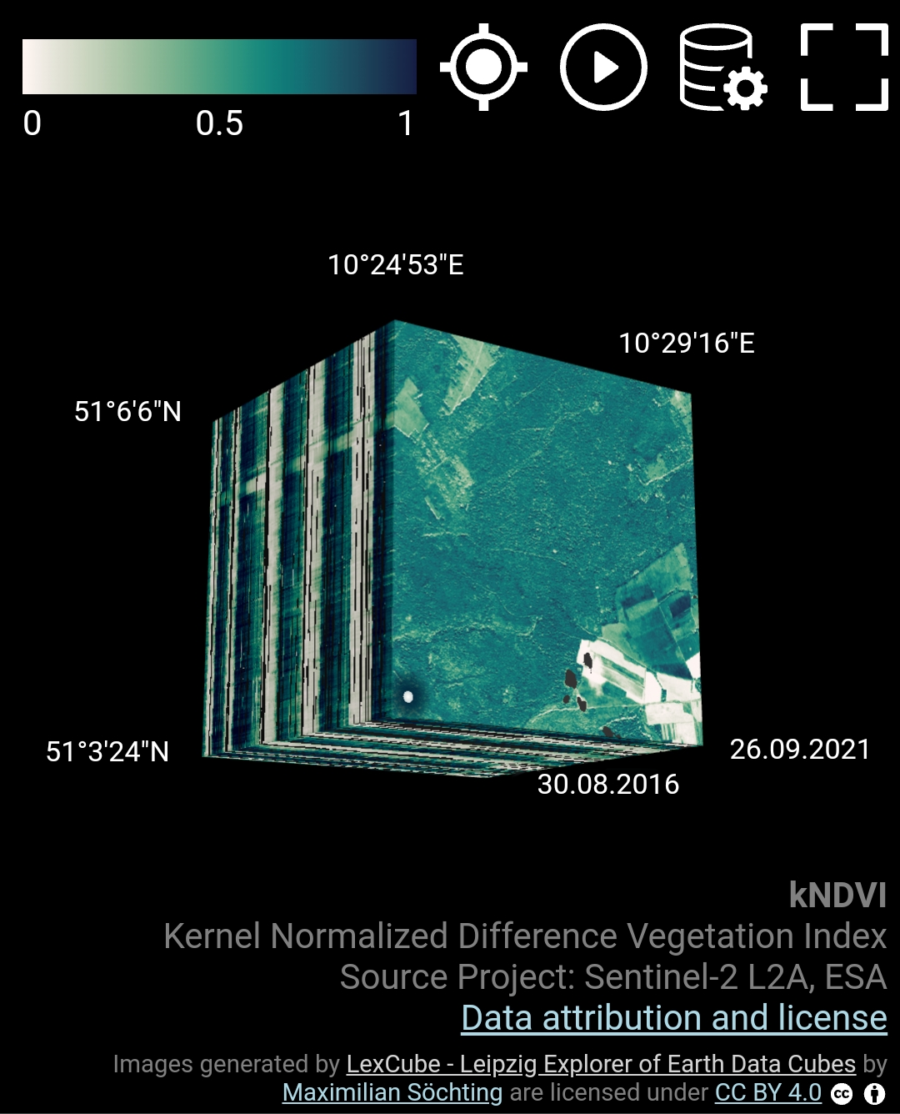
BONUS: GPS TRACKING IN THE FIELD
Displays current user geo location on the cube
Compare historic data to situation in the field
→ Will be available on lexcube.org with the next update
Current user location

