Slide 1
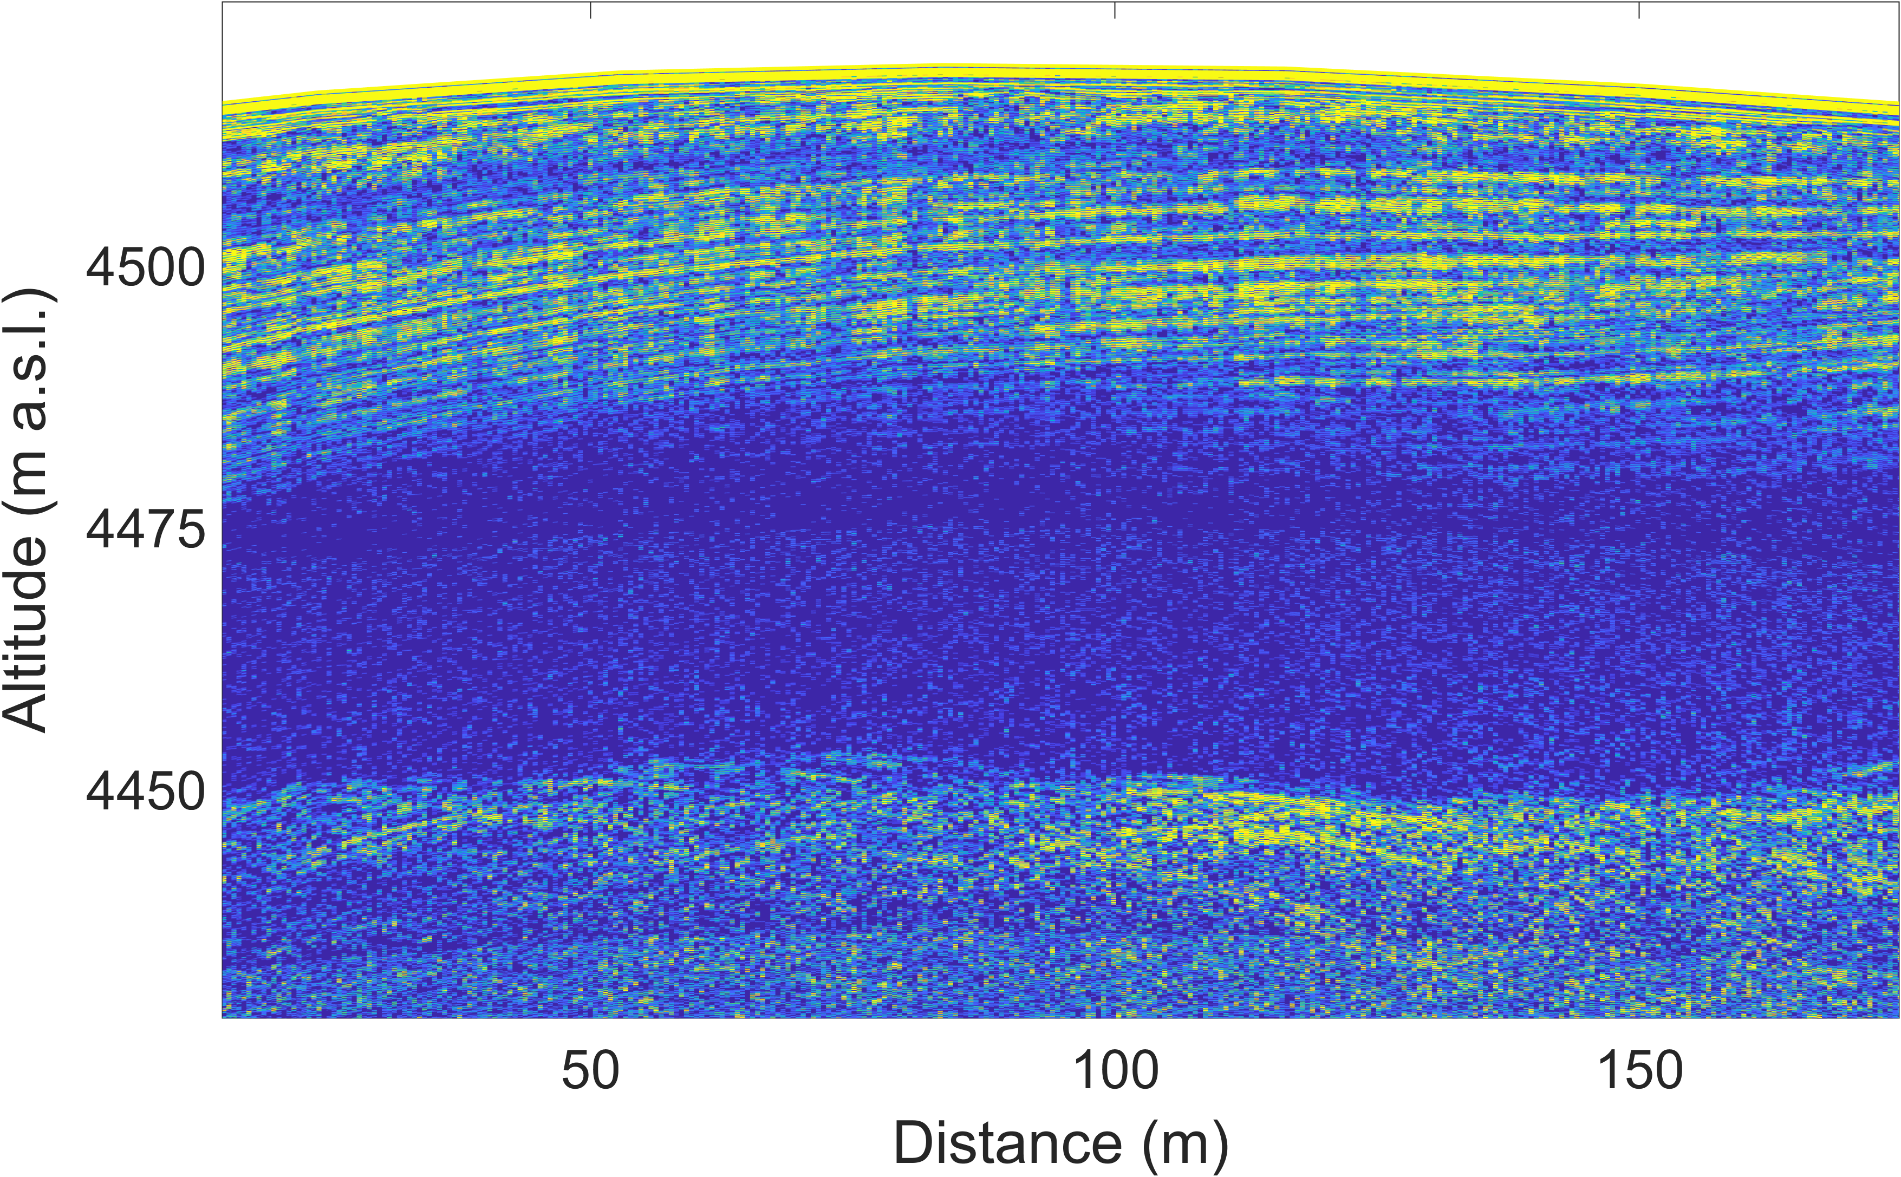
Layer-optimized SAR processing with a mobile pRES to illuminate the internal layering of an alpine glacier
Falk Oraschewski, Inka Koch, Reza Ershadi, Jonathan Hawkins, Olaf Eisen and Reinhard Drews
Normal GPR: No deep reflections
Can we observe deep internal layers of cold alpine glaciers?
Data: Konrad et al., 2013
Scientific question
Study site
Motivation
Radar setup
LoSAR processing
Results
Discussion
Take home
Next

Slide 2
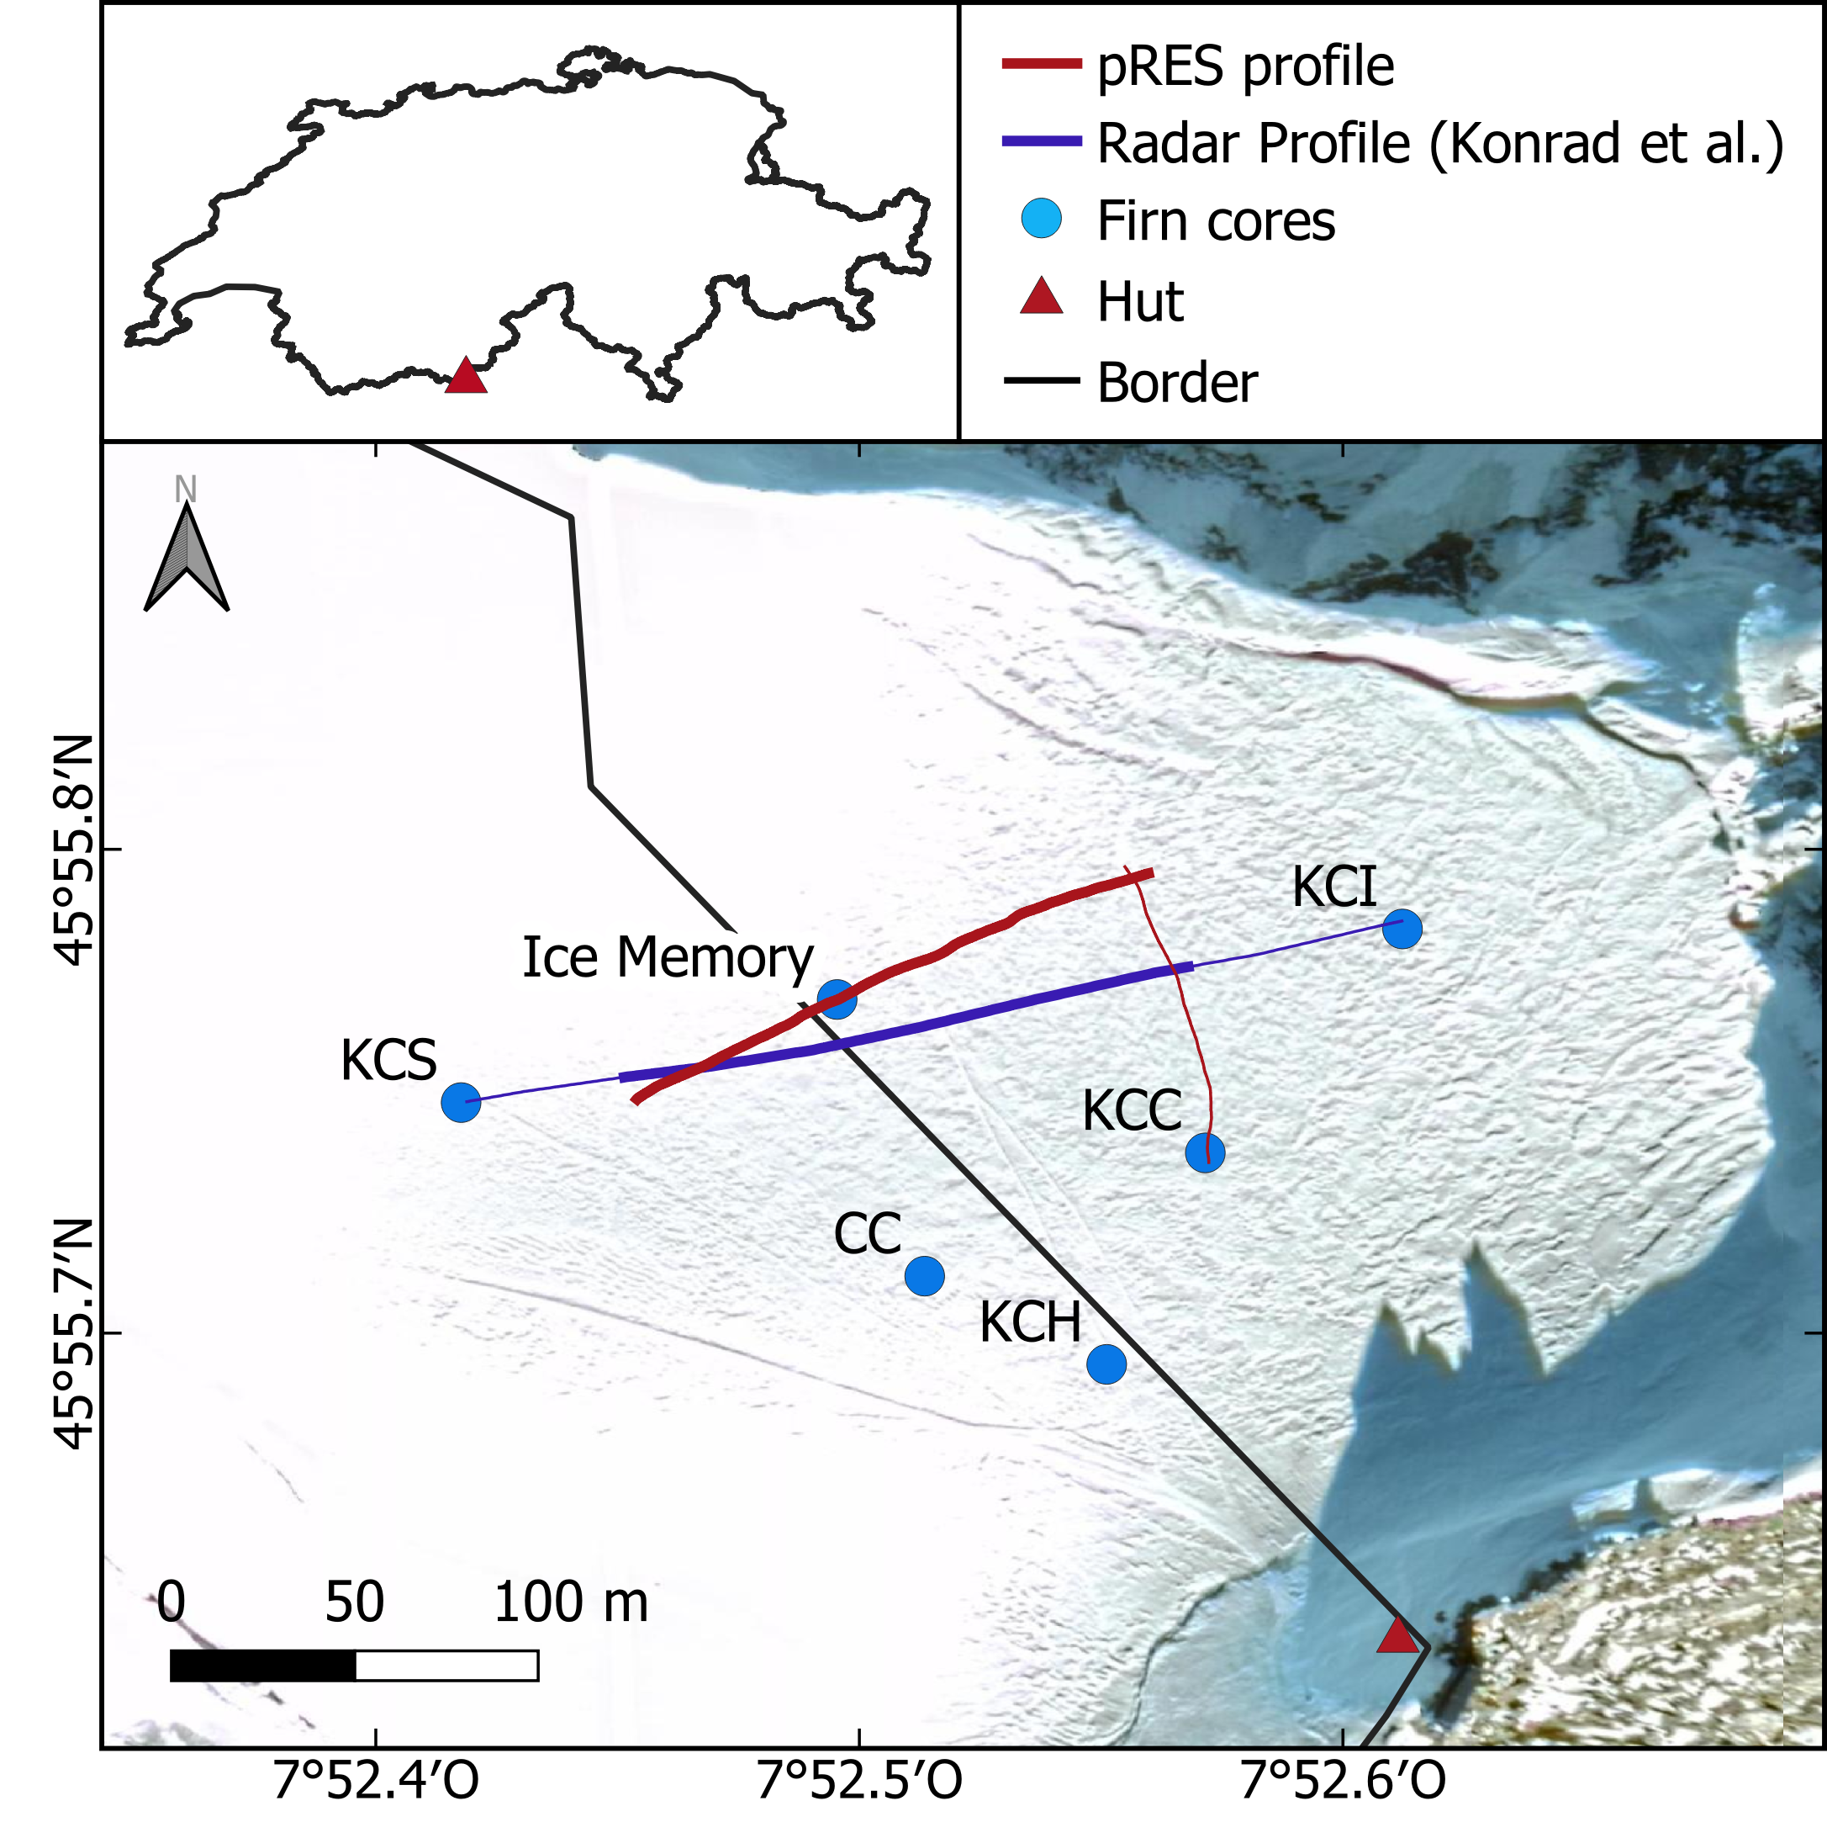
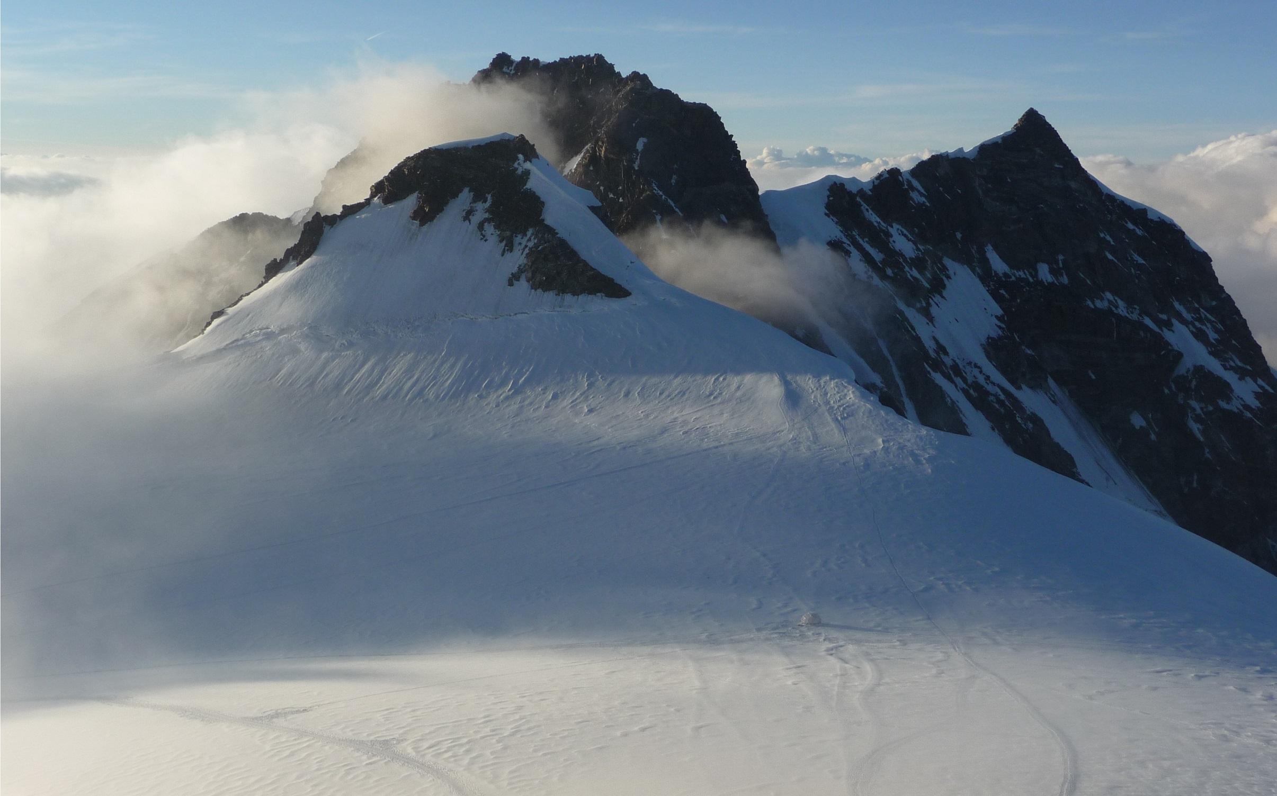
Study site
Colle Gnifetti, Monte Rosa, Switzerland/Italy
Elevation: 4.500 m
Cold glacier and climate archive
→ Need Geophysics to intercalibrate ice cores
Back
Scientific question
Study site
Motivation
Radar setup
LoSAR processing
Results
Discussion
Take home
Next

Slide 3
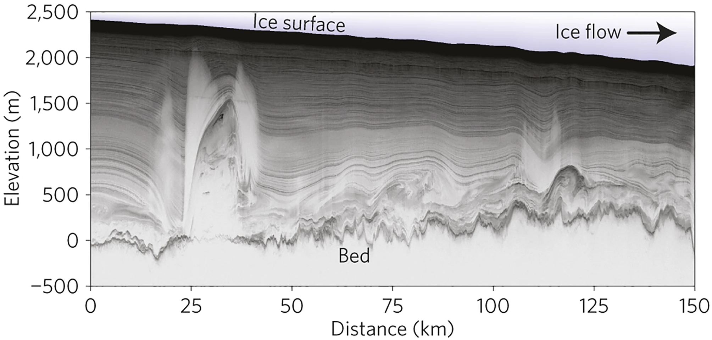
Motivation
Take coherent radars from the poles to the Alps
Coherent radars & SAR processing allow the detection of basal features in the polar ice sheets.
But the use of these radar systems in alpine terrain is limited (e.g,. airborne radar, snow cat pulled systems).
Devevlop SAR processing techniques for the cheap and lightweight phase sensitive Radio Echo Sounder (pRES).
Radargram collected at Peterman Ice Stream, Greendland (Bell et al., 2014)
Back
Scientific question
Study site
Motivation
Radar setup
LoSAR processing
Results
Discussion
Take home
Next

Slide 4
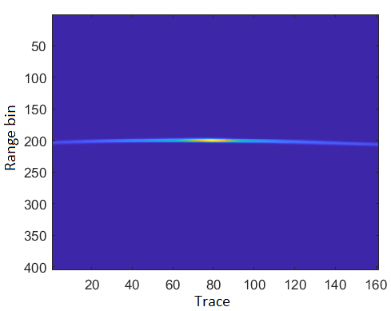
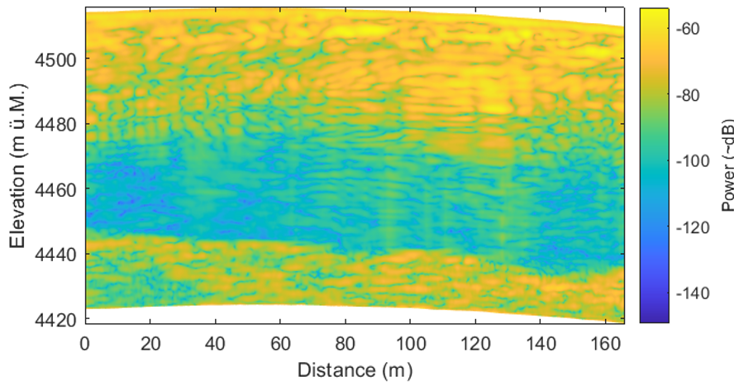
Motivation
Why do we need layer-optimized SAR processing?
A reflection hyperbola
Radargram after back projection processing
Conventional SAR processing techniques are based on the idea of increasing signal strength of point reflectors by summing up the power along their reflection hyperbola recorded over consecutive traces.
For closely-spaced, specular reflectors this approach entails several problems:
Reflection hyperbolas may reach across several layers
Sloping layers cause destructive interference
Resulting radargrams are patchy and can be misinterpreted
→ Need a different approach for SAR processing of internal layers: Summation along the layer
Back
Scientific question
Study site
Motivation
Radar setup
LoSAR processing
Results
Discussion
Take home
Next

Slide 5
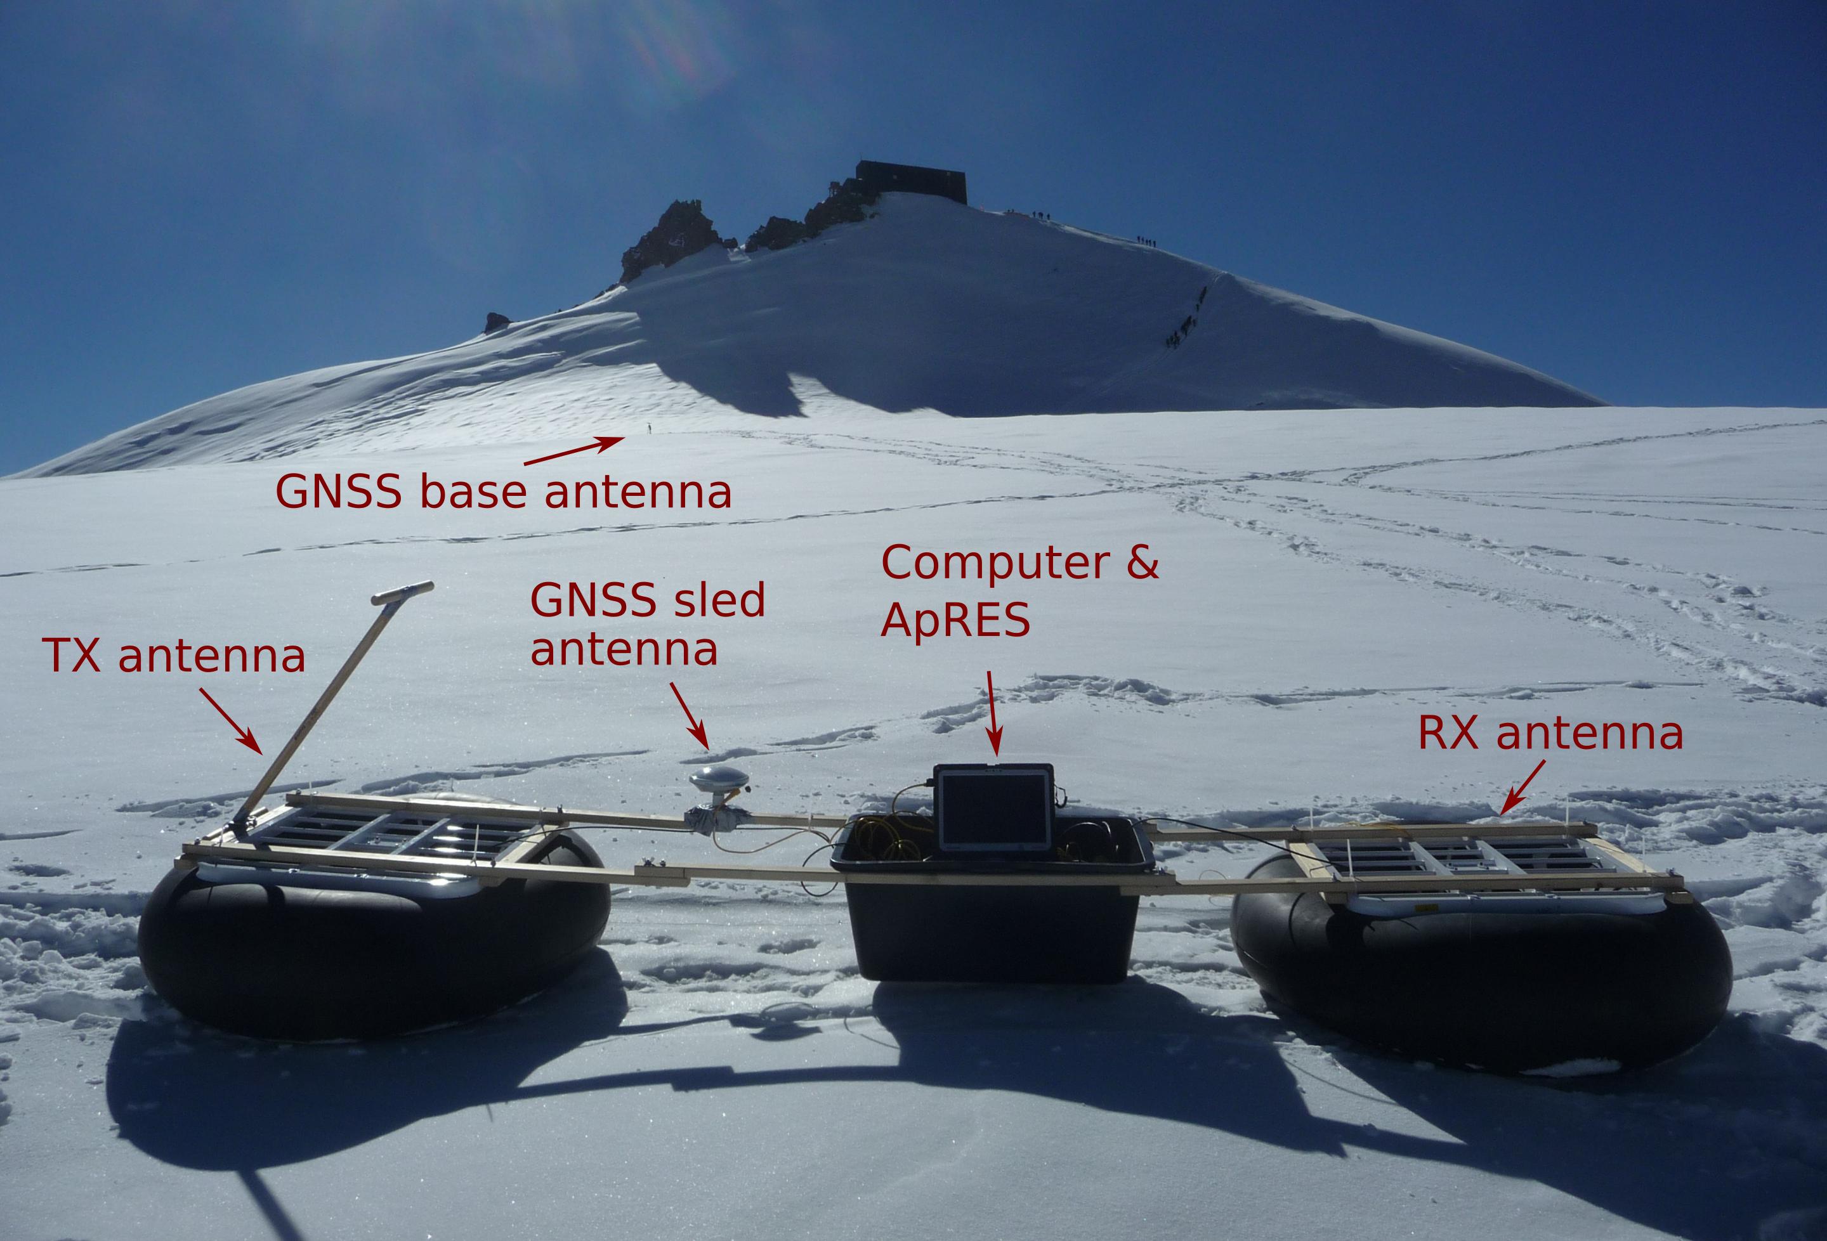
Radar setup
Tx/Rx antennae:
Mounted in tractor inner tubes and fixed with wood/bamboos.
GNSS system:
Used in real time kinematic (RTK) mode to correct the signal of the sled antenna and achieve ~5 cm positioning accuracy.
Computer & pRES:
Receive GPS coordinates, trigger shots and tell user when to move/stop.
Because of the 1 s chirp time of the pRES, the data needs to be recorded in Start-Stop mode, making data acquisition slow.
What is the pRES?
Back
Scientific question
Study site
Motivation
Radar setup
LoSAR processing
Results
Discussion
Take home
Next

Slide 6
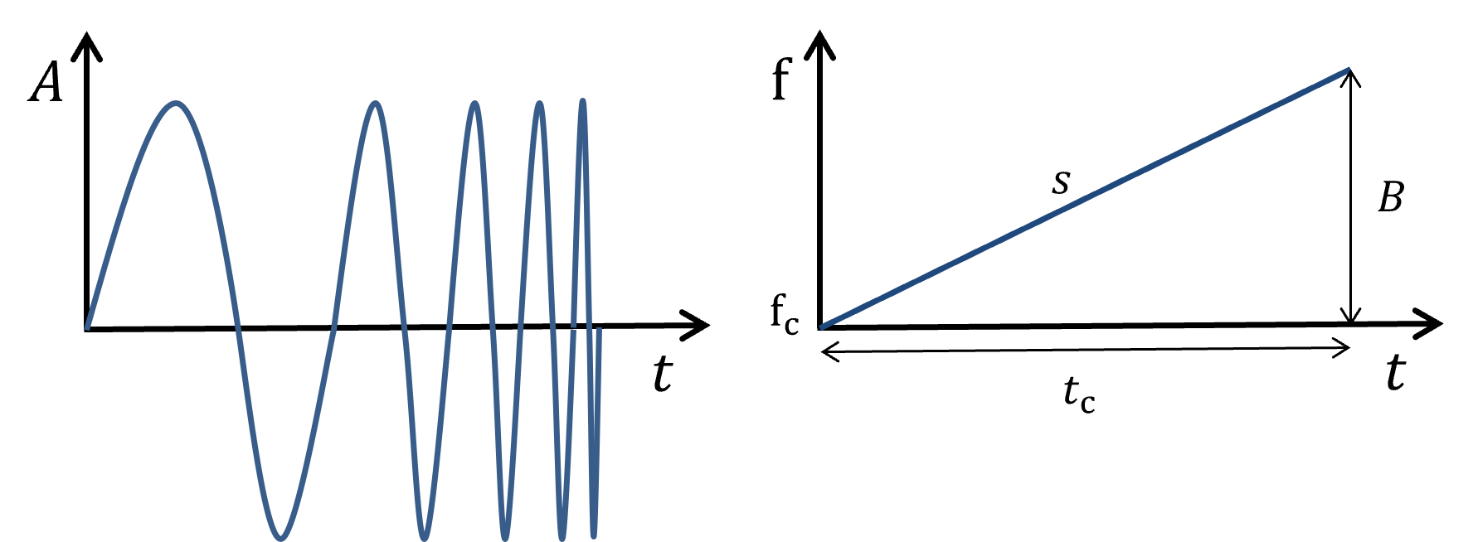
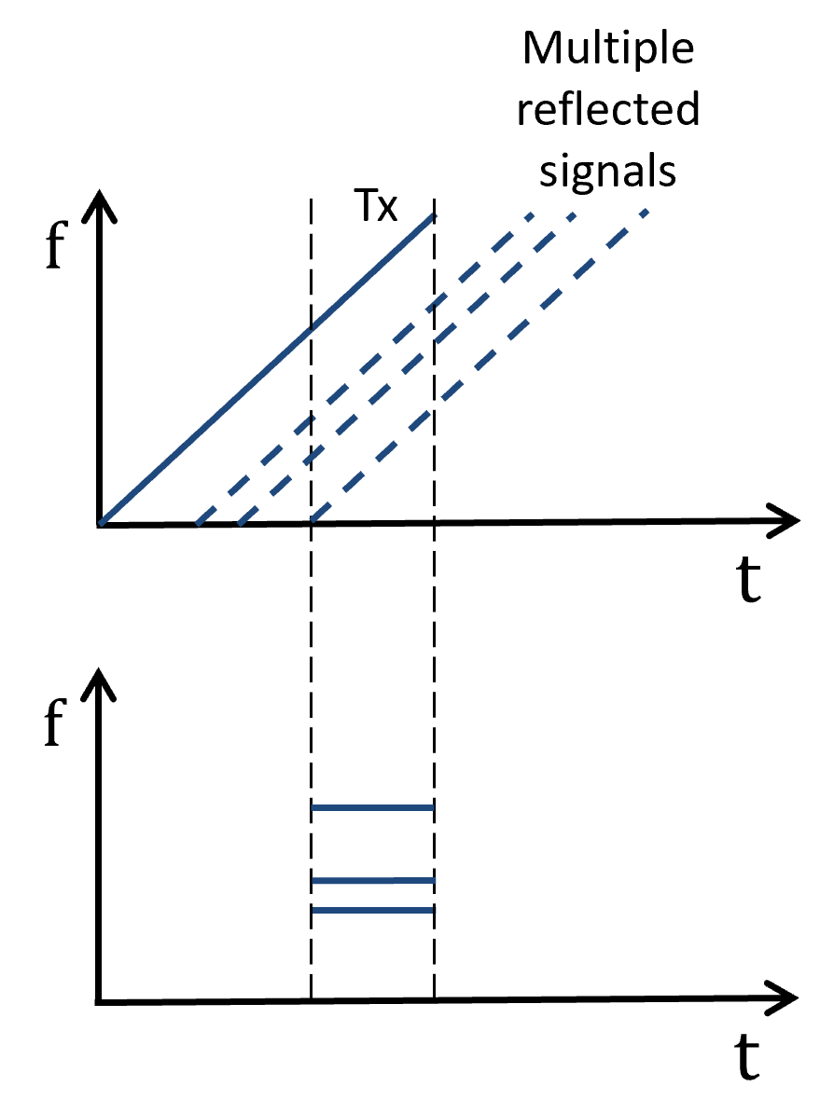
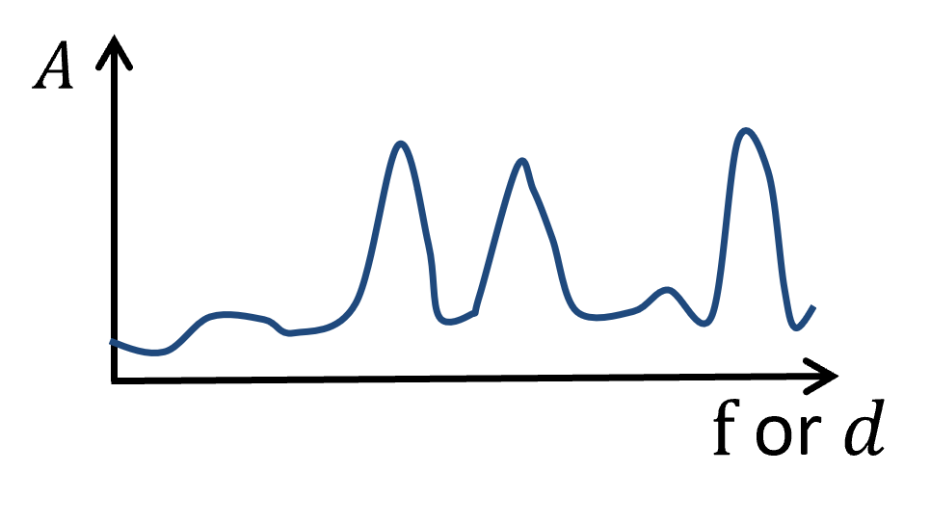
Motivation
What is the pRES?
A chirp
Recorded signal After Fourier transform
The pRES is a frequency modulated continuous wave (FMCW) radar with:
Bandwidth $B$: $200 \text{MHz}$
Center frequency $f_{\text{c}}$: $300 \text{MHz}$
Chirp time $s$: $1$s
The signal is deramped by subtracting the recorded from the transmitted signal.
After Fourier transforming the deramped signal a frequency spectrum is obtained that translates into an amplitude-depth relation.
Back
Scientific question
Study site
Motivation
Radar setup
LoSAR processing
Results
Discussion
Take home
Next

Slide 7
Layer optimized Synthentic Aperture (LoSAR) processing
Idea
Sum along internal layers to improve their signal strength
Workflow
Phase correction
Find layer slopes
in phase signal
Coherent
summation along slope line
pRES data
LoSAR processed radargram
Shape matching
Filter slopes
Back
Scientific question
Study site
Motivation
Radar setup
LoSAR processing
Results
Discussion
Take home
Next

Slide 8
Phase correction
Compared to the power signal, the phase is very coherent
But the raw phase is difficult to interpret. Only after performing a phase correction, as explained by Brennan et al. (2013), the phase response aligns with the layer slopes.
Back
Scientific question
Study site
Motivation
Radar setup
LoSAR processing
Results
Discussion
Take home
Next

Slide 9
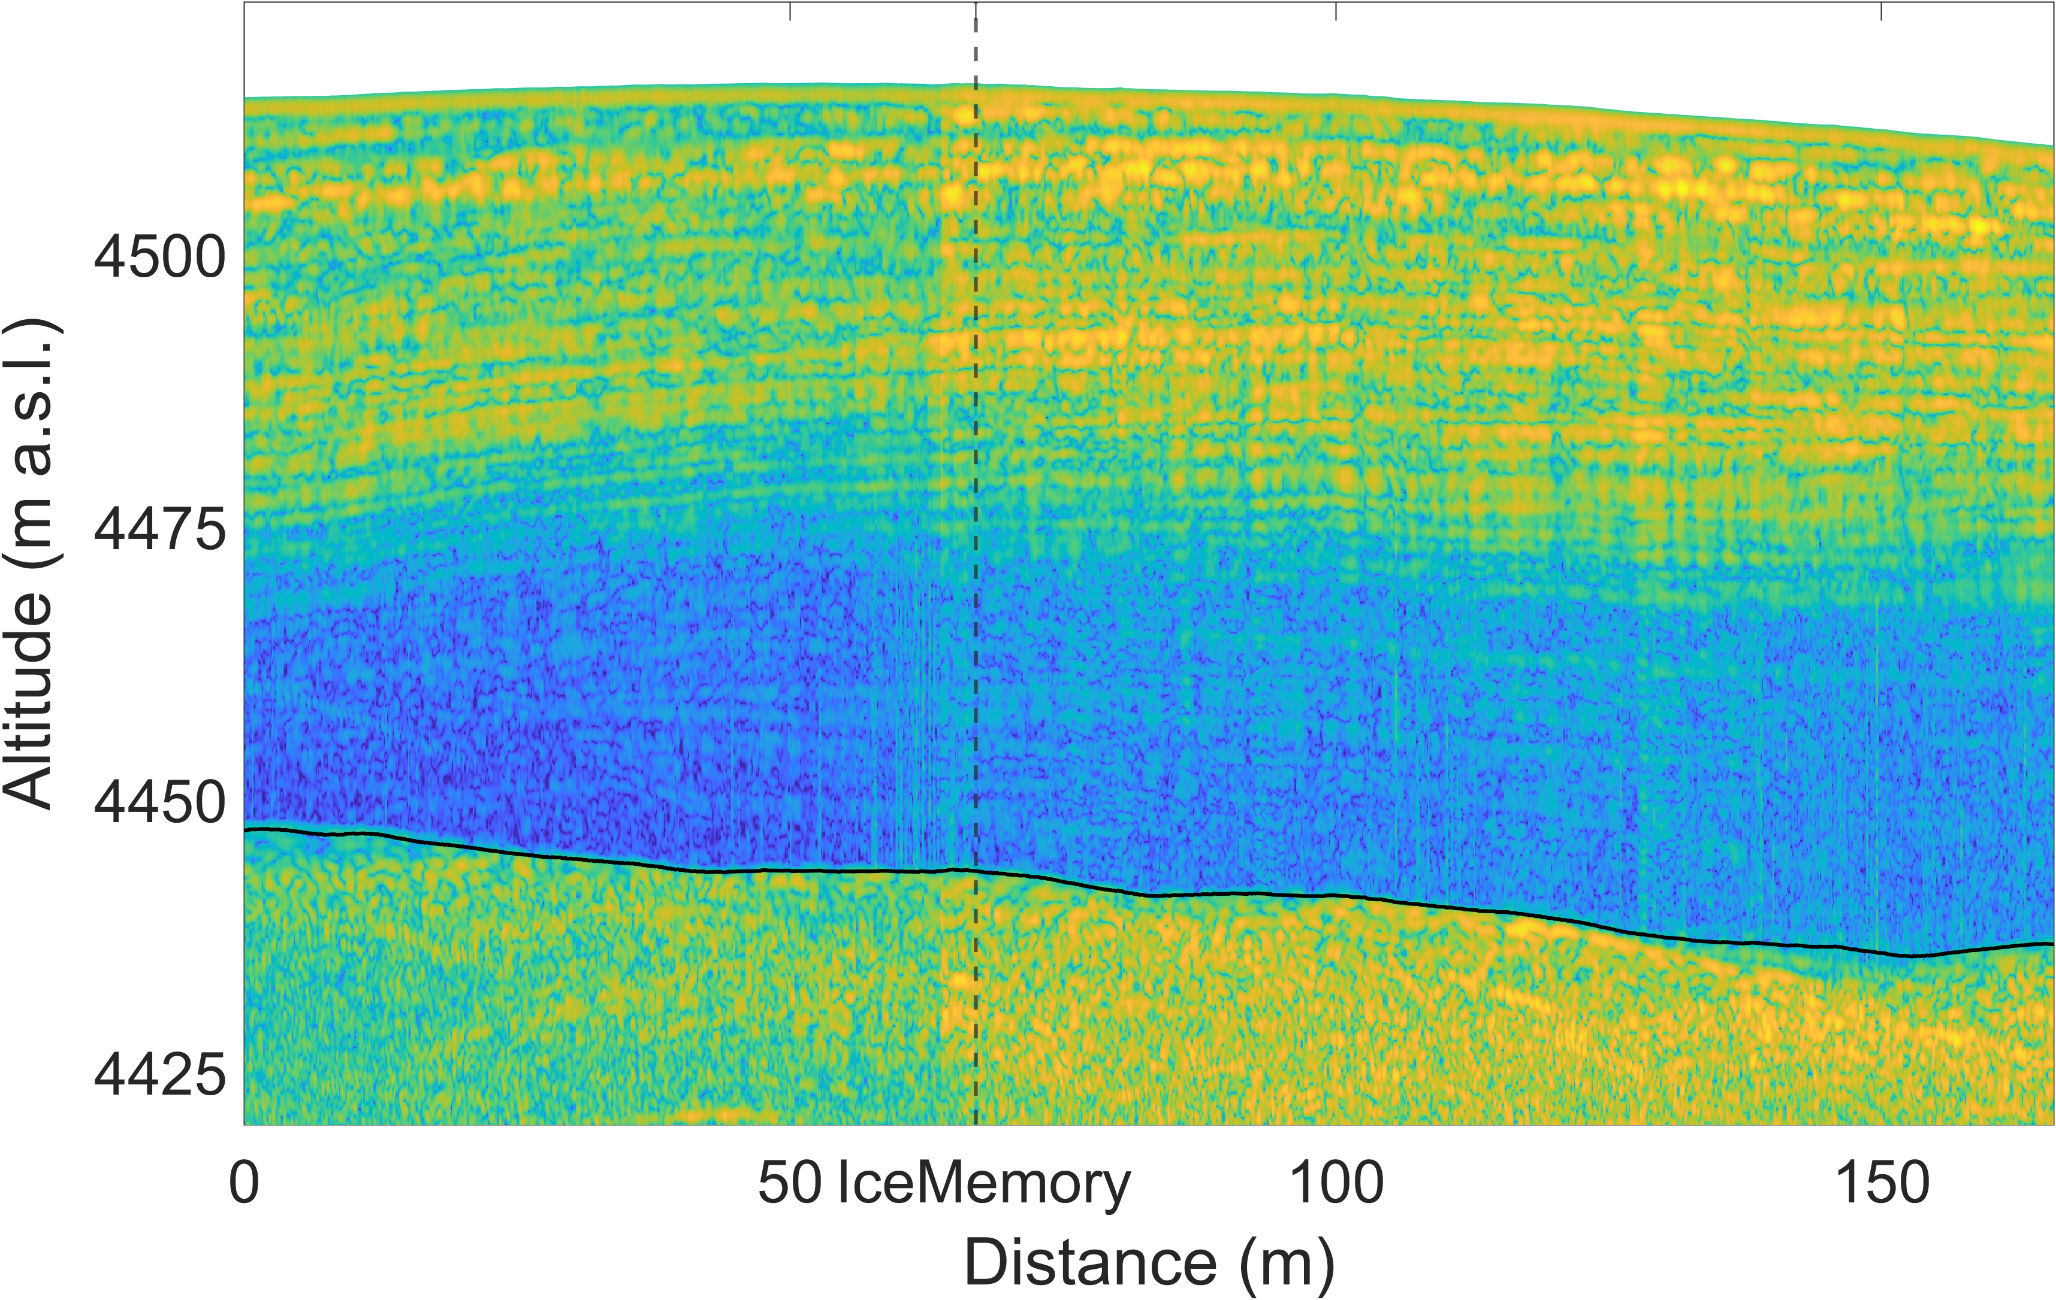
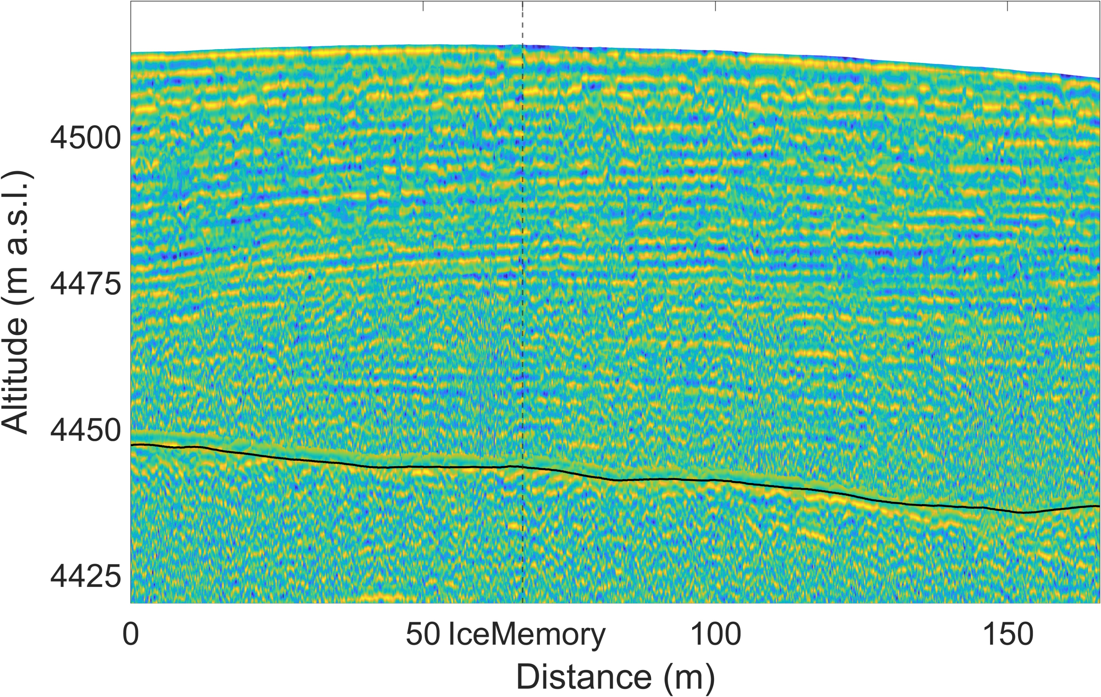
Shape matching
Before: Raw radar data
After: Shape matched radar data
Convolute input data with a reference reflector to
Increase strength of good reflections
Suppress non-reflector type signals/noise
Relatively increase the strength of weak reflectors
Method following Rahman et al. (2014)
Back
Scientific question
Study site
Motivation
Radar setup
LoSAR processing
Results
Discussion
Take home
Next

Slide 10
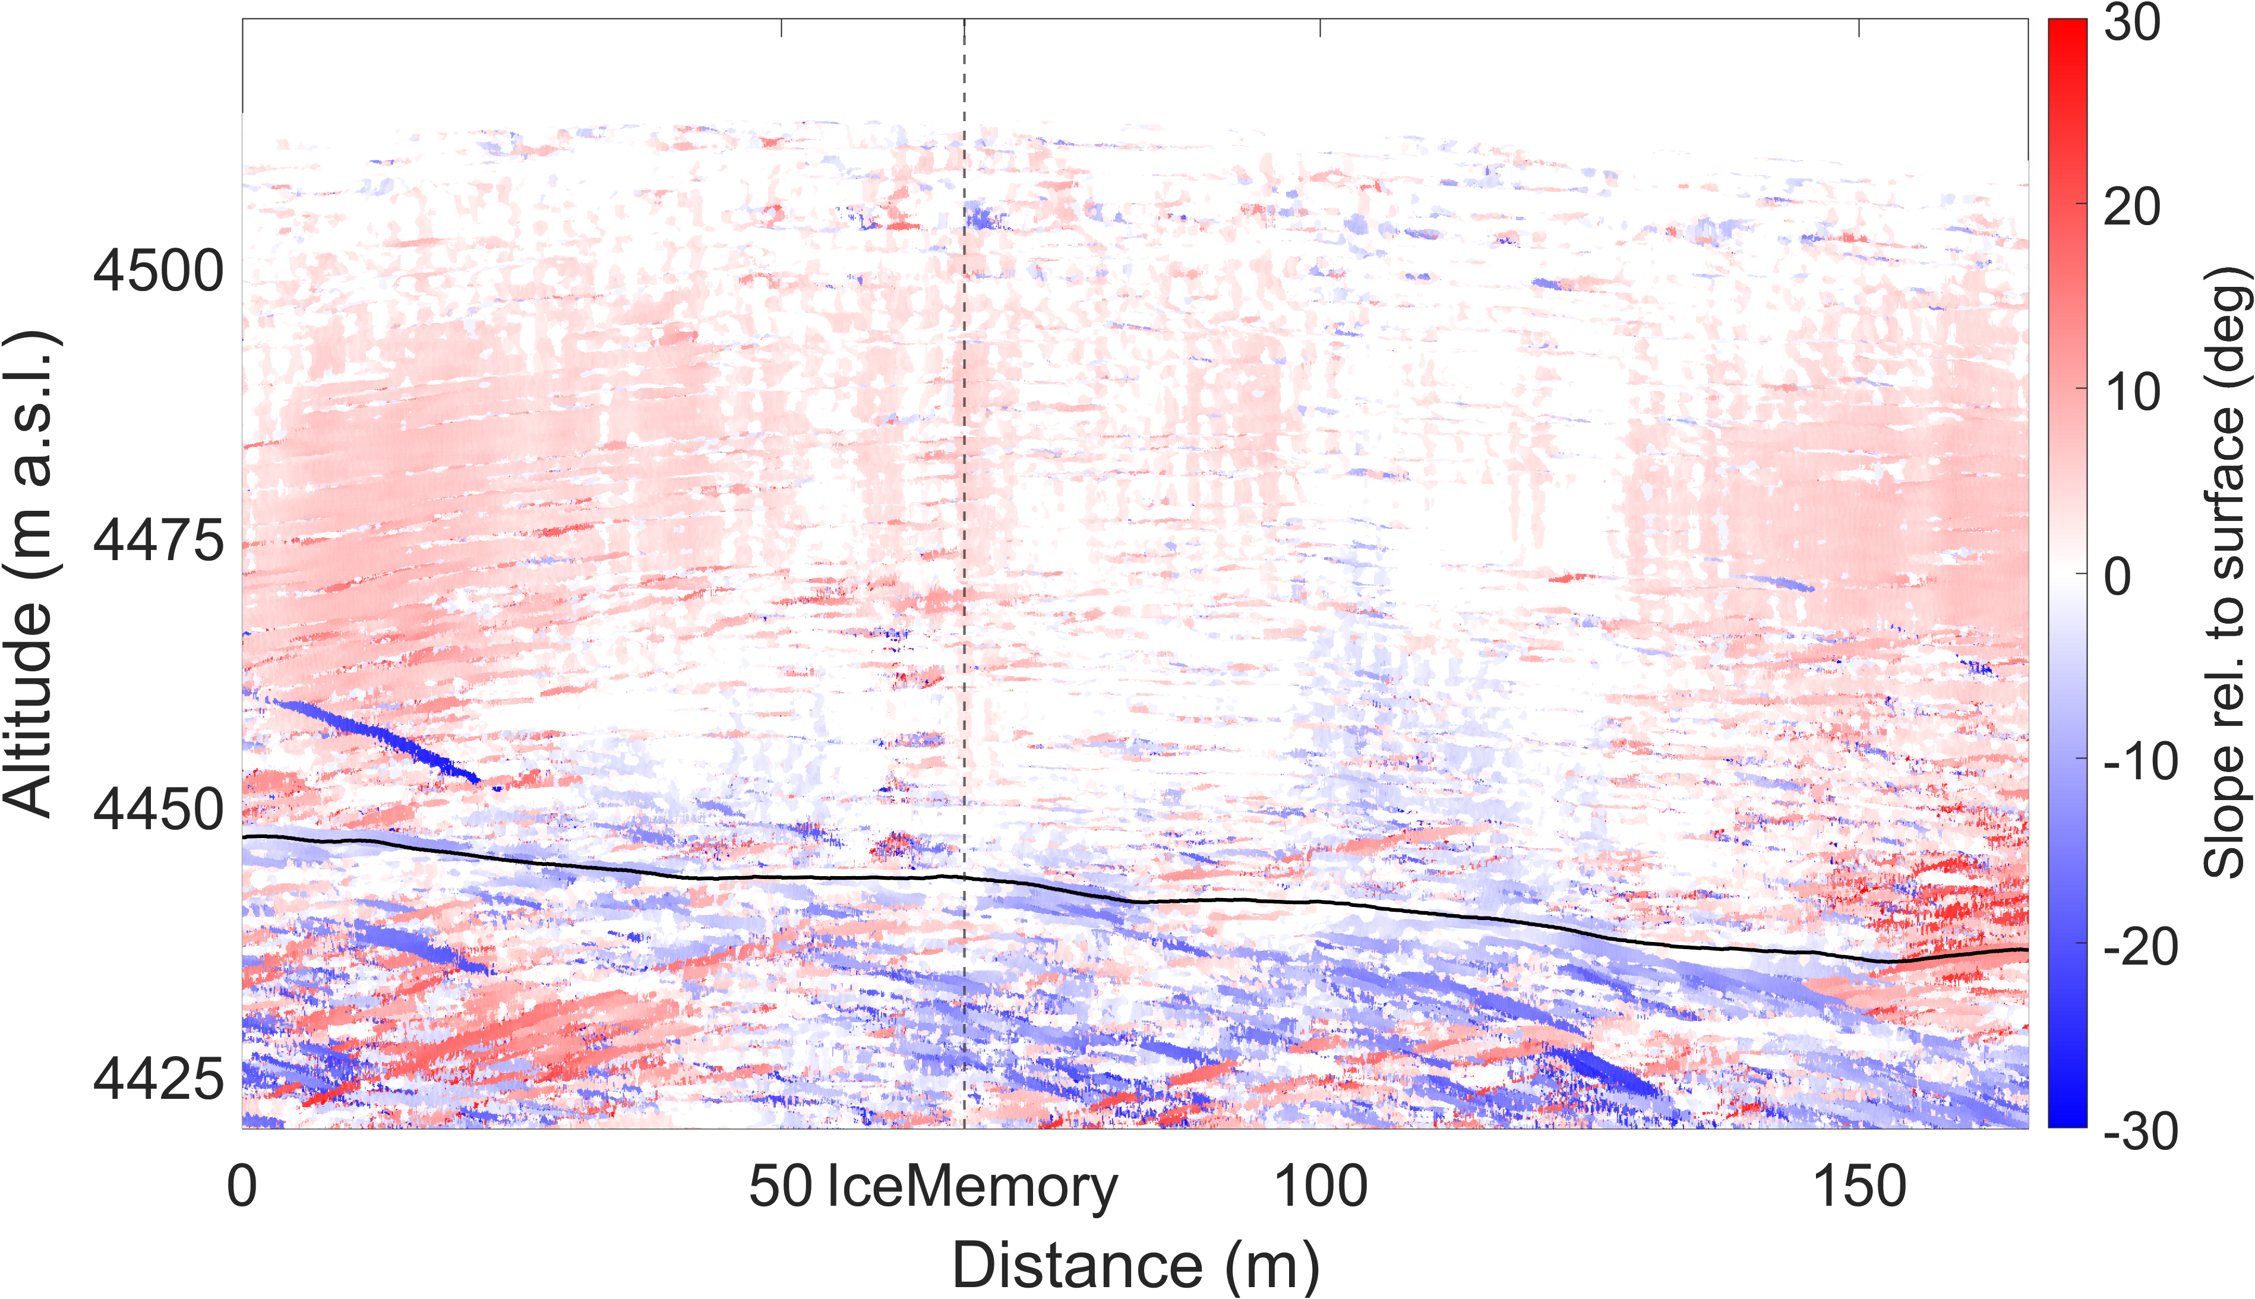
Find layer slopes in phase signal
Power of raw radar data
Derived layers slopes
The phase is coherent along the layer slope. At every grid point we can find the slope as follows:
Normalize the radargram
Iteratively sum coherently over all possible slope lines (Positive interference when in-phase, otherwise destructive interference)
Take the slope with the maximal return
Back
Scientific question
Study site
Motivation
Radar setup
LoSAR processing
Results
Discussion
Take home
Next

Slide 11
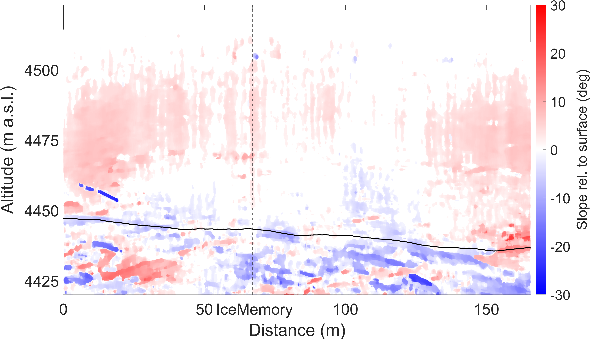
Filter layer slopes
Before: Layer slopes with maximal phase coherence
After: Filtered layer slopes
In areas with a weak power return the phase is still more noisy and we observe extrema in the slope.
Assuming that internal slopes cannot vary strongly in space , we filter these extrema using a 2D-moving mean filter to
reduce the coherence in the following along slope summation
to avoid an overestimation of the signal power
and let true reflectors become more clear
Back
Scientific question
Study site
Motivation
Radar setup
LoSAR processing
Results
Discussion
Take home
Next

Slide 12
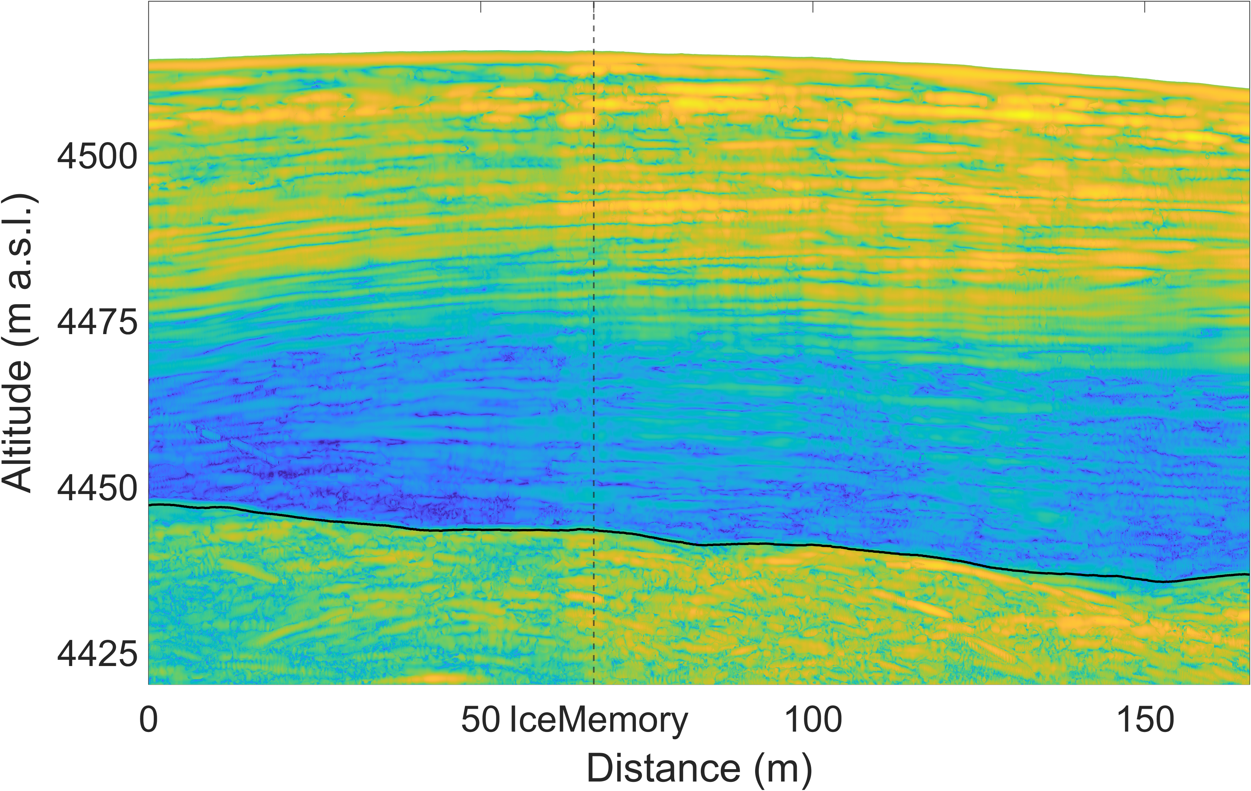
Coherent summation along layer
Before: Power of raw mobile pRES radar data
After: LoSAR processed radargram
By coherently summing up the power along the layer slope lines
the power of true reflectors will add up coherently, become stronger and more uniform
the power signal of noise in reflector free areas will blur out and become indistinct
→ Deep reflectors become clear
Back
Scientific question
Study site
Motivation
Radar setup
LoSAR processing
Results
Discussion
Take home
Next

Slide 13
Results: LoSAR processed radargram
Back
Scientific question
Study site
Motivation
Radar setup
LoSAR processing
Results
Discussion
Take home
Next

Slide 14
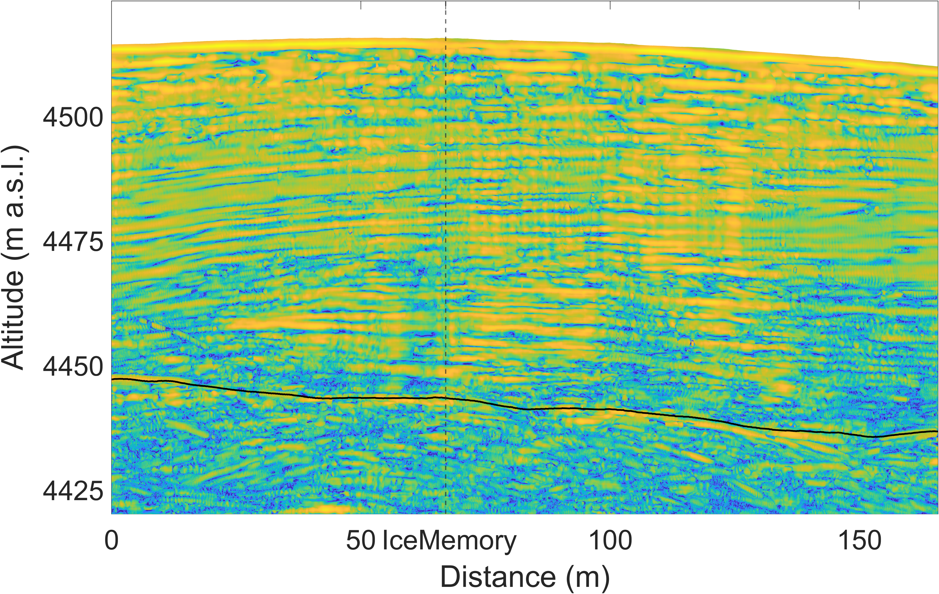
Results: LoSAR processed and shape matched radargram
Back
Scientific question
Study site
Motivation
Radar setup
LoSAR processing
Results
Discussion
Take home
Next

Slide 15
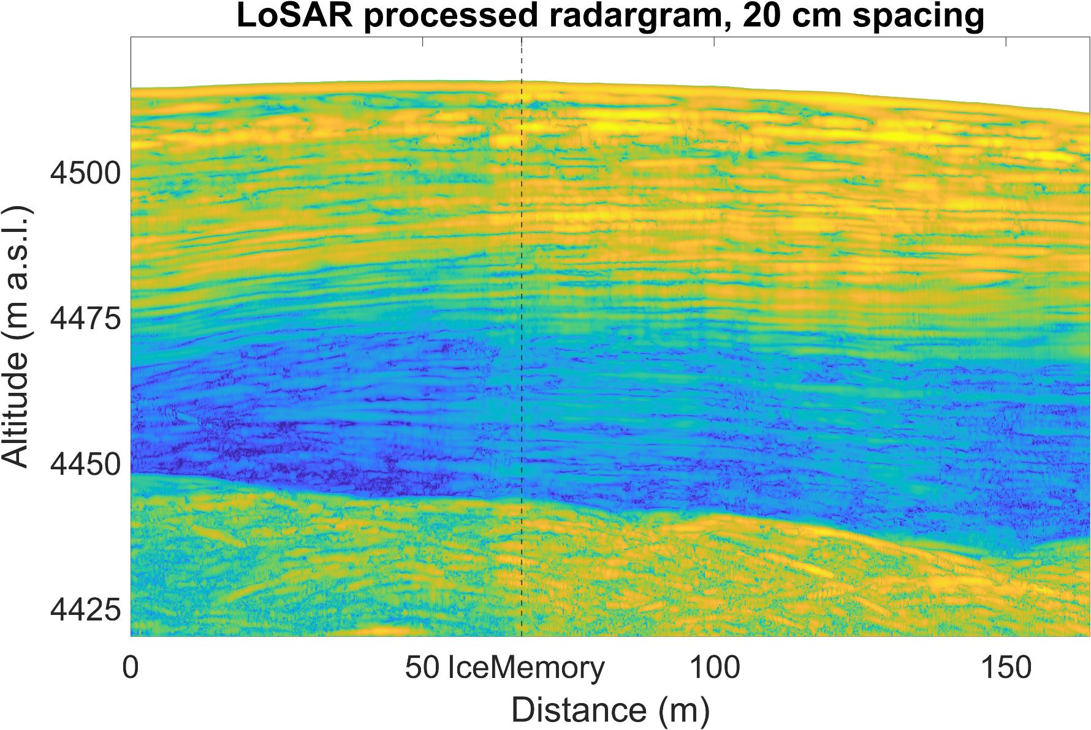
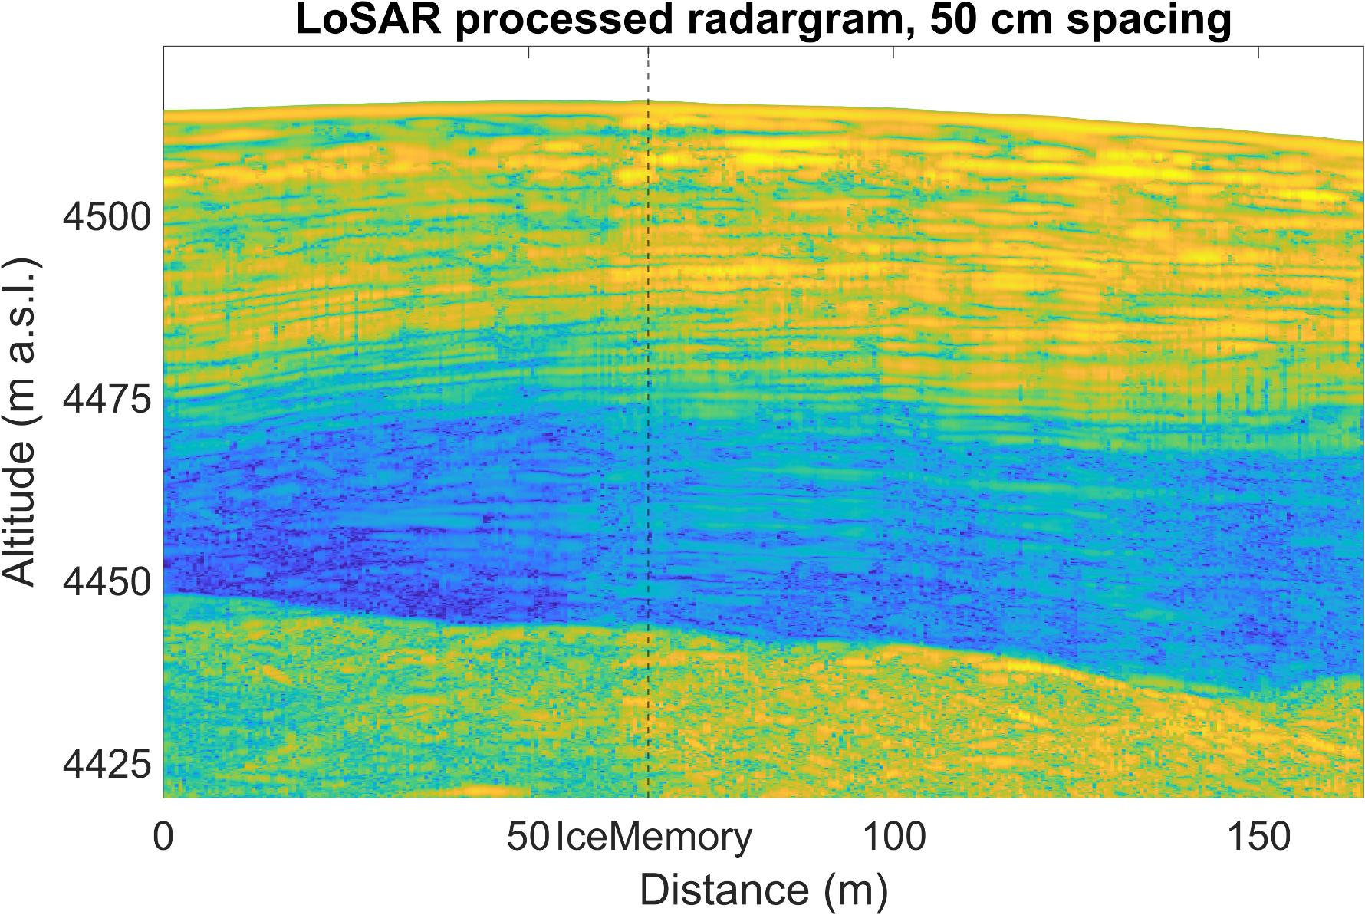
Discussion: Spacing requirements
The along track summation of LoSAR processing does not set a general limit on the trace spacing during data acquisition.
But the trace spacing sets a limit on the slope $α$ of reflectors that can be traced:
$$α<\tan^{−1}\left(\frac{λ}{4d}\right)$$
For example, for the pRES with a center frequency of $300 \text{MHz}$ the detection of layers with $20°$ slopes requires a trace spacing of $39 \text{cm}$.
Back
Scientific question
Study site
Motivation
Radar setup
LoSAR processing
Results
Discussion
Take home
Next

Slide 16
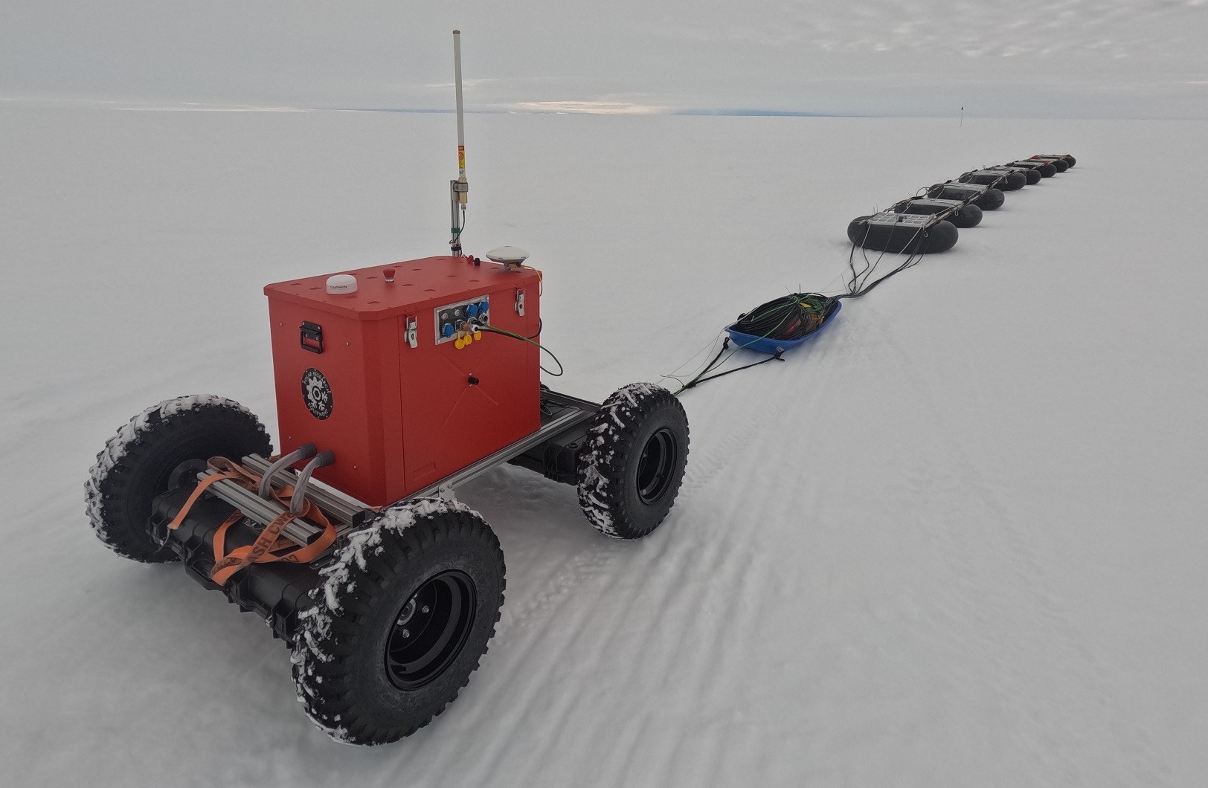
Discussion: Multi antenna configurations
Multi antenna configurations are needed to:
Solve the left-right ambiguity
Reduce the measurement time by moving in bigger steps
Cover larger profile distances
Difficulties:
Differing phase responses from different antennae and cable
Cable noise from long cable
Using an autonomous Rover, we recorded a $400 \text{m}$ profile on Ekström ice shelf to study the feasibility.
Back
Scientific question
Study site
Motivation
Radar setup
LoSAR processing
Results
Discussion
Take home
Next

Slide 17
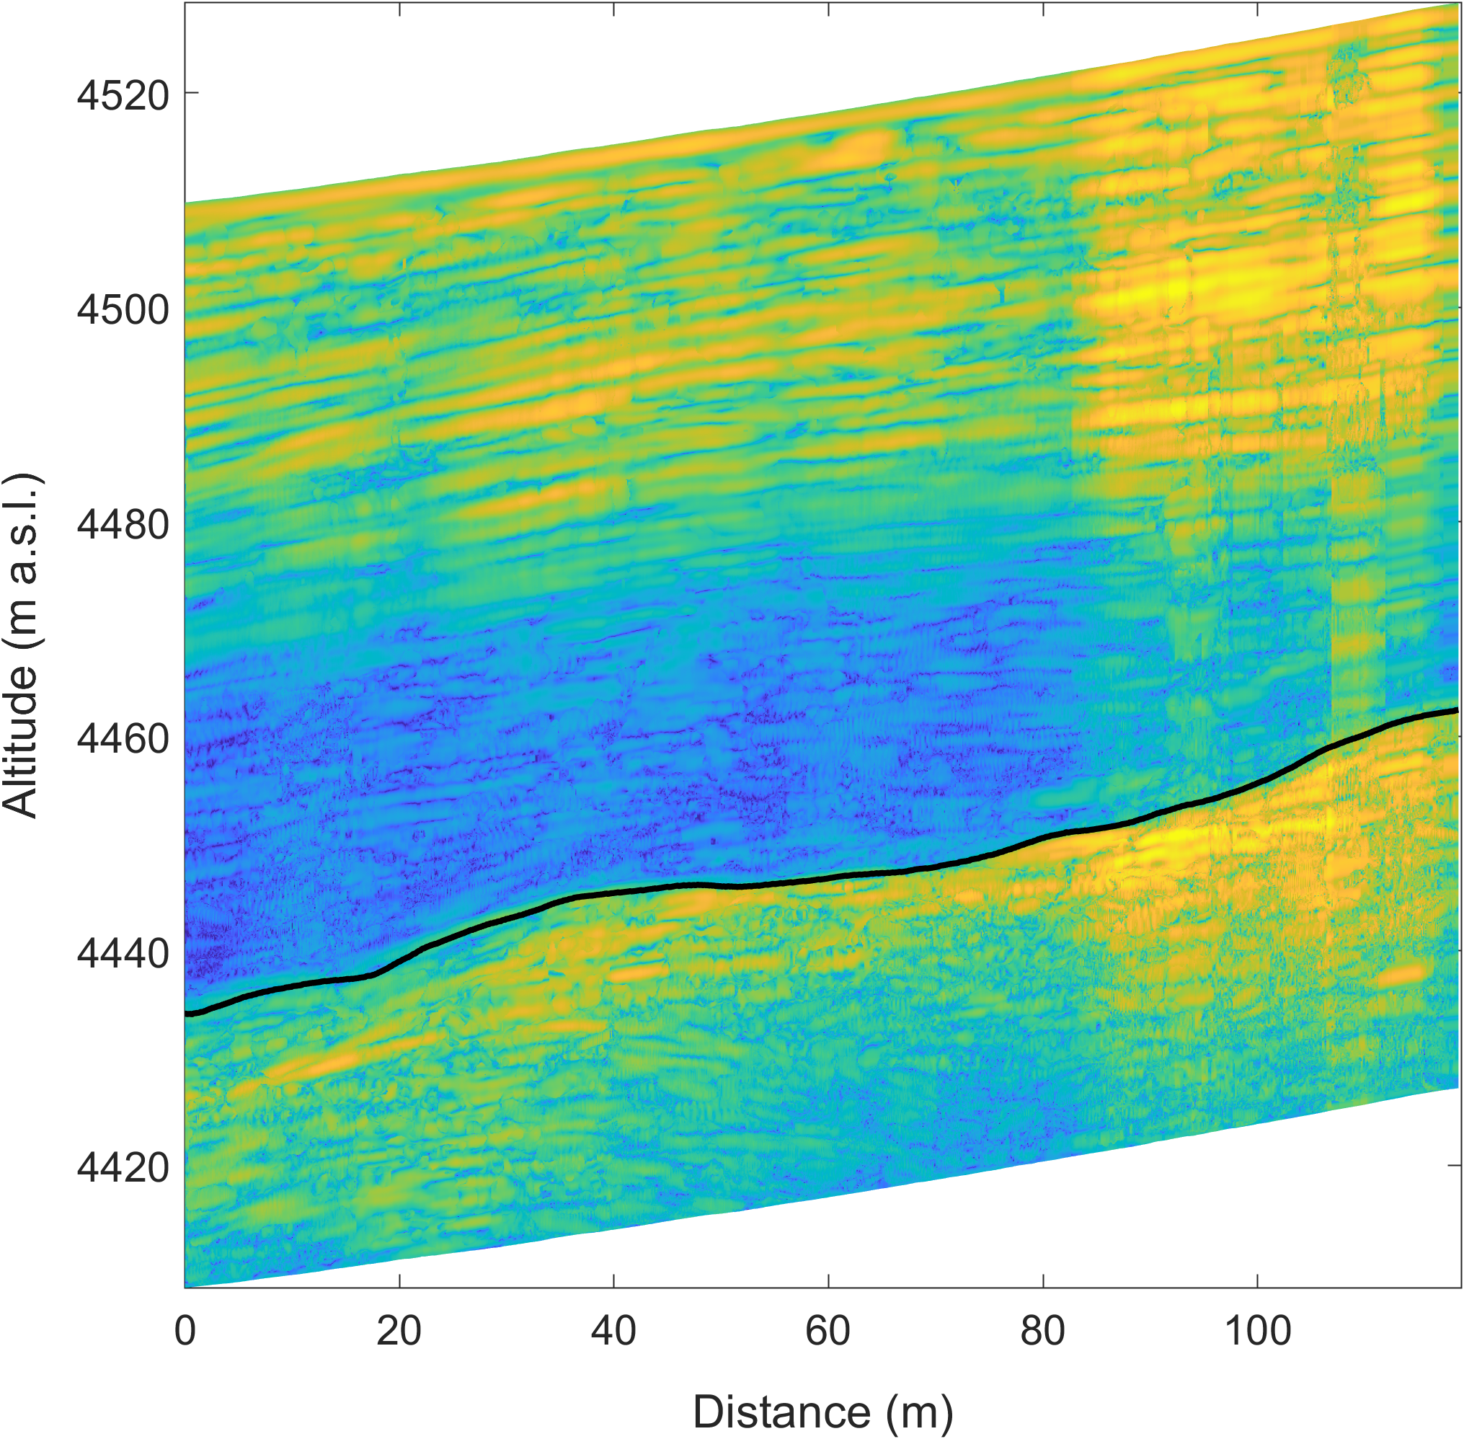
Discussion: Signal stability
In an additional uphill section of the profile, the phase coherence is significantly reduced, decrease the power gain by LoSAR processing
Potentially the signal are noisier as it was more difficult to keep the antenna stable during the chirp times.
Stabilizing the antennae and cable during data acquisition is critical and need to be improved in future deployments.
Uphill profile after LoSAR processing
Back
Scientific question
Study site
Motivation
Radar setup
LoSAR processing
Results
Discussion
Take home
Next

Slide 18
Take home messages
There are deep layers at Colle Gnifetti that can continuously be traced and used to intercalibrate ice core records
The pRES can also be used for radar profiling.
LoSAR processing and shape matching can improve the visibility of internal reflection horizons in the ice.
The spacing requirements for LoSAR processing are less strict than for conventional SAR processing. But the spacing sets a limit on the slope of reflectors to be traceable.
LoSAR processed mobile pRES radargram
Back
Scientific question
Study site
Motivation
Radar setup
LoSAR processing
Results
Discussion
Take home
Next

Slide 19
References
Bell, R.E., K. Tinto, I. Das, M. Wolovick, W. Chu, T.T. Creyts, N. Frearson, A. Abdi, and J. D. Paden. “Deformation, Warming and Softening of Greenland’s Ice by Refreezing Meltwater.” Nature Geoscience 7, no. 7 (2014): 497–502. https://doi.org/10.1038/ngeo2179.
Brennan, P.V., L.B. Lok, K. Nicholls, and H. Corr. “Phase‐sensitive FMCW Radar System for High‐precision Antarctic Ice Shelf Profile Monitoring.” IET Radar, Sonar & Navigation 8, no. 7 (2014): 776–86. https://doi.org/10.1049/iet-rsn.2013.0053.
Konrad, H., P. Bohleber, D. Wagenbach, C. Vincent, and O. Eisen. “Determining the Age Distribution of Colle Gnifetti, Monte Rosa, Swiss Alps, by Combining Ice Cores, Ground-Penetrating Radar and a Simple Flow Model.” Journal of Glaciology 59, no. 213 (2013): 179–89. https://doi.org/10.3189/2013JoG12J072.
Rahman, S., and P.V. Brennan. “Shape Matching Algorithm for Detecting Radar Hidden Targets to Determine Internal Layers in Antarctic Ice Shelves.” In 2014 IEEE Radar Conference, 1430–33. Cincinnati, OH: IEEE, 2014. https://doi.org/10.1109/RADAR.2014.6875824.
Back
Scientific question
Study site
Motivation
Radar setup
LoSAR processing
Results
Discussion
Take home

