Slide 1
BG3.18
Poster
A.270

Slide 2
Assessing Disturbance Regimes based on
High-resolution biomass observations
Siyuan Wang
Hui Yang
Sujan Koirala
Matthias Forkel
Markus Reichstein
Nuno Carvalhais
EGU 2023

Slide 3
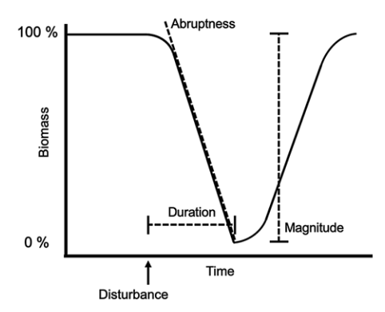
What is disturbance?
…
Fire
Drought
Clearcut
Urbanization
Windthrows
Single disturbance events
Relatively, a deviation from the normal dynamics of an ecosystem, also called ‘deviation’ (Odum et al. 1979) and ‘perturbation’ (Pickett and White 1985).
Absolutely, the loss of biomass (Grime 1979), or the rapidly changing availability of resources (Davis et al. 2000).
Disturbance regimes
Describes the temporal and spatial dynamics of all disturbances affecting a landscape and their interactions over a longer period of time (Turner 2010; Burton et al. 2020).
Includes the type of disturbances, spatial and temporal characteristics, magnitude (intensity), specificity, and interactions with other disturbances (Sousa 1984; Burton et al. 2020).

Slide 4
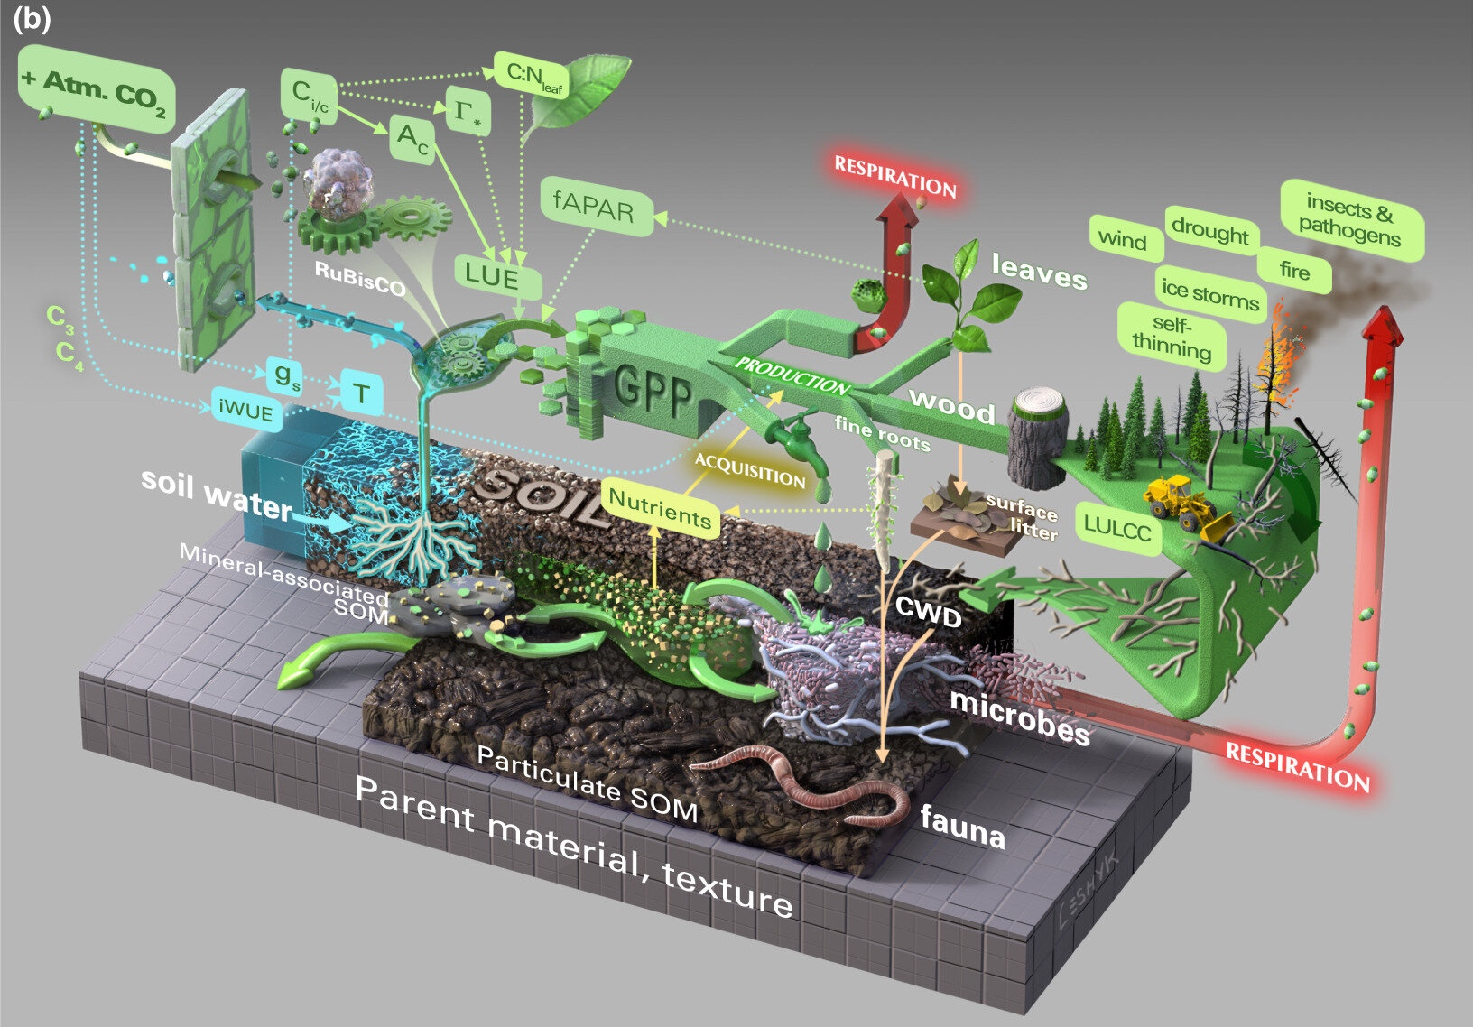
Motivation
Why disturbance important?
Mortality caused by disturbances plays an important role in determining the spatial gradients of AGB and is currently poorly monitored due to its highly stochastic nature;
The representation and corresponding ecological impacts of disturbance events, manipulated by disturbance regimes, have not been well established in DVMs or ESMs;
Quantifying the occurrence attributes of disturbance events is essential for understanding and reducing the uncertainty in modeling the terrestrial ecosystem carbon cycle across scales.
Disturbances
Observation-Driven Method (Senf et al.) - Large scale time-series remote sensing data - Information of vegetation change - Spectral bands indices, vegetation indices, segment outline - Describe the magnitude, duration and change rate of disturbances..
Model-Data-Integration Method (Chambers, Williams et al.) - With dynamic carbon cycling model (individual- and processed model) - Assimilate observations to constrain - Build the links between disturbance regime parameters and model outputs (e.g. equilibrium AGB)
Walker et al. 2021
Notes:
Previously a few studies quantified the disturbance events’ distribution from remote sensing data, but the intensity information is hard to interpret solely relying on the visible bands.

Slide 5
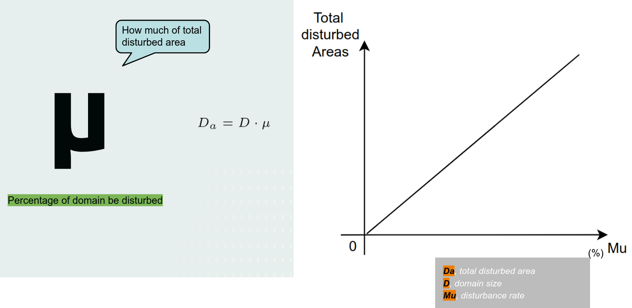
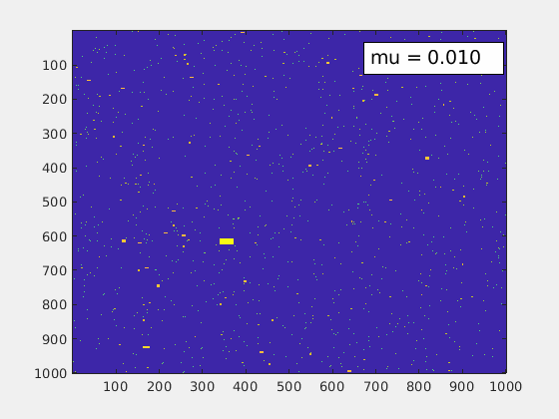
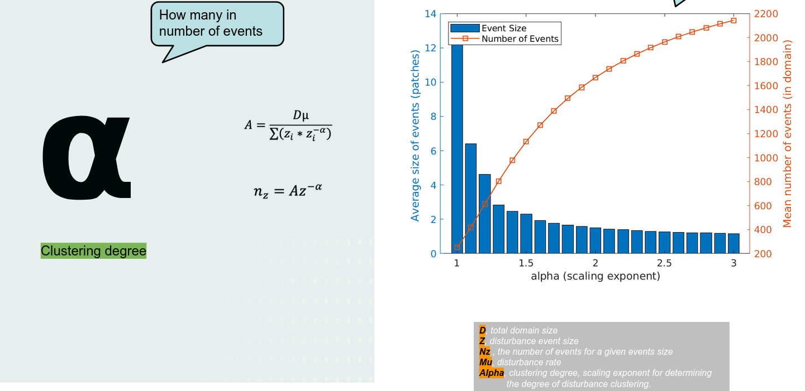
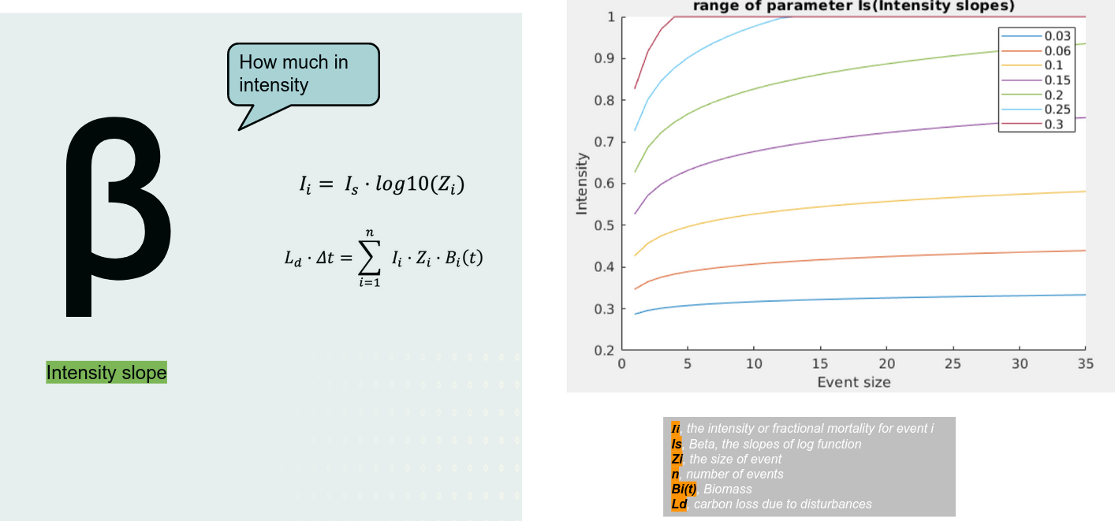

Slide 6
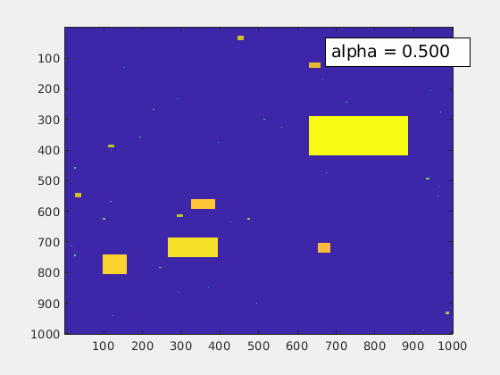

Slide 7
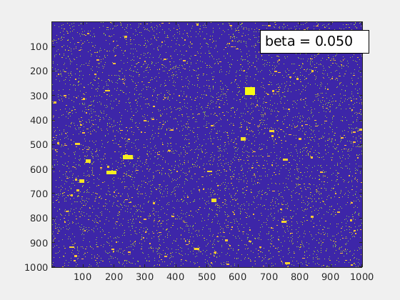

Slide 8
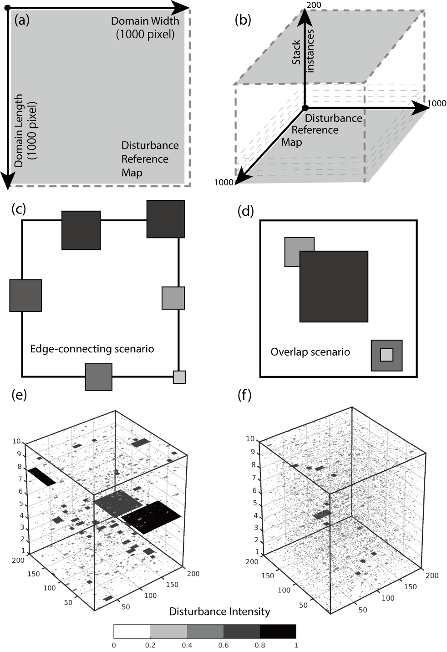
Disturbance Regime Parameter | Range | Interval | Amount | Reference
Mu | [0.01:0.05] | 0.005 | 9 | Moorcroft, Hurtt, and Pacala 2001
Alpha | [0.5:1.8] | 0.05 | 27 | Jans et al. 1993; Yavitt et al. 1995; Lawton and Putz 1988; Nelson et al. 1994
Beta | [0.03:0.5] | 0.01/0.05/0.1 | 14 | Chambers et al. 2013
3402 Disturbance regimes

Slide 9
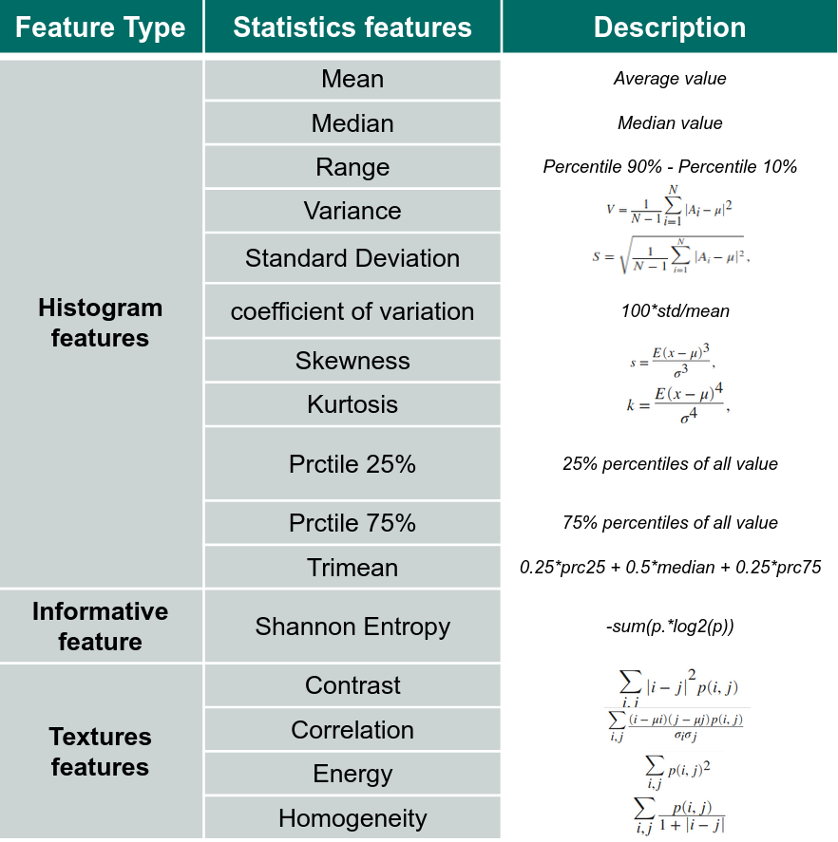
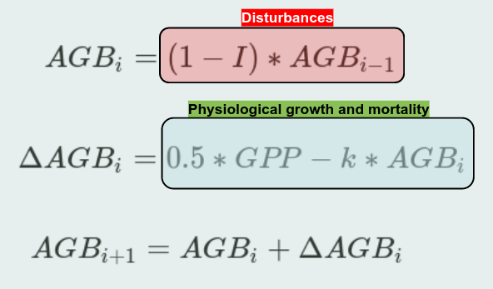
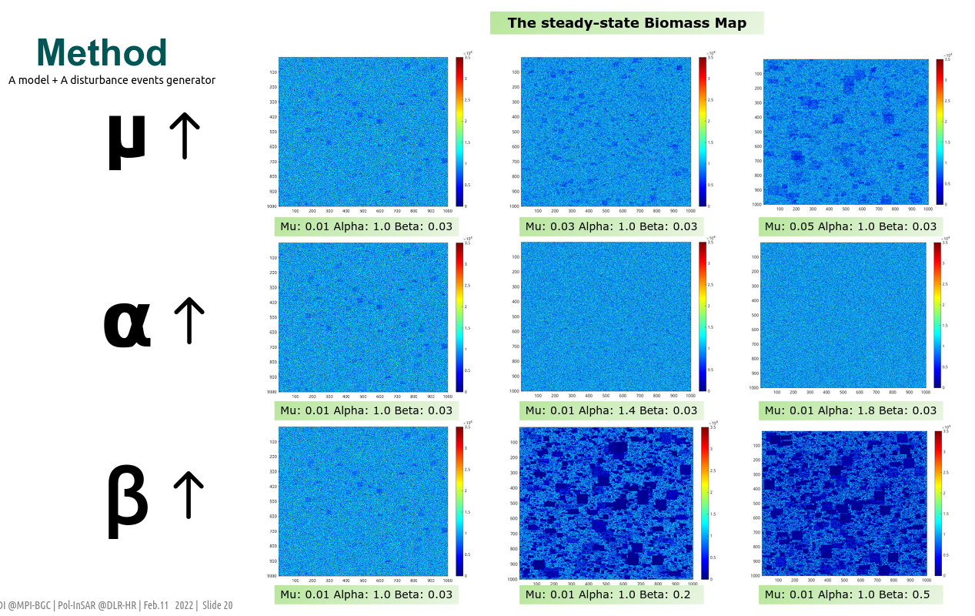
Links statistics and disturbance regimes
3402 Disturbance regimes
Simple carbon dynamic model
Steady-state biomass map

Slide 10
Result
ML
Disturbance regimes parameters
𝜇 (probability scale)
𝛼 (clustering degree) 𝛽 (intensity slope)
Informative statistics
From
simulated biomass distribution
Ⓒ Airbus BIOMASS mission
Q1
NSE | Completely random 10-fold CV | LOSO | LOPO
Mu | 0.951 | 0.952 | 0.779
Beta | 0.952 | 0.952 | 0.850
Alpha | 0.959 | 0.961 | 0.857
What's the impact of varied disturbance event shapes setting?

Slide 11
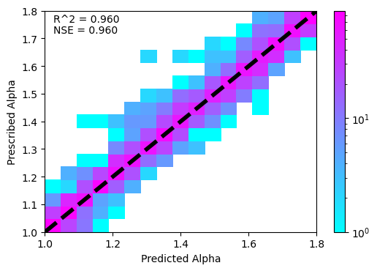
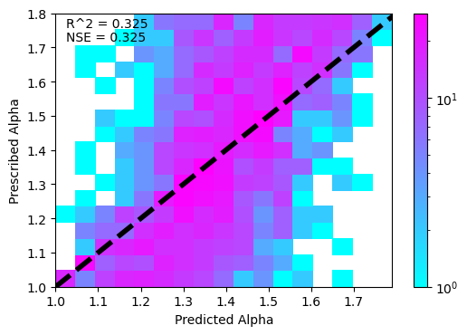
Result
Validation
 | Completely random 10-fold CV |  | LOSO |  | LOPO
NSE | with textures | without textures | with textures | without textures | with textures
Mu | 0.951 | 0.920 | 0.952 | 0.916 | 0.779
Beta | 0.952 | 0.933 | 0.952 | 0.922 | 0.850
Alpha | 0.959 | 0.325 | 0.961 | 0.302 | 0.857
Textures features are essential for predicting Alpha
Notes:
The Nash-Sutcliffe efficiency coefficient is used to quantify how well a model simulation can predict the outcome variable.
All over 0.9

Slide 12
Questions
Ongoing
ML
Disturbance regimes parameters
𝜇 (probability scale)
𝛼 (clustering degree) 𝛽 (intensity slope)
Informative statistics
From
simulated biomass distribution
Ⓒ Airbus BIOMASS mission
Q1
What's the impact of varied disturbance event shapes setting?
Notes:
Does the downscaling of biomass simulation affect the statistical features and prediction accuracy?

Slide 13
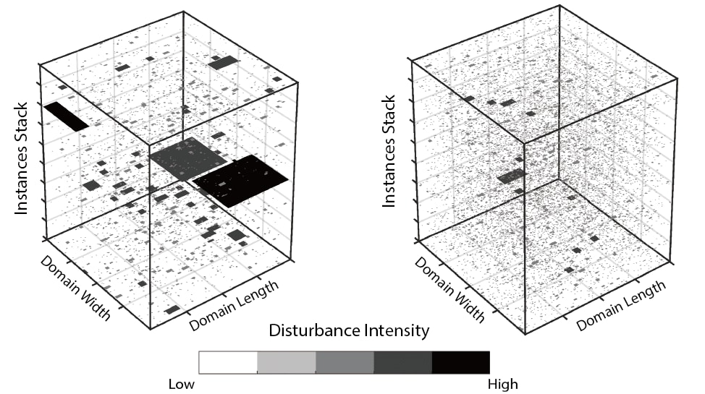
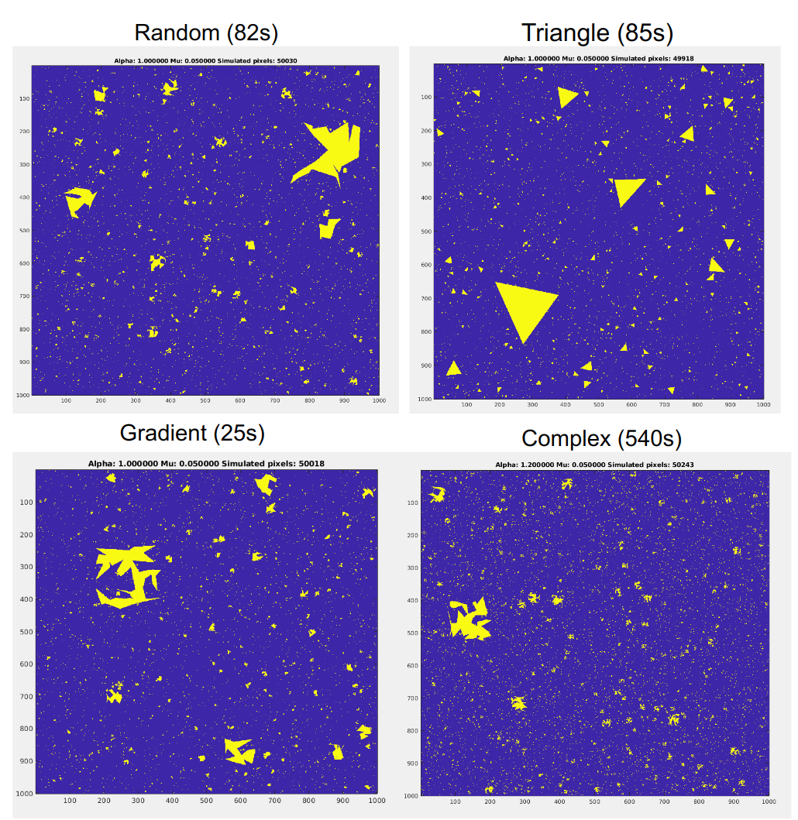
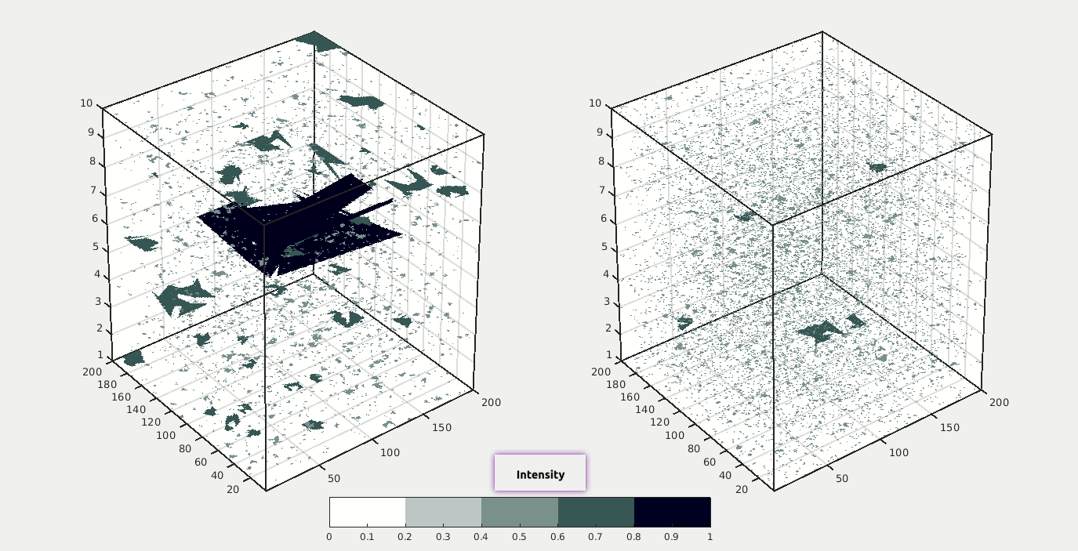

Slide 14
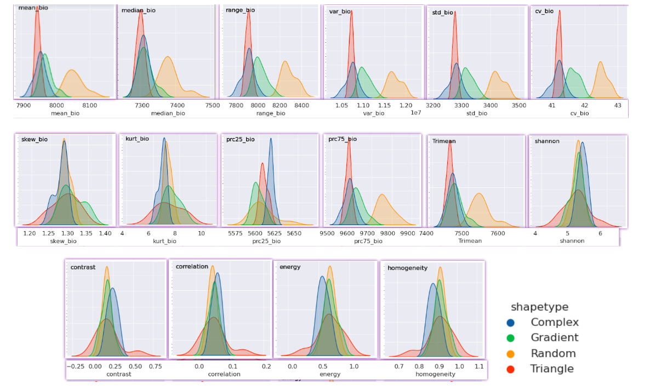
Q1: Impact of varied disturbance event shapes
One disturbance scenario
[𝜇=0.05, 𝛼=1.2, 𝛽=0.05, G=0.1]
Random strategy results in a relatively greater offset for most histogram statistics;
Relatively similar normal distribution patterns and value ranges for four shape settings;
Histogram distribution for all statistical features with four different shape settings
Notes:
One scenario
Theoretically, if the shape settings have an obvious impact on biomass statistics, reflected in two aspects: the numerical range and histogram distribution pattern.
Shape settings have a minor impact on the steady-state biomass distribution over a long successional period.

Slide 15
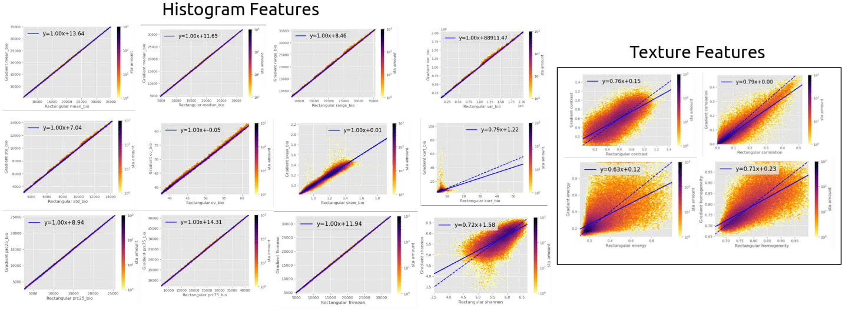
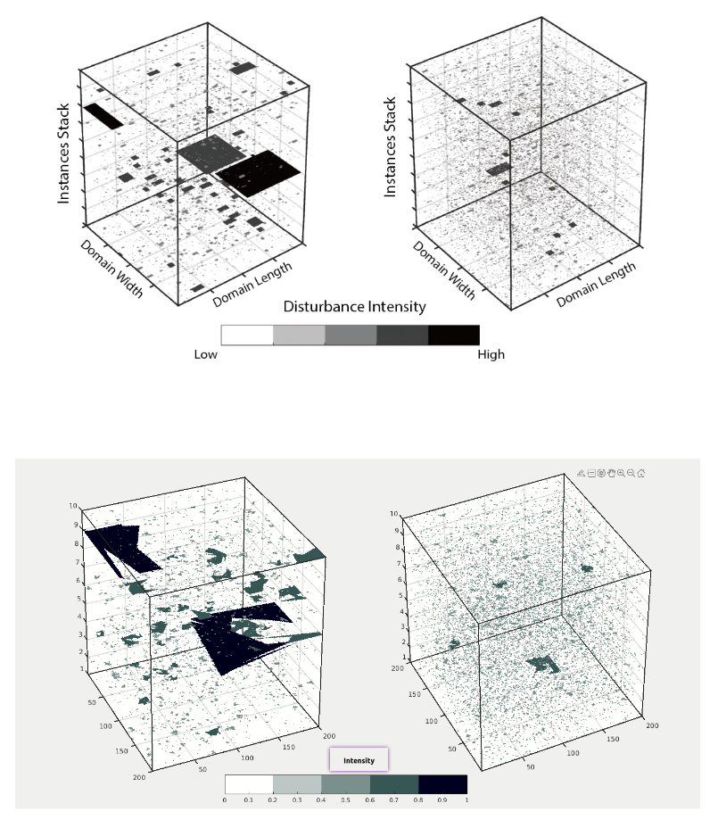
Q1: Impact of varied disturbance event shapes
Comparison of biomass statistics between rectangular and Gradient settings
Nash–Sutcliffe model efficiency coefficient (NSE) | Prediction Accuracy
 | Rectangular | Gradient (Multi-Output)
𝜇 | 0.973 | 0.967
𝛼 | 0.966 | 0.973
𝛽 | 0.979 | 0.978
Notes:
deforestation fire, understory fire, Savanna fire would result in different shaped events in Amazon (Andela et al. 2022).
The robustness of shape settings is expected to be examined for the accuracy of predicting disturbance regimes.

Slide 16
Questions
Ongoing
ML
Disturbance regimes parameters
𝜇 (probability scale)
𝛼 (clustering degree) 𝛽 (intensity slope)
Informative statistics
From
simulated biomass distribution
Ⓒ Airbus BIOMASS mission
Q2
What ecological spatial level does the model actually represent?
Notes:
Does the downscaling of biomass simulation affect the statistical features and prediction accuracy?

Slide 17
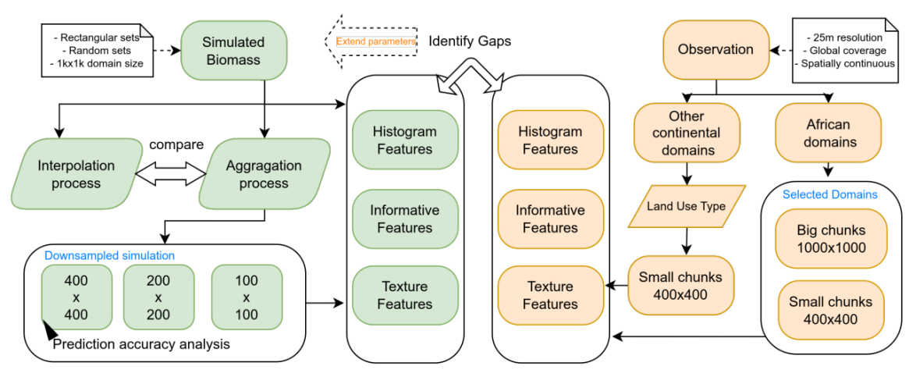

Slide 18
Questions
Ongoing
ML
Disturbance regimes parameters
𝜇 (probability scale)
𝛼 (clustering degree) 𝛽 (intensity slope)
Informative statistics
From
simulated biomass distribution
Ⓒ Airbus BIOMASS mission
Q3
What's the gap between model simulation and biomass observation?
Notes:
Does the downscaling of biomass simulation affect the statistical features and prediction accuracy?

Slide 19
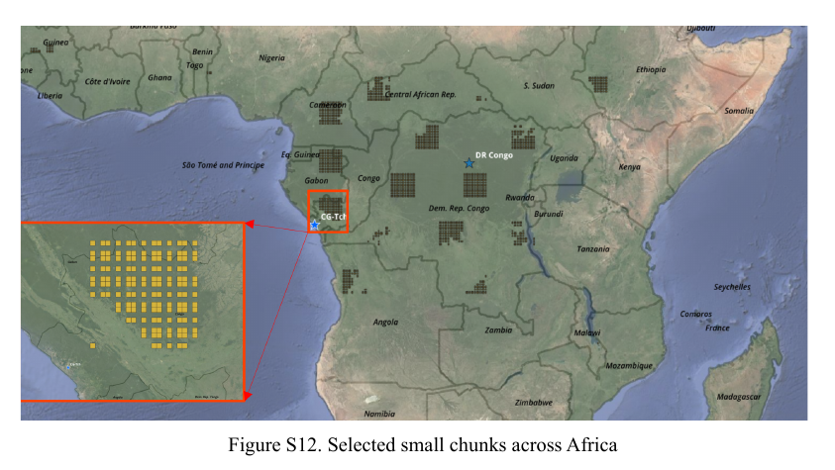
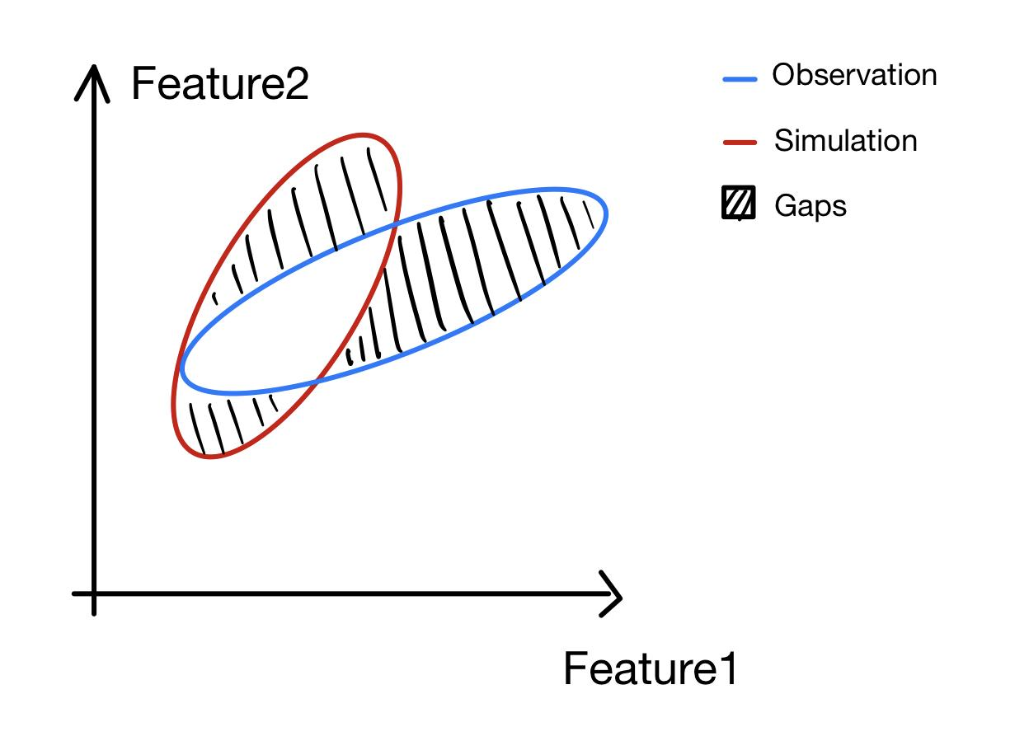
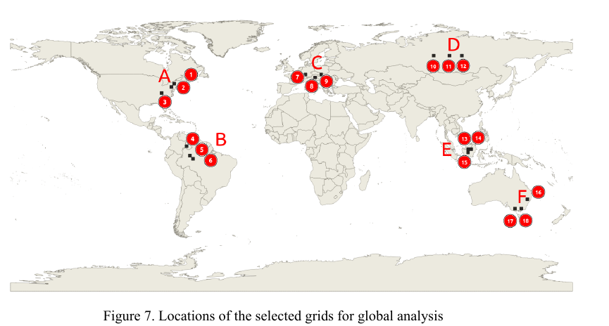
Q3: Gaps between simulation and observation
What’s the discrepancy of multiple biomass distribution features between model simulation and biomass observation?
How to improve the model setting for narrowing the gaps away from real-world biomass distribution?

Slide 20
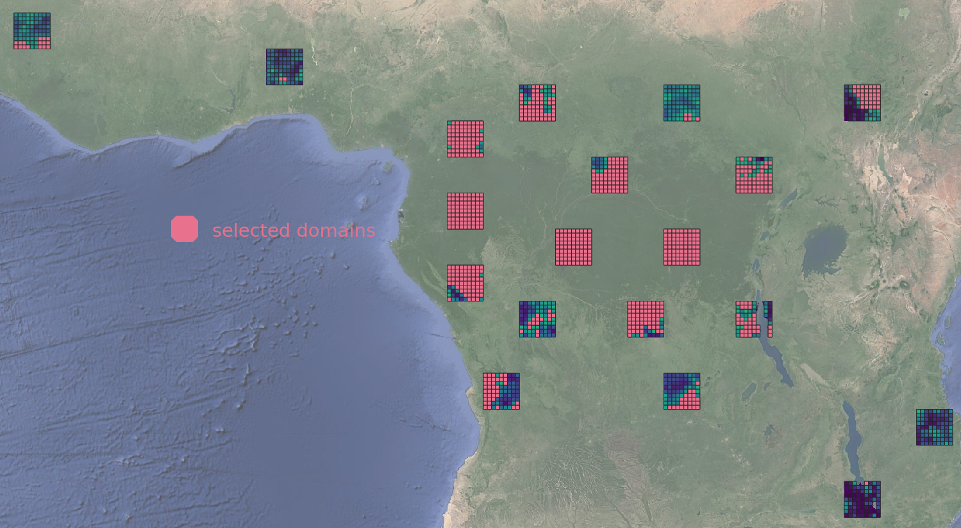
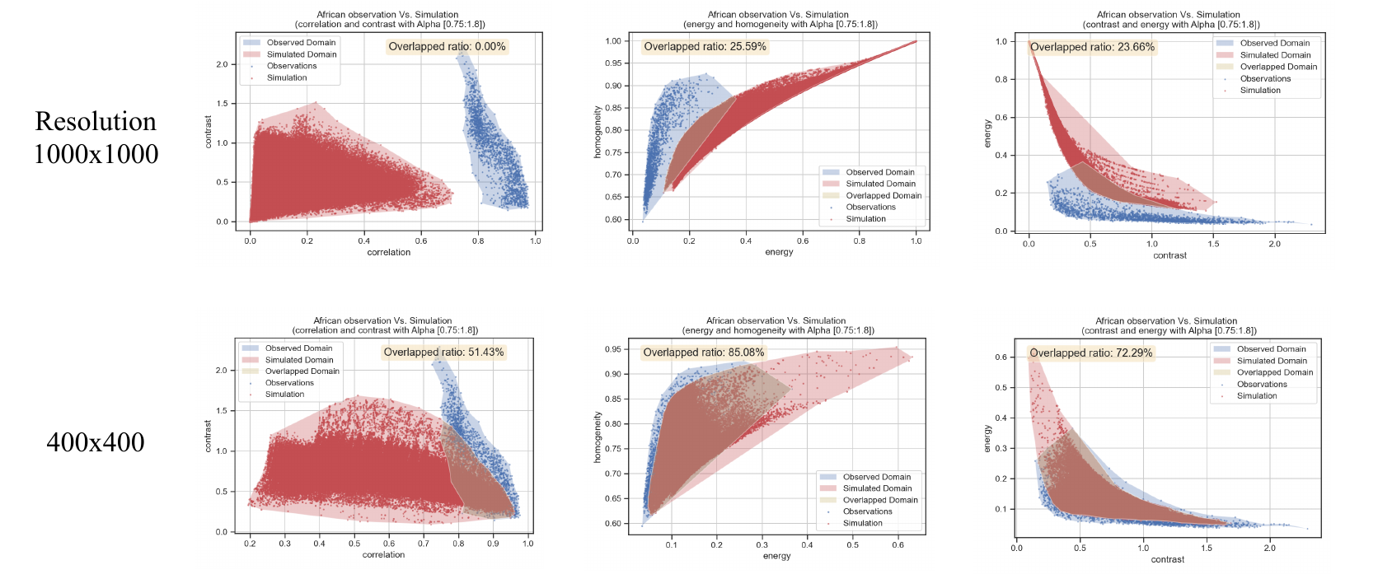
Q3: Gaps between simulation and observation
What’s the discrepancy of multiple biomass distribution features between model simulation and biomass observation?
How to improve the model setting for narrowing the gaps away from real-world biomass distribution?

Slide 21
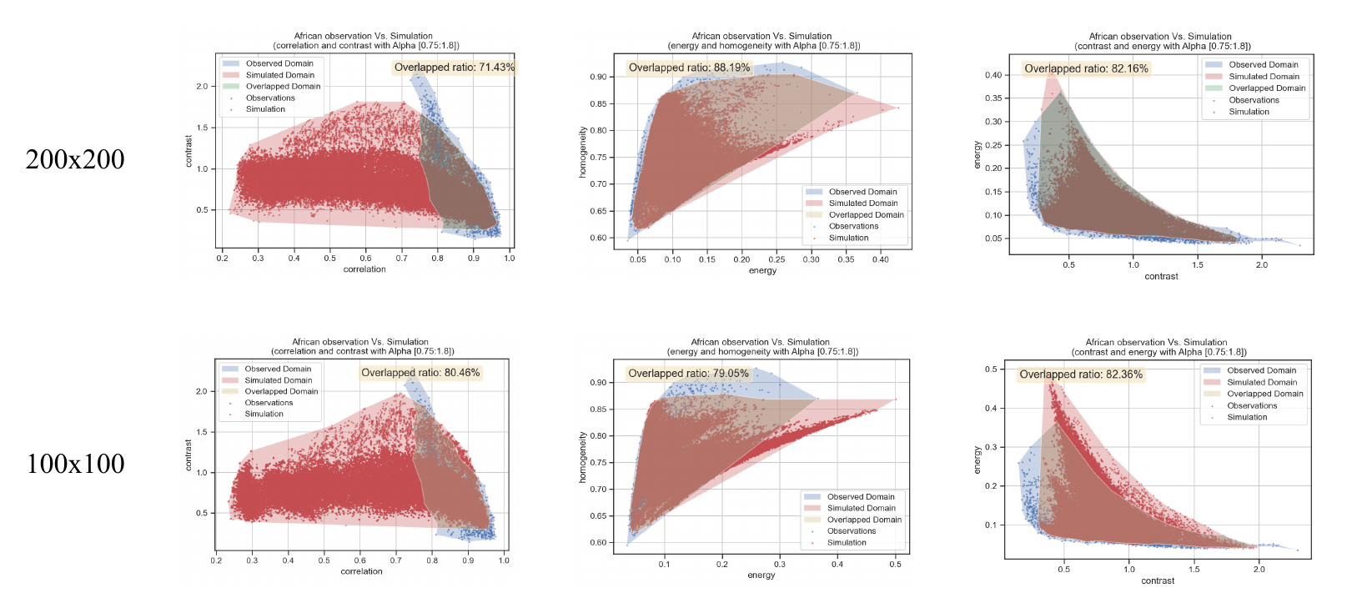
Q3: Gaps between simulation and observation
Non-simulated scenarios
What’s the discrepancy of multiple biomass distribution features between model simulation and biomass observation?
How to improve the model setting for narrowing the gaps away from real-world biomass distribution?

Slide 22
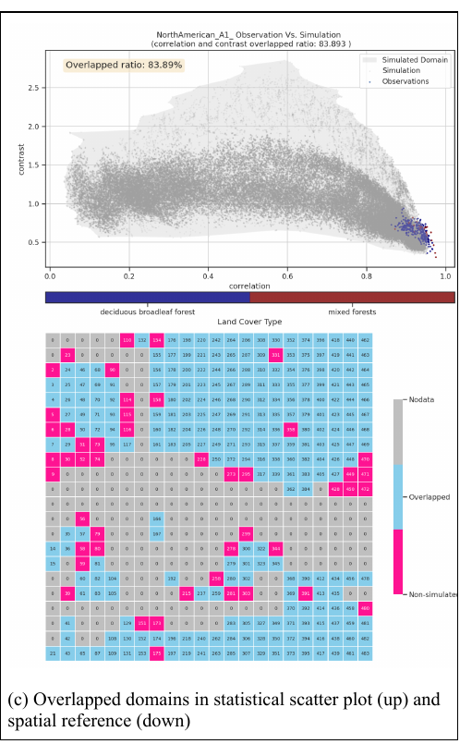
Q3: Gaps between simulation and observation
A1
What’s the discrepancy of multiple biomass distribution features between model simulation and biomass observation?
How to improve the model setting for narrowing the gaps away from real-world biomass distribution?

Slide 23
Questions
Ongoing
ML
Disturbance regimes parameters
𝜇 (probability scale)
𝛼 (clustering degree) 𝛽 (intensity slope)
Informative statistics
From
simulated biomass distribution
Ⓒ Airbus BIOMASS mission
Q4
What's the impact of recovery rates?
Notes:
Does the downscaling of biomass simulation affect the statistical features and prediction accuracy?

Slide 24
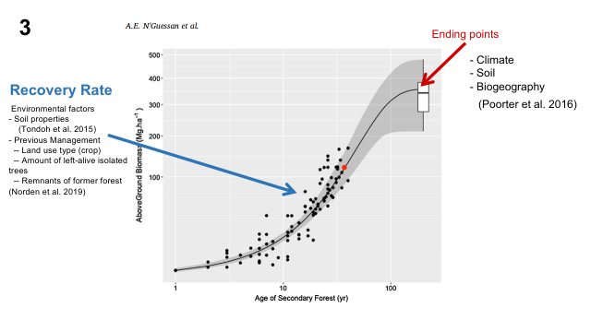
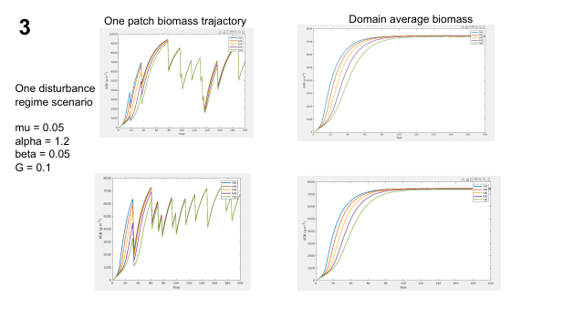

Slide 25
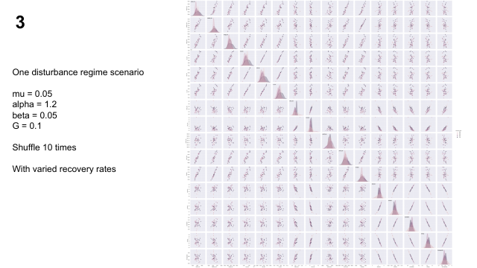
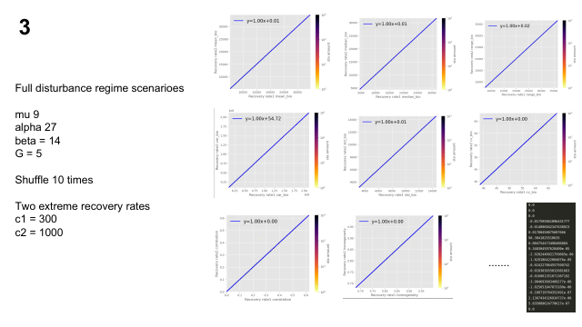

Slide 26
Conclusions
A strong link between disturbance regime and biomass statistics;
Textural features are highly associated with parameter alpha;
Shape setting has minor impacts on modeling performance;
Recovery rate has no influence on steady-state biomass statistics;
Current model could simulate most biomass scenarios compared to the observation;
But the actual spatial representation scale of the model simulation still needs to be determined.

