Slide 1
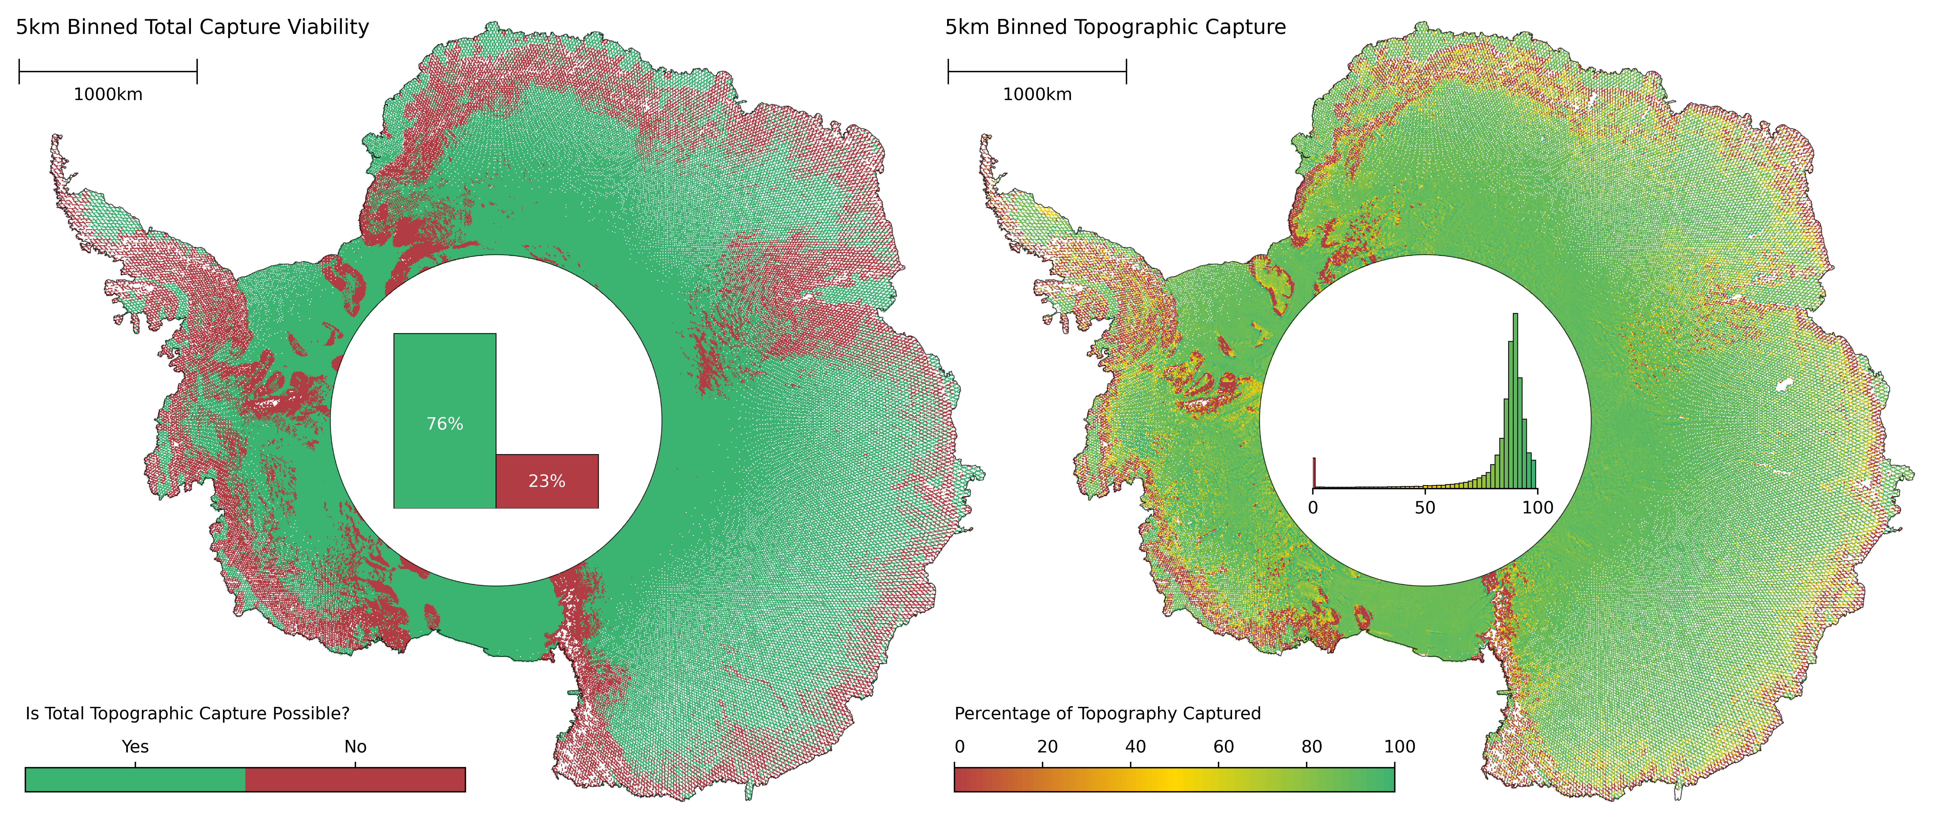
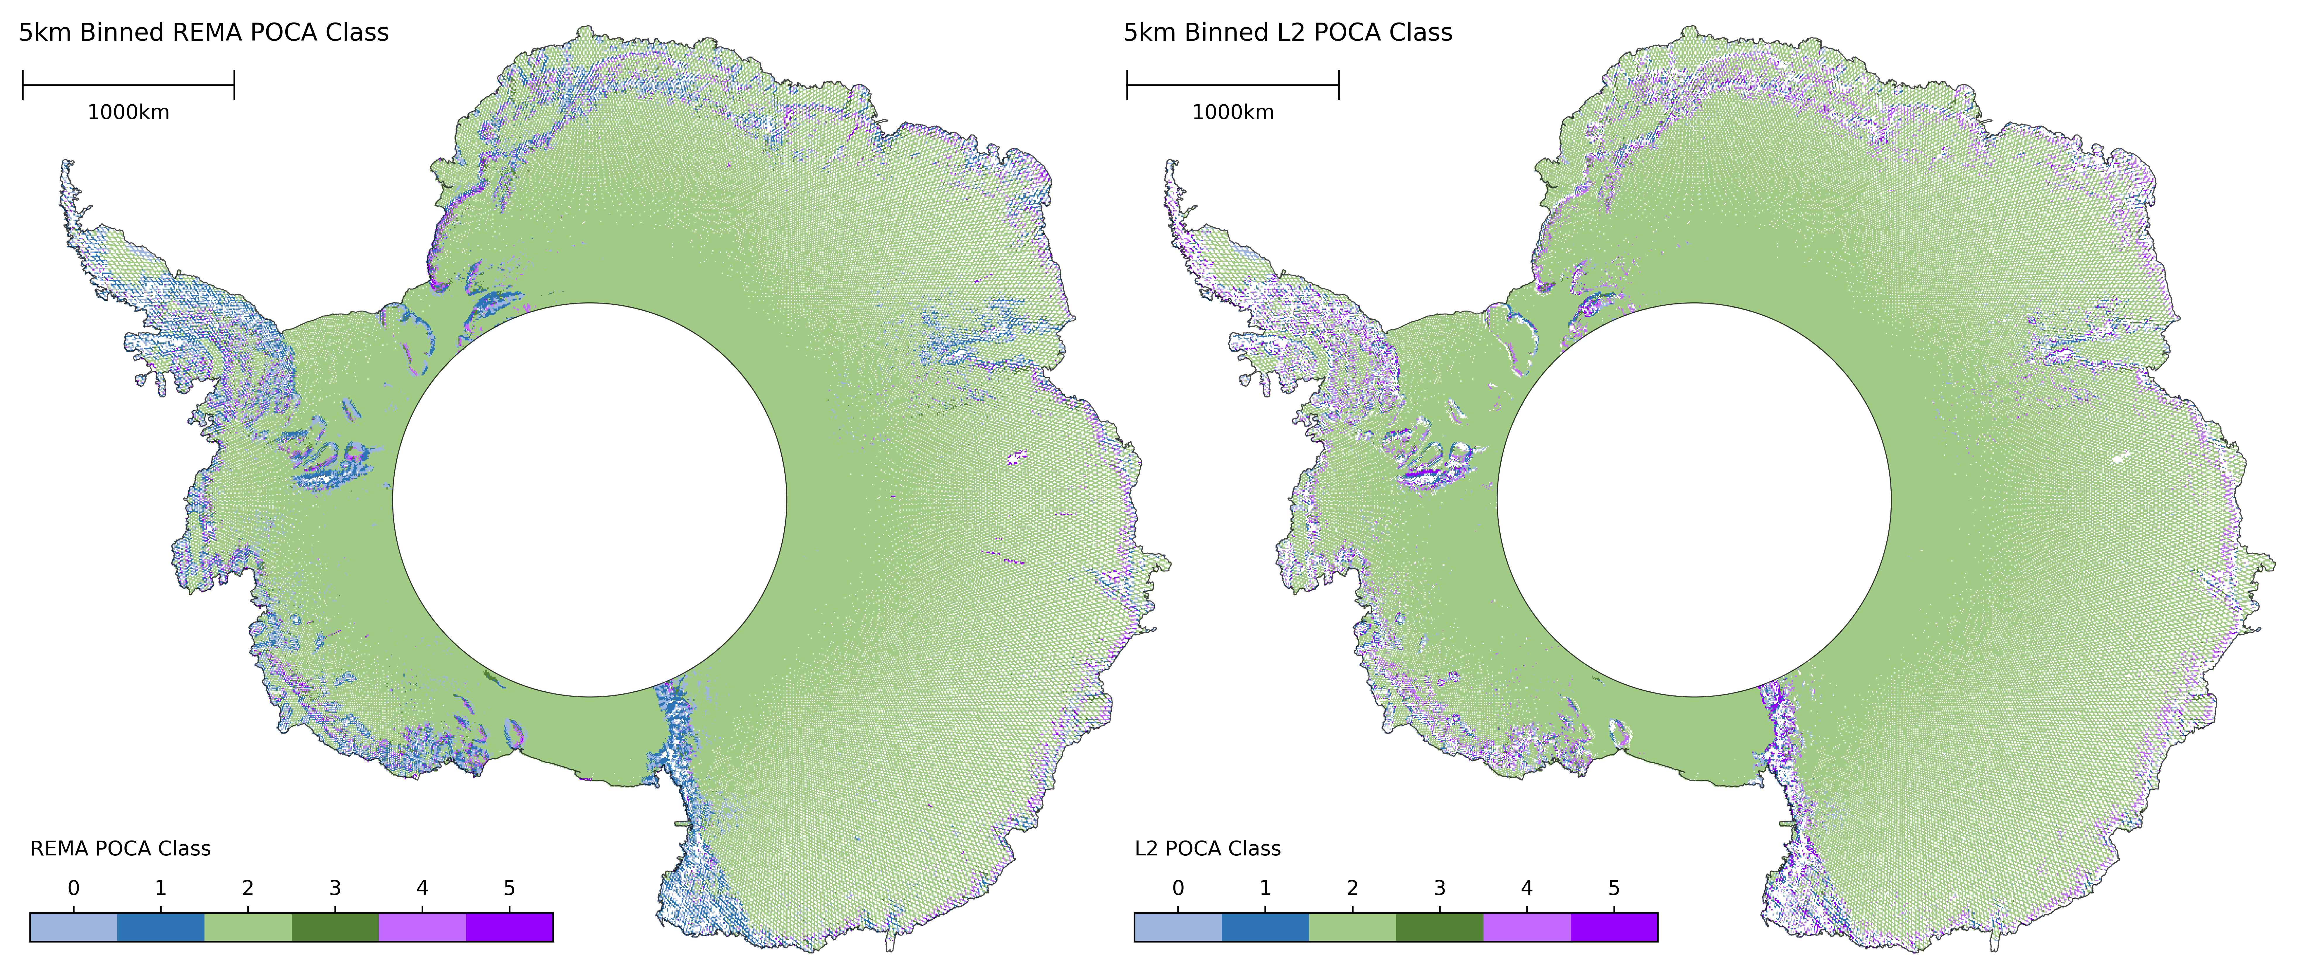
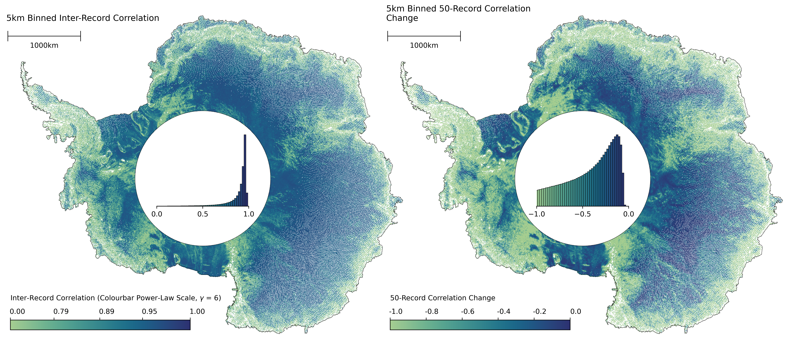
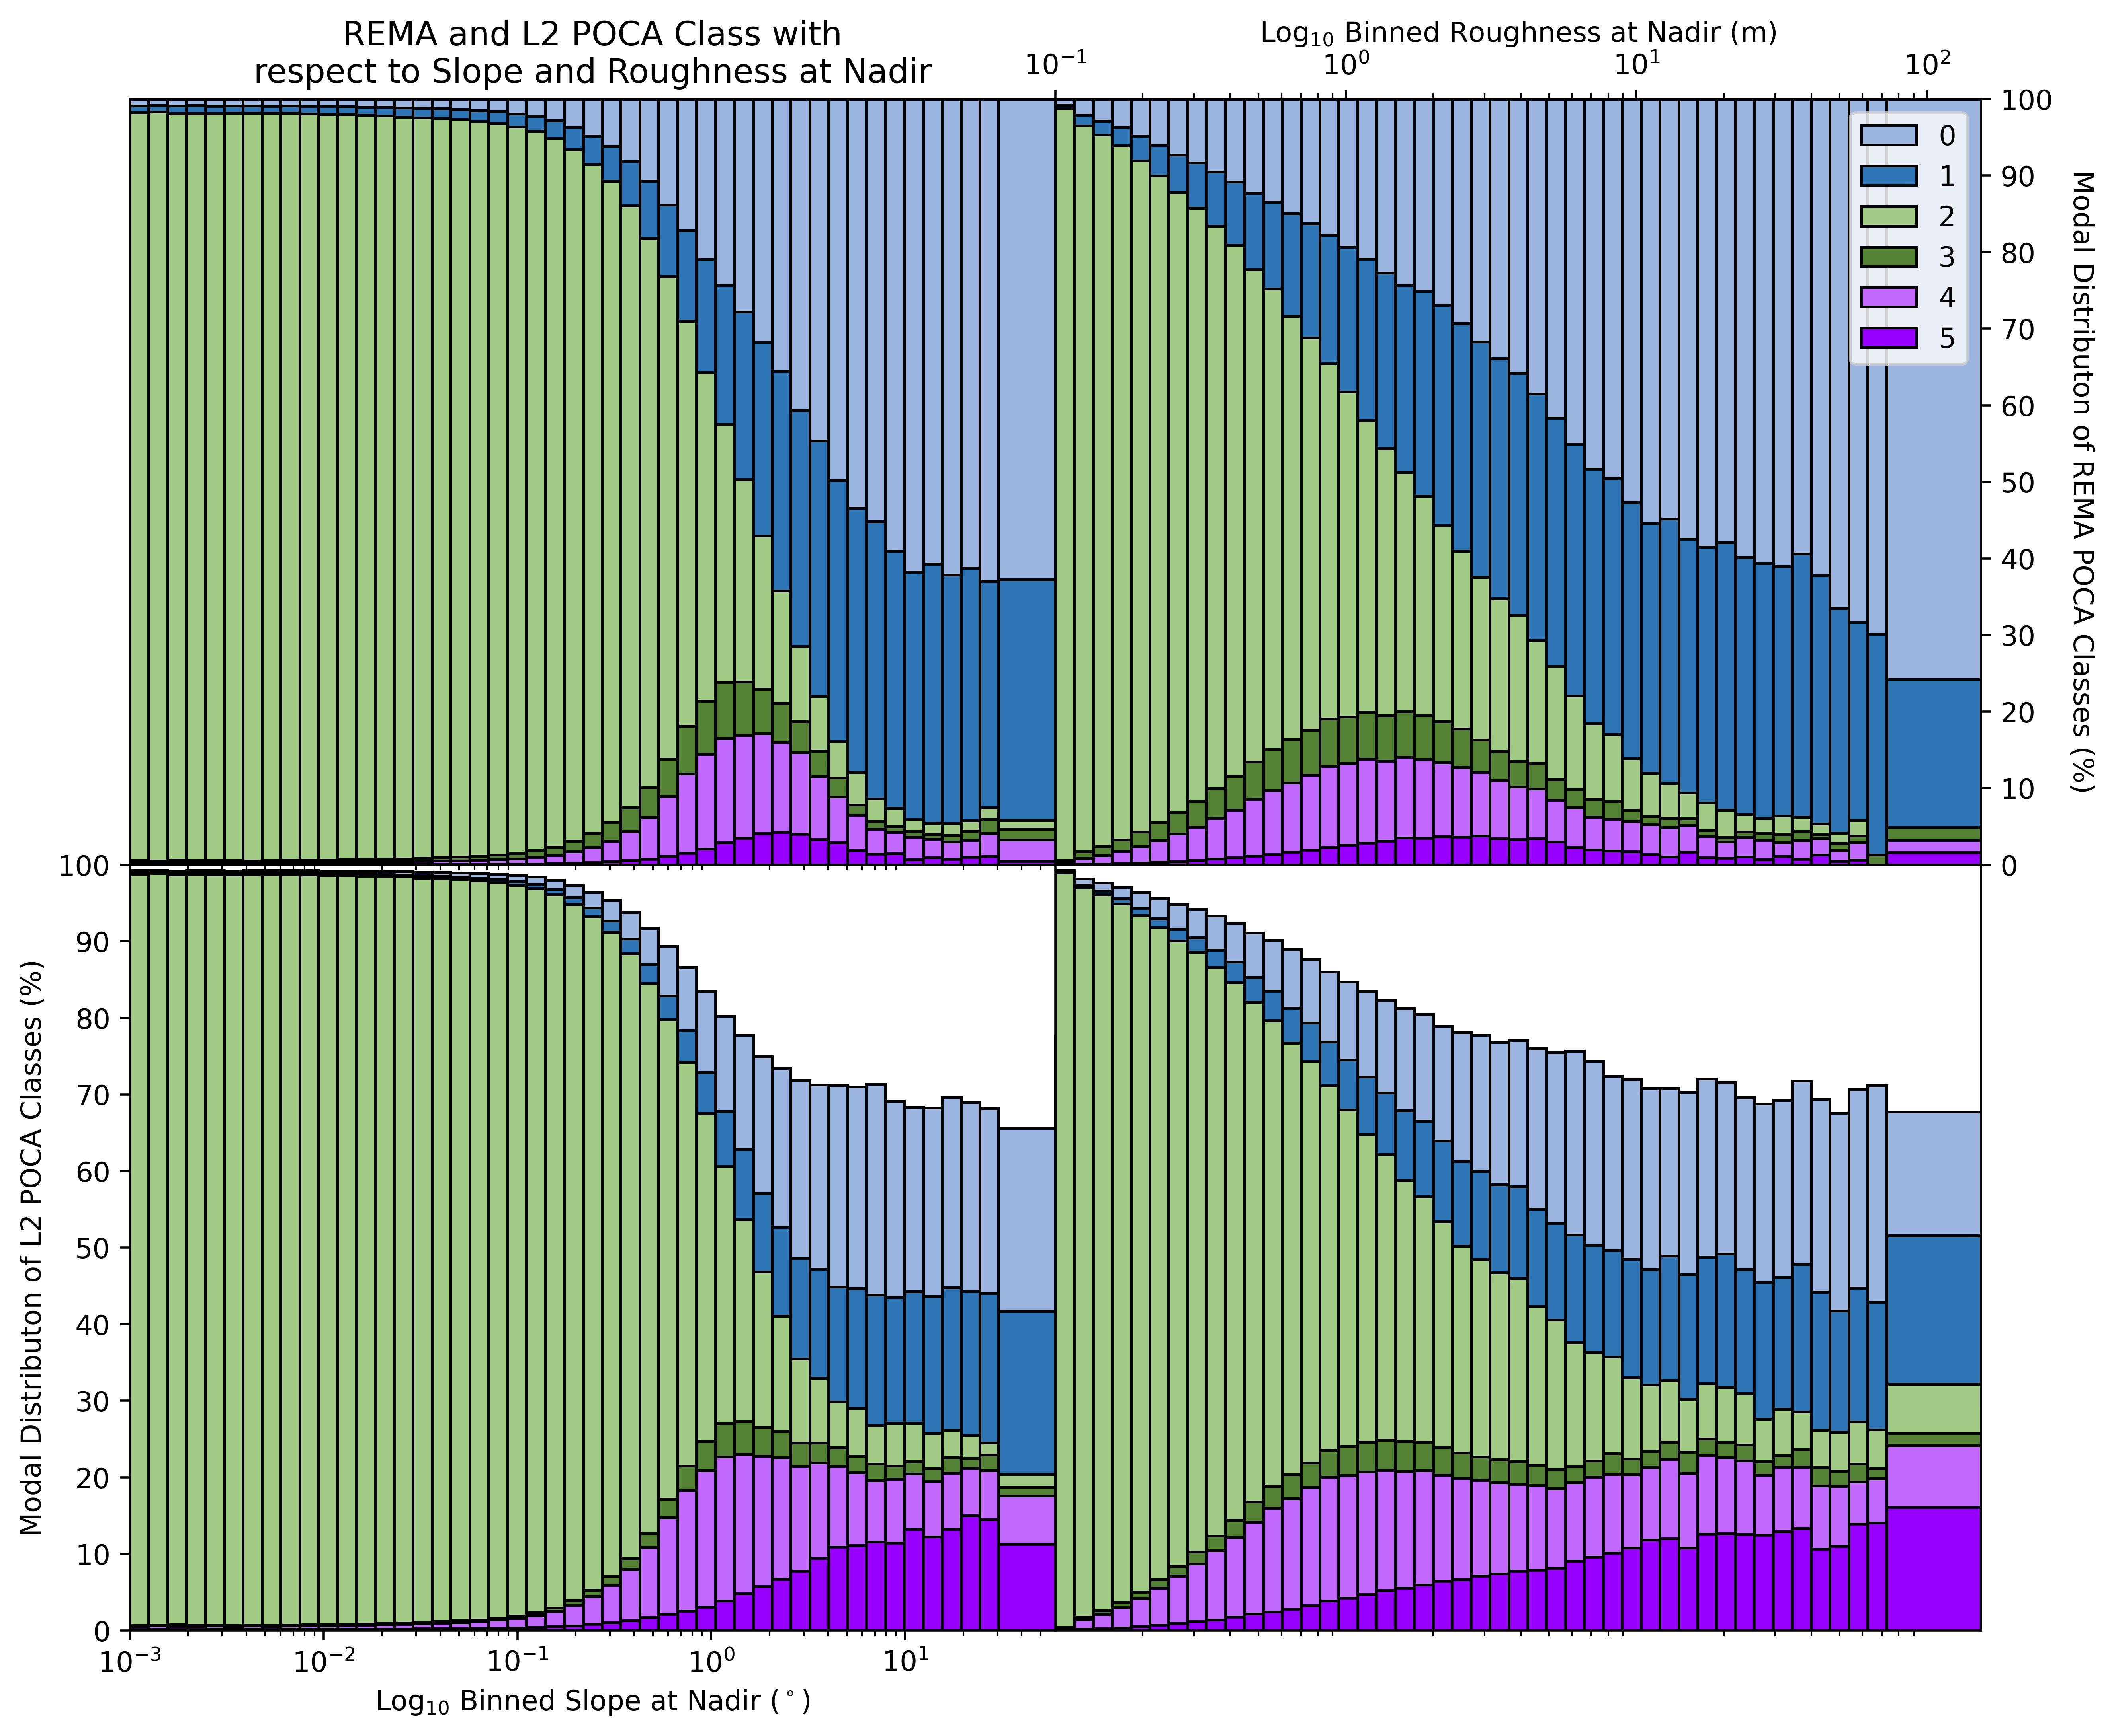
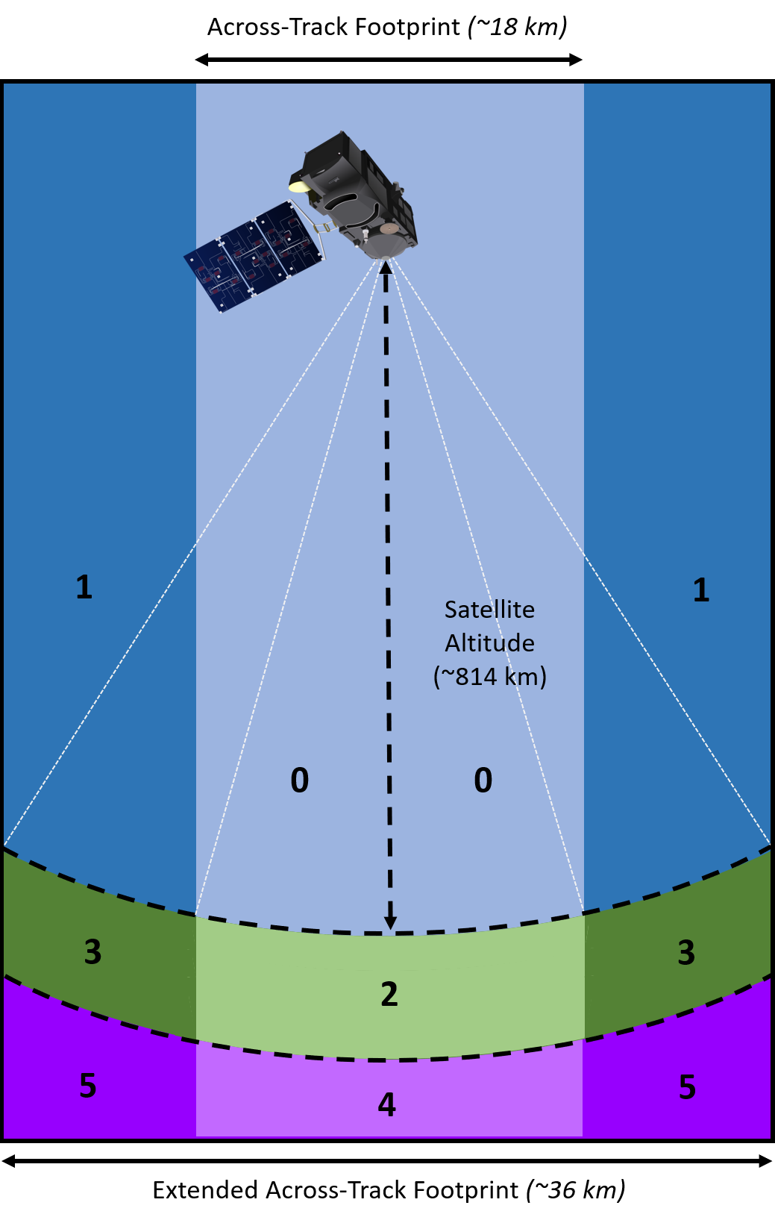
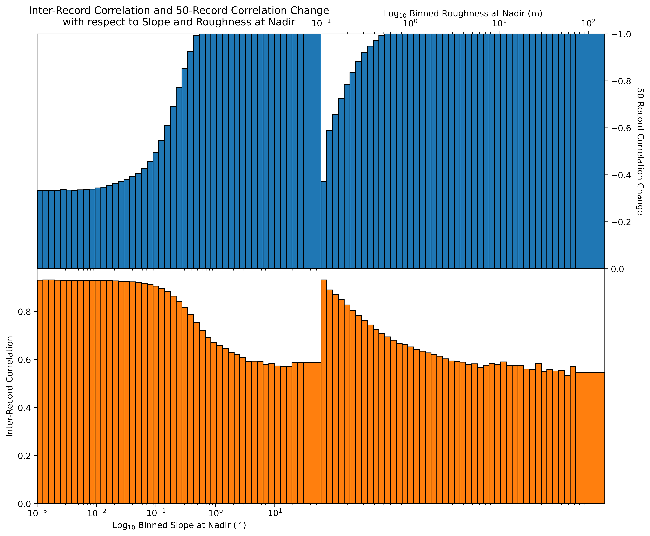
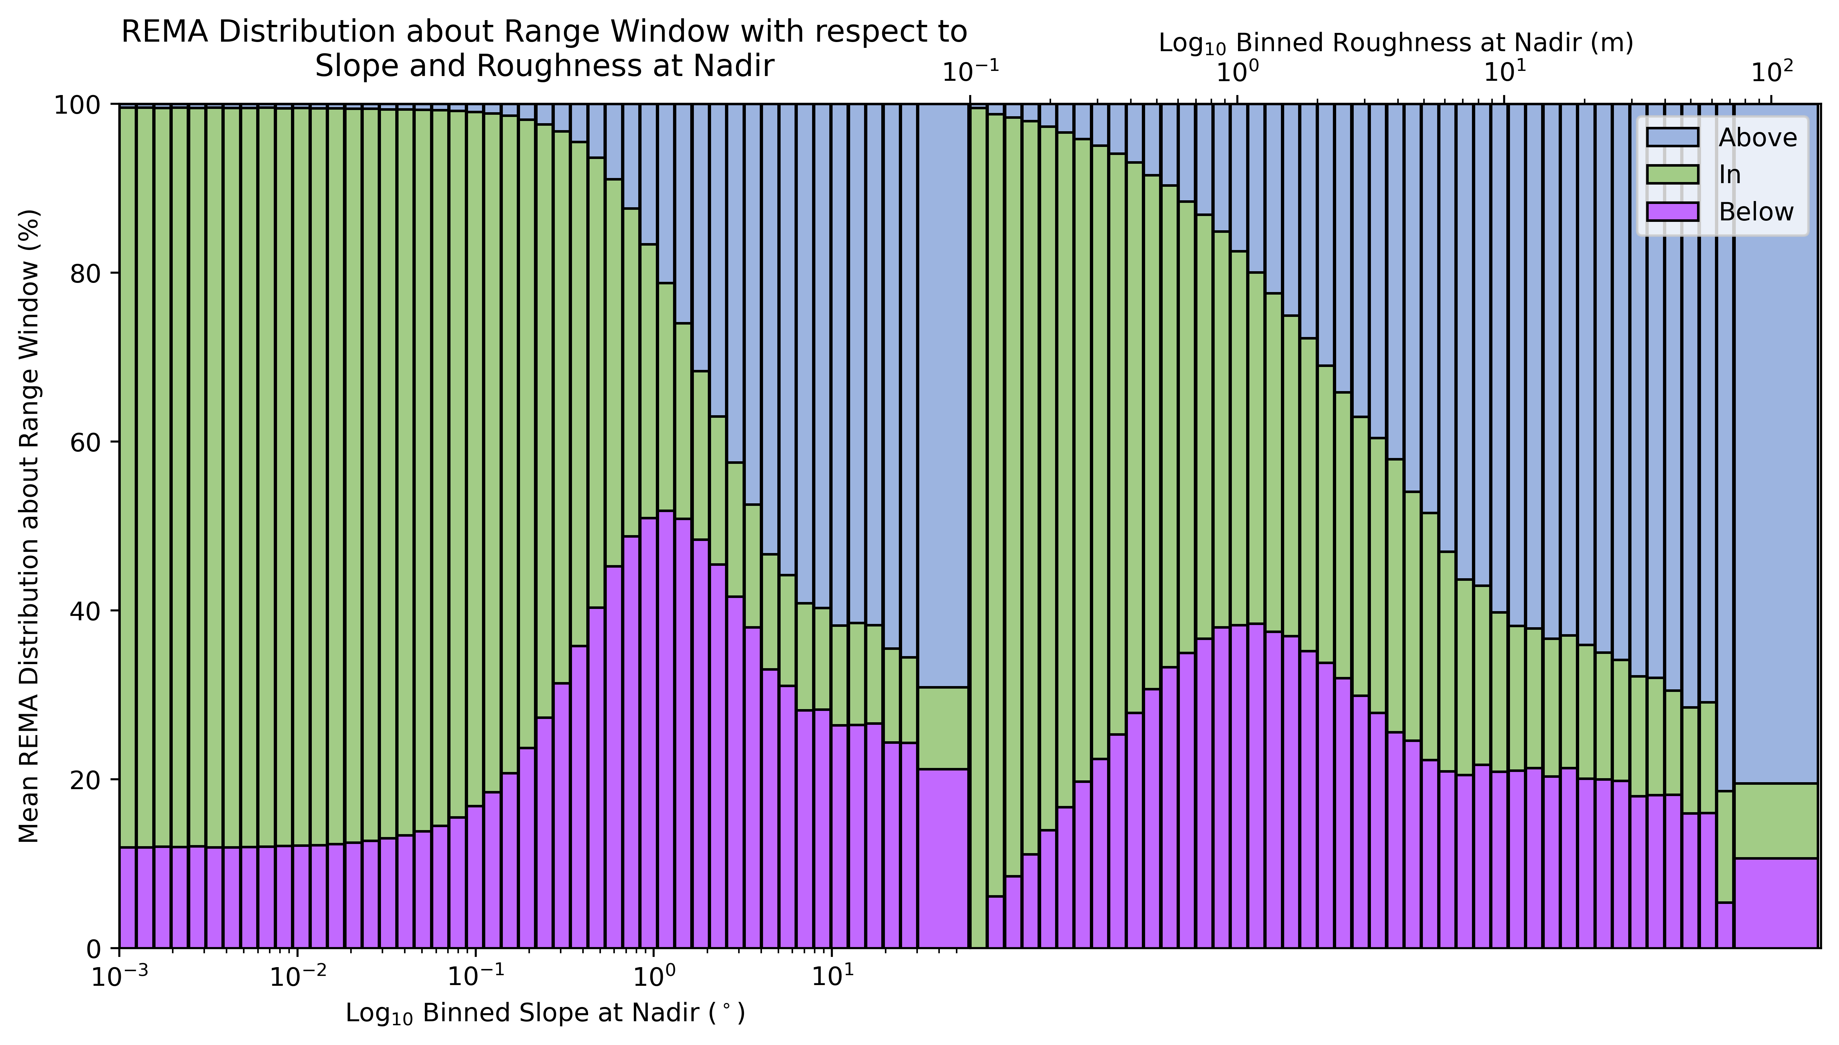
Assessment of Sentinel-3 Altimeter
Performance over Antarctica
Joe Phillips^{1,2,3} Malcolm McMillan^{1,2,3}
j.phillips5@lancaster.ac.uk
¹Lancaster University, UK ²UK Centre of Excellence in Environmental Data Science ³Centre for Polar Observation and Modelling
The Copernicus Sentinel-3 (S3) mission is the latest in a near 30-year long series of satellite radar altimetry missions. Altimetry works to derive information relating to the topographic and electromagnetic scattering characteristics of the ice surface by emitting radar pulses and recording the timing and shape of the backscattered echoes. Whilst S3 provides high accuracy and sub-decimetre precision over oceans and uniform terrain, performance over more complex topography (such as the Antarctic peninsula and coastal regions) is challenging, with waveforms strongly diverging from their theoretical shape, as well as difficulties in capturing returns and successfully locating the true echoing point within the satellite beam footprint.
Several validation studies have already been performed for S3 in the context of the cryosphere, however, these studies predominantly concentrate on measured elevation accuracy and precision, and do not always perform investigations into lower-level performance, and hence a comprehensive understanding of the origin of measurement variability. To further investigate this, we use REMA (Reference Elevation Model of Antarctica - www.pgc.umn.edu/data/rema/) in order to compare echo capture, echoing point variation, and waveform correlation to surface slope and roughness statistics over cycles 54 (S3A) and 31 (S3B). By doing so, we hope to improve our understanding of S3 performance over ice sheets and provide insight useful for the design of future missions.
① Echoing Point Variation
② Echo Capture
③ Along-Track Correlation of Echoes
Commonly, elevation information extracted from altimetry waveforms is attributed to the point-of-closest-approach (POCA) to the satellite. For S3, finding POCA can be difficult over complex terrain.
Here, we classify POCA, given by the L2 product, and additionally calculated using REMA, based on location with respect to the L1b range window (Figure 1c, class 2/3). This allows us to assess when POCA is correctly captured by the range window and when it lies above or below the window placement.
Figures 1a and 1b outline dependencies of these classes in space and with respect to topographic slope and roughness.
S3 records the energy backscattered from the surface over a range window of ~60m. As such, there are large areas of Antarctica wherein full topographic capture is impossible (Figure 2a), due to the topographic variability within the beam footprint.
By taking the ratio of actual to maximum possible topographic capture we find that, on average, topographic capture occurs with a median of 89.6% and median absolute deviation of 3.47% (Figure 2a).
In order to investigate the extent to which ice sheet surface topography causes decorrelation in sequences of waveforms as they are acquired along the satellite track, we compute inter-record correlations.
We also compute correlations between waveforms and their subsequent 50 records (spanning ~15 km), in order to assess the rate of correlation change over distances representative of those over which altimetry measurements are commonly aggregated.
Figures 3a and 3b outline dependencies of these metrics in space and with respect to topographic slope and roughness.
(2a)
(1a)
(3a)
Due to the closed-loop surface tracking method employed by S3 over Antarctica, the range window is commonly misplaced over complex terrain, leading to missed captures.
We explore this degree of misplacement with respect to topographic slope and roughness by calculating the percentage of topography (given by REMA) that lies above, within, and below the range window (Figure 2b).
(1b)
(1c)
(3b)
(1c)
Range Window (~60m)
(2b)

