Slide 2
Topography of North China
Broad low elevation and relief area in the East “North China Plain”
To the West high plateau like area of high elevation and low relief – the Ordos
Surrounding the Ordos are a series of mountainous areas which high relief is produced by a series of rift faults in the Miocene (and possibly contractional Mesozoic orogens): Shanxi, Weihe and Hetao

Slide 3
Underlying North China is the North China Craton (NCC)
NCC formed in the Paleoproterozoic (~1.8Ga ago) when the Eastern and Western blocks (cratonic nuclei) collided
During the collision orogenic belts formed such as the Trans-North China Orogen (TNCO) which rocks are exposed to the surface at present
These cratonic belts might have not only left an anisotropy in the crust but also in the upper mantle/lithosphere
Present day rifts surrounding the Ordos are superimposed on these ancient orogenic belts (exploiting the lithospheric anisotropy?)
Modified from Zhao et al. 2005

Slide 4
Lithospheric thickness decreases rapidly eastwards
Eastern block has lithospheric thickness of 80-120km which is not what is commonly associated as a craton
Western block has lithospheric thickness of 180-200km only at the margins where rifting occurs does it thin to 100-140km
Western block pretty much intact thick cratonic lithosphere, Eastern block modified and partially destroyed cratonic lithosphere
Partial destruction of NCC occurred due to flat slab subduction of Pacific underneath East Asia causing thermal erosion/partial delamination
Modified from Shi et al. 2020​

Slide 5
Rifting in North China migrates from the East to West in the Cenozoic
20-30 Ma break in between formation of Bohai Basin and the circum-Ordos rift (Shanxi, Hetao, Weihe)
Neogene rifts principally occur superimposed on the Paleoproterozoic orogenic belts surrounding the pristine cratonic Ordos block
Does inherited lithospheric weaknesses guide migration pattern?
Modified from Ye et al. 1987; Qi & Yang 2010
and Zhang et al. 2019
“Wide” rifting over thin(ned) lithosphere in the Paleogene
Narrow rifting over cratonic lithosphere in the Neogene
How and why does rifting migrate?

Slide 6
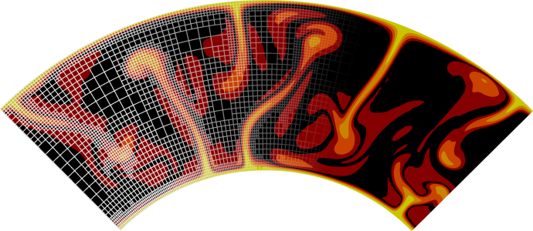
ASPECT
Advanced Solver for Problems in Earth’s ConvecTion
Thermo-mechanical code
Open source
C++
Martin Kronbichler, Timo Heister, and Wolfgang Bangerth. 2012. “High Accuracy Mantle Convection Simulation through Modern Numerical Methods.” Geophysical Journal International 191 (1) (August 21): 12–29. doi:10.1111/j.1365-246x.2012.05609.x. http://dx.doi.org/10.1111/j.1365-246X.2012.05609.x. Timo Heister, Juliane Dannberg, Rene Gassmöller, and Wolfgang Bangerth. 2017. “High Accuracy Mantle Convection Simulation through Modern Numerical Methods – II: Realistic Models and Problems.” Geophysical Journal International 210 (2) (May 9): 833–851. doi:10.1093/gji/ggx195. http://dx.doi.org/10.1093/gji/ggx195. Bangerth, Wolfgang, Juliane Dannberg, Menno Fraters, Rene Gassmoeller, Anne Glerum, Timo Heister, Robert Myhill, and John Naliboff. 2022. <i>ASPECT v2.4.0</i> (version v2.4.0). Zenodo. https://doi.org/10.5281/zenodo.6903424. Bangerth, Wolfgang, Juliane Dannberg, Menno Fraters, Rene Gassmoeller, Anne Glerum, Timo Heister, Robert Myhill, and John Naliboff. 2022. “ASPECT: Advanced Solver for Problems in Earth's ConvecTion, User Manual.” <i>Figshare</i>. https://doi.org/10.6084/M9.FIGSHARE.4865333.
https://aspect.geodynamics.org/

Slide 7
Material Model
“Buffer region” of background material (same as ML) to avoid edge effects
There is no compositional difference between mantle lithosphere and asthenosphere the different behaviour is controlled by temperature
The crustal and lithospheric scar have the same material properties as the surrounding material but their angle of internal friction is reduced to 2 (standard value for all materials is 20) to make them rheological weak

Slide 8
Temperature Model
Lithosphere-asthenosphere boundary is defined by the 1573K temperature contour
Thicker and colder lithosphere in the West, warmer and hotter in the East.

Slide 9
0 Myr
Model at 0 Myr
White contour line denotes the 1573K temperature contour (base of lithosphere)

Slide 10
10 Myr
Start extension for 10 Myr at a velocity of 10mm yr-1
After 10 Myr of extension a broad region of plastic strain accumulates in the eastern part over the thinner part of the lithosphere. Crust and lithosphere start to thin
Little to no plastic strain accumulated in the Western part
After 10 Myr, velocity is decreased to a very low value to stop extension for 30 Myr

Slide 11
40 Myr
Extension is stopped for 30 Myr, very little strain is accumulated during that time
Lithosphere in the East strengthens and thickens again and is now stronger as before as the mantle lithosphere to crust ratio has increased

Slide 12
42 Myr
Extension is restarted at 4mm yr-1 (slightly slower than in the Paleogene to simulate slower Neogene extension)
Now most of the plastic strain is accumulated in the Western part of the lithosphere where the discrete mantle weak zone is the weakest part now which starts to reactivate

Slide 13
45 Myr
A narrow rift establishes in the Western part…

Slide 14
52 Myr

Slide 15
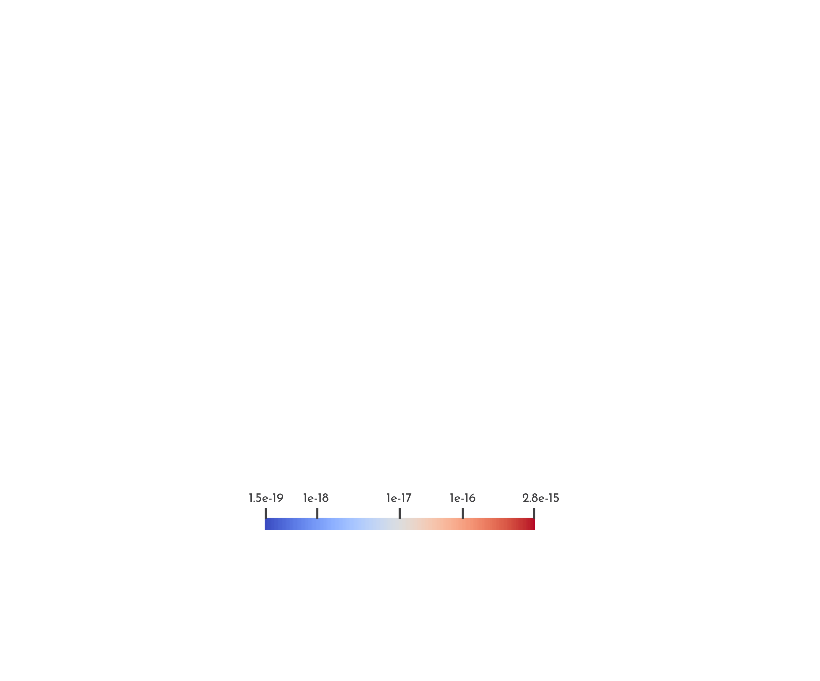
10 Myr - Strainrate
In the strain rate the same pattern is observed. At the start of the extension period we observe very high strain rates in the East but rather low ones in the West

Slide 16
40 Myr - Strainrate
During the break in rifting the strain rate overall is rather low across the whole model but existing heterogeneities such as the earlier formed faults or the scar region show higher strain rates

Slide 17
42 Myr - Strainrate
As the rifting is restarted the strain rate is now the highest in the western part above the lithospheric scar.
Strainrate in the east is medium-high and mainly reactivates the earlier formed faults

Slide 18
45 Myr – Strainrate

Slide 19
52 Myr - Strainrate
As model progresses the strain rate further localises on the faults and weakness in the West

Slide 20
Different parameters were chosen for multiple models to show how robust the model is
The two most important ones were how weak the lithospheric weakness* is (What is its angle of internal friction) and the relative thickness of Eastern to Western lithosphere (at 1.0 they are the same thickness, at 0.5 the Eastern lithosphere is 90km thick)
*crustal weakness was found to be less important than the lithospheric one as models worked without a crustal one

Slide 21
Light grey runs are all runs that were conducted, coloured dots denote runs that “worked”
Working being defined as:
Wide rifting in the eastern part at the start with little strain in the Western one
Narrow rift above the lithospheric weakzone after the break, minor strain accumulation in the East

Slide 22
Goldilocks zone of working runs under which conditions the migration occurs

Slide 23
If there is no significant difference in lithospheric thickness at the start the weakzone will become the weakest part of the model…

Slide 24
…and rifting will start in the west over the weakzone…

Slide 25
…and continue in the west after the tectonic quiescence

Slide 26
If the Eastern part of the model is too thin for a given angle of internal friction of the model…

Slide 27
… the rifting will start in the East…

Slide 28
…but will not migrate to the West after the quiescence as the lithosphere does not thicken and strength enough

Slide 29
Lithosphere in the East is too thick
Angle of internal friction of lithosphere weakness: 2
Thickness of lithosphere in the east: 160km (~0.9)

Slide 30
Lithosphere in the East is too thin
Angle of internal friction of lithosphere weakness: 5
Thickness of lithosphere in the east: 90km (0.5)

Slide 31
Fast extension ~10mm yr-1
Distributed Rifting in the Eastern Block
Little to no strain accommodated in the Western Block

Slide 32
Faults become largely inactive
Pause in extension for ~30 million years
Lithosphere starts to thicken and strengthen again

Slide 33
Renewed Extension but slower at 4mm yr-1
Minor strain accommodated in the Eastern block
Narrow localised rift forms above lithospheric weakness

Slide 34
East Asia - Tectonics
Modified from Ren et al. 2002
Neogene Rifts (Shanxi, Weihe, Hetao) traditionally thought to be related to India-Asia collision
Open questions:
Are far field effects of India-Asia collision significant enough to cause rifting in Neogene Rifting?
Are two different drivers needed to explain the rifting migration in N China or can the same behaviour be replicated with a single driver (Pacific)?
Paleogene Rift (Bohai Basin) formed by rollback of the pacific plate

Slide 35
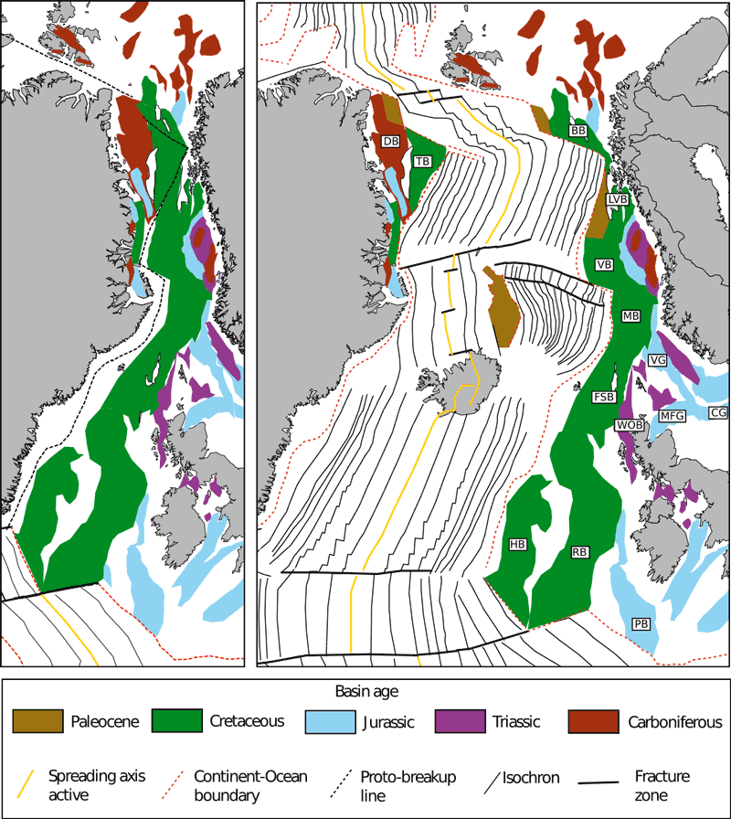
Relevance to other rifts
North Atlantic Breakup
First formation of broad rifted regions (Rockall/Hatton/…)
Then breakup along possible lithospheric structure offaxis of previous rifts?
Western Antarctic Rift System?
Schiffer et al. 2020

Slide 36
Thank you for listening!
111@Malte_Geology
malte.froemchen@ durham.ac.uk
Questions?
We thank the Computational Infrastructure for Geodynamics (geodynamics.org) which is funded by the National Science Foundation under award EAR-0949446 and EAR-1550901 for supporting the development of ASPECT.
Computations were done using the ASPECT code version 2.4.0

Slide 37
References
Qi, J. and Yang, Q. (2010) “Cenozoic structural deformation and dynamic processes of the Bohai Bay Basin Province, China,” Marine and Petroleum Geology, 27(4), pp. 757–771. Available at: https://doi.org/10.1016/j.marpetgeo.2009.08.012.
Ren, J. et al. (2002) “Late mesozoic and Cenozoic rifting and its dynamic setting in eastern China and adjacent areas,” Tectonophysics, 344(3-4), pp. 175–205. Available at: https://doi.org/10.1016/s0040-1951(01)00271-2.
Schiffer, C. et al. (2020) “Structural inheritance in the North Atlantic,” Earth-Science Reviews, 206, p. 102975. Available at: https://doi.org/10.1016/j.earscirev.2019.102975.
Shi, Y.-N. et al. (2020) “Craton destruction links to the interaction between subduction and mid-lithospheric discontinuity: Implications for the Eastern North China Craton,” Gondwana Research, 83, pp. 49–62. Available at: https://doi.org/10.1016/j.gr.2020.01.016.
Ye, H., Zhang, B. and Mao, F. (1987) “The Cenozoic tectonic evolution of the Great North China: Two types of rifting and crustal necking in the Great North China and their tectonic implications,” Tectonophysics, 133(3-4), pp. 217–227. Available at: https://doi.org/10.1016/0040-1951(87)90265-4.
Zhang, Y., Dong, S. and Li, J. (2019) “Late Paleogene Sinistral strike-slip system along East Qinling and in southern North China: Implications for interaction between collision-related block trans-rotation and subduction-related back-arc extension in East China,” Tectonophysics, 769, p. 228181. Available at: https://doi.org/10.1016/j.tecto.2019.228181.
Zhao, G. et al. (2005) “Late Archean to Paleoproterozoic evolution of the North China Craton: Key Issues Revisited,” Precambrian Research, 136(2), pp. 177–202. Available at: https://doi.org/10.1016/j.precamres.2004.10.002.

