Slide 1
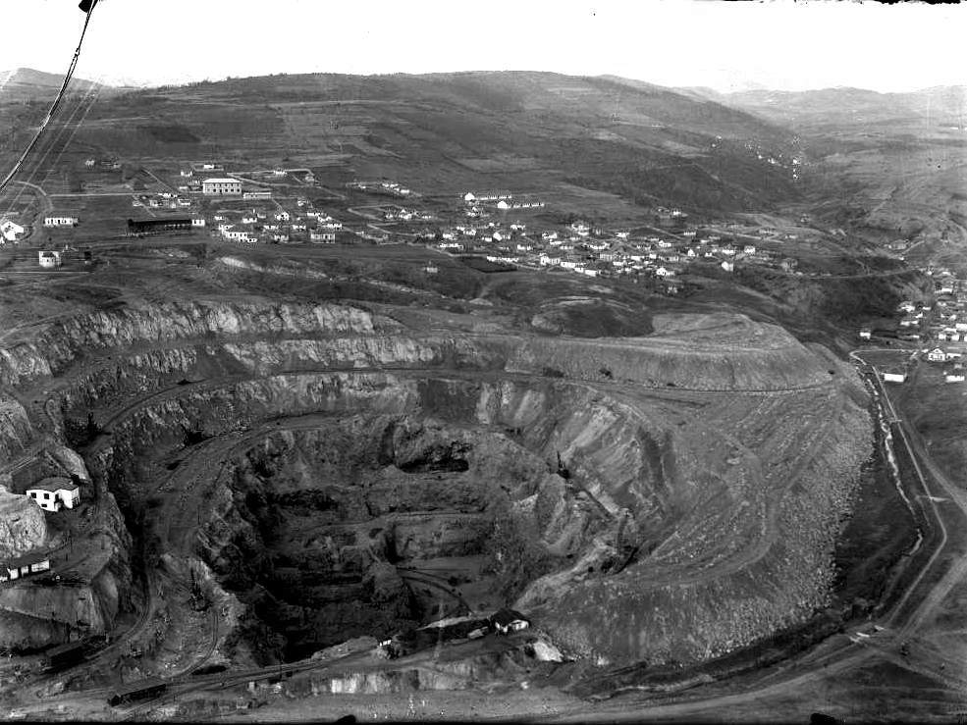
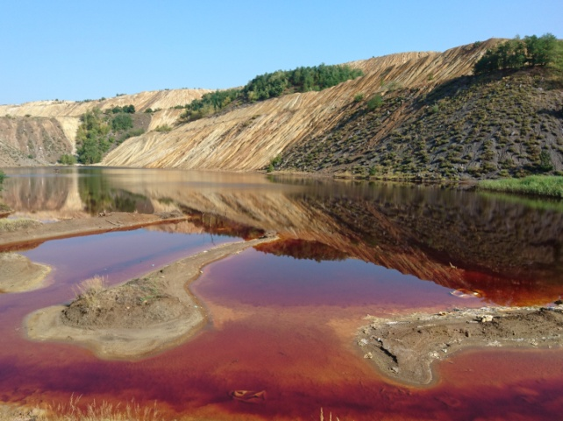
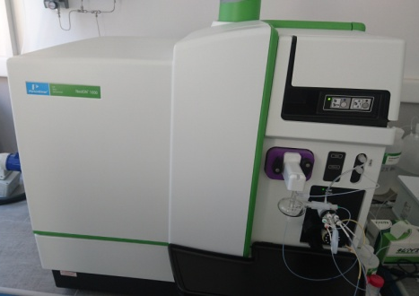
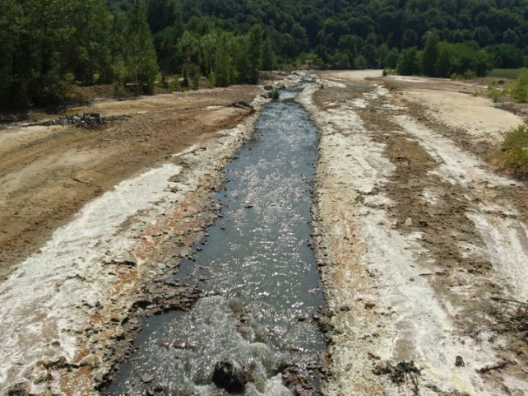
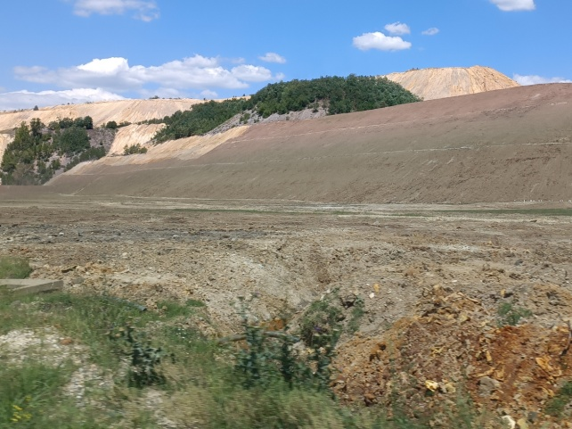
Past and present monitoring results of acid mine drainage around copper mines and smelter in Bor, Serbia Stefan Đorđievski, Mining and Metallurgy Institute Bor, Serbia
Open pit Bor and Bor River in 1930s
Water of Bor River:
in 1931
0.0168 % of free acid as H₂SO₄
in 1935
pH = 4.5
81 mg/L Fe
22 mg/L Cu
Robule Lake in 27 August 2019
(AMD accumulation)
Advanced equipment for monitoring of river water
RECLAMATION
Bor River in 10 August 2017
Robule Lake in 19 July 2022
Water of Bor River
from 2015 to 2021
pH 2.1 - 6.3
66 - 355 mg/L Fe
4 to 116 mg/L Cu
Reclamation activities are intensified

Slide 2
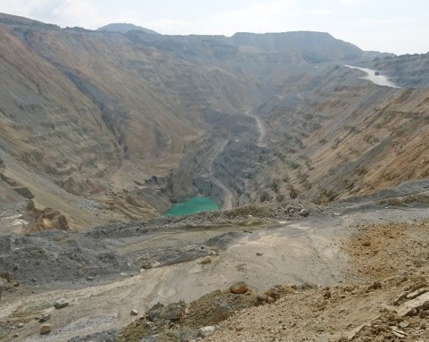
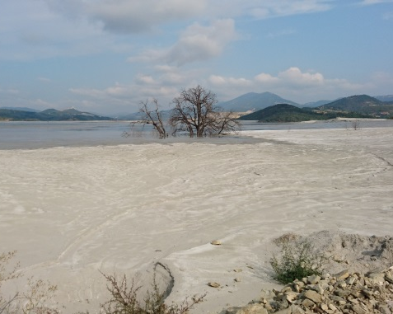
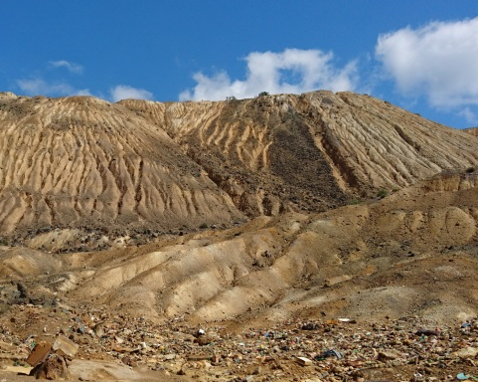
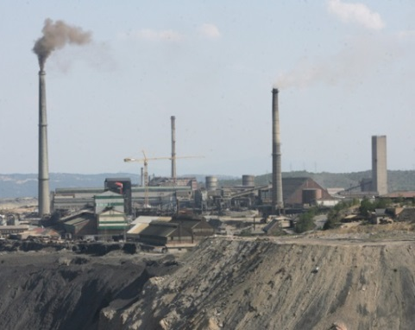
STUDY AREA
Open pit Veliki Krivelj (3)
Flotation tailing pond (5)
Overburden in Bor (8)
Smelter in Bor (13)

Slide 3
Results of the chemical analysis of Bor River from 1931
Parameter | Unit | Bor River upstream from the mine | Bor River downstream from the mine | Bor River near the Village Slatina
Alkalinity (+) or Acidity (−) as CaCO₃ | mg/L CaCO₃ | +109 | −171 | −105
Copper, Cu | mg/L | not detected | 71 | 48
Sulfate, SO₄²⁻ | mg/L | 35 | 1463 | 831
Fe₂O₃ + Al₂O₃ | mg/L | not detected | 370 | 78
Precipitate FeO + Fe₂O₃ | mg/L | not detected | very large quant. | large quantities
The sampling and analysis were carried out by the Agricultural Experimental and Control Station in Topčider, Begrade, the institution from which the contemporary Institute of Soil Science in Belgrade, Serbia was developed.. Andrejić B., Sulfuric fume from 1908. to 1935. year – archive material, Book XXVIII, Štampa, radio i film, Bor, Serbia (1983), p. 114.

Slide 4
Results of the chemical analsis of rivers around Bor Mine from 1935
Parameter | Unit | I | II | III | IV |  | V | VI | VII
pH | mg/L | 7.5 | 7.1 | 5.7 | 7.5 |  | 7.7 | 4.5 | 4.3
Dry residue | mg/L | 557.6 | 581.6 | 1766 | 651.6 |  | 1942.7 | 2152.6 | 3164.3
SiO₂ | mg/L | 13.6 | 15.9 | 66.2 | 33.2 |  | 17.9 | 34 | 59.2
Al₂O₃ Fe₂O₃ | mg/L | 4 | 17 | 89 | 7 |  | 8.5 | 155 | 396.5
Al₂O₃ | mg/L | traces | traces | 41.1 | traces |  | traces | 39.2 | 149
Fe | mg/L | 2.8 | 11.9 | 33.5 | 4.9 |  | 5.9 | 81 | 173.1
Ca | mg/L | 110 | 127.0 | 274.2 | 122.1 |  | 453.3 | 348.2 | 338.8
Mg | mg/L | 20.3 | 22.1 | 34.1 | 37.6 |  | 17.7 | 54 | 80.3
SO₄²⁻ | mg/L | 204.9 | 267.1 | 1023.0 | 198.1 |  | 1163.3 | 1387.2 | 1884.1
Cl⁻ | mg/L | 4.6 | 4.7 | 12.5 | 12.8 |  | 19.6 | 18.7 | 13
Cu | mg/L | 0 | 0 | 20 | 0 |  | 0 | 22 | 17
I Water from Bela River after passing the village of Rgotina II Water immediately after the junction of Krivelj River and Bor River III Water from Bor River after passing the village of Slatina IV Water from the Bor Stream in Bor, upstream from the flotation V Water behind the flotation near the barrage VI Water from Bor River after the junction with Bor Stream VII Water from Bor River after passing the cementation |  |  |  |  |  | Andrejić B., Sulfuric fume from 1935. to 1941. year – archive material, Book XXIX, Štampa, radio i film, Bor, Serbia (1983), p. 161.

Slide 5
Geochemical maps of river water from 2015
Acknowledgement: This study was conducted as part of the project “Research on the Integration System of Spatial Environment Analyses and Advanced Metal Recovery to Ensure Sustainable Resource Development” that belongs to SATREPS program (Science and Technology Research Partnership for Sustainable Development) supported by the Japan International Cooperation Agency (JICA) and Japan Science and Technology (JST).

Slide 6
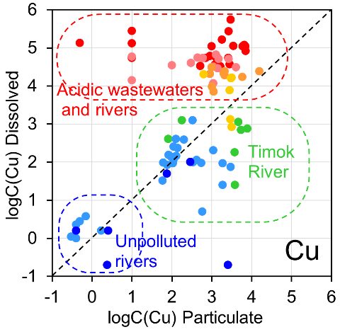
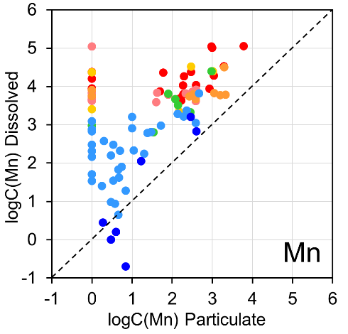
Distributions of dissolved and particulate forms of Cu and Mn from 2015 to 2021

Slide 7
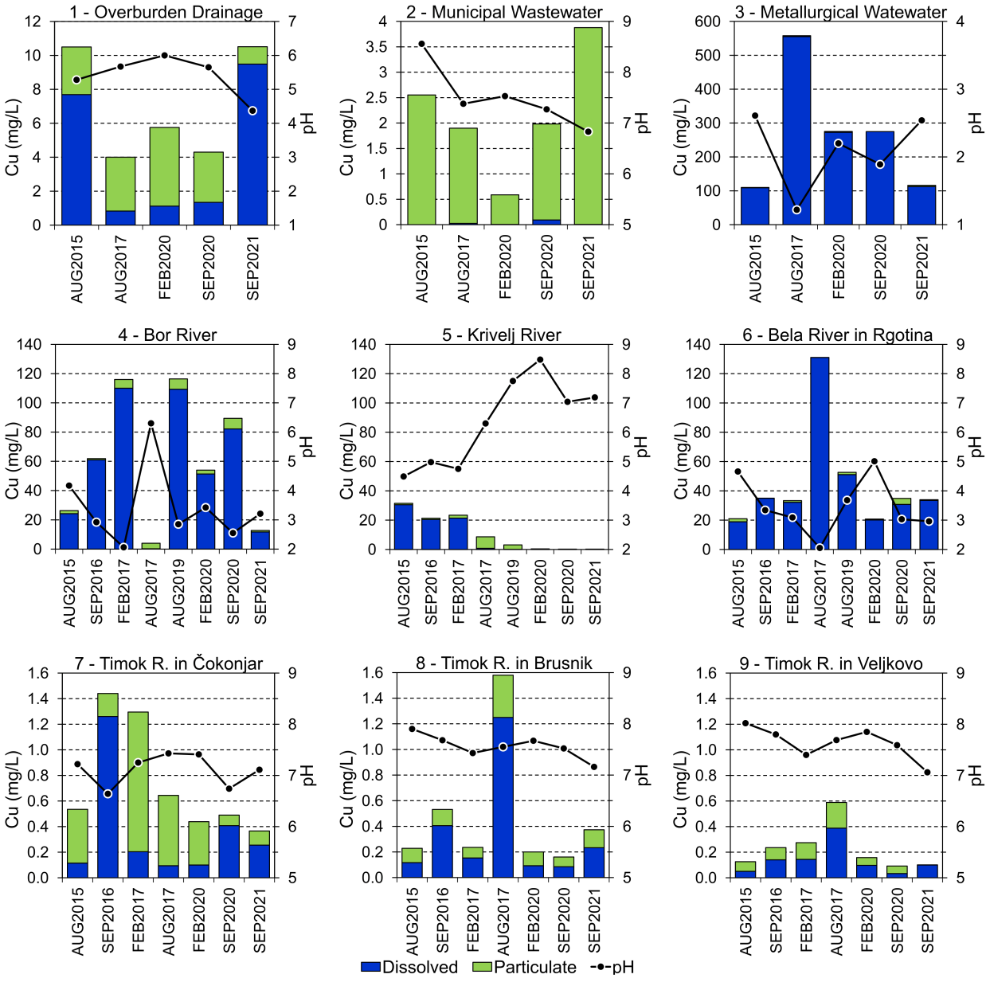
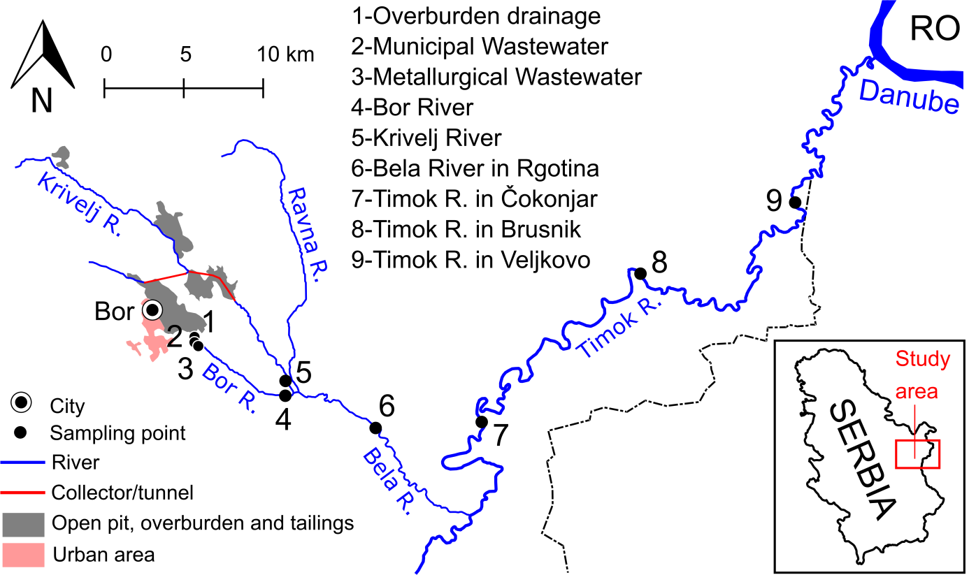
Results of the monitoring of pH value and concentration of the dissolved and particulate form of copper in the period from 2015 to 2021
Copper was mainly present in dissolved form in acidic river water, while in neutral and alkaline river water copper was present relatively equally in dissolved and particulate form.

Slide 8
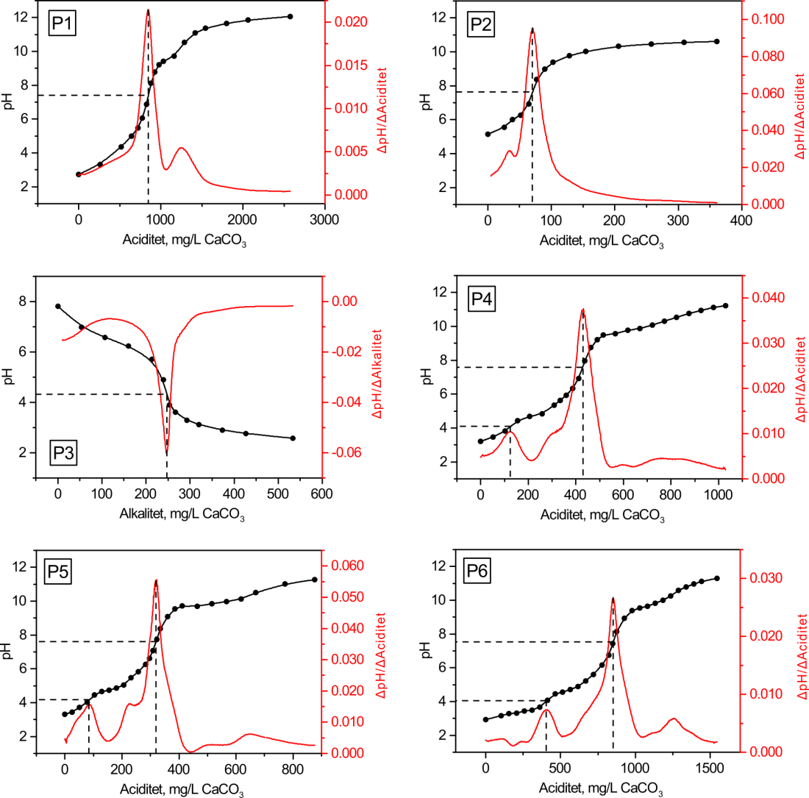
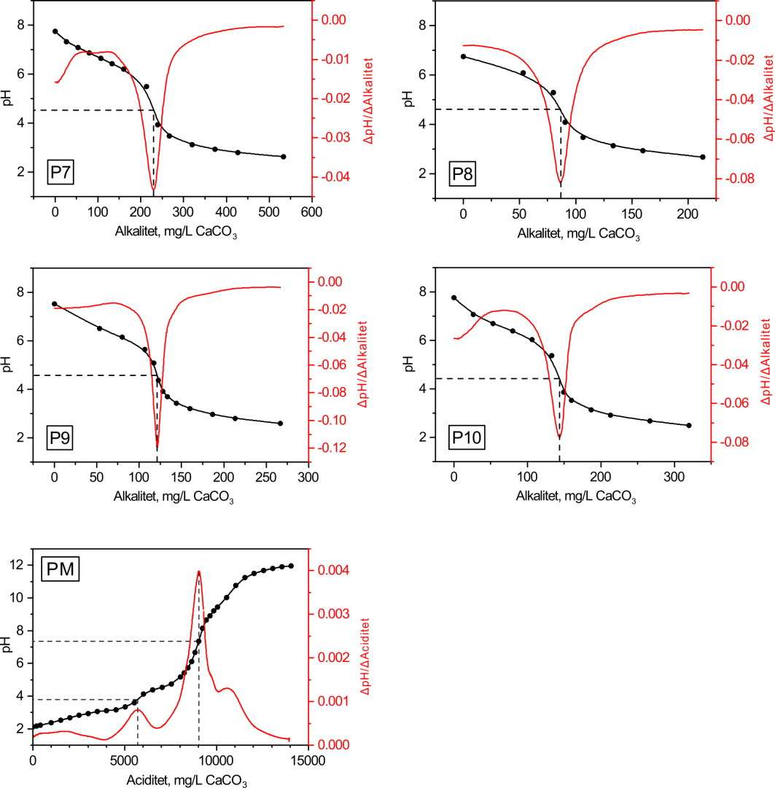
Acidity and alkalinity of rivers around copper mines in Bor in 2016
Đorđievski, S., Stanković, S., Copper 43 (2) (2018), 81–90.

Slide 9
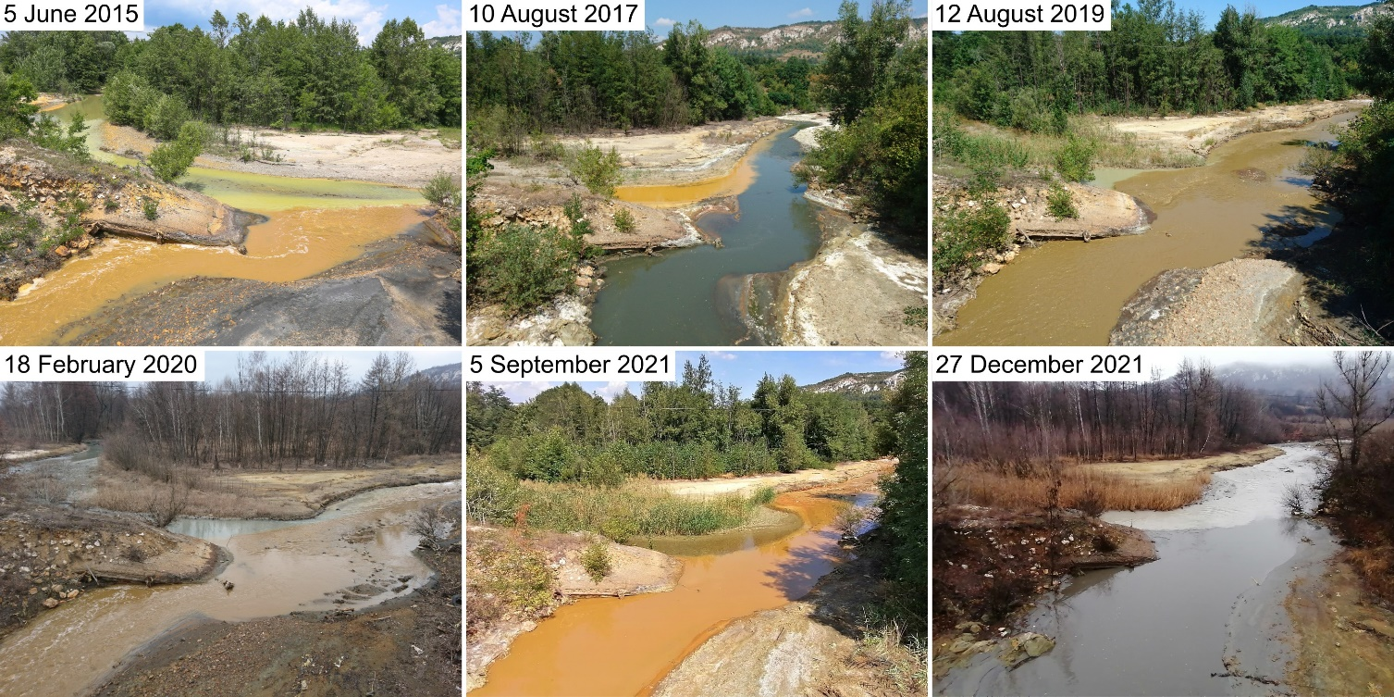
Confluecne of Bor River and Krivelj River in different seasons

Slide 10
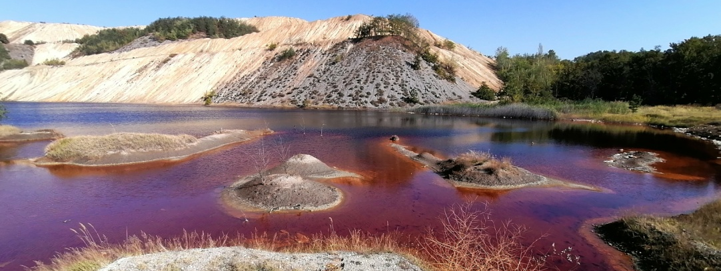
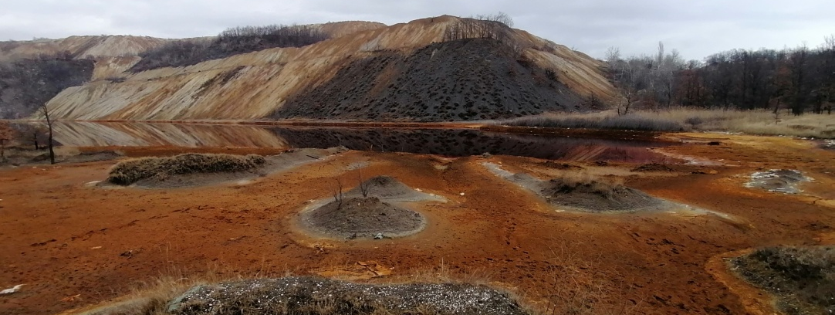
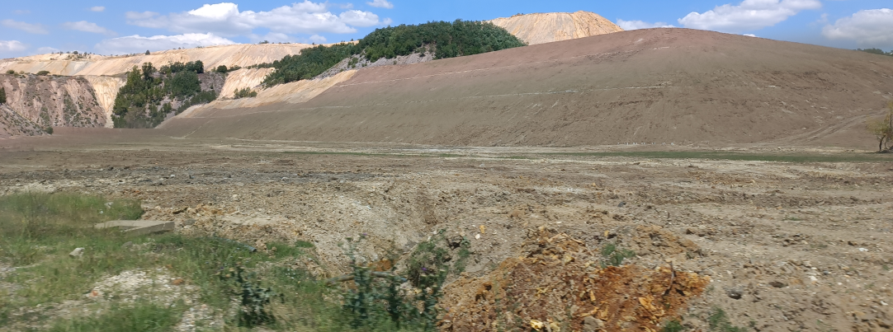
Reclamation of Robule Lake
Monitoring and reclamation activities were intensified in last several years.
Minimum and maximum values of water quality parameters from June 2011 to May 2012
Parameter | Unit | Robule Lake
pH | - | 2.56 – 4.20
SO₄²⁻ | mg/L | 4604.2–10570.6
Cu | mg/L | 53.0 – 77.2
Fe | mg/L | 526.4 – 835.6
Stevanović Z, Obradović L, Marković R, et al., Mine Waste Water Management in the Bor Municipality in Order to Protect the Bor River Water in Waste Water - Treatment Technologies and Recent Analytical Developments, InTech (2013), p. 41–62.
Water quality parameters in September 2021
Parameter | Unit | Robule Lake
pH | - | 2.70
SO₄²⁻ | mg/L | 10200
Cu | mg/L | 56.7
Fe | mg/L | 554

