Slide 1
EGU General Assembly, 23-28 April 2023
ERA5-Land: More than 7 decades of land surface consistency with timely updates
Motivation
Methodology
Conclusions & data access
Evaluation
- Joaquín Muñoz Sabater -
with contributions from many colleagues

Slide 2
Motivation
Climate reanalysis does not occur very often (ERA-Interim, ERA5)
Need to bring rapid land model developments to long, consistent time series in a cost-effective way (ERA-Interim/Land)
Provide consistent land initial conditions to weather and climate models.
Climate reanalysis often produce inconsistencies on land fields
Provide dedicated datasets to support and encourage land applications
ERA5-Land
ERA5
Soil Moisture
→ First operational land European reanalysis: daily updates (5-days delay wrt real-time), documentation, user support, independent quality control, etc.

Slide 3
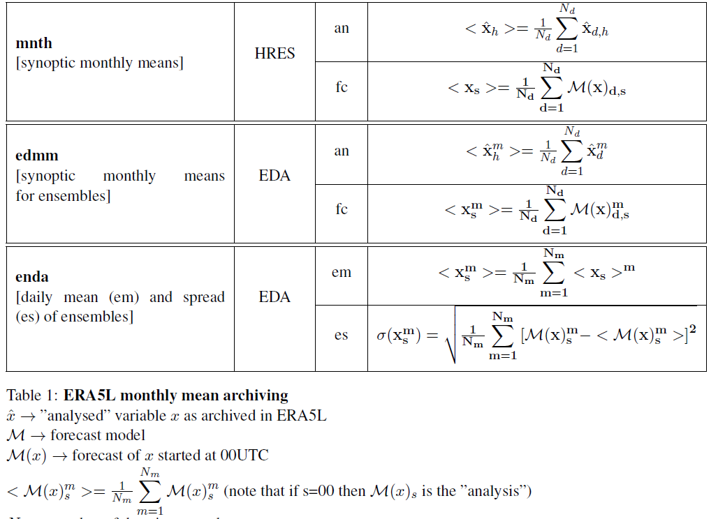
ERA5-Land in a simple diagram
Climatology (static+dynamic fields) & Initial States
ERA5
Temperature
Humidity
[…]
Precipitation
Radiation
ERA5L hourly meteorology
Next cycle States
Lapse-rate & forcing adjustment
Land Surface integration
NO DA
uncoupled
Output archival
Statistics & archival
Applications

Slide 4
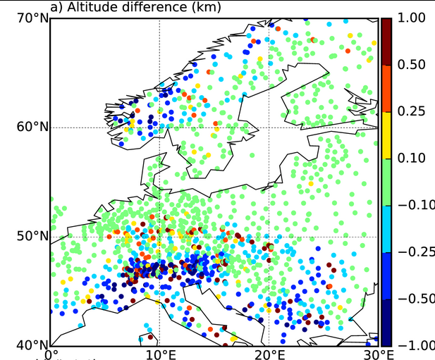
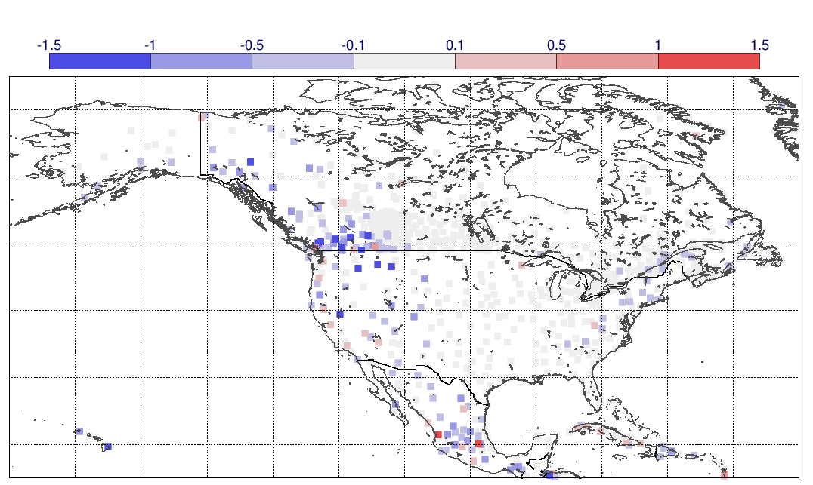
Lapse-rate adjustment
Correct for differences in orography due to different model resolutions.
T2m RMSE(corrected)- RMSE(no corrected) (K)
Δh (km)
E. Dutra, J. Muñoz-Sabater, S. Boussetta, T. Komori, S. Hirahara and G. Balsamo, 2020: "Land surface downscaling of ERA5 and the role of the lapse rate correction: An application to ERA5." Earth and Space Science, https://doi.org/10.1029/2019EA000984.

Slide 5
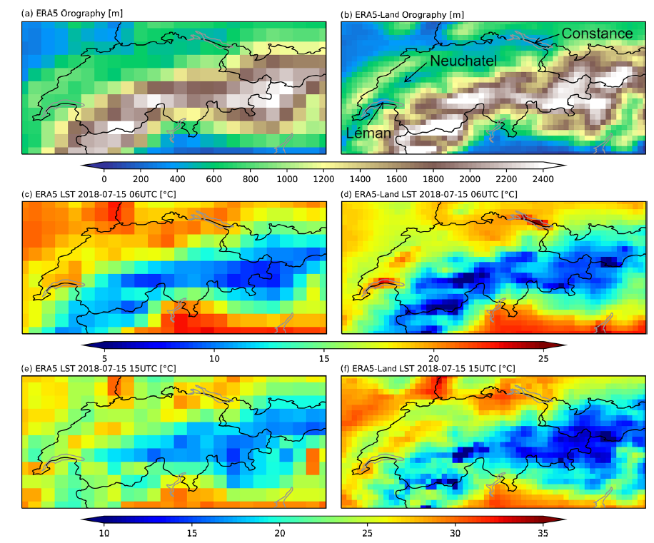
Add value of higher resolution and lapse-rate correction
orography
Soil Temperature (15 July 2018 06UTC)
Soil Temperature (15 July 2018 15UTC)

Slide 6
ERA5-Land specs compared to…
 | ERA-Int | Era-Int/Land | ERA5 | ERA5-Land
Period covered | Jan 1979 – Jul 2019 | Jan 1979 – Dec 2010 | Jan 1950 - NRT | Jan 1950 - NRT
Spatial resolution | ~79km / 60 levels | 79 km | ~32 km / 137 levels | ~9 km
Model version | IFS (+TESSEL) | HTESSEL cy36r4 | IFS (+HTESSEL) | HTESSEL cy45r1
LDAS | cy31r1 | NO | cy41r2 | NO
Uncertainty estimate | - | - | Based on a 10-member 4D-Var ensemble at 62 km | Based a 10-member 4D-Var ensemble at 62 km
Output frequency | 6-hourly Analysis fields | 6-hourly Analysis fields | Hourly (three-hourly for the ensemble) | Hourly (three-hourly for the ensemble)

Slide 7
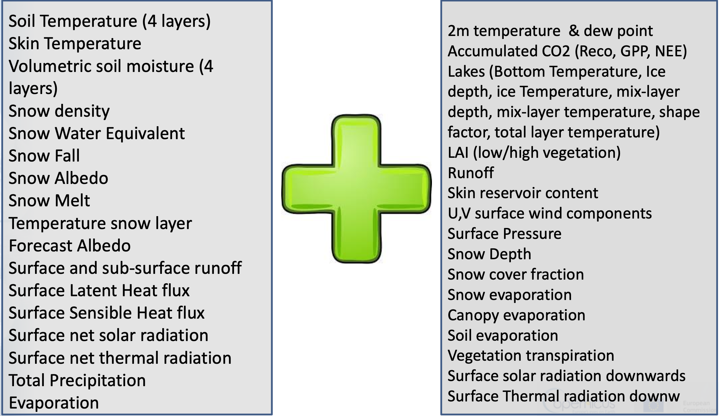
ERA-Int/Land vs ERA5-Land inventory of fields

Slide 8
Evaluation
The quality of ERA5-Land was evaluated comparing reanalysis estimates with in-situ observations and remote sensing products.
Soil moisture
Snow
Lakes
River discharge
International Soil Moisture Network
ESM SnowMIP; GHCN daily
Alqueva reservoir; Finnish (SYKE) LSWT; Global distributed LSWT 1985-2009
Global Runoff Data Centre
QC
ERA-Interim
ERA5
ERA5-Land
Sensible heat flux
Latent heat flux
Bowen ratio
Land surface temperature
FLUXNET 2015; GLEAM
MYD11C3/MOD11C3 v6 monthly LST
QC
RMSE, bias, anomaly correlation, STDD, MAE, KGESS

Slide 9
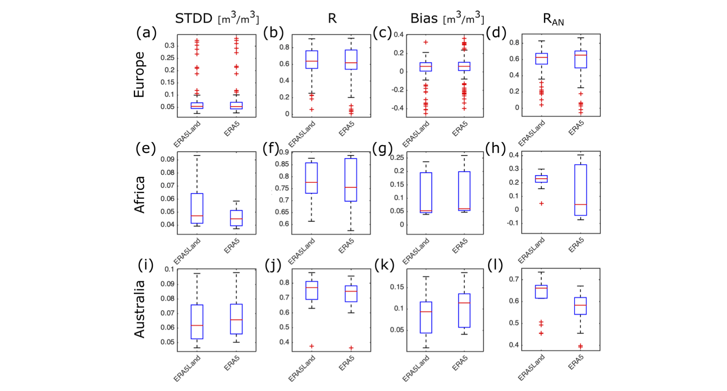
Evaluation – Soil Moisture
Box plots showing the evaluation of ERA5-Land and ERA5 top layer soil moisture against in situ measurements at 5 cm for sites in Europe (a–d), Africa (e–h), and Australia (i–l). Panels (a), (e), and (i) show the standard deviation of the difference (STDD), (b), (f), and (j) the Pearson correlation coefficient (R), (c), (g), and (k) the bias, and (d), (h), and (l) the Pearson correlation of the anomaly time series (RAN). On each box, the central mark indicates the median, and the bottom and top edges of the box indicate the 25th (q25) and 75th (q75) percentiles, respectively. The whiskers extend to the most extreme data points not considered outliers.

Slide 10
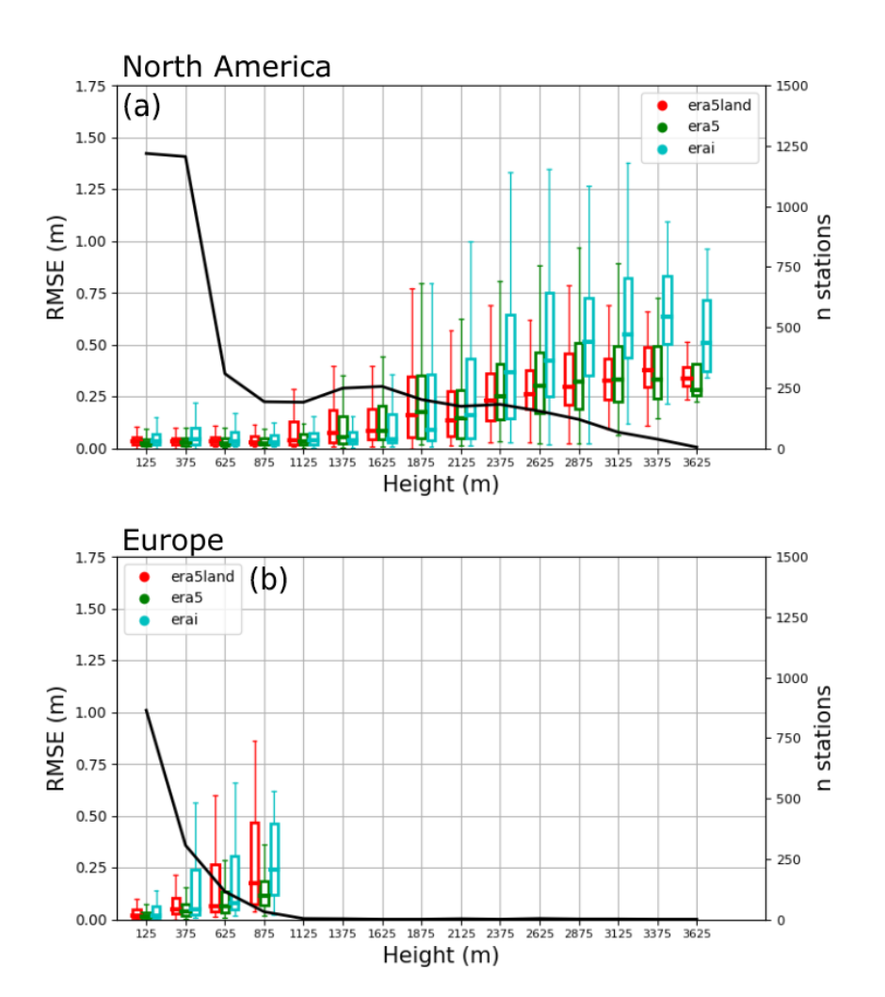
Evaluation – Snow depth
Box plot of the snow depth RMSE distribution as func- tion of the site altitude, for North America (30–80◦ N, 60–160◦ W, a) and Europe (25–80◦ N, 10◦ W–40◦ E, b), for ERA5-Land (red), ERA5 (green), and ERA-Interim (cyan). Boxes extend between the lower (25 %) and upper quartiles (75 %), and the horizontal lines within each box represent the median value of the distribution. The black line represents the number of stations grouped at each bin.

Slide 11
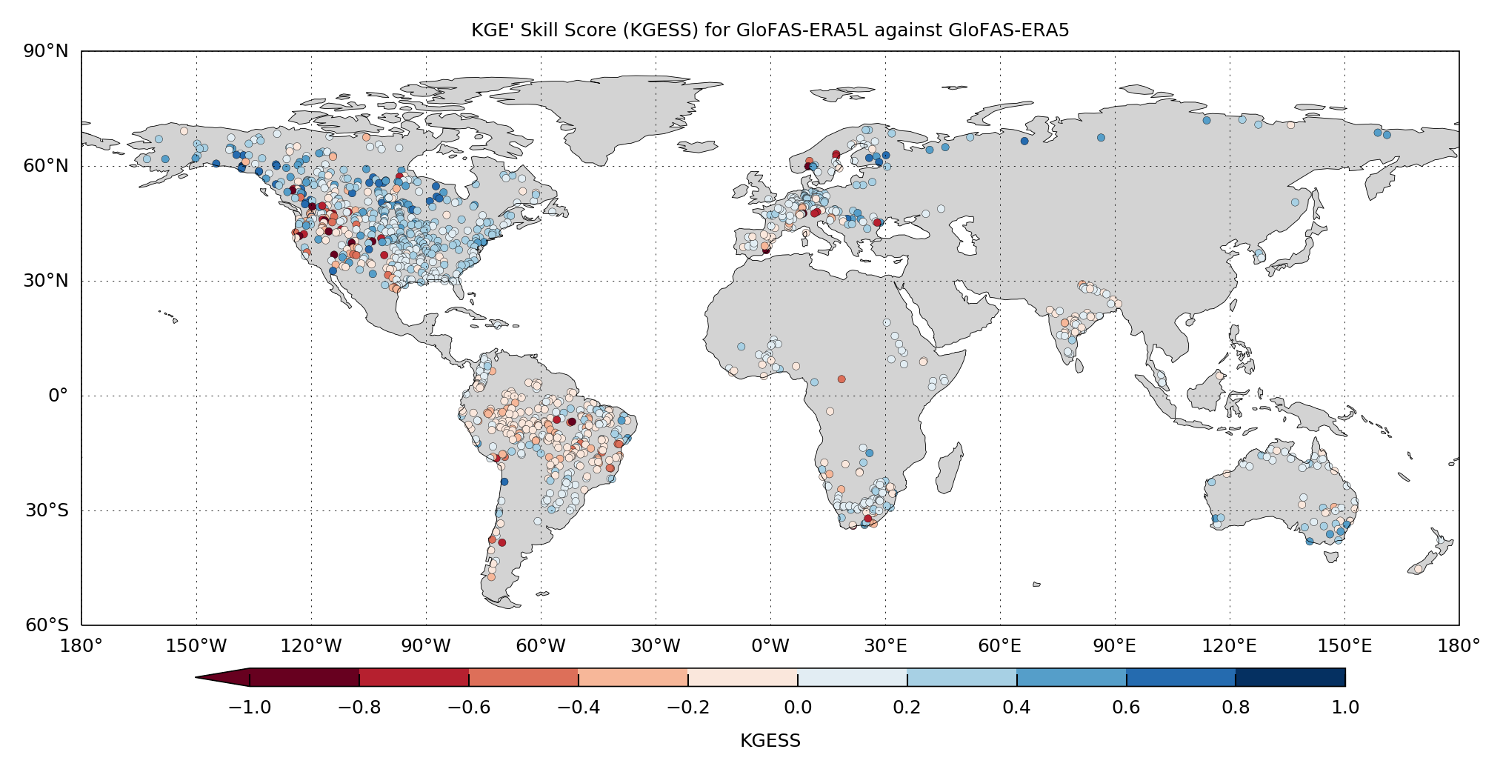
Evaluation – River discharge
Runoff from ERA5/ERA5-Land + channel routing model LISFLOOD → GloFAS-ERA5/ERA5-Land
More than 2000 stations from the Global Runoff Data Centre
Modified Kling-Gupta Efficiency Skill Score (KGESS) for GloFAS-ERA5L river discharge reanalysis against the GloFAS-ERA5 benchmark across 1285 observation stations. Optimum value of KGESS is 1. Blue (red) dots show catchments with positive (negative) skill.

Slide 12
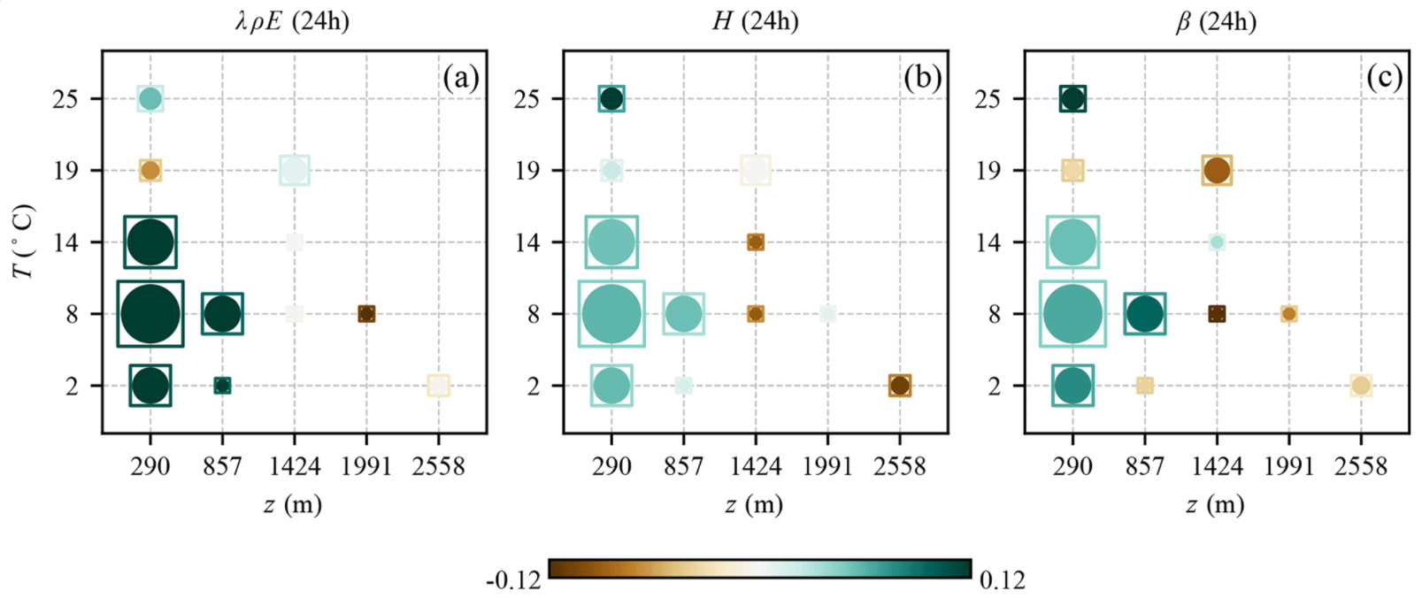
Evaluation – Heat fluxes
Heat fluxes from ERA5-Land vs GLEAM+ERA5-Land.
Standardized anomaly correlation difference (circles) and standardized mean absolute differences (squares) between ERA5-Land and GLEAM-ERA5-Land latent heat flux (a), sensible heat flux (b), and Bowen ratio (c), grouped as a function of stations’ temperature and altitude. The size of circles and squares is proportional to the number of eddy-covariance towers. Green values denote better matching of ERA5-Land with in situ data.

Slide 13
Conclusions
ERA5-Land provides a view of the land surface from 1950 to present (5-days delay w.r.t real time), i.e., more than 7 decades of land surface evolution;
Consistently,
Globally,
Hourly,
9 km horizontal resolution,
Reduced computational cost
Operational services (update documentation, user support, quality assurance, etc.)
Horizontal resolution matters
Clear signs of improvements in all components of the hydrological cycle compared to previous reanalysis
Evaluation of the energy cycle comparable to ERA5, but the devil is in the detail…

Slide 14
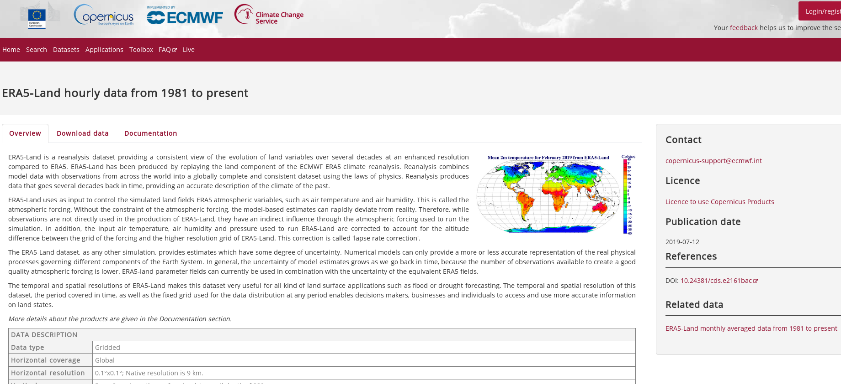
Data availability & way forward
Data is open and available in the Climate Data Store (doi: 10.24381/cds.e2161bac)
Hourly and monthly averaged fields
Interpolated to 0.1° x 0.1° (grid and netCDF formats)
The CDS provides a tool to build daily aggregates
From 1950 to present (validated data with 2-3 months delay w.r.t real time)
ERA5-Land-T: preliminary (non-validated) data with 5-days delay w.r.t real time
Improvements under research for potential future versions:
Dynamic land use maps
LAI measured from satellites
Bias corrected precipitation
Offline data assimilation
…

Slide 15
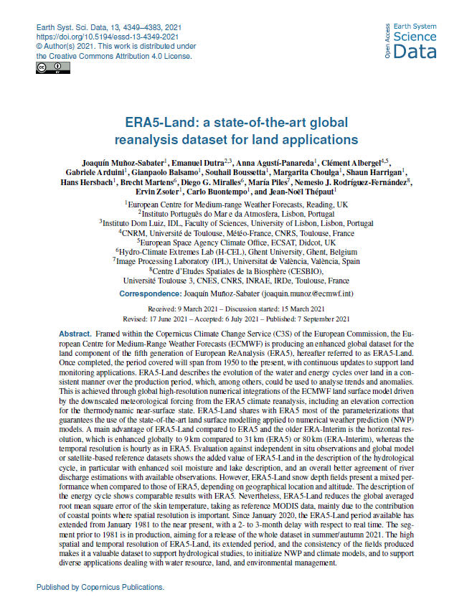
Thank you!
@j_munoz_sabater
C3S: https://climate.copernicus.eu/
Climate Data Store: https://cds.climate.copernicus.eu/
ERA5-Land: https://www.ecmwf.int/en/era5-land
Muñoz-Sabater et al., 2021
Earth Syst. Sci. Data, 13, 4349–4383;
https://doi.org/10.5194/essd-13-4349-2021

