Slide 1
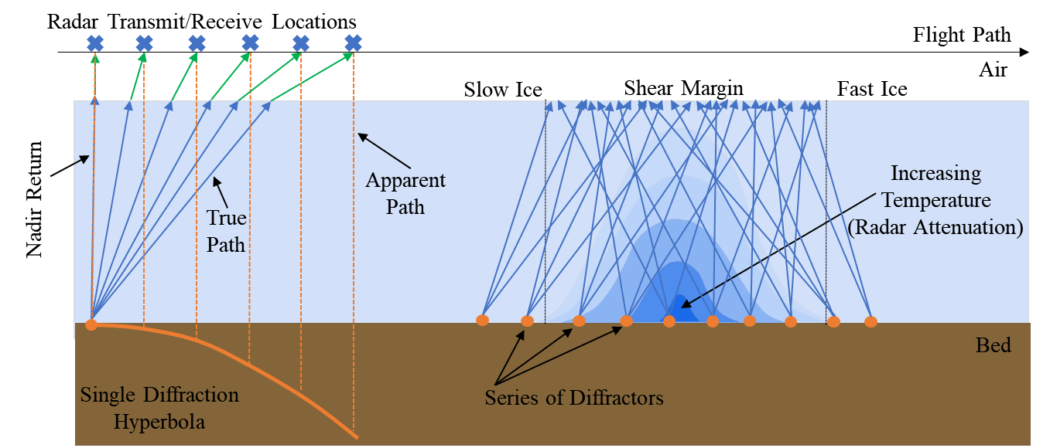
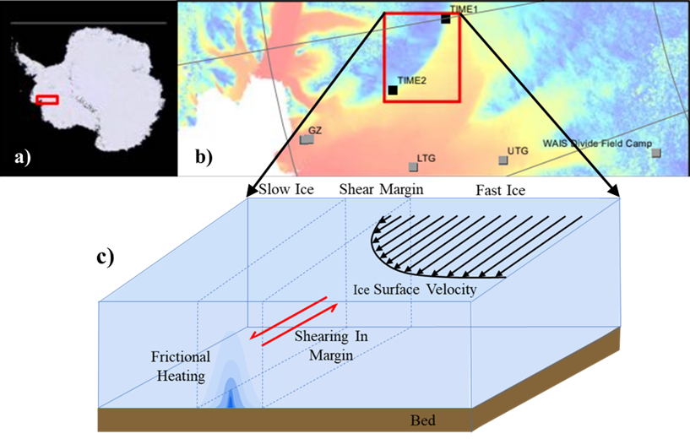
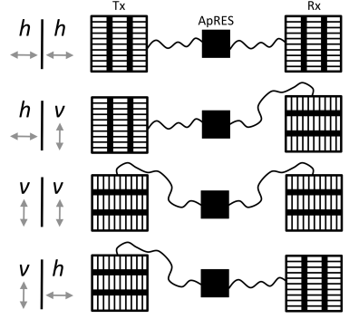
Radar Attenuation Tomography for Mapping Englacial Temperature Distributions Using Off-Nadir Airborne Radio-Echo Sounding Daniel May, Dustin Schroeder, and Tun Jan Young

Slide 2
Radar Attenuation Tomography for Mapping Englacial Temperature Distributions Using Off-Nadir Airborne Radio-Echo Sounding Daniel May, Dustin Schroeder, and Tun Jan Young

Slide 3
Radar Attenuation Tomography for Mapping Englacial Temperature Distributions Using Off-Nadir Airborne Radio-Echo Sounding Daniel May, Dustin Schroeder, and Tun Jan Young

Slide 4
Radar Attenuation Tomography for Mapping Englacial Temperature Distributions Using Off-Nadir Airborne Radio-Echo Sounding Daniel May, Dustin Schroeder, and Tun Jan Young

Slide 5
Radar Attenuation Tomography for Mapping Englacial Temperature Distributions Using Off-Nadir Airborne Radio-Echo Sounding Daniel May, Dustin Schroeder, and Tun Jan Young

Slide 6
Radar Attenuation Tomography for Mapping Englacial Temperature Distributions Using Off-Nadir Airborne Radio-Echo Sounding Daniel May, Dustin Schroeder, and Tun Jan Young

Slide 7
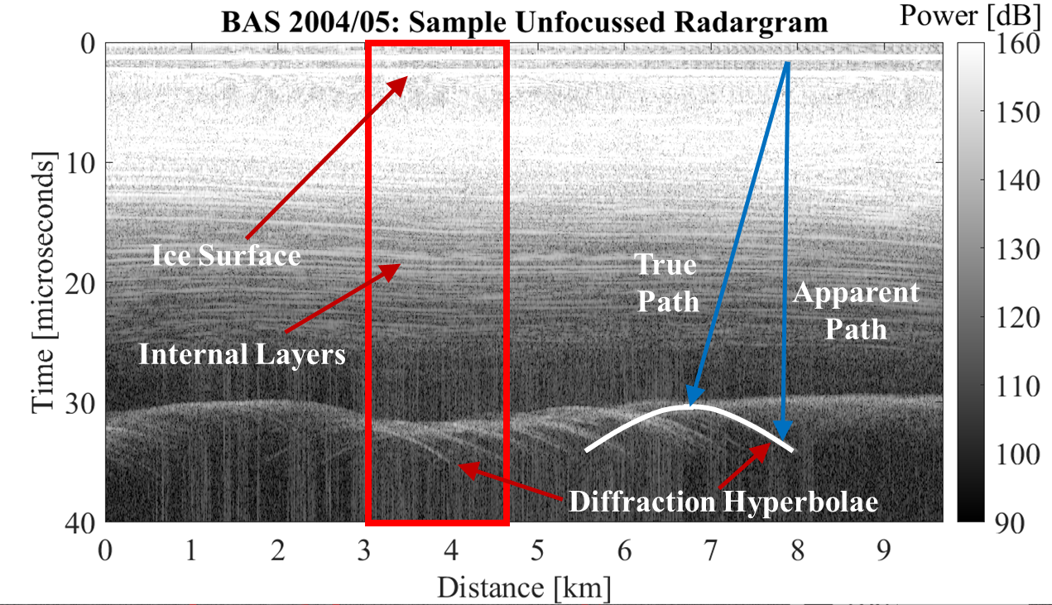
Radar Attenuation Tomography for Mapping Englacial Temperature Distributions Using Off-Nadir Airborne Radio-Echo Sounding Daniel May, Dustin Schroeder, and Tun Jan Young
Context: Thwaites Glacier Eastern Shear Margin
Airborne RES Data From Thwaites Glacier
Off-Nadir Radio-Echo Sounding
Ground-Based Bistatic Surveys
Expected Attenuation Rate Anomalies

Slide 8
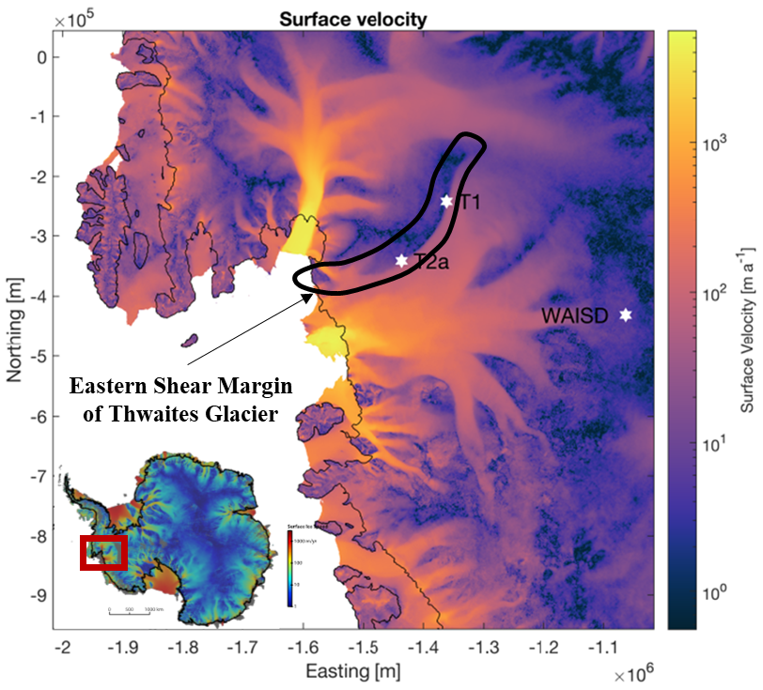
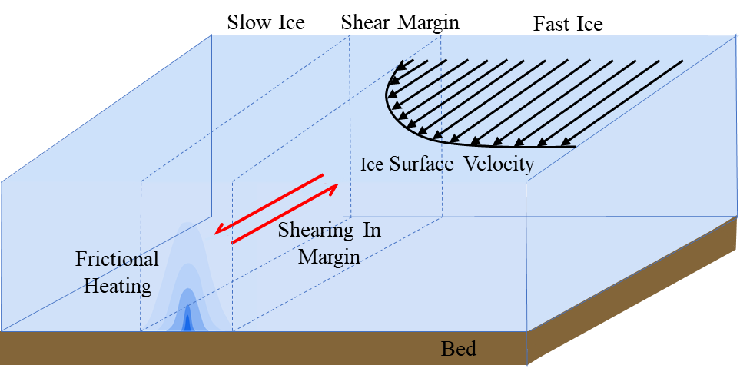
Context: Eastern Shear Margin of Thwaites Glacier
Eastern Shear Margin
Fast ice meets slow ice: shear heating
Ice rheology influenced by temperature
Study evolution of margin: boundary not controlled by topography
Constrain bed properties: presence of water?
Young, 2021

Slide 9
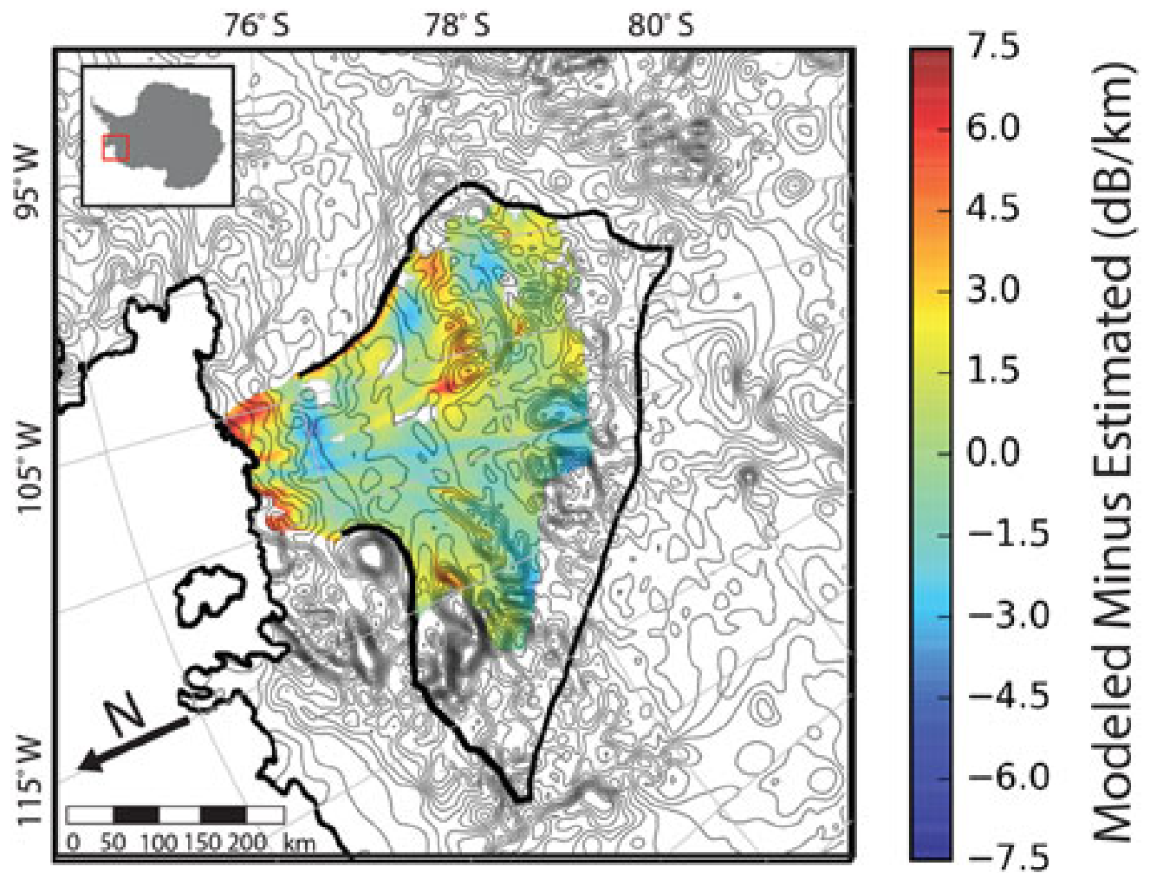
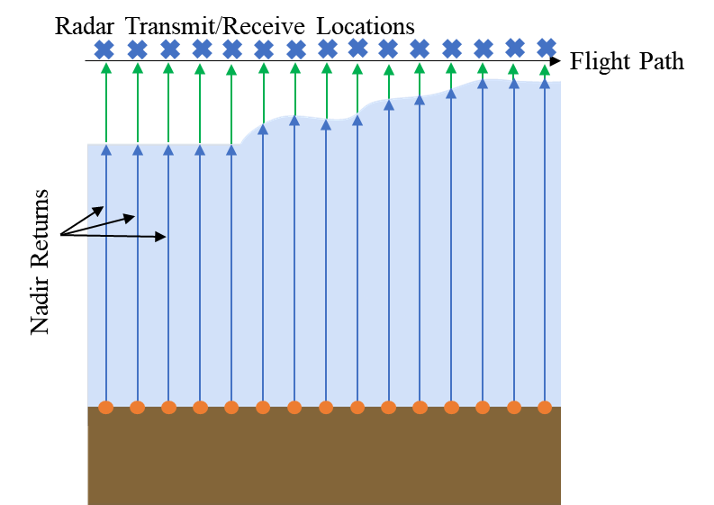
Estimating Englacial Attenuation at Eastern Shear Margin
Nadir-Only Methods
Rely on large spatial variations in ice thickness
May need 100s of km to estimate attenuation rate
Perform poorly near shear margins and grounding zones
Only depth averaged estimates with low spatial resolution
Modeled vs Estimated Attenuation
(Derived From Nadir Returns)
Nadir-Only RES Geometry
Schroeder, 2016

Slide 10
Off-Nadir Radio-Echo Sounding Geometry
Airborne RES data are collected with zero-offset between transmitter and receiver (monostatic)
Backscattered energy still recorded from ground locations not directly below radar (off-nadir)
Returned power decreases with increasing attenuation rate, path length in ice, and incidence angle
Diversity of ray lengths and incidence angles used to estimate attenuation rates within shear margin

Slide 11
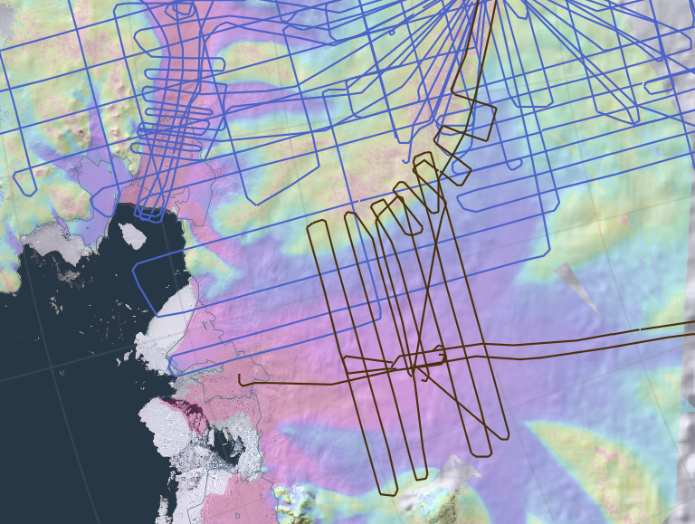
Off-Nadir Radio-Echo Sounding Geometry
Path Diversity: Off-Nadir vs Nadir Only
Benefit of Off-Nadir Returns
Significant variation in path length over few kilometers (even hundreds of meters) in areas of constant ice thickness
Ice paths significantly vary in directionality: infer vertical changes in attenuation rates
Confounding factor: angular dependence of bed return power
Limited geometry control compared to ground-based methods
But: lots of available airborne data (easier than collecting ground-based profiles)
PASIN and PASIN2 Airborne RES Lines
British Antarctic Survey, 2023

Slide 12
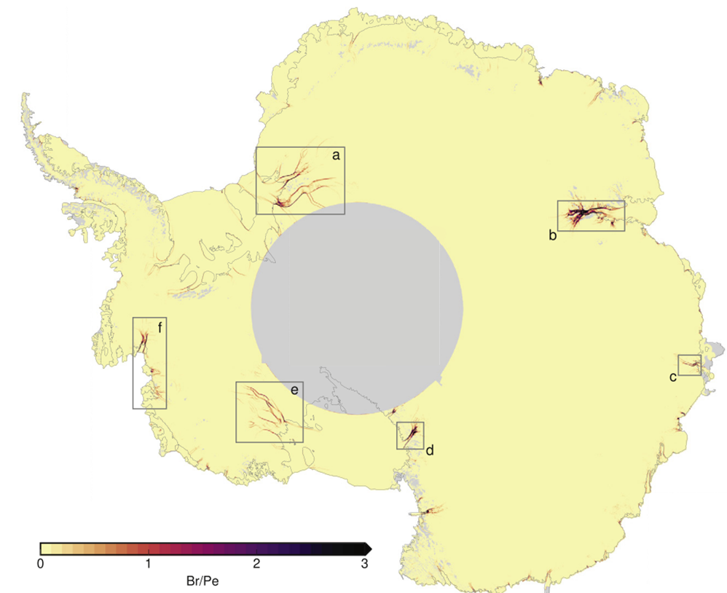
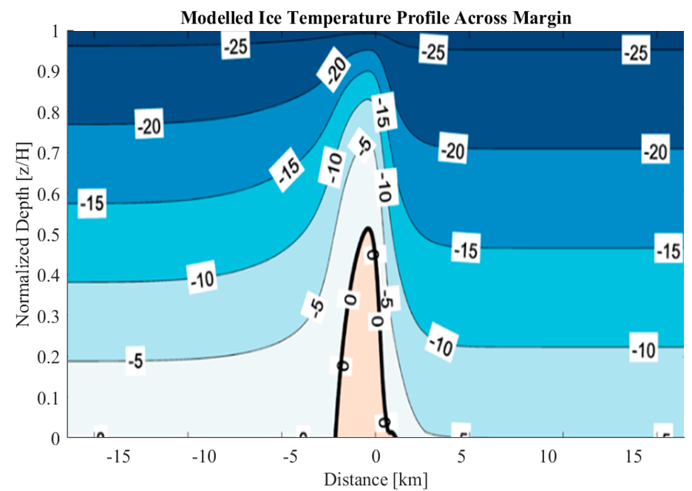
Expected Anomalies: Radio Wave Attenuation and Ice Temperature
Temperature Inferred From Attenuation
Attenuation of radio waves highly dependent on ice temperature
Small lateral but significant vertical temperature anomalies expected within shear margins
Temperate ice may exist throughout significant fraction of ice column at margins
Meyer, 2018
Suckale, 2014

Slide 13
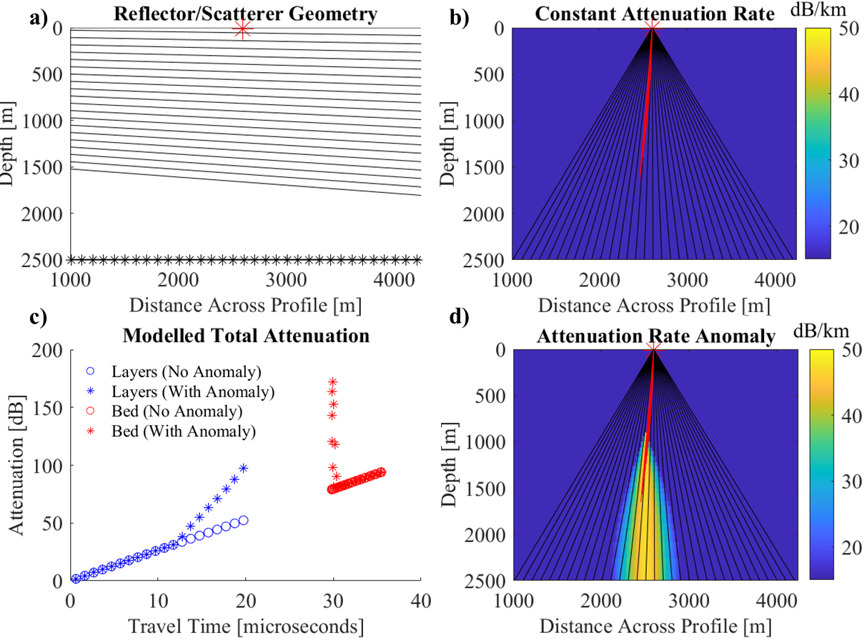
Expected Anomalies: Initial Modeling
Modeling Expected Attenuation
Consider single, monostatic observation
Simplified attenuation rate profile
Assume isotropic scattering at bed and specular layer reflections
Attenuation integrated over paths from dipping layers and bed scatterers
Need to consider next: effects of diffuse bed scattering and non-uniform layer reflectivity

Slide 14
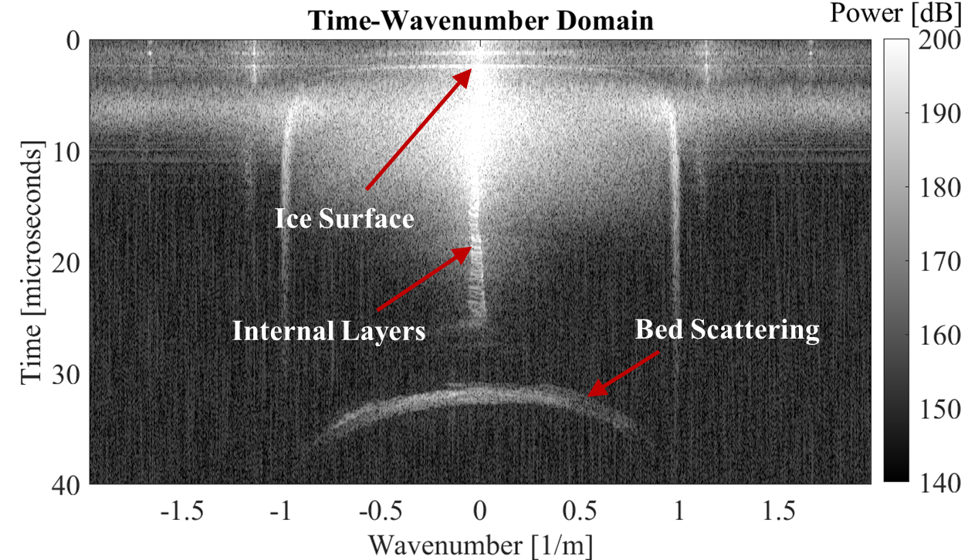
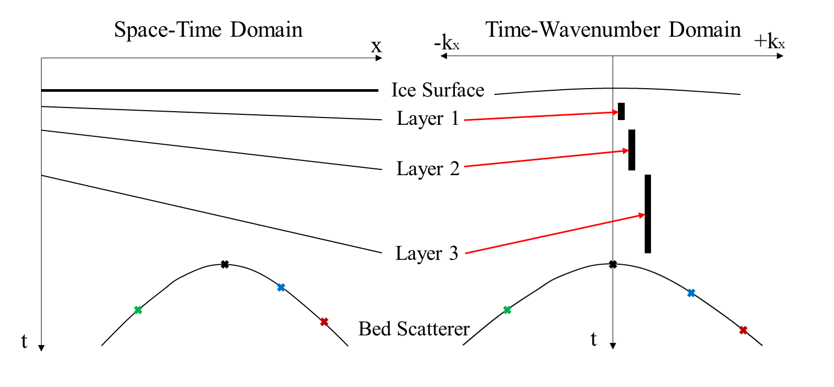
Data Processing: Time-Wavenumber Domain
Spatial Fourier Transform
Specular layers → Narrow Doppler signature
Bed Hyperbolas → ‘Average’ Bed Hyperbola
Basis of attenuation tomography:
Energy along bed hyperbola in time-wavenumber domain can be mapped to along track location: Doppler wavenumber gives insight into propagation angle.

Slide 15
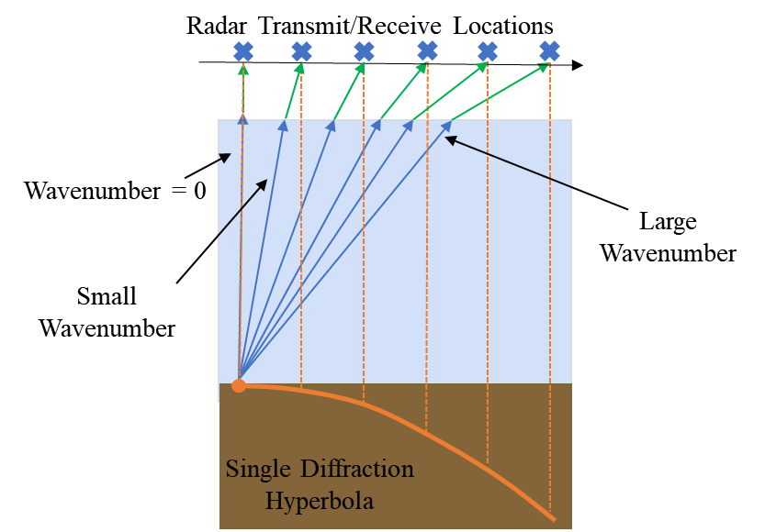
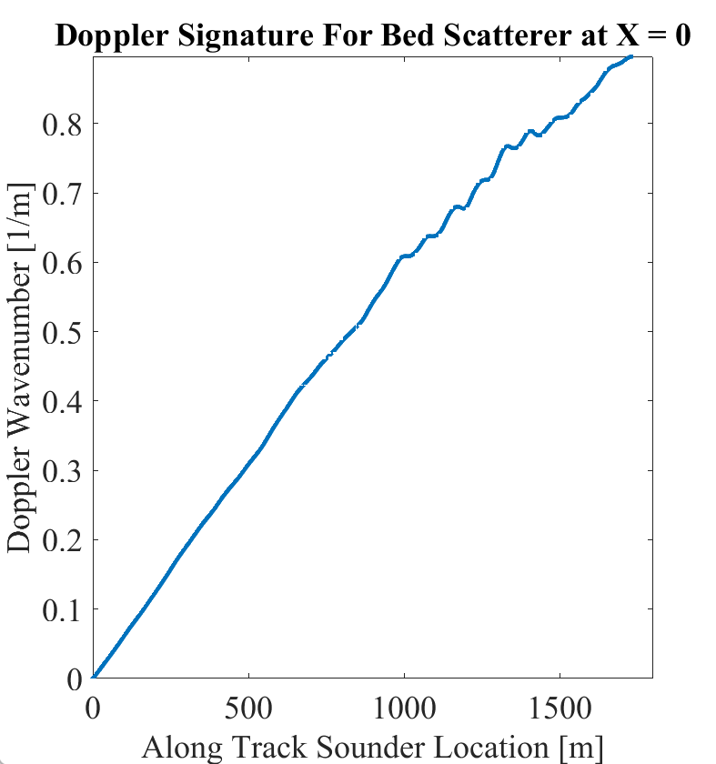
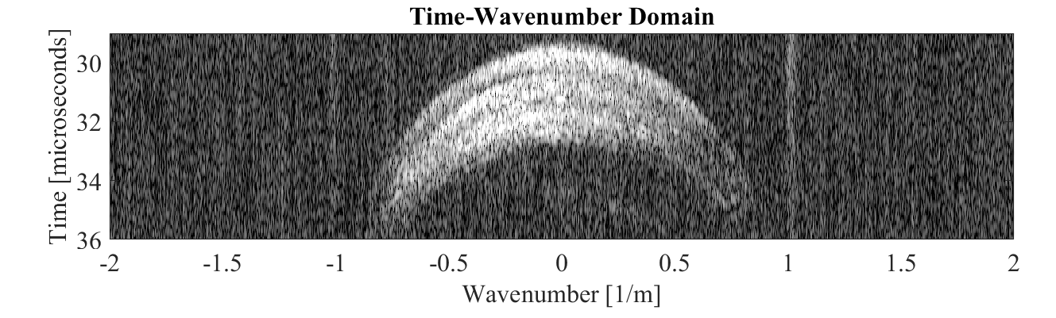
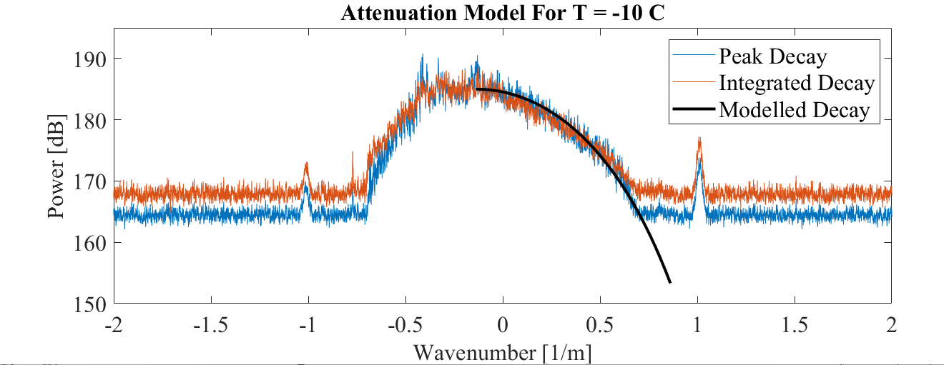
Data Processing: Power Drop With Wavenumber
Processing in Wavenumber Domain
Wavenumber related to lateral distance between sounder and origin of energy
For uniform temperature ice column, tomography not needed, but effects of scattering still need to be considered
Complex attenuation profile: assign bed power to associated travel paths and use straight ray reflection tomography.

Slide 16
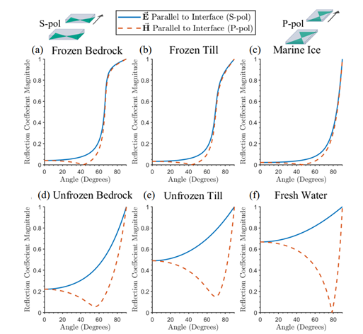
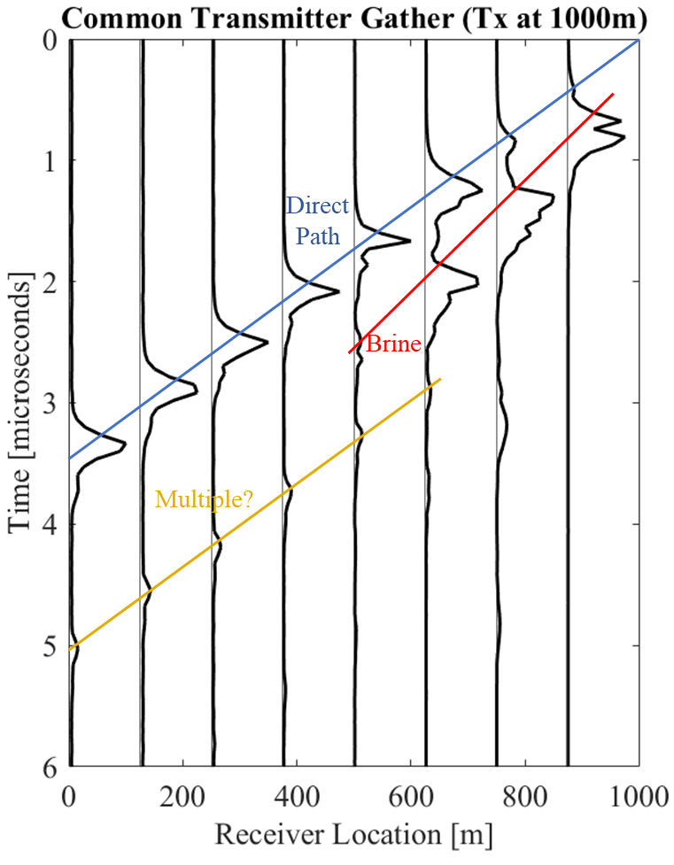
Ground-Based Polarimetric Surveys: Motivation
Planned Ground-Based Surveys
Bistatic radar system with theoretically unlimited offset → use active seismic survey geometries
Polarimetric survey constrains bed materials→ separate attenuation from reflectivity
Greater control on raypath geometry
More labor intensive than collecting airborne data
Young, 2021
Bienert, 2022

Slide 17
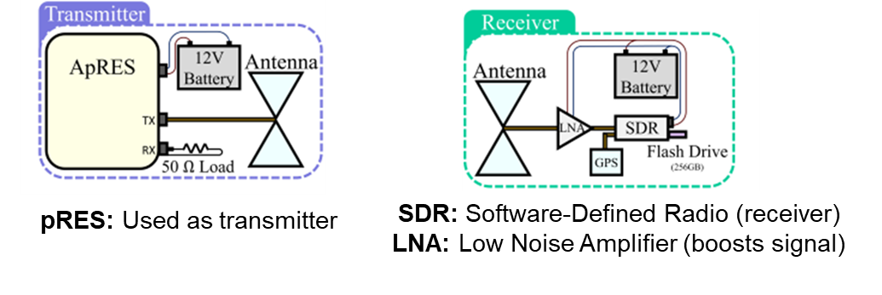
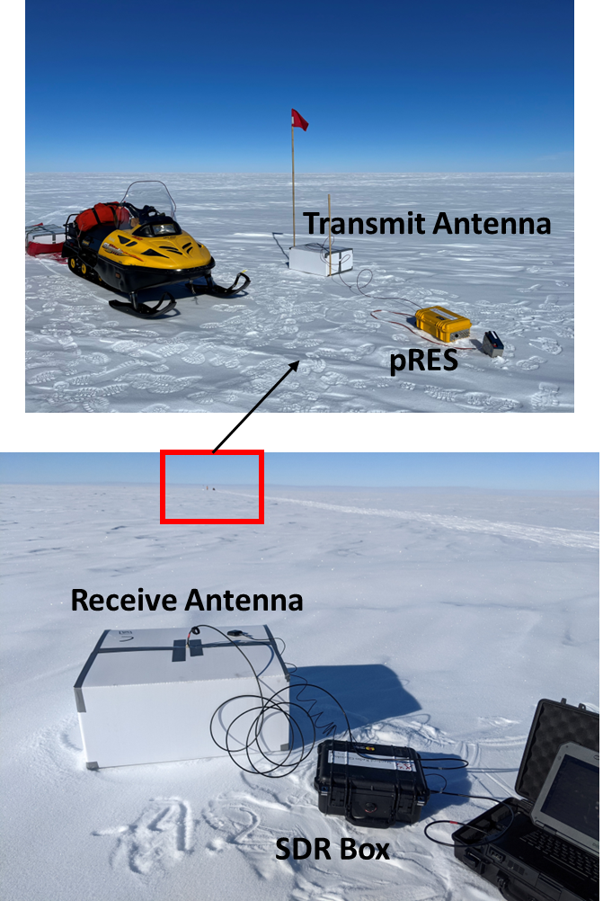
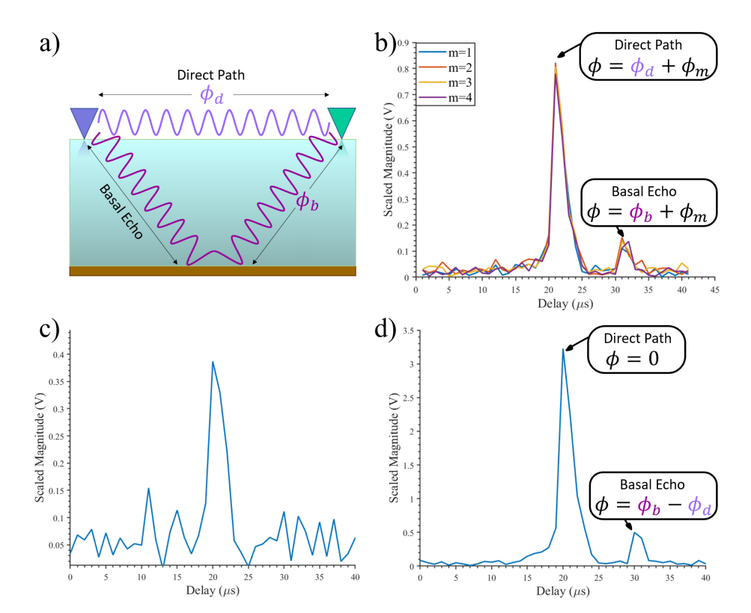
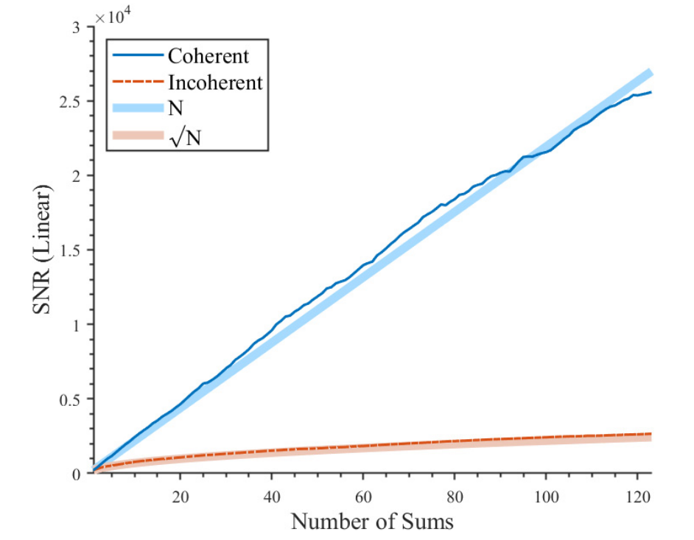
Ground-Based Polarimetric Surveys: Radar System
Without cable, extra processing required to phase align repeated chirps before coherent summation:
Bienert, 2022

Slide 18
Intermediate Processing Step: Downward Continuation
Redatuming
Motivation
Get rid of ‘uninteresting’ air layer
Simplify raypaths: Doppler information now related to angle of propagation in the ice only
No need to calculate refraction points along surface (which has no analytical solution, inefficient).
More efficiently implement 2D and 3D imaging techniques for improved geometry constraints (e.g., migration)

