Slide 1
EGMS data for desirable national-scale landslides zonation
Nicușor Necula¹, Mihai Niculiță²
nicusor.necula@uaic.ro mihai.niculita@uaic.ro
¹ Tulnici Research Station, Alexandru Ioan Cuza University of Iasi
² Department of Geography, Faculty of Geography and Geology, Alexandru Ioan Cuza University of Iasi

Slide 2
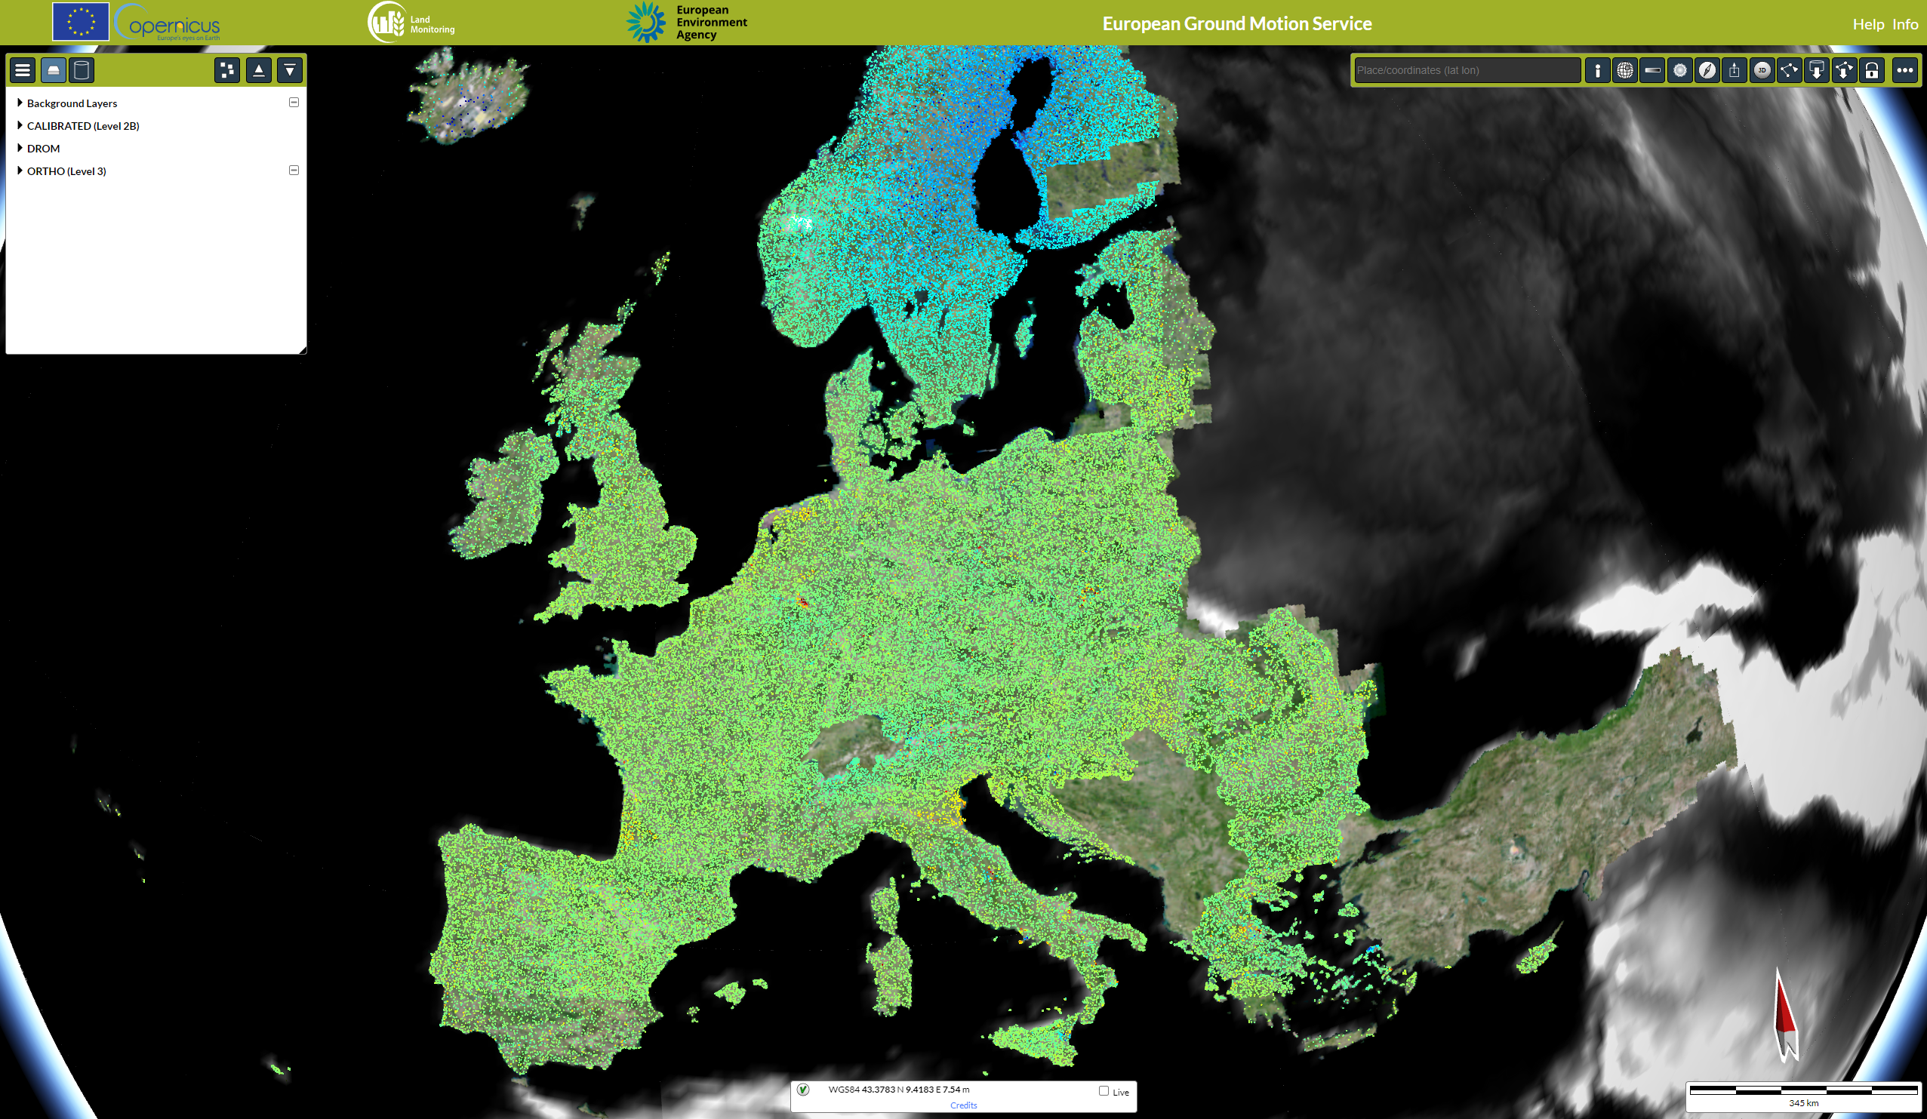
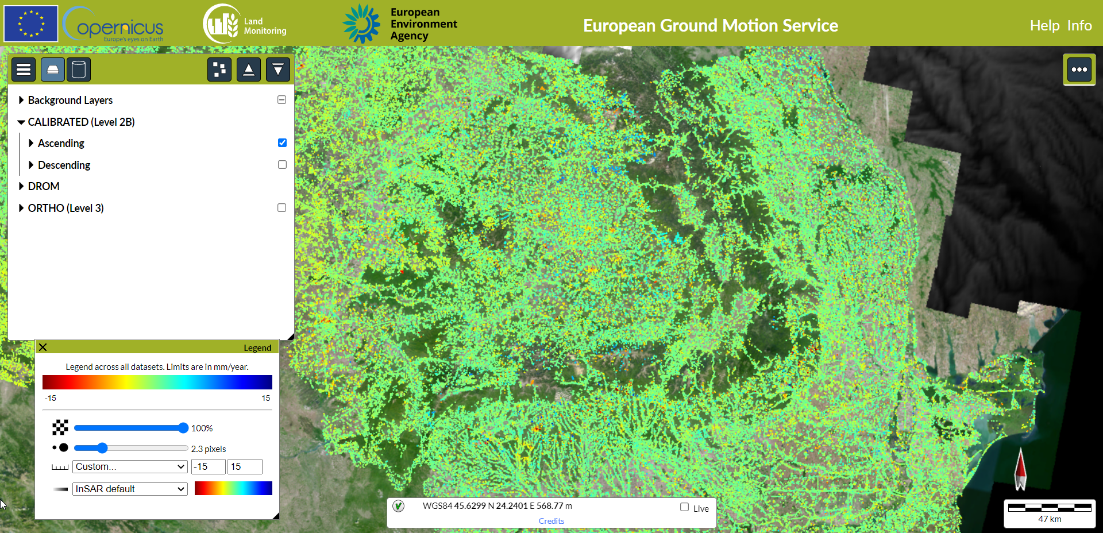
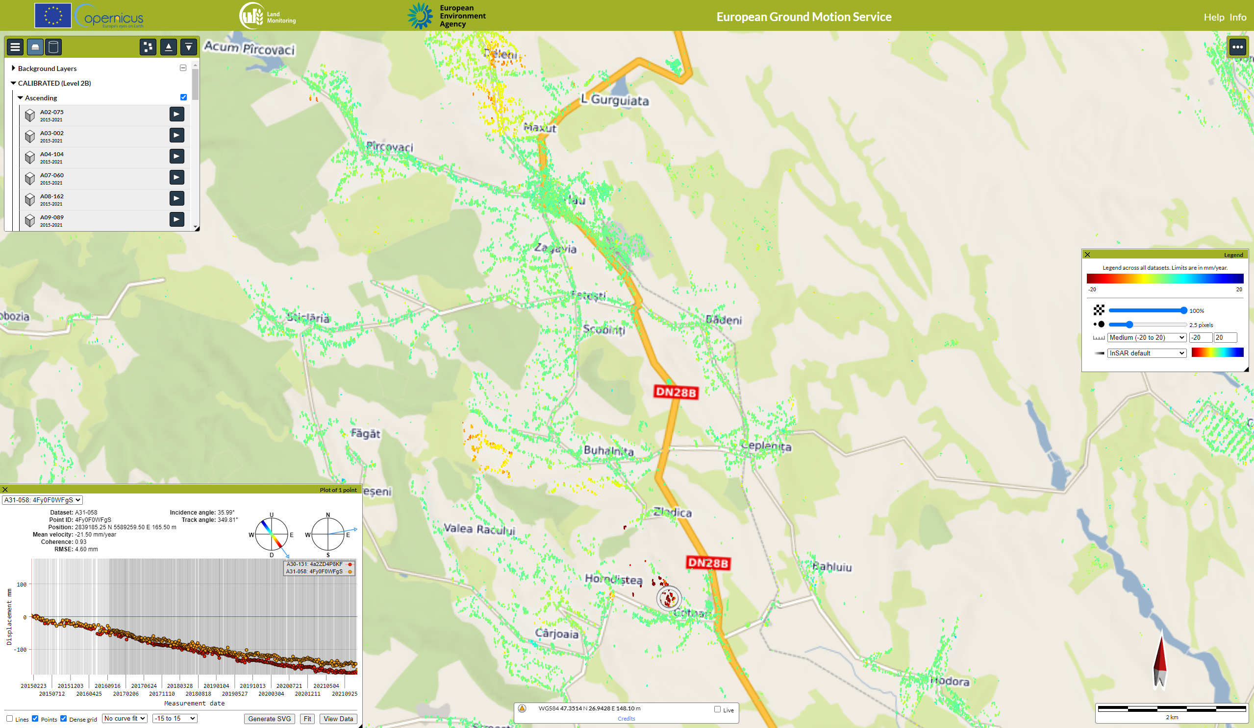
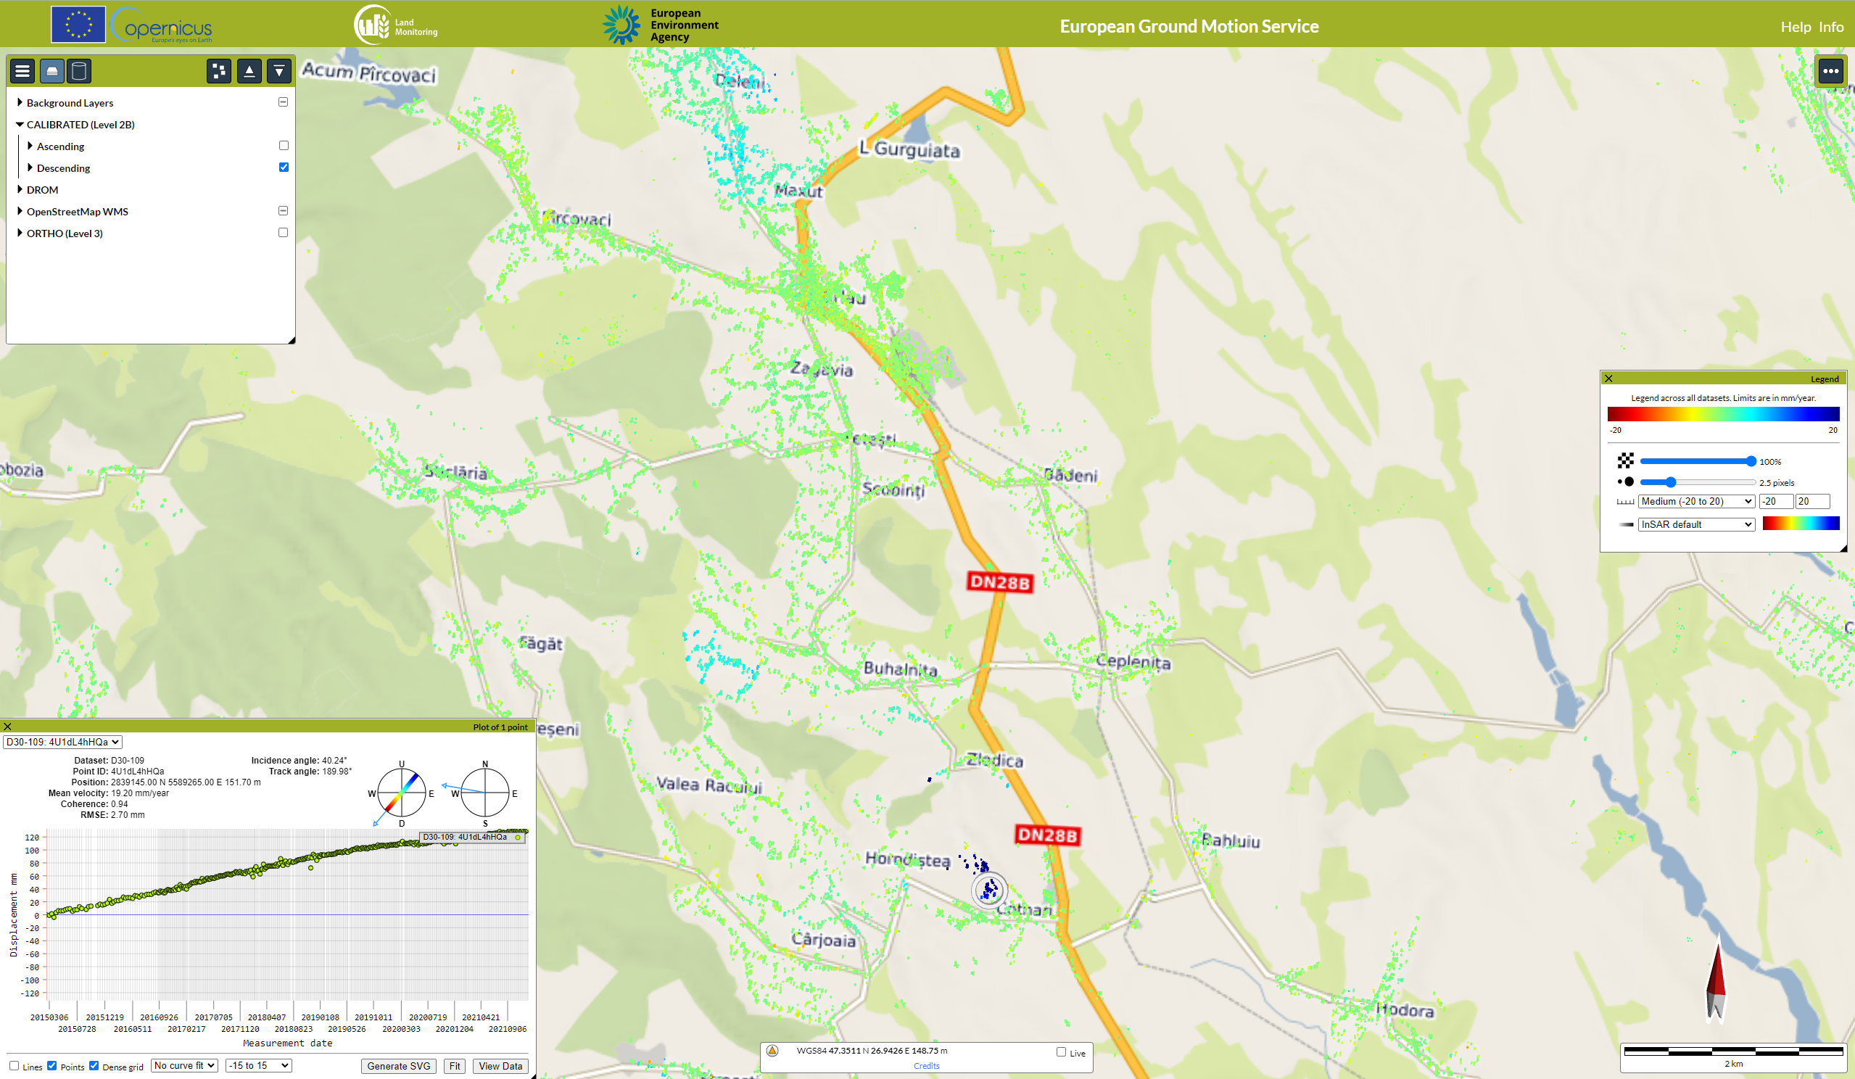
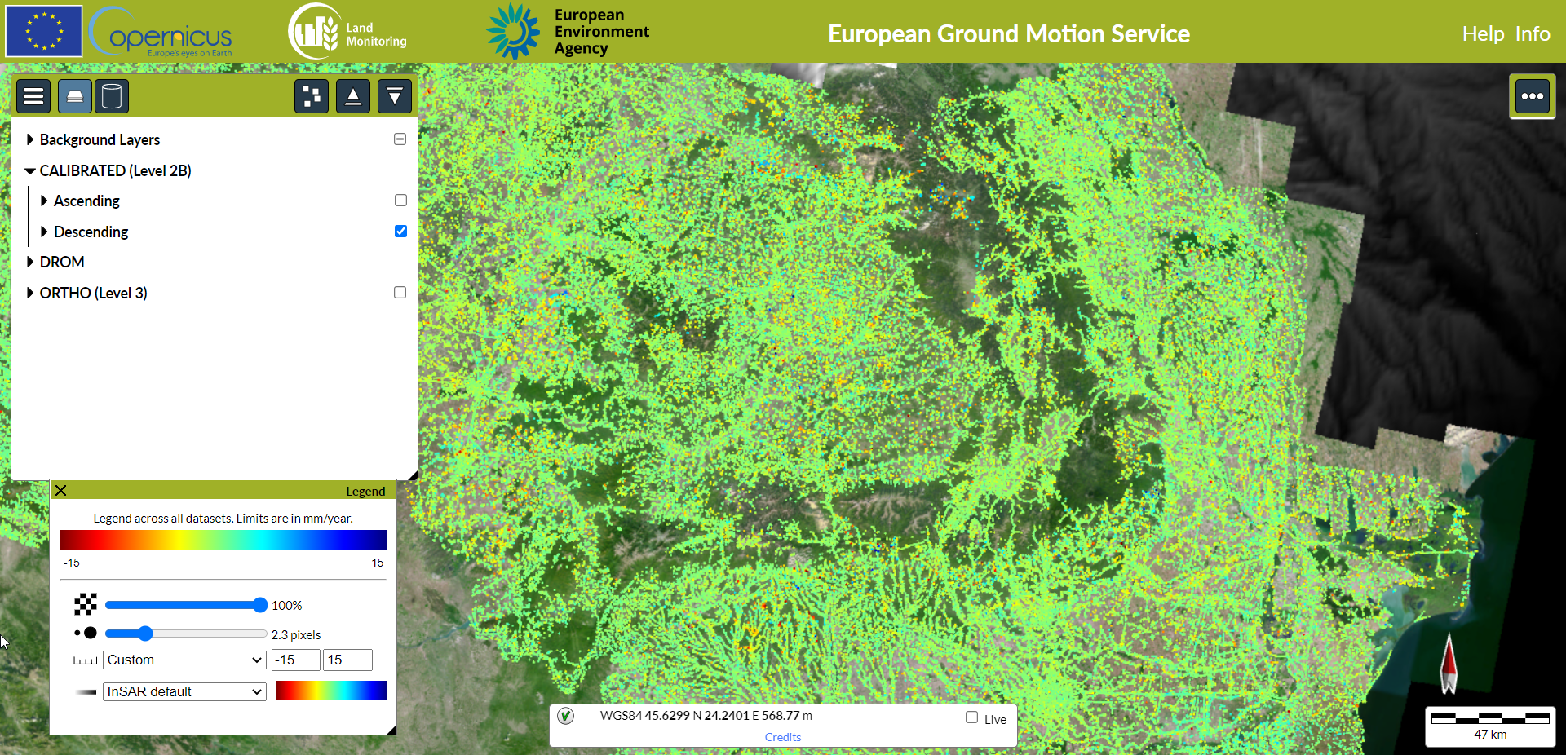
European Ground Motion Service (EGMS) products provide ground motion velocity and displacement measurements over the Copernicus Participating States. The millimeter accuracy products consist of processed Sentinel-1 SAR images with the Multi-temporal Differential SAR Interferometry algorithms and are available for visualization and download.
The EGMS offers measurements for February 2015 - December 2021: velocity and displacement time series for ascending and descending orbits and the derived displacement vectors for the vertical and horizontal E-W components.
EGMS Platform Interface.
Example of ascending and descending DS points over landslides.
Ascending and descending points over Romania.

Slide 3
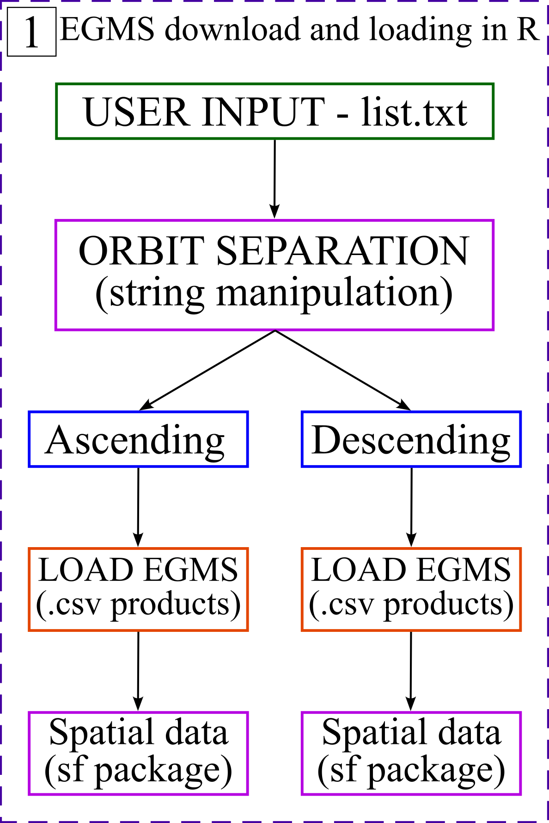
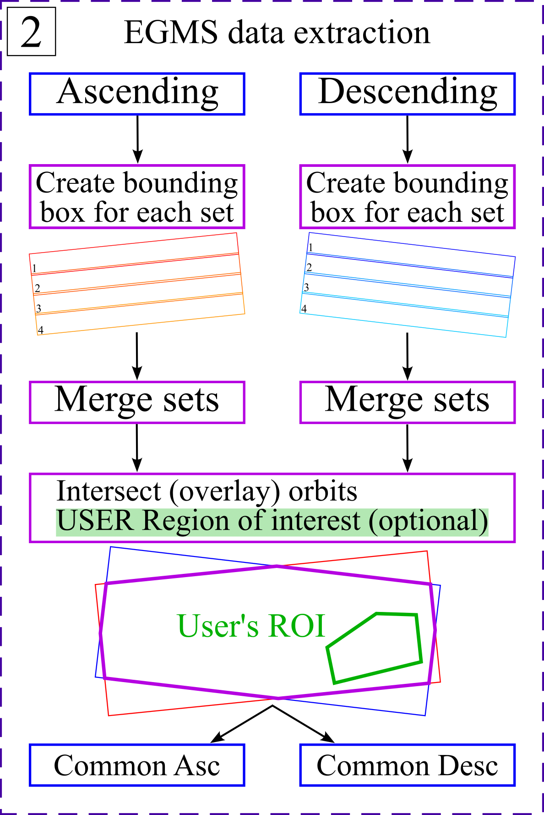
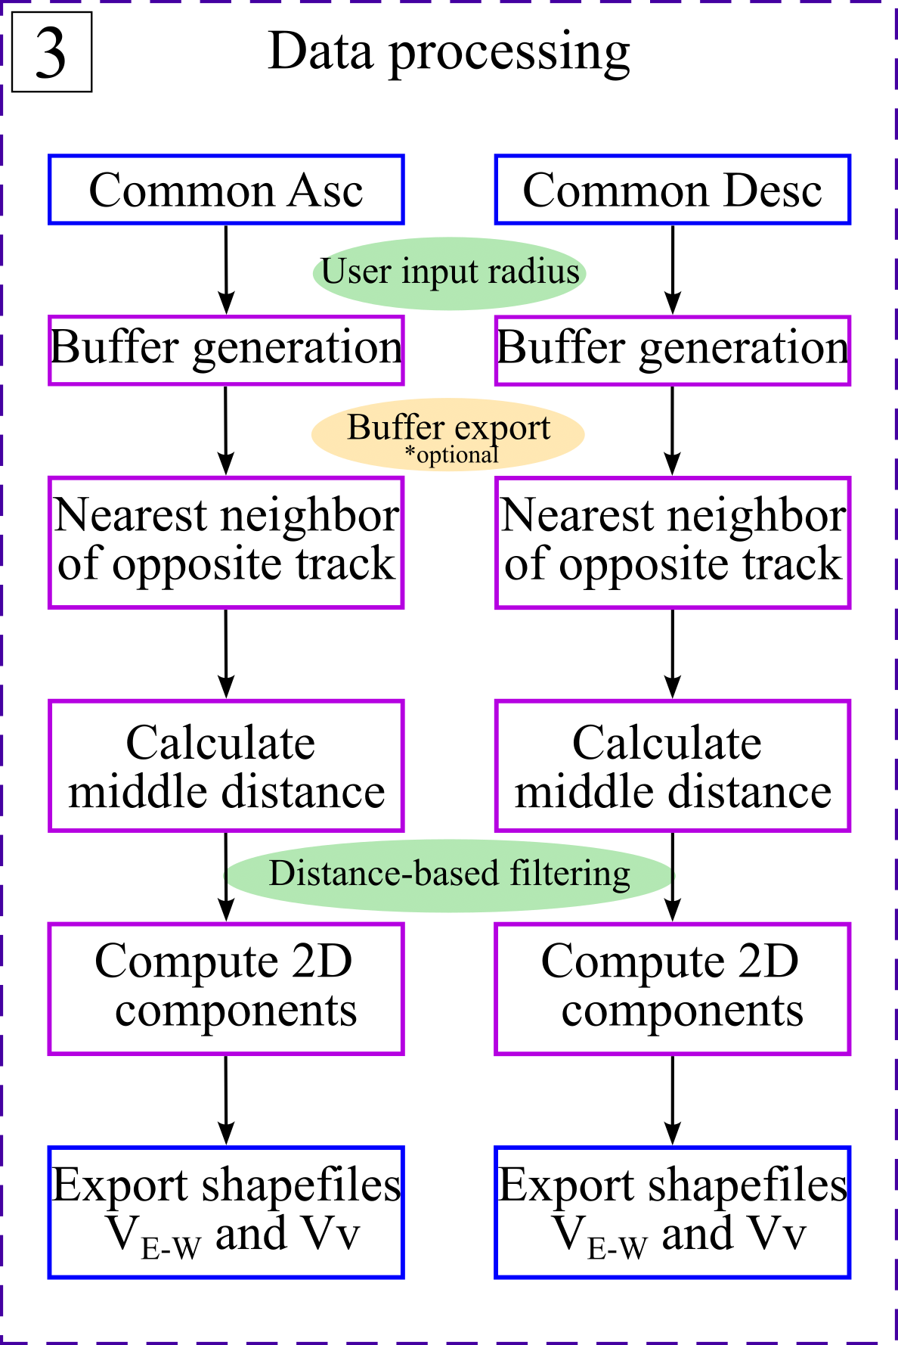
Products download, manipulation, and processing.
Workflow implementation and calculation of E-W and Vertical components were done in R, and the sf package was used due to its powerful capabilities to deal with spatial data.
Computation of the E-W and Vertical components relies on the methodology of Notti et al. (2014).
Workflow chain for the computation of vertical and horizontal velocity components.
Computed horizontal velocity.

Slide 4
European Ground Motion Service (EGMS) products provide ground motion velocity and displacement measurements over the Copernicus Participating States. The millimeter accuracy products consist of processed Sentinel-1 SAR images with the Multi-temporal Differential SAR Interferometry algorithms and are available for visualization and download.
The EGMS offers measurements for February 2015 - December 2021: velocity and displacement time series for ascending and descending orbits and the derived displacement vectors for the vertical and horizontal E-W components.
EGMS Platform Interface.
Example of ascending and descending DS points over landslides.
Ascending and descending points over Romania.

Slide 5
MT-InSAR (Multi-temporal Interferometric Synthetic Aperture Radar)
Source: un-spider.org

Slide 6
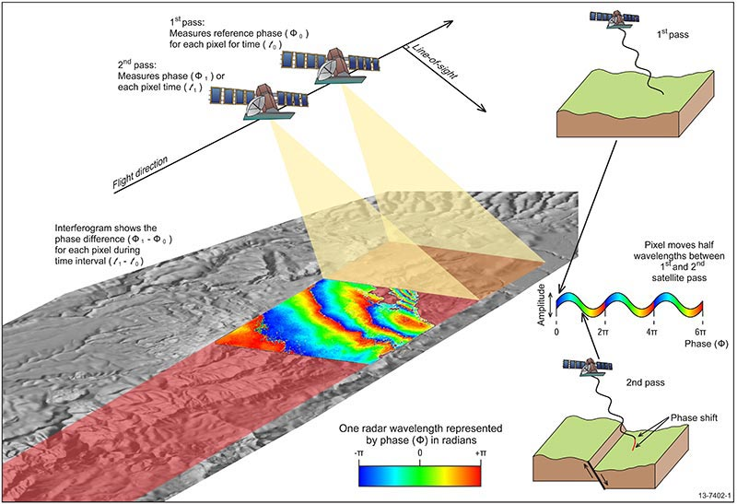
Source:
un-spider.org

Slide 7
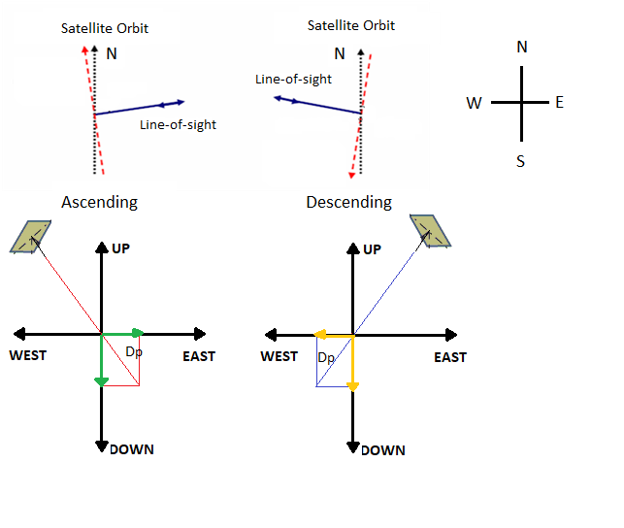
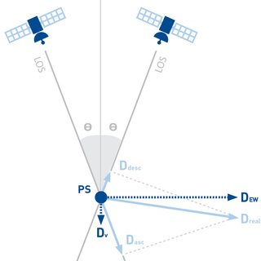
Source: un-spider.org
Source: https://site.tre-altamira.com/company/our-technology/

Slide 8
CALIBRATED (Level 2B) ascending orbit (full resolution)

Slide 9
CALIBRATED (Level 2B) descending orbit (full resolution)

Slide 10
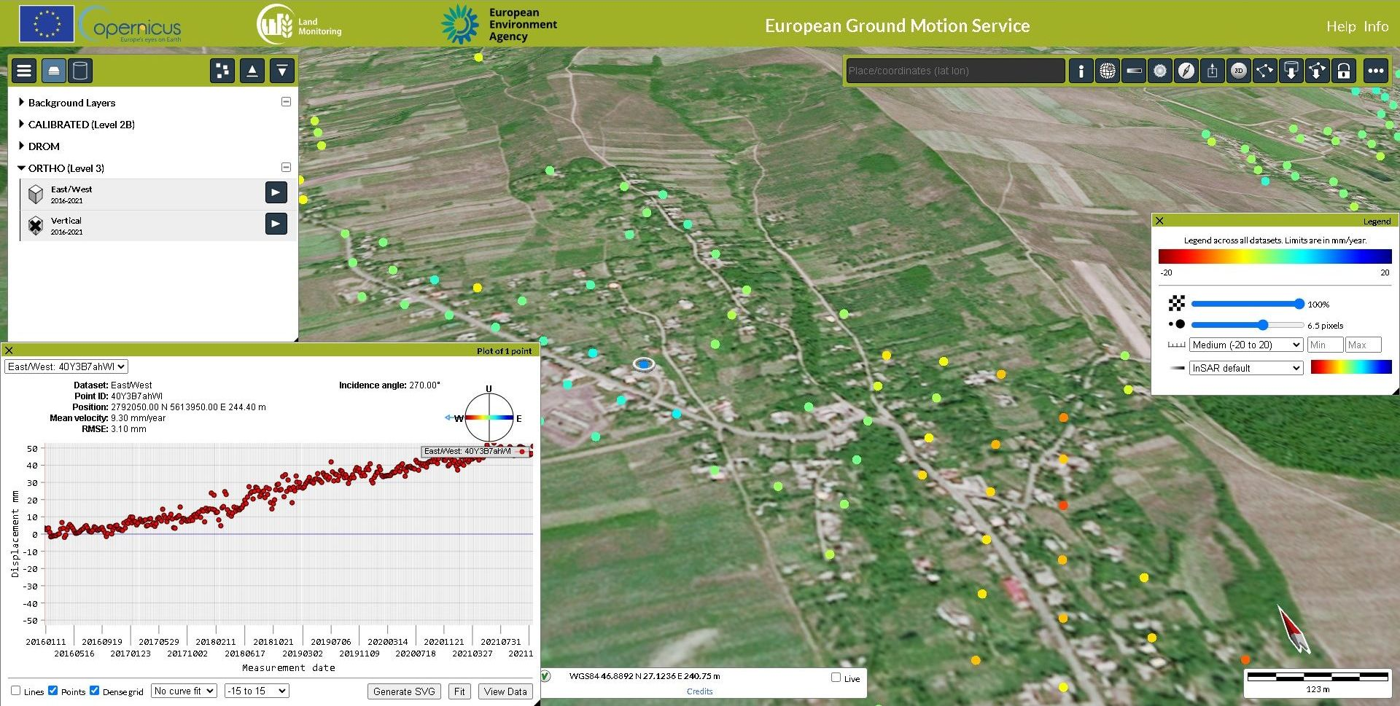
ORTHO (Level 3) 100 m resampled EW and Vertical components

Slide 11
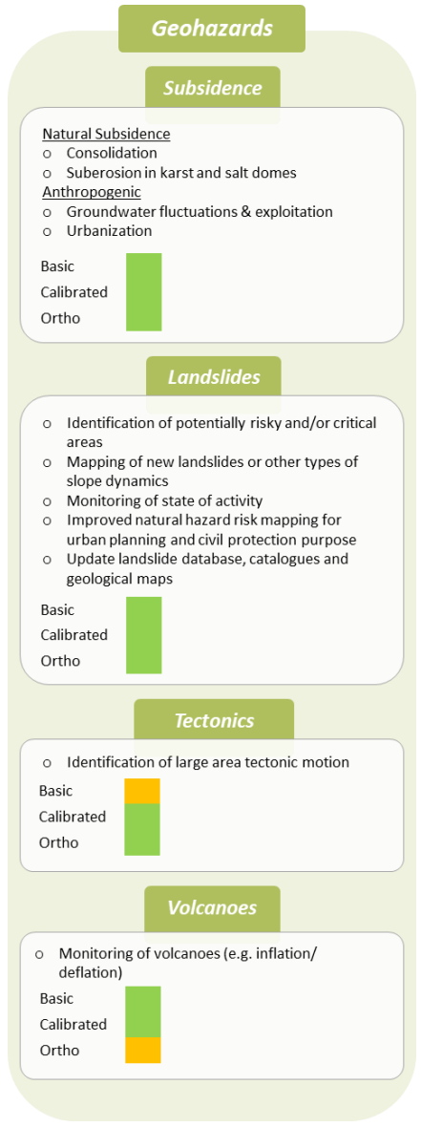
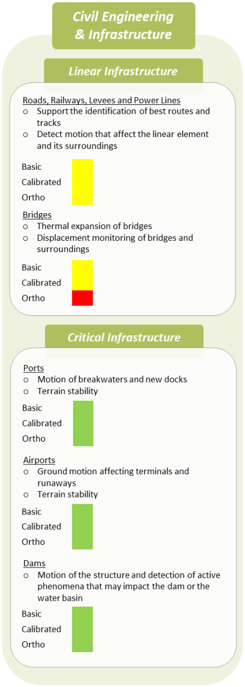
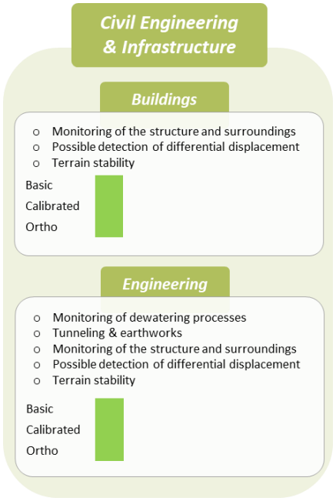
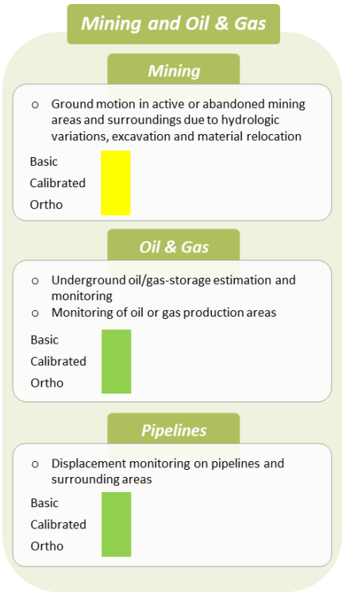
Fields of application of EGMS products
Suitable
Possible suitable
Partly suitable
Not suitable

Slide 12
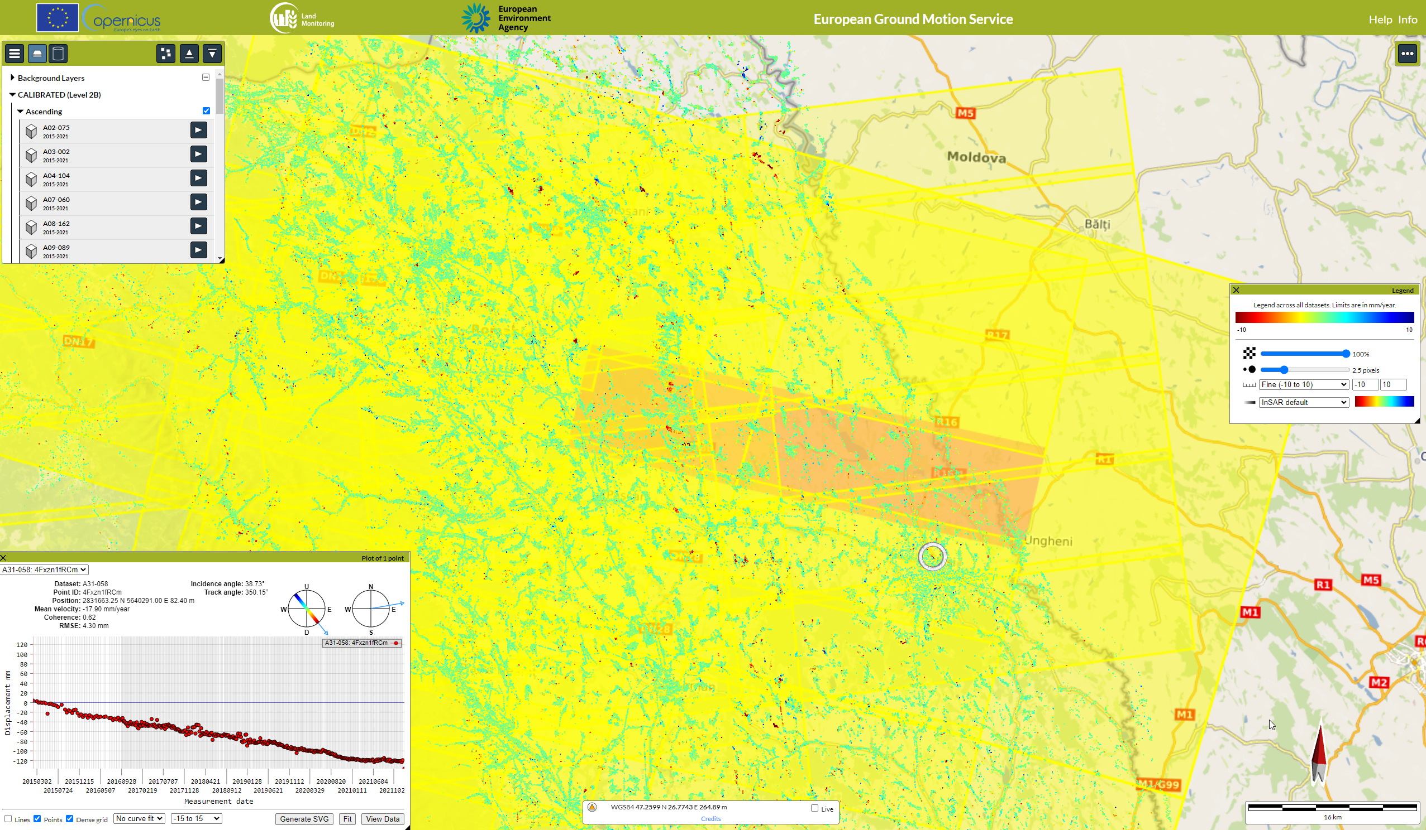
Downloading inconvenience of EGMS data

Slide 13
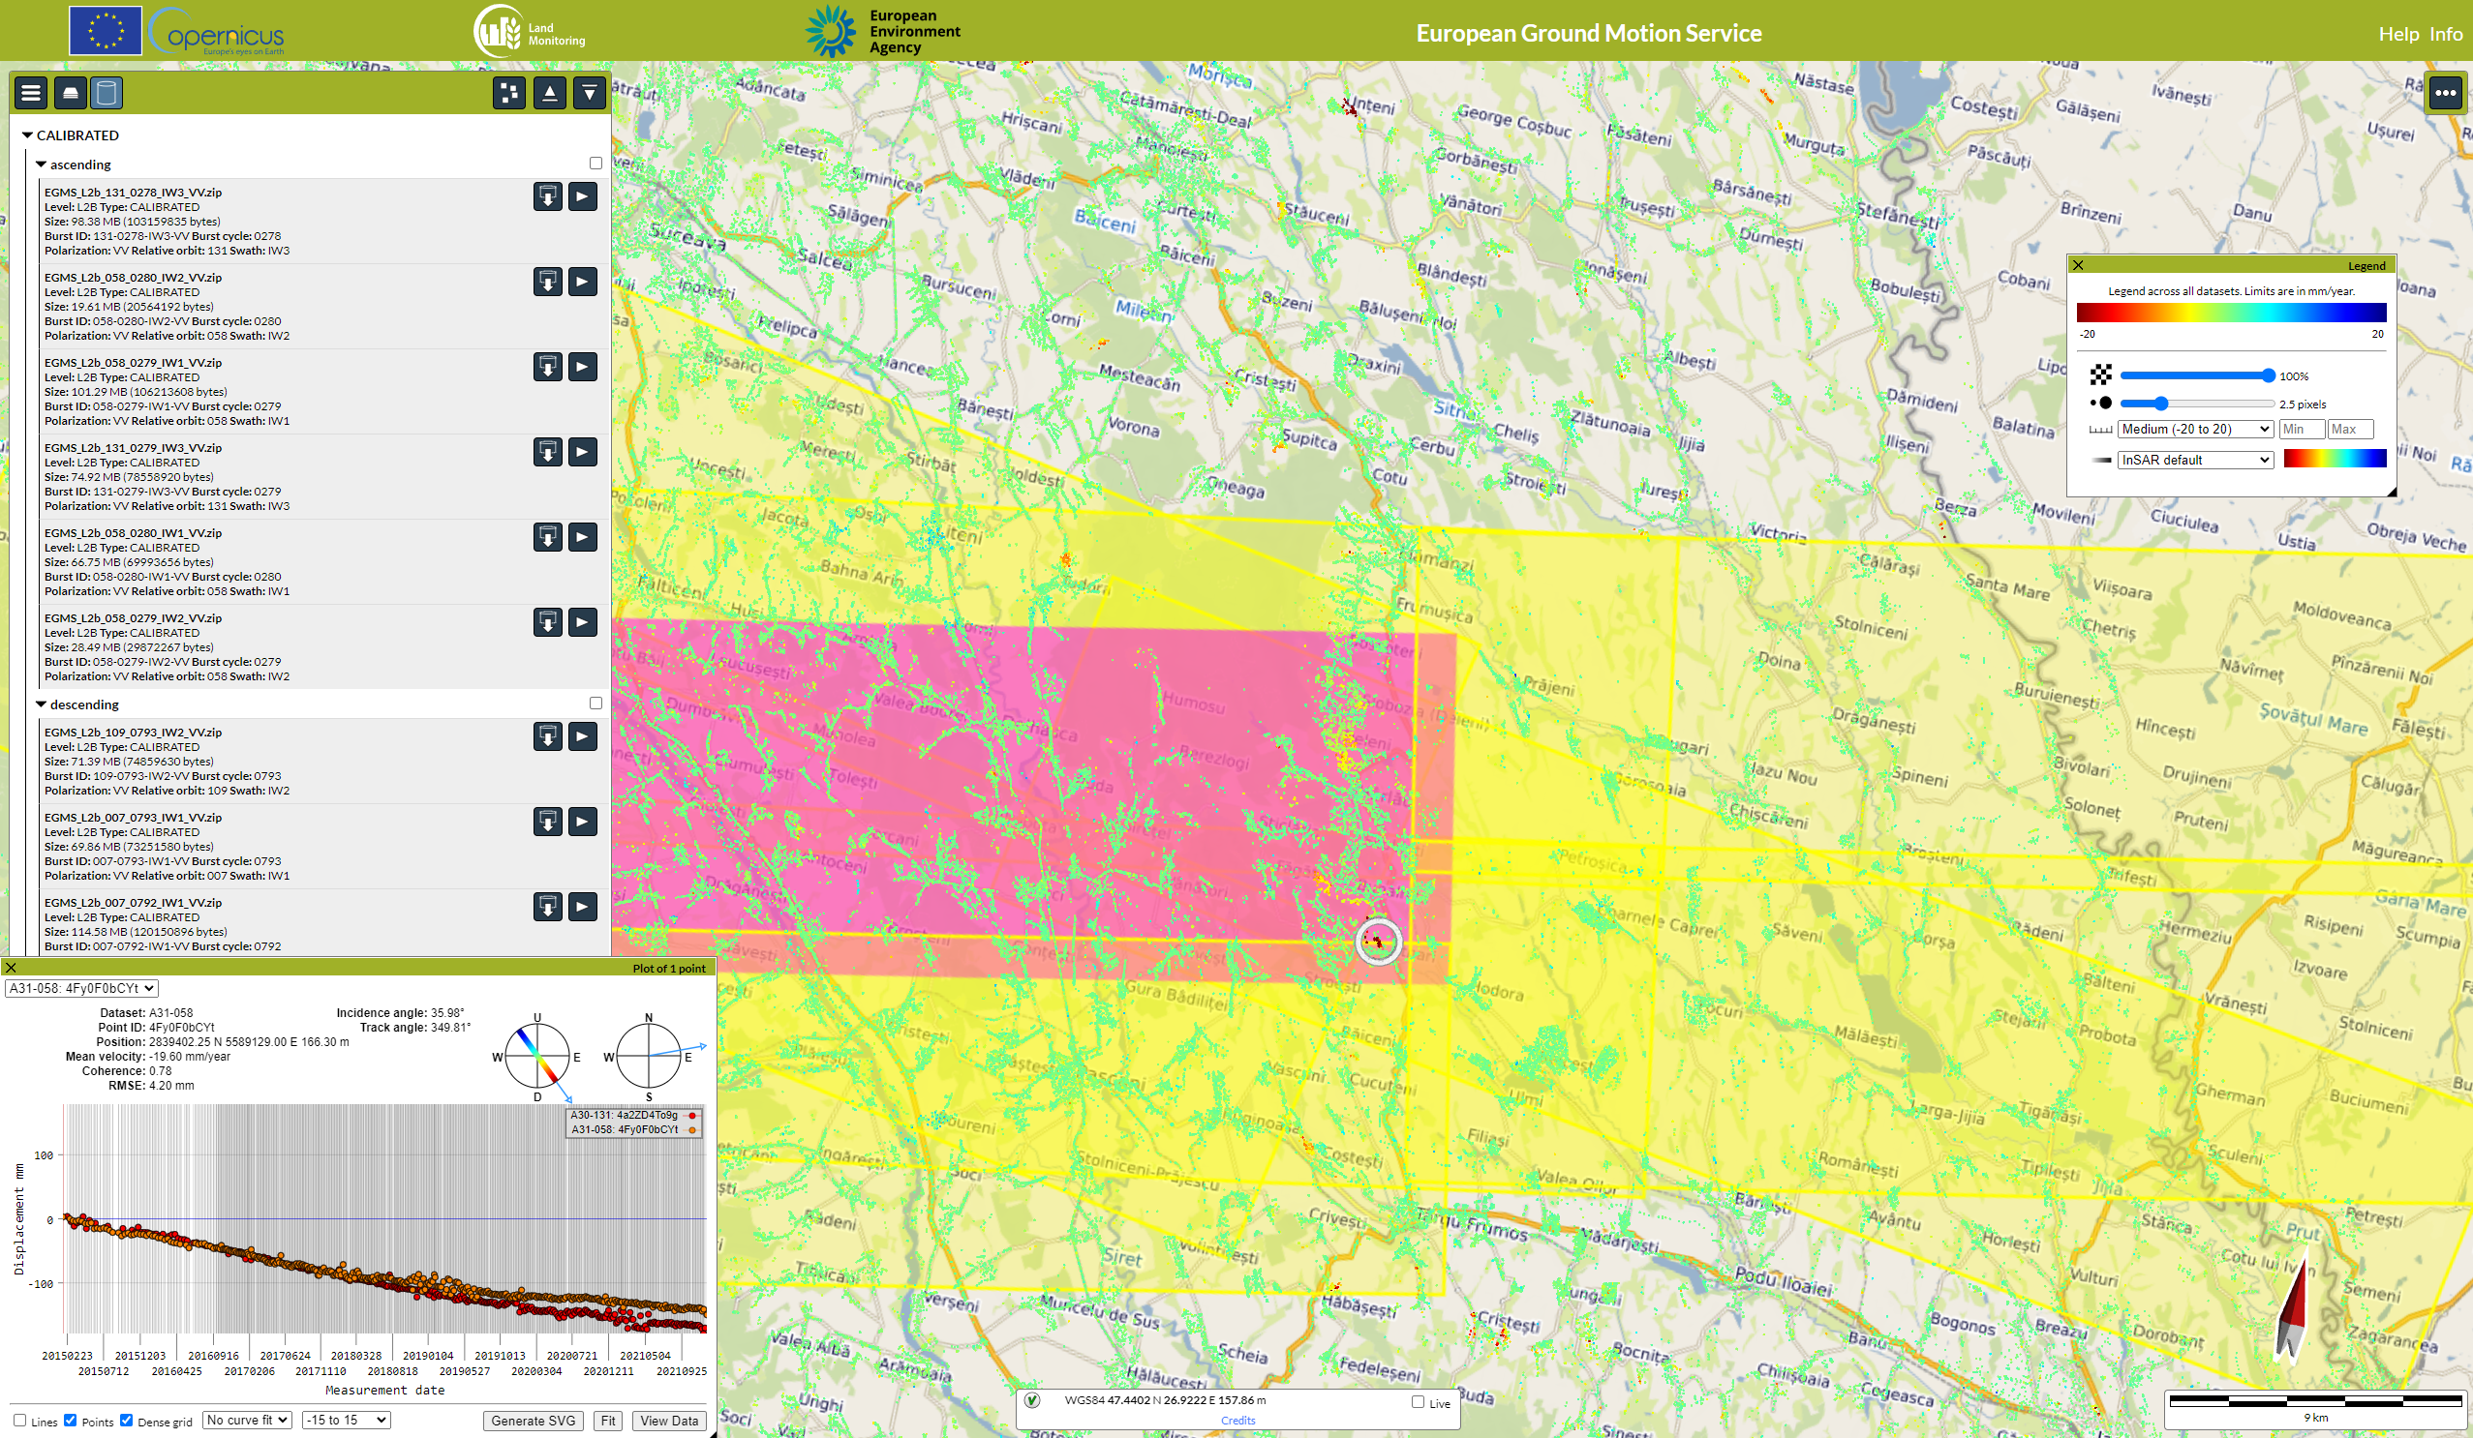
Downloading inconvenience of EGMS data

Slide 14
The East-West and Vertical Components of velocity
The same slope movement can be recorded by PS data with opposite signs and different modules from ascending and descending orbits, making interpretation of slope dynamics not immediately intelligible.
Under the assumption of the small contribution of N–S horizontal motion, the availability of two geometries (ascending and descending) allows the E–W (V_{EW}) and vertical (V_{v}) velocity components to be resolved.
The slopes where resolving the component of the velocity can be considered valid are not strictly limited to the West (270°) and East (90°) directions, but ±45 degrees of tolerance can be considered valid: the East component is prevalent from 45° (NE) to 135° (SE) and the West component is prevalent from 225° (SW) to 315° (NW).

Slide 15
Computation
The parameters necessary to calculate these components are the ascending (V_{a}) and descending (V_{d}) velocities (units: mm year^{–1}) and the direction cosines (elos, hlos), which are derived from the azimuth (θ) and incidence angle (α) of the Line Of Sight (LOS) in radians:
where:
$$V_{EW}=\frac{\left(\frac{V_{d}}{{hlos}_{d}}−\frac{V_{a}}{{hlos}_{a}}\right)}{\left(\frac{{elos}_{d}}{{hlos}_{d}}−\frac{{elos}_{a}}{{hlos}_{a}}\right)}$$
$$V_{V}=\frac{\left(\frac{V_{d}}{{elos}_{d}}−\frac{V_{a}}{{elos}_{d}}\right)}{\left(\frac{{hlos}_{d}}{{elos}_{d}}−\frac{{hlos}_{a}}{{elos}_{a}}\right)}$$
$$hlos=\cos\left(α\right)$$
$$elos=\cos\left(1.571−α\right)×\cos\left(ω\right)$$
$$ω=4.712−θ$$
Source: https://www.mdpi.com/2079-9292/8/2/174

Slide 16
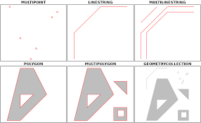
GIS implementation
R stat was used because it does give acces to powerfull statistical methods;
sf package is the newest package wich deals with spatial data based on GEOS library;
sf implements spatial data based on the geodatabase approach with data.frames (R tables) that store a geometry column with the coordinates;
Spatial function are easily performed and attributes are accessible for statistical analysis;
data.table fread() function can read quickly .csv files.

Slide 17
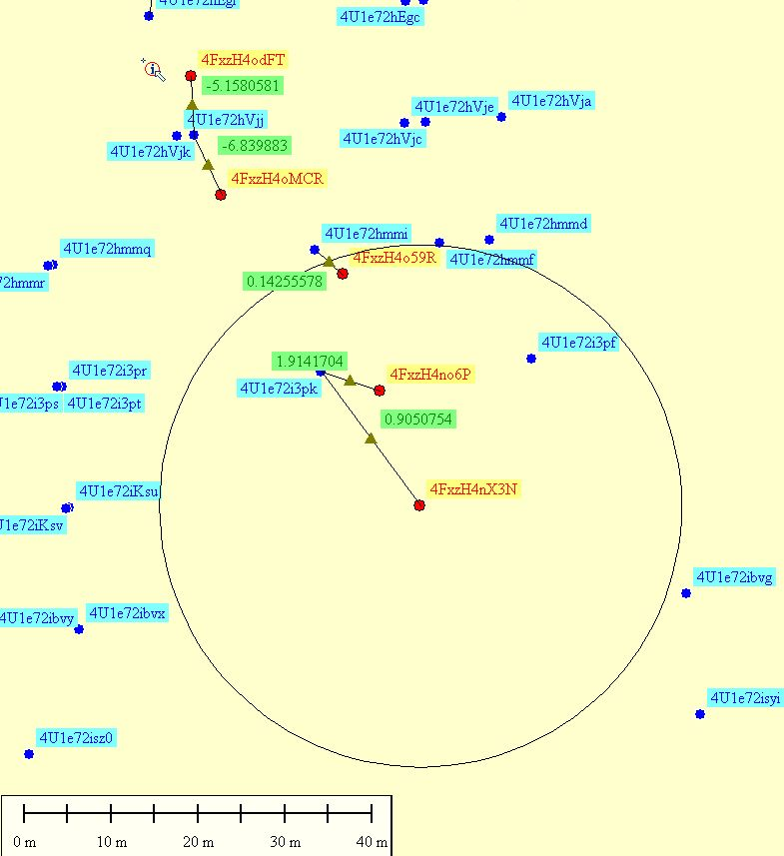
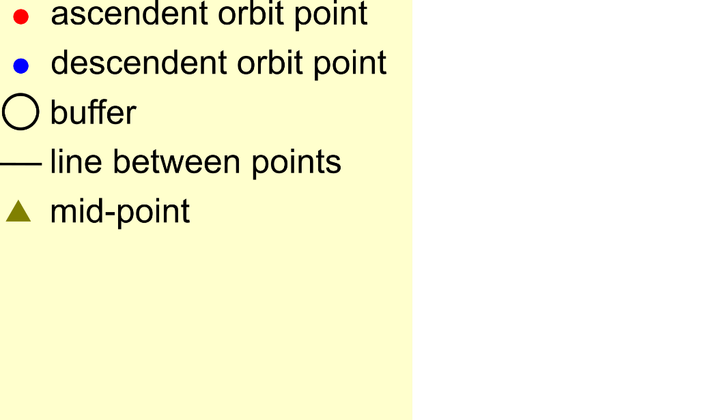
Pseudocode
Import ascending and descending .csv files
Convert to spatial sf
For each point in ascending compute buffer
Cut the descendent for every buffer
Get the closest point in the cut buffer
The synthetic point will be at the midline between the ascendent and descendent points
Use the attributes for computation
30 m radius

Slide 18
Moldavian Plateau – slow-moving landslides
Northeatern Romania (Moldavian Plateau) is known for widespread relict and old landslides, that sometimes cover entire hillslopes (from ridge to toe) along several kilometers;
Very often entire villages or city neighborhoods sit on these landslides, since medieval times because due to the clayey bedrock, the landslides were sites where water was available in the thin landslide material; the thick loess on ridges and the frequently flooded floodplains were not ideal sites for habitation, and were only recently used;
This geographical situation creates a setting where settlements have to deal constantly with slow-moving landslides; scarp areas are the most prone to reactivations, and this regard DInSAR data could be used for monitoring and even for landslides early warning systems (LEWs).

Slide 19
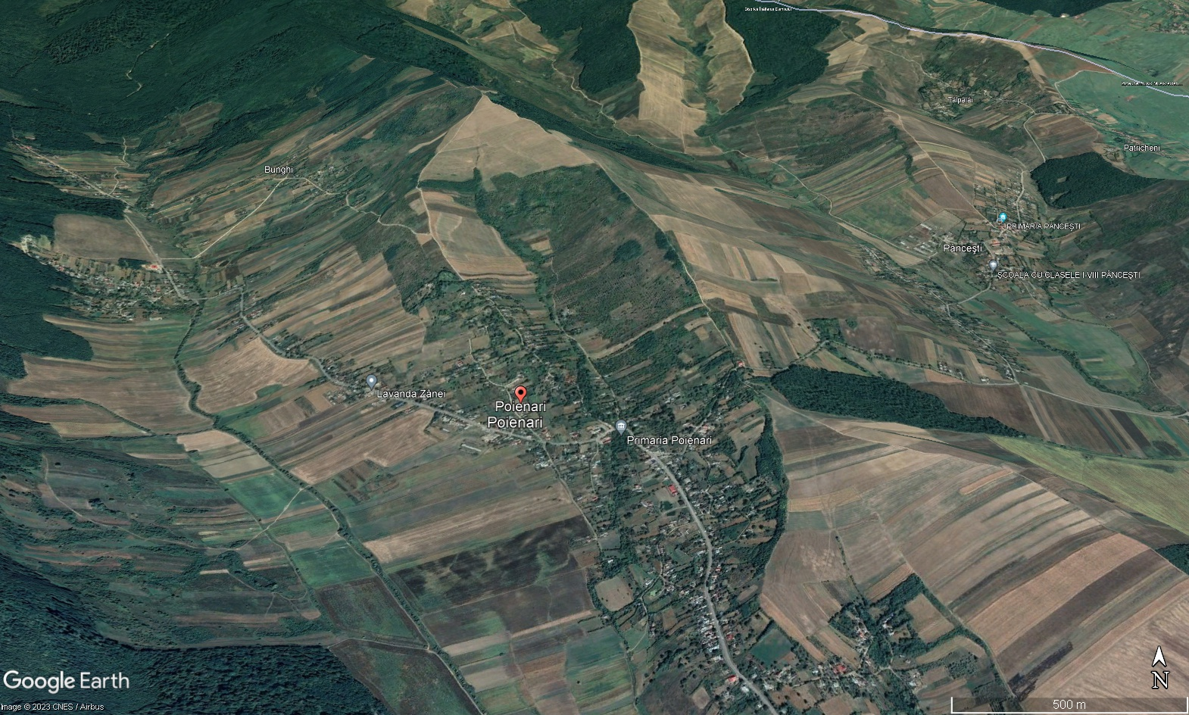
Study case: Poienari village, Neamț County
1183 points on ascendent orbit
910 points on descendent orbit

Slide 20
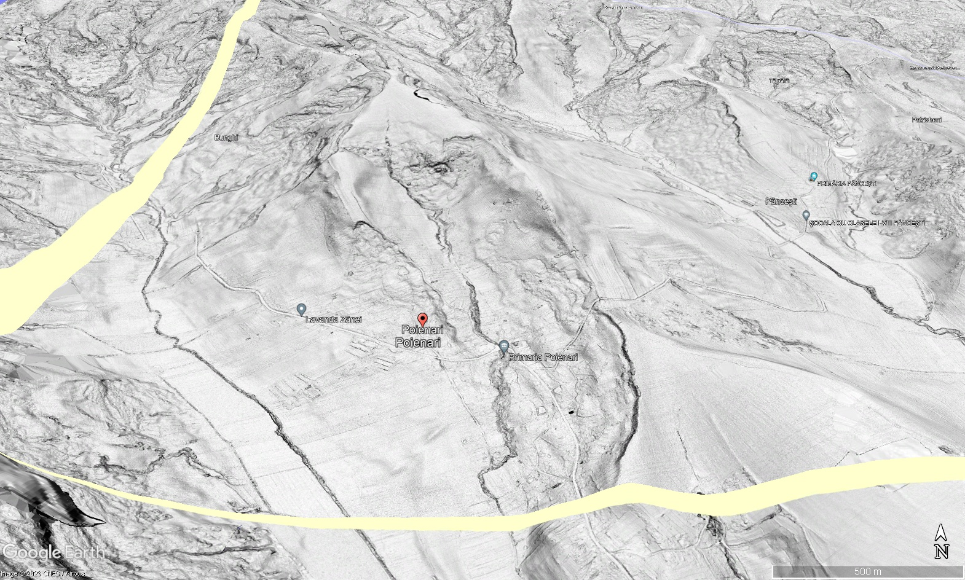

Slide 22
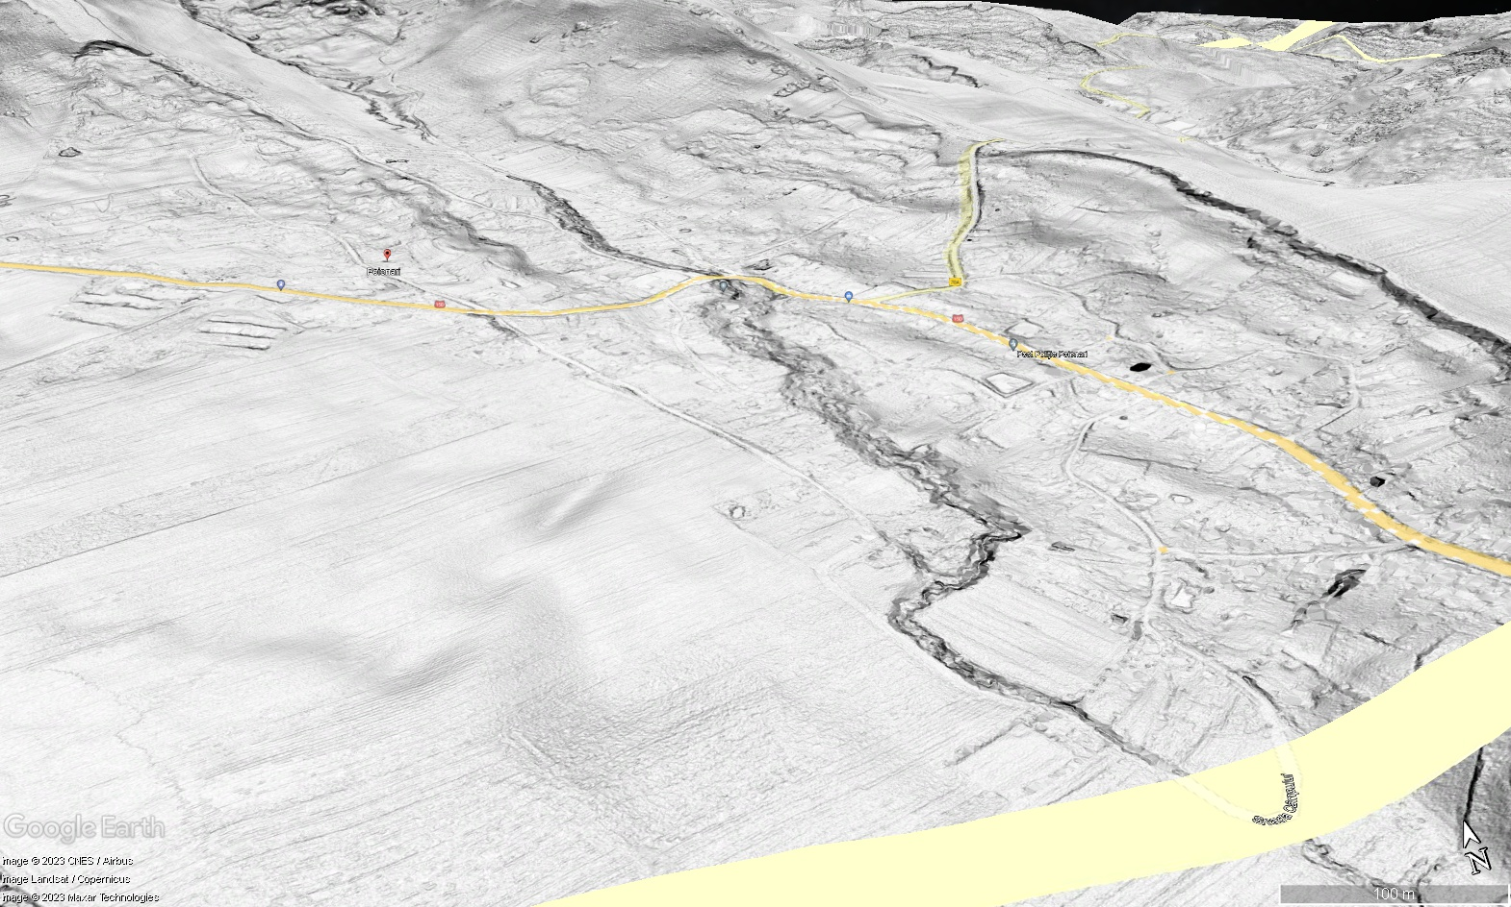

Slide 23
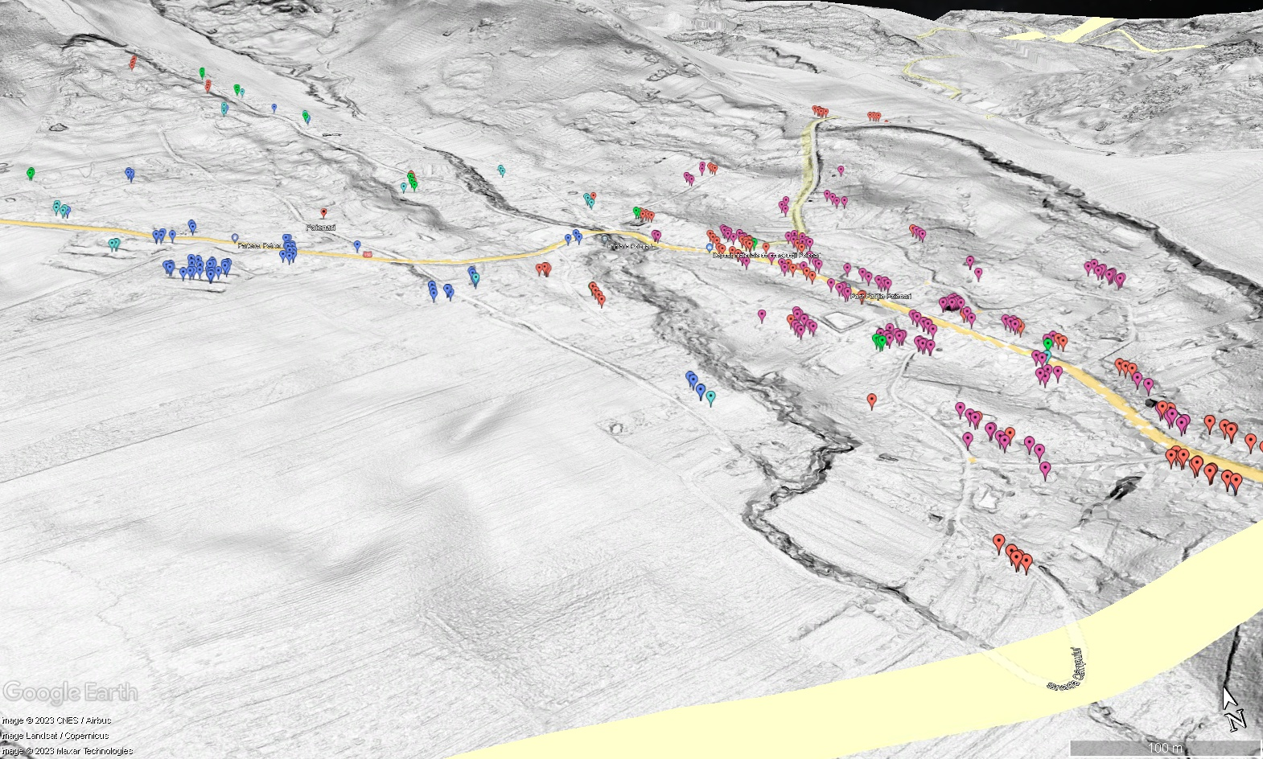
mm/year
849 points with EW and Vertical deformation

Slide 24
Discussions
The presented study case shows that the EGMS processing of the full-resolution dataset is feasible, thus improving the coarse 100 m data;
A 30 m radius buffer was used, but depending on the density of the data points (higher in urban settings), this radius can be decreased;
In denser settings, other information can be used to filter the nearest neighbor points: DEM-based geomorphometry (Niculiță, 2016) or trend of multitemporal data (Necula et al., 2021);
The deformation components can be used for monitoring, for mechanism validation coupled with numerical modeling (Necula et al., 2021) or for Early Warning Systems;

Slide 25
Conclusions
EGMS is the European-wide dataset that is highly usable for natural hazards assessment, including slow-moving landslides investigations;
The availability of the full-resolution data, including the ascending and the descending LOS velocities, allows the computation of the horizontal and vertical displacement components;
We apply the methodology of Notti et al. (2014) for a better spatial resolution of these components, compared to the Level 3 (Ortho) of the EGMS products, necessary for correct landslide evaluation and mapping;
Near improvements of the approach include the implementation of the slope units morphometric variable and slope aspect segmentation to exclude the combination of DS points from different landforms, especially opposing hillslopes;
The proposed Open Source GIS implementation will be integrated into a GUI environment to be available to others.

Slide 26
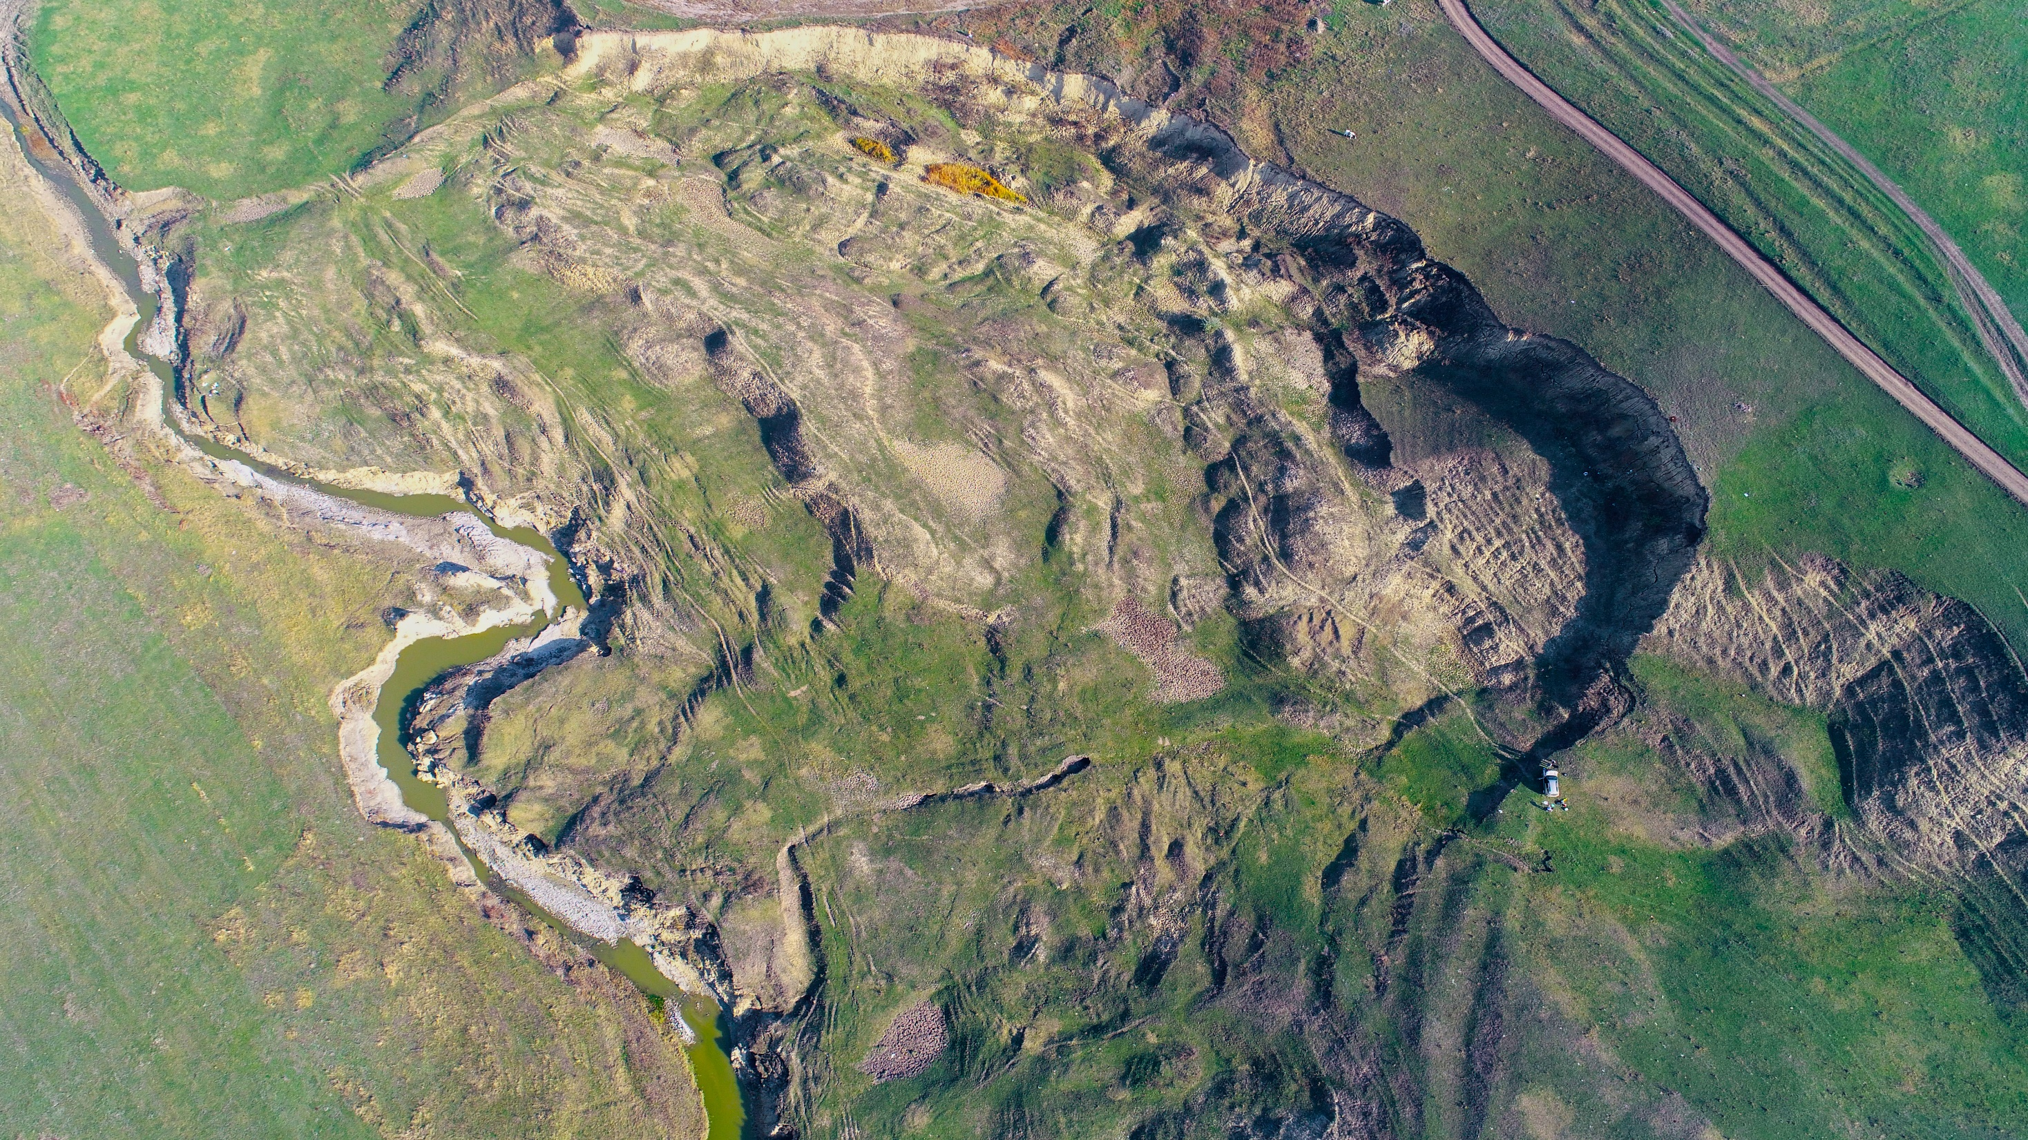
Thank
you for your
attention ☺

