Slide 1
Exploring controls on the spatial distribution of bedrock exposure in mixed bedrock and alluvial river systems
April 2023
Mel Oliveira Guirro, Rebecca Hodge, Fiona Clubb and Laura Turnbull
Durham University
Contact: mel.oliveira-guirro@durham.ac.uk

Slide 2
Rivers and sediment transport: A complex dynamic system
Introduction
Field analysis
Simulation analysis
Next steps
Summary
Interaction between sediment, channel morphology and water flow
Alluvial cover is constantly changing
It is not understood well how and when alluvial cover changes
Relevant for :
Stability of the riverbed, aquatic habitats and water quality
River management decisions
Notes:
Rivers are dynamic systems that are constantly changing.
Understanding the spatial distribution of sediment cover is crucial in predicting their response to future disturbances.

Slide 3
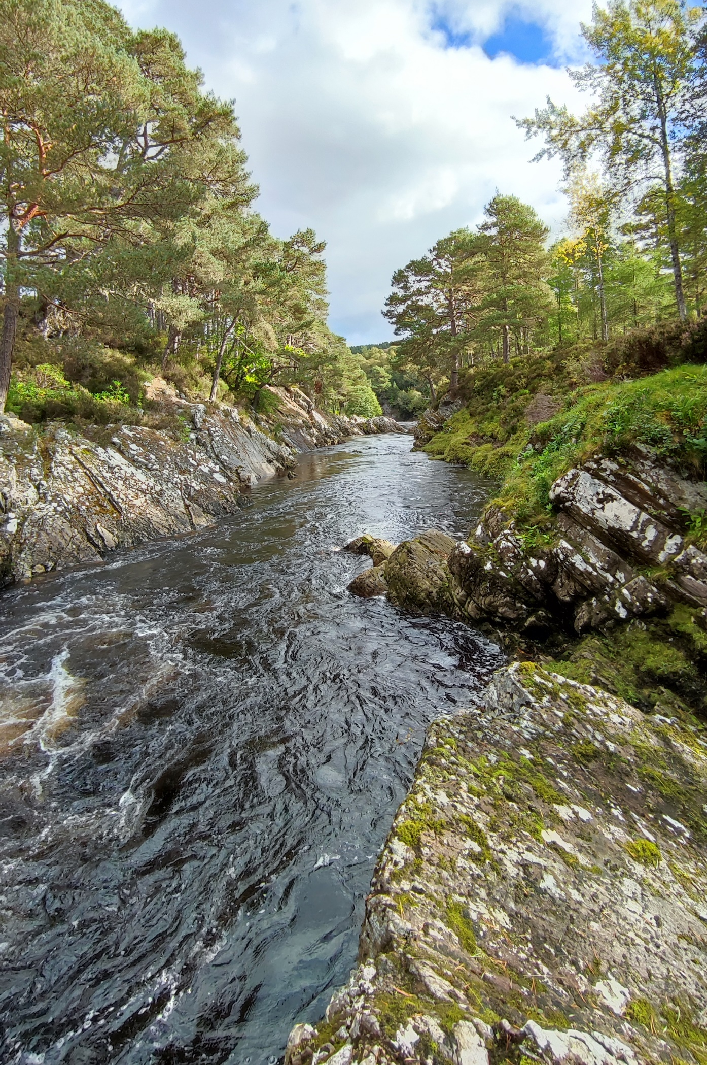
Introduction
Field analysis
Simulation analysis
Next steps
Summary
Bedrock reach
Mixed reach
Alluvial reach

Slide 4
Introduction
Field analysis
Simulation analysis
Next steps
Summary
Flow
Bedrock
Alluvial
River network
Sediment deposition
Spatial distribution of alluvial cover

Slide 5
Research Aim
Introduction
Field analysis
Simulation analysis
Next steps
Summary
To understand how channel and sediment properties affect the spatial distribution of riverbed cover in mixed bedrock and alluvial systems using field data analysis and numerical modelling.
This study is part of a PhD project that aims to understand how sediment connectivity drives the spatial distribution and temporal changes of bedrock and alluvial reaches.
Research questions of PhD project:
How do channel and sediment properties interact with alluvial cover?
How do channel and sediment properties affect the spatial distribution of alluvial cover in equilibrium?
How do temporal variations in sediment supply and flow affect the pattern of alluvial cover?
→ Empirical analysis of field data
→ Steady state (numerical modelling)
→ Perturbations (numerical modelling)
Notes:
Link research questions with sediment connectivity

Slide 6
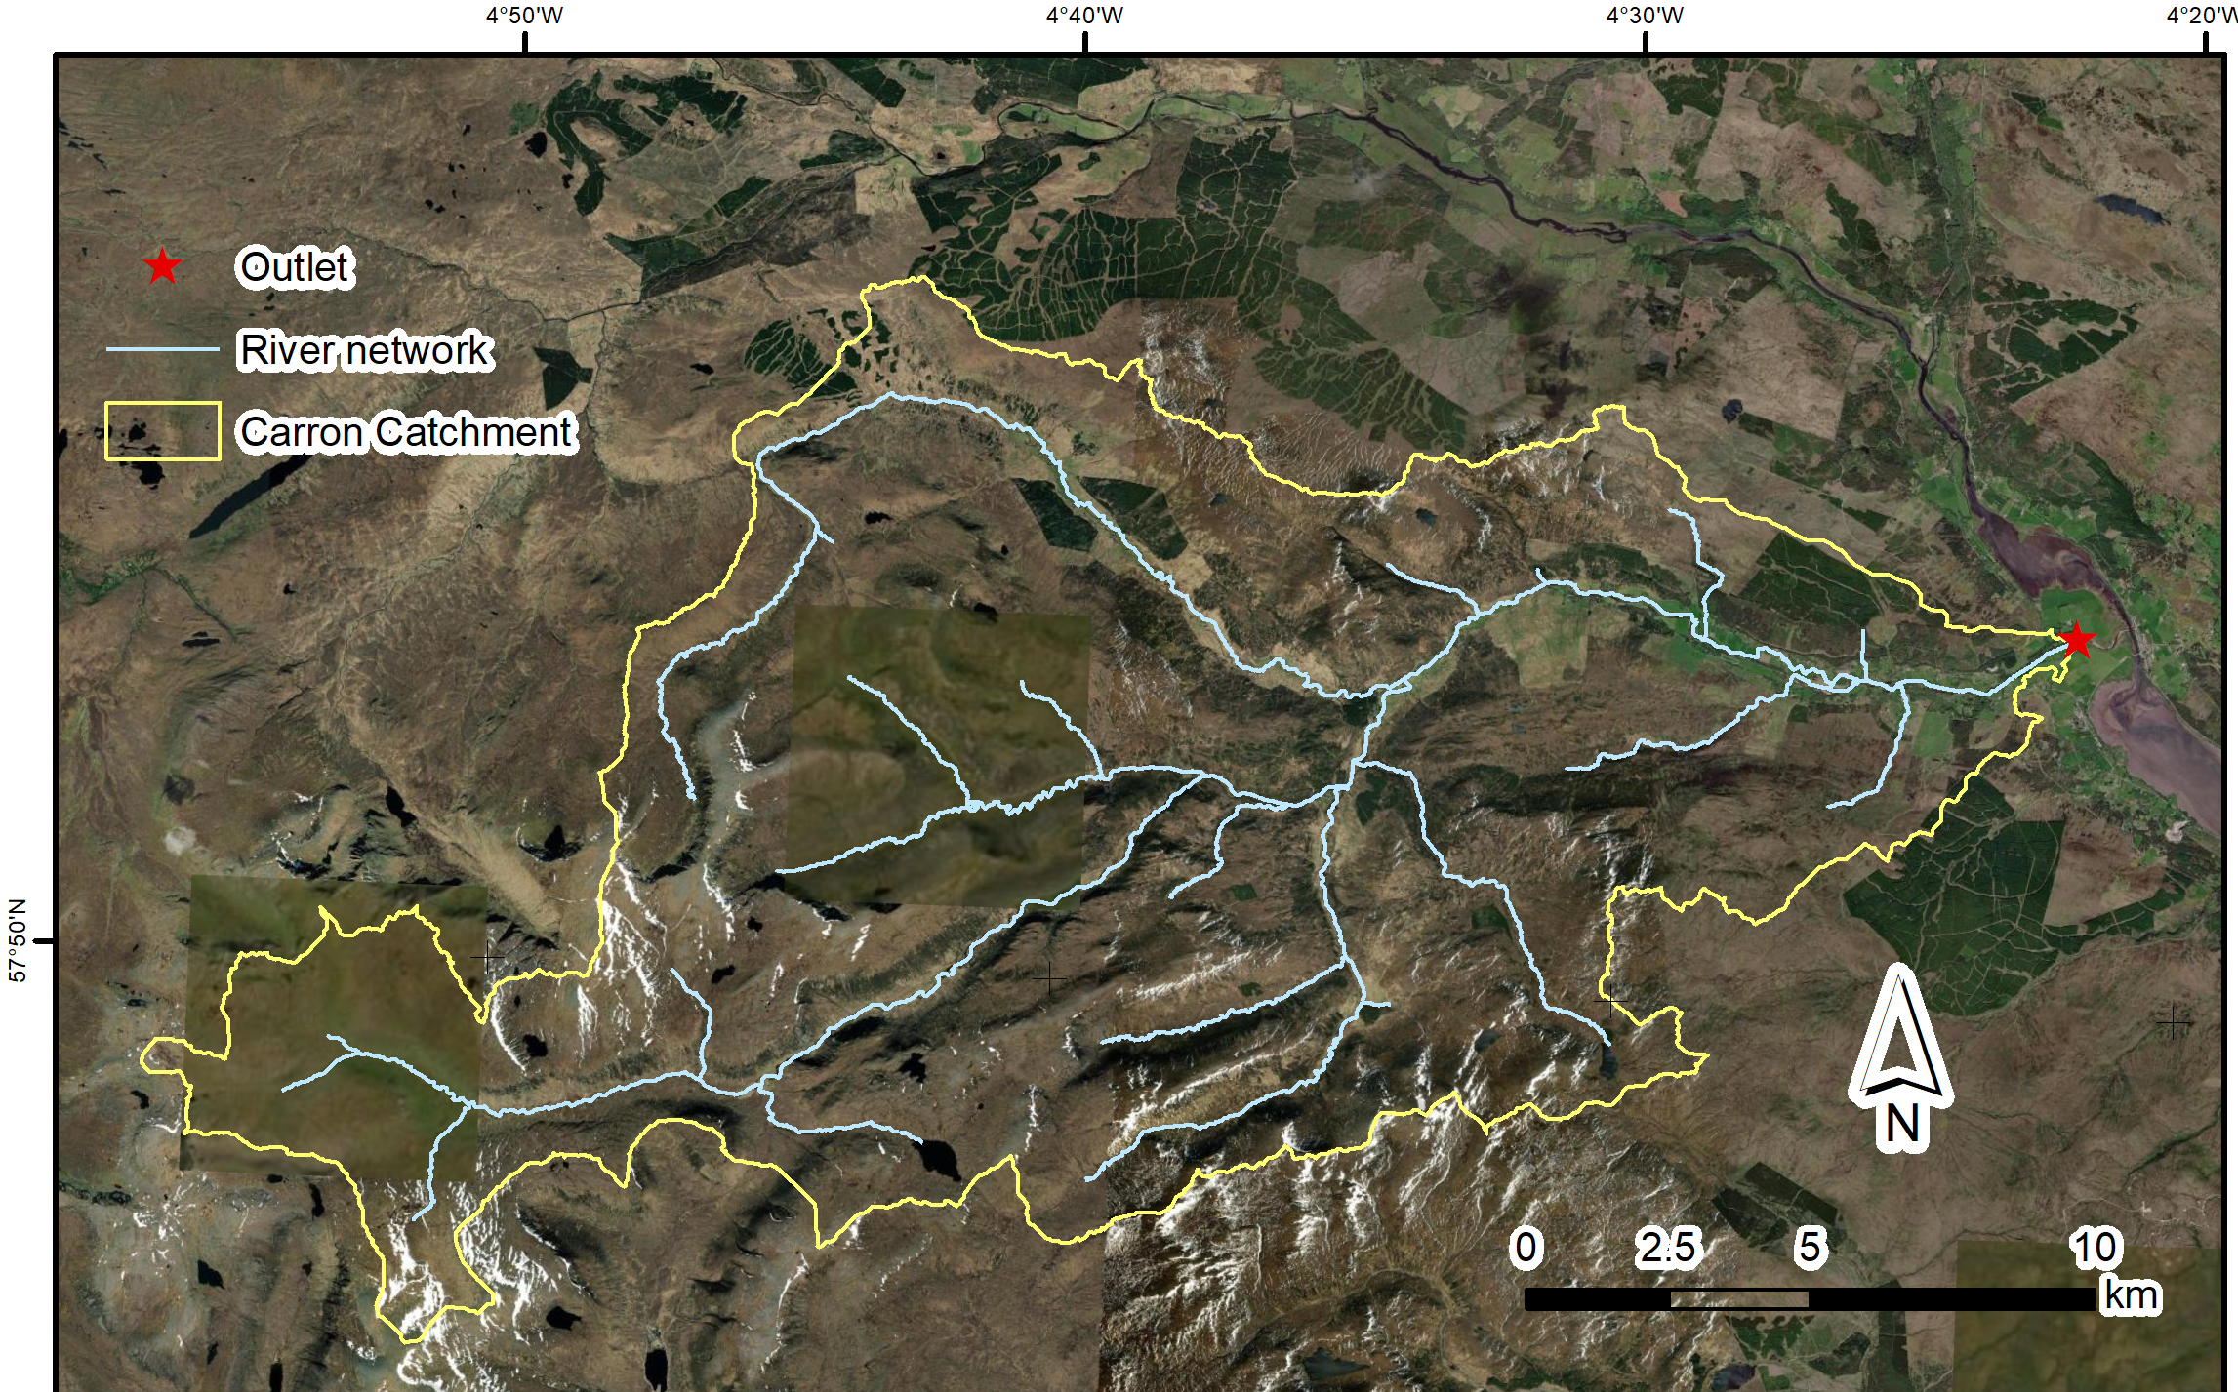
Study Area
Introduction
Field analysis
Simulation analysis
Next steps
Summary
Carron River network, Scottish Highlands
System with mixed bedrock and alluvial reaches
Datasets:
Whitbread (2015) – main channel:
Sediment cover fraction
Width
Depth
Slope
Field work (2022):
Sediment cover fraction
Grain size
Carron Catchment and river network

Slide 7
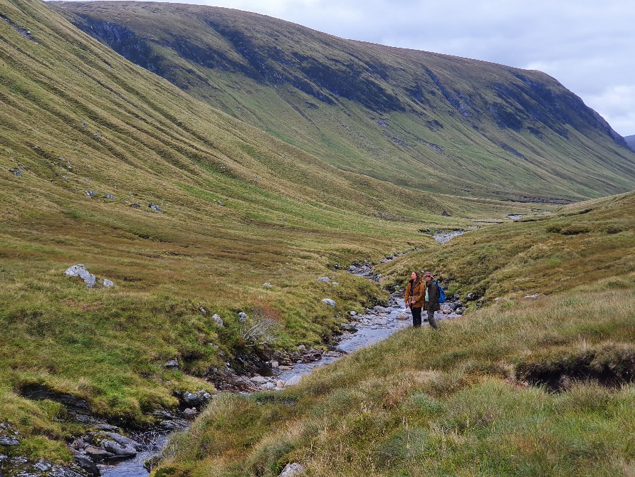
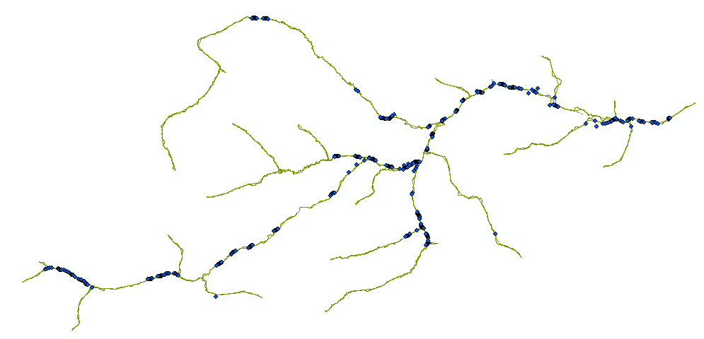
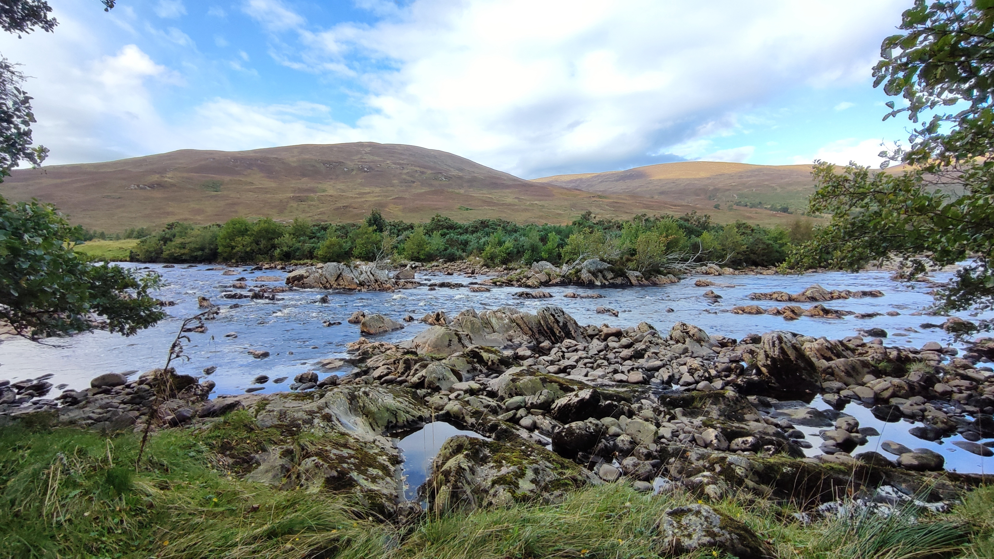
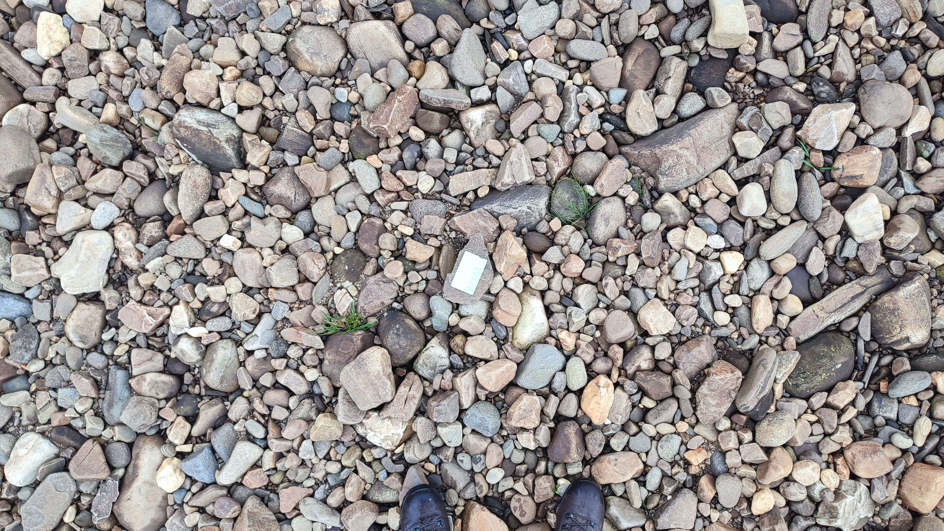
Field work (Sept 2022)
Introduction
Q1 – Empirical
Q2 – Steady state
Q3 - Perturbations
Summary
Data collection sites:
Collected data on:
Sediment cover
Grain size

Slide 8
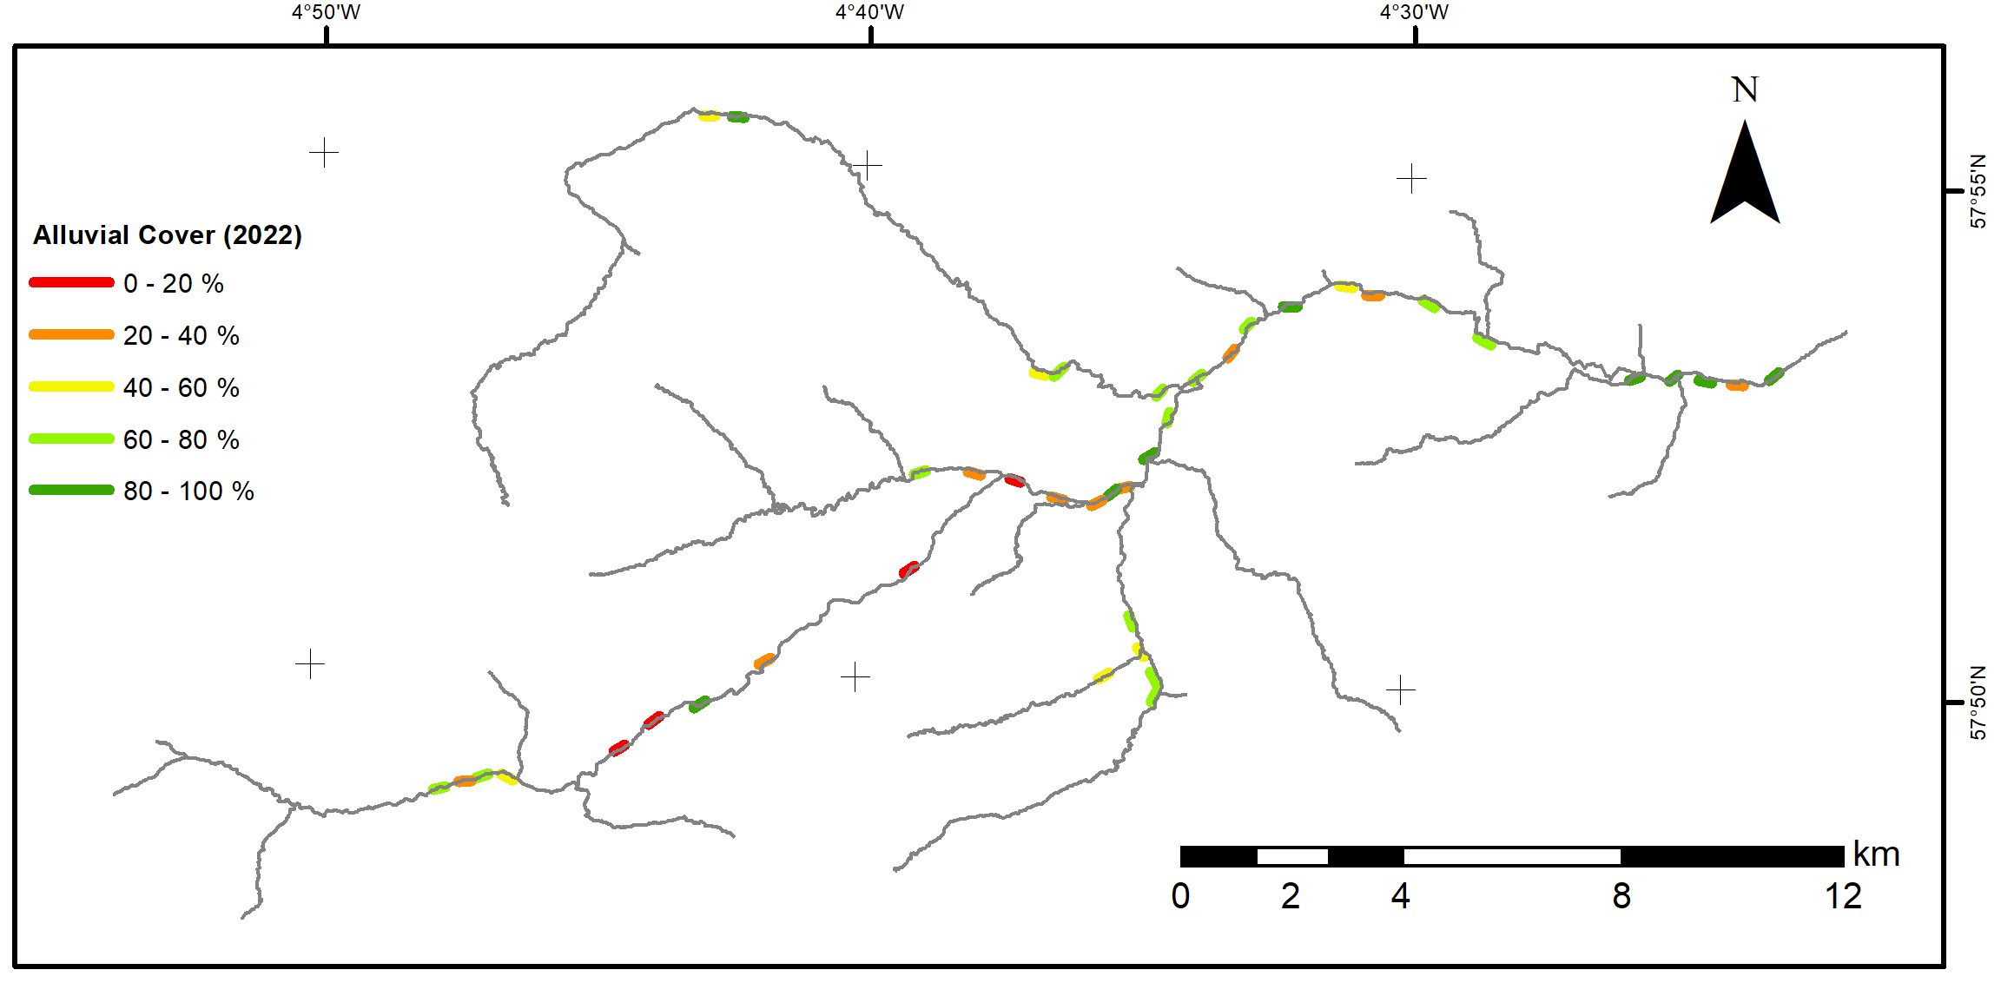
Field data analysis: sediment cover
Introduction
Field analysis
Simulation analysis
Next steps
Summary
Alluvial
Results: Spatial distribution
PCA:
Bedrock
PCA for Scottish Highlands
Bedrock-alluvial
Alluvial cover (2022)
PC2 – 20%
PC1 – 72%
Clusters indicates geometric distinction between bedrock and alluvial reaches
Drainage area is the main parameter for PC1 and channel depth is the main for PC2

Slide 9
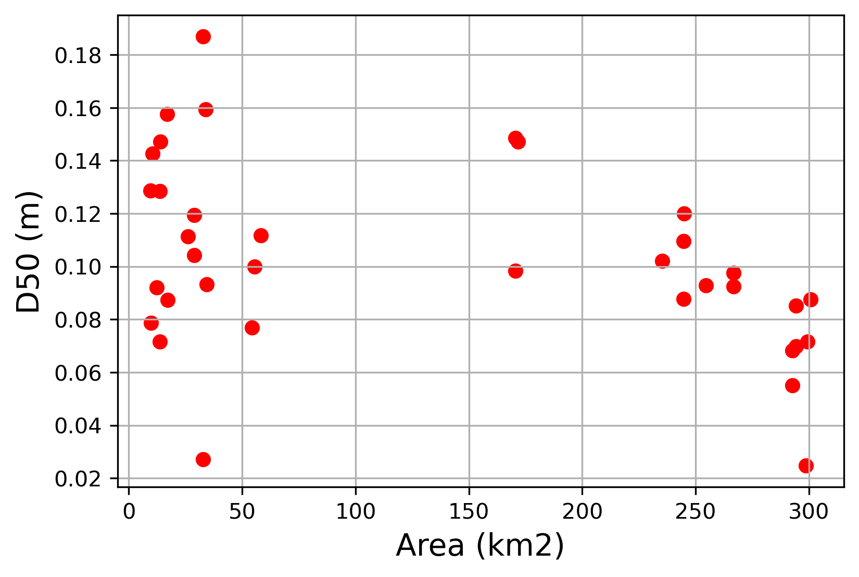
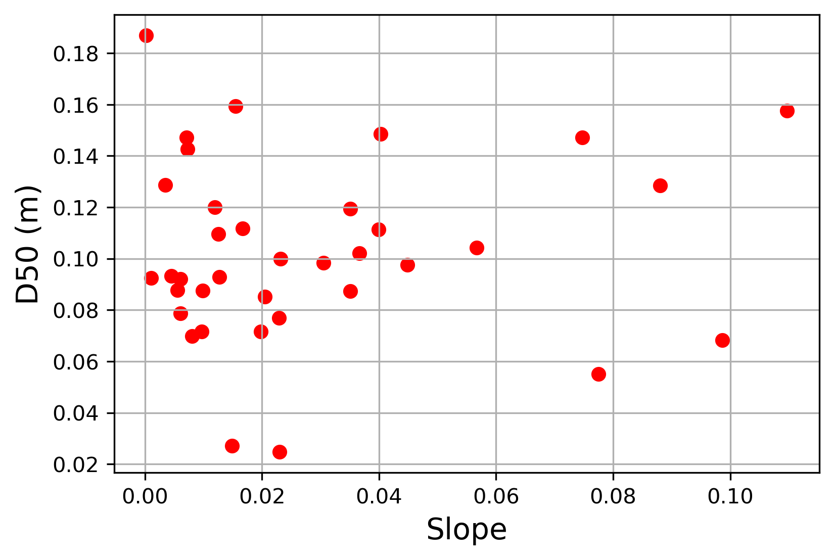
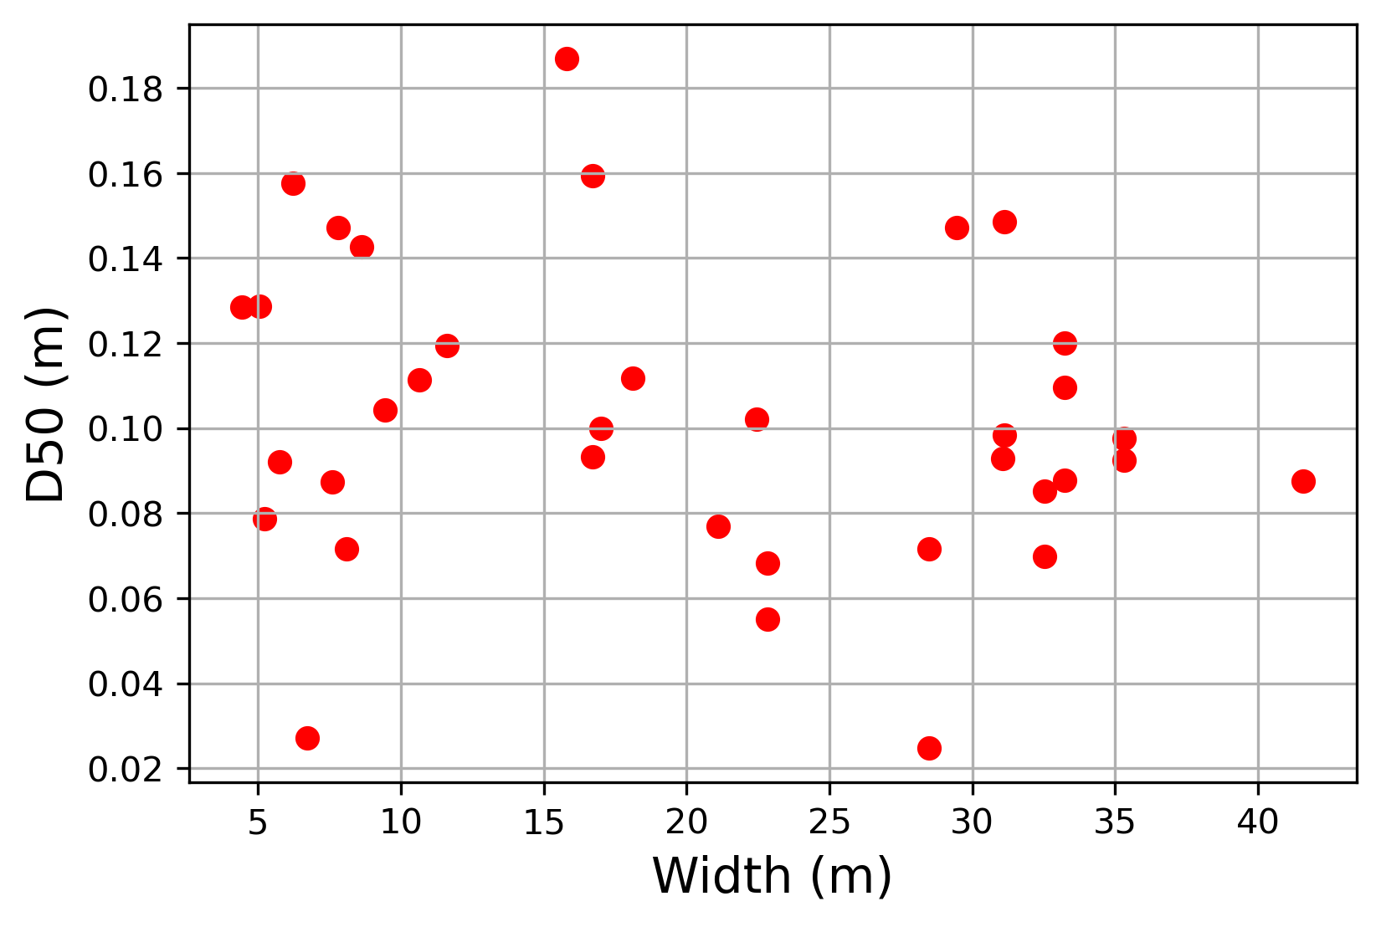
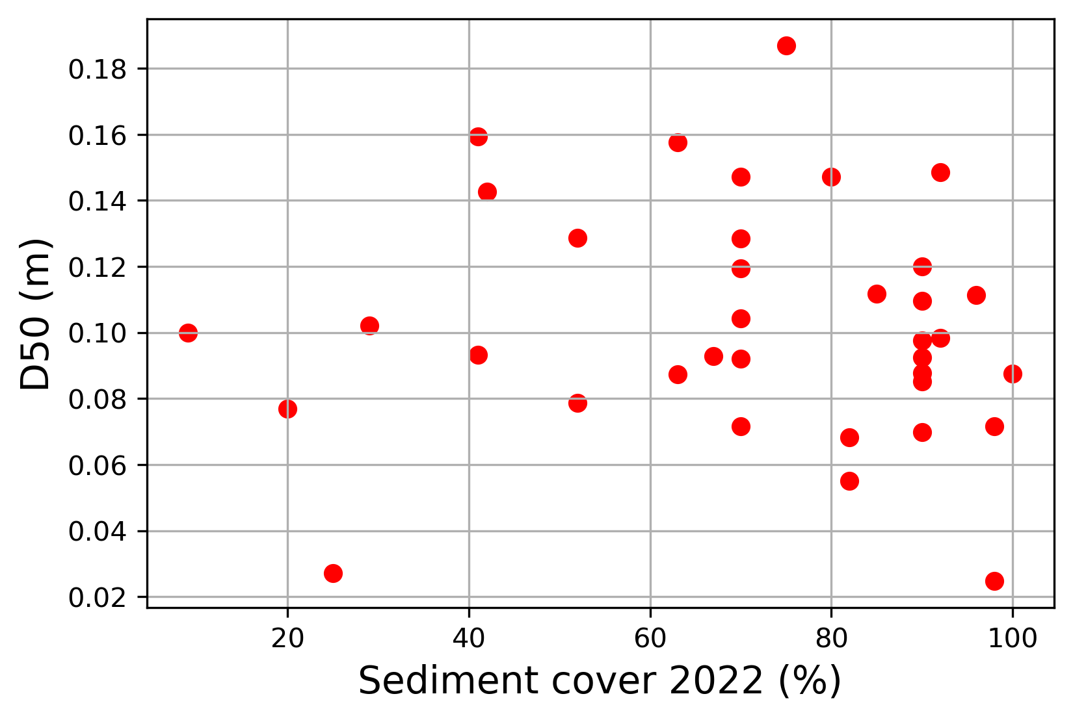
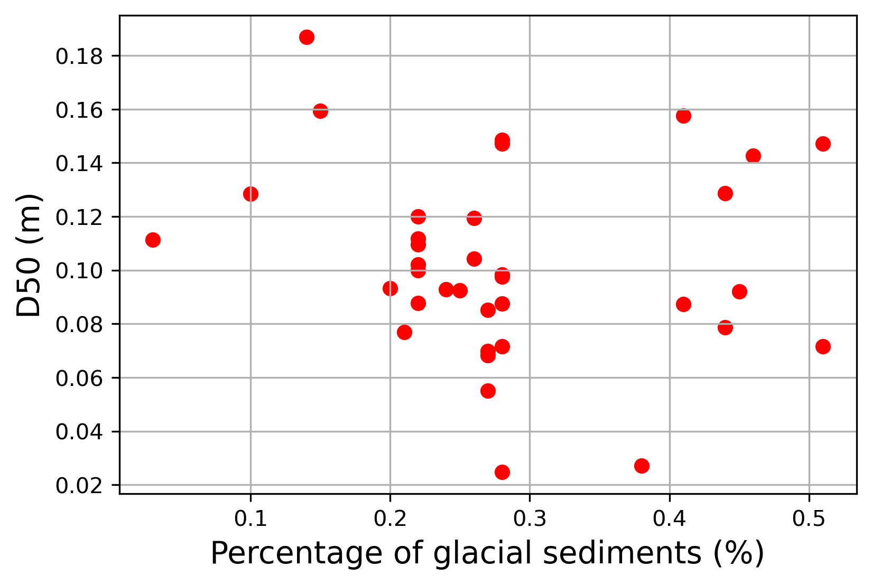
Field data analysis: grain size data
Introduction
Field analysis
Simulation analysis
Next steps
Summary
Grain size distribution:
Median grain size: D50 = 10 cm
Multiple regression analysis:
Dependent variable: D50 of each gravel bar
Drainage area, channel slope, width and riverbed cover have a significant correlation with D50
Field data is noisy. Numerical modelling can isolate parameters.
Independent variable | Coef | Std err | p-value
Drainage area | -0.0005 | < 0.001 | < 0.001
Channel slope | 0.5223 | 0.196 | 0.012
Channel width | 0.0047 | 0.001 | < 0.001
Riverbed cover | 0.0006 | < 0.001 | 0.031
% coarse superficial deposits | 0.0369 | 0.025 | 0.148
This study site had geological glacial processes that transported sediments and might be affecting the results

Slide 10
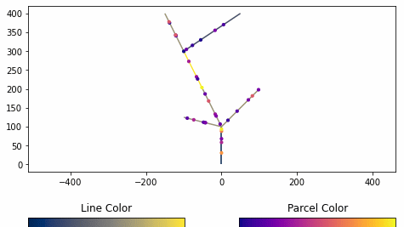
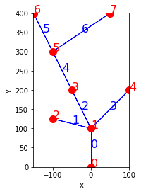
Modelling: Network Sediment Transporter (Pfeiffer et al, 2020)
Introduction
Field analysis
Simulation analysis
Next steps
Summary
Tracks sediment parcels on a river network
River segments are represented by links
Notes:
Based on physical equations of bedload sediment transportation

Slide 11
Modelling: Network Sediment Transporter
Introduction
Field analysis
Simulation analysis
Next steps
Summary
Modifications on the source code:
Implemented sediment input at every time step
Modified how sediment parcel moves downstream
Set up minimum transport capacity to solve bottleneck issue
Output: sediment cover fraction
Cover fraction | Definition | Type | Diagram
0.0 | 0% cover | Bedrock
0.5 | 50% cover | Mixed
1.0 | 100% cover | Alluvial
2.0 | 200% cover | Alluvial
3.0 | 300% cover | Alluvial
6
5
4
Sediment depth relative to grain size
3
2
1
0
0
50
100
150
200
250
11/20
Days
Notes:
Based on physical equations of bedload sediment transportation

Slide 12
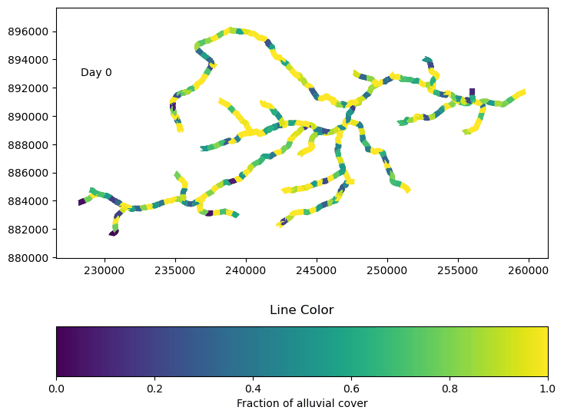
Sensitivity Analysis of Network Sediment Transporter
Introduction
Field analysis
Simulation analysis
Next steps
Summary
Find the best set of parameters to run scenarios
Modify:
Initial sediment cover
Grain size
Flow depth
Sediment input
Analyse results when system is in steady state
Latitude
Bedrock
Longitude
Alluvial
Notes:
Link length
Flow depth
Initial sediment over
Sediment input
Grain size
Timestep length

Slide 13
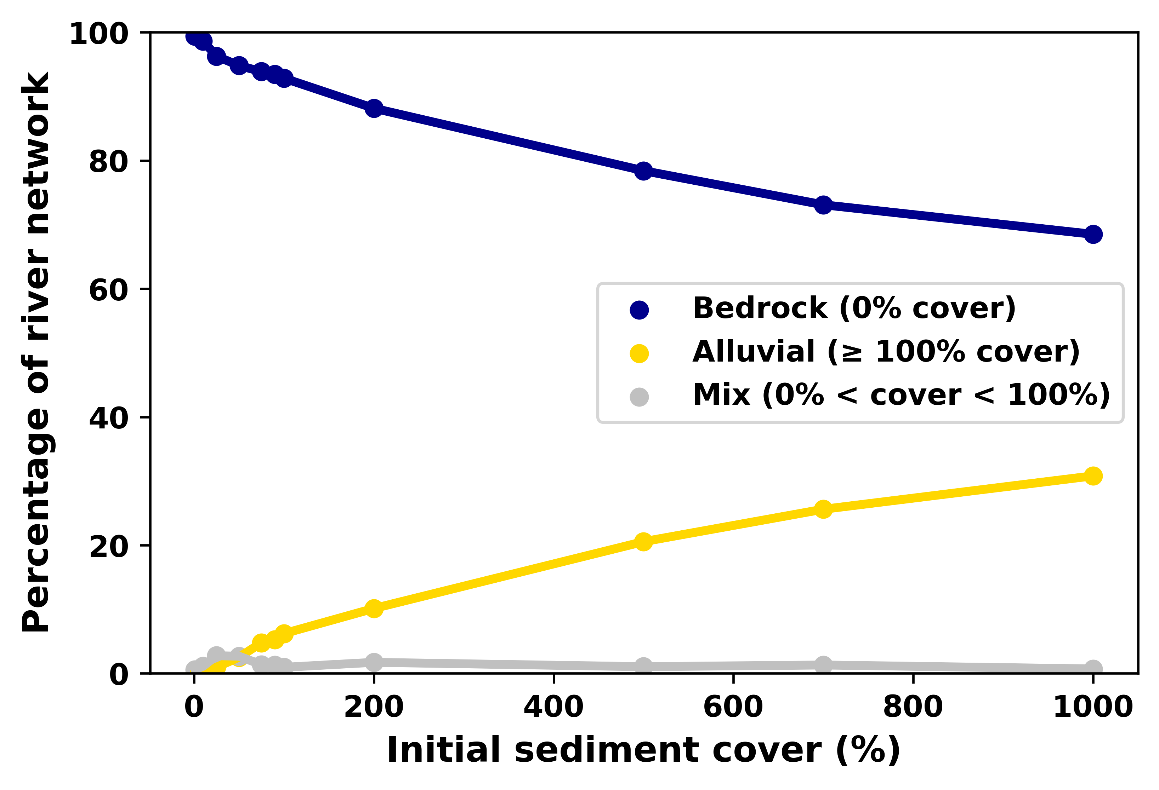
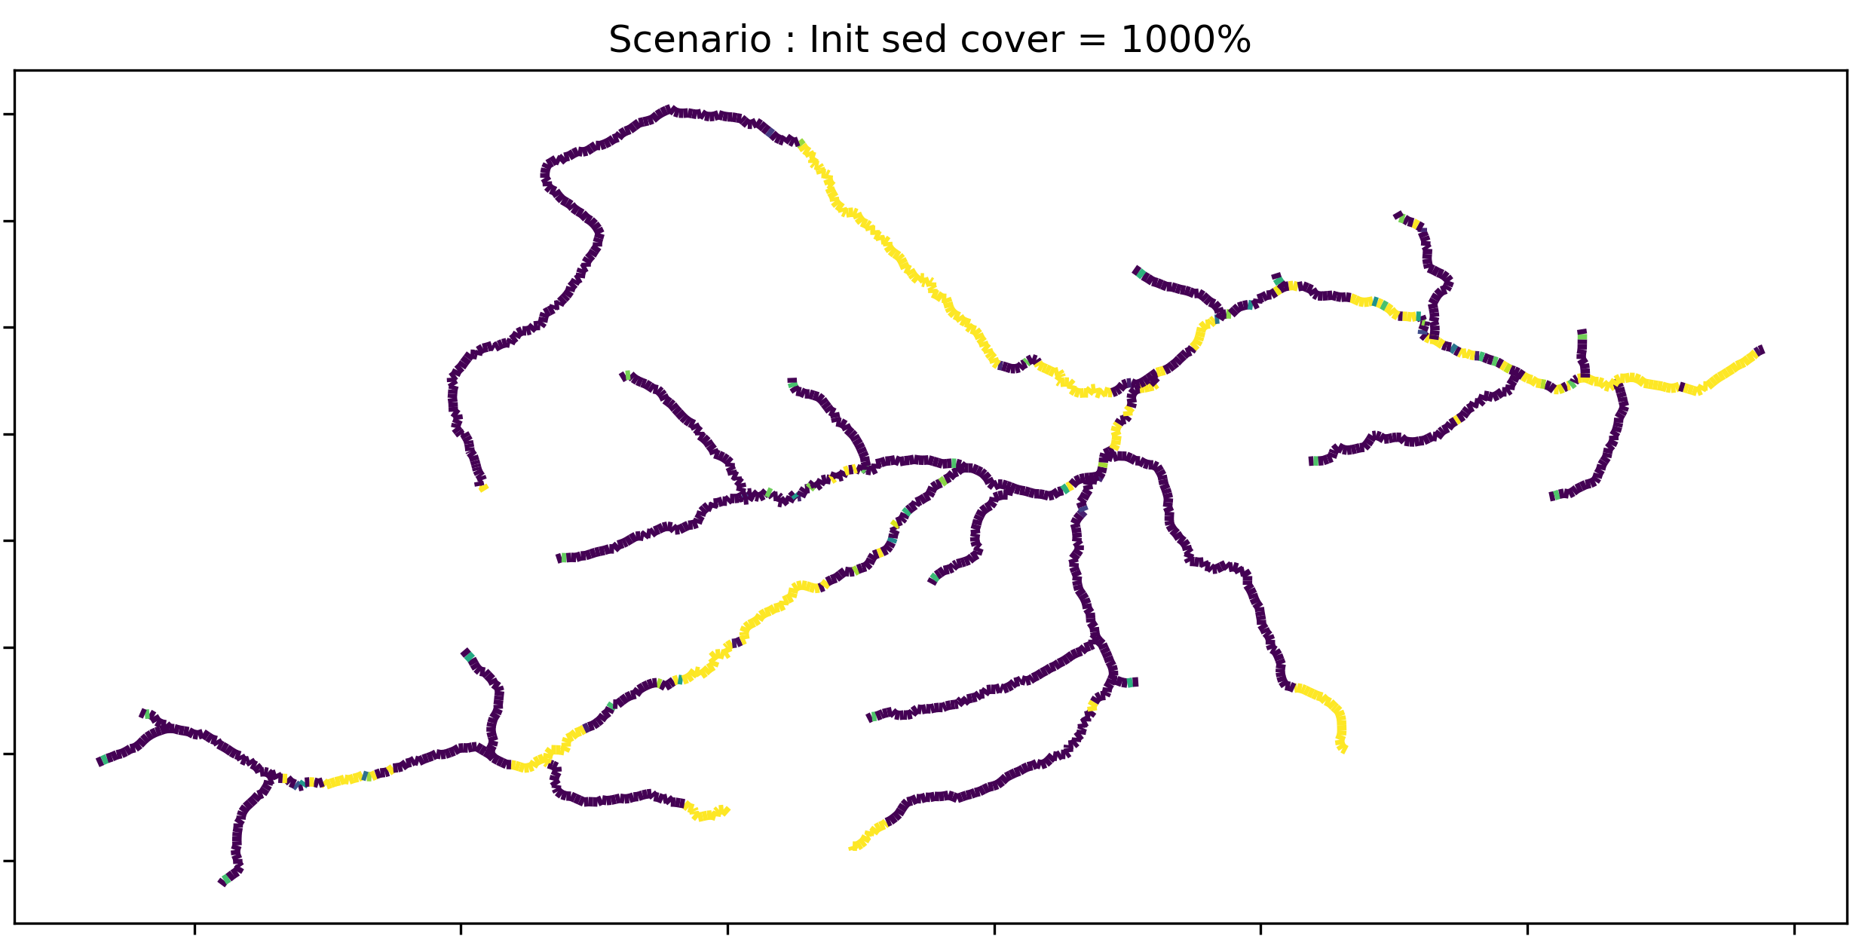
Sensitivity Analysis of Network Sediment Transporter - Results
Introduction
Field analysis
Simulation analysis
Next steps
Summary
Initial sediment cover
Increasing initial sediment cover increases final alluvial cover when the simulation finds steady state.
When alluvial cover increases, it tends to lengthen a continuous alluvial patch.
Fraction of alluvial cover

Slide 14
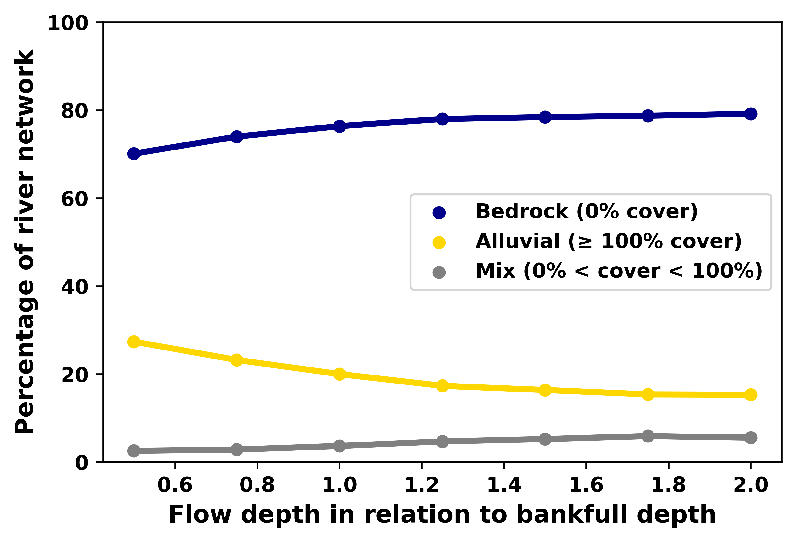
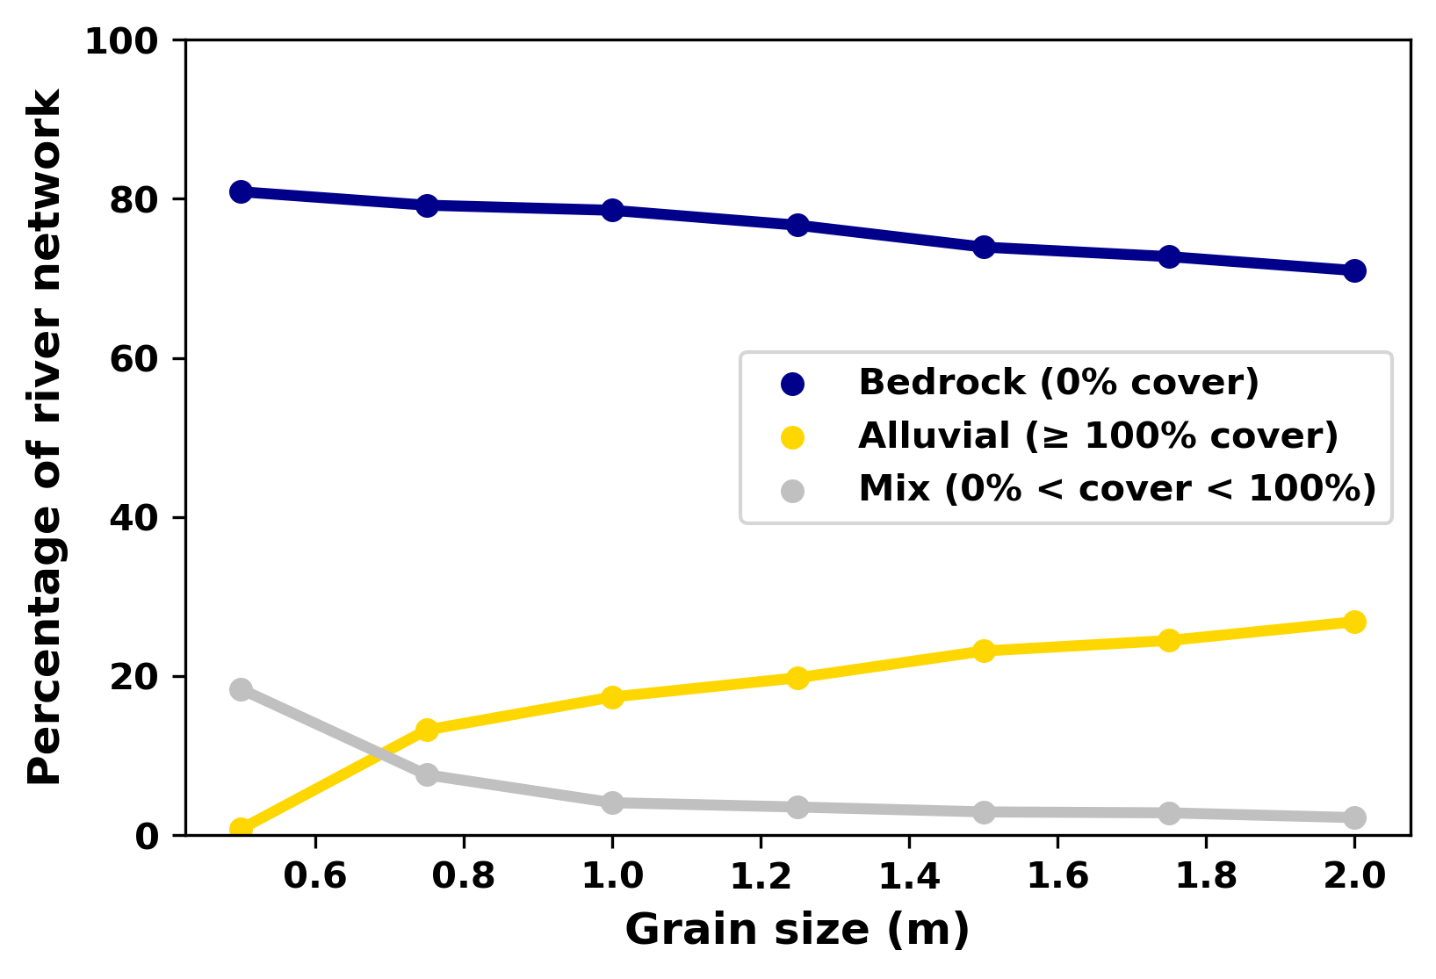
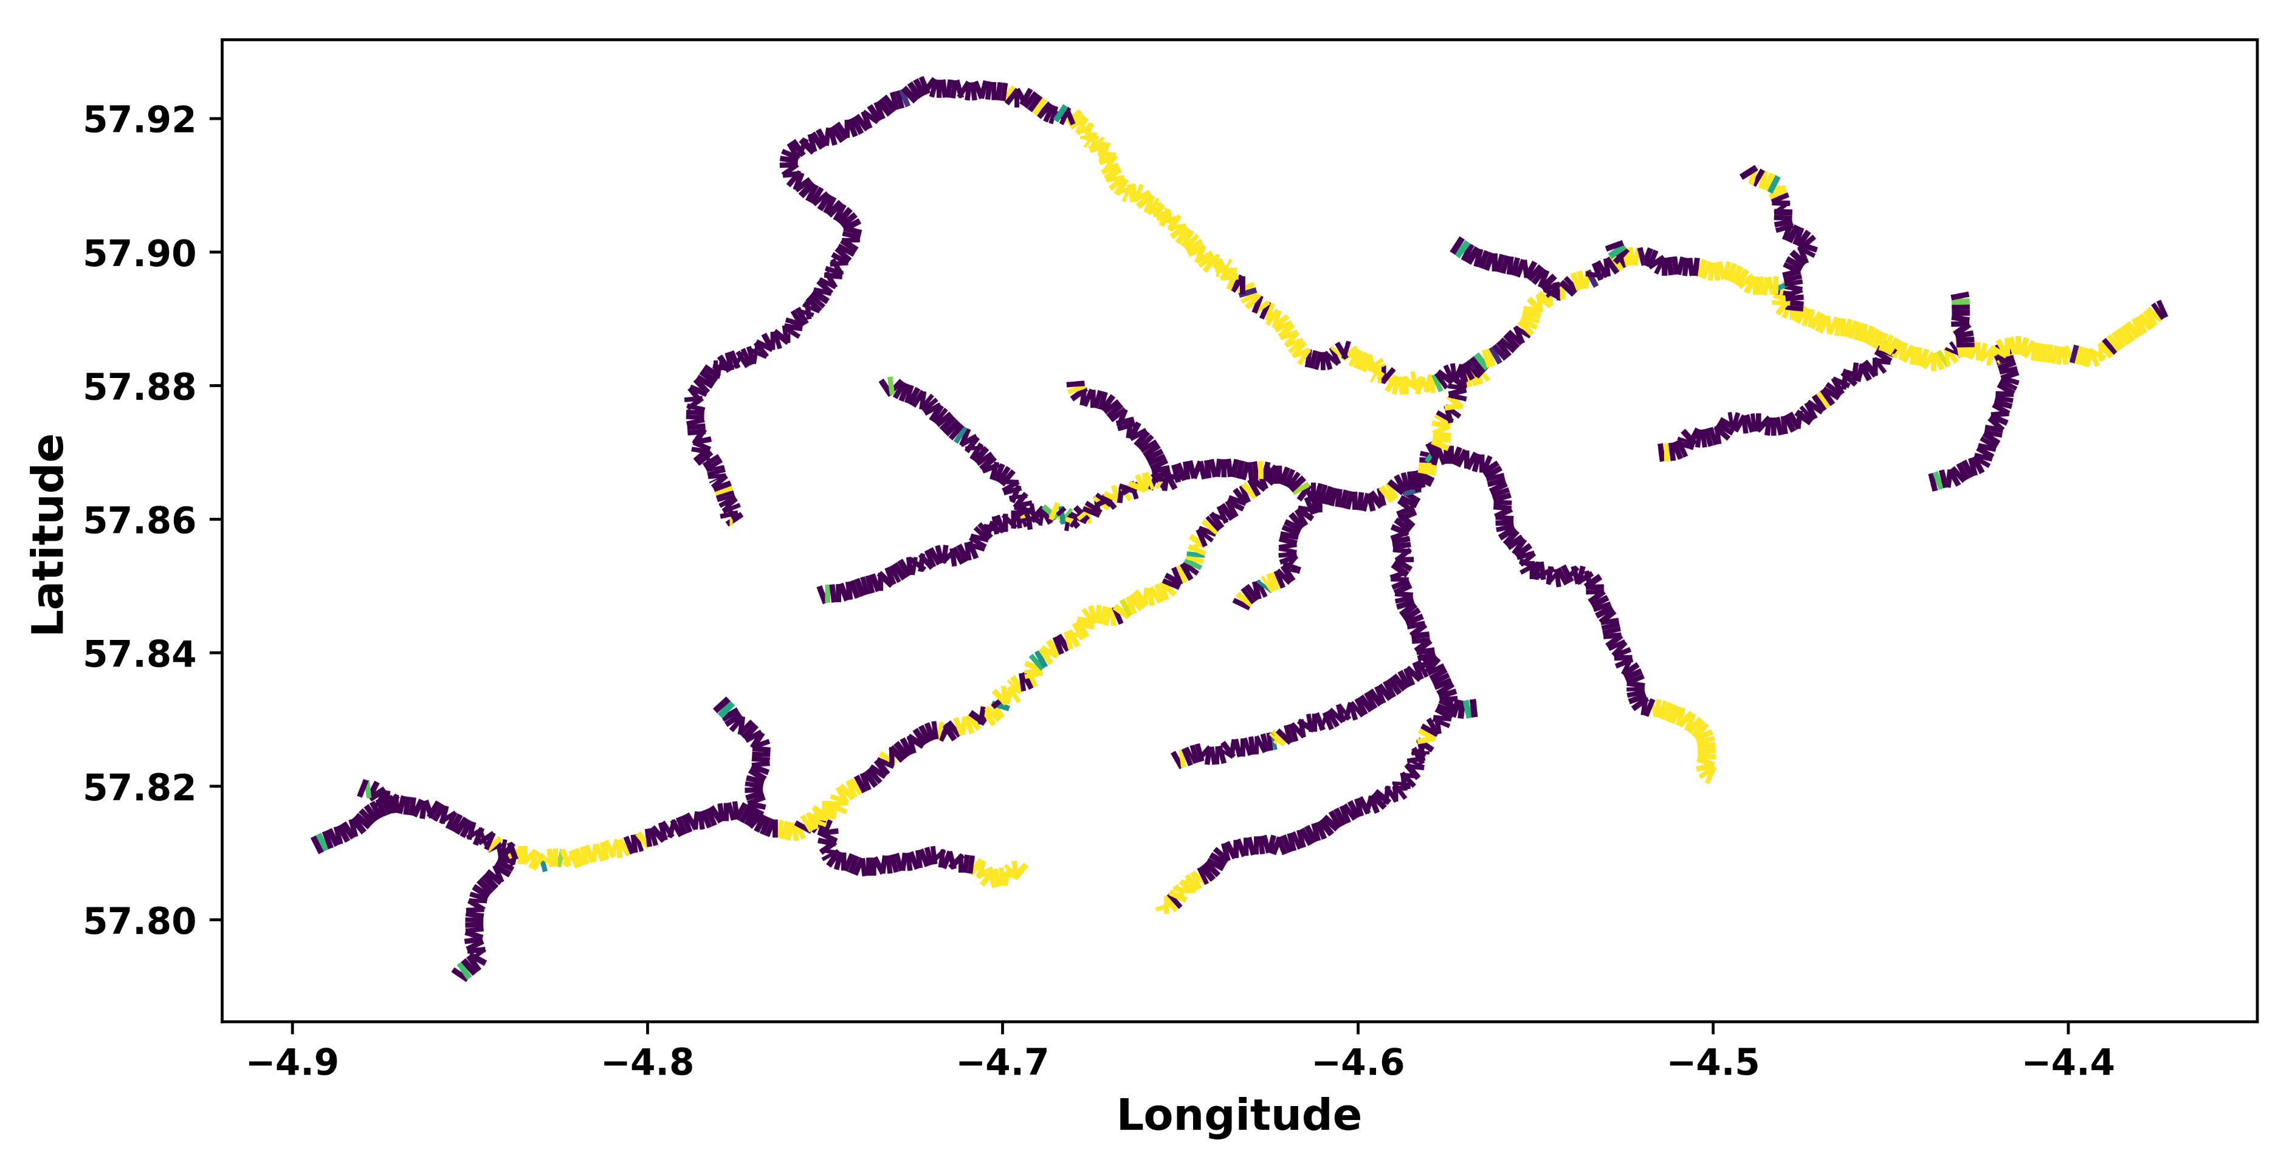
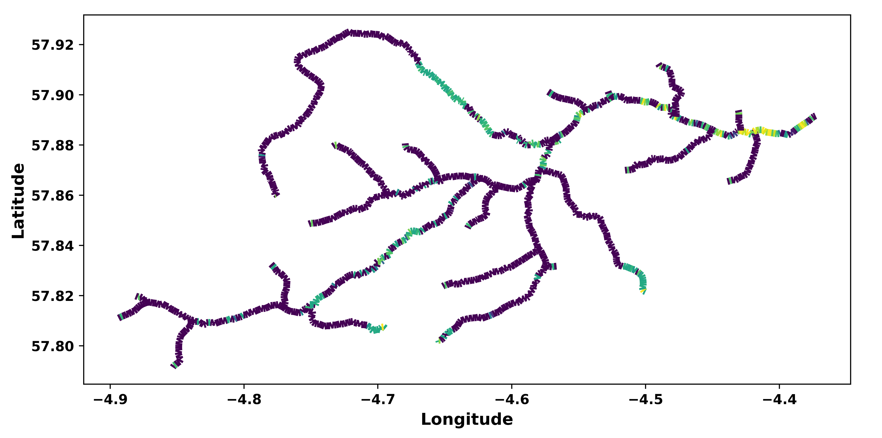
Sensitivity Analysis of Network Sediment Transporter - Results
Introduction
Field analysis
Simulation analysis
Next steps
Summary
Results:
Alluvial cover decreases when flow depth increases.
Alluvial cover increases com grain size increases.
The spatial pattern of alluvial cover is similar when changing flow depth and grain variables because channel structure, such as slope, was the main control in alluvial cover.
Flow depth:
Grain size:
Scenario map: Flow depth = 0.5 bankfull depth
Scenario map: Grain size = 3 cm
Fraction of alluvial cover

Slide 15
Next steps of bedload sediment transport simulations:
Introduction
Field analysis
Simulation analysis
Next steps
Summary
Create more scenarios by modifying:
Sediment input
Flow depth
Grain size
Compare model results with field data:
In a preliminary analysis, they have a Pearson correlation around 0.50, showing a moderate correlation
Connectivity analysis of results sediment cover at steady state

Slide 16
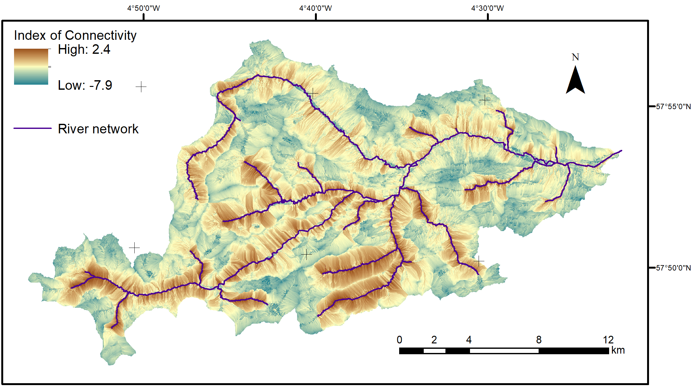
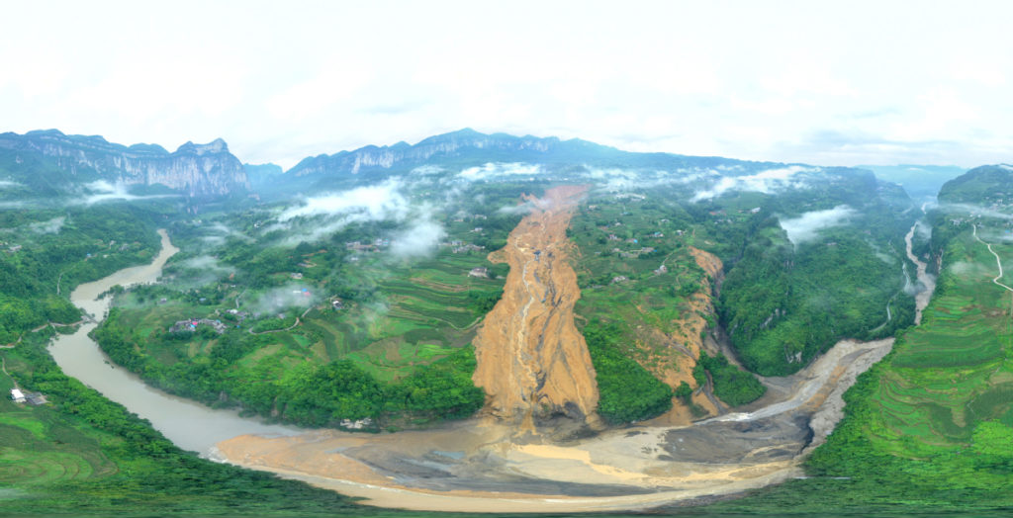
Next step: Perturb the system by adding sediment pulses
Introduction
Field analysis
Simulation analysis
Next steps
Summary
Sediment input from hillslope:
How to choose locations:
Index of Connectivity (Cavalli et al, 2013)

Slide 17
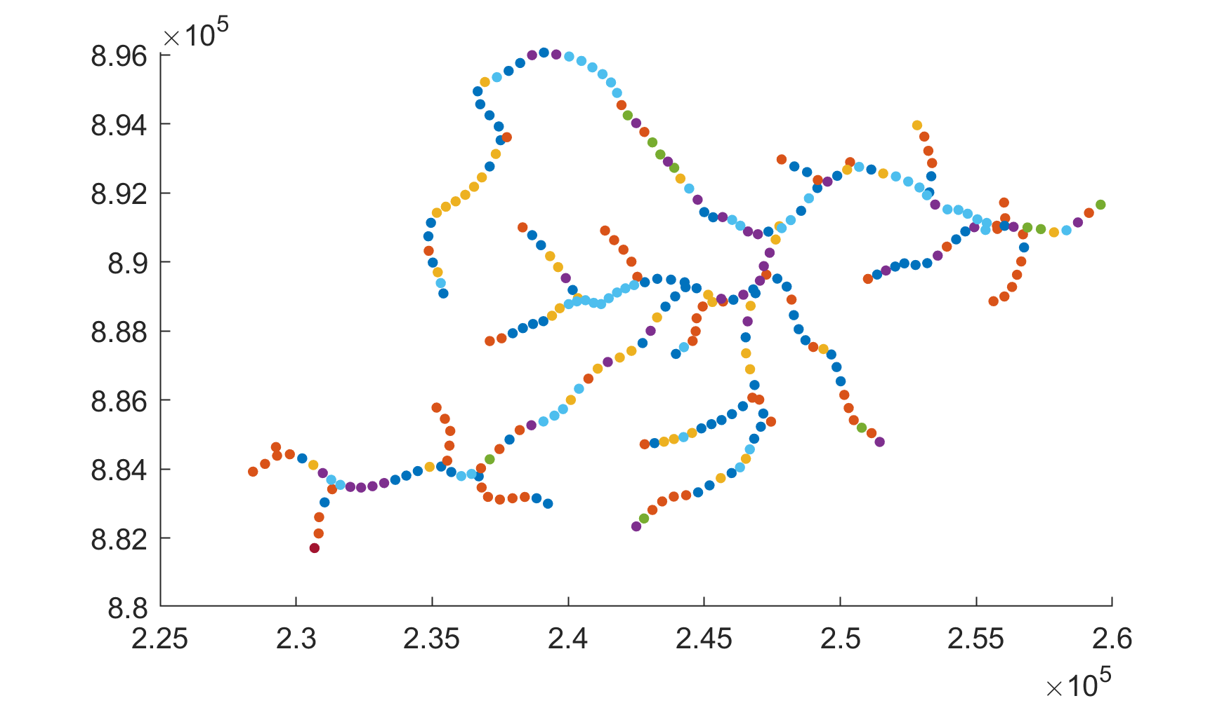
Spatial analysis by clustering river segments with similar time-courses: structural connectivity
Introduction
Field analysis
Simulation analysis
Next steps
Summary
Spectral clustering (11 clusters)
For example, the cluster in red is represented by river segments that loose sediments quickly. They are mainly bedrock reaches. In this case, they have a higher slope than other clusters.
Reach 151
Reach 164
Cluster example (red): 72 nodes

Slide 18
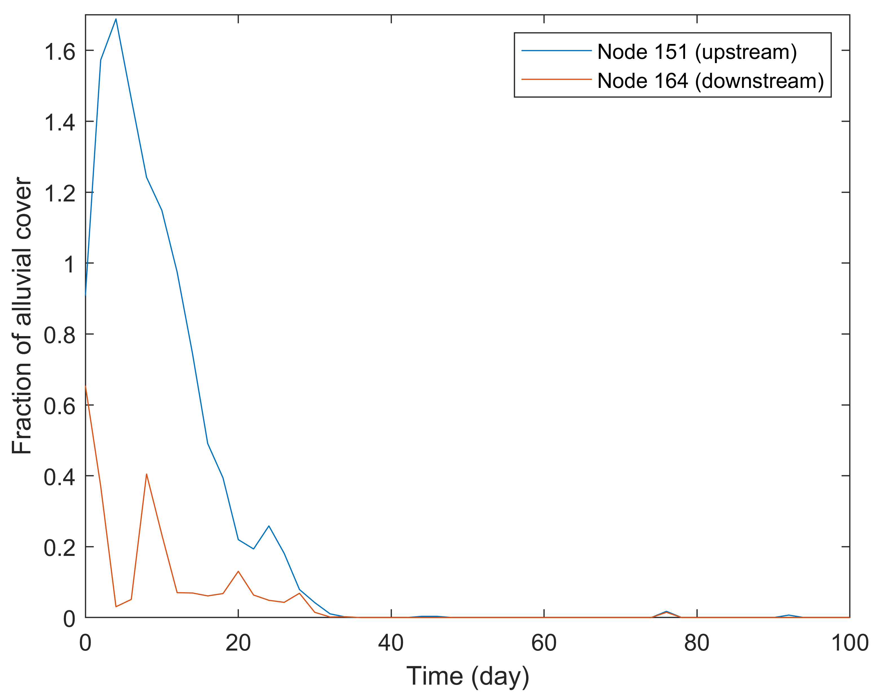
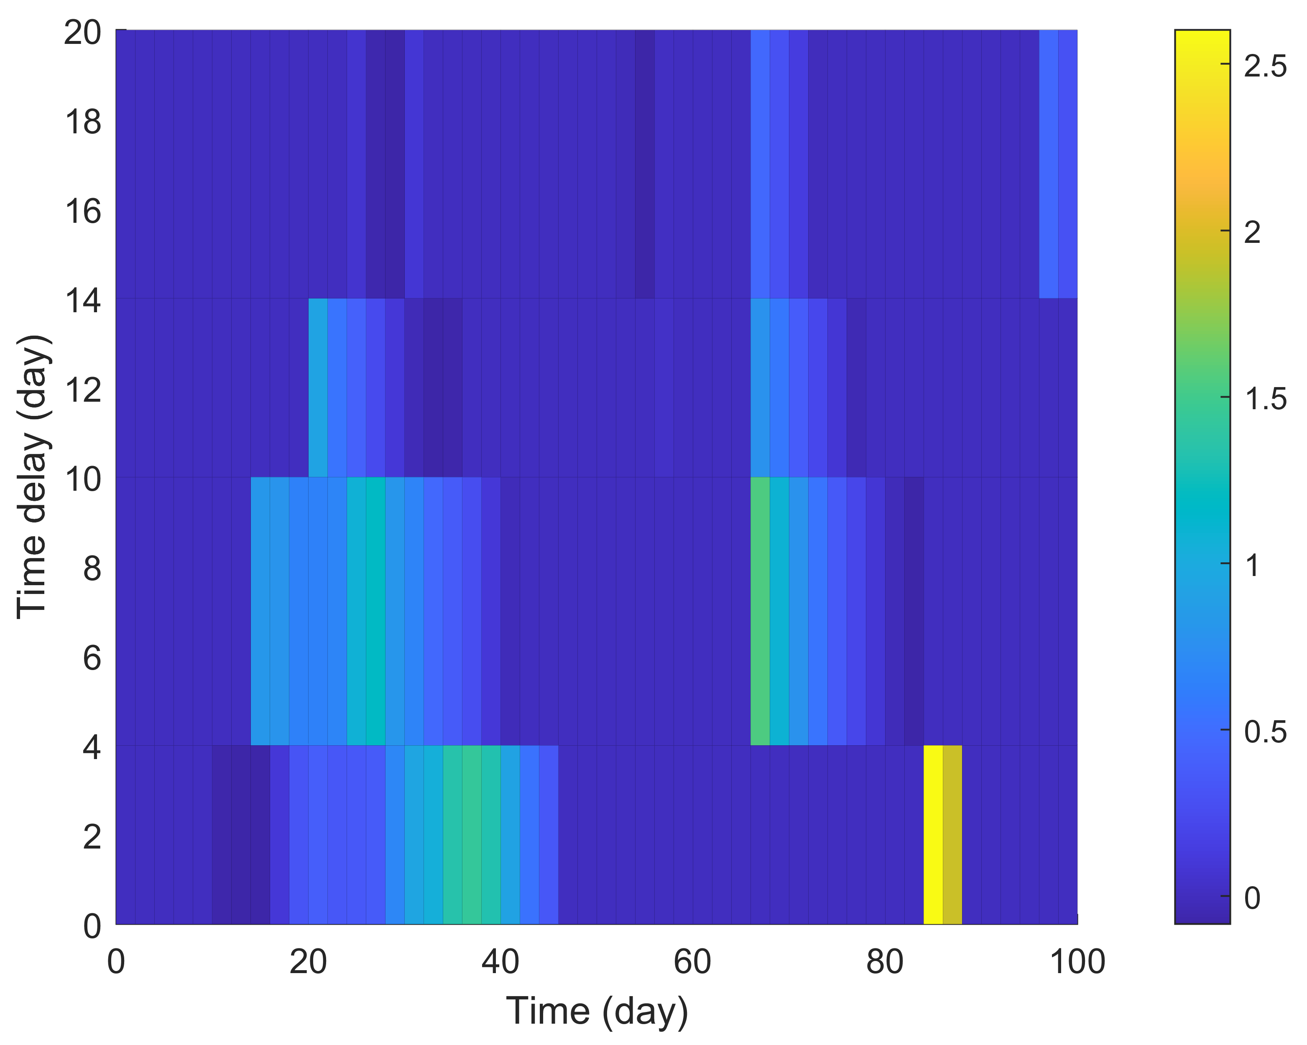
Temporal analysis and functional connectivity
Introduction
Field analysis
Simulation analysis
Next steps
Summary
Time Delayed and Mutual Information (TDMI):
Example: TDMI identifies similar behaviour between two river segments (nodes) around day 26 with a 5-day time-delay and on day 84 simultaneously.
Mutual Information (bits)

Slide 19
Summary
Introduction
Field analysis
Simulation analysis
Next steps
Summary
Several parameters affect sediment cover: water flow, sediment and channel characteristics.
From field data analysis:
Drainage area and depth are the main parameters that make alluvial and bedrock reaches distinct
Each study site can have specifications: Carron has coarser sediments from glacial source.
From modelling results analysis:
Channel slope is one of the most important parameters.
Connectivity analysis can further understand controls on alluvial cover
Questions? Contact me: mel.oliveira-guirro@durham.ac.uk
This project has received funding from the European Union’s Horizon 2020 research and innovation programme under the Marie Skłodowska-Curie grant agreement No 859937.

Slide 20
References
Introduction
Field analysis
Simulation analysis
Next steps
Summary
Pfeiffer, A., Barnhart, K., Czuba, J., & Hutton, E. (2020). NetworkSedimentTransporter: A Landlab component for bed material transport through river networks. Journal of Open Source Software, 5(53).
Wilcock, P. R., & Crowe, J. C. (2003). Surface-based transport model for mixed-size sediment. Journal of Hydraulic Engineering, 129(2), 120-128.
Whitbread, K. 2015. Channel geometry data set for the northwest Scottish Highlands. British Geological Survey Open Report, OR/15/040. 12pp.
Questions? Contact me: mel.oliveira-guirro@durham.ac.uk
This project has received funding from the European Union’s Horizon 2020 research and innovation programme under the Marie Skłodowska-Curie grant agreement No 859937.

