Slide 1
Assessing Ensemble Flood Forecasts With Action-relevant Scores To Support Flood Preparedness Actions: An Application To The Global Flood Awareness System In Uganda
Douglas Mulangwa^{1,2,5}, Andrea Ficchi³, Philip Nyenje¹, Jotham Sempewo¹, Linda Speight⁸, Hannah Cloke^{4,5}, Shaun Harrigan⁶, Benon Zaake², and Liz Stephens^{4,5,7}
¹ Makerere University, College of Engineering Design Art and Technology, Department of Civil and Environmental engineering, Uganda; ² Department of Water Resources Monitoring and Assessment, Directorate of Water Resources Management, Ministry of Water and Environment, Uganda; ³ Department of Electronics, Information and Bioengineering, Politecnico di Milano, Italy; ⁴ Department of Geography and Environmental Science, University of Reading, Reading, UK; ⁵ Department of Meteorology, University of Reading, Reading RG6 6BB, UK ;⁶ European Centre for Medium-Range Weather Forecasts, ECMWF, Reading, UK; ⁷ Red Cross Red Crescent Climate Centre, The Hague, 2521 CV Netherlands; ⁸ School of Geography and the Environmental, University of Oxford, Oxford, UK
@Mul_Douglas1
www.reading.ac.uk/fathum
@liz_stephens
@andrea_ficchi

Slide 2
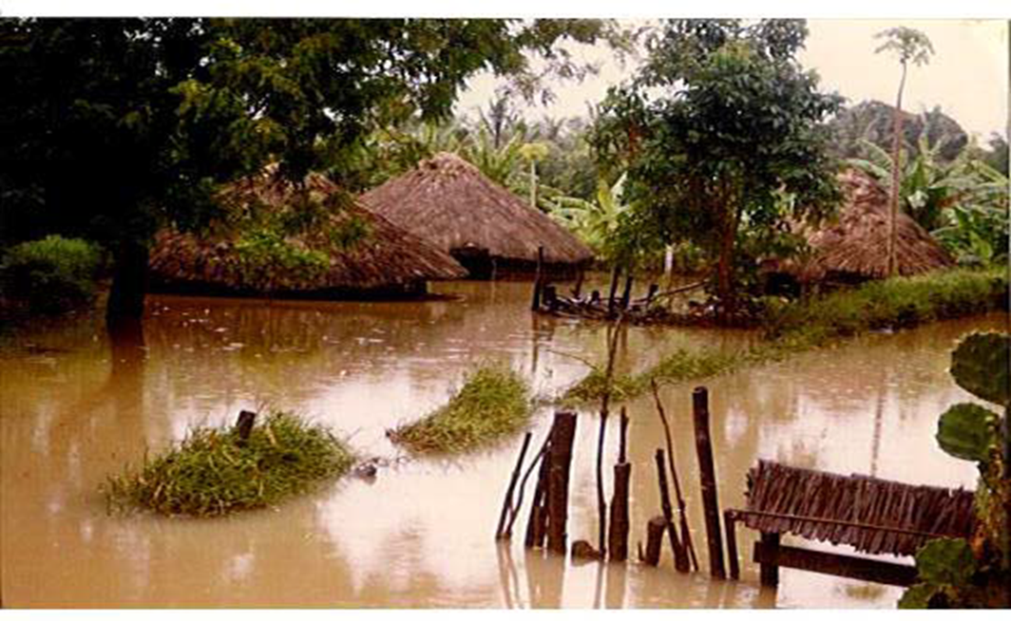
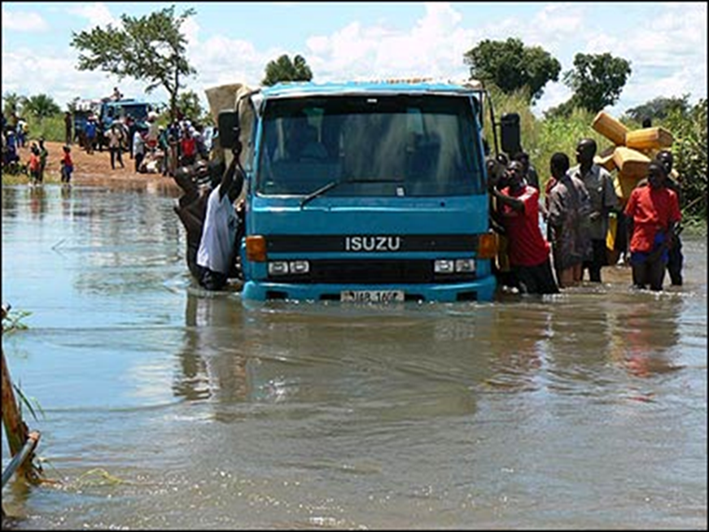
Motivation and Objectives
WMO proposed flood forecasting as a valuable tool in the strategy of ‘living with floods’ (WMO, 2010) to reduce impacts and loss of lives
Uganda Red Cross Society (URCS) piloted Forecast-based Financing (FbF) in NE Uganda in 2013-2018 (Coughlan De Perez et al., 2016)
To better prepare to flood events, we need reliable flood forecasting systems
Limitation: lack of validated flood forecasting information for Uganda.
Objective
This study investigates the importance of assessing ensemble flood forecasts with action-relevant scores to support flood preparedness actions by analyzing the discrepancies between traditional general scores and more specific flood event-based scores.
Two versions of the Global Flood Awareness System (GloFAS) are evaluated:
GloFAS2.1: coupled setup of two models, a land surface scheme (HTESSEL) and a hydrological model (LISFLOOD).
GloFAS3.1 uses a global setup of the hydrological model LISFLOOD which gives operators a better control of all calibration parameters
Contact: muldouglas99@gmail.com

Slide 3
False Alarm Ratios (FAR) & Probability of Detection (POD)
Best POD score is 1; 0 .5 ≤ POD ≤ 1 taken as acceptable range for this study
Two catchments, both originating from Mt. Elgon (Manafwa and Mpologoma), have POD scores outside the acceptable range and this could be to the frequent flash floods
Based on POD, GloFAS V3.1 has more catchments within the acceptable range compared to V2.1
Best FAR score is 0; 0 ≤ FAR ≤ 0.5 taken as acceptable range for this study
All catchments are within the acceptable range for both GloFAS V2.1 and GloFAS V3.1 except two
Based on FAR scores, GloFAS V3.1 outperforms 2.1 at most stations
Contact: muldouglas99@gmail.com

Slide 4
KGE Values and Components
GloFAS V2.1 at 1 day lead time |  |  |  |  | GloFAS V3.1 at 1 day lead time
Catchment (Area km²) | KGE value | R component Value | β component value | Alpha component value | KGE value | R component Value | β component value | Alpha component value
Muzizi (2,224 km²) | 0.468 | 0.647 | 0.664 | 0.787 | -2.133 | 0.713 | 3.795 | 2.387
Akokorio (12,641 km²) | 0.338 | 0.499 | 1.294 | 1.318 | -26.838 | 0.456 | 27.399 | 9.817
Nkusi (1,880 km²) | 0.243 | 0.641 | 1.661 | 1.090 | -2.035 | 0.689 | 3.828 | 2.057
Sio (1,400 km²) | 0.239 | 0.394 | 0.753 | 1.388 | -0.767 | 0.687 | 2.188 | 2.270
Rwizi (2,101 km²) | 0.049 | 0.486 | 1.427 | 1.676 | -2.026 | 0.640 | 3.434 | 2.761
Mayanja (2,297 km²) | -0.208 | 0.424 | 1.931 | 1.512 | -3.804 | 0.529 | 5.465 | 2.707
Mitano (2,106 km²) | -2.858 | 0.587 | 4.004 | 3.385 | -5.682 | 0.623 | 5.836 | 5.597
Mpologoma (3,494 km²) | -11.936 | 0.261 | 9.326 | 10.873 | -16.870 | 0.274 | 11.967 | 15.090
Manafwa (462 km²) | -69.972 | 0.328 | 61.261 | 38.487 | -35.226 | 0.252 | 29.992 | 22.708
GloFAS V2.1 at 5 days lead time |  |  |  |  | GloFAS V3.1 at 5 days Lead time
Catchment (Area km²) | KGE value | R component Value | β component value | Alpha component value | KGE value | R component Value | β component value | Alpha component value
Muzizi (2,224 km²) | 0.384 | 0.560 | 0.657 | 0.739 | -2.051 | 0.709 | 3.771 | 2.242
Akokorio (12,641 km²) | 0.330 | 0.490 | 1.299 | 1.314 | -25.991 | 0.454 | 26.655 | 9.369
Nkusi (1,880 km²) | 0.510 | 0.642 | 1.203 | 0.734 | -1.708 | 0.693 | 3.556 | 1.843
Sio (1,400 km²) | 0.298 | 0.604 | 1.019 | 1.579 | -0.779 | 0.731 | 2.228 | 2.259
Rwizi (2,101 km²) | 0.319 | 0.411 | 1.228 | 1.255 | -1.701 | 0.648 | 3.249 | 2.453
Mayanja (2,297 km²) | -0.294 | 0.317 | 1.948 | 1.555 | -3.620 | 0.537 | 5.312 | 2.592
Mitano (2,106 km²) | -1.252 | 0.591 | 2.871 | 2.185 | -4.249 | 0.644 | 4.931 | 4.461
Mpologoma (3,494 km²) | -9.019 | 0.315 | 7.840 | 8.289 | -14.340 | 0.288 | 10.682 | 12.878
Manafwa (462 km²) | -57.456 | 0.355 | 51.790 | 29.932 | -27.584 | 0.283 | 24.552 | 17.181
Based on KGE, GloFASV2.1 shows higher performance compared to V3.1 for both lead-times: this is mainly due to larger biases in 3.1
At a few stations, surprisingly, we find higher performance at 5 days lead-time compared to 1 day lead-time for both GloFASV2.1 and V3.1
This can imply that GloFAS initialisation is not optimal while initial biases may be counter-balanced by rainfall forecasts
Contact: muldouglas99@gmail.com

Slide 5
Catchment Characteristics
Climatic Zones
Catchment | Connected Districts | Climate Zone(s) | Comment | LTA Annual Precipitation [mm] (1991-2020)
Akokorio (12,641 km²) | Abim; Amuria; Kapelebyong; Katakwi; Kotido; Napak | G, H | Upstream in Zone G while Downstream in Zone H | 937.1 - 1460
Manafwa (462 km²) | Budaka; Bududa; Butaleja; Manafwa; Mbale; Namisindwa | F | Entire catchment in Zone F | 1587.3 – 1940 .6
Mpologoma (3,494 km²) | Bugiri; Buyende; Kaliro; Kibuku; Namatumba; Pallisa; Tororo | D, A2 | Over 90% of catchment in Zone D; A small area in Zone A2 while a small portion of the catchment also lies in Kenya | 1407.7 – 1605.6
Mitano (2106 km²) | Kanungu; Rukungiri | C | Entire catchment in Zone C | 1417.6 – 1425.3
Rwizi (2,101 km²) | Mbarara; Ntungamo; Sheema | C | Entire catchment in Zone C | 1145.5 – 1353.2
Muzizi (2,224 km²) | Kyenjojo; Ntoroko | C, M | Over 85% of catchment in Zone M while the rest falls in Zone C | 1398.4 – 1545.1
Nkusi (1,880 km²) | Kagadi; Kikuube | L, M | Over 70% of catchment is in Zone L while the rest lies in Zone M | 1447.7 – 1562.6
Sio (1,400 km²) | Busia; Namayingo | D, A2 | Over 80% of catchment area is in Kenya with the rest falling in Zones D and A2 | 1288.5 – 1695.4
Mayanja (2,297 km²) | Kiboga; Kyankwanzi; Mityana; Nakaseke; Wakiso | B | Entire catchment in Zone B | 1394.8 -1590.2
Contact: muldouglas99@gmail.com

Slide 6
Land Use and Land Coverage
Muzizi, Akokorio and Rwizi have highest grassland coverage (31% - 48%)
All other catchments predominantly covered with croplands (65% -94%)
Only Mayanja has built up area of approximately 5%; the rest of the catchments are below 2%
The higher grassland coverage for Muzizi, Akokorio and Rwizi probably explains the relatively good performance for KGE, FAR, POD as compared Manafwa and Mitano which are predominantly cultivated
Contact: muldouglas99@gmail.com

Slide 7
Wetlands Cover and Flow Duration Curves
Catchment | Catchment Area (km²) | Area covered by wetlands (km²) | Percentage area covered by wetlands
Akokorio | 12641 | 1128 | 8.92
Manafwa | 462 | Negligible | Negligible
Mayanja | 2297 | Negligible | Negligible
Mitano | 2106 | 114.97 | 5.46
Mpologoma | 3494 | 126 | 4
Muzizi | 2224 | 116.07 | 5.22
Nkusi | 1880 | 22.64 | 1.2
Rwizi | 2101 | 315.8 | 15.03
Sio | 1400 | 35.02 | 3
Muzizi, Akokorio and Rwizi have a wetland coverage > 5% and this could explain their relatively good performance, as some natural hydrological processes may be better modelled
Faster catchment response for Mpologoma: most of the catchment is on the steep slopes of the mt. Elgon and is highly cultivated. This explains the relatively poor performance in the catchment (KGE)

Slide 8
Conclusions and Further Work
Takeaways
Global forecasts can provide an interim solution for Countries like Uganda with gaps in local forecasts, as they provide relatively good results especially for larger catchments (e.g. > 2000 km2)
General scores like KGE may not be action-relevant to support preparedness actions
KGE provides different conclusions than action-relevant scores (FAR and POD), since the bias component is predominant for most catchments, but correlation can be more informative for action
For a few stations, surprisingly, there is a higher performance at 5 days lead-time compared to 1 day lead-time for both GloFASV2.1 and GloFASV3.1
There are substantial differences due to the model set ups of the two versions (GloFAS2.1: HTESSEL + LISFLOOD models; GloFAS3.1: LISFLOOD model only)
Further work:
Under The INFLOW PROJECT, we will compare the performance of GloFAS against other global forecasting models like the Google Forecasting Model

Slide 9
Thank you FOR YOUR ATTENTION
Contact: muldouglas99@gmail.com
@Mul_Douglas1
@liz_stephens
@andrea_ficchi

