Slide 1
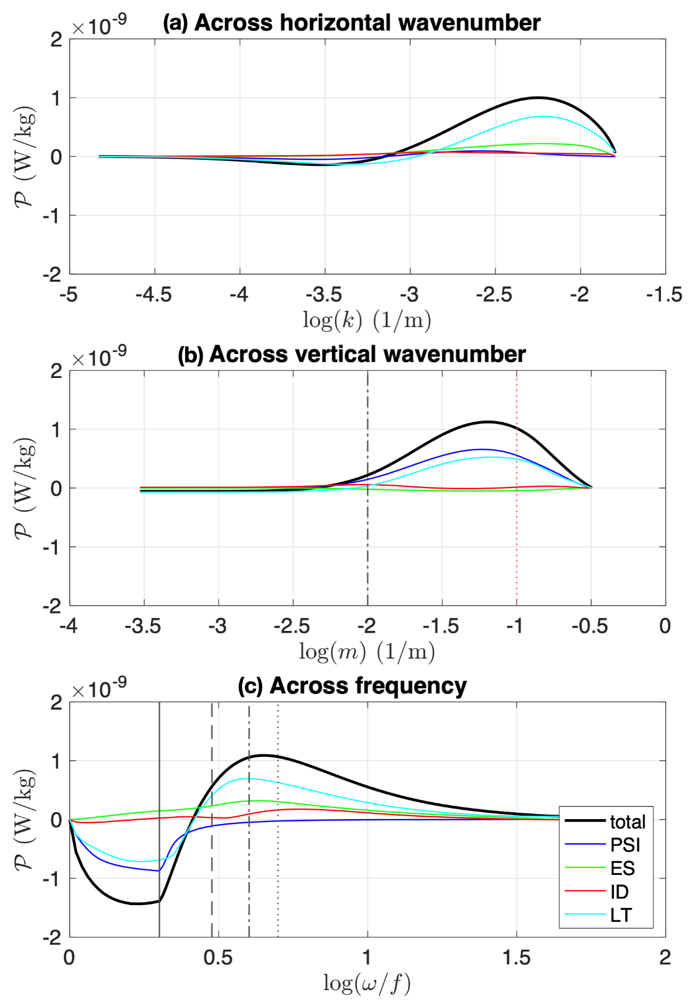
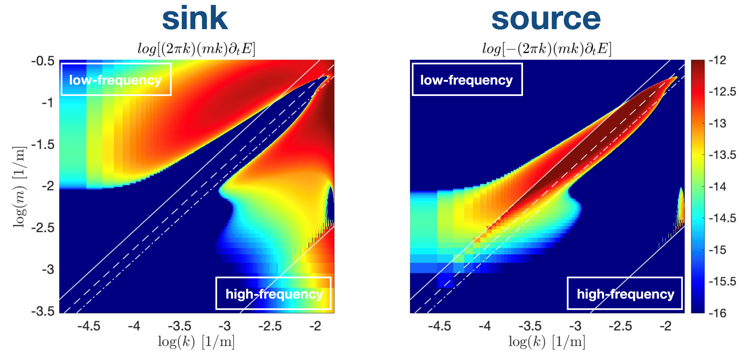
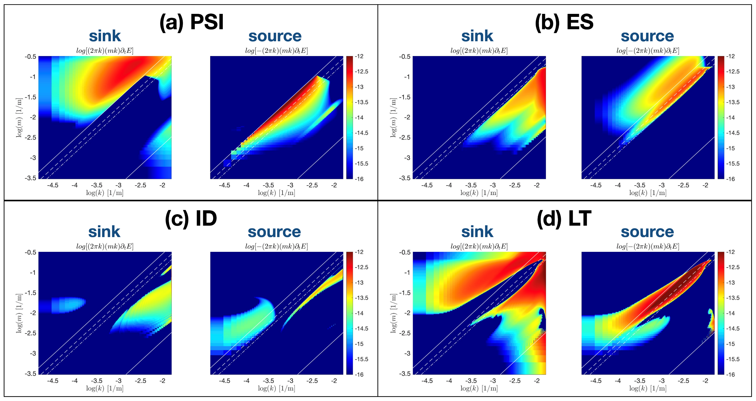
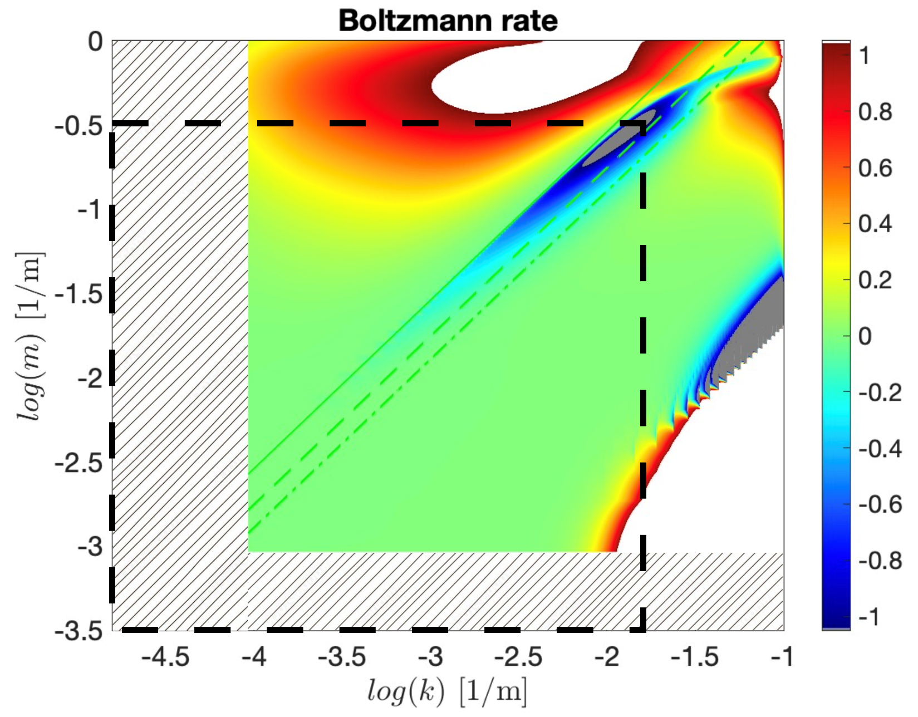

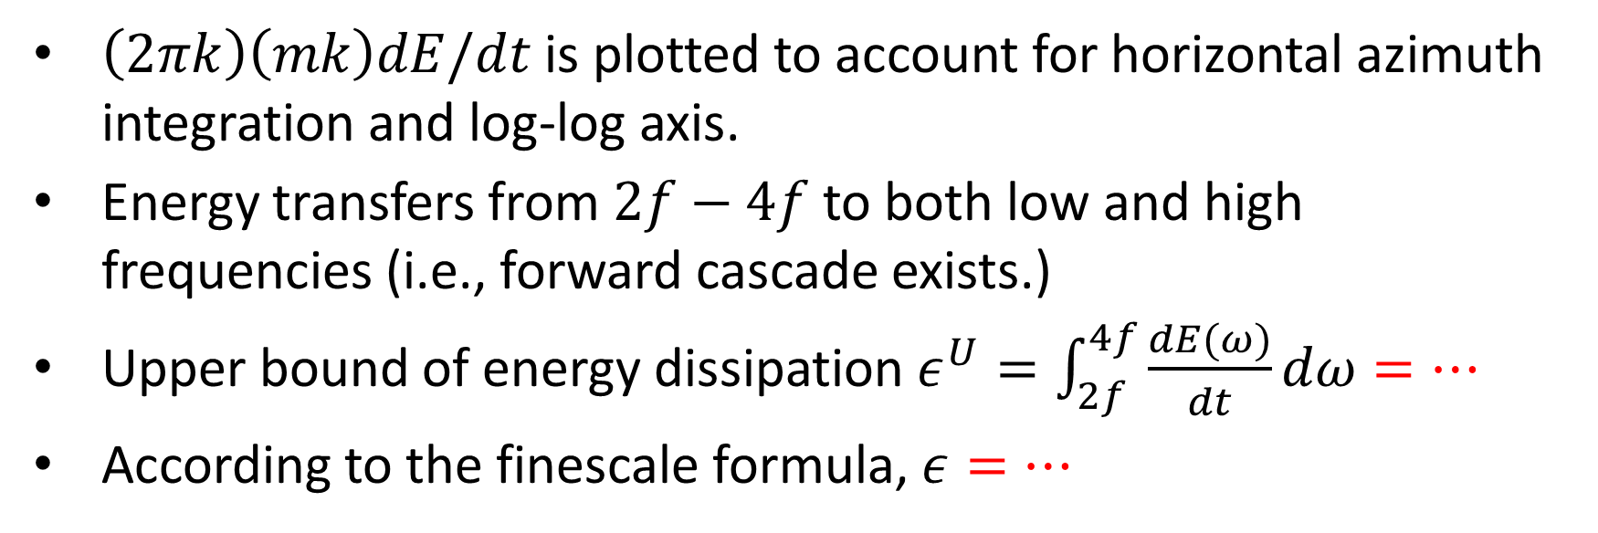
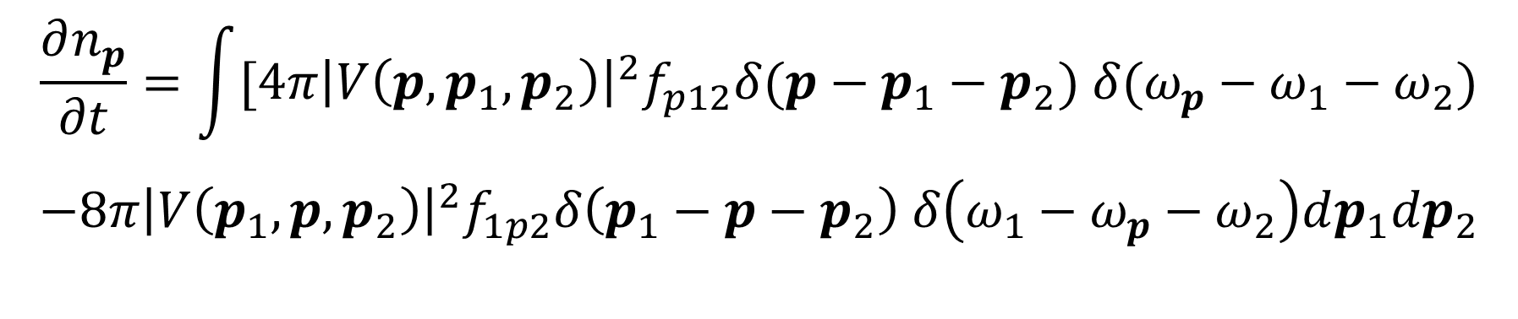
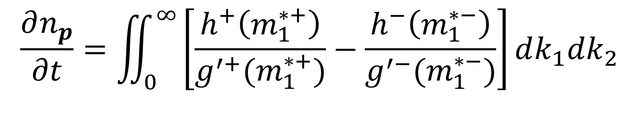
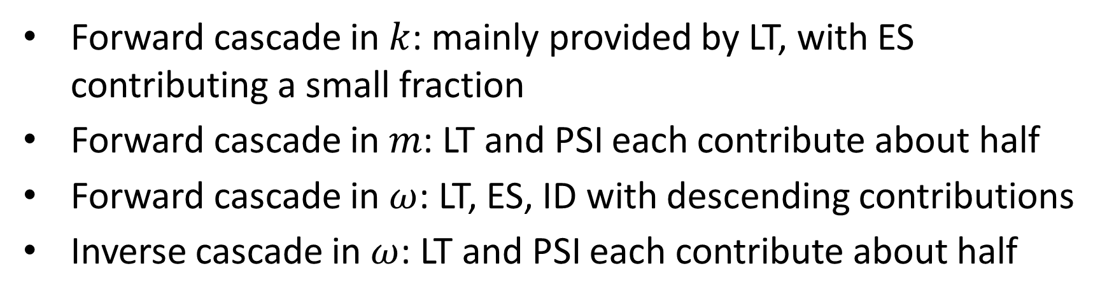

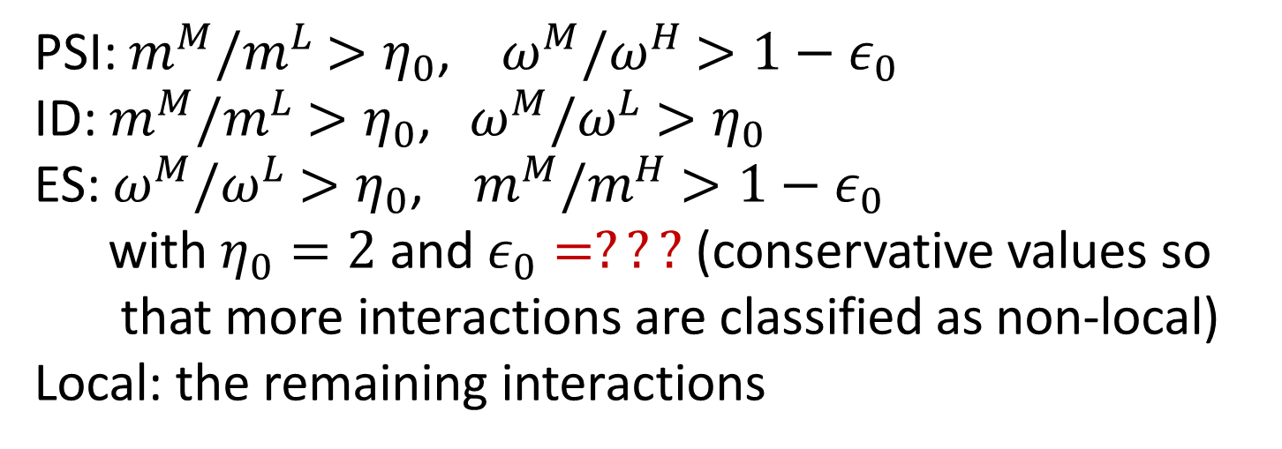

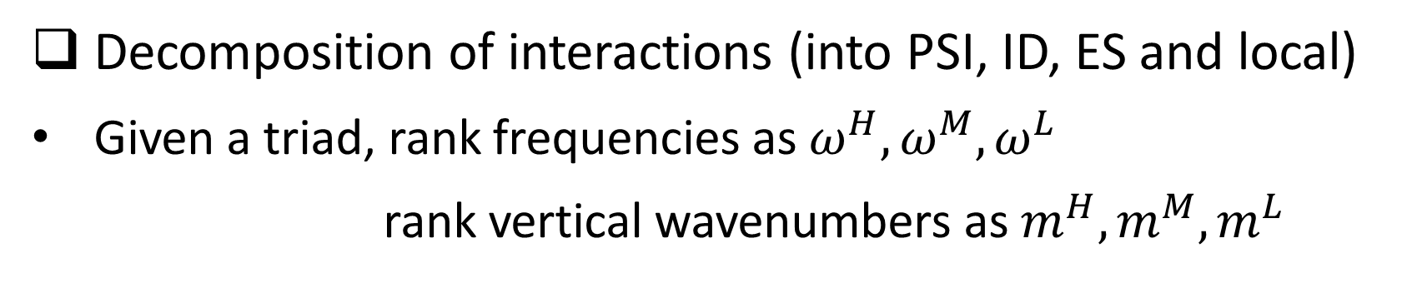
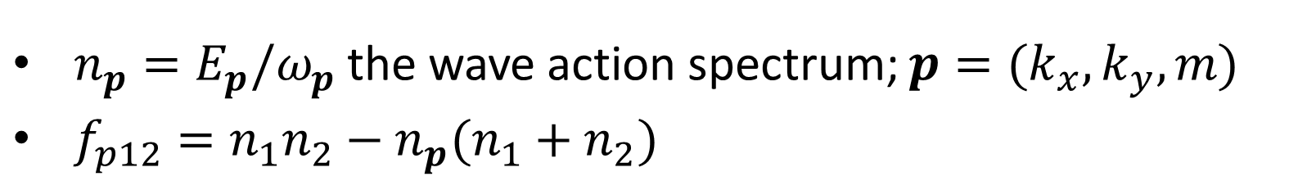
Numerical evaluation of the spectral evolution of internal gravity waves due to wave-wave interactions
Yulin Pan and Yue (Cynthia) Wu
Department of Naval Architecture and Marine Engineering, University of Michigan
Motivation
Objective
Results
Through numerical evaluation of WKE, we aim to
direct evaluate energy cascade in GM76 to provide basis for finescale parameterization
analyze in detail the role of different interaction mechanisms
resolve the paradoxes regarding McComas et al’s analysis
Overall spectral energy transfer (similar pattern as Eden et al. 2020, but obtained with different method)
Constituents of energy flux
Methodology
Numerical evaluation of WKE
step 1: integrate out the horizontal angle dependence (assuming isotropy) and reduce to resonant manifold
(definition of $g$ and $m$ neglected here)
step 2: numerically integrate the reduced two-dimensional equation to compute $∂n_{p}/∂t$
$$\frac{∂n_{p}}{∂t}=\iint_{0}^{∞}{\left[\frac{h^{+}\left(m_{1}^{∗+}\right)}{g^{′+}(m_{1}^{∗+})}−\frac{h^{−}\left(m_{1}^{∗−}\right)}{g^{′−}(m_{1}^{∗−})}\right]}dk_{1}dk_{2}$$
Forward cascade in $k$: mainly provided by LT, with ES contributing a small fraction
Forward cascade in $m$: LT and PSI each contribute about half
Forward cascade in $ω$: LT, ES, ID with descending contributions
Inverse cascade in $ω$: LT and PSI each contribute about half
Energy cascade by internal gravity waves (IGWs) is critical in
transferring energy from large scales to feed ocean mixing
shaping the IGW spectrum into Garrett-Munk (GM)-like form
mixing parameterization in ocean and climate models
finescale parameterization to estimate the diffusivity
$\left(2πk\right)\left(mk\right)dE/dt$ is plotted to account for horizontal azimuth integration and log-log axis.
Energy transfers from $2f−4f$ to both low and high frequencies (i.e., forward cascade exists.)
Upper bound of energy dissipation $ε^{U}=\int_{2f}^{4f}{\frac{dE(ω)}{dt}}dω=…$
According to the finescale formula, $ε=…$
Setup of the calculation
consider a domain with a horizontal circular radius of 67.5 km and a vertical extent of 3.375 km
use 1080$×$1080 uniform grid in $k$ and $m$, with smallest resolved scales to be 62.5 m and 3.125 m.
set $n_{p}$ as the GM76 spectrum with $f=…, N=…$
Check for Boltzmann rate: condition $Bo<1$ is only marginally violated at the edge of the computational domain
Revisiting the paradoxes in McComas et. al.
Background
Re paradox 1: Forward frequency cascade provided by LT, ES, ID.
Re paradox 2: ID is indeed approximately a zero-flux state for GM76. McComas et. al.’s argument of ID providing significant portion of downscale cascade should be replaced by LT.
Spectral energy transfer by wave-wave interactions described by the wave kinetic equation (WKE) (Olbers 1976; McComas & Muller 1981a,b; Lvov et al. 2004, 2010; Eden et al. 2020)
Contribution from each type of interaction
Conclusion and Future Work
$$\frac{∂n_{p}}{∂t}=\int{[4π{\left|V\left(p,p_{1},p_{2}\right)\right|}^{2}f_{p12}δ(p−p_{1}−p_{2}) δ(ω_{p}−ω_{1}−ω_{2})}$$
$$−8π{\left|V\left(p_{1},p,p_{2}\right)\right|}^{2}f_{1p2}δ\left(p_{1}−p−p_{2}\right) δ\left(ω_{1}−ω_{p}−ω_{2}\right)dp_{1}dp_{2}$$
Conclusions
Direct numerical evaluation of WKE is conducted to study the energy cascade for GM76 IGW spectrum.
Our calculation of energy flux is close to that obtained from the finescale parameterization
Local interactions are important for energy cascade in all spectral directions.
ES provides a forward frequency cascade.
Downscale energy cascade is provided by PSI and local interactions, instead of PSI and ID.
$n_{p}=E_{p}/ω_{p}$ the wave action spectrum; $p=(k_{x},k_{y},m)$
$f_{p12}=n_{1}n_{2}−n_{p}(n_{1}+n_{2})$
computational domain
Analysis by McComas et. al. in the 80s
Hypothesis: transfer dominated by non-local interactions
PSI: inverse cascade in $ω$ and forward cascade in $m$ (as expected).
ES: forward cascade in frequency
ID: insignificant energy cascade compared to other mechanisms
in contrast to McComas et. al. which assert that ES plays no role
can be understood as a diffusion process
Future work
Evaluate flux properties and magnitudes for different IGW spectral forms and compare to the finescale parameterization
Study spectral evolution into stationary state and compare to analytical stationary solution of WKE.
Consider eddy effect in the kinetic equation framework
Decomposition of interactions (into PSI, ID, ES and local)
Given a triad, rank frequencies as $ω^{H}, ω^{M}, ω^{L}$
rank vertical wavenumbers as $m^{H},m^{M},m^{L}$
in contrast to McComas et. al. which assert 30% downscale energy cascade by ID
can be predicted by the diffusion equation with GM76 spectral slope
can become significant and reverse direction by change of spectral slopes (test results available but not shown)
Paradox 1: no mechanism for frequency forward cascade
Paradox 2: standard GM76 corresponds to a zero-flux state
analyzed through ID mechanism
PSI: $m^{M}/m^{L}$ $>η_{0}$, $ω^{M}/ω^{H}$ $>1−ε_{0}$
ID: $m^{M}/m^{L}$ $>η_{0}$, $ω^{M}/ω^{L}$ $>η_{0}$
ES: $ω^{M}/ω^{L}$ $>η_{0}$, $m^{M}/m^{H}$ $>1−ε_{0}$
with $η_{0}=2$ and $ε_{0}=???$ (conservative values so
that more interactions are classified as non-local)
Local: the remaining interactions
Acknowledgement
Finescale parameterization (e.g. Polzin 2014)
Local (LT): maybe the most significant energy transfer mechanism, contributing to forward frequency cascade
Discussion with Giovanni Dematteis
Funding support fron NSF OCE 2241495
Formula here
Functional form obtained from theory with empirical coefficient
completely ignored by McComas et. al.
Our manuscript on this work will be uploaded to arxiv soon.

