Slide 1


Session HS8.2.9
Spatiotemporal Characteristics and Drivers of Groundwater Change in North China Revealed by GRACE
Time-Variable Gravity
Tengfei Feng¹, Yunzhong Shen^{1*}, Qiujie Chen¹, Fengwei Wang¹, Xingfu Zhang²
1. College of Surveying and Geo-Informatics, Tongji University (https://gteam.tongji.edu.cn/)
2. Department of Surveying and Mapping, Guangdong University of Technology
April 26, 2023

Slide 2
Outline
Ⅰ
Introduction
Ⅱ
Data and Methodology
Ⅲ
GWSA Change and Decomposition
Ⅳ
Driving Factors
Ⅲ
Summary

Slide 3
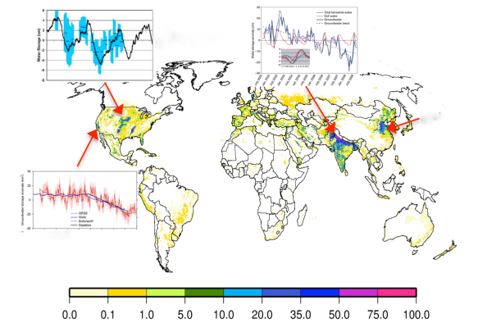
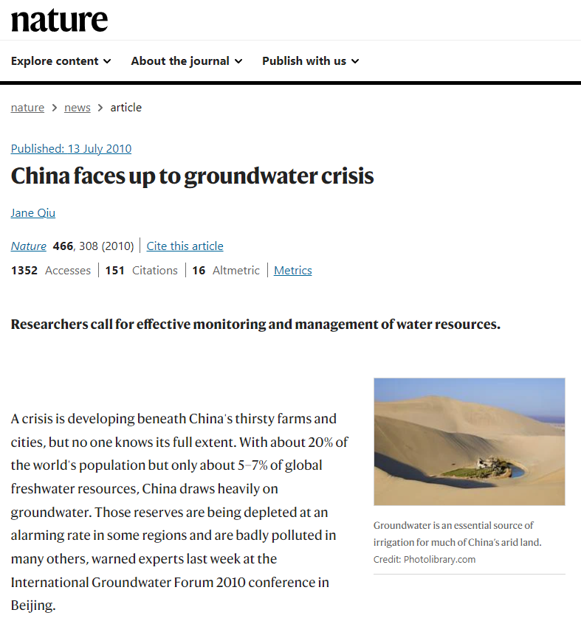
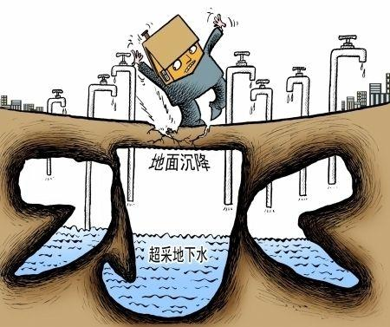
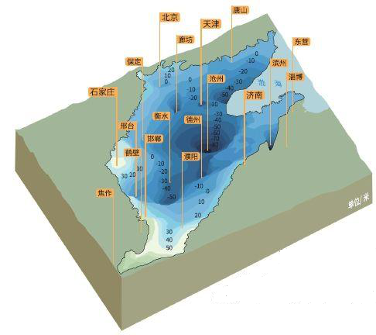
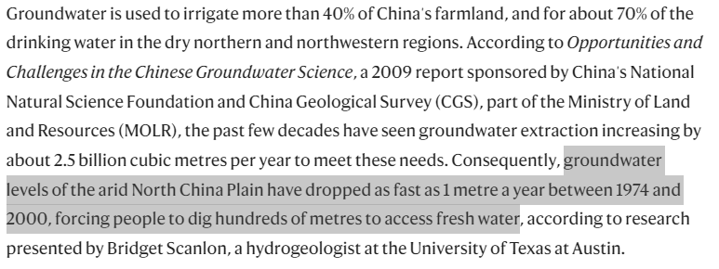
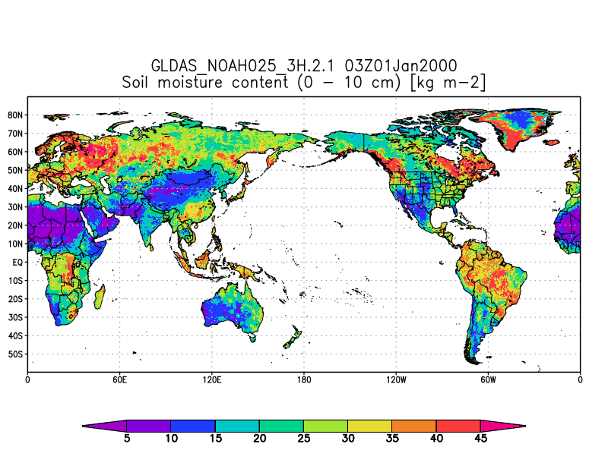
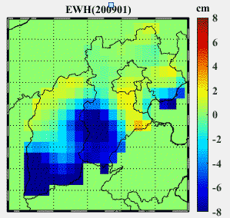
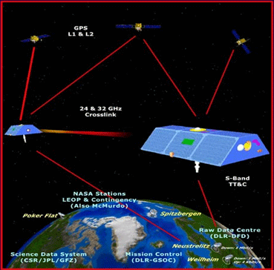
Introduction: Background
Great Plains
India
subsidence
North China
salinization
Central Valley
Focus on Groundwater change Based on GRACE + Hydrological models
GRACE/GRACE-FO

Slide 4
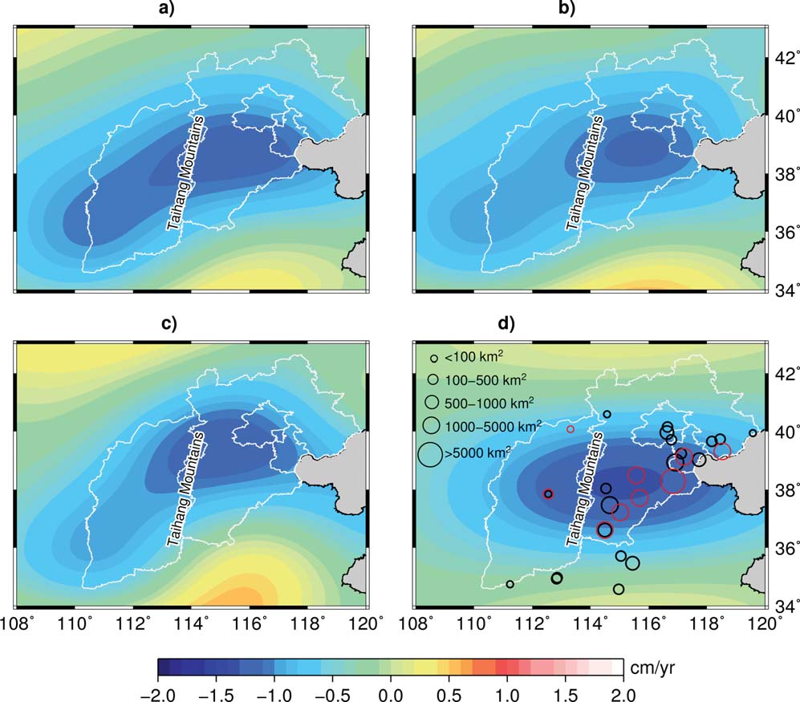
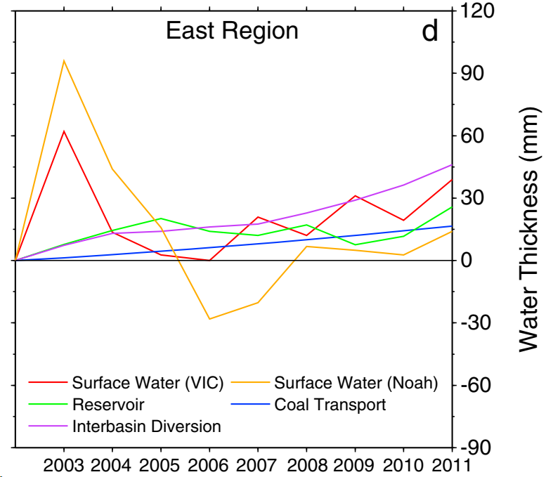

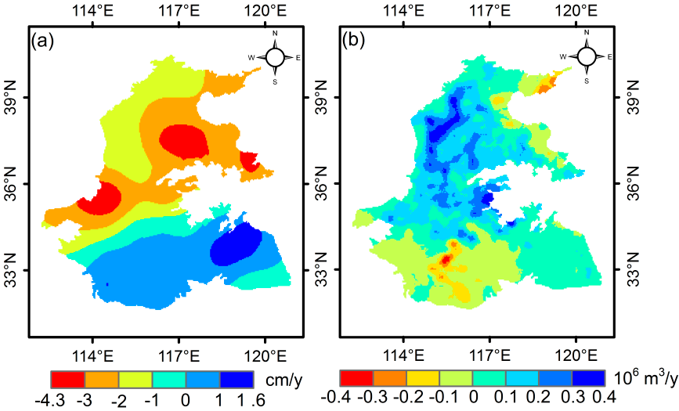
Introduction: Motivation
Current
Feng et al., 2013, WRR
Tang et al., 2013, GRL
water footprint (Su et al., 2020, JOH)
GRACE models with higher spatial resolution.
Hidden spatiotemporal features.
Quantitative identification of drivers.
Further

Slide 5
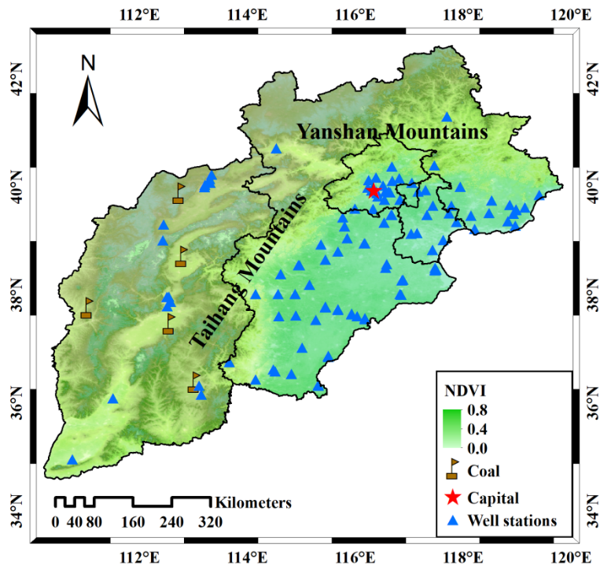

Introduction: Research object
Estimate terrestrial water storage anomaly (TWSA) and groundwater storage anomaly (GWSA) with high resolution model Tongji-RegGRACE2019.
Implement spatiotemporal decomposition for GWSA with ICA, explore the periodic characteristics of source signals.
Identify the driving factor and driving mechanism for GWSA source signals.

Slide 6
Data sets (2004-2015)
Variable | Source | Temporal resolution | Spatial resolution | Annotation
Terrestrial water storage (TWS) | GRACE (Tongji-RegGrace2019) | monthly | 0.5º×0.5º | Chen et al., 2021, JGR
Soil moisture (SM), snow water equivalent (SWE) | GLDAS | monthly | 0.25º×0.25º | Rodell, 2004, AMS
Surface water (SW), groundwater storage (GWS) | WGHM | monthly | 0.5º×0.5º | Döll et al., 2003, JOH
Evaporation | GLEAM | daily | 0.25º×0.25º | Martens et al., 2017, GMD
Precipitation | TCH Weighted product | monthly | 0.5º×0.5º | Xu et al., 2020, WRR
Groundwater level | Observation wells (2005-2014) | monthly | /
Water consumption of agricultural irrigation, industrial development | Yearbooks, bulletins | yearly | / | /
Coal mining | Yearbooks, bulletins | monthly and yearly | /
Normalized difference vegetation index (NDVI) | SPOT satellite | monthly | 1 km

Slide 7
Method: Drivers identification
Decomposing GWS with independent component analysis (ICA) to derive the spatial pattern (SP) and temporal component (TC)
Calculating grey absolute correlation degree (GACD) for each GWS component and drivers
Decomposition-ICA
Correlation-GACD
Normalized GWS matrix (m : epoch, n : gridpoint number):
Factor time series y and GWS time series u:
PCA
Initialization and first-order differential
Correlation
Absolute correlation degree
S, A
ICA
P, principal component (PC) matrix; E, eigenvector matrix
S, temporal component; A, spatial pattern
W, rotation matrix, estimated with Joint approximate diagonalization of eigenmatrices (JADE) algorithm (Cardoso 1993; Forootan and Kusche 2012; 2014)
GACD can analyze multiple factors simultaneously and rank the importance.

Slide 8
Results: TWSA and GWSA estimates
GWSA from GRACE and hydrologic model: GWSA=TWSA-SMA-SWEA-SWA
Trend (cm/yr) | 2004.01-2009.12 | 2010.01-2013.12 | 2014.01-2015.12 | 2004.01-2015.12 | 2005.01-2013.12
TWSA-GRACE | -1.96±0.12 | 0.72±0.27 | -4.64±0.54 | -1.00 ± 0.06
GWSA-GRACE |  |  | -3.71±0.49 | -0.87±0.04 | -0.85±0.06
GWSA-WGHM |  |  | -2.11±0.07 | -1.51±0.01 | -1.43±0.01
GWSA-Well |  |  |  |  | -0.80±0.03

Slide 9
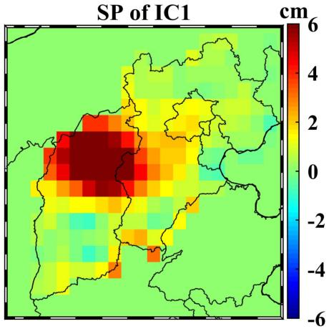
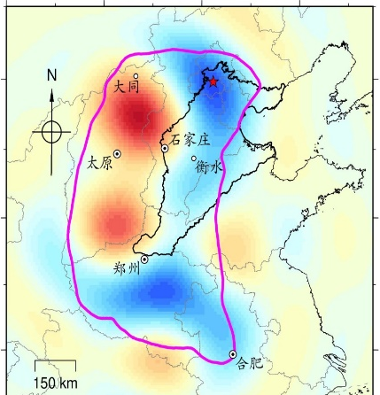
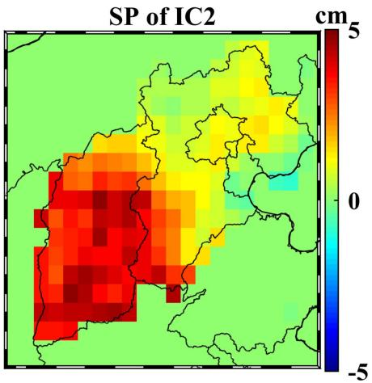
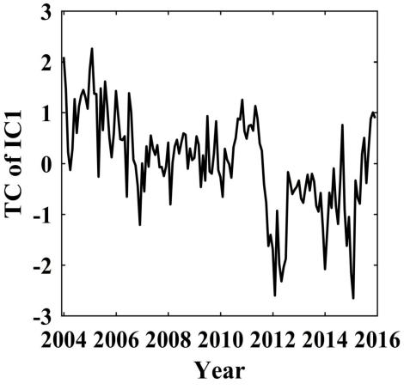
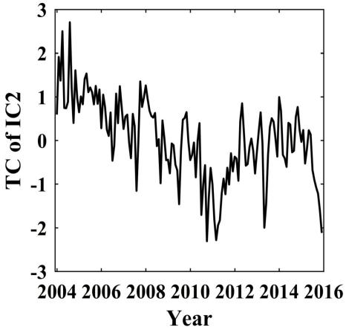
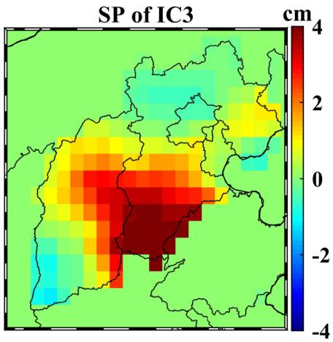
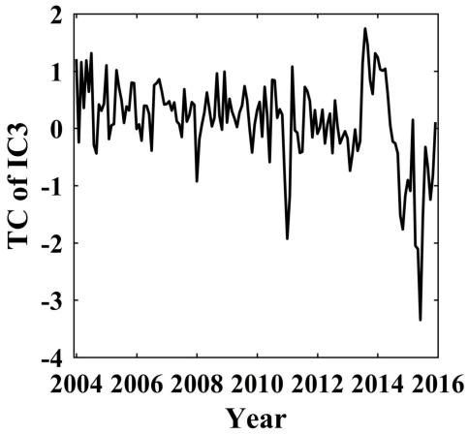
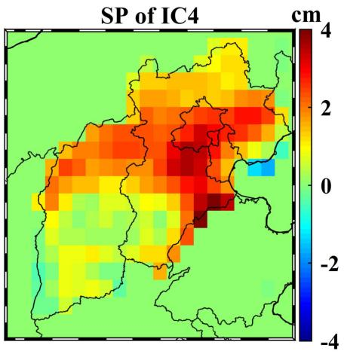
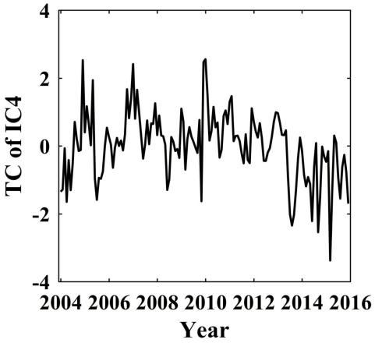
Results: Spatiotemporal decomposition for GWSA
Cumulative variance：89%
Contribution ratios：36，32，18，14%
TC is generally less clustered by different time cycles
SP shows distinct localized characterstics
Arctic Oscillation
and La Niña
Slepian localization analysis method (Han et al., 2021, CJG)

Slide 10
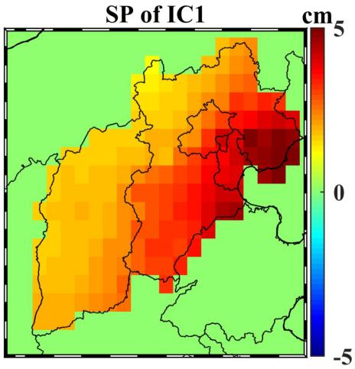
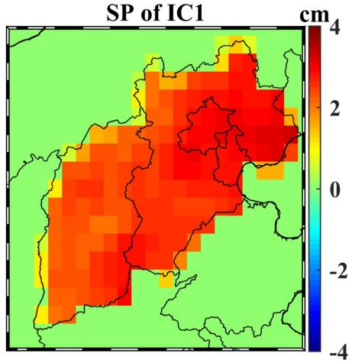
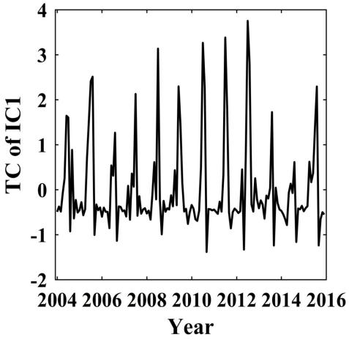
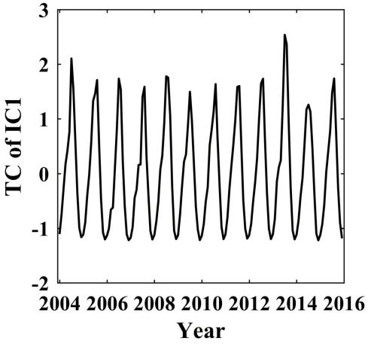
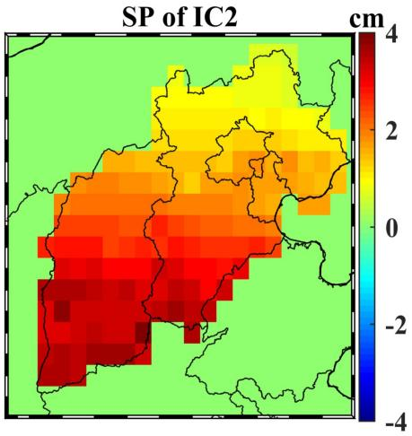
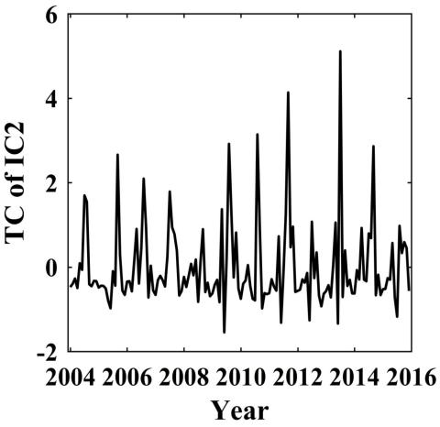
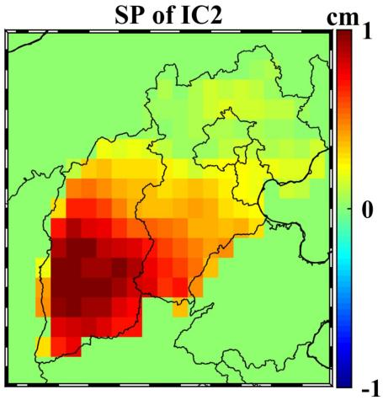
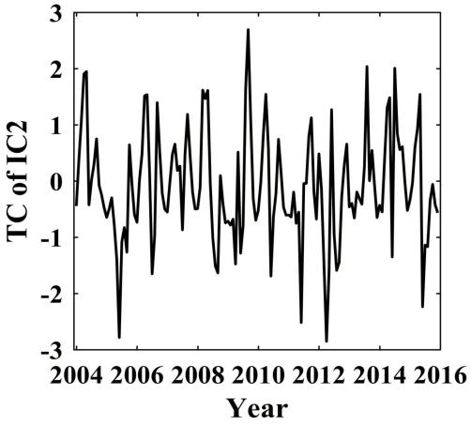
Results: Spatiotemporal decomposition for P and Et
Precipitation
Evaporation

Slide 11
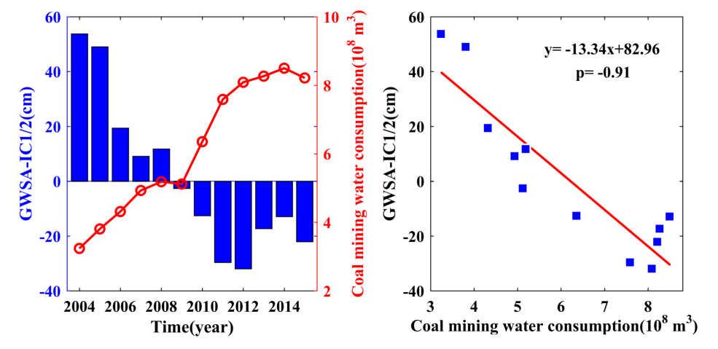
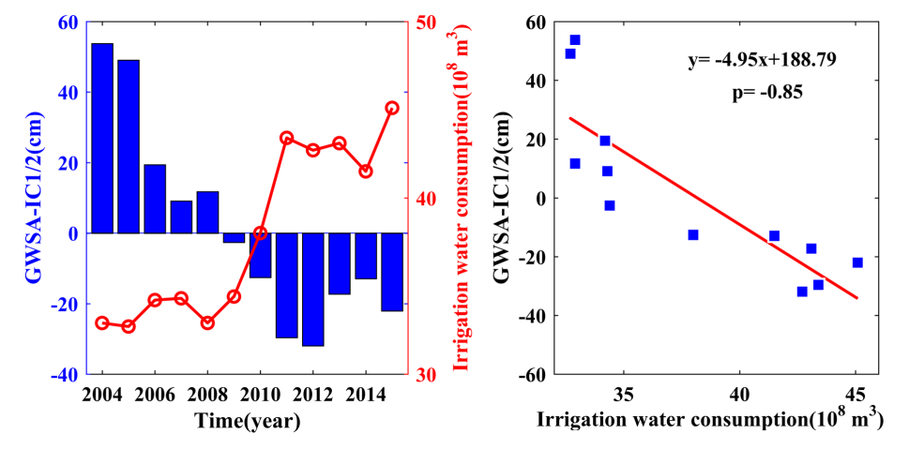
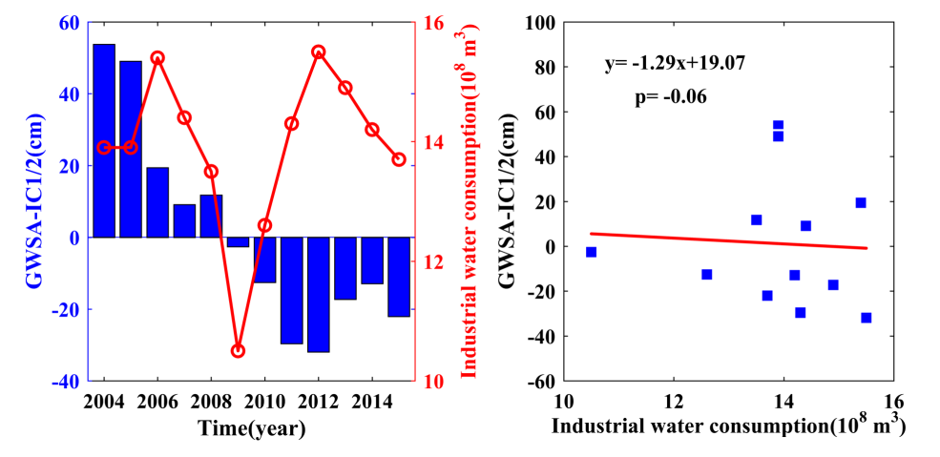
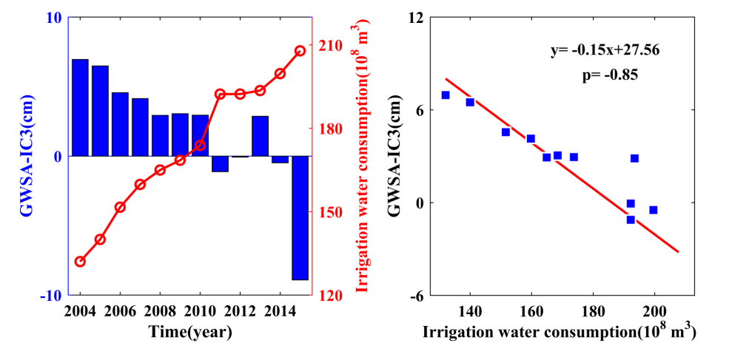
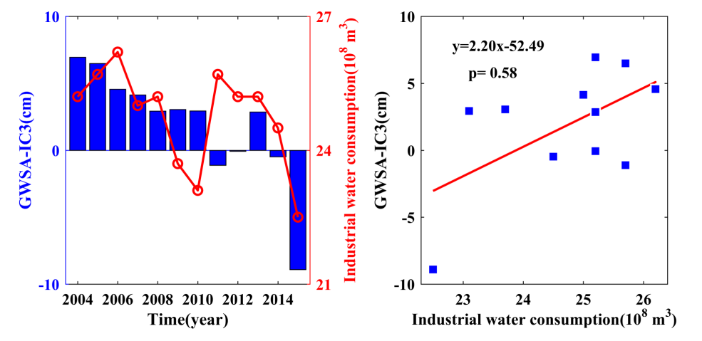
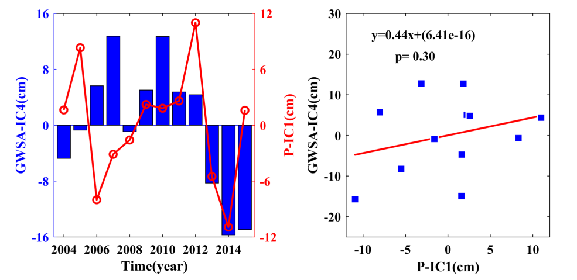
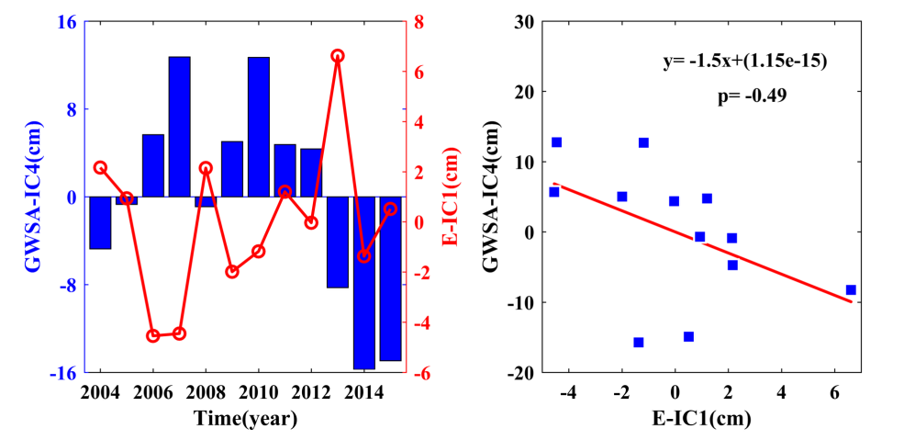
Results: Driving factors identification
Potential factors: irrigation, coal mining, industry, precipitation, evaporation

Slide 12
Results: Driving factors identification
Natural factors: precipitation, evaporation
Anthropogenic factors: agricultural irrigation, coal mining

Slide 13
Results: Intra-annual distributions
GWS declines throughout the first half of the year and reaches the annual low in July (-4.07 cm) before increasing rapidly during July to August, following by a gradual reduction again.
NDVI highlights a bimodal distribution, which matches with the growing season (annual double-cropping system) of crops.

Slide 14
Summary
GWS derived from Tongji-RegGRACE2019 in North China is depleted with a rate of -0.87±0.04 cm/yr from Jan. 2004 to Dec. 2015, which is basically consistent with that from monitoring well.
By ICA decomposition, the temporal components of GWSA present significant annual or intra-annual cycles, and the spatial pattern has distinct localized characteristics, which is helpful for identificating source signal.
The driving factors, including uneven spatiotemporal distribution of precipitation, intense seasonal evaporation, severe loss by coal mining, coupled with exhaustive exploitation for irrigation, jointly restrict the GWS rise and fall at different time nodes.
Feng, T., Shen, Y., Chen, Q., Wang, F., Zhang, X. (2022). Groundwater storage change and driving factor analysis in North China using independent component decomposition. J. Hydrol., 609, 127708, doi: 10.1016/j.jhydrol.2022.127708.

Slide 15
Major references
Feng, W., Zhong, M., Lemoine, J. M., Biancale, R., Hsu, H. T., Xia, J., 2013. Evaluation of groundwater depletion in North China using the gravity recovery and climate experiment (GRACE) data and ground-based measurements. Water Resour. Res. 49(4), 2110-2118.
Forootan, E., Kusche, J., 2012. Separation of global time-variable gravity signals into maximally independent components. J. Geod. 86(7), 477-497.
Forootan, E., Kusche, J., Loth, I., Schuh, W. D., 2014. Multivariate prediction of total water storage changes over west Africa from multi-satellite data. Surv. Geophys. 35(4), 913-940.
Han, J., Chen, S., Lu, H., Xu, W., 2021. Time-variable gravity field determination using Slepian functions and terrestrial measurements: A case study in North China with data from 2011 to 2013. Chin. J. Geophys. (in Chinese) 64(5), 1542-1557.
Liu, B., Dai, W., Liu, N., 2017. Extracting seasonal deformations of the Nepal Himalaya region from vertical GPS position time series using independent component analysis. Adv. Space Res., 60, 2910-2917.
Mei, Z. G., 1992. The concept and computation method of grey absolute correlation degree. Systems Engineering (in Chinese) 10, 43-44.
Tang, Q., Zhang, X., Yin, T., 2013. Anthropogenic impacts on mass change in North China. Geophs. Res. Lett. 40, 3924-3928.

Slide 16
Thank you for your attention !
Spatiotemporal Characteristics and Drivers of Groundwater Change in North China Revealed by GRACE Time-Variable Gravity Field
Tengfei Feng¹, Yunzhong Shen¹, Qiujie Chen¹, Fengwei Wang¹, Xingfu Zhang²
1. College of Surveying and Geo-Informatics, Tongji University
2. Department of Surveying and Mapping, Guangdong University of Technology
April 26, 2023
https://gteam.tongji.edu.cn/

