Slide 1
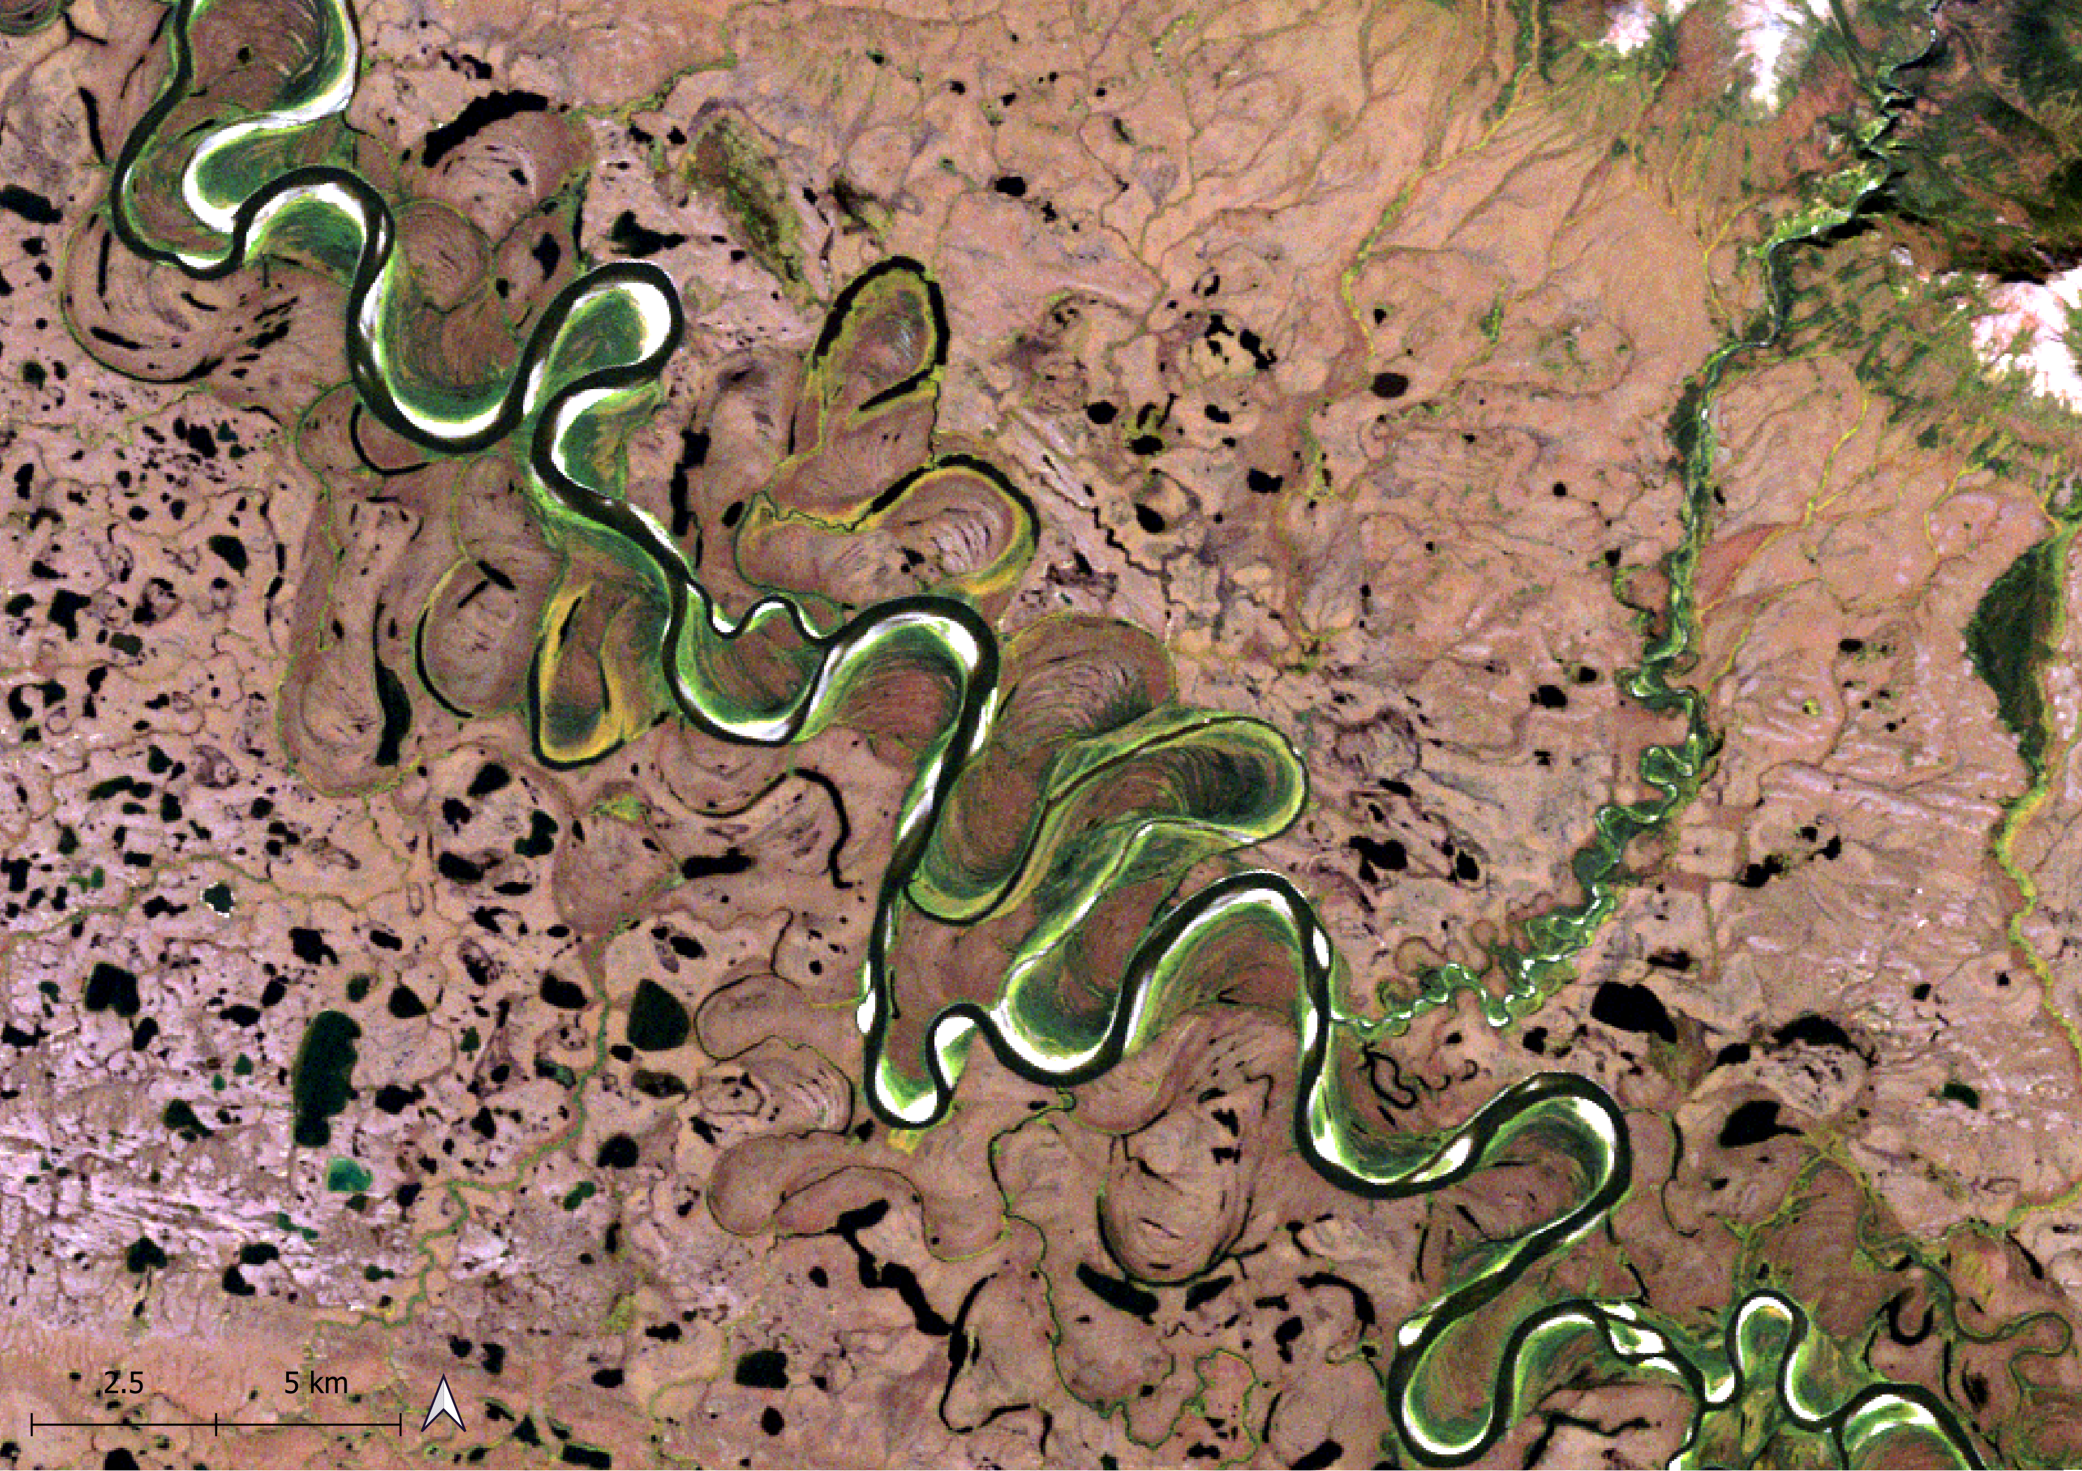
Morphological exploration of Arctic rivers using Google Earth Engine
EGU General Assembly 2023
GM5.1 | Progress in Fluvial and Estuarine Geomorphology: Process Dynamics, Big Data, and Data-driven Modeling
Convener: Anne Baar
Co-conveners: Simone Bizzi, Manudeo Singh, Richard Boothroyd, Paul Hudson, Lisanne Braat, Muriel Brückner
${\text{Marta} \text{Crivellaro}}^{1}$, ${\text{Riccardo} \text{Bonanomi}}^{1}, {\text{Niccol}\text{ò }\text{Ragno}}^{2}$, ${\text{Marco} \text{Tu}bino}^{2}$, ${\text{Guido} \text{Zolezzi}}^{1,2} and {\text{Alfonso} \text{Vitti}}^{2}$
1 University of Trento, Centre Agriculture Food Environment, Trento, Italy 2 University of Trento, Department of Civil, Environmental and Mechanical Engineering, Trento, Italy Fri, 28 Apr 2023 | 08:35–08:45 | EGU23-9966
Notes:
Good morning, I am Marta Crivellaro, PhD student at the University of Trento, Italy. First of all, thank you for being here at 8.35 of the morning in this EGU23 Friday after a quite intense week! I will try my best to boost your energy and curiosity introducing our work on the Morphological exploration of Arctic rivers using Google Earth Engine

Slide 2
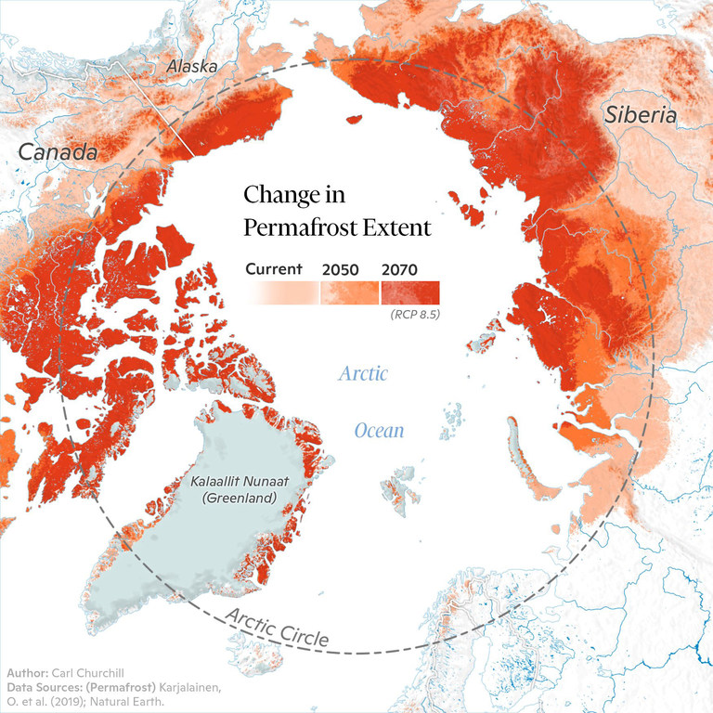
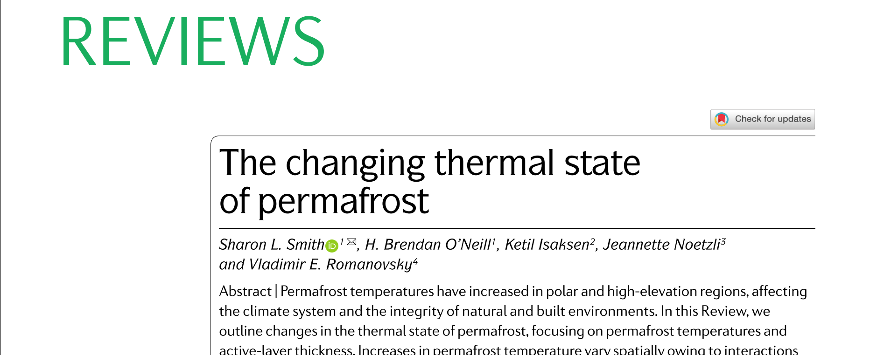
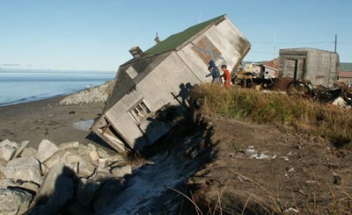
EGU23-9966 | GM 5.1 | 28 Apr 2023| Marta Crivellaro
Permafrost rivers in a warming climate
Permafrost thawing:
Greenhouse gases release (1)
Soil collapse and coastal erosion (2)
Communities’ displacement (3)
Source: Carl Churchill/Woodwell Research Center
Change in permafrost extent map.
Source: Alaska Conservation Foundation
(1) UN Environment , (2) U.S. Global Change Research Program, (3) UN
Notes:
Nowadays, many studies outline climate change impacts in the arctic region. Referring to permafrost related impacts, its thawing is already real and causing several environmental impacts ( greenhouse gases releases, soil and coastal erosion) and related damages to infrastructures’ damages, forcing many communitiesto displace.

Slide 3
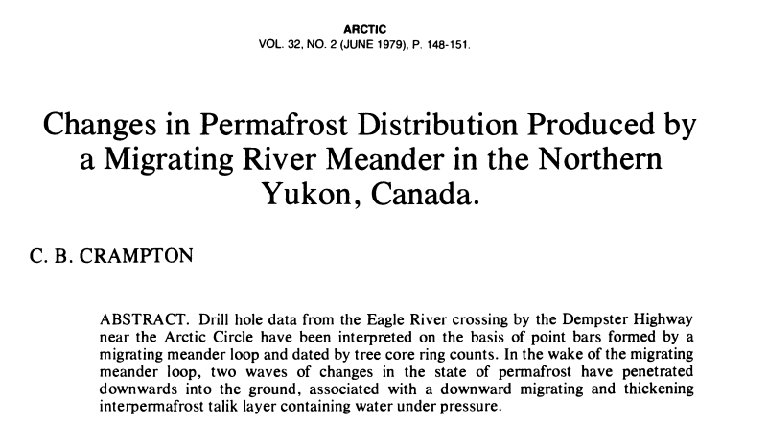
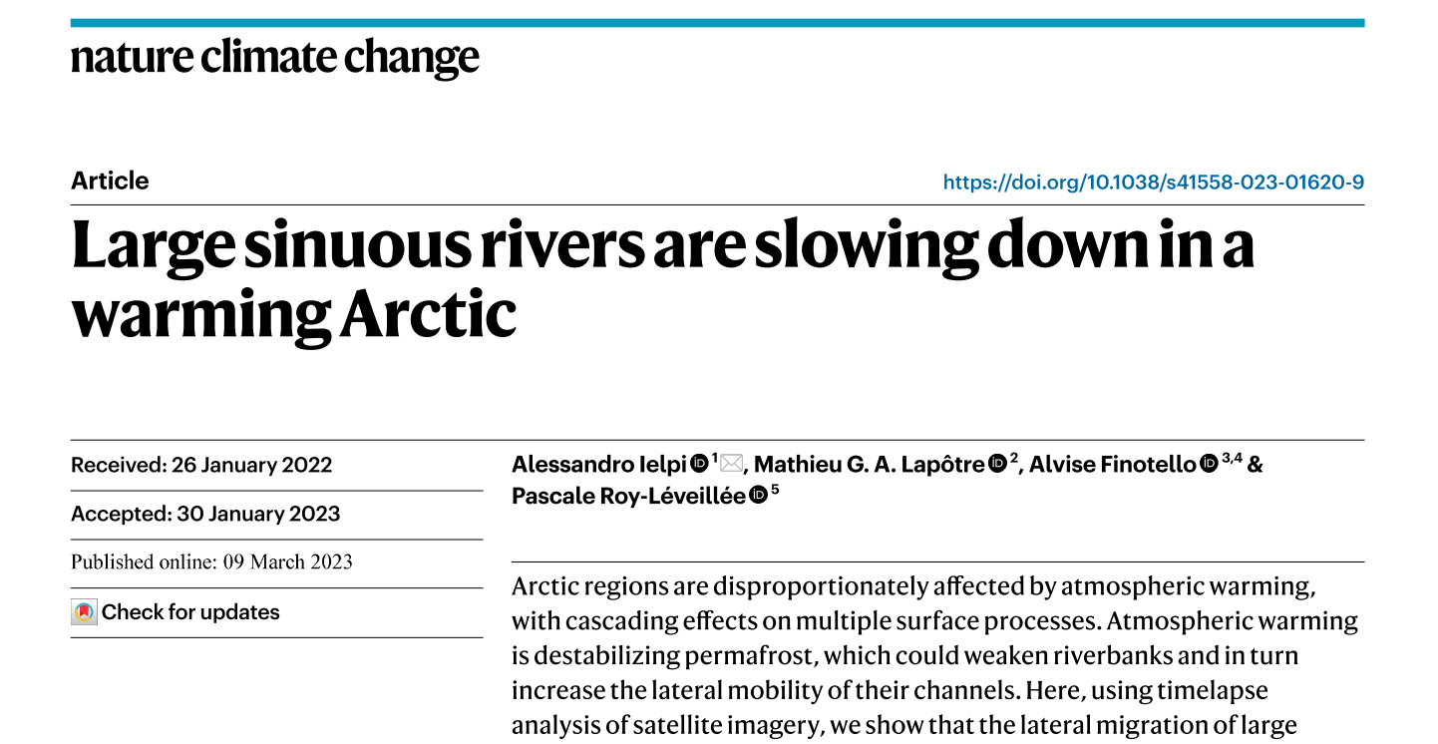
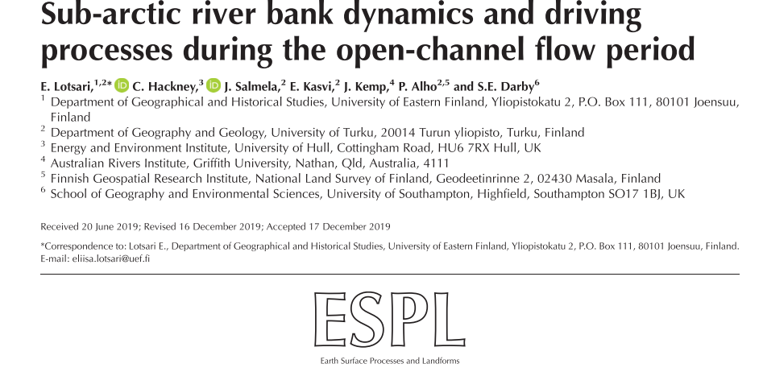
EGU23-9966 | GM 5.1 | 28 Apr 2023| Marta Crivellaro
Permafrost rivers in a warming climate
Most studies focus on mobility rates
→ slower migration rates than non-permafrost rivers
Difficult to assess net effect of climate warming on these systems
Notes:
And what about rivers flowing on permafrost? Up to now, most studies focus on mobility rates , outlining that meandering rivers flowing on permafrost tends to have slower migration rates, but the assessmentof the effect of climate warming on these systems remains difficult.

Slide 4
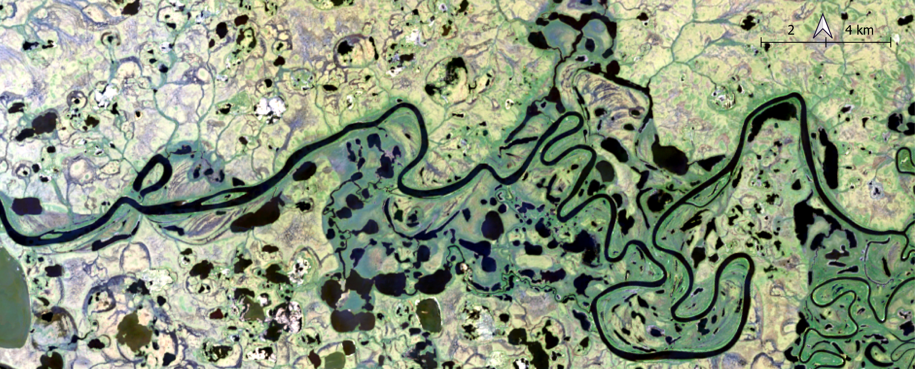
EGU23-9966 | GM 5.1 | 28 Apr 2023| Marta Crivellaro
Remote sensing exploration of meandering rivers flowing on permafrost
flow
River …
AND ….thermokarst lakes, sinkholes, pits
→ Spatial and multispectral complexities
Selawick River, Alaska – 2015 RGB seasonal median image from Landsat 8 Surface Reflectance products
Notes:
Having a look on a medium resolution multispectral image of a meandering river segment flowing on permafrost, as the Selawick river in Alaska you can see in the image, it is possible to notice that the river is flowing among thermokarst lakes, sinkholes, pits, typical of permafrost areas.

Slide 5
EGU23-9966 | GM 5.1 | 28 Apr 2023| Marta Crivellaro
Remote sensing exploration of meandering rivers flowing on permafrost
flow
Research Objective
Coupling of existing tools and image filtering and segmentation techniques to explore morphological evolution of Arctic rivers
Selawick River, Alaska – 2015 RGB seasonal median image from Landsat 8 Surface Reflectance products
Notes:
How to face these spatial and multispectral complexities using remote sensing? Our objective is to couple existing tools and image filtering and segmentation techniques to explore morphological evolution of Arctic rivers.

Slide 6
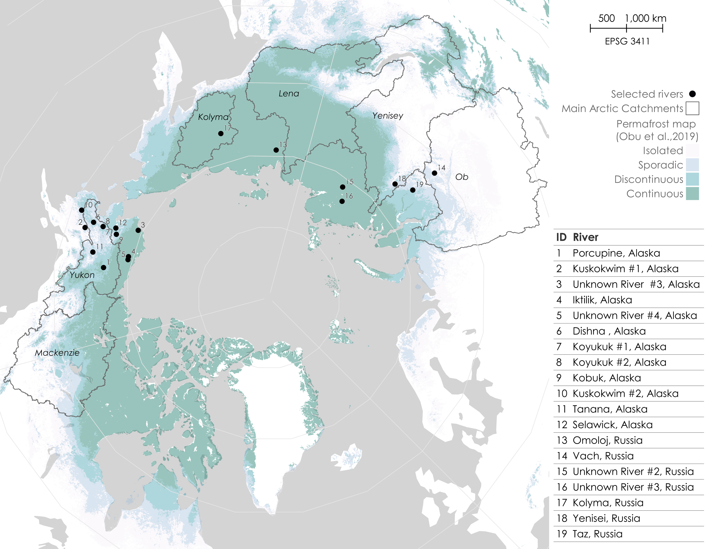
EGU23-9966 | GM 5.1 | 28 Apr 2023| Marta Crivellaro
Rivers meandering on permafrost: selected case studies
19 rivers
meandering on permafrost *
Multitemporal
active channel
extraction
Landsat 5/7/8 images
1985-2020
54 active channel masks of river segments
* Permafrost map proposed by Obu et al., 2019
Notes:
To investigate morphological dynamics od permafrost rivers flowing on permafrost, we selected a set of 19 meandering rivers flowing of permafrost in Alaska and Russia for the multitemporal extraction of active channel masks from Landsat Surface Reflectance products from 1985 to 2020, for a total of 54 active channel masks of river segments.

Slide 7
EGU23-9966 | GM 5.1 | 28 Apr 2023| Marta Crivellaro
Landsat 5-7-8 SR
Methods
+
MNDWI
Saturation
NDVI
GEE: Image preprocessing
Landsat SR products collection
Multispectral indexes collection creation
Reduction to representative images Image filtering and segmentation
Active channel mask extraction
Representative MNDWI
Representative Saturation
Representative NDVI
Perona-Malik* filter
Otsu ** segmentation
Otsu ** segmentation
Thresholding
Active channel mask
PyRIS: Metrics extraction***
Selection
Skeletonization
Axis delineation
Metrics extraction
Mask features selection
Image collection
Skeletonization
Image
e.g. half width, migration rate,
curvature, bend index
Axis.csv
Axis extraction
Operation
Metrics.csv
Morphological metrics extraction
csv
* Perona & Malik, 1987 , ** OTSU, 1979, ***Monegaglia et al. 2018
Notes:
In this work, we combined GEE WITH PYRIS tool, developed by Monegaglia et al., 2018. Taking advantage of the cloud, the first part of our approach is Image preprocessing in GEE, producing the active channel mask as input to PyRIS, which is able to provide morphological metrics such as axis, half width , migration rates, curvature, bend index.

Slide 8
EGU23-9966 | GM 5.1 | 28 Apr 2023| Marta Crivellaro
Landsat 5-7-8 SR
Methods
MNDWI
Saturation
NDVI
GEE: Image preprocessing
Landsat SR products collection
Multispectral indexes collection creation
Reduction to representative images Image filtering and segmentation
Active channel mask extraction
Representative MNDWI
Representative Saturation
Representative NDVI
Perona-Malik* filter
Otsu ** segmentation
Otsu ** segmentation
Thresholding
Active channel mask
PyRIS: Metrics extraction***
Selection
Skeletonization
Axis delineation
Metrics extraction
Mask features selection
Image collection
Skeletonization
Image
e.g. half width, migration rate,
curvature, bend index
Axis.csv
Axis extraction
Operation
Metrics.csv
Morphological metrics extraction
csv
* Perona & Malik, 1987 , ** OTSU, 1979, ***Monegaglia et al. 2018
Notes:
I will briefly present the major steps of the preprocessing phase, adapted for permafrost environments.

Slide 9
EGU23-9966 | GM 5.1 | 28 Apr 2023| Marta Crivellaro
Landsat 5-7-8 SR
Methods – GEE Image preprocessing
Multispectral indexes in permafrost environments
Multispectral indexes
Representative Images
General indexes
NDVI (Rouse et al., 1973)
EVI (Jiang et al., 2003)
NDWI ( McFeeters, 1996)
AWEI (Mustafa et al., 2017))
RGB to HSV (Spada et al., 2018)
MNDWI (Xu, 2006)
Permafrost-Specific indexes
ILI Icy Lakes Index
WICI Water-Ice Classification Index (Barbieux et al., 2018)
Filtering
Segmentation
Active channel mask
Notes:
First of all? Which multispectral indexes can be considered for active channel extraction? Some permafrost specific indexes have been proposed in literature, mainly for Iced surface water, and not properly suitable for our scope. Thus, we selected some more general indexes and information in our studi, as the NDVI, Saturation values and MNDWI.

Slide 10
EGU23-9966 | GM 5.1 | 28 Apr 2023| Marta Crivellaro
Landsat 5-7-8 SR
Methods – GEE Image preprocessing
Multispectral indexes in permafrost environments
Multispectral indexes
Representative Images
General indexes
NDVI (Rouse et al., 1973)
EVI (Jiang et al., 2003)
NDWI ( McFeeters, 1996)
AWEI (Mustafa et al., 2017))
RGB to HSV (Spada et al., 2018)
MNDWI (Xu, 2006)
Permafrost-Specific indexes
ILI Icy Lakes Index
WICI Water-Ice Classification Index (Barbieux et al., 2018)
Filtering
Segmentation
Active channel mask
Synthetic representative images
Seasonal/annual composites
Median/90p value per each pixel*
→ f(Hydrological regime, study objective)
Arctic rivers hydrological and thermal regimes
Tolovana river
Alaska
USGS
* Boothroyd et al., 2021 and ongoing research
Notes:
Secondly, we aim to have a representative image of the active channel on annual basis. The use of representative synthetical images derived from images reduction in a defined time range is established in riverine remote sensing. Anycase, it’s always important to decline the composites considering the hydrological regime and the study objective. In our case, arctic rivers are carachterized by a limited hydro-morphological activity, as exemplified by the Tolovana river, in Alaska, thermal and hydrological regime.

Slide 11
EGU23-9966 | GM 5.1 | 28 Apr 2023| Marta Crivellaro
Landsat 5-7-8 SR
Methods – GEE Image preprocessing
Multispectral indexes in permafrost environments
Multispectral indexes
Representative Images
General indexes
NDVI (Rouse et al., 1973)
EVI (Jiang et al., 2003)
NDWI ( McFeeters, 1996)
AWEI (Mustafa et al., 2017))
RGB to HSV (Spada et al., 2018)
MNDWI (Xu, 2006)
Permafrost-Specific indexes
ILI Icy Lakes Index
WICI Water-Ice Classification Index (Barbieux et al., 2018)
Filtering
Segmentation
Active channel mask
Synthetic representative images
Seasonal/annual composites
Median/90p value per each pixel*
→ f(Hydrological regime, study objective)
May to September for each available year
Arctic rivers hydrological and thermal regimes
Tolovana river
Alaska
USGS
* Boothroyd et al., 2021
Notes:
Thus the considered seasonal composite goes from May to September,

Slide 12
EGU23-9966 | GM 5.1 | 28 Apr 2023| Marta Crivellaro
Landsat 5-7-8 SR
Methods – Anisotropic image filtering
Multispectral indexes
Perona Malik (PM) anisotropic filter
aim: reducing image noise without reducing
the image’s quality in the process
Representative Images
PM GEE Variables **
Input raw image | MNDWI seasonal image
Number of iterations | 5
Kernel dimension | 30m
2D isotropic Gaussian filter creation (based on a defined lambda value) | Lambda = 0.3
Filtering
Segmentation
Active channel mask
Lambda value assessment for permafrost environments
*Perona and Malik, 1987, **Donchyts, 2018
Notes:
Third, how to simplify spatial complexity keeping the information related to the active channel? Perona-Malik diffusion or anisotropic diffusion is a computer vision filtering technique that aims at reducing image noise without reducing the image’s quality in the process. This diffusion technique an image generates a parameterized family of successively more and more blurred images based on a diffusion process. Each of the resulting images in this filter is given as a convolution between the image and a 2D isotropic Gaussian filter. This diffusion is a linear and space invariant transformation of the original image. Anisotropic diffusion is a much generalized version of the diffusion process.
Starting from Perona Malik GEE implementation proposed by Donchyts et al, we assessed lambda (Gaussian filter parameter) value testing a different range of it in a subset of out dataset, deriving as lambda = 0.3 as a satysfing result in terms of spatial simplification maintaining the delineation of river features ( lower std)

Slide 13
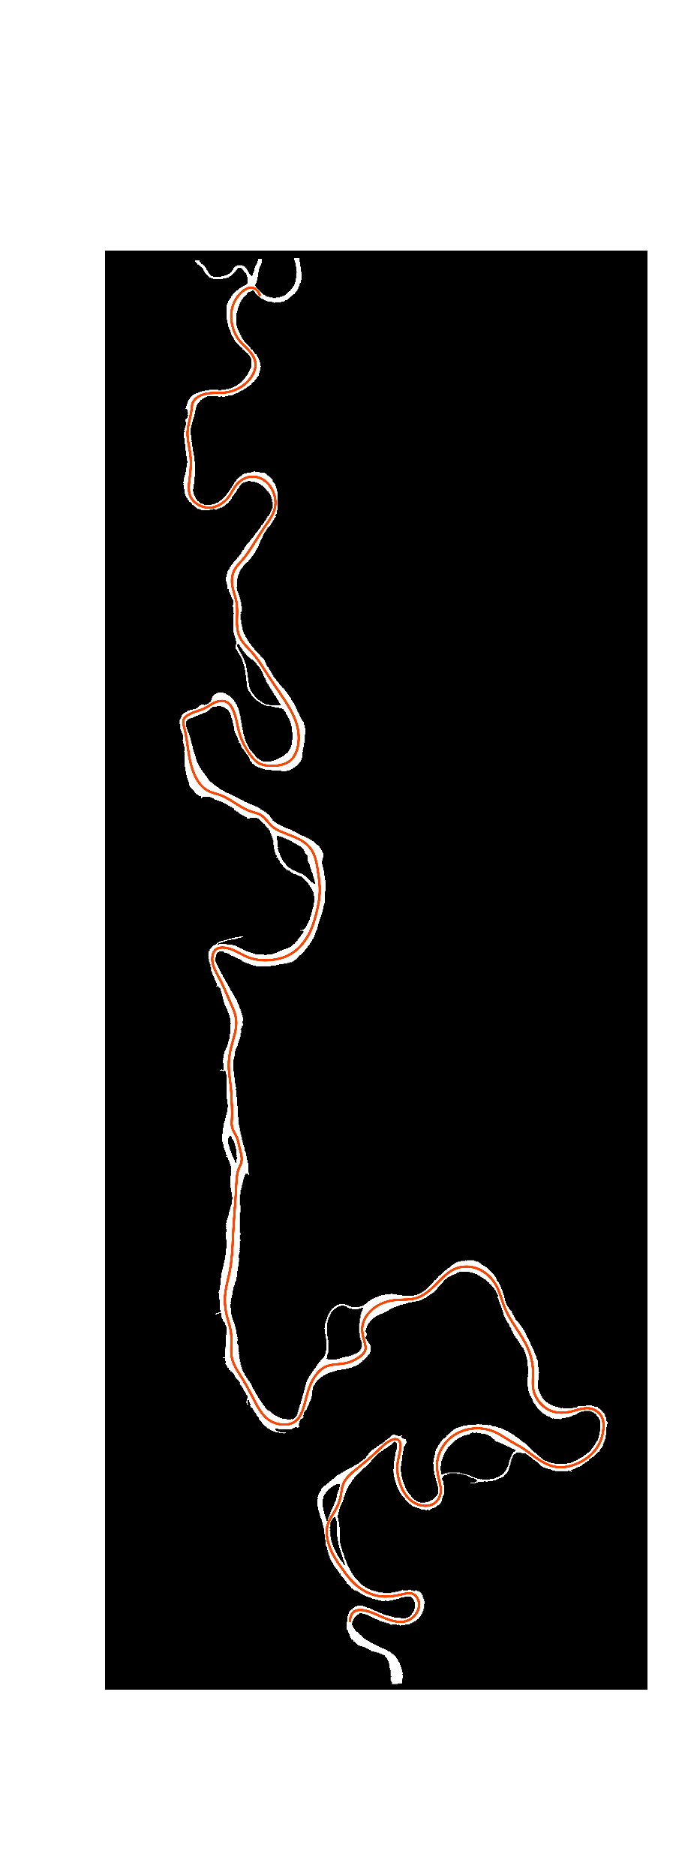
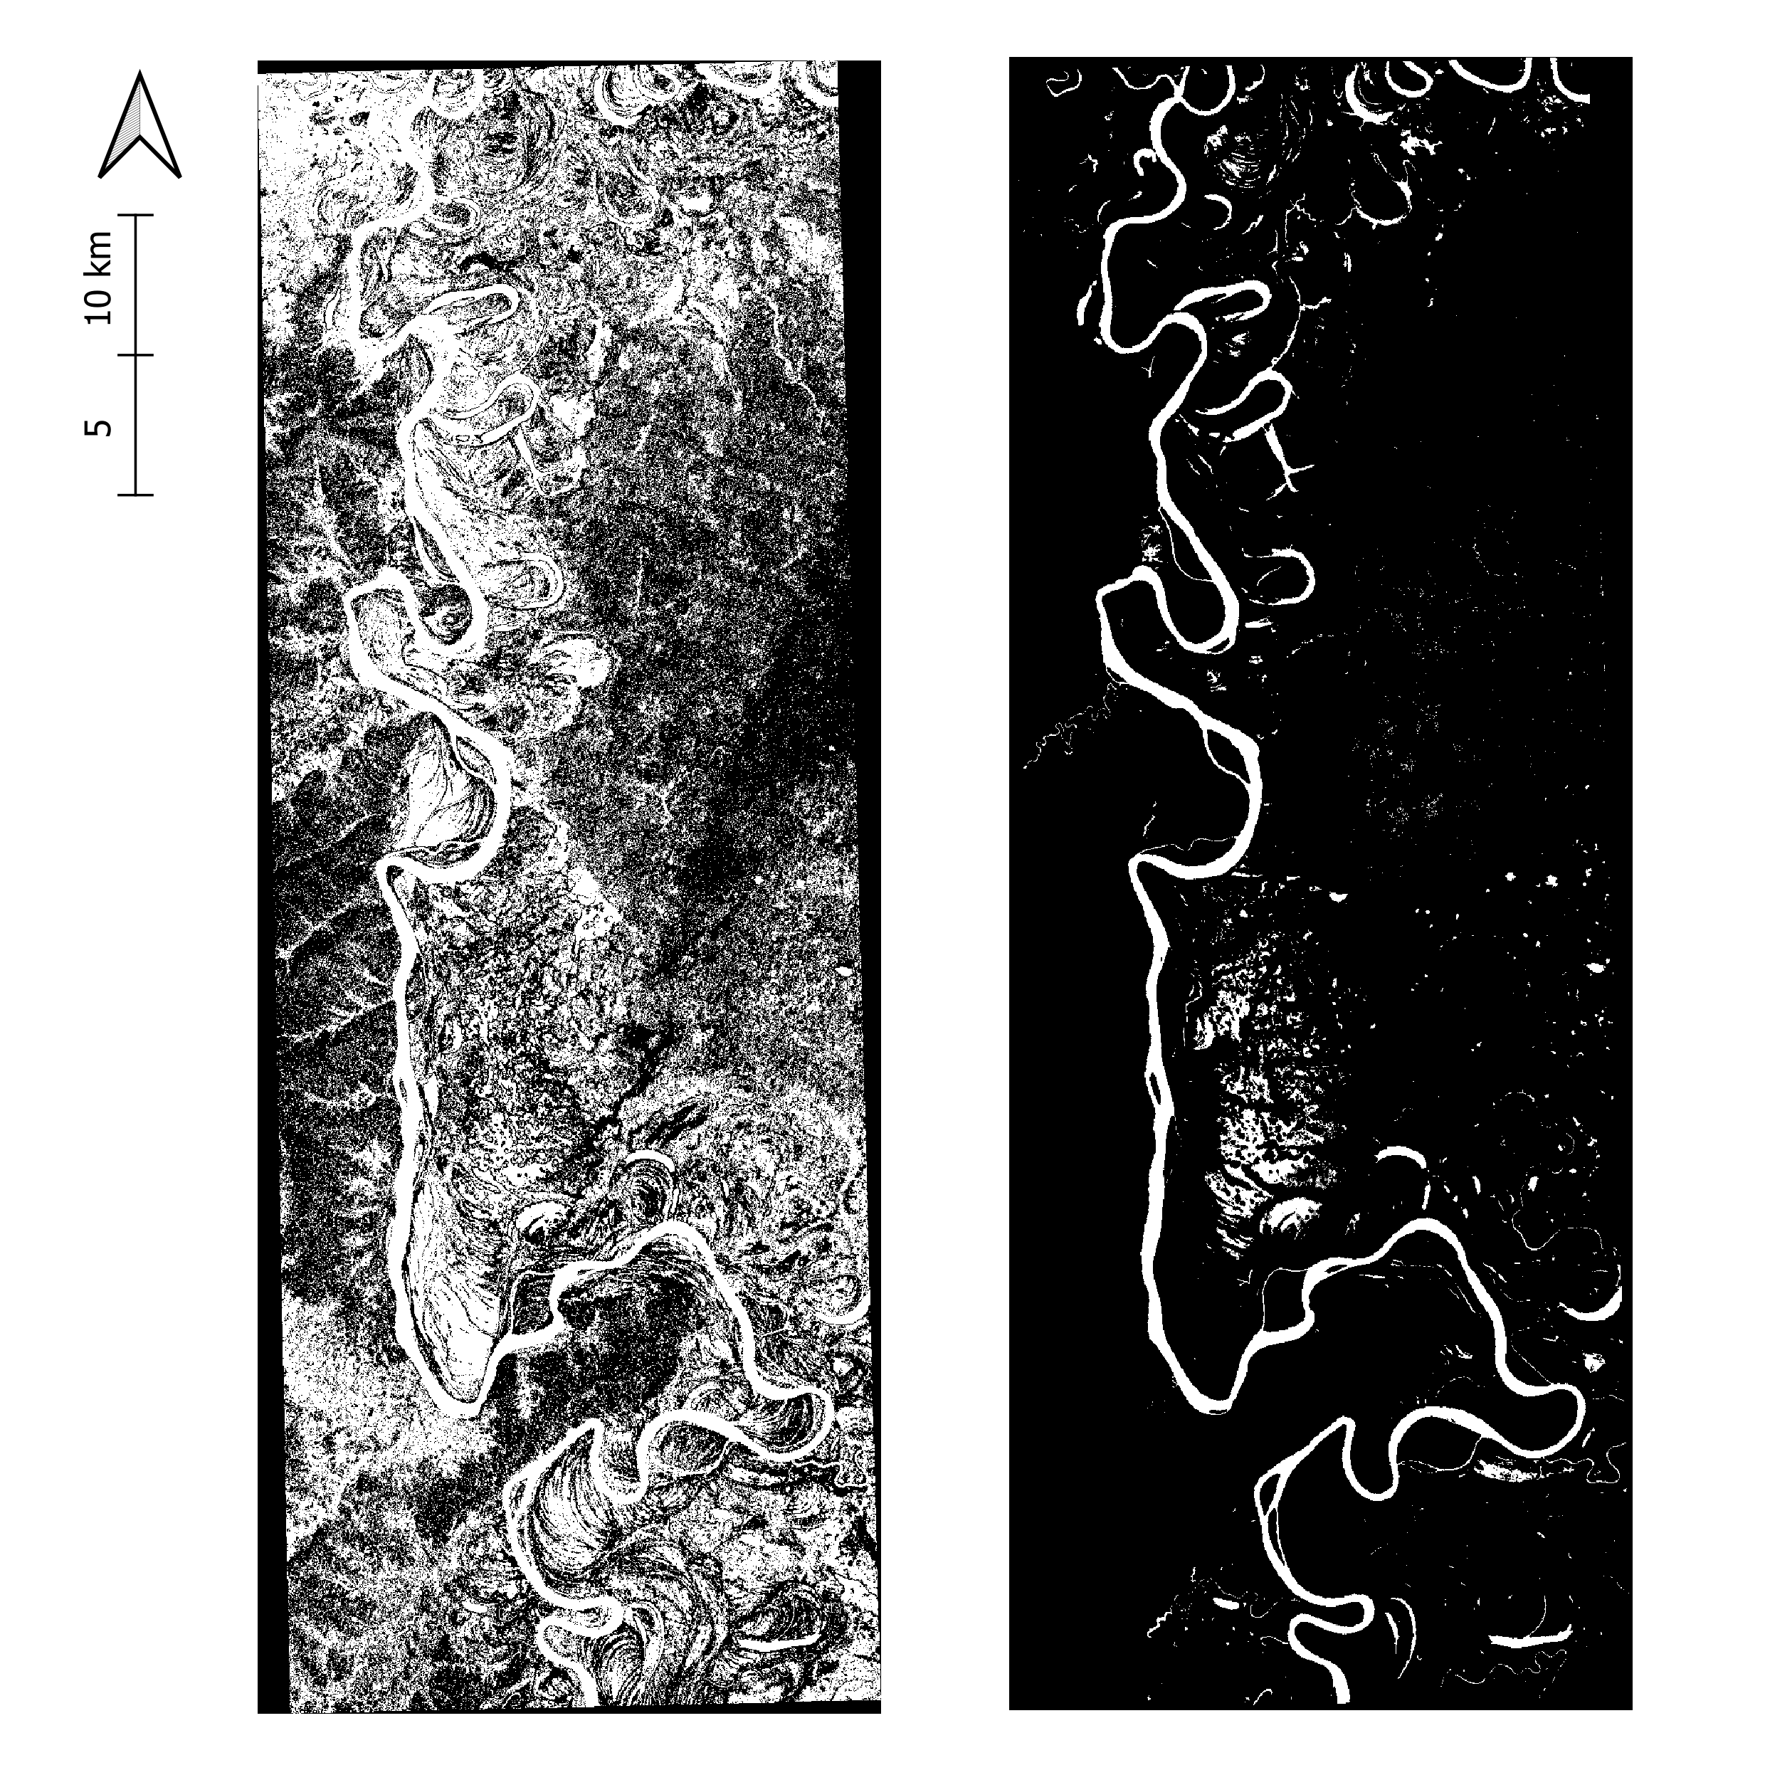
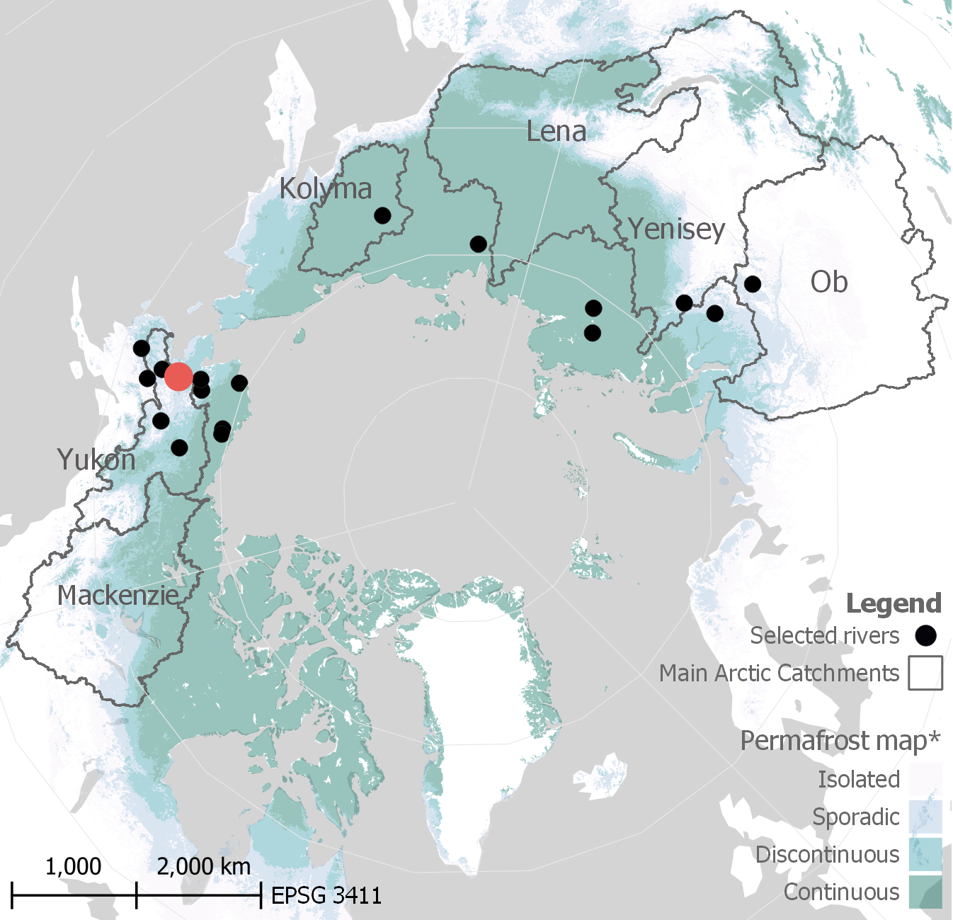
EGU23-9966 | GM 5.1 | 28 Apr 2023| Marta Crivellaro
Results: morphological metrics in spatially-complex areas
Koyukuk
(Alaska)
1986
flow
Raw Mask
(without Perona-Malik
applied to MNDWI)
Active channel feature
and centerline
Filtered Mask
Notes:
Results of the image preprocessing outlines the potentiality of Anisotropic image filtering and authomatic segmentation to enhance river active channel extraction in spatial and multispectral complex areas, as you can see in this example of the Koyukuk river segment, where the first and the second images show the masks derived without and with MDNWI anisotropic filtering.

Slide 14
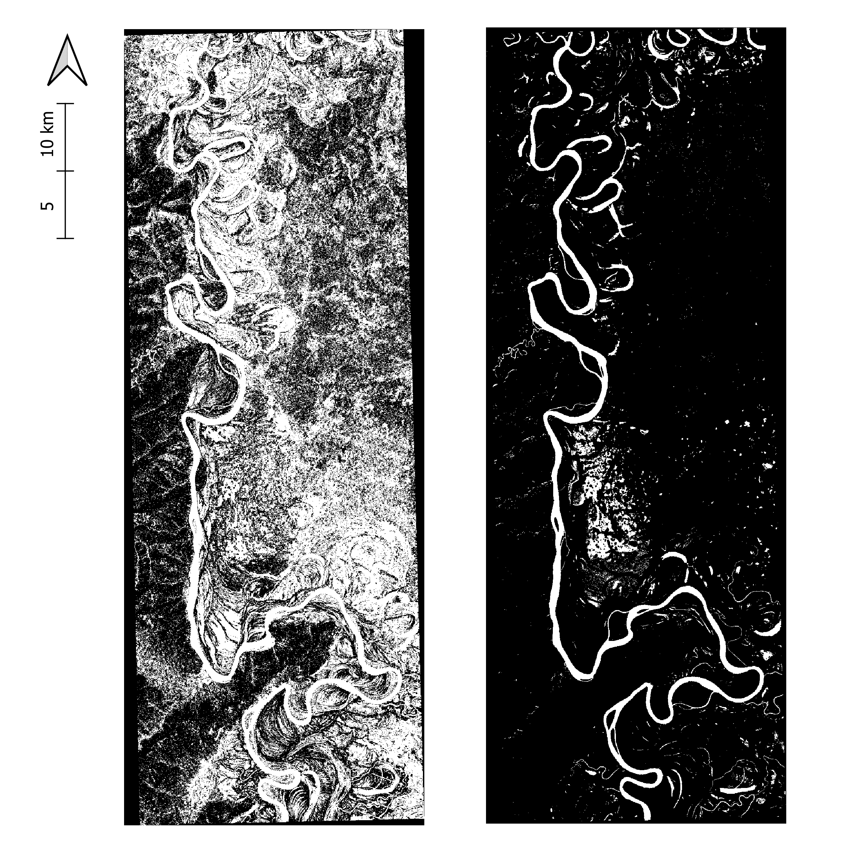
EGU23-9966 | GM 5.1 | 28 Apr 2023| Marta Crivellaro
Results: morphological metrics in spatially-complex areas
Koyukuk
(Alaska)
2006
flow
Raw Mask
(without Perona-Malik
applied to MNDWI)
Active channel feature
and centerline
Filtered Mask
Notes:
And the same for the same river in 2006

Slide 15
EGU23-9966 | GM 5.1 | 28 Apr 2023| Marta Crivellaro
Take home messages
GEE & PyRIS integration
Methodology to tackle spatial and multispectral complexities of permafrost environments
Preliminary database of meandering rivers flowing on permafrost environment to better understands river processes and inherent spatiotemporal scales in arctic climates and climate change implications
If you want to know more….
Looking for permafrost signatures in Arctic streams: the case of meandering rivers
…Jump to our EGU23 contribution!
EGU23-9776 , session GM 5.2
Notes:
To conclude, we suggest to work mor for the integration of existing tools, for data driven modeling in fluvial geomorphology. Moreover, we propose novel methodology to tackle spatial and multispectral complexities of permafrost environments, setting up a preliminary database of meandering actic rivers.
If you want to know more about permafrost signature on such rivers, I warmly suggest you to jump back to yesterday presentation of my colleague Niccolò Ragno

Slide 16
Morphological exploration of Arctic rivers using Google Earth Engine
EGU General Assembly 2023
GM5.1 | Progress in Fluvial and Estuarine Geomorphology: Process Dynamics, Big Data, and Data-driven Modeling
Convener: Anne Baar
Co-conveners: Simone Bizzi, Manudeo Singh, Richard Boothroyd, Paul Hudson, Lisanne Braat, Muriel Brückner
Thank you for
your attention!
${\text{Marta} \text{Crivellaro}}^{1}$, ${\text{Riccardo} \text{Bonanomi}}^{1}, {\text{Niccol}\text{ò }\text{Ragno}}^{2}$, ${\text{Marco} \text{Tu}bino}^{2}$, ${\text{Guido} \text{Zolezzi}}^{1,2} and {\text{Alfonso} \text{Vitti}}^{2}$
marta.crivellaro@unitn.it
1 University of Trento, Centre Agriculture Food Environment, Trento, Italy 2 University of Trento, Department of Civil, Environmental and Mechanical Engineering, Trento, Italy
3 California Institute of Technology, Geological and Planetary Sciences, Pasadena, California, USA Fri, 28 Apr 2023 | 08:35–08:45 | EGU23-9966
Notes:
Thank you for you attention!

Slide 17
EGU23-9966 | GM 5.1 | 28 Apr 2023| Marta Crivellaro
References
Kévin Barbieux, Antigoni Charitsi & Bertrand Merminod (2018) Icy lakes extraction and water-ice classification using Landsat 8 OLI multispectral data, International Journal of Remote Sensing, 39:11, 3646-3678, DOI: 10.1080/01431161.2018.1447165
Donchyts, Gennadiy. (2018). Planetary-scale surface water detection from space. 10.4233/uuid:510bd39f-407d-4bb6-958e-dea363c5e2a8.
Hanqiu Xu (2006) Modification of normalised difference water index (NDWI) to enhance open water features in remotely sensed imagery, International Journal of Remote Sensing, 27:14, 3025-3033, DOI: 10.1080/01431160600589179
Jiang, Z., Huete, A., Didan, K., & Miura, T. (2008). Development of a two-band enhanced vegetation index without a blue band. Remote Sensing of Environment, 112(10), 3833–3845. https://doi.org/10.1016/j.rse.2008.06.006
S. K. McFEETERS (1996) The use of the Normalized Difference Water Index (NDWI) in the delineation of open water features, International Journal of Remote Sensing, 17:7, 1425-1432, DOI: 10.1080/01431169608948714
Monegaglia, F., Zolezzi, G., Güneralp, İ., Henshaw, A. J., & Tubino, M. (2018). Automated extraction of meandering river morphodynamics from multitemporal remotely sensed data. Environmental Modelling and Software, 105, 171–186. https://doi.org/10.1016/j.envsoft.2018.03.028
Mustafa Mustafa T., Hassoon Khalid I., Hassan Modher and Abd Modher H. "Using water indices (NDWI, MNDWI, NDMI, WRI and AWEI) to detect physical and chemical parameters by apply remote sensing and GIS techniques". International Journal of Research - Granthaalayah 5, no. 10 (2017): 117-128.
Obu, J., Westermann, S., Bartsch, A., Berdnikov, N., Christiansen, H. H., Dashtseren, A., Delaloye, R., Elberling, B., Etzelmüller, B., Kholodov, A., Khomutov, A., Kääb, A., Leibman, M., Lewkowicz, A. G., Panda, S., Romanovsky, V., Way, R. G., Westergaard-Nielsen, A., Zhao, L.,. Zou, D. (2019). Northern Hemisphere permafrost map based on TTOP modelling for 2000–2016 at 1 km2 scale. Earth-Science Reviews, 193, 299–316. https://doi.org/10.1016/j.earscirev.2019.04.023
Pietro Perona and Jitendra Malik (November 1987). "Scale-space and edge detection using anisotropic diffusion". Proceedings of IEEE Computer Society Workshop on Computer Vision. pp. 16–22.
Pietro Perona and Jitendra Malik (July 1990). "Scale-space and edge detection using anisotropic diffusion" (PDF). IEEE Transactions on Pattern Analysis and Machine Intelligence. 12 (7): 629–639. doi:10.1109/34.56205. S2CID 14502908.
Rouse, J.W., Haas, R.H., Schell, J.A. and Deering, D.W. (1973) Monitoring Vegetation Systems in the Great Plains with ERTS (Earth Resources Technology Satellite). Proceedings of 3rd Earth Resources Technology Satellite Symposium, Greenbelt, 10-14 December, SP-351, 309-317.
Spada, Daniele, Paolo Molinari, Walter Bertoldi, Alfonso Vitti, and Guido Zolezzi. 2018. "Multi-Temporal Image Analysis for Fluvial Morphological Characterization with Application to Albanian Rivers" ISPRS International Journal of Geo-Information 7, no. 8: 314. https://doi.org/10.3390/ijgi7080314

Slide 18
EGU23-9966 | GM 5.1 | 28 Apr 2023| Marta Crivellaro
Supplementary Materials - Database
ID | River | Years |  |  |  |  |  | Migration
1 | Porcupine | 1985 | 1991 | 2010 | 2017 | 2020 |  | yes
2 | Kuskokwim | 1986 | 2007 | 2008 |  |  |  | yes
3 | UnknownAlaska3 | 2015 | 2020 |  |  |  |  | yes
4 | Iktilik | 1985 |  |  |  |  |  | no
5 | UnknownAlaska4 | 1985 | 1986 |  |  |  |  | yes
6 | Dishna | 2006 |  |  |  |  |  | no
7 | KoyukukUpstream | 1985 | 1986 | 2006 |  |  |  | yes
8 | KoyukukDownstream | 1985 | 1986 | 2006 | 2007 |  |  | yes
9 | Kobuk | 1985 | 2006 | 2015 | 2019 | 2021 |  | yes
10 | Kuskokwim2 | 2008 | 2019 | 2022 |  |  |  | yes
11 | Tanana | 1991 | 2007 | 2019 | 2021 |  |  | yes
12 | Selawick | 1986 | 2015 | 2019 | 2021 |  |  | yes
13 | Omoloj | 2007 | 2011 | 2017 | 2020 |  |  | yes
14 | Vach | 2006 | 2010 | 2015 |  |  |  | no
15 | UnknownRussia2 | 2006 |  |  |  |  |  | no
16 | UnknownRussia3 | 1986 | 1998 |  |  |  |  | yes
17 | Kolyma | 2019 | 2021 |  |  |  |  | yes
18 | Yenisei | 1985 | 1991 | 2007 |  |  |  | no
19 | Taz | 2007 | 2020 |  |  |  |  | yes

Slide 19
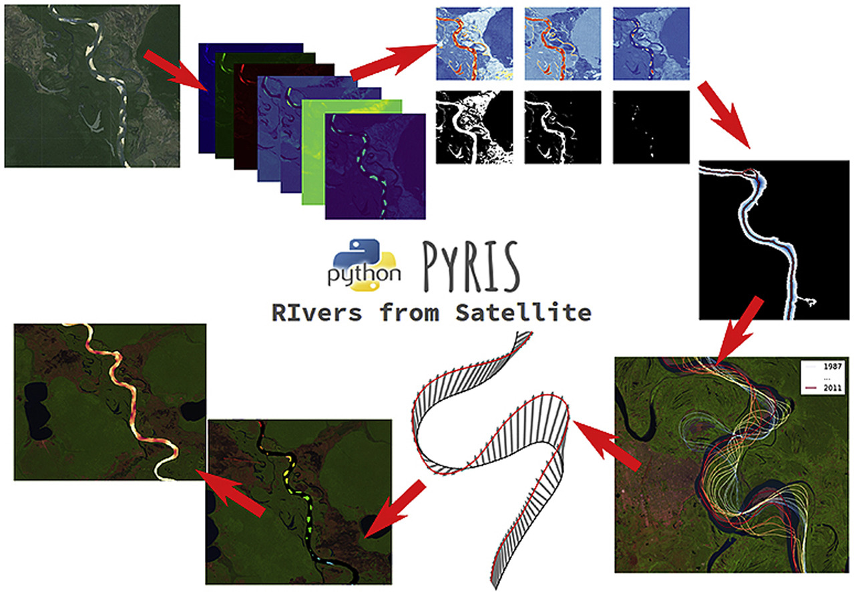
EGU23-9966 | GM 5.1 | 28 Apr 2023| Marta Crivellaro
Results: GEE & PyRIS integration
* Adapted from Monegaglia et al., 2018

