Slide 1
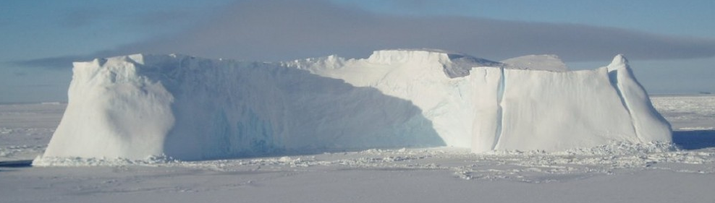
Transient calibration of Thwaites Glacier: a model and methodology comparison (with extended)
Daniel Goldberg
Univ. Edinburgh, UK
Mathieu Morlighem
Dept Earth Sciences, Dartmouth, USA
Thanks to Evans Family Dartmouth visiting professorship

Slide 2
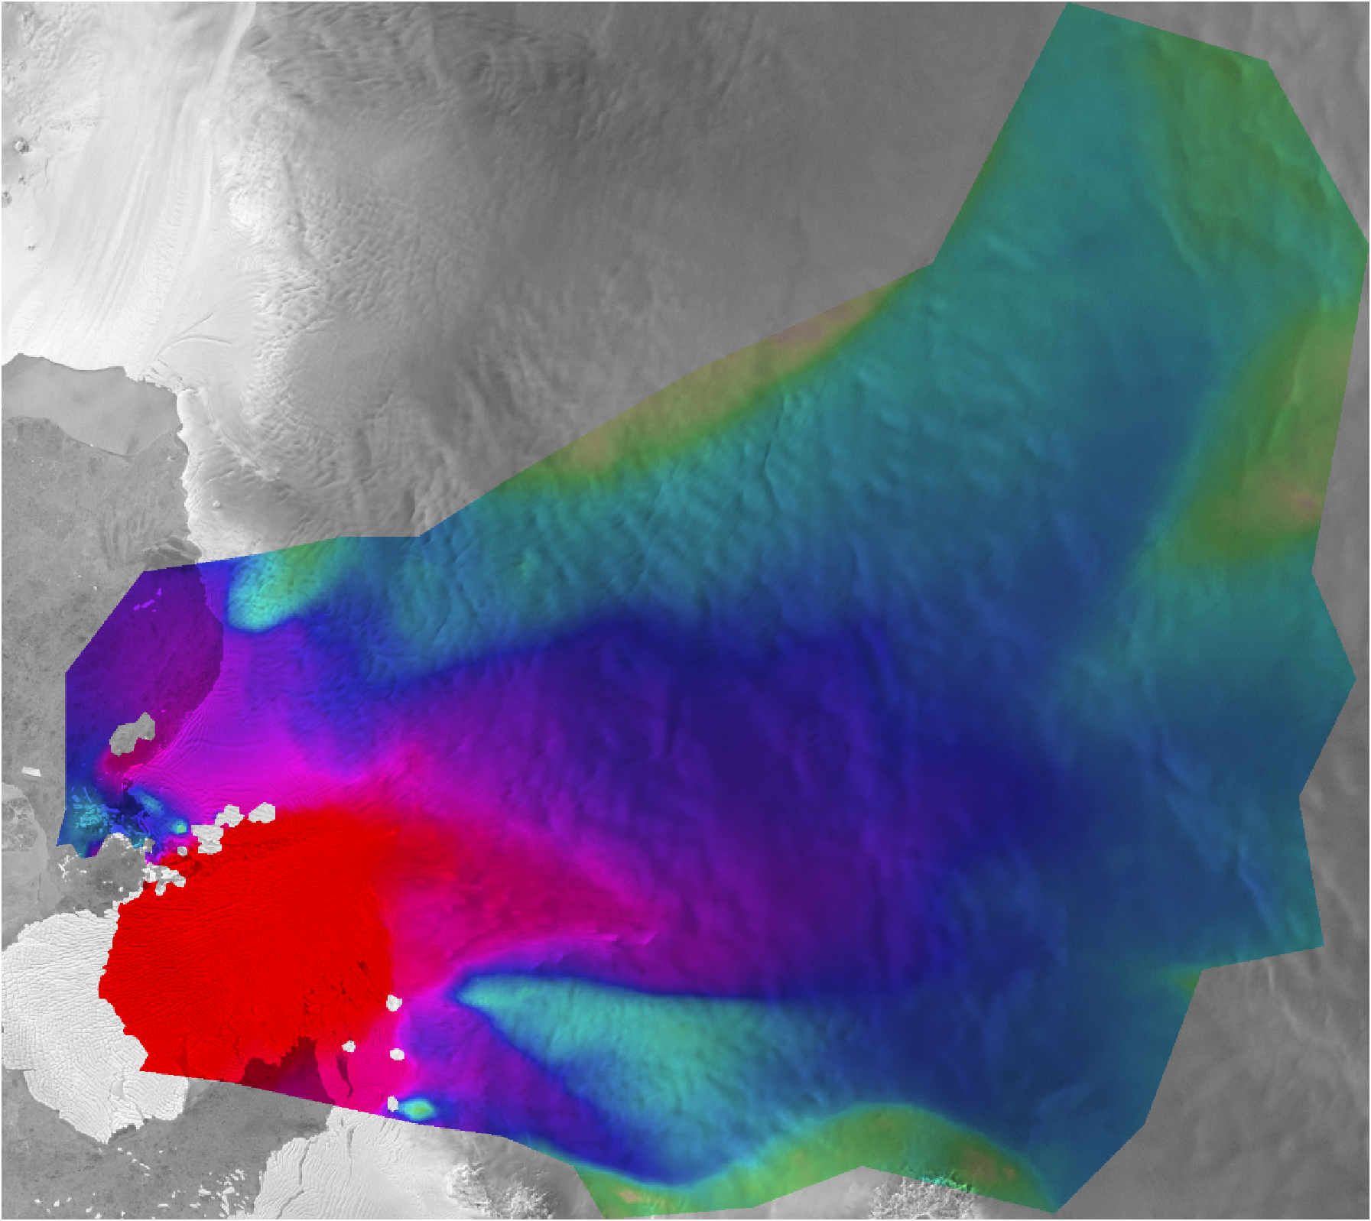
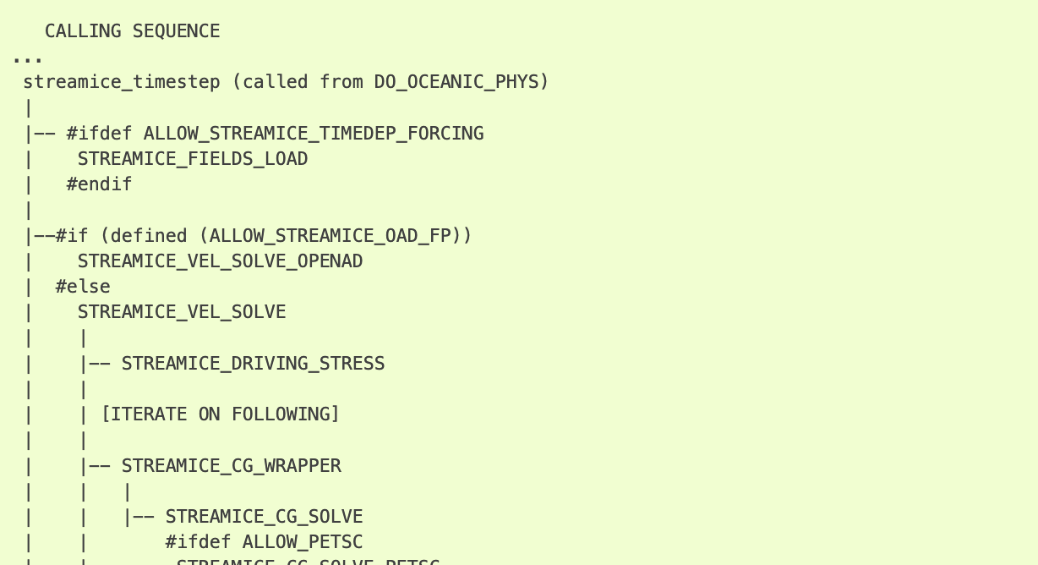
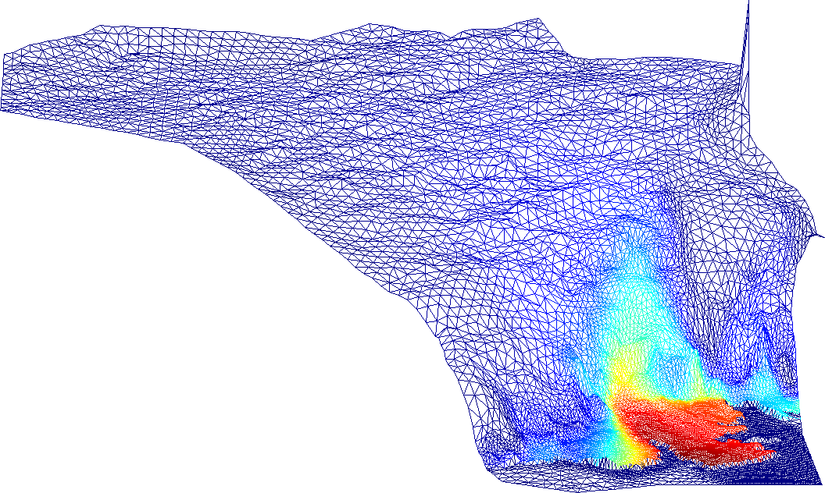
Observations
S
“Snapshot” Calibration
c.f. MacAyeal 1992
Discrepancy ?
Numerical model
Input parameters
Geometry (Bed, surface, …)
Material properties (B, n, …)
Boundary conditions
…
Model output
Surface velocities
Model physics
Parameterization of Physical processes
Basal friction
Constitutive law
…
Stress balance
Incompressible Stokes flow
Notes:
With 8 minutes ill jump right into it!
The method that’s emerged to initialize ice sheet models is what some term snapshot calibration, a process where boundary conditions and material properties are adjusted to achieve optimal fit with satellite velocities.
The inversion is constrained by time-independent ice-sheet physics – only the velocity solve for a fixed geometry is used.

Slide 3
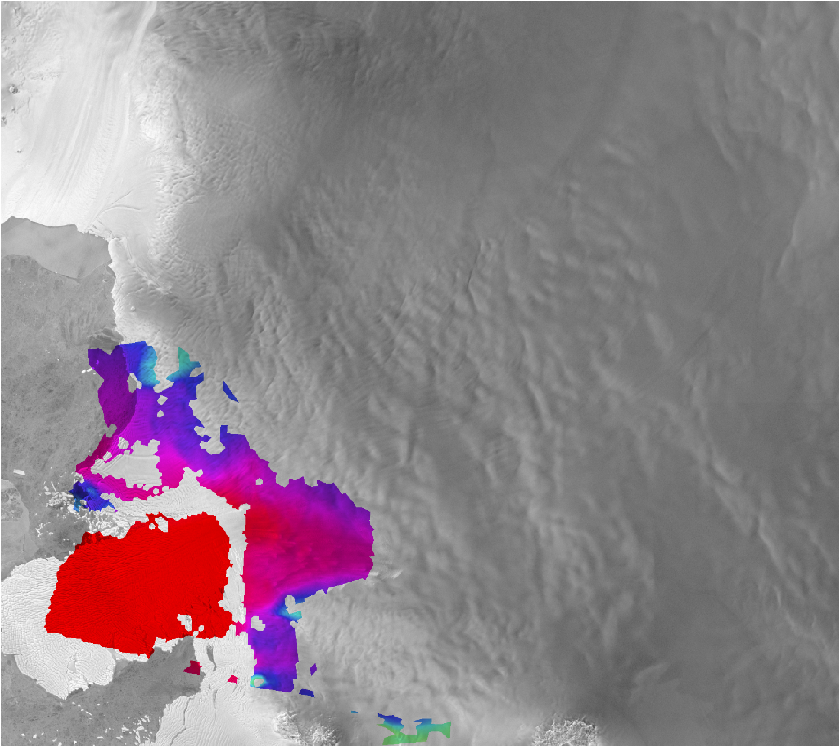
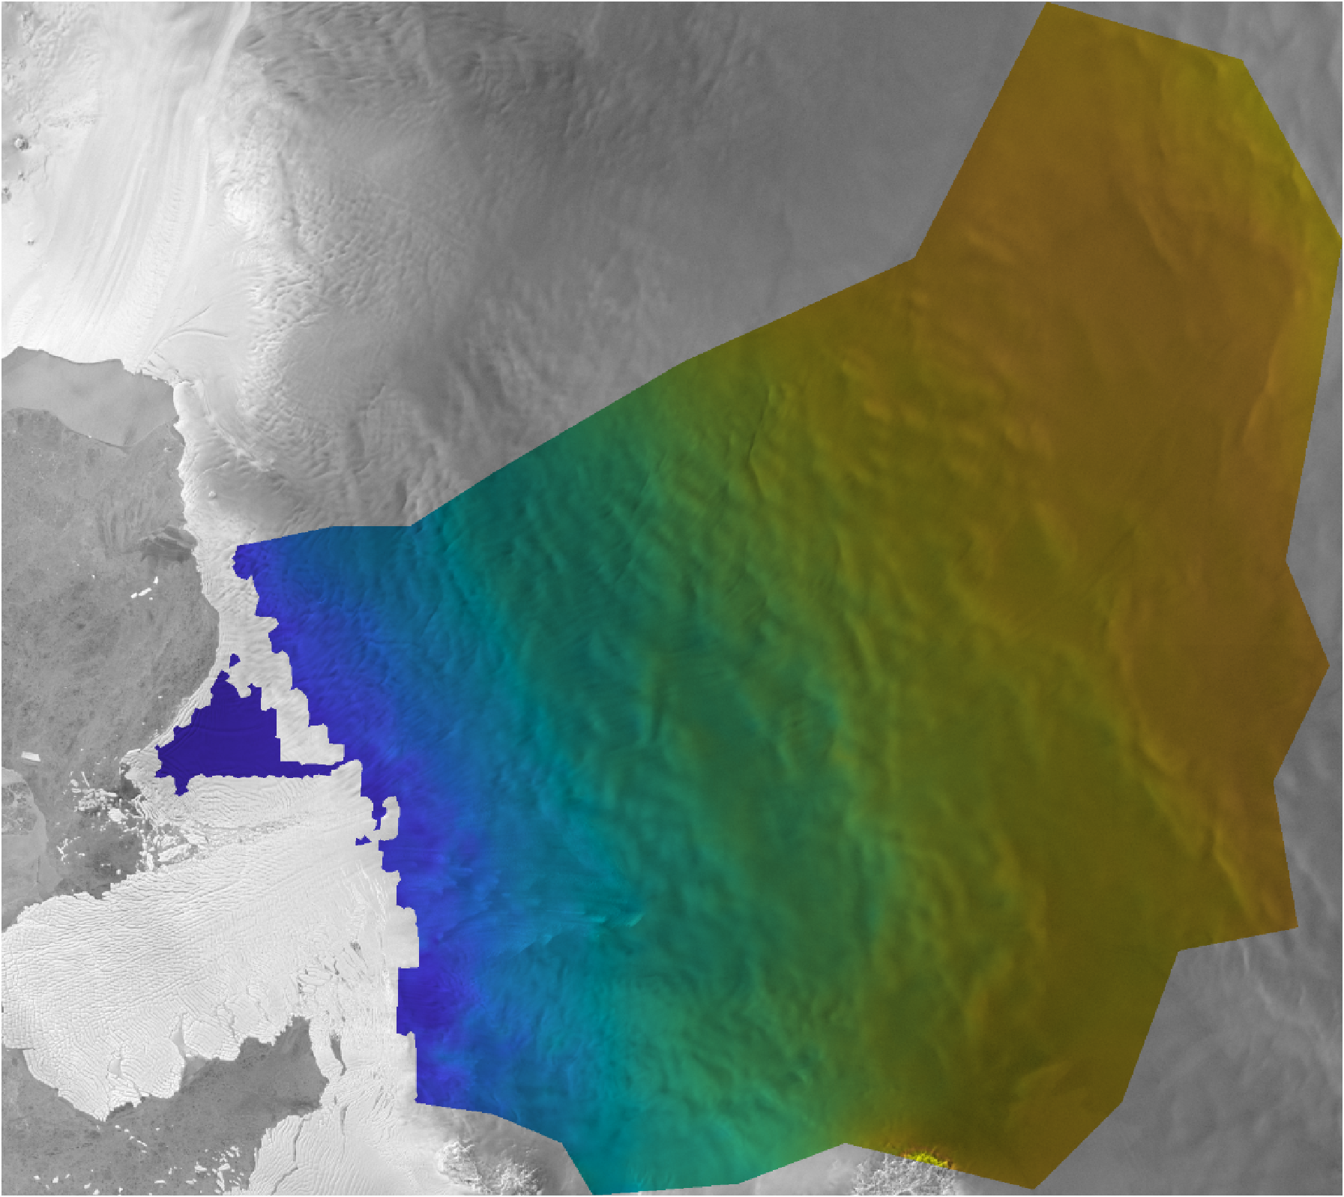
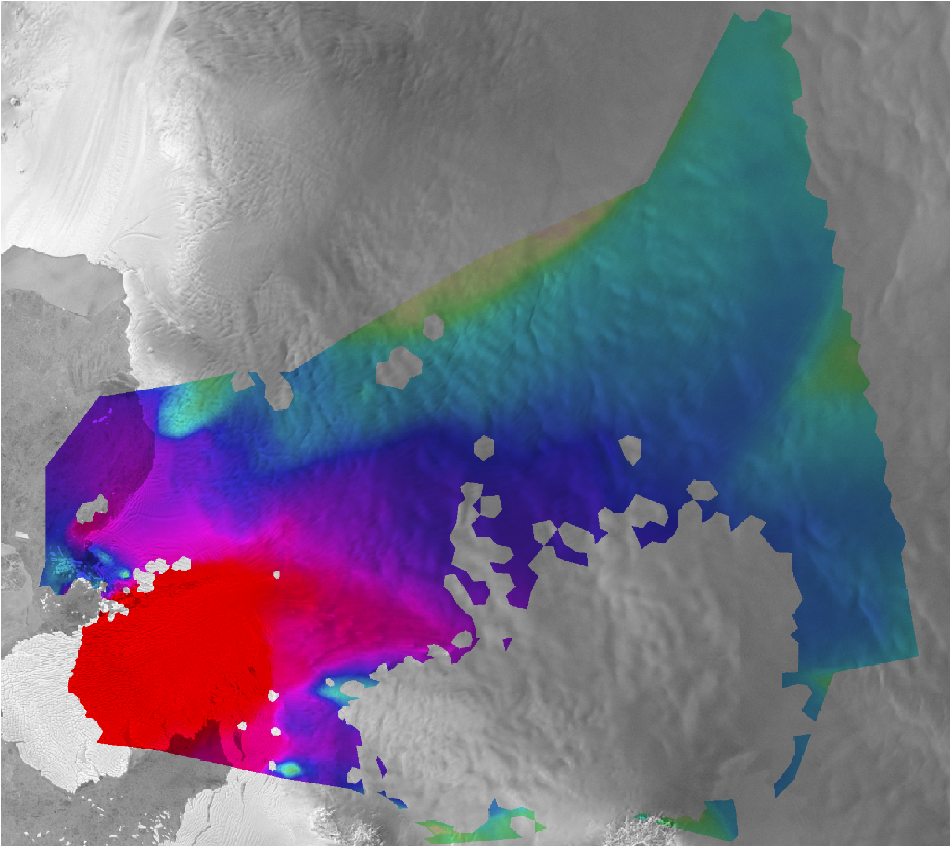
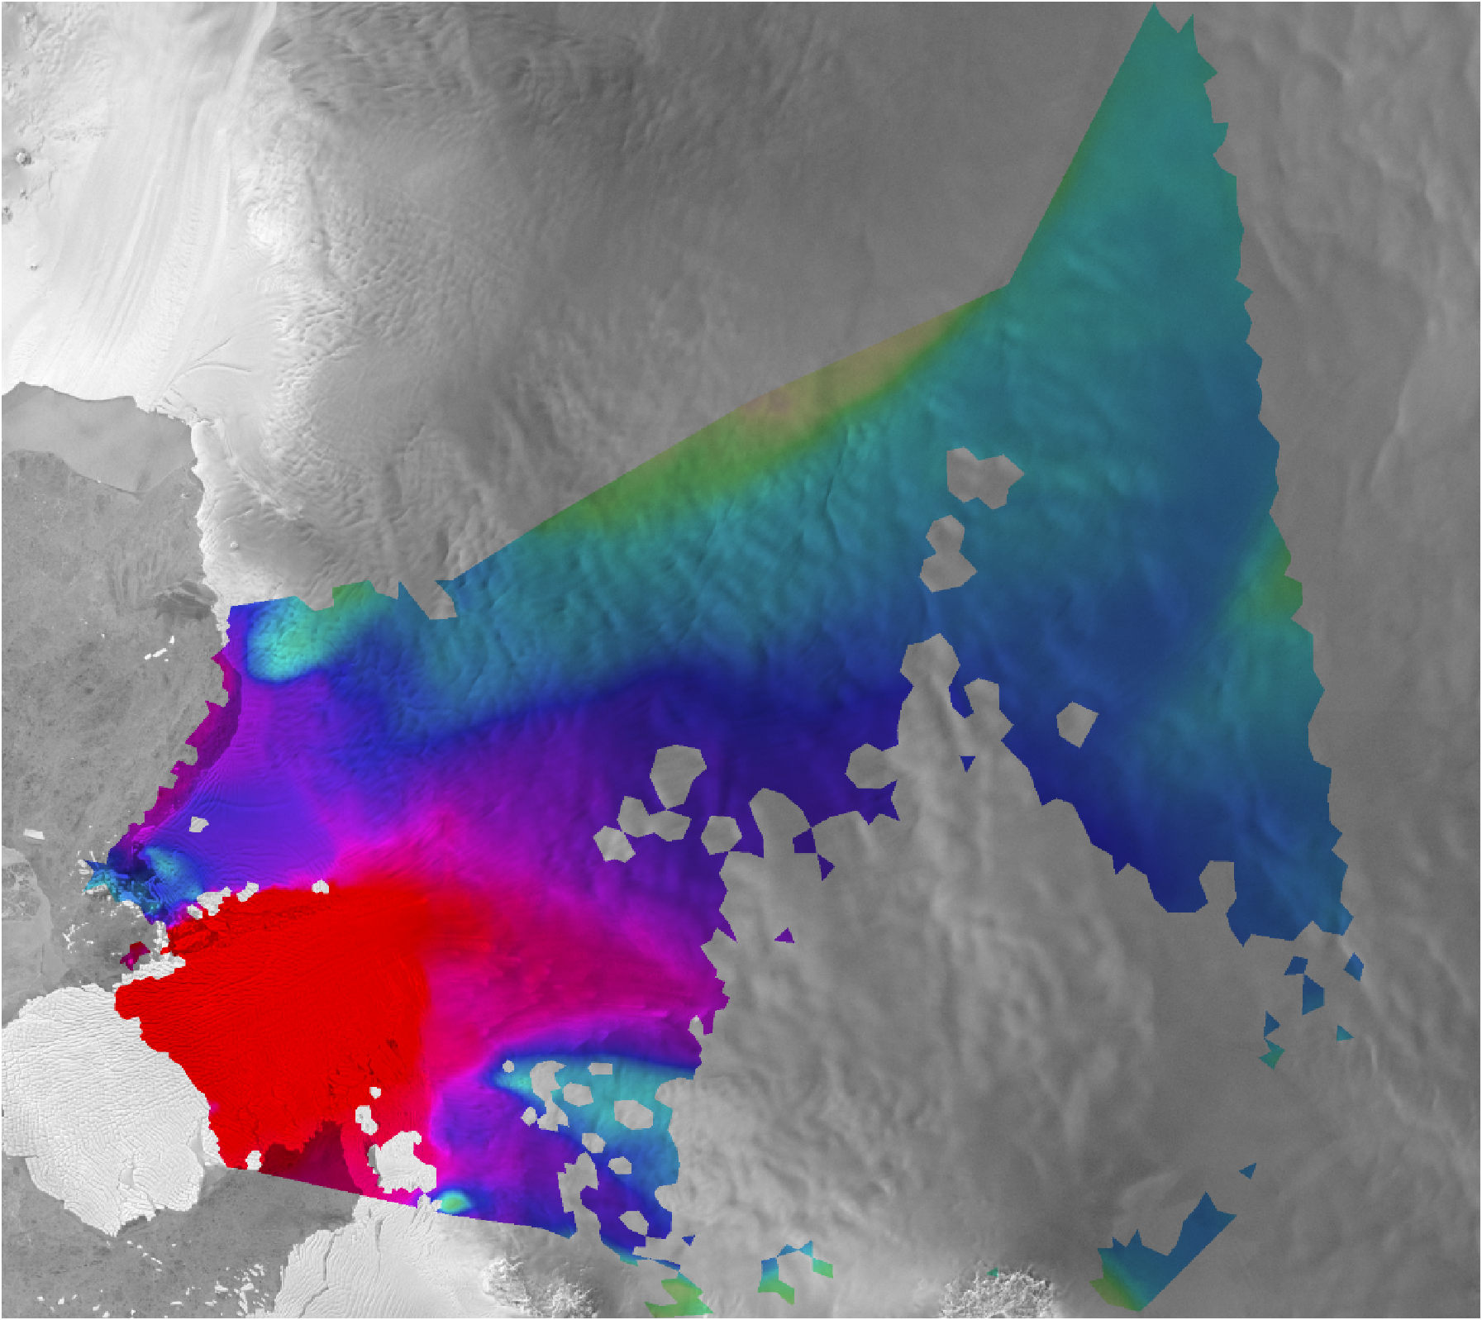
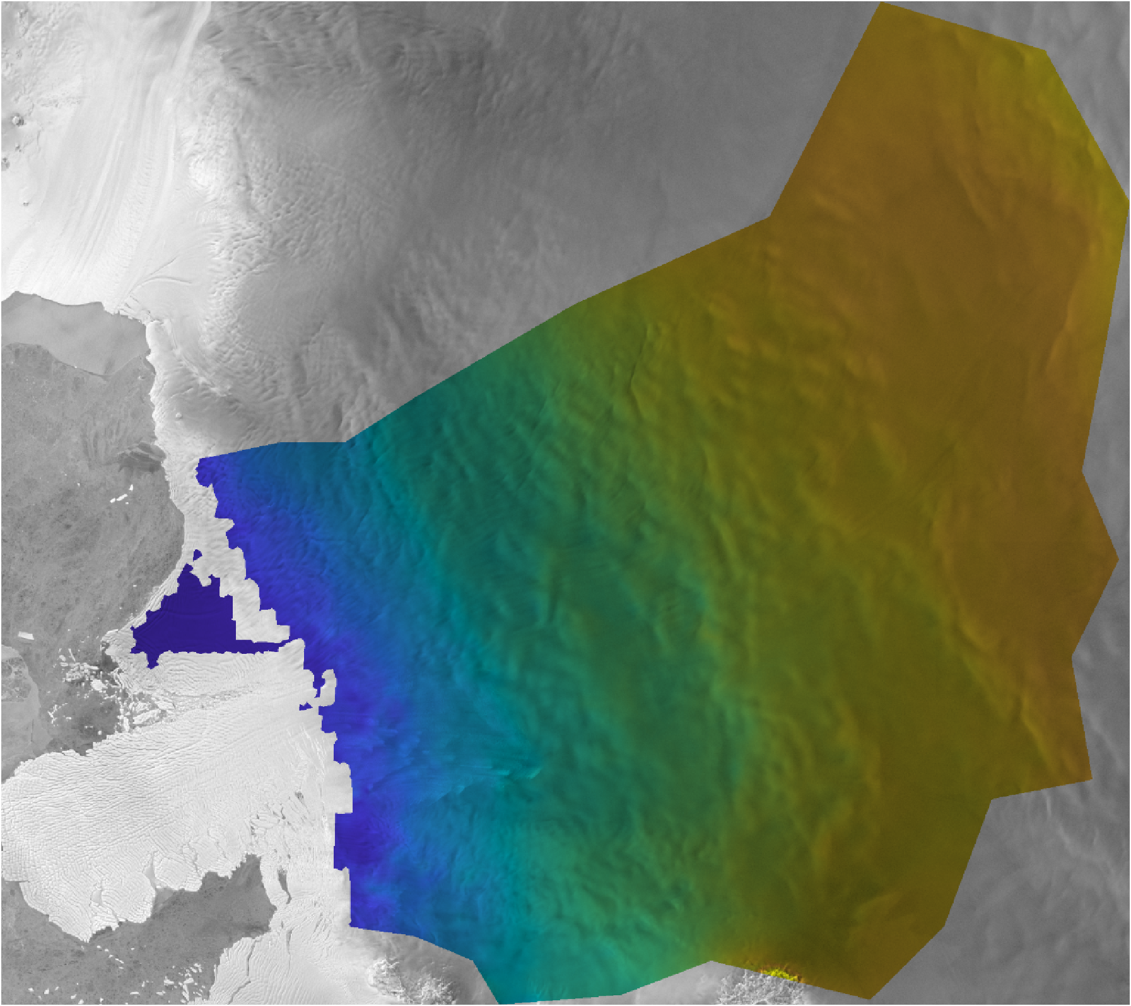
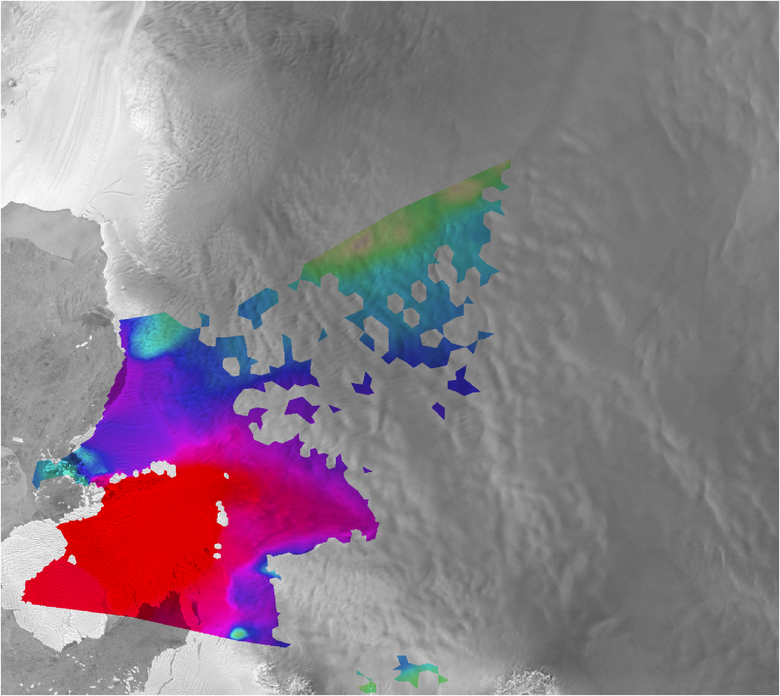
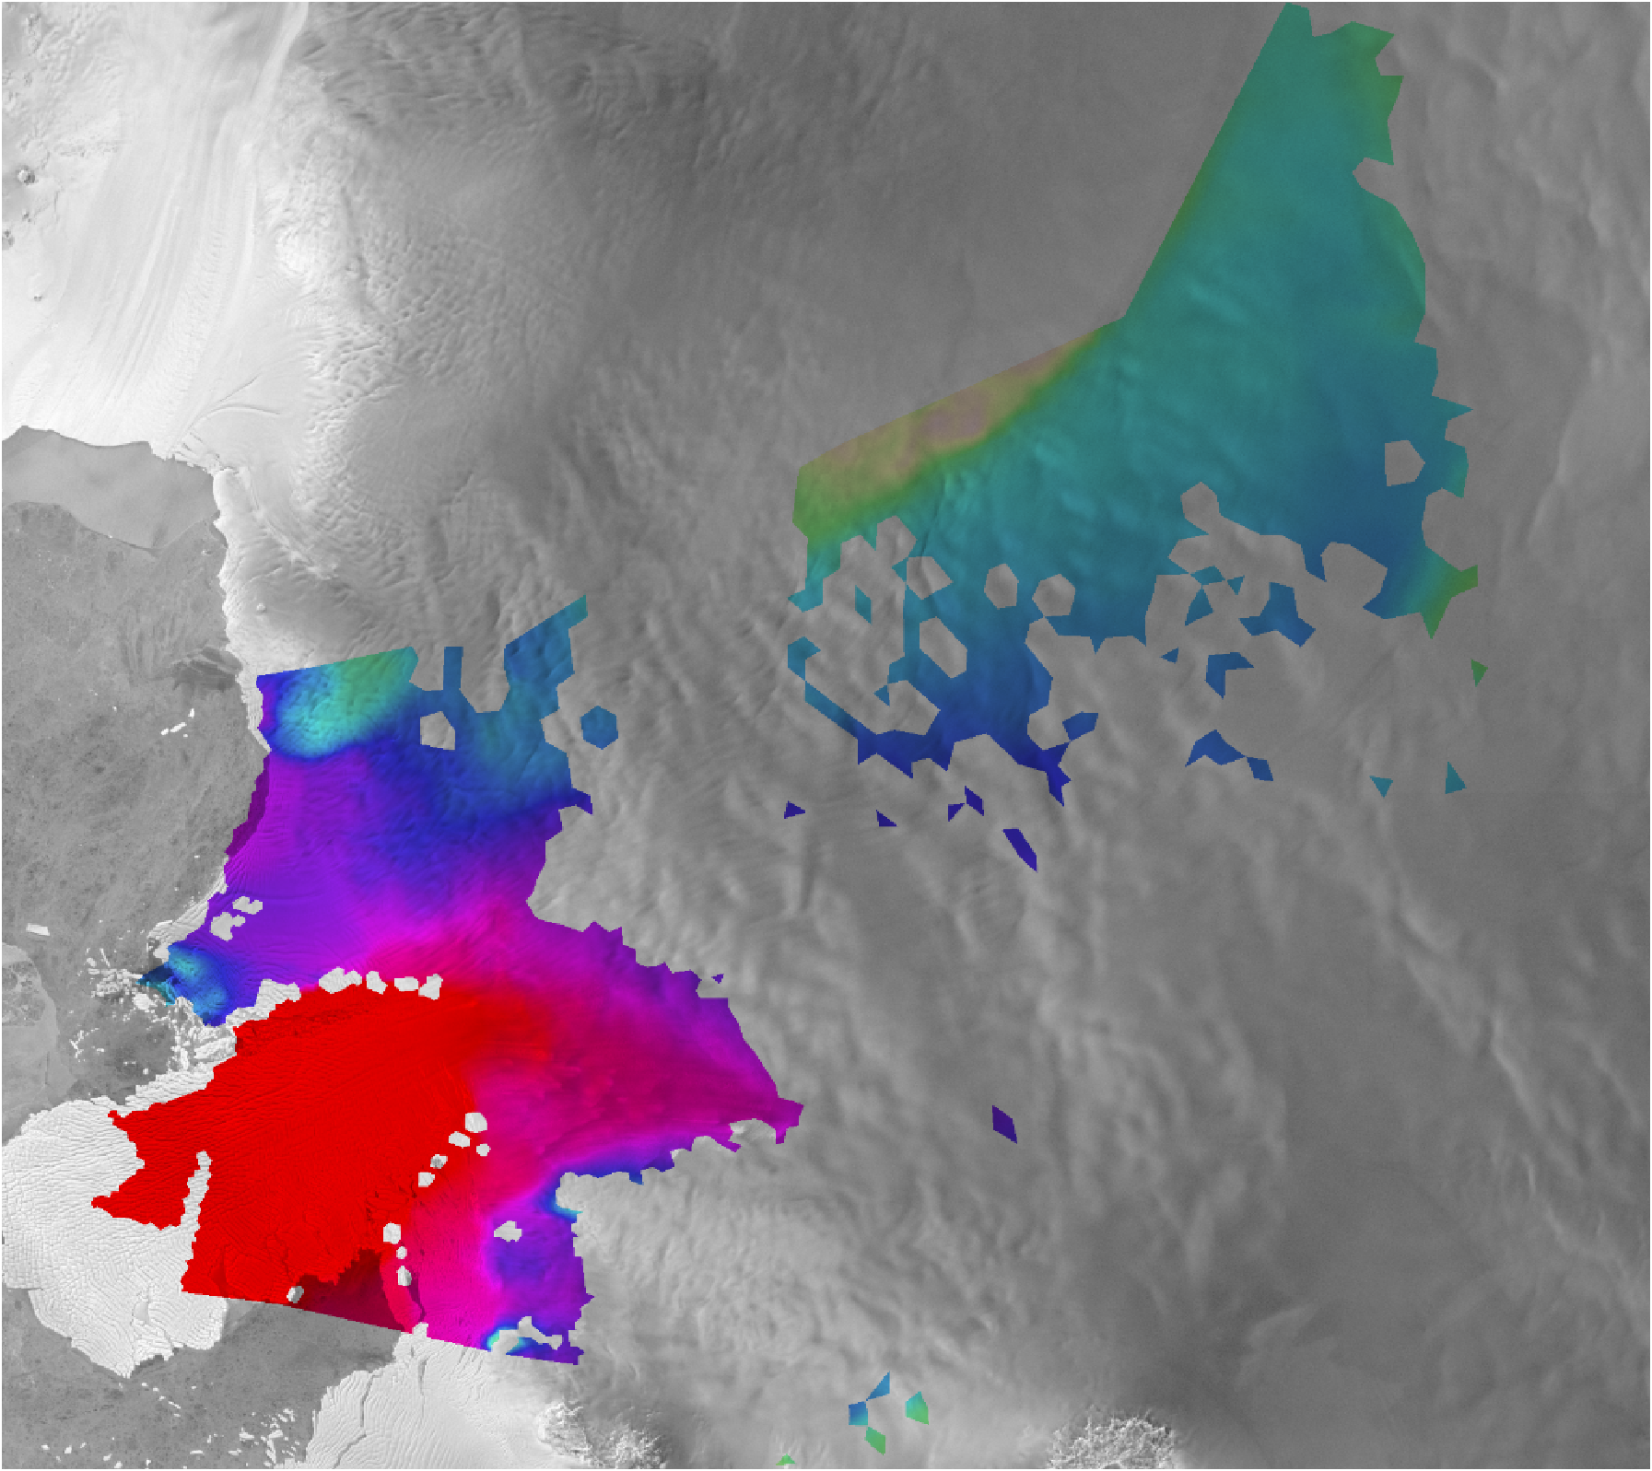
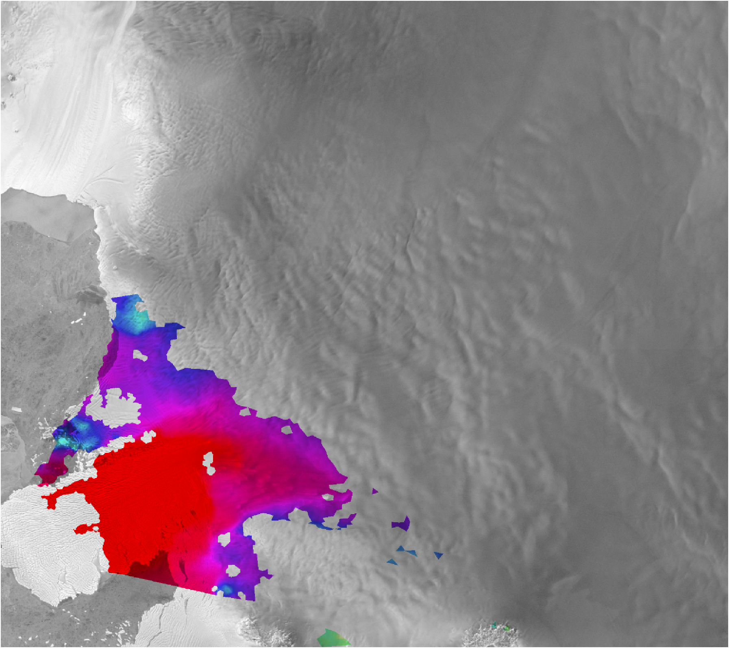

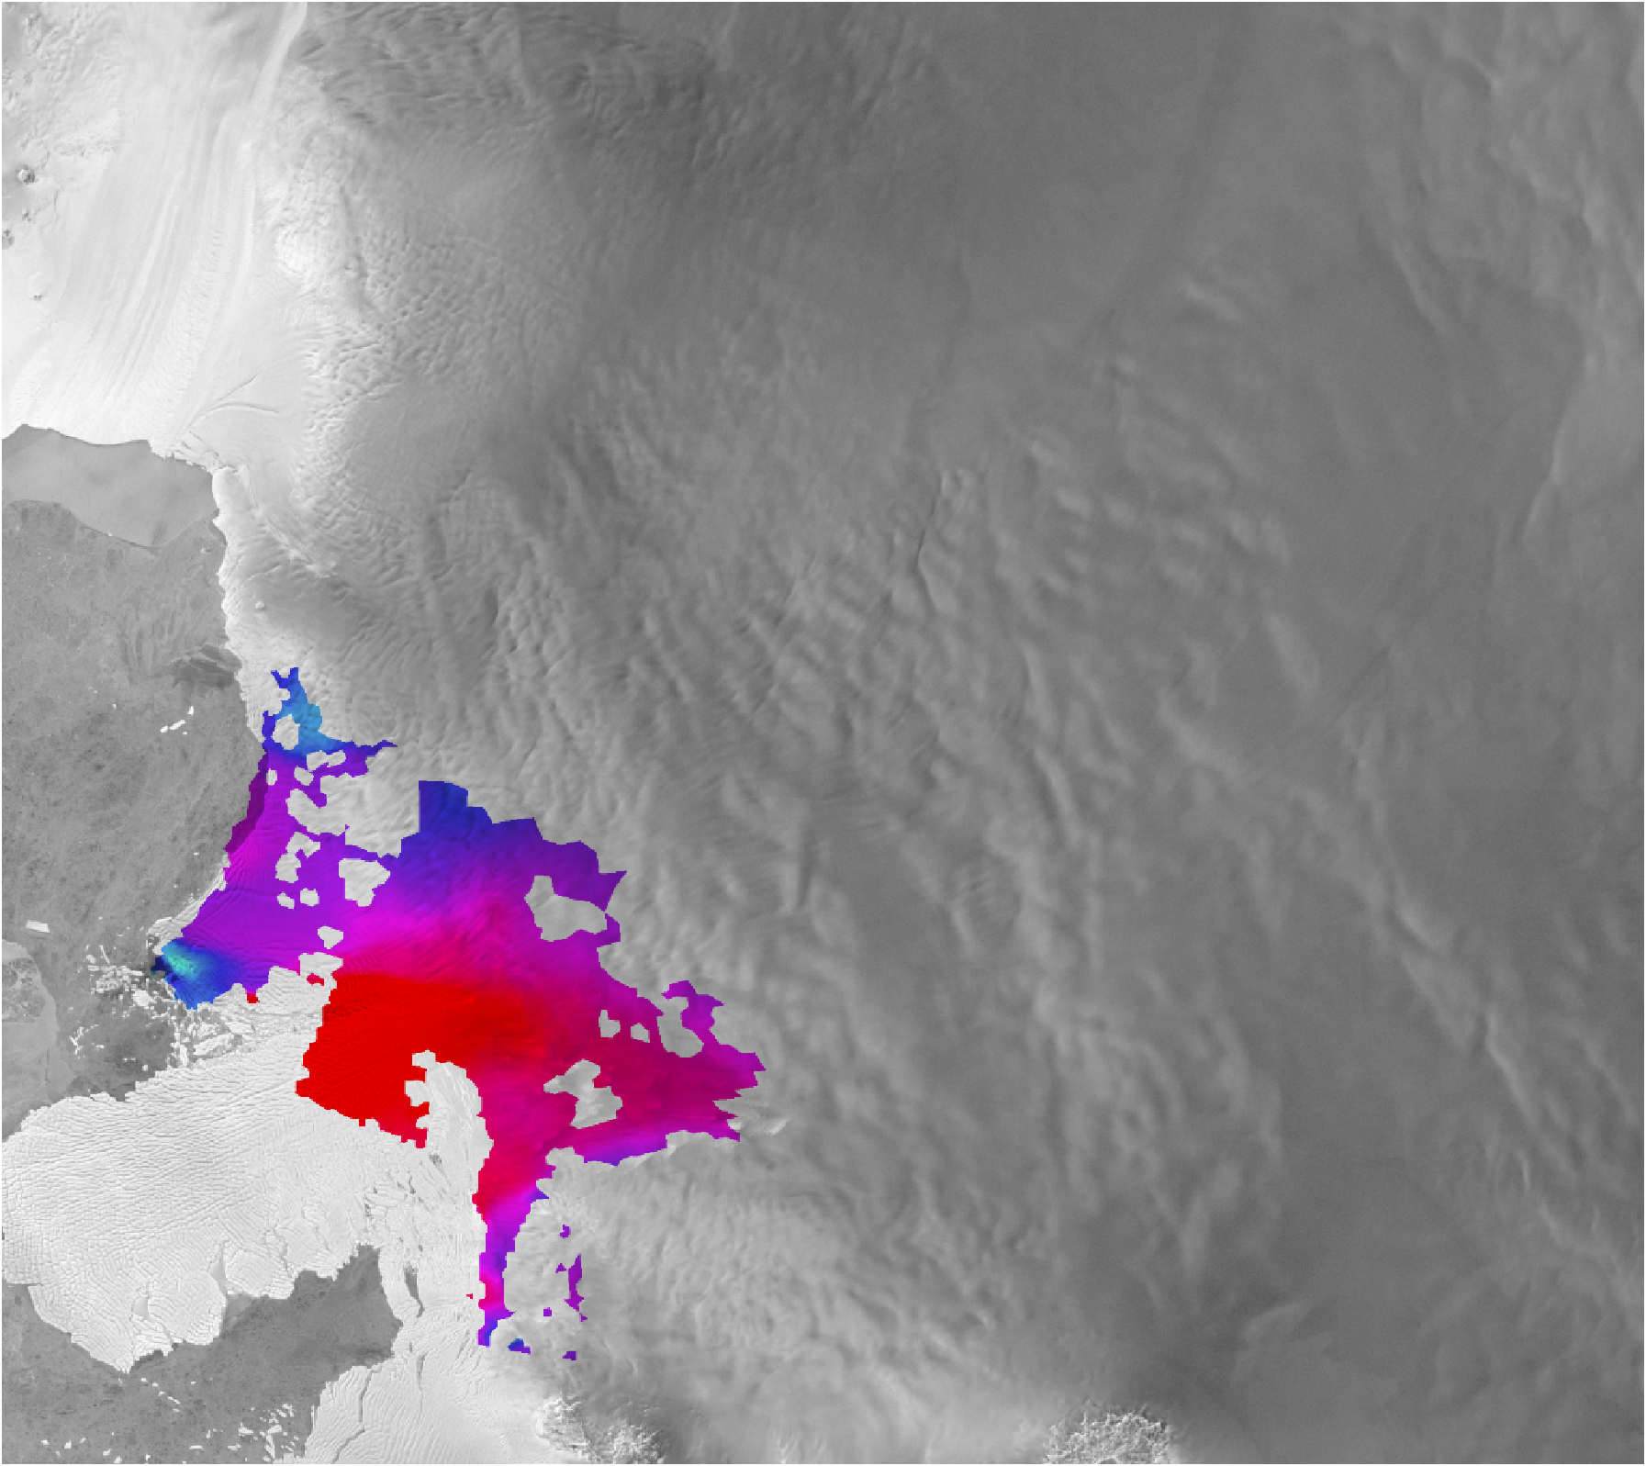
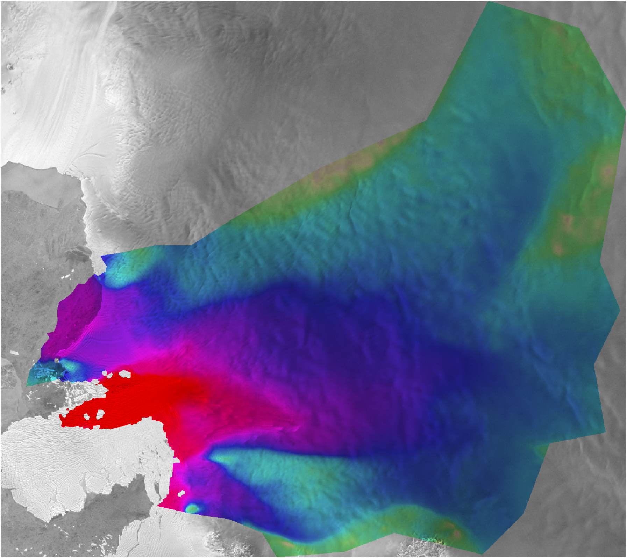
Observations
Transient
Calibration
RADARSAT, LandSat, ALOS,…
2005…2017
Cryosat, ICESat, …
2007 2012 2017
Goldberg et al 2015
Choi et al 2023
Discrepancy ?
Numerical model
Input parameters
Geometry (Bed, initial surface, …)
Material properties (B, n, …)
Boundary conditions
Initial conditions
Forcings (melt, SMB, …)
Model output
Surface velocities (t)
Surface height (t)
Grounding line dynamics (t)
…
Model physics
Parameterization of Physical processes
Basal friction
Constitutive law
Ice shelf melt
…
Stress balance
Incompressible Stokes flow
Mass balance
Incompressibility
Notes:
Transient calibration generalizes to a time-evolving ice sheet
Time-evolving velocity and surface elevation are used as constraints
In our study, we’ve used annual velocities from MEaSUREs and the dhdt product of CPOM for constraints on Thwaites

Slide 4

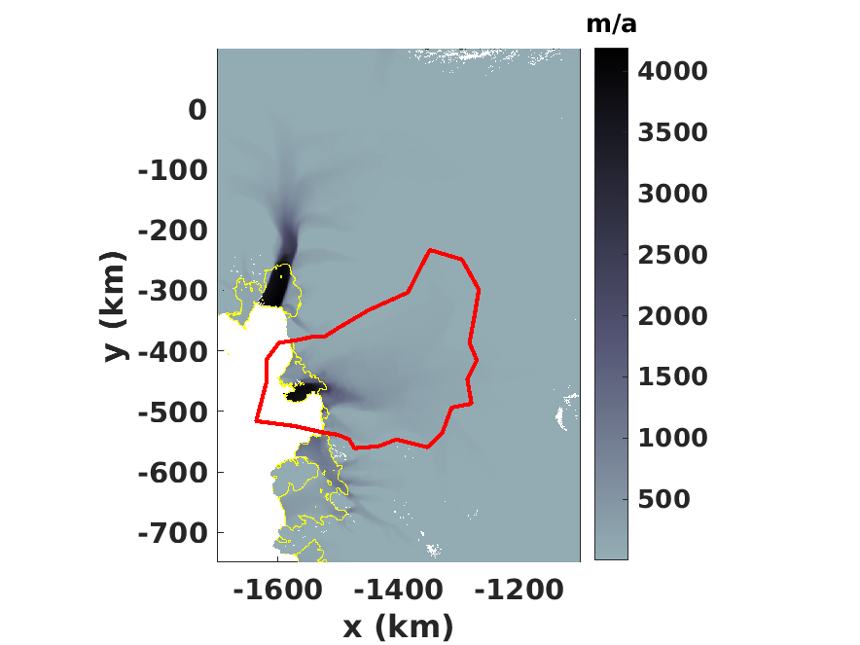

Shallow Shelf Approximation
Finite element code
19000 elements, 1.5km at GL
DIVA Approximation
Finite difference/volume code
1.5 km uniform resolution
Pine Island
STREAMICE
Thwaites Glacier
  Depth-dependent linear melt parameterization
  friction law: Regularized-coulomb (m=1/3)
  No calving (cf dos Santos 2021, Gudmundsson 2023)
Smith Glacier
Notes:
We use 2 models which both can implement transient calibration through use of Automatic Differentiation.
We consider a subset of the Thwaites catchment where strong thinning is observed
We consider a simple melt parameterization (adjusted as part of the calibration), but do not consider calving as recent studies have shown it less important than other factors in evolution of TG

Slide 5
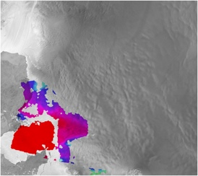

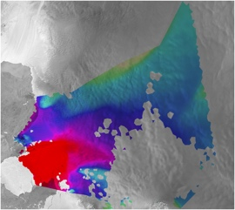

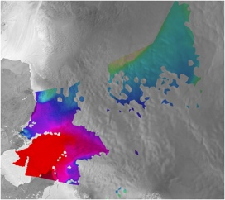
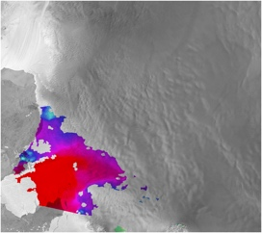





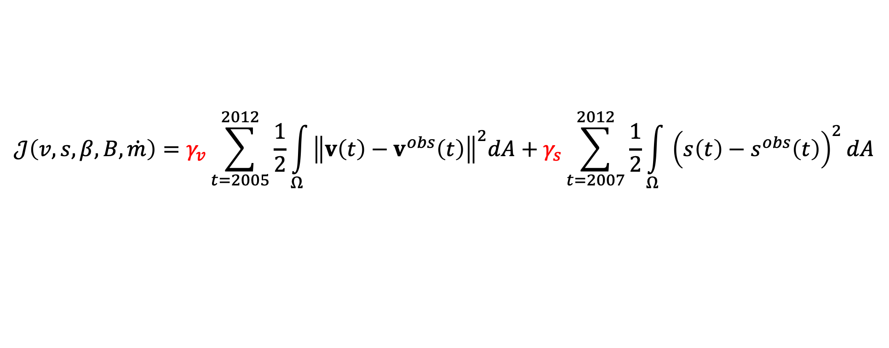
Transient Calibration and Validation
Ice Velocity
(MEaSUREs)
2004
2005
2006
2007
2008
2009
2010
2011
2012
2017
Validation
Training (hindcast)
Surface Altimetry
$$𝒥\left(v,s,β,B,\dot{m}\right)=γ_{v}\sum_{t=2005}^{2012}{\frac{1}{2}}\int_{Ω}{{\left\|v\left(t\right)−v^{obs}\left(t\right)\right\|}^{2}dA}+γ_{s}\sum_{t=2007}^{2012}{\frac{1}{2}}\int_{Ω}{{\left(s\left(t\right)−s^{obs}\left(t\right)\right)}^{2}}dA$$
Velocity constraints
Surface constraints
Notes:
Our calibration period is 2004-2012 (with remainder reserved for validation). CPOM data gives dhdt over 5-year periods, hence longer spacing below.
Below is shown the misfit cost function which is optimized – gamma_v and gamma_s control the relative weightings of velocity and altimetry

Slide 6
Transient Calibration and Validation
Ice Velocity
(MEaSUREs)
2004
2005
2006
2007
2008
2009
2010
2011
2012
2017
Validation
Training (hindcast)
Surface Altimetry
Here results are shown with
Velocity constraints only (γ_{surf}=0)
Surface constraints only (γ_{vel}=0)
Mixed constraints
Snapshot calibration
Calibration and validation results – please see online material
Notes:
Ill show results from 4 experiments: where only velocity is used to constrain (velocity only); surface only; a calibration using both (mixed), and snapshot.
All transient calibrations used the snapshot-derived parameters as their initial guess

Slide 7
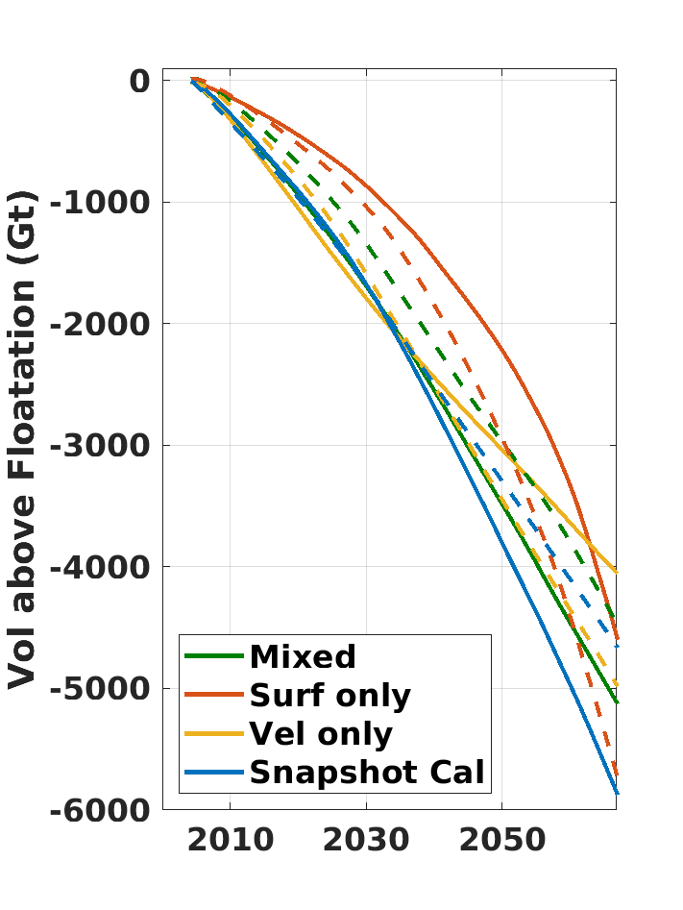
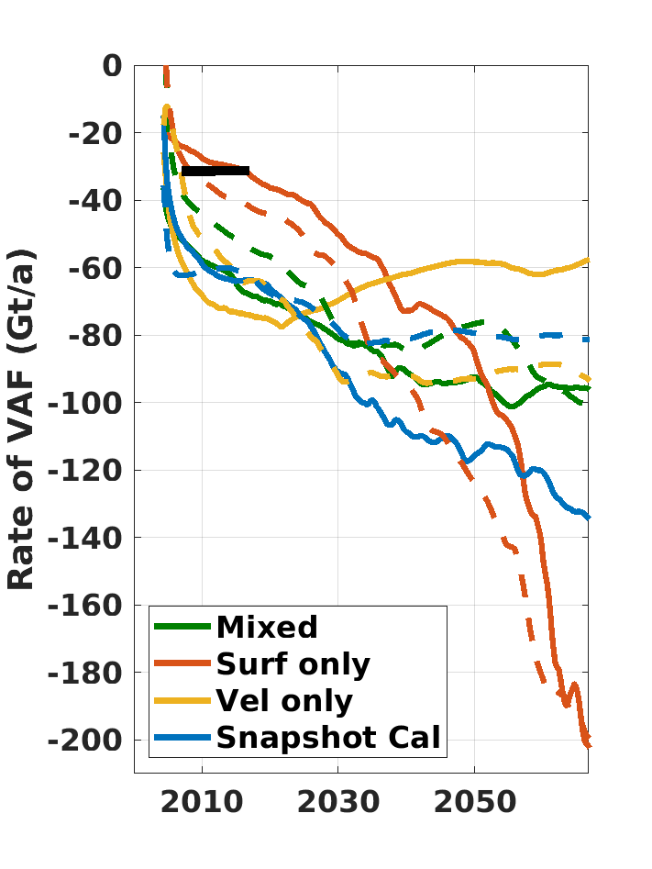
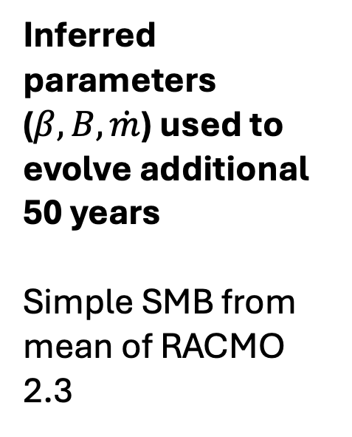
Implications for forecasting
Obs dVAFdt
Dashed: ISSM
Solid: Streamice
Inferred parameters ($β,B, \dot{m}$) used to evolve additional 50 years
Simple SMB from mean of RACMO 2.3
Notes:
We then evolve the experiments an additional 50 years to examine behaviour (forced with simple, fixed SMB). NEXT SLIDE

Slide 8
Implications for forecasting
Obs dVAFdt
Dashed: ISSM
Solid: Streamice
VAF loss over 50 years not strongly variable
But vastly different loss rates
when altimetry is the prime constraint:
  Best Agreement with obs
  Best Agreement between models
  greatest future loss rates (nearly mm/yr)
Inferred parameters ($β,B, \dot{m}$) used to evolve additional 50 years
Simple SMB from mean of RACMO 2.3
Notes:
Little difference in VAF loss (12-18 mm)

Slide 9
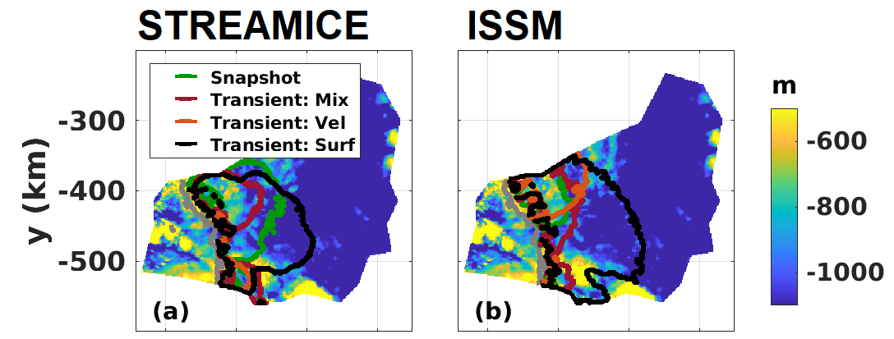

WHY is behaviour so different?
3 m/a contours of the mean 2067 thinning rate overlain on bed topog
Only surface-constrained expt has significant thinning into deep trough

Slide 10
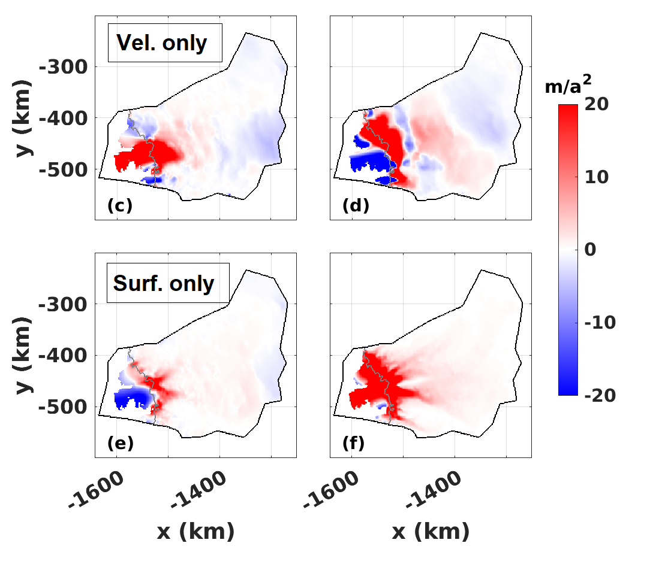
WHY is behaviour so different?
Mean 2004-2017 Change in Speed (vel only vs surf only)
With altimetry-constrained, inland speedup follows deep trough

Slide 11
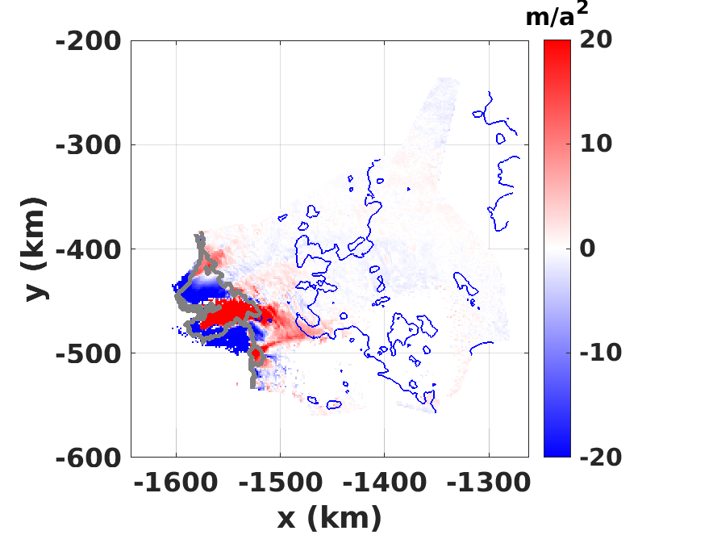
WHY is behaviour so different?
Mean 2004-2017 Change in Speed (vel only vs surf only)
With altimetry-constrained, inland speedup follows deep trough
Not unlike observations
Notes:
This does not seem to be coincidence either – please see online material

Slide 12
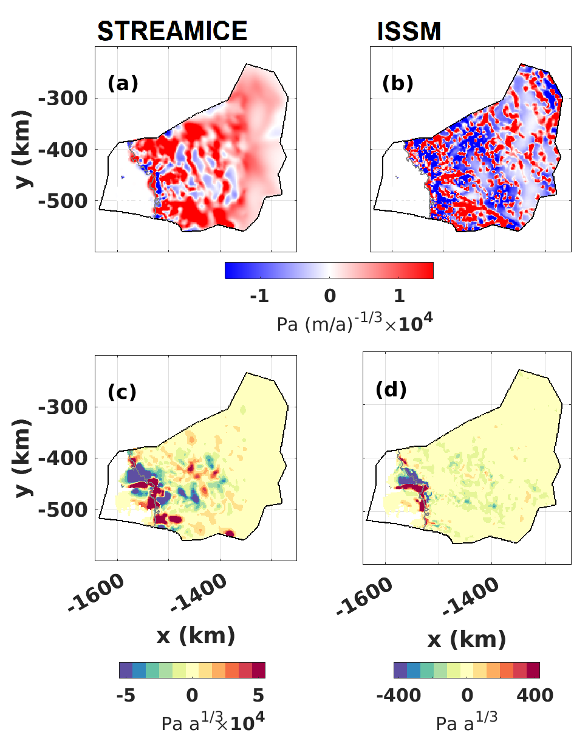
Configuration of sliding and rheology
Sliding Coeff
Differences in parameters between experiments
Surface constraints demand weaker bed in trough and stronger ice at TwIT grounding line
Ice Stiffness
Notes:
This does not seem to be coincidence either – which can be examined by looking at the differences in inferred parameters between experiments
The surface constraints demand a weaker bed in the trough and stronger ice at the Thwaites Tongue grounding line and connection to TEIS. This means that melting near the ice tongue grounding line has a larger inland effect…

Slide 13
Tentative Conclusions
Transient Calibration could improve ice-sheet modelling.. But choices must be made that are not applicable to snapshot (relative weighting, analysis period) – with implication for projections
For Thwaites, only the Surface-constrained model led to
  patterns of retreat consistent with observations
  patterns of retreat consistent with potential MISI
  greater agreement among models

Slide 14
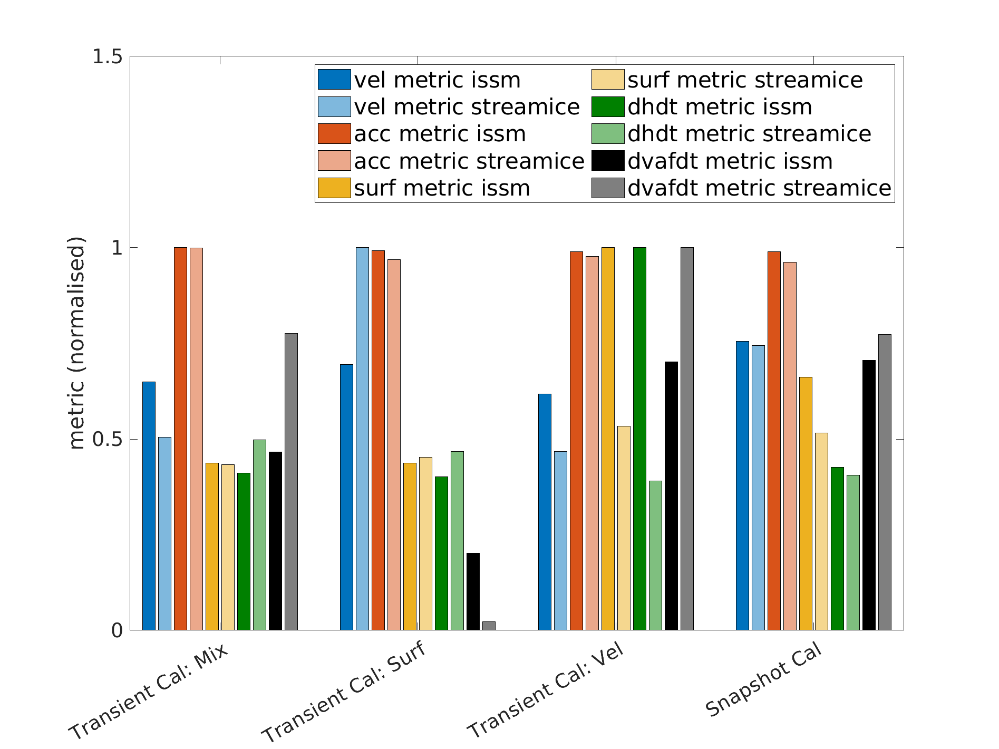
Transient Calibration and Validation
4 Experiments:
Snapshot
TC, Vel cost only
TC, Surf cost only
TC, Mix constraint
5 Metrics (2012-2017)
RMS Vel Error
RMS d(vel)/dt Error
RMS Surface Error
RMS d(surf)/dt Error
d(VAF)/dt Error
Tradeoff between surface and velocity fit
Acceleration: independent
VAF: best for surface-only
VAF: Volume Above Floatation

Slide 15
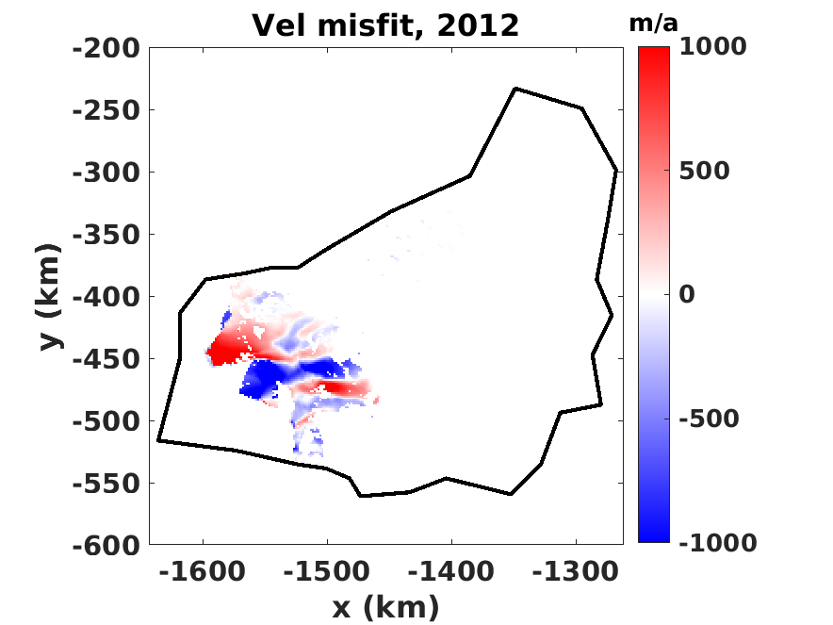
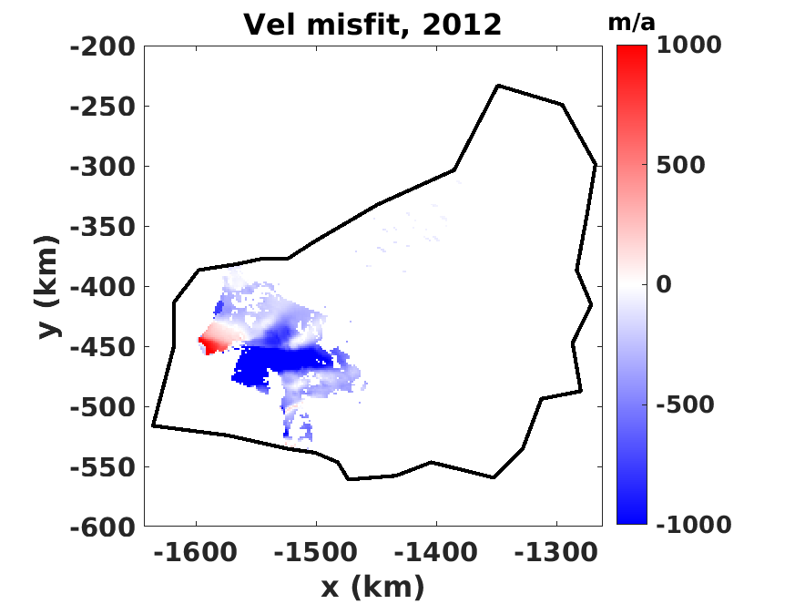
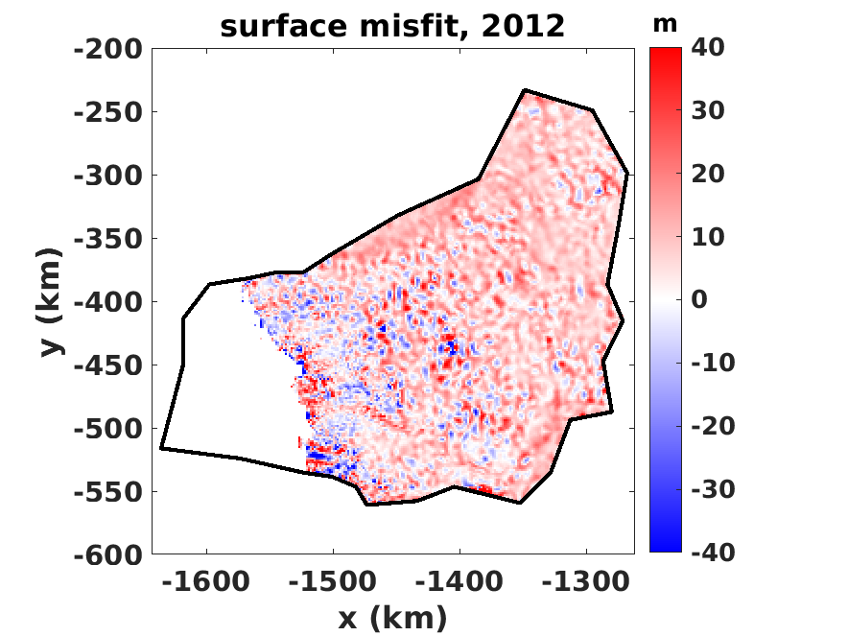
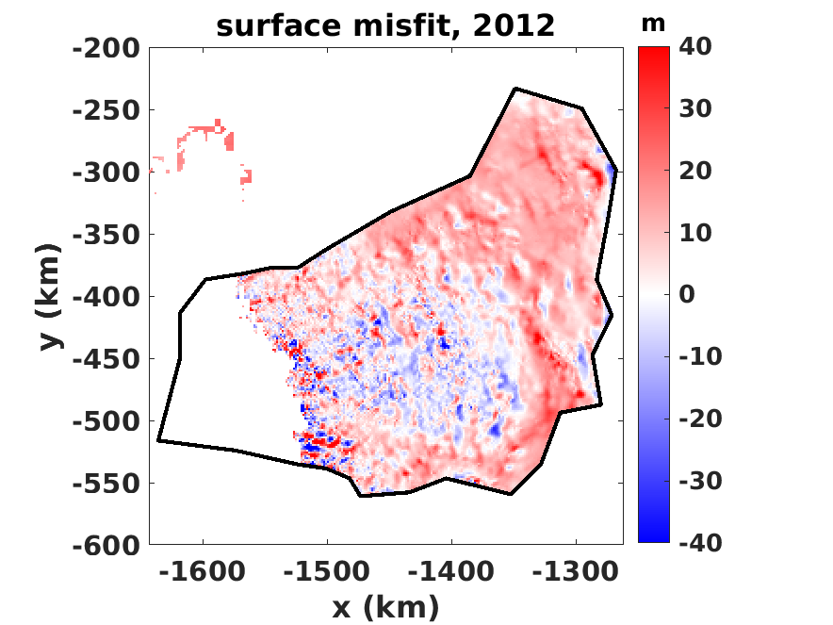
Surf Only
ISSM
Streamice
Vel misfit 2012
Surf misfit 2012

Slide 16
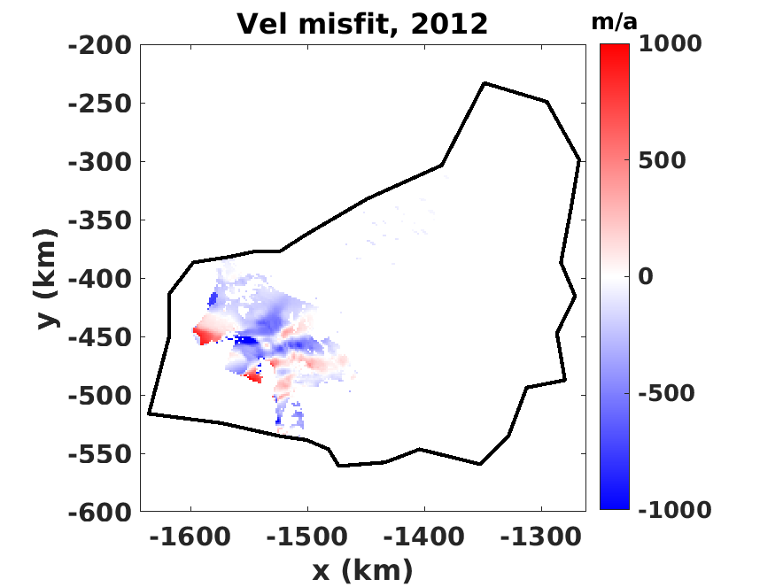
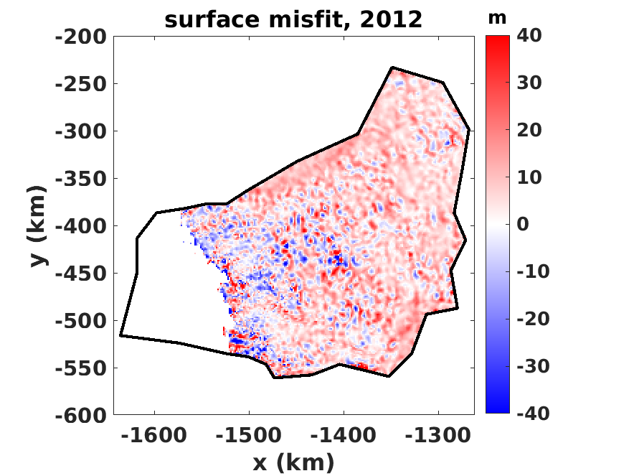
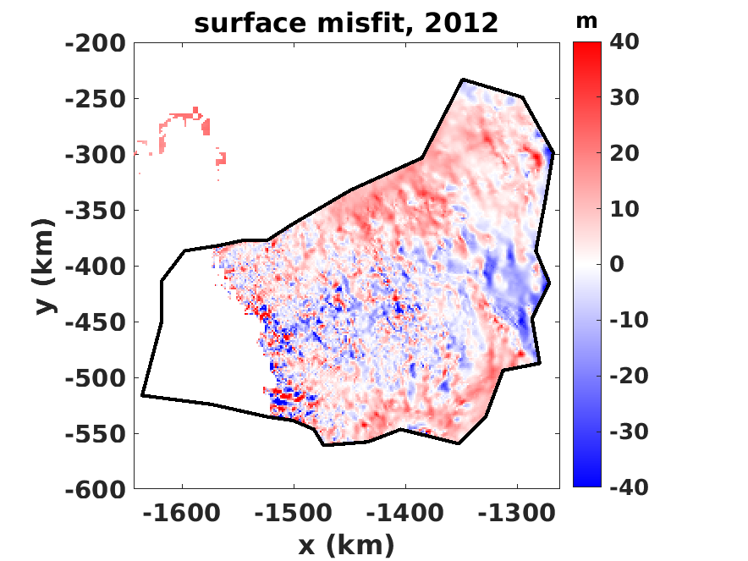
Mix
ISSM
Streamice
Vel misfit 2012
Surf misfit 2012

Slide 17
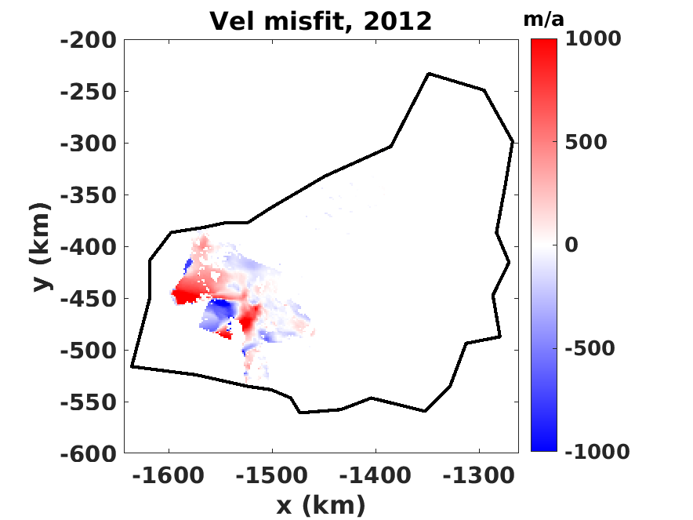
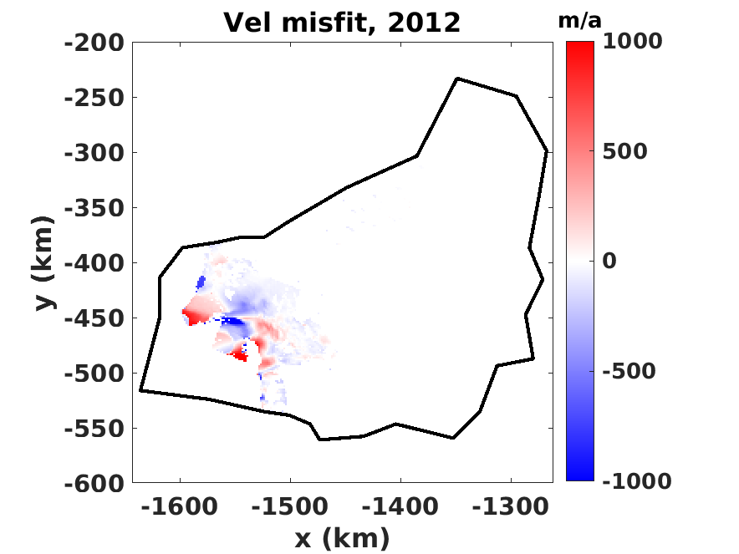
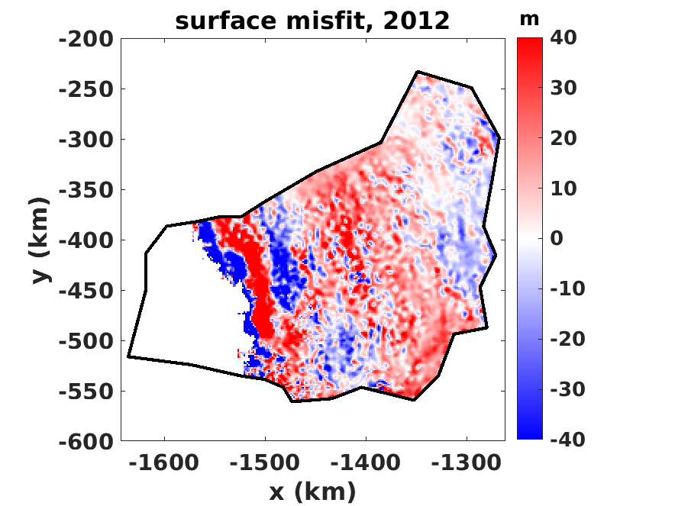
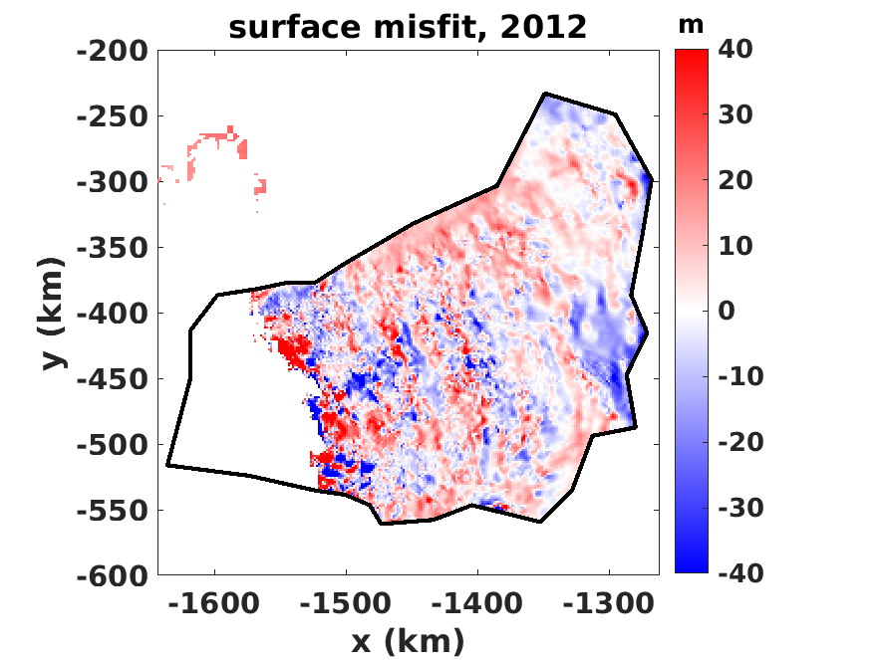
Velocity Only
ISSM
Streamice
Vel misfit 2012
Surf misfit 2012

Slide 18
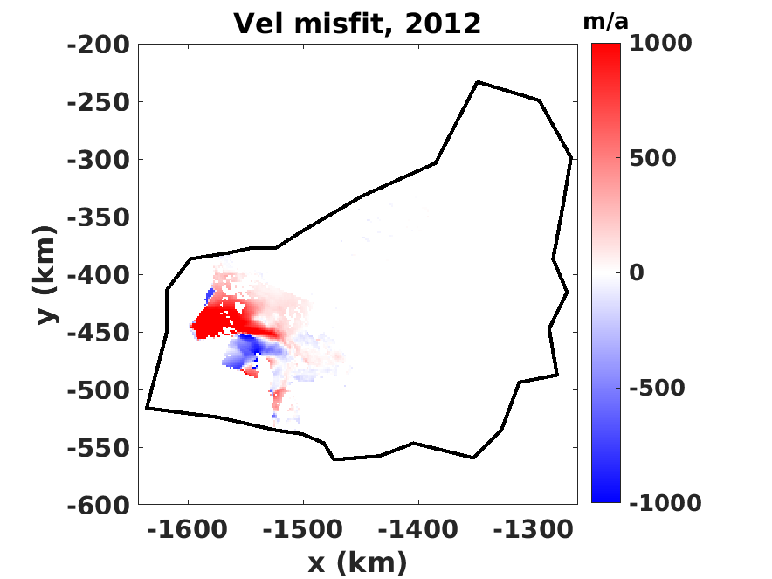
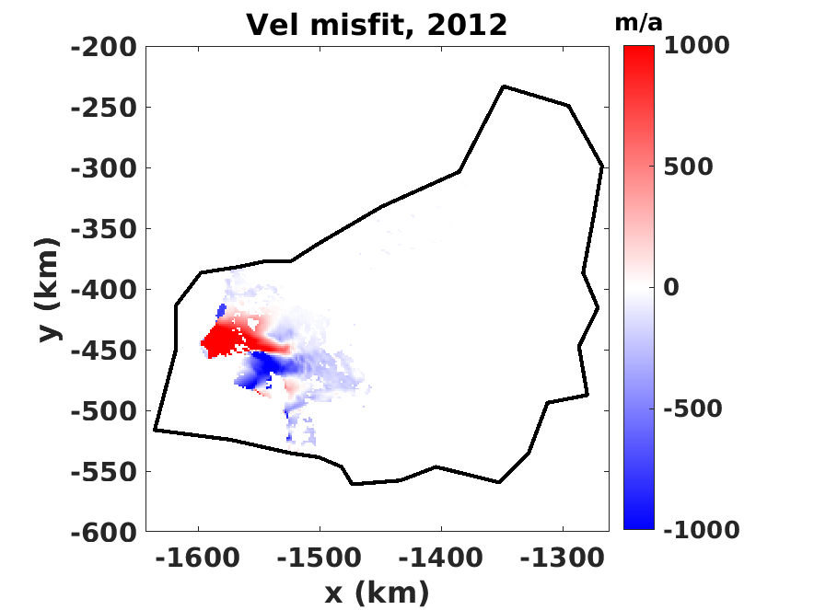
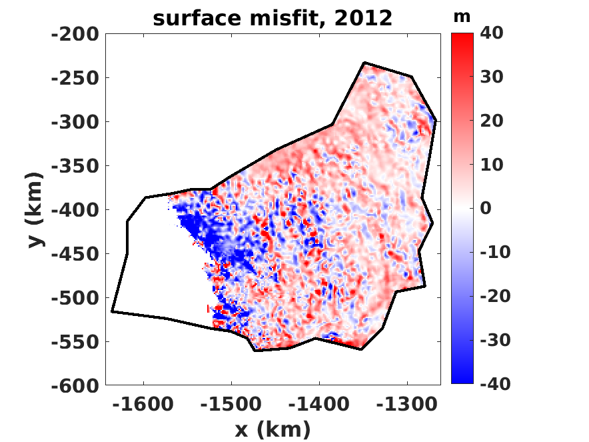
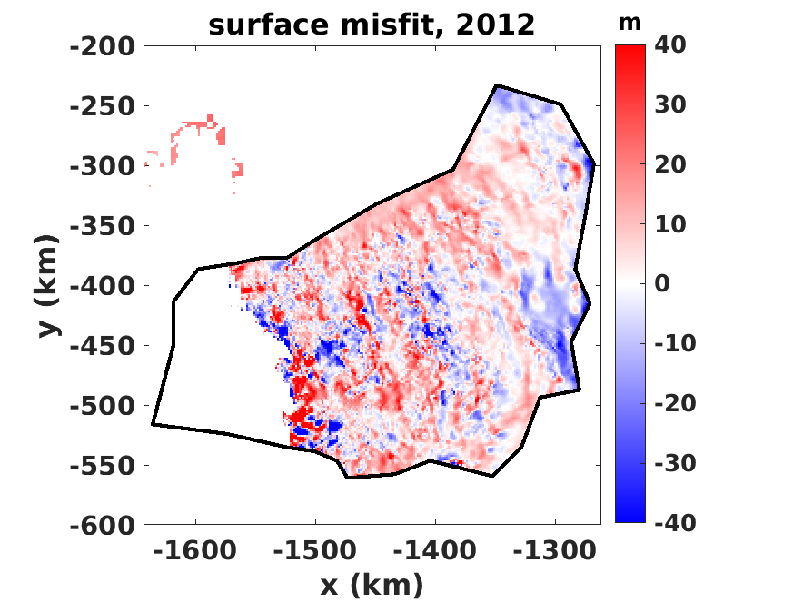
Snapshot
ISSM
Streamice
Vel misfit 2012
Surf misfit 2012

